Slide 1
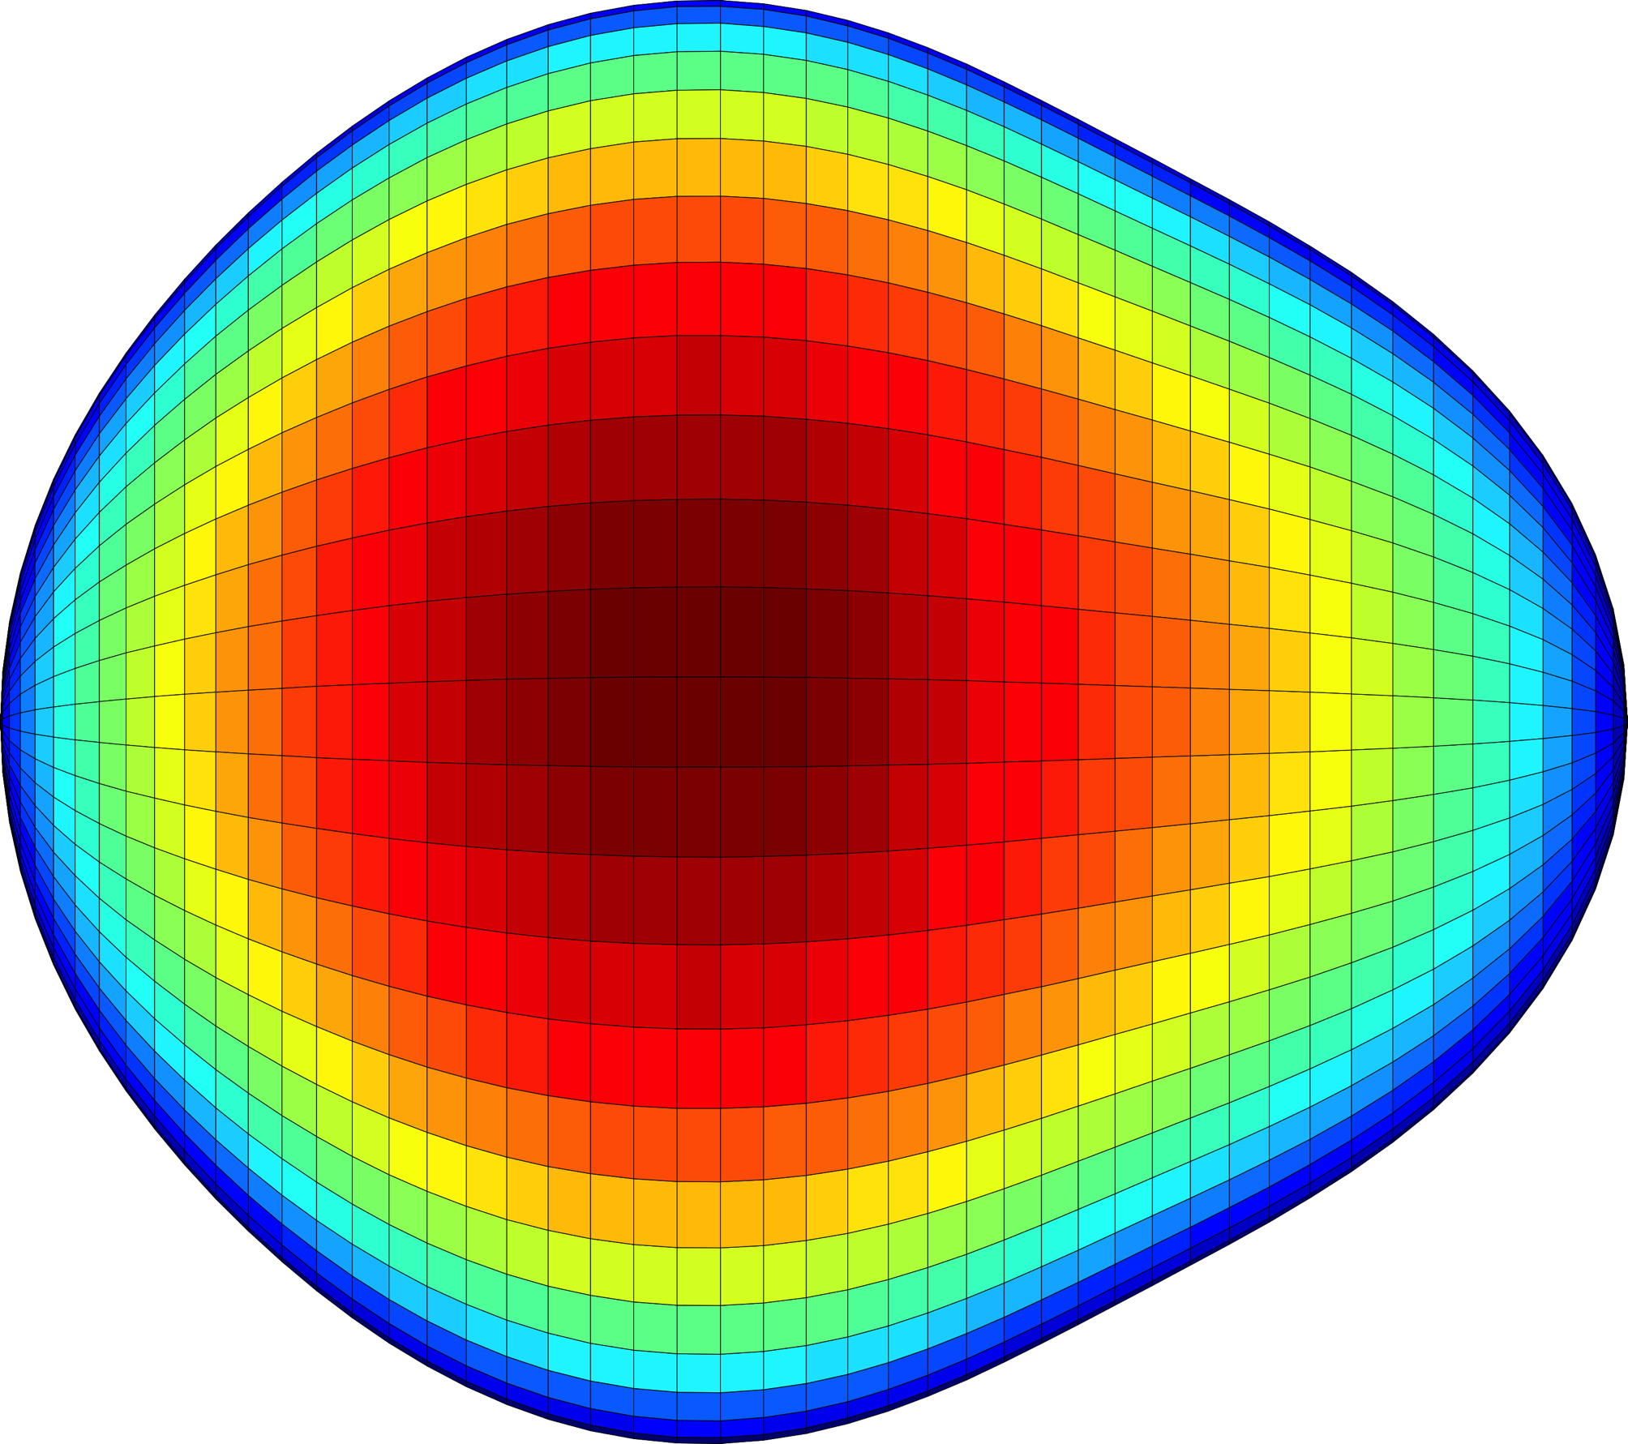







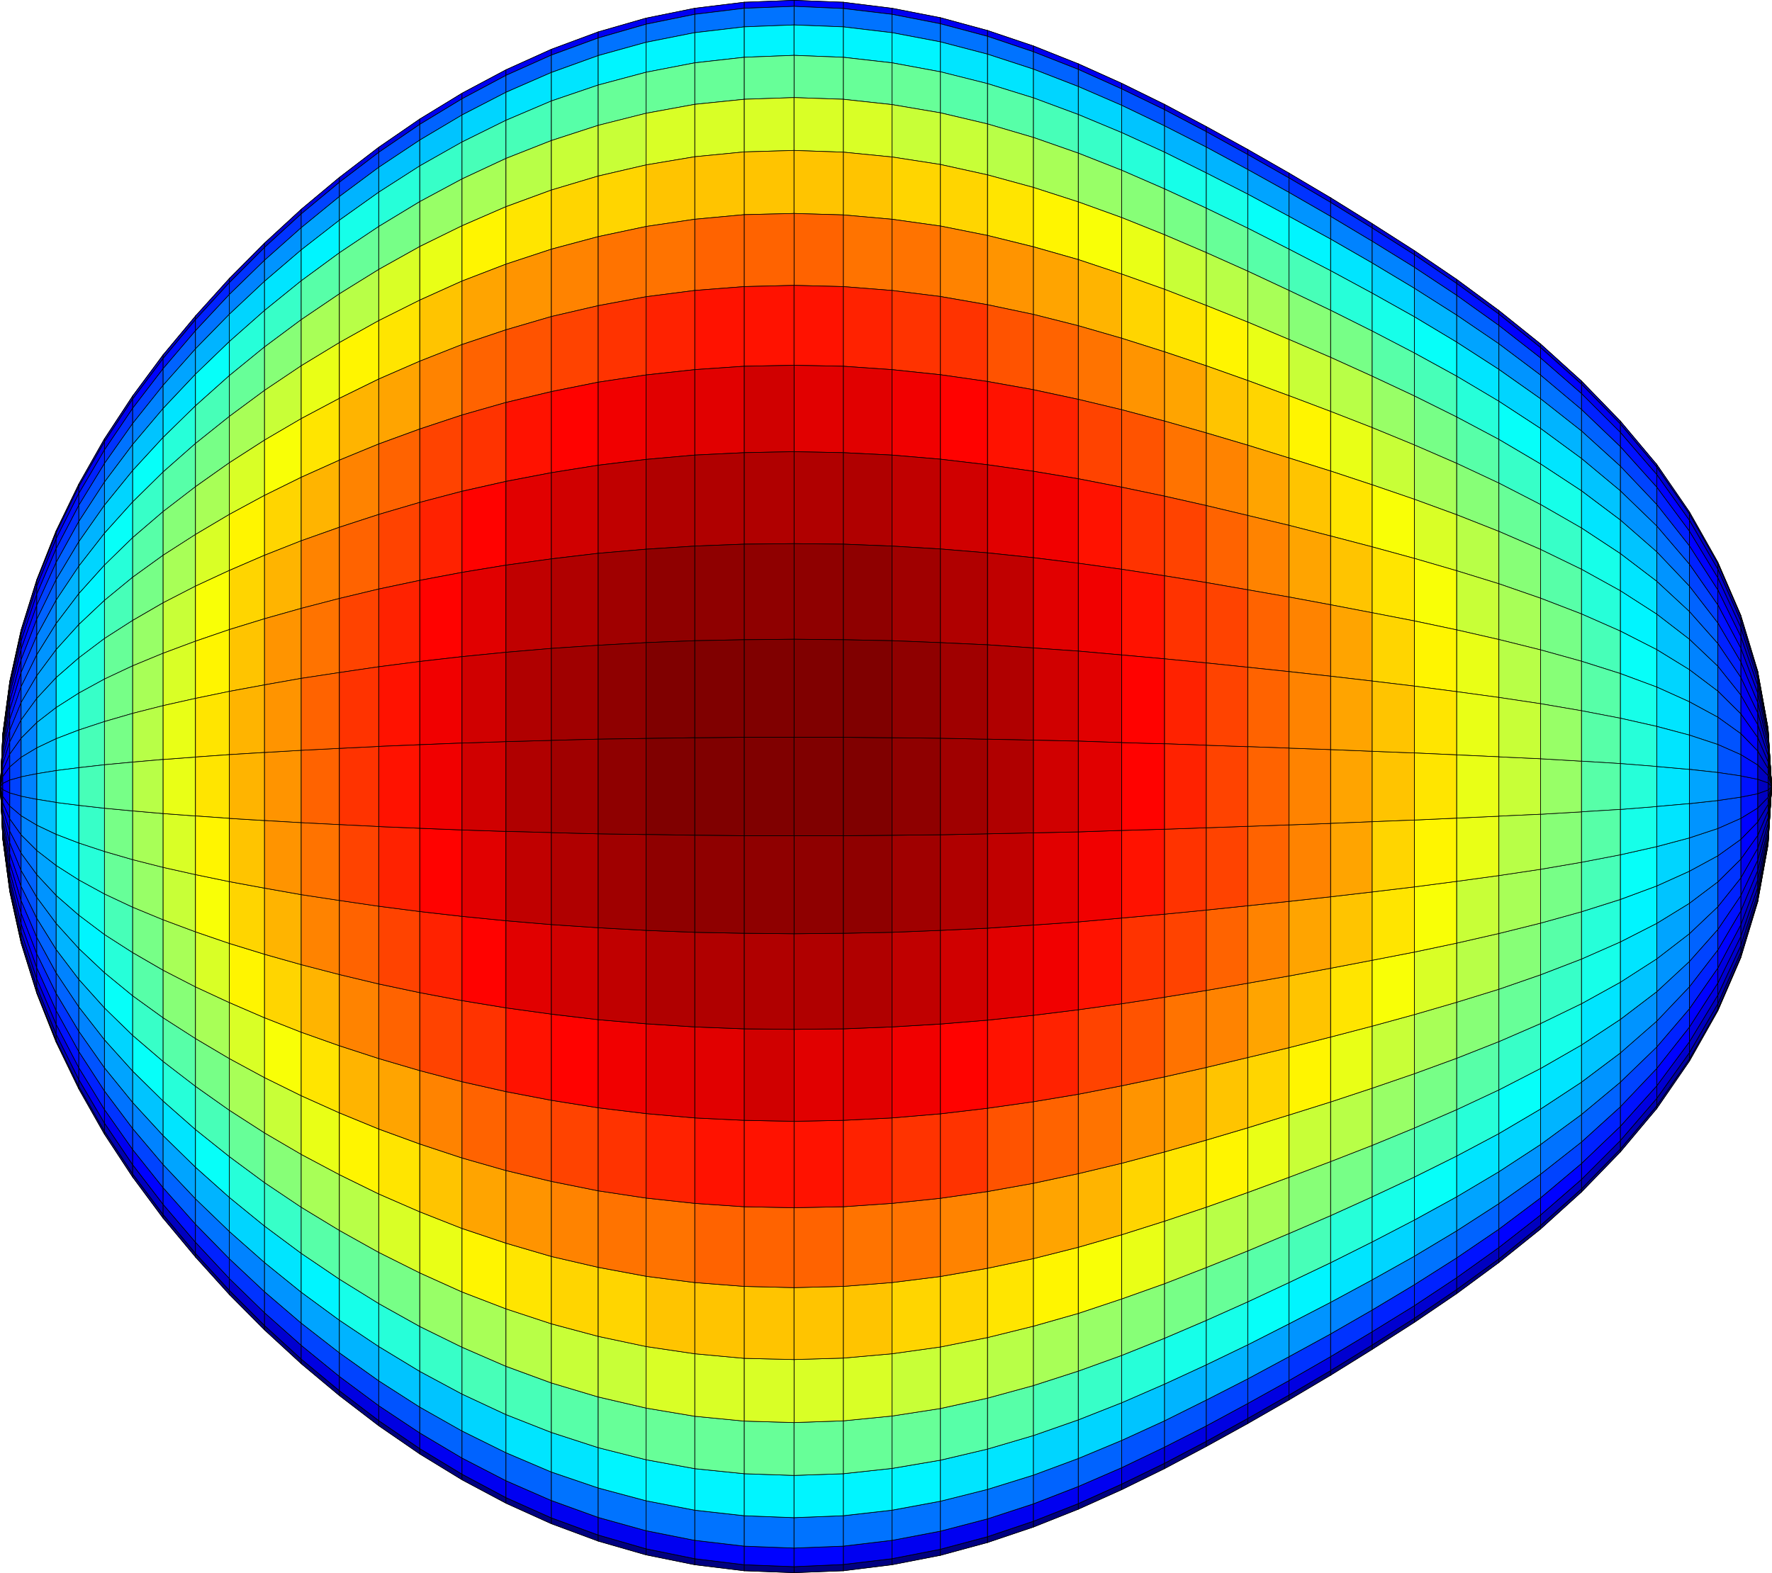
Pear-shaped nuclei measured via Coulomb excitation at REX-ISOLDE
Peter Butler
PhD Supervisor
EuNPC2015
Liam P. Gaffney
University of the West of Scotland, UK
University of Liverpool, UK

Slide 2


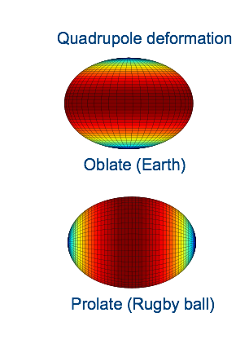
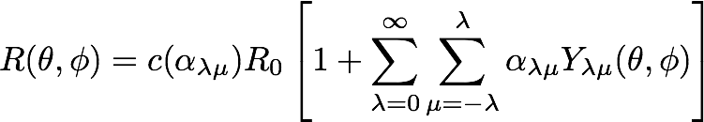
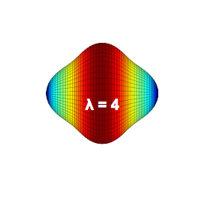
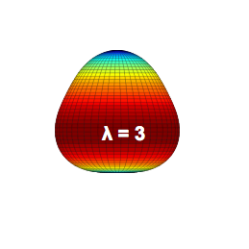
Nuclear Shapes
Described by a multipole expansion in λ
Multipole order: 2^{λ}
2⁰ = monopole - breathing mode
2¹ = dipole - centre of mass shift
2² = quadrupole - axial deformation
2³ = octupole - asymmetric deformation
2⁴ = hexadecapole - pinching

Slide 3
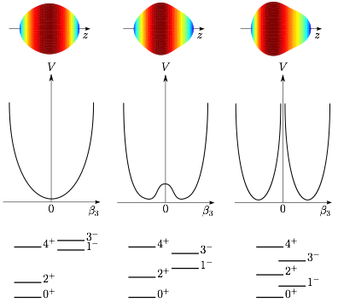
Reflection Asymmetry (Nuclei)
Macroscopically...
Nuclei take on a “pear” shape
Reflection asymmetric
• β₃-vibration
• Static β₃-deformation
• Rigid β₃-deformation...
Signatures...
Odd-even staggering, negative parity
Parity doublets in odd-A nuclei
Collective B(E3) transitions

Slide 4
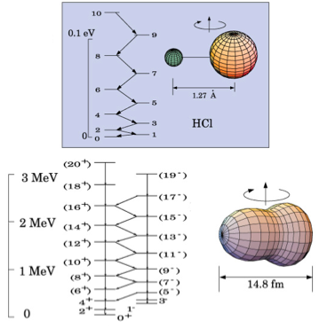

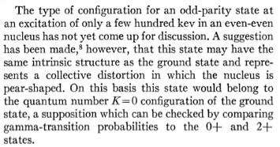
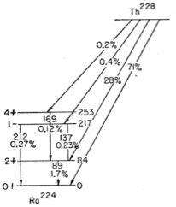
Reflection Asymmetry (Molecules)
Asymmetric HCl molecule
Rotational band – staggering of odd and even spin states
²²⁴Ra
F. Stephens, Jr., F Asaro and I. Perlman
Phys. Rev. 96 (1954) 1568, 100 (1955) 1543

Slide 5


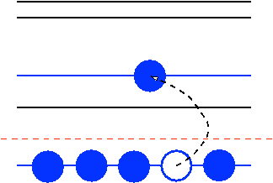



Reflection Asymmetry
184
Microscopically driven...
Intruder orbitals of opposite parity and ∆J, ∆L = 3 close to the Fermi level
134
126
88
82
56
ε_{F}
50
34
Enhancement of octupole part of nucleon-nucleon force...
- Small energy gap
- High sub-state density
28
}
Heaviest nuclei
20

Slide 6
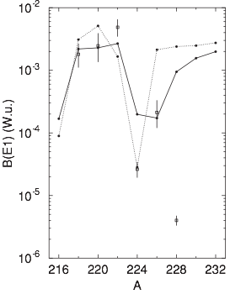

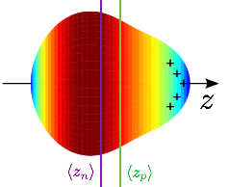

Quantifying the pear-shape
Ra
Two contributions to Q1:
- Macroscopic of the order +0.1 fm
- Microscopic of the order -0.1 fm
Cancellation gives small B(E1) in ²²⁴Ra
Mean-field calculations reproduce behaviour of E1 transitions
L.M. Robledo et al., Phys. Rev. C 81, 034315 (2010)

Slide 7



Quantifying the pear-shape
Pros:
- Less sensitive to single particle effects
- Direct measure of octupole collectivity
- Link to deformation via β3 parameter
Cons:
- Difficult to access E3 transitions
- Excited state decay dominated by E1/E2
B(E3) >~ 30 s.p.u. gives significant β3

Slide 8
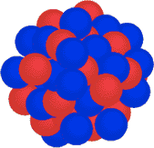
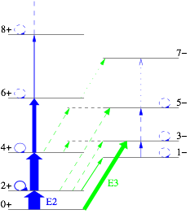

Coulomb Excitation
Projectile (Z1,A1)
θ
b
v
Target (Z2,A2)
Sommerfeld parameter:
“Safe” Coulex:
Dominated by E2 and E3 excitation near the Coulomb barrier

Slide 9
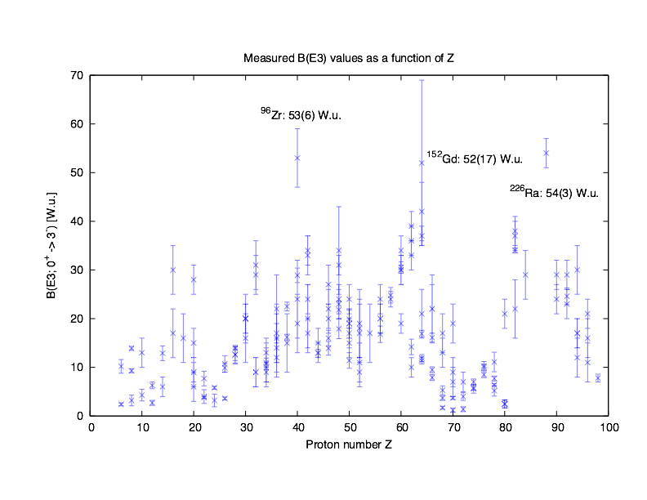
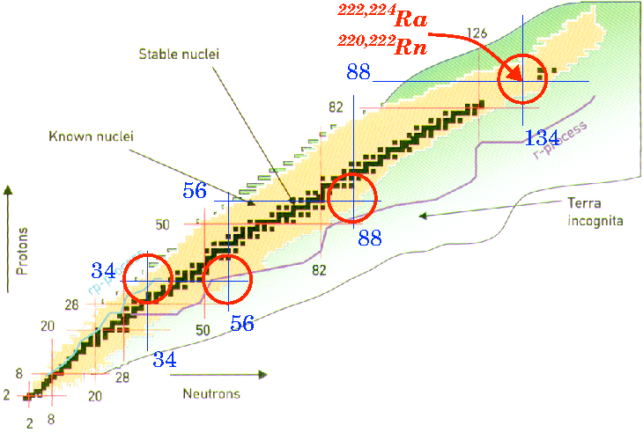
Octupole Collectivity
Z = 34
Z = 88
N = 134
Z = 56
²²⁶Ra
Rn (Z=86)?

Slide 10
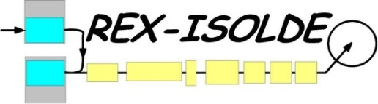

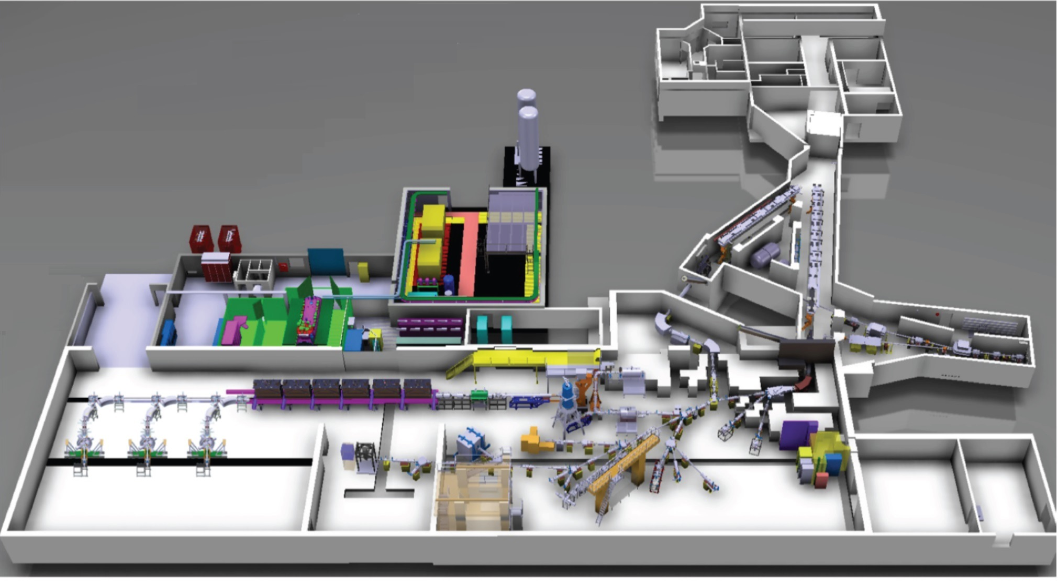
REX-ISOLDE, CERN
VADIS (Rn)
1.4 GeV p⁺ primary target
Hot W line (Ra)
HRS
GPS
Post acceleration up to 3 MeV/u
REXTRAP + EBIS
Miniball

Slide 11

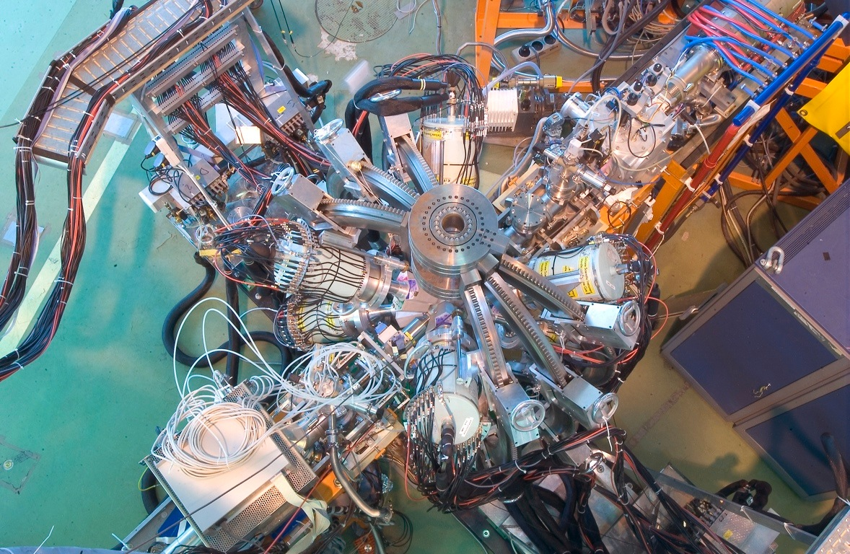
Miniball @ REX-ISOLDE
²²⁰Rn/²²⁴Ra beam
@ ~2.83 MeV/u
Coulex target
~2 mg/cm²

Slide 12
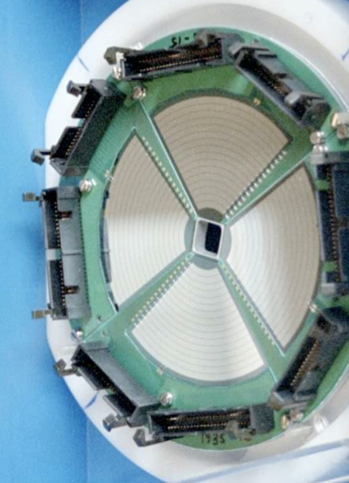
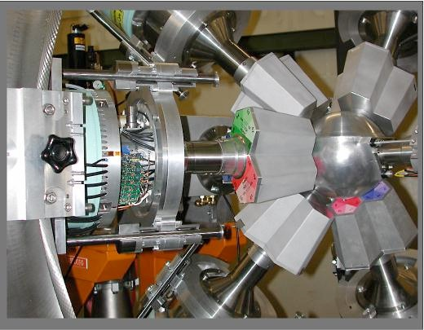
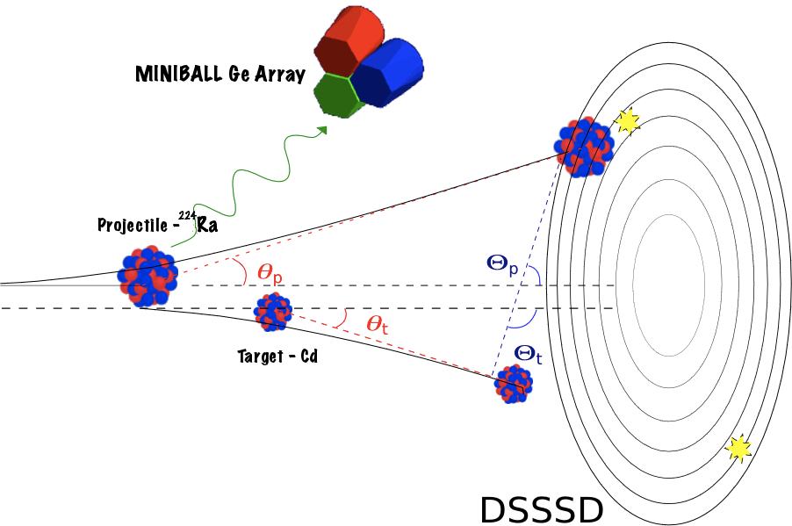
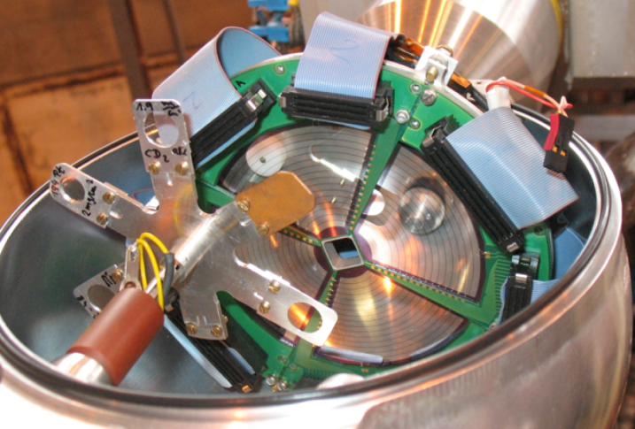
Miniball: Coulex set-up
• Particle ID in a Double-Sided Si Strip Detector.
• Event by event Doppler correction.
• 17˚ < θlab < 54˚
• Array of HPGe of 8 triple clusters
• 6-fold segmentation for positioning
• ε > 7% for 1.3MeV γ-rays
N. Warr et al., EPJ 49 (2013)

Slide 13
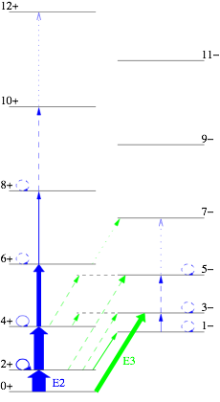
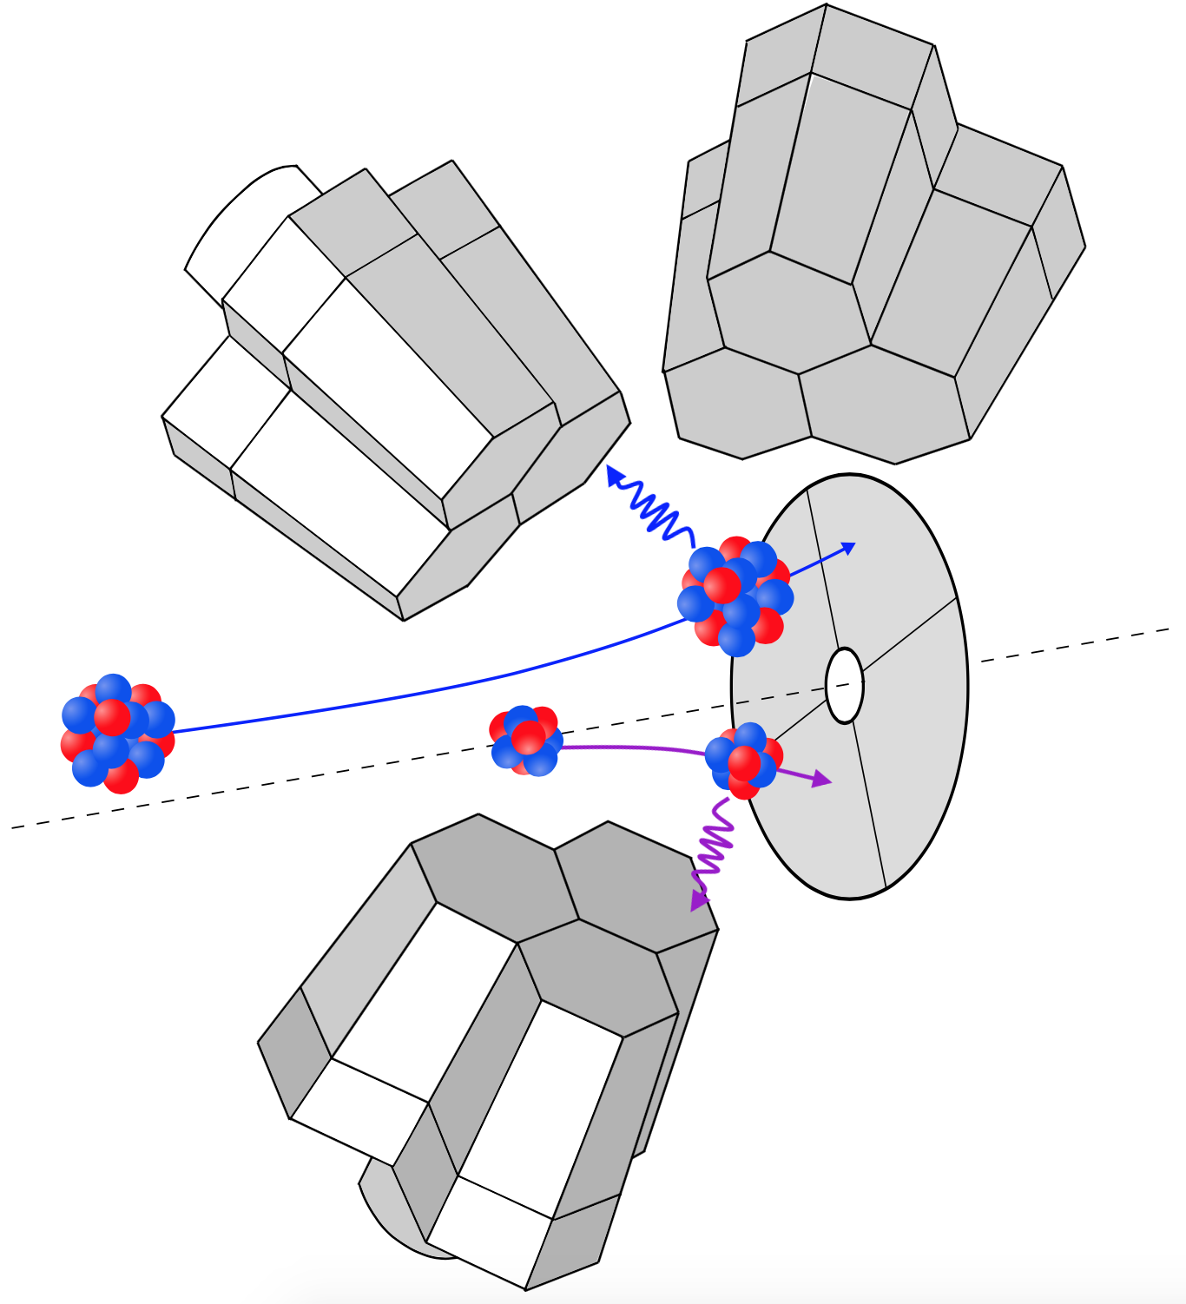
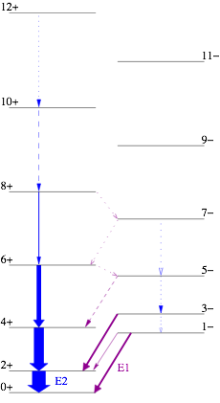
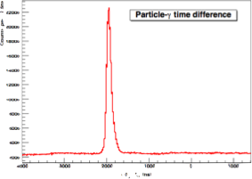
Particle-gamma coincidences
²²⁴Ra
Random
Prompt
¹²⁰Sn
Normalisation = tprompt
    trandom

Slide 14
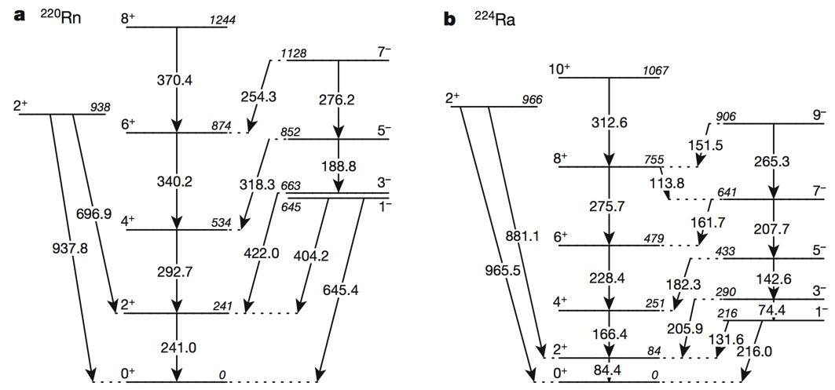
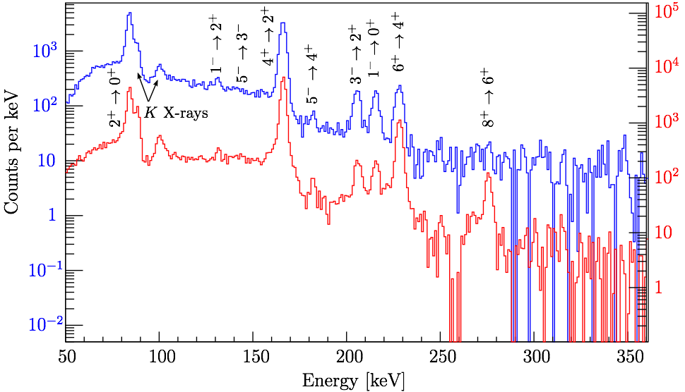
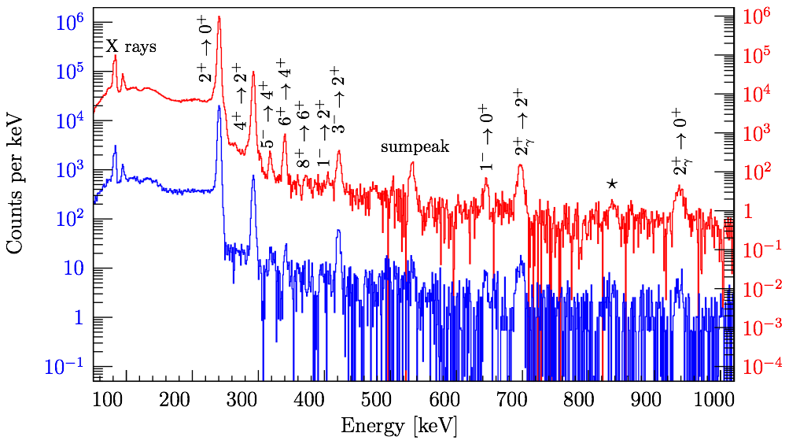
Spectra - ²²⁰Rn and ²²⁴Ra
Heaviest short-lived ISOL beams to date
²²⁴Ra
⁶⁰Ni target - 2.1mg/cm2
¹²⁰Sn target - 2.0mg/cm2
⁶⁰Ni target - 2.1mg/cm2
¹²⁰Sn target - 2.3mg/cm2
²²⁰Rn

Slide 15
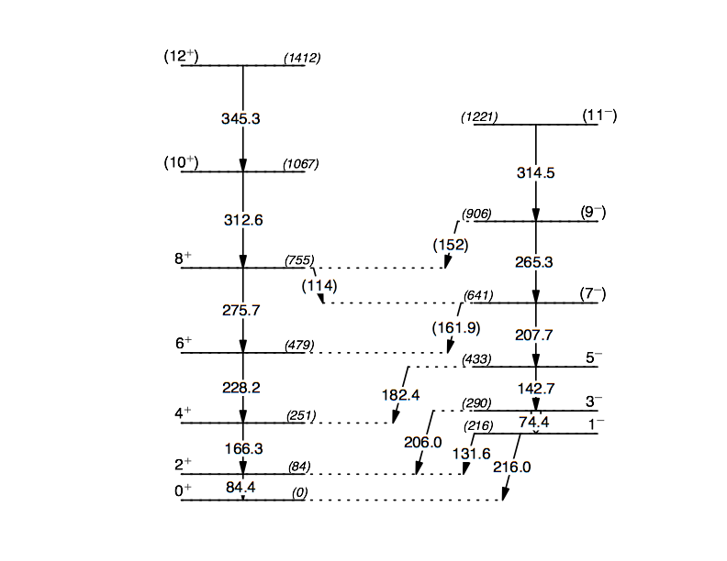
Analysis - ²²⁴Ra Gosia
16 free matrix elements + 6 normalisation factors
“Experiment” | Number and type of data
Multi-nucleon transfer[1,2] ²²⁶Ra(⁵⁸Ni,⁶⁰Ni)²²⁴Ra ²³²Th(¹³⁶Xe,¹²⁸Te)²²⁴Ra Alpha, alpha-prime[3] ²²⁶Ra(α,α’2n)²²⁴Ra Alpha(beta)-decay[4] ²²⁸Th(²²⁴Fr) → α(β) | Branching ratios (1⁻, 3⁻, 5⁻, 7⁻, 2⁺γ) -- 5
Delayed-coincidence [5,6] | Lifetimes (2⁺, 4⁺) -- 2
Cd/Sn high CoM range 23.9˚ < θ_{lab} < 40.3˚ | γ-ray yield -- 8 + 7
Ni high CoM range 23.1˚ < θ_{lab} < 39.9˚ | γ-ray yield -- 10
Cd/Sn low CoM range 40.3˚ < θ_{lab} < 54.3˚ | γ-ray yield -- 8 + 8
Ni low CoM range 39.3˚ < θ_{lab} < 53.2˚ | γ-ray yield -- 7
Total | 55 data points
χ²_{total} = 27
[1] Poynter et al., Phys. Lett. B 232, 447 (1989)
[2] J.F.C. Cocks et al., Nucl. Phys. A 645, 61 (1999)
[3] Marten-Tölle et al., Z. Phys. A 336, 27 (1990)
[4] W. Kurcewicz, et al., Nucl. Phys. A 289 (1977)
[5] W.R. Neal and H.W. Kraner, Phys. Rev. 137, B1164 (1965)
[6] H. Ton et al., Nucl. Phys. A 155, 235 (1970)

Slide 16
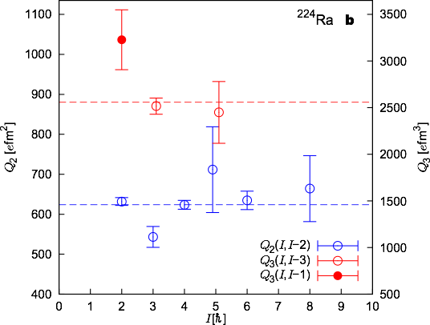
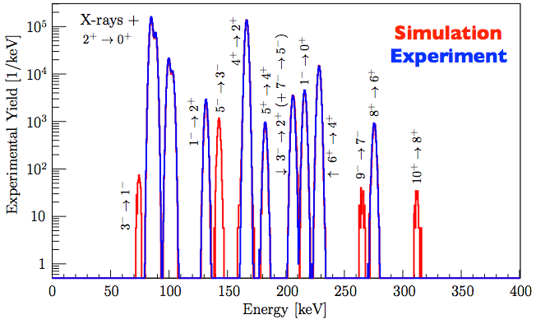
Results - ²²⁴Ra
• Consistent with rotational model
• Unstretched E3 matrix elements are non-zero.
• Coupled with level energy data, we observe a static octupole deformation in ²²⁴Ra

Slide 17
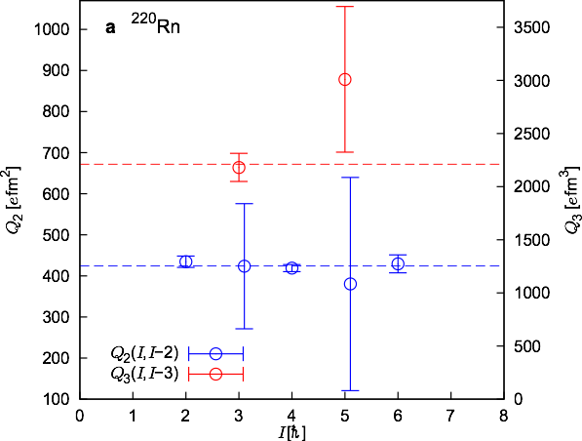
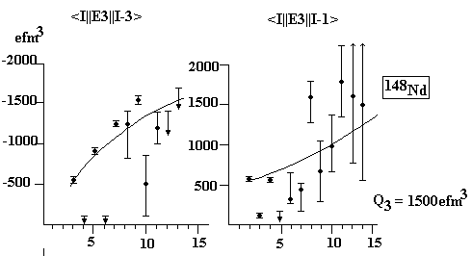
Results - ²²⁰Rn
Fit: 34 data points -> 21 free parameters
• Consistent with rotational model.
• No information on unstretched E3.
• Much larger data set required to determine if <1⁻||E3||4⁺> vanishes.
• δE and Δix implies a coupling of an octupole phonon to the even-spin rotational band.
• Dynamic collectivity in ²²⁰Rn
January 2015:
¹⁴⁶Nd, ¹⁴⁸Sm, ¹⁵²Gd measure <1⁻||E3||4⁺>
with MINORCA (Miniball at Orsay)

Slide 18
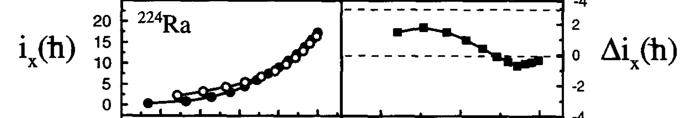
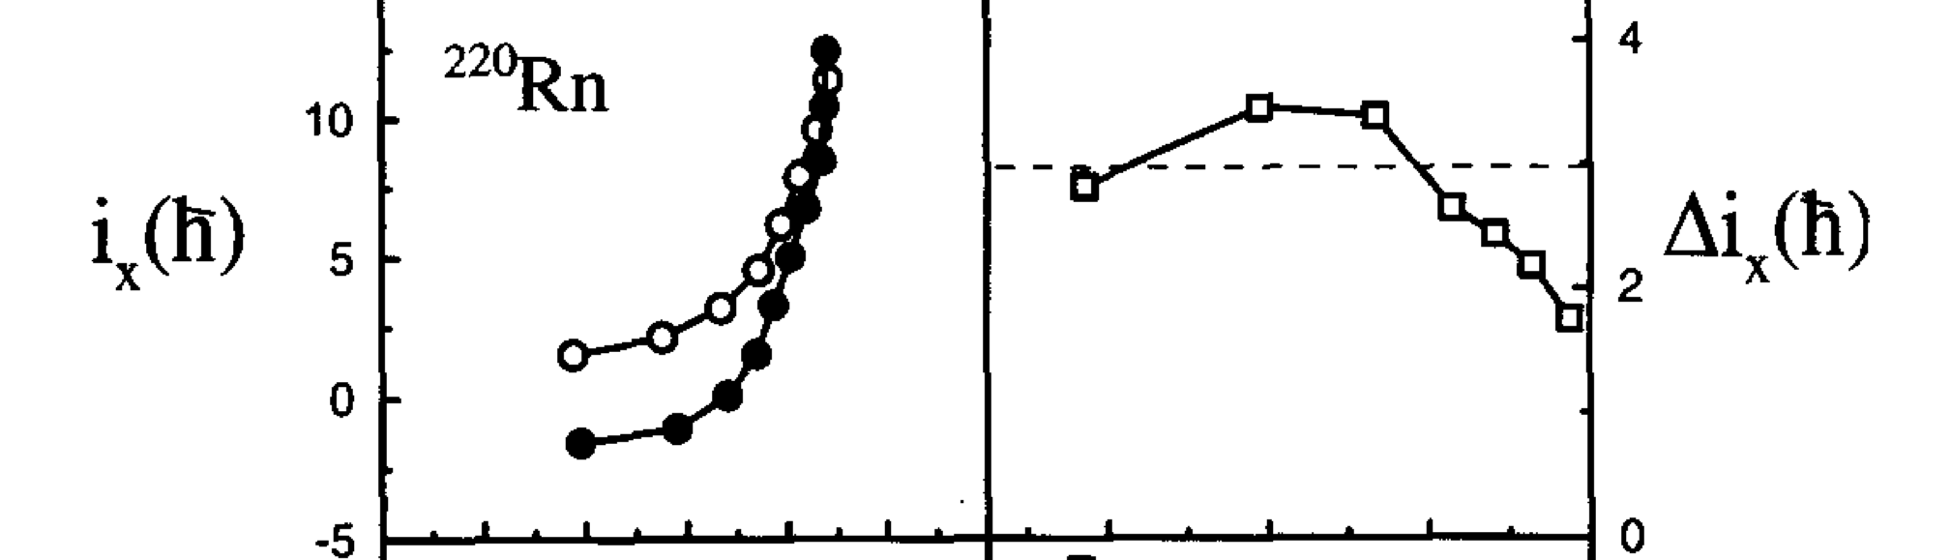
Static or dynamic pear-shape?
Odd-spin states aligned to intrinsic rotational structure of the even-spin band.
Octupole phonon coupled to even-spin rotational band.
• Even-spin band
^{O} Odd-spin band
J.F.C. Cocks et al., Nucl. Phys. A 645, 61 (1999)

Slide 19
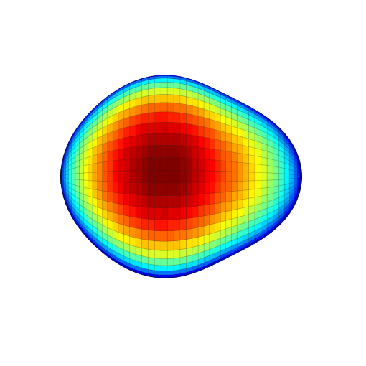
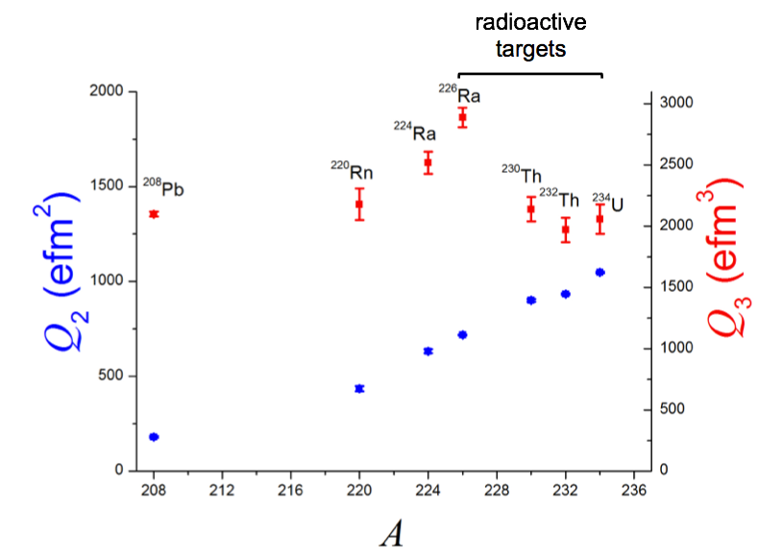

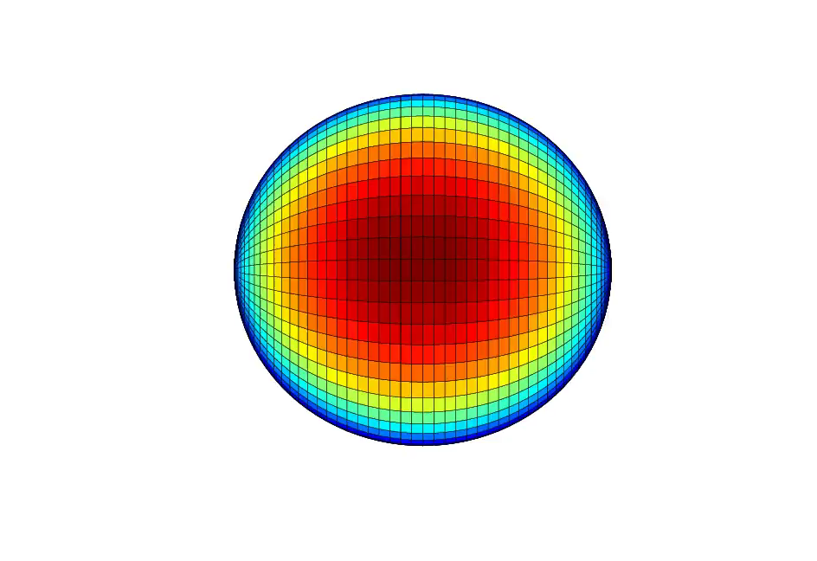
Statically deformed or vibrational?
Octupole vibrational
Our data
Radioactive beams

Slide 20


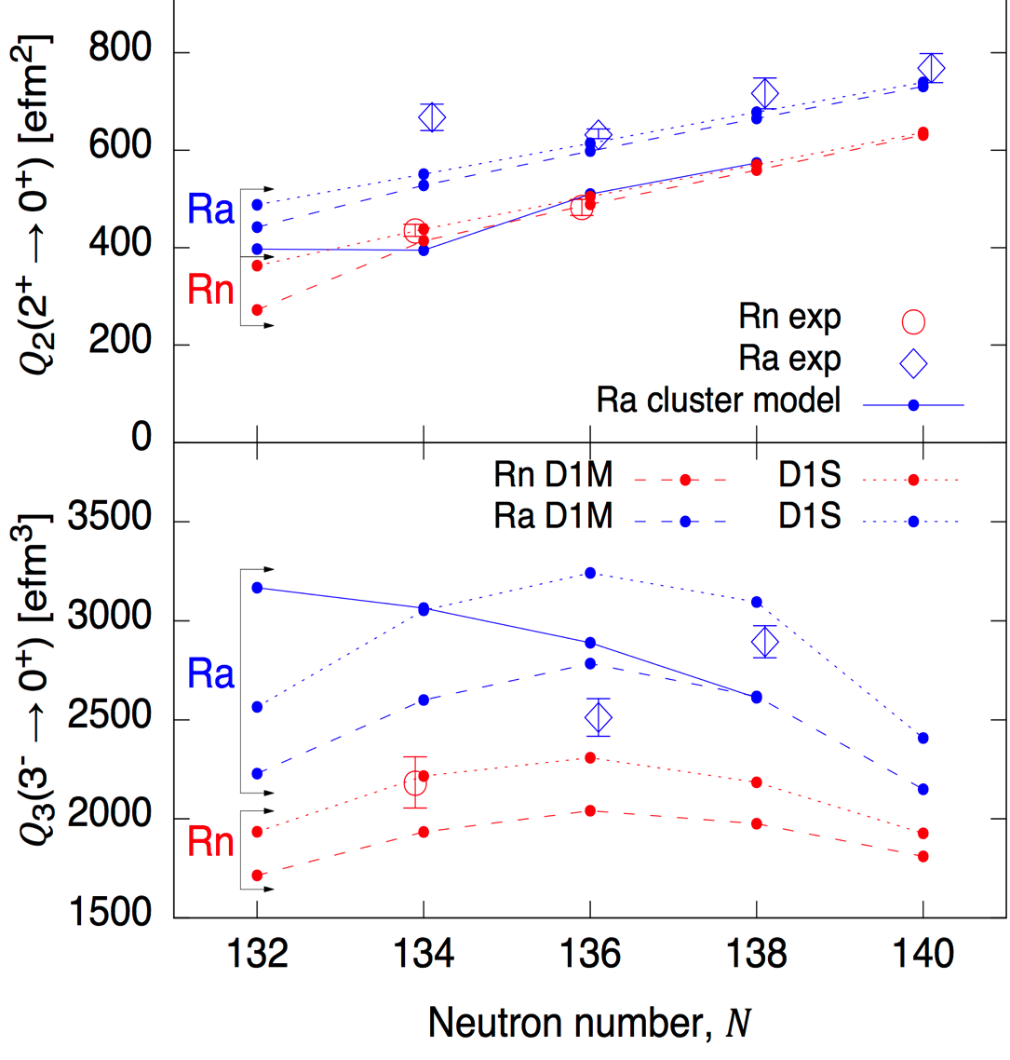
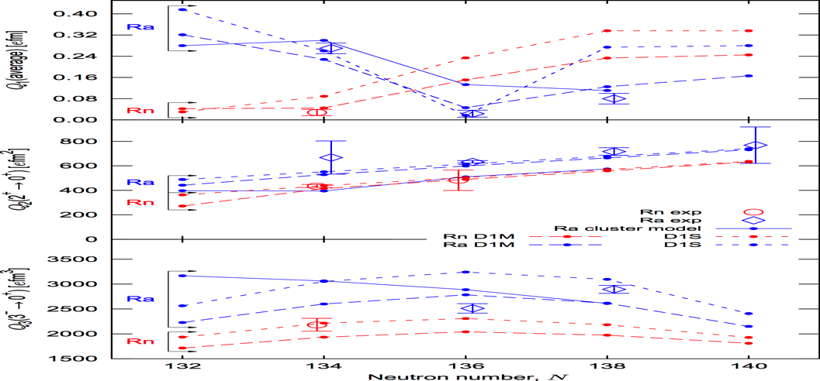

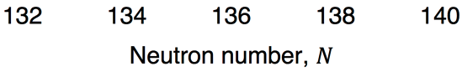
Comparison to theory
• Cluster model [1] - Misses small Q1
  - Q₂ is consistently too low
  - Q₃ trend not observed
• Mean field, HFB with D1S or D1M [2]
  - Predicts cancelation of Q₁
  - Differences in Q₃ predictions
• More (good) mean-field models on the market
• Important Q₂-Q₃ coupling [3]
[1] Shneidman, et al. (2003). Phys. Rev. C, 67(1) 14313
[2] Robledo & Bertsch (2011). Phys. Rev. C, 84(5) 54302.
2nd place
to ICECube
Q₂
Q₃
Q₁
[3] Robledo & Butler (2013). Phys. Rev. C, 88 051302R

Slide 21
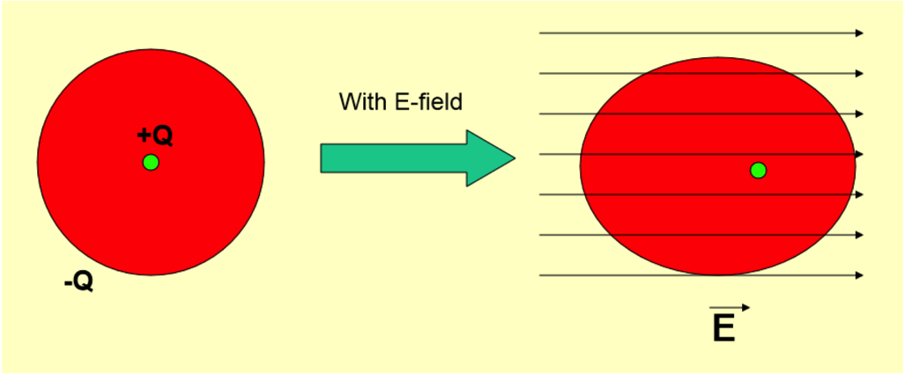
Electric Dipole Moment (EDM)
A static atomic EDM implies CP-violation
or equivalently T-violation
Schiff theorem: neutral atomic system of point particles in electric field readjusts itself to give zero E field at all charges.
BUT: finite size of nucleus and shape of charge distribution can break the symmetry
RadonEDM @ TRIUMF (S929)
^{221,223}Rn
Radium EDM experiment @ ANL
²²⁵Ra
TRIμP @ KVI
(+atomic sensitivity) ²⁰⁹⁻²¹⁴Ra
Atomic EDM proportional to Schiff moment
- Experiments are taking advantage of this in North America and right here in Groningen! →

Slide 22
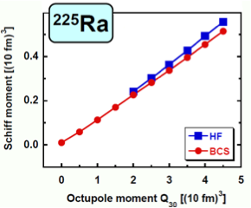

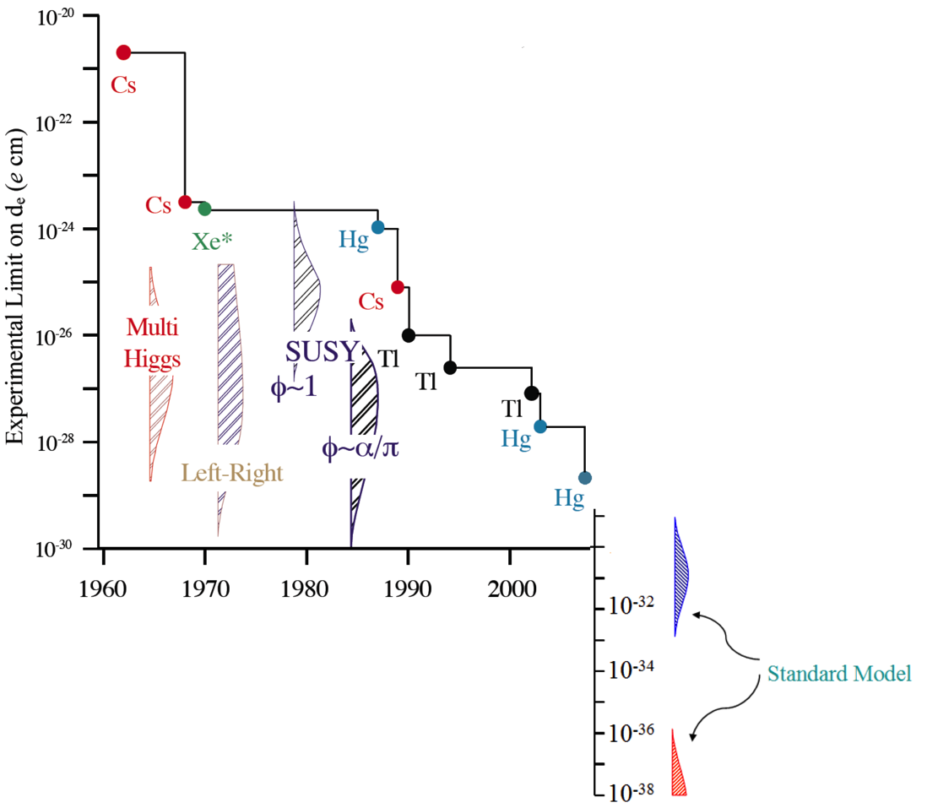
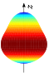


Octupole enhanced EDM
[1]
Schiff moment
²²⁴Ra
Energy splitting of parity doublets
²²⁵Ra
∆E = 55 keV
²²¹Rn
∆E = ?? keV
Current Limit: |d(¹⁹⁹Hg)| < 3.1x10⁻²⁹ e cm [1]
Sensitivity increase of ~1000 for octupole deformed nuclei
+ experimental improvements
[3] M. Pospelov & A. Ritz,
Annals of Physics, 318, 119 (2005)
[1] J. Dobaczewski, & J. Engel, Phys. Rev. Lett., 94, 232502 (2005)
[2] W. C. Griffith et al. Phys. Rev. Lett. 102, 101601 (2009)

Slide 23
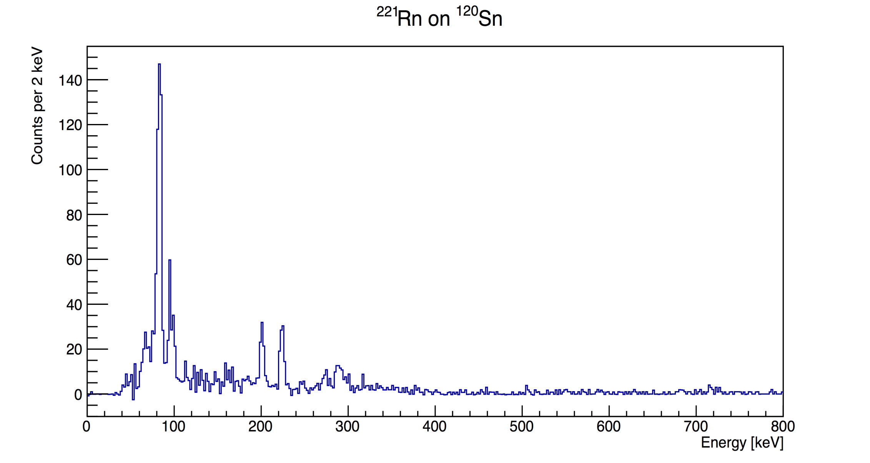
Preliminary Coulex of ²²¹Rn
Large x-ray excess implies strongly converted, low-energy transitions which are not observed...
... SPEDE - e⁻ detector for MINIBALL
Experiment to be re-run to define level scheme
Complementary β-decay experiment in the pipeline (LOI @ ISOLDE)
K X rays
224 keV
201 keV
273 keV
290 keV - doublet
Courtesy of George O’Neill, PhD student
University of Liverpool

Slide 24
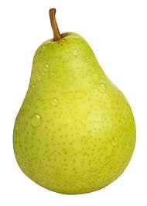
Summary and outlook
Demonstrated sensitivity and ability to measure E3 matrix elements with Radioactive Ion Beams (RIBs).
B(E3; 3⁻ → 0⁺) measured for the first time in Rn’s and only second measurement in Ra’s, both to ~10% precision.
Proposal for measurements in ^{222,226,228}Ra and Ba region at HIE-ISOLDE (starting next year).
Plus odd-mass nuclei (²²¹Rn), in progress
Odd-mass nuclei key to atomic EDM measurements. Nuclear structure input vital; beginning to appear.

Slide 25




Collaborators
T.E. Cocolios, J. Pakarinen, J.Cederkall, D. Voulot, F. Wernander
Th. Kröll, S. Bönig, C. Bauer, M. von Schmid
B. Bastin
T. Grahn, A. Herzan
A. Blazhev, M. Seidlitz, N. Warr, M. Albers, M. Pfeiffer, D. Radeck
M. Rudigier, P. Thöle
P. van Duppen, N. Bree, J. Diriken, N. Kesteloot, M. Huyse
S. Sambi, K. Reynders
L. P. Gaffney, P. A. Butler, M. Scheck, D.T. Joss, S.V. Rigby
E. Kwan
T. Chupp
K. Wimmer, R. Lutter
D. Cline, A.B. Hayes, C.Y. Wu
P. Napiorkowski, M. Kowalczyk, K. Wrzosek-Lipska
D.G. Jenkins
M. Zielinska
CERN-ISOLDE, Switzerland
TU Darmstadt, Germany
Ganil, France
University of Jyväskylä, Finland
University of Köln, Germany
KU Leuven, Belgium
University of Liverpool, UK
Lawrence Livermore Laboratory, US
University of Michigan, US
TU München, Germany
University of Rochester, US
HIL University of Warsaw, Poland
University of York, UK
CEA Saclay, France
and the REX-ISOLDE and MINIBALL collaborations
Thank you!
Dankjewel!

Slide 26



Future measurements
[1] Robledo, L. M., & Bertsch, G. F. (2011). Phys. Rev. C, 84(5), 54302.
[1] Robledo & Bertsch (2011). Phys. Rev. C, 84(5) 54302.
^{226,228}U
²²⁶Th
Estimated intensity at FRIB for ²²⁸U ~ 4x10⁶ s⁻¹
[2] P.T. Greenlees et al. J. Phys. G: Nucl. Part. Phys. 24 (1998) L63

Slide 27

HIE-ISOLDE
High Intensity and Energy upgrade
CERN Long Shutdown; HIE-ISOLDE upgrade synchronised
First experiments expected next month (^{182,184}Hg, ; October 2015!!)
Q4 2015
1.2 MeV/u
3
MeV/u
4.5 MeV/u
5.5 MeV/u
^{221,222}Rn
^{222,226,228}Ra
¹⁴⁴Ba
8
MeV/u
10 MeV/u
Q2 2017

Slide 28



Analysis - 220Rn: High/Low θ
High CoM θ
Low CoM θ

Slide 29

Analysis - 220Rn γ-γ
γ(697 keV)

