Slide 1

High accuracy neutron inelastic cross
section measurements on ²⁰⁶Pb
Negret¹, L.C. Mihailescu ^{1,2}, C. Borcea¹, Ph. Dessagne³, K.H. Guber⁴,
M. Kerveno³, A.J. Koning⁵, A. Olacel^{1,6}, A.J.M. Plompen², C. Rouki², and G. Rudolf³
¹ Horia Hulubei National Institute for Physics and Nuclear Engineering, Bucharest-Magurele, Romania
² European Comission, Joint Research Center, Institute for Reference Materials and Measurements, Geel, Belgium
³ Universite de Strasbourg, IPHC and CNRS, UMR7178, Strasbourg, France
⁴ Reactor and Nuclear Systems Division, Oak Ridge National Laboratory, USA
⁵ Nuclear Research Group Petten, The Netherlands
⁶ University of Bucharest, Faculty of Physics, Romania
EuNPC2015, Groningen, September 2015

Slide 2
A. Negret – ²⁰⁶Pb(n,n’γ) cross section measurements
Summary
Neutron inelastic cross section measurements at GELINA
Details of the ²⁰⁶Pb measurement
Results
Conclusions
EuNPC2015, Groningen, September 2015

Slide 3
A. Negret – ²⁰⁶Pb(n,n’γ) cross section measurements
Inelastic cross section measurements at GELINA
Neutron inelastic cross section measurements at GELINA
Details of the ²⁰⁶Pb measurement
Results
Conclusions
EuNPC2015, Groningen, September 2015

Slide 4
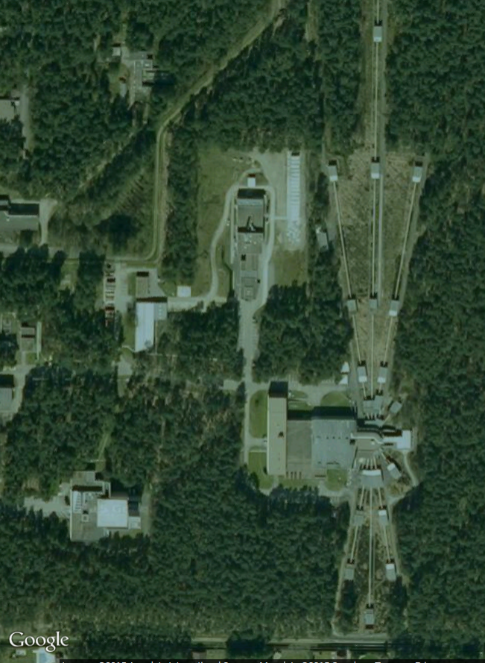
A. Negret – ²⁰⁶Pb(n,n’γ) cross section measurements
GELINA (Geel Linear Accelerator):
the white neutron source
Neutron source: GELINA
(white flux 100 keV – 20 MeV), operated by EC-JRC-IRMM, Geel, Belgium
Pulsed beam, 800 Hz
TOF technique (200 m flight path) using 4 HPGe detectors:
  Amplitude ⬄ gamma energy
  Time ⬄ neutron energy
Flux monitored win a ²³⁵U Fission Chamber
EuNPC2015, Groningen, September 2015

Slide 5
A. Negret – ²⁰⁶Pb(n,n’γ) cross section measurements
The gamma spectroscopy used to determine
X(n,n’γ)X cross sections
4 x HPGE yield
FC yield
HPGe Efficiency:
Monte-Carlo simulation
FC Efficiency
E_{γ} = xxx
Gamma Production cross sections
Cross section
ENSDF: level scheme
Neutron energy
L2
γ2
γ3
L1
γ1
Total inelastic cross section
Level cross sections
g.s.
EuNPC2015, Groningen, September 2015

Slide 6
A. Negret – ²⁰⁶Pb(n,n’γ) cross section measurements
What’s so special about it?
Precision – up to 5% uncertainty
Neutron energy resolution – 1.3 keV for E_{n}=1 MeV
Utility:
  Precise data are requested by reactor developers
  Reaction code calibration
EuNPC2015, Groningen, September 2015

Slide 7
A. Negret – ²⁰⁶Pb(n,n’γ) cross section measurements
The ²⁰⁶Pb(n,n’γ) experiment
Neutron inelastic cross section measurements at GELINA
Details of the ²⁰⁶Pb measurement
Results
Conclusions
EuNPC2015, Groningen, September 2015

Slide 8
A. Negret – ²⁰⁶Pb(n,n’γ) cross section measurements
The ²⁰⁶Pb(n,n’γ)²⁰⁶Pb experiment
Two independent measurement campaigns:
  One with a large radiogenic sample (88.59% ²⁰⁶Pb, 8.46% ²⁰⁷Pb, 2.87% ²⁰⁸Pb)
  One with an enriched sample (99.82% ²⁰⁶Pb)
EuNPC2015, Groningen, September 2015

Slide 9
A. Negret – ²⁰⁶Pb(n,n’γ) cross section measurements
The ²⁰⁶Pb(n,n’γ)²⁰⁶Pb experiment
The level scheme of ²⁰⁶Pb:
  The second excited level is 0+ and it decays only to the g.s. through an E0 transition
  At 2200.2 keV there is an isomer (T_{1/2} = 125μs)
T_{1/2} = 125 μs
2200.2
7-
(…)
1466.8
2+
1340.5
3+
1166.4
0+
E0
803.1
2+
0
0+
EuNPC2015, Groningen, September 2015

Slide 10
A. Negret – ²⁰⁶Pb(n,n’γ) cross section measurements
²⁰⁶Pb(n,n’γ) results
Neutron inelastic cross section measurements at GELINA
Details of the ²⁰⁶Pb measurement
Results
Conclusions
EuNPC2015, Groningen, September 2015

Slide 11
A. Negret – ²⁰⁶Pb(n,n’γ) cross section measurements
²⁰⁶Pb(n,n’γ)²⁰⁶Pb γ production cross sections
We measured the γ production cross section for 34 γ rays.
EuNPC2015, Groningen, September 2015

Slide 12
A. Negret – ²⁰⁶Pb(n,n’γ) cross section measurements
²⁰⁶Pb(n,n’γ)²⁰⁶Pb level cross sections
EuNPC2015, Groningen, September 2015

Slide 13
A. Negret – ²⁰⁶Pb(n,n’γ) cross section measurements
²⁰⁶Pb(n,n’γ)²⁰⁶Pb total inelastic cross section
EuNPC2015, Groningen, September 2015

Slide 14
A. Negret – ²⁰⁶Pb(n,n’γ) cross section measurements
²⁰⁶Pb(n,n’γ)²⁰⁶Pb – the bonus
Whenever we detect two or more gammas from one level, we can determine (for each neutron energy!) the branching ratio:
E_{level} (keV) | E_{γ} (keV) | Branching ratio
 |  | Present | Evaluated value
1684.0 | 343.5 | 37.3(7) | 35.4(5)
 | 881.0 | 100 | 100.0(1)
2196.7 | 856.6 | 100 | 100
 | 1393.8 | 82.7(13) | 78(5)
2423.4 | 718.92 | 63.5(21) | 48.5(20)
 | 956.6 | 24.6(18) | 20.6(16)
 | 1620.3 | 100 | 100(4)
2782.2 | 398.0 | 81.8(15) | 79.6(7)
 | 1098.3 | 100 | 100(11)
3244.2 | 1246.5 | 36.9(37) | 22.2(21)
 | 1560.3 | 100 | 100(5)
 | 1903.6 | 104.2(36) | 92(4)
γ1
γ2
EuNPC2015, Groningen, September 2015

Slide 15
A. Negret – ²⁰⁶Pb(n,n’γ) cross section measurements
Conclusions
Neutron inelastic cross section measurements at GELINA
Details of the ²⁰⁶Pb measurement
Results
Conclusions
EuNPC2015, Groningen, September 2015

Slide 16
A. Negret – ²⁰⁶Pb(n,n’γ) cross section measurements
Conclusions
We presented a short overview of the neutron inelastic scattering experiment on ²⁰⁶Pb, an important structural material.
The production cross sections for 34 γ rays were determined with unprecedented accuracy (up to 5%) up to E_{n}=18 MeV.
Level cross sections and the total inelastic cross section were calculated up to E_{n}=3.5 MeV.
For more details see:
A. Negret et al., Phys Rev. C91, 064618 (2015)
EuNPC2015, Groningen, September 2015

