Slide 1
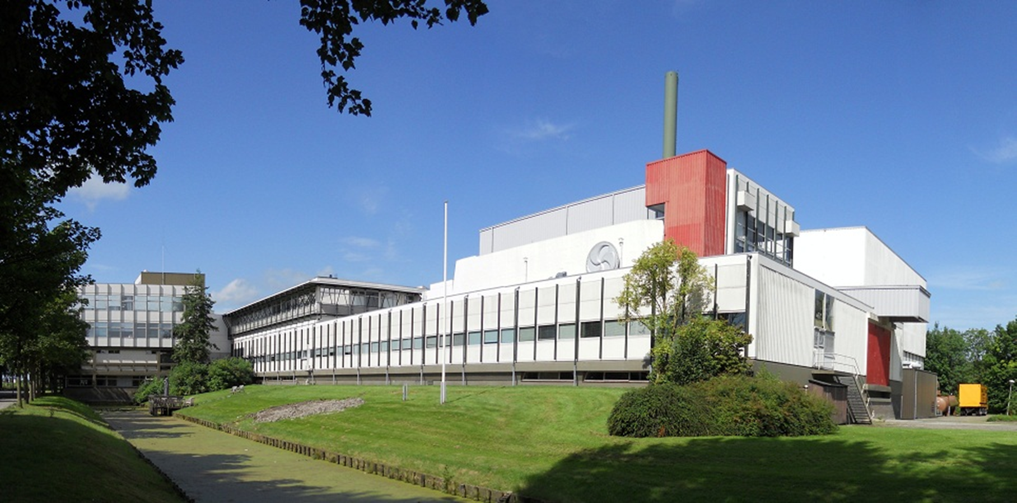
Ad M. van den Berg
Director
KVI - Center for Advanced Radiation Technology
University of Groningen

Slide 2

The Future of Nuclear Physics, Today!

Slide 3
Confucius
Study the past, if you want to define the future
Abridged historic overview nuclear physics at University of Groningen
- 1968 commissioning first cyclotron in new building
- 1996 commissioning second cyclotron aka AGOR
- 2014 continuation of KVI into KVI – CART

Slide 4
KVI - CART
basic research:
nuclear & hadronic physics
astroparticle physics
application driven research:
accelerator physics
physics in medicine
cross fertilization:
common expertise in radiation technology
common technological departments

Slide 5
International context
From its very beginning KVI acted as host for many researchers taking advantage of the world-class expertise available

Slide 6
International context
Continued into the future through strong national and international collaborations
  PARTREC (University Medical Center and KVI - CART)
  GSI FAIR / BESIII
  ENSAR(2) and their predecessors under the EU FPs
  Pierre Auger Collaboration / LOFAR / KM3NeT
Major impact through KVI – CART staff members

Slide 7
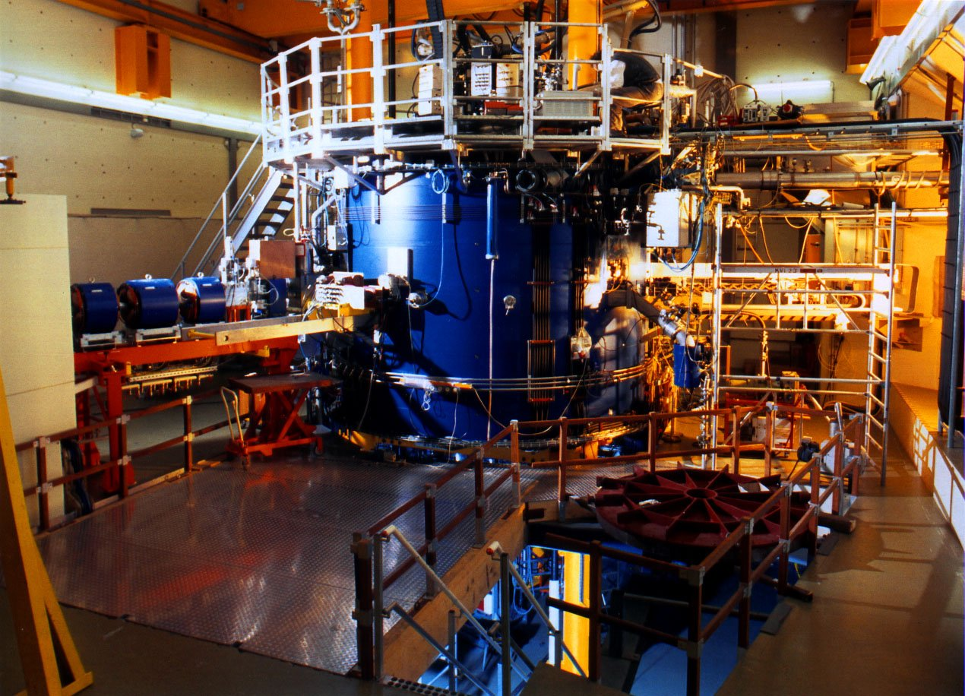
Consolidating our position
AGOR for application driven research, mainly to advance techniques for particle therapy
Strengthening collaboration with partners
  University Medical Center
  ASTRON & SRON
  Nuclear & Hadronic physics

Slide 8

The Future of Nuclear Physics, Today!
Conferences are an excellent way to strengthen collaborations and to identify new opportunities for the future, taking advantage of the expertise built up in the past!
Enjoy the Netherlands and the city of Groningen!
Wish you a very fruitful meeting!

