Slide 1
GAMOW-TELLER TRANSITIONS IN THE ⁴⁶Ti(3He,t)⁴⁶V REACTION
Merve DOĞAN
İstanbul University

Slide 2
Contents
Importance of Gamow-Teller and Fermi Transitions
Gamow-Teller and Fermi Selection Rules
Measurement of B(GT) Transition Strengths
- Beta Decay
-Charge Exchange Reactions
Isospin Structure
RCNP-Grand Raiden Spectrometer
Extraction of B(GT) Values ⁴⁶V

Slide 3
IMPORTANCE of GAMOW-TELLER and FERMI TRANSITIONS
Gamow Teller transition is one of the allowed transition which is observed in beta decay.
It is the most common (στ) type of weak interaction in nuclei.
It gives information about excited states and nuclear structure of the core
It is a key process in the Nuclear Astrophysics field.
Fermi transition is an allowed transition in beta decay too.
isospin (τ) type interaction in nuclei.
only one transition to a state(İsobaric Analog State)

Slide 4
GAMOW-TELLER and FERMI SELECTION RULES
Decay Mode | Transition Operator | Spin s | Angular Momentum l | Parity π | Isospin T
F | τ | ΔS = 0 | Δl = 0 | Δπ = 0 | ΔT = 1
GT | στ | |ΔS| = 0,1 | Δl = 0 | Δπ = 0 | |ΔT| = 0,1
σ: spin operator
τ: isospin operator

Slide 5
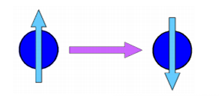
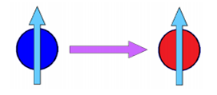
GAMOW-TELLER AND FERMI TRANSITION STRENGTHS
Spin-flip
İsospin-flip

Slide 6
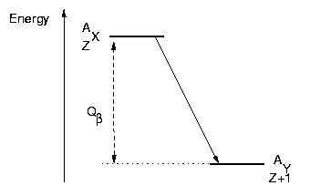
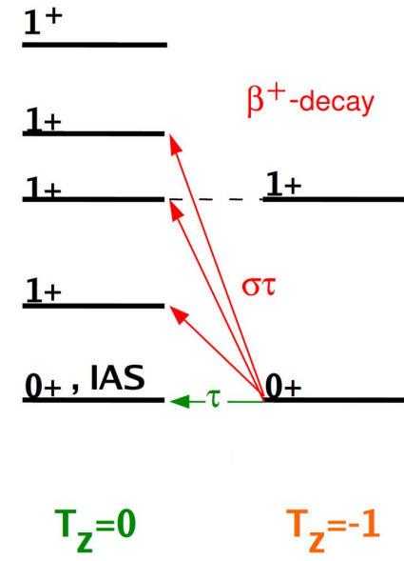
BETA DECAY
Beta Decay Studies;
- Direct information of B(GT) values can be obtain from
β decay experiments.
-Weak interaction process
- Beta decay studies are limited in the low excitation energy regions.
ADVANTAGE!!!
Absolute B(GT) values

Slide 7
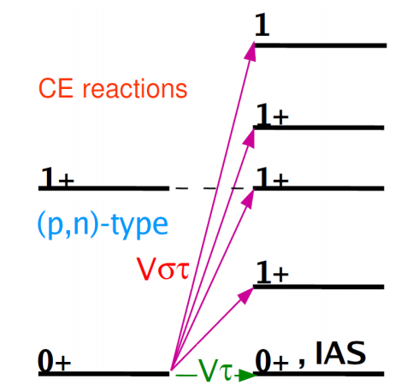
CHARGE EXCHANGE REACTIONS
In order to study the GT transitions to the states inaccessible by beta decay, (p,n) type charge exchange reactions was performed at intermediate energies (100-500 MeV/u) in 1980s.
Extensive information was obtained about Gamow-Teller transition strengths.
Because of the insufficent enrgy resolution (~ 300 keV) each peak could not be studied in detail.
By adding different techniques , in RCNP/Osaka,(³He,t) type charge exchange reactions was performed and better energy resolution was achieved. (~30 keV)
It was not possible to determine GT states in (p,n) reactions.
ADVANTAGE!!!
Highly excited states can be accesed

Slide 8
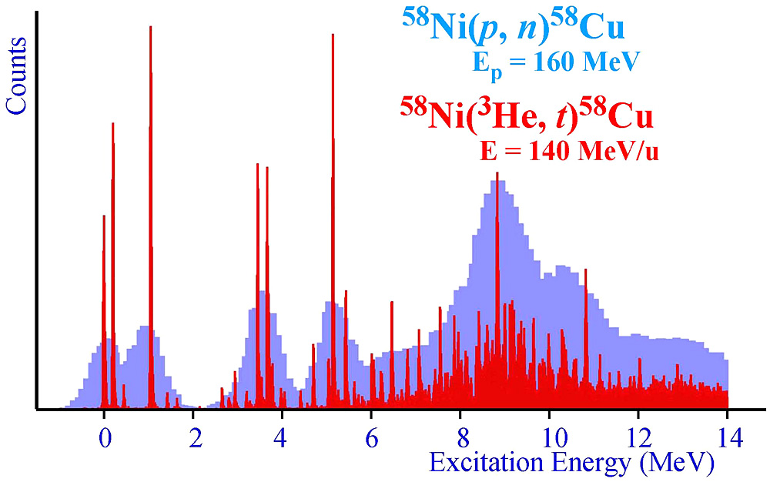
J. Rapaport et al. NPA (‘83)
Y. Fujita et al., EPJA 13 (‘02)
H. Fujita et al., PRC75 (‘07) 034310

Slide 9
Under the assumption of isospin symmetry, beta decay and charge exchange reactions in mirror nuclei complemet each other.
GT transition strengths can be anaylsed by combining beta decay and charge exchange reactions under this mirror symmetry process.

Slide 10
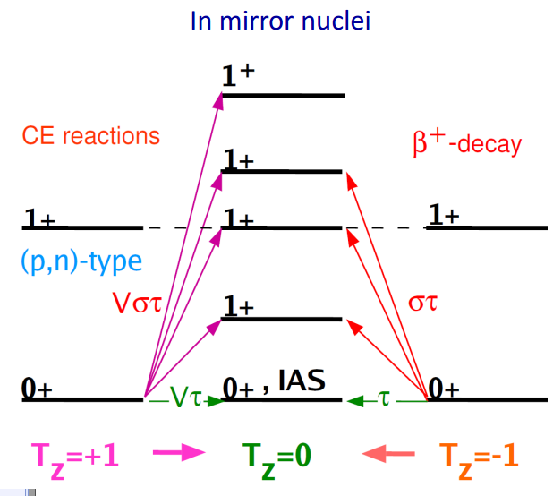
Isospin Structure
B(GT) values are almost the same!

Slide 11
MEASUREMENT OF GAMOW-TELLER TRANSITION STRENGTHS
Gamow-Teller transition strengths can be obtained when a absolute B(GT) value deduced in beta decay.
Since we know the total half life of decay and branching ratios them we can find half life of individual states and accordingly to this absolute B(GT) values can be found as well.
Here is a proportion between the measured cross section and B(GT) values at intermediate energies ( 100 MeV/u) and at 0°;

Slide 12
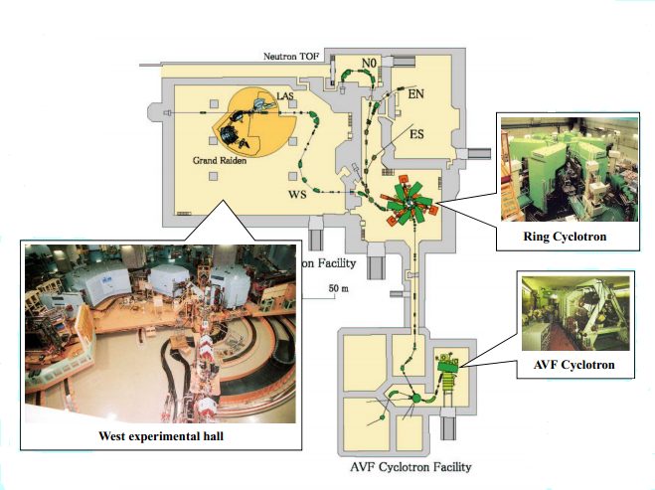
RCNP

Slide 13
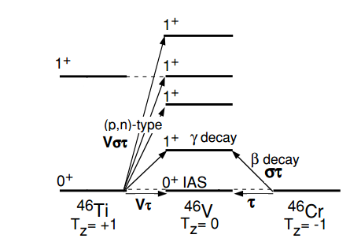
EXTRACTION of B(GT) VALUES
Super Allowed Fermi Transition
0⁺ 0⁺

Slide 14
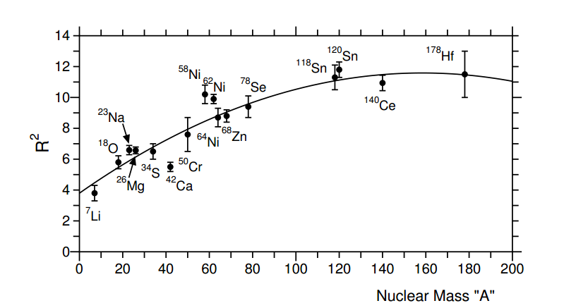
EXTRACTION of B(GT) VALUES
B(F)=N-Z
σ_{GT-} , σ_{F} ≈ peak counts
7.7±0.9

Slide 15
RESULTS

Slide 16
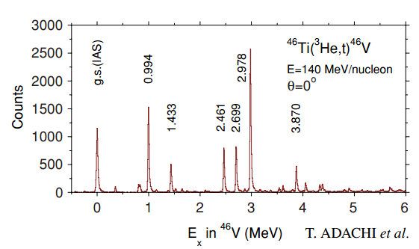
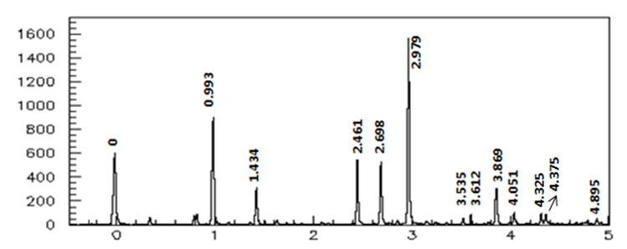
COUNT
ENERGY

Slide 17
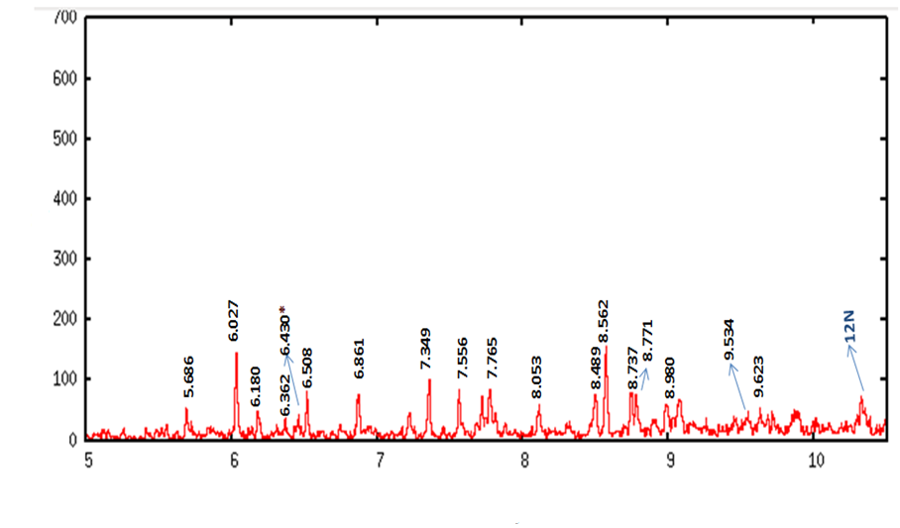
COUNT
ENERGY(MeV)

Slide 18
SUMMARY
The GT transition is usually measured in a beta decay, in which this transition is allowed.
High excitation energies can be studied which are enable to study with beta decay.
Isospin symmetry is a useful tool to study GT transition strengths because it provide us to combine charge exchange and beta decay.
Excitation energies up to 12 MeV has been studied for the first time
To add new informations to the literature, this study will be useful tool for the next studies.

Slide 19
SPECIAL THANKS TO
ASSOC. PROF. ELA GANİOĞLU
PROF. YOSHITAKA FUJITA
DR. HIROHIKO FUJITA
PROF. BAKİ AKKUŞ
PROF. YEŞİM ÖKTEM

