Slide 1
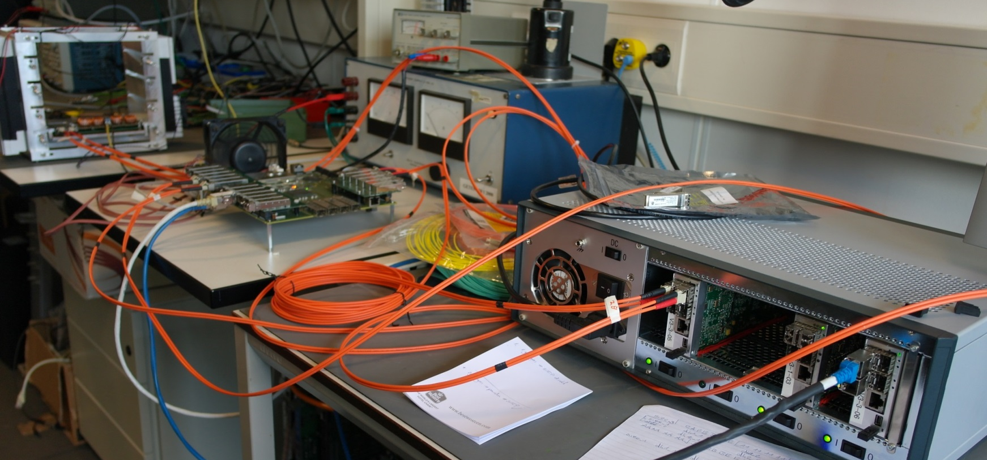
The new readout concept of the PANDA experiment
3rd European Nuclear Physics Conference
Groningen
2015
M. Tiemens, M. Kavatsyuk, J.G. Messchendorp, N. Kalantar-Nayestanaki, P. Schakel, P. Lemmens – For the PANDA Collaboration

Slide 2
M. Tiemens
| 2
Setting the Stage
EM Particles
EMC Crystal
Primary
Interaction:
EVENT
Pile-up of particles Probability: ~10%
Hit rates up to 500 kHz
20 MHz

Slide 3
M. Tiemens
| 3
Setting the Stage
Typical background channel:
$$p\overline{p}→J/ψηη→e^{+}{e }^{−}+4γ$$
Typical background channel:
$$p\overline{p}→J/ψηπ^{0}→e^{+}{e }^{−}+4γ$$
Example of desired signal:
$$p\overline{p}→Y\left(4260\right)→J/ψπ^{0}{π }^{0}→e^{+}{e }^{−}+4γ$$
Signal:
~1 Hz
Typical background channel:
$$p\overline{p}→J/ψ{π^{+}{π }^{−}π}^{0}{π }^{0}⇝e^{+}{e }^{−}+4γ$$
Background: ~20 MHz
Low E, lost

Slide 4
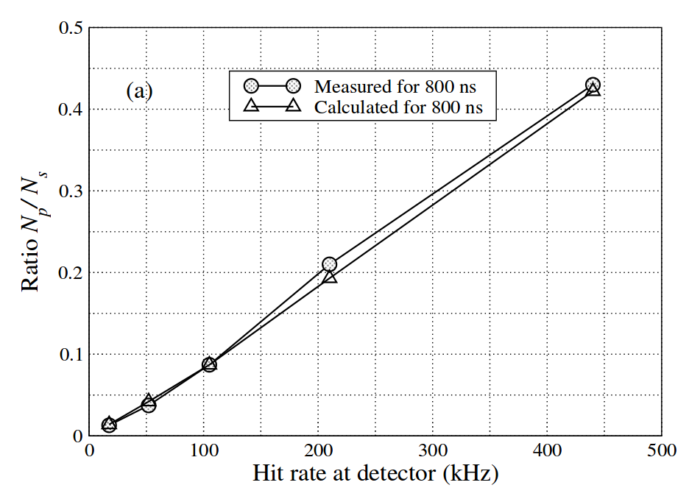
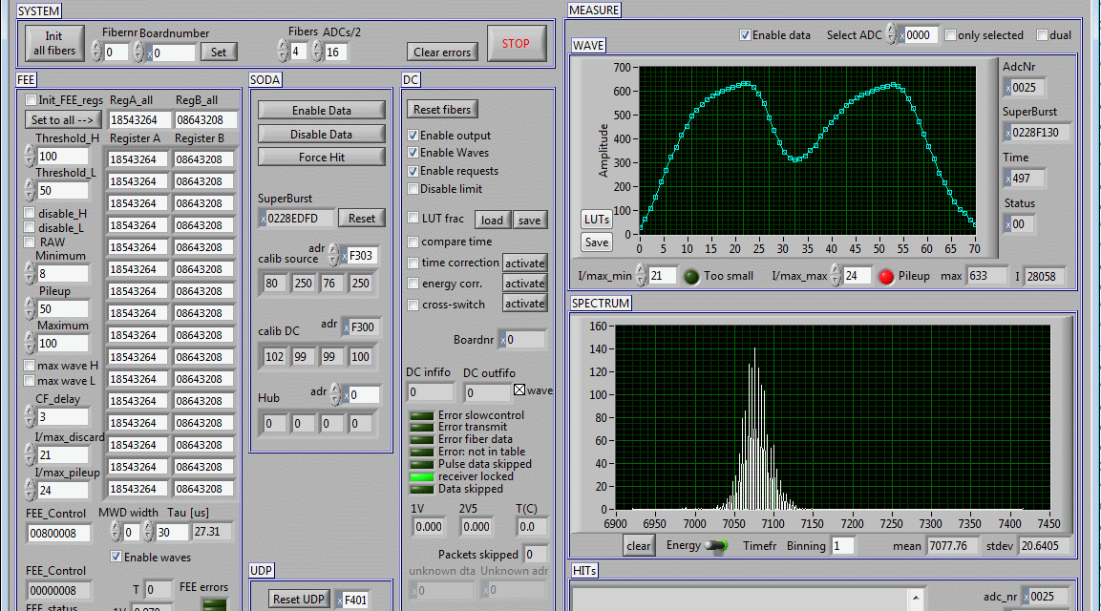
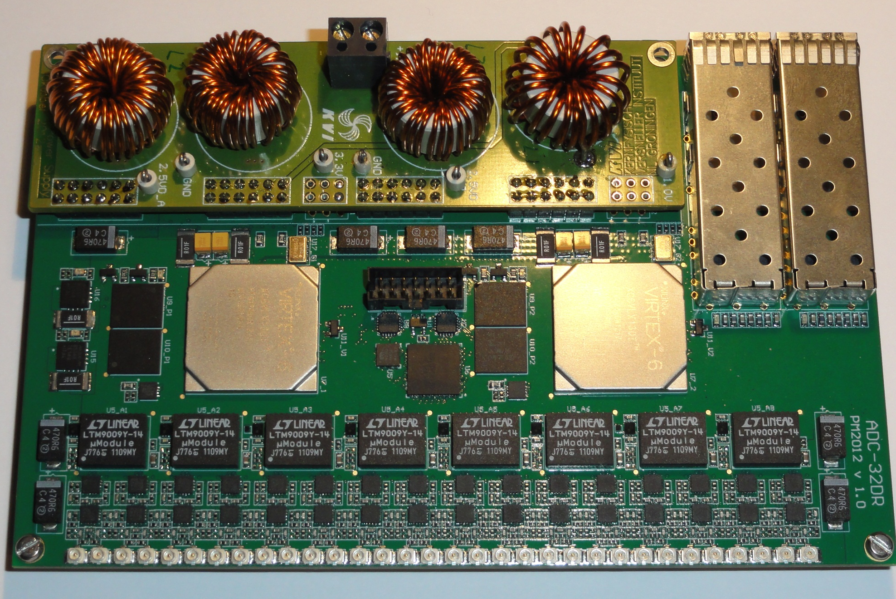
M. Tiemens
| 4
Triggerless Readout Concept
Baseline Correction
160 mm
Pile-up Detection
?
?
?
1 or 2?
80 MHz
14-bit resolution
32 ch. dual gain
100 mm
Digitiser
PhD Thesis G. Tambave, Univ. of Groningen
Feature Extraction
0101
E
Preamp Output
Dynamic Range: 10,000
t

Slide 5
M. Tiemens
| 5
Triggerless Readout Concept
Recombine Data
Recover Pile-up Pulses
Time-Order Data
0
1
E
t
0101
0101
n
Correct for Nuclear Counter Effect
E
t
SODANET
Clock Source
Data Concentrator
1 Fibre:
Clock+Synch
Slow Ctrl
Det. Ctrl
20 ps jitter
E
t
E
t
0101
0101
0101

Slide 6
M. Tiemens
| 6
Triggerless Readout Concept
Reconstruct Particles
Combine DC Data
Event Building
∑E
γ
E² - p² = M²
STT
E…
t…
Compute Node
MDC
Prototype Exists
Event Building is Working
Reco. Alg. Under Development: Track Finding, EMC Clustering
…

Slide 7
M. Tiemens
| 7
Applying the Concept
Reduce Data
By Factor 1,000
Typical background channel:
$$p\overline{p}→J/ψηη→e^{+}{e }^{−}+4γ$$
Typical background channel:
$$p\overline{p}→J/ψηπ^{0}→e^{+}{e }^{−}+4γ$$
Example of desired signal:
$$p\overline{p}→Y\left(4260\right)→J/ψπ^{0}{π }^{0}→e^{+}{e }^{−}+4γ$$
Typical background channel:
$$p\overline{p}→J/ψ{π^{+}{π }^{−}π}^{0}{π }^{0}⇝e^{+}{e }^{−}+4γ$$
Low E, lost

Slide 8
M. Tiemens
| 8
Simulation
Classic Style:
No Interaction
Between
Signals
EVENT 1
EVENT 2
GOAL: As close to real data stream as possible

Slide 9
M. Tiemens
| 9
Simulation
TIMEBASED
Pile-up
1
Which Hit Belongs To Which Event?
Event
2
Seen as 1
Event
t₁
t₂
Distance Between t₁ and t₂ Determined by Interaction Rate
GOAL: As close to real data stream as possible

Slide 10
M. Tiemens
| 10
Simulation
TIMEBASED
Event Building
E
E
E
E
p
IP
GOAL: As close to real data stream as possible

Slide 11
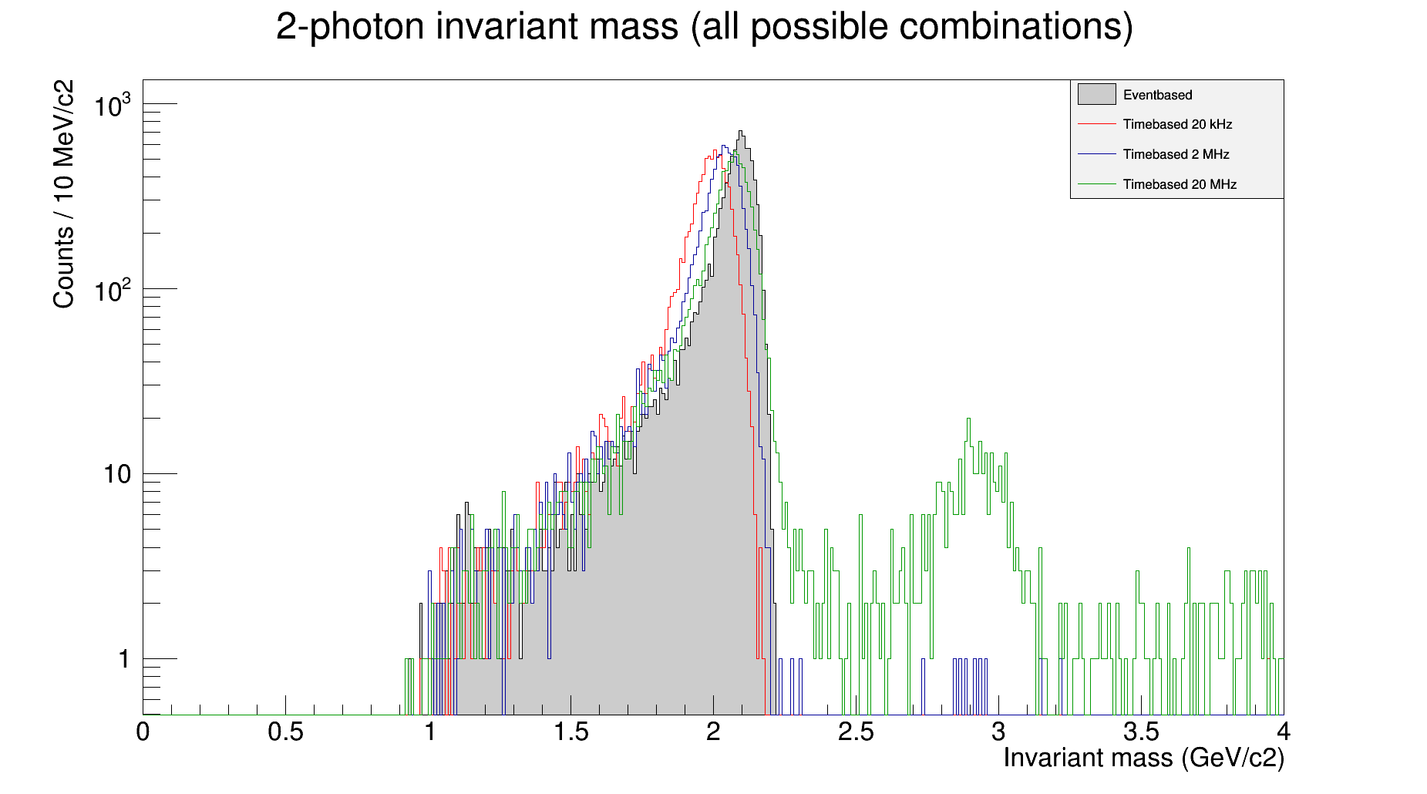
M. Tiemens
| 11
Simulation
Simple Test Channel: $p\overline{p}→γγ$
$\sqrt{s}=2.081$ GeV
~75% Recovered

Slide 12
M. Tiemens
| 12
Summary
Pile-up and too similar final state topology require a different type of readout system.
New intelligent, deadtime-free, self-triggering readout system processes and reduces data on-the-fly.
Most hardware and algorithms exist or are in their final stage of development.
New simulation type closely mimics the real data flow and readout chain.

Slide 13
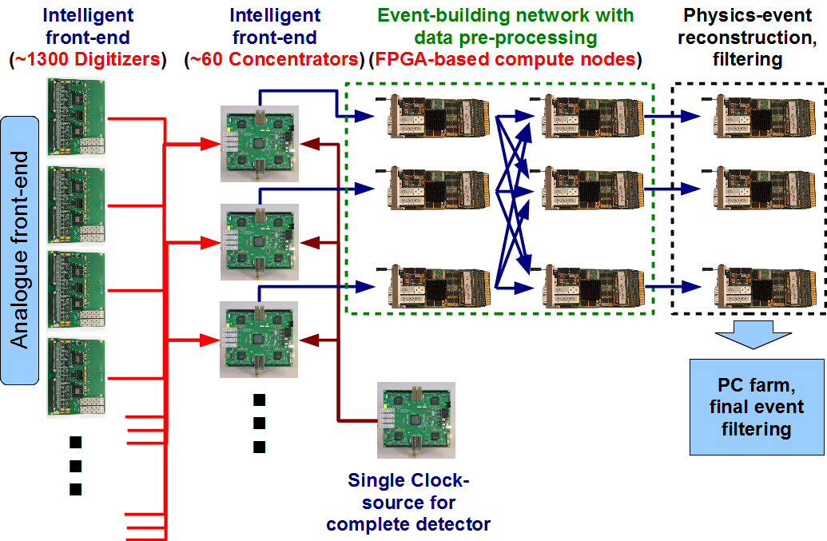
M. Tiemens
| 13

