Slide 1





Status and Perspectives of the
ELI–NP
Research Facility
EUROPEAN UNION
GOVERNMENT OF ROMANIA
Structural Instruments
2007-2013
Călin A. Ur
for the ELI–NP Team
“European Nuclear Physics Conference – EuNPC”
August 31 – September 4, 2015, Groningen, The Netherlands

Slide 2

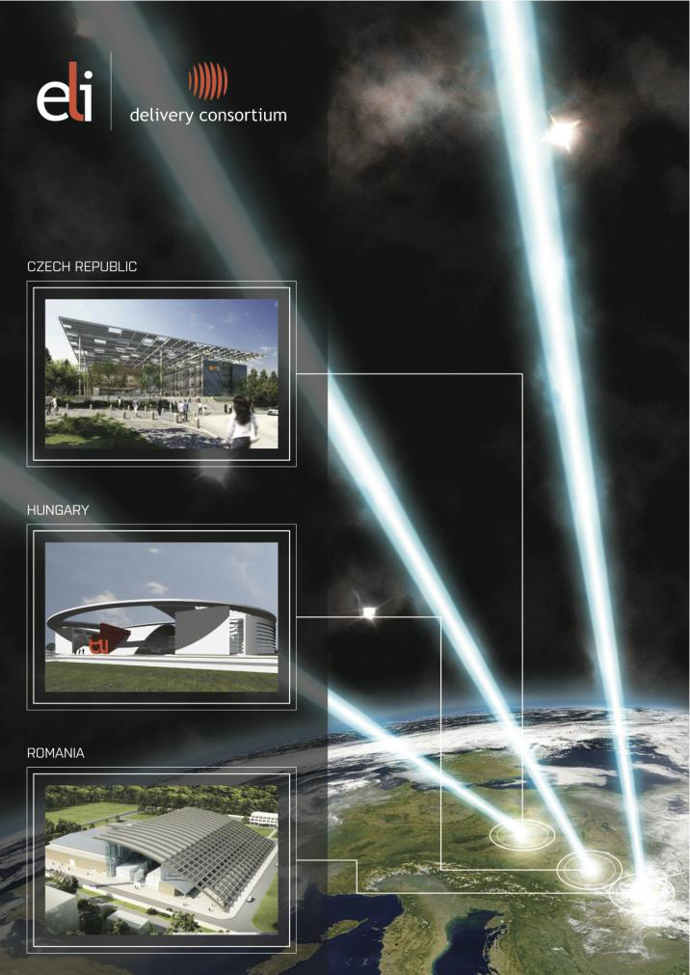
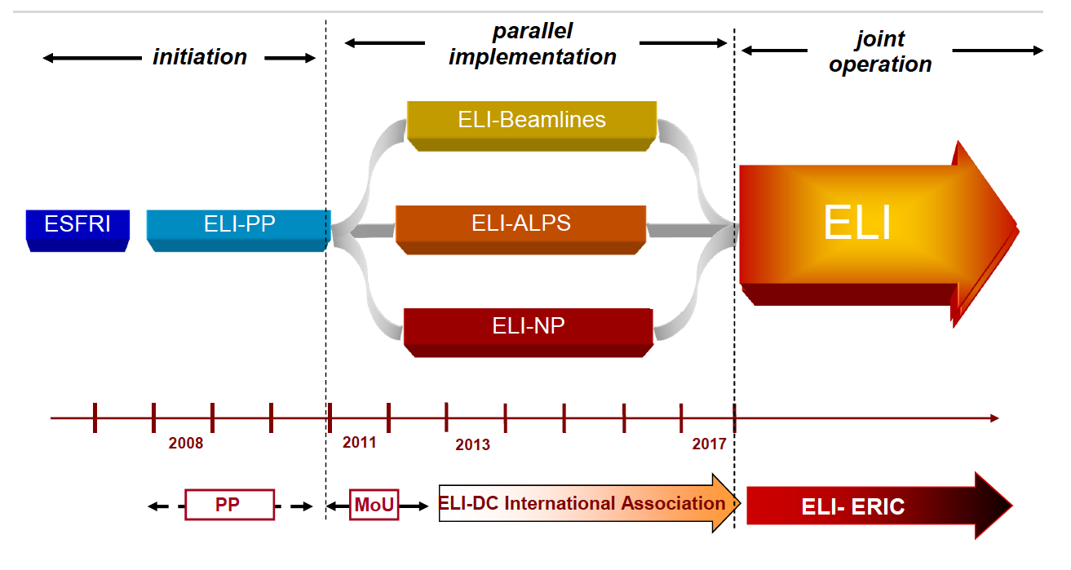
Extreme Light Infrastructure in a Nutshell
Extreme Light Infrastructure
Pan–European Research Center
Target: implement the world’s largest laser research infrastructure
Infrastructure: distributed over three complementary pillars (CZ, HU, RO) – user facilities
Strategy: first ESFRI project to be fully implemented in newer EU member states
ELI–DC
Funding: novel model combining ERDF funds for the implementation and contributions to an ERIC for the operation

Slide 3
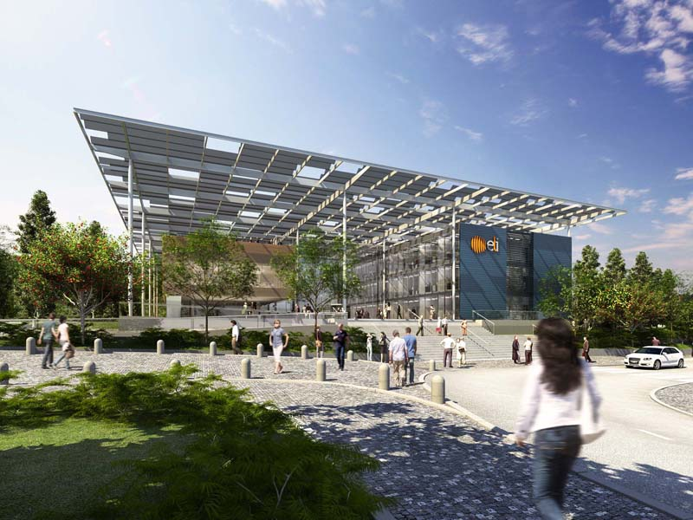
Extreme Light Infrastructure – Beamlines
Short–pulse secondary sources of radiation and particles
multidisciplinary applications in molecular, biomedical and material sciences
physics of dense plasmas, warm dense matter, laboratory astrophysics
high-power, high-repetition-rate lasers for high-field physics experiments with focused intensities of about 10²³ W/cm², investigating exotic plasma physics, and non-linear QED effects
Dolni Brezhany, near Prague, Czech Republic

Slide 4
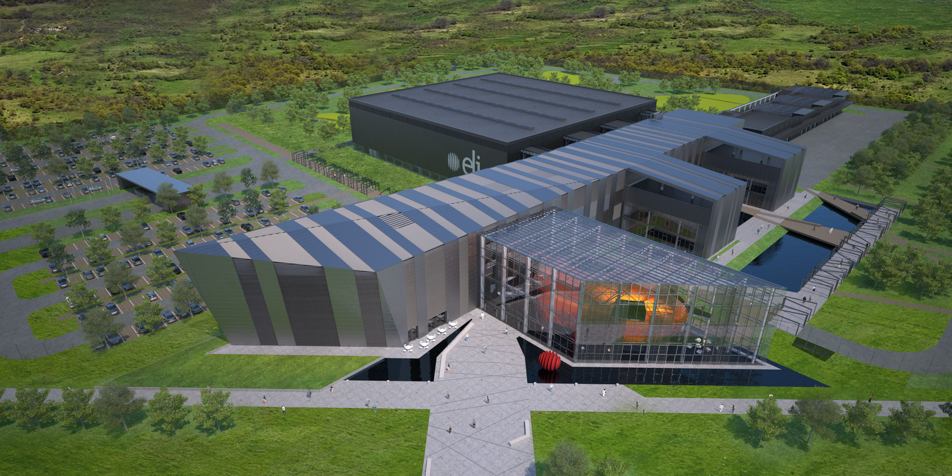
Extreme Light Infrastructure – ALPS
Ultra short laser pulses with high repetition rates
light source with frequencies between THz and X–ray
study of extremely fast dynamics by taking snap–shots in the attosecond scale of the electron dynamics in atoms, molecules, plasmas and solids
research with ultrahigh intensity lasers.
Szeged, Hungary

Slide 5
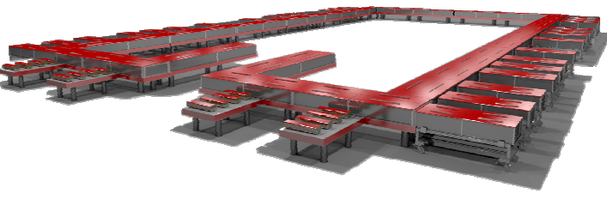

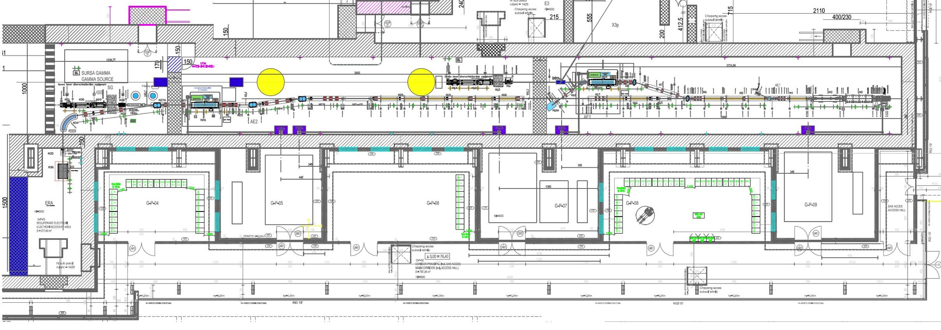
Extreme Light Infrastructure – Nuclear Physics
Nuclear Physics research with extreme electromagnetic fields
Host for two major systems
Based on the National Physics 2 x 10 PW High–Power Lasers System
Platform in Magurele (Bucharest)
High Brilliance Gamma Beam System
Thales Optronique
EuroGammaS

Slide 6

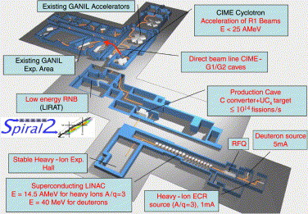
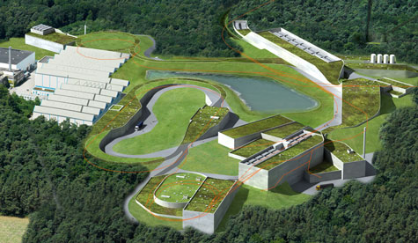
Extreme Light Infrastructure – Nuclear Physics
Nuclear Physics experiments
Nuclear Photonics
      Nuclear Resonance Fluorescence
      Photo–fission & Exotic Nuclei
      Photo–disintegration and Nuclear Astrophysics
complementary to other ESFRI Large Scale Physics Facilities
(FAIR, SPIRAL2)
    Nuclear Physics diagnostics
      Laser–Target interaction characteristics
    Laser Ion driven nuclear physics
              Laser–Target interaction characteristics
Applications based on high intensity laser and very brilliant γ beams complementary to the other ELI pillars

Slide 7
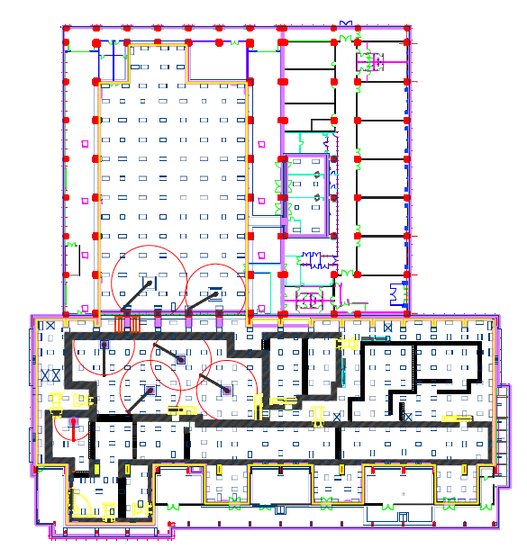
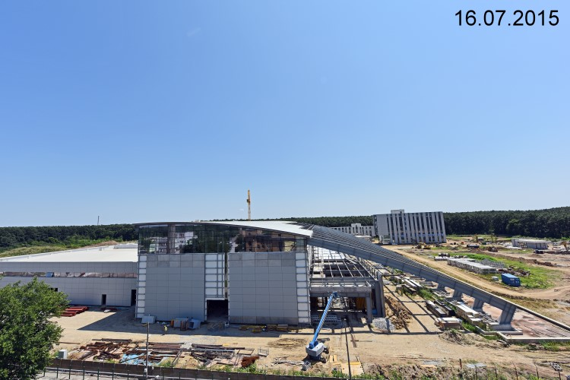
ELI–NP – Experimental Building Layout
Anti–vibration platform
±1 μm @ < 10 Hz
HPLS
Laboratories
Experiments
GBS
Platform supported on dampers

Slide 8

ELI–NP Implementation Timeline
2010 2011 2012 2013 2014 2015 2016 2017 2018
ELI–NP White Book
Feasibility Study
Cost estimate 293M€
Preparation of the Application
E.C. Eval. & Funding Approval
Building
Procurement Laser System
Laser System – installation
Procurement Gamma Beam
Gamma Beam – installation
Experimental Areas TDR
Recruitment

Slide 9
ELI–NP Building the Experiments
White Book ⟹ Day–1 Experiments
Towards TDR of experiments with intense laser beams at ELI-NP
June 27-28, 2013 – Bucharest-Magurele (Romania)
Towards TDR of experiments with brilliant gamma-ray beams at ELI-NP
July 25-26, 2013 – Bucharest-Magurele (Romania)
building the main working groups
conveners and local liaisons
ELI-NP TDRs at Midway – High Power Laser March 16-17, 2014 – Bucharest-Magurele (Romania)
ELI-NP TDRs at Midway – SystemGamma Beam System
March 16-17, 2014 – Bucharest-Magurele (Romania)
added new working groups
applied physics
ELI-NP Science Program and Instruments: Technical Design Reports
February 18-20, 2015 – Bucharest-Magurele (Romania)
final TDRs
definition of the experimental setups
June 2015 – Scientific evaluation of the TDRs by ISAB

Slide 10
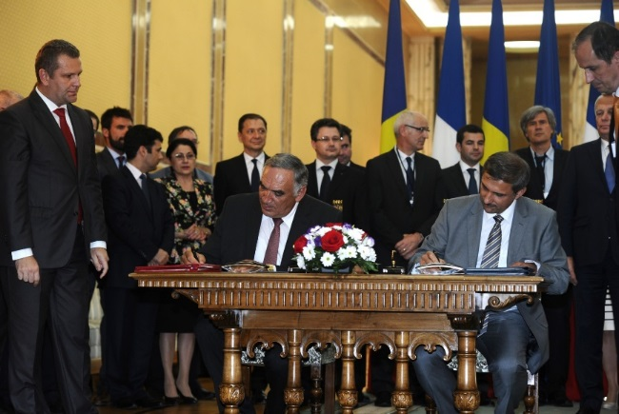
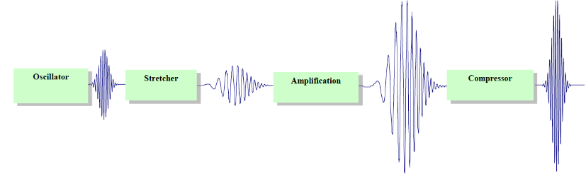
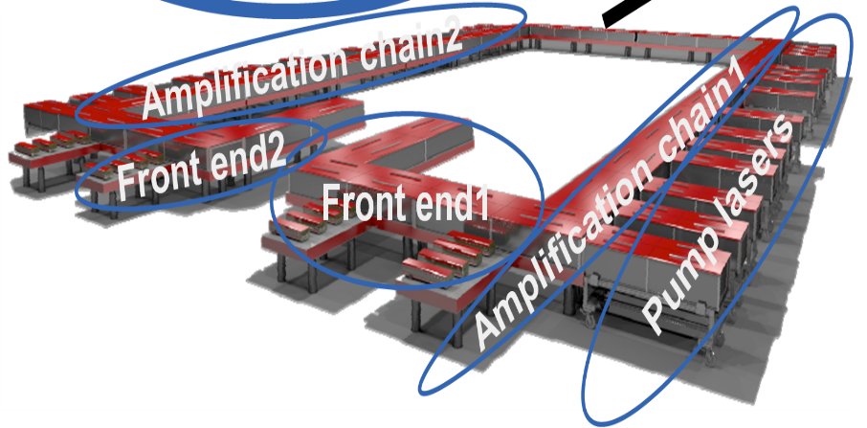
The High–Power Lasers System 2 x 10 PW
Provided by THALES Optronique & Thales Romania
Lasers
Compressors & Diagnostics
Experiments
Based on OPCPA
July 12th, 2013

Slide 11
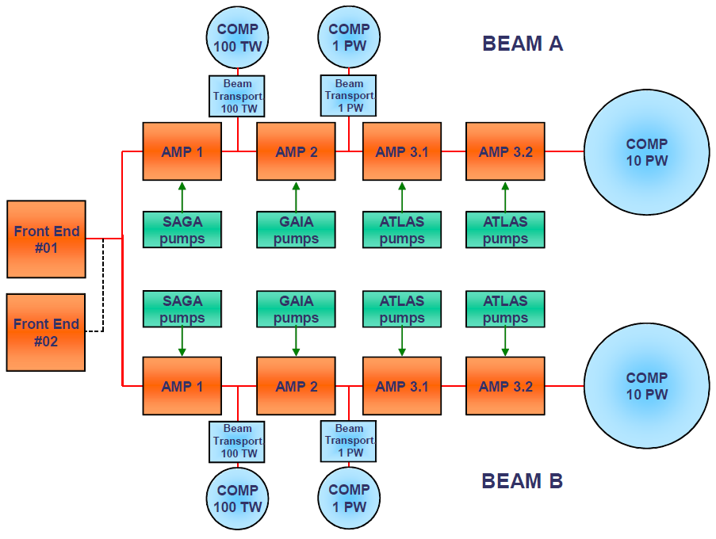
ELI–NP HPLS schematic layout
2 HPLS up to 10 PW – 6 outputs
2 x 0.1 PW 10Hz
2 x 1 PW 1Hz
2 x 10 PW 0.1Hz

Slide 12
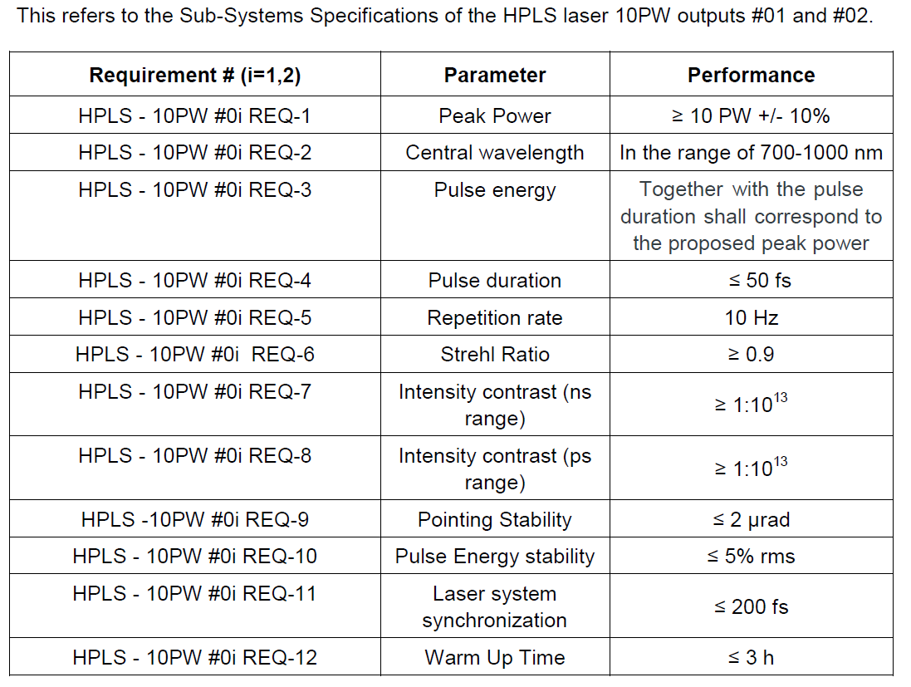
ELI–NP HPLS Parameters
~ 250 J
~ 25 fs
Intensity ~10²⁴ W/cm²

Slide 13
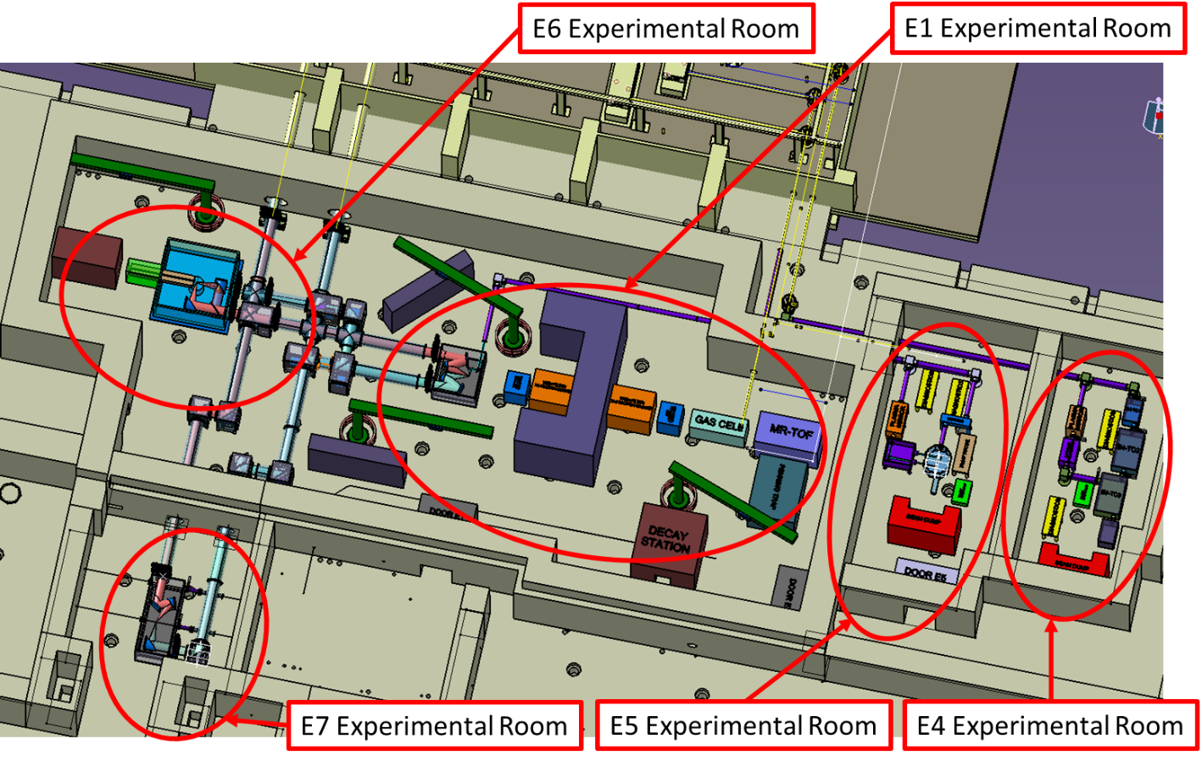
HPLS Experimental Areas
10 PW
10 PW
0.1 PW
1 PW

Slide 14
Laser Driven Nuclear Physics
Convener: M. Roth (TUD) ELI-NP Liaison: F. Negoita (IFIN-HH)
1. Nuclear fusion reactions from laser-accelerated fissile ion beams P. Thirolf (LMU)
Goal: Production of nuclei around rich N~126 waiting point et al.
2. Nuclear (de-)excitations induced by lasers F. Hannachi (CENBG/IN2P3) et al.
Goal: Observation of NEET/NEEC processes in plasma. Changes in nuclear T_{1/2}
3. Nuclear reactions in laser plasma S. Tudisco (LNS/INFN) et al.
Goal: Understanding screening effect in plasma conditions
4. Neutron production and other applications
4.1 Hot plasma confinement for
high flux neutron generation
S. Moustaizis (TU.Crete) et al.
4.2 Neutron production in light ion reactions
S. Kar (QUB), J.Fuchs (LULI) et al.
4.3 Muon-source and muon catalysed fusion
S.R.Mirfayzi, S.Kar (QUB)
I. Combined laser/gamma
Topic Stellar photoreaction
GBS
MeV γ
e + γ + A in E7
Production and
photoexcitation of isomers
LPA
~MeV e-
H.Utsunomiya (Konan U.) et al.

Slide 15
Laser Driven Nuclear Physics
Nuclear (de–)excitations in plasma
NEET observed in cold targets.
Never observed
in plasma.
NEEC was never observed
Significant changes in lifetimes are predicted in plasma conditions:
F. Hannachi (CENBG/IN2P3) et al.

Slide 16
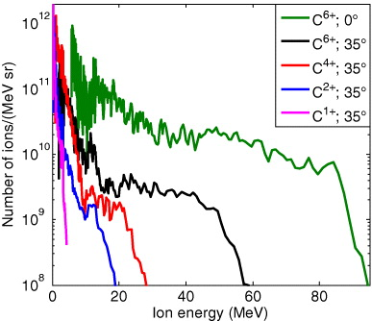
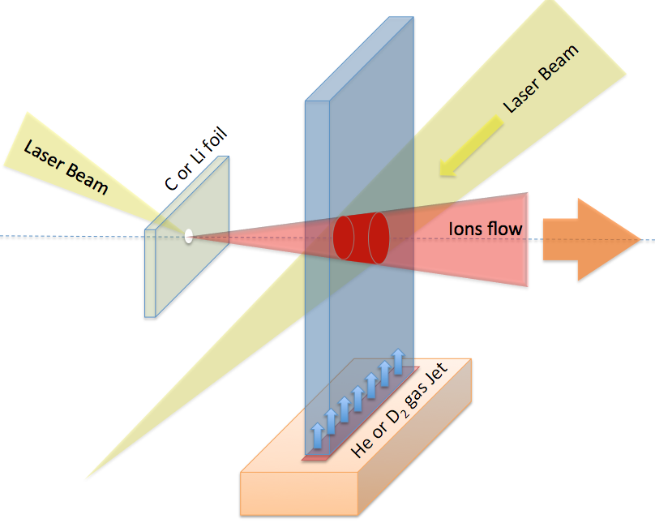
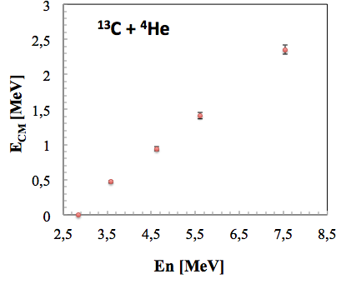
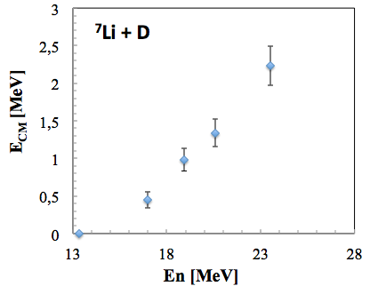
Laser Driven Nuclear Physics
Study of screening factor – The method and cases
Peta-Watts
6×10²⁰ W/cm²
10¹⁸ Atoms/cm³
D.C. Carrol et al., New J. of Phys. 12 (2010) 045020
The method requires
measuring high energy neutrons
S. Tudisco (LNS/INFN) et al.

Slide 17
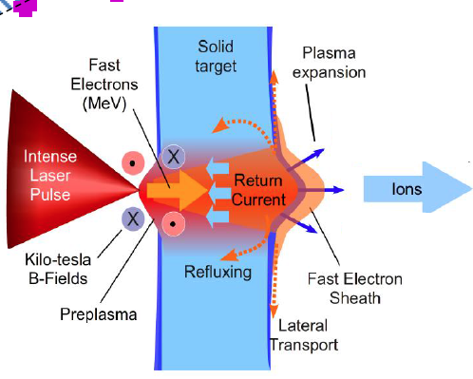
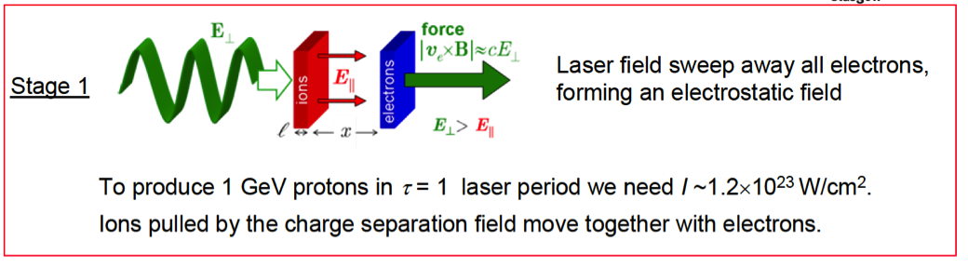
Laser Particle Acceleration – RPA
Short pulse high–power lasers ➞ strong charge separation by laser–matter interaction
➞ intense electric fields ➞ ion acceleration
Target Normal Sheath
Acceleration (TNSA)
Radiation Presure
Acceleration (RPA)
Conversion of laser radiation into kinetic energy of relativistic electrons in μm thick targets
Electrons move and recirculate through the solid target and appear at the surfaces where give rise to intense longitudinal electric fields
Direct action of the ponderomotive force of the laser on the surface electrons
Ultrathin targets (< 100–200 nm)
Highly efficient energy conversion (> 60%)
Ions and electrons accelerated as a neutral bunch→ avoid Coulomb explosion
Solid state beam density :
10²² – 10²³ e/cm³
P.McKenna, CETAL Workshop, Bucharest, Nov. 19, 2013

Slide 18
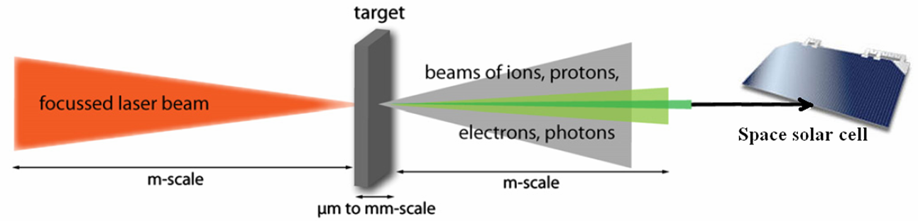
Materials in Extreme Environments
Convener: Marilena Tomut (GSI) ELI-NP Liaison T. Asavei
* Testing of new materials for accelerator components
- materials at fast energy deposition & mixed radiation fields
- laser induced shock waves
- laser modification of materials
* Evaluation of high energy ionizing radiation effects in materials
* Biological science research
  - radiation effects on bio-molecules & cells
* Testing and developments of detectors
* Irradiated optical components testing, Materials for fusion energy systems
Irradiation of components for space radiation studies

Slide 19
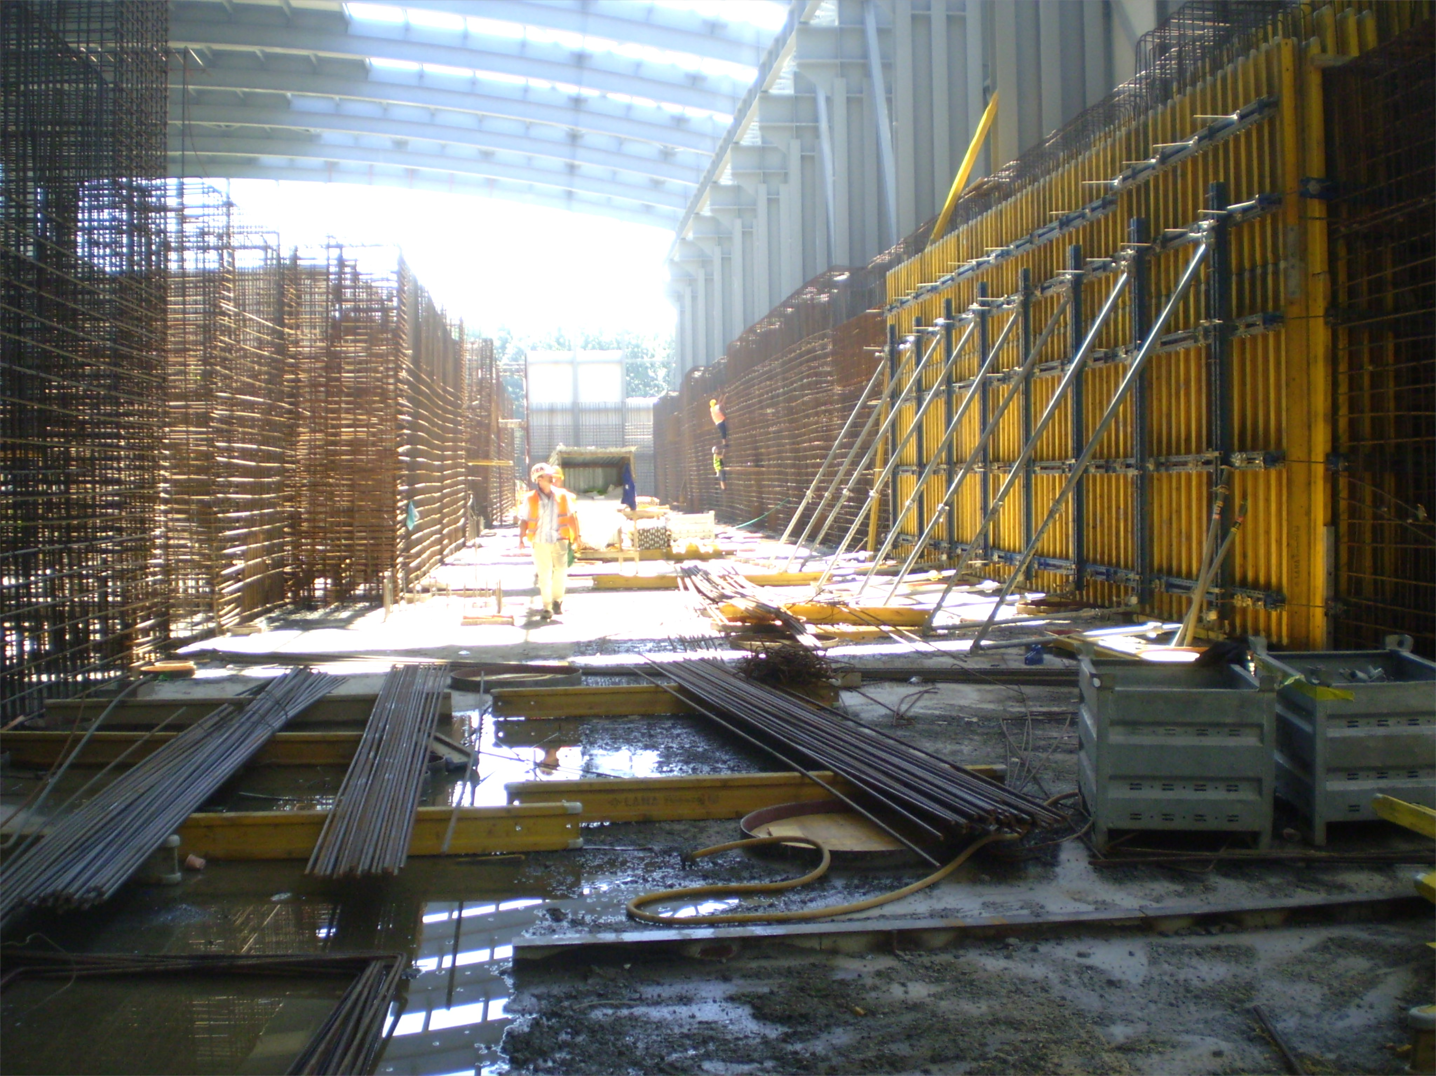
ELI–NP Gamma Beam System
AIM: System with outstanding key features
high peak brilliance (>10²¹ ph/s・mm²・mrad²・0.1%bwd), high spectral density (> 0.5・10⁴ ph/s・eV), tunable energy (0.2 – 19.5 MeV), quasi–monochromatic (relative bandwidth < 0.5%), high degree of linear polarization (> 95%)
GBS
GBS

Slide 20

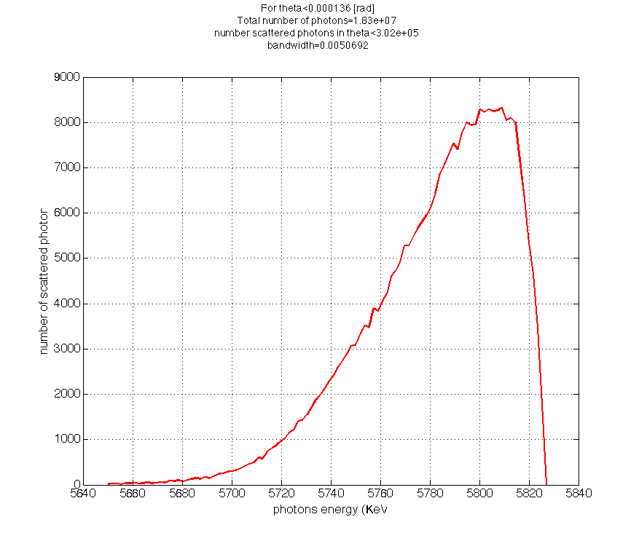
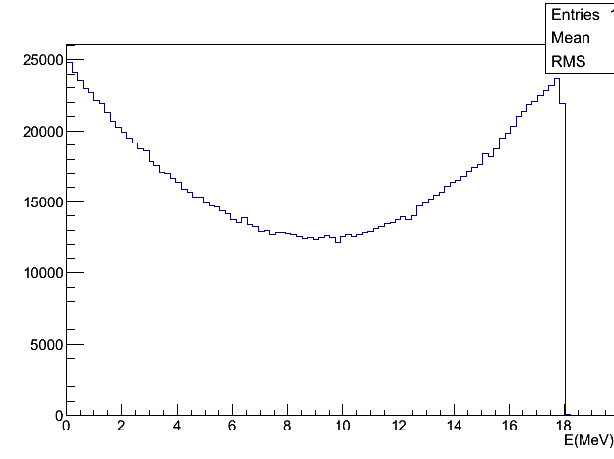
ELI–NP Gamma Beam System Concept
10²¹
Brilliance
E_{L} = 2.3 eV
MEGA-ray
ELI–NP
laser
10¹⁹
θ_{L} = 8º
E_{e–}
ph/(mm²・mrad²・s・0.1%bw)
T-REX
10¹⁷
e–
γ–ray beam
E_{γ} < 19.5 MeV
10¹⁵
PLEIADES
LNBL
HIGS
Good bandwidth
➞ Collimated γ beam
10¹³
1995 2000 2005 2010 2015 2020
year
THE SOLUTION: Inverse Compton Scattering of laser pulses on relativistic electron pulses
  high intensity / small emittance e– beam from a warm LINAC
  very brillant high rep./rate int. laser
  small collision volume
dN/dE
< 0.5%

Slide 21

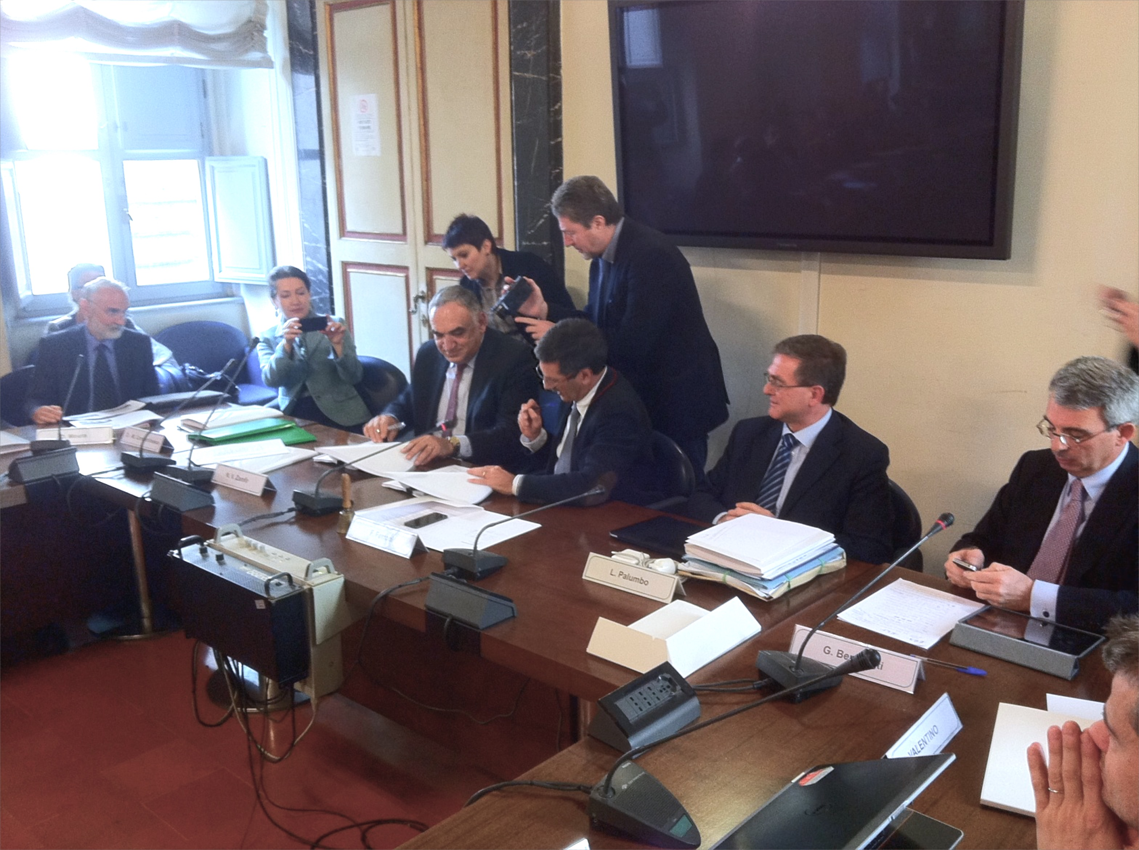
ELI–NP Gamma Beam System
Provider – EuroGammaS Association
Academic Institutions
INFN (Italy), Sapienza University (Italy), CNRS (France)
Industrial Partners
ACP Systems (France), ALSYOM(France),
COMEB (Italy), ScandiNova Systems (Sweden)
19/03/2014
March 19, 2014
… and sub – contractors
Academic Institutions
STFC (UK), ALBA Cell (Spain)
Industrial Partners
Amplitude Systems (France), Amplitude Technologies (France), Cosylab (Slovenia),
Danfysik (Denmark), Instrumentation Technologies (Slovenia), M&W Group (Italy),
Research Instruments (Germany), Toshiba (Japan)

Slide 22
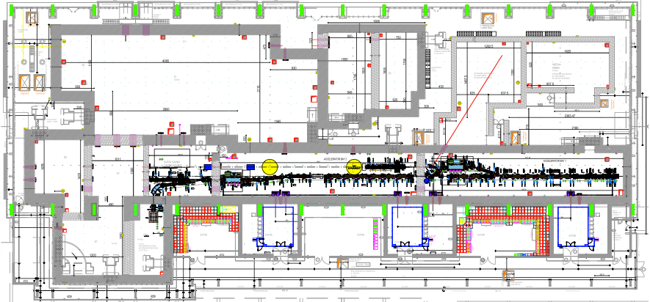
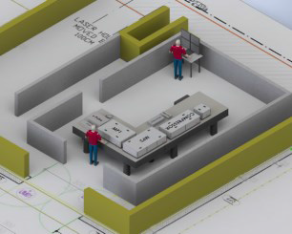
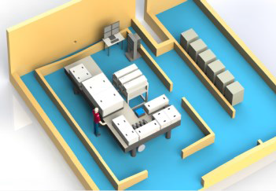
Gamma Beam System Layout
Provider – EuroGammaS Association
Photo–gun
e– source
Interaction Laser
High Energy
e– RF LINAC
High Energy
720 MeV
Interaction Laser
Low Energy
e– RF LINAC
Low Energy
300 MeV
Photo–gun
Laser

Slide 23
Gamma Beam System Layout
Low Energy
Gamma Beam
< 3.5 MeV
Photo–gun
e– source
Interaction Laser
High Energy
e– RF LINAC
High Energy
720 MeV
Interaction Laser
Low Energy
e– RF LINAC
Low Energy
300 MeV
Photo–gun
Laser

Slide 24
Gamma Beam System Layout
High Energy
Gamma Beam
< 19.5 MeV
Photo–gun
e– source
Interaction Laser
High Energy
e– RF LINAC
High Energy
720 MeV
Interaction Laser
Low Energy
e– RF LINAC
Low Energy
300 MeV
Photo–gun
Laser

Slide 25
ELI–NP Gamma Beam Features
Two stage system:
Low–energy stage: Eγ < 3.5 MeV
  March 2017
High–energy stage: Eγ < 19.5 MeV
September 2018
Energy (MeV) | 0.2 – 19.5
Spectral Density (ph/s∙eV) | > 0.5∙10⁴
Bandwidth rms (%) | ≤ 0.5
# photons per pulse within FWHM bdw. | ≤ 2.6∙10⁵
# photons/s within FWHM bdw. | ≤ 8.3∙10⁸
Source rms size (μm) | 10 – 30
Source rms divergence (μrad) | 25 – 200
Peak brilliance (N_{ph}/sec∙mm²∙mrad²∙0.1%) | 10²⁰ – 10²³
Radiation pulse length rms (ps) | 0.7 – 1.5
Linear polarization (%) | > 95
Macro repetition rate (Hz) | 100
# pulses per macropulse | 32
Pulse–to–pulse separation (nsec) | 16
E_{L} = 2.3 eV
laser
E_{e–}
θ_{L} = 8º
e–
γ–ray beam
E_{γ} < 19.5 MeV

Slide 26
ELI–NP Gamma Beam Features
Two stage system:
Low–energy stage: Eγ < 3.5 MeV
  March 2017
High–energy stage: Eγ < 19.5 MeV
September 2018
Energy (MeV) | 0.2 – 19.5
Spectral Density (ph/s∙eV) | > 0.5∙10⁴
Bandwidth rms (%) | ≤ 0.5
# photons per pulse within FWHM bdw. | ≤ 2.6∙10⁵
# photons/s within FWHM bdw. | ≤ 8.3∙10⁸
Source rms size (μm) | 10 – 30
Source rms divergence (μrad) | 25 – 200
Peak brilliance (N_{ph}/sec∙mm²∙mrad²∙0.1%) | 10²⁰ – 10²³
Radiation pulse length rms (ps) | 0.7 – 1.5
Linear polarization (%) | > 95
Macro repetition rate (Hz) | 100
# pulses per macropulse | 32
Pulse–to–pulse separation (nsec) | 16

Slide 27
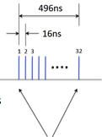

ELI–NP Gamma Beam Features
Two stage system:
Low–energy stage: Eγ < 3.5 MeV
  March 2017
High–energy stage: Eγ < 19.5 MeV
September 2018
Energy (MeV) | 0.2 – 19.5
Spectral Density (ph/s∙eV) | > 0.5∙10⁴
Bandwidth rms (%) | ≤ 0.5
# photons per pulse within FWHM bdw. | ≤ 2.6∙10⁵
# photons/s within FWHM bdw. | ≤ 8.3∙10⁸
Source rms size (μm) | 10 – 30
Source rms divergence (μrad) | 25 – 200
Peak brilliance (N_{ph}/sec∙mm²∙mrad²∙0.1%) | 10²⁰ – 10²³
Radiation pulse length rms (ps) | 0.7 – 1.5
Linear polarization (%) | > 95
Macro repetition rate (Hz) | 100
# pulses per macropulse | 32
Pulse–to–pulse separation (nsec) | 16
One pulse
~ 1 ps
~ 10⁵ photons

Slide 28
Gamma Beam Experiments
separation energy S_{n} or S_{p}
n or p
γ
γ
γ‘
γ
β
^{A`}Y
^{A}X
Photodisintegration, Photofission, Photoactivation
Nuclear Resonance Fluorescence - NRF

Slide 29
Gamma Beam Experiments
Fundamental Research
  Nuclear Resonance Fluorescence (A.Zilges U.Cologne, C.A.Ur)
  Nuclear Astrophysics (γ,p) (γ,α) (M.Gai U.Conn, O.Tesileanu)
  Photonuclear Reactions (γ,n) (H.Utsunomiya U.Konan, F.Camera U.Milano and
  INFN, D.Filipescu)
  Photofission&Studies of Exotic Nuclei (A.Krasznahorkay ATOMKI Debrecen,
  F.Ibrahim IPN Orsay, D.L.Balabanski)
Applications
  Gamma Imaging (H.Ohgaki U.Kyoto, V.Iancu)
  Material Science with Positrons (C.Hugenschmidt TU Munich, N.Djourelov)
  Medical Radioisotopes (D.Niculae IFIN-HH Bucharest, M.Bobeica)
R&D Gamma Beam Diagnostics Detectors
  Gamma Beam Delivery and Diagnostics (H.Weller U.Duke, C.A.Ur)
  Broad International Collaboration
  Germany, USA, Japan, Italy, Hungary, France,
  Poland, Vietnam, Switzerland, UK, Russia, ……….

Slide 30
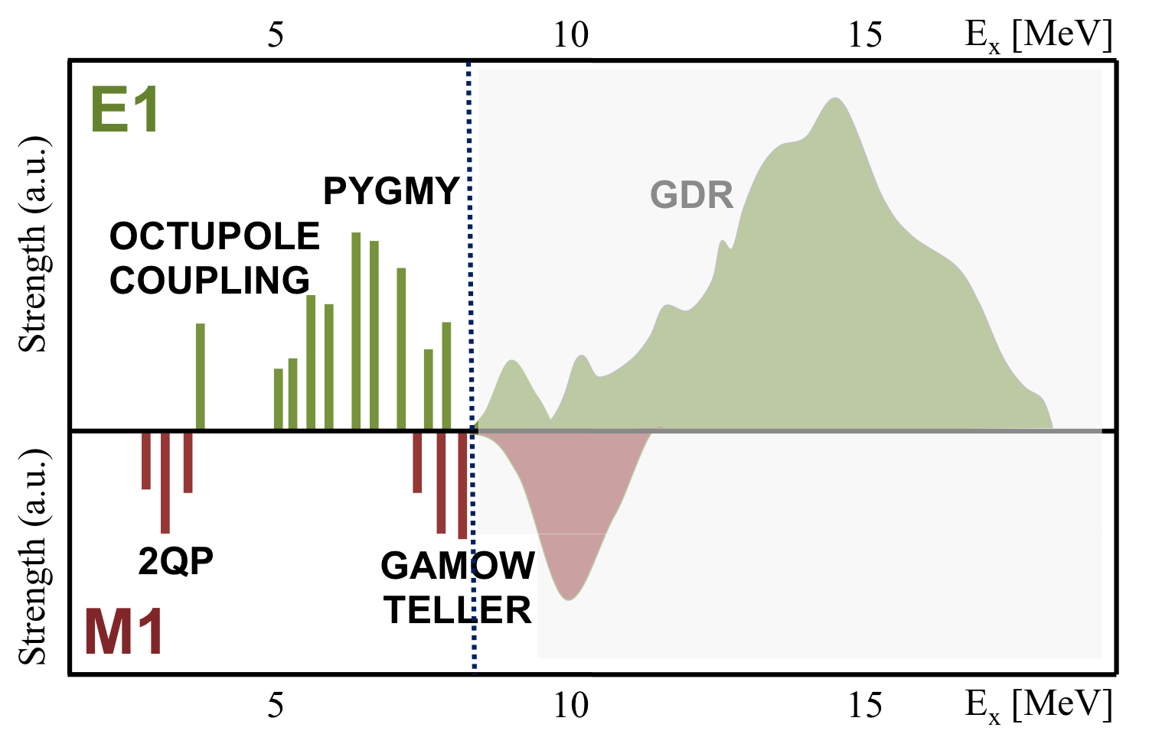
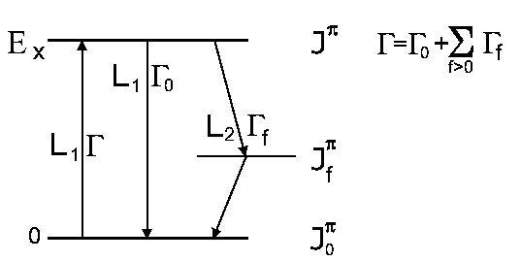

Nuclear Resonance Fluorescence
Electromagnetic dipole response of nuclei
Photoresponse of weakly abundant p–nuclei and actinides
Rotational 2+ states of the nuclear scissor modes
Pygmy Dipole Resonances
Γ₀ and Γ/Γ₀ measurements
Access to nuclear observables
Excitation Energy E_{r}
Spin and parity J, π
Decay Energies E_{γ}
Partial Widths Γ_{i}/Γ₀
Multipole Mixing δ
Decay Strengths B(πλ)
Level Width Γ (eV)
Separation threshold
γ

Slide 31
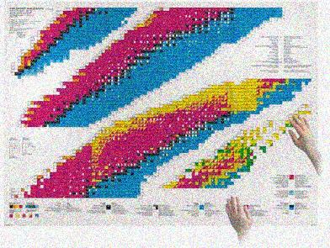
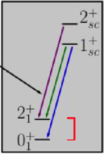
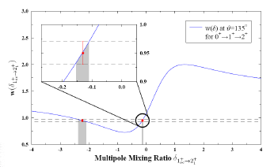
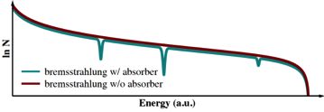
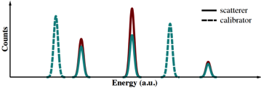
Discovery Frontiers for NRF at ELI–NP
Availability frontier
access to rare isotopes
photoresponse of weakly abundant p–nuclei
and actinides
Sensitivity frontier
weak channels
rotational 2+ states of the nuclear
scissor modes
Precision frontier
high statistics
Γ₀ and Γ/Γ₀ measurements

Slide 32
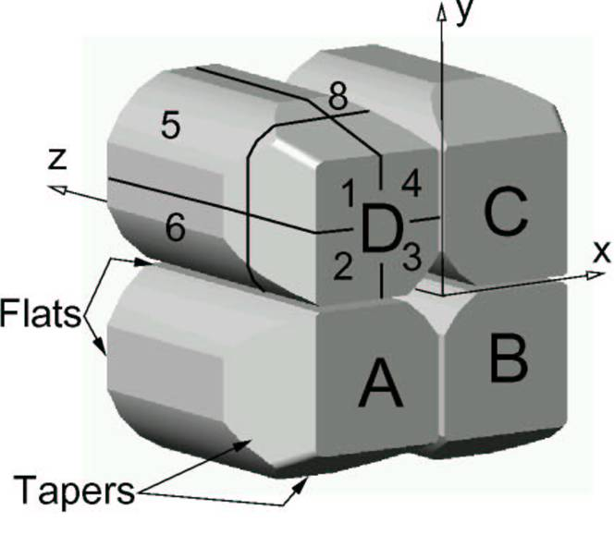
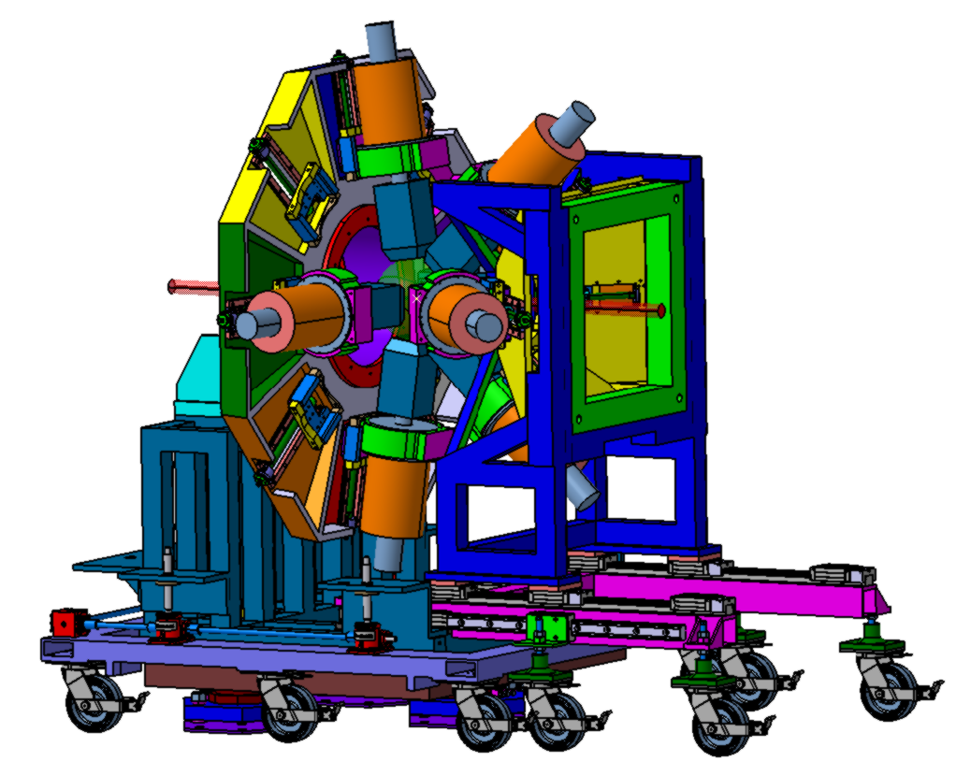
Nuclear Resonance Fluorescence
Instrumentation:
ELIADE = ELI–NP Array of DEtectors
8 x TIGRESS – type Clover detector (segmented) with back–catcher (ε_{ph} ~ 6%)
4 x 3”x3” LaBr₃(Ce) detectors
CAD : C.Petcu and E.Udup

Slide 33
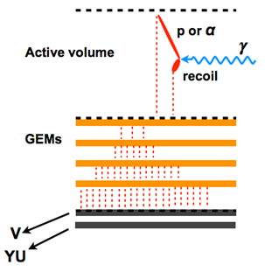
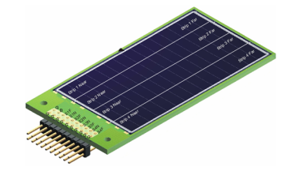
Nuclear Astrophysics
Molecular states and symmetries in light nuclei
Photodisintegration – astrophysics interest
  the ¹⁶O(γ,α)¹²C reaction
  the ²⁴Mg(γ,α)²⁰Ne reaction
  the ²²Ne(γ,α)¹⁸O reaction
  the ¹⁹F(γ,α)¹⁸O reaction
  the ²¹Ne(γ,α)¹⁷O reaction
Instrumentation:
Large–area Si DSSD array
eTPC (35x20x20 cm³)

Slide 34
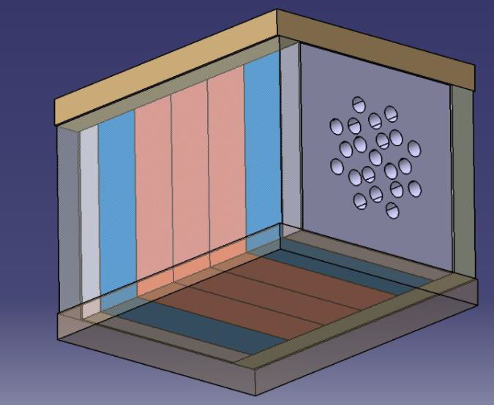
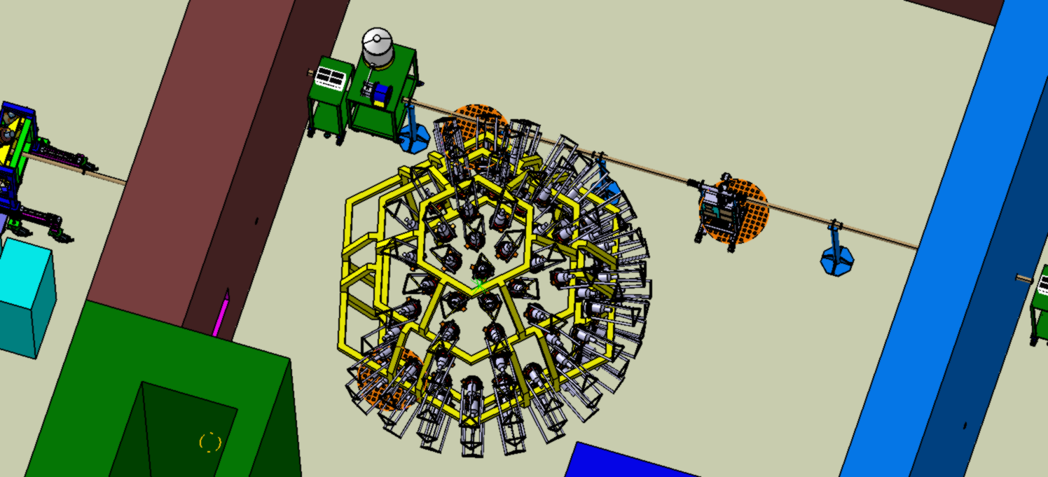
Gamma Above n Threshold
Studies of GDR and PDR decay
Studies of spin–flip M1 resonances
Absolute (γ,n) cross section measurements, e.g. p–process related measurements:
  the ¹³⁸La(γ,n) ¹³⁷La reaction
  the ¹⁸¹Ta(γ,n)¹⁸⁰Ta reaction
  the ¹⁸⁰Ta^{m}(γ,n)¹⁷⁹Ta reaction
Instrumentation:
³He neutron counter array
LaBr₃(Ce) / CeBr₃ array – high–energy gamma rays
Li–glass and NE213 liquid scintillator array – neutrons

Slide 35
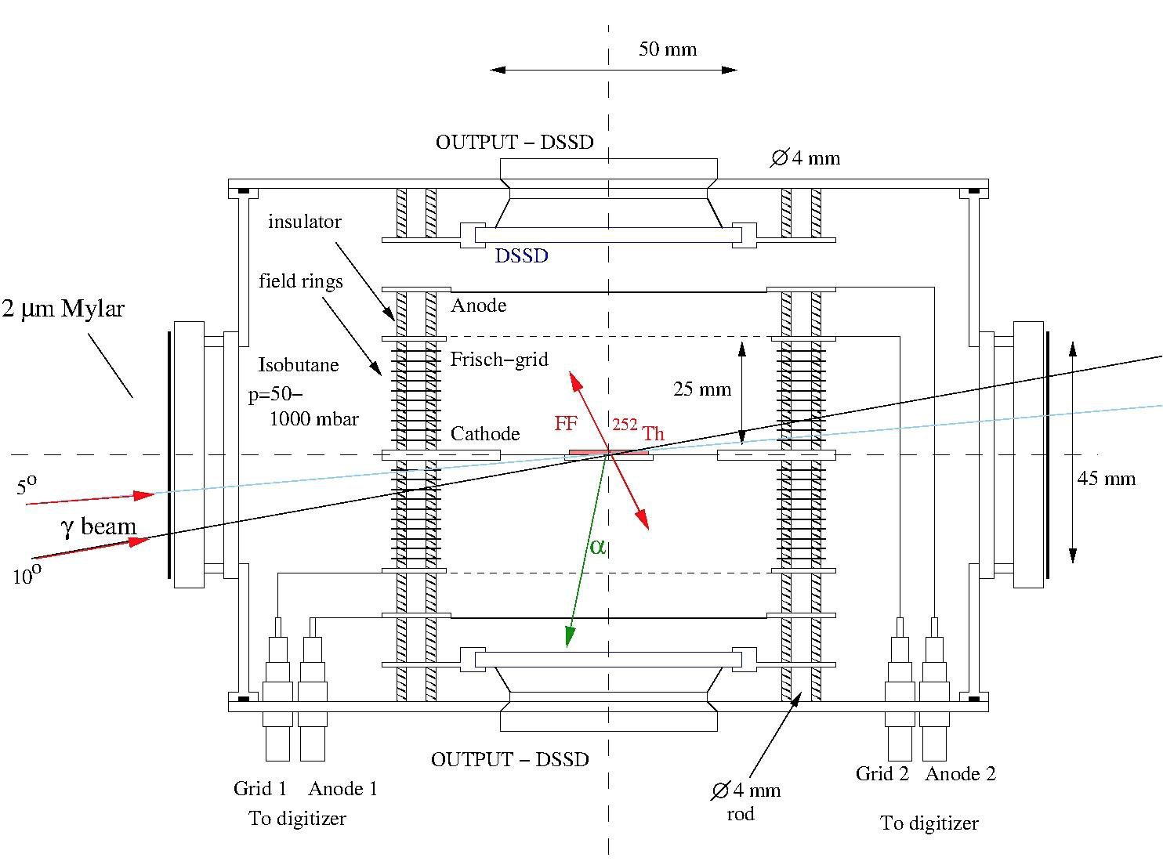
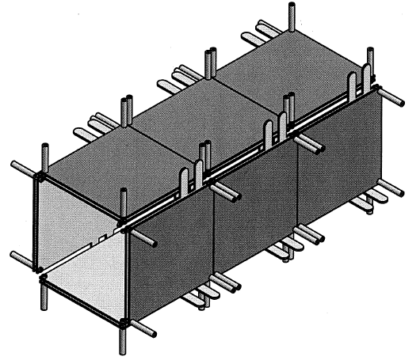
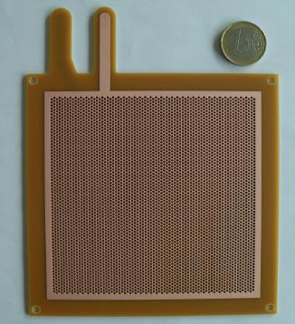
Photofission
Studies in the 2nd and 3rd minimum of the fission barrier: measurement of transmission resonances, angular and mass distributions of the fragments
Rare fission modes: ternary fission
Structure of neutron–rich nuclei: the rare–earth neutron–rich deformed region
Instrumentation:
System of multi–target Frisch–gridded twin ionization chambers and DSSD detectors
Array of 12 x THGEM detectors

Slide 36

Photofission and Exotic Nuclei
ALTO, ARIEL, etc.
Photofission cross section for ²³⁸U
Caldwell et al., Phys. Rev. C 21 (1980) 1215

Slide 37
Photofission and Exotic Nuclei
ALTO, ARIEL, etc.
ELI-NP
Inverse Compton Scattering
Photofission cross section for ²³⁸U
Caldwell et al., Phys. Rev. C 21 (1980) 1215
~10¹¹ photons/s

Slide 38
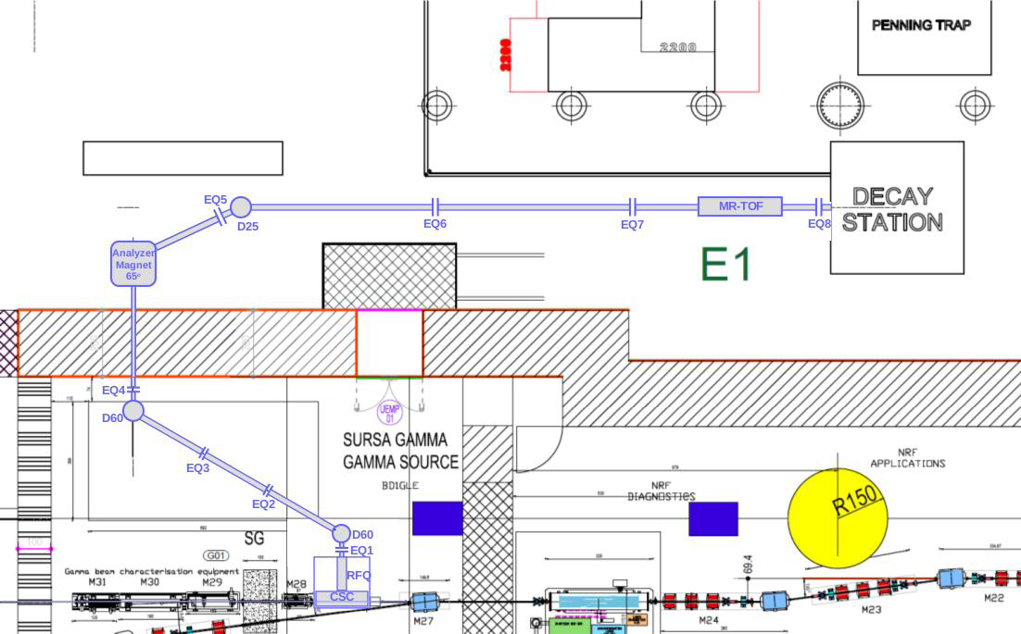
IGISOL Setup
β-decay studies at the IGISOL beam line :
Emphasis on refractory elements that can be separated with the IGISOL technique;
Test of the SM around the doubly-magic ¹³²Sn;
Studies of the onset and fading away of deformation in the A = 100 Sr–Zr region;
Studies of collective excitations in the A = 150 deformed region;
Studies of octupole excitations in Sm-Nd nuclei.

Slide 39
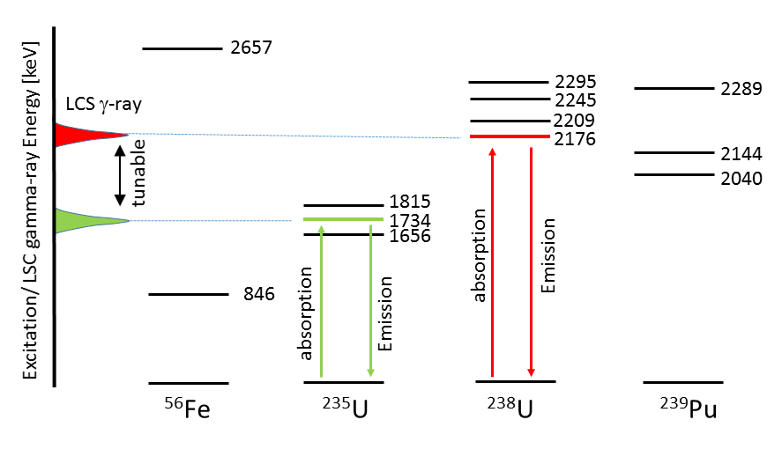
Gamma Beam Industrial Applications
Non–destructive Inspection
Active interrogation – Nuclear resonance fluorescence
Nuclear waste management
Cargo screening/Material identification
Origin of objects
Metal count in food and in plants
Density screening in ill tissues
High resolution imaging – Radiography and Tomography
Test quality of industrial objects (engines faults, steel quality)
Test strength of sinterization/welding
Phase distribution
Diffusion
2θ
NRF + CT: Elemental/isotopic maps

Slide 40

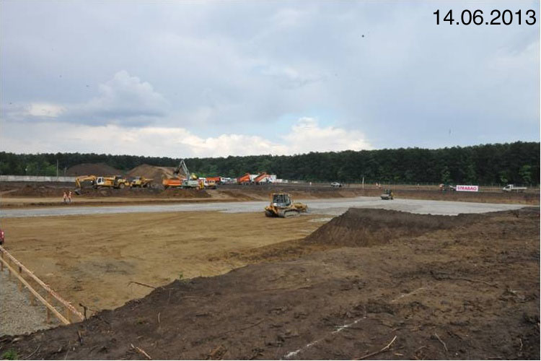


Summary
a new nuclear physics research facility is being constructed at Bucharest
  systems with features beyond state–of–the–art : HPLS and GBS
➞ many new research opportunities and challenges
  nuclear physics
    Laser Driven Nuclear Physics, combined laser–gamma
    NRF, photofission, photodissociation
  applications
    materials in extreme environments
    non–destructive inspection of materials
    positrons for material sciences

Slide 41





Slide 42





Main Components of the Gamma Beam System
Warm electron RF Linac (innovative techniques)
multi–bunch photogun (32 e– microbunches of 250 pC @100 Hz RF)
  2 x S–band (22 MV/m) and 12 x C–band (33 MV/m) acc. structures
  low emittance 0.2 – 0.6 mm⋅mrad
  two acceleration stages (300 MeV and 720 MeV)
High average power, high quality J–class 100 Hz ps Collision Laser
  state–of–the–art cryo–cooled Yb:YAG (200 mJ, 2.3 eV, 3.5 ps)
  two lasers (one for low–Eγ and both for high–Eγ)
Laser circulation with μm and μrad and sub–ps alignment/synchronization
  complex opto/mechanical system
  two interaction points: Eγ < 3.5 MeV & Eγ < 19.5 MeV
Gamma beam collimation system
  complex array of dual slits
  relative bandwidths < 5 x 10^{–3}
Gamma beam diagnostic system
  beam optimization and characterization: energy, intensity, profile

Slide 43



Photogun Laser
Photocathode Laser
based on Ti:Sa amplifier
cryo–cooled
@ 100 Hz
Time structure of the electron beam
Photocathode = Copper
500 pC = max. charge
→ 250 μJ / pulse
Output: UV (266 nm)
> 3 mJ , 32 pulses
producing 32 replica (before the last amplifier)
MULTIBUNCHING
TDR – arXiv:1407.3669 [physics.acc-ph]

Slide 44


Main Components of the Gamma Beam System
Main requirements are:
Low transmission of gamma photons (high density and atomic number)
Continuously adjustable aperture (to adjust the energy bandwidth in the entire energy range)
Avoid contamination of the primary beam with production of secondary radiation
Collimation aperture varies from 20 mm to less than 1 mm, depending on the beam energy
Tungsten slits – 20 mm thick
14 independent slits with 25.7º relative angle

Slide 45




Main Components of the Gamma Beam System
Electrons rep. rate –macropulses 100 Hz
32 micropulses @ 16 ns
Laser rep. rate – 100 Hz → laser recirculation
‘Dragon–shaped’ Laser Recirculation
e– beam
Laser beam
insertion
≈ 7º
≈ 0º
Laser beam
spots map a
circle on the
parabolic mirrors
K.Dupraz et al., Phys.Rev. STAB 17 (2014) 033501

Slide 46


Nuclear Resonance Fluorescence
ELI–NP
/ 1000
HIγS @ Duke U.
¹³⁸Ba (pol γ,γ‘)
Background radiation in the detectors
@ ELI –NP
Compton scattering of the beam
511 keV from positrons annihilation
⬇︎
Courtesy of N.Pietralla
Segmented Clover detectors + digital DAQ
Reduce the 511 keV background
Distinguish events from different pulses of gamma beam
GEANT4 by G.Suliman

Slide 47

The ELIADE Array – Background Reduction
Background radiation in the detectors
Compton scattering of the beam
511 keV from positrons annihilation
C.Petcu and E.Udup
Segmented Clover detectors + digital DAQ
Reduce the 511 keV background
Distinguish events from different pulses of gamma beam
Eliminate pile-up events

Slide 48

Cryogenic Stopping Cell
50% efficiency,
5 ms extraction time
at a rate of ~ 10⁷ ions/s
technical design
at GSI, Darmstadt
γ beam
He gas @ 70 K
pressure 300 mb and 10 mb
> 100 V/sm DC field
RF carpet

Slide 49

Photofission

Slide 50

Gamma Beam Industrial Applications
Active interrogation – Nuclear resonance fluorescence
High intensity gamma beam and small bandwidth
Tunable energy
High efficiency detector array – ELIADE
Witness foil (sample)
Object
Object
ELI-NP
γ beam
ELI-NP
γ beam
Two experimental methods will be carried out:
  Scattering NRF – Standard Method in Nuclear Physics Study
  Self-absorption/Transmission NRF (proposed by Bertozzi in 2005)
    Main interest in SNM control management

Slide 51

Gamma Beam Industrial Applications
Industrial Radiography and Tomography
Two tomography tables with biaxial movement and rotation
Various collimators with collimation holes between 0.2 mm and 5 mm.
High volume detector for pencil-beam
2D detector for cone-beam: CCD based gamma-ray camera or 2D flat panel
Implementation: 2015 -2017
Operation: 2018

Slide 52


Positrons for Material Sciences
The ELI-NP e⁺ factory
Production method
(γ, e⁺e–) reaction;
circular polarized γ–beam
I_{γ}= 2.4×10¹⁰ s⁻¹
E_{γ}< 3.5 MeV
W converter
Estimated e⁺ beam parameters
moderated e⁺ intensity 1.9×10⁶ s⁻¹
degree of e⁺ spin polarization 31%
Spectrometers
PALS – Positron Annihilation Lifetime
Spectroscopy
CDBS – Coincidence Doppler Broadening
Spectroscopy
TOF–PAES – Positron annihilation initiated
Auger Electron Spectroscopy
GiPALS – Gamma induced PALS

