Slide 1
Hard Probes of Heavy Ion collisions at the LHC
Marco van Leeuwen,
Nikhef and Utrecht University

Slide 2
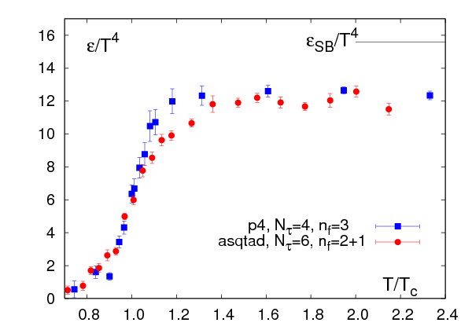
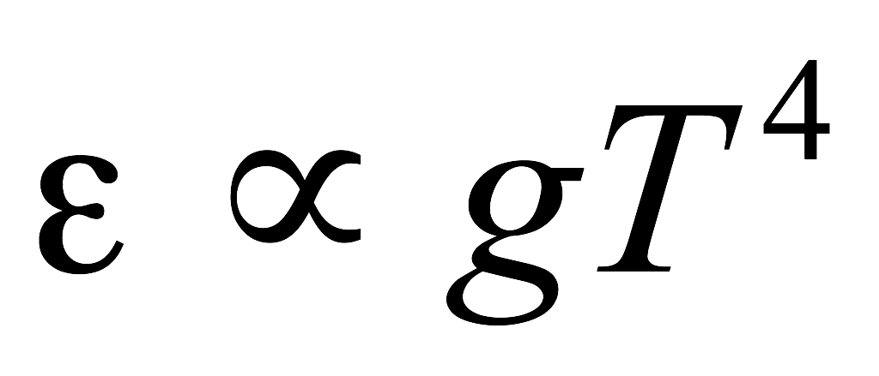
Introduction: Heavy Ion Physics
Phase diagram
Energy density vs temperature (lattice)
Quark Gluon Plasma
(Quasi-)free quarks and gluons
Temperature
Critical
Point
Early universe
Bernard et al, hep-lat/0610017
Confined hadronic matter
Elementary collisions
(accelerator physics)
High-density phases?
Neutron stars
Nuclear matter
T_{c} ~ 170 -190 MeV
ε_{c} ~ 1 GeV/fm³
Study the properties of many-body QCD systems
Properties of equilibrium matter: equation of state, transport coefficient
Dynamics: hadronisation, interactions of partons with the medium

Slide 3
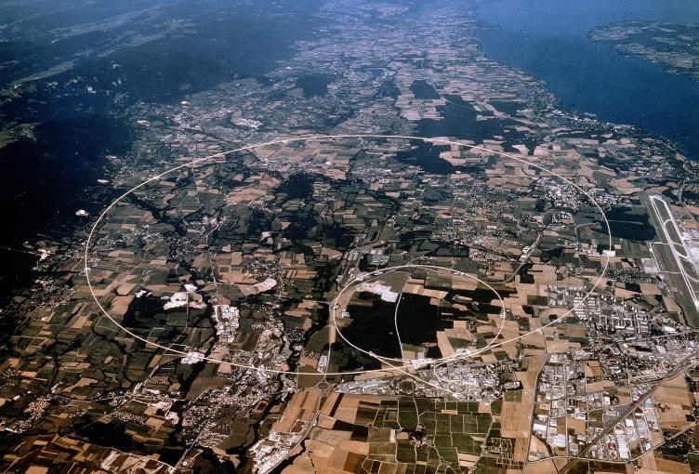
Large Hadron Collider at CERN
LHC, Geneva
Run 1: 2010-2013
pp √s = 7, 8 TeV
p+Pb √sNN = 5.02 TeV
Pb+Pb √sNN = 2.76 TeV
Run 2: 2015-(2018)
pp √s = 13 TeV
Pb+Pb √sNN = 5.13 TeV
p+Pb
This talk:
focus on p+Pb, Pb+Pb
4 large experiments:
ALICE, ATLAS, CMS, (LHCb)

Slide 4
Heavy ion collisions
Heavy-ion collisions produce ‘quasi-thermal’ QCD matter
Dominated by soft partons p ~ T ~ 100-300 MeV
‘Bulk observables’
Study hadrons produced by the QGP
Typically p_{T} < 1-2 GeV
B. Schenke, Wed 11:30
K. Redlich, Wed 12:00
‘Hard probes’
Hard-scatterings produce ‘quasi-free’ partons
⇒ Probe medium through energy loss
p_{T} > 5 GeV
Two basic approaches to learn about the QGP
Bulk observables
Hard probes

Slide 5
Hard processes in QCD
Factorization
Cross section calculation can be split into
Hard part: perturbative matrix element
Soft part: parton density (PDF), fragmentation (FF)
parton density
matrix element
FF
Hard process: scale Q >> Λ_{QCD}
Hard scattering High-p_{T} parton(photon) Q ~ p_{T}
Heavy flavour production m >> Λ_{QCD}
Talk S. Masciocchi Tue 12:00
QM interference between hard and soft suppressed (by Q²/Λ² ‘Higher Twist’)
Soft parts, PDF, FF are universal: independent of hard process
This is likely to break down in a QGP, but still a good starting point

Slide 6
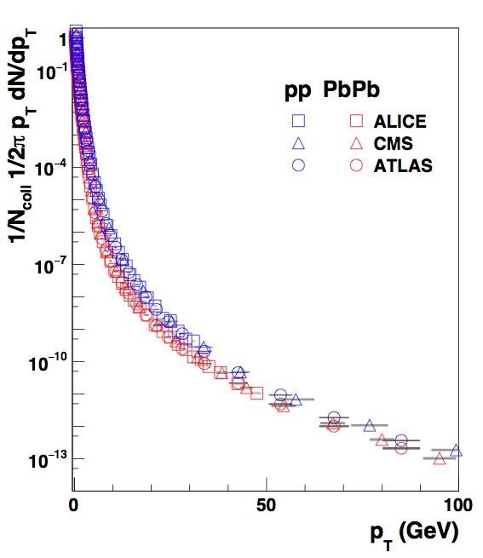
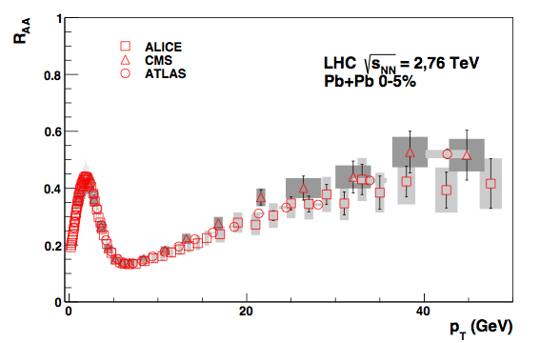
Nuclear modification: Pb-Pb
ALICE, PLB720, 52
CMS, EPJC, 72, 1945
ATLAS, arXiv:1504.04337
Charged particle pT spectra
Nuclear modification factor
Low pT: soft production,
Npart scaling
Ncoll: number of binary nucleon-nucleon collisions
Pb+Pb: clear suppression (RAA < 1): parton energy loss

Slide 7
Intermezzo: p+Pb
Pb
p
Sensitive to
Initial state effects: modified PDF, energy loss
‘Cold Nuclear Matter’ * effects: rescattering, energy loss
* Recent results indicate that p+Pb might also be hot, see talk B. Schenke Wed 11:30

Slide 8
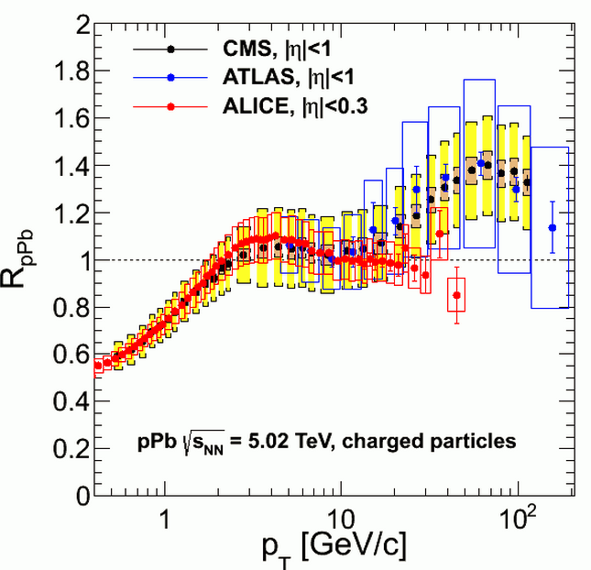
p+Pb collisions: RpPb
Nuclear modification factor p-Pb
Charged particle RpPb ~ 1 at pT 2-30 GeV
CMS, EPJC 75, 237, ALICE PRC 91, 064905, ATLAS-CONF-2013-107
No ‘cold nuclear matter effects’ at high pT
Possible rise at pT > 30 GeV:
Unexpected; no obvious physics mechanism
Not seen in jets; recent CMS studies hint at a larger uncertainty in the pp reference (interpolated from other energies)
LHC will run pp at 5.02 TeV for reference
CMS talks at Hard Probes, Montreal

Slide 9
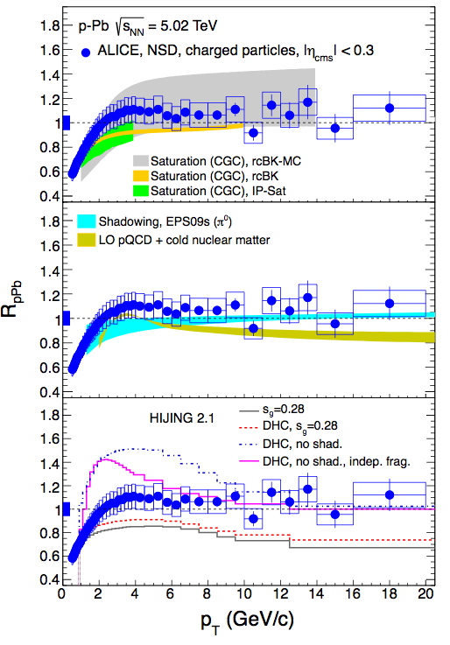
p-Pb theory expectations
ALICE, PRL 110, 082302
Color Glass Condensate, gluon saturation: expect RpPb ≈ 1 at mid rapidity
Albacete, Nucl Phys A 897, 1, Tribedy, Venugopalan, PLB 710, 125
Nuclear PDFs: very small modifications
Cold nuclear matter: some suppression at higher pT expected (model dependent)
Helenius et al, JHEP1207, 073, Kang et al, Phys Lett B 718, 482
Xu et al, PRC 86, 051901
Observed RpPb ≈ 1 in line with known nuclear effects

Slide 10
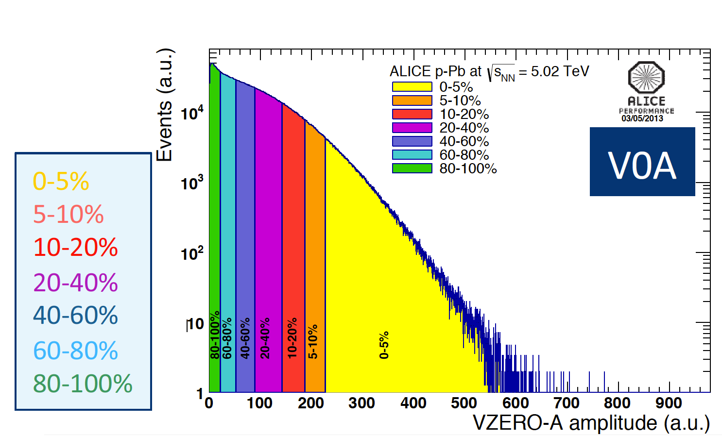
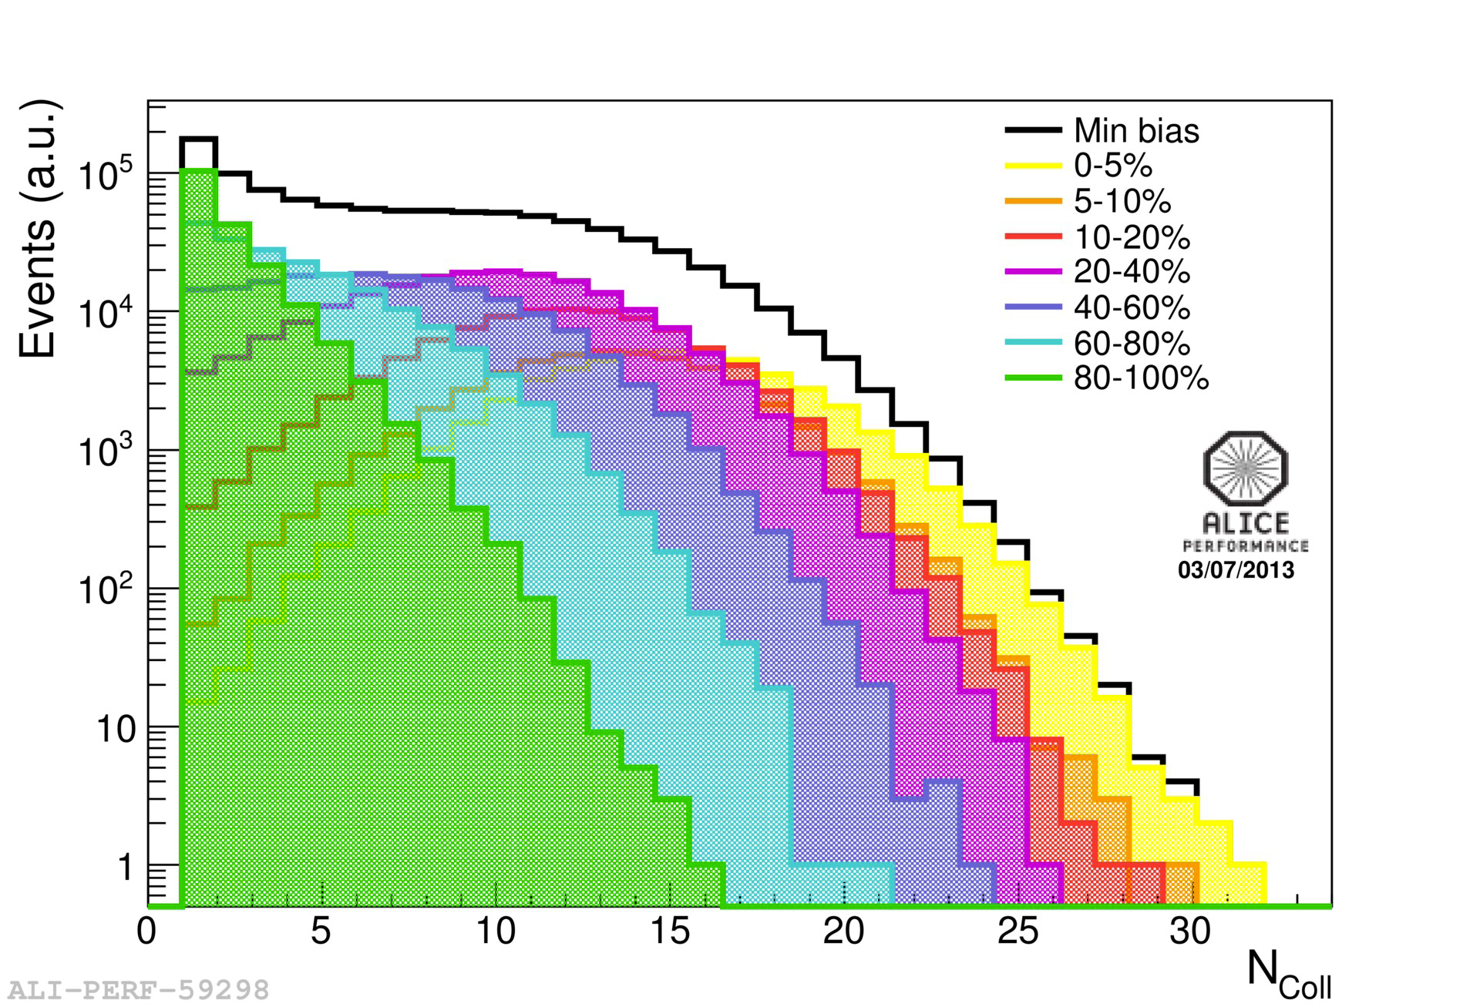
Centrality: standard MC Glauber approach
Pb
Glauber MC: calculate geometrical relation between Ncoll, Npart and b
p
Fold with particle production model,
e.g. Negative Binomial Distribution
Ncoll distributions for different multiplicity bins
3)
1) Fit to data
2) Bin observed distribution
p+Pb: fluctuations of particle production per p-N collision large compared to centrality bin width!

Slide 11
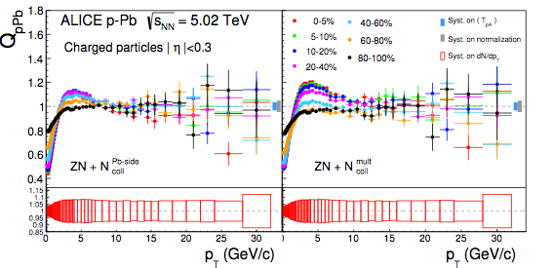
RpPb centrality dependence
Centrality based on forward multiplicity
RpPb with hybrid method
ALICE, PRC 91, 064905
Measure centrality with forward particle production:
Large bias effects
Hybrid method: use Zero Degree Calorimeter for selections
+ Ncoll estimated from forward multiplicity
Simple model: incoherent superposition of Ncoll PYTHIA events describes this

Slide 12
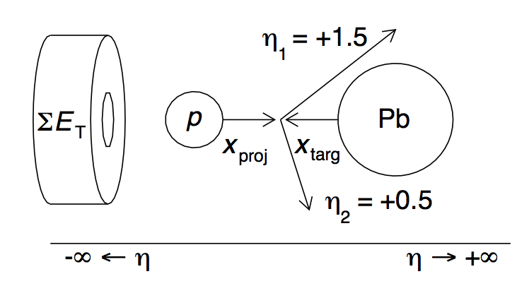
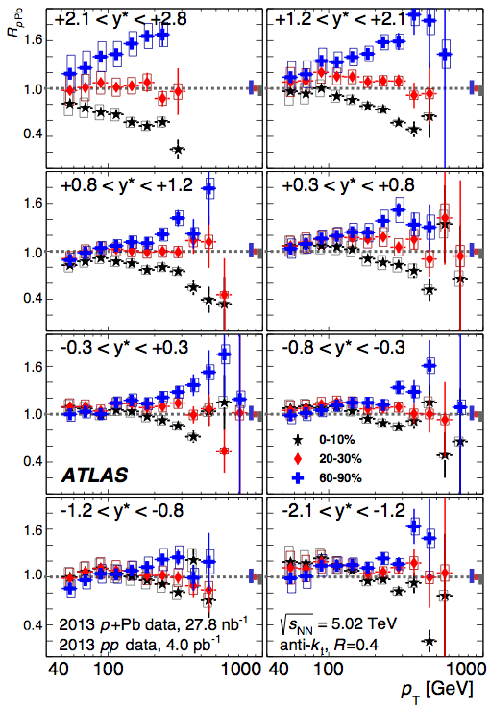
Centrality dependence at high pT
p-going
ATLAS, arXiv:1412.4092
ATLAS: centrality based on Pb-going (backward) ET
Mid and forward rapidity: Large deviations from RpPb ≈ 1 at pT > 100 GeV
Centrality bias, a dynamical effect?
Something else?
Suggested mechanisms:
Relation between spatial configuration and high-x Alvioli et al, arXiv:1409.738, gluon content: Bathe et al, arXiv:1408.3156
E-loss, cms shift Armesto et al, arXiv:1502.02986
Correlation between high and low x patrons in PDF Kordel& Majumder
Pb-going

Slide 13
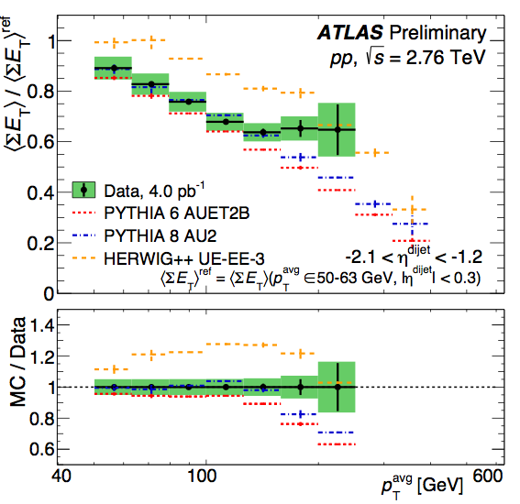
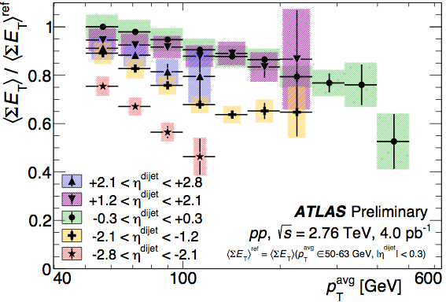
Recent update: check biases in pp
ATLAS-CONF-2015-019
No strong correlation between between jet yields and ET production (‘centrality’) in relevant region (Anti-) correlation stronger when ET and jet are at same side
Effect reasonably well described by MC generators
Effect observed in p-Pb must be a pure p-Pb effect or interplay between pp bias and centrality

Slide 14
Back to Pb+Pb
Do we understand this behaviour; can we model the interactions?

Slide 15
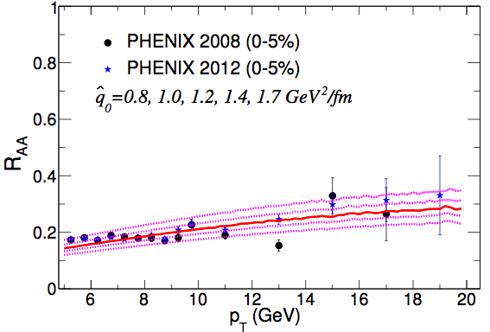
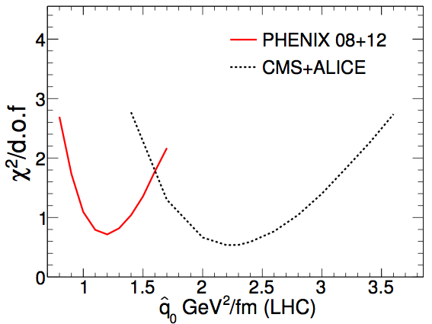
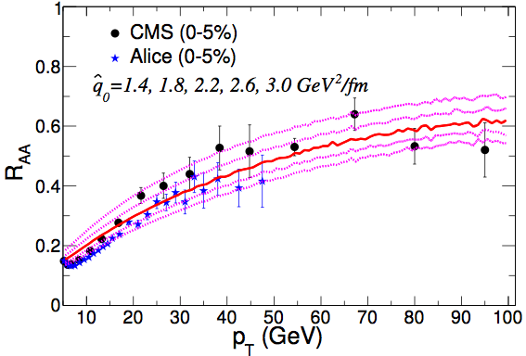
Determining the medium density from RAA
RHIC
𝜒² of data wrt model
Burke et al, JET Collaboration, arXiv:1312.5003
LHC
Clear minimum: found best value for transport coefficient
: mean transverse momentum kick per unitpath length
Observed pT dependence well described by models
Factor ~2 larger at LHC than RHIC

Slide 16
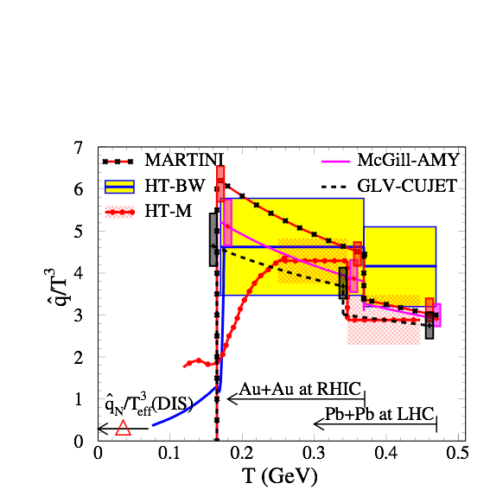
Energy dependence of transport coefficient
RHIC:
(T0 = 370 MeV)
LHC:
Burke et al, JET Collaboration, arXiv:1312.5003
(T0 = 470 MeV)
values from different models agree
Expect (density)
Observed values at RHIC and LHC agree with expected scaling

Slide 17
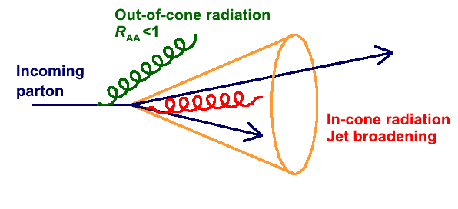
Jets and parton energy loss
Motivation: understand parton energy loss by tracking the lost energy
Qualitatively two scenarios:
In-cone radiation: R_{AA} = 1, change of fragmentation
Out-of-cone radiation: R_{AA} < 1
Reality is somewhere in-between

Slide 18
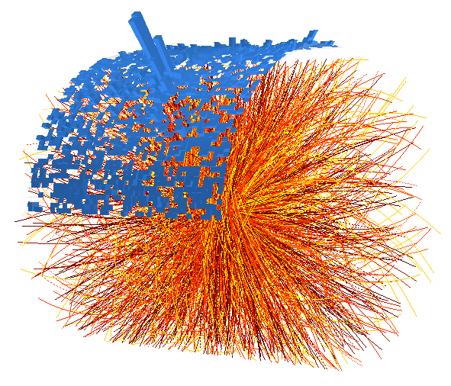
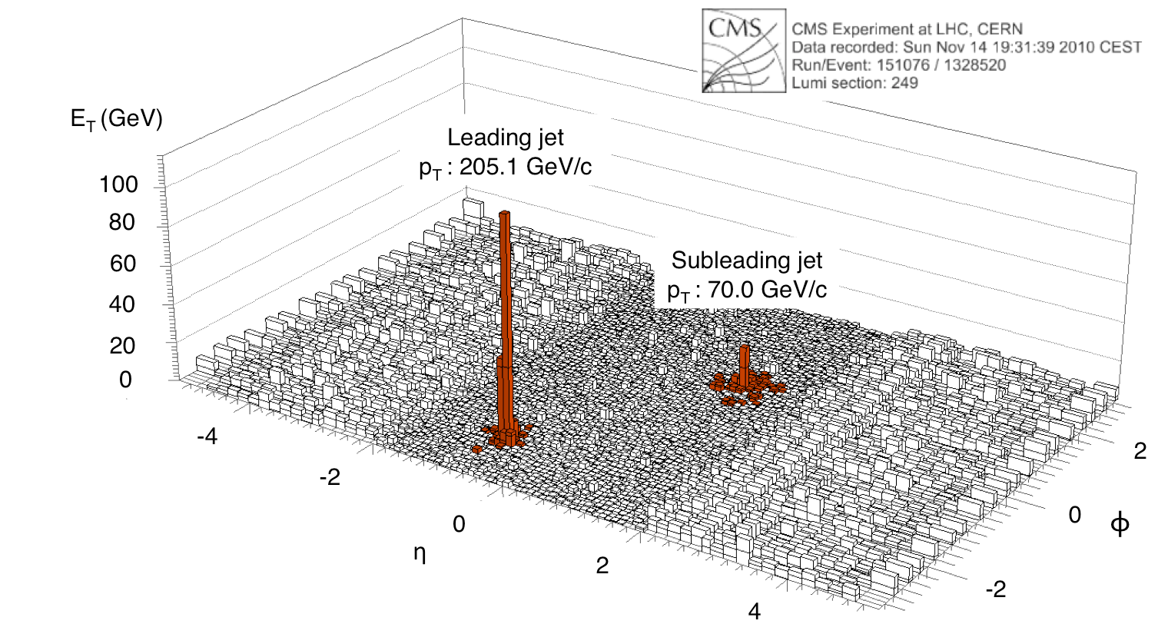
Jets at LHC
ALICE
Transverse energy map of 1 event
ϕ
η
Clear peaks: jets of fragments from high-energy quarks and gluons
And a lot of uncorrelated ‘soft’ background - subtracted/corrected for

Slide 19
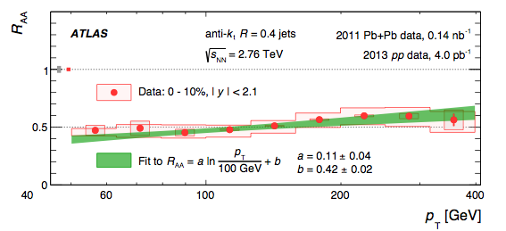
Nuclear modification factor for jets
ALICE: Charged jet RCP
CMS: calorimeter/particle flow jets
RAA
R=0.3
ALICE arXiv:1311.0633
CMS PAS-HIN-12-004
ATLAS: calorimeter jets
ATLAS, arXiv:1208.1967, arXiv:1411.2357
R_{AA} < 1: not all produced jets are seen; out-of-cone radiation and/or ‘absorption’
For jet energies up to ~400 GeV: energy loss is a very large effect

Slide 20
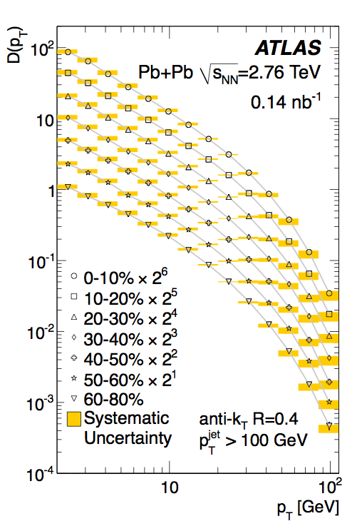
Intra-jet distributions: longitudinal
ATLAS, PLB 739, 320
Fragment distributions pT,jet > 100 GeV/c
Ratio central/peripheral
Enhancement at low pT
Suppression at intermediate pT
Softening of the fragmentation; consistent with energy loss expectation

Slide 21
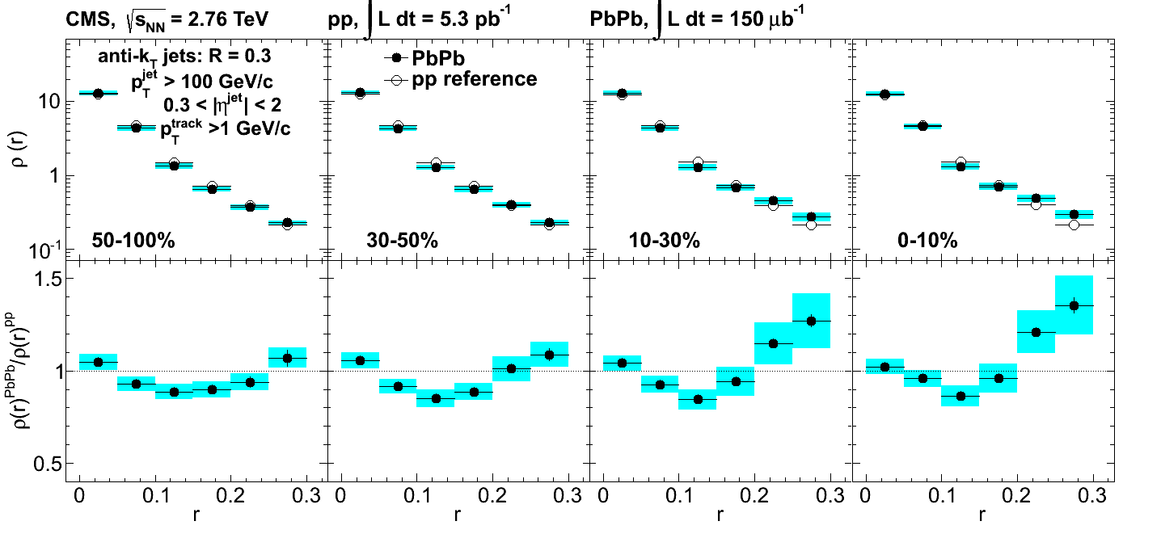
Intra-jet distributions: transverse
CMS, arXiv:1310.0878
Measures momentum flow vs distance to jet axis
Medium effects small for R < 0.2; modest enhancement at R > 0.2

Slide 22
Connecting in-cone and out-of-cone momentum flow
Where does the lost energy go?
Jet RAA is not close to 1
RAA ~ 0.4 - 0.6 for R < 0.5
5-10 GeV energy transported outside of cone
Large energy loss ⟹ Out-of cone radiation
II) Particle distributions in jets show only modest change
~ 10 % at large momentum, small R
larger effects at small pT, large R
Small/modification of in-cone energy flow
(My) naive expectation: Large redistribution O(10 GeV) outside cone ⟹ Large effects inside cone
Not seen…
Several caveats … Modelling ongoing
Talk G. Milhano, Thu 10:00

Slide 23
Summary
p+Pb
As baseline for ‘cold nuclear effects’: probably understood/no surprises (Minimum bias collisions)
Centrality: interplay between biases (picking out ‘special’ nucleon-nucleon collisions) and geometry
Possibly new effects ?
Hot matter effects — not covered here: B. Schenke
Pb+Pb: Clear suppression of high-pT yields
Magnitude of inclusive hadron suppression basically understood: parton energy loss
Jets also suppressed (R < 0.5)
Significant out-of-cone radiation
In-cone distributions show some modification (redistribution of fragments)
Theory/interpretation under development/discussion: G. Milhano

Slide 24
Extra slides

Slide 25
Nuclear modification factor R
Sketch: transverse momentum spectrum
‘Energy loss’
1/N_{bin} d²N/d²p_{T}
p+p
Shift spectrum to left
A+A
p_{T}
Measured nuclear modification factor R_{AA} is a ratio of yields at a given p_{T}
The physical mechanism is energy loss; shift of yield to lower p_{T}

Slide 26
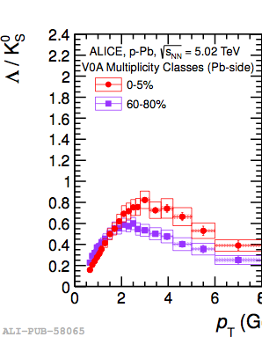
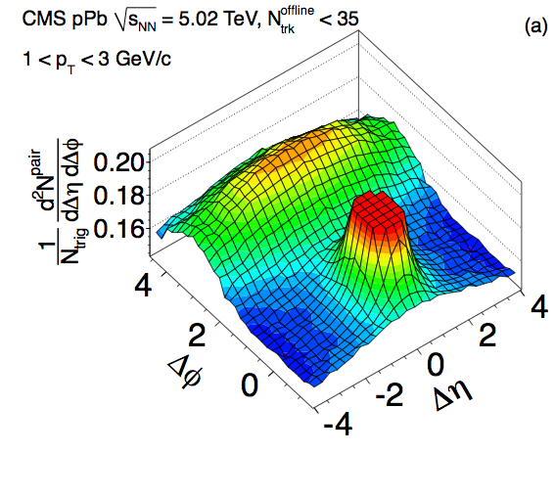
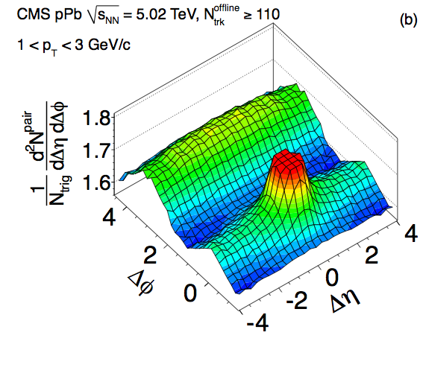
p+Pb centrality dependence
Di-hadron correlations
Baryon/meson ratio
Peripheral Ntrk < 35
ALICE, arXiv:1307.6796
CMS, PLB 718, 795
Central Ntrk > 110
pT (GeV/c)
Modifications in the soft sector mostly seen in central p+Pb collisions
How about the nuclear modification factor for central events?

Slide 27
Biases: some remarks
NB: bias and selection are almost synonyms
Centrality selection purposefully biasing the sample
So the question is rather: can we control the centrality selection/bias
Distinguish:
Geometrical biases/selections: b, Ncoll, Npart
Dynamical biases caused by correlations in the particle production process, i.e. selecting ‘special’ nucleon-nucleon collisions

Slide 28
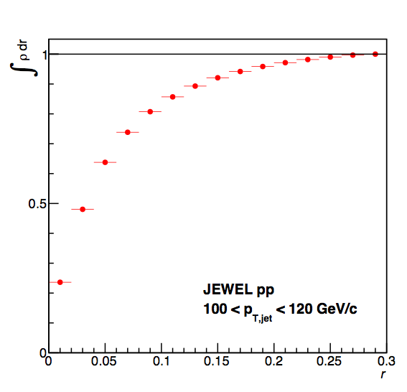
What’s up with the large angle radiation?
Jet energy profile
~25% in first bin:
r < 0.02
10% of energy
r > 0.13
5% of energy
r > 0.2
Redistribution of energy should be continuous
Would expect O(100%) effect at r > 0.15 or so
and O(30%) effects at r = 0

Slide 29
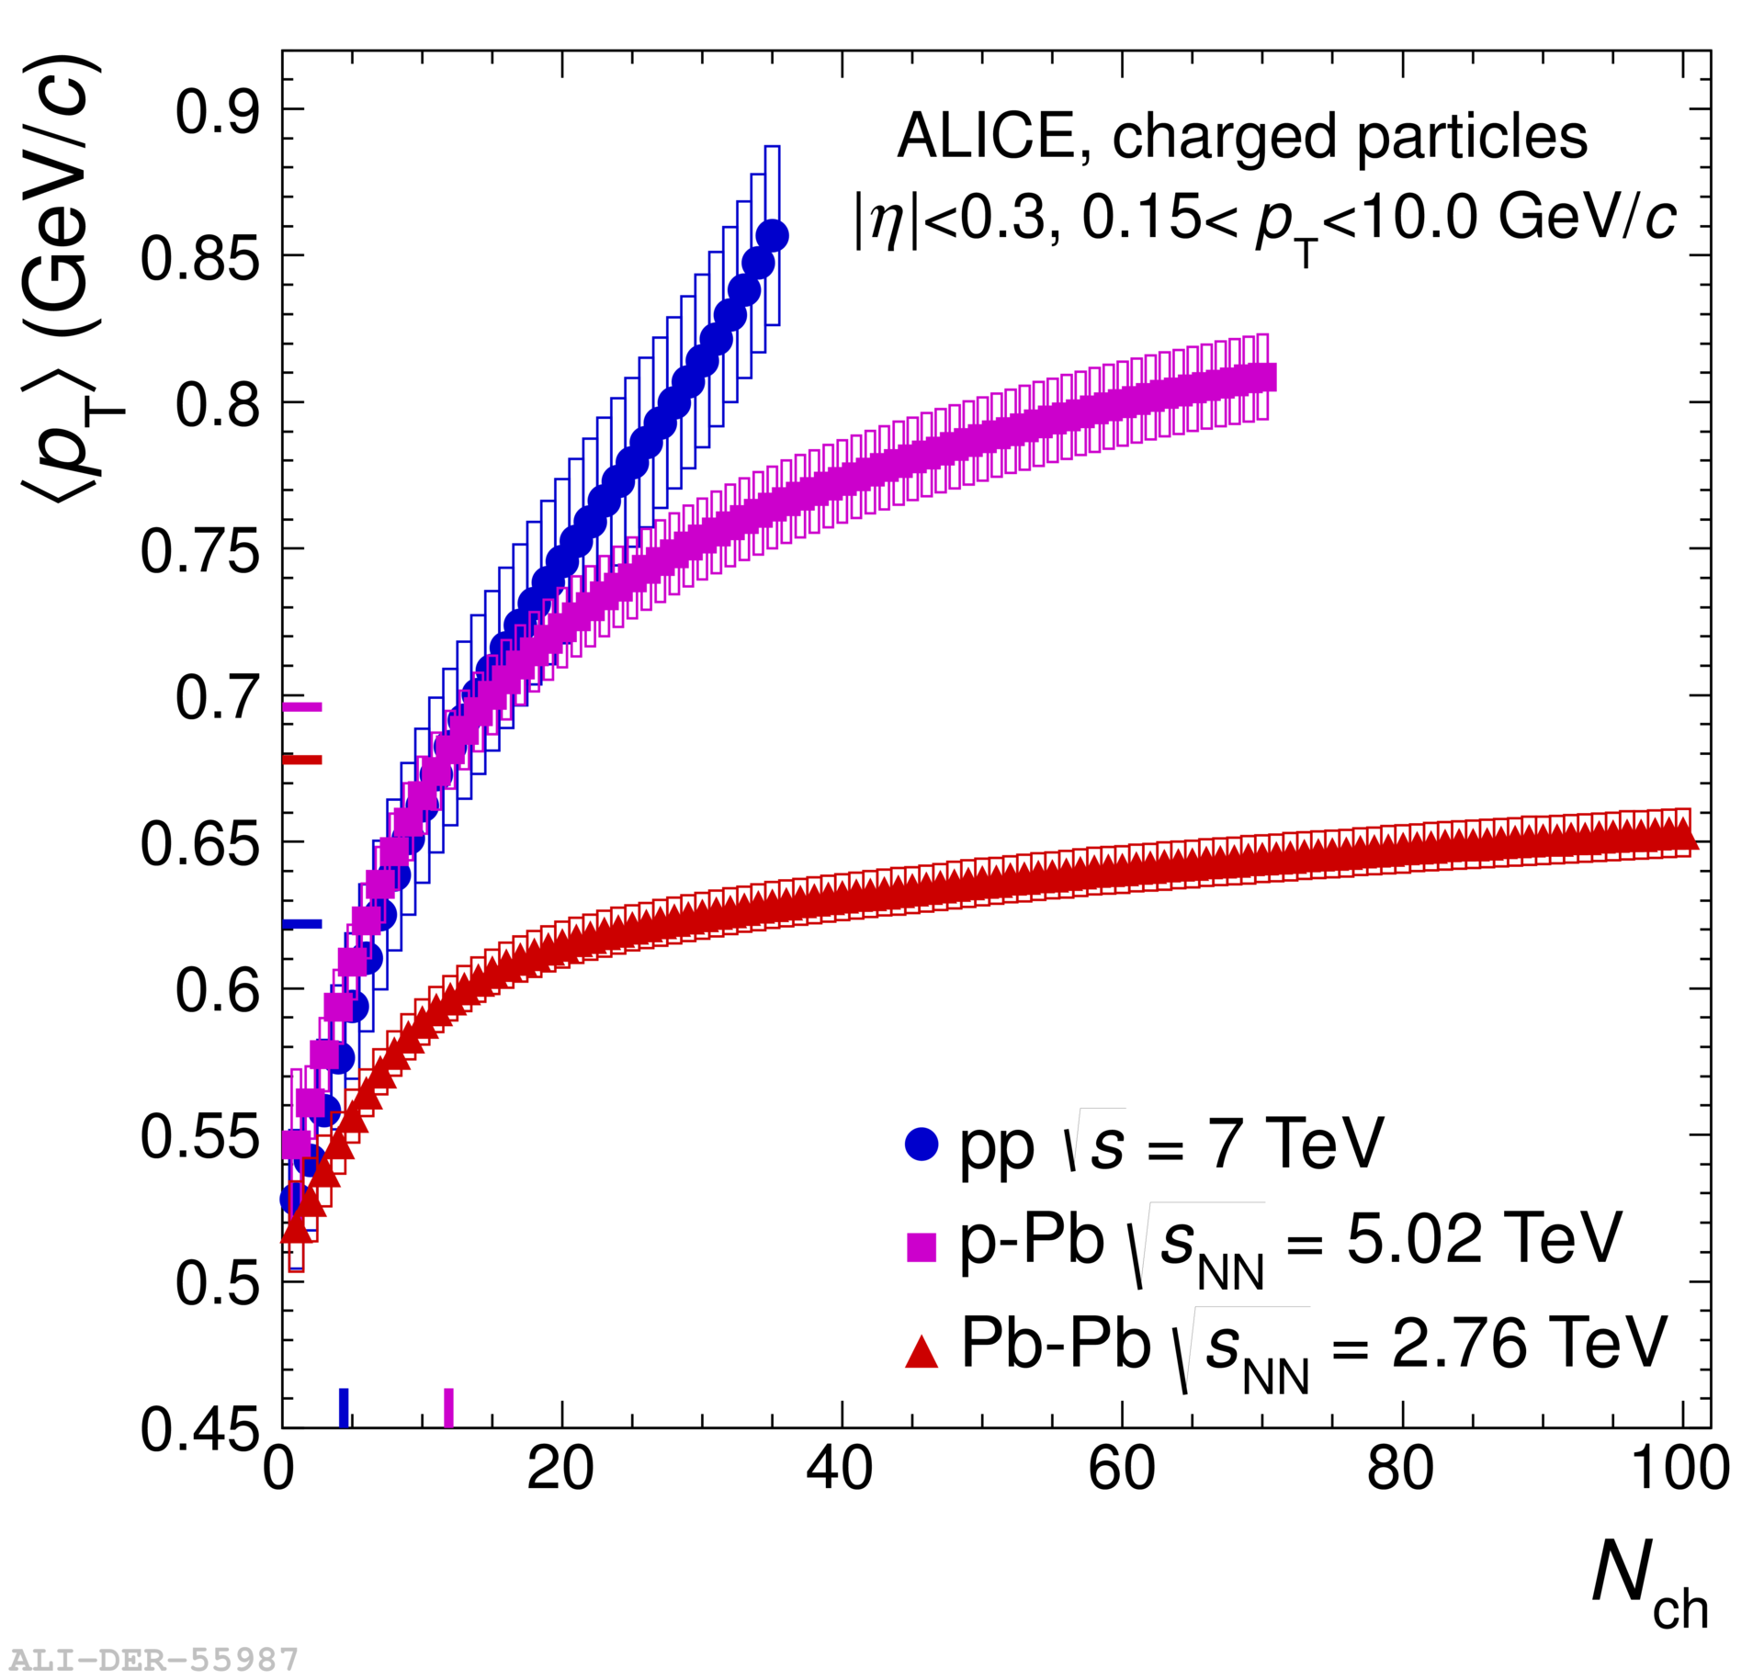
More multiplicity bias
ALICE, PLB 727, 371
pp dynamics depends
on multiplicity:
for example <pT>
Mean pT in p+Pb does not reach highest values from pp Trade-off between Ncoll and high-activity pp
Large spread in multiplicity already in pp
p+Pb only ‘extends twice as far’

Slide 30
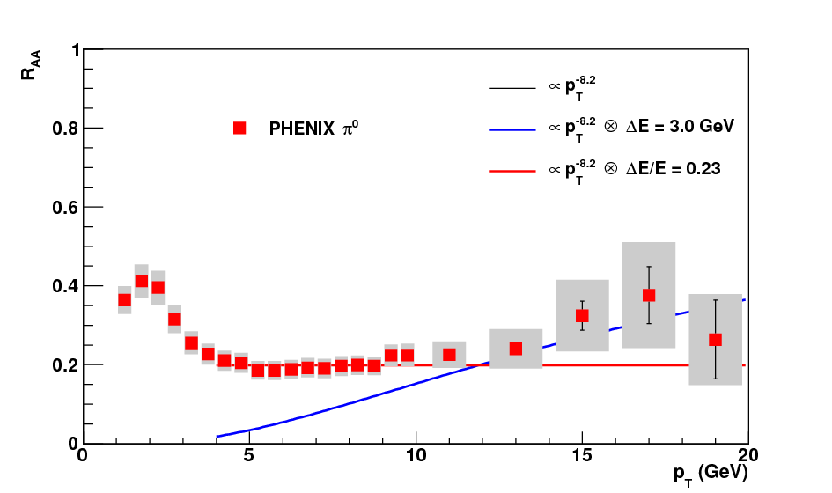
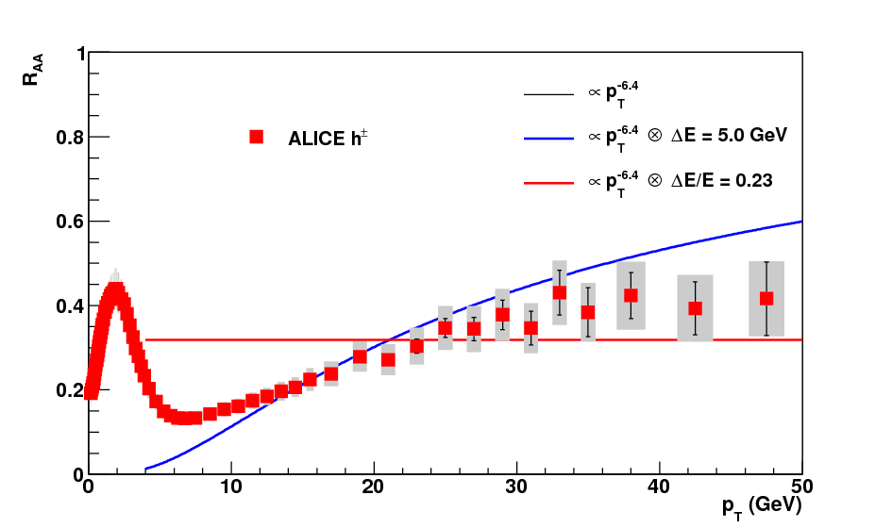
From RHIC to LHC
RHIC
LHC
Difference PbPb - pp
RHIC: n ~ 8.2
LHC: n ~ 6.4
Energy loss at LHC is larger than at RHIC
RAA is similar due to flatter pT dependence

Slide 31
So, are we done?
Not quite: discussed only one (type of) measurement so far; does not constrain the theory/models
Want to verify our understanding:
Color charge dependence of energy loss
e.g. heavy flavour
Path length dependence of energy loss
Expect L² for weak coupling, interference
Different at strong coupling
Distribution of radiation/energy loss
Radiative vs elastic loss
Interference effects
Dead cone effect
Azimuthal dependence, recoil measurements
Jets

Slide 32
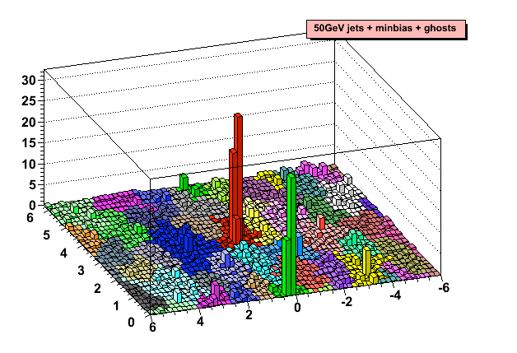
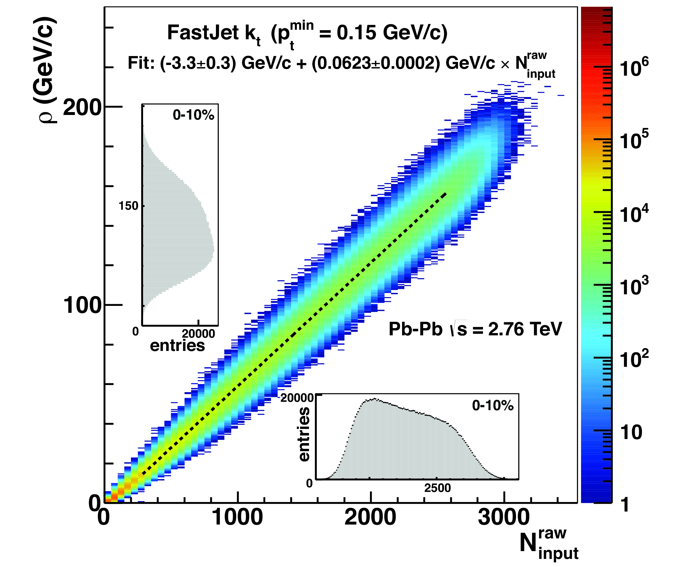
PbPb jet background
Jet finding illustration
Background density vs multiplicity
Cacciari et al
η-ϕ space filled with jets
Many ‘background jets’
Background contributes up to ~180 GeV per unit area
Subtract background:
Statistical fluctuations remain after subtraction

Slide 33
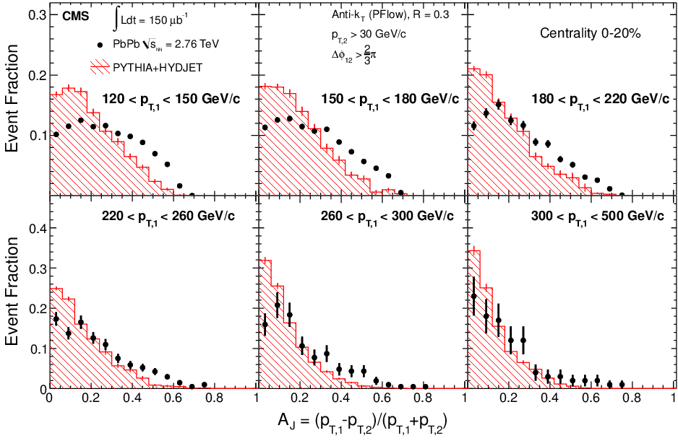
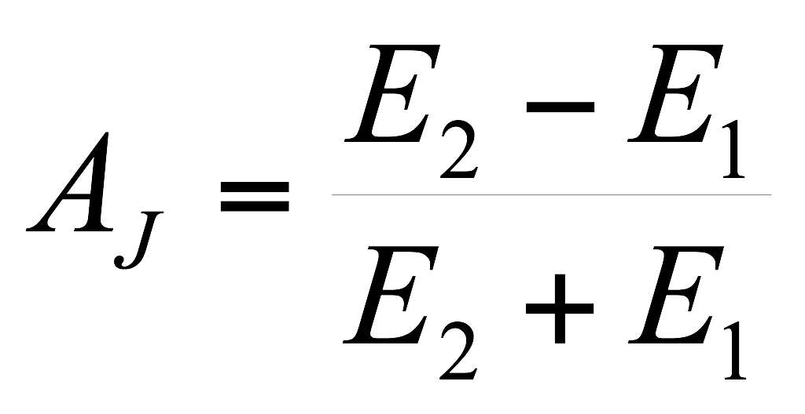
Jet energy asymmetry
jet-jet
𝛾-jet
jet-jet
ATLAS-CONF-2012-121
ATLAS, arXiv:1011.6182 (PRL)
CMS, arXiv:1202.5022
Energy dependence: asymmetry persists to high pT > 300 GeV/c
Large asymmetry seen for central events
Suggests large energy loss: many GeV
~ compatible with expectations from RHIC+theory
However:
Only measures reconstructed di-jets (don’t see lost jets)
Not corrected for fluctuations from detector+background
Both jets are interacting – No simple observable

Slide 34
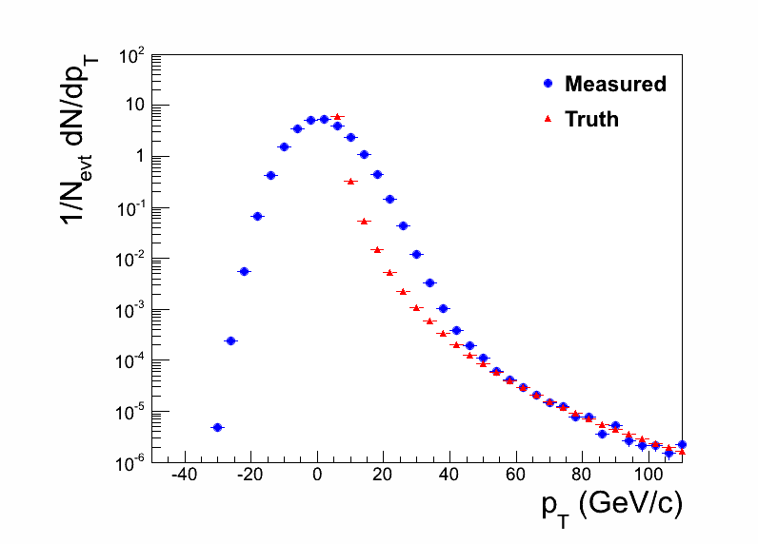
PbPb jet background
Toy Model
Jet spectra are corrected for background fluctuations by unfolding
Size of fluctuations depends on p_{T} cut, cone radius
PbPb results mostly R=0.3, 0.4 so far

Slide 35
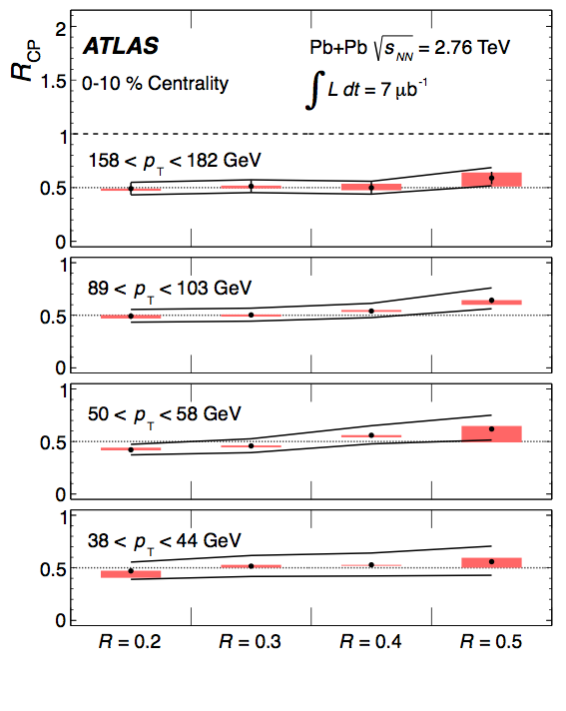
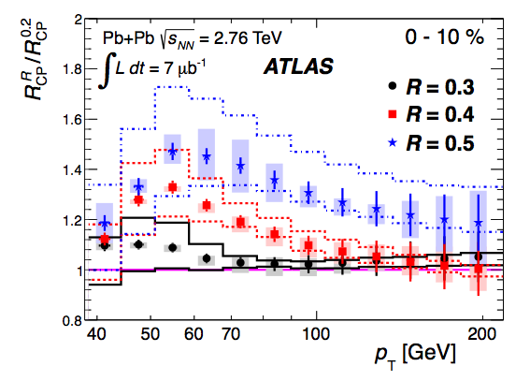
Increasing R to recover the energy
Ratio of spectra with different R
ATLAS, arXiv:1208.1867
ATLAS, arXiv:1208.1967
Larger jet cone: ‘catch’ more radiation → Jet broadening
However, R = 0.5 still has R_{AA} < 1
– Hard to see/measure the radiated energy

Slide 36
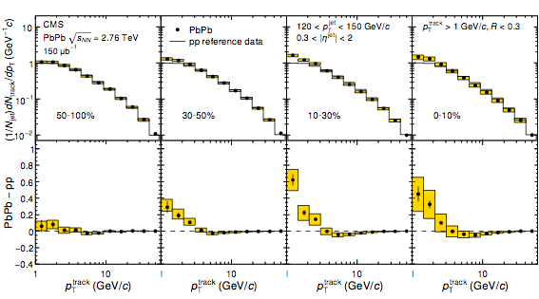
Intra-jet distributions: longitudinal
Fragment distributions: 120 < pT,jet < 150 GeV/c
Difference PbPb - pp
CMS, PRC 90, 024908
Enhancement at low pT
Suppression at intermediate pT

Slide 37
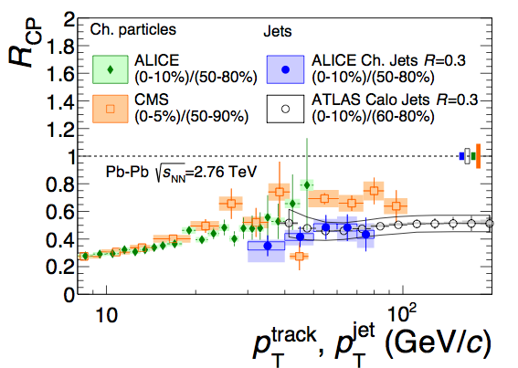
Comparing hadrons and jets
Suppression of hadron (leading fragment) and jet yield similar
Is this ‘natural’? No (visible) effect of in-cone radiation?

