Slide 1
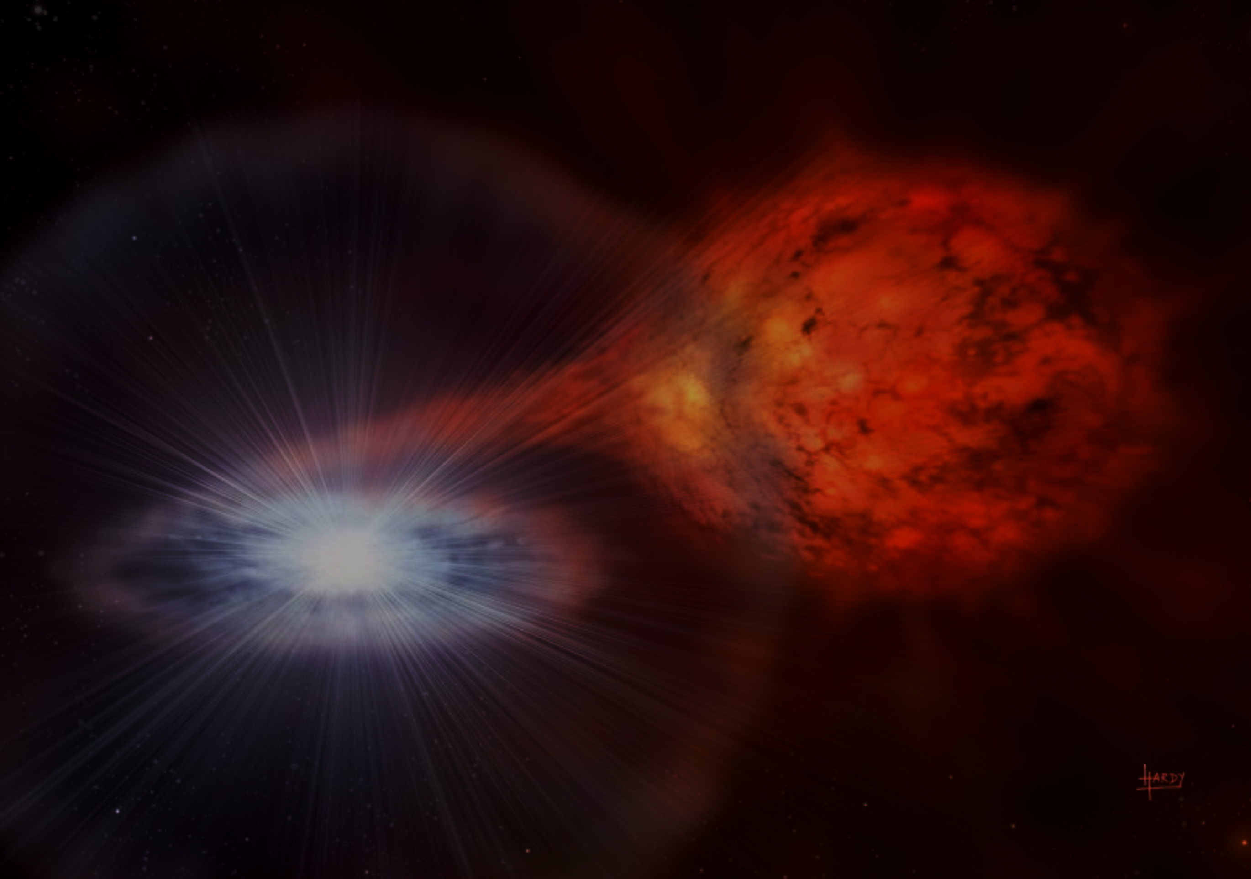
The Impact of
New Thermonuclear Reaction Rates of ⁶⁴Ge(p,γ)⁶⁵As and ⁶⁵As(p,γ)⁶⁶Se for Type-I X-ray Bursts
Yi Hua LAM (藍乙華), Jian Jun HE (何建軍), Anuj PARIKH, Hendrik Schatz,
B. Alex BROWN, Meng WANG (王猛), Bing GUO (郭冰), Yu Hu ZHANG (張玉虎),
Xiao Hong ZHOU (周小紅), Hu San XU (徐瑚珊)
中国科学院近代物理研究所
Institute of Modern Physics (IMP)
Chinese Academy of Sciences (CAS)
EuNPC 2015
The 3rd European Nuclear Physics Conference, 31 Aug. – 4 Sept. 2015, Groningen, Netherland.

Slide 2
The Impact of
New Thermonuclear Reaction Rates of ⁶⁴Ge(p,γ)⁶⁵As and ⁶⁵As(p,γ)⁶⁶Se for Type-I X-ray Bursts
Background
  Type-I x-ray burst
  Type-I x-ray burst models
  Rapid-proton capture (rp) process
New rp-process reaction rates of ⁶⁴Ge(p,γ)⁶⁵As and ⁶⁵As(p,γ)⁶⁶Se
The impact on end-stage abundances and light curve.
Summary and Perspectives

Slide 3
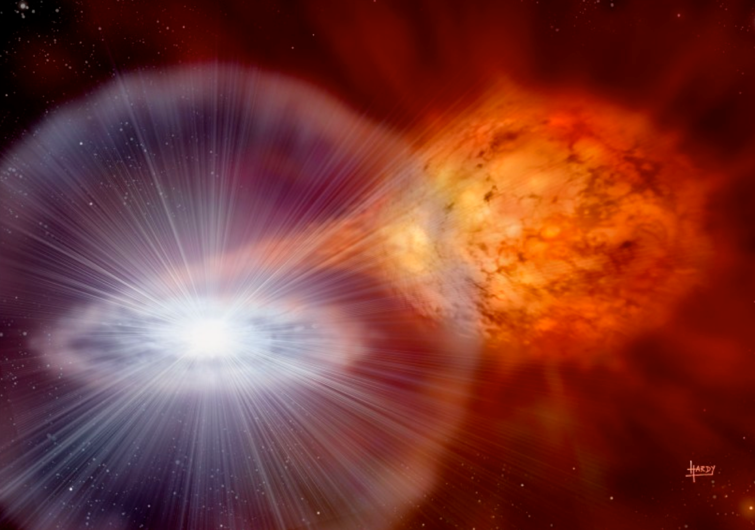
Type I X-ray burst (XRB)
Discovered independently by Belian+. (1976) and Grindlay+. (1976)
The stellar binary system is close enough to permit mass transfer.
The solar-type matter flow forms an accretion disk surrounding the neutron star and ultimately accumulates on its surface, building up an envelope in semi-degenerate conditions.
As material piles up on top of the neutron star, the envelope is heated up without any significant expansion due to degeneracy, driving a violent thermonuclear runaway.
Image from David. A. Hardy / STFC

Slide 4
Type I X-ray burst (XRB)
Discovered independently by Belian+. (1976) and Grindlay+. (1976)
The stellar binary system is close enough to permit mass transfer.
The solar-type matter flow forms an accretion disk surrounding the neutron star and ultimately accumulates on its surface, building up an envelope in semi-degenerate conditions.
As material piles up on top of the neutron star, the envelope is heated up without any significant expansion due to degeneracy, driving a violent thermonuclear runaway.
Image from David. A. Hardy / STFC

Slide 5
Type I X-ray burst (XRB)
Discovered independently by Belian+. (1976) and Grindlay+. (1976)
The stellar binary system is close enough to permit mass transfer.
The solar-type matter flow forms an accretion disk surrounding the neutron star and ultimately accumulates on its surface, building up an envelope in semi-degenerate conditions.
As material piles up on top of the neutron star, the envelope is heated up without any significant expansion due to degeneracy, driving a violent thermonuclear runaway.
Image from David. A. Hardy / STFC

Slide 6

Type I X-ray burst (XRB)
Discovered independently by Belian+. (1976) and Grindlay+. (1976)
Drive nucleosynthesis along the proton-rich side:
rp process [(p, γ) reactions ] (main process)
αp process [a sequence of (α,p), (p, γ) reactions ]
3α-reaction
β+ decay (occasionally)
Reaching A>60 and even A>100
Burst energies:
${10}^{39}$ – ${10}^{40}$ ergs;
timescales: 10 – 100s;
recurrence times: hours – days; max. temperatures: 1 – 2 GK;
densities: ~${10}^{6}$ ${g/cm}^{3}$.
Parikh+ (2008, 2009, 2013), Schatz+ (1999)
Image from David. A. Hardy / STFC

Slide 7
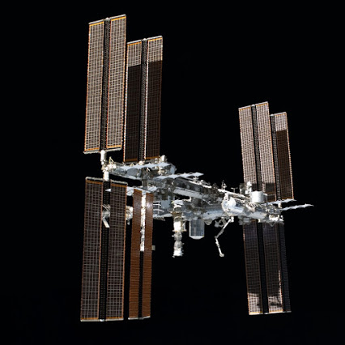
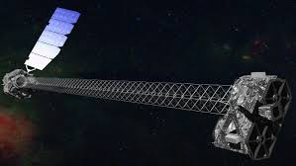
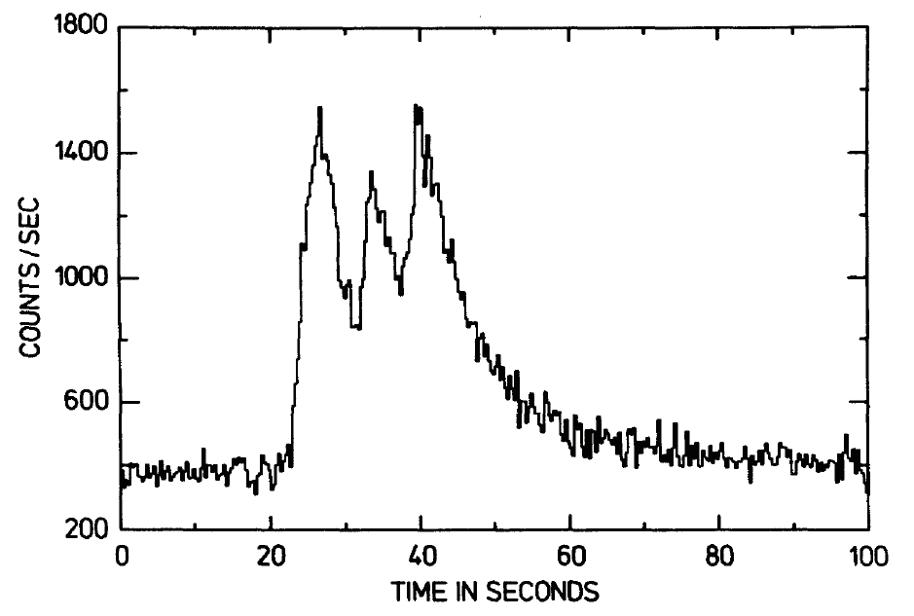
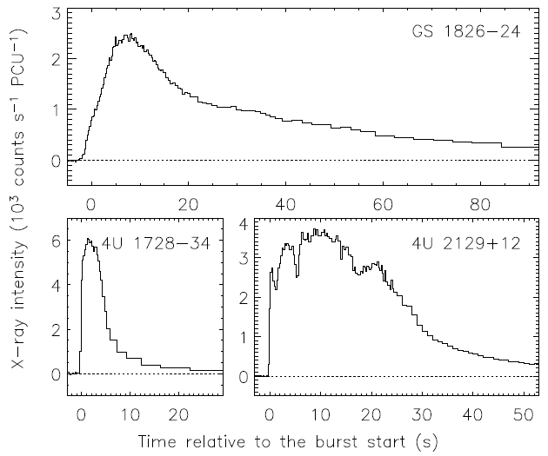
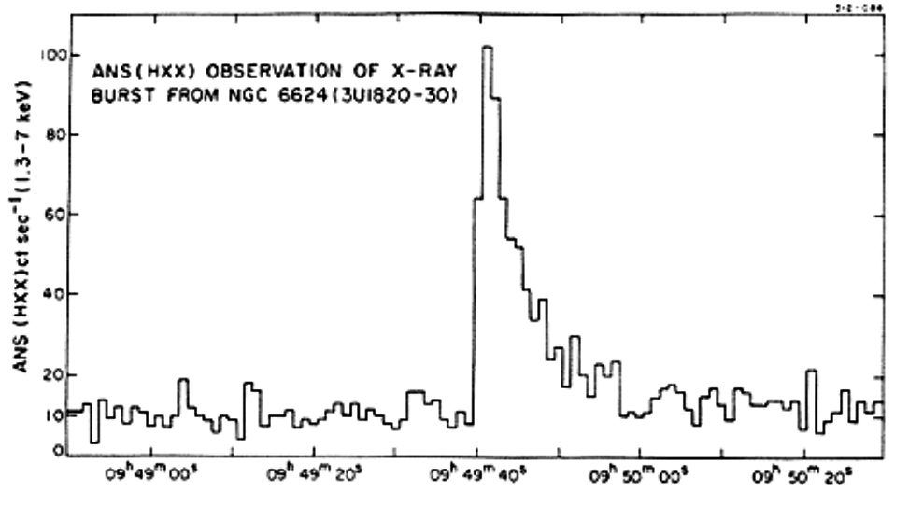
Type I X-ray burst (XRB)
Space Science Reviews 62: 223-389, 1993.
Image from David. A. Hardy / STFC
Astrophysical Journal, vol. 205, L127,1976

Slide 8
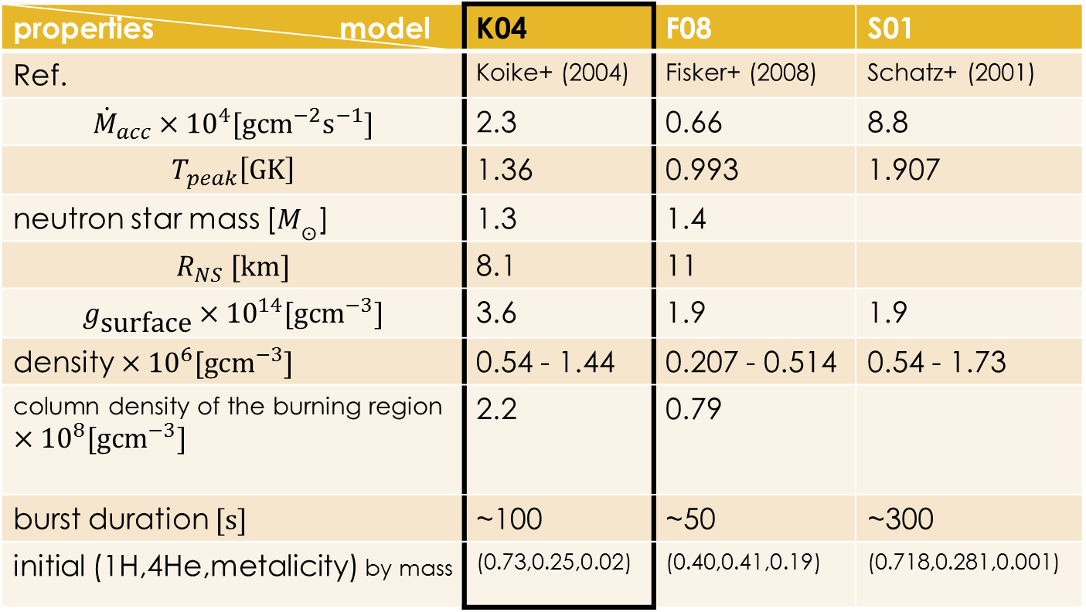
Type I X-ray burst models
properties model | K04 | F08 | S01
Ref. | Koike+ (2004) | Fisker+ (2008) | Schatz+ (2001)
$${\dot{M}}_{acc}×{10}^{4}\text{[}\text{g}{\text{cm}}^{−2}{\text{s}}^{−1}]$$ | 2.3 | 0.66 | 8.8
$$T_{peak}\left[\text{GK}\right]$$ | 1.36 | 0.993 | 1.907
neutron star mass [$M_{\text{☉}}$] | 1.3 | 1.4
$$R_{NS} [\text{km}]$$ | 8.1 | 11
$$g_{\text{surface}}×{10}^{14}[\text{g}{\text{cm}}^{−3}]$$ | 3.6 | 1.9 | 1.9
density $×{10}^{6}[\text{g}{\text{cm}}^{−3}]$ | 0.54 - 1.44 | 0.207 - 0.514 | 0.54 - 1.73
column density of the burning region $×{10}^{8}[\text{g}{\text{cm}}^{−3}]$ | 2.2 | 0.79
burst duration $[\text{s}]$ | ~100 | ~50 | ~300
initial (1H,4He,metalicity) by mass | (0.73,0.25,0.02) | (0.40,0.41,0.19) | (0.718,0.281,0.001)

Slide 9
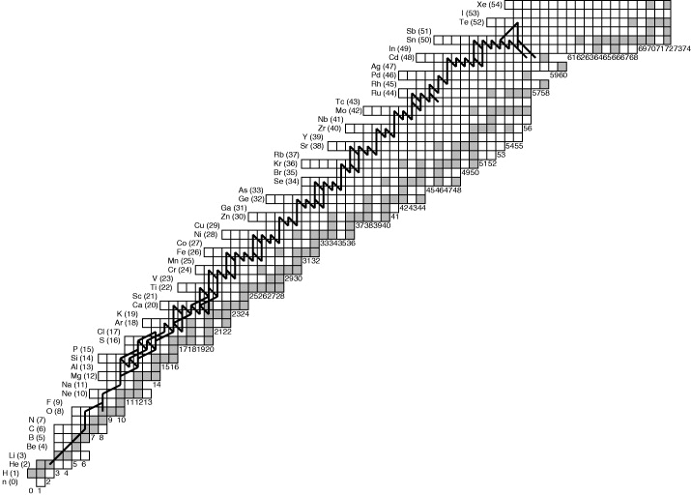
rapid proton capture (rp)-process
Nuclear chart from Langanke K. & Schatz H, Phys Scr T152 (2013) 014011

Slide 10
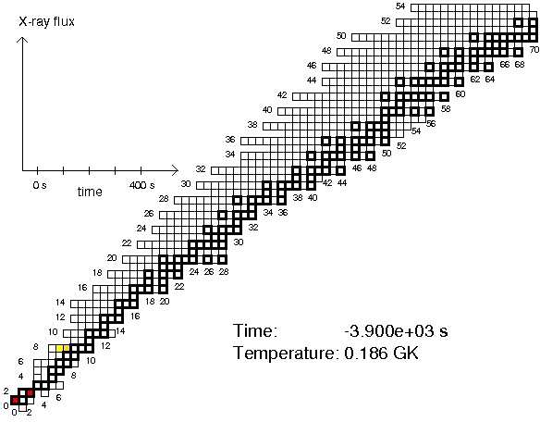
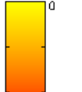
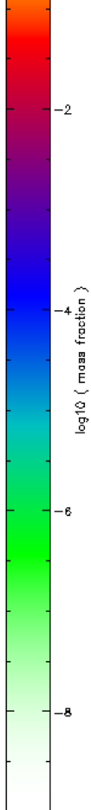
rapid proton capture (rp)-process
Simulation model: S. E. Woosley/A. Heger

Slide 11
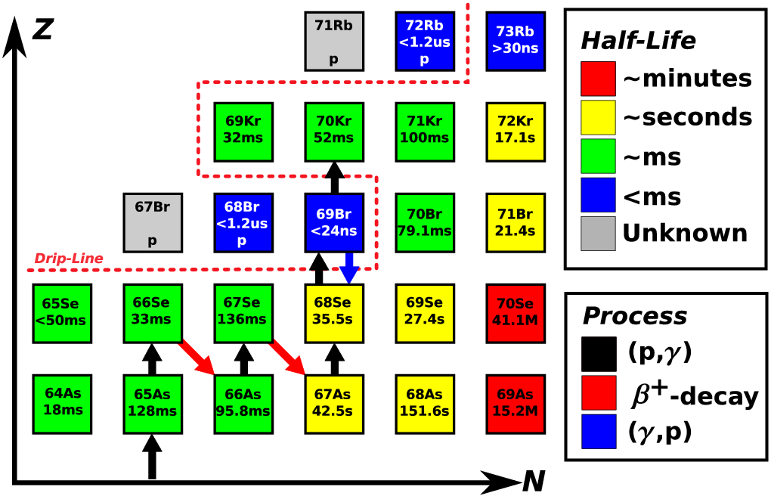

rapid proton capture (rp)-process
⁶⁵As(p,γ)⁶⁶Se
⁶⁴Ge(p,γ)⁶⁵As
impact on nucleosynthesis during XRBs
Parikh+ (2014);
(2009); (2008)
waiting point
$$\left(p,γ\right)≈\left(γ,p\right)$$
λ(β) ↓
Rogers+ J. Phys. Conf. Ser. 312 (2011) 042020
small (p,γ) Q-value : kT at XRB temperatures
Nuclear chart from Langanke K. & Schatz H, Phys Scr T152 (2013) 014011

Slide 12
rapid proton capture (rp)-process
waiting point: ⁶⁵As
Tu+ (2011)
⁶⁵As(p,γ)⁶⁶Se
⁶⁴Ge(p,γ)⁶⁵As
waiting point: ⁶⁴Ge Schatz+ (1998);
Woosley+ (2004);
Fisker+ (2008); Parikh+ (2009);
Jose+ (2010)
waiting point
waiting point
$$\left(p,γ\right)≈\left(γ,p\right)$$
$$\left(p,γ\right)≈\left(γ,p\right)$$
λ(β) ↓
λ(β) ↓
Rogers+ J. Phys. Conf. Ser. 312 (2011) 042020
small (p,γ) Q-value : kT at XRB temperatures
Nuclear chart from Langanke K. & Schatz H, Phys Scr T152 (2013) 014011

Slide 13
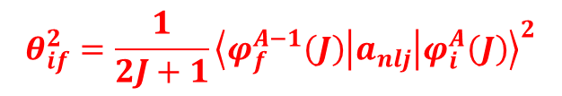
Nuclear structure
Experiment:
Obertelli+ (2011), Ruotsalainen+(2013),
NNDC
Theory:
Shell model (GXPF1a)
Sp:
AME(2013),
Tu+ (2011)
gamma width, Γγ
Spectroscopic factor:
$$θ_{if}^{2}=\frac{1}{2J+1}{\left\langle φ_{f}^{A−1}\left(J\right) | a_{nlj} | φ_{i}^{A}\left(J\right)\right\rangle }^{2}$$

Slide 14
Reaction rates
resonant reaction rate
direct capture rate
Rolfs & Rodney (1988), Iliadis (2007)

Slide 15
Contributions of proton capture at different initial states to reaction rates
⁶⁴Ge(p,γ)⁶⁵As
⁶⁵As(p,γ)⁶⁶Se

Slide 16
Comparisons of present reaction rates with JINA data (REACLIB)
rpsm (Sp=-0.081MeV) | Audi & Wapstra (1995)
rath (Sp= 0.128MeV) | FDRM Rauscher & Thielemann (2000)
thra (Sp= 1.399MeV) | ETSFIQ
laur (Sp= 0.169MeV) | Van Wormer+ (1994)
ths8 (Sp= 0.255MeV) | Rauscher (Cyburt+ 2010)
present work (Sp= -0.090+/- 0.085MeV) | Exp. levels & Sp + evaluated mass + shell model
⁶⁴Ge(p,γ)⁶⁵As
⁶⁵As(p,γ)⁶⁶Se

Slide 17
Comparisons of reaction rates
⁶⁴Ge(p,γ)⁶⁵As
⁶⁵As(p,γ)⁶⁶Se

Slide 18
Main abundance flows
~⁶⁴Ge waiting point
Tpeak = 1.4 GK in the adopted XRB
model.
present rate
equilibrium
thra

Slide 19
Final abundances
replaced with present ⁶⁴Ge(p,γ)⁶⁵As only

Slide 20
Final abundances
replaced with present ⁶⁵As(p,γ)⁶⁶Se only

Slide 21
Nuclear energy generation rates during the burst
replaced with present ⁶⁴Ge(p,γ)⁶⁵As only

Slide 22
Nuclear energy generation rates during the burst
replaced with present ⁶⁵As(p,γ)⁶⁶Se only

Slide 23
Final abundances
present ⁶⁴Ge(p,γ)⁶⁵As and ⁶⁵As(p,γ)⁶⁶Se

Slide 24
Nuclear energy generation rates during the burst
present ⁶⁴Ge(p,γ)⁶⁵As and ⁶⁵As(p,γ)⁶⁶Se

Slide 25
Summary & Perspective
New thermonuclear rates of ⁶⁴Ge(p,γ)⁶⁵As and ⁶⁵As(p,γ)⁶⁶Se reactions have been determined based on newly measured Sp(⁶⁵As), evaluated Sp(⁶⁶Se), large-scale shell model calculation. These new rates differ, for instance at ≈ 1 GK, a factor of ≈ 3 – 90 from others.
New rates strongly suppress the flow of abundances toward A≈100.
⁶⁴Ge is a significant rp-process waiting point (with K04 model).
Nuclear energy generation rate, , during the decline of the burst at late times differ by a factor of up to ≈ 2 with different ⁶⁴Ge(p,γ)⁶⁵As rate.
We propose to measure the mass of ⁶⁶Se, higher precision of mass ⁶⁵As, and nuclear structure of both nuclei.
Further investigation with hydrodynamic XRB models…

Slide 26
Acknowledgments
National Natural Science Foundation of China (Nos. 11490562, 11135005, U1432125, U1232208) and the Major State Basic Research Development Program of China (2013CB834406).
YHL gratefully acknowledges the financial supports from Ministry of Science and Technology of China (Talented Young Scientist Program) and from the China Postdoctoral Science Foundation (2014M562481).
AP was supported by the Spanish MICINN under Grant No. AYA2013-42762.
Thank you…

Slide 27

Model: Woosley/Heger

Slide 28
Type I X-ray burst (XRB)
discovered independently by Belian et al. (1976) and Grindlay et al. (1976)
The stellar binary system is close enough to permit mass transfer.
The solar-type matter flow forms an accretion disk surrounding the neutron star and ultimately accumulates on its surface, building up an envelope in semi-degenerate conditions.
As material piles up on top of the neutron star, the envelope is heated up without any significant expansion due to degeneracy, driving a violent thermonuclear runaway.
Drive nucleosynthesis along the proton-rich side:
rp process [(p, γ) reactions ] (main process)
αp process [a sequence of (α,p), (p, γ) reactions ]
3α-reaction
β+ decay (occasionally)
reaching A>60 and even A>100
Burst energies: 10^39 – 10^40 ergs; timescales: 10 – 100s; recurrence times: hours – days; max. temperatures: 1 – 2 GK; densities: ~10^6 g/cm3.
Parikh+ (2008, 2009, 2013), Schatz+ (1999)

Slide 29

Reaction rates
$$N_{A}\left\langle σv\right\rangle =\sum_{i}{\frac{\left(2J_{i}+1\right)\text{exp}\left(−E_{i}/kT\right)}{\sum_{n}{\left(2J_{n}+1\right)\text{exp}\left(−E_{n}/kT\right)}}}$$
$$×\left({N_{A}\left\langle σv\right\rangle }_{res i}+{N_{A}\left\langle σv\right\rangle }_{dc i}\right) \left[{\text{cm}}^{3}{\text{s}}^{−1}{\text{mol}}^{−1}\right]$$
Rolfs & Rodney (1988), Iliadis (2007)
resonant reaction rate
direct capture rate

Slide 30




Direct Capture rate
$${N_{A}\left\langle σv\right\rangle }_{dc}=N_{A}\sqrt{\frac{8}{πμ}}{\left(kT\right)}^{−3/2}\int_{0}^{∞}{S_{i}\left(E_{p}\right)\text{exp}\left(−\frac{E_{p}}{kT}−\frac{b}{\sqrt{E_{p}}}\right)dE_{p}}$$
$$\left[{\text{cm}}^{3}{\text{s}}^{−1}{\text{mol}}^{−1}\right]$$
barrier penetrability, $b=\frac{\sqrt{2μ}πe^{2}Z_{1}Z_{2}}{h}$
Rolfs & Rodney (1988), Iliadis (2007)
$${N_{A}\left\langle σv\right\rangle }_{dc}≈7.83×{10}^{9}{\left(Z/A\right)}^{1/3}T_{9}^{−2/3}S_{i}\left(E_{0}\right) \text{exp}\left(−4.249{\left(\frac{Z^{2}A}{T_{9}}\right)}^{\frac{1}{3}}\right)$$

Slide 31





Resonant reaction rate
$${N_{A}\left\langle σv\right\rangle }_{res}=1.54×{10}^{11}{\left({μT}_{9}\right)}^{−3/2}ωγ \text{exp}\left(−\frac{11.605E_{r}}{T_{9}}\right)$$
$$\left[{\text{cm}}^{3}{\text{s}}^{−1}{\text{mol}}^{−1}\right]$$
Rolfs & Rodney (1988), Iliadis (2007)
$ωγ=\frac{2J+1}{2\left(2J_{T}+1\right)}\frac{{\text{G}}_{p}×{\text{G}}_{γ}}{{\text{G}}_{\text{tot}}}$, ${\text{G}}_{\text{tot}}{≈\text{G}}_{p}+{\text{G}}_{γ}$
${\text{G}}_{p}=\sum_{nlj}{C^{2}S\left(nlj\right){\text{G}}_{sp}\left(nlj\right)}$,
${\text{G}}_{sp}=\frac{3h^{2} }{μR^{2}}P_{l}\left(E\right)C^{2}S\left(nlj\right)$,
$P_{l}\left(E\right)=\frac{kR  }{F_{l}^{2}\left(E\right)+G_{l}^{2}\left(E\right)}$, $k=\sqrt{2μE}/h$

Slide 32
Final abundances
replaced with present ⁶⁴Ge(p,γ)⁶⁵As only
replaced with present ⁶⁵As(p,γ)⁶⁶Se only

Slide 33
Nuclear energy generation rates during the burst
replaced with present ⁶⁴Ge(p,γ)⁶⁵As only
replaced with present ⁶⁵As(p,γ)⁶⁶Se only

