Slide 1
Calculation of efficiency for a high-resolution gamma-ray spectrometer used for environmental radioactivity measurements
Ileana Radulescu, Marian Romeo Calin
SALMROM laboratory, Life and Environmental Physics Department,
Horia Hulubei National Institute for R&D in Physics and Nuclear Engineering (IFIN-HH)

Slide 2
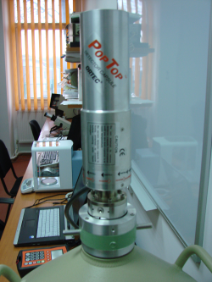
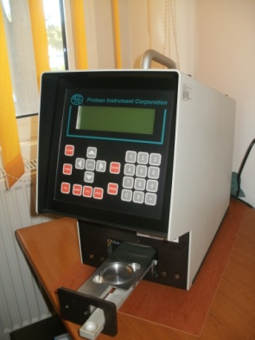
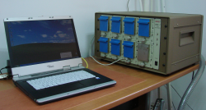
Introduction
The activity of SALMROM laboratory for α, β, γ Spectrometry
and Radon Measurements, part of Life and Environmental Physics Department from IFIN-HH, consists in regular monitoring the environmental radioactivity, on daily/monthly bases, in the area of the institute and nearby. Routinely measured isotopes in environmental samples are ⁶⁰Co, ²⁴¹Am, ⁴⁰K, progenies of ²³⁸U and ²³²Th series.
Octete Plus alpha
Spectrometer
Pylon Model AB-5 Portable Radiation Monitor
ORTEC HPGe detector
MPC 2000 alpha-beta counter

Slide 3
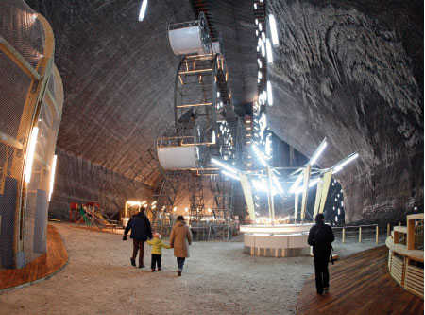
Introduction
Other activities, devoted to research programs, are related to evaluation of radon concentration in salt mines, caves, construction sites or former industrial area, to radionuclide inventory in water, soil and sediments in the environment.
Type of samples:
surface/sea/precipitations/drinking water,
cultivated and spontaneous vegetation,
aerosols fixed on filters
soil, sediments

Slide 4
Reliability and traceability of the gamma spectrometry system
Coaxial p-type HPGe detector (ORTEC, model GEM 30P4, 35 % relative efficiency, 1.85 keV at 1,332.5 keV, 60Co energy resolution), 59.1 mm diameter, 54.3 mm length (149 cm3 and 0.8 kg)
The detector is surrounded by a specially designed shield consisting of 10 cm lead lined with 3 concentric parallelipipedic layers, from copper and aluminium, each of 0.5 mm thickness
Traceability of the equipment is assured by using radioactive standards provided by RML IFIN-HH and IAEA.

Slide 5
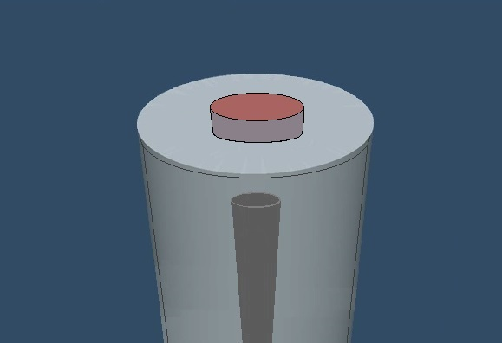
Detector characterisation
• Monte Carlo modelling of gamma-ray interactions with the detector
Includes modelling of cryostat
• Parametrised model supplied as input file
– Validation measurements
According to the specifications of the manufacturer:
0.6 mm thick dead layer of the outer contact,
1 mm thick aluminium end cap,
3 mm distance of the end cap to the crystal top surface,
10 mm diameter and 46 mm long central cylindrical hole,

Slide 6
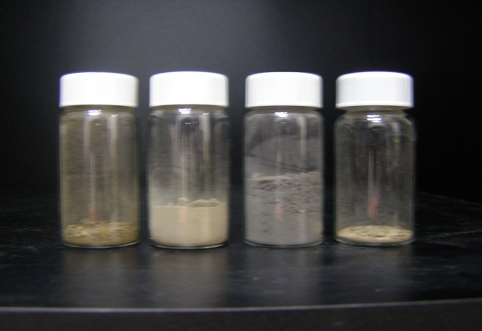
Samples geometry
Marinelli beakers
pill boxes
vials (h=45 mm and d=25 mm, made of glass (density: ~2.50 g cm³) with a wall thickness of 0.5 mm)
To determine the efficiency of the detector for these geometries quality control sample material from IAEA was used. Six vials have been filled to different heights (3, 8, 18, 23, 30, 40 mm) with soil from one quality control sample (²⁴¹Am, ¹³⁷Cs, ⁶⁰Co), after it has been dried and homogenized. These calibration samples were then measured for long time. The calibration material was modelled as soil with density 1.6 g cm³.
These calibration samples were then measured for long time between 240 000 s and 330 000 s.

Slide 7
Modelling Code: MCNPX
The MCNP-X code is a general purpose Monte Carlo radiation transport code developed at the Los Alamos National Laboratory and designed to track different types of particles (neutrons, electrons, gamma rays, etc.) over a broad range of energies.
The individual probabilistic events that comprise a process of interaction of nuclear particle with material are simulated sequentially.
The process consists of following each of many particles since its emission from a source until it reaches an energy threshold; the particle energy is transferred to the medium by absorption, escape, physical cut-off, etc.
The quantities of interest are tallied, along with estimates of the statistical precision of the results. The MCNP-X code can be used, as in the case of this work, to simulate gamma-rays interactions which comprise: i) incoherent and coherent scattering; ii) the possibility of fluorescent emission after photoelectric absorption; iii) pair production with local emission of annihilation radiation and Bremsstrahlung effect.

Slide 8
Experimental results

Slide 9
Simulation results

Slide 10
Simulation results

Slide 11
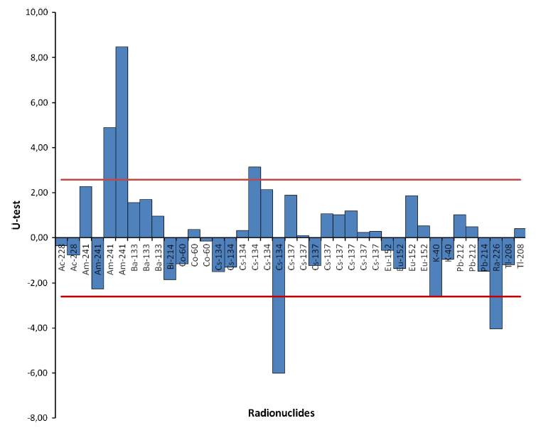
Measurements reliability – Proficiency tests
Evaluation of the results | 228Ac | 214Bi | 137Cs | 40K | 212Pb | 214Pb | 226Ra | 208Tl | 134Cs | 152Eu | 241Am
IAEA S4 | 41.0 ± 2.0 | 50.0 ± 2.8 | 14.4 ± 0.6 | 485 ± 11 | 36.5 ± 1.6 | 50.0 ±3.8 | 50.2 ± 2.0 | 13.0 ± 0.7 | 306 ± 20 | 118.6 ± 1.0 | 120.9 ± 2.7
Lab S4 | 38.3 ± 2.9 | 42.5 ± 2.9 | 14.6 ± 0.6 | 465.9 ± 17.0 | 37.6 ± 1.6 | 43.6 ± 2.0 | 39.6 ± 1.7 | 13.5 ± 1.0 | 277.6 ± 8.7 | 114.7 ± 7.0 | 132.7 ± 5.0
 | A | A | A | A | A | A | N | A | A | A | A

Slide 12
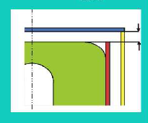
Conclusions
- For our MC simulation, the manufacturer’s specifications were not sufficient basis for an accurate model, taking into account that for different analyzed geometrical configurations high discrepancies up to 45% with measured data were encountered
- deviation between experimental data and simulation 10-45%
- for high energy – comparable data 10-20%
- good reliability on the experimental data
- decrease in the efficiency with increasing the height of sample
Optimization of the model by increasing dead layer, shapes and distance between crystal and end cap

Slide 13
Thank you

