Slide 1
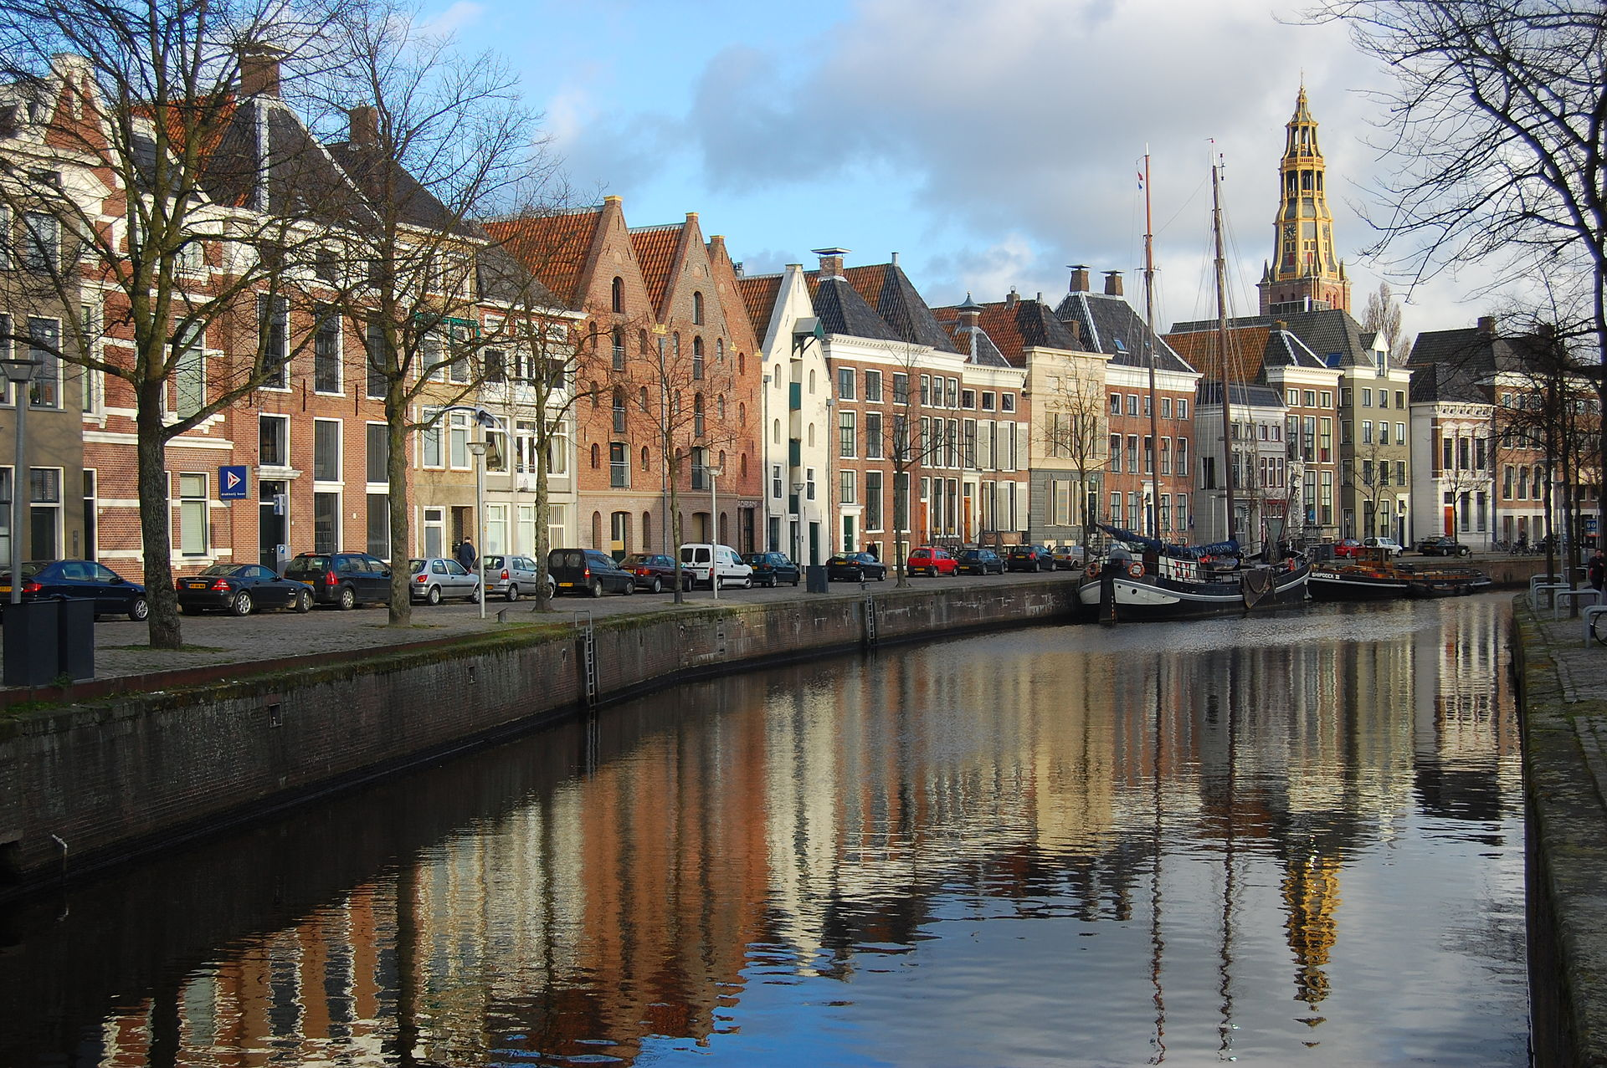
Recent results of the
COMPASS Experiment
EuNPC 2015
Johannes Bernhard (CERN PH-SME-CO)
on behalf of the COMPASS collaboration
31.08.2015

Slide 2
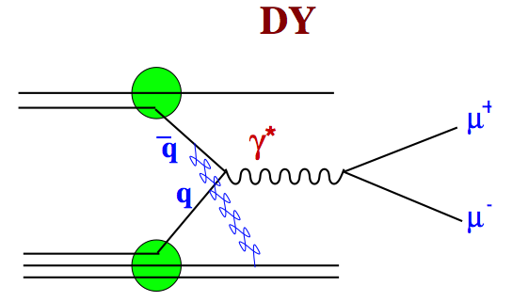
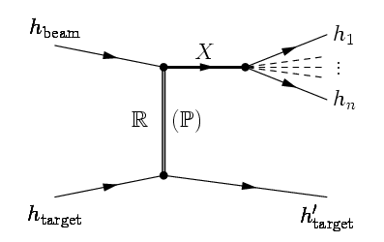
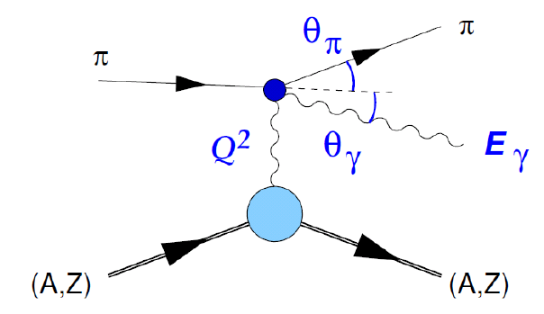
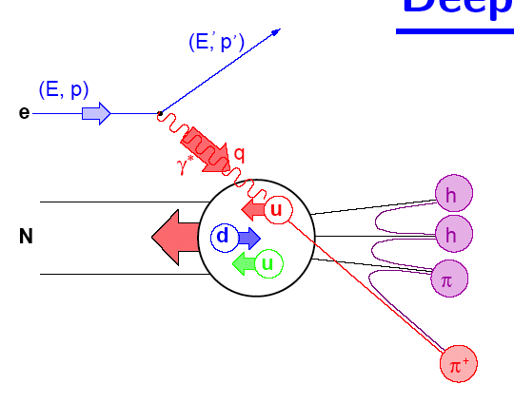
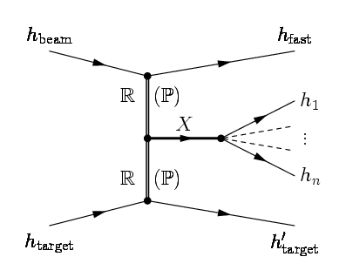
COMPASS - A facility to study QCD
Large Q²:
Nucleon structure
Helicitiy, transversity PDFs
TMDs and GPDs (2015-17)
Low Q²:
Spectroscopy
Hadronic mass spectrum
Gluonic excitations /
spin-exotics
Very low Q²:
Chiral dynamics
π and K polarisibilities
radiative widths
DY
π
p
Diffraction
(SI)DIS
μ
Central
Production

Slide 3














The COMPASS experiment at CERN
COmmon Muon and Proton Apparatus for Structure and Spectroscopy
13 countries 24 institutions 220 physiscists
LHC
Large Hadron Collider
COMPASS
SPS
Super Proton Synchrotron

Slide 4
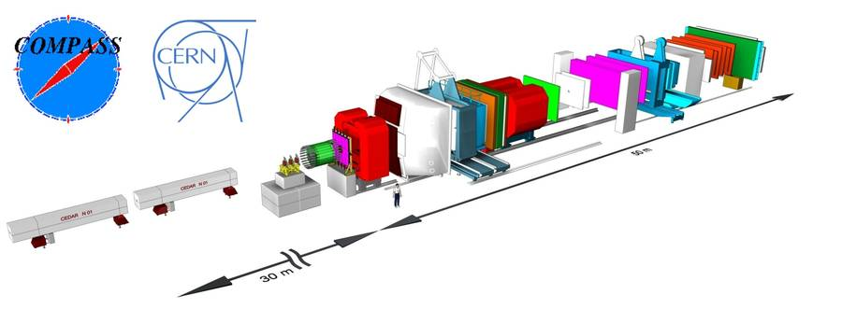
The COMPASS spectrometer
ECAL2
ECAL1
SM2
SM1
Brian Greene
RPD
Beam
RICH
CEDARs
Target
Spectroscopy (“Hadron”) Set-up: NIMA 779 (2015) 69
Data taking in 2008 and 2009 with 190 GeV/c hadron beam (π±, K±, p, p)
5∙10⁷ particles/10 s SPS-spill on 40cm liquid hydrogen target
Trigger: Recoil Proton Detector + beam (minimum bias on forward system)

Slide 5
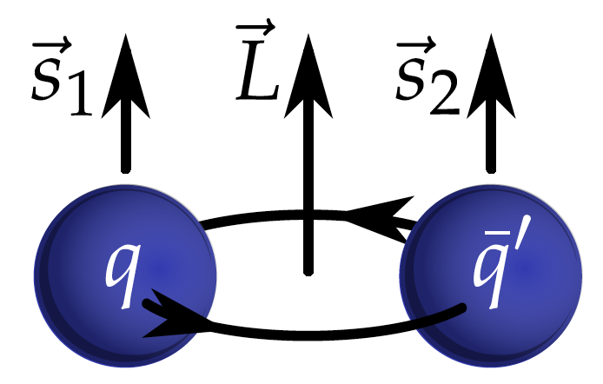
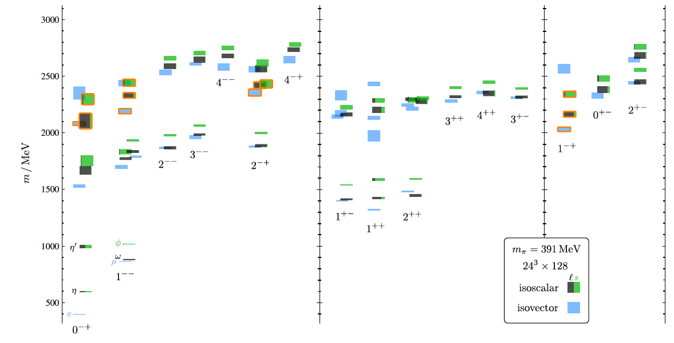
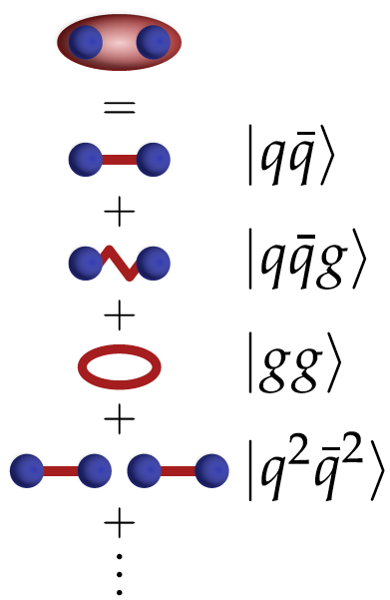
Meson Spectroscopy
Constituent quark model: color neutral qq systems
quantum numbers I^{G} J^{PC}
P = (-1)^{L+1} C = (-1)^{L+S} G = (-1)^{I+L+1}
Allowed J^{PC}: 0 ⁺ ⁺ , 0 ⁻ ⁺ , 1 ⁻ ⁻ , 1 ⁺ ⁻ , 1 ⁺ ⁺, …
Forbidden: 0 ⁻ ⁻, 0 ⁺ ⁻ , 1 ⁻ ⁺, …
P = +
P = -
Exotics
Dudek et.al. PRD 88, 094505 (2013)

Slide 6
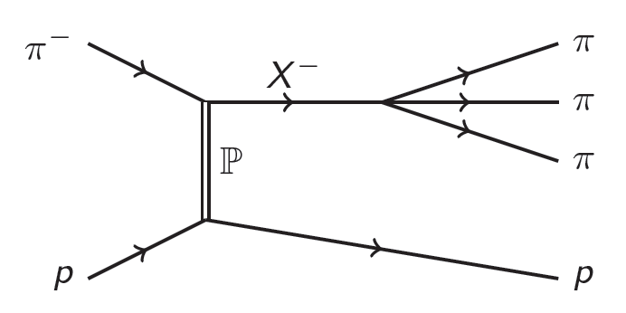
Meson Spectroscopy
Constituent quark model: color neutral qq systems
quantum numbers I^{G} J^{PC}
P = (-1)^{L+1} C = (-1)^{L+S} G = (-1)^{I+L+1}
Allowed J^{PC}: 0 ⁺ ⁺ , 0 ⁻ ⁺ , 1 ⁻ ⁻ , 1 ⁺ ⁻ , 1 ⁺ ⁺, …
Forbidden: 0 ⁻ ⁻, 0 ⁺ ⁻ , 1 ⁻ ⁺, …
Experiment (1.3 - 2.2 GeV/c²):
hybrid candidates with exotic J^{PC} =1⁻⁺
π₁(1400): VES, E852 −> ηπ
π₁(1600): E852, VES −> ρπ, η‘π, f₁π, b₁π
COMPASS (2004) −> ρπ
π₁(2000): E852 −> f₁(1285)π, b₁(1235)π
Diffractive Production

Slide 7
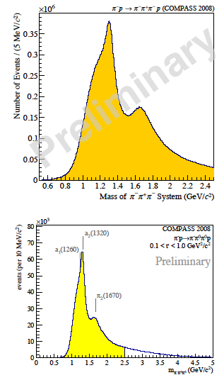
Meson Spectroscopy at COMPASS: 3π
Diffractive Production
Exclusive 3π events in πp -> πππ p_{recoil}
channels: π⁻π⁺π⁻, π⁻π⁰π⁰
high t‘ region: 0.1 (GeV/c)² < t‘ < 1 (GeV/c)²
large data set
  50 Million events for π⁻π⁺π⁻
  3.5 Million events for π⁻π⁰π⁰

Slide 8
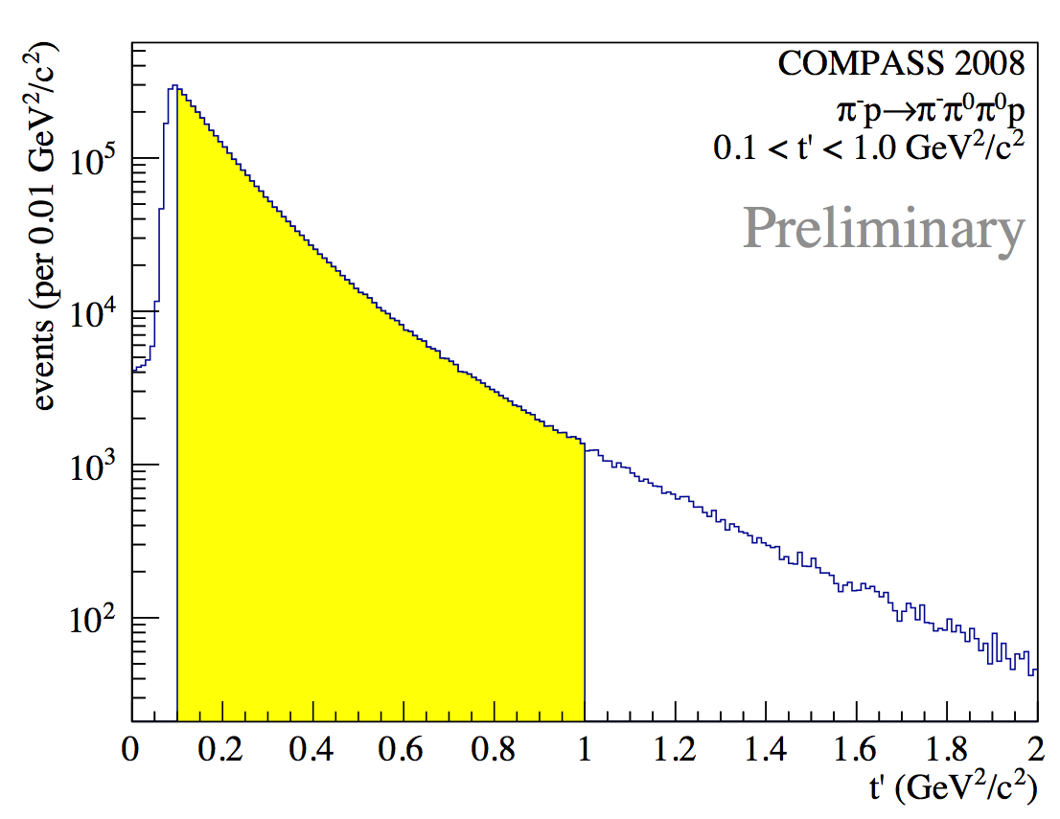
Meson Spectroscopy at COMPASS: 3π
Diffractive Production
Exclusive 3π events in πp -> πππ p_{recoil}
channels: π⁻π⁺π⁻, π⁻π⁰π⁰
high t‘ region: 0.1 (GeV/c)² < t‘ < 1 (GeV/c)²
large data set
  50 Million events for π⁻π⁺π⁻
  3.5 Million events for π⁻π⁰π⁰
400 mass bins & 11 bins of t‘
200 mass bins & 8 bins of t‘

Slide 9
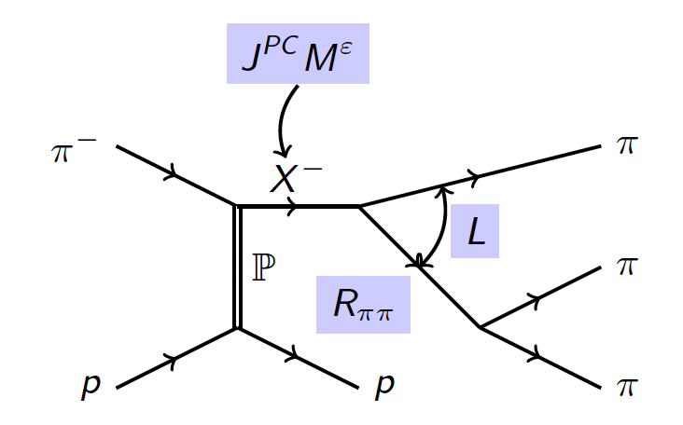
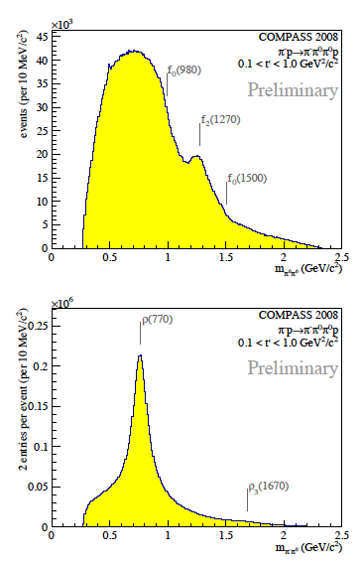
Partial Wave Analysis 3π
Isobar Model
Acceptance correction
Factorisation of process with production and decay amplitude
Fit in two steps:
  fit in mass and t’ bins -> production amplitudes
  fit mass dependence of spin-density matrix -> resonance parameters

Slide 10
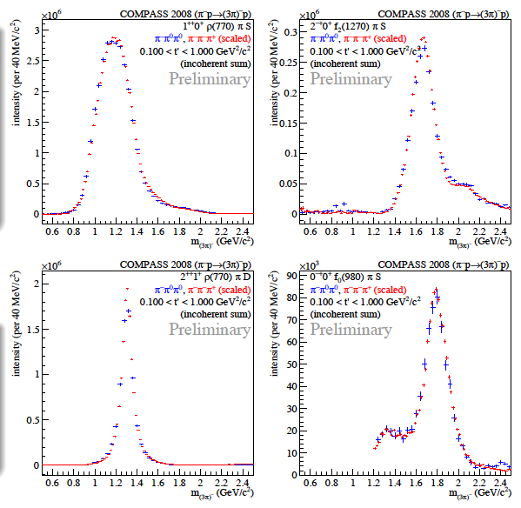
Partial Wave Analysis 3π
87 waves + flat wave
π⁻π⁰π⁰ scaled to π⁻π⁺π⁻
good agreement between channels
a₁(1260)
π₂(1670)
a₂(1320)
π(1800)

Slide 11
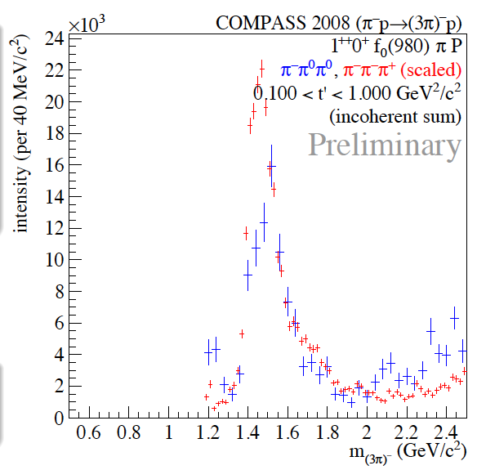
Partial Wave Analysis 3π
first observation of structure in 1⁺⁺ f₀(980) π P
small intensity (~0.25%)
π⁻π⁰π⁰ scaled to π⁻π⁺π⁻

Slide 12
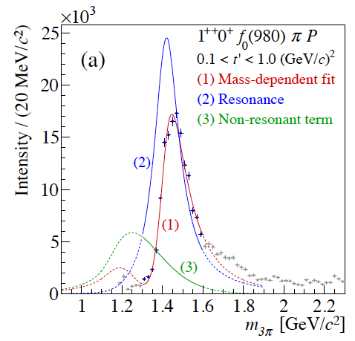
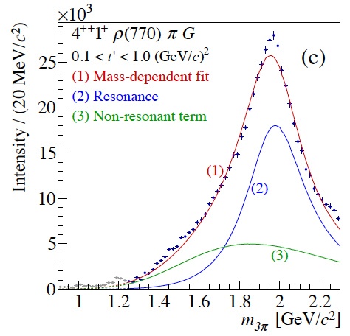
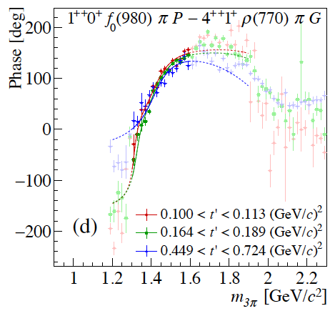
New axial-vector meson
Mass dependent fit for π⁻π⁺π⁻ reveals new resonance: a₁(1420)
Mass 1414 ⁺¹⁵₋₁₃ MeV/c²
Width 153 ⁺⁸₋₂₃ MeV/c²
a₄(2040)
PRL 115 (2015) 082001

Slide 13
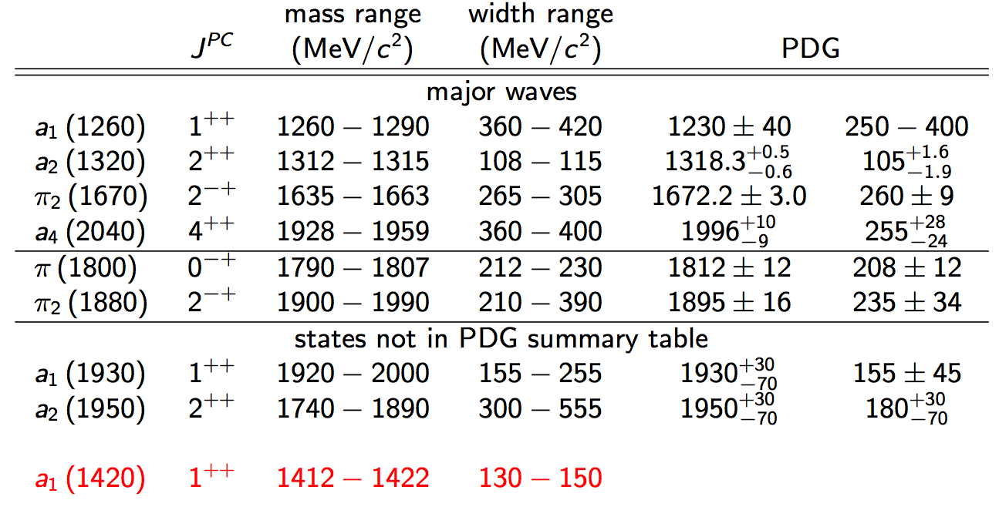
New axial-vector meson
Nature of a₁(1420) still to be understood:
isospin partner of f₁(1420)?
no quark model state expected at 1.4 GeV/c²
ground state a₁(1260) close and wider
only seen in decays to f₀(980) π, not in ρπ
close to K*K* threshold
PRL 115 (2015) 082001

Slide 14
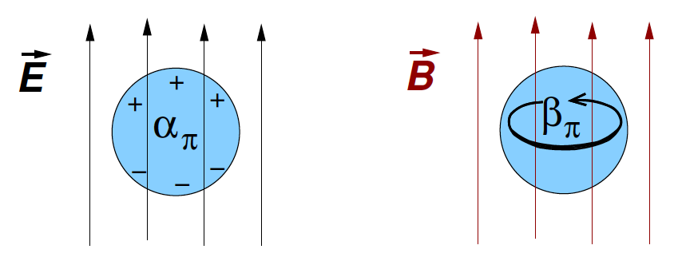
Pion polarisability
electric
magnetic
χPT prediction (2-loop):
  α – β = (5.7 ± 1.0) 10⁻⁴ fm³
  α + β = (0.2 ± 0.1) 10⁻⁴ fm³
Experimental results vary: α – β = (4…14) 10⁻⁴ fm³ (assuming α + β = 0)
Compass study with Primakoff production
Cross section proportional to α – β in LO
Compare π and µ beam data to search for deviation from cross section of point-like particle
14

Slide 15
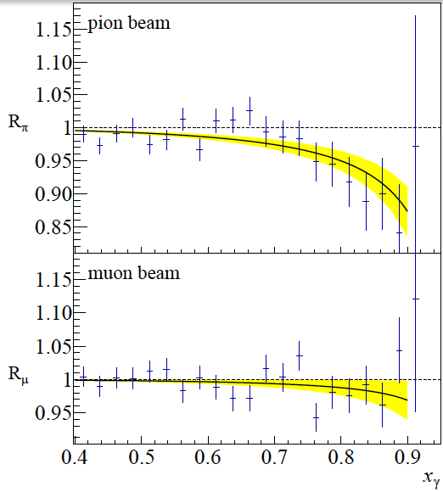
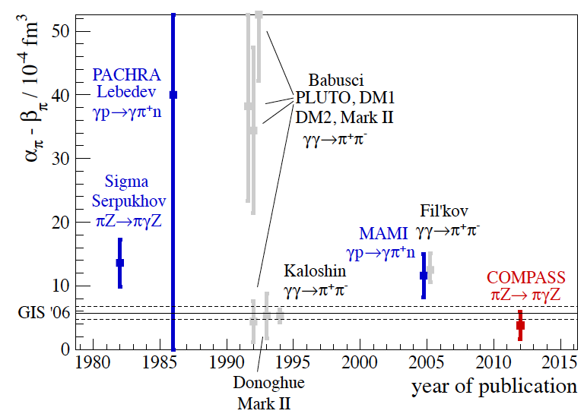
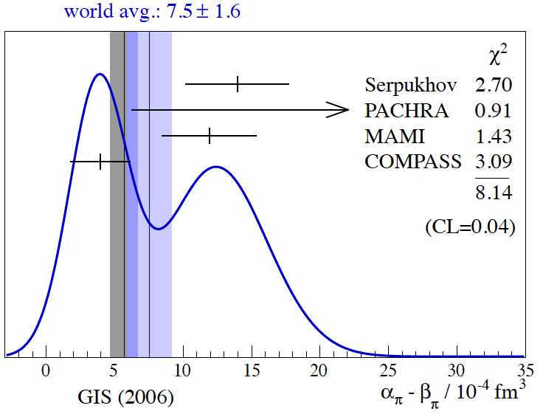
Pion polarisability
[PRL 114 (2015) 062002]
α_{π} = (2.0 ± 0.6_{stat.} ± 0.7_{sys.} ) × 10⁻⁴ fm³
α_{μ} = (0.5 ± 0.5_{stat.}) × 10⁻⁴ fm³
result confirms χPT prediction
in tension with former experiments
15

Slide 16
Conclusions and Outlook
COMPASS high precision spectroscopy program
Unchallenged data sets (e.g. π⁻π⁺π⁻) with access to charged and neutral channels
Partial wave analyses extended to m and t’ bins
Found new axial-vector meson a₁(1420), interpretations:
  Tetra-quark state [Hua-Xing Chen et al., arXiv:1503.02597], [Zhi-Gang Wang, arXiv:1401.1134]
  Dynamic effect of interference with Deck [Basdevant et al., arXiv:1501.04643]
  Triangle singularity [Mikhasenko et al., arXiv:1501.07023]
Several improvements coming up (e.g. integrate Deck amplitude to 1⁻⁺, include de-isobaring: fit isobars with step-wise functions from data)
π polarisability and tests of χPT with Primakoff production [PRL 114 (2015) 062002]
more analyses published and ongoing, but not shown here: Precision study of exotic 1⁻⁺ wave, π₁(1600), study of production mechanisms via OZI violation [NPB 886 (2014) 1078], central production, baryons, spin structure related analyses
16

Slide 18
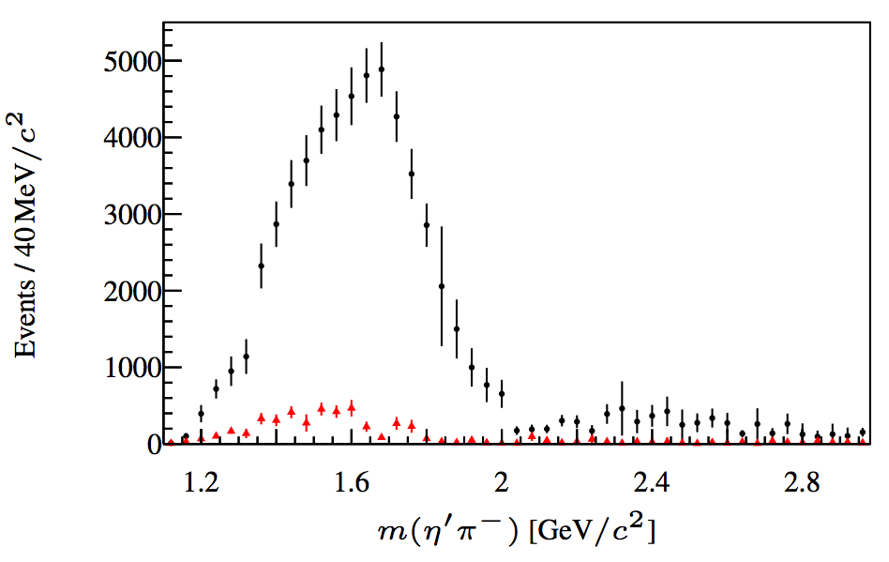
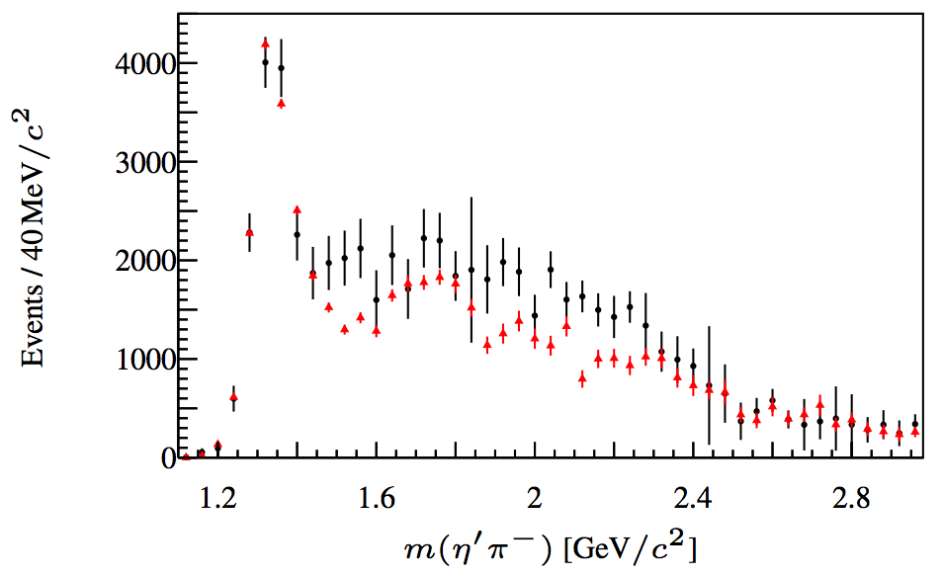

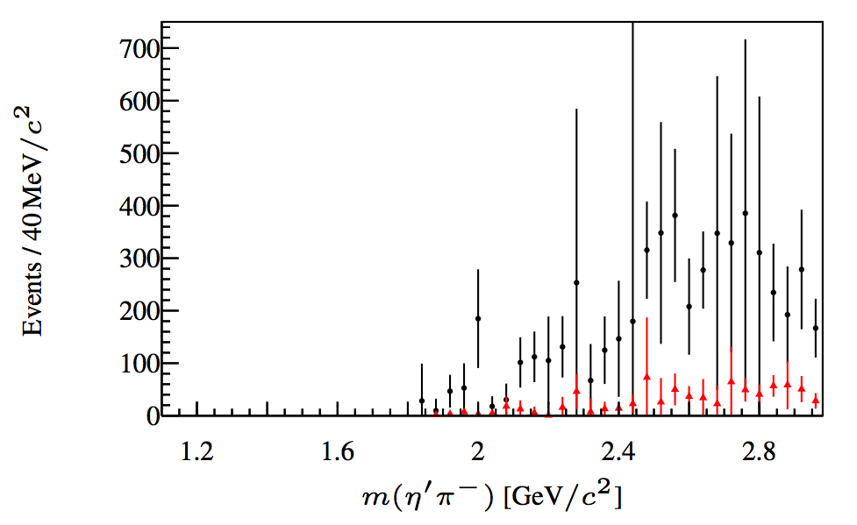
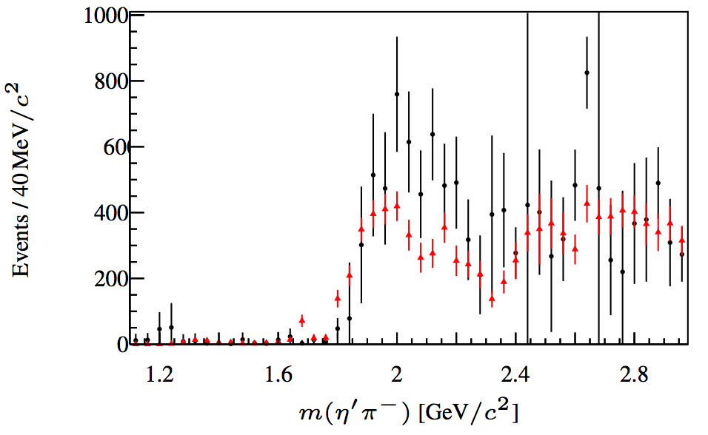
Partial wave analysis πη / πη‘
D-wave, L=2
PLB 740 (2015) 303-311, hep-ex/1408.4286
P-wave, L=1
F-wave,
L=3
G-wave,
L=4
Even-L waves: similar intensity distributions in η and η’
Odd-L waves: suppressed in ηπ by factor 5-10
mass dependent fits highly model dependent

Slide 19
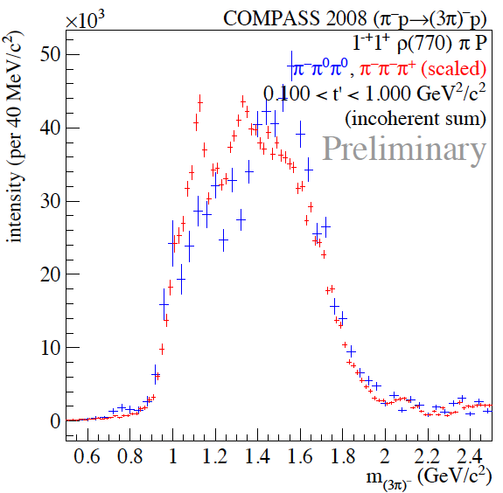
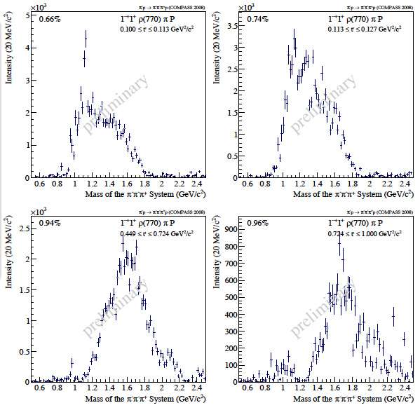
Status of exotic 1⁻⁺ wave
again, π⁻π⁰π⁰ scaled to π⁻π⁺π⁻
some differences between channels
study in different t’ bins:
  peak in high t’ region
  structure in low t’, non-resonant

Slide 20
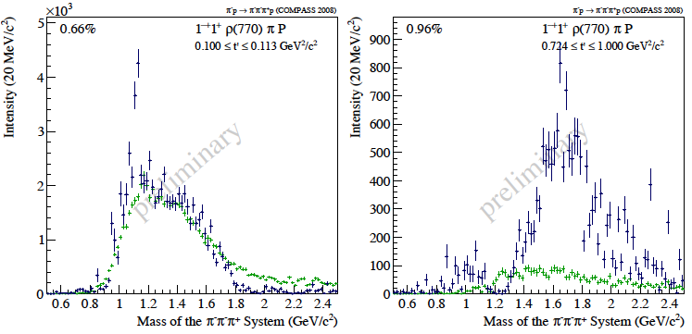
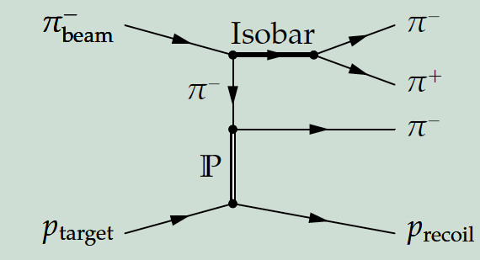
Status of exotic 1⁻⁺ wave
MC data generated with Deck-amplitude
analysed like real data and scaled to integrated intensity of each t’ bins
to be included in PWA

Slide 21
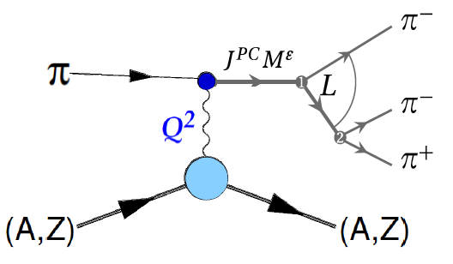
Very low t’ region
study resonances with electromagnetic probes, but “inverted”: Coulomb field of heavy target (Pb) becomes photon target
t‘ < 0.001 (GeV/c)²
Analysis:
photo-production (Primakoff): cross section proportional to e^{-at’}
diffractive production: cross section proportional to (t’)^{M} e^{-bt’}
distinguish by spin projection M with partial wave analysis
include chiral amplitude in PWA instead of isobars for very low masses

Slide 22
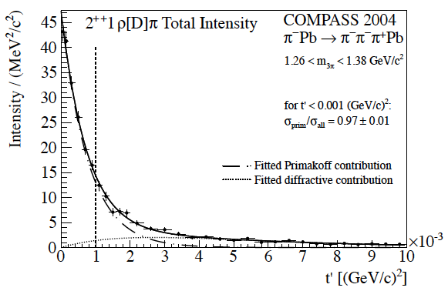
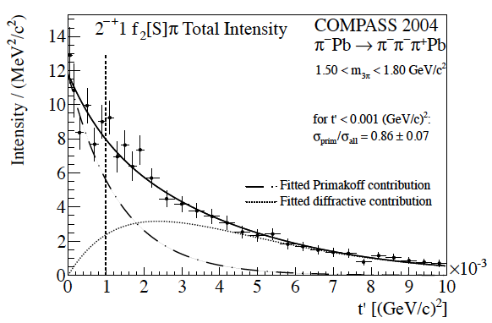
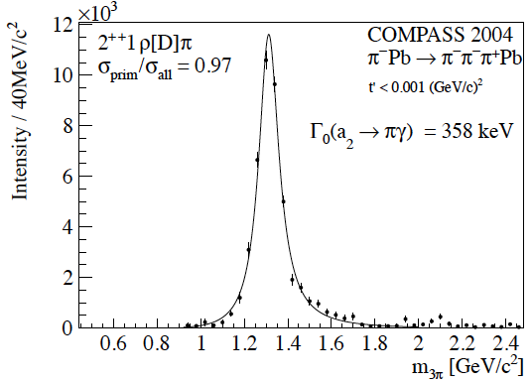
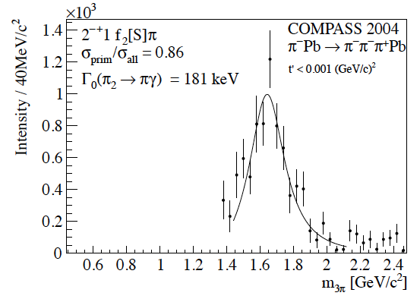
Radiative widths
[hep-ex/1403.2644, EPJ A 50 (2014) 79]
π₂(1670)
a₂(1320)
M2 transition
First E2 transition observed for mesons
22

Slide 23
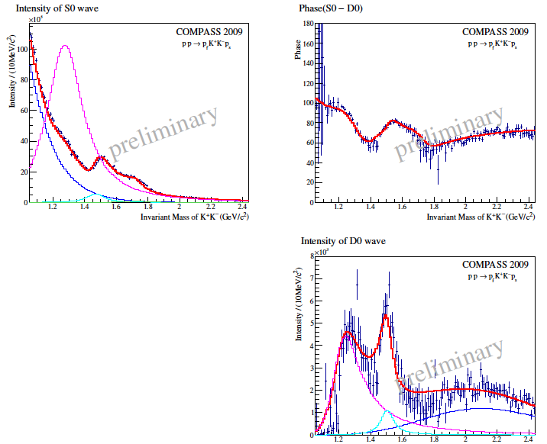
Central Production
“glue-rich” process: search for glueballs
mass-dependent fits with phases available
f₀(980), f₀(1500), f₀(1710) found, hints for further states beyond 2 GeV/c²
analysis to be improved (handling of ambiguities, model dependence)

Slide 24
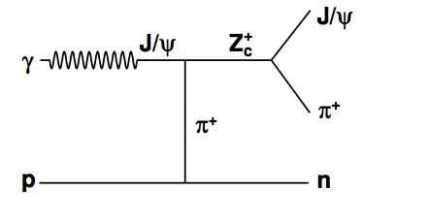
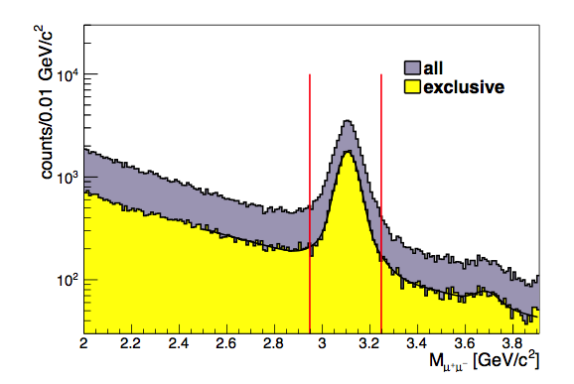
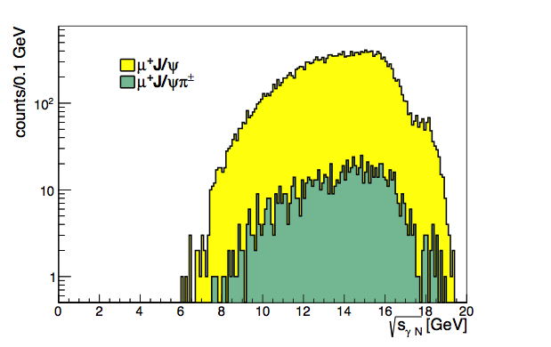
Search for Z_{c}±(3900)
sizable cross section [Q.-Y. Lin et al., PRD 88 114009 (2013)]
branching ratio seems to be small
search with exclusive J/ψ π±, J/ψ -> µµ production in muon beam data
normalise to µN -> J/ψ N cross section (acceptances cancel largely, only acceptance for π± left)
24

Slide 25
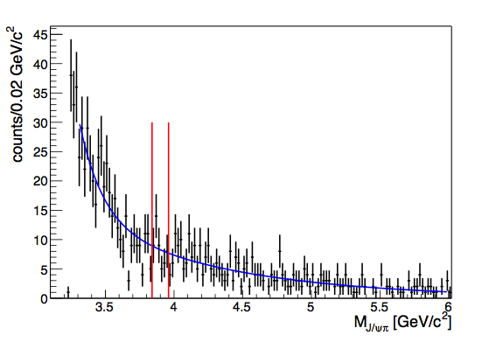
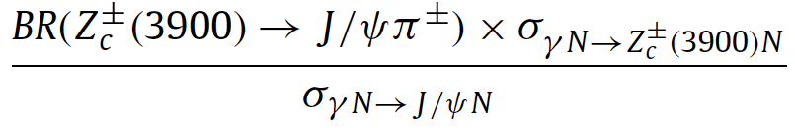

Search for Z_{c}±(3900)
PLB 742 (2015) 330, hep-ex/1407.6186
no excess / signal
< 3.7 10⁻³
use NA14 cross section for µN -> J/ψ N for normalisation:
< 52 pb
Conclusion: Z_{c}±(3900) -> > J/ψ π± not dominant decay mode
25

