Slide 1
How to get your research published

Slide 2
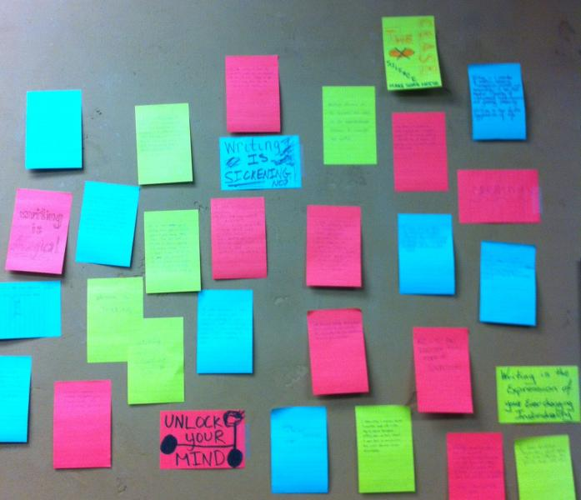
Plan ahead: the most important step

Slide 3
Decide on a ‘first choice’ journal
Consider:
Journal audience and scope
Type of article (letter, paper, review, comment, etc)
Reputation (of journal!)
Who publishes in this journal?
Visibility and relevance
Speed of publication
Open access or subscription model
Select the journal that will provide the most recognition for your work

Slide 4
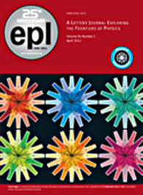
Letter, paper, review, comment?
Broad-scope titles offer:
Large and varied readership
Reach to researchers in other fields
General interest element
Niche titles offer:
  Smaller, more specialized readership
  More technical articles
  Direct link to separate communities
Equal levels of quality criteria
Letters journals may have different criteria

Slide 5
Differences among journals
Submission requirements
  File formats
  Author details
  Article length limits
  Other required information
Supplementary information
Video files
Appendices
Additional data
Different requirements for copyright and/or licencing

Slide 6
Remember that…
You need to be sure this research is ready to be published - select your ‘key’ message?
Too much information is just as bad as too little information
Before writing ‘reduce’ your results to 2 or 3 significant items that improve on existing knowledge
Select your best result(s) – one(s) with the greatest impact - to provide a focus for the paper

Slide 7
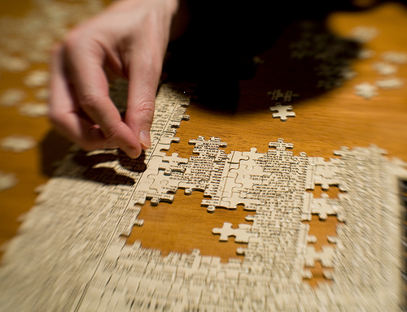
Structure your paper (not all categories may be needed)
Title
Abstract
Introduction
Methods
Results
Discussion
Conclusions
Acknowledgments
References
Tables & Figures

Slide 8

Title and abstract
The title and abstract are the most visible part of your manuscript
Title: Concise yet informative
Abstract: Summarizes the content of the article into a single paragraph

Slide 9
Introduction
The introduction is the first part of your article to contain substantial amounts of text
Describe the main goals
Overview of methods
Set the work in the context of previous research
Cite all relevant references

Slide 10
Methods, results and discussion
Represent your data in an organized manner
Give enough information to allow duplication of your results
Demonstrate the significance and impact of your results
Compare with other published work
Discuss the implications and applications

Slide 11
Conclusions
Summarize your major points
Highlight the novelty and significance of your work
Answer any questions set in the Introduction
Include your plans for future work

Slide 12
References and acknowledgments
Cite the appropriate references
  Original works both historical and recent
Check for accuracy
Follow the reference style of the journal
Recognize the contribution of funders or other assistance

Slide 13
Images, figures & tables
Must be referred to in the text
Should be clear, uncluttered, not ‘busy’ – an image communicates over 100 times better than text
Should have a legible and relevant caption
Ought to be clearly labelled (scales, axes, data points & lines) with font size & colour legible in journal print page size
Should follow the journal guidelines on style and format

Slide 14

Get feedback
Get feedback and comments on your manuscript before submission from
  Your supervisor
  Other colleagues
  Internal review
Make changes following their input and guidance

Slide 15

Permissions and copyright
Permissions are needed to reproduce copyright-protected material
  Photographs
  Charts, tables or graphs
  Reproductions of works of art
Anything where copyright is owned by a third party
Copyright protects original work and ideas
copyright.iop.org

Slide 16
Do the top 10 tips…
Check the literature for work in your field to check for similar results
Use appropriate references that show context of your work and why is it new and significant
Consider who you are writing for – specialist or non-specialist
Decide which journal will be most appropriate and check the author guidelines; also check other articles in the journal for style
Write a clear title and abstract – this will be what most people will see first.

Slide 17
Do the top 10 tips…
Limit jargon, abbreviations, acronyms or technical terms – e.g. STM, CCTV
Avoid speculation or anecdotes – keep to the facts
Keep it concise – even when there are no limits as it makes it easier to read your article. State your conclusions clearly
Allow time for rewriting
Ask a colleague to read your article before submitting it to the journal

Slide 18
Do NOT…
Submit an article to more than one journal at a time
Add someone as a co-author without their permission – or exclude any authors who have made a significant contribution
Sign any forms on behalf of your co-authors unless you are authorized to do so
Copy and paste from other articles, including your own – this will be classed as plagiarism or duplicate publication
Fabricate, falsify or misrepresent data or results

Slide 19
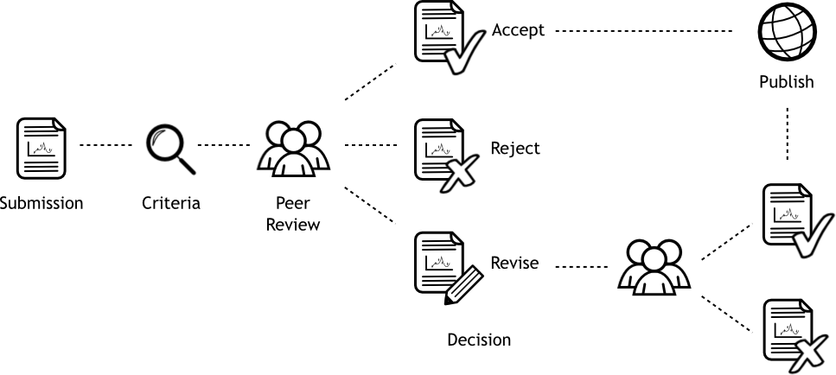

Pre-refereeing

Slide 20
What kind of papers get rejected in pre-refereeing?
Submissions that do not meet the journal style, limit, format, etc
Papers that
  Are incremental – a very small advance on earlier work. This is not enough for many quality journals
  Are outside the scope of the journal
  Do not have sufficient content or new data - the expected quality level may vary between journals
  Reproduce earlier work – including text and including the author’s own previous work

Slide 21
What is peer review?
Peer review is “a process of subjecting an author's scholarly work or ideas to the scrutiny of others who are experts in the field” (Wikipedia)
Peer review is used in:
  Publishing
  Grant applications
  Job/promotion applications
  State or national reviews
  Prizes

Slide 22
Why undertake peer review?
To ensure that the paper is suitable for the journal
  Quality, originality and importance
To obtain feedback that can help to improve a paper
To add credibility for the work from independent experts
Submissions are assessed as fairly as possible, usually by at least two knowledgeable scientists, before any decision is made

Slide 23
The peer review process

Slide 24
First decision – the first response from the referees
Immediate accept
  Unusual but does happen
Revision – major or minor
  Comments and suggestions from the referees
Rejection
  Many journals have rejection rates of over 50%
  This decision may happen quickly after the initial assessment, if the paper is found unsuitable

Slide 25
Responding to the reviewer comments
Read each report carefully
Respond to each and every comment specifically
Keep a list of all your changes
If you disagree with the reviewer, clearly explain why
  Don’t just ignore the comment!

Slide 26
Following revision

Slide 27

If your paper is accepted?
Congratulations!
Share your research on social media and collect citations
Do more research…
Write more papers !!

Slide 28

If your paper is rejected…
Do not panic – there are other journals!
The problem is most likely poor explanation (to the reviewers)
Use the advice you received to improve your paper
Re-write your paper and re-submit it to another journal
If you are still convinced the decision is incorrect, contact the journal with your reasoning

Slide 29
What the reviewer checks…
Does the article fit the journal criteria
Does the title fit the work?
Is the abstract complete?
Are the diagrams, tables and captions clear and essential?
Is the text clear and concise?
What about any included data?
Is the conclusion a good summary of the work and its reported results?
Are the references relevant?
Does the paper appear original and novel?
Notes:
This is a summary slide – I provide extended slides (straight from the Introduction guide) next

Slide 30
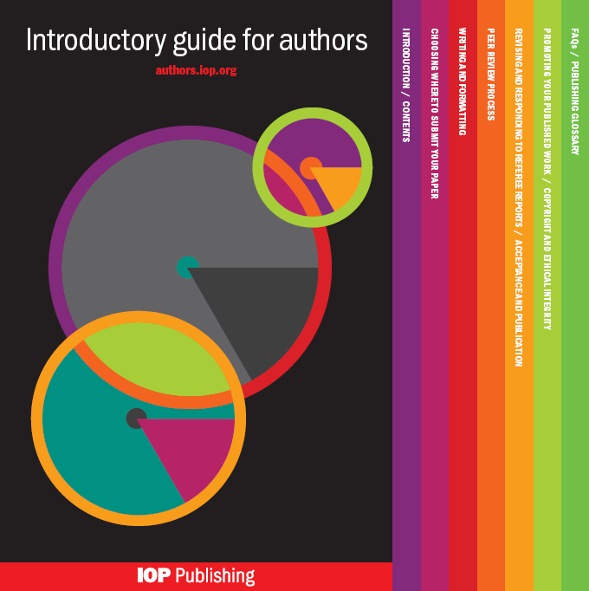
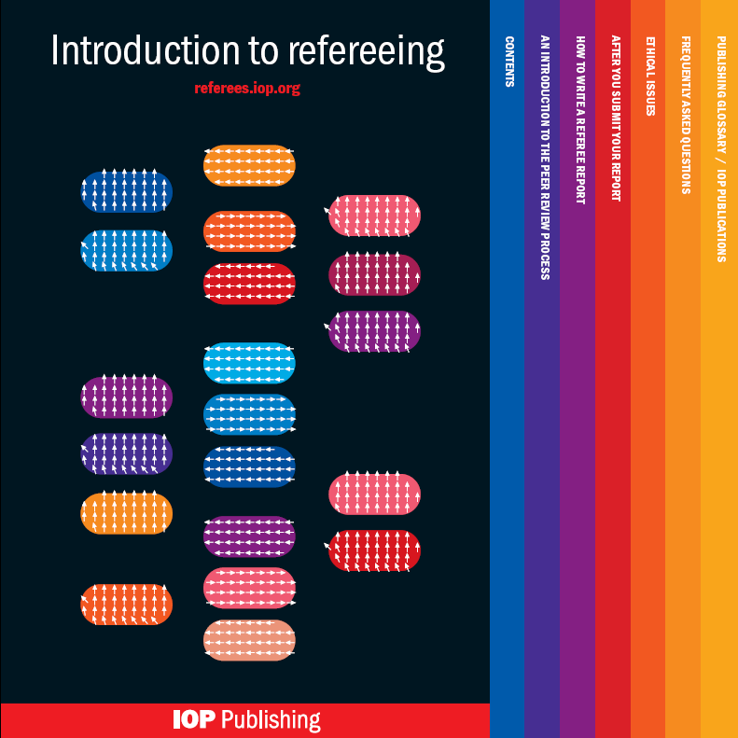
For more information…
iopscience/author-guide & iopscience.org/referee_guide

Slide 31
Refereeing extended…

Slide 32
Further reviewer checks…
Is the work understandable and correct?
  Can you clearly see what the authors want to achieve?
  Do the references provide background and context for the work?
  Are the results backed up with evidence?
  Are there any unsupported claims?
  Is the work correct – no errors, flaws or mistakes?
  Are the mathematics or statistics correct?
  Do you understand the work?
Notes:
Extended slide 1

Slide 33
And more…
Is the work novel and interesting?
  Are the results interesting?
  Is the research important and do the authors explain why it is important, or how it advances understanding of the field?
  Is the work original?
    Does it contain new material?
    Have any parts of the paper been published before?
  How relevant is the work to researchers in your field?
  Would you suggest getting an opinion from a researcher in another field?
  Is this just an incremental advance over previous work?
Notes:
Extended slide 2

Slide 34
And even more…
Is the work well presented?
  Does the title reflect the contents of the paper?
  Does the abstract include all essential information?
  Are the figures and tables correct and informative?
  Are there too many figures, or too few?
  Does the conclusion summarize the work well and explain why it is interesting and useful?
  Is the text clear and concise?
  Is the paper an appropriate length for its content?
  Are the appropriate/relevant references included?
Notes:
Extended slide 3

