Slide 1




Recent results from the mass spectrometer ISOLTRAP
André Welker
31.08.2015
EuNPC

Slide 2

Outline
Motivation
Setup
Overview of ISOLDE
ISOLTRAP-Tools:
    Multi Reflection Time-of-Flight Separator/Spectrometer (MR-ToF)
  Precision Penning-Traps
Results and physics
Neutron-rich cadmium isotopes
Studies of neutron-rich A ≈ 100 nuclides
Neutron-rich chromium masses
Conclusions
André Welker for ISOLTRAP, EuNPC 2015, Groningen, 31.08.2015
2

Slide 3
Why neutron-rich nuclides?
Sr
Rb
Cr
André Welker for ISOLTRAP, EuNPC 2015, Groningen, 31.08.2015
3

Slide 4
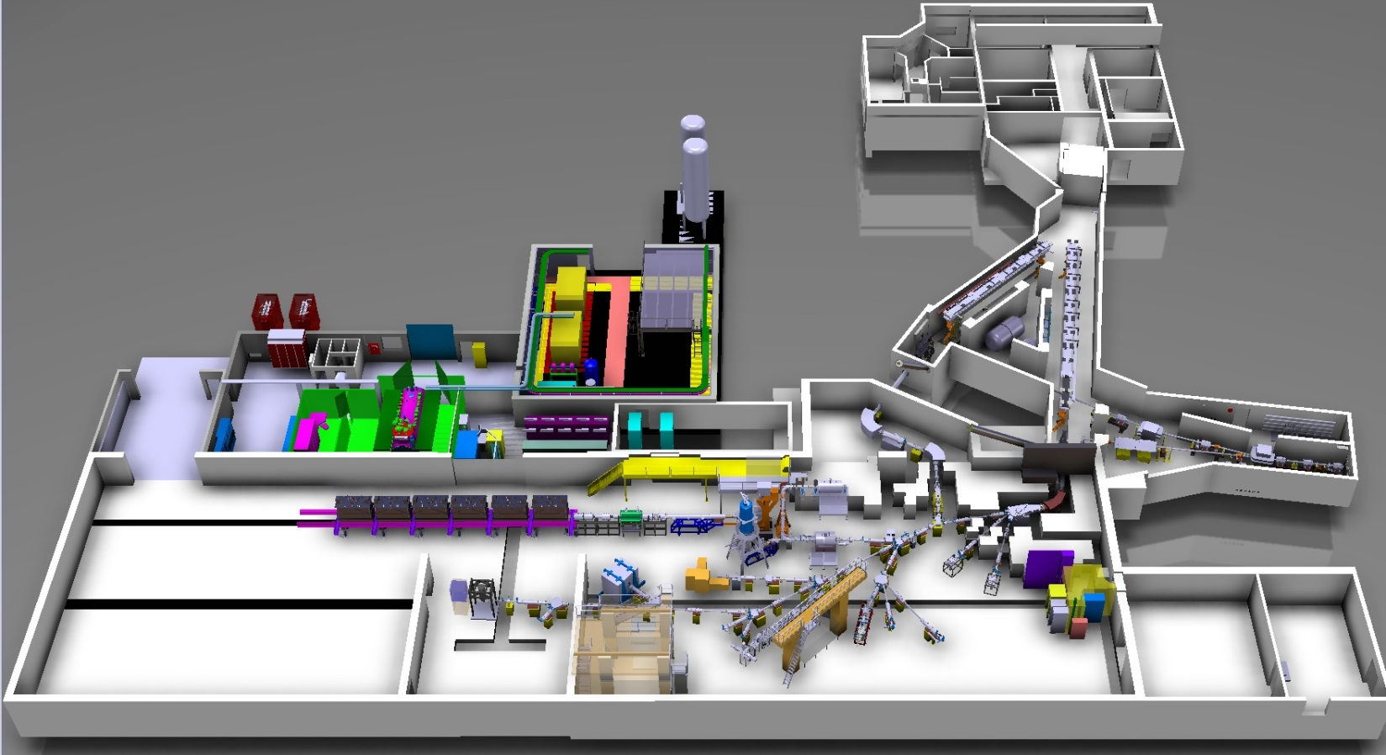
ISOLTRAP@ISOLDE@CERN
Laser ionization
of cadmium and
chromium isotopes
RILIS
HIE-ISOLDE (still under construction)
HRS
1.4-GeV protons
from PSB
GPS
ISOL beams
ISOLTRAP
André Welker for ISOLTRAP, EuNPC 2015, Groningen, 31.08.2015
4

Slide 5
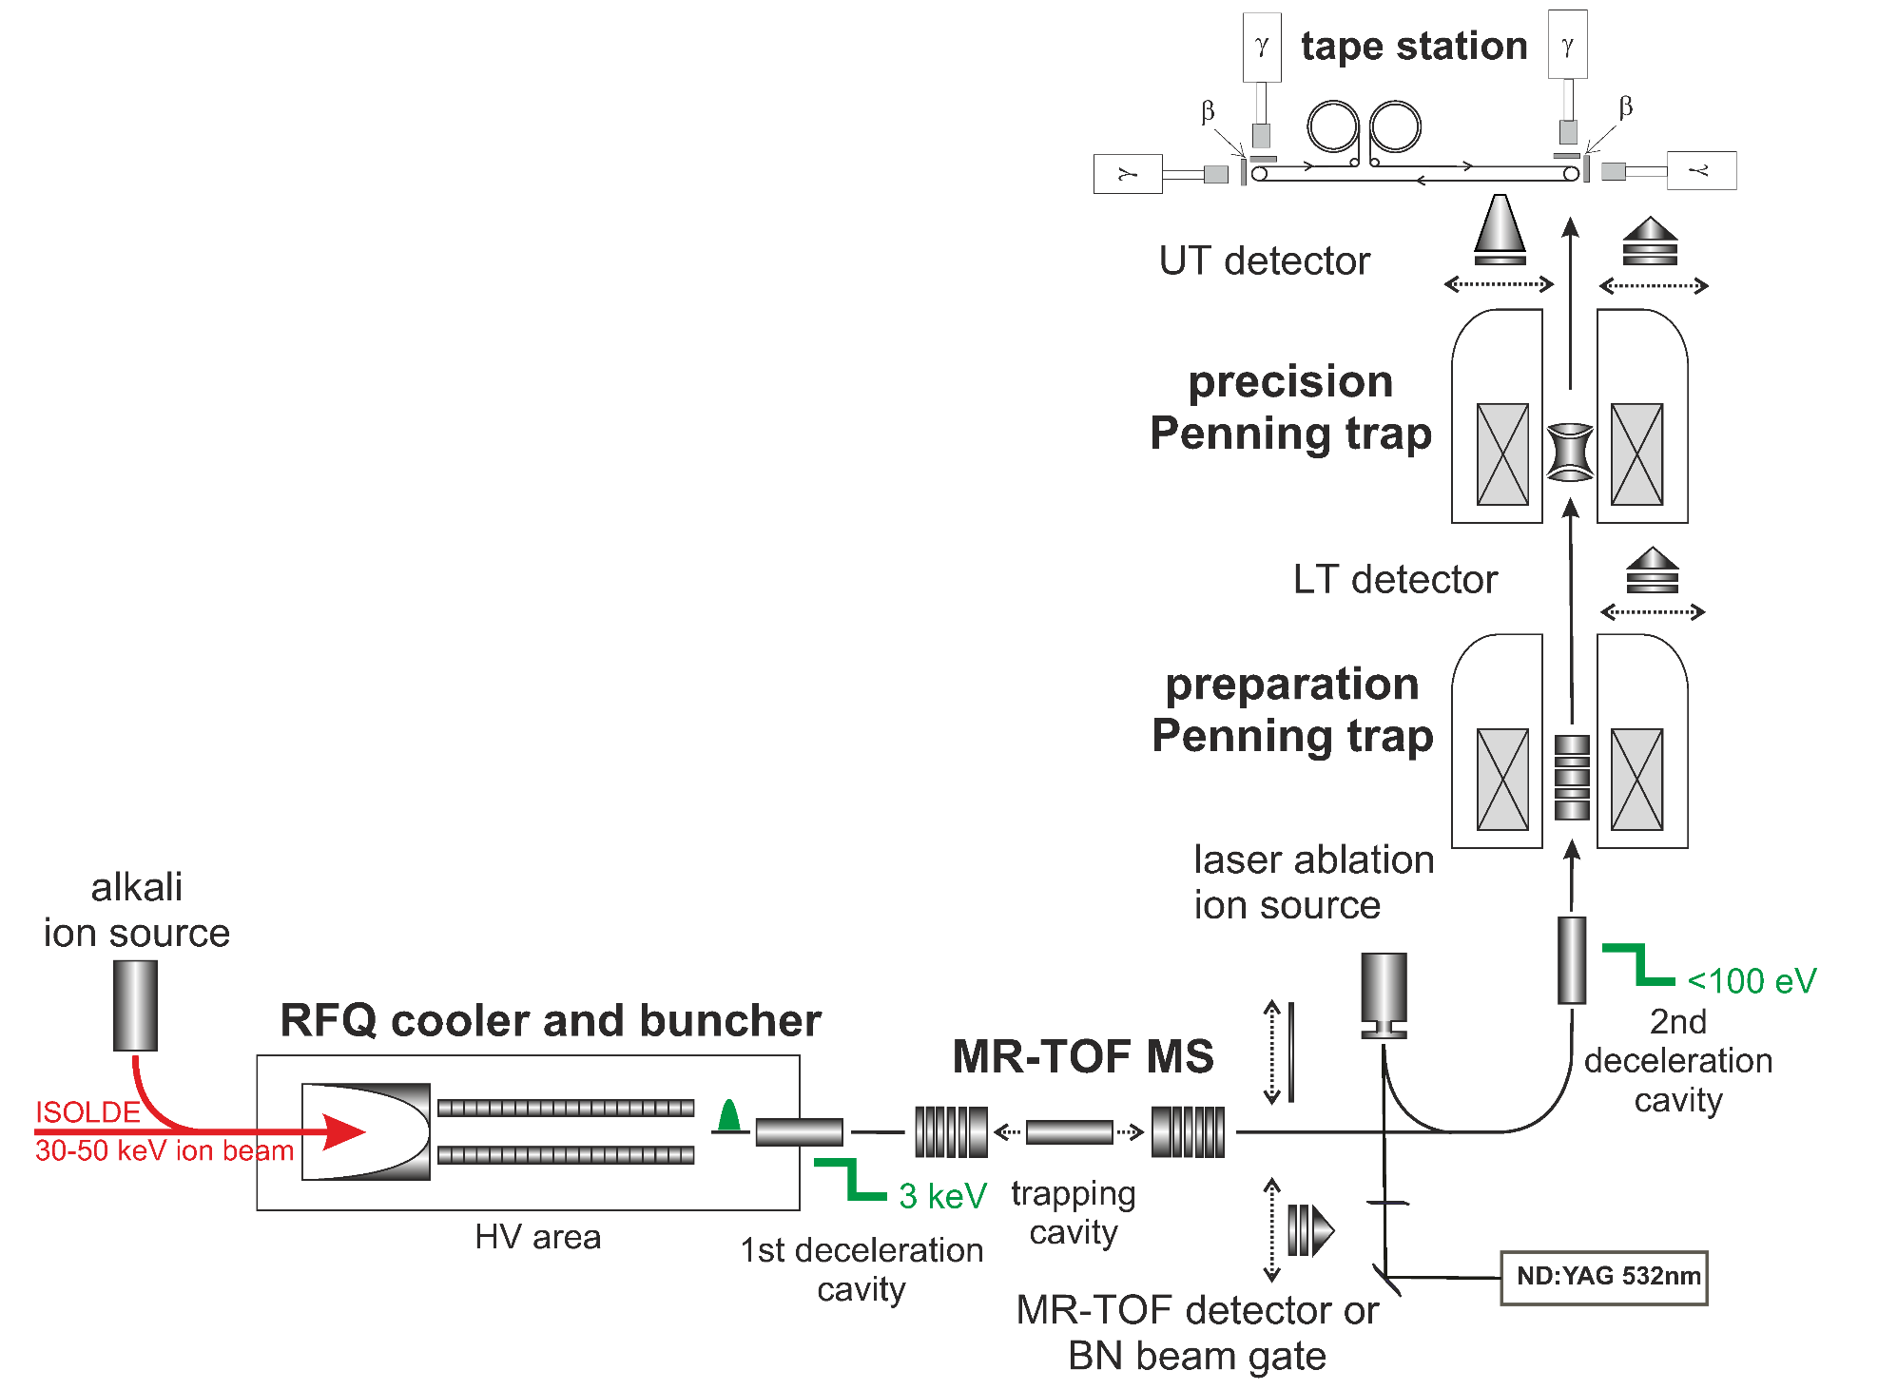
Tools of ISOLTRAP
F. Herfurth et al., NIM A 469, 254 (2001).
R. N. Wolf et al., Int. J. Mass Spectrom 313, 8 (2012).
G. Savard et al., Phys. Lett. A 158, 247 (1991).
M. König et al., Int. J. Mass Spectrom. 142, 95 (1995).
André Welker for ISOLTRAP, EuNPC 2015, Groningen, 31.08.2015
5

Slide 6
Tools of ISOLTRAP
Measurement of cyclotron frequency:
100 ms – 1 s trapping for σ_{m}/m = 10⁻⁶-10⁻⁸
Beam purification:
1 s trapping for
m/Δm =10⁵-10⁶
Beam purification:
200-300 ms trapping
for m/Δm =10⁴-10⁵
Beam purification:
30 ms trapping
for m/Δm = 10⁵
F. Herfurth et al., NIM A 469, 254 (2001).
R. N. Wolf et al., Int. J. Mass Spectrom 313, 8 (2012).
G. Savard et al., Phys. Lett. A 158, 247 (1991).
M. König et al., Int. J. Mass Spectrom. 142, 95 (1995).
André Welker for ISOLTRAP, EuNPC 2015, Groningen, 31.08.2015
5

Slide 7
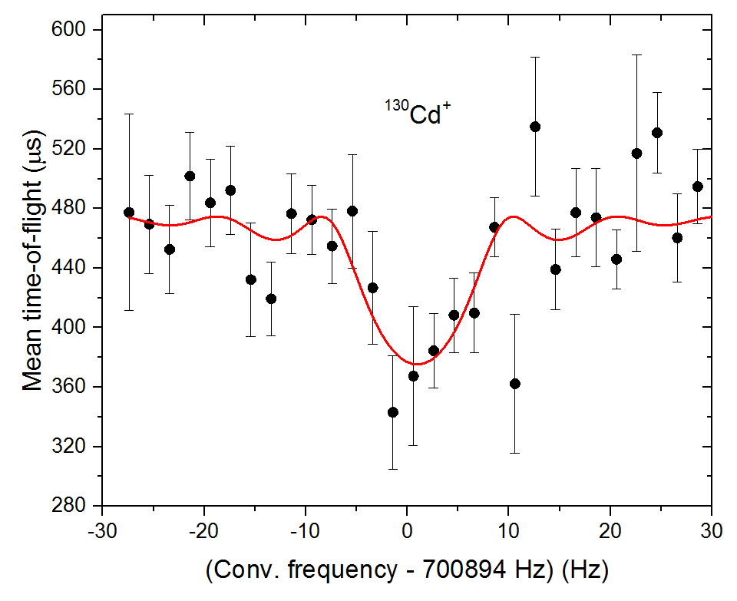

Tools of ISOLTRAP
Measurement of cyclotron frequency:
100 ms – 1 s trapping for σ_{m}/m = 10⁻⁶-10⁻⁸
Beam purification:
1 s trapping for
m/Δm =10⁵-10⁶
Beam purification:
200-300 ms trapping
for m/Δm =10⁴-10⁵
Beam purification:
30 ms trapping
for m/Δm = 10⁵
$$ν_{c}=\frac{qB}{2π m}$$
First ToF-ICR of ¹³⁰Cd⁺
F. Herfurth et al., NIM A 469, 254 (2001).
R. N. Wolf et al., Int. J. Mass Spectrom 313, 8 (2012).
G. Savard et al., Phys. Lett. A 158, 247 (1991).
M. König et al., Int. J. Mass Spectrom. 142, 95 (1995).
André Welker for ISOLTRAP, EuNPC 2015, Groningen, 31.08.2015
2

Slide 8
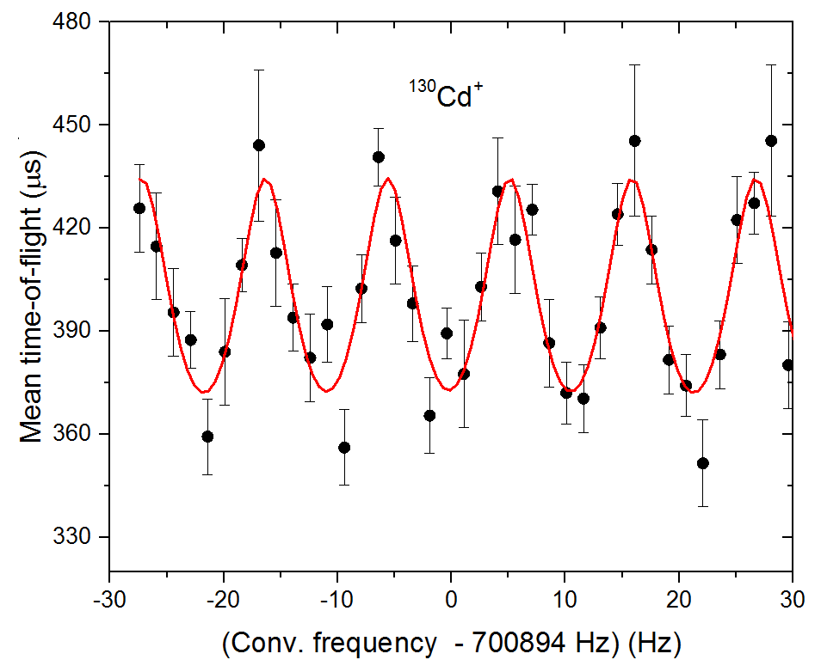
Tools of ISOLTRAP
Measurement of cyclotron frequency:
100 ms – 1 s trapping for σ_{m}/m = 10⁻⁶-10⁻⁸
Beam purification:
1 s trapping for
m/Δm =10⁵-10⁶
Beam purification:
200-300 ms trapping
for m/Δm =10⁴-10⁵
Beam purification:
30 ms trapping
for m/Δm = 10⁵
$$ν_{c}=\frac{qB}{2π m}$$
First ToF-ICR of ¹³⁰Cd⁺
F. Herfurth et al., NIM A 469, 254 (2001).
R. N. Wolf et al., Int. J. Mass Spectrom 313, 8 (2012).
G. Savard et al., Phys. Lett. A 158, 247 (1991).
M. König et al., Int. J. Mass Spectrom. 142, 95 (1995).
André Welker for ISOLTRAP, EuNPC 2015, Groningen, 31.08.2015
2

Slide 9
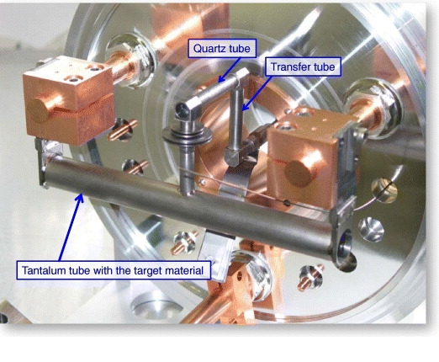
Neutron-rich cadmium isotopes
Very good quality of the cadmium beam from UC_{x}-n/quartz+RILIS.
¹³⁰Cs/¹³⁰Ba
¹³⁰In
¹³⁰Cd
p⁺
Laser blocked
E. Bouquerel et al., Nucl. Instrum. Meth. B 266, 4298-4302 (2008)
André Welker for ISOLTRAP, EuNPC 2015, Groningen, 31.08.2015
6

Slide 10
Neutron-rich cadmium isotopes
^{129,130}Cd measured in the Penning trap.
T_{1/2}= 162ms
¹³⁰Cd⁺
André Welker for ISOLTRAP, EuNPC 2015, Groningen, 31.08.2015
7

Slide 11
Neutron-rich cadmium isotopes
¹³¹Cd measured using the MR-TOF MS.
500 laps
André Welker for ISOLTRAP, EuNPC 2015, Groningen, 31.08.2015
8

Slide 12
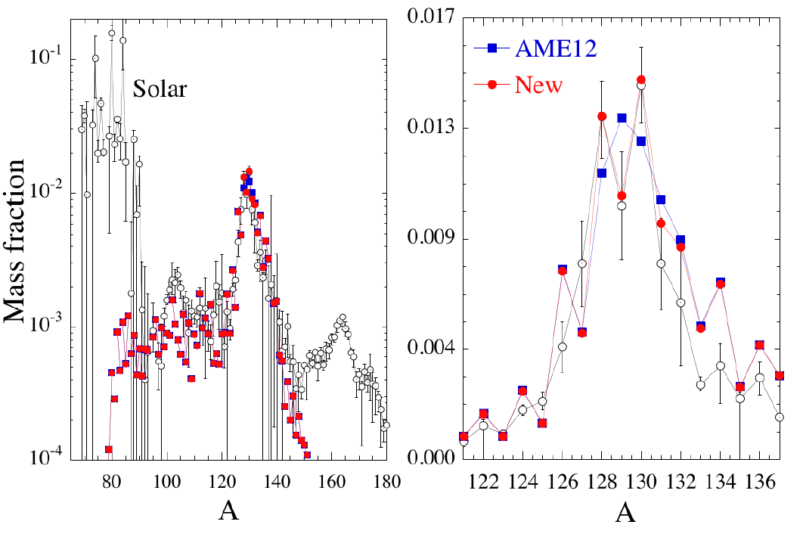
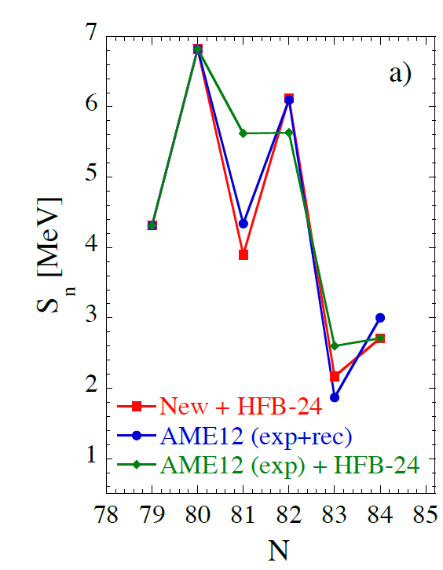
Neutron-rich cadmium isotopes
Important impact of the neutron separation energy S_{n} on the predicted r-process abundances.
Irrespective of mass model, ^{A>130}Cd isotopes have among the largest impact.
≈0.5 MeV deviations found from AME values and extrapolations (D. Antanasov et al. paper submitted, calculated by S. Goriely)
André Welker for ISOLTRAP, EuNPC 2015, Groningen, 31.08.2015
9
Notes:
An important point for r-process calculations is what type of model to use for computing the masses (e.g. with strong shell reduction, with moderate reduction or without significant reduction far from stability). Our measurements show a significant reduction of the one-neutron shell gap for Z<50, which, although it is only one point, supports models which reproduce this effect (for example, it support HFB21 against FRDM, the latter predicting practically no reduction of the gap). This is great indirect impact, because using one model or another changes a lot of masses used as input for the calculations.
FRDM = finite-range droplet model (enhanced liquid drop model so it combines macroscopic liquid drop model effects (Volume, Surface, Pairing (odd/even), Coulomb, Assymmetry) and microscopic shell and pairing corrections.
HFB = takes two different interactions into account : interaction of nearby nucleons (pairing effect) and mixing between different orbitals
DZ =

Slide 13
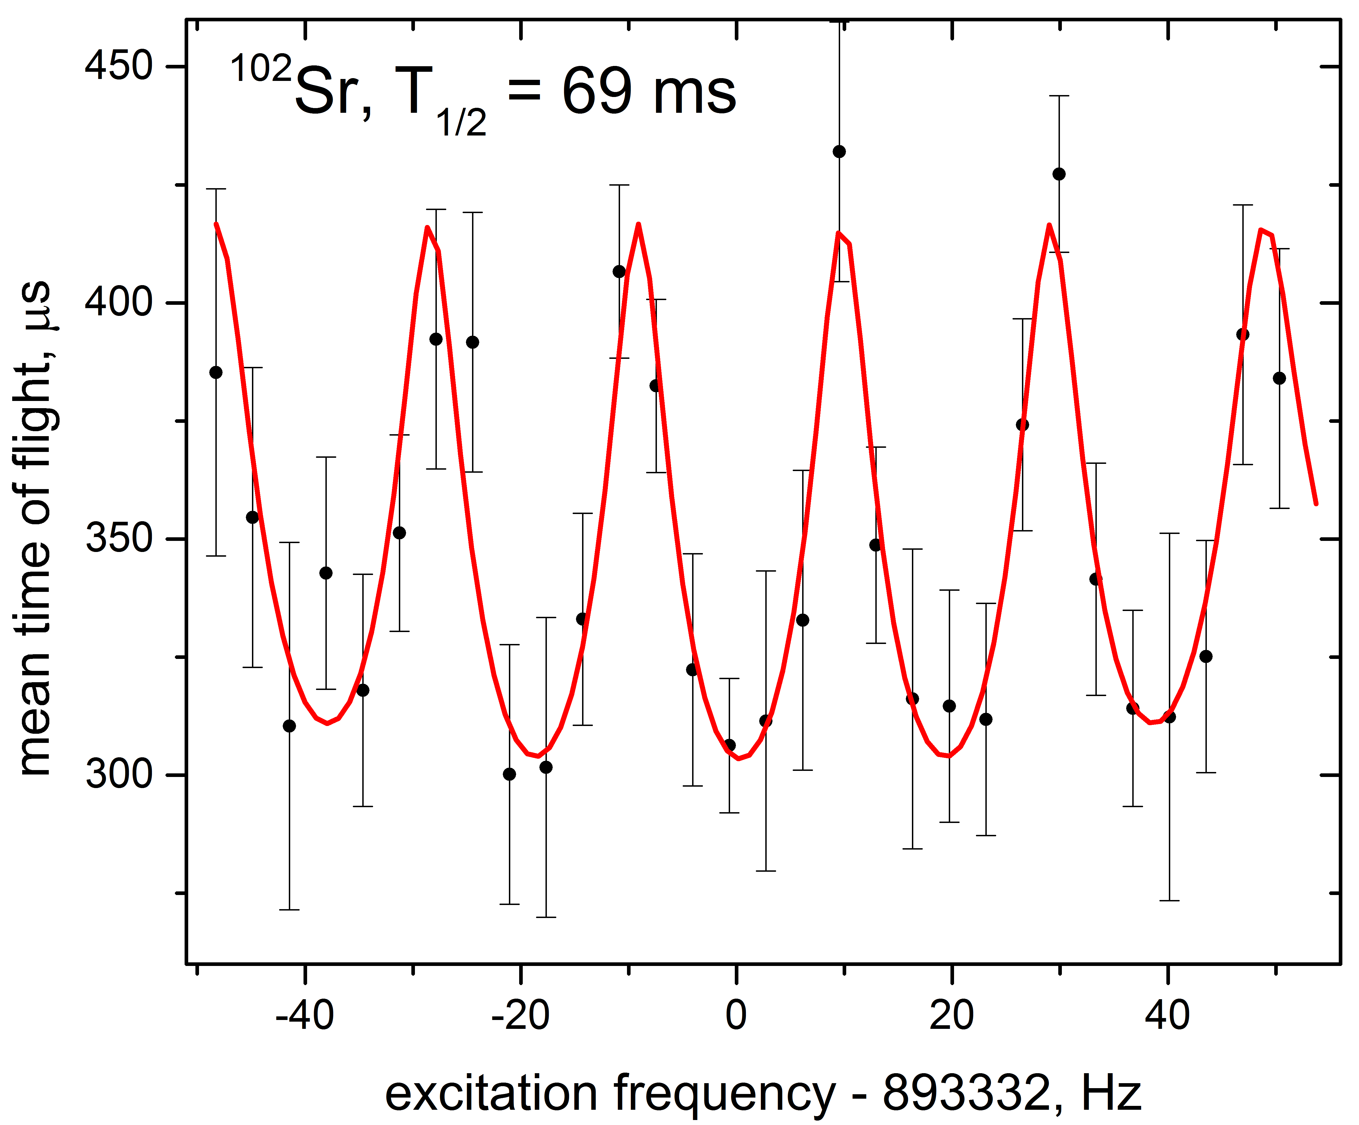
Studies of neutron-rich A ≈ 100 nuclides
Intense beams from UC_{x}-Ta.
^{101,102}Sr measured in Penning trap, ¹⁰⁰⁻¹⁰²Rb in MR-TOF MS
André Welker for ISOLTRAP, EuNPC 2015, Groningen, 31.08.2015
10

Slide 14
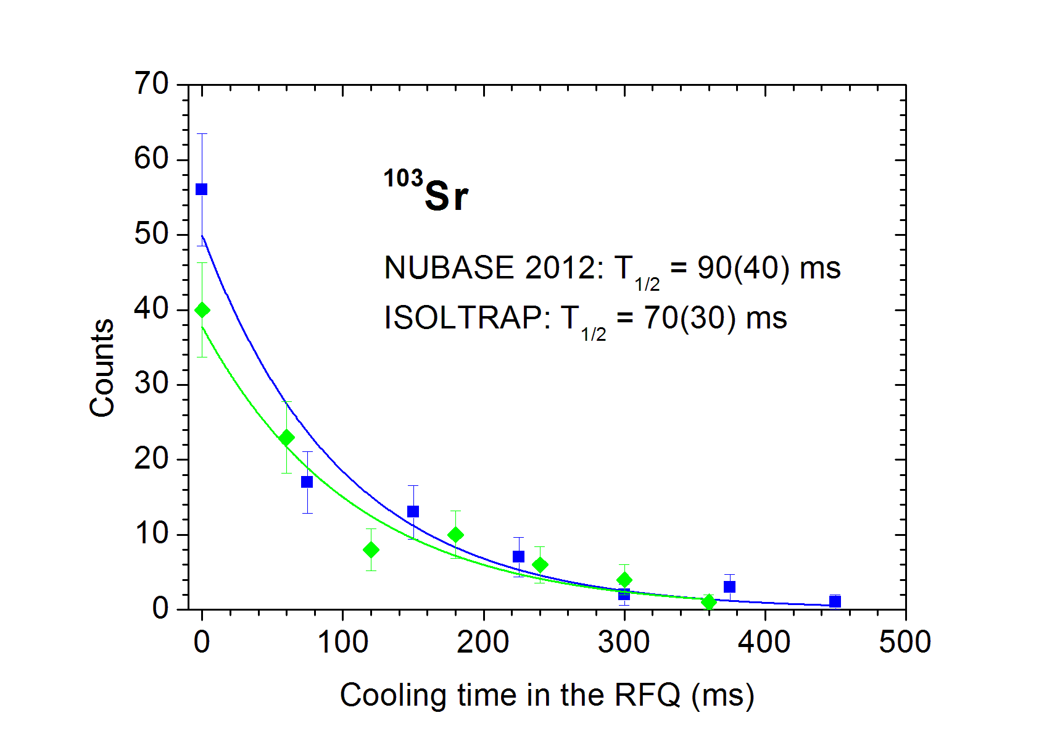
Studies of neutron-rich A ≈ 100 nuclides
Vary RFQ cooling time, record decrease in count rate: determine half-life
(new measurement or use for identification).
R. Wolf et al., NIMB EMIS 2015
Preliminary
André Welker for ISOLTRAP, EuNPC 2015, Groningen, 31.08.2015
11

Slide 15
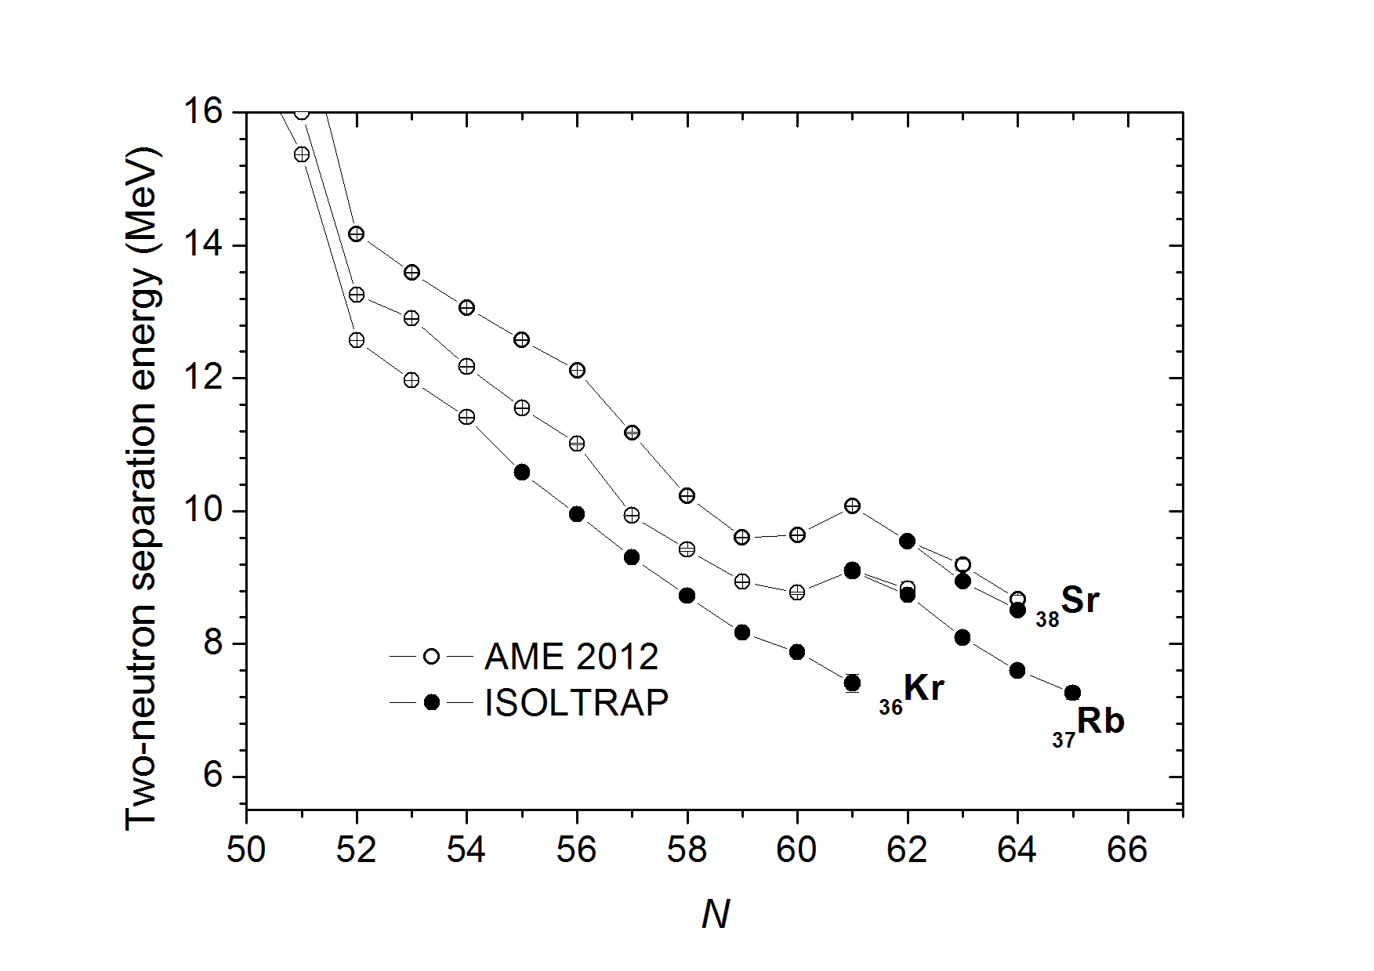



Studies of neutron-rich A ≈ 100 nuclides
Improvement of mean-field (HFB) calculations using the HFODD code: observables can be computed for each individual configuration.
S_{2n, ob}
S_{2n, pro}
oblate
E
prolate
lowest in energy
S_{2n, gr}
0
β₂₀
M. Wang et al., Chinese Physics C 36, 1603 (2012).
S. Naimi et al., Phys. Rev. Lett. 105, 032502 (2010).
P. Delahaye et al.,Phys. Rev. C 74, 034331 (2006).
V. Manea et al., Phys. Rev. C 88, 054322 (2013).
A. de Roubin, article and thesis in preparation.
André Welker for ISOLTRAP, EuNPC 2015, Groningen, 31.08.2015
12

Slide 16
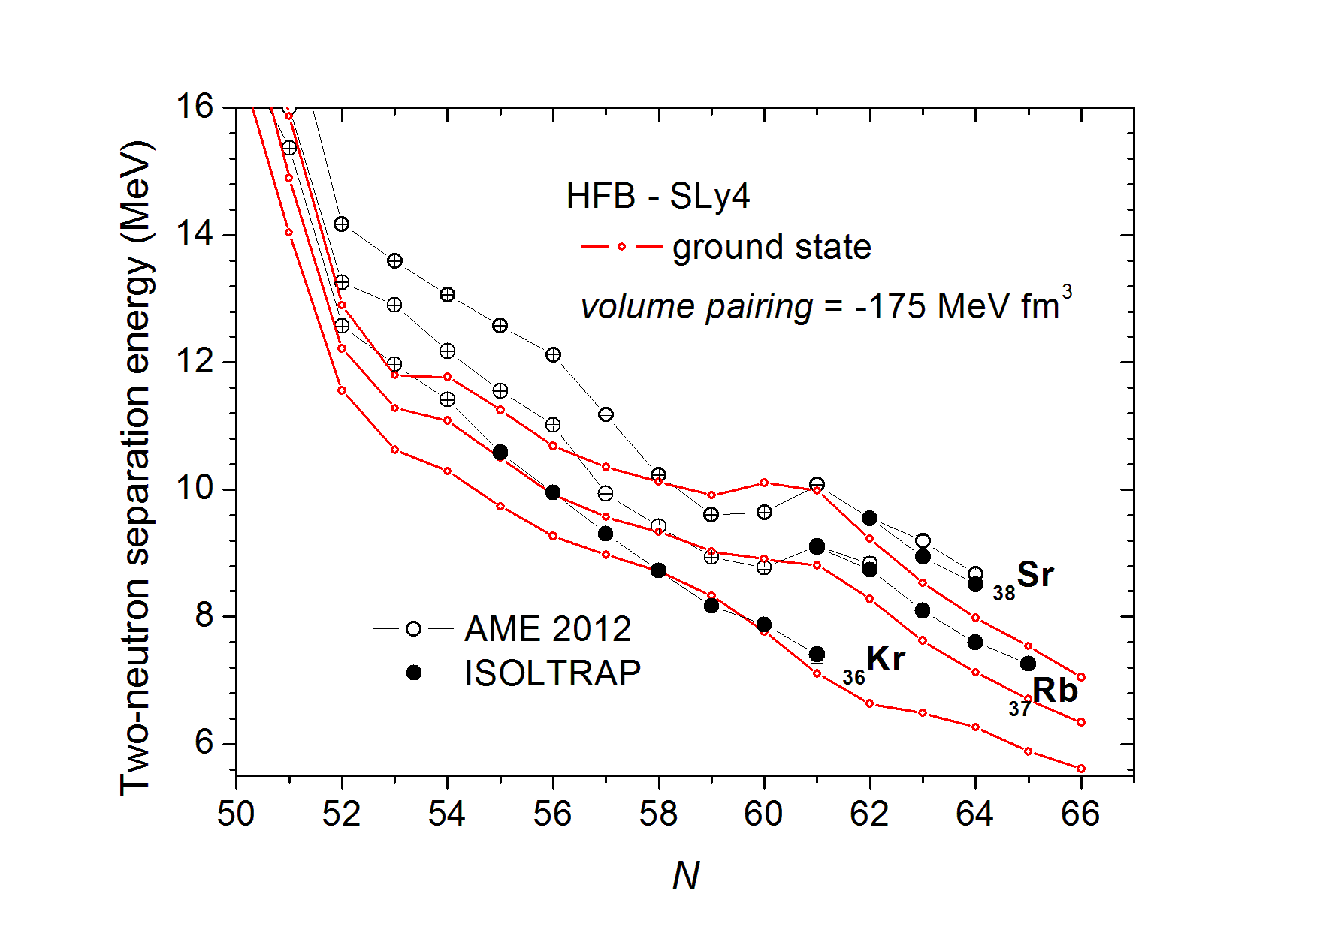
Studies of neutron-rich A ≈ 100 nuclides
Improvement of mean-field (HFB) calculations using the HFODD code: observables can be computed for each individual configuration.
The simulation gives the right trend
Up to N = 60 the krypton chain behaves differently, but what happens after?
S_{2n, ob}
S_{2n, pro}
oblate
E
prolate
lowest in energy
S_{2n, gr}
0
β₂₀
M. Wang et al., Chinese Physics C 36, 1603 (2012).
S. Naimi et al., Phys. Rev. Lett. 105, 032502 (2010).
P. Delahaye et al.,Phys. Rev. C 74, 034331 (2006).
V. Manea et al., Phys. Rev. C 88, 054322 (2013).
A. de Roubin, article and thesis in preparation.
André Welker for ISOLTRAP, EuNPC 2015, Groningen, 31.08.2015
12

Slide 17
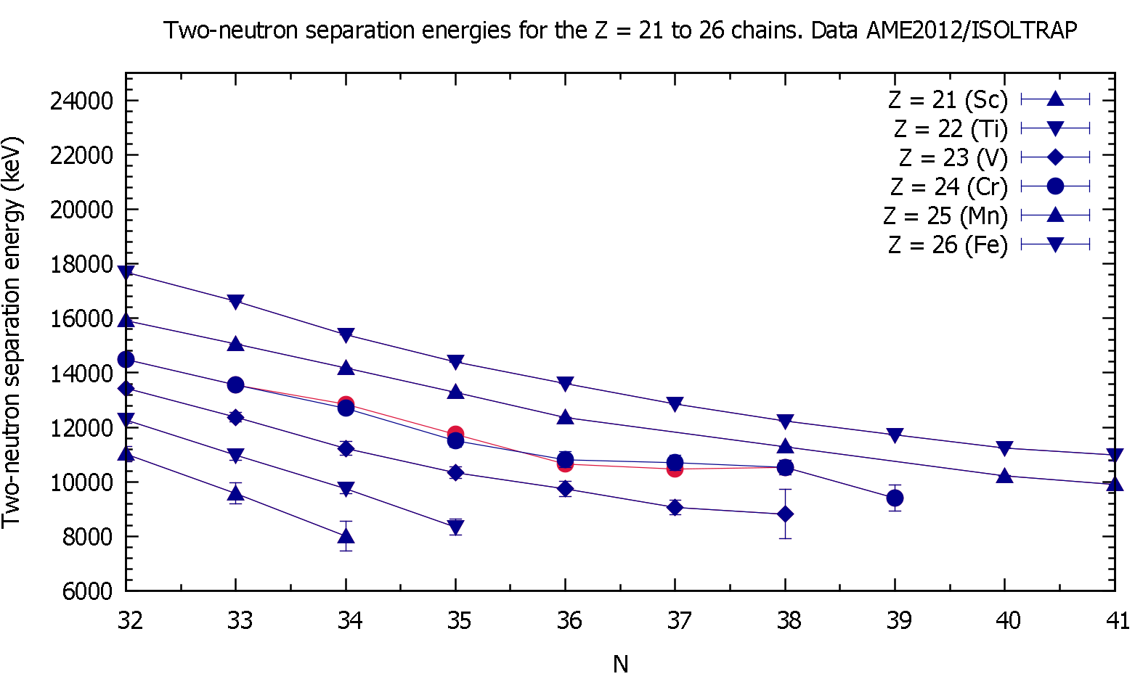
Neutron-rich chromium masses
Probing N=34: With a mid-shell nucleus ⁵⁶⁻⁵⁹Cr, the behaviour of the shell evolution
Preliminary
₂₄Cr
André Welker for ISOLTRAP, EuNPC 2015, Groningen, 31.08.2015
13

Slide 18
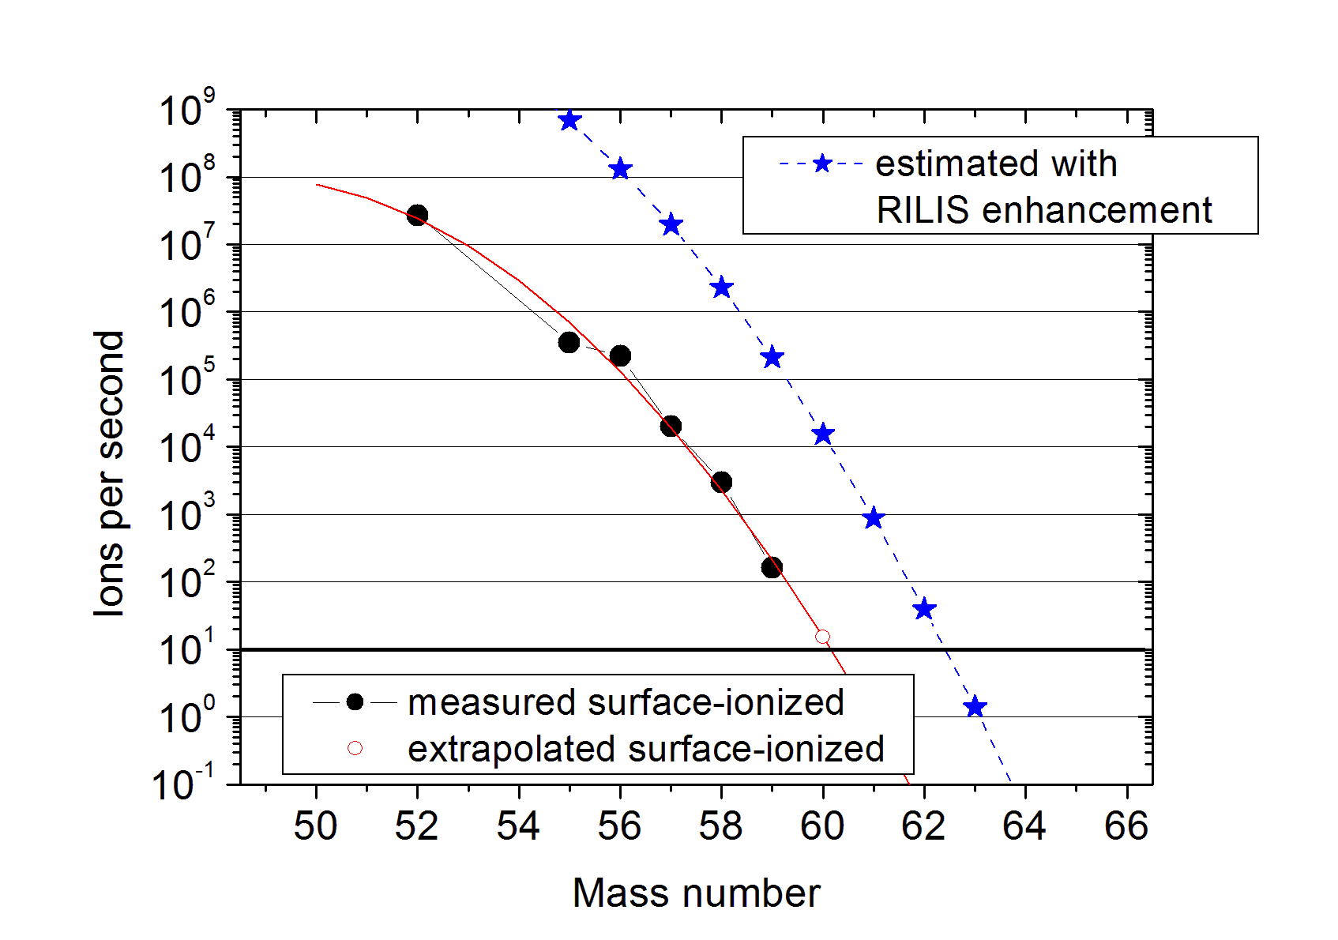
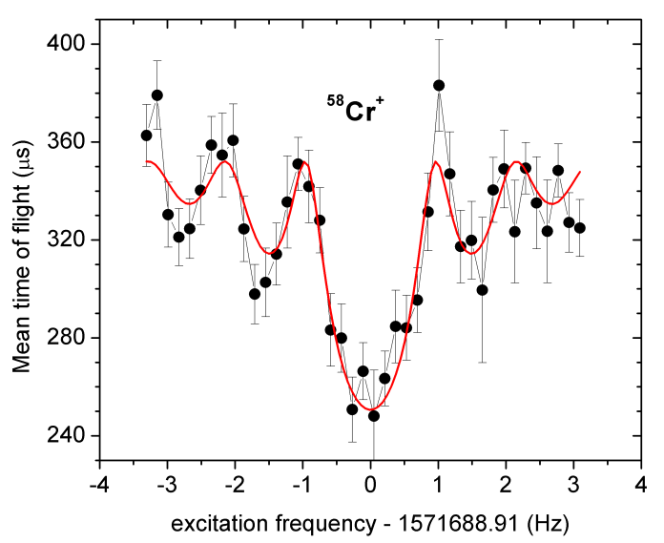
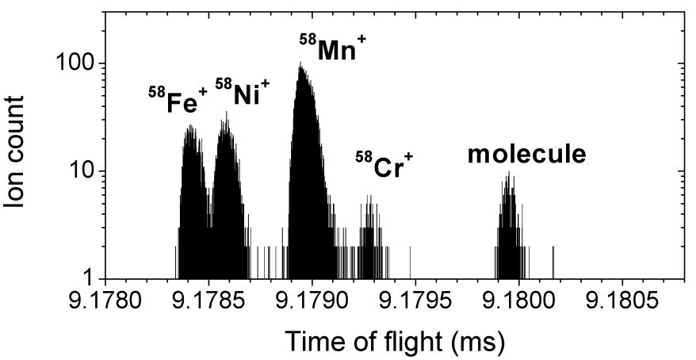
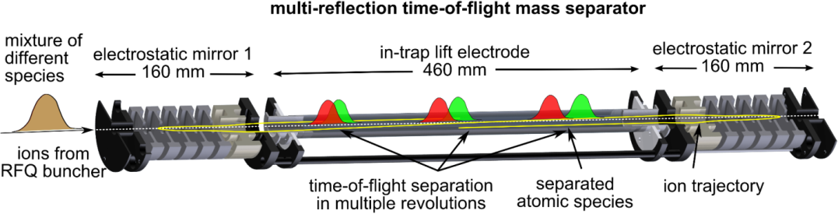
Neutron-rich chromium masses
Possible improvement to accomplish N=40 in chromium with the RILIS scheme
Preliminary
Thesis of Tom Day Goodacre
André Welker for ISOLTRAP, EuNPC 2015, Groningen, 31.08.2015
14

Slide 19
Summary
Setup:
Presented the ISOLTRAP setup and possibilities
Physics:
Impact in the r-process with neutron-rich ¹²⁹⁻¹³¹Cd
Improvements in HFB calculations with ¹⁰¹⁻¹⁰³Sr and ¹⁰⁰⁻¹⁰²Rb
Enhancement of the trend of neutron-rich chromium ⁵⁶⁻⁵⁹Cr
Outlook:
New techniques with a position sensitive detector will be installed to get a better precision
Decay spectroscopy after ion selection with our traps at ISOLTRAP
André Welker for ISOLTRAP, EuNPC 2015, Groningen, 31.08.2015
15

Slide 20


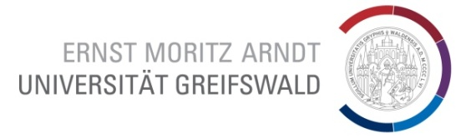
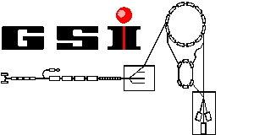

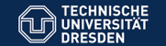




Acknowledgements
N. Althubiti, P. Ascher, G. Audi, D. Atanasov, D. Beck, K. Blaum, G. Bollen, Ch. Borgmann, M. Breitenfeldt, R. B. Cakirli, T. Cocolios, S. Eliseev, T. Eronen, S. George, F. Herfurth, A. Herlert, D. Kisler, M. Kowalska, S. Kreim, J. Kluge, Yu. A. Litvinov, D. Lunney, V. Manea, E. Minaya-Ramirez, M. Mougeot, S. Naimi, D. Neidherr, M. Rosenbusch, A. de Roubin, L. Schweikhard, F. Wienholtz, M. Wang, A. Welker, R. Wolf, K. Zuber, S. Schwarz
Grants No.:
05P12HGCI1
05P12HGFNE
ISOLDE Target
and Technical Group
http://isoltrap.web.cern.ch

Slide 21
Backup

Slide 22
Table of Nuclides
Applied filters:
André Welker for ISOLTRAP, EuNPC 2015, Groningen, 31.08.2015
2

Slide 23
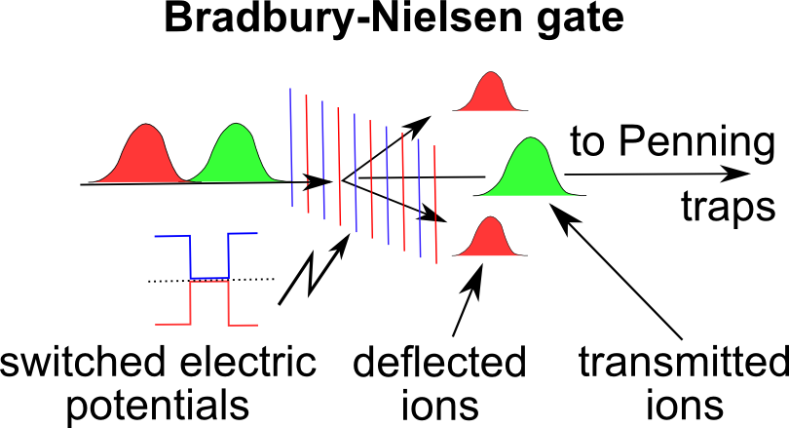
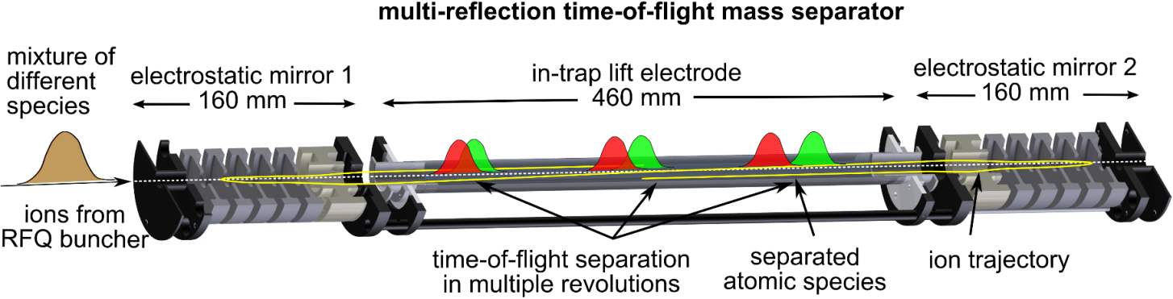
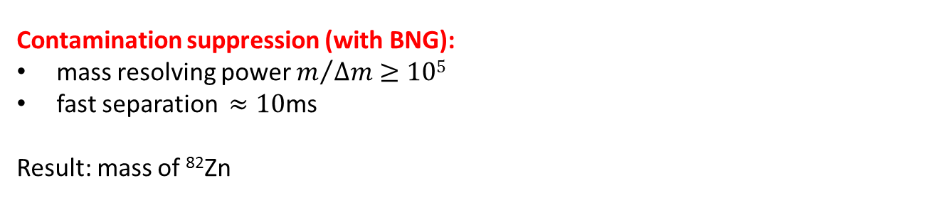
The MR-ToF MS
Contamination suppression (with BNG):
mass resolving power $m/{∆m≥105}$
fast separation $≈10\text{ms}$
Result: mass of ⁸²Zn
mass
separator
Mass determination:
relative precision better than 10⁻⁶
Result: mass of ⁵⁴Ca
mass
spectrometer
Wollnik & Przewloka, Int. J. Mass Spectrom. Ion Proc. 96, 267 (1990)
Wolf et al., IJMS 349-350, 123 (2013)
Wienholtz et al., Nature 498, 346-349 (2013)
André Welker for ISOLTRAP, EuNPC 2015, Groningen, 31.08.2015
2

Slide 24
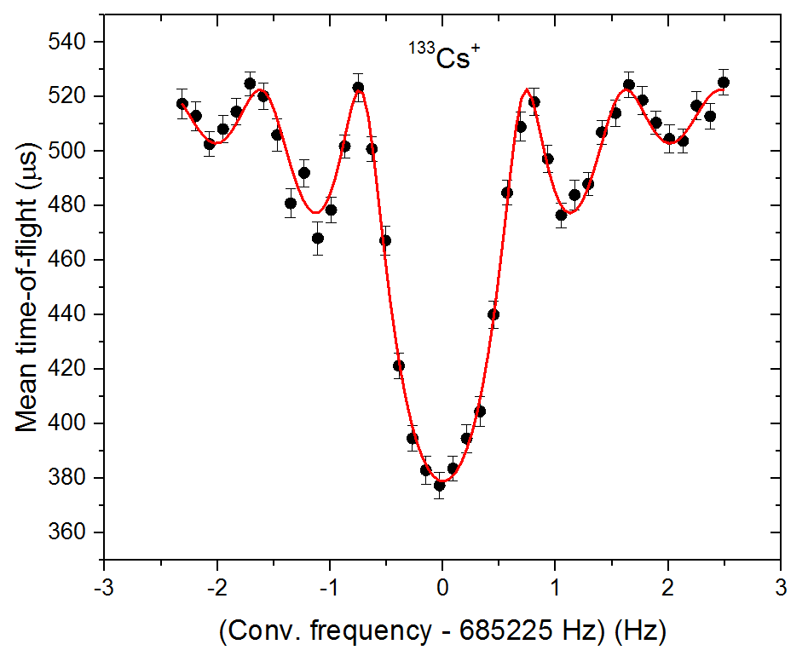
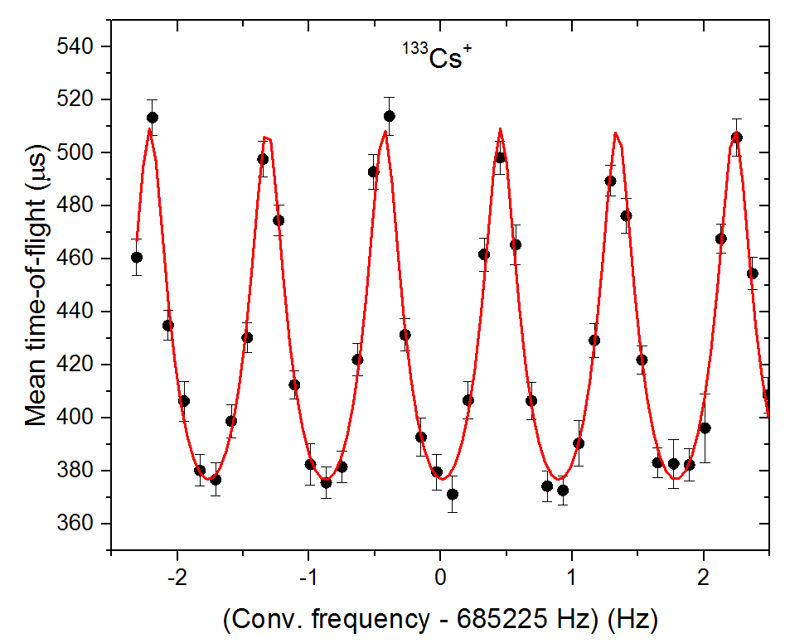
Tools of ISOLTRAP
Measurement of cyclotron frequency:
100 ms – 1 s trapping for σ_{m}/m = 10⁻⁶-10⁻⁸
Beam purification:
1 s trapping for
m/Δm =10⁵-10⁶
Beam purification:
200-300 ms trapping
for m/Δm =10⁴-10⁵
Beam purification:
30 ms trapping
for m/Δm = 10⁵
$$ν_{c}=\frac{qB}{2π m}$$
First ToF-ICR of 2014
F. Herfurth et al., NIM A 469, 254 (2001).
R. N. Wolf et al., Int. J. Mass Spectrom 313, 8 (2012).
G. Savard et al., Phys. Lett. A 158, 247 (1991).
M. König et al., Int. J. Mass Spectrom. 142, 95 (1995).
André Welker for ISOLTRAP, EuNPC 2015, Groningen, 31.08.2015
2

Slide 25
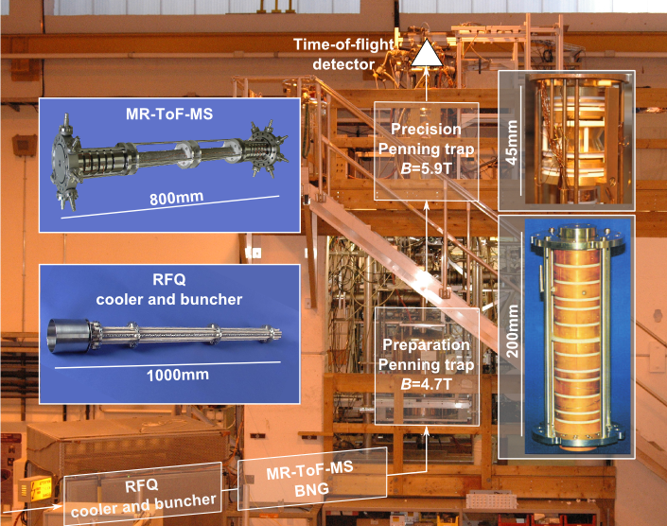
ISOLTRAP@ISOLDE@CERN
1987
2010
1999
1994
M. Mukherjee et al., Eur. Phys. J. A 35, 1 (2008).
S. Kreim et al., Nucl. Instrum. Methods B 317, 492 (2013).

Slide 26
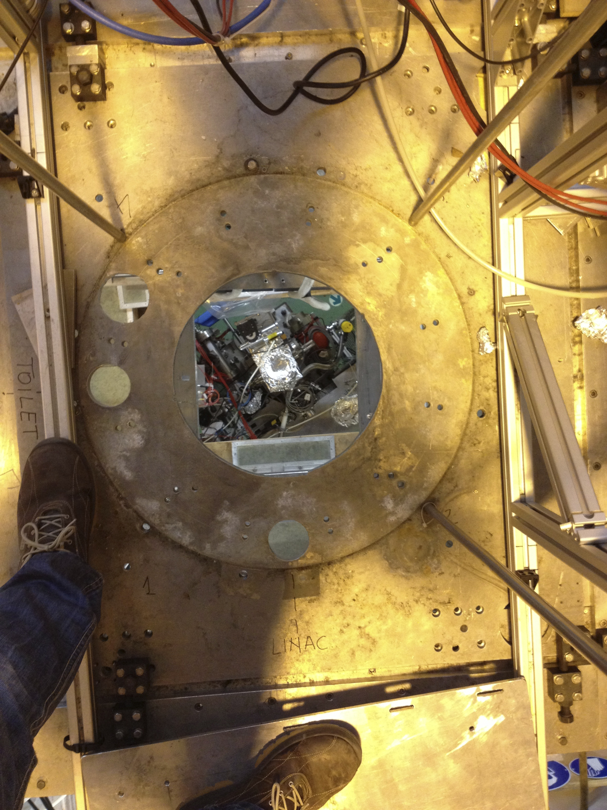
ISOLTRAP@ISOLDE@CERN
1987
2013
2010
!
1999
1994

Slide 27
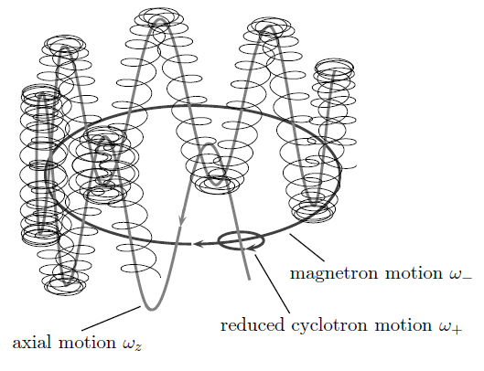
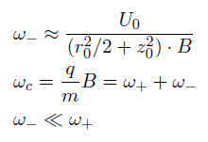
Backup
Eigenmotion:
In/dependend

Slide 28
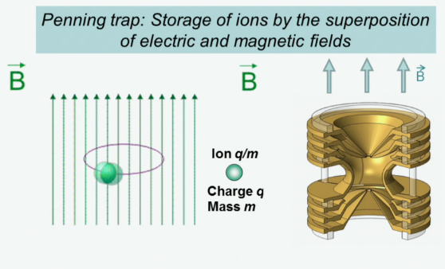
Penning-Trap
Hyperbolic
Penning-Trap
Function:
2,5 cm
K. Blaum
André Welker, Group Meeting, IKTP Dresden, Oct. 25, 2014
16

Slide 29
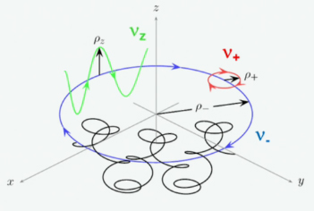


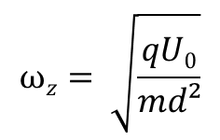
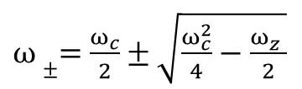
Penning-Trap
Hyperbolic
Penning-Trap
Motions:
$$νc= \frac{qB}{2πm}$$
2,5 cm
Three eigenmotions:
K. Blaum
- : Modified Cyclotron/
+ : Magnetron frequency
z : Axial frequency
$ω±=$ $\frac{ω_{c}}{2}±\sqrt{\frac{ω_{c}^{2}}{4}−\frac{ω_{z}^{}}{2}}$
$ω_{c}^{}=$ $\sqrt{ω_{+}^{2}+ω_{−}^{2}+ω_{z}^{2}}$
$$ωz= \sqrt{\frac{qU0}{md²}}$$
André Welker, Group Meeting, IKTP Dresden, Oct. 25, 2014
16

Slide 30
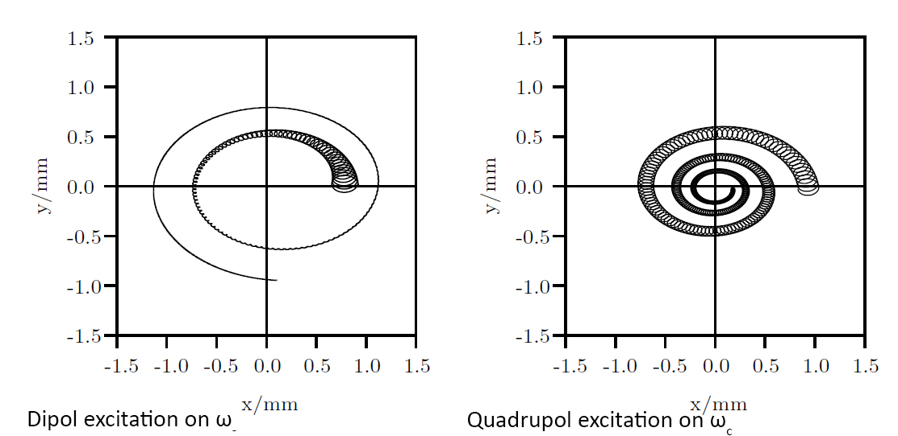

Penning-Trap
Motions:
With cooling gas in trap
-
+
-
+
-
+
+
-
$ω_{c}^{}=$ $\sqrt{ω_{+}^{2}+ω_{−}^{2}}$
André Welker, Group Meeting, IKTP Dresden, Oct. 25, 2014
17

Slide 31
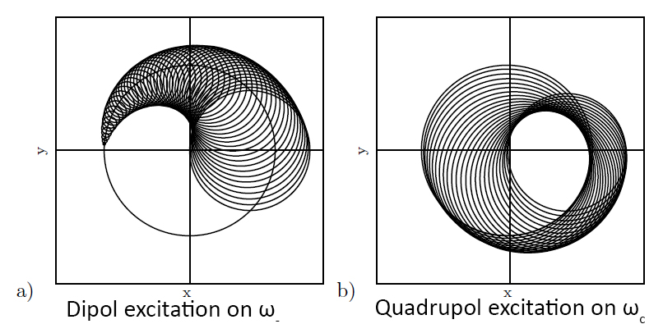
Penning-Trap
Motions:
Without cooling gas in trap
-
+
-
+
-
+
+
-
André Welker, Group Meeting, IKTP Dresden, Oct. 25, 2014
18

Slide 32
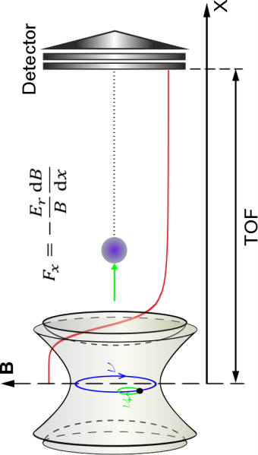


Penning-Trap
Motions conversion:
André Welker, Group Meeting, IKTP Dresden, Oct. 25, 2014
18

Slide 33
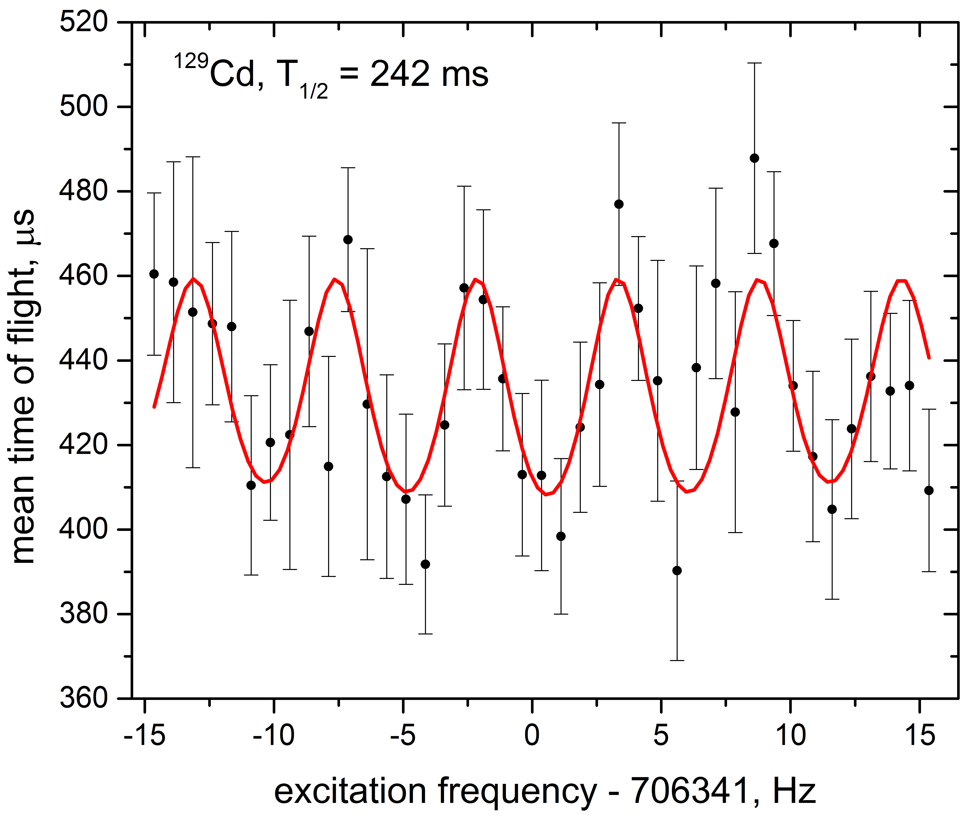
129Cd, 130Cd – Mass measurement
¹²⁹Cd Ramsey-type resonance
20ms – 160ms – 20ms
¹³⁰Cd Ramsey-type resonance
10ms – 80ms – 10ms
¹²⁹Cd, T_{1/2}=242(8)ms
¹³⁰Cd, T_{1/2}=162(7)ms
≈6300 ions/s from ISOLDE; 1539 ions
4 ToF-ICR resonances
  1 normal, 3 Ramsey
→ Δm/m≈1.2E-7
≈625 ions/s from ISOLDE; 588ions
¹³⁰Cd/cont. ≈ 0.2; only R ≈ 15k needed
3 ToF-ICR resonances
  1 normal, 2 Ramsey
→Δm/m≈1.6E-7
Frank Wienholtz NUSTAR 2015

