Slide 1
Open Heavy-Flavour
Measurements in Pb-Pb
Collisions with ALICE at the
LHC
Sedat Altınpınar for the ALICE Collaboration
EuNPC2015

Slide 2
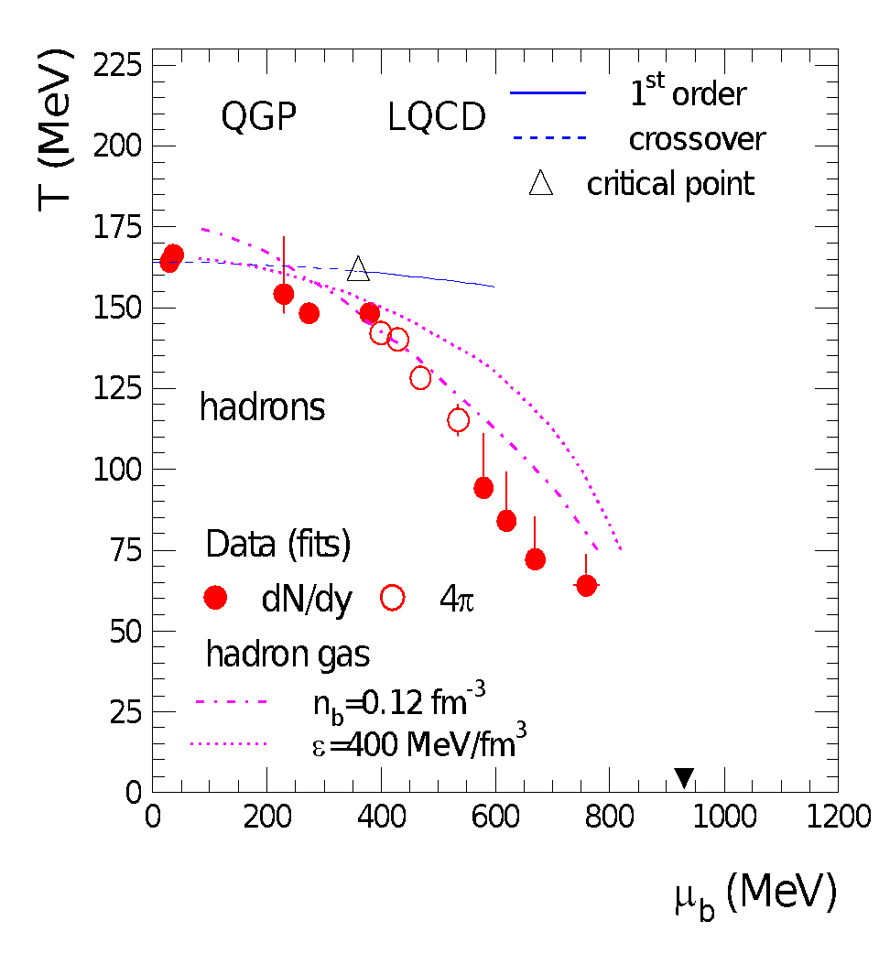
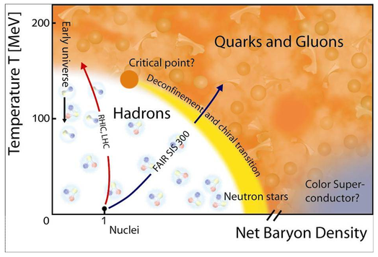
Phase Diagram of Nuclear Matter
Phase diagram is dictated by QCD
In the regime of Quark Gluon Plasma quarks
are deconfined
Energy density ~1 GeV/fm³, critical temperature ~150-200 MeV (at μ_{b}=0)
These conditions are thought to be present in the first microseconds of the universe and can be created in high-energy nuclear collisions
ALICE is designed for the study of this state of matter
In this presentation two aspects: # R_{AA} -Colour density, temperature of QGP, interaction with probes
# v₂ - Phase of QGP, transport properties, hydrodynamical properties
Nuclear Physics A, 834(1-4):237c – 240c, 2010
Sedat Altınpınar

Slide 3
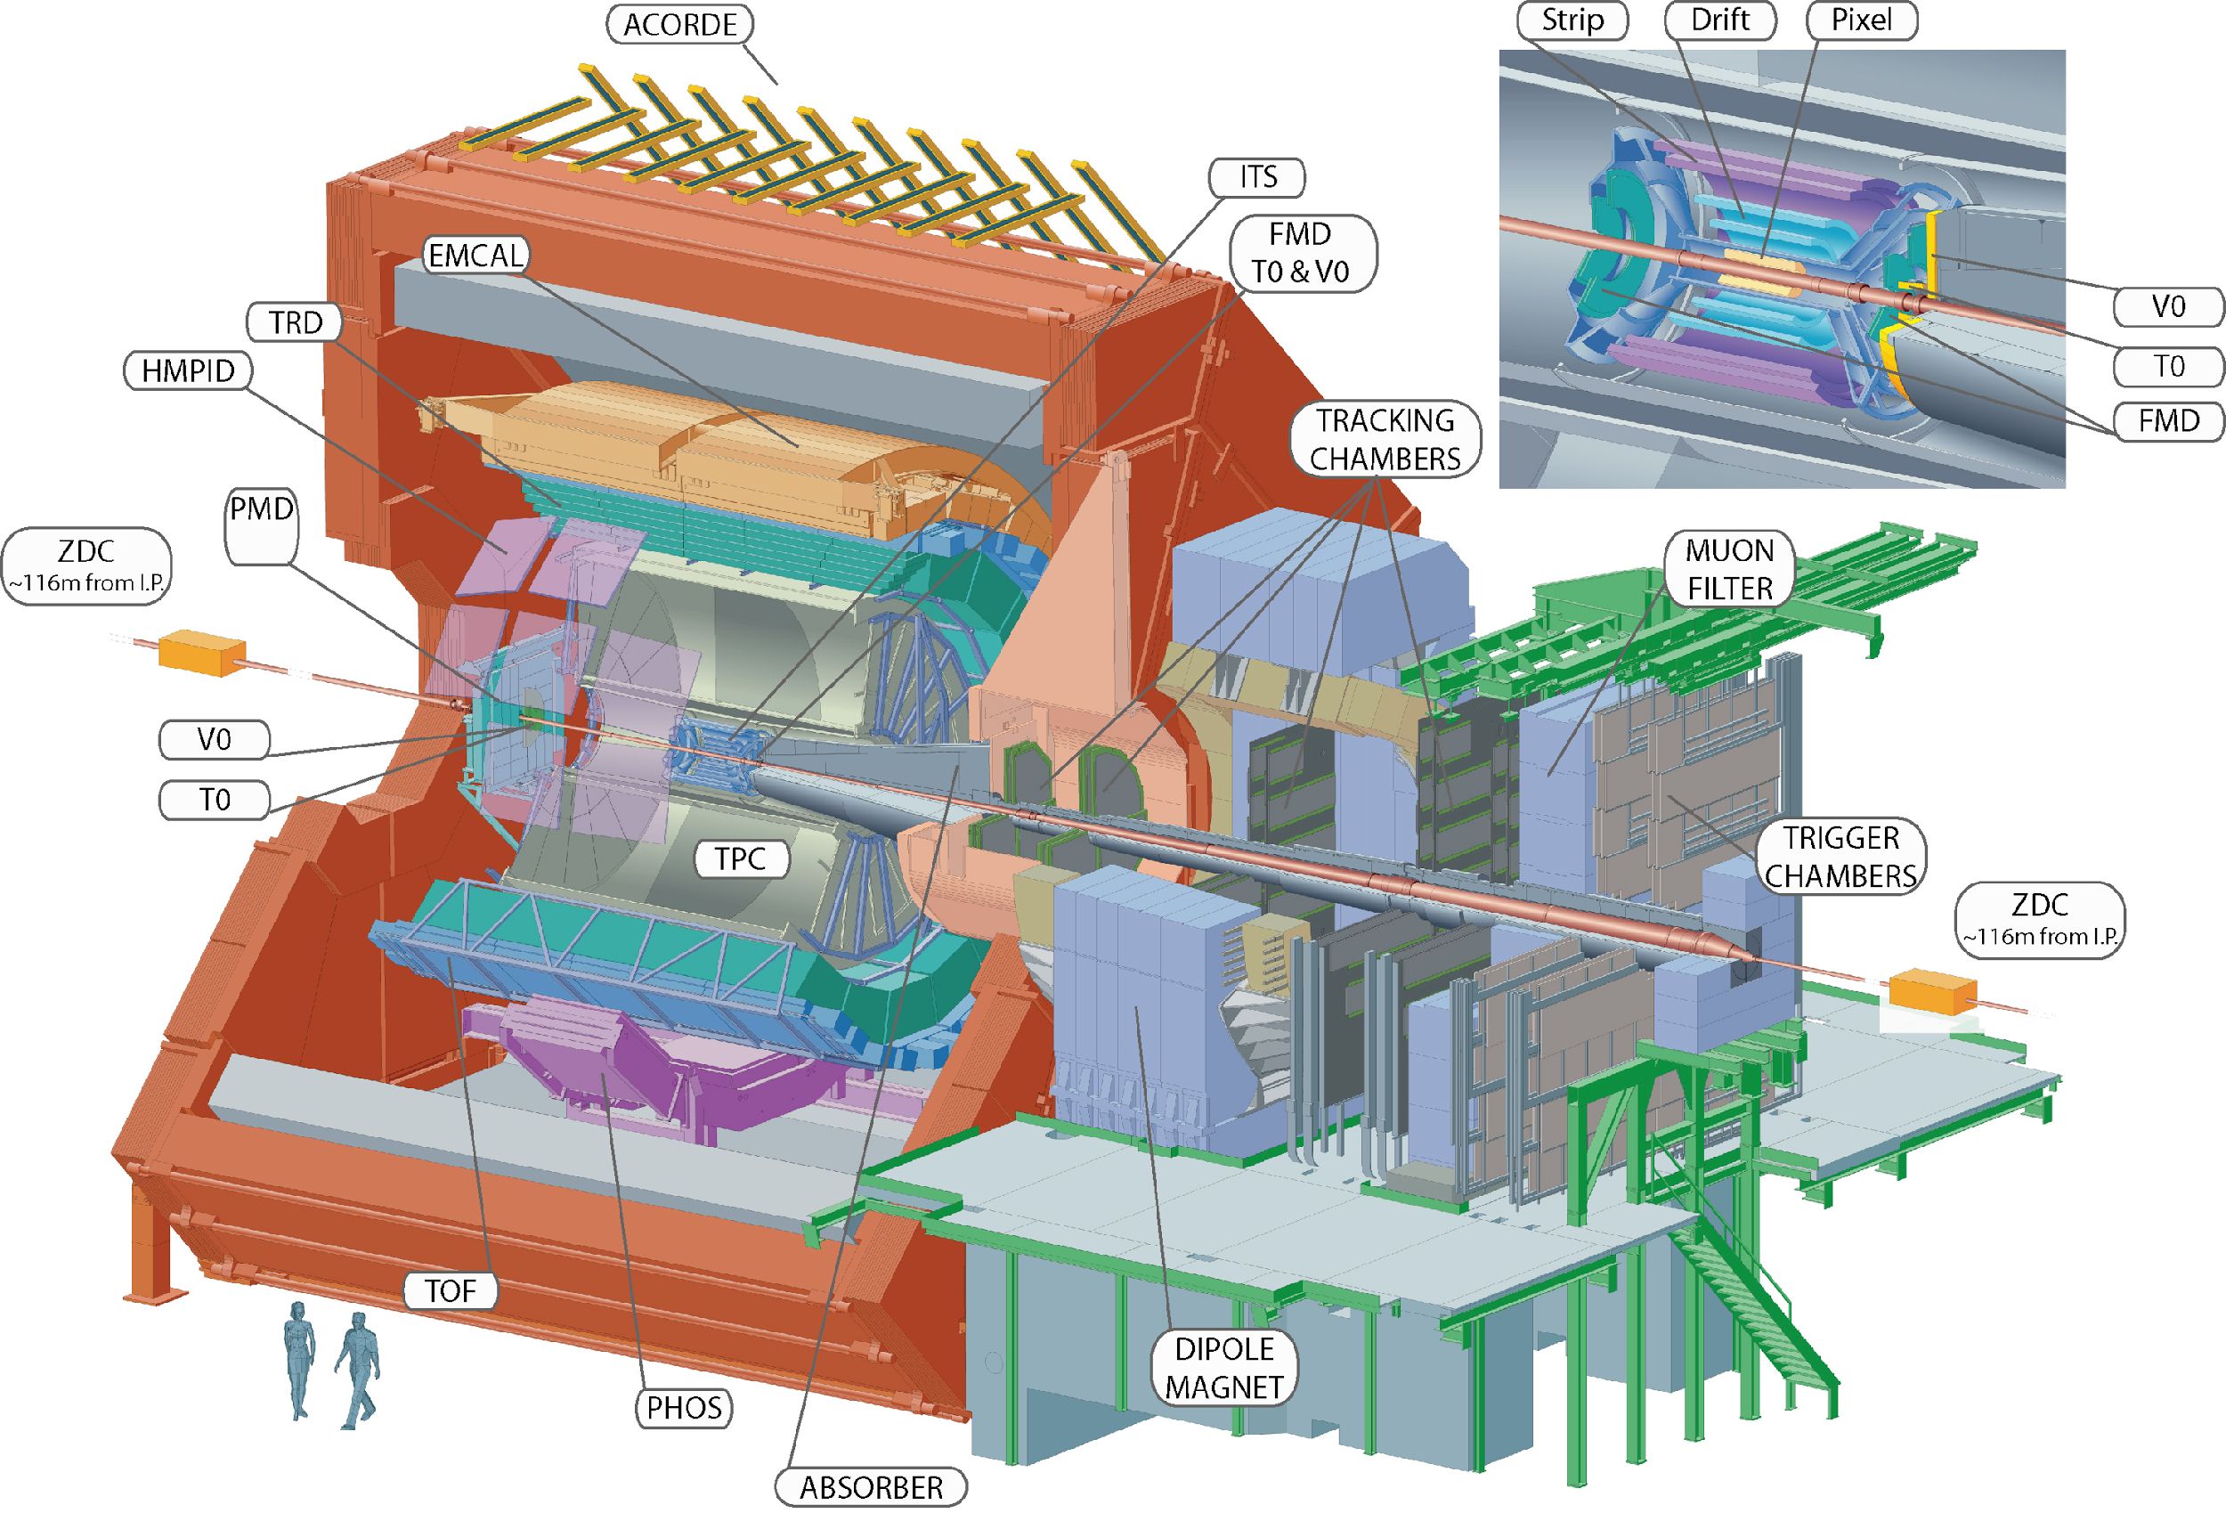
ALICE Setup
Sedat Altınpınar

Slide 4
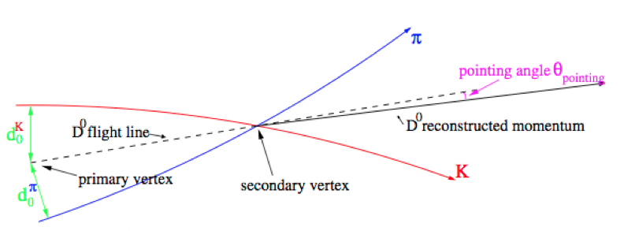
Basic Information
Heavy Flavour: Related quark masses > Λ_{QCD}
c charm -> ~1.3 GeV/c²
b beauty -> ~4.2 GeV/c²
(t top) -> ~173.3 GeV/c²
Open Heavy Flavour: Heavy quark without heavy partner
D⁰(c, u-bar), D+(c, d-bar),…
B⁰(d, b-bar), B+(u, b-bar),…
Λ_{C}(u, d, c),…
Lepton decay products of heavy flavour particles are referred to as heavy- flavour decay lepton
e.g. D⁰-> K⁺ + e⁻ + ν
Typical decay length (cτ)
above ~ 100 microns
Sedat Altınpınar

Slide 5
Why Heavy Quarks ?
Heavy quarks (large mass, large Q²) are created in an early phase of the collision and carry along rich information by experiencing the full collision history
Charm formation time vs QGP lifetime ~0.1 fm/c vs ~10 fm/c
Because of their early creation heavy quarks provide a solid reference represented by proton-proton collisions
Mass is a relevant parameter in partonic energy loss models*
Safe against mass related uncertainties because of almost exclusive Higgs mass and excluded (or negligible) creation in the medium
There are large heavy flavour cross sections at the LHC
Sedat Altınpınar
*Phys. Lett. B519 (2001) 199

Slide 6
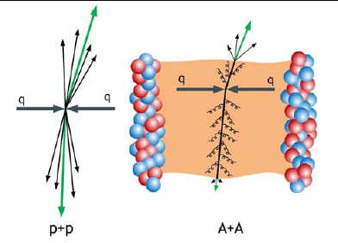
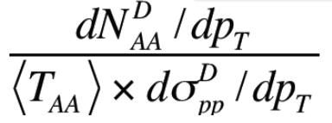
R_{AA} Observable
R_{AA} Nuclear Modification Factor
D
R_{AA}(p_{T})= ––––––––––––––––– =
X <N_{coll}>
R_{AA} = 1 No medium effect (valid at high pt), binary scaling e.g. photon measurements
R_{AA} characterizes the modification in the momentum distribution and accordingly energy loss properties. -> Colour density and transport properties of the medium
Is ΔE(g) > ΔE(uds) > ΔE(c) > ΔE(b)* ( R_{AA}(g) < R_{AA}(uds) < R_{AA}(c) < R_{AA}(b) )?
Hierarchy reflects the color-charge and quark-mass dependence of energy loss
Sedat Altınpınar
(*Phys. Lett. B519 (2001) 199)

Slide 7
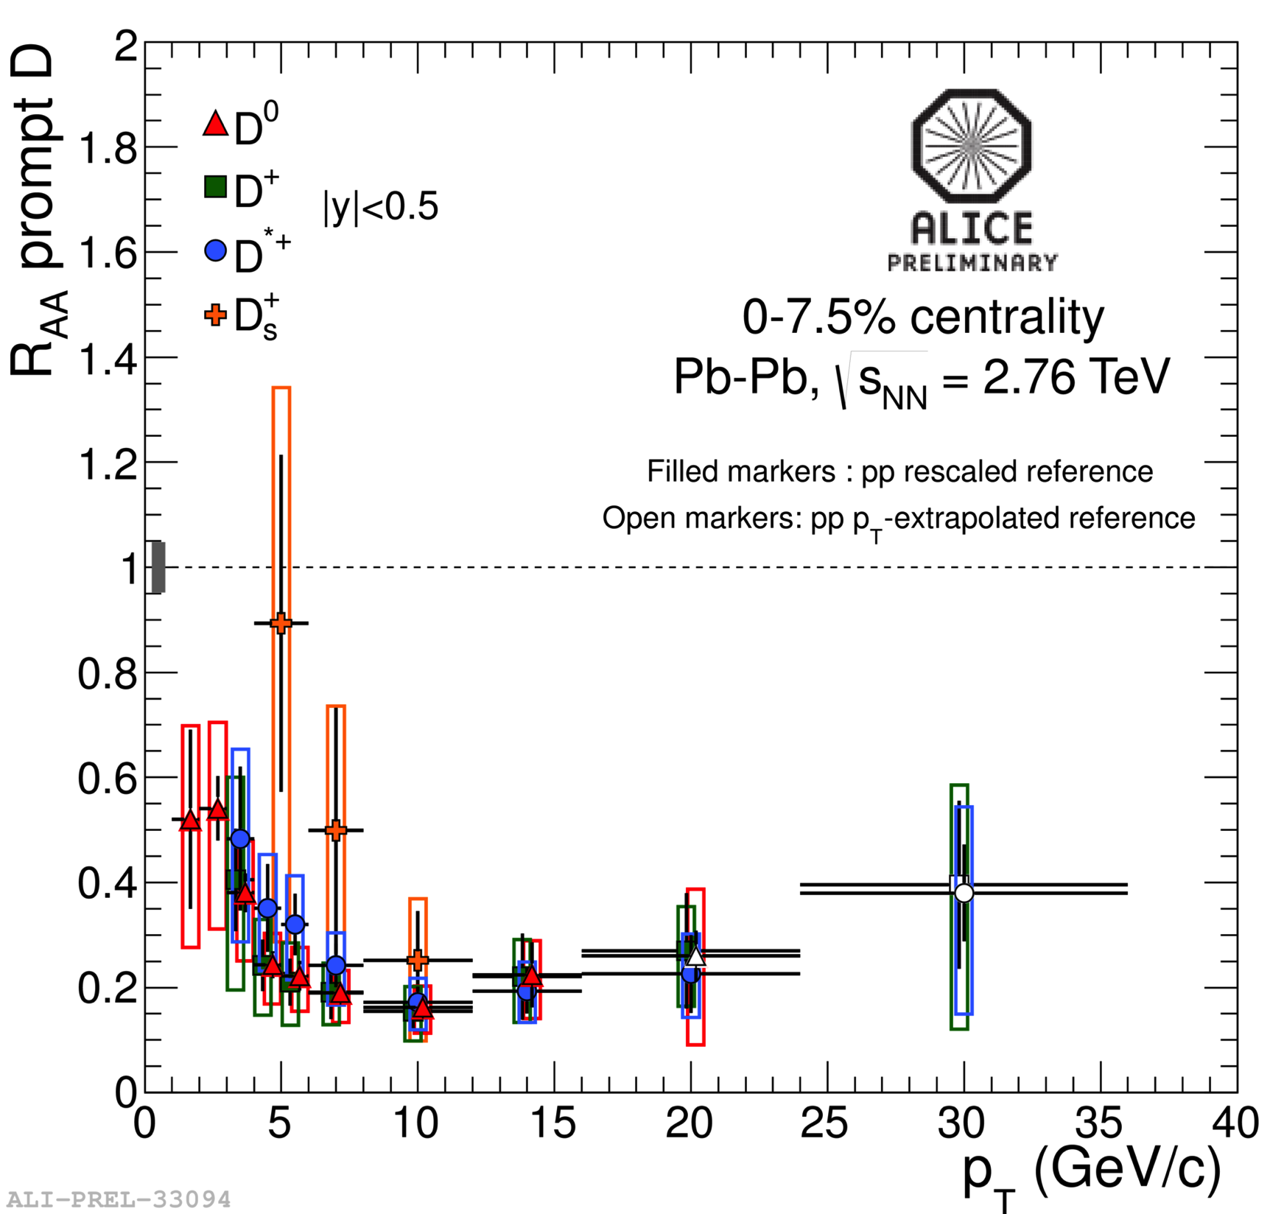
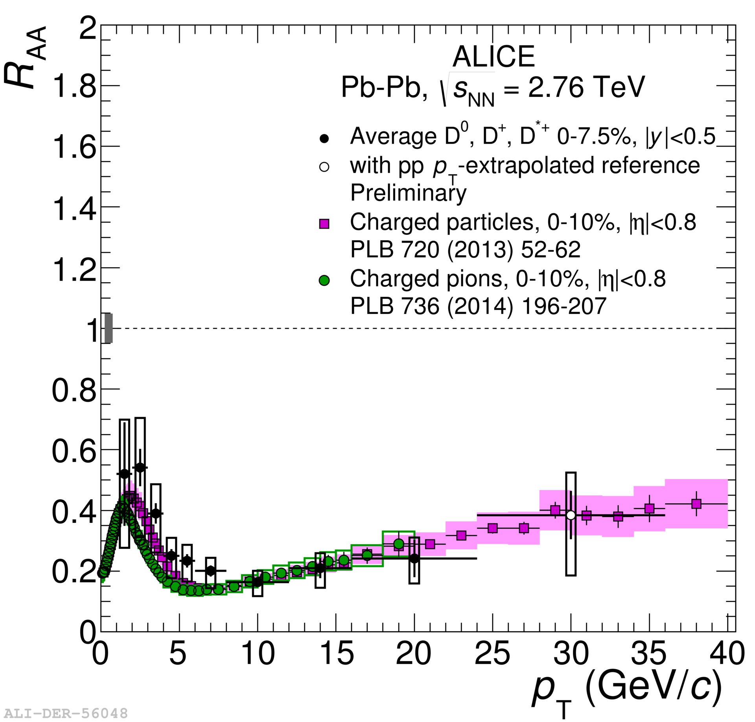
D-meson R_{AA}
D⁰, D⁺, D^{*+} mesons have similar R_{AA}. Suppression of a factor 4-5 at 5-16 GeV/c
Charm is significantly suppressed over a large transverse momentum range-> In-medium energy loss
First measurement of D⁺_{S} R_{AA}. Suppression of factor 3-5 at 8-12 GeV/c
More statistics is needed to conclude on the expected enhancement of low-p_{T} D_{s} mesons as predicted by Coalescence models*
D mesons and charged particles have similar R_{AA}! Compensation of colour-charge dependence of energy loss by effects of different shapes of parton p_{T} distributions and fragmentation functions **
* Kuznetsova & Rafelski, EPJ C51(2007)113;
He et al., arXiv:1204.4442;
Andronic et al., arXiv:0708.1488
**(PRL 112, 042302 (2014))
M.Djordjevic
Sedat Altınpınar

Slide 8
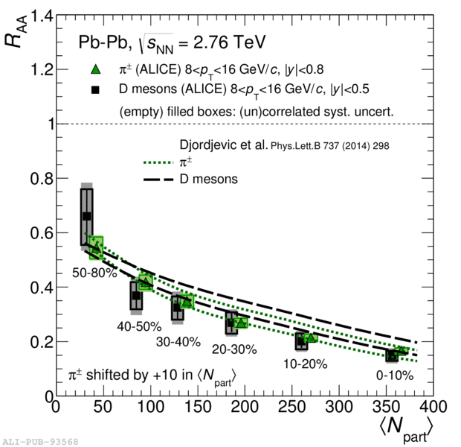
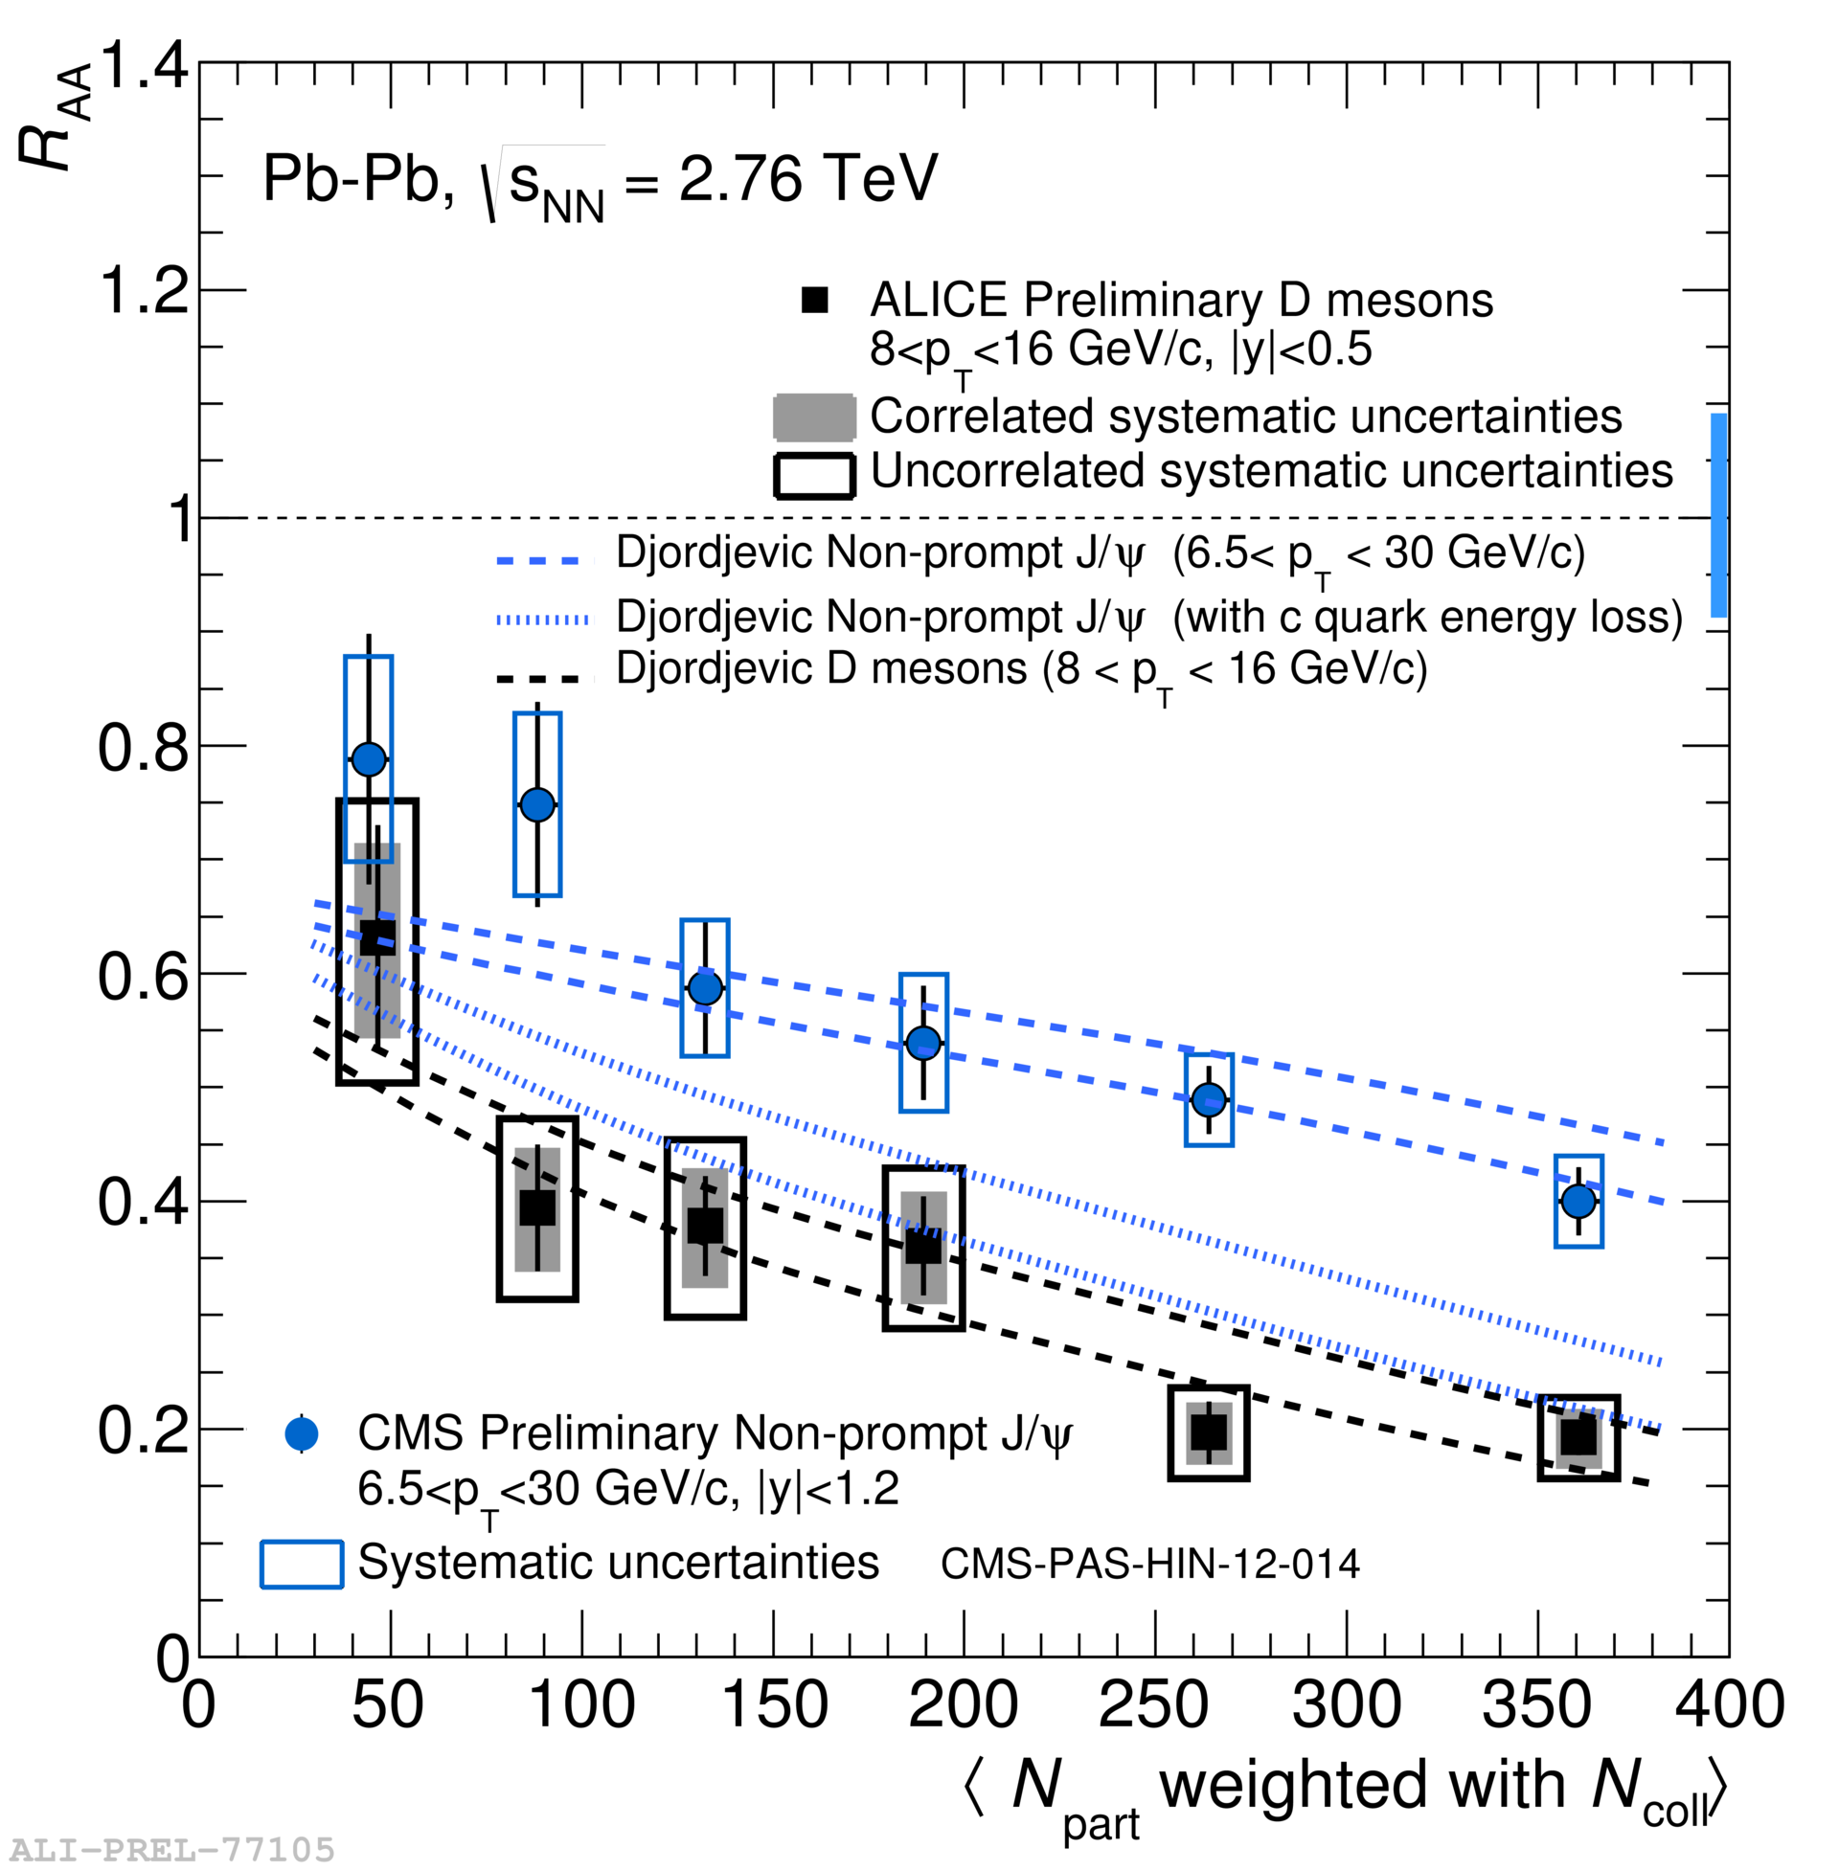
D-meson R_{AA} vs Centrality and Model Comparison
D mesons and charged pions have consistent R_{AA}
arXiv:1506.06604
Indication of R_{AA}(B<-J/PSi) > R_{AA}(D) in most central collisions at 8<p_{T}<16 GeV/c
Model is based on perturbative QCD and contains radiative and collisional energy loss
It contains quark masses (b, c ,s) as well as different fragmentation functions, different shapes of quark and gluon p_{T} distributions
Model is in general agreement with ALICE and CMS measurements
(Lesson: ΔE(uds) > ΔE(c) order is not necessarily translated to R_{AA} )
Sedat Altınpınar

Slide 9
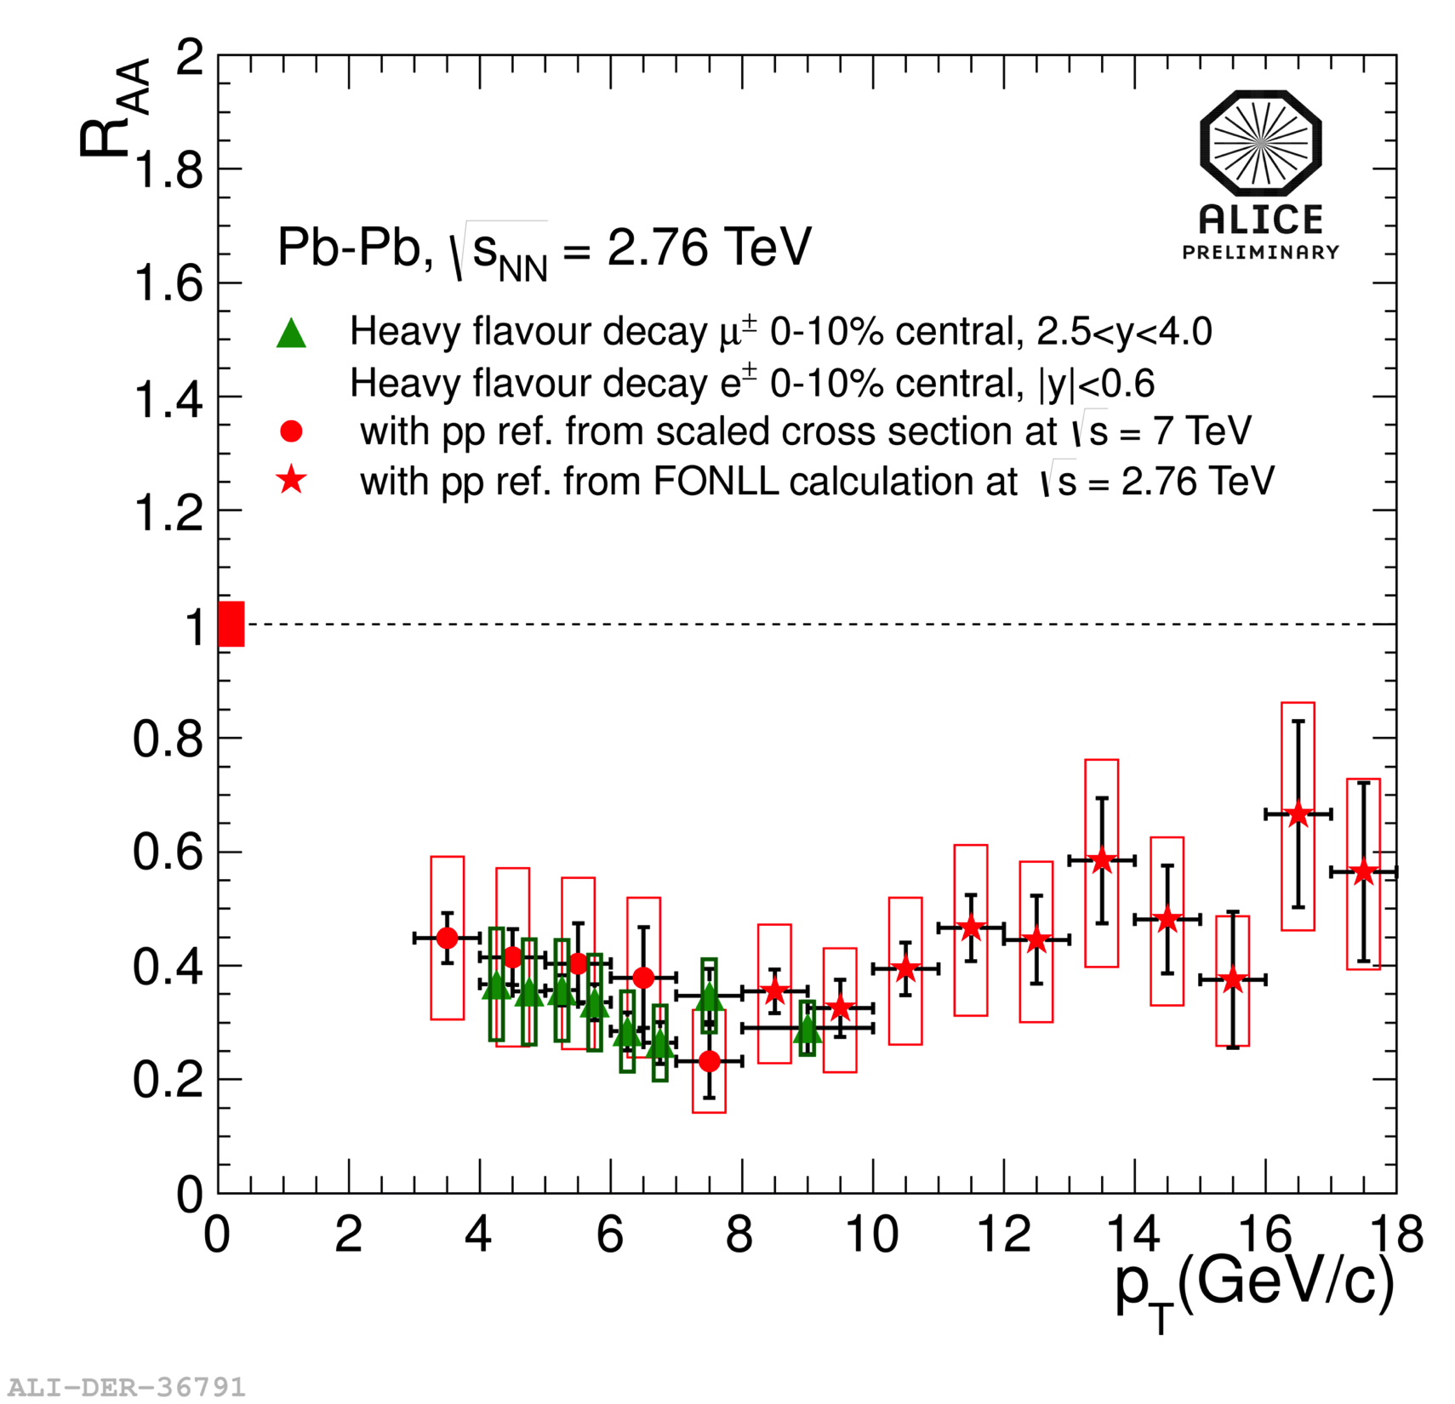
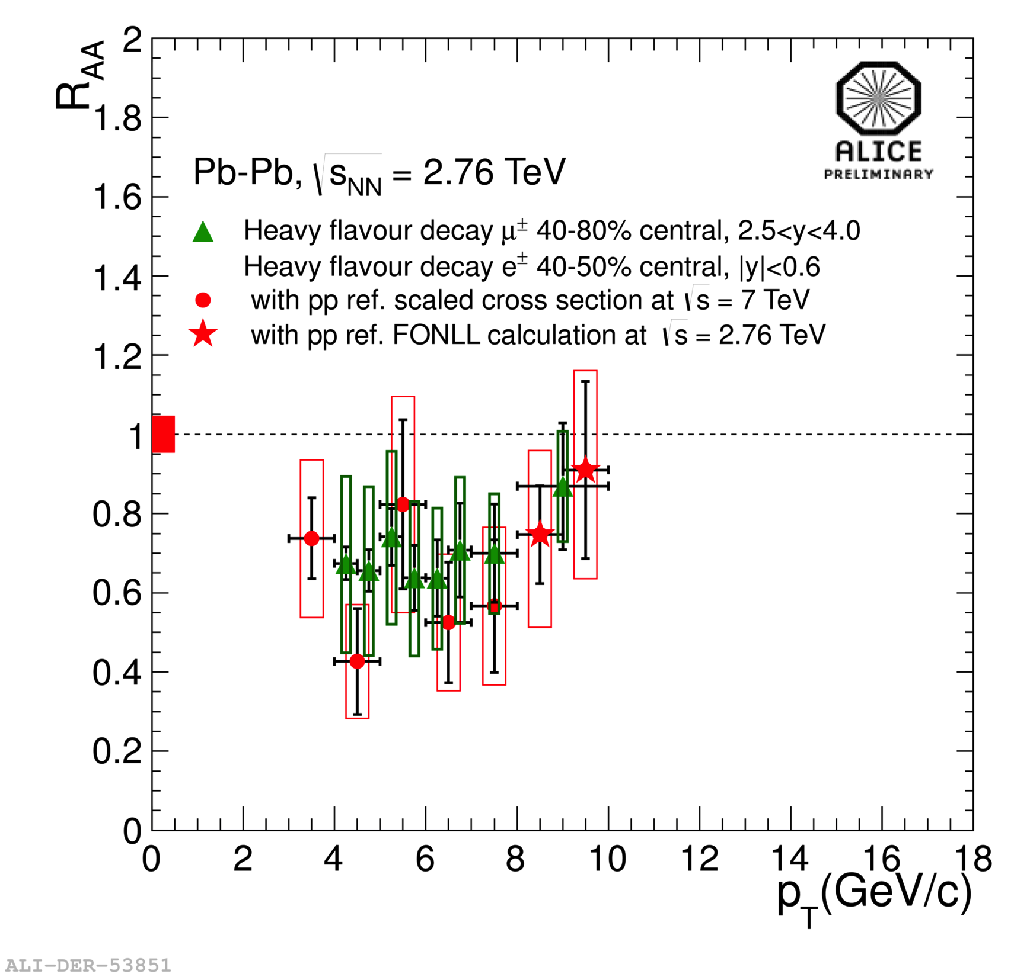
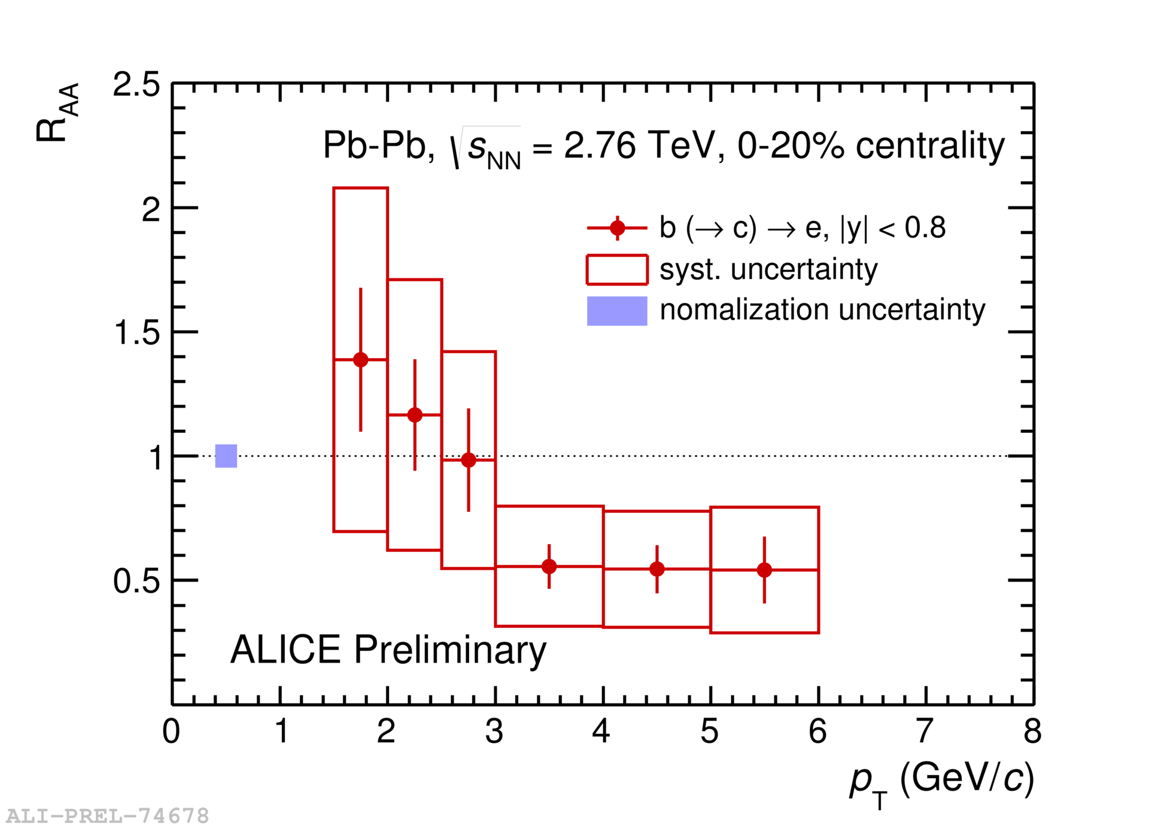
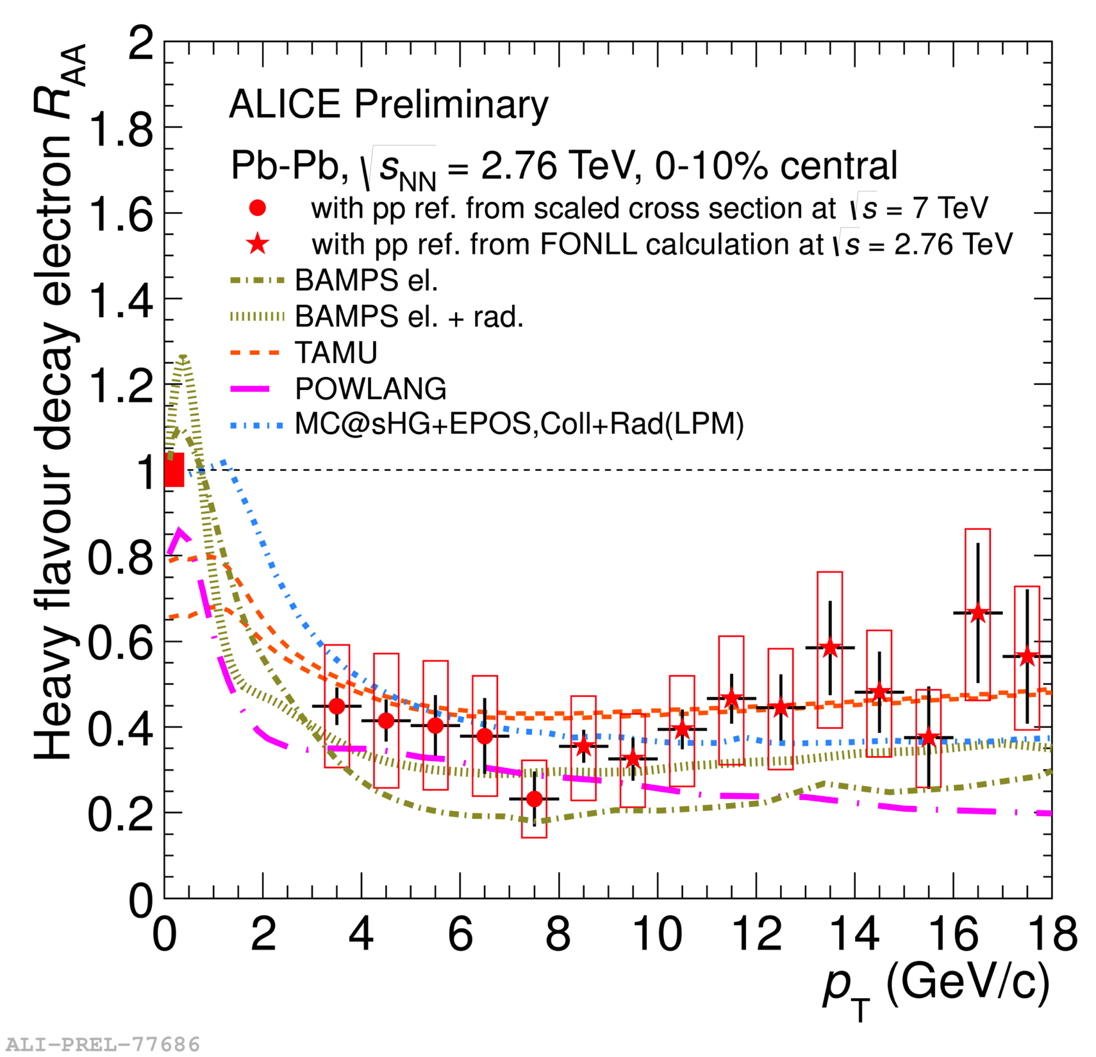
Heavy-Flavour Decay Electron and Muon R_{AA}
0-10 %
40-80 %
Similar suppression of μ <- c,b and e <- c, b yields at forward and mid-rapidity, respectively
Increasing R_{AA} with more peripheral collisions (smaller collision volume)
Hint of suppression of beauty decay electrons for p_{T}>3 GeV/c.
Theoretical models* based on in-medium energy loss reproduce R_{AA} of heavy-flavour decay electrons reasonably well
μ<- c,b
e<- c,b
μ<- c,b
e<- c,b
PRL 109 (2012) 112301
0-10 %
b(->c)->e
Sedat Altınpınar
*References to theory models in the backup

Slide 10
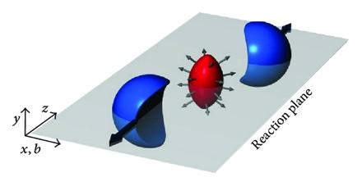
v₂ (Elliptic Flow) Observable
Initial spatial asymmetry in non-central collisions transfers into anisotropic momentum distribution
Azimuthal distribution is characterised by Fourier decomposition
Anisotropic flow via the 2nd Fourier coefficient v₂ (elliptic flow)
v₂ gives information on the participation of charm quarks in the collective motion (low p_{T})
Path-length dependence of partonic energy loss can also contribute to v₂, particularly at high p_{T}
Sedat Altınpınar

Slide 11
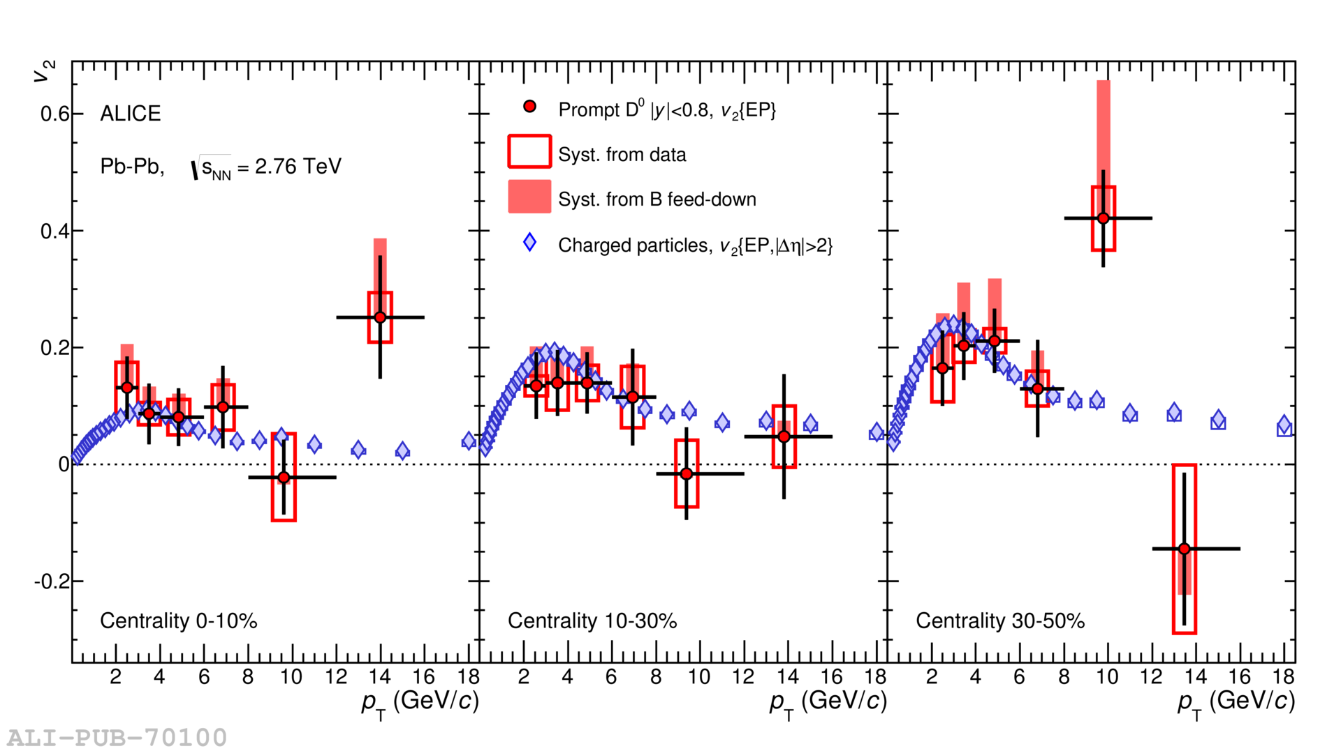
D⁰-meson v₂
Phys. Rev. C 90 (2014) 034904
Similar v₂, positive at intermediate p_{T}, measured for charged particles and D⁰ mesons
Hint of increasing v₂ with decreasing centrality in the D⁰ meson p_{T} range 3<p_{T}<6 GeV/c
Charm participates in collective motion at low transverse momentum
More statistics is needed for an assessment at higher transverse momenta
Sedat Altınpınar

Slide 12
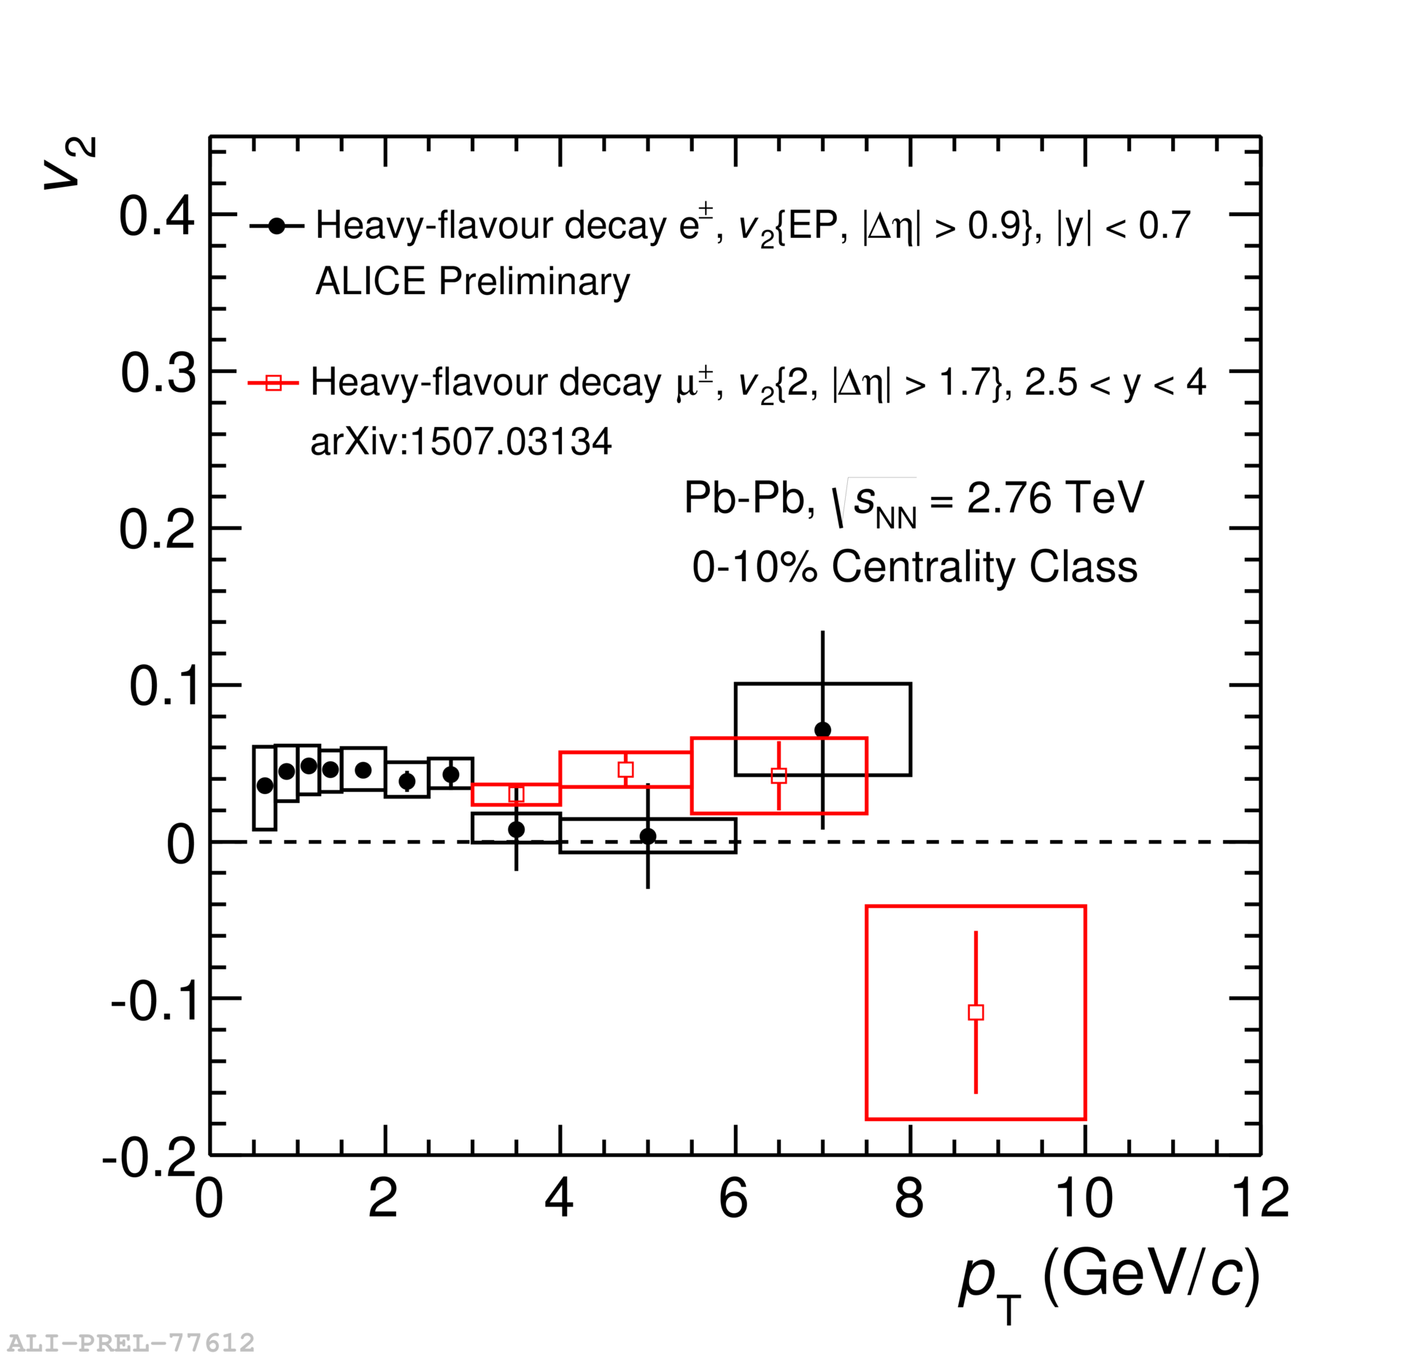
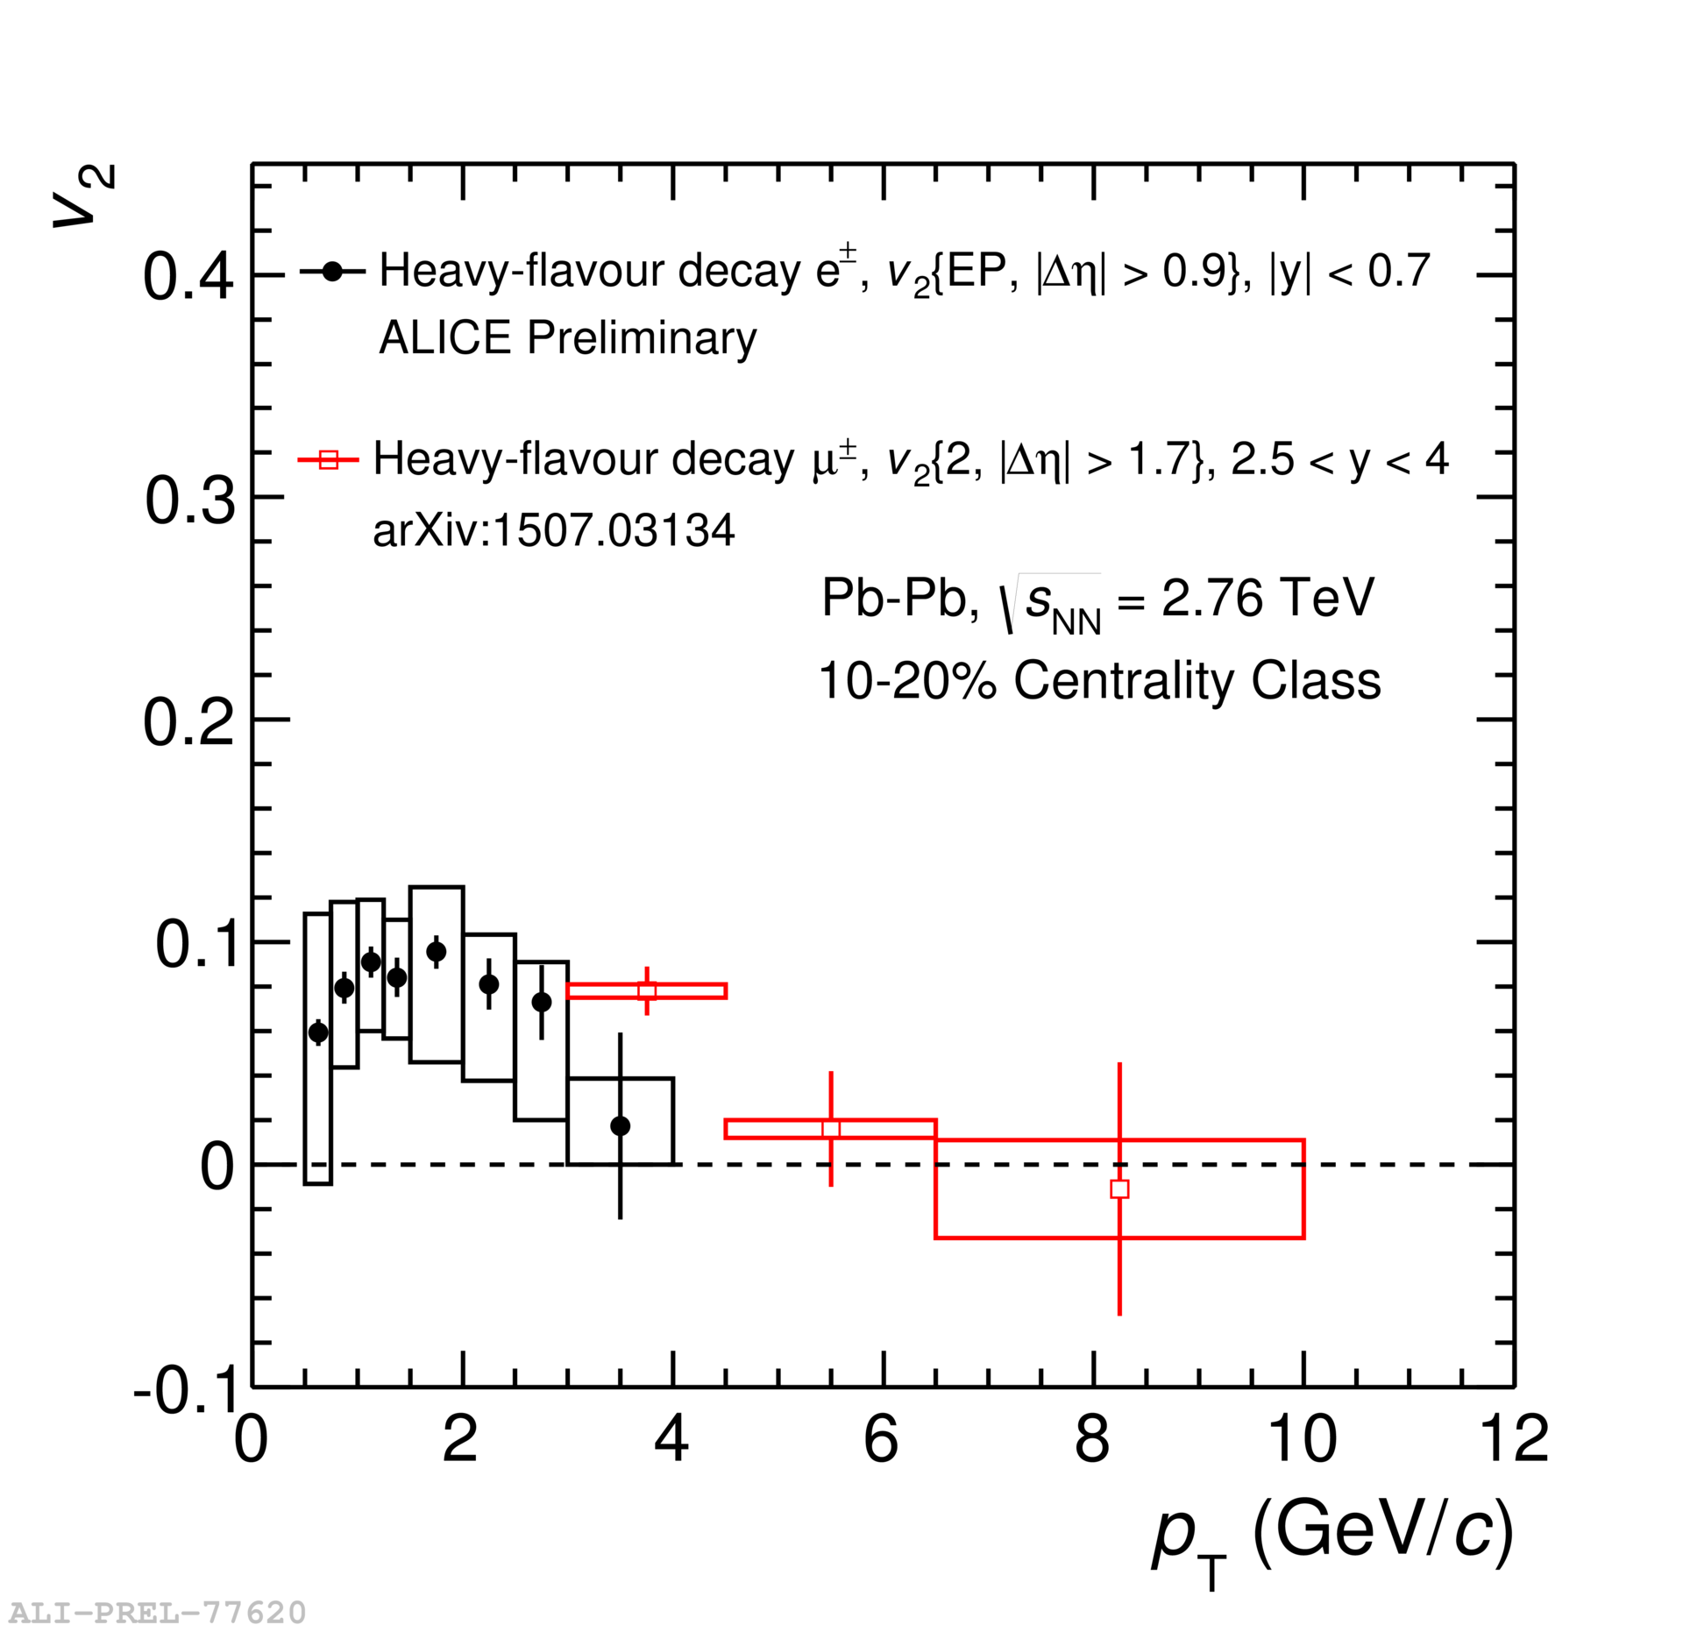
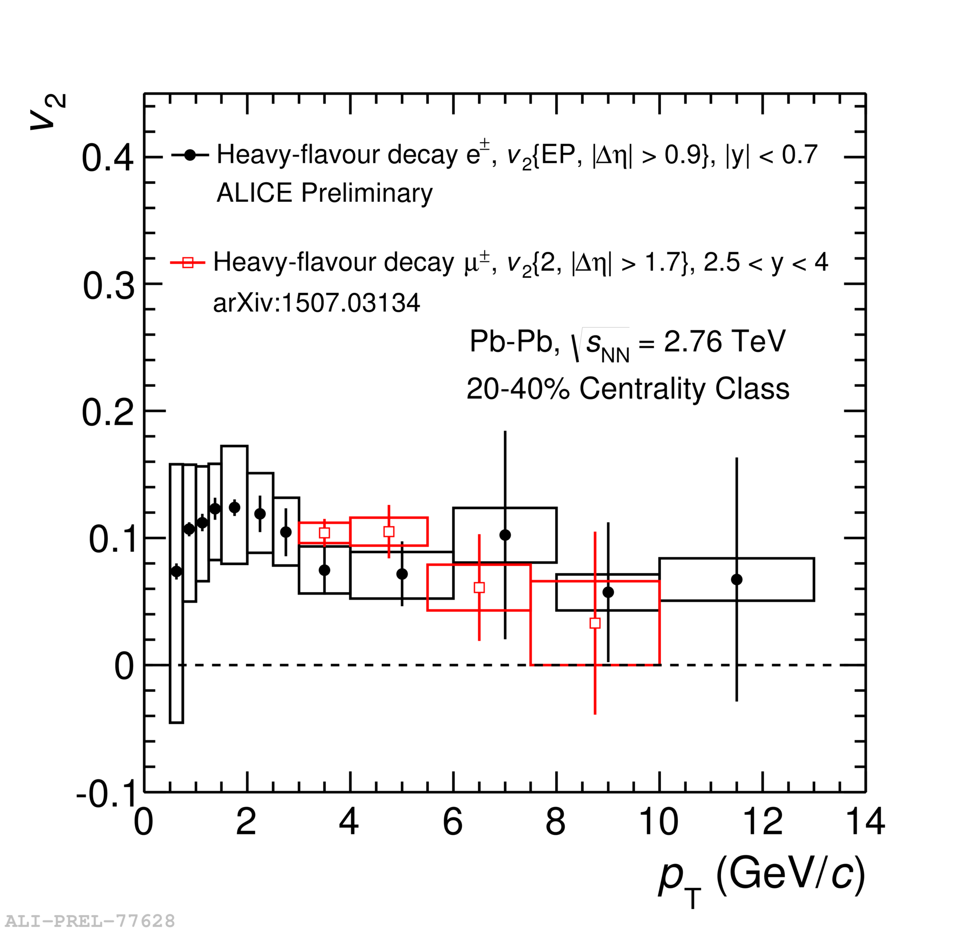
Heavy-Flavour Decay Electron and Muon v₂
Positive v₂ of heavy-flavour decay electrons and muons is observed
Also consistent picture of increasing v₂ with decreasing centrality
Agreeing trend of heavy-flavour decay electron and muon v₂
Electrons and muons originating from heavy flavour participate in collective motion
More statistics is needed to refine high-p_{T} measurements
Sedat Altınpınar

Slide 13
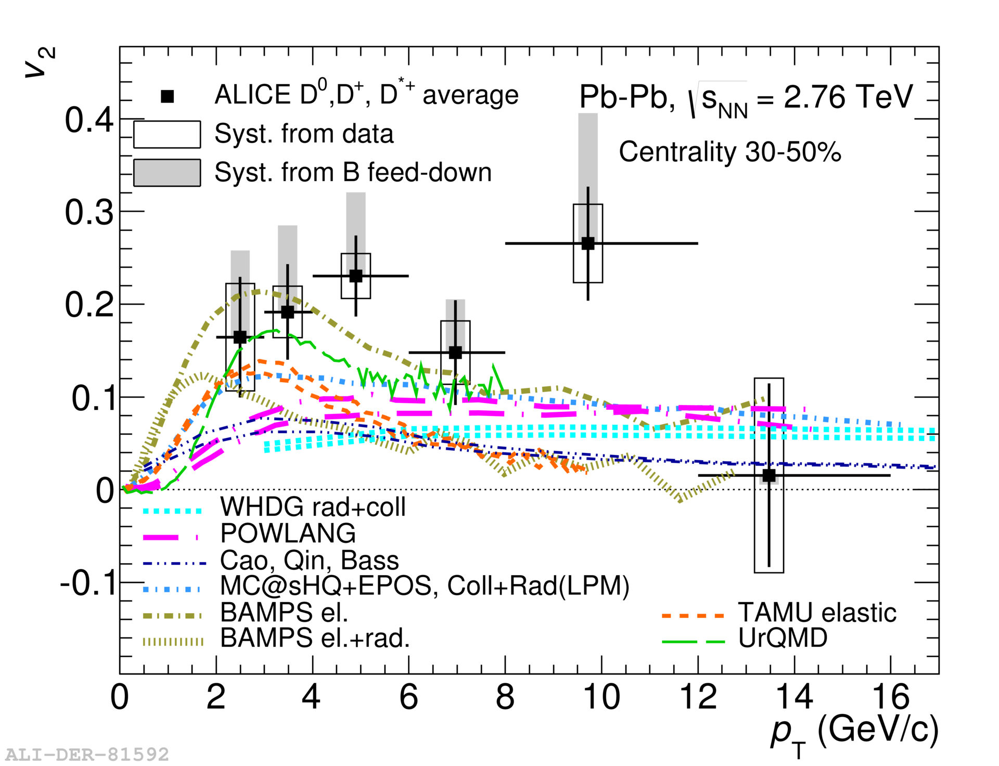
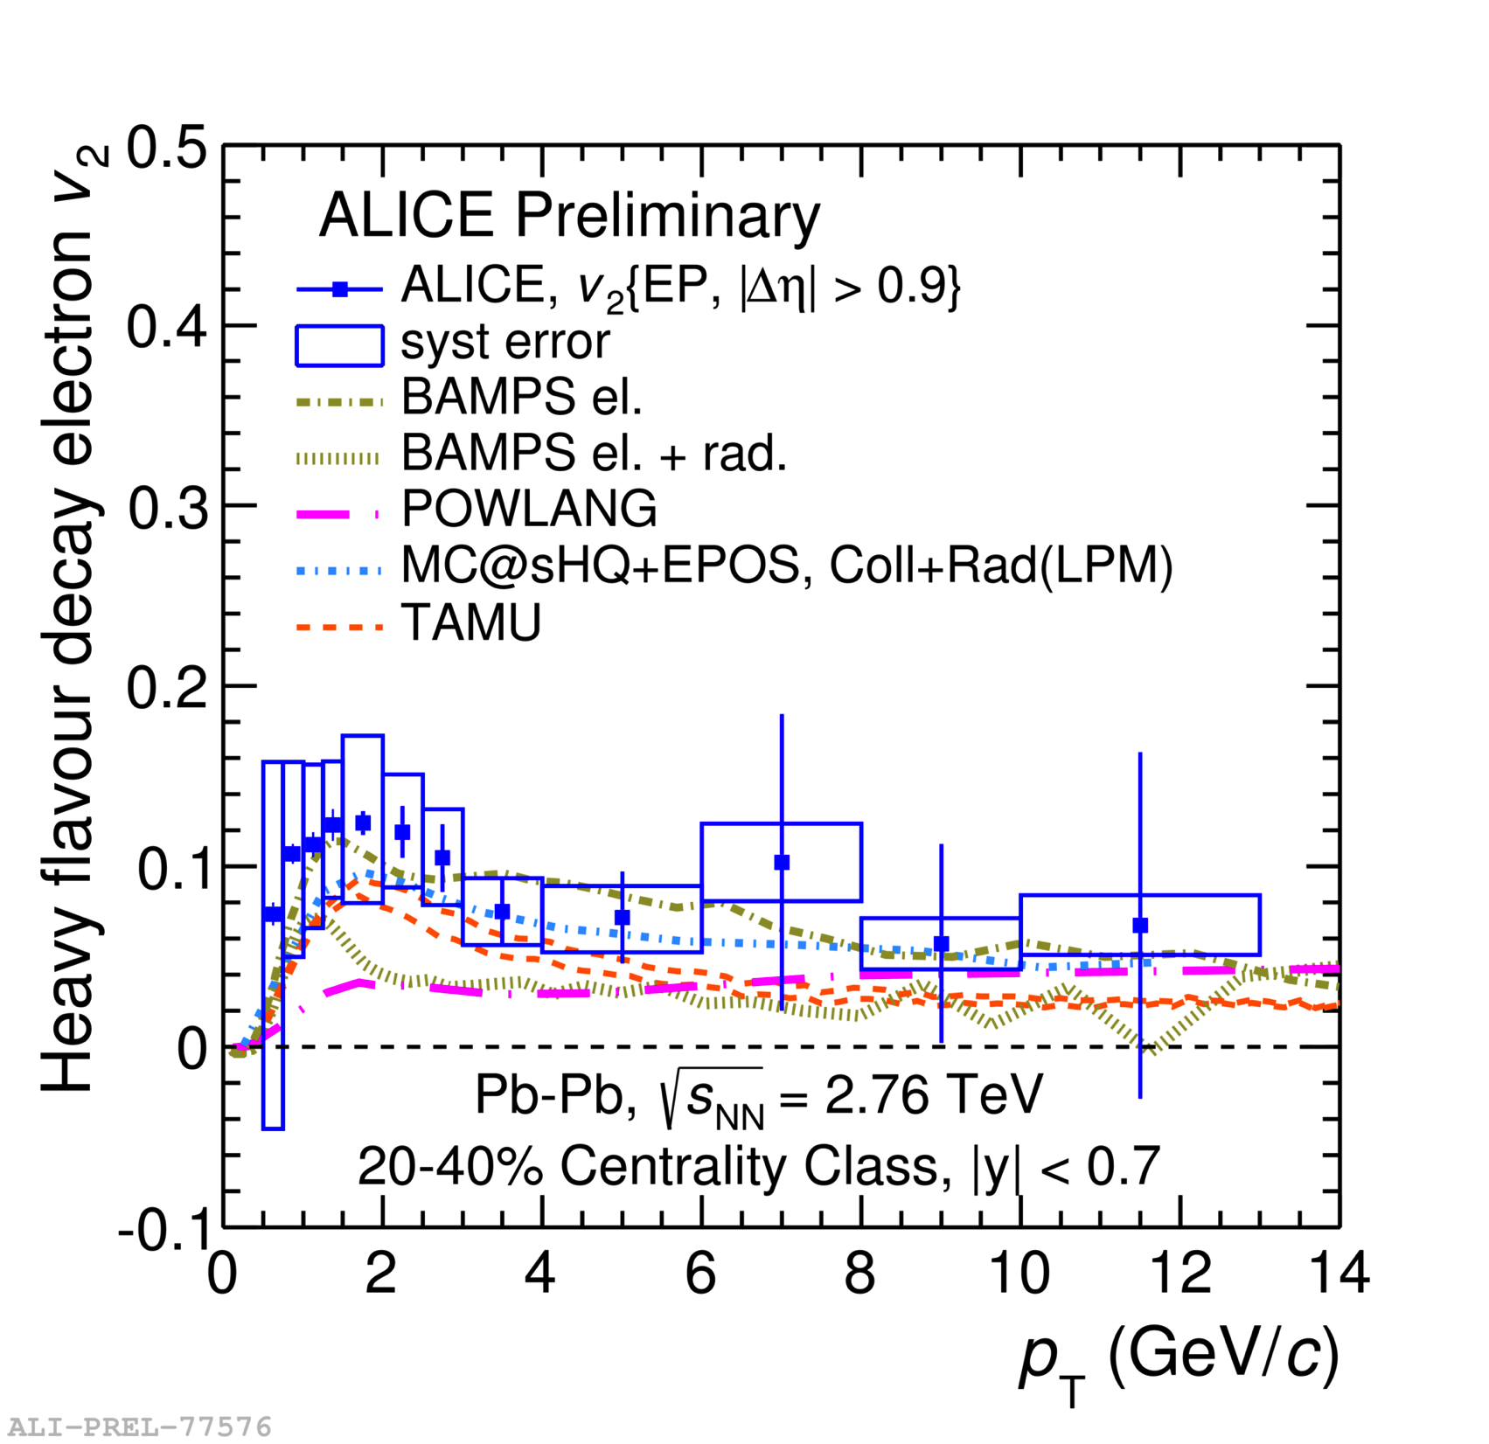
Heavy-Flavour v₂ and Theoretical Models
Phys. Rev. C 90 (2014) 034904*
Current precision and differential measurements already provide constraints to models
Models incorporate hydrodynamics and energy-loss mechanisms.
Heavy-flavour v₂ measurements are best described by models which include collisional energy loss
Sedat Altınpınar
*References to theory models in the backup

Slide 14
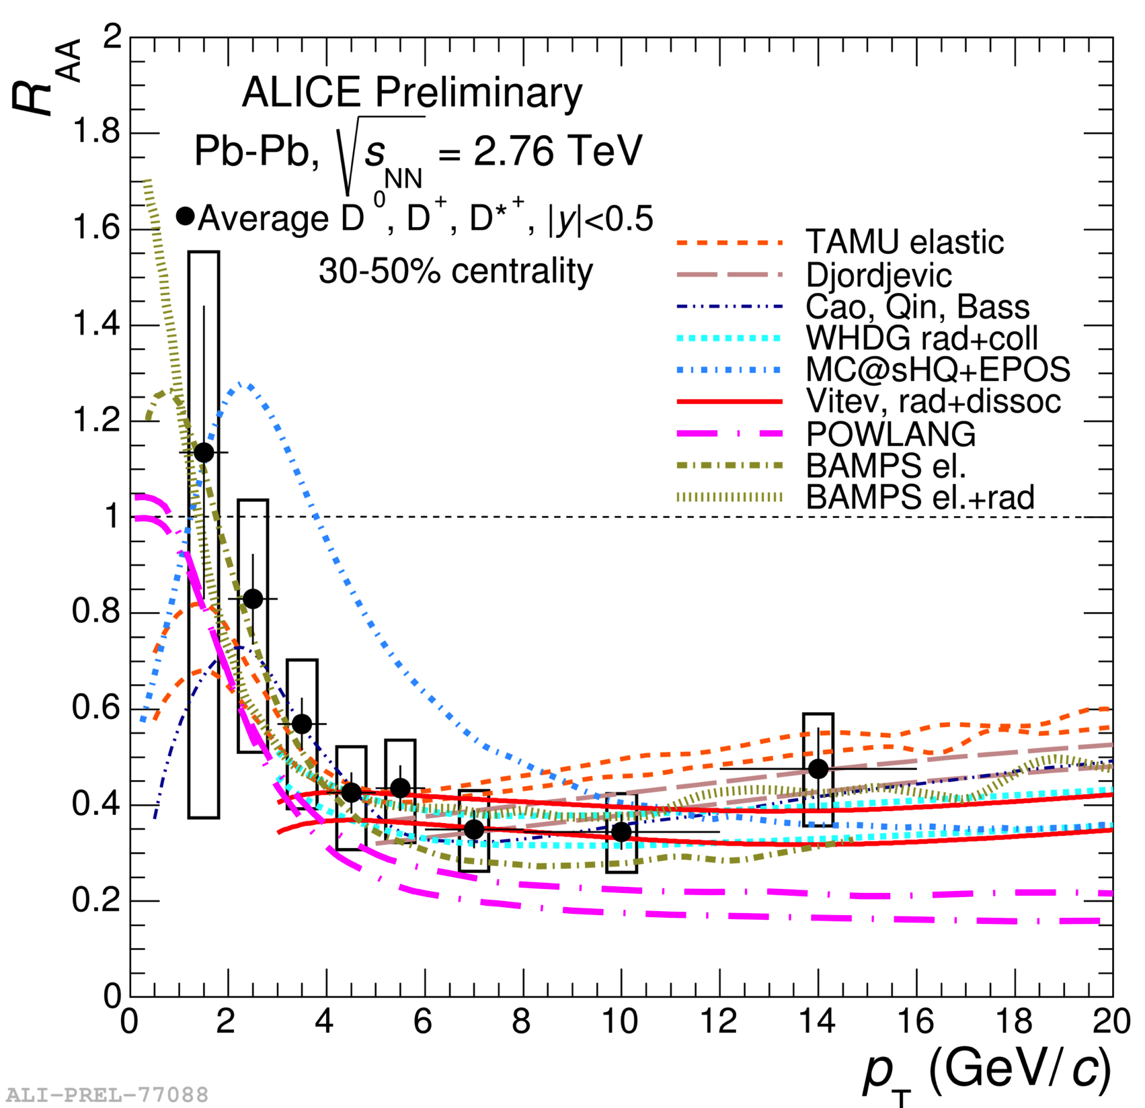
Comparison of R_{AA} and v₂ with models
Phys. Rev. C 90 (2014) 034904
Models are challenged by simultaneous description of v₂ and R_{AA}
Sedat Altınpınar

Slide 15
Summary & Conclusions
Heavy quarks are pushed to lower momenta by their interaction with the medium
Indication of stronger suppression of charm than beauty at higher p_{T} in central collisions
D mesons and charged particles have consistent R_{AA} values. Model is consistent with these results.
Heavy-flavour measurements in the leptonic channels support the measurements via hadronic channels
Indication that heavy quarks participate in collective motion at low-intermediate p_{T} at LHC energy
Smaller uncertainties and new differential measurements will help to further constrain theory models
ALICE is taking data in Run 2 and prepares for Run 3 detector upgrades
Sedat Altınpınar

Slide 16
Thank You

Slide 17
Backup
BAMPS: Fochler et al., J. Phys. G 38 (2011) 124152
POWLANG: Alberico et al., Eur. Phys. J C 71 (2011) 1666
UrQMD: T. Lang et al., arXiv:1211.6912 [hep-ph]; T. Lang et al., arXiv:1212.0696 [hep-ph].
TAMU: Rapp, He et al., Phys. Rev. C 86 (2012) 014903
WHDG: Horowitz et al., J. Phys. G 38 (2011) 124114
Aichelin et al.: Phys. Rev. C79 (2009) 044906; J. Phys. G 37 (2010) 094019.
Cao, Qin, Bass: arXiv:1308.0617 [hep-ph]
MC@sHQ+EPOS, Coll+Rad(LPM) (M. Nahrgang et al, PRC 89 (2014) 014905 )

