Slide 1
A QCD ghost reconstruction scheme for f(T) gravity in flat FRW universe
Surajit Chattopadhyay
Pailan College of Management and Technology, Kolkata 700104, India
Email: surajitchatto@outlook.com

Slide 2
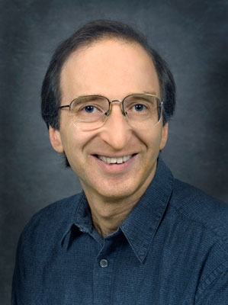
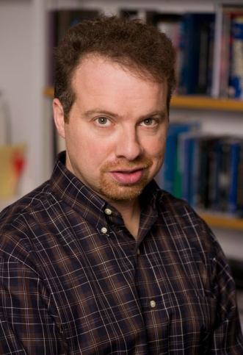
Cosmic observations from Supernovae Ia (SNe Ia) (Perlmutter et al. 1999; Riess et al. 1998) have implied that the expansion of the universe is accelerating at the present .
DE approach
One is to introduce “dark energy” in the right-hand side of the Einstein equation in the framework of general relativity (for reviews on dark energy, see Copeland et al., 2006; Bamba et al., 2012).
Modified gravity approach
The other is to modify the left-hand side of the Einstein equation, called as a “modified gravitational theory”. e.g., f(R) gravity (for reviews, see Nojiri and Odintsov, 2011; Clifton et al., 2012).
A.G. Riess et al., Astron. J. 116, 1009 (1998). doi:10.1086/300499
Approaches for accelerated expansion
S. Perlmutter, Astrophys. J. 517, 565 (1999). doi:10.1086/307221

Slide 3
One of the most important quantity to describe the features of dark energy models is the equation of state (EoS) w_{DE}, which is the ratio of the pressure p to the energy density ρ_{DE} of dark energy, defined as w_{DE} ≡ p_{DE}/ρ_{DE}.
We suppose that in the background level, the universe is homogeneous and isotropic and hence assume the Friedmann-Robertson-Walker (FRW) space-time.
ΛCDM model, in which w_{DE} is a constant and exactly equal to −1, quintessence model, where w_{DE} is a dynamical quantity and −1 < w_{DE} < −1/3, and phantom model, where w_{DE} also varies in time and w_{DE} < −1. This means that one cosmology may be described equivalently by different model descriptions.

Slide 4
Cosmological constant Λ
Holographic dark energies
Scalar field models
Chaplygin gas models
Types of DE
Reviews on DE
Clifton, T., Ferreira, P.G., Padilla, A., Skordis, C.: Phys. Rep. 513, 1 (2012). arXiv:1106.2476 [astro-ph.CO]
Kunz, M.: (2012). arXiv:1204.5482 [astro-ph.CO]
Bamba, K., Capozziello, S., Nojiri, S., Odintsov, S. D., Astrophys Space Sci (2012) 342:155–228

Slide 5
Λ may arise due to vacuum fluctuation.
However, there is a large discrepancy between the vacuum energy density predicted in particle physics (~M_{p}⁴) and the energy density of Λ obtained by fitting ΛCDM model to observations (~(2.3×10⁻³eV)⁴).
The discrepancy is of 60th order of magnitude.
Many models have been proposed to overcome this problem.
F.R. Urban, A.R. Zhitnitsky, Phys. Lett. B 688, 9 (2010) established relation between QCD vacuum and vacuum energy.
They proposed Veneziano ghost [G. Veneziano, Nucl. Phys. B 159, 2013 (1979)] as an alternative to scalar field to account for the late time acceleration.
Veneziano proposed this ghost to solve U(1) problem and it describes long range interactions of QCD.
In the Urban and Zhitnitsky QCD vacuum model (ρ_{vac}~(4.3×10⁻³eV)⁴ ) and hence it is in the same order of magnitude as that of the observations.

Slide 6
D. J. Schwarz, Nucl.Phys. A642 (1998) 336 showed that different phases of QCD at finite temperature and density lead to interesting effects in cosmology and astrophysics.
E.C.Thomas et al., JHEP 0908 (2009) 043 it was stated that the gravity may a low energy effective theory of QCD.
QCD nature of dark energy and its cosmological implications were reviewed in K. Azizi, N. Katirci, arXiv:1506.06986v1
The present work is motivated by R. Garcia-Salcedo, T. Gonzalez, I. Quiros, M. Thompson-Montero, Phys. Rev. D 88, 043008 (2013), where the QCD-ghost dark energy, adopted in the present work, was proposed.

Slide 7
Motivation behind the approach
Viewing the modified gravity model as an effective description of the underlying theory of DE,
and
considering the various versions of the HDE (M. Li, PLB, 603, 1-5 (2004)) as pointing in the direction of the underlying theory of DE,
it is interesting to study how the modified-gravity can describe the various forms of HDE densities as effective theories of DE models.
This motivated us to consider a correspondence between f(T) gravity and QCD ghost dark energy.
X. Wu , Z-H. Zhu, Phys. Lett. B, 660, 293 (2008) | W. Yang et al., Mod. Phys. Lett. A 26, 191 (2011).
M. R. Setare, Int. J. Mod. Phys. D, 17, 2219 (2008). | L. N. Granda, Int. J. Mod. Phys. D, 18, 1749 (2009).
K. Karami, M.S. Khaledian, JHEP 03, 086 (2011). | M.R. Setare, Phys. Lett. B, 644 , 99 (2007) .

Slide 8
Modifications of the Hilbert-Einstein action by introducing different functions of the Ricci scalar have been systematically explored in various literatures.
These are so-called f(R) gravity models. Reviewed in
Nojiri, S. and Odintsov, S. D., arXiv:hep-th/0601213 (2007).
As is known, f(R) gravity can be written in terms of a scalar field - quintessence or phantom like - by redefining the function f(R) with the use of a scalar field, and then performing a conformal transformation.
Another interesting sort of modified theories is so-called f(T ) - gravity (T is torsion).
Literatures show that such f(T )-gravity theories also admit the acceleted expansion of the Universe without resorting to DE.
f(T) gravity

Slide 9
.
In the present work, our purpose is to reconstruct f(T) gravity based on QCD GDE.
The f(T) (T is torsion) gravity is an interesting sort of modified theories of gravity .
Reconstruction schemes for dark energy models have been attempted in various studies.
The studies that are more relevant to the present work fall in the category of the DE-based reconstruction of modified gravity model.
S. Nojiri, S.D. Odintsov, Int. J. Geom. Methods Mod. Phys. 4, 115 (2007).
S. Nojiri, S.D. Odintsov, M. Sasaki, Phys. Rev. D 71, 123509 (2005).
K. Bamba, R. Myrzakulov, S. Nojiri, S.D. Odintsov, Phys. Rev. D 85, 104036 (2012).
References

Slide 10
The reconstruction scheme
Density of the ghost dark energy (GDE) is considered as
Scale factor is chosen as and hence
For spatially flat universe (k=0) the GDE takes the form
It may be noted that for k=0 the tapping horizon coincides with Hubble horizon i.e.
Hubble parameter
Event horizon
R.
Garcia-Salcedo, T et al., Phys. Rev. D 88, 043008 (2013).

Slide 11
We consider a flat Friedmann-Robertson-Walker (FRW) universe filled with the pressureless matter. Choosing (8πG = 1), the modified
Friedmann equations in the framework of f(T) gravity are given by
T=-6H²
For the choice of scale factor
R. Myrzakulov, Eur. Phys. J. C 71, 1752 (2011).
M.E. Rodrigues et al., JCAP 11, 024 (2013).
M.J.S. Houndjo, D. Momeni, R. Myrzakulov, Int. J. Mod. Phys. D 21,
1250093 (2012).

Slide 12
Case I
reconstructed ρ_{T} and p_{T}
In the first modified field Eqn.
we put ρ=ρ_{gde}
which is a linear differential equation
with t and f as the independent and
dependent variables, respectively.
reconstructed effective equation-of-state parameter

Slide 13
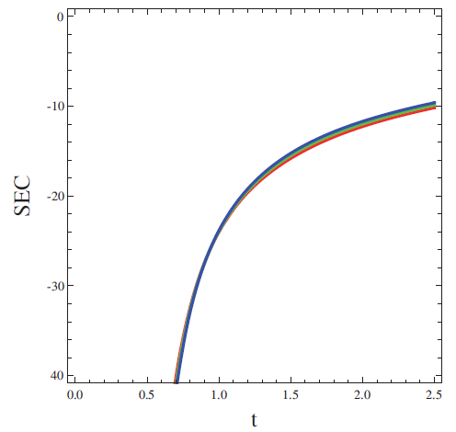
Strong energy condition (SEC) is
ρ_{T}+ ρ_{gde}+3(p_{T}+p_{gde})≥0
Clearly, the SEC is violated in this case of reconstruction.
Hence, w_{eff}<-1/3
This result is consistent with accelerated expansion of the universe.
ρ_{T}+ ρ_{gde}+3(p_{T}+p_{gde})<0
In all of the plots, red, green and blue lines corresponds to α = 5.6, 5 and 4.5, respectively.

Slide 14
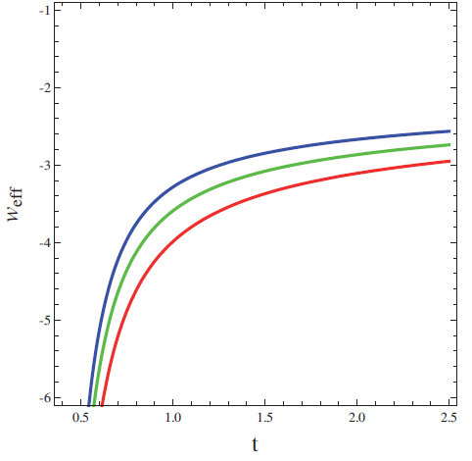
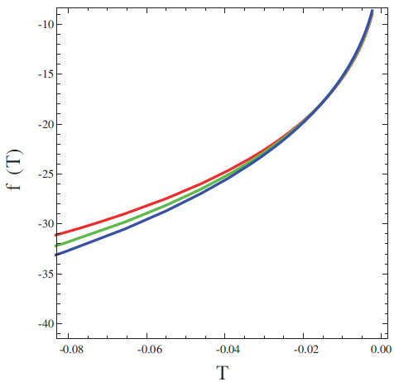
Satisfaction of one of the sufficient
conditions for realistic model.
Indication of “phantom” behaviour.

Slide 15
We now want to study an important quantity, namely the squared speed of sound v_{s}². The sign of v_{s}² =p/ρ is crucial for determining the stability of a background evolution.
v_{s}²<0
v_{s}² < 0 and this indicates that the model is unstable against small perturbations.

Slide 16
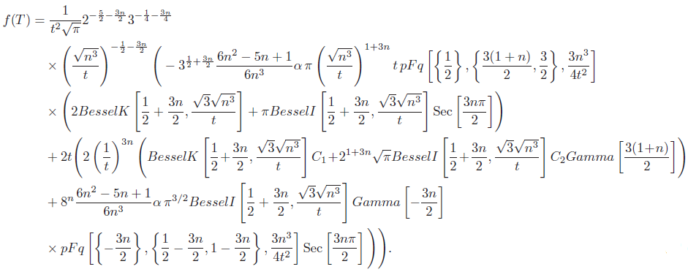
Case II: In this case we derive reconstructed f(T) based on the conservation equation
ῥ+3H(ρ+p)=0
Using this equation in the equation for p_{T} we get
the following differential equation
Reconstructed f(T)

Slide 17
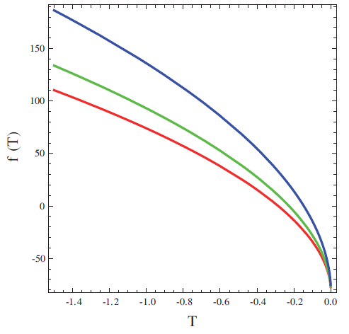
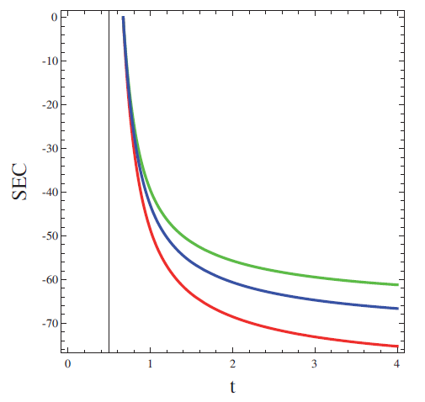
SEC is violated
Case II
w_{eff}<-1/3
Reconstructed f(T)→0 as T→0
Case II

Slide 18
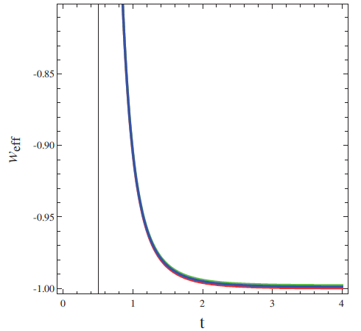
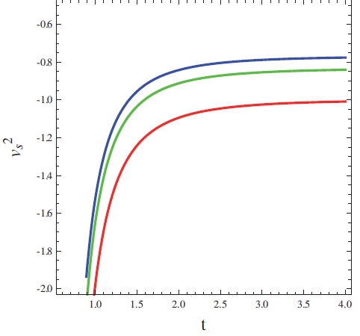
Case II
w_{eff}>-1
w_{eff}→-1
The reconstructed effective
EoS parameter is exhibiting
“quintessence” behaviour.
It is tending to the phantom boundary, but is not crossing it anyway.
Negative sign of the squared speed of sound
again shows that the model is not stable under
small perturbations.

Slide 19
Case I
Case II
f(T)→0 as T→0
w_{eff}<-1/3
Consistent with accelerated expansion of the universe
Model is unstable to small perturbations
w_{eff}<-1 i.e. phantom
w_{eff} does not tend to -1
f(T)→0 as T→0
w_{eff}<-1/3
Consistent with accelerated expansion of the universe
Model is unstable to small perturbations
w_{eff}>-1 i.e. quintessence
w_{eff} tends to -1

Slide 20
Concluding remarks
Due to non-positivity of the squared sound speed as seen in the plots, both QCD ghost f(T) models are classically unstable against perturbations in flat Friedmann-Robertson-Walker backgrounds. This instability problem is consistent with the result presented for QCD ghost dark energy model by [R. Garcia-Salcedo, T. Gonzalez, I. Quiros, M. Thompson-Montero, Phys. Rev. D 88, 043008 (2013)].
However, the instability problem raised by negativity of by arguing that the Veneziano ghost does not have a physical propagating degree of freedom and the corresponding GDE model does not violate unitarity causality or gauge invariance. This argument can be seen in [A. Rozas-Fernandez, Phys. Lett. B 709, 313 (2012)].

Slide 21
We would like to mention the work of [S. Nojiri, S.D. Odintsov, Phys. Rev. D 72, 023003 (2005).], where the dark energy universe equation of state with inhomogeneous, Hubble parameter dependent term was considered and crossing of the phantom barrier was realized.
In our current work we have reconstructed f(T) gravity based on QCD ghost dark energy and our equation of state parameter has been found to be above −1 and gradually tending to −1.
We propose as future work to consider the assumed equation of state parameter of the work of Nojiri and Odintsov [S. Nojiri, S.D. Odintsov, Phys. Rev. D 72, 023003 (2005).] in the f(T) reconstruction and to investigate whether this helps the reconstructed f(T) to cross the phantom barrier.

Slide 22
Bibliography
On modified gravity
S. Nojiri, S.D. Odintsov, Int. J. Geom. Methods Mod. Phys. 4, 115 (2007).
S. Nojiri, S.D. Odintsov, M. Sasaki, Phys. Rev. D 71, 123509 (2005).
M. Jamil, D. Momeni, R. Myrzakulov, Eur. Phys. J. C 72, 2137 (2012).
M. Jamil, D. Momeni, R. Myrzakulov, Eur. Phys. J. C 72, 1959 (2012).
K. Bamba, M. Jamil, D. Momeni, R. Myrzakulov, Astrophys. Space Sci. 344, 259 (2013).
M. Jamil, D. Momeni, R. Myrzakulov, Eur. Phys. J. C 72, 2122 (2012).
M. Jamil, D. Momeni, R. Myrzakulov, Eur. Phys. J. C 72, 2075 (2012).
M. Jamil, D. Momeni, R. Myrzakulov, Eur. Phys. J. C 72, 2137 (2012).
M. Jamil, K. Yesmakhanova, D. Momeni, R. Myrzakulov, Cent. Eur. J. Phys. 10, 1065 (2012).

Slide 23
On QCD GDE
F.R. Urban, A.R. Zhitnitsky, Phys. Lett. B 688, 9 (2010).
R. Garcia-Salcedo, T. Gonzalez, I. Quiros, M. Thompson-Montero, Phys. Rev. D 88, 043008 (2013).
A. Rozas-Fernandez, Phys. Lett. B 709, 313 (2012).
Acknowledgements:
Support from DST, Govt of India, under its international travel
support grant number ITS/2896/2015-2016
Support from CICS, Govt of India, under its international travel
fellowship number DO/Lr/TF-II/2015-16

Slide 24
Thank you

