Slide 1
Straw Production: Status, Plans, Timelines
Peter Wintz (IKP - FZ Jülich)
(A. Cebulla, I. Georgadze, V. Kozlov, S. Orfanitski)
PANDA Tracking Meeting,
Oct-10, 2013, Jülich

Slide 2
Outline Straw Production
STT layout
Straw tubes
Straw modules
Straw production
Risk factors
Timelines

Slide 3
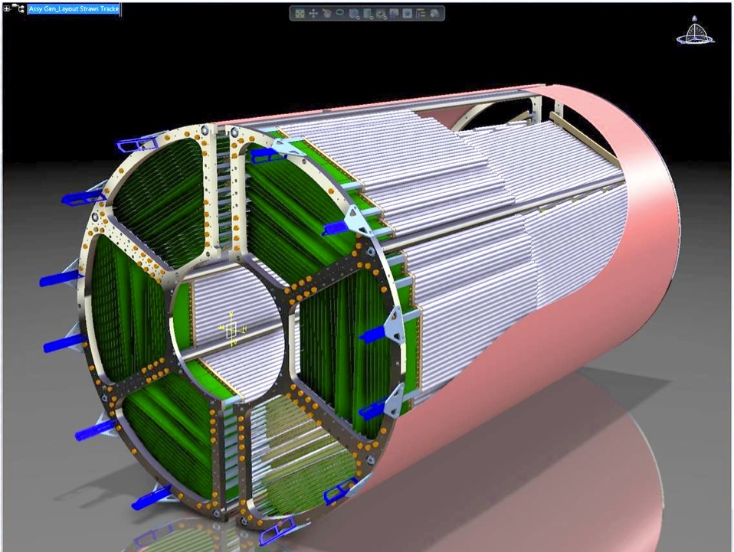
STT Layout
A
F
4636 straw tubes in 2 separated semi-barrels
6 hexagonal sectors (A-F)
23-27 planar layers in radial direction
15-19 axial layers (green) in beam direction
4 stereo double-layers: ±3° skew angle (blue/red)
STT dimensions
R_{inner}/R_{outer}: 150/418 mm
Length: ~ 1500 + 150 mm
Inner / outer walls (~ 1mm kevlar → Dario)
Material budget: X/X₀ = 1.23 % (radial)
B
E
D
C
STT x-y view
STT 3-D view

Slide 4
STT Layout Parameters
Basic parameter list
STT inner/outer radius
Straw length
Skew angle of stereo layers
Straw pitch
Straw positions
Straw module layout (gas sectors)
Attachment points to mechanical frame
straw pitch

Slide 5
Straw Length
Straw length = cut length of mylar film tube
1400 mm length for axial straws (1418 mm incl. endplugs)
Stereo layers
6× shorter straws with different length: L= i×200mm -15mm, i = 1..6
-15 (20) mm gap for electric/gas connection
Skew angle: α = 2.90(5)° (→ σ_{z} ~ 2.9 mm)

Slide 6
Straw Pitch
New straw diameter (pressurized) for new mylar film tubes (LAMINA specs.)
New straw pitch in layout
Pitch = straw diameter + 20µm gap (glue), straws pressurized to Δp=1 bar
Diameter meas. method developed & approved, ~1-2µm precision (Artur)
Change (prelim.): 10.10 → 10.14(5) mm
Small change in radial STT dimension (ΔR_{max}~1.3mm)
Few mm safety margin in layout still left
Re-calculation of all straw positions
CAD & text file for MC input (Artur/Peter)
Mechanical frame adaption
New reference plate for layer gluing neccessary
Final decision of straw pitch in Nov/Dec 2013
Change of radial dimensions by larger straw diameter
ΔR ∼ 1.3 mm

Slide 7
Straw Tubes
Straw materials
New mylar film tubes
Repeat orders necessary
All materials for 10.000 straws
No redesigns (or only minor changes)
Endplugs, crimp pins, grounding springs, ..

Slide 8
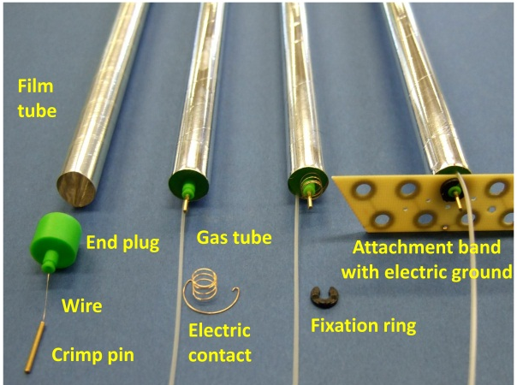
Straw Tube Materials
Minimised number of materials and material budget (thickness)
Al-mylar film, d=27µm, ∅_{ID}=10mm, L=1400mm
20µm sense wire (W/Re, gold-plated)
Wire tension 50g at 1 bar overpressure
End plug (ABS thermo-plastic)
Crimp pin (Cu, gold-plated)
Gas tube (PVCmed, ∅_{OD}=0.8mm, 150µm wall)
Cathode spring (Cu/Be, gold-plated)
Attachment strip (GFK), locator ring (POM)
All materials radiation-hard
(p-beam tested)
Straw components
Element | Material | X [mm] | X₀ [cm] | X/X₀
Film Tube | Mylar, 27µm | 0.085 | 28.7 | 3.0× 10⁻⁴
Coating | Al, 2× 0.1µm | 6.3× 10⁻⁴ | 8.9 | 7.0× 10⁻⁶
Gas (2bar) | Ar/CO₂ (10%) | 7.85 | 6131 | 1.3× 10⁻⁴
Wire | W/Re, 20µm | 3× 10⁻⁵ | 0.35 | 8.6× 10⁻⁶
 |  |  | Σ_{Straw} | 4.46× 10⁻⁴

Slide 9
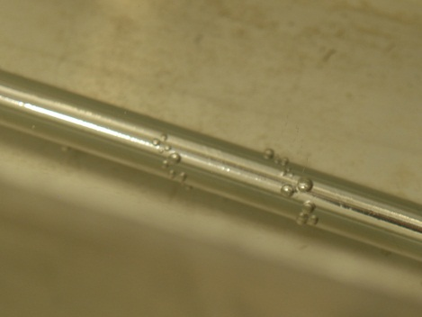
Mylar Film Tube
Specifications:
Mylar film, 10.00mm ID, 27µm wall (LAMINA, UK)
2× 12µm mylar strips, + ~3µm glue
2× 0.1µm aluminisation (×3 higher than before)
At inner side + outer side of tube
Two different specifications of inner strip layer winding
w/ 1mm self-overlap → single tube with higher rigidity
w/o self-overlap → minimal wall (27µm)
Reminder:
straw tube = 2 long Al-mylar
film strips, helically wound around mandrel and glued together
Former straw leakage
at winding gap (2012)
Short history summary (2011-2012):
1st delivery: excess glue at straw inner side caused broken wires inside assembled straws
2nd delivery: new specification with self-overlapping inner strip, same spec as COSY-STT
straws, there only ~1% broken wires
We found stronger leakage (>10× permeation level) at winding spiral
Explanation: too much! glue, inhomogenous glue layer

Slide 10
Mylar Film Tube Tests
Close co-operation with LAMINA
Setup of our proposed leakage test bench at LAMINA, test sample tested ok by us
Quick new mass production, charge-free
1st replacement order (both specs 2500+2500 straws) received in Jun-2013
Both straw types tested sucessfully up to Δp ~ 2bar
No leakage observed anymore
Elongation ok, ΔL/Δp ~ 0.9mm/1bar
Twisting negligible , Δϕ/Δp < 2°/1bar
Diameter rise still to be measured, ΔR/Δp
Decision between both specs after precise diameter measurement

Slide 11
Straw Modules
Axial layer modules
Stereo layer modules
Gas manifolds & sectors
3-D gauge of straw modules
Alignment structures
Mechanical frame attachment

Slide 12
Axial Straw Modules
Axial quad-layer module
4 close-packed planar layers, (dot) glued together
Increased rigidity compared to double-layer
Replacement of faulty single straws still possible (from outer to inner layer)
Even number of straws and gas lines per module
Only 1 inlet + 1 outlet gas pipe for one module
In-/outlet at same end by connecting 2 straws in series at far end
Outer axial module
3-7 close-packed planar layers
Outer circular shape
Axial straw
modules

Slide 13
Stereo Straw Modules
Stereo quad-layer module
2× closed-packed double-layers with opposite skew angle (± 2.9° to axial)
Even number of straws
Gas in-/outlet at same end
Shorter tubes at corners, connected (gas+electric) to next skewed double-layer in same module
Stereo layers
Connection scheme of shorter straws in skewed double-layers
+2.9° -2.9° view from top

Slide 14
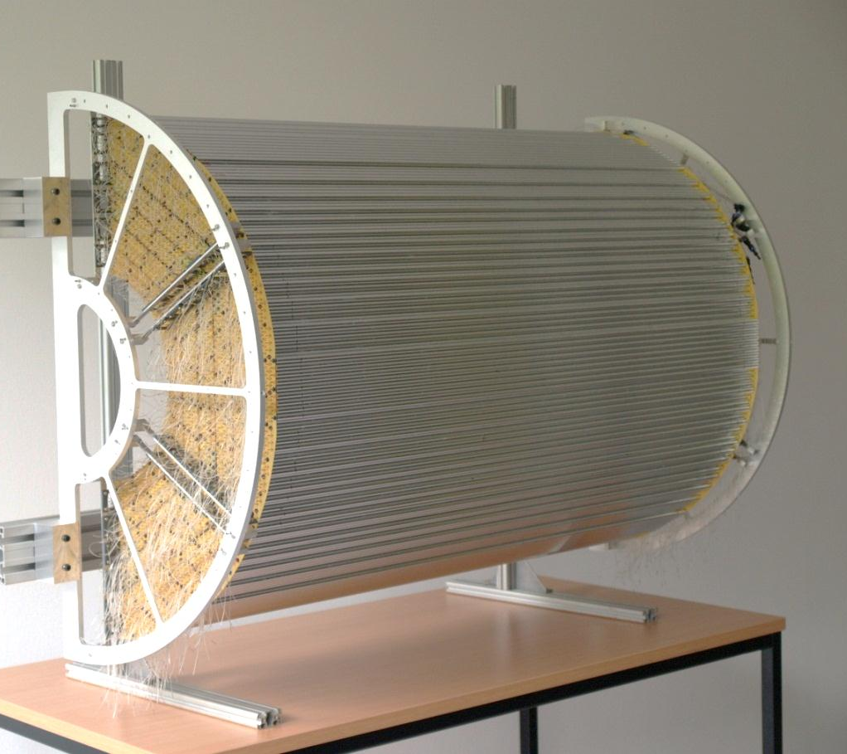
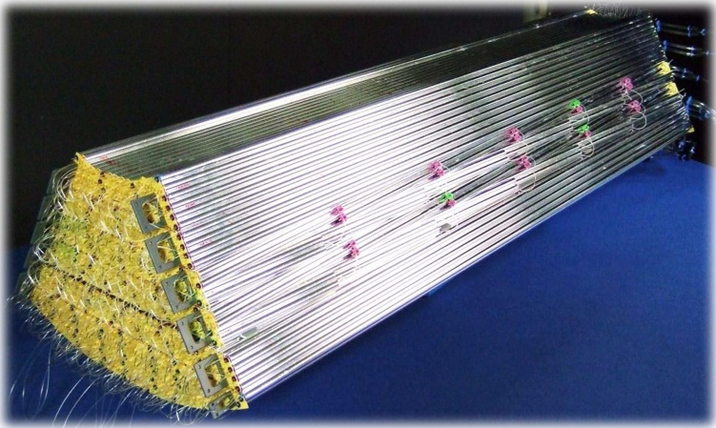
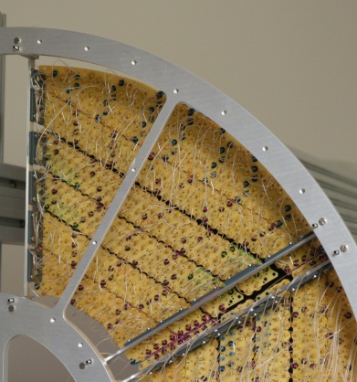
Straw Modules Layout
Semi-barrel, length 1.2 m, final radial dimensions, reduced mech. frame
Hexagon sector, mounting brackets to fix modules in mechanical frame
STT sector consisting of 6 straw modules:
2 inner axial + 2 stereo + 2 outer axial
STT prototype, one semi-barrel

Slide 15
Gas Manifolds
Stainless steel pipes
∅ = 4 × 0.1 mm (OD × wall)
10mm long end pieces with thicker wall (0.4 mm)
Capillary pins (∅ = 0.55mm) for individual straws
1 inlet pipe + 1 outlet pipe per straw module
Inlet + outlet pipe at same end

Slide 16
Gas Sectors
Per semi-barrel: 12 gas lines, 2×12 gas pipes (in-/outlet)
Arrangement of 4 parallel gas lines per hexagon sector
Proposed scheme: lines 1, 2, 3a+b, 4a+b
Similar number (=gas flux) of straws per gas line: #205, 196, 190, 142
Still 3d tracking possible with momentum reso. in each sector if one line failures
Still 3d-online track recognition possible
No hints for serious gas failures (leakage)
from COSY-STT, 4yrs in vacuum,
leakage at permeation level
1
3a
2
4a
3b
4b

Slide 17
3-D Gauge of Straw Modules
Task:
Measure absolute straw positions, define reference points in hexagon sector
Check gas overpressure / temperature effects
Define full assembly method
Check minimal support / alignment structures (forw/backw connecting tubes)
Define attachment points of straw modules to mechanical frame
Method:
Assembly (step-by-step) of one complete hexagon sector
3D gauge arm measurement, ~ 1.8m volume length
Input to CAD file
Is important step: final positioning/alignment check, to be finished by end 2014

Slide 18
Straw Mass Production
Status
Quality assurance
Timelines

Slide 19
Straw Mass Production Preparations
Pilot straw mass production run (~ 600 straws) was done in 2012
Quality criteria & assurance approved
Leakage test & wire tension check of each assembled straw
Mylar tube quality checked last month (Sep-2013), ok!
All straw materials available for first few 1000 straws
Repeat order for some parts neccessary during 2014
Clean room set up for straw production
Clean storage of assembled straws outside in preparation
Final straw mass production has started (Oct-2013)

Slide 20
Straw Mass Production Plan
Final mass production of 10.000 straws:
1000 straws for hexagon sector setup
5000 straws for STT construction
3000 - 4000 spare (fully assembled) straws to avoid new production cycle later
During 2013 – 2017

Slide 21
Straw Related Risk Factors
Quality control during straw mass production
Wire tension measurement & leakage test of each single straw (also long-term)
Criteria (sensitivity) approved (prototype productions, COSY-STT)
Assembly in clean room, storage in clean containers
Straw operation, avoid/reduce aging by
Contamination of straws and gas system, e.g. SiO2 → destruction of straws
Gas gain limit, 5×10⁴ (LSM few %)
STT assembly
Pre-mounting foreseen (pre-series test)
One complete hexagon sector
Risk factors under control

Slide 22
Timelines Straw Production
Funding period 2012-2016 (BMBF, Germany)
2013 (Q4): Final straw design freeze
2013-2017: Straw mass production & assurance tests (3-4 years)
2014 (Q4): 3-D gauge of straw modules (absolute positioning)
2015/16: Pre-series test
Full STT Hexagon sector assembled
Equipped with readout (~ 800 channels), DAQ
Beam tests at COSY
2017: Completion of STT assembly

Slide 23
Timelines Straw Production
Funding period 2012-2016 (BMBF), timelines for straw constructions
2013 (Q4): Final design freeze
2013-2017: Straw mass production & assurance tests (3-4 years)
2014 (Q4): 3-D gauge of straw modules (absolute positioning)
2015: Final mechanical frame design & manufacturing
2015/16: Pre-series test
Full STT Hexagon sector assembled
Equipped with readout (~ 800 channels), DAQ
Beam tests at COSY

Slide 24
Timelines Straw Production
Funding period 2012-2016 (BMBF), timelines for straw constructions
2013 (Q4): Final design freeze
2013-2017: Straw mass production & assurance tests (3-4 years)
2014 (Q4): 3-D gauge of straw modules (absolute positioning)
2015: Final mechanical frame design & manufacturing
2015: Final frontend electronic readout design
2015/16: Pre-series test
Full STT Hexagon sector assembled
Equipped with readout (~ 800 channels), DAQ

