Slide 1
- ST_TRACKER, MAIN MECHANICAL ISSUES -
-THE AIM OF THIS TALK IS TO SUMMARIZE ALL THE WORK THAT HAS BEEN DONE FOR EACH
MECHANICAL ITEMS.
- IN ADDITION I ATTEMPT TO DESCRIBE THE STILL OPEN PROBLEMS, THE CRITICAL
SITUATIONS AND SPCIFY THE INVOLDED GROUPS.
1)– CENTRAL TRACKER INTEGRATED ITEMS:
> Central Tracker, “Assembly & Insertion Auxiliary Structure”.
> “CSF”- Central Tracker Support Frame (In collaboration with MVDTorino group);
> “Straw-Tubes Tracker”, Support Frame;
2)- “Straw-Tubes Tracker Services”, Support Frame;
3)- “Straw-Tubes Modules / Electronic ….. / Gas Manifold System” Integration.
JUELICH – OCTOBER 2013 - D.Orecchini / P.Gianotti

Slide 2
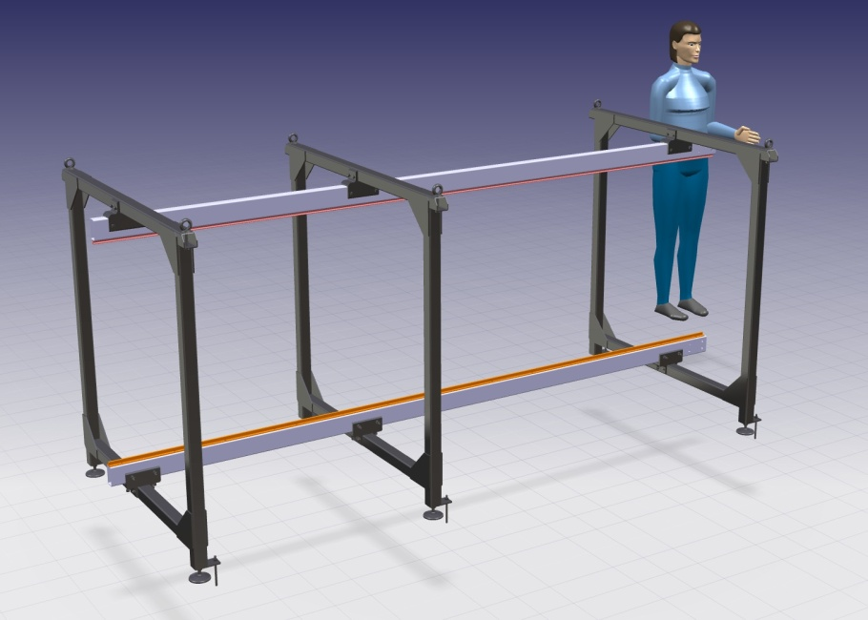
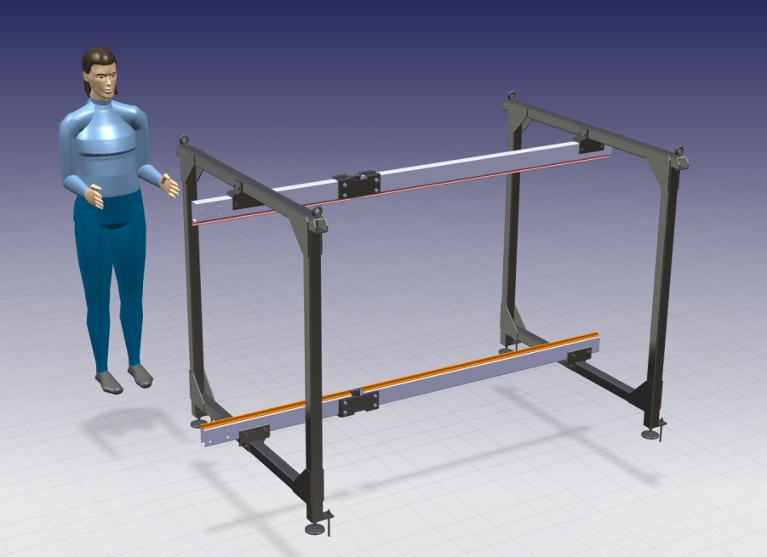
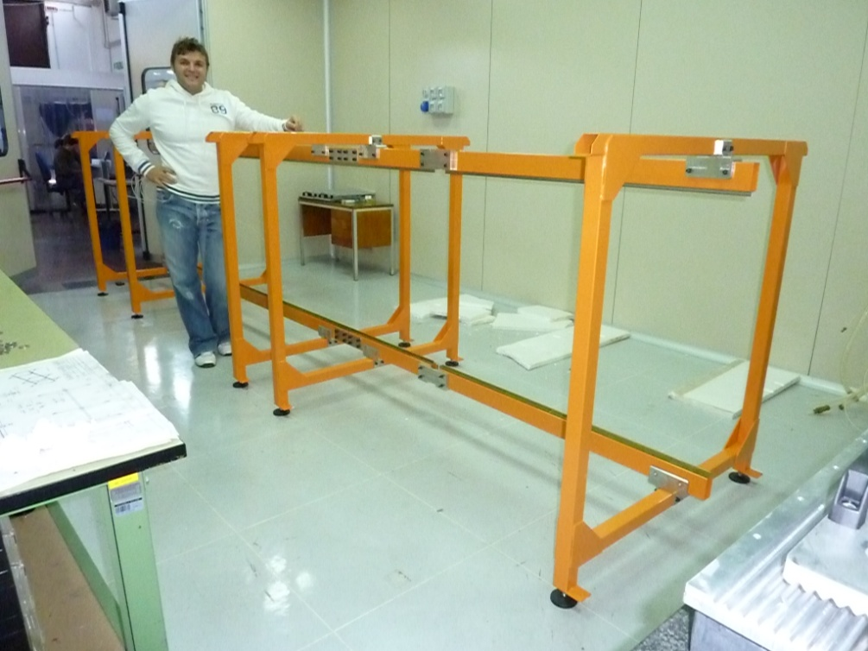
CENTRAL TRACKER INTEGRATED ITEMS: “Assembly & Insertion Auxiliary Structure” ………
…THINGS DONE ………………
INSERTION AUXILIARY STRUCTURE.”.
ASSEMBLY AUXILIARY STRUCTURE.”.
-The general design , the main dimensions and the operating steps
has been fixed;
A full scale prototype has been realized in INFN
Frascati workshop.
- Involved groups Frascati, Torino.
JUELICH – OCTOBER 2013 - D.Orecchini / P.Gianotti

Slide 3
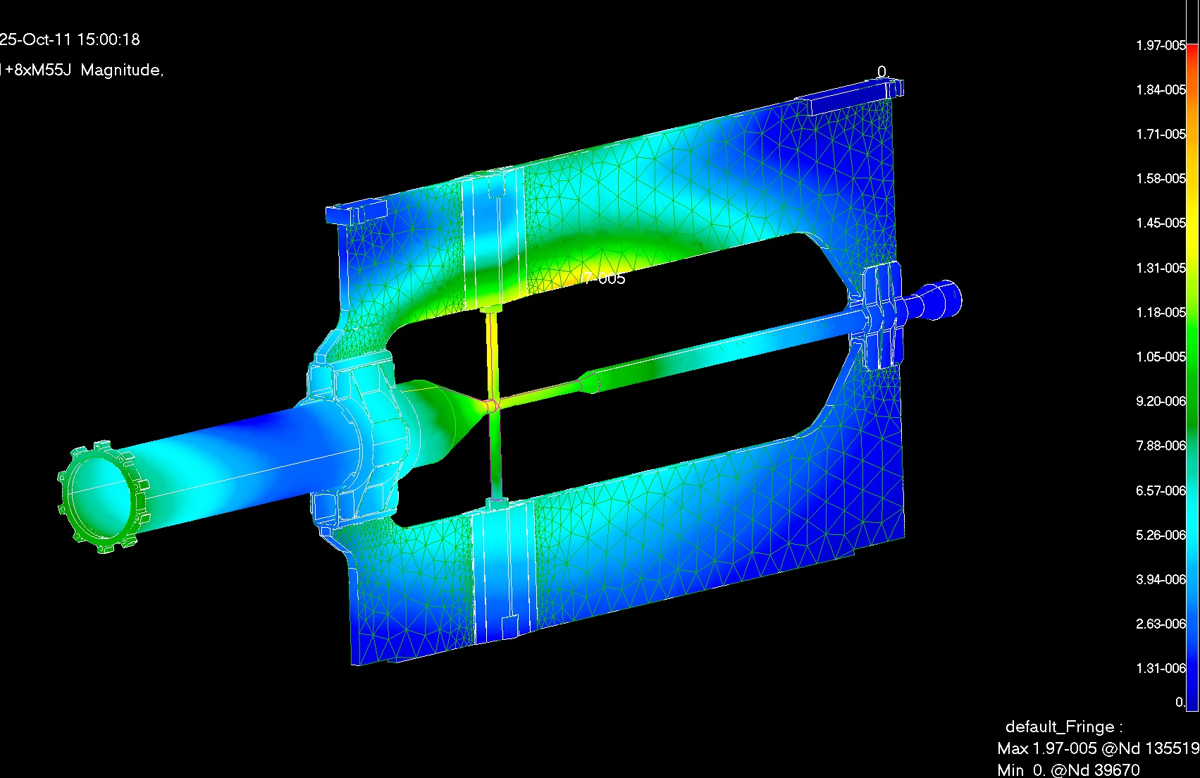
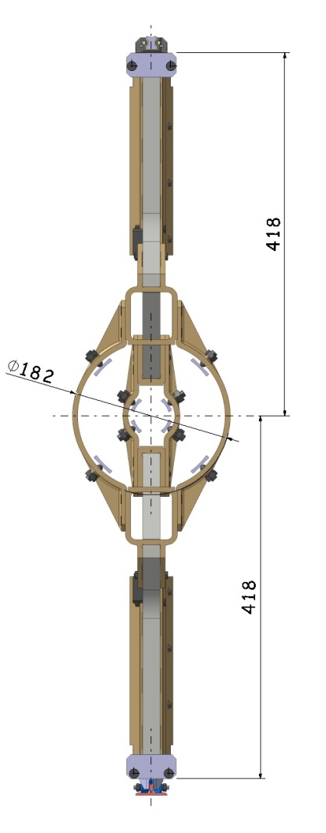
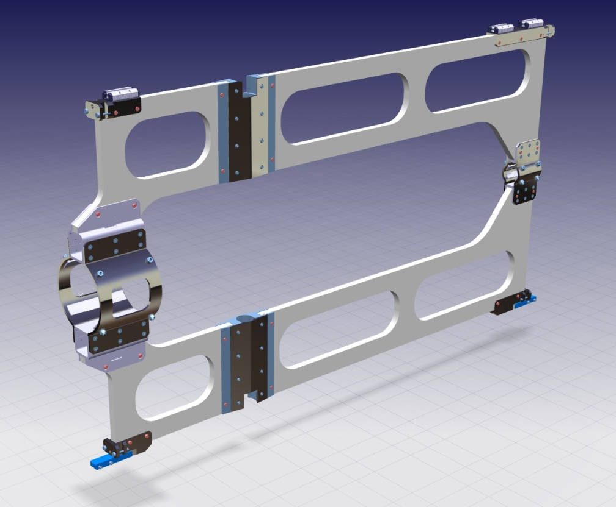
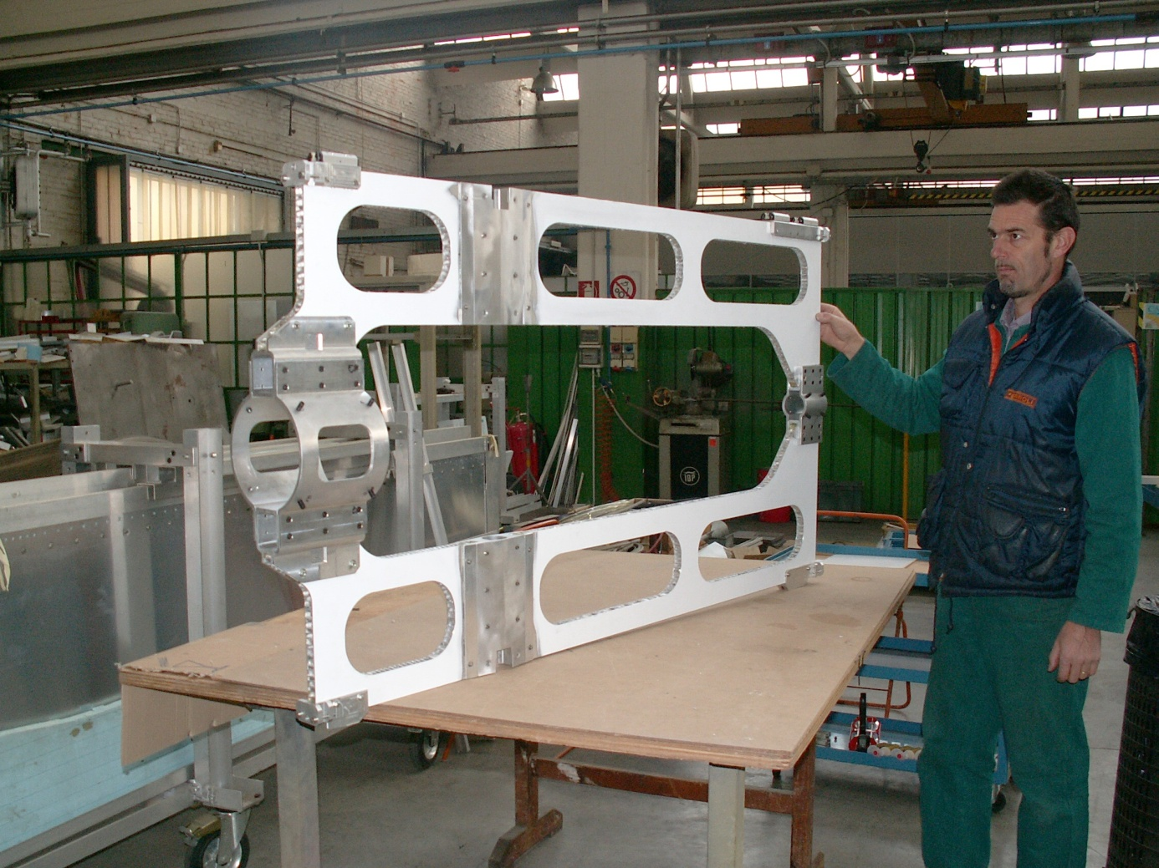
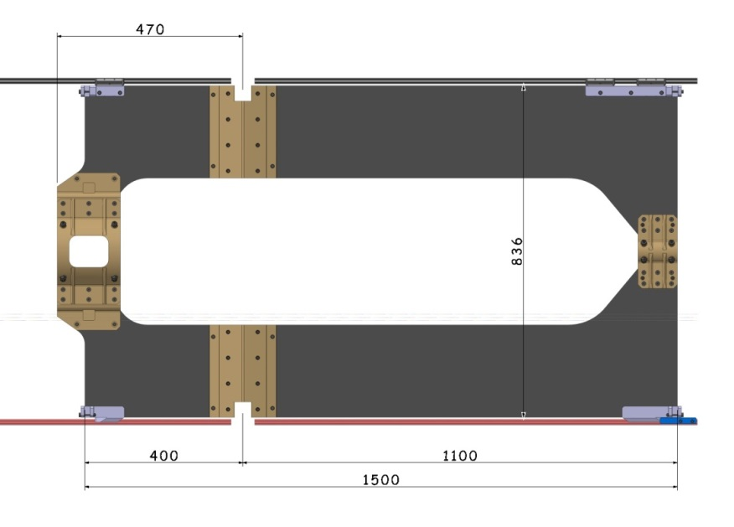
CENTRAL TRACKER INTEGRATED ITEMS: “CSF – Central Tracker Support Frame” ………
…THINGS DONE ………………
-TARGET : ACCEPTABLE MAX DISPLACEMENT (Due the Titanium Cross Pipe thickness): 0.05mm
> Hypothesized material: 8xM55J+ Rohacell+8xM55J
>Translational values – Magnitude Max 0.0197mm
> Von Mises: Max 3.75MPa
-A) The general design and the main dimensions are fixed;
-B) Preliminary mechanical solutions to support the “Cross Pipe” has been developed;
-C) The preliminary structural calculations has been made ;
-D) A full scale prototype has been realized in collaboration with Torino Group.
C
A
D
B
- Involved groups: Frascati,Torino.
JUELICH – OCTOBER 2013 - D.Orecchini / B. Giraudo / P.Gianotti

Slide 4
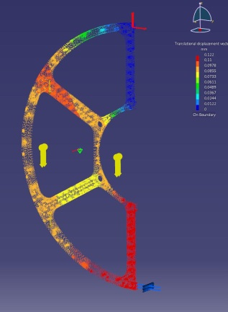
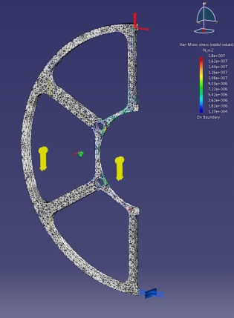
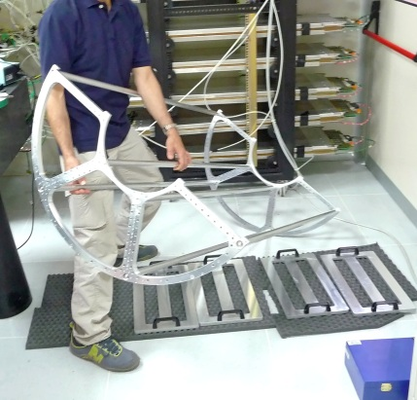
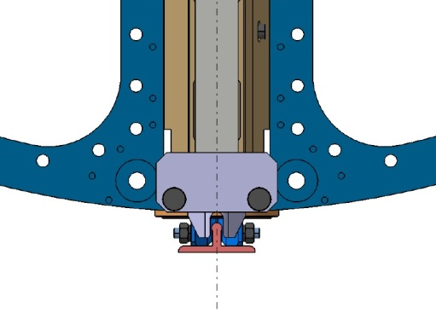
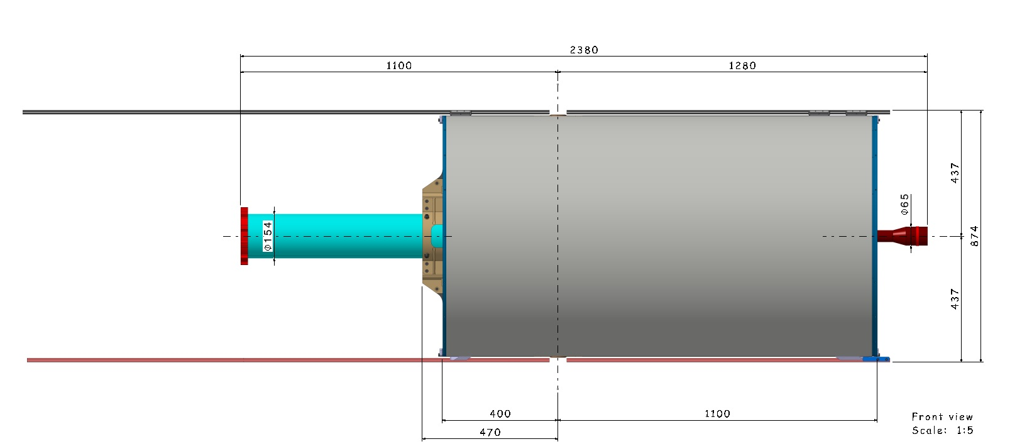
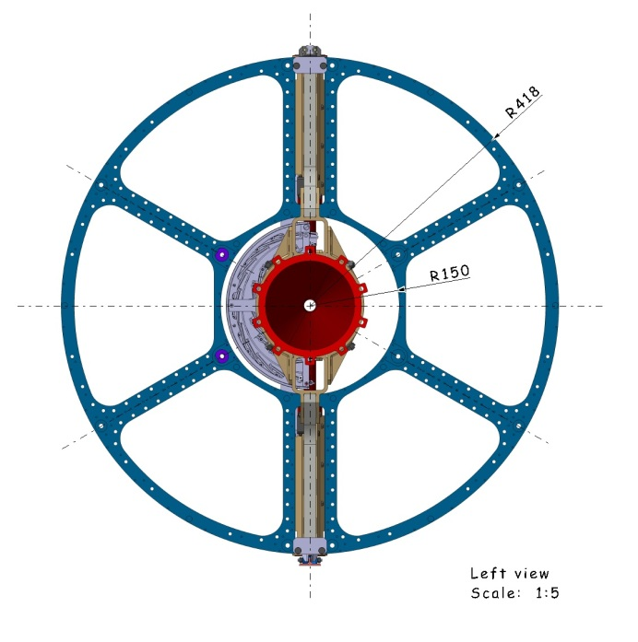
CENTRAL TRACKER INTEGRATED ITEMS: “Straw Tubes Tracker Support Frame” ………
- RAIL UP
…THINGS DONE ………………
- A) The general design and the main dimensions are fixed;
- B) The preliminary structural calculations have been made ;
- C) Mechanical solutions to support and move the frame has been developed;
- D) A full scale prototype has been realized.
- A set of measurements has been made (details in the next slides)
874
D
B
A
- RAIL DOWN
DISTANCE BETWEEN THE OUTER
FACES OF THE RAILS
- CROSS PIPE
- ST_TRACKER
- CENTRAL SUPPORT FRAME
C
- Involved groups: Frascati.
JUELICH – OCTOBER 2013 - D.Orecchini / P.Gianotti

Slide 5
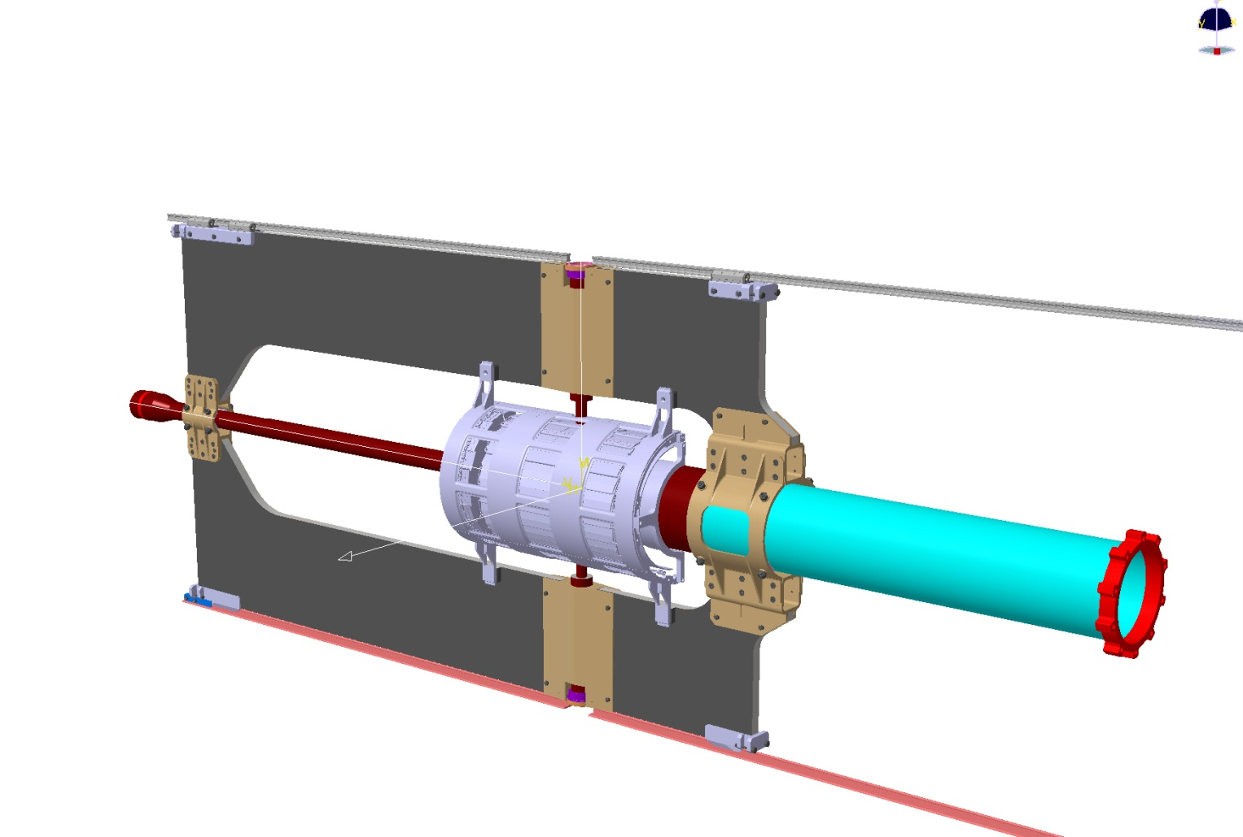
CENTRAL TRACKER INTEGRATED ITEMS: “CSF – Central Tracker Support Frame” ………
….THINGS TO DO ………
-However, all the final design, is still evolving.
- Involved groups: Torino and Frascati.
-The solutions to support the “Cross Pipe” have had a preliminary approval by the “Cross Pipe” people.
A common development of the final solution is still to be worked-out
- Involved groups: Torino, Frascati and Juelich (Cross-Pipe people).
JUELICH – OCTOBER 2013 - D.Orecchini / B. Giraudo / P.Gianotti

Slide 6
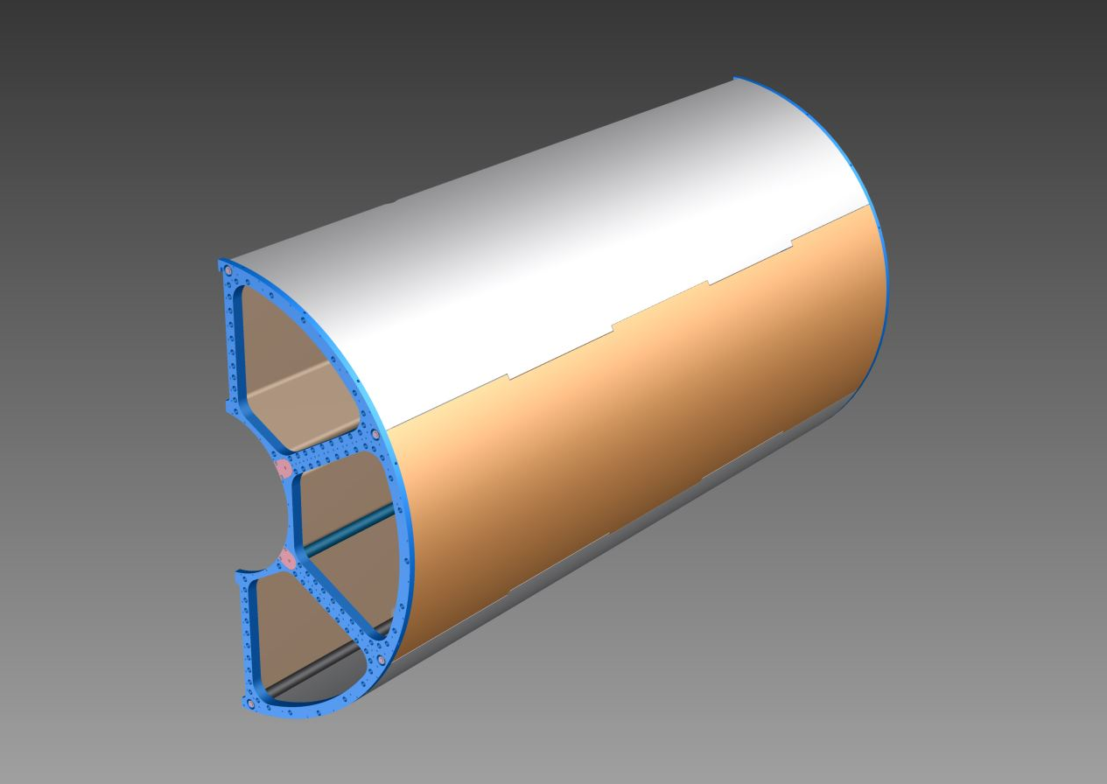
- STT Support Frame: Protective Skins Proposal.
HALF TRACKER WITH ASSEMBLED PROTECTIVE SKINS.”.
- PROTECTIVE SKINS –
-MATERIAL PROPOSED: Kevlar
-THICKNESS HYPOTIZED: 1mm
OUTER SKIN
- INNER SKIN: One piece
- OUTER SKINS: Three integrated pieces
HALF TRACKER WITH EXPLODED PROTECTIVE SKINS.”.
INNER SKIN
INNER SKIN
- KEVLAR PROTECTIVE SKINS –
-KEVLAR MAIN CHARACTERISTICS:
-Excellent light weight
-Good Radiation Length =28cm ( CF 25cm – Aluminum 9 cm)
-Good resistance to hits.
-Good thermal insulation
-Low electrical conductivity.
- BAD ASPECTS:
-Preliminary economic evaluation:
Skins plus molds: 16000€
OUTER SKIN
- Involved group: Frascati.
JUELICH – OCTOBER 2013 - D.Orecchini / P.Gianotti

Slide 7
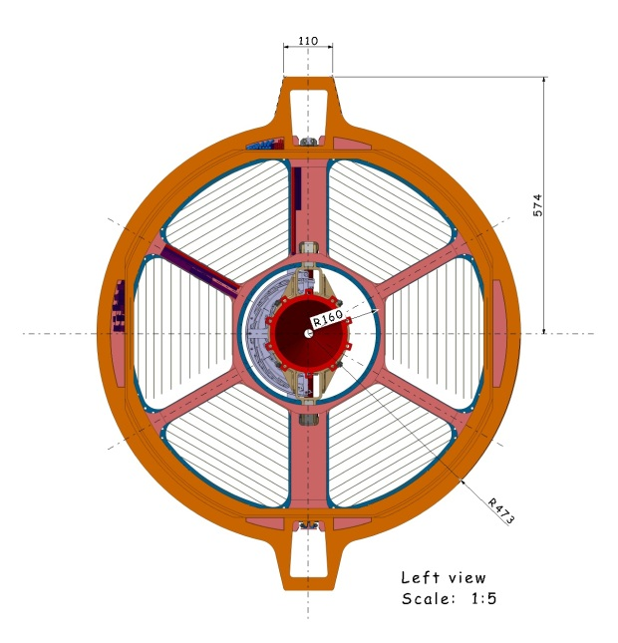
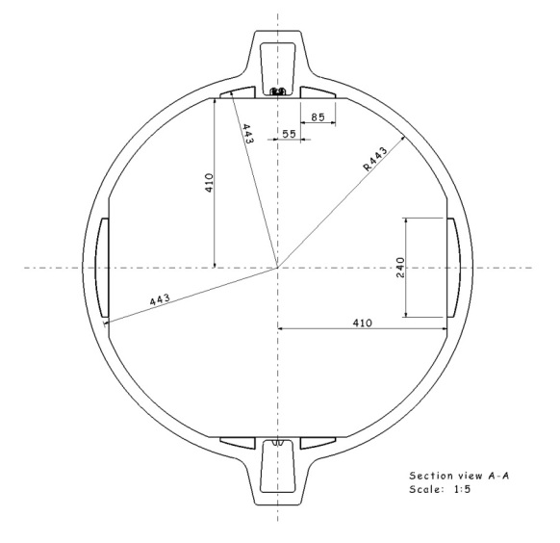
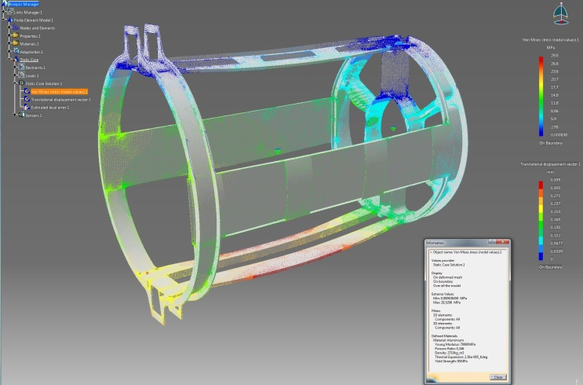
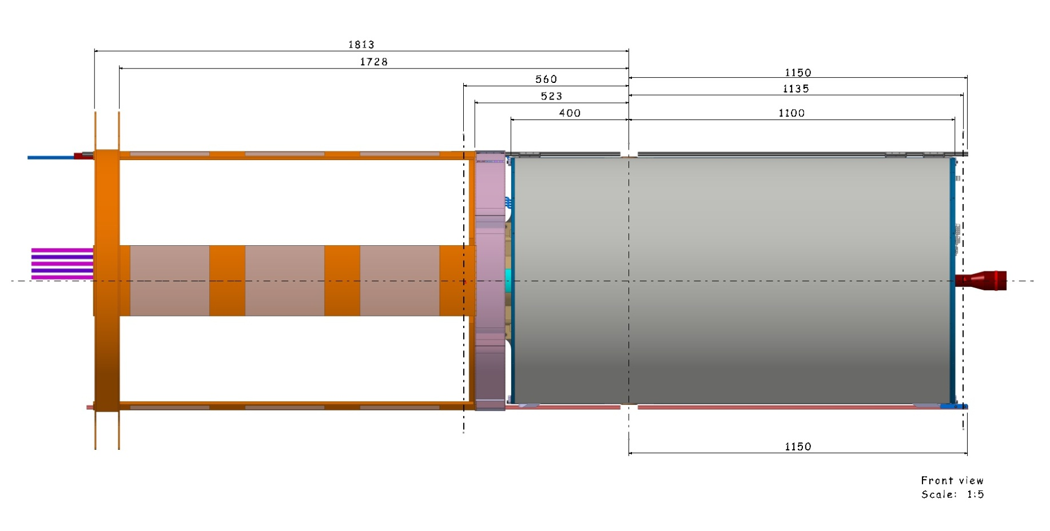
STT (Straw Tubes Tracker ) “Services Support Frame”:
…THINGS DONE ………………
-The general design and the main dimensions are fixed and the
solution to support and move the frame is the same
of the ST_Tracker;
-The preliminary structural calculations has been made with
positive results;
- CLASCHES BETWEEN BW-EMC AND
SST_SERVICES FRAME HAVE BEEN RESOLVED.
Hypothesized material: Aluminum Alloy
>Translational values – Magnitude Max 0.4mm
> Von Mises: Max 29,5MPa (Max 95MPa)
- STT SERVICES SUPPORT FRAME
- ST_TRACKER
- Involved group: Frascati.
GSI – DECEMBER 2012 - D.Orecchini / P.Gianotti

Slide 8
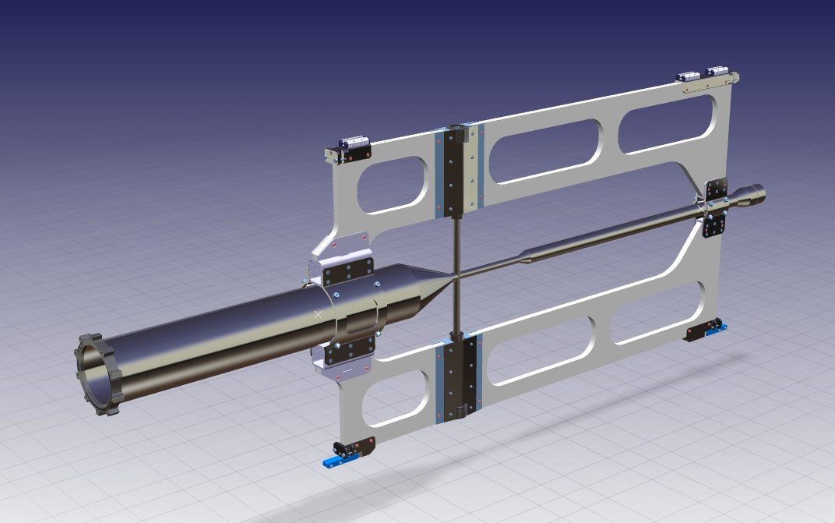
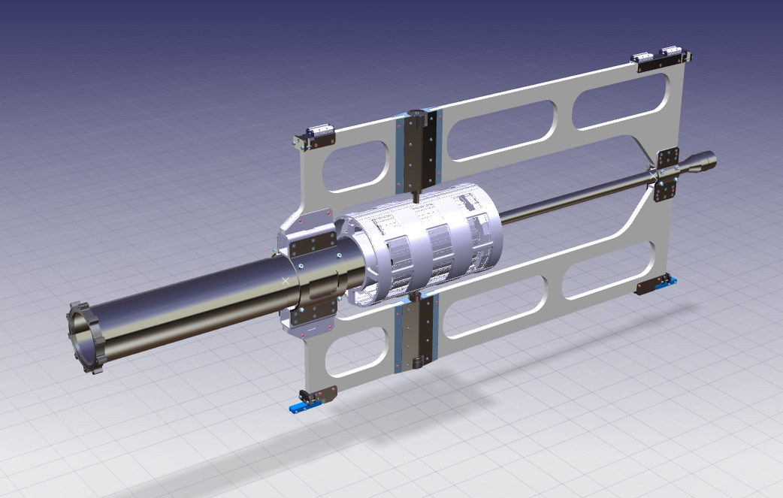
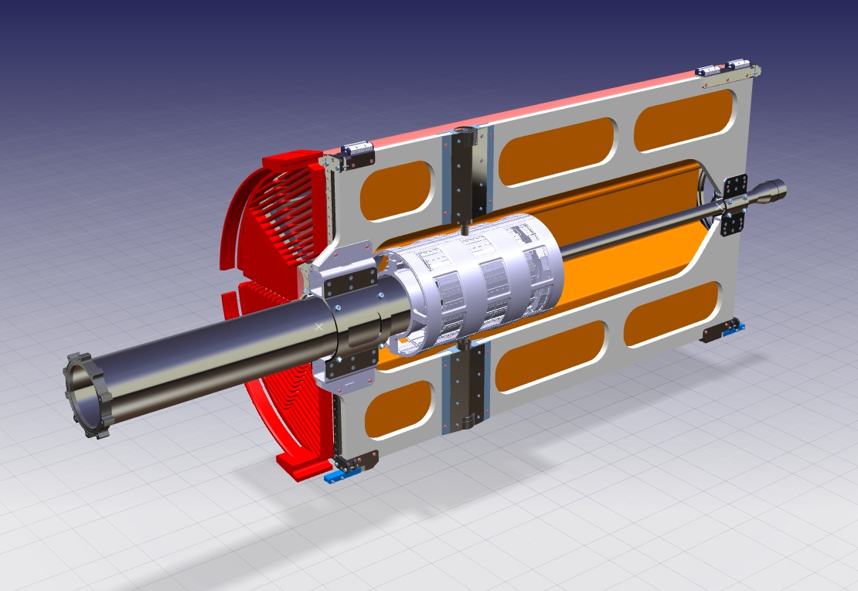
CENTRAL TRACKER INTEGRATED ITEMS: ………
….THINGS TO DO ………
….. inside the “Central Tracker Components” …………..
TO CHECK THE ASSEMBLING PROCEDURES FOR THE “CROSS PIPE”;
- TO CHECK THE ASSEMBLING PROCEDURES FOR WHAT CONCERN THE “VERTEX” ASSEMBLY;
- TO DEFINE THE ASSEMBLING PROCEDURES FOR WHAT CONCERN THE “ VERTEX CABLING & GAS SYSTEM”,
- Involved groups: Torino, Frascati and Juelich (Cross-pipe people ).
JUELICH – OCTOBER 2013 - D.Orecchini / B. Giraudo / P.Gianotti

Slide 9
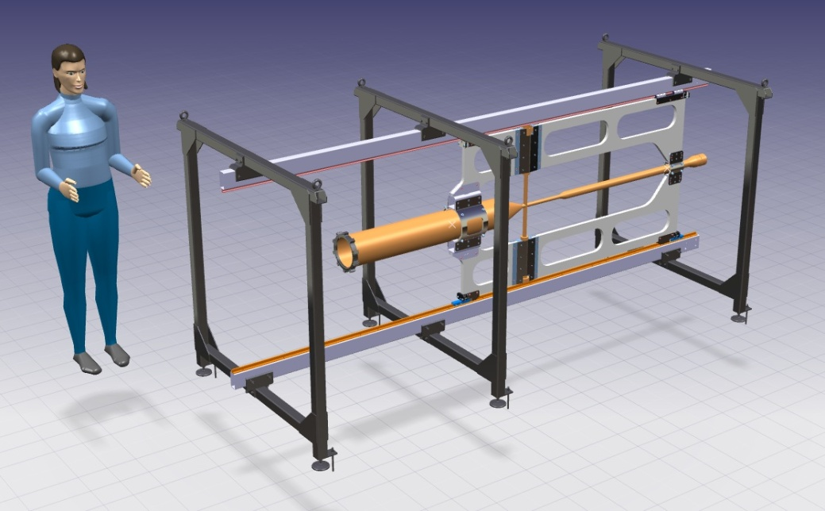
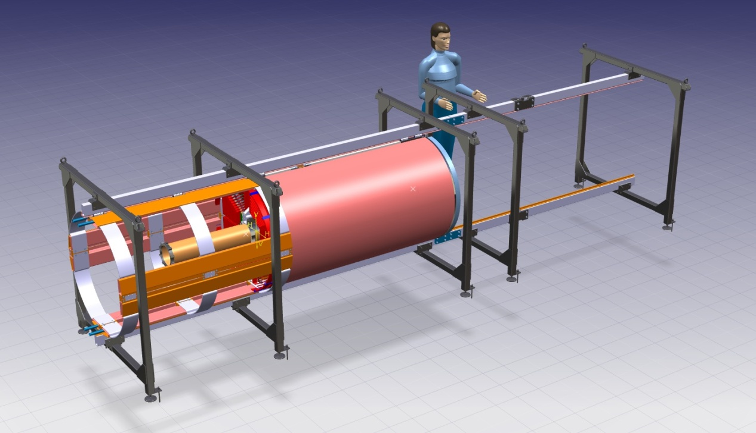
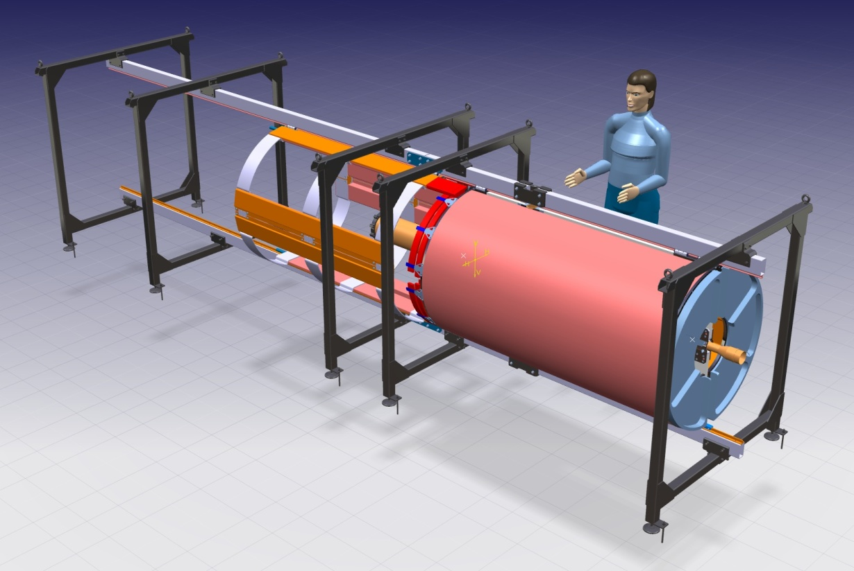
CENTRAL TRACKER INTEGRATED ITEMS ……………
….THINGS TO DO ………
….. And for what concerns the “Central Tracker” general assembly …………..
- TO CHECK THE ASSEMBLING PROCEDURES OF THE “CENTRAL SUPPORT FRAME” ON THE “ASSEMBLING STRUCTURE”.
-TO CHECK THE PROBLEMS RELATED WITH THE “CABLING & GAS SYSTEM” ON THE SUPPORT STRUCTURE .
TO CHECK THE INSERTING PROCEDURES OF THE COMPLETE “CENTRAL TRACKER.”.
- Involved groups:Torino Frascati and Juelich
(Cross-Pipe and Straws Tracker groups).
JUELICH – OCTOBER 2013 - D.Orecchini / B. Giraudo / P.Gianotti

Slide 10
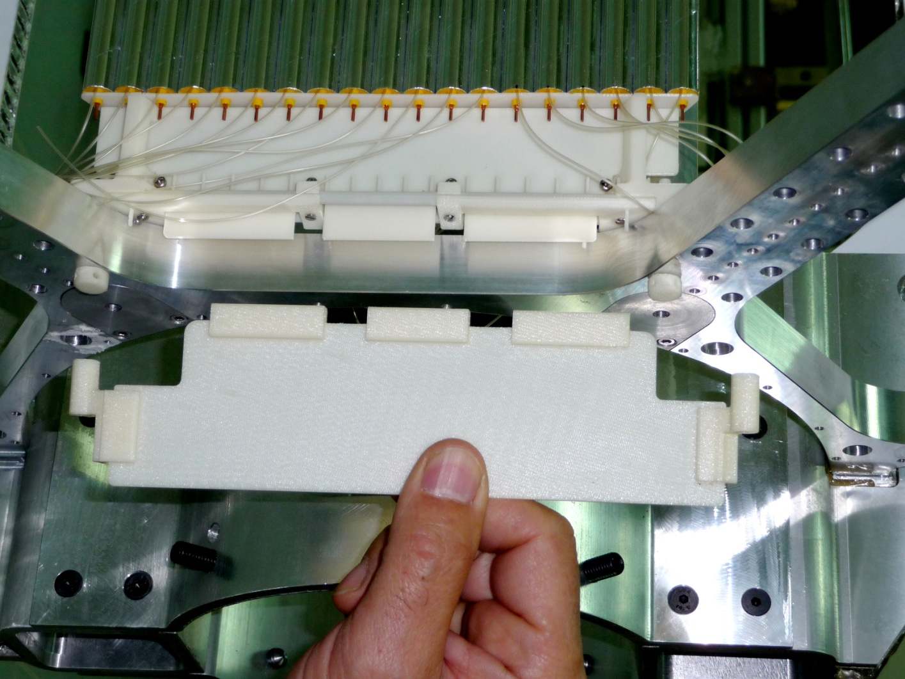
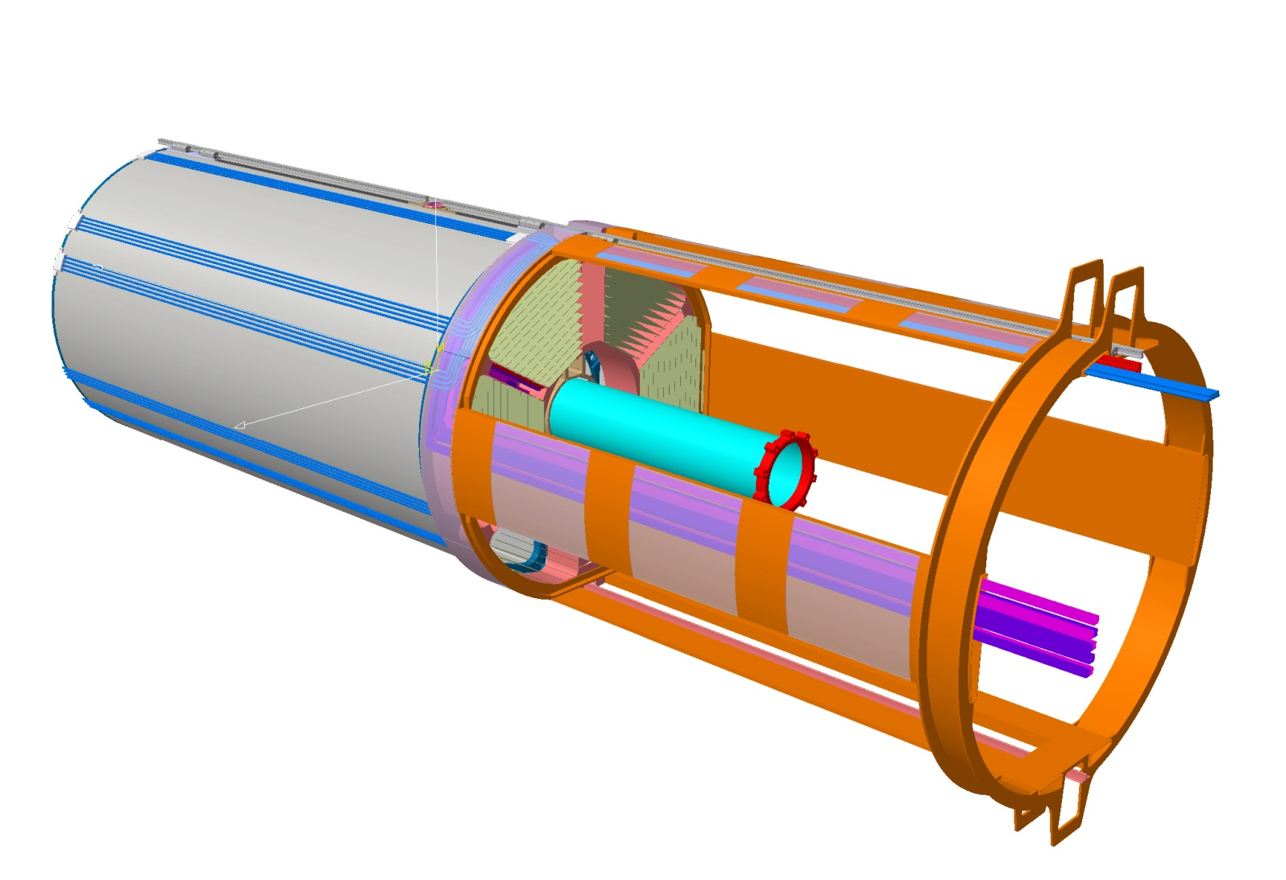
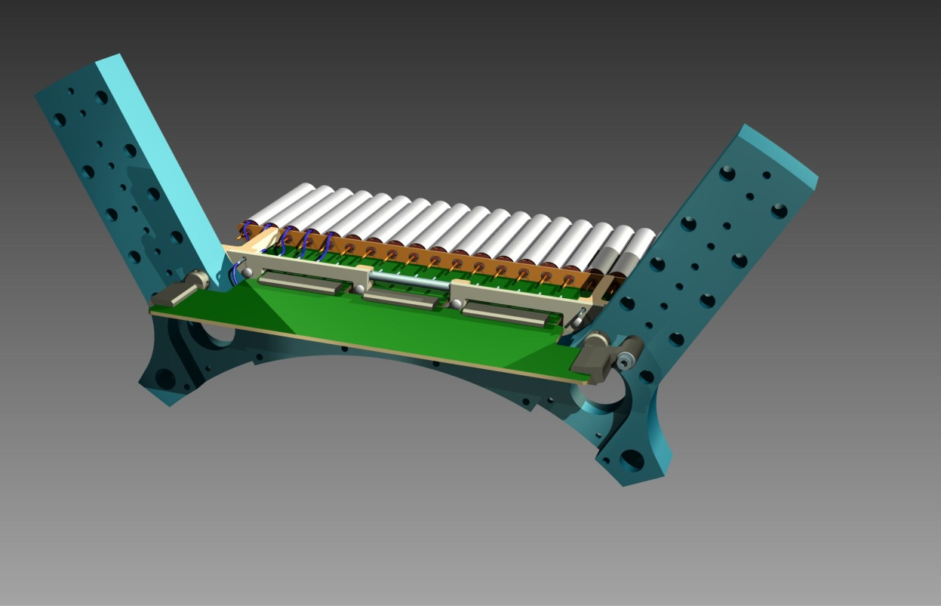
STT (Straw Tubes Tracker ) “Services Support Frame”:
….THINGS TO DO ………
-A detailed solution for the integration between the straws modules, the
electronics cards, the cables, the gas manifolds, etc. is still under development.
- Involved groups: Frascati , Juelich and Krakow people.
-The new proposed route of the “gas pipes” (outside the STT outer encumbrance)
has been accepted by the DIRC group.
- Involved groups: Frascati and GSI-DIRC .
-A final solution for an integrated system of the patch-panels (STT-Vertex-BW-EMC)
placed outside the magnet is still to be developed.
- Involved groups: Frascati ,Torino and BW-EMC people.
-The geometry in the backward side will be surely modified
due the integration with the evolution of the“DIRC Read-Out”
geometry.
- Involved groups: Frascati and GSI-DIRC.
GSI – DECEMBER 2012 - D.Orecchini / P.Gianotti

Slide 11
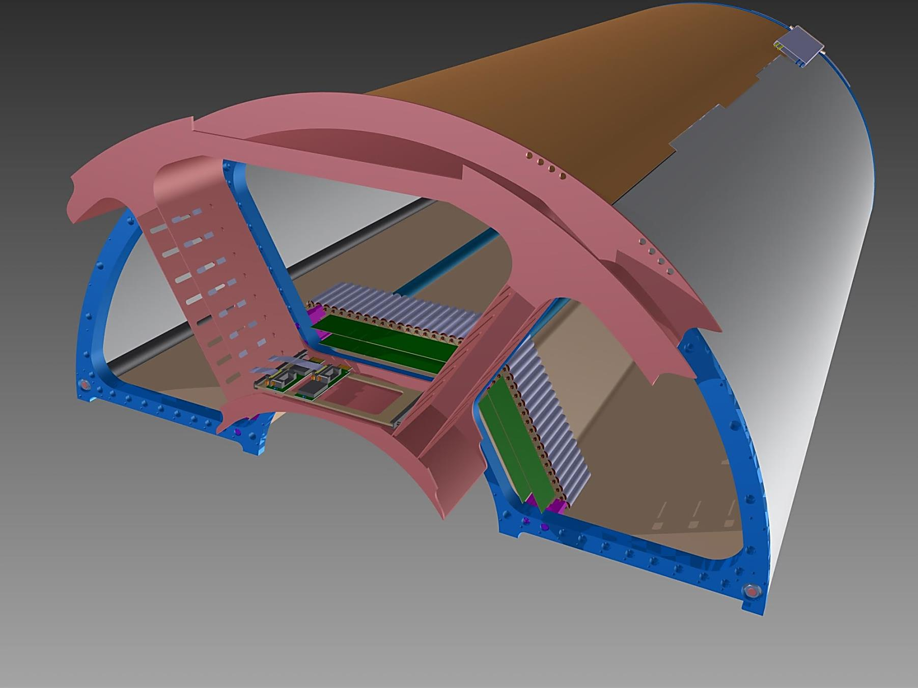
- STRAW TRACKER ELECTRONICS INTEGRATION.
…THINGS DONE ………………
- The general design and the main components location;
-The preliminary mechanical solutions to support and manage
the different components.
STRAW MODULES
CABLE SUPPORT STRUCTURE
HV DISTRIBUTION
SUPPORT END-PLATE
READ-OUT ELECTRONICS MODULES
….THINGS TO DO ………
- All the detailed solutions are still to develop waiting the definition of the
electronic components.
- Involved groups: Frascati, Juelich and Krakow.
GSI – DECEMBER 2012 - D.Orecchini / P.Gianotti

Slide 12
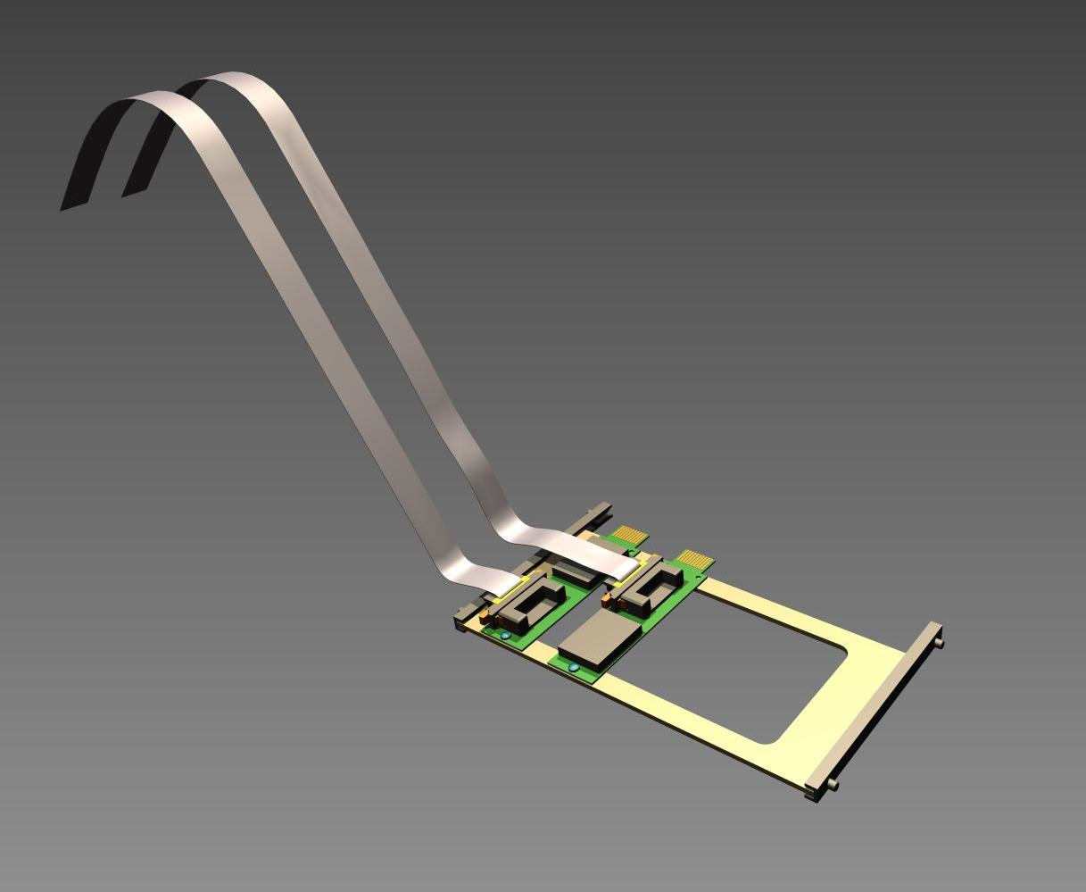
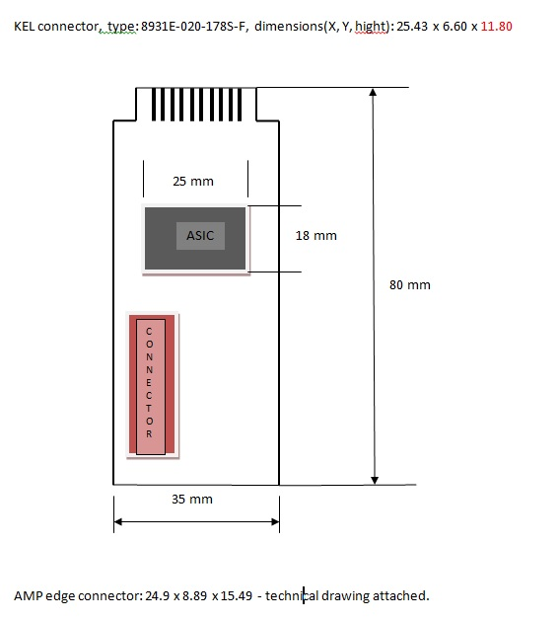
- STRAW TRACKER ELECTRONICS INTEGRATION.
…THINGS DONE ………………
…… PRELIMINARY INTEGRATION IDEA OF READ-OUT MODULES …….
STAGGERED FLAT CABLES
KEL 20 PAIRS CONNECTOR
(Staggered one respect to the other)
….THINGS TO DO ………
- THE GOAL IS TO DEFINE ALL THE COMPONENTS AND TO REALIZE A
SIGNIFICANT PROTOTYPE.
DUE THE VERY HIGH DENSITY OF THE COMPONENTS, IT’S FUNDAMENTAL
TO CHECK ALL THE ASPECTS :
COMPONENTS ASSEMBLING
FLAT MANAGEMENT AND ROUTING
MANAGEMENT OF THE SERVICE SUPPORT FRAME
- Involved groups: Frascati, Juelich and Krakow.
GSI – DECEMBER 2012 - D.Orecchini / P.Gianotti

Slide 13
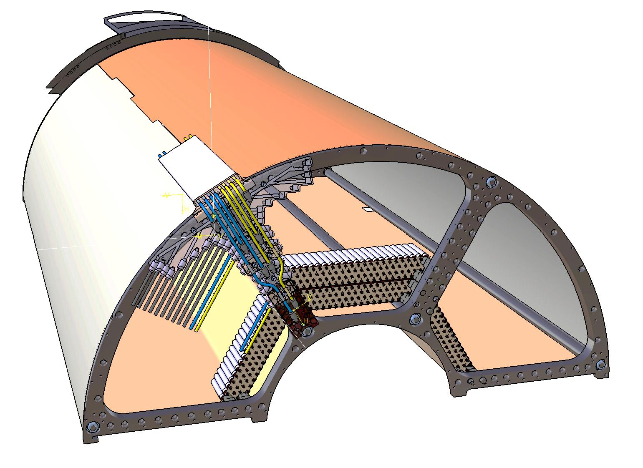
- STRAW TRACKER GAS SYSYTEM INTEGRATION.
…THINGS DONE ………………
- PRELIMINARY INTEGRATION IDEA OF THE SYSYTEM.
GAS PIPES GUIDE
STRAW MODULES
SUPPORT END-PLATE
… IN A DEDICATED TALK VINCENZO LUCHERINI WILL SHOW YOU MORE IN DETAILS
THE GAS SYSTEM IDEA DEVELOPED IN FRASCATI………………
….THINGS TO DO ………
- THE GOAL IS TO DEFINE THE CONCEPTS AND THE
COMPONENTS THAT ALLOW THE REALIZATION OF
A SIGNIFICANT PROTOTYPE.
GAS MANIFOLD SYSTEM
- Involved groups: Frascati, Juelich and Krakow.
GSI – DECEMBER 2012 - D.Orecchini / P.Gianotti

Slide 14
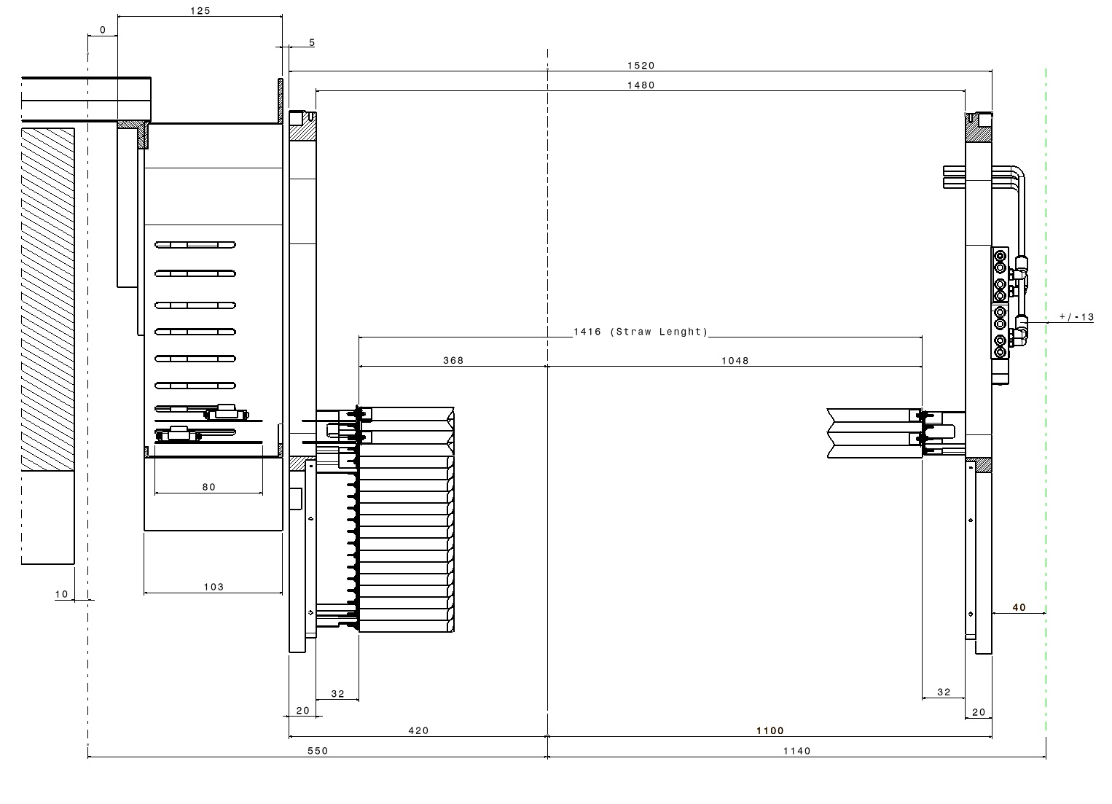
- STRAW-TUBES TRACKER : General layout.
560
1150
10
40
EMC_BW
Limit
1500
1460
IP
GEM Forward
Limit
TUBE LENGTH: 1400mm
380
1020
40
20
110
Free Space
Free Space
30
30
20
1070
20
430
GSI – DECEMBER 2012 - D.Orecchini / P.Gianotti

Slide 15
- STRAW TUBES TRACKER SUPPORT FRAME: Geometrical survey test………
A series of geometrical tests has been performed with the help of the “LNF Alignments Service” with a “laser tracker”.
The aim of these tests, was to verify fluctuations of values ​​of concentricity between the “positioning and support holes” of the straws modules, realized on the two end-plate of the support frame.
A second series of geometrical tests has been performed to characterize the behavior of the “Support Frame” under the simulated load transmitted by the “Straw Modules”, the electronics and the gas system components.
JUELICH – OCTOBER 2013 - D.Orecchini / P.Gianotti

Slide 16
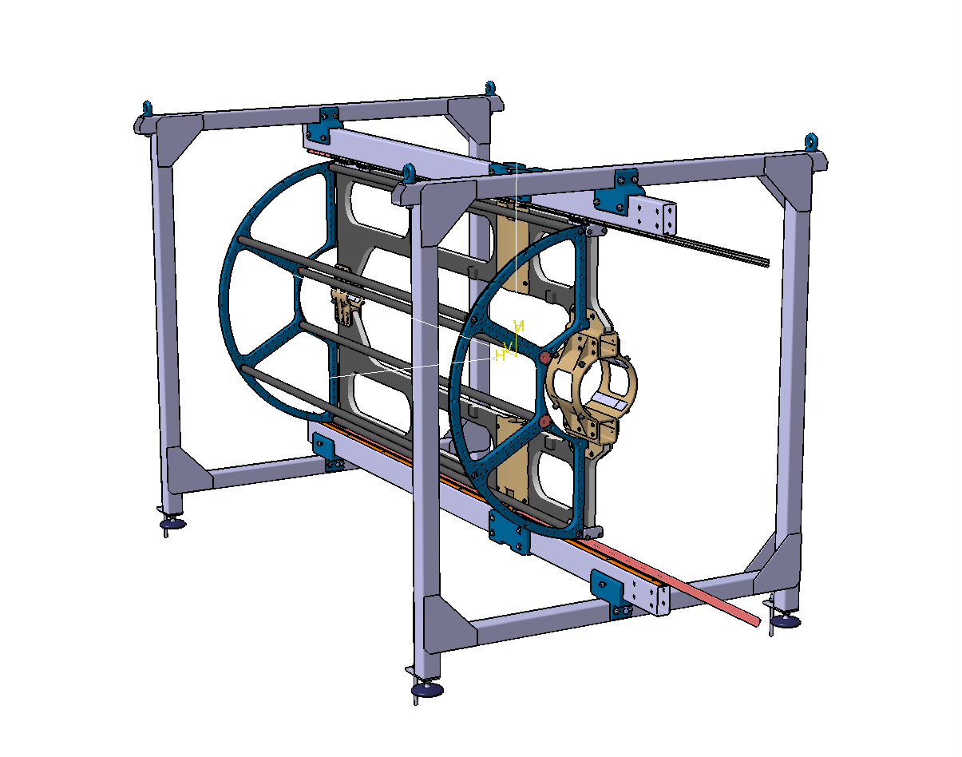
- STT Support Frame: Laser Tracker Survey_1
Y
AUXILIARY ASSEMBLY FRAME
Z
FORWARD PLATE
x
- In a first configuration, the “Support Frame” has been mounted in his
“working position”, attached on the “Central Support Frame” prototype.
- In this way we can check all the stresses that the frame should have
suffered due to its handling and the adaptation to the
geometry of the support frame
BACKWARD PLATE
1)- It has been defined a medium plane detected on the “Backward Plate”.
2)- Respect to this plane, It has been defined an orthogonal axis (z).
JUELICH – OCTOBER 2013 - D.Orecchini / P.Gianotti

Slide 17
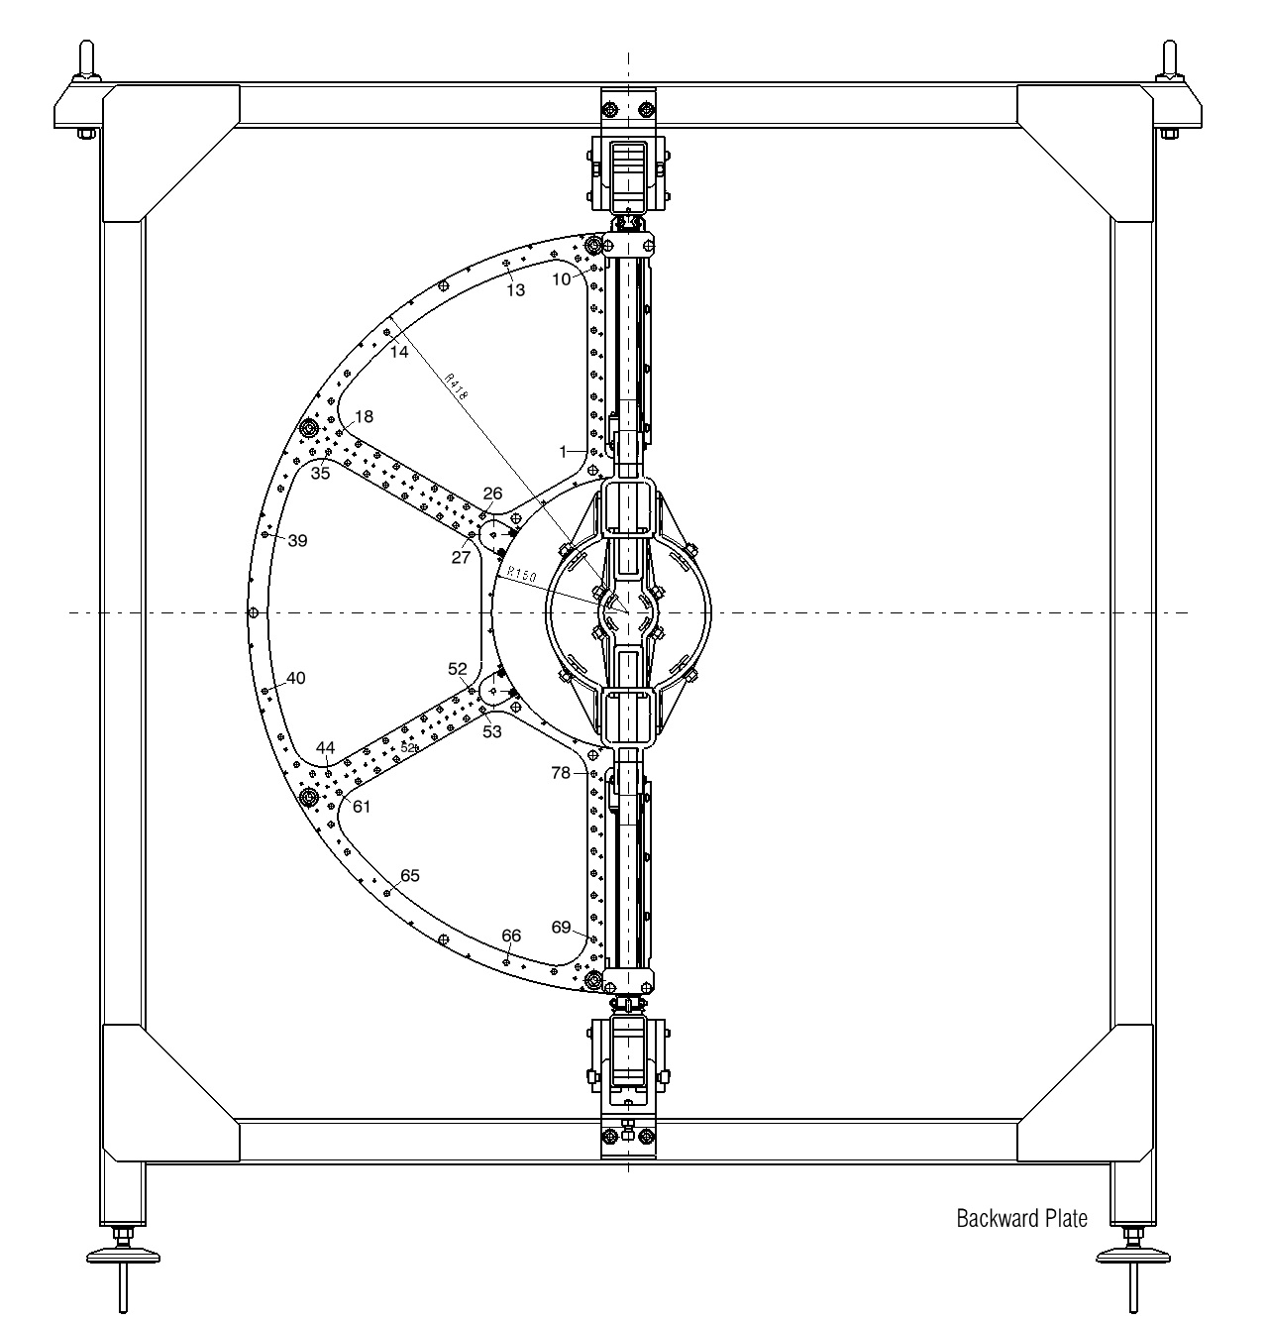
- STT Support Frame: Tracker Laser Survey_1
Y
AUXILIARY ASSEMBLY FRAME
x
BACKWARD PLATE
- It has been given a reference numbering to the “Straw modules Support Holes.
- B1 – B2 – B……….. for the “Backward Plate”.
- F1 – F2 – F………….for the “Forward Plate”.
JUELICH – OCTOBER 2013 - D.Orecchini / P.Gianotti

Slide 18
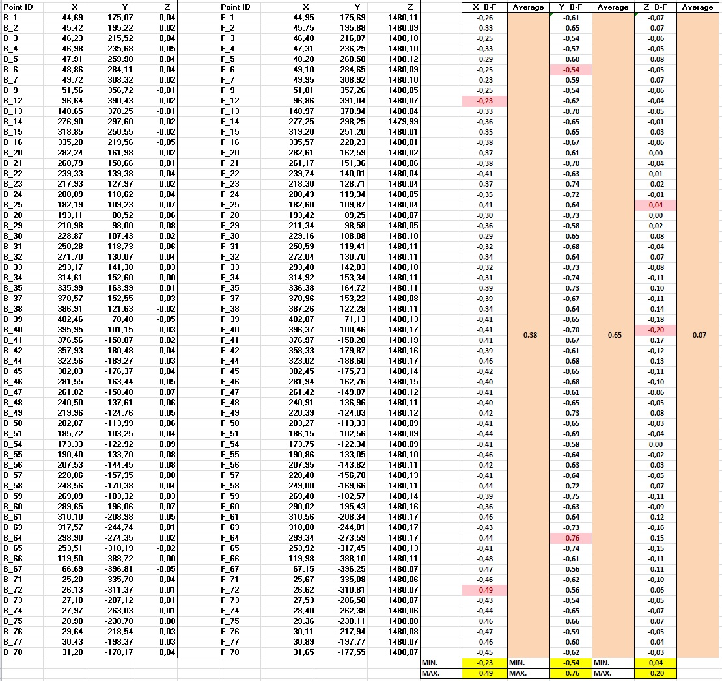
- STT Support Frame: Tracker Laser Survey_1 Results
“Z” DEVIATIONS
MIN: 0,04mm
MAX: -0,20mm
Average: -0,07
“Y” DEVIATIONS
MIN: -0,54mm
MAX: -0,76mm
Average: -0,65
“X” DEVIATIONS
MIN: -0,23mm
MAX: -0,49mm
Average: -0,38

Slide 19
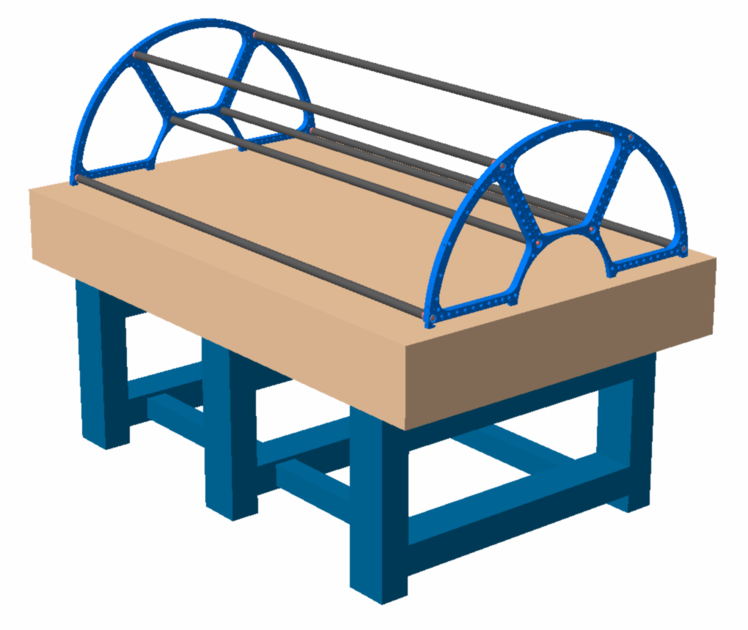
- STT Support Frame: Laser Tracker Survey_2
1)- It has been defined a medium plane detected on the “Backward Plate”.
2)- Respect to this plane, It has been defined an orthogonal axis (z).
Y
Z
FORWARD PLATE
BACKWARD PLATE
GRANITE TABLE
x
-In a second configuration, the “Support Frame” has been placed on a granite table, avoiding to give it any possible distortions.
This configuration is necessary to obtain a comparison with the
results of the survey of the previous configuration.
A first goal is to understand the intrinsic degree of precision of the
frame.
A second aspect is try to quantify the deformations caused by the
“Central Support Frame”.
JUELICH – OCTOBER 2013 - D.Orecchini / P.Gianotti

Slide 20
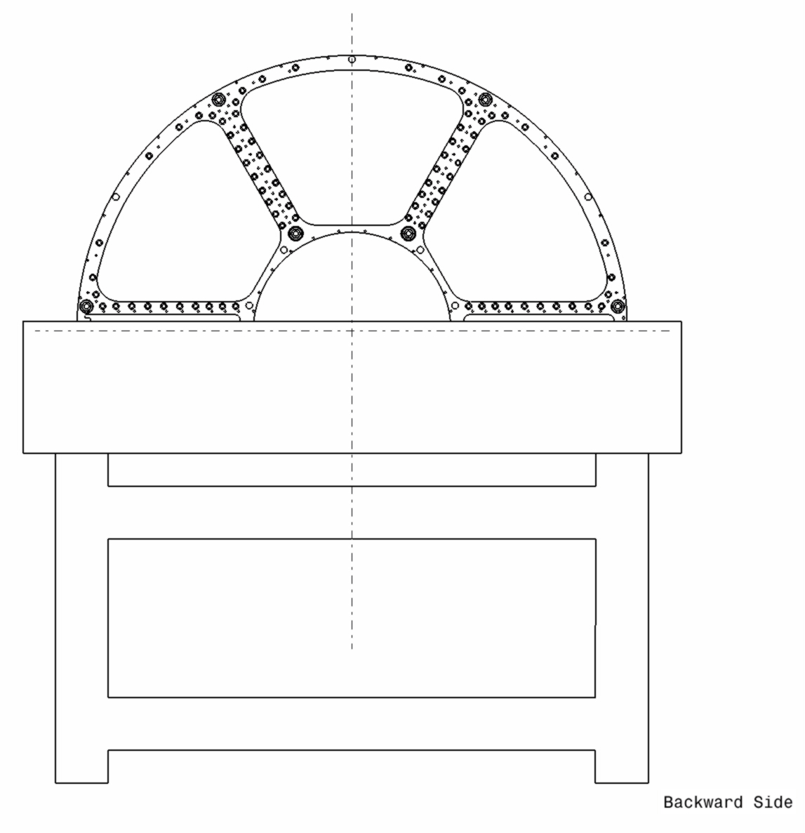
- STT Support Frame: Tracker Laser Survey_2
Y
BACKWARD PLATE
78
1
x
GRANITE TABLE
- It has been given a reference numbering to the “Straw modules Support Holes.
- B1 – B2 – B……….. for the “Backward Plate”.
- F1 – F2 – F………….for the “Forward Plate”.
JUELICH – OCTOBER 2013 - D.Orecchini / P.Gianotti

Slide 21
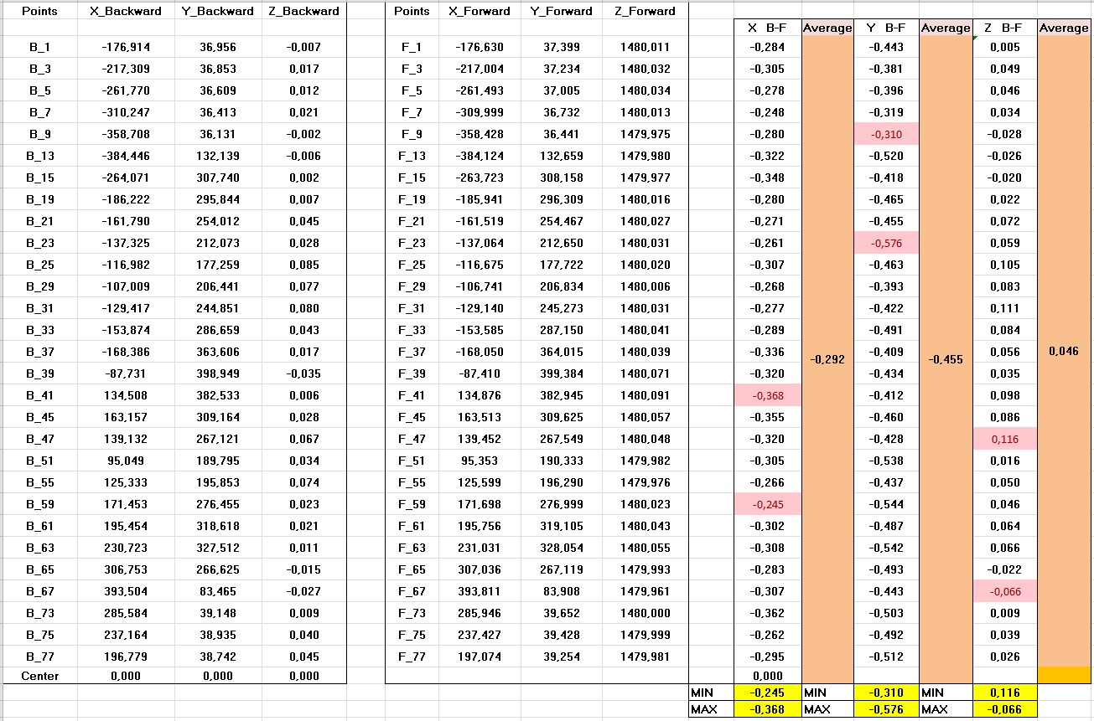
- STT Support Frame: Tracker Laser Survey_2 Results
“Z” DEVIATIONS
MIN: 0,07mm
MAX: -0,12mm
Average: -0,05
“Y” DEVIATIONS
MIN: -0,31mm
MAX: -0,58mm
Average: -0,45
“X” DEVIATIONS
MIN: -0,24mm
MAX: -0,37mm
Average: -0,29
JUELICH – OCTOBER 2013 - D.Orecchini / P.Gianotti

Slide 22
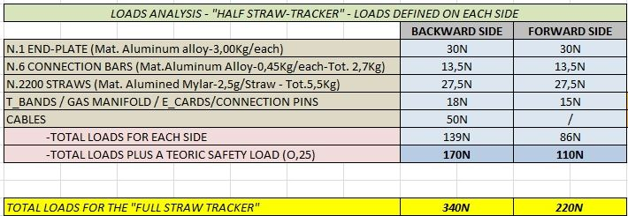
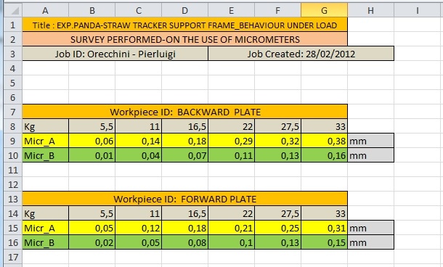
- STT Support Frame: Behavior of the Support Frame Under Load.
STT Support Frame - Preliminary Loads Analysis
LOADS
BACKWARD PLATE: EXPECTED LOAD 7.5 Kg
FORWARD PLATE: EXPECTED LOAD 5.5 Kg
MICROMETERS
In this test the aim was to characterize the behavior of the support frame under the simulated loads of the supported components .
It has been simulated a series of increasing loads, measuring the displacements by means of two micrometers positioned under the profile of the frames.
B
A
-It has been made a survey of the behavior of the two plates (Backward e Forward), under load.
1)- Have been placed two micrometers “A” e “B” under the plates.
2)- Have been loaded the two plates with six different conditions of load.
JUELICH – OCTOBER 2013 - D.Orecchini / P.Gianotti

Slide 23
- BACK-UP SLIDES -

Slide 24
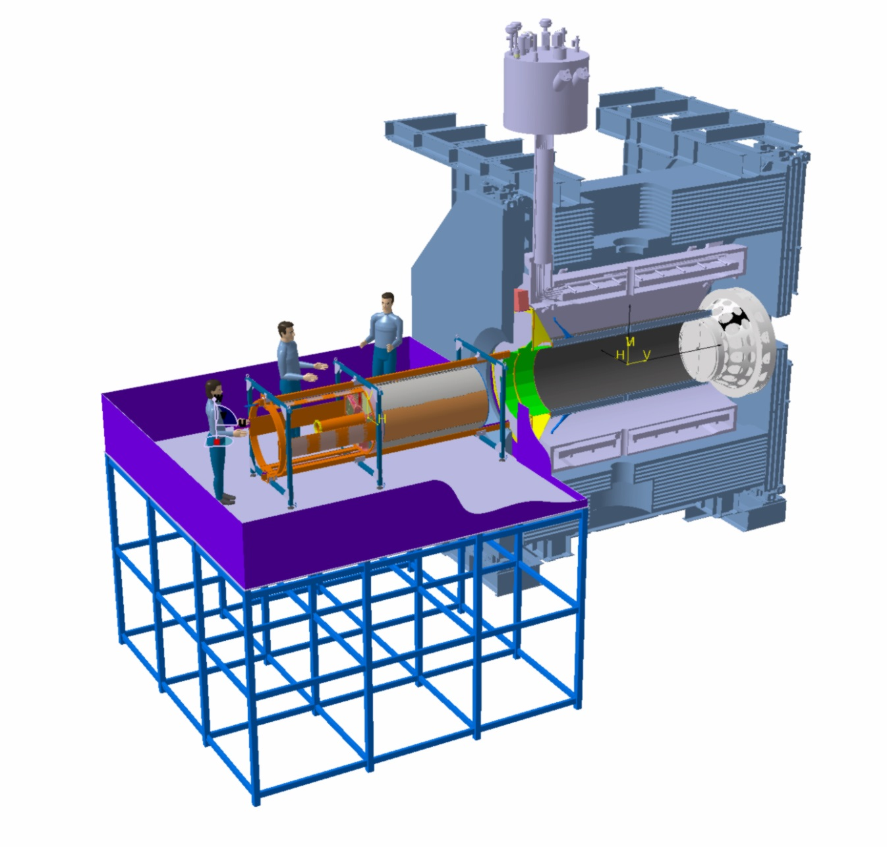
CENTRAL TRACKER INTEGRATED ITEMS: ………
….THINGS TO DO ………
….. And about inserting in the apparatus …………..
-TO TEST AND DEVELOP THE EQUIPMENT AND PROCEDURES.
- Involved groups:“Torino” ,”Frascati” (and “Juelich” people???).
JUELICH – OCTOBER 2013 - D.Orecchini / B. Giraudo / P.Gianotti

Slide 25
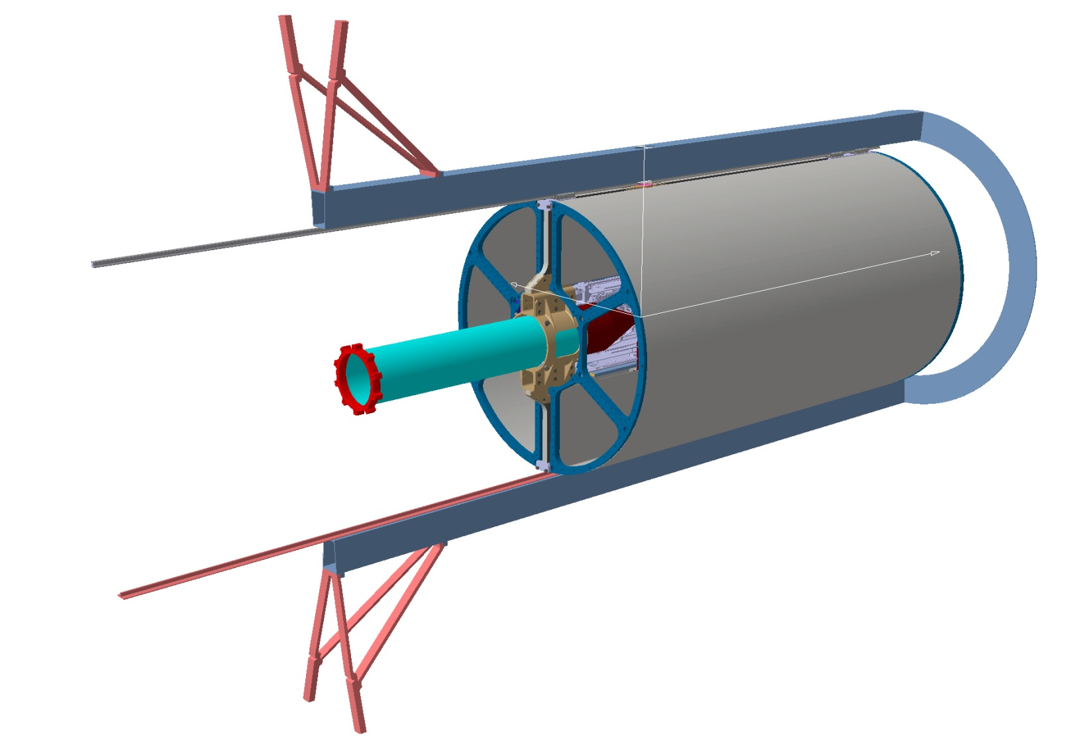
STT (Straw Tubes Tracker ) “Support Frame”, things to do:
-A final solution for the inner and outer skins is under development.
- Involved groups:“Frascati” people.
-The final solution for the interface between the “Support and Shifting Rails”,
and “Up & Down” support beam, is still be to be developed;
- Involved groups:“Frascati” and “GSI” people.
- Involved groups:“Frascati” people.
-A series of survey of the “coaxiality” between the geometry of the two “End-plates” has been made.
An improvement of the “connection system” between the end-plates is under development.
GSI – DECEMBER 2012 - D.Orecchini / P.Gianotti

Slide 26
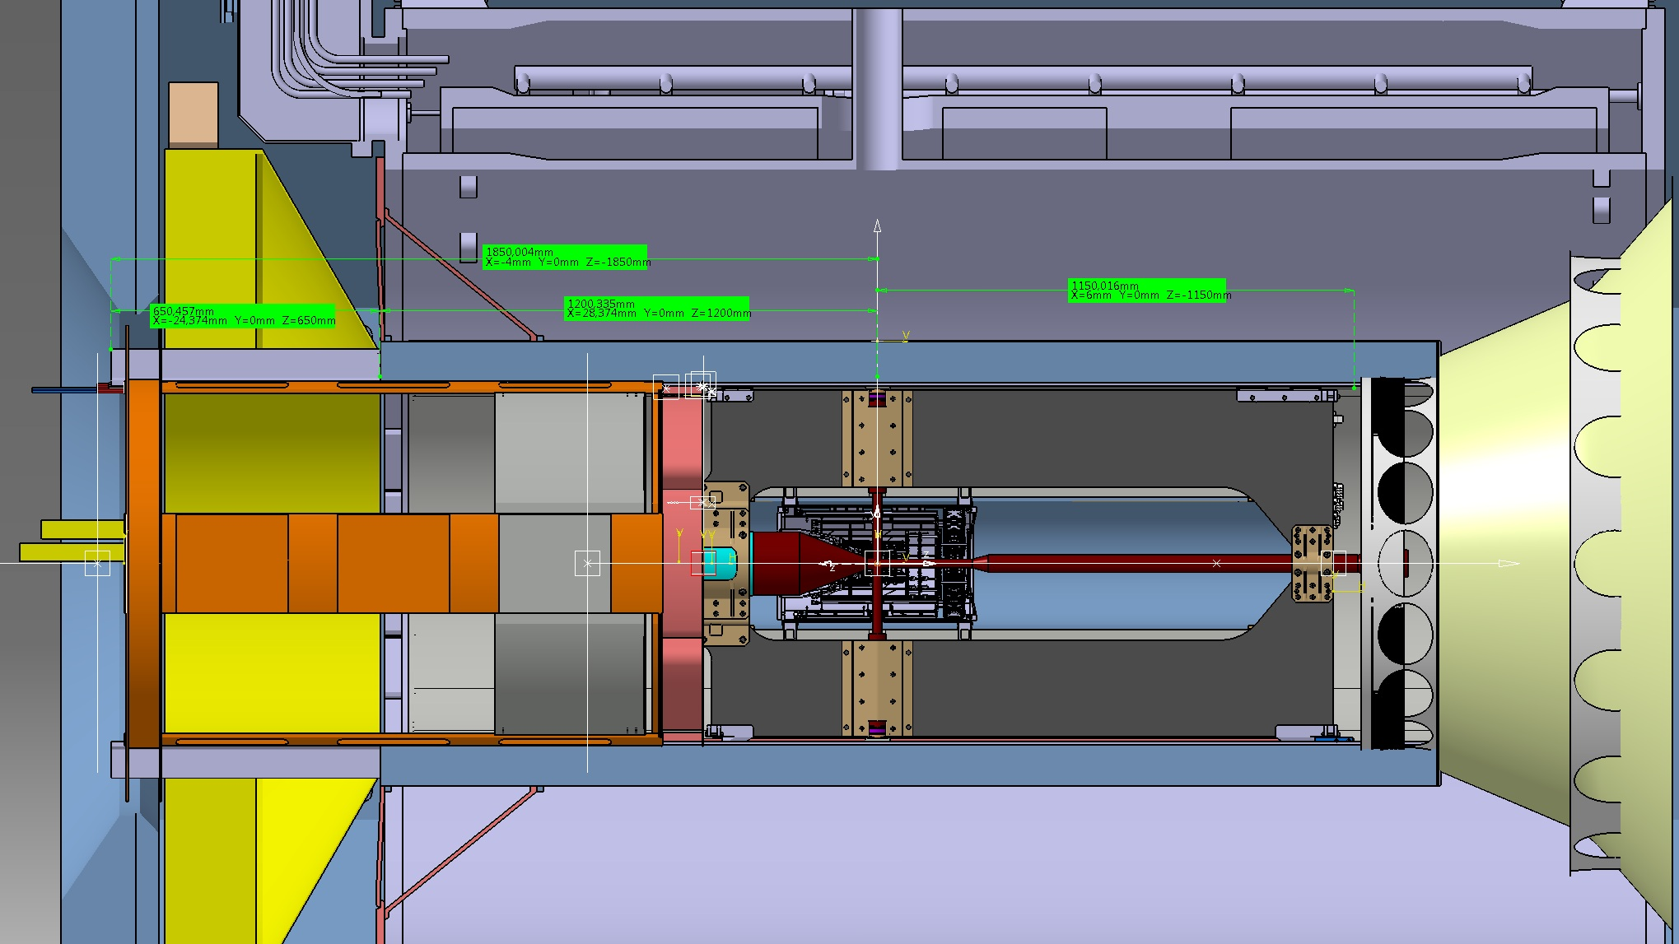
- CT SUPPORT BEAM LENGHT-
- Forward Z-coordinate necessary for the Central Tracker rails: 1150
550mm
1142mm
1692mm
- TOTAL LENGHT OF THE «STRAW TRACKER»

Slide 27
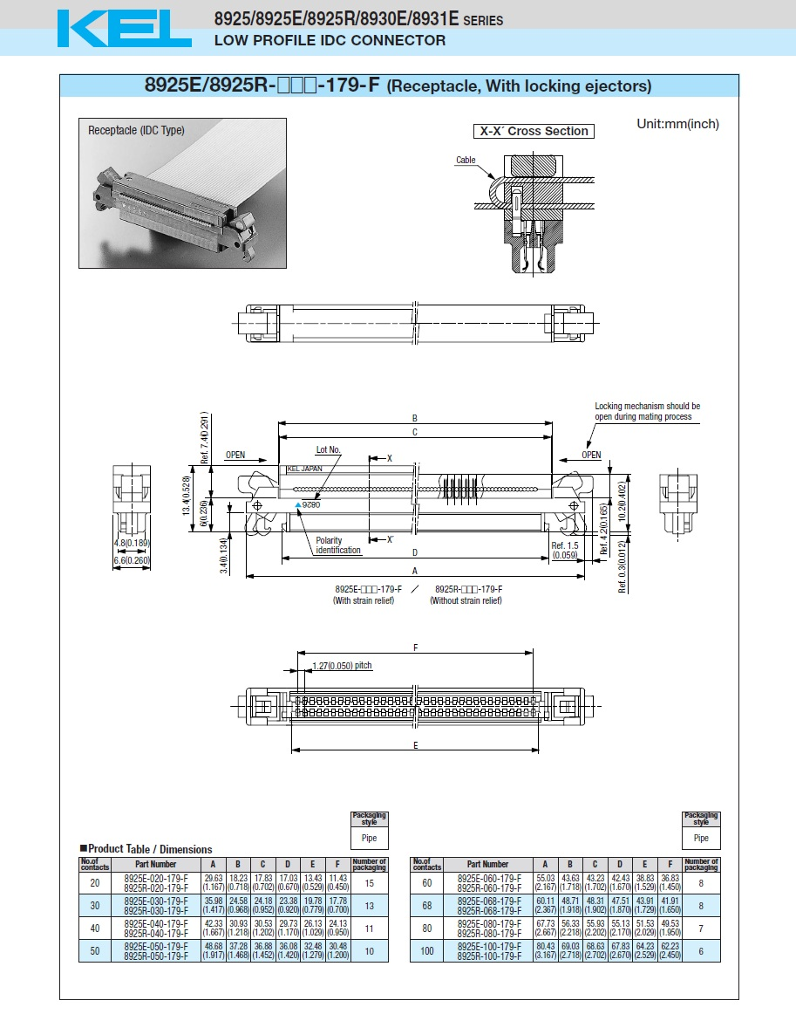
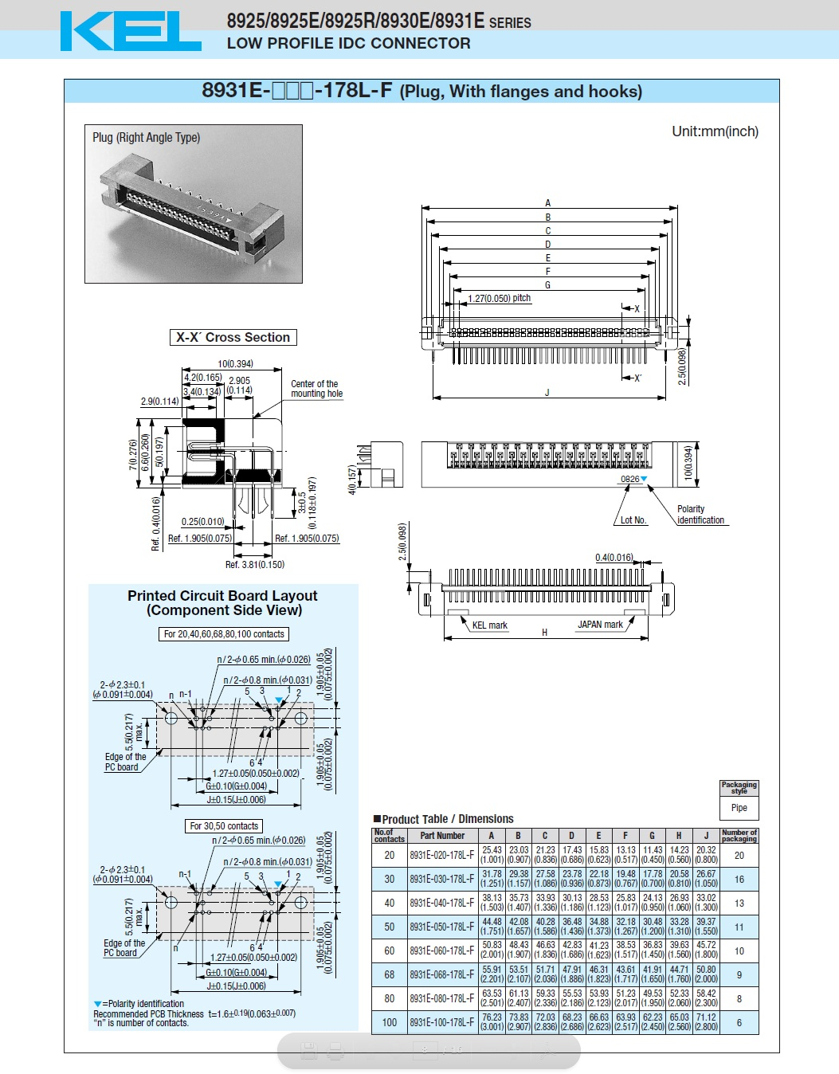
- FLAT CABLE CONNECTORS -
ELECTRONIC CARD CONNECTOR
25,5mm
FLAT CABLE CONNECTOR
10mm
13,5mm
7mm
30mm
E_Card
6,6mm
- Approx. weight of connector: 3g / Each

Slide 28
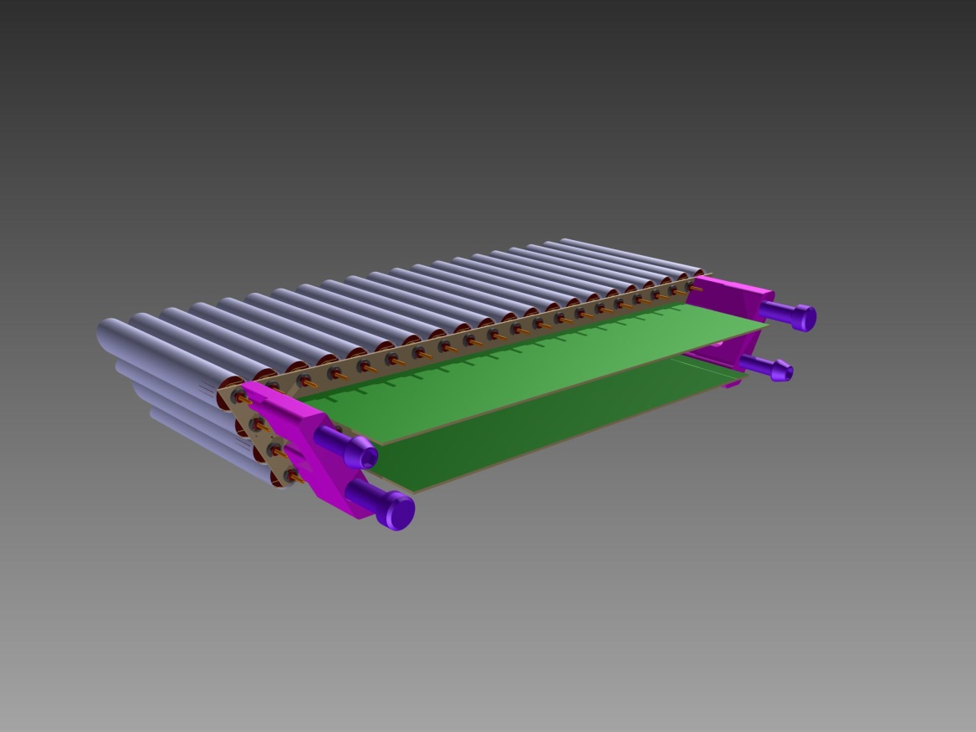
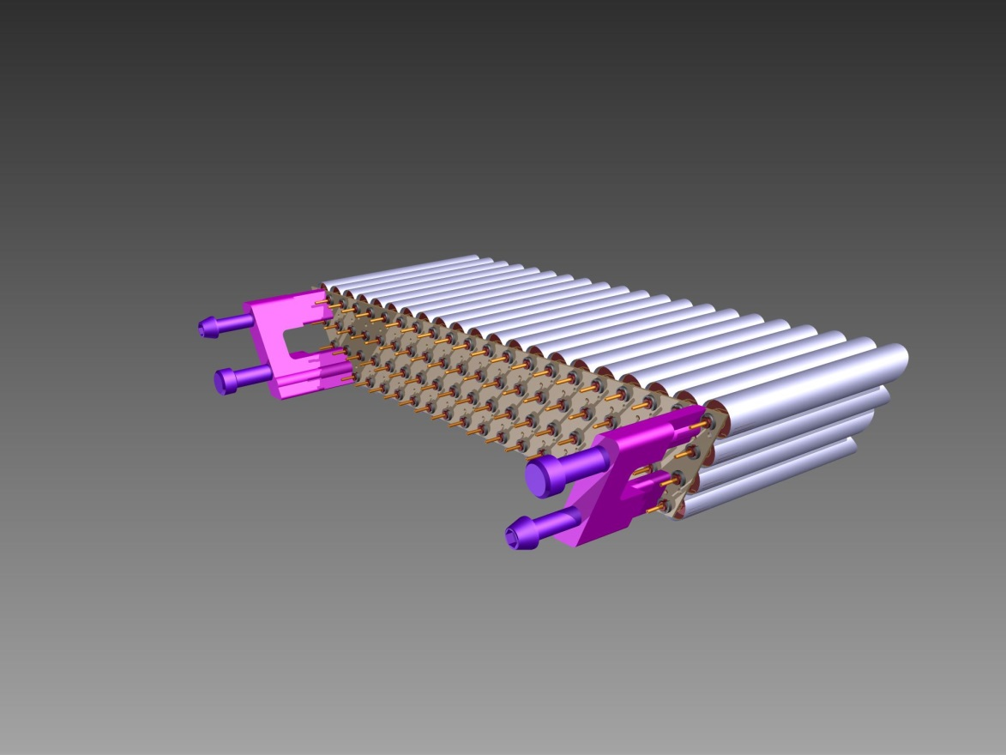
GSI – DECEMBER 2012 - D.Orecchini / P.Gianotti

Slide 29
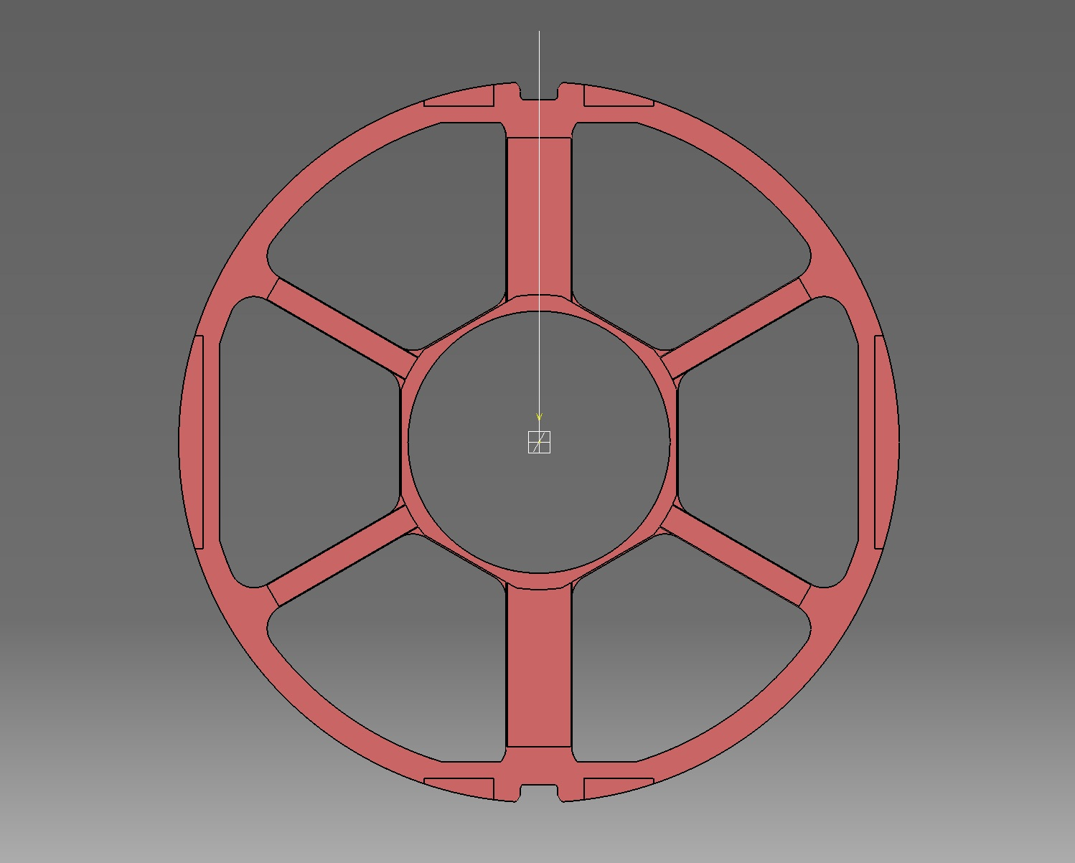
- PATHWAYS OF FLAT CABLES BUNCHES -
-The encumbrance of the connectors
has not been considered!
24
Flat cable cross section (8,5)10mm^2/each
(In twisted region of the cable)
- Total: 10x296 = 2980mm^2
17
95
Weight: 0.017 kg/m
19
13
22
13
9
54
41
53
17
Theoretical needed cross section for the
lateral pathway: 2980 mm^2
14
296 Flates
(2960 Ch.)
106
13
54
41
53
17
0,65mm
23
9
13
13mm
19
13
95
17
24
Notes:
in reality we would have had considered 3478 = 2318 tubes + 1160 control lines

Slide 30
- LOADS OF FLAT CABLES BUNCHES -
-The encumbrance of the connectors
has not been considered!
24x0,06=1,44m
Flat cable cross section (8,5)10mm^2/each
(In twisted region of the cable)
- Total: 10x296 = 2980mm^2
95 Flats
12mx0,017=0,204Kg
17x0,16=2,72m
Weight: 0.017 kg/m
19x0,045=0,855m
13x0,14=1,82m
13x0,24=3,12m
22x0,045=0,99m
9x0,33=2,97m
54
41
53
17x0,14=2,38m
Theoretical needed cross section for the
lateral pathway: 2980 mm^2
14x0,23=3,22m
296 Flates
(2960 Ch.)
106 Flats
13mx0,017=0,22Kg
296 FLATS - 0,70Kg
13x0,23=2,99m
41
17x0,14=2,38m
0,65mm
54
53
23x0,045=1,035m
9x0,23=2,07m
13x0,14=1,82m
13x0,24=3,12m
13mm
19x0,045=0,8,55m
17x0,16=2,72m
95 Flats
12mx0,017=0,204Kg
24x0,06=1,44m
Notes:
in reality we would have had considered 3478 = 2318 tubes + 1160 control lines

Slide 31
- HV CABLES -
Weight: 0,0162Kg/m
Out diam.: 3.2 mm
L = 50mm
-Thinner cables exist, but we have only 40...

Slide 32
- GAS PIPES -
Weight: 0,0162Kg/m
Outer diam: 6 mm

Slide 33
- PATHWAYS OF HV CABLES AND GAS PIPES -
12 Gas Pipes
20 HV Cables
-The encumbrance of the
connectors has not been
considered!
4 Gas Pipes
(From the Forward Side)
HV CABLE DATA
- Cross Section 8,1mm^2/each
- Total: 8,1x20 = 162mm^2 (Each Pathway)
- Weight: 0,0162 Kg/m
8 Gas Pipes
(From the Forward Side)
13 HV Cables
13
7
13 HV Cables
Theoretical needed cross section for each
top & bottom pathway: 162+340= 502mm^2
6
8 Gas Pipes
(From the Forward Side)
13 HV Cables
13
GAS PIPE DATA
- Cross Section 28,26mm^2/each
- Total: 28,26x12 = 340mm^2 (Each Pathway)
- Weight: 0.016 kg/m
4Gas Pipes
(From the Forward Side)
12 Gas Pipes
20 HV Cables

Slide 34
- LOADS OF HV CABLES AND GAS PIPES -
12 Gas Pipes
20 HV Cables
-The encumbrance of the
connectors has not been
considered!
4 Gas Pipes
(From the Forward Side)
HV CABLE DATA
- Cross Section 8,1mm^2/each
- Total: 8,1x20 = 162mm^2 (Each Pathway)
- Weight: 0,0162 Kg/m
8 Gas Pipes
(From the Forward Side)
13 HV Cables
13
7
13 HV Cables
Theoretical needed cross section for each
top & bottom pathway: 162+340= 502mm^2
6
8 Gas Pipes
(From the Forward Side)
13 HV Cables
13
GAS PIPE DATA
- Cross Section 28,26mm^2/each
- Total: 28,26x12 = 340mm^2 (Each Pathway)
- Weight: 0.016 kg/m
4Gas Pipes
(From the Forward Side)
12 Gas Pipes
20 HV Cables

Slide 38
- FLAT CABLE CONNECTORS -
ELECTRONIC CARD CONNECTOR
25,5mm
FLAT CABLE CONNECTOR
10mm
13,5mm
7mm
30mm
E_Card
6,6mm
- Approx. weight of connector: 3g / Each

Slide 40
CENTRAL TRACKER INTEGRATED ITEMS: “Straw Tubes Tracker Support Frame” ………
Cabling options and improvements could be tested on the available prototype once we realize also a
prototype of the cabling support system.
The prototype of the “Straw Tracker Support Structure”, will be shipped to Juelich in the next weeks.

Slide 41
INFN-(TURIN / LNF)
-“AUXILIARY ASSEMBLING STRUCTURE” PROTOTYPE-
AN “EXTRA PART” HAS BEEN REALIZED TO ALLOW THE TEST OF THE “INSERTION OPERATIONS”.
THE PROTOTYPE OF THE “AUXILIARY ASSEMBLING STRUCTURE”, HAS BEEN COMPLETED IN INFN FRASCATI WORKSHOP.
GSI – November / December 2010 (B. Dulach - B.Giraudo - D. Orecchini)

Slide 42
STT (Straw Tubes Tracker ) “Support Frame”, things done_2:
-There are indications (Jost preliminary calculations) that the present
max sag of the up support beam with the CT load is ∼ 1mm.
A TEST WITH PROGRESSIVELY BIGGER SAG VALUES OF THE RAIL
SYSTEM, HAS BEEN DONE.
- SUPPORT BEAM
- INDUCED SAG (Progressive insertion of metallic plates).
-“Assembly & Insertion Auxiliary Structure” prototype.
ALUMINIUM SKATE
- RAILS
1°SKATE
2°SKATE
-THE RESULTS ARE:
THE SYSTEM WORKS ANYWAY FOR VALUE OF THE SAG UP TO 0.8mm
BUT THE MAX VALUE OF SAG ACCEPTABLE FOR A SMOOTH MOVEMENT, IS 0.5mm
- RECOMMENDED FLATNESS AND
PARALLELISM TOLERANCES.
GSI – DECEMBER 2012 - D.Orecchini / P.Gianotti

