Slide 1
SIS18 Injection:
Parameter studies on MTI with space charge and longitudinal aspects
Sabrina Appel, GSI, Beam physics

Slide 2
Outline
- Introduction to the injection process into the SIS18 (specific aspects)
- Longitudinal aspects
- Multi-turn injection model and parameter studies
- UNILAC emittance, horizontal tune and effect of space charge
- Summary and Outlook
Notes:
Work the statement stronger out!
Codes and model should explain!

Slide 3
Overview injection into SIS18
- We assume that the longitudinal and transverse planes are decoupled
- Horizontal multi-turn injection
- During injection the RF in the SIS18 is turned off
- The micro-bunches debunch, filament and form a
coasting beam within a few turns
T_{rev}=5 μs
- Final full momentum spread after injection should be within the rf bucket area
(equivalent parabolic distribution)
- Transverse beam size (4 rms physical emittance) should be within the machine acceptance
(equivalent K-V distribution)

Slide 4
Longitudinal beam quality
Debunching of the micro-bunches
- Debunching in the SIS18:
- The space charge energy of the micro-bunches is transformed into incoherent thermal momentum spread
- Longitudinal perveance
- The geometry factor describes the influence of the transversal beam distribution on the longitudinal motion
- See for more information:
S. Appel, O. Boine-Frankenheim, Phys. Rev. ST Accel. Beams 15, 054201 (2012)

Slide 5
Longitudinal beam quality
Debunching of the micro-bunches
- Measured momentum spread in SIS18 after injection (dc beam)
Minimum momentum spread given by SC
I [mA] (Uran equivalent)
- Since the SC effect depends on the initial micro-bunches length, the micro-bunches are stretched in the TK (further optimization might be possible)
- Space charge and the initial momentum spread from UNILAC are the main sources of the momentum spread in SIS18!

Slide 6
Horizontal multi-turn injection into SIS18
Measured MTI performance in SIS18 (low intensities)
≈20 turns
T_{rev}=5 μs
- Beams are stacked until machine acceptance is reached
Cathode
- Loss should be as low as possible (activation, damage, vacuum)
300 kV
Anode
SIS electrostatic injection septum
Notes:
Altitude

Slide 7
Multi-turn injection
Model and quality parameters
- To achieve high intensity the beams should be packed as compact as possible
End of injection
(optimal)
t
- Loss of particles at the septum due to the betatron
oscillation, if the orbit is not reduced fast enough
- Loss maxima
- Quality:
n_{s}: Effectively stacked turns (multiplication factor)
n: Injected turns
- Intensity
- Loss
- MTI model implemented in the tracking codes PATRIC (GSI) and pyORBIT (Oak Ride Lab.)
- Both codes include a 2D space charge solver
Notes:
certain

Slide 8
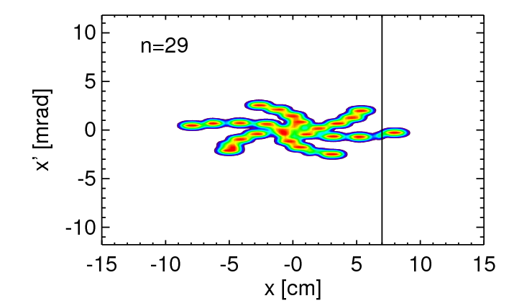
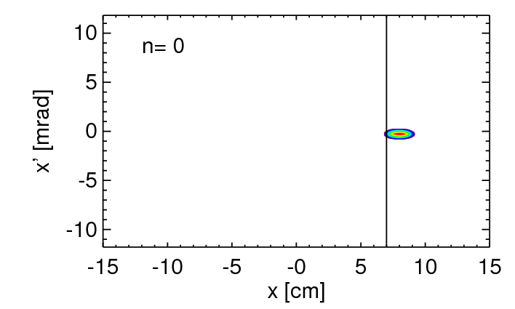
MTI: Emittance and tune dependency
Simulation results
- Animation of MTI
(Horizontal phase space)
- Acceptance limitation due to septum
- No optimization for loss
- Arm formation given by fractional tune
- Orbit bump reduction
- Horizontal tune
- Position of beam center
- MTI efficiency depends very strongly on the initial emittance and fractional tune!
Notes:
Take place

Slide 9
MTI simulation studies
Comparison between experiment and simulations (low intensity)
- Measurement results provided by Y. El-Hayek, GSI
- No space charge effects
- In the simulation the same parameters were used for the bump reduction and the measured emittance as in the experiment
- In this measurements the loss for Q_{x}=4.17 is larger as generally (optimization possible)
- The loss maxima are located at the same fractional tunes
- Measurements and simulations are in good agreement for the first time for the SIS18 injection
Notes:
One fifth; A quarter, one third

Slide 10
MTI simulation studies
Space charge effects for FAIR design intensities
- Space charge affects the betratron motion of the individual particles
- Therefore also the injection efficiency
- With space charge the maxima of the efficiency are shifted
- Space charge tune shift
- Mirco-bunch
Changes during injection
- In the most cases:
The increase of intensity and emittance compensate each other and the shift is nearly the space charge shift of the micro-bunches
- For Q_{x}= 4.18 a beam loss minimum for low and high intensity beams exists (FAIR currents)
Notes:
Work the statement stronger out!

Slide 11
Optimization of intensity and loss (quality)
- Goal (After we found the optimum tune):
Find best compromise between compact packing and loss by varying the speed of bump reduction
- Simulation parameters: A_{h} = 150 mm mrad, Q_{x}= 4.17
- Current and brilliance for the linac with 2x10¹¹ U²⁸⁺ particles stored in SIS18
I
t
B (norm.)
mm mrad
mA
μs
mA / (mm mrad)
3
10
140
3.3 (21)
5
15
80
3.0 (19)
7
16
75
2.3 (15)
slow reduction
Reduction parameter (normalized to beam radius)
fast reduction
10
20
60
2.0 (13)
Notes:
Loss machining

Slide 12

Collimation
Effect of collimation in the TK (before injection)
- Scraped-off beam edges of Gaussian distribution
- Intensity is reduced by ~ 20% and emittance by ~ 30%
2.0
- Note: Quality parameters includes the scraped-off particles
Intensity
1.5
1.0
Intensity
Loss
0.5
0.0
- Non collimation (blue line):
5
4
3
Loss in SIS18
2
- Collimated (red line):
1
0
0
10
20
30
40
50
60
70
Number of turns
- Loss in the SIS18 could be reduced
- Similar intensity could be injected

Slide 13
Summary and Outlook
Longitudinal:
- Space charge is one important source of the ‘initial’ momentum spread in SIS18!
- For high intensity beams the momentum spread could be larger than the rf bucket area
- Stretching of the micro-bunches in the TK could help (limited by the available bunchers)
Transverse:
- MTI quality (intensity + loss) depends very strongly on the initial emittance and hor. tune!
- Space charge leads to a tune shift of the beam loss maxima
- For Q_{x}= 4.18 a beam loss minimum for low and high intensity beams exists (FAIR currents)
- Current and brilliance required in order to achieve the FAIR parameters are be shown
Outlook:
- The MTI model and micro-bunch parameters (long. + trans.) from UNILAC with space charge must be verified accurately with measurements
- Dependence of the MTI efficiency on initial beam distribution should be studied more accurately
- Possible influence of skew quads on the MTI efficiency

