Slide 1
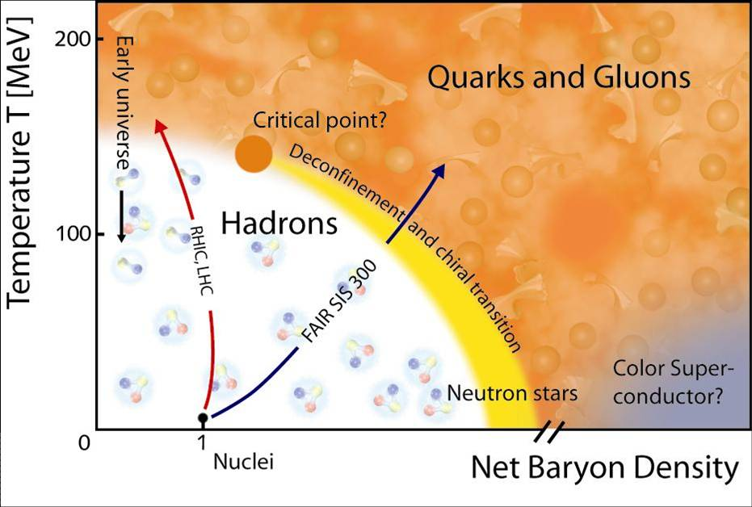
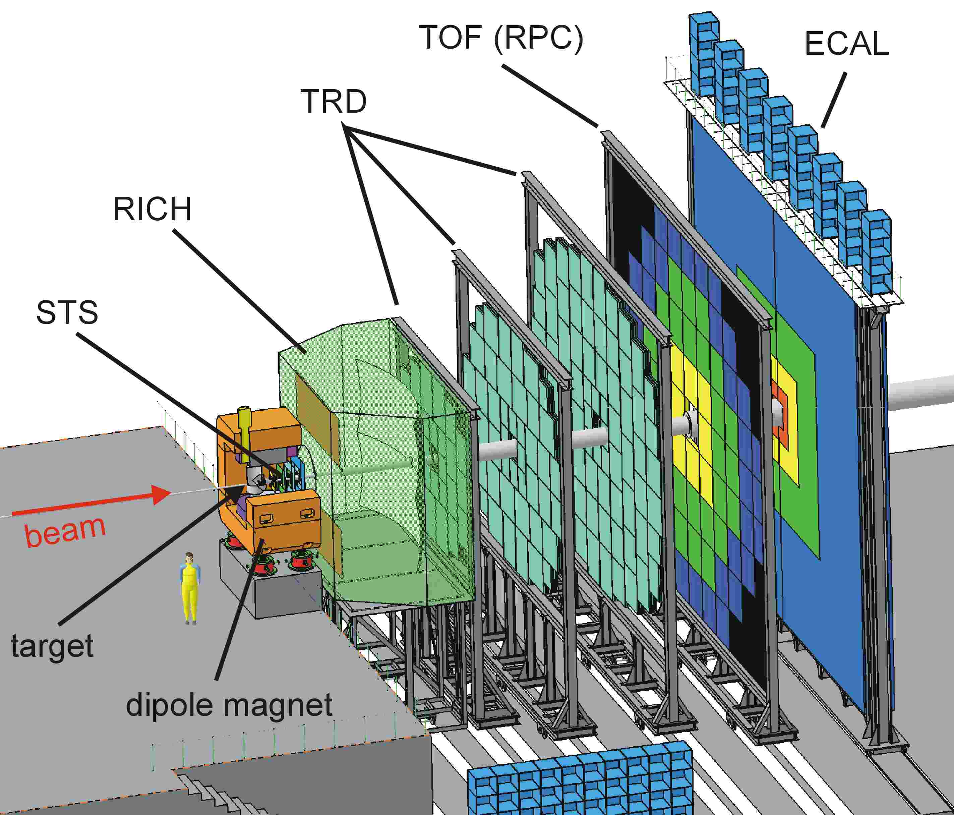
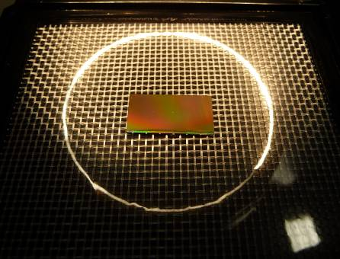
Radiation Tolerance of CMOS Sensors
Dennis Doering*, Michael Deveaux,
Benjamin Linnik, Stefan Strohauer and Joachim Stroth
for the CBM-MVD Collaboration
Goethe University Frankfurt am Main, Germany
PHD physics day
August 2013
The Heavy Ion Experiment CBM
The Task
Target
(Gold)
Z=5cm
Detector2
Sensor requirements for CBM@SIS-100:
- 5 µm spatial resolution
- 0.05 % X₀ material budget (sensor only)
- 30 µs time resolution
- Power dissipation: ~350 mW/cm²
- Ionizing radiation tolerance: 1-3 Mrad
- Non-ionizing radiation tolerance: 10¹³ n_{eq}/cm²
Detector 1
Primary Beam: 25 AGeV Au Ions (up to 10⁹/s)
Primary
vertex
Secondary
vertex
The CBM-experiment (at FAIR)
Short lived particle
D⁰ (cτ = ~ 120 µm)
The Compressed Baryonic Matter (CBM) experiment at FAIR will explore the nuclear phase diagram in the region of highest net-baryon densities at moderate temperatures. One of the promising probes is open charm which will be identified by reconstructing their secondary vertex with 50 µm precision.
Reconstruction concept for open charm
CMOS Monolithic Active Pixel Sensors (MAPS)
MAPS are pixel sensors for charged particle tracking. Their small pitch of 10 – 40 µm and 50 µm thickness provides excellent spatial resolution of a few µm.
Track of a particle
Pixel pitch: 10-40 µm
Radiation damage in MAPS
SiO₂
Diode
P+
P-Well
N+
Bulk damage
(non-ionizing radiation)
50 µm
Epitaxial
Layer
-
-
P-
Track of a particle
Surface damage
(ionizing radiation)
Leakage current
due to surface damage
Substrate
P+
+
+
+
+
+
+
+
+
+
+
+
+
+
+
+
+
+
+
-
-
-
-
-
-
-
-
-
-
Leakage current
due to bulk damage
The (P++, P, P++) doping of the MAPS sensor generates a potential minimum in the region of the epitaxial layer. Impinging particles excite electrons which diffuse within this region until they are collected by the P-Epi/N-Well diode.
Signal recombinations
due to bulk damage
Tolerance to non-ionizing radiation
Thermal annealing
D.Doering et al. Annealing studies on X-ray and neutron irradiated CMOS MAPS, NIM-A 2011
D.Doering et al. Pixel pitch dependence of the tolerance of CMOS MAPS to non-ionizing radiation, NIM-A 2013
-70 % leakage current
Cooling helps
No reverse annealing
Improved non-ionizing rad. tol.: High-resistivity and/or smaller pitch
Performance in beam
Tolerance to ionizing radiation
High initial noise is currently under further study, maybe due to not yet optimized transistor layout
IPHC Strasbourg
Sufficient S/N even after 10 Mrad
CBM radiation requirements fulfilled
Excellent detection efficiency of >99.5% despite of irradiation
Conclusion: MAPS based on a 0.18 µm-CMOS process with a (1 kΩcm) high-resistivity epi-layer provide the radiation hardness needed for the next generation Heavy Ion experiments.
*supported by BMBF (06FY9099I, 06FY173I and 05P12RFFC7),
GSI (F&E) and HIC for FAIR
Contact: doering@physik.uni-frankfurt.de

