Slide 1
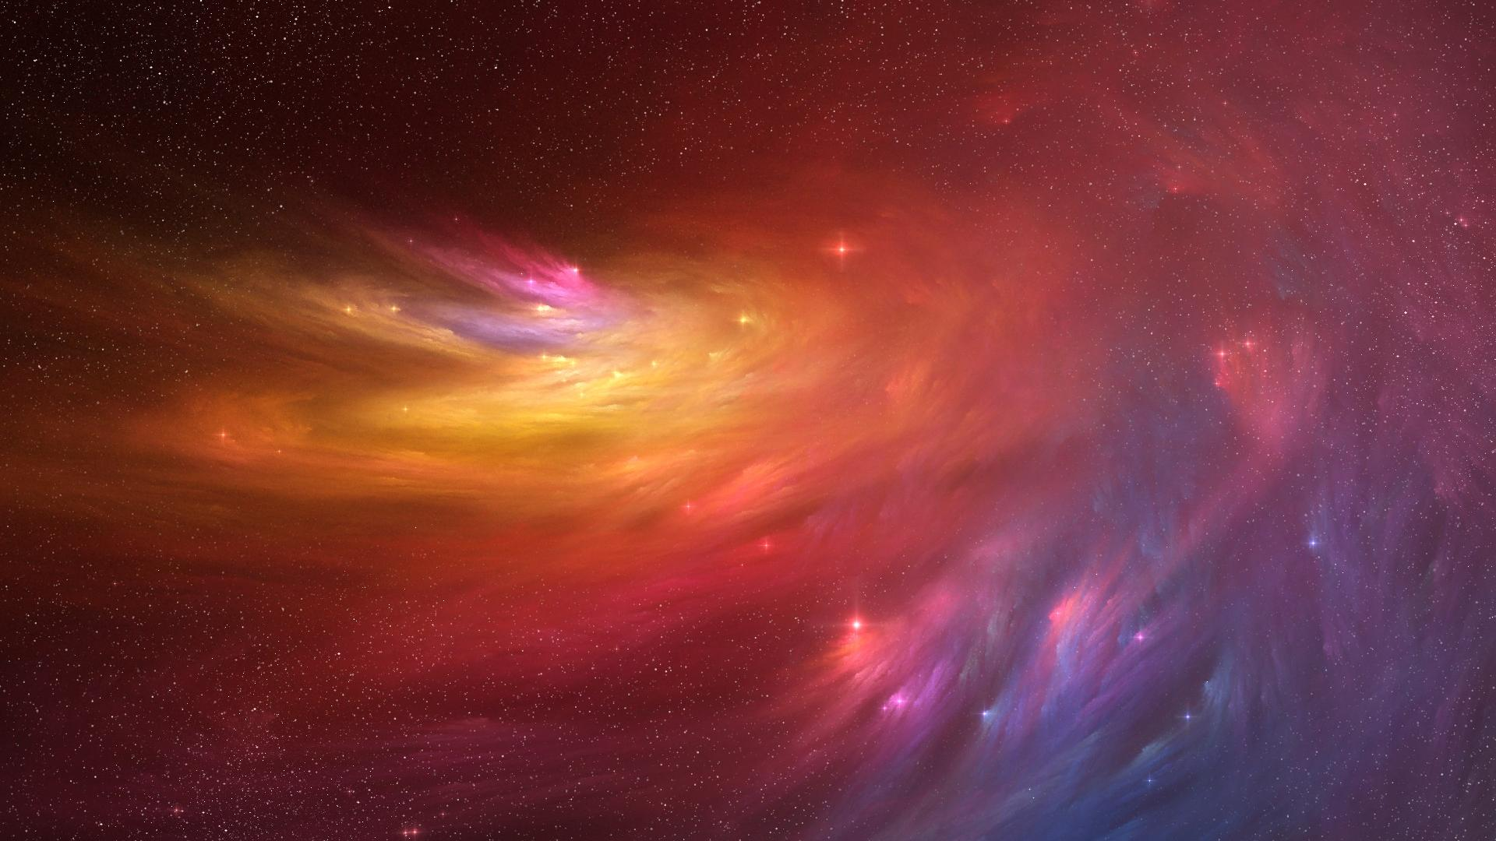
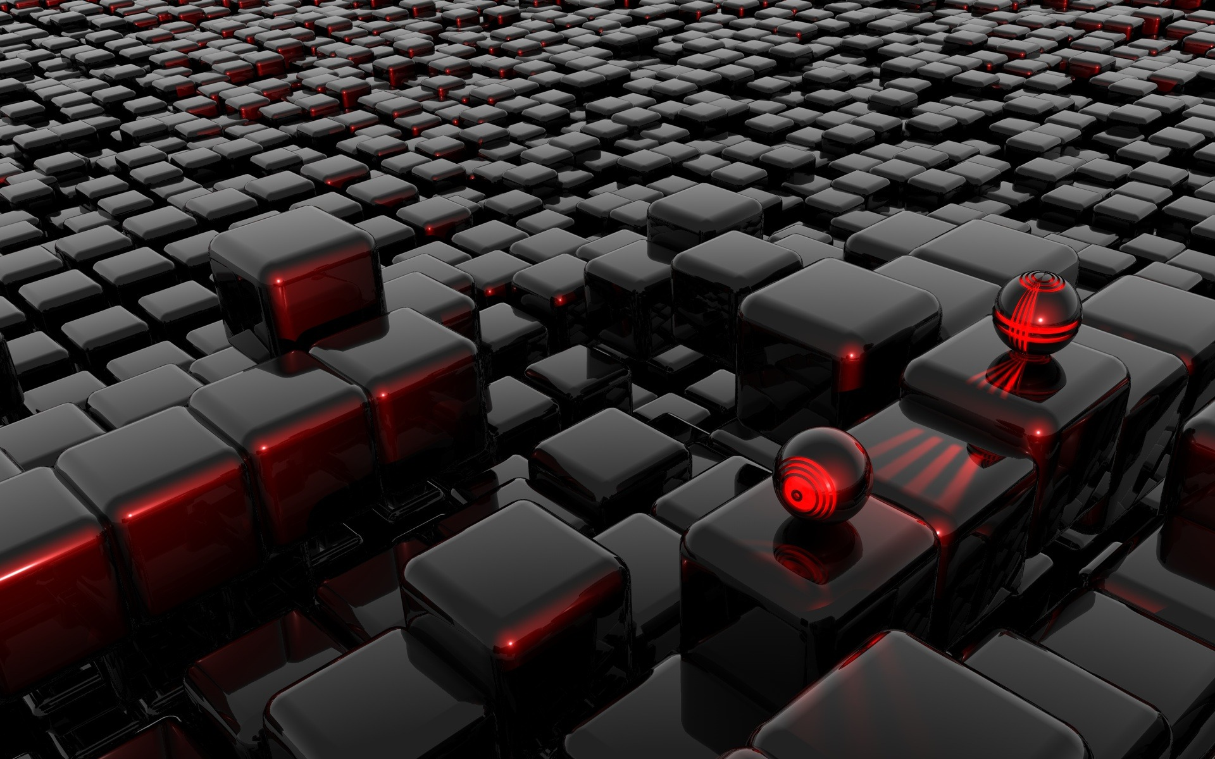
2013
26th August
PhD Science Day
26th Aug’13
14:00-17:00 hrs
Main Lecture Hall
GSI, Darmstadt
Highlights:
Achievements of GSI in Science & Update from FAIR
Career Prospects @ FAIR
Interaction with Alumni’s (former PhD’s)
Poster Session (PhD Students)
All PhD Students and GSI Summer Students are invited.
For more information: https://indico.gsi.de/conferenceDisplay.py?confId=2360

