Slide 1
Beam dynamics in accelerators: nonlinear dynamics and experiments Wolfram Fischer, BNL 1st XBEAM-XRING Workshop – Beam Dynamics meets Magnets 2-4 December 2013, Darmstadt
Notes:
40 min (including questions) = 32 slides

Slide 2
Acknowledgments
N. Abreu/Milas, R. Bartolini, J. Bengtsson, O. Boine-Frankenheim, A. Burns, M. Bai, M. Blaskiewicz, O. Brüning, Y. Cai, A. Chao, R. Calaga, J. Camas, P. Cameron, G. Crockford, E. Carlier, L. Ducimetière, M. Ellison, A. Faugier, G. Ferioli, E. Forrest/P. Nishikawa, G. Franchetti, M Furman, D. Gall, J. Gareyte, P. Görgen, J.J. Gras, M. Giovannozzi, X. Gu, W. Herr, B. Holzer, I. Hofmann, G. Hofstätter, H. Jakob, R. Jung, J. Koopman, J.-P. Koutchouk, H.-J. Kim, M. Laffin, J. Laskar, T. Linnecar, Y. Luo, N. Malitsky, W.W. MacKay, E. Metral, E. McIntosh, I. Milstead, C. Montag, S. Nagaitsev, K. Ohmi, S. Peggs, F. Pilat, V. Ptitsyn, G. Robert-Demolaize, T. Roser, T. Satogata, W. Scandale, F. Schmidt, P. Schmüser, M. Seidel, T. Sen, G. Stancari, S. Tepikian, V. Shiltsev, M. Syphers, F. Ruggiero, R. Talman, R. Tomàs, D. Trbojevic, A. Valishev, M. Vogt, L. Vos, S.M. White, F. Willeke, V. Ziemann, F. Zimmermann, …

Slide 3
Content
Stability of single particle motion – the dynamic aperture
Sources and descriptions of nonlinear magnetic fields
Experimental methods and simulation tools to assess stability of motion

Slide 4
Particle motion in storage rings
s
S
- dipoles (bending) define design orbit - total bend angle = 2π
N
N
S
- quadrupoles (focusing) define s-dependent beam envelope (for given ε) - focusing force proportional to transverse amplitude - number of transvers oscillations per turn = tune ν_{x,y}
S
N
Already possibilities for instabilities
ν = integer and dipole error
ν = half integer and quadrupole error
Magnet pictures from W. MacKay and T. Satogata, USPAS 2013.

Slide 5
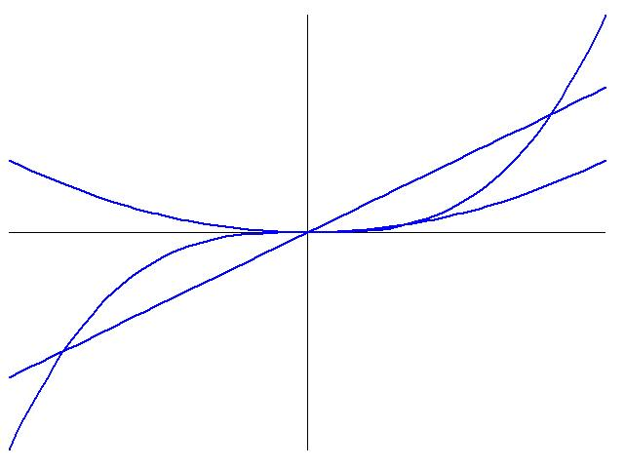
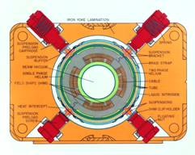
Sources of nonlinear fields
N
Sextupoles – correct for change in focusing strength for particles with energy deviations δp/p
Octupoles – introduce tune spread and Landau damp instabilities
Field errors of magnets, in particular
superconducting magnets without pole tips
when/where beam is large (injection, final focus quadrupoles)
S
S
N
N
S
force
octupole
Tevatron quadrupole
quadrupole
sextupole
amplitude
higher order multipole magnets create very fast rising field at high amplitudes (strong nonlinearity)

Slide 6
Particle motion with nonlinear forces
Oscillation frequencies (tune ν) is amplitude dependent
Infinite number of resonances: k, l, p integers (not all are equally dangerous)
x’
x
L. Evans, LHC w/ BB, CERN courier (2008).
Nonlinear forces give rise to chaotic motion. Sextupole already can generate all nonlinear phenomena.

Slide 7
Hamiltonian description of motion
particle coordinates
1/K_{x,z} – bending radii
equations of motion
(A_{x},A_{z},A_{s}) – vector potential
solved piece-wise in a simulation
Hamiltonian near a resonance
tunes
detuning
action-angle variables
actions (I_{x},I_{y}) are constants for linear motion
resonance driving term
G. Ripken and F. Schmidt, DESY 95-063 and CERN SL/95-12 (AP).

Slide 8
Nonlinear phenomena in storage rings
Phenomena observed in experiment and simulations:
Amplitude detuning
Resonance driving terms
Phase space deformations
Smear (amplitude variations)
Tune response matrix (sampling nonlinear fields with closed orbit distortions, G. Franchetti, PRST-AB 11, 094001 (2008))
Resonance island in phase space
Echoes (only possible with detuning)
Tune and amplitude diffusion
Halo formation
Beam size growth
Particle loss
Dynamic aperture

Slide 9
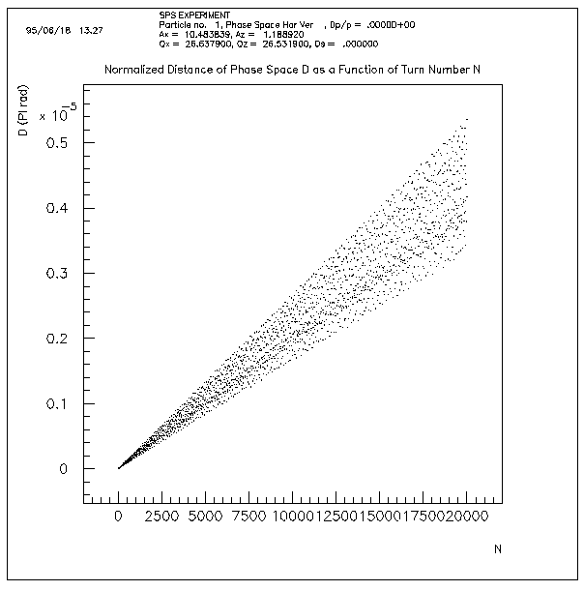
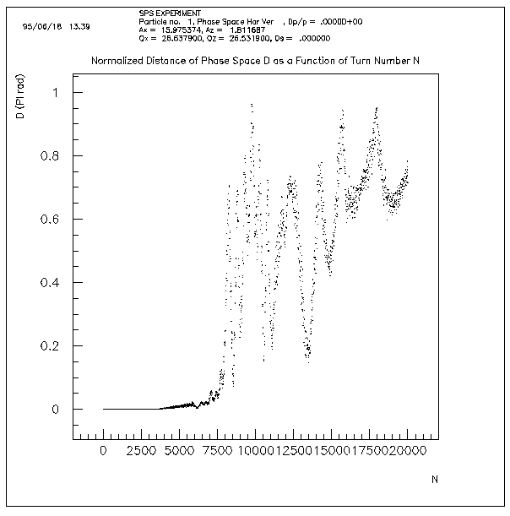
Chaotic particle motion
Motion in nonlinear systems (accelerators) is chaotic at large amplitudes chaotic = deterministic but not predictable chaoticity tested by following distance d of 2 initially closed particles
Regular motion: d ~ t
Chaotic motion: d ~ exp(t)
10⁻⁵
1
Chaotic particle motion gives to a dynamic aperture

Slide 10
The dynamic aperture
DA range
DA depends on time scale of interest
Frank Schmidt, Ph.D. Thesis (March 1988)

Slide 11
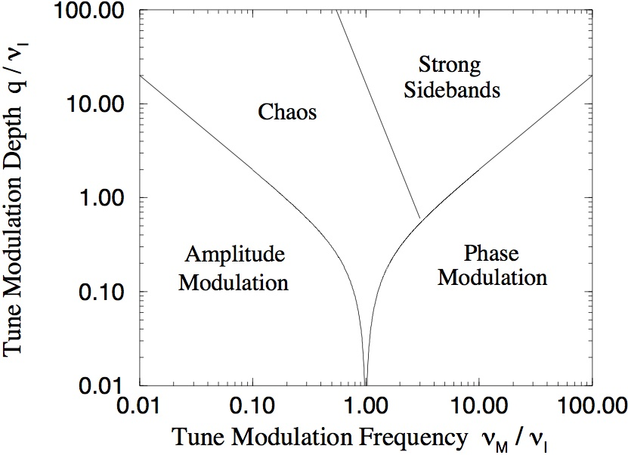
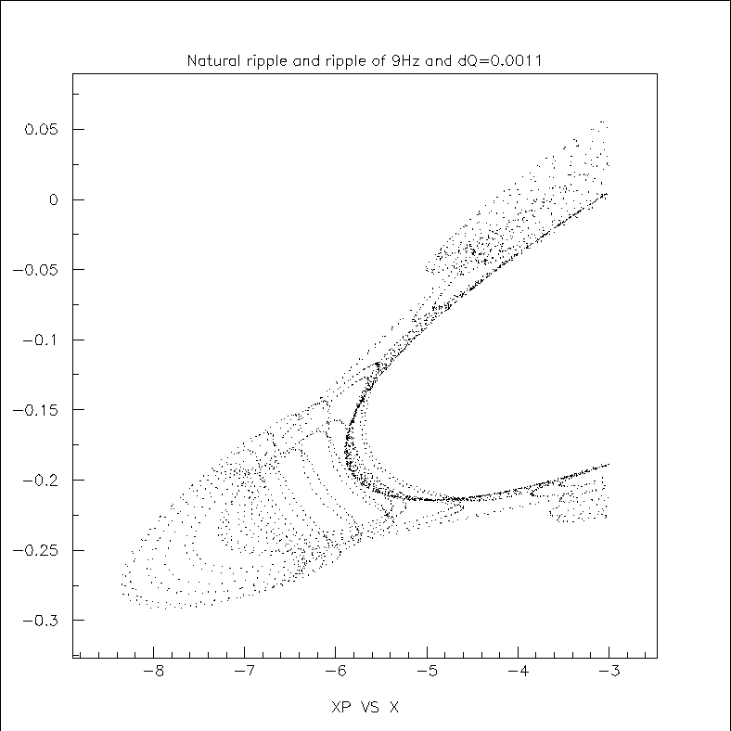
Tune modulation phase diagram
Dynamic aperture also affected by time-dependent machine parameters,
e.g. tune modulation from 50/60 Hz power supply harmonics
Resonance island with tune modulation
T. Satogata et al., PRL 68, pp. 1838 (1992)

Slide 12
Field description – circular multipoles
y
r
B₀ magnetic field at reference radius r₀ with r₀ ≈ 2/3 or beam pipe radius
b₁ dipole, b₂ quadrupole, …, a₁ vertical dipole, a₂ skew quadrupole, … b_{n},a_{n} usually given in units of 10⁻⁴ of B₀
θ
x
r₀
Now standard notation, previously US also used b₀ for dipole dipole etc. and different sign for a_{n}
Multipoles can be measured with rotating coils or hall probes.

Slide 13
Field description – elliptical multipoles, see Talk P. Schnizer
Used if elliptical beam pipe must be filled with beam, e.g. SIS100.
New coordinates:
η₀ reference ellipse
B₁ elliptical dipole, B₂ elliptical quadrupole, …, A₁ elliptical vertical dipole, A₂ elliptical skew quadrupole, …
P. Schnizer et al., IEEE Transactions on Applied Superconductivity, Vol. 18, No. 2, pp. 1605-1608 (2008). P. Schnizer et al., EPAC’08, pp. 1703-1705 (2008).

Slide 14
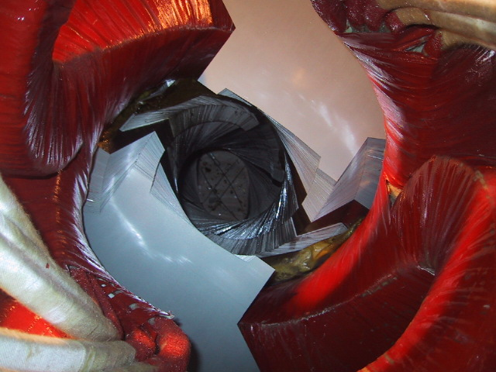
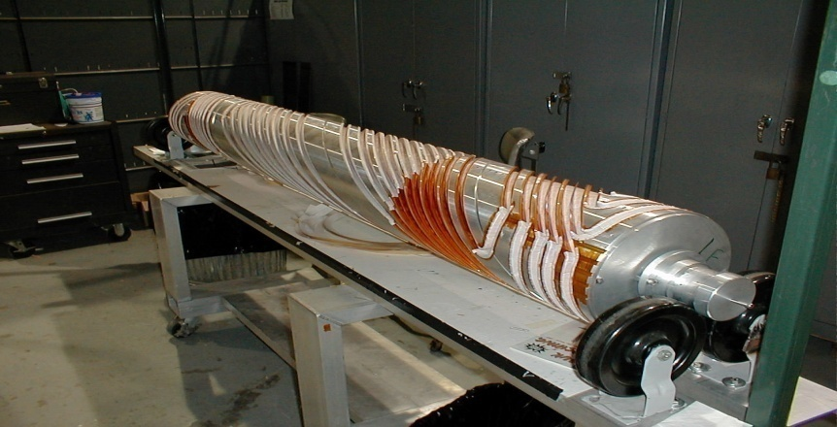
Field description – helical multipoles
Helical magnets used e.g. for wigglers/undulators, spin manipulations, muon cooling.
New coordinates:
λ helical wave length, k helical wave number
B₁ helical dipole, B₂ helical quadrupole, …, A₁ helical vertical dipole, A₂ helical skew quadrupole, …
AGS warm snake
AGS cold snake
RHIC cold snake

Slide 15
Fringe fields – important for short magnets (small rings)
Descriptions on previous slides for infinitely long magnets – a good approximation for large machines
For short magnets (small rings) fringe fields can dominate beam dynamics
Fringe fields often models with computer
Some analytical models available
Analytical potential for quadrupoles, long and short
Smooth change in strength function resulting lower field aberrations
R. Baartman, PRST-AB 15 074002 (2012).

Slide 16
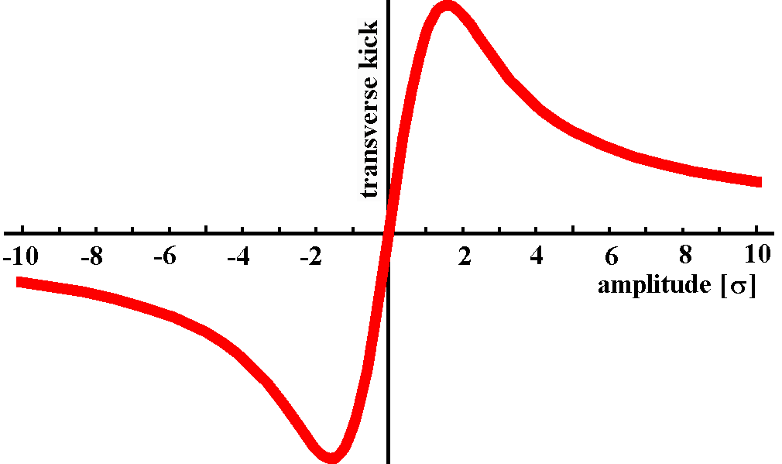
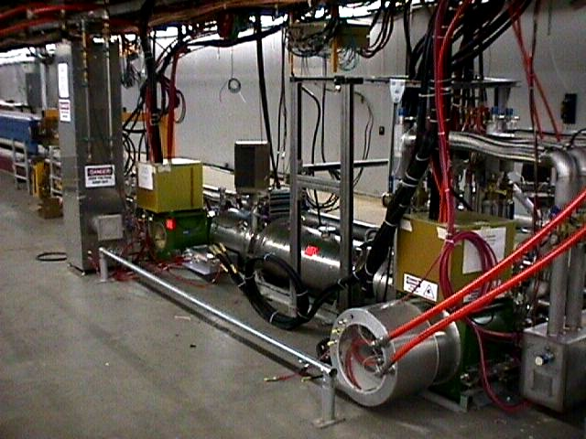
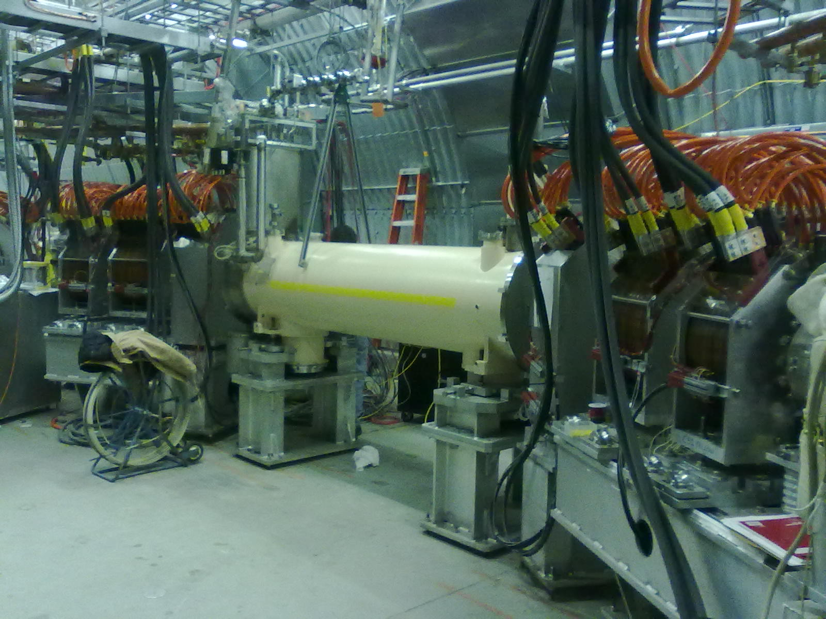
Nonlinear fields from beam-beam interaction
Amplitude dependence of beam-beam kick fundamentally different from magnets strength not monotonically increasing in BB cannot be described by multipoles for r ≈ σ
beam-beam kick
magnet kicks
electric field
magnetic field
(the other beam is not like a magnet – at least 50% of the force is from the electric field)
Tevatron
RHIC

Slide 17
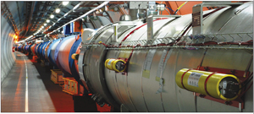
Primary beam observation tools
B.R. Poole, et al. PAC’97
Beam Position Monitors (BPMs) – Turn-by-Turn
Buttons (higher frequency resolution)
Striplines (higher sensitivity)
Beam Profile Monitors
Wire scanners
Ionization Profile Monitors
Synchrotron Light Monitors (mostly e⁺/e⁻)
Beam Loss Monitors (BLMs)
Ionization chambers
PIN diodes
Kickers to fill the aperture
AC dipoles for sustained oscilation
Collimators to define the aperture
…
R. Connolly et al. BIW10
LHC

Slide 18
Experimental techniques
Make small beam (pencil beam) – approximation for single particle
Kick beam to amplitude of interest OR use AC dipole (dipole oscillating near tune but outside distribution, M. Bai – AGS)
Observe beam in BPMs
Observe time dependent profile

Slide 19
Simulation tools – particle tracking
Particle tracking
Simulate single particle motion
Model for all accelerator components (magnets, drifts, cavities, …)
Integrator (often kick approximation) – symplectic for hadron beams
Programs: SixTrack, MAD, SimTrack, Lifetrack, …
Simulations steps
Good model of linear machine (orbit, coupling, chromaticity, beta-beat, misalignments)
Include known effects such as tune ripple, …
Analysis of short-term behavior (phase space, chaoticity, …)
Reproduce detuning
Long-term tracking
Parameter scans (e.g. multipole error range and distribution)

Slide 20
Nonlinear phenomena in storage rings
Phenomena observed in experiment and simulations:
Amplitude detuning
Resonance driving terms
Phase space deformations
Smear (amplitude variations)
Tune response matrix (sampling nonlinear fields with closed orbit distortions, G. Franchetti, PRST-AB 11, 094001 (2008))
Resonance island in phase space
Echoes (only possible with detuning)
Tune and amplitude diffusion
Halo formation
Beam size growth
Particle loss
Dynamic aperture
[Reference: Accelerator Handbook, Nonlinear experiments]

Slide 21
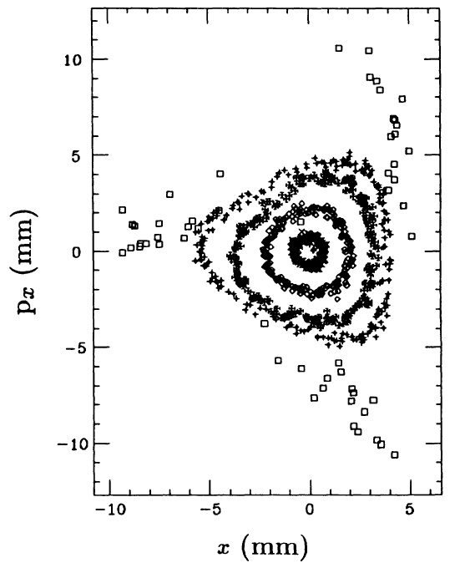
Experimental Poincaré surface of section – IUCF
45 MeV cooled p beam, kicked to different amplitudes
Used to beam position monitors (BPMs) to reconstruct beam position and angle at one location in the ring
Phase space plot shows 3rd order resonance
Can be compared to a simulation
D.D. Caussyn et al., PRA 46, pp. 7942 (1992)

Slide 22
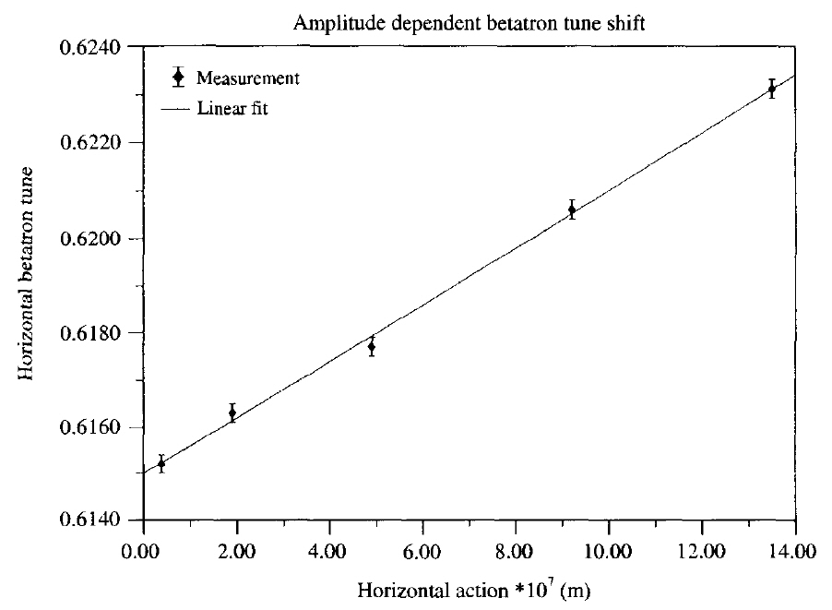
Amplitude dependent tune measurement – VEPP-4M
Horizontal betatron tune as function of horizontal action (emittance)
1.8 GeV e⁻ beam, kicked to different amplitudes
FFT of 4096 turns
Linear dependence for sextupoles and octupoles (nonlinear for higher order multipoles, and beam-beam)
Can be compared to a simulation
V. Kiselev et al., PA 57, pp. 65 (1997)

Slide 23
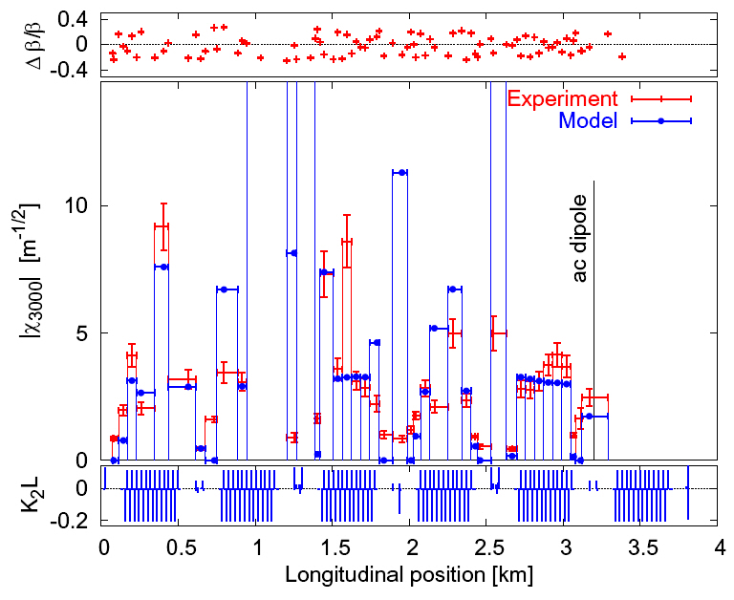
Measurement of resonance driving terms – RHIC
10 GeV/n Au beam
Sustained transv. oscillation with an AC dipole (sustained oscillation)
Observation of oscillation around the ring with BPMs
Resonance driving terms derived
Compared to a simulation
R. Tomàs et al., PRST-AB 8, 024001 (2005)

Slide 24
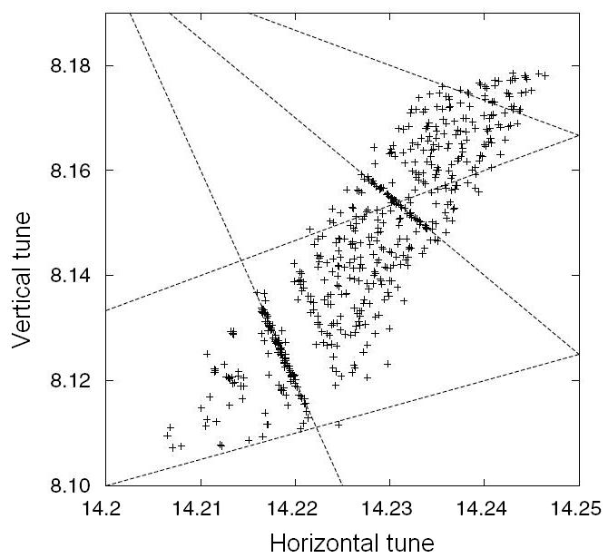
Experimental frequency map – ALS
1-2 GeV e⁻ beam, kicked to different amplitudes
Frequency Map Analysis (FMA) of 1024 turns identified resonances
Compared to Frequency Map Analysis (FMA) of model
D. Robin et al., PRL 85, pp. 558 (2000); FMA: H.S. Dumas, J. Laskar, PRL 70, 2975 (1993).

Slide 25
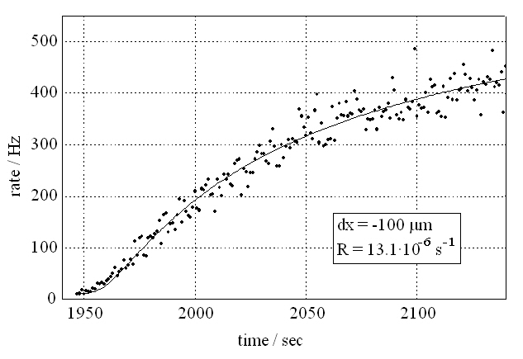
Amplitude diffusion measurement – HERAp
920 GeV p beam, collimator retracted
Empty transv. space fills again with beam
Observed with loss monitor at collimator
Can be compared to a simulation (difficult – needs many particles, has large errors)
M. Seidel, PhD Thesis, DESY 94-103 (1994)

Slide 26
Amplitude diffusion measurements in halo
G. Stancari, Beam-Beam 2013 (2013).
[F. Zimmermann, PA 49, pp. 67-104 (1995) calculated D_{J} over ~40 orders of magnitude]

Slide 27
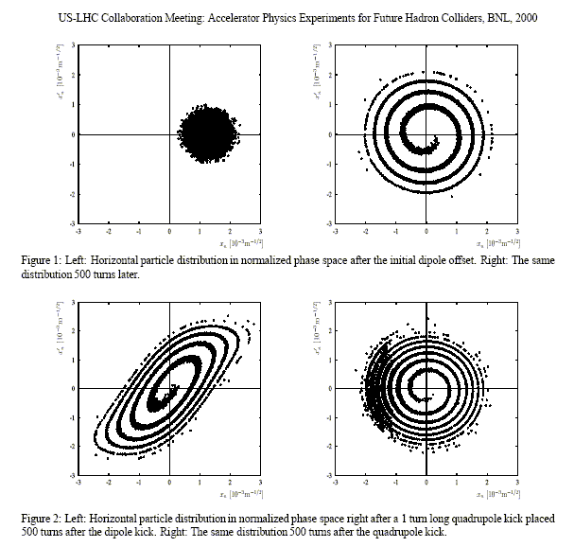
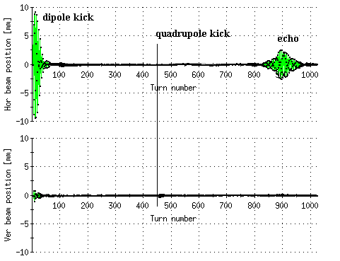
Echoes
Echoes well known in plasma physics, proposed for accelerators by G. Stupakov (1992), observed in longitudinal plane in Fermilab AA (1996) and SPS (1996).
dipole kick
filamentation
measurement in RHIC, Au⁷⁹⁺ injection
hor
quadrupole kick
echo
ver
echo response sensitive to amplitude diffusion
Can be compared to a simulation – too insensitive for IBS [S. Sorge et al, ICAP 2006]

Slide 28
Dynamic aperture measurement
Dynamic aperture = largest amplitude where most particles will survive over a time-period of interest
In simulation:
Place particles over amplitude range, track over time period of interest ➔ survival plot
In experiment:
Place particle over amplitude range (kick), observe transverse profile as function of time
Frank Schmidt (1988).

Slide 29
Dynamic aperture measurement
1. Kick beam over aperture to have many particles over border of stability (due to detuning beam will filament in phase space)
2. Measure transverse profile as function of time (wire scanner, IPM)
Time-dependent dynamic aperture
Note: Filling aperture with many small kicks is possible, but gives poor signal at DA.

Slide 30
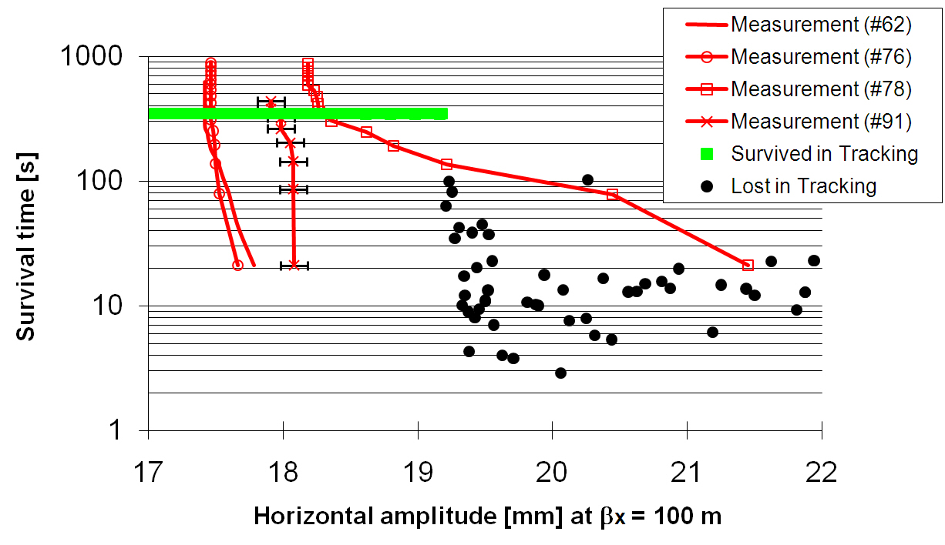
Dynamic aperture measurement and simulation – SPS
120 GeV p beam, kicked to 5 rms beam sizes
Time-dependent transverse profile measured with wire scanner
Compared to a simulation: agreement within 10%, over 5 min
W. Fischer, M. Giovannozzi, F. Schmidt, PRE 55, pp. 3507 (1995)

Slide 31
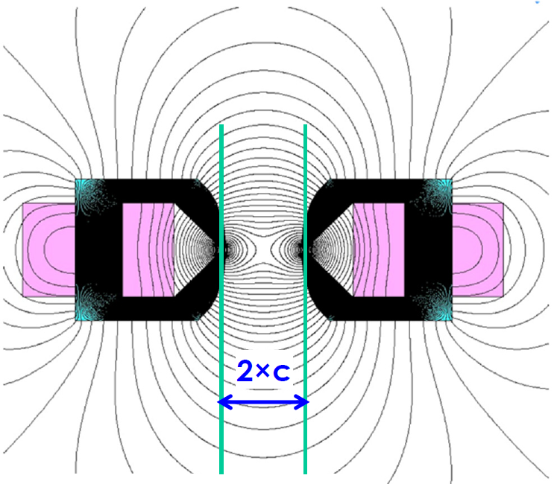
Integrable Optics Test Accelerator (IOTA) at Fermilab
Goal of IOTA is to provide
practical nonlinear focusing with zero resonance strength with either
Special magnets
Electron lenses
Successful implementation could accommodate very large tune spread
e/p storage ring 50-150 MeV
Example of stable trajectory in nonlinear lattice
(x,p_{x})
(y,p_{y})
(x,y)
(x,y,p_{x})
S. Danilov and S. Nagaitsev, PRST-AB 13, 084002 (2010); S. Nagaitev, AAC (2013).

Slide 32
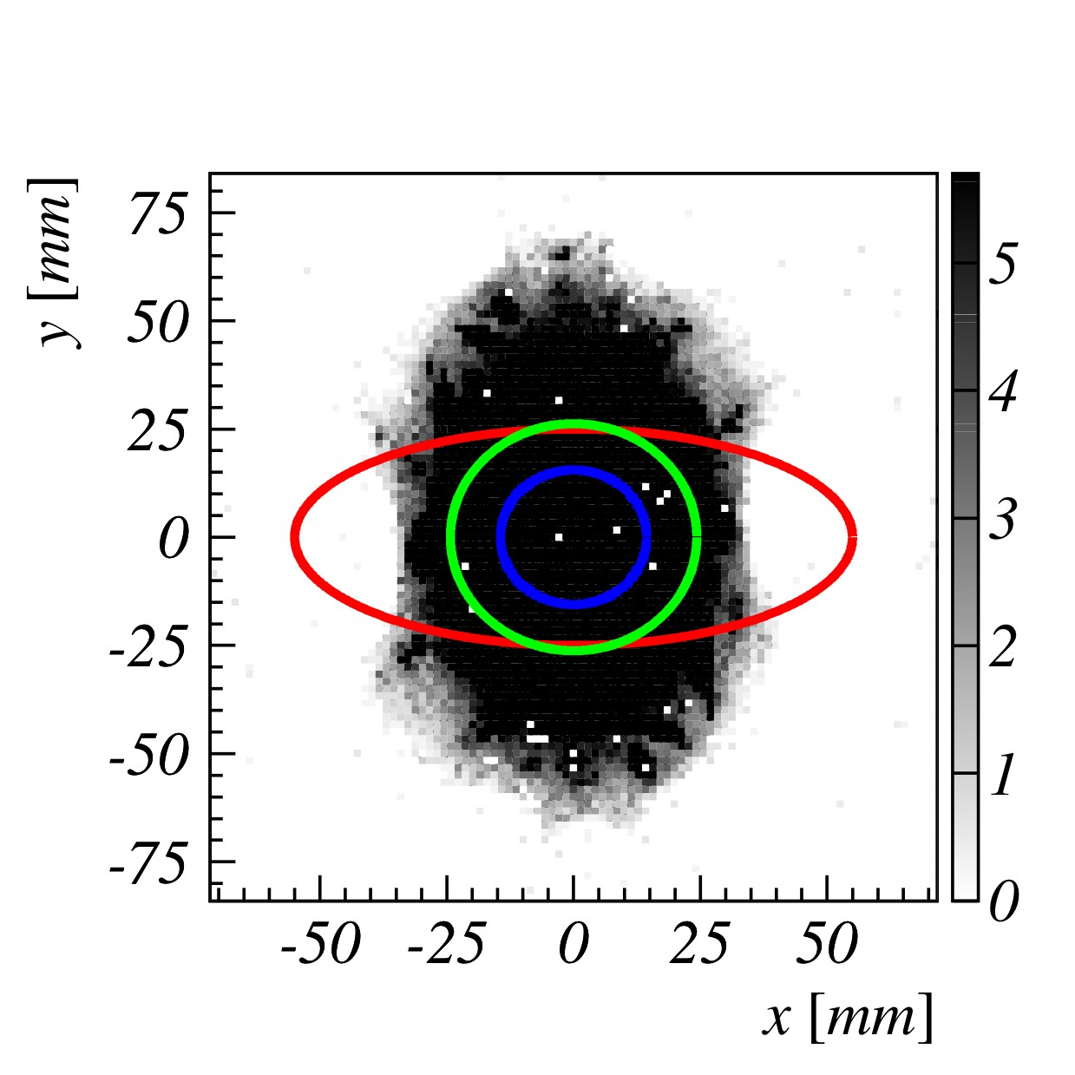
SIS-100 transverse apertures at injection (0.2 GeV/u)
Summary
dynamic
aperture
beam
Nonlinear magnets are needed to correct for chromatic aberrations (sextupoles), and to suppress instabilities (octupoles)
Nonlinear magnetic fields also arise from magnet errors (especially in superconducting magnets without pole tips)
These fields give rise to a dynamic aperture (limit for stable amplitudes – DA depends on time scale of interest)
Nonlinear dynamics experiments have shown that well-prepared simulations can predict DA within 10-20% over time scales of minutes, simulations also useful for time scales of hours
Today there is enough computing power to calculate DA directly (even with parameter scans); faster precursors that must be correlated with the DA are only needed for preparation (e.g. phase-space distortions, detuning, smear, tune-diffusion, test for chaoticity)
lattice
aperture
magnet
aperture
G. Franchetti (2008)

Slide 33
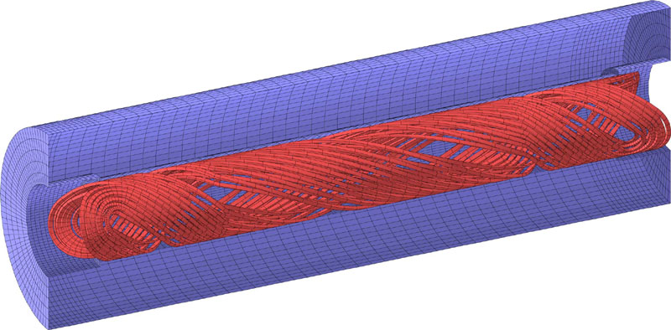
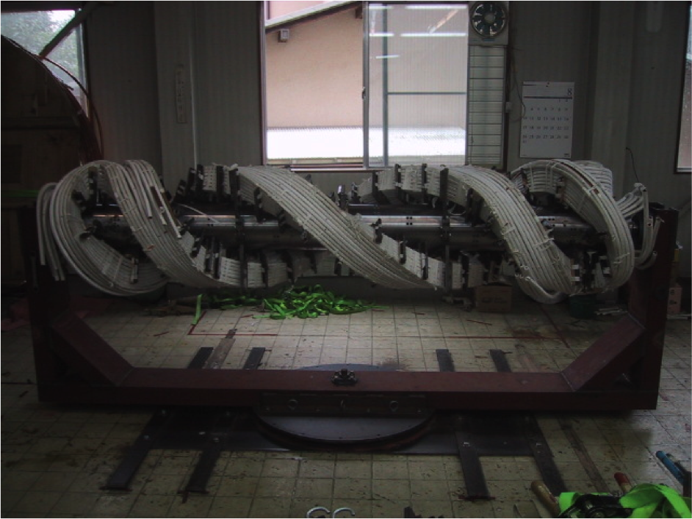
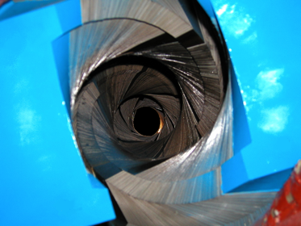
AGS warm snake pictures
Example of helical magnet

