Slide 1
Magnets in Accelerators: an Historical Overview
EuCARD-2 XBEAM-XRING Network
Beam Dynamics meets Magnets Workshop
Thomas Taylor
Darmstadt, 2-4 December 2013

Slide 2
Introduction
Early history
Escalation of size
Evolution of types
Computation and Field quality
Magnet types
Conventional
Permanent
Superconducting
Interfaces
Beam / magnet
Magnet / experiment / beam
Conclusion
Postscript – on purchasing magnets

Slide 3
Early history
The first machines relied purely on the electric field to accelerate, focus and bend the stream of particles
Rutherford
van de Graaff
Cockroft and Walton
But the potential of such devices is limited
Widerøe: idea 1: following Ising (1924) → use induction → Betatron (failed) idea 2: (1928) ‘resonance' accelerator – repeated kicks / AC field
(linear device worked)
→ Lawrence (+ Livingston) (1931) cyclotron
This was to be the first appearance of a rudimentary magnet in an real accelerator

Slide 4
Escalation of size
The first cyclotron was very small – 5” diameter (and worked “by accident”…)
But Lawrence immediately set out to build larger and larger machines
→ 5” → 11” → 60” → 184”
Due to the war the last project was delayed (fortunately, as useful studies in the meantime led to a better understanding of the mechanisms – and limitations – of the original design and its conversion to a synchro-cyclotron)
In parallel, the inductive method of acceleration was analyzed (Kerst) and large working Betatrons were constructed
It was not sufficient to make just very large magnets –
The field had to be sculpted to provide optimal focusing, and to take into account the parameters of the beams as they became relativistic
Accelerator magnet technology was born!

Slide 5
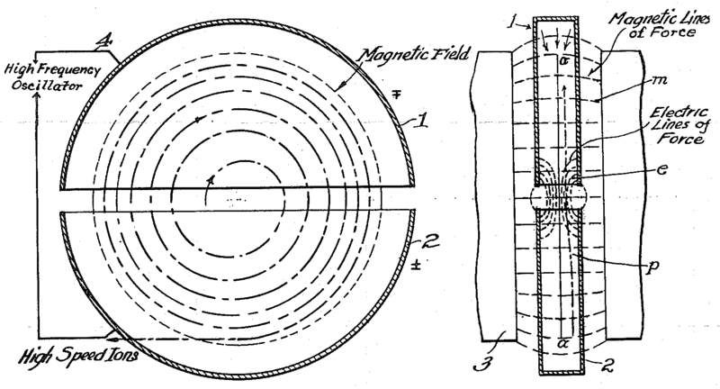
1934: Picture in Lawrence’s patent application

Slide 6
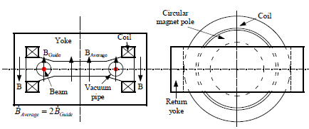
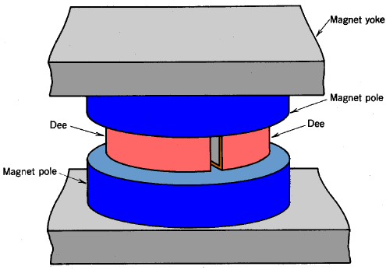
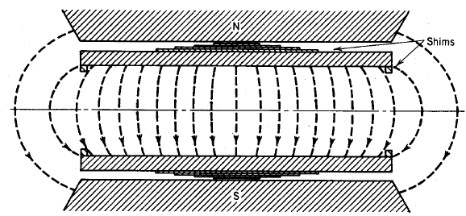
Examples of early accelerator magnets
Betatron
Cyclotron

Slide 7
Impact of other technologies
The cyclotron required high frequency RF power
Thanks to the progress with thermionic tubes, high frequency RF power had became available around the same time
This progress accelerated with the invention of the klystron (Varian, 1937)
Note: the invention of the cyclotron could also have been partially inspired by that of another microwave device, the magnetron (Hull, 1926; Okabe, 1929), and which was itself the object of intensive development (GEC, etc.) in the early 1940s
(The multi-cavity magnetron was instrumental in the advance of airborne radar)
We note that it can be useful to keep an eye on parallel developments…!

Slide 8
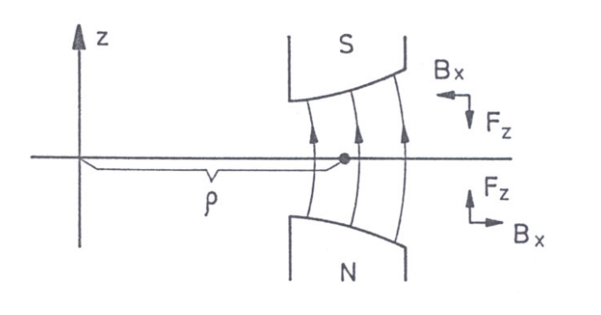
Condition for double focusing
Concept of field index n, defined by
B = B₁(r₁/r)^{n}
where B₁ is field at reference radius r₁.
For focusing in H-plane: n ≤ 1
For focusing in V-plane: n > 0
Whence condition for double focusing
0 < n < 1
(Kerst and Serber, 1941)
Typically n chosen between 0.2 and 0.3

Slide 9
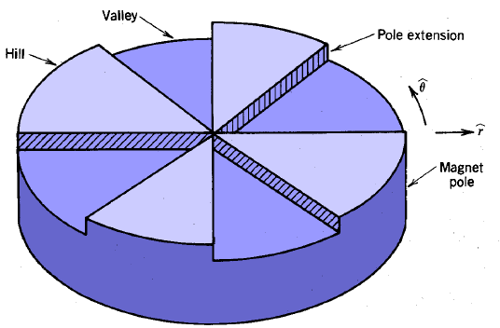
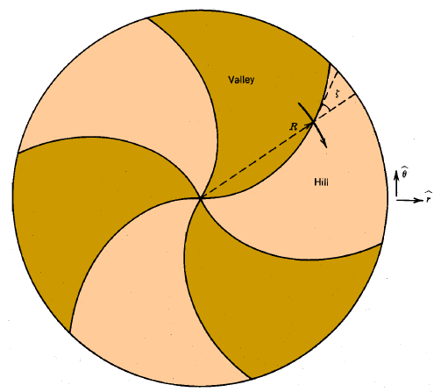
Thomas focusing
For relativistic beams the classical cyclotron/betatron focusing is insufficient
Enter a new focusing concept of “hills and valleys” in the field around the azimuth
The repeated edge focusing
works like strong focusing
This was further refined by curving
and tapering segments
Magnets got much larger and much more complicated

Slide 10
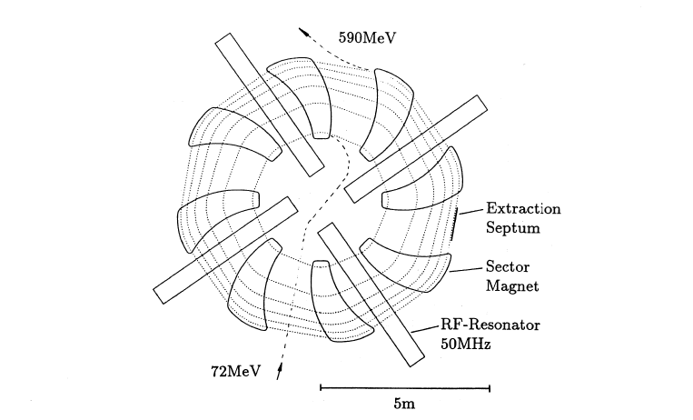
590 MeV ring cyclotron at PSI, showing 6 orbits from 72 MeV to 590 MeV.

Slide 11
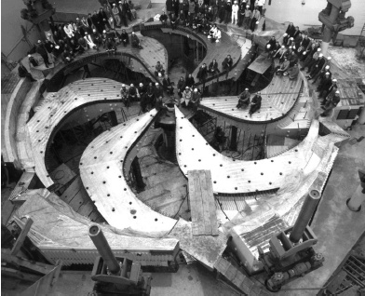
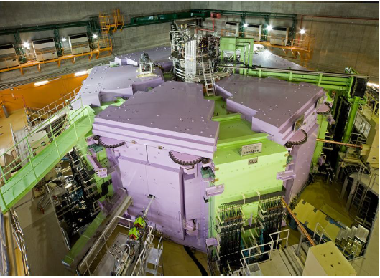

Slide 12
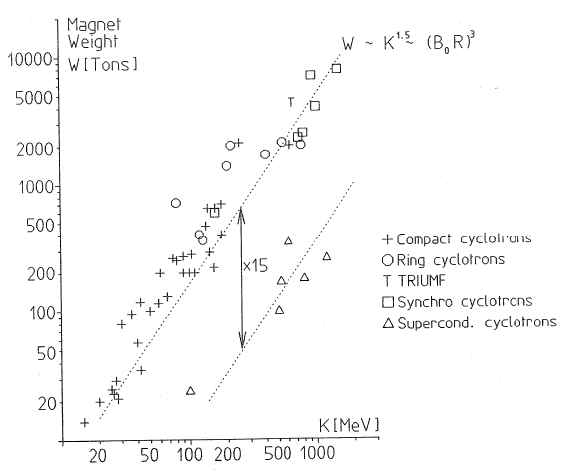

Slide 13
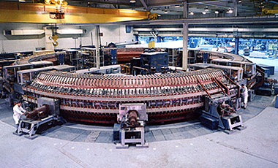
Cyclotrons → synchrotrons
The cyclotron is very convenient to provide low to medium energy particles,
But the magnets become too large and cumbersome for high energies, the largest synchro-cyclotrons reaching about 500 MeV
Idea: put the beam in a narrow circular channel equipped with a local magnetic field that could be ramped as the particles gained momentum
Enter the synchroton - first with weak focusing
Cosmotron (BNL)
Bevatron (LBL)
later with strong focusing
(n>>1)
Cosmotron 6”x36” aperture -> 1”
The magnets are much smaller – but field quality is very important…

Slide 14
Weak focusing magnets
Cosmotron (BNL) 3.3 GeV (1953)

Slide 15
Strong focusing magnets – combined function
Christofilos (1950) -> Courant, Livingston, Snyder (1952)

Slide 16
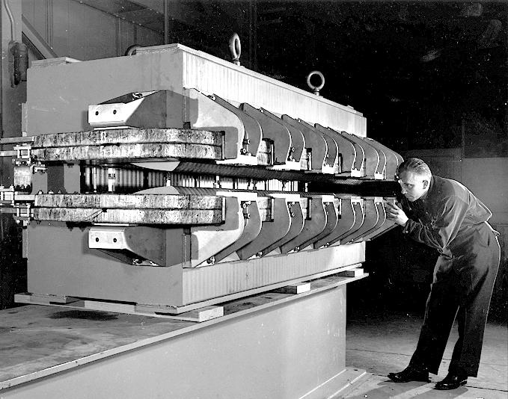
Strong focusing magnets – combined function
An AGS magnet
(PS, ISR are similar)
Accurate pole (2-D)
+ steel mixing
+ measurements
+ magnet sorting
+ poleface windings
(But finally ISR magnets were sorted by weight!)
Idea of using punched laminations to obtain accurate pole profile over whole length

Slide 17
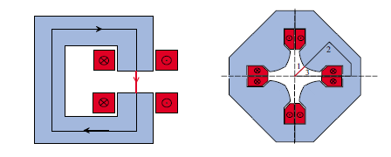
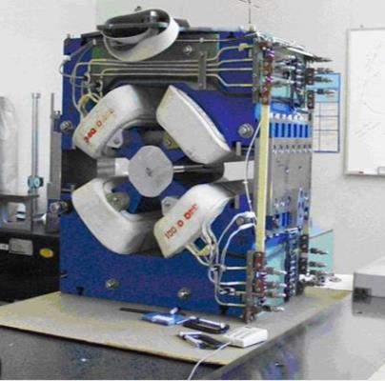
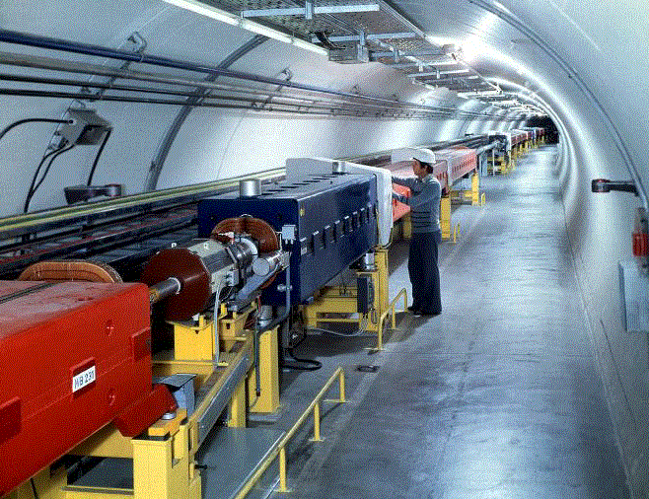
Strong focusing magnets – separated function
Increased operational flexibility
Adopted for 300 GeV machines at CERN and Fermilab

Slide 18
Field: flux density and field quality
Iron-dominated magnets
Flux density and field quality determined by pole profile
Yoke size (mass) determined by aperture and field
Limited to magnets with pole-tip field of up to about 1.7 T
High-field superconducting magnets
Flux density is (largely) determined by current density
Field quality is determined by winding accuracy (and conductor type)
Equivalent pole-tip field limit: 6.5 T Nb-Ti 4.5 K
9 T Nb-Ti 1.8 K 13.5 T Nb₃Sn 4.5 K
15 T Nb₃Sn 1.8 K (20 T HTS 10 K)

Slide 19
Computation
Computers → far-reaching effect on ability to design accelerator magnets
Early on, as was done for electrostatic problems (before SUPERFISH), equipotentials were plotted using 2-D simulations with electrolytic baths and resistive paper…
Iron characteristics are non-linear, requiring iterative calculation for accuracy: this was done by hand, and by measuring models and prototypes. But from the
1960s there were new tools (for 2-D) (programs MAGNET, MARE,POISSON).
Edge and end effects were simulated in 2-D; shimming done on models/prototypes
(program G-FUN was also used to estimate values of field integral)
From 1980s more sophisticated 2-D and 3-D programs became available (TOSCA , ROXIE, etc) enabling accurate determination of fields without the need for measuring scale models, as well as programs that enabled the integration of mechanical aspects (e.g. ANSYS)
NB: this progress has been instrumental in the renaissance of the FFAG

Slide 20
Magnet types
Conventional electro-magnets
Permanent magnets
Superconducting magnets

Slide 21
Conventional electro-magnets
Pros
Cons
Mature technology
Cheap raw materials
Pulsing not an issue
Quenching not an issue
Costs are understood
Conventional services
Power consumption
Weight
Limited maximum field
Water cooling
Generally speaking, if conventional magnets fit the requirement, use them!
Superconducting magnets need cryogenics – the capital and maintenance cost of which must be taken into account when comparing.
And permanent magnets can’t be pulsed…
Uniformly good field quality can be guaranteed if magnetic circuit consists of stamped (nowadays fine-blanked) laminations (of steel of known chacteristics)
Examples: AGS, PS, SPS etc. But see the ‘cons’...

Slide 22
Permanent magnets
Electromagnets consume power, and field fluctuates with fluctuating current
Certain alloys can be magnetized to provide the mmf for DC magnets
Al-Ni-Co alloy was discovered in 1930, but better performance is now obtained using rare-earth alloys samarium- cobalt (~1970) or neodymium-iron (~1982)
These materials have revolutionized the electric motor/generator industry, enabling reductions in size and weight. For these reasons they have also found their place in magnets for accelerators (as pioneered by Klaus Halbach, LBL)
Blocks of the material can
- either be used in conjunction with iron yokes and/or poles, where the pole determines the field shape and the magnetized length its strength ,
- or combined in trapezoidal pieces to form strong compact magnets having the desired field shape

Slide 23
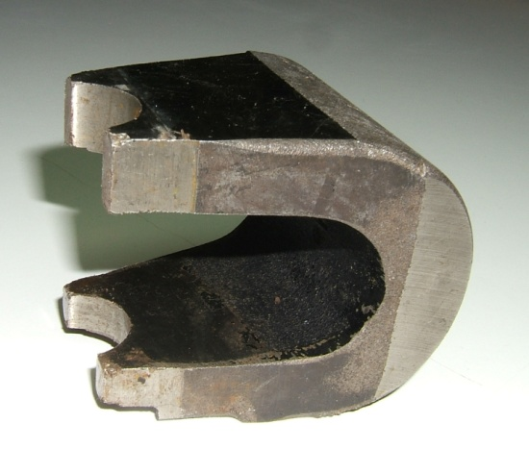
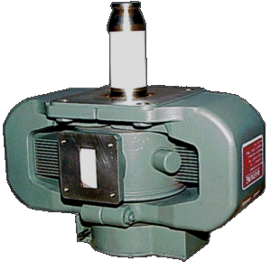
Permanent dipole with iron pole/yoke
Magnetron with AlNiCo magnet
(BH)_{max} AlNiCo ~ 50 SmCoFe ~ 100 NdFeB ~ 200 T∙A/m or kJ/m³

Slide 24
Common permanent magnet materials
 | B_{r} (T) | H_{c} (kA/m) | (BH)_{max} (kJ/m³) | T_{c}(°C) | price ratio
AlNiCo (sintered) | 0.6–1.4 | 275 | 10–88 | 700–860 | 10
Sr-ferrite (sintered) | 0.2–0.4 | 100–300 | 10–40 | 450 | 1
SmCo₅ (sintered) | 0.8–1.1 | 600–2000 | 120–200 | 720 | 25
Sm(Co, Fe, Cu, Zr)₇ | 0.9–1.2 | 450–1300 | 150–240 | 800 | 30
Nd₂Fe₁₄B (sintered) | 1.0–1.4 | 750–2000 | 200–440 | 310–400 | 15
Nd₂Fe₁₄B (bonded) | 0.6–0.7 | 600–1200 | 60–100 | 310–400 | 10
Ranges are given because characteristics vary between suppliers according to the refinement of the powders and the detailed manufacturing procedure.
Price ratio is given as a very approximate guide.
While neodymium iron boron is the evident favourite for high field applications (but beware the limited operating temperature), cost effective strontium ferrite material is often sufficient. Bill Foster chose the latter material for the Fermilab 8 GeV/c recycler.

Slide 25
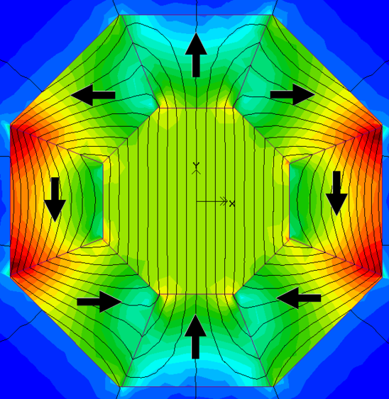
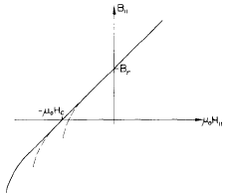
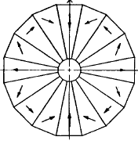
Permanent magnets made from trapzoidal components
y
y
Dipole
Quadrupole
(Klaus Halbach)

Slide 26
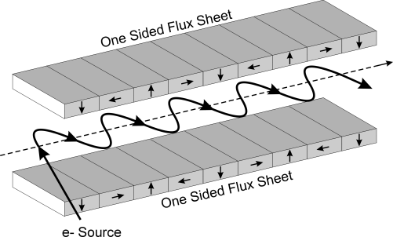
Example of wiggler for FEL

Slide 27
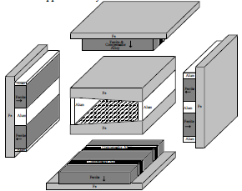
Strontium Ferrite based hybrid permanent magnet used for the Fermilab 8 GeV recycler ring, and for an 8 GeV transfer line
Required field ~ 0.1 T
Sr PM chosen
cheaper system
steady field
Built-in compensation for thermal effects
(Bill Foster)

Slide 28
Variable field permanent magnets
Permanent magnets need not be confined to use as sources of constant field.
In situations where a constant offset of magnetic field is required, this can be provided by either
two concentric cylindrical PMs that can be rotated independently, or
a permanent magnet, with the variable component excited by coil windings. This can lead to significant power saving (and simpler coils),
Both approaches have been studied and magnets made.
The use of permanent or combined permanent /electro magnets is being explored for CLIC and ILC final focus quadrupoles

Slide 29
Superconductivity
Superconducting magnets fall into 2 major categories:
so-called superferric magnets, where the resistive coils of a ‘normal’ magnet are replaced by superconducting coils and the field is determined by the contour of iron poles (the main objective being the reduction of power consumption);
Coil-dominated, when requirements dictate an equivalent pole-tip field of > 2 T, and there is no alternative to using superconducting coils to provide the field.
Superconductors require cryogenics.
Cryogenics is expensive and requires expert maintenance.
This must be taken fully into account in the cost/benefit analysis at the outset of the project.

Slide 30
Superconductivity applied to accelerators
1911 Discovery of (type I) superconductivity
1950s Theoretical understanding of superconductivity (BCS)
Early 1960s Discovery of Type II superconductivity (Nb-Zr, Nb-Ti, Nb₃Sn)
1968 Brookhaven summer study → GESSS (KIT, CEA, RAL, CERN)
1966-1973 Rutherford lab. group work on defining the technology
1973-1978 SC low-beta insertion at ISR wire Nb-Ti
1974-1978 ESCAR (LBL) cable Nb-Ti
1974-1981 ISABELLE study (BNL) braid Nb-Ti
1973-1983 Tevatron (FNAL) cable Nb-Ti
1980-1988 HERA (DESY) cable Nb-Ti
1980-1992 SSC studies (BNL, FNAL, LBL, SSC) cable Nb-Ti
1991-2000 RHIC (BNL) cable Nb-Ti
1983-1995 LHC studies (CERN) cable Nb-Ti/Nb₃Sn
1995-2008 LHC manufacture, test + installation cable Nb-Ti
2005- LHC upgrade study (BNL, FNAL, LBL, CERN) cable Nb₃Ti

Slide 31
Emergence of practical superconductivity
The emergence of applied superconductivity as practiced today owes a great deal to pioneering work done at the Rutherford Laboratory in the 1960s + 70s
This work, both theoretical and practical, was performed in a small group, in collaboration with an industrial partner (IMI), with the goal of producing practical conductors and high-field magnets for accelerators.
The group studied and documented the need for (and methods to achieve):
Fine filaments
Twisted strands
In order to make magnets, the now ubiquitous Rutherford cable was developed, and expertise was gained in low temperature electrical insulation
The group spawned spin-off enterprises (e.g. Vector Fields, Oxford Instruments),
and based on the know-how the laboratory built several large superconducting magnets for experiments (e.g. DELPHI, ATLAS End Cap Toroids). But the group was not maintained as people left and retired, and has now dissolved…

Slide 32
Superconducting low-beta insertion at ISR I8
1. CERN took the decision not to outsource the work to other
labs (such as RAL), but to accumulate in-house expertise in magnet building and cryogenics. This was later very important for LEP and LHC
2. CERN decided to build models and prototypes in-house and then
to write a detailed engineering specification for tendering to
industry for the series production. In this approach, the magnetic
design is the responsibility of CERN. The manufacturer is only
responsible for respecting the tolerances, choice of materials and
adherence to the various qualified procedures.
This philosophy was also applied for LHC
The low-β was a great success, increasing the luminosity at point 8 by × 6.5.
This was the first time that industrially built SC quadrupoles had been
operated in the lattice of a synchrotron (and typically operated for 60 h)
The record luminosity of 1.4 × 10³² cm⁻² s⁻¹ (December 1982) in the SC low-β
was not beaten until 1991 by CESR (Cornell) with 1.7 × 10³² cm⁻²s⁻¹ .

Slide 33
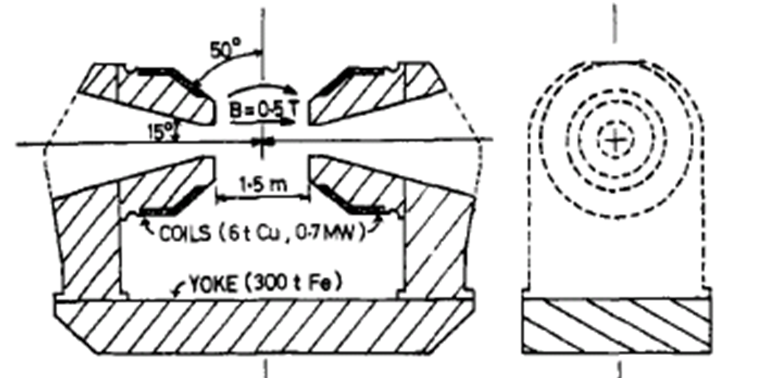
Axial field magnet for R807 at the ISR, used with the SC low beta insertion

Slide 34
Machine experiment interface
In colliding beam machines the interface with the experiment is important.
The experiment occupies space and its spectrometer magnet affects the beams
BUT without the experiment there would be no need for the accelerator!
Magnet is usually a solenoid. Compensation can be provided by
- reverse field solenoids in close proximity, or
- sets of skew quadrupoles
- compensating dipoles if the beam traverses at an angle (as at ISR)
For small β* the final focus quadrupoles may project into experiment (and field). So the quadrupole may have to be iron-free (usually SC or rare earth PM)
+ mechanically stable support must be provided
Good mutual understanding (beam physics, magnets, experiment) is vital !

Slide 35
Requirements of the experiments
Stable beams, low background, long runs, well-planned shutdowns!
Integrated luminosity is more important than peak luminosity.
Machine development runs have to be well-planned and executed
– so that they are perceived to improve performance!
Otherwise users push for increasing data taking time at the expense of MDs.
Machine physicists should curb desire to chase for record luminosity until background is fully understood and controlled.
Luminosity leveling is definitely a worthwhile pursuit
(and should be taken into account in estimation of beam losses, aperture, etc.)

Slide 36
The beam/magnet interface
This interface is vitally important in the quest for efficient accelerator design
While the cost of a magnet system of a given technology will depend on its size, it must be remembered that the difficulty (cost, time, risk) of providing a magnetic field for an accelerator is not a linear function of equivalent pole-tip field.
(Neither is it a linear function of ‘field quality’ …)
Both the beam dynamics scientist and the magnet scientist must understand this, and collaborate closely to arrive at an efficient compromise for the common good. This is work, and may require dedicated negotiation!
Validity of tracking models has been checked on real machines
Computer models for magnets have been validated
Everyone wants the machine to be a success
→ compromise should be easy!

Slide 37
Example of negotiation at LEP
Initial request from beam dynamics group:
magnet aperture should be such that ‘beam stay clear’ in insertion ≥ that in arc.
Initial reaction of Magnet GL was to launch study of magnets fitting the request…
But arcs were designed with large safety margin → very large insertion magnets!
We therefore studied the possibility of using movable aperture limiting collimators in the arc, to be closed at collision energy before squeezing beta*, and to be combined with cruciform chambers in insertion magnets (which could then be based on standard quadrupoles) to address concerns about background.
The proposal was accepted by the parameter committee (and it worked…)
When asked to provide a magnet, the magnet specialist should make an effort to understand what the magnet is for, and if necessary propose an alternative…

Slide 38
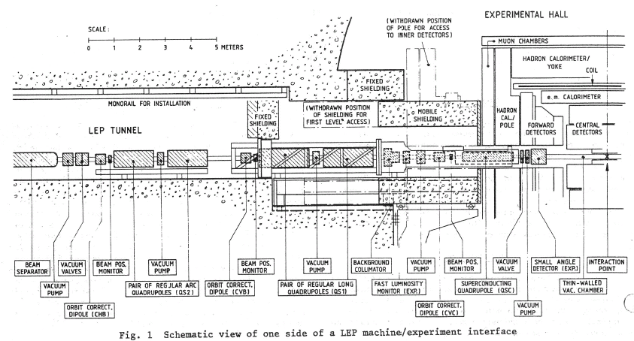
Layout of LEP low beta insertion

Slide 39
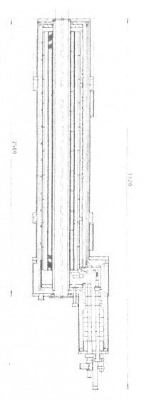

Slide 40
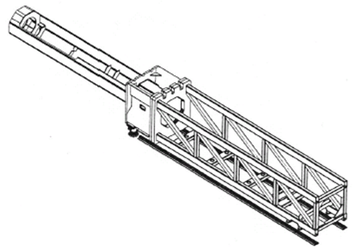
Interface with the experiment at LEP
Initial plan was to install conventional magnet doublets for phase 1.
Physics groups saw the advantage (ISR, DESY), and demanded an SC version!
Solution was to develop a special SC quadrupole to be installed in front of the conventional doublet, on a cantilevered girder that penetrated into the detector
Alignment: the vertical position of the cantilevered SC magnet was controlled by actuating jacks supporting the girder, using signals from a precise level gauge

Slide 41
Some other lessons from LEP
→ Remember that magnetic properties of iron depend on mechanical stress
Low field dipoles featured laminations spaced with concrete.
Concrete shrinks as it sets, and this affected the B-H charcteristics
Remedy: ‘crack’ the backleg of the yoke on every unit
→ Check every process liable to affect the magnetic circuit
The surface of aluminium vacuum chambers were plated with a flash of nickel to allow soft soldering of the lead shielding. The 1.25 mm layer became magnetized in the process causing a massive error in phase advance
Remedy: demagnetize all chambers (in situ) using specially designed equipment

Slide 42
LHC
Main dipole. In order to
Foster interest in the project
Prepare industry for the task
only small-scale model work was done at CERN and contracts were placed to develop magnets in industry. Possibly politically useful, but not very efficient…
Three suppliers. To get reasonable price CERN took technical responsibility.
Main quadrupoles were designed by CEA Saclay, which also followed contract
Matching quads and correctors designed and prototyped at CERN
All magnets were warm and cold tested + trained to 9 T + some measurements
Low beta quads were supplied (and tested) via Japan and US contributions
The warm bore of the low beta quadrupoles was chosen to be 70 mm, in agreement with beam physics, as matching the design parameters. At the time there was not a beam screen. When the beam screen appeared it was too late to change (but with the better than expected emittance it is OK…)

Slide 43
LHC consolidation and upgrade
The consolidation and upgrade of the injectors is clearly useful
The low beta quadrupoles in the high luminosity insertions will suffer radiation damage, and is expected to require their replacement
A model Nb-Ti magnet with larger aperture (90 mm) and improved insulation (for better extraction of heat) has been designed and successfully tested.
Development of Nb₃Sn quadrupoles is ongoing in the US and more recently at CERN. A model magnet with an aperture of 120 mm has given good results. Designs are underway to satisfy the present requirement of 150 mm.
(Question: has the 3x better than predicted behaviour of LHC been properly taken into account when establishing the parameters for the upgrade?)
An 11 T Nb₃Sn dipole is being developed to make space for collimator…
There will have to be extensive tests on a string of full-size versions of such magnets before committing to install them in the LHC. (Schedule risk…)
+ in longer term, there is a hope to make 13 to 16 T dipoles…

Slide 44
HTS magnets in accelerators
HTS materials work at higher temperatures and higher magnetic fields than familiar LTS (NB-Ti and Nb₃Sn) material, but they are brittle, expensive and only made in specific topologies.
1G (first generation) multi-filamentary Bi-2223 in silver matrix (tape)
multi-filamentary Bi-2212 in silver matrix (wire)
2G (2nd generation) thin-film REBCO on Hastelloy substrate (tape)
Bi-2223 material is the most developed
Bi-2212 can be made into flat cable and used in wind and react coils, but reaction is at high (and precise) temperature and under high pressure …
REBCO is in intense development and is promising, but is tape. Work is being done to use it to make transposed cable of the Roebel type.
BNL has made superferric magnets requiring good resistance to radiation damage using both 1G and 2G HTS material (and metal insulation), for the FRIB (facility for rare isotope beams).
BNL is also studying the use of HTS in very high field solenoids (~30 T) for the Muon Accelerator Program (MAP).
Inserts have been made in several places to boost the field of solenoids
CEA(Grenoble) (+CERN) are making a test insert coil to boost a dipole field

Slide 45
HTS now and in the future
HTS is interesting, but it’s different, we must gain familiarity with its use
For us the ultimate goal will be to use it in magnets, but that will take time
Companies developing the material need customers
CERN’s approach has therefore been to identify real applications that can be justified now, to buy quantities of material, and gain experience
HTS current leads for LHC (largest commercial order of 1G material)
Superconducting cables for powering links (+ potential for spin-off?)
Seeking other applications; + collaborating on conductor development
A recurring problem is the cost of material
The hybrid approach is essential for high field magnets
Field quality could be an issue with windings made using the tape material
Can we reduce the requirements…? (point to be discussed)
BNL is the most advanced laboratory regarding application of HTS to magnets
NB: Solenoids are easier…!

Slide 46
A gripe about ‘coordination’
It is generally agreed that everything takes longer than it did in the past…
This is partly due to there being more reporting constraints than before, but is also due to long chains of ‘Coordination’ (and the multiplication of meetings…)
The excuse for so many coordinators is partly to control sprawling collaborations, partly due to matrix management (and partly to create titles, it would seem…)
The problem is that coordinators should regard their coordination activity as an
accessory (say up to 10 % effort), and spend most energy adding technical value!
Yet it appears that some of them busy themselves full-time with ‘coordination’…!
This is wasteful of resources, both directly (due to insufficient technical input from the coordinator) and indirectly (due to de-motivation of the ‘coordinated’)
Scientists should be able to ‘coordinate’ most (>90%) of their own work!
even in the environment of multiplying collaborations (another problem...)
as well as increasing specialization (yet another problem...)
We need a better way too deal with the increasing complexity of our activity…

Slide 47
Conclusion
So what is the message I would like to pass?
Beam physics and magnet specialists must work together to define, optimize procure and measure the magnets that best match the constraints of the project as a whole (beams, magnets, environment, installation, cost…)
Encourage (some) collaborators to look beyond their specialties
Magnet R&D should target the real needs of the accelerators
Question the hypotheses
Apply sensible safety factors (avoid unnecessary accumulation)
Only specify things you absolutely need (and that can be tested…)
Make estimates using hand calculations before embarking on the FE work
Emulate successful management models (avoid questionable ones…)

Slide 48
So in the end it’s just an appeal to use common sense…
Thanks for listening!
If there is time, there is a postscript…

Slide 49
Commonsense magnet purchasing
Over the years we have learnt important lessons with regard to purchasing magnets. These have been neatly catalogued in a recent report by the BNL SR Magnet Team, following the NSLS-II exercise, on interactions between beam physicists, engineers, procurement staff, and magnet suppliers.
Some points are summarized below:
▪ Magnet Lattice Design – The magnet lattice should be finalized and documented as early as possible - before the magnet procurement phase. The lattice design should be optimized to minimize different magnet types.
▪ Specifications – Specifications must be concise, clear and verifiable. All requirements and dimensions must be given with tolerances. Magnetic field specifications should be driven by the performance requirements of the machine - not by what ‘might be achievable’ or what is reported elsewhere.
▪ Reference Designs – The reference designs need to be specific regarding the magnet’s critical envelope dimensions and interface details (vacuum chamber, girder, utility connections). For other design aspects the suppliers should be allowed flexibility to meet the performance specifications.

Slide 50
▪ Prototype Program – A thorough in-house testing of the prototype magnets is essential. This requires advance preparation of the testing facility, including the magnetic measurement setup. The procurement program should be set up to leverage experience gained in building the prototypes.
▪ Procurement Strategy and Selection of Suppliers – Limit the number of suppliers asked to tender (~ 3), to limit requirement for technical assistance. Reduce risk by splitting the production of a magnet type (two suppliers).
▪ Magnet Designs – Suppliers usuaklly stick to reference designs. Be aware that weak features may go unnoticed (iron-starved yoke, multiple mating surfaces).
▪ Magnetic Measurements – A strong magnetic measurement capability is crucial for ensuring field quality (and for resolving technical issues).
▪ Manufacturing Issues – Technical manufacturing issues (e.g. de-bonding of yoke laminations, and field reproducibility after magnet splitting and reassembly) require close (and decisive) technical interaction.

Slide 51
▪ Monitoring Progress – Use weekly conference calls and extensive visits to the supplier to resolve technical issues and to establish rapport with management.
▪ Assembly and Interference Issues – Detailed 3-D models that combine the suppliers’ magnet designs with girders, supports and chambers should kept up to date, to avoid costly assembly and interference issues. Magnet designs should address magnet splitting (to install vacuum chambers) and reassembly.
▪ Magnet Alignment – The magnets should be properly fiducialized using modern alignment techniques to meet the specified requirements.
▪ Transportation Issues – Suppliers’ designs of the shipping crates, shock and temperature sensors, and shipping methods, should be evaluated and approved. The supplier should prepare a pre-shipment checklist for approval.
▪ Spare Magnets – should be included in the initial contracts to avoid unexpected delays during the final period of assembly (and commissioning).
▪ Magnet Database and Travelers – An online database should be available to store the documents, datasets, and travelers generated during procurement.

Slide 52
Bibliography
Lawrence, E.O. and Livingston, M.S. The production of high-speed protons without the use of high voltages, Phys. Rev. 40, 1932
Kerst, D.W. and Serber, R. Electronic orbits in the induction accelerator, Phys. Rev. 60, 1941
Livingston, M.S. Particle accelerators: a brief history, Cambridge: Harvard Univ. Press, 1969
Halbach, K. A Program for inversion of system analysis and its application to the design of magnets, Proc. Int. Conf. on Magnet Technology (MT2), The Rutherford Laboratory, 1967
Winslow, A.A. Numerical solution of the quasi-linear Poisson equation in a non-uniform triangular mesh, Journal of computational physics 1, 1971
Halbach, K., Holsinger, R. Poisson user manual, Tech. Report, LBL, Berkeley, 1972
Halbach, K. Design of permanent multipole magnets with oriented rare earth cobalt material Nucl. Instr. and Meth. 169, 1980
Wilson, M.N., Superconducting Magnets, Oxford Science Publications, 1983
Taylor, T.M. Technological aspects of the LEP low beta insertions, IEEE Tr. Nucl. Sci. NS-32, 1985
Binns, K.J., Lawrenson, P.J., Trowbridge, C.W., The analytical and numerical solution of electric and magnetic fields, John Wiley & Sons, 1992
Mess, K.H., Schmüser, P., Wolff S. Superconducting Accelerator Magnets, World Scientific, 1996
Wilson, E.J.N. Introduction to Particle Accelerators, 1996-1997
Russenschuck, S. ROXIE: Routine for the Optimization of magnet X-sections, Inverse field calculation and coil End design, Proc.ROXIE users meeting, CERN 99-01, ISBN 92-9083-140-5.
The LHC study group, The Large Hadron Collider, Conceptual Design, CERN/AC/95-05

