Slide 1
Procuring the Accelerator Test Facility #2 Magnets:
Something old, something new
CHERRILL SPENCER, Magnet Engineer at the
SLAC National Accelerator Laboratory
Presented at the “Beam Dynamics Meets Magnets” Workshop
Darmstadt, Germany, 3rd December 2013
Notes:
Summary of project scope
key milestones
funding profile
commissioning by LCLS operations
path to CD-2
priority of longer tunnel
urgency of getting CF bids
mention FAC

Slide 2
Overview of this talk on procuring the ATF2 magnets
What is the ATF2?
Summary description of the ATF2 magnets
    (I worked on them from January 2005 until January 2009)
Engineering challenges faced by the ATF2 magnets
Problems with some magnetic measurements
Procuring the Final Doublet Quadrupoles
    See what happens when you re-use old magnets to “save money”
    Negotiating the multipole tolerances
  Keeping all the magnets and especially the last 4 before the “Interaction point” vibrationally stable
  Aligning the magnets with standard alignment techniques
  Lessons learned from the ATF2 magnet procurement project

Slide 3
What is the ATF2 at the KEK Laboratory in Tsukuba, Japan
An important technical challenge of the proposed International Linear Collider is the collision of extremely small e⁻ & e⁺ beams of a few nanometers in size. Note: the ILC is a single pass machine.
This challenge has three distinct issues:
    creating small emittance beams,
    preserving the emittance during acceleration and transport,
    focusing the beams to nanometers and colliding them.
The Accelerator Test Facility (ATF) at KEK was built to create small emittance beams, and has succeeded in obtaining a vertical emittance that can satisfy the ILC requirements.
The ATF2 facility, which uses the beam extracted from ATF damping ring, was constructed to address two major challenges of ILC: focusing the 1.3GeV beams to nanometer scale using an ILC-like final focus and providing nanometer stability.

Slide 4
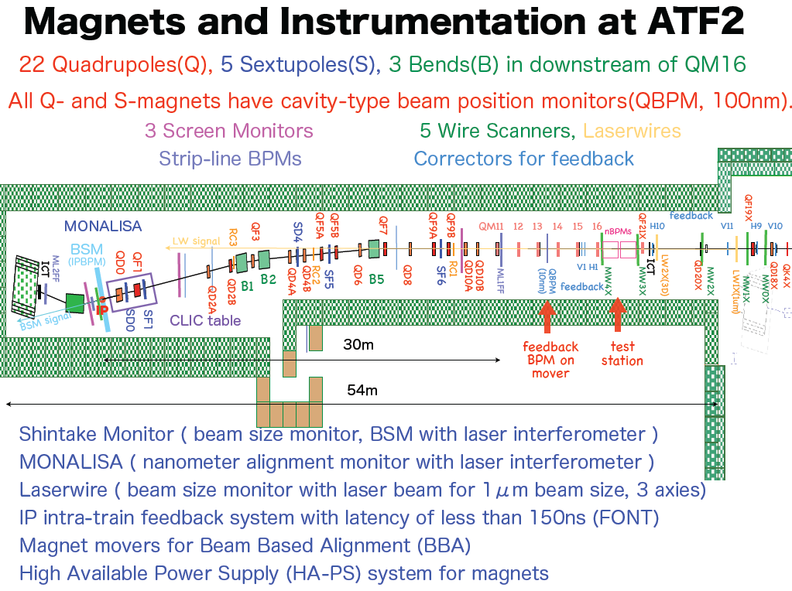
1.3 GeV electron beam comes via extraction line from the ATF damping ring
All magnets specified by a lattice designed initially in 2004, which evolved over 2 years and was finalized in 2006. Spencer started working on designing and procuring the new magnets in January 2005. Their supports and magnet movers also had to be procured. Spencer worked on procuring the magnets until they were all installed in November 2008. But my involvement did not stop there, it has continued until the present.

Slide 5
New Magnets Made for the ATF2: Philosophy & Constraints
In general we took steps to minimize the cost of the new magnets and to produce them in timely way
Using existing SLAC and KEK magnets when appropriate
  Modifying existing magnet designs [old KEK magnets were designed by commercial companies, limited drawings available]
  Using existing magnet movers from the FFTB at SLAC
  Using existing adjustable mounts
Constraints on magnet sizes, apertures, coil ends, operating currents & voltages, from:
  Need to fit in with existing movers
  Beam height from floor of 1.2 m
  Interface with 2 different styles of Beam Position Monitors (BPM)
  Fit in with new, high reliability, power supply’s current & voltage limits: 200Amps, 30 volts

Slide 6
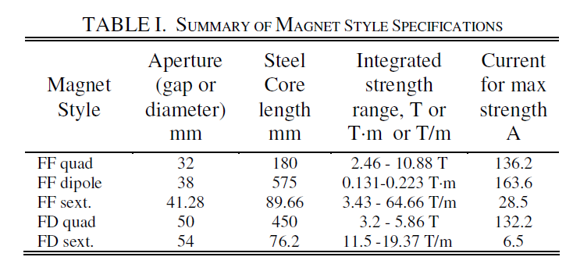
ATF2 magnet specifications: 5 different new styles
The integrated magnet strengths were easy to achieve with room-temperature, steel-cored electromagnets.
Engineering issues emanated from
  stringent field quality requirements
  required positional stability of the magnets

Slide 7
ATF2 Magnet Styles : where they ultimately came from; periods of design, fabrication, magnetic measurements
28 FF and extraction line quads :14 final focus quads + 6 matching section quads + 8 extraction quads
  All made from one design, called “QEA”; based on an existing KEK quad design. Spencer modified it; IHEP, Beijing made complete drawing set according to Spencer’s detailed requirements & standards. 29 quads fabricated at IHEP shops. Measured at IHEP and again at KEK.
  April 2005 to April 2006
3 dipoles B1,B2,B5 to be made:
  brand new design by Spencer, drawings made at SLAC; fabrication & measurement by IHEP, called “DEA”
  August 2006 – November 2007
5 new sextupoles are needed:
  3 in the FF: SD4, SF5 and SF6. Refurbished SLC FF sextupoles, originally designed by Spencer in 1993. Re-measured at SLAC.
  2 in the “final doublet” (FD) (interleaved with final 2 quads): SF1 and SD0. Modified FFTB sextupoles, solid wire coils- easily installed cooling circuit designed
  December 2006 – September 2008
2 new FD quads : QF1 & QD0: old FFTB quads with increased bore diameter- extremely strict multipole requirements and vibrational stability.
  August 2006- April 2008 [original QF1 replaced in October 2012]

Slide 8
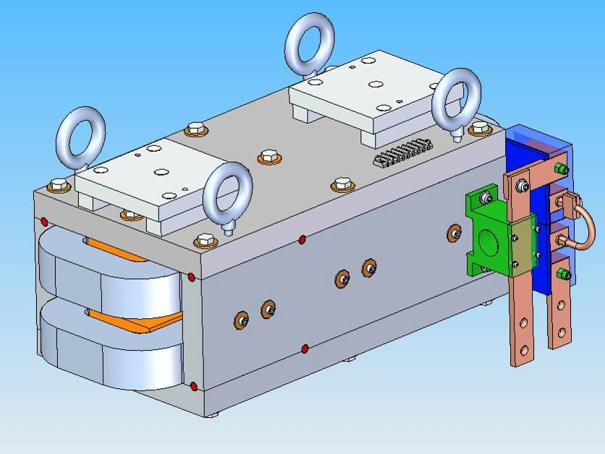
Design of ATF2 dipole: 3D model
Gap 38mm, core length 575mm
Thermal switch; one water circuit
Bases for KEK alignment targets
Magnet can be split for installation in the beam line & precisely re-assembled
Power terminals oriented to receive power cables from floor
Overall length 72.6 cm

Slide 9
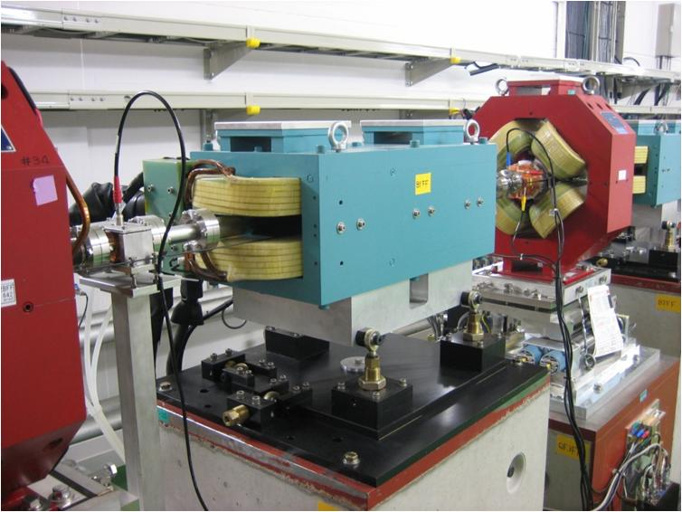
One of the three “DEA” dipoles in the ATF2 FF
Maximum integrated strength 0.2334T-m at 154 amps
Where the magnets came from:
3 FF dipoles B1,B2,B5
Brand new design by Spencer, called “DEA”
drawings made at SLAC;
fabrication & measurement by IHEP, Beijing.
August 2006 – November 2007

Slide 10
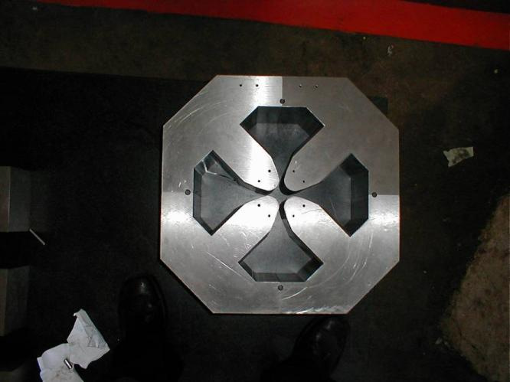
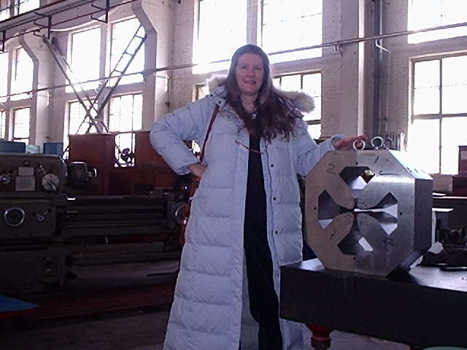
First QEA-D32T180 core after all machining finished , in the IHEP Machine Shop, Beijing. Spencer visits to inspect core and start of coil winding 9th December 2005. 34 “QEA” quads were made.
Novel situation for Spencer: Magnet designed in the USA, to be made in China and operated in Japan-> issues of materials: e.g. availability of copper; standards; fittings thread sizes, usual practices. Good example of the issues that will arise when making the ILC magnets all over the world.
  Discussions took place (sometime lengthy) to resolve which practice to use. Extensive use of video conferencing and web-conferencing, across multiple time zones.

Slide 11
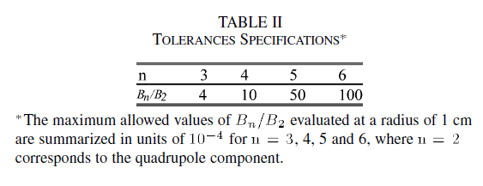
Tolerances on the higher order multipoles in the FF quads: had been first set in Design Report; re-issued later
FF quads measured first at IHEP, where they were fabricated then again at KEK by two different radial –field measuring rotating coils.
Measured integrated gradient and higher order multipoles (also call them :”harmonics”)
First comparison of the two sets of data was done in August 2006 by Mika Masuzawa of KEK’s magnetic measuring department.
She concluded that the IHEP measurements of the multipoles (skew and normal components were quoted separately) were very reliable.
But she preferred the KEK integrated gradient measurements.
.

Slide 12
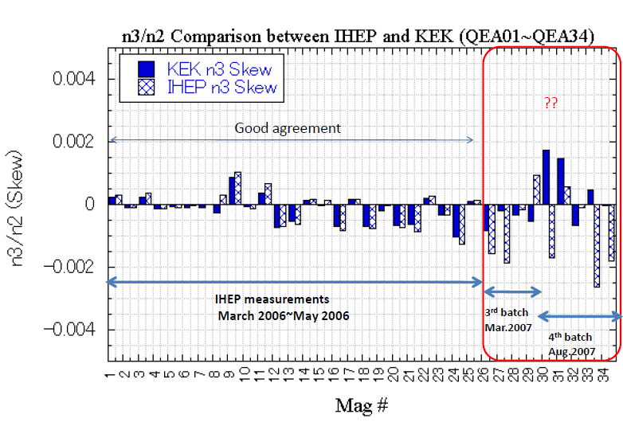
But as more quads were produced and measured the good agreement disappeared
Skew sextupole measurements of the Final Focus Quads

Slide 13
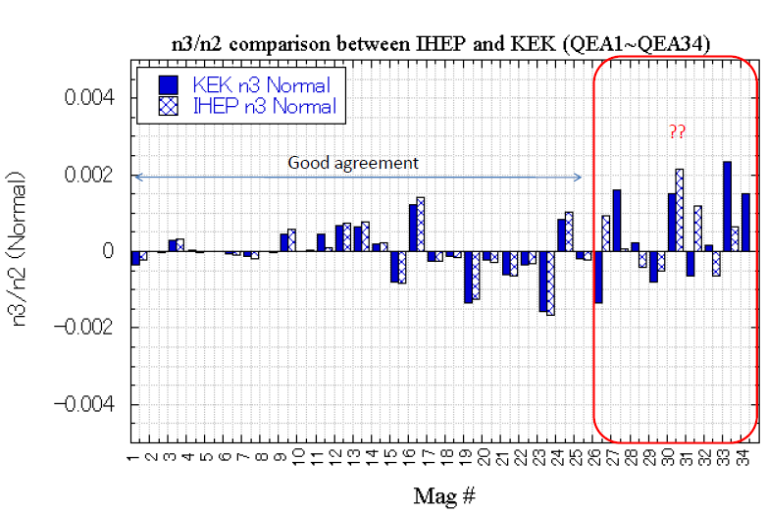
To start with we passed the IHEP multipoles to the beam physicists, but came to realise there were differences in the 2 sets
It became necessary to discover which measurements of the multipoles we should trust.
The signs of the components were accounted for in the beam simulations. It took about two years to have the personnel available to investigate the discrepancies.

Slide 14
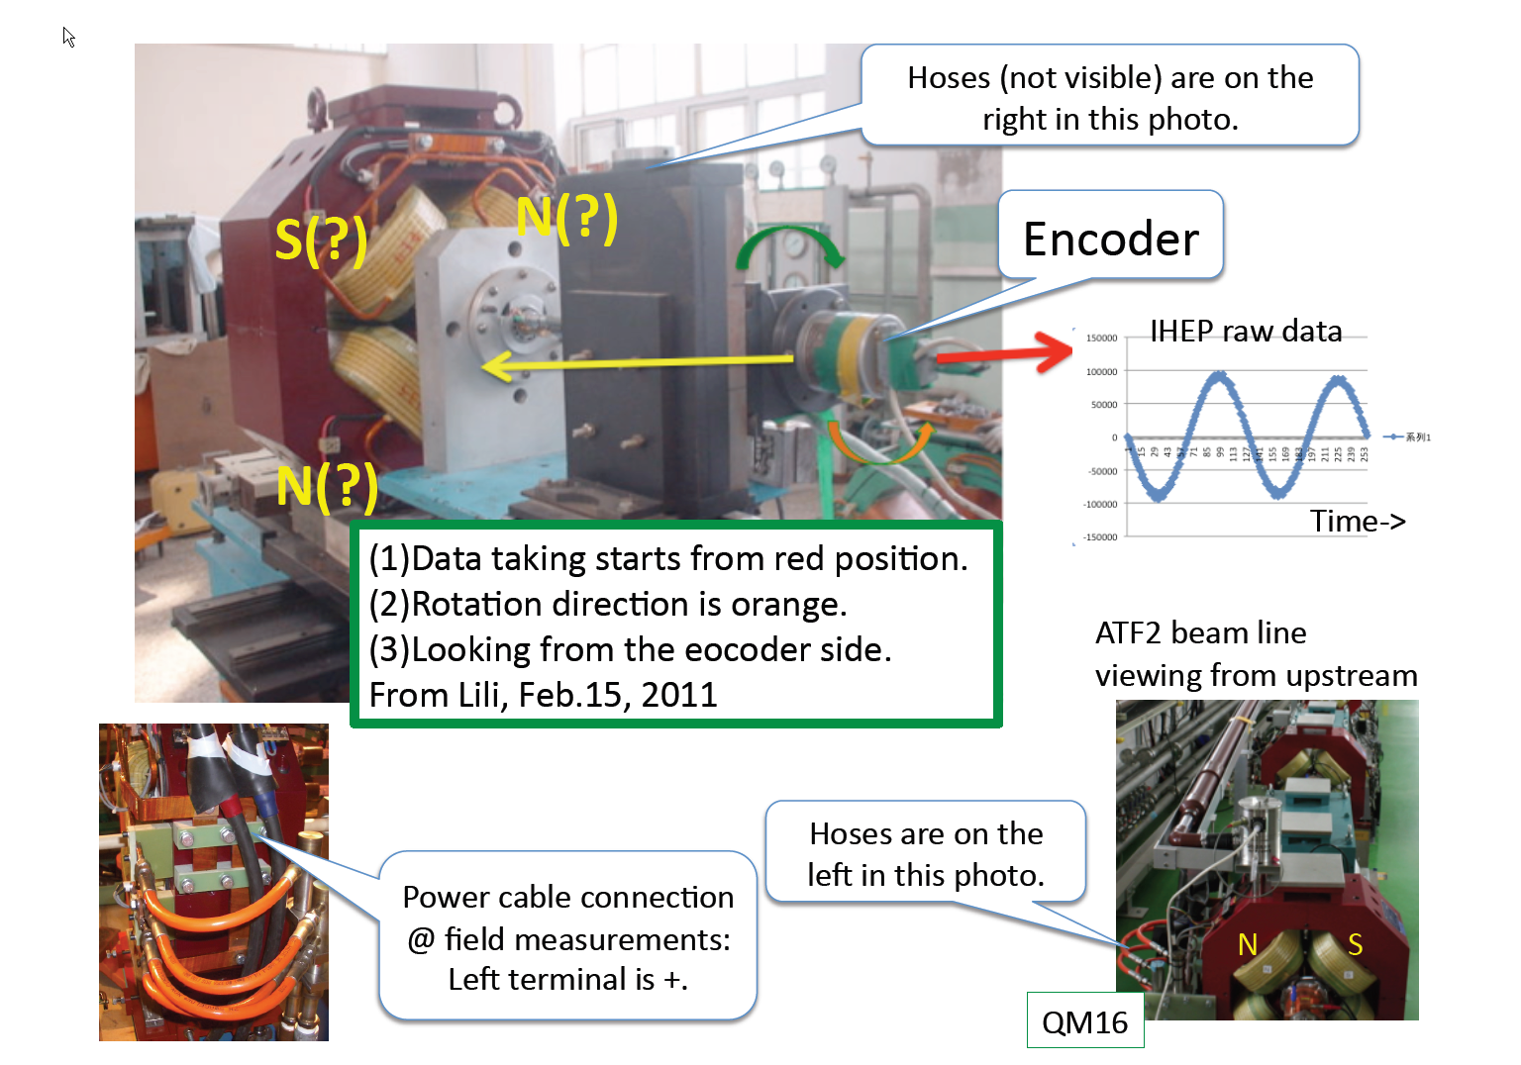
Needed to understand the polarities of the multipoles, had to recall which way the coil was rotating etc.
IHEP magnetic measurement apparatus. No longer in place

Slide 15
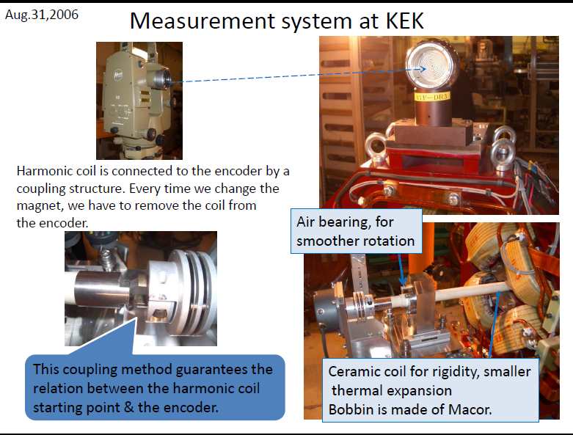
Had to compare the IHEP system to the KEK system, was not immediately obvious who was wrong!

Slide 16
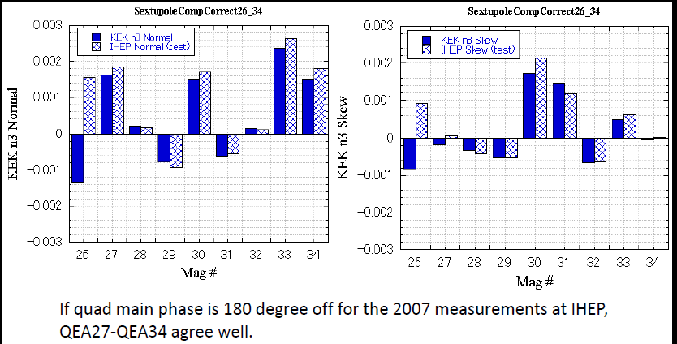
The resolution of the problem with disagreeing multipole measurements- final values available in January 2011
Rogelio Tomas will talk about the effect of incorrect multipole measurements on the design of the ATF2 lattice in the next talk

Slide 17
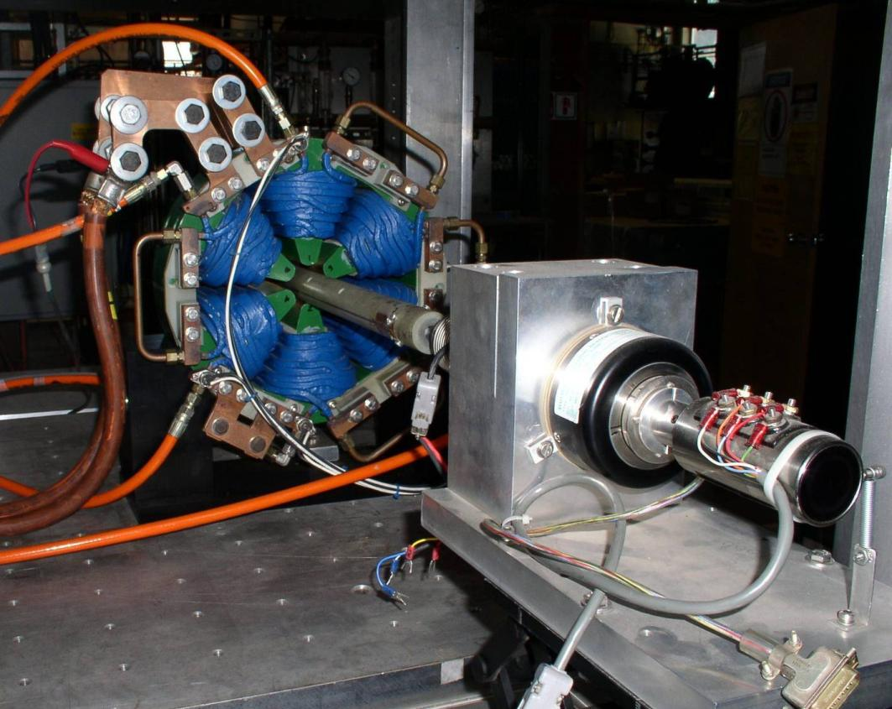
1.625SX3.53 after refurbishment, on magnetic measuring stand at SLAC-> ATF2 FF sextupole
Where the magnets came from
3 new FF sextupoles are needed: SD4, SF5 and SF6. Refurbished Stanford Linear, Collider FF sextupoles originally designed by Spencer in 1993. Aperture: 41.28mm
  Core length: 89.66mm
  Re-measured at SLAC.

Slide 18
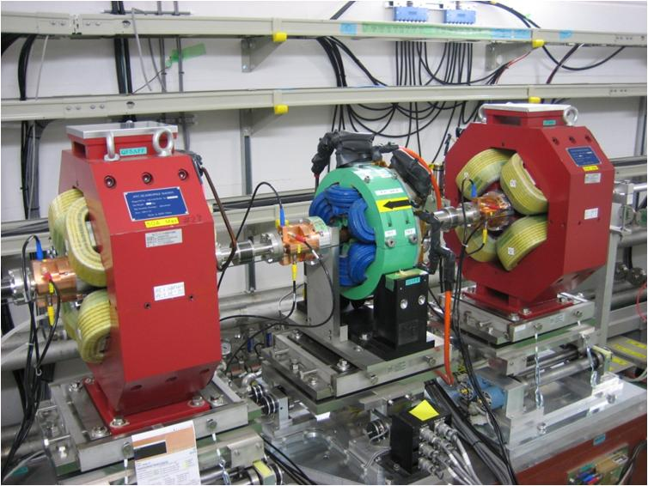
One of the three refurbished SLC sextupoles in the ATF2 Final Focus, between 2 “QEA” quads

Slide 19
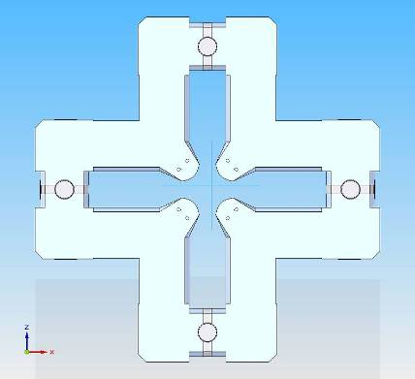
Procure QF1 and QD0: re-use old FFTB/SLAC quads , but have to increase their aperture to accommodate a fancy BPM and satisfy beam optics requirements
Hyperbolic pole-tip is moved, along a radius, further out than it’s equation says it should be. XY= r²/2.
Consequence: the 12-pole component increases, ~17 times predicts 2D modelling program : POISSON.
Place a very flat and precise thickness shim in each split plane to “explode” the quad and enlarge the bore diameter.
Shim will be low carbon steel, ground to 0.013mm flatness

Slide 20
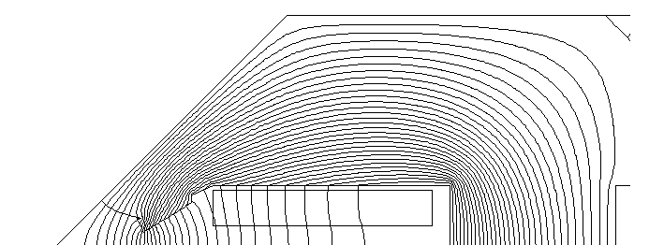
Modelled different shapes of steel shims with POISSON-ones that would be easy to fabricate & install on the existing magnets.
Increasing bore by pulling back the poletips created a large 12 pole (as predicted), had to reduce this 12-pole component.
This shape gives 12pole/quad = 0.02% at 1cm
Better than Glen White’s revised tolerance of 0.05%

Slide 21
In order to achieve the very small multipoles : mechanical specification for the bore diameters and gaps between the ends of the adjacent hyperbolas
Sextupole component is very sensitive to poletip being at wrong radius or the poletip being offset “azimuthally”.
Units = inches
In fact the actual value of the gaps is less important than their being the same to within some value,
+/- 0.0254mm is typical mechanical tolerance for quads.
We predicted that to achieve the very small sextupole component requirement the equivalency of the gap values would need to be: approx <+/- 0.013mm.
Many mechanical adjustments made trying to achieve desired symmetry. Almost meet specs

Slide 22
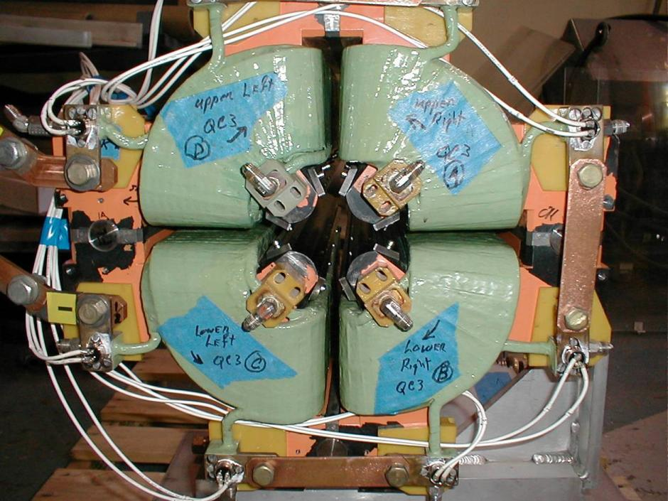
POLE SIDE SHIMS IN PLACE- reduce the 12-pole to below tolerance
Problem: when the pole side-shims are installed you cannot access the ends of the hyperbolic pole-tip to measure the adjacent pole distances anymore. The shim to shim distances don’t tell you how good the pole-tip distances are.
But need these pole-tip distances to be correct to better than 0.013mm
We will shorten the pole-side shims by about 1cm at each end so gauge blocks can still be used to adjust the adjacent pole distances.
12-pole will increase a little- but we are sufficiently below the 12-pole tolerance we can afford to let it increase.
IN FACT THE SKEW 12POLE WAS LARGER THAN DESIRED
Magnet will be split for a BPM to be installed, so need a method to be able to measure the adjacent poles’ gaps again

Slide 23
Final Multipole Measurements on both Final Doublet quads at r=1cm, in % Measured at SLAC
Magnet Name | Sextupole/quad | Octupole/quad | 10pole/quad | 12pole/quad | 20pole/quad
Tolerance (tightest)* | <0.03 | <0.025 | <~0.01 | <0.05 | <0.12
QD0 at 132.2 amps | 0.0255 | 0.0052 | 0.007 | 0.036 | 0.0027
QF1 at 77.5 amps | 0.0274 | 0.0058 | 0.0128 | 0.036 | 0.0027
Multipole tolerances arrived at by many iterations between magnet engineer and beam dynamics experts. E.g. original sextupole tolerance was 0.0053%, such a small sextupole might be too difficult to even reliably measure.
The sextupoles in both QD0 & QF1 had skew and normal components and 12 pole in QF1 had both skew and normal components.

Slide 24
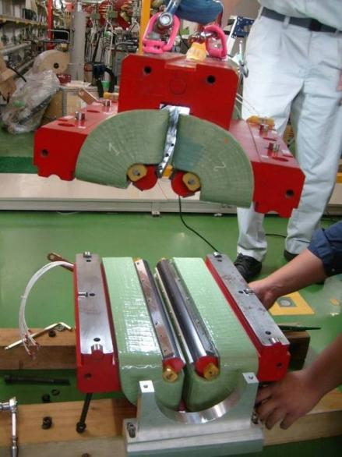
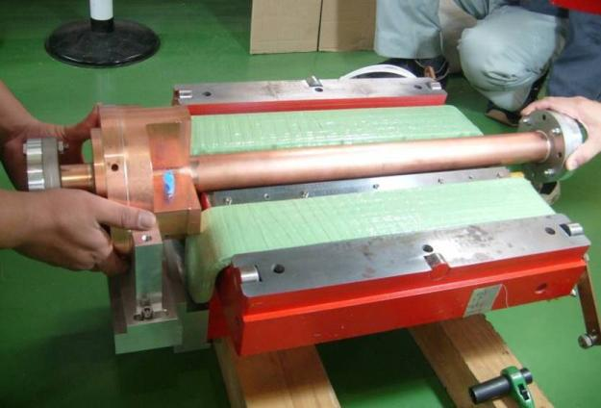
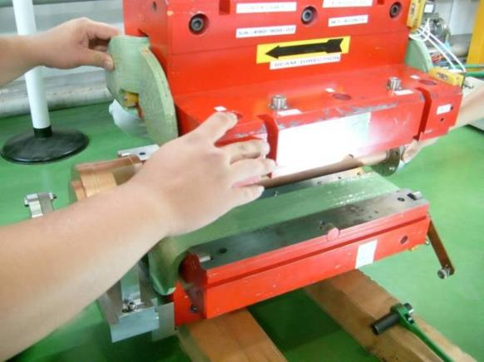
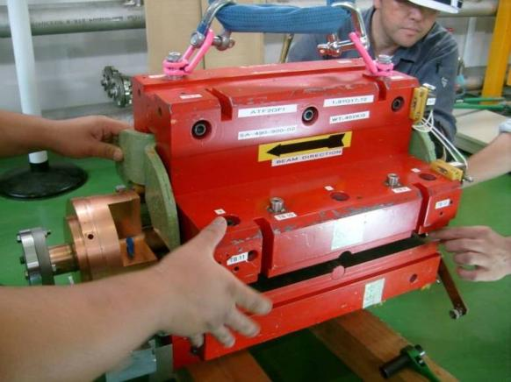
SBPMs installed in FD magnets, mid-Oct ’08 Magnets had to be split. Great care w/ re-assembly so mechanical dimensions preserved..

Slide 25
Beam physicists run beam simulations using the measured multipoles in QF1 and QD0
The angle of the 1st south pole of each multipole is measured; measurements indicate there is significant skew sextupole mixed in with the normal sextupole.
Glen White modelled the beam passing through QF1 & QD0 with the smallest multipoles achieved, at their measured angles, and the spot size is still “too large”. (as of late 2008)
But when the FD sextupoles strength and roll (using their magnet movers) are adjusted to compensate for the unwanted sextupoles in QF1 & QD0 then the simulated spot size is below 40 nm (if all FF quads are assumed to meet their tolerances).
The skew 12-pole in QF1 has an effect on the beam size in the vertical axis, it causes it to increase, we have no 12 pole magnet to compensate.
Rogelio Tomas will discuss this problem in the next talk.

Slide 26
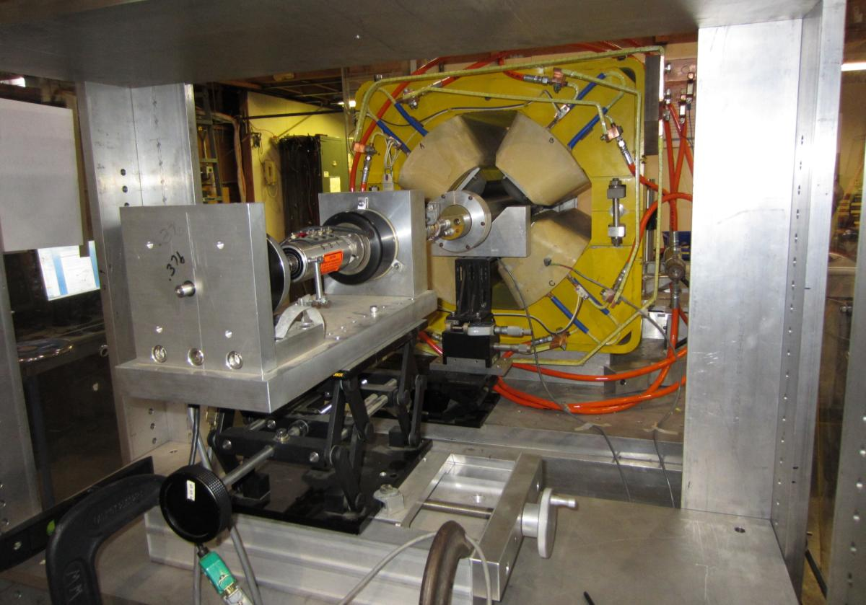
Spencer was happy to identify an old PEPII quad that has an amazingly small 12 pole and met the integrated strength requirements of QF1 with the QF1 power supply.
The 4Q17 style quad was refurbished and measured at SLAC in October 2012, sent to KEK and installed in the final doublet section in November 2012.
Rogelio will talk about the effect of this new QF1, its skew 12 pole is 1/4000 of old QF1’s

Slide 27
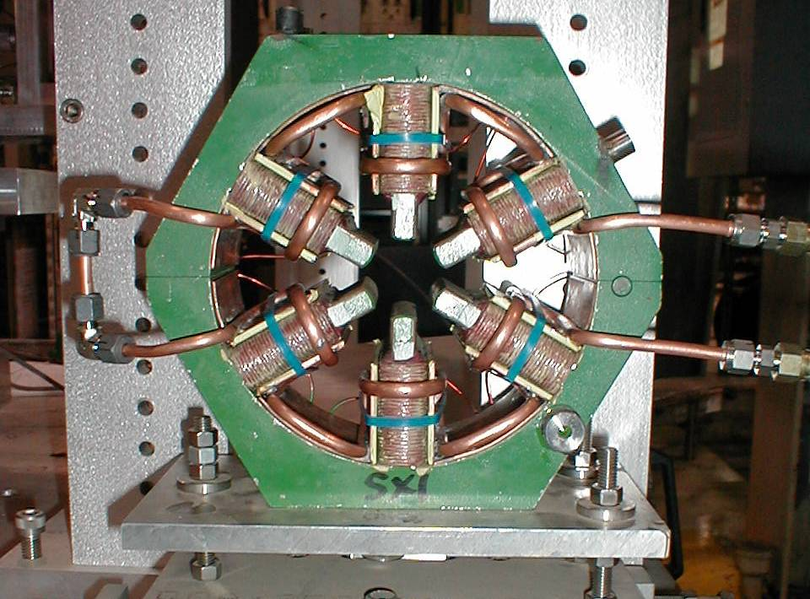
Two “Final Doublet” sextupoles are interleaved with QF1 and QD0. Again: are old SLAC magnets
Solid-wire coils that get hot when run at nominal current. Would warm up the adjacent magnet supports, take them out of alignment. So designed a cooling circuit that was added onto existing magnets.
Push the custom-made cooling circuit into place by hand (install one half at a time)
Hold the copper plates tight against the coils’ sides with cable tie-wraps

Slide 28
Conclusions on ATF2 magnet design, fabrication & measurements
All 5 “new” magnet styles provide the integrated fields as required within the current and voltage limits of the power supplies
All 5 styles’ operate with low temperature rises in their LCW (~ < 3ºC)
The magnets met the multipole tolerances, where they were typical “a few times10E-04” at a radius of 1 cm,
But the QF1 skew 12 pole tolerance of 7x10E-06 at 1cm (in one of the beam optics lattices) took a few years to beat..

Slide 29
Accessories to the magnets: needed to satisfy alignment and stability tolerances on the magnets
The ATF2 beamline, in addition to the final focus, includes a diagnostics section to make measurements of the beam shape and correct it at the entrance to the final focus.
To measure the beam orbit and maintain the beam size there is a feedback system : the beamline magnets are equipped with sub-micron resolution cavity-BPMs and are placed on remotely controlled mechanical movers (more details on a later slide).
In order to achieve the 37nm spot size the beam’s emittance must not increase above 12 picom.picorad as it passes through the beamline. Higher multipoles, magnets vibrating between 0.1 and 100 Hz and misaligned magnets will all cause the beam to blow up. So the beam physicists set tight tolerances on these parameters; they vary from magnet to magnet.

Slide 30
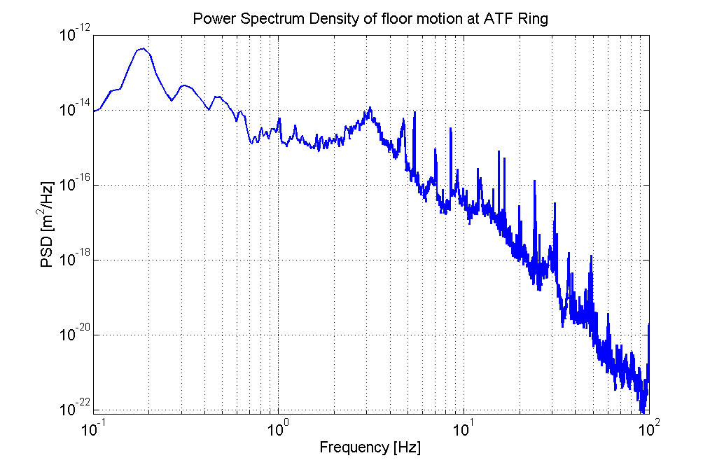
ATF2 specifications
ATF ground motion
6-7nm
0.1Hz
~100Hz
For QD0 at ATF2: 6-7nm tolerance
Repetition rate 1Hz=> need a “mechanical” stabilisation from >0.1Hz (below, the beam based alignment works)
Two solutions possible:
Isolate/cut vibrations in the desired frequency range
Push the first resonance peaks at higher frequencies where ground motion is lower

Slide 31
Measuring the beam spot size accurately is a difficult job: project to understand the Shintake Monitor is ongoing
Because the ATF2 is a single-pass beam line, proof of the achievement of the goal of spot sizes of about 40 nanometres requires the use of an interferometer-based beam size monitor (BSM, also called the Shintake monitor).
There are no other types of beam size monitors that can measure beam sizes of tens of nanometres.
Rogelio in following talk can speak about the latest analyses of the Shintake monitor data.

Slide 32
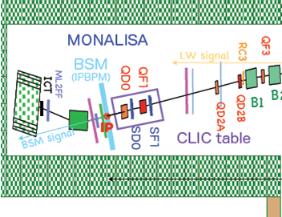
The layout of the last 4 magnets and the Beam Size Monitor, it sits at the “interaction point”.
Shintake Monitor: information on the beam size
2 Final quads & 2 final sextupoles
IP
1225
575
575
QC3
QC3
180
311.9
200
180
311.9
200
SBPM
FFTB
2.13
S3.00
SBPM
SBPM
FFTB
2.13
S3.00
SBPM
76.2
76.2
450.1
450.1
45
53.1
65
45
53.1
450.1
65
380
785
380
785
SF1
QF1
1940 mm
SD0
QD0
Not the latest drawing!
What is needed to support all these components?

Slide 33
Beam physicists have specified how much relative motion there can be between the final doublets & BSM
We want the measurement to have coherent behaviour with respect to the “beam” => Relative motion between Shintake monitor and final doublets: 6-7nm in the vertical axis above 0.1Hz
Shintake monitor
Interference
fringes
Final doublets
If Shintake Monitor and FD put on separate active supports, coherence is lost
Beam
B. Bolzon & A,Jeremie, Annecy, project
Ground
4m
Good ground motion coherence: measured on KEK site
➔ Separate stiff supports rigidly fixed to the floor
For FD support: Consider a honeycomb block without active feet

Slide 34
Introduction to issue of stability of the final magnets before the interaction point
To have only 2% error on the beam size measurements at the IP, tolerance of vertical relative motion above 0.1Hz between:
  Shintake Monitor and QF1: 20nm
  Shintake Monitor and QD0: 7nm
Tolerances are about 0.5µm in direction perpendicular to the beam and 10µm in direction parallel to the beam
Tolerances are less strict if QD0 and QF1 move in the same way
2 sources of excitation which can make final doublets vibrate:
  Ground motion: amplitude depends on time (coherence does not)
  Cooling water: low flow velocity had been designed into the ATF2 final doublets

Slide 35
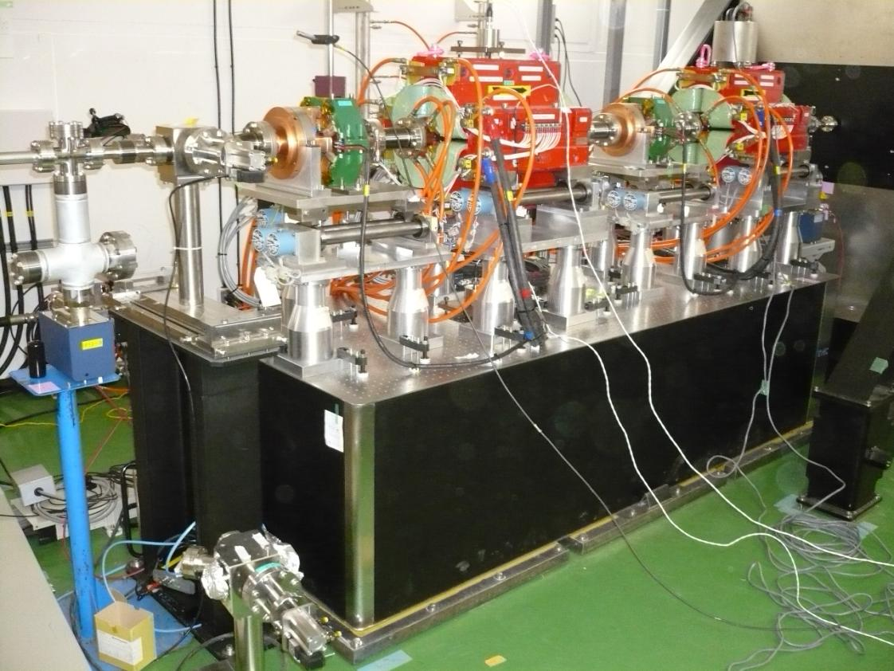
Final Doublet on chosen common support in mid-November 2008
BSM
Must minimize effects of ground motion
Must not amplify vibrations in this frequency range : 0.1Hz-100Hz
Support that can evolve as FF design evolves
Control relative motion between FD magnets & IP (=BSM)
6-7nm vertical jitter tolerance
1.2m beam height: 3 extra legs under each magnet put them at beam height
Vibration damping table attached to floor with steel plates, a thin layer of natural beeswax is spread between the table and the plates

Slide 36
Flowing water: no impact on [QD0; QF1] relative motion to the floor
With ground motion, relative motion of Shintake to [QD0; QF1]:
 | Tolerance | Measurement (between QD0) | Measurement (between QF1)
Vertical | 7 nm (for QD0) 20 nm (for QF1) | 4.8 nm | 6.3 nm
Perpendicular to the beam | ~ 500 nm | 30.7 nm | 30.6 nm
Parallel to the beam | ~ 10,000 nm | 36.5 nm | 27.1 nm
In horizontal directions, vibrations are well below tolerances
In vertical direction, tolerances are stricter but vibrations are still within tolerances

Slide 37
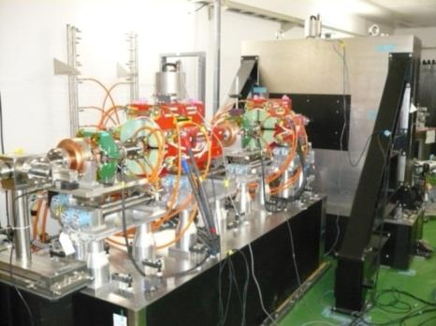
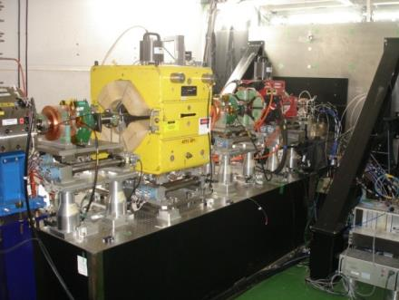
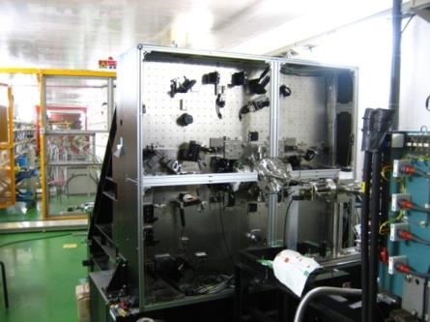
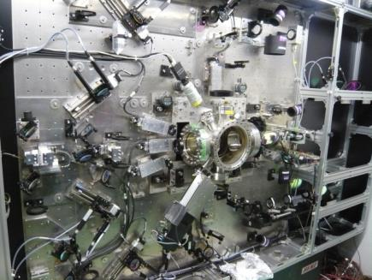
In October 2012 we replaced the poorer quality QF1 with the much better magnet as described above, but it is heavier and larger than original.
So the question to be answered was- did QF1’s vibration behaviour change?
2008
2013
QD0
QF1
Also, since 2008 the Shintake monitor has more components and is in operation:
2008
2013

Slide 38
With ground motion, relative motion at 1 Hz of Shintake to [QD0; QF1] :
2008 by B. BOLZON | Tolerance | Measurement [SM-QD0] | Measurement [SM-QF1]
Vertical | 7 nm (for QD0) 20 nm (for QF1) | 4.8 nm | 6.3 nm
Perpendicular to the beam | ~ 500 nm | 30.7 nm | 30.6 nm
Parallel to the beam | ~ 10,000 nm | 36.5 nm | 27.1 nm
2013 by A. JEREMIE | Tolerance | Measurement [SM-QD0] | Measurement [SM-QF1]
Vertical | 7 nm (for QD0) 20 nm (for QF1) | 4.8 nm | 30 nm
Parallel to the beam | ~ 10,000 nm | 25 nm | 290 nm
New QF1 : relative motion of Shintake monitor to new QF1 > Tolerance
Outside tolerance for 2% effect on beam!
From talk by Laurent Brunetti, LAPP-IN2P3-CNRS, Université de Savoie, Annecy, France at 2013-11-13 LCWS meeting in TOKYO .

Slide 39
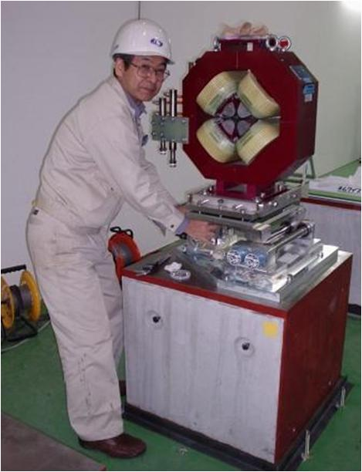
All the final focus magnets must have supports to minimize their vertical jitters. Tolerances range 0.1-1 µm
Alignment target
Sugahara-san and small crew installed the concrete base blocks in the ATF2 beamline.
Each FF quad and sextupole had these support items:
Height adjustment plates
Old FFTB magnet mover: so BEAM-BASED ALIGNMENT CAN BE CARRIED OUT
Concrete base block—evaluated to be best option for stability and was made in various lengths to match lengths of magnets. Blocks were shimmed to account for floor height variations

Slide 40
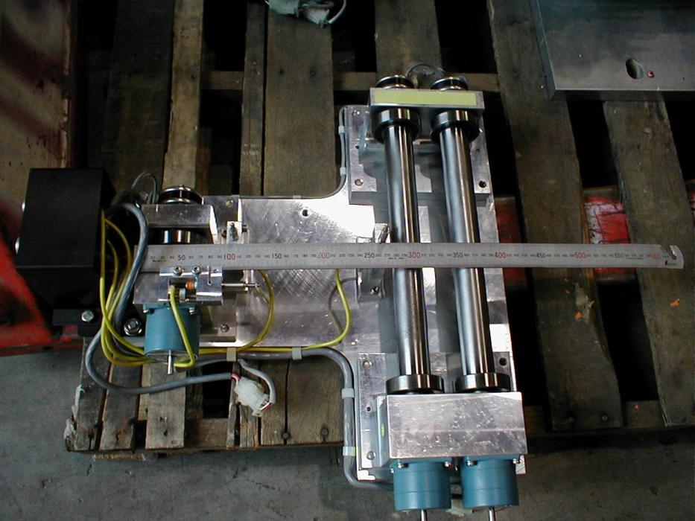
We re-used the remote-controlled 3 –axis movers that had been successfully used in the Final Focus Test Beam (FFTB) at SLAC
Each mover has 3 camshafts :
Adjustment of vertical & horizontal position with 1-2 µm precision & rotation angle (tilt, with precision of 3-5 µrad)
Anticipated the gradual movement of the supports and magnets caused by thermal variations or slow ground motion. So put the re-cycled magnet movers under the FF magnets.
Free space between LVDTs is 140mm
Camshaft driving motors controlled through a CAMAC mover module.
The potentiometer read backs of camshaft rotation are read by an ADC. Are 3 Linear Voltage Differential Transformers on each support plate.

Slide 41
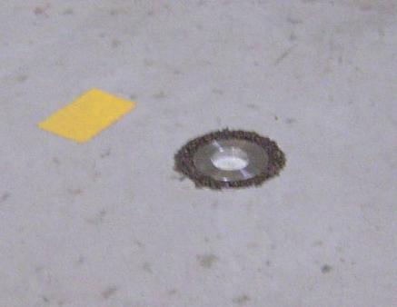
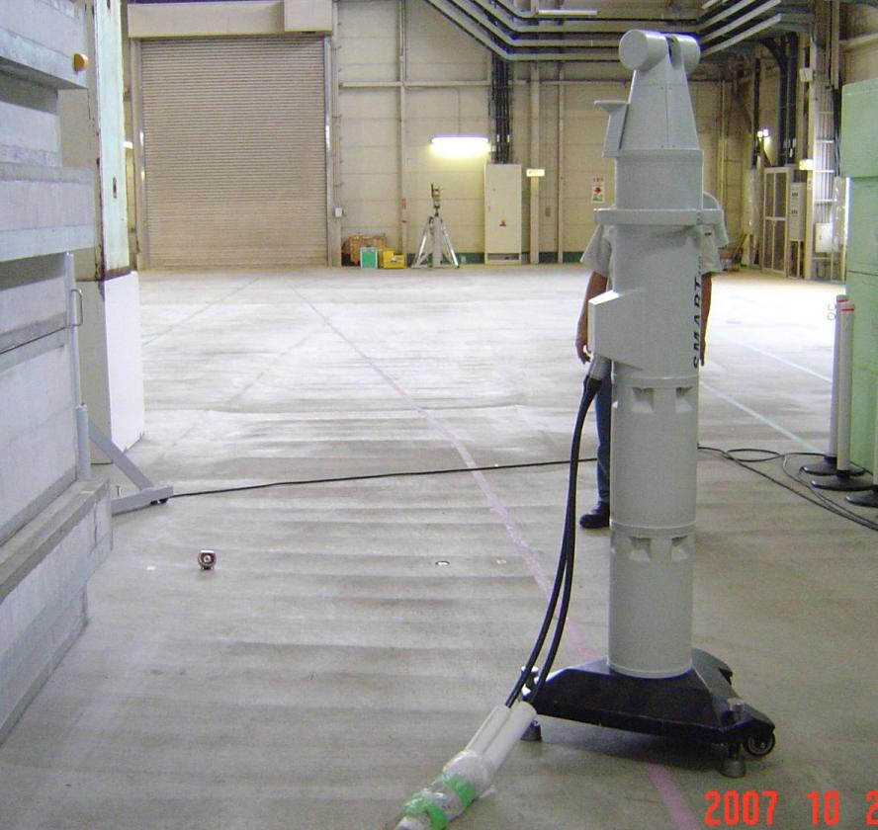
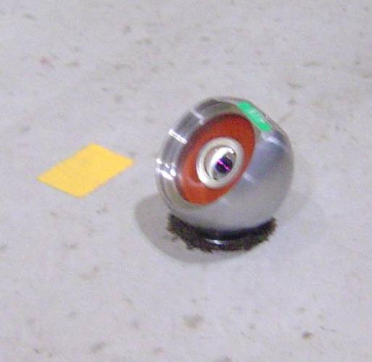
A brand new thick concrete pad with steel rebar was carefully poured where the ATF2 beamline was to sit. Beamline installation work started in October 2007 : 1st installed monuments for horizontal positioning of beamline components- want to measure if and how much concrete shrinks

Slide 42
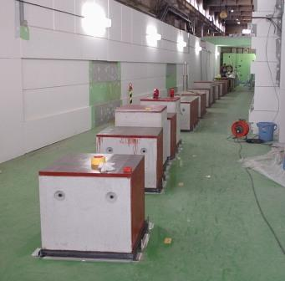
20 concrete blocks of various styles were installed in Dec 2007, each block custom made for its magnet
Previously Sugahara-san put layout markers on the NEW floor, having measured the ATF2 floor relative to the ATF floor.
Measurements of the floor height over 3 weeks in late 2007 shows
It is shrinking.
It varies over space by several mm
Measured day to night variation of floor tilt with Hydraulic Level Systems: caused by ambient temperature variations.
Blocks installed as of 20th December 2007
Started installing movers and magnets in early January 2008 –the QEAs & DEAs. Other magnets were installed as they became available.

Slide 43
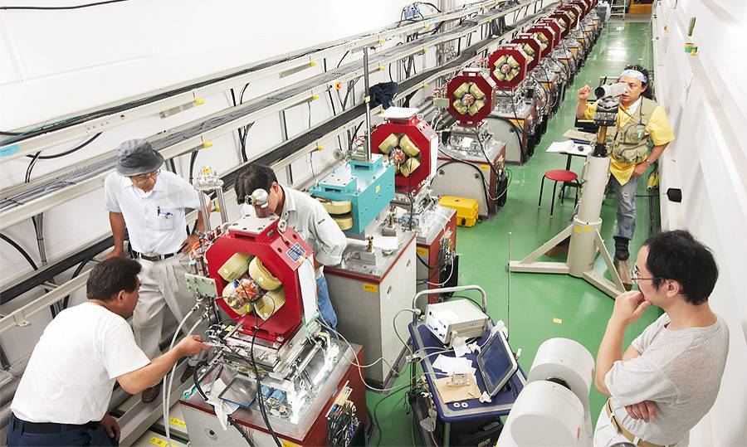
After the air-conditioning is working then first alignment of downstream FF magnets, happens in August 2008. Sugahara-san & contractors

Slide 44
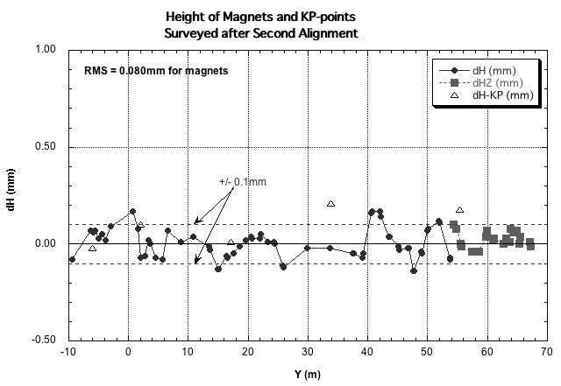
Fine adjustments of mover tilts and magnet positions done in September 2009 with this satisfactory result
FF magnet alignment activities carried out by KEK physicists & contractors from August ‘08 through September ‘09. Mover tilts measured with laser tracker.
Plot shows each FF magnet’s height, with a total RMS deviation of 80µm
Remaining alignment done using
Beam Based Alignment
“KP” points are alignment monuments not used in this process.

Slide 45
Lessons learned and comments on ATF2 magnet engineering, fabrication & installation (written in 2009)
Integration of magnets with rest of beamline apparatus needs attention of fulltime integration engineer from early-on in project
Beamline installation drawings showing all beamline devices and their supports and their precise locations must be made before installation starts
Beam Delivery System of ILC will have magnets with tight harmonic & stability tolerances, avoid using old magnet designs or actual old magnets as they will rarely match the ILC requirements, quality will be compromised & money won’t be saved in the end
Different countries have different standards and rules regarding magnet fabrication & integration. ILC-wide magnet group must develop, promulgate and enforce design + fabrication standards; integration rules (e.g. can a beam-pipe touch a magnet’s pole-tips?)
If choose to have magnet vendors “build to spec” rather than “build to print” then must carefully review vendor drawings before they start fabrication & have on-going visits by ILC magnet engineer to their factory (later is best practice even if building to ILC-provided drawings)
Have regular engineering meetings just on magnet issues via webex

Slide 46
CONCLUSION and ACKNOWLEDGEMENTS
Conclusion: It IS possible to design, fabricate, install and instrument a beam line of magnets with the involvement of physicists and engineers from 5 countries in 5 different time zones who’d prefer to speak 5 different languages.
Sometimes its even fun!
Acknowledgements: This presentation describes the ATF2 magnet work done by a small group of engineers, physicists and technicians between January 2005 and December 2008. I gratefully acknowledge the hard work and collegiality of Benoit Bolzon, Andrea Jeremie, Mika Masuzawa and Ryuhei Sugahara. (I also borrowed and modified some of their slides)
And for their ongoing explanations of beam dynamics I thank Mark Woodley and Glen White.

Slide 47
Some publications on the magnets of the ATF2 and the status of the ATF2 beamline over several years
“A Project to Design and Build the Magnets for a New Test Beamline, the ATF2, at KEK”
http://www-public.slac.stanford.edu/sciDoc/docMeta.aspx?slacPubNumber=SLAC-PUB-14339
“A Flight Simulator for ATF2: A Mechanism for International Collaboration in the Writing and Deployment of Online Beam Dynamics Algorithms “ ( May 2008)
http //inspirehep.net/record/792445
“Present status and first results of the final focus beam line at the KEK Accelerator Test Facility “ Phys.Rev.ST Accel.Beams 13 (2010) 042801 or at http://inspirehep.net/record/853172
“Operational Experiences Tuning the ATF2 Final Focus Optics Towards Obtaining a 37nm Electron Beam IP Spot Size “, May 2010, SLAC-PUB-15165, IPAC-2010-WEOBMH01 or at : http://inspirehep.net/record/869675
”ATF2 summary and status”, ICFA Beam Dynamics Newsletter. 54 (2011) 62-80
SLAC-REPRINT-2012-046 or at: http://inspirehep.net/record/1086708?ln=en
The high reliability of their accelerator magnets should be a goal of all magnet engineers, here is a paper by Spencer which provides much advice on making reliable magnets:
“Improving the Reliability of Particle Accelerator Magnets: Learning from our Failures”
http://www-public.slac.stanford.edu/sciDoc/docMeta.aspx?slacPubNumber=SLAC-PUB-15697

Slide 48
End of Presentation

