Slide 1
Welcome to
“Beam Dynamics meets Magnets”
G. Franchetti
GSI

Slide 2
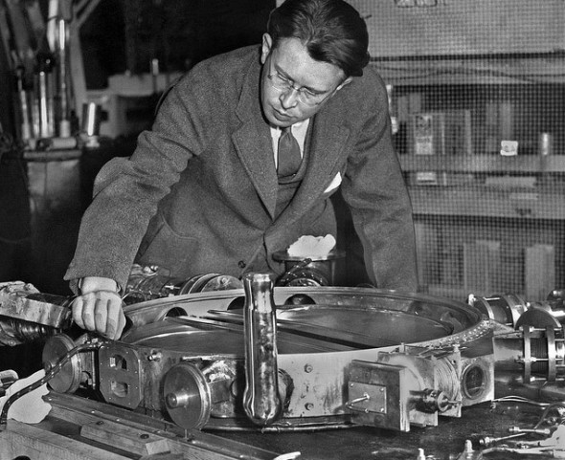
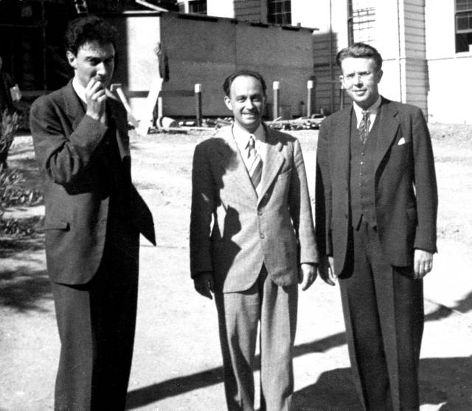
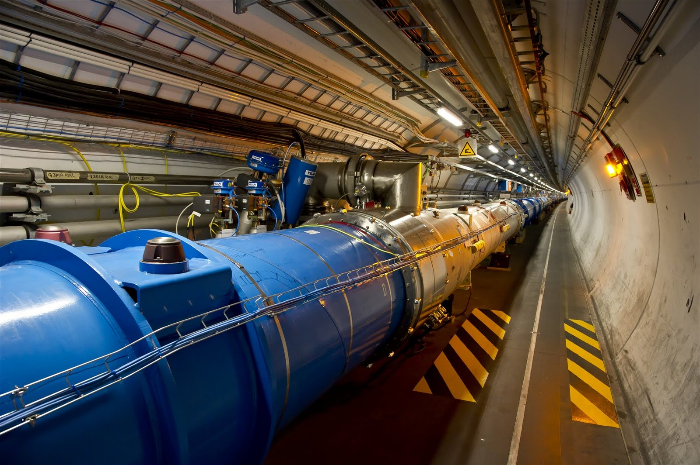
Accelerators were
born within science
Basic
research
Beam
dynamics
Magnets
increase of energy / intensity
Fragmentation
in areas of
competence
increase of complexity

Slide 3

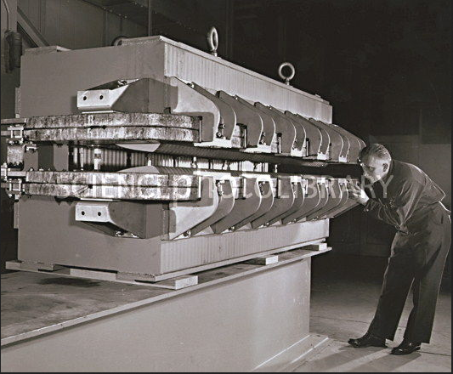
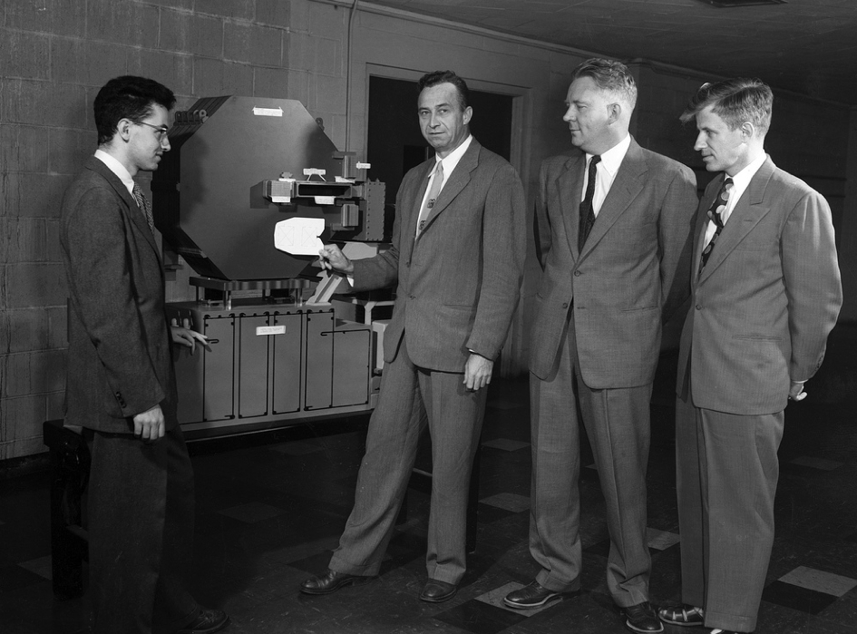
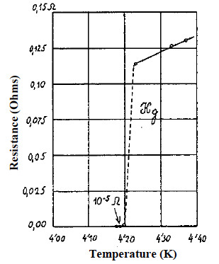
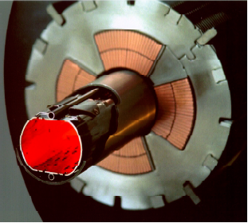
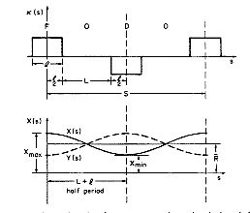
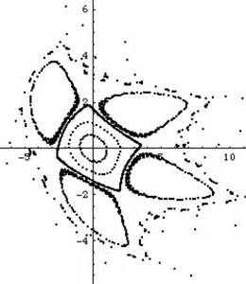
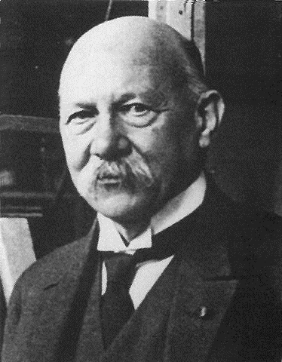
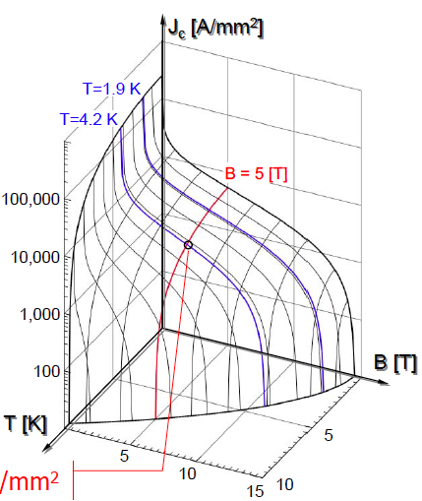
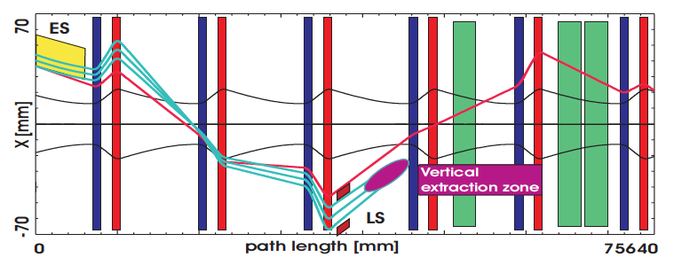
Magnets
Beam Dynamics

Slide 4
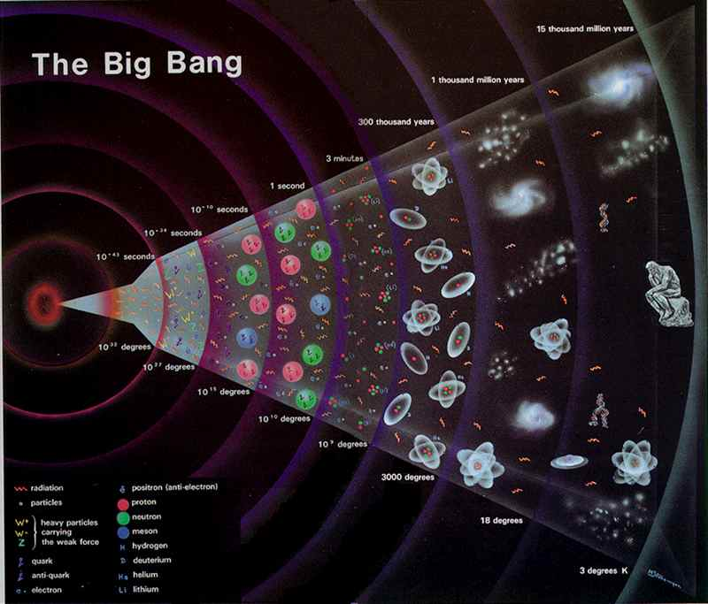
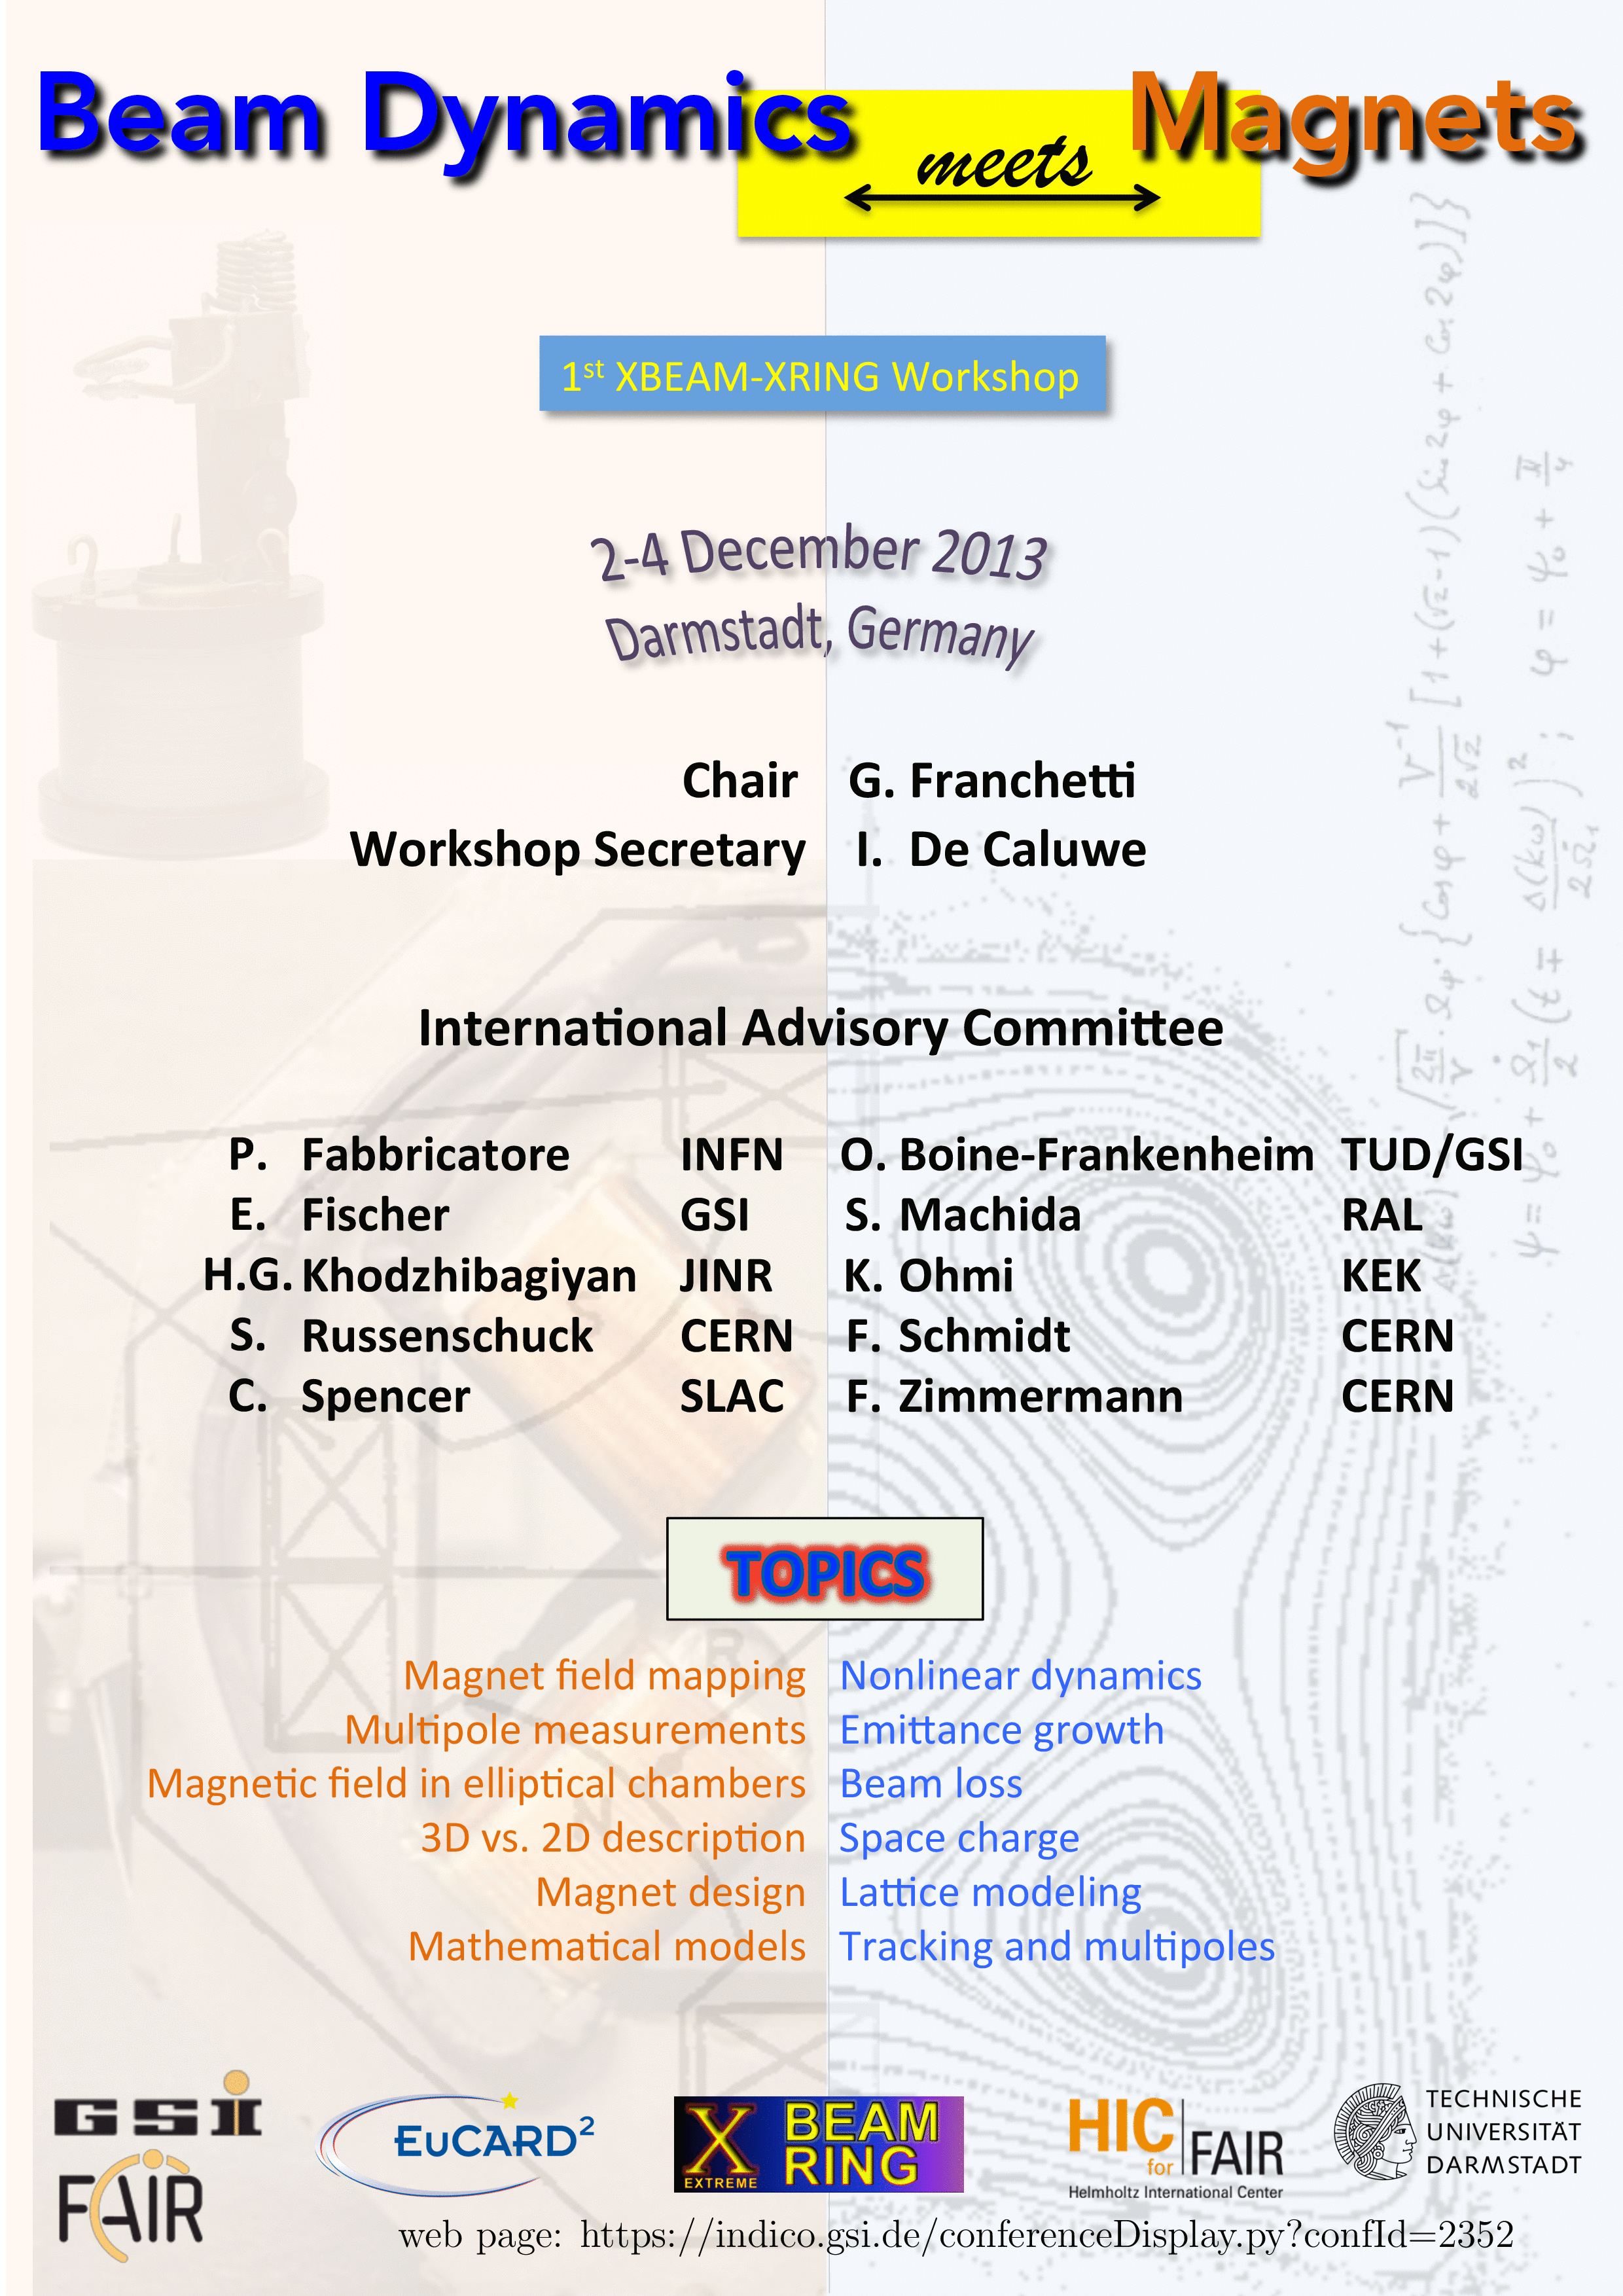
New physics
New and more
complex
Accelerators
New projects
Magnets
LHC, J-PARC,
FAIR, …
Beam Dynamics

Slide 5
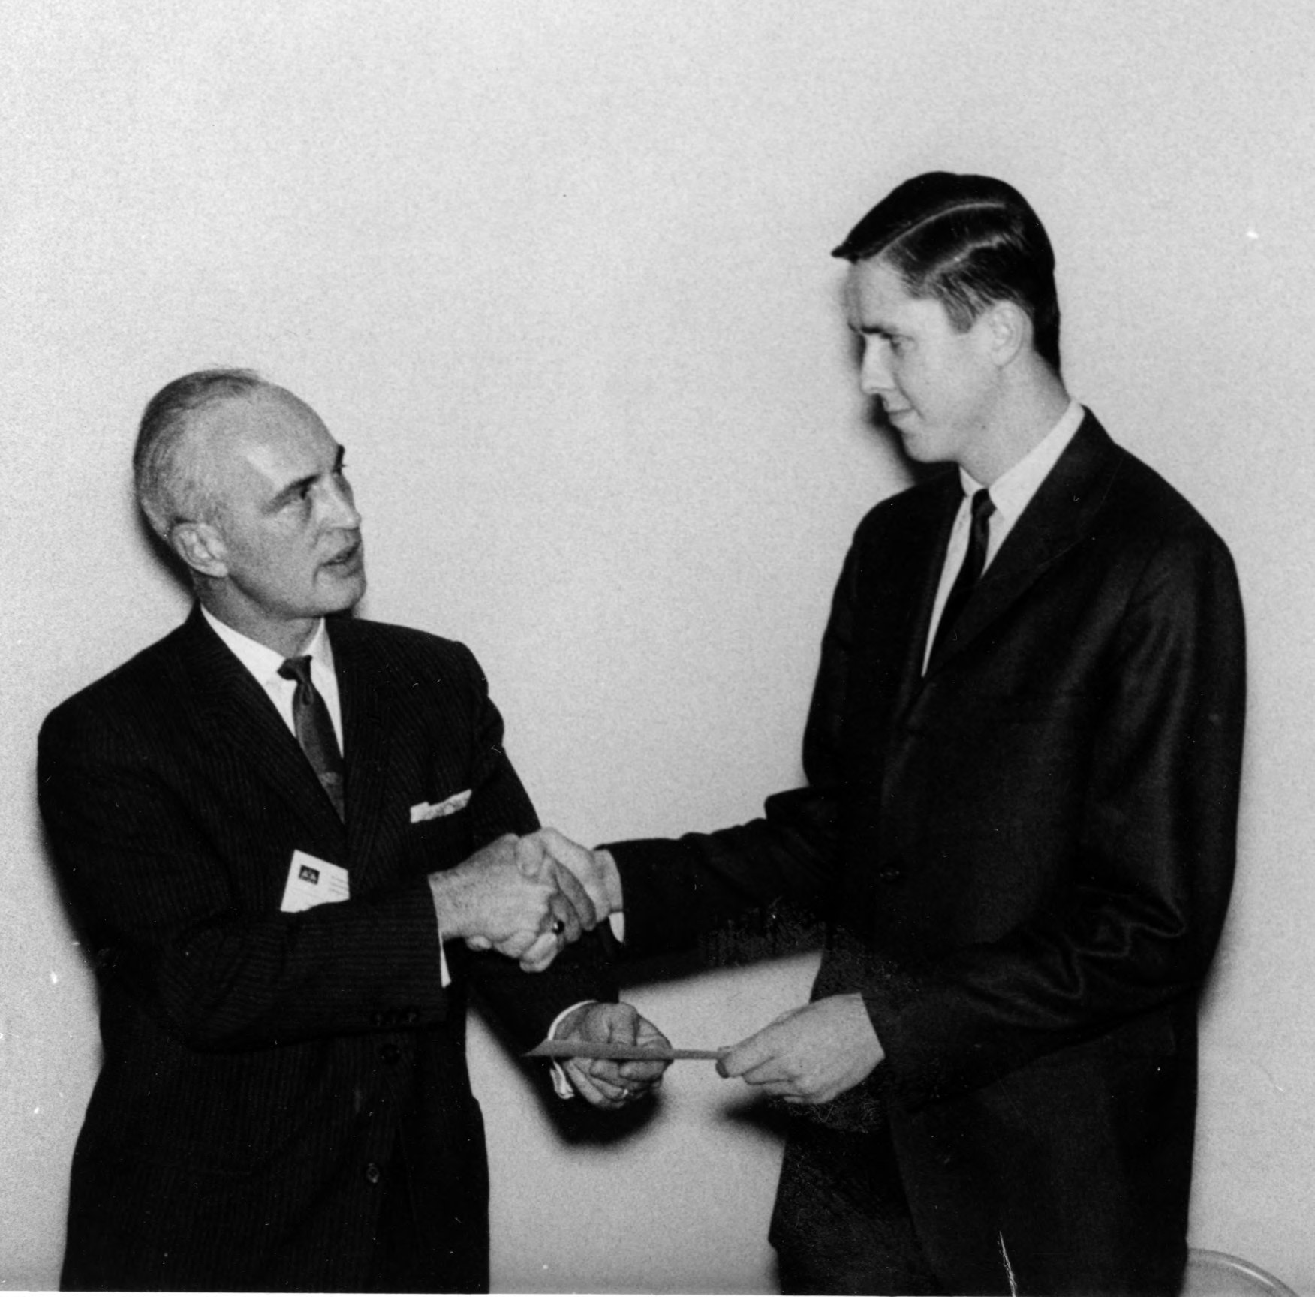

Beam Dynamics & Magnets
communication level ?
Good / Friendly
Turbulent / Agitated

Slide 6
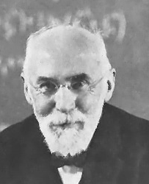
We all are interconnected

Slide 7


Task 5.3: Extreme performance rings (XRING)
GSI will coordinate XRING and integrate the activities of the accelerator, nuclear and particle physics communities towards reaching the optimum performance of FAIR, ISIS and PSI-HIPA, and helping guide the upgrade strategy for the LHC injector complex. Ultimate limitations for the aforementioned projects will be identified. XRING will also support studies on critical beam diagnostics (e.g. continuous emittance & beam-loss measurements) and on advanced FFAGs designs, including machine experiments at EMMA in the UK. XRING will create strong synergies across communities, countries and continents. XRING will be THE European forum for discussing performance limitations of high-intensity high-brightness hadron rings, and for analyzing and optimizing the proposed upgrade paths of several European facilities. XRING will bring together experts in beam dynamics with specialists of magnets and collimation to arrive at optimum upgrade solutions with risk mitigation. XRING will integrate the efforts of large laboratories, smaller institutes and universities, and it will form and maintain a community capable of advancing the technical realization & scientific exploitation of the European high-power hadron-ring facilities. Task participants will attend and contribute to events addressing high-intensity hadron beams and participate in beam experiments, e.g. at PSI, ISIS, and EMMA. The following institutes have expressed interest in the EUROLUMI activities: CNRS-LPSC, UJF (FR), GSI (DE), Unibo (IT), CERN (INO), JAEA, KEK (JP), UM (MT), CINVESTAV (MX), IHEP, JINR (RU), PSI (CH), RHUL, STFC, UNIMAN and ULANC as Cockroft Institute, UOXF (UK), BNL, and FNAL (US).

Slide 8
Two different areas
Two different communities
Beam
Dynamics
Magnets

Slide 9
Beam
Dynamics
meets
Magnets
Beam
Dynamics
Magnets

Slide 11
CERN | 22
GSI | 20
STFC | 7
Goethe U Ffm | 6
TU Darmstadt | 4
PSI | 3
ISIS | 3
FZ Jülich | 2
KEK | 2
KIT | 2
ASTeC | 1
BNL | 1
Cockcroft I. | 1
FAIR | 1
Imperial College | 1
INFN | 1
KU Leuven | 1
JPARC | 1
LNL | 1
MedAustron | 1
MSU | 1
SLAC | 1
Tokyo U. | 1
Energy
Frontiers
Intensity
Frontiers
Unparalleled
participation
of institutions
representing a
large spectrum of
the accelerator
community
Electron
Machines
Ion
Machines
Proton
Machines
Beam Dynamics
meets
Magnets

Slide 12
Unique opportunity to face issues that requires
the expertise of magnet and beam dynamics
The workshop will attempt to enhance the scientific-technical "project" experience:
in every project (LHC,FAIR,JPARC,ATF2,EMMA, etc...) the experience of the communications
and synergy between "Beam Dynamics & Magnets" has developed differently.
This is due to project features, laboratory styles and traditions, people personalities and
experiences.
Workflow of “beam dynamics” and “magnets” in different projects
Magnets
Beam Dynamics
How well should a magnet be measured for beam dynamics ?
Example:
Benchmarking experiments: beam dynamics <-> magnets

Slide 13
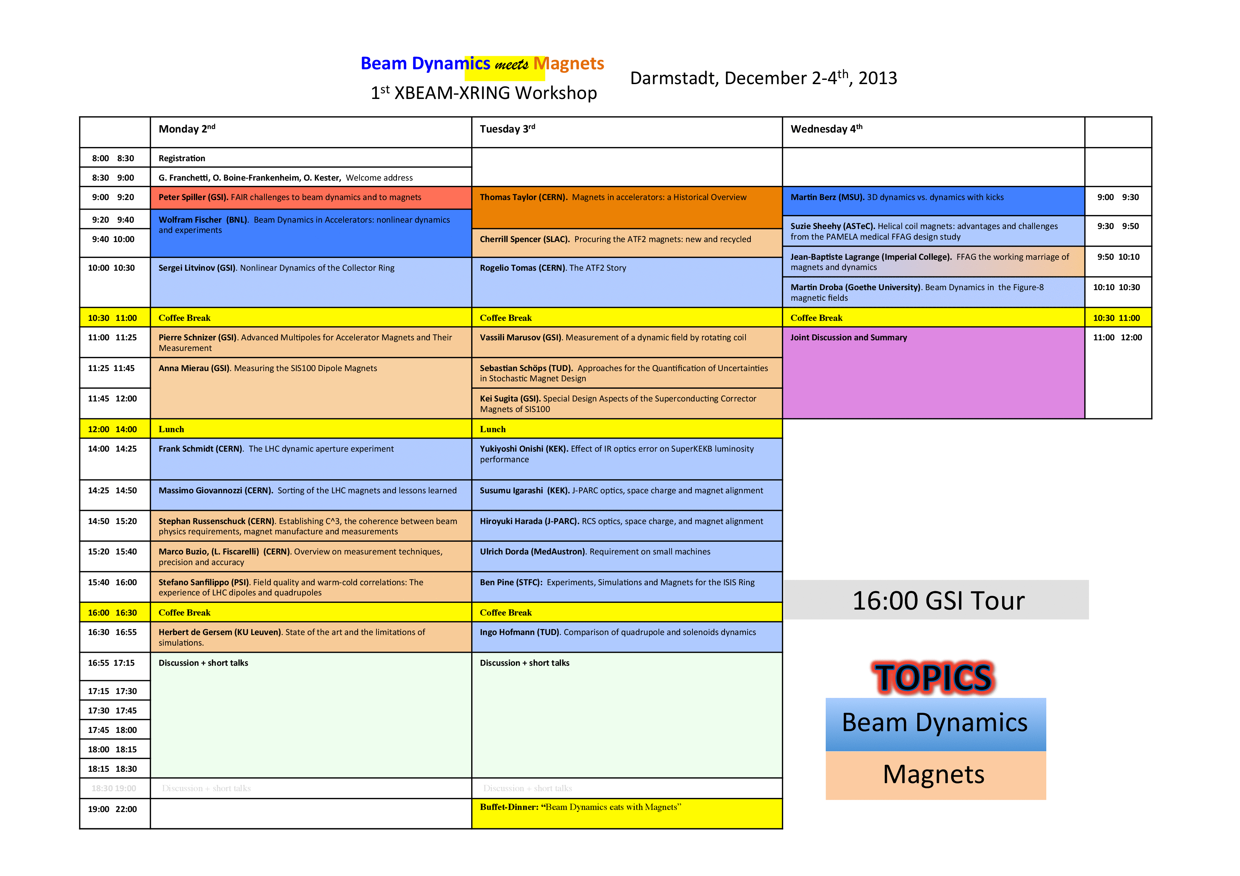
WLAN:
SSID -> BEAM
password -> DYNAMICS

Slide 15

Acknowledgments
Isabel de Caluwe
for all the secretariat work
Lucilla Croce Ferri
EU-bureau coordination
Irene Reinhard
EU-bureau coordination
Oliver Kester
Sponsoring Audio/Video Package
Oliver Boine-Frankenheim
TUD link to Darmstadtium
Cherrill Spencer
Constant help to the organization
All members of the International Advisory Committee
The students that cover this event as scientific secretary

