Slide 1
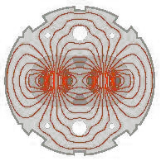
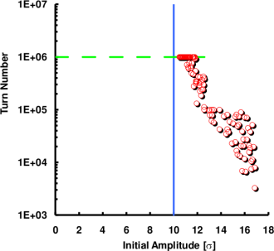
LHC Dynamic Aperture Experiment
What is the Dynamic Aperture (DA)?
Definition & Chaos Criteria
Causes for single particle losses
Phase Space
Survival Plots
Measurement (Classic Kick Technique)
Simulation & Computing
DA experiments since the late `80s
SPS
Tevatron
Hera
LHC DA Experiment (E.H. Maclean, R. Tomàs, F. Schmidt, and T.H.B. Persson)
1

Slide 2
Definition of Dynamic Aperture
Real World Dynamic Aperture (RW-DA) Definition:
Largest Amplitude at which particles remains in the accelerator over a time range of interest.
Potential Dynamic Aperture (PO-DA) = Onset of global Chaos
Largest Amplitude with mainly regular motion.
Insignificant chaotic layers within the regular regime will be ignored.
However considerable wide chaotic spikes have to be taken into account
➔ It turns out that the PO-DA is typically too small as RW-DA estimate

Slide 3
Chaos Criteria
PO-DA Detection ➔ find amplitude with non-zero Lyapunov Exponent:
In practice, the Lyapunov is rarely evaluated directly.
Instead, one follows the evolution of the distance and most effectively by using the angular distance that is most sensitive to find even weakly chaotic motion

Slide 4
Dynamic Aperture Scheme
Rapid amplitude growth and loss
Stable Islands in chaotic sea
Fine chaotic layers in stable regime
Mostly stable particle motion
RW-DA
PO-DA

Slide 5
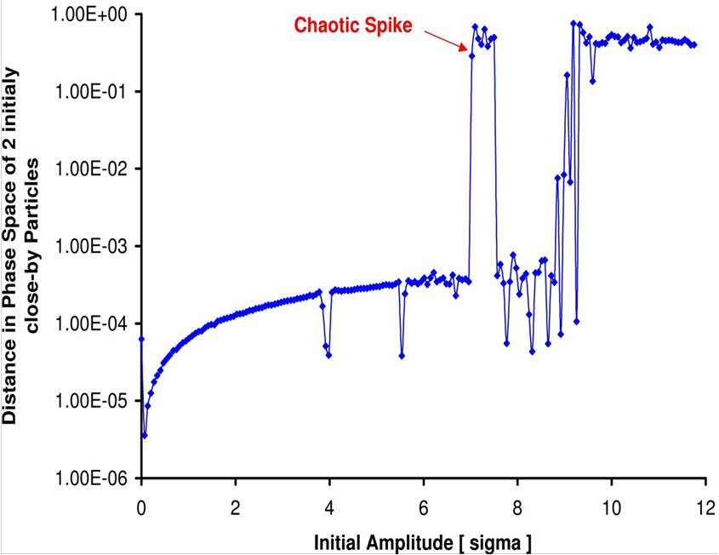
BB Survival Plots (Y. Luo et al.)
The BB force gives rise to significant broad chaotic “spikes” below the onset of global Chaos and separated by a sizable amplitude range with stable motion. This leads to particle loss at those lower amplitudes. However, this particle loss is slower forcing us to extend the LHC BB tracking to more than 1E6 turns.

Slide 6
Causes for Single Particle Losses
The causes are basically the reason why we are all here!
Wanted and un-wanted Multipolar Components
Magnet Misalignments
Tune Modulations due to Power Supply Ripple
Weak-Strong BB Interaction

Slide 7
DA in 1D

Slide 8
1D close-up

Slide 9
2D Stable and Chaos

Slide 10
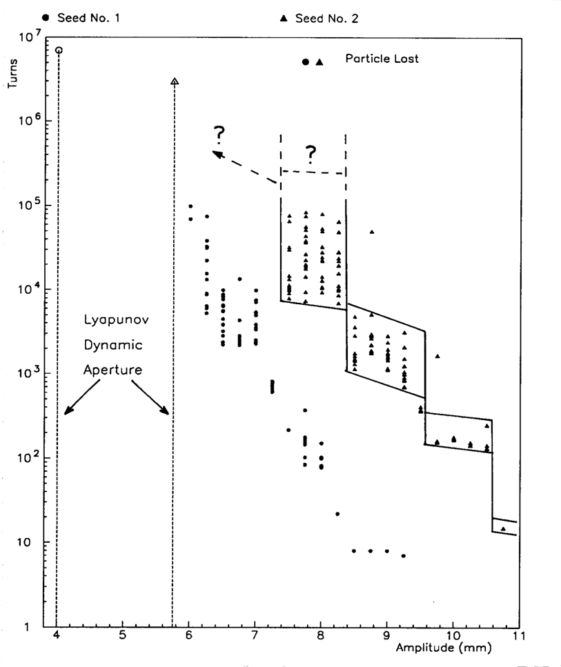
Survival Plots and Resonance Wandering 1/2 (F. Galluccio et al.)
The survival plots depict the number of turns particles stay in the machine for a given amplitude. In this particular example we tracked an ensemble of particles started in a tiny volume of phase space. The width of the survival times tends to grow inverse proportionally with amplitude since the chaotic motion becomes weaker. There is no known method that could predict the evolution to smaller amplitudes toward the onset of global chaos.

Slide 11
Survival Plots and Resonance Wandering 2/2

Slide 12
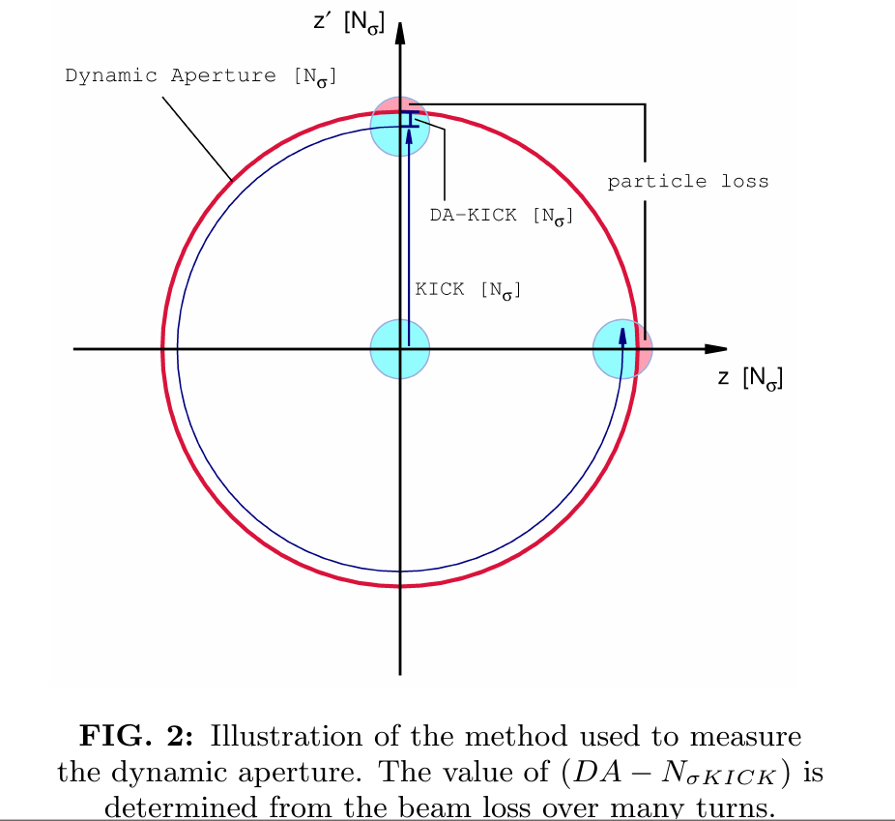
Classic Kick Technique

Slide 13
Tracking Engine for massive LHC Tracking Studies 1/2
Many Thanks to Eric McIntosh
For LHC tracking we are using SixTrack which is kept rigorously bug-free while continuously optimizing the code for speed.
The lattice is transferred from MAD-X. MAD-X, SixTrack & PTC are benchmarked against each other.
Great care has been taken to sample the 6D phase space appropriately!
We have prepared a SixTrack run environment which allows to automatically launch 10’000 of jobs at a time and storing all output data in a elaborate directory structure. After all jobs have been finished automatic post-processing procedure are being launched for a full analysis of the data.

Slide 14
Tracking Engine for massive LHC Tracking Studies 2/2
Jobs can be sent to various batch systems, e.g. a local CERN batch cluster with hundreds nodes is at our disposal.
Moreover, we have created LHC@Home. Presently about >100’000 volunteers have sign up to contribute world-wide. The so-called BOINC system organizes the flow of jobs to the contributors and sends back the results into our directory structure.
Special care has been taken Eric McIntosh to guarantee bit-by-bit accuracy on any computer platform. A checkpoint-restart mechanism is implemented as well.

Slide 15
DA Experiments 1988 - 1994
In view of the proposed 2 competing projects the SSC and LHC, experiments have been conducted both at SPS and Fermilab
SPS (1988)
E778 (1989) at Tevatron
With the following agenda:
DA measurements to compare with simulation code:
SPS: the machine is too linear, therefore 8 strong sextupoles have been powered with self-compensation of the low order resonances.
Tevatron: Non-linear but there has never been a complete model of Tevatron including non-linearities
Effect of Resonances
Influence of Tune Modulation
Diffusion speed at large amplitudes
2004 Hera DA experiment

Slide 16
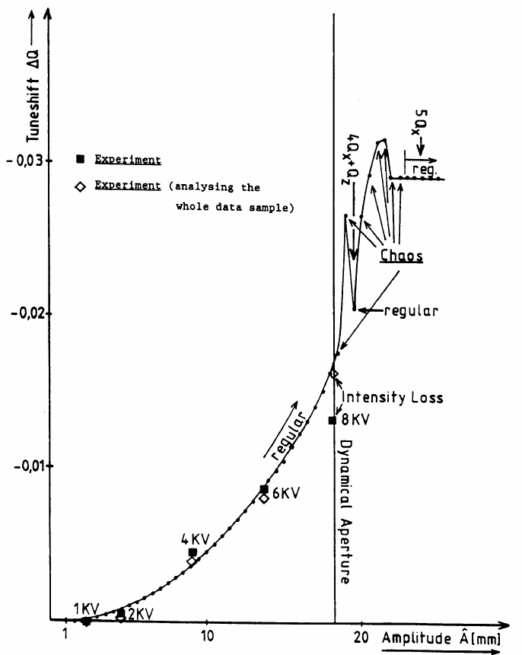
SPS DA Experiment 1988
J. Gareyte
A. Hilaire
F. Schmidt
Dynamic Aperture

Slide 17
DA Experiment (HERA)
(Wolfram Fischer’s PhD thesis)

Slide 18
DA Experiments LHC 2012
At the LHC in 2011 and 2012 we had 1 shot each to do this DA experiments. We have been fortunate enough to do independent experiments on Beam1 and Beam2
Beam1: This was dedicate to a new technique to probe the dynamic aperture according to the inverse logarithm scaling law for the dynamic aperture. This scaling law, derived from tracking data, has been recently used to derive a possible relation between the intensity evolution and dynamic aperture. This has been performed by Massimo Giovannozzi and his team. In fact, Massimo will report about this in a GSI seminar scheduled for this week.
Beam2: This part of the experiment determines the DA with the classical kick technique and will be reported here. Rogelio Tomàs and Frank Schmidt have been leading this effort and the PhD student Ewen Maclean was doing all the job! It goes without saying that we are indebted to the machine protection group that allowed us to use the powerful MKA kicker and also the BI experts and the LHC operation team. Report ready for publication:
E.H. Maclean, R. Tomàs, F. Schmidt, and T.H.B. Persson.
“Measurement of LHC non-linear observables using kicked beams.”

Slide 19
Kick Experiment and Simulation Conditions
Experiment
LHC Injection Energy 450 GeV
Aperture kicker (MKA) up to ~14 beam sigma
collimators set to 11.7 beam sigma to protect the triplets
BPM system calibrated before the experiment
Wire scanners scale enlarged to cover 12 sigma kicks
DA Measurement via Loss monitors
Simulation
Latest LHC lattice
Multipole of machine as build
Seeds needed for cold-warm variations. The usual 60 seeds tracked.
Misalignment measurement of all magnets (offsets and tilts)
For the corrected machine detuning has been matched to the measured ones.

Slide 20
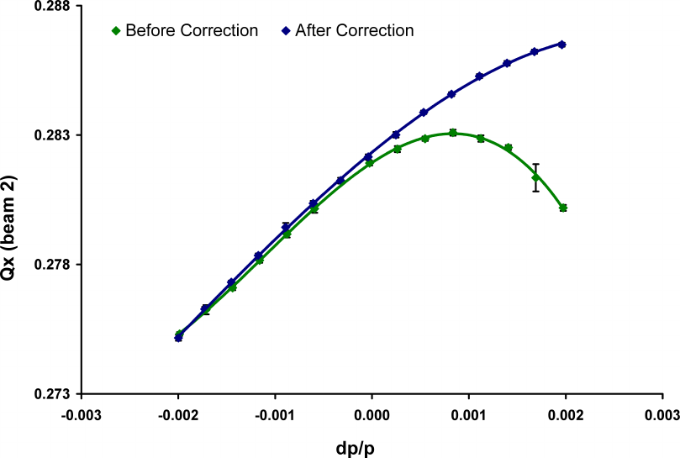
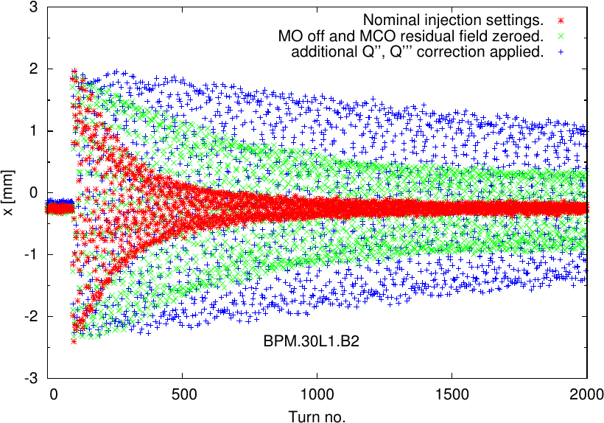
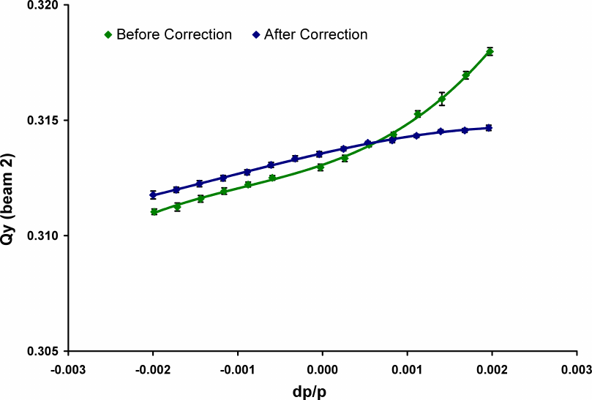
Q’’ & Q’’’ Correction - LHC 1/6
2012
2011
Horizontal
Nominal Machine
Vertical
E.H. Maclean, R. Tomàs, F. Schmidt, and T.H.B. Persson.

Slide 21
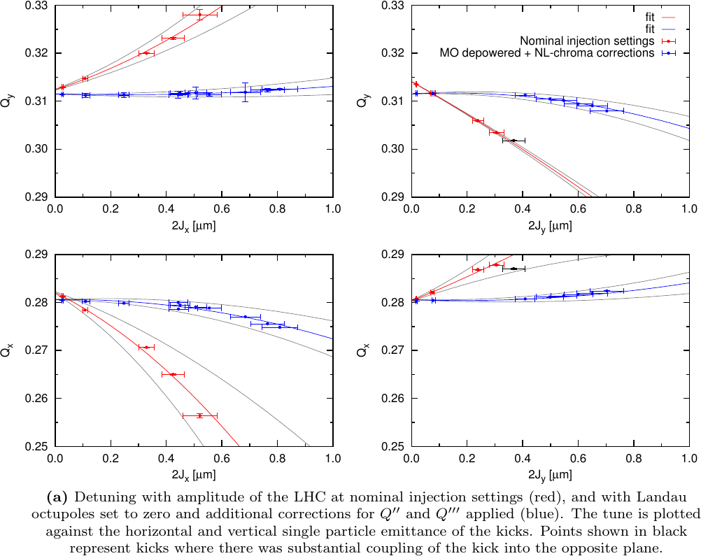
Detuning with Amplitude - LHC 2/6
Corrected Machine
Nominal Machine
E.H. Maclean, R. Tomàs, F. Schmidt, and T.H.B. Persson.

Slide 22
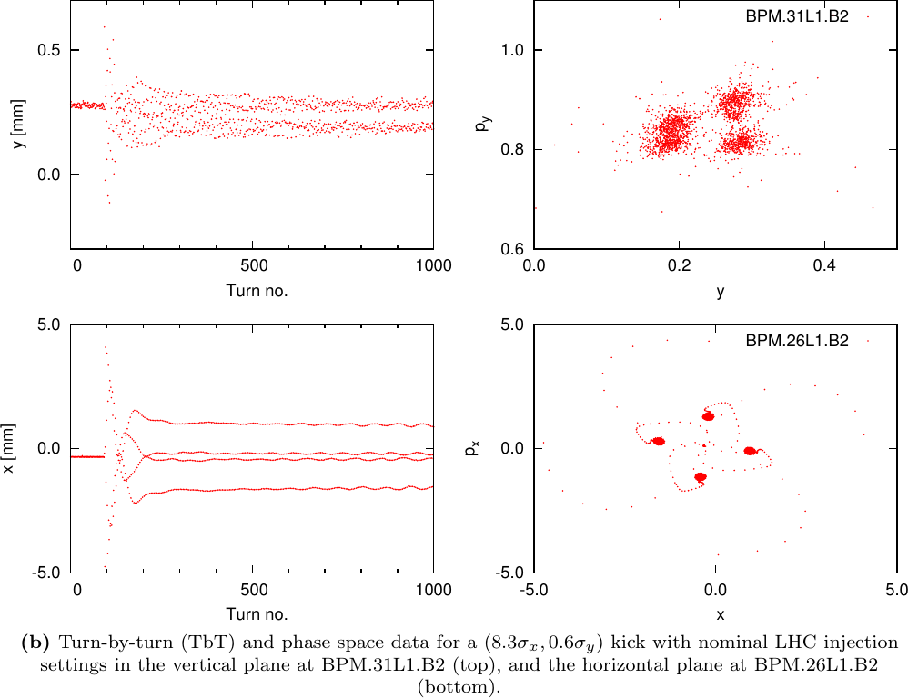
H&V Resonances - LHC 3/6
Nominal Machine
E.H. Maclean, R. Tomàs, F. Schmidt, and T.H.B. Persson.

Slide 23
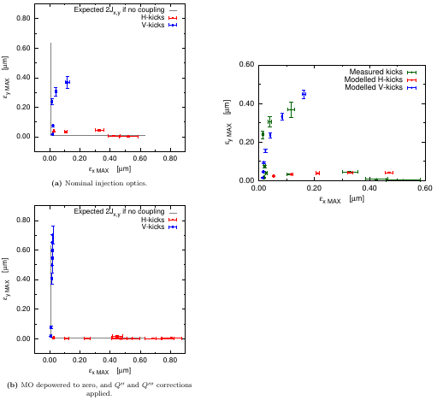
Non-Linear Coupling LHC 4/6
Non-Linear Effect
Nominal
Machine
Corrected Machine
Non-Linear Coupling
reproduced in Simulations:
Red/Blue: H & V Model
Green: Measurement
Lines Linear Expectation

Slide 24
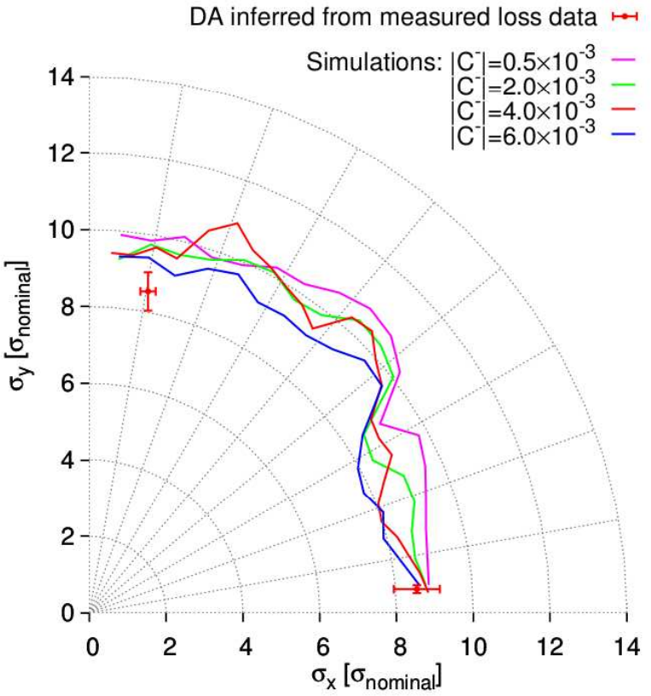
DA Nominal Machine - LHC 5/6
E.H. Maclean, R. Tomàs, F. Schmidt, and T.H.B. Persson.

Slide 25
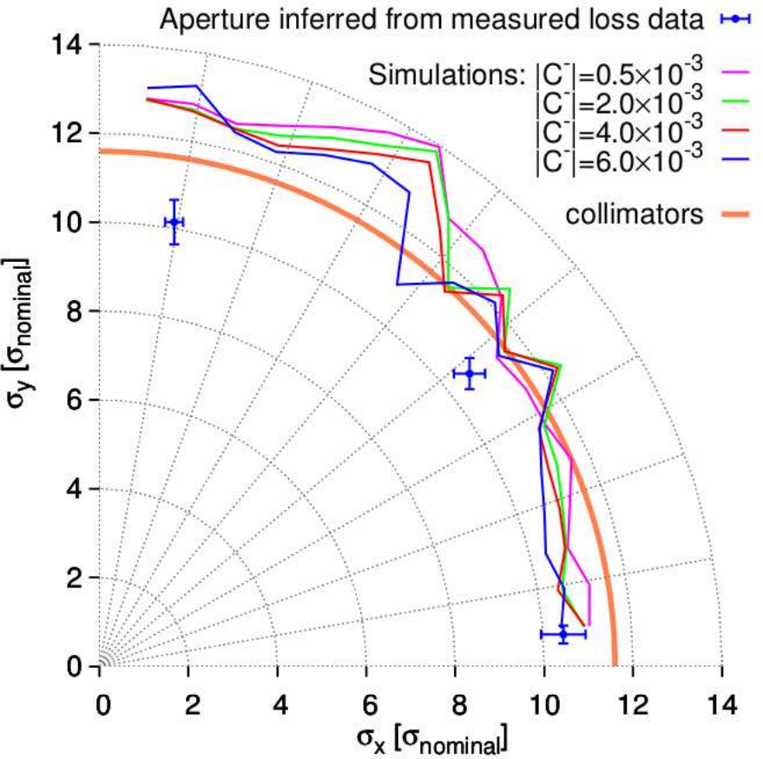
DA Corrected Machine - LHC 6/6
E.H. Maclean, R. Tomàs, F. Schmidt, and T.H.B. Persson.

Slide 26
Conclusion 1/2
After 30 years of simulations from HERA, SPS, Tevatron, RHIC to LHC we can conclude that our simulation tools are reliable.
In particular, we can perform any kind of massive simulation studies via distributed and scalable computing facilities.
The theoretical understanding is advanced enough to understand the non-linear dynamics caused by multipolar components. In particular, we understand single particle loss due to deterministic chaos.

Slide 27
Conclusion 2/2
The 2012 LHC DA experiment (Part II) using the classic kick technique allows to say that we can predict the DA to about 10% rather than the expected factor 2. Reasons are:
Excellent knowledge of multipolar components, magnet by magnet, including misalignments (Fidel & Wise)
Apparently the power supply ripple is under control
➔ This does increase our confidence in simulation studies for the HL-LHC.
We are waiting for confirmation from the PART I LHC DA experiment performed on BEAM1 with more modern techniques.

