Slide 1
Sorting of the LHC magnets and lessons learnt
S. Fartoukh, M. Giovannozzi
Introduction
The LHC in a nutshell
The LHC magnet sorting
Sorting results (selection)
  Arc magnets: main bends (MBs) and short straight sections (SSSs) (Q12-Q12)
  Insertion quadrupoles (Q4-Q11)
  Low-beta quadrupoles (Q1-Q3)
Lessons from LHC sorting exercise
Acknowledgements

Slide 2


Introduction - I
Sorting is any process of arranging
items according to a certain
sequence or in different sets, and
therefore, it has two common, yet
distinct meanings:
  ordering: arranging items of the same kind, class or nature, in some ordered sequence,
  categorizing: grouping and
  labeling items with similar
  properties together (by sorts).
From Wikipedia

Slide 3
Introduction - II
Magnet Sorting comprises both stages:
  categorizing: grouping magnets with similar properties together.
  ordering: arranging magnets from the various categories in some ordered sequence.
Beam dynamics specifies the figure-of-merit function to perform categorizing and ordering.
Magnets provides the best design possible and the best data for perform sorting.
Sorting requires that Beam Dynamics meets Magnets!

Slide 4
Introduction - III
  Magnet Sorting algorithms are affected by combinatorial explosion.
  In practice, each magnet class (e.g., main dipoles) are present in a number of hardware types, which reduce the number of possible combinations, but also the effectiveness of sorting.
  To perform an effective magnet sorting it is mandatory to act early in the construction phase, i.e., before characterizing the hardware for a specific machine location.
  Production rate and installation schedule are essential for an effective magnet sorting as they define the set of magnets available for sorting. A stock of magnets corresponding to 8 FODO cells is ideal.
  Magnet sorting acts on random variations of certain quantities, by reducing their spread. The smaller the random variations the less effective will be the sorting.

Slide 5
Introduction - IV
Properties useful for magnet sorting
  Magnet geometry → beam aperture
  Magnet alignment → beam aperture
  Transfer function → closed orbit (dipoles)
  → optics (quadrupoles)
  Field quality
  a₂ → linear coupling
  b₃ → chromaticity correction, off-momentum effects
  a_{n}, b_{n}, n ≥ 3 → resonances, dynamic aperture
Increased complexity in the evaluation of the beam dynamics quantity

Slide 6
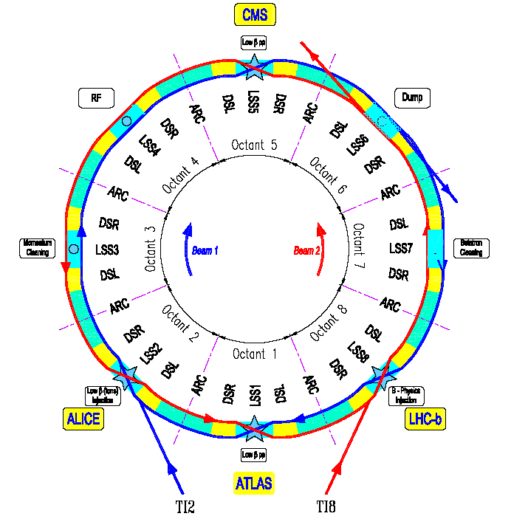
The LHC in a nutshell - I
The LHC machine has an height-fold symmetry.
Eight arcs (arc is the curved periodic part of the machine).
Sixteen dispersion suppressors to match the arc with the straight sections (geometry and optics).
Eight long straight sections (also called insertion regions).

Slide 7
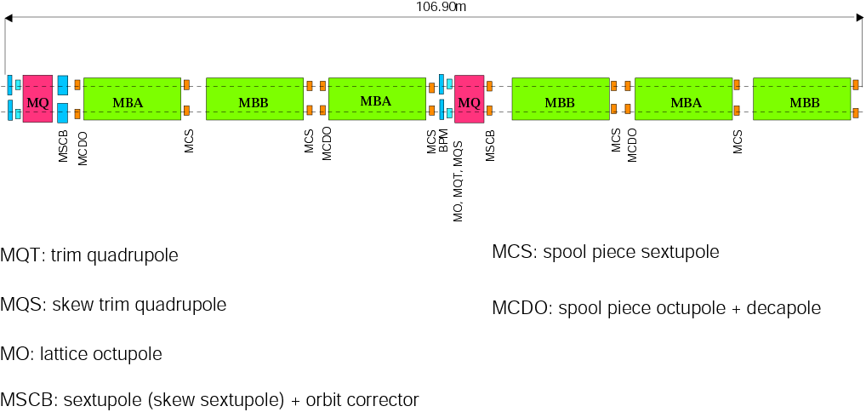
The LHC in a nutshell - II
H
beam
waist
V
silver
mid-cell
silver
silver
mid-cell
silver
Six dipoles are located in each cell. Each dipole comprises correctors:
  Sextupoles
  Octupoles and decapoles
Two quadrupoles are located in each cell. Each quadrupole is e quipped with:
  Beam Position Monitor
  Dipole corrector (for closed orbit)
  Sextupoles (for chromaticity)

Slide 8
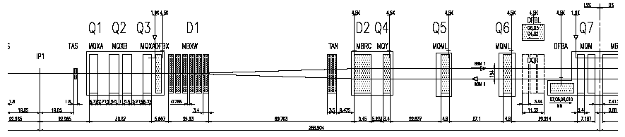
The LHC in a nutshell - III
Towards dispersion suppressor and arc
Separation/ricombination dipole
Absorber (neutral particles)
To be replaced for upgrade
Separation/ricombination dipole
Low-beta quadrupoles
Interaction point
High luminosity insertions

Slide 9
The sorting of LHC magnets - I
Past studies on magnet sorting focused on the dynamic aperture as figure-of-merit to define the optimal sequence.
For the LHC a different approach has been
selected, namely using
  Aperture (geometry and alignment)
  Transfer function
  Coupling
  Strength of 3rd order resonance
Dynamic aperture of a model of the LHC ring in physical space:
  The red points represent the initial conditions stable up to 10⁵ turns
  The blue points represent unstable conditions and their size is proportional to the number of turns by which their motion is still bounded.
Figure-of-merit of beam dynamics behaviour.

Slide 10
The sorting of LHC magnets - II
Two types of sorting:
  Large scale (superconducting magnets): main dipoles (1232) and quadrupoles (about 400).
  Small scale (superconducting and normal conducting magnets): insertion quadrupoles, separation dipoles.
  To note that insertion quadrupoles sometimes are made of more magnets in the same cryostat. Sorting of cold masses inside the same cryostat has been performed, too.
The Magnet Evaluation Board was the body that dealt with slot allocation of LHC magnets based on sorting, trying to
  Find suitable places (slots) for the available magnets that perform better than specified, as specified, or out-of-tolerance.
  Preserve and (if possible) optimize the machine performance.
  Include provisions to face day-to-day requirements.
  Follow the planned installation schedule.

Slide 11
MEB Workflow Diagram
Production
Stock
Board meeting
Presentation by Co-ordinator
Discussion by Experts
Electrical performance (quench/insulation/protection)
Geometry (V-lines/flanges)
Field quality
Slot proposal by Accelerator Physics experts, confirmed by Co-ordinator
Co-ordinator
+
Accelerator Physics experts (sorting)
magnet
ID card
Performance Assent report
Geometry report
NC report
performance
OK
Y
N
Installation
shift & roll
Accelerator Physics experts
Hold
+
Actions
Co-ordinator
Co-ordinator
Install OK

Slide 12

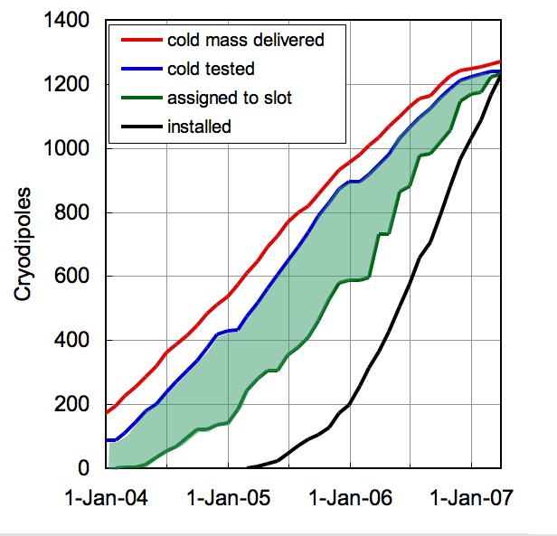
Slot allocation for MB’s
Most slotting took place in 2 years (2005 and 2006).
1232 dipoles of 4 hardware types
  diode L/R
  type A/B with or w/o octupole and decapole spool pieces
Working mode was drastically modified at the end of 2004 from manual assignment to semi-automatic assignment by batches to take profit from magnet production planning and availability on site.
A stock of 200 to 300 magnets was used for batch selection and local sorting (1 to 2 sectors at a time).
Sorting figure-of-merits: aperture and field quality.
Comfortable stock for sorting: maximum of 300 MB’s by end 2005, tapered down in 2006

Slide 13
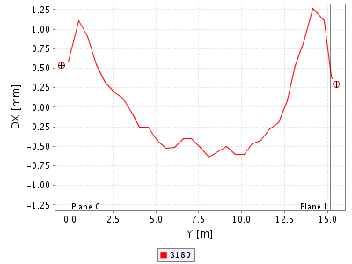
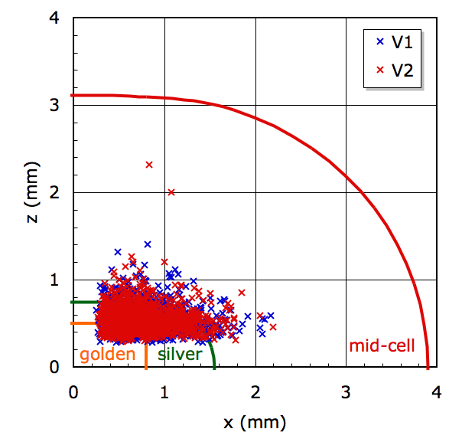
MB geometry sorting and gain
Proposals of S. Fartoukh and J.-B. Jeanneret, database implementation by E. Wildner et al.
Proceedings Of Chamonix XIII, p. 148
H
beam
waist
V
silver
mid-cell
silver
silver
mid-cell
silver
Geometry of as-built MB’s
Data courtesy of E. Wildner and P. Hagen
More non-silver magnets than allowed.
A bit less golden magnets than desired.
Approximately 500 MB’s required sorting to avoid loss of aperture at 1 mm level.

Slide 14
MB FQ sorting and gain - I
Algorithm devised by S. Fartoukh
Proceedings EPAC04, p. 176
Local sorting on geometry, transfer function, b₃, a₂ w.r.t average value per sector to:
  Ensure that the closed orbit can be corrected with < 30 % of the corrector strength (random b1).
  Control the driving terms of coupling resonance and vertical dispersion (random a2): up-down pairing at 2π.
  Minimize the driving terms of 3rd order resonance (random b3): up-down pairing of consecutive MBs.
Estimated standard deviation of b₃ at start of injection, and effective standard deviation of sorted pairs for each sector batch.

Slide 15
MB FQ sorting and gain - II
  Possibility to evaluate the beam dynamics quantities for the machine as-built. Hence, possibility to evaluate impact of sorting.
Beam 1
Beam 2
Impact of sorting on coupling and 3rd order resonance strength.
Selected generic seeds
Each sequence of errors is reshuffled.
The various dynamical quantities are computed.
Yellow: all seeds (initial and re-ordered)
Blue: selected seeds.

Slide 16
MB FQ sorting and gain - III
Beam 1
Beam 2
Impact of sorting on dynamic aperture.
Selected generic seeds
Each sequence of errors is re-ordered.
The various dynamical quantities are computed.
Yellow: all seeds (initial and re-ordered)
Blue: selected seeds.
Red: average DA for as-built machine.

Slide 17
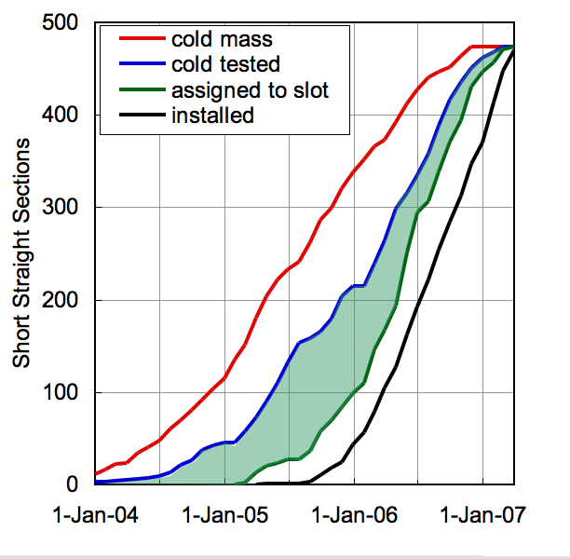
Slot allocation for SSS’s
The slot approval process was driven by the magnet availability after cold test and fiducialisation.
MEB slotting started about half-way into the production, reducing the sorting possibility.
Approval rate doubled in February 2006, as a result of global sorting of 4 sectors.
Partial re-shuffling of pre-allocated sectors was performed a few times to cope, e.g., with installation schedule changes.

Slide 18
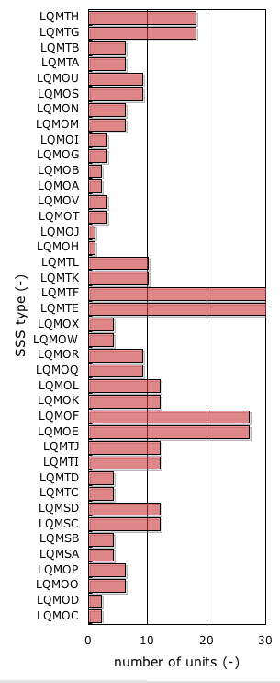
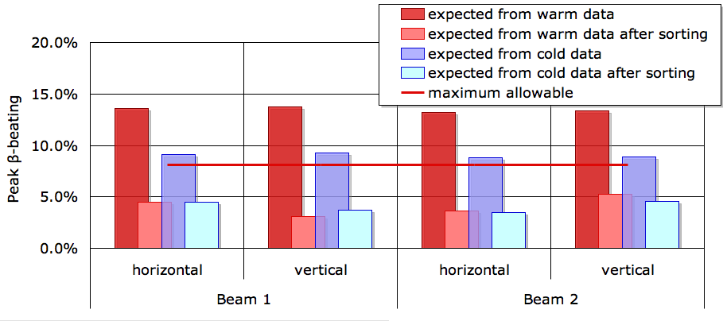
SSS sorting and gain
Algorithm devised by A. Lombardi and Y. Papaphilippou
Proceedings of EPAC06, p. 2017
SSS come in 61 different types, with reduced sorting possibility.
Batch selection and sorting is performed in advance to cold test, based on warm data (cold mass and collared coil): pairing at π/2 (or at 3π/2) magnets with similar TF.
The result of sorting was a pre-allocation, used for cold mass assembly and cryostating.
Installation shifts were based on geometric data taken after cold test: aperture under control.
Courtesy of Y. Papaphilippou
Catalogue by courtesy of M. Modena

Slide 19
Slot allocation for insertion quadrupoles
The discussion of the insertion quadrupoles at MEB was driven by the magnet production and installation schedule.
The approval was based on a one-by-one analysis of performance, aperture and field quality.
Sorting was very limited, but crucial:
  Current rating of weak magnets vs. required optics.
  Swapping of magnets based on aperture considerations.
  Local optimization of field quality for assemblies of several magnets.
Several cases resulted in requests for additional measurements (re-training and geometry).
To be noted:
  Transfer function and field quality essential for machine performance (beta-beating, squeeze, and dynamic aperture).
  Extended measurements required to ensure good knowledge of magnetic properties and hence, smooth operation.

Slide 20
Aperture in insertion quadrupoles
Dispersion suppressor:
  Limited aperture loss due to the tight optics in IR3 and IR7 (~0.6 σ)
Matching section:
  Marginal aperture loss due to the tight optics (~0.3 σ)

Slide 21
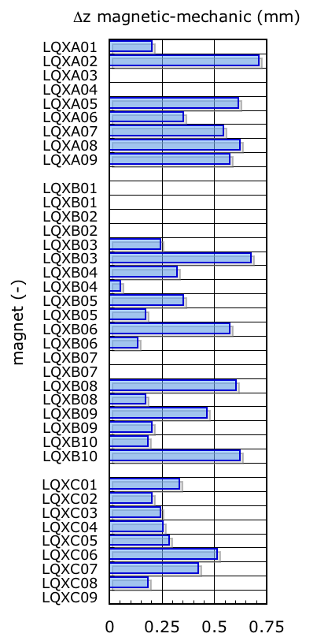
Low-beta quadrupoles
Sorting (within the constraints of hardware and magnet availability) was used to maximize the aperture.
Field quality is good, with good compensation between Q2a and Q2b.
Installation shifts (transverse and longitudinal) were chosen to:
  Reduce the feed-down and the required dipole corrector strength.
    Δz ≈ 1 mm magnetic offset at nominal conditions equals the MCBX correction capability.
    MCBX is quench and force limited.
  Achieve the required mechanical aperture.
  Limit the beta-beating induced by longitudinal positioning errors.
Alignment in all directions remains critical.
0.5
0.34
0.3

Slide 22
Lessons from LHC sorting exercise - I
From PAC 2007 paper, “Magnet Acceptance and Allocation at the LHC Magnet Evaluation Board”
Field quality
  The magnetic properties are under control (using sorting and compensation), the LHC should be at least as good as expected.
  The installation sequence was optimized to gain margin (limiting linear imperfections, required corrector strength, and low-order resonance driving terms).
Aperture
  The mechanical aperture has been preserved/kept at the target value of 8.4 sigma using sorting and installation shifts/rolls on most magnets as well as other passive elements (MKI, MKD, LE, DFB).
  Exceptions:
    Negligible aperture loss in arc quadrupoles (slots: 12/360).
    Modest aperture loss in insertion quadrupoles. A study is in progress to re-match the optics (slots: 8/64).
    Isolated insertion quadrupoles have larger aperture reduction. A study is in progress to re-match the optics (slots: 8/50).

Slide 23
Lessons from LHC sorting exercise - II
After the end of LHC Run I, i.e.
  Three years of full exploitation of the machine
  A final performance of
    Peak luminosity: 0.7×10³⁴ cm⁻² s⁻¹ (nominal 1×10³⁴ cm⁻² s⁻¹)
    Beta* in ATLAS and CMS: 60 cm (nominal 55 cm)
    Energy in collision: 4 TeV (nominal 7 TeV)
    Beta-beating in collision: 7% (expected 20%)
  A detailed series of measurements, e.g., mechanical aperture, optics, non-linear beam dynamics
The statement made at the end of MEB activity is certainly true! And even more…

Slide 24
A short digression - I
  High-luminosity upgrade aims at a performance increase by
    Improving beam parameters (current and brightness).
    Reducing beta* in the LHC.
  Recently, the ATS scheme (by S. Fartoukh) as been proposed to achieve small beta* with perfectly controlled chromatic properties of the lattice.

Slide 25
A short digression - II
  The principle of the ATS requires to increase the beta-functions in the arcs, thus possibly enhancing the harmful effect of the field quality of the main dipoles.
Impact of sorting on dynamic aperture for ATS optics.
Error bars represent the effect of different realisations of the random magnetic field errors.
Red: reshuffled sequence of dipoles.
Blue: sorted sequence of dipoles for as-built machine.

Slide 26
Lessons from LHC sorting exercise - III
Other comments:
  Detailed measurement programme (mechanical, geometry and magnetic properties) is an added value for
    Installation (sorting)
    Operation (field model)
  Magnet sorting is multi-disciplinary activity: it requires detailed preparation well before it is needed.
  Software infrastructure is essential (huge amount of data to be stored over a long time): it requires detailed preparation and long-term views.
  A core structure (team and infrastructure) should be kept alive even after completion of machine installation (magnets’ replacement, incidents, upgrades).

Slide 27
Acknowledgements
The Manifacturing and Test Folder database team (T. Pettersson, E. Manola-Poggioli, et al.) for the steady support of tools, reports, views.
The database responsible’s and services for magnetic data and alignment (L. Deniau, et al., P. Hagen, E. Todesco, et al.) for input to the sorting work.
The fiducialisation team for their competence and precision.
The cold test team supporting groups (L. Walckiers, et al.).
The many engineers, technicians, operators that have entered an overwhelming amount of data that we looked at, and thought we made sense of.
The Magnet evaluation Board members (P. Bestmann, L. Bottura, N. Catalan-Lasheras, S. Fartoukh, S. Gilardoni, M. Giovannozzi, J. B. Jeanneret, M. Karppinen, A. Lombardi, K.-H. Meß, D. Missiaen, M. Modena, A. Musso, R. Ostojic, Y. Papaphilippou, P. Pugnat, S. Ramberger, S. Sanfilippo, W. Scandale, F. Schmidt, N. Siegel, A. Siemko, T. Tortschanoff, D. Tommasini, E. Wildner) for the good time during the 169 meetings required to allocate all the LHC magnets.
Accelerator Beam Physics sorting team: MBs (S. Fartoukh), MQs (Y. Papaphilippou, A. Lombardi), insertion magnets (M. Giovannozzi), triplets (F. Schmidt), geometry (B. Jeanneret, global, and S. Gilardoni, MBs).

