Slide 1
Magnetic measurements:
an overview
Marco Buzio, CERN, Technology Department
Contents
1 – Introduction
Why to do magnetic measurements ?
2 – Overview of measurement techniques
General outline of methods, performances and limitations
Criteria for the choice of the best combination of instruments
3 – Instruments for accelerator magnets
NMR and Hall probes, fixed/rotating coils, stretched wires
4 – Conclusions

Slide 2
Acknowledgement
This talk is based on the results of many years of work of past and present members of the
Magnetic Measurement team:
Pasquale Arpaia, Anthony Beaumont, Jacques Billan, Ricardo Beltron, Luca Bottura, Didier Cornuet, Domenico Caiazza, Dominique Cote, Regis Chritin, Ernesto De Matteis, Vincenzo Della Selva,
Guy Deferne, Laurent Deniau, Olaf Dunkel, Lucette Gaborit, Peter Galbraith, Juan Garcia Perez,
Lucio Fiscarelli, David Giloteaux, Giancarlo Golluccio, Samira Kasaei, Mario Kazazi, Oliver Koester, Giuseppe Montenero, Daniel Oberson, Carlo Petrone, Vittorio Remondino, Stephan Russenschuck, Louis Walckiers
Notes:
Fields for accelerator magnets: confined volume, longitudinal = along the beam
choice = f(available resources, logistics)

Slide 3
Introduction

Slide 4
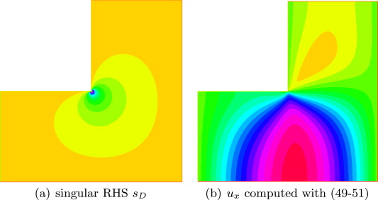
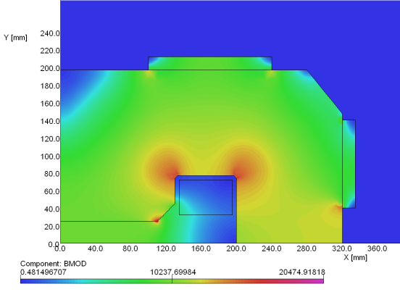
Computer simulations
Advantages
predict behavior without having the physical object (!!!)
fast and inexpensive (for relatively simple cases)
virtually unlimited resolution and precision
Limitations
partial physical model: including all couplings (thermal, mechanical) and phenomena (magnetostriction, magnetoresistivity …) that may be relevant is extremely expensive
off-nominal geometry: random assembly errors can dominate results; combinatorial explosion makes Monte Carlo prediction costly
material properties uncertainty : inhomogeneous properties cannot practically be measured throughout volume; even homogeneous material can be measured only within 2-5% typical accuracy
numerical errors: e.g. singularities in re-entrant corners, boundary location of open regions; these may spoil results. Special techniques (special corner elements, BEM) require skill and time
high cost of detailed, 3D models ∝ Δx^{2~3}, Δt⁻¹ (2D simulations OK, but not always sufficient)
field singularity → saturation
Computer simulation targeting ∼10⁻⁴ accuracy are difficult and expensive

Slide 5
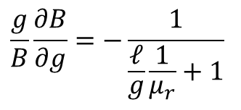
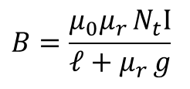
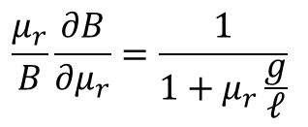
Impact of model uncertainties
Analytical 1D model (neglecting leakage and non-linearity),
typical accuracy 20~50%
$$B=\frac{μ_{0}μ_{r }N_{t}I}{𝓁+μ_{r }g}$$
impact of geometrical uncertainty
(mechanical tolerances, assembly errors)
impact of material property uncertainties
$$\frac{g}{B}\frac{∂B}{∂g}=−\frac{1}{\frac{𝓁}{g}\frac{1}{μ_{r}}+1}$$
$$\frac{μ_{r}}{B}\frac{∂B}{∂μ_{r}}=\frac{1}{{1+μ}_{r}\frac{g}{𝓁}}$$
μ_{r}= 10000
μ_{r}= 1000
μ_{r}= 100
μ_{r}= 10
μ_{r}= 1
μ_{r}= 10000
μ_{r}= 1000
μ_{r}= 100
μ_{r}= 10
μ_{r}= 1
10 μm gap error→ 10⁻⁴ field error at high field
5% μ_{r} error → 5⋅10⁻³ field error at low field (typical values)

Slide 6
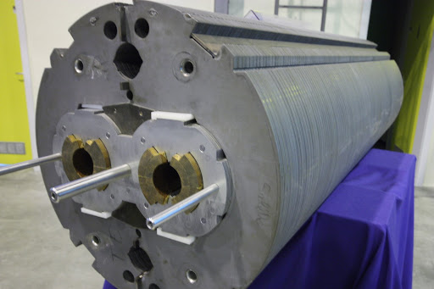
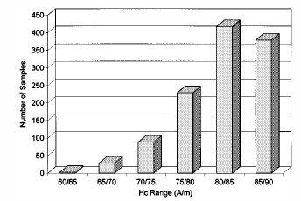
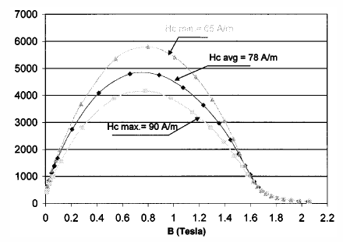
Material measurement uncertainty
40%
variation of the coercivity over 50 ktons of
MAGNETIL steel sheets for LHC cryomagnets
1%
Giuseppe Peiro et al., Toward the Production of 50 000 Tonnes of Low-Carbon Steel Sheet for the LHC Superconducting Dipole and Quadrupole Magnets, IEEE TRANSACTIONS ON APPLIED SUPERCONDUCTIVITY, VOL. 12, NO. 1, MARCH 2002
scatter over three ARMCO steel samples
taken from same batch
Courtesy Giuseppe Montenero, CERN
Add typical absolute uncertainties of permeability values up to 3∼5%

Slide 7
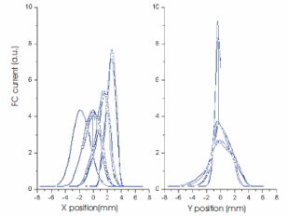
Beam-based measurements
Advantages
the beam sees all that’s relevant (by definition) in the actual operating conditions
only practical option to deal with the unexpected
Limitations
difficult interpretation: all effects integrated by the beam, unique inversion may not be possible
require very precise instrumentation (e.g. ppm tune measurements, 10-50 μm BPM), stable machine, as many correctors as possible, dynamic aperture and a well-known optic model
→ only non-linearities small enough not to cause beam lifetime issues can be measured
GFR corners cannot be explored well due to the finite size of the beam
very time consuming (e.g. LEP bump FFT took 2 months)
M. Giovannozzi et al., OPTICS STUDIES FOR THE CERN PROTON SYNCHROTRON: LINEAR AND NONLINEAR MODELLING USING BEAM BASED MEASUREMENTS, PAC 2003
proposed scheme for the measurement
of solenoid tilt angle in ISOLDE REX
M. Marchetto, BEAM DYNAMICS STUDIES ON THE ISAC II
SUPERCONDUCTING LINAC, LINAC 2006, Knoxville, USA
single bunch, RF energy perturbation measure Q(Δp/p)
PS lattice model fitted with nonlinear elements

Slide 8
Relative costs (qualitative)
All equipment already in place
(special cycles to be programmed)
machine development time is extremely costly !!
setup tests: R&D of specialized instrumentation, magnet and instrument installation/alignment, magnet transport, power supplies
test bench time is very costly (e.g. 5000 CHF/hour for cryogenic LHC magnets)
operator cost: 1-2 staff throughout tests
beam-based
measurements
total cost
lab measurements
simulations
(parametric, scripted)
detailed, validated 3D models may be extremely time consuming to setup (e.g.: many full PhDs for CERN PS magnets)
ideally, variations run without human intervention
setup 1 2 3 4 …
number of test cases

Slide 9
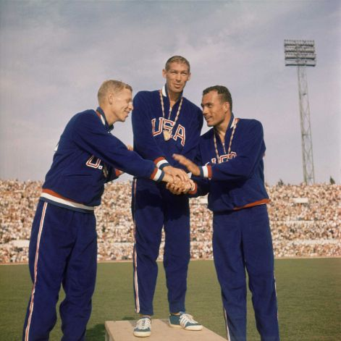
Synergies
Magnetic measurements and computer simulations:
a FE model validated by comparison with measurement, can be modified and run with confidence
measurement (preferably on simple geometries) → hard-to-predict average material parameters to plug in simulations (e.g. resistivity in a eddy current problem)
measurements OK for absolute values; relative differences (e.g. for) optimization are best done with parametric FE simulations
and also: calculations can also help to spot gross errors in measurements …
Magnetic measurements and beam-based measurements
magnetic measurements speed-up machine commissioning: get as much information as possible when it’s cheap to do so
beam studies may be mandatory when no alternatives are possible (no spare magnets, in-situ measurements not possible)
Notes:
complementarity

Slide 10
Overview
of measurement
techniques

Slide 11
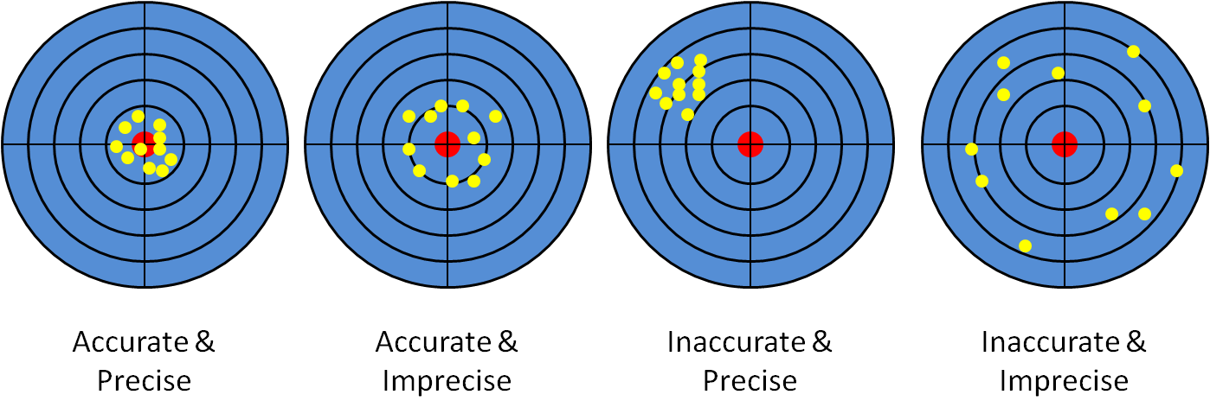
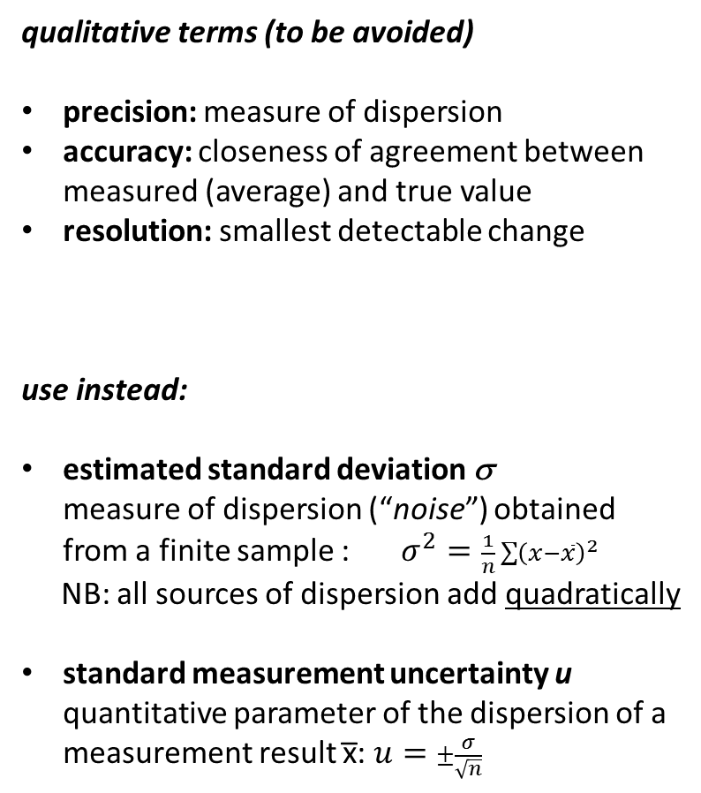
Metrology recap
qualitative terms (to be avoided)
precision: measure of dispersion
accuracy: closeness of agreement between measured (average) and true value
resolution: smallest detectable change
use instead:
estimated standard deviation σ
measure of dispersion (“noise”) obtained from a finite sample :$σ^{2}=\frac{1}{n}\sum{{\left(x−\overline{x}\right)}^{2}}$
NB: all sources of dispersion add quadratically
standard measurement uncertainty u
quantitative parameter of the dispersion of a measurement result x̅: $u=±\frac{σ}{\sqrt{n}}$
reproducibility error
random noise when test conditions change
(method, time, temperature, current cycles, operator …)
y (measured)
dy=(k+Δk)dx
Δk = gain error
repeatability error
random noise in the same test conditions
linearity error
systematic
error (unknown!)
difference between true and measured
y=kx
k= ideal sensitivity
y₀
bias (systematic offset)
x (true)
Reference: ISO GUM (Guide to the Expression of Uncertainty in Measurement)
Notes:
precision often confused with accuracy

Slide 12

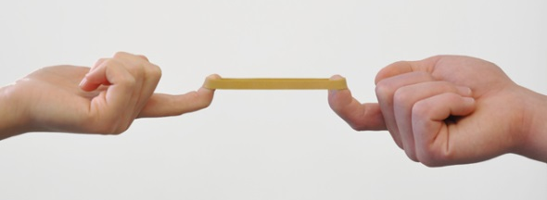
Instrument selection
Criteria for instrument selection (in order of priority)
Compatibility with field level/gradients (could not work at all!)
Transverse size (it must fit, and should reach as wide as possible)
- accuracy of harmonics degrades with transversal size
- extrapolation can be applied, at a cost
Bandwidth (it must see a signal)
sensitivity decays at the bounds
Longitudinal size (do we want integral or profile)
- the integral can be computed by scanning longitudinally (time-consuming)
- de-convolution of longitudinal scans done with a longer probe → low-pass filter, noise
Accuracy
uncertainty can be reduced by repetition, changing orientation, cross-checks …
Result format: harmonics vs. uniformity
can be translated into one another, with caveats
Practical considerations: cost, measurement time,
output signal format, cabling length,
availability of trained personnel …
Notes:
Hard constraints vs. elastic

Slide 13
Typical performance of B measurement techniques
Method | Type¹ | Range [T] | u² [-] | BW³ [Hz] | Cost⁴ [€] | Size⁵ [mm] | Length⁶ [mm] | Notes
SQUID | V | 10⁻¹⁴∼10⁻⁴ | 10⁻⁵ | DC∼10⁰ | 10³ | < 1 | < 1 | Highest sensitivity, needs cryogenics
Fluxgate | V | 10⁻⁷∼10⁻² | 10⁻² | DC∼10³ | 10² | 3 | 10 | Main application: geomagnetic fields
Fiber optic | V | 10⁻¹²∼10⁻³ | 10⁻⁶ | DC∼10² | 10⁴ | 30 | 100 | Magnetostrictive sample deformation detected by Mach-Zender interferometer
M-optical | V | >10⁻⁴ | 10⁻² | DC∼10⁹ | 10³ | >100 | >100 | Faraday effect (rotation of polarization). Extreme BW, compatible with extremely high fields
M-induction | V | 10⁻⁶∼10⁻³ | 10⁻² | DC∼10³ | 10⁰ | 5 | 5 | Used for low-power compass devices in GPS, smartphones … Digital out, T-insensitive
M-resistance | V | 10⁻⁹∼10⁻³ | 10⁻² | DC∼10⁹ | 10¹ | < 1 | < 1 | GMR sensor vital for magnetic recording industry; non-linear
M-diode | V | 10⁻⁵∼10¹ | 10⁻¹ | DC∼10⁴ | 10¹ | < 1 | < 1 | High sensitivity = 10x Hall, non-linear
M-transistor | V | 10⁻⁶∼10⁰ | 10⁻¹ | DC∼10⁴ | 10¹ | < 1 | < 1 | Very high sensitivity = 100x Hall, non-linear
Hall effect | V | 10⁻⁵∼10² | 10⁻³ | DC∼10⁴ | 10³ | <1 | <1 | Higher low-prec BWsimple, cheap, commercially available accuracy requires laborious calibration
Fixed coil | V | >10⁻¹² | 10⁻⁴ | 10⁻²∼10⁶ | 10⁴ | 5∼500 | 1 mm ∼ 10 m | Linear, sensitivity increases wth BW
Rotating coil | V | >10⁻¹² | 10⁻⁴ | DC∼10¹ | 10⁴ | ∅8-400 | 1 mm ∼ 2 m | Best all-round performer for accelerator magnets
Translating wire | V | >10⁻³ | 10⁻⁴ | DC | 10⁴ | ∅0.1 | < 20 m | Classical system
Oscillating wire | V | >10⁻³ | 10⁻³ | DC | 10⁴ | ∅0.1 | < 20 m | Ongoing R&D
NMR | S | 10⁻⁵∼10² | 10⁻⁶ | DC∼10⁰ | 10⁴ | 10 | 10 | Low field range only with custom flowing/water method
FMR/EPR | S | 10⁻⁸∼10⁻¹ | 10⁻⁴ | DC∼10³ | 10⁴ | 40 | 40 | Experimental
Optical pump | S | 10⁻⁵∼10⁻⁴ | 10⁻⁶ | DC∼10¹ | 10⁴ | 100 | 1 m | Based on Zeeman effect in Rb, Ce Best resolution: 10 pT
(1) V=vector, S=scalar (2) u=typical uncertainty (3) bandwidth (4) system cost (5) transversal sensor size (6) sensor size along the beam direction
Notes:
Typical ranges (power important for handheld or embedded application)

Slide 14
Select instrument by size
(mm)
Fixed coils
Rotating
coils
FMR
NMR
Hall
sensor
Stretched wires
(mm)

Slide 15
Select instrument by field range and uncertainty
(-)
NMR
FMR
Stretched wires
Fixed/rotating coils
Hall sensor
(T)

Slide 16
Magnetic
Resonance

Slide 17
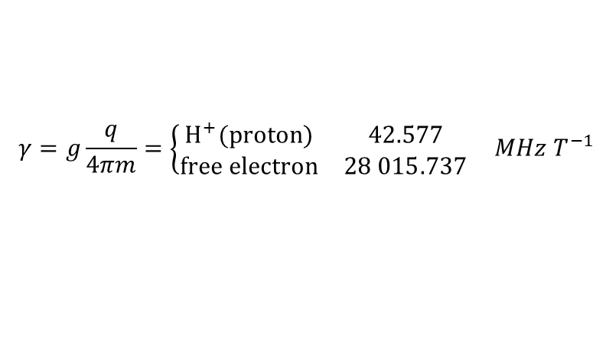

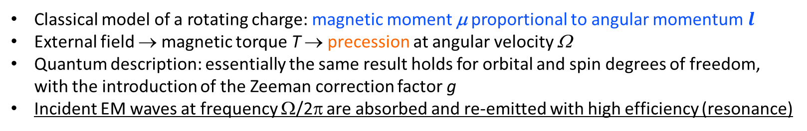

Magnetic resonance
Classical model of a rotating charge: magnetic moment μ proportional to angular momentum$l$
External field → magnetic torque T → precession at angular velocity Ω
Quantum description: essentially the same result holds for orbital and spin degrees of freedom,
with the introduction of the Zeeman correction factor g
Incident EM waves at frequency Ω/2π are absorbed and re-emitted with high efficiency (resonance)
B
T (magnetic torque)
$$μ=IA=\frac{1}{2}q{ωr}^{2}=\frac{q}{2m}l$$
precession velocity Ω
μ (magnetic moment)
gyromagnetic ratio γ
$$T=μB=Ωl$$
angular velocity ω
r
charge q
mass m
$$γ=\frac{q}{2m}=\frac{μ}{l}=\frac{Ω}{B} rad s^{−1}T^{−1}$$
NMR (Nuclear Magnetic Resonance)
γ constant to better than 1 ppm
$$γ=g\frac{q}{4πm}=\left\{\begin{matrix}H^{+}(proton) & 42.577 \\ free electron & 28 015.737\end{matrix}\right. MHz{ T}^{−1}$$
EPR/ESR (Electron Paramagnetic/Spin Resonance), FMR (FerriMagnetic Resonance)
actual value in materials depends on: chemical composition, temperature …
Notes:
No EPR/ESR/FMR teslameters in commerce; custom application at CERN as a marker

Slide 18
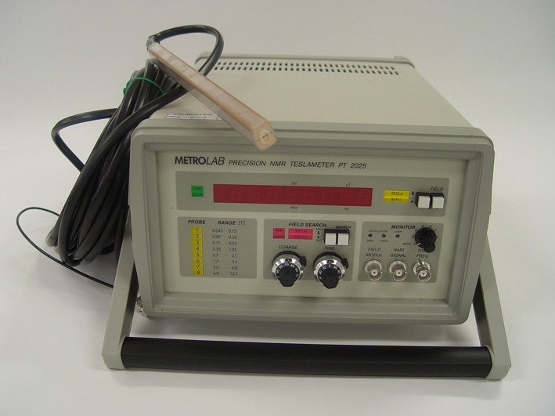
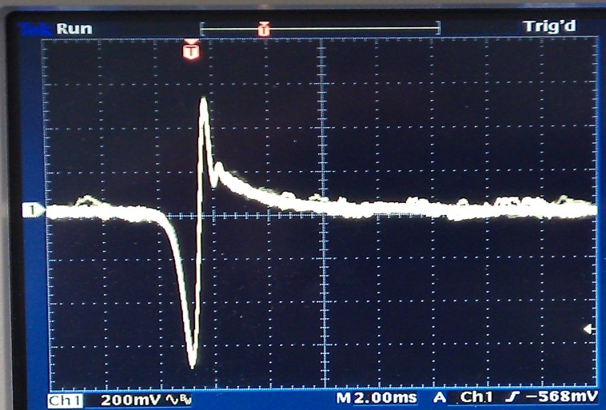
Metrolab NMR Teslameter
Metrological reference for ||B|| used as a calibration standard for uniform fields (σ = 0.1 ppm, u=5 ppm)
Major limitations:
lowest field level 430 G (lower range possible with flowing water NMR, no commercial solutions)
max. tracking rate 1%/s (4.5 G/s @ 450 G)
max. field gradient for tracking 2%/m (10 G/m @ 450 G)
∼ 10 μT
demodulated RF output in “marker mode”
f₀
B(t)
B₀=γf₀
Courtesy www.metrolab.com
Notes:
Avg on sensor volume

Slide 19
Hall effect
sensors

Slide 20
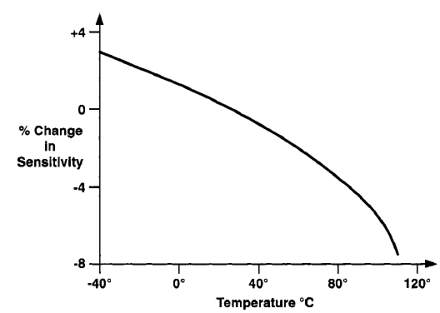
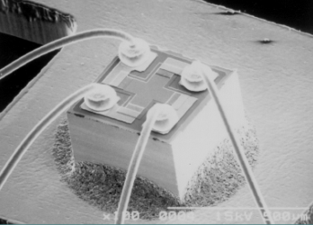
Hall effect sensors
Widespread sensor based on a semiconductor plate (Si, InAs, InSb, GaAs)
Charge carriers separate under the effect of Lorentz forces → Hall voltage V_{H}
Pros: small (→ field maps), rugged, cheap, easy to use
Cons: non-linearity, sensitivity and offset drifts with temperature, sensitivity to in-plane field components → frequent calibration needed, thermal compensation or stabilization desirable
$$V_{H}=V_{0}+GR_{H}(B)IB\cos{θ} +P_{H}(B)IB\sin{θ}$$
typical non-linearity
0.5%-2%
planar Hall coefficient
(1∼2% error if uncorrected)
offset due to:
geometrical asymmetry,
piezoresistive effects
drifts randomly due to T, ageing
geometric
factor
sensitivity (material parameter)
depends reproducibly upon T
typical values: 50-1000 mV/T

Slide 21
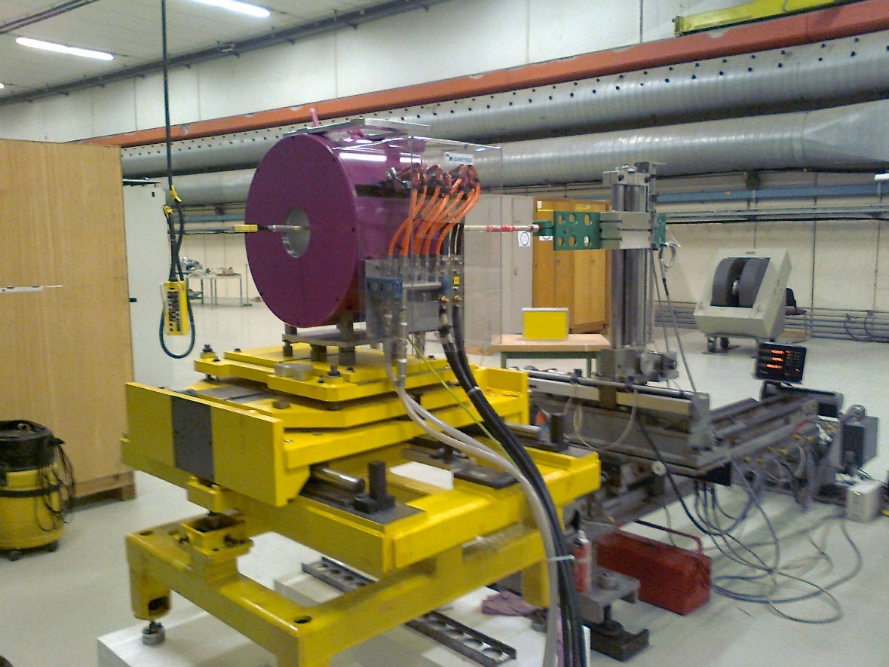
Hall-based instruments
  Hall head
  3D Teslameter based on 3x Hall probe sensors
  (typically 1% absolute uncertainty)
  3D/3D hall probe mapper
  rotating hall probe
  polarity checker
  (high tolerance !)
  b3/b5 probe: based on rings of fixed Hall plates
  1 kHz local harmonic decay and snapback in SC magnets

Slide 22
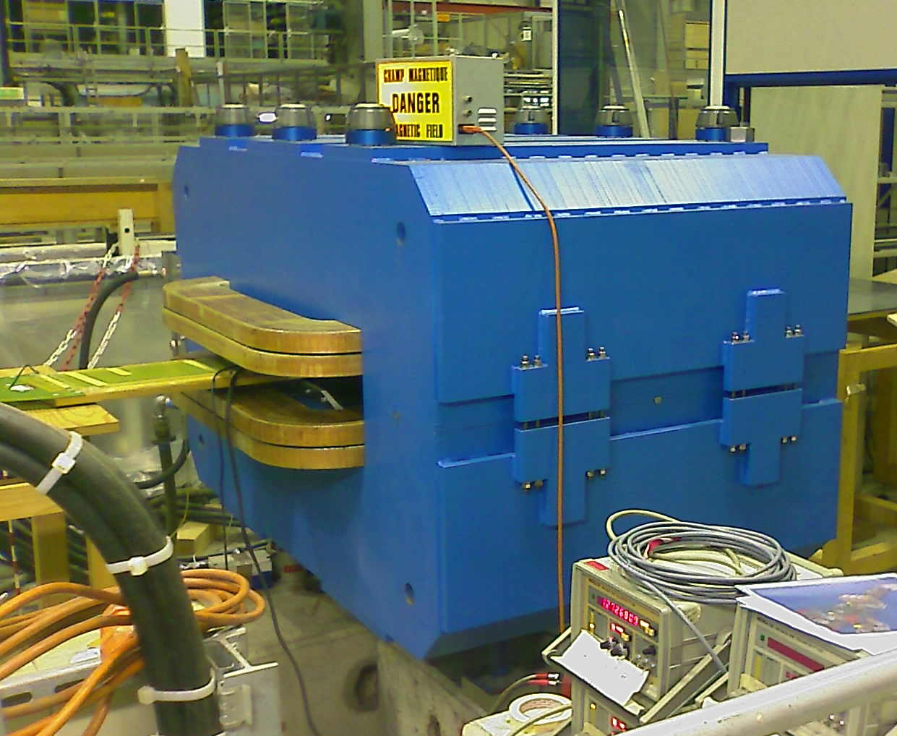
Example of results: fringe field of a resistive dipole
B < 1 mT
externally to iron yoke
1.5 T inside
5 mT @ 260 mm outside

Slide 23
Practical considerations
Typical applications
“Quality Assurance” checks
∼ few % accuracy acceptable to spot gross errors
field polarity
much easier to verify than with rotating coils
detailed maps of gradient field zones such as:
magnetic lenses, fringe field of bendings, dipoles with large harmonic errors, spectrometers …
works where NMR does not work (need overlap for calibration)
Caveats
sees local effects (< 1 mm²) → integrals require many points
small size → precise mechanical alignment is difficult
uncertainty < ∼10⁻³ requires rigorous and time-consuming calibration, T control, mechanics
AC measurements affected by errors unless special techniques are used (powering, wiring …)
Notes:
QA = not true MM

Slide 24
Fixed and rotating
search coils

Slide 25
Search coils
  Workhorse of CERN instrumentation park: most accurate and cost-effective method
  Size, effective surface, number of turns, resistance, assemblies … must be adapted to the specific requirements of each magnet → no commercial solution, (traditionally) in-house winding
  Main parameter: total area exposed to flux change Ac, which determines the peak
  induced voltage (dictated by electronics, typically ±5 or ± 10 V)
Faraday’s Law (total derivative)
+ Lenz Law (energy conservation)
fixed-coil,
time-varying field
coil rotating,
translating or deforming
(stretched wire)
Fixed coil in a time-varying field
Coil rotating at angular speed ω in stationary, uniform field
Coil translating at speed v in stationary field with gradient ∇B
  Main advantages
  inherently linear sensor w.r.t. B
  sensitivity increases with frequency (attention to self and parasitic L, C)
Notes:
or induction/flux coil

Slide 26
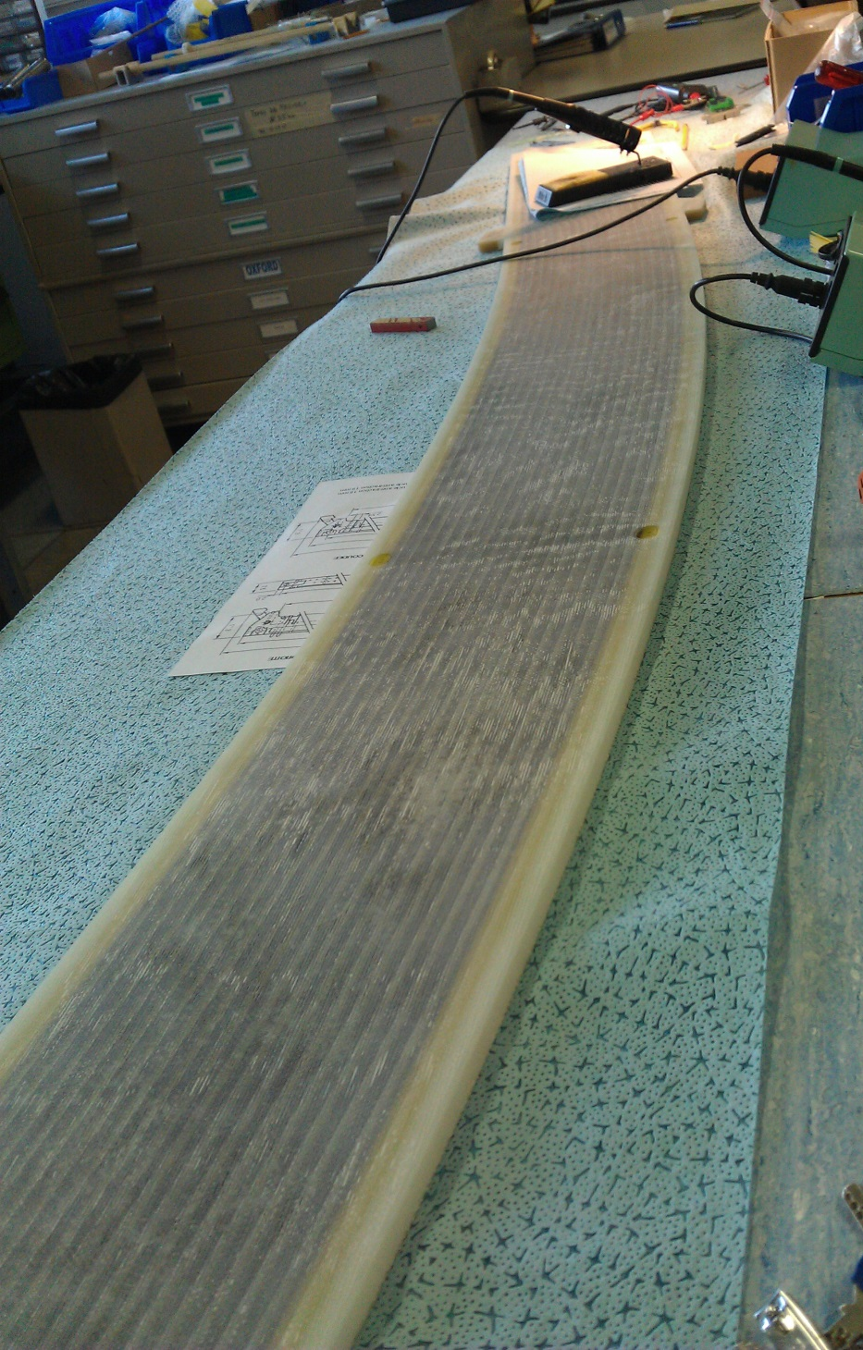
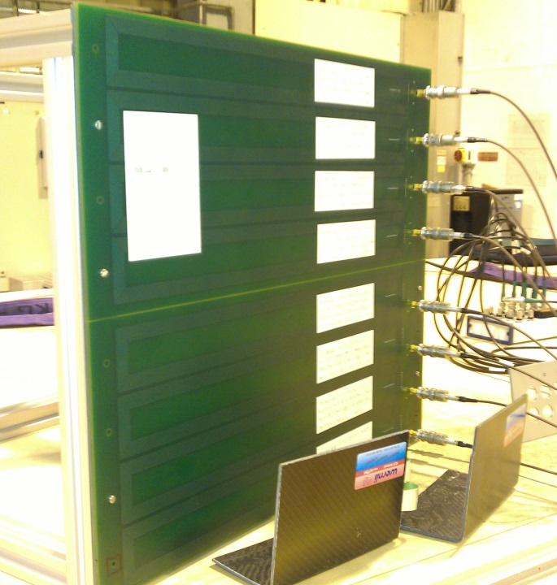
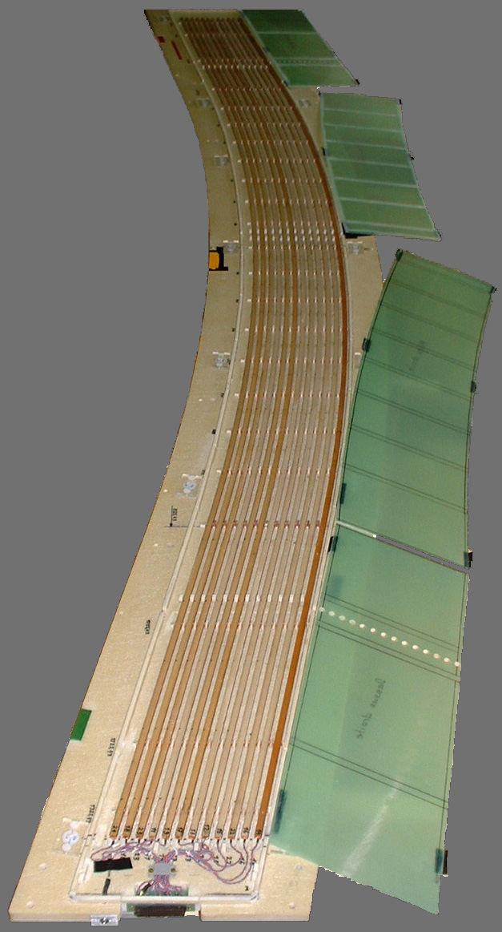
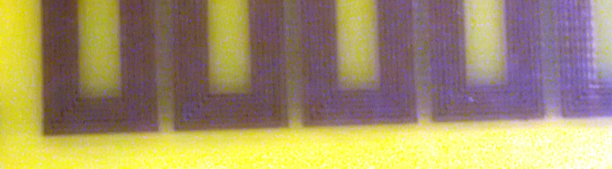
Fixed coils (fluxmeter)
Natural solution to measure AC fields over large areas
Arrays measure field quality in one go
PCB technology for inexpensive, precise large series runs (but: lower winding density, high resistance)
Absolute calibration requires adequately sized reference magnet → often impossible
Relative calibration OK for ∫Bd measurements
  2-part PCB fluxmeter for the integrated field strength and
  homogeneity of MedAustron dipoles
  AC fluxmeter for current centroid localization of ITER TF coils
  bent-coil integrated field strength and homogeneity fluxmeter for CNAO dipoles

Slide 27
Rotating coils
    Rotating coils: yield simultaneously field strength, quality (harmonics), direction and center
2D ideal rectangular rotating
coil geometry
integration constant: lost with fixed coil measurements,
irrelevant (unphysical) for rotating coils
integration bounds
set by precise angular encoder
→ rotation speed fluctuations
have negligible effects
measured flux depends
on both the field
and coil geometry
Discrete sampling of flux → Fourier components → field harmonics

Slide 28
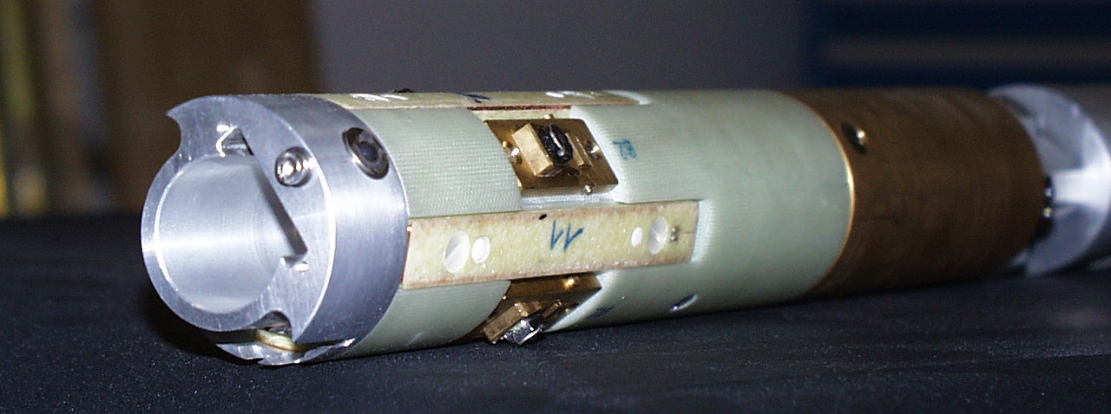
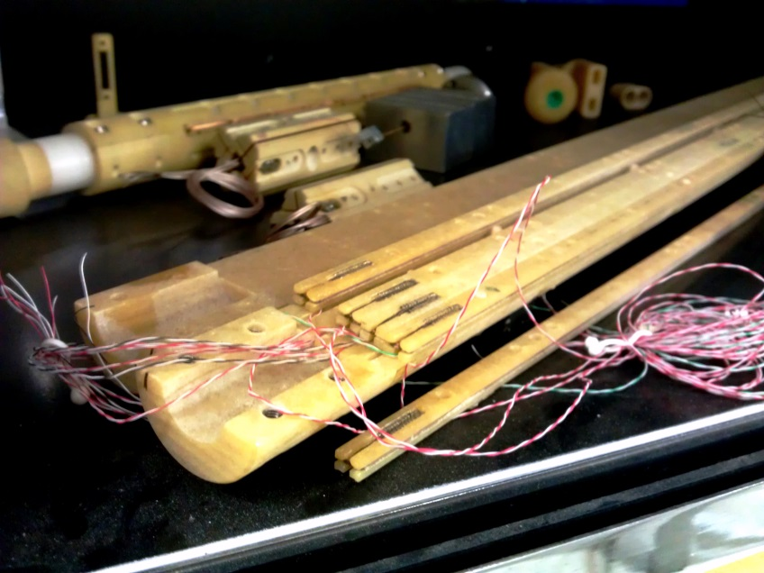
Rotating coil types
  Tangential coils:
  higher signal for the same area
  (the coil moves on the boundary of the convergence domain)
  blind spot; difficult to align precisely
  Radial coils
  easier to build and to calibrate
  sensitive to all harmonics

Slide 29
Coil sensitivity factors
All coefficients can be calculated from coil length L, width w and radius R₀
All coefficients proportional to total coil area A_{c}=N_{T}Lw
All coefficents increase like radius R₀^{n-1}

Slide 30


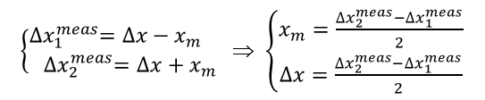
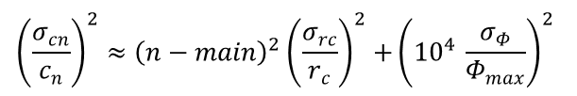
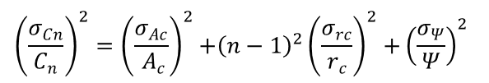
Random and systematic errors of rotating coils
  Propagation of random errors
  absolute harmonic coefficients:
  relative uncertainty:
  normalized harmonic coefficients:
  relative uncertainty:
  Systematic axis offset correction
Fourier component of the flux
$C_{n}=\frac{2}{N}r_{ref}^{n−1}\frac{Ψ_{n+1}}{{ A}_{c}r_{c}^{n−1}}$ [T @ r_{ref} ]
Coil area
Coil rotation radius
$${\left(\frac{σ_{Cn}}{C_{n}}\right)}^{2}={\left(\frac{σ_{Ac}}{{ A}_{c}}\right)}^{2}{+{\left(n−1\right)}^{2}\left(\frac{σ_{rc}}{r_{c}}\right)}^{2}{+\left(\frac{σ_{Ψ}}{Ψ}\right)}^{2}$$
∼ 10⁻⁴
10⁻³ ∼ 10⁻⁴
dominant term for higher harmonics
10⁻³ ∼ 10⁻⁴
$c_{n}={10}^{4}\frac{C_{n}}{C_{main}}$ [units @ r_{ref}]
$${\left(\frac{σ_{cn}}{c_{n}}\right)}^{2}≈{{\left(n−main\right)}^{2}\left(\frac{σ_{rc}}{r_{c}}\right)}^{2}{+\left({10}^{4 }\frac{σ_{Φ}}{Φ_{max}}\right)}^{2}$$
$\left\{\begin{matrix}{∆x}_{1}^{meas}=∆x−x_{m} \\ {∆x}_{2}^{meas}=∆x+x_{m}\end{matrix}\right.$⇒ $\left\{\begin{matrix}x_{m}=\frac{{∆x}_{2}^{meas}−{∆x}_{1}^{meas}}{2} \\ ∆x=\frac{{∆x}_{2}^{meas}−{∆x}_{1}^{meas}}{2}\end{matrix}\right.$
no impact of A_{c}
10⁻³ ∼ 10⁻⁴
dominant term for higher harmonics

Slide 31
Effective coil width
B
s
w
average coil width
weighted with the field
L
L can be considered as known from mechanical measurements
The flux corresponding to a given coil position can be obtained in various ways (flipping or rotating the coil, pulsing the field from zero) (NB: same consideration for a dipole or any other multipole)
Unless B(s) or w(s) are constant and can be taken out of the integral sign, the flux cannot be obtained from average width and average field:
The calibration of a coil depends on the profile of the field being measured

Slide 32
Practical considerations
Advantages
provide directly integrated field as required by most beam applications
complete 2D field characterization in the volume defined by the spanned boundary:
strength, multipoles, axis and direction
quick: one rotation i.e. 0.1~1 s is (in principle) sufficient
bucking (i.e. using coil arrays to cancel n≤n_{main} harmonics) → high accuracy higher order harmonics despite torsional/flexural mechanical imperfections
Drawbacks
Not commercially available, in-house winding (or PCB design) required
expensive complex mechanics (encoder, motor) and top-quality electronics (digital integrators, programmable amplifiers) necessary to get good results
not well suited to strongly curved, or large aspect-ratio gap magnets
(slowly) time-varying fields can be measured, but demand complex post-processing

Slide 33
Stretched-wire
systems

Slide 34
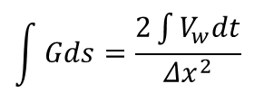
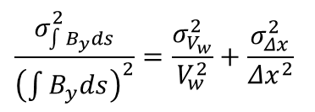
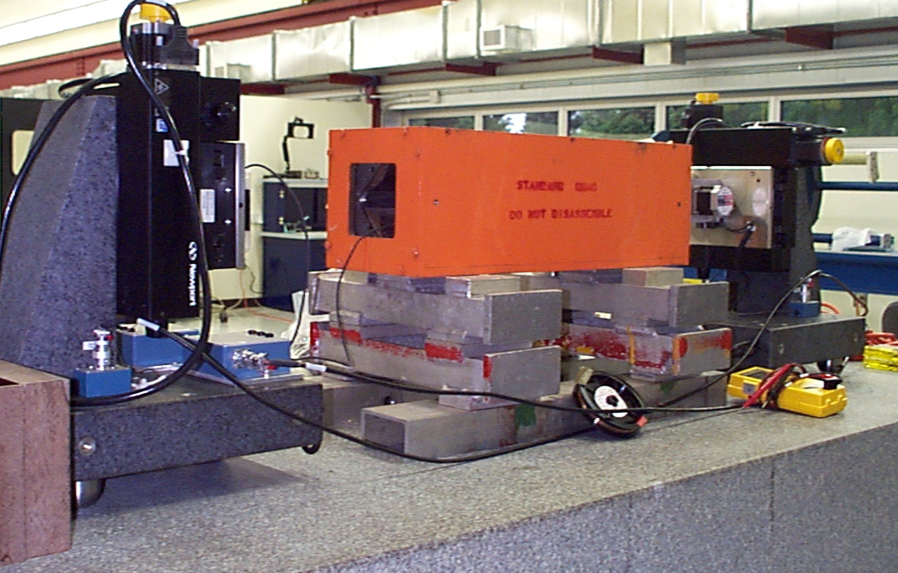
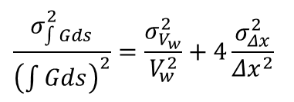
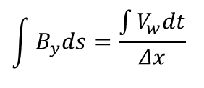
Single Stretched Wire
J Di Marco’s (FNAL) SSW System
3 units used at CERN for LHC test campaign
0.1 mm single CuBe wire moved by 2× XY translation stages with μm resolution
Geometrical reference provided by retro-reflector optical targets
Variable wire tension to measure and compensate sag effects
FFT detection of flux linked by AC field source greatly enhances sensitivity (warm SC magnets)
Example of random error estimation:
integrated dipole
integrated gradient
$$\frac{σ_{\int{B_{y}ds}}^{2}}{{\left(\int{B_{y}ds}\right)}^{2}}=\frac{σ_{V_{w}}^{2}}{V_{w}^{2}}+\frac{σ_{Δx}^{2}}{{Δx}^{2}}$$
$$\int{Gds}=\frac{2\int{V_{w}dt}}{{Δx}^{2}}$$
$$\frac{σ_{\int{Gds}}^{2}}{{\left(\int{Gds}\right)}^{2}}=\frac{σ_{V_{w}}^{2}}{V_{w}^{2}}+4\frac{σ_{Δx}^{2}}{{Δx}^{2}}$$
$$\int{B_{y}ds}=\frac{\int{V_{w}dt}}{Δx}$$
wire
displacement
wire
voltage
10⁻⁴
10⁻³ ∼ 10⁻⁴
wire
voltage

Slide 35
Practical considerations
Advantages
unique flexibility: the same sensor adapts to any size, shape and length of magnet gap
(limited by the range of the translation stages)
unique capability to measure longitudinal center + pitch and yaw axis angles in lenses and solenoids (counter-directional wire movements)
unique sub-micron sensitivity for axis localization in vibrating mode at resonance
metrological reference for integrated field strength, axis and direction in high-field magnets
Very promising ongoing R&D:
- integrated harmonics in vibrating mode
- longitudinal field profiles from measurements in vibrating mode at multiple frequencies
Limitations
Equivalent to 1 turn-coil only → low sensitivity of field integrals in short/weak magnets
(but: complex multi-wire implementations have been done)

Slide 36
Conclusions

Slide 37
Summary of main points
Magnetic measurements are an essential part of the magnet qualification process, in complementary fashion to coputer simulation and beam measurements
No single instrument or method can cover all requirements
Very little available commercially – be prepared for R&D
Precise mechanics, stable materials, heavy benches are the foundation of good instruments
Multiple instruments are complementary + overlaps provide estimation of absolute uncertainty
Many trade offs: bandwidth for sensitivity, time for accuracy, time for spatial resolution …
Different strategies for error correction:
- (if possible) optimize critical parameters at design time e.g. rotating coil radius
- random errors are reduced by repetition
- systematic errors are reduced cross-checks and by the use of symmetries
Notes:
Take-home message

Slide 38





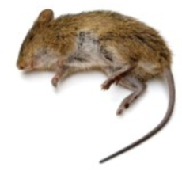

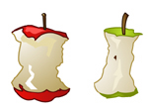
What accuracy shall I serve sirs ?
The best
you can do !
0.15 mm RMS for the axis,
6⋅10⁻³ at 2 σ for ∫Bd
10⁻⁴ !
Guess who will get the best service …
Notes:
Take-home message

