Slide 1
Simulations of supersonic beams by means of open source packages:
recent results for H₂ and prospective studies
Gianangelo (Nino) Bracco & Renzo Parodi
Department of Physics & INFN
University of Genoa, Italy
HP3: Future Jet Meeting, SMI Vienna, April 18-19, 2013

Slide 2
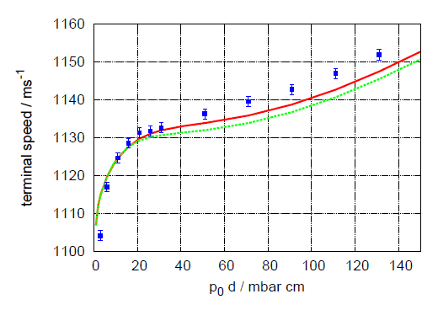
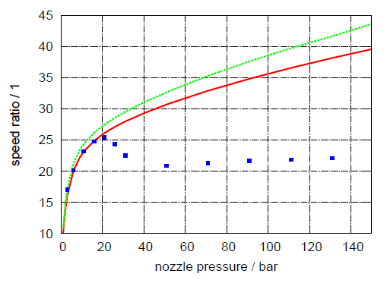
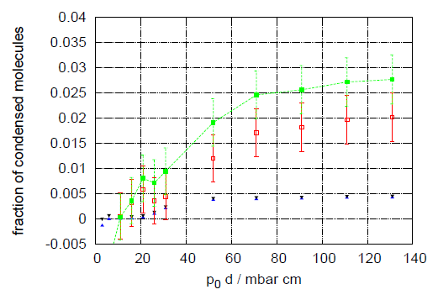
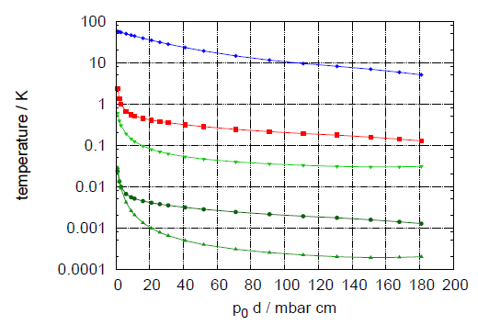
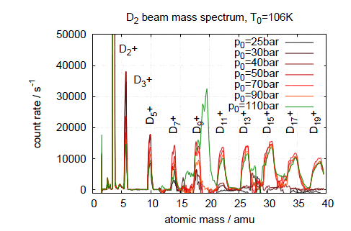
Model: solution of the Boltzmann eq.with the method of moments
Result obtained with: real gas enthalpy, approx: spherical symmetric expansion, monoatomic gas.
D₂: T=106 K
Enthalpy released during condensation

Slide 3
Sonic nozzle
Laval nozzle
Spherical symmetric expansion
Spherical symmetric expansion
Possible solution through a continuum approach: Navier-Stokes equations of hydrodynamics, equations obtained starting from the Boltzmann equations
Mass conservation
Conservation of momentum, τ is the stress tensor related to the fluid viscosity μ
Conservation of energy
Commercial as well as open source software programs can solve NS equations, sometimes with limitations to incompressible flow
Fluent(ANSYS), ELMER (Finite Element Software for Multiphysical Problems), OpenFOAM (Open Source Field Operation and Manipulation)

Slide 4
OpenFOAM “Open Source Field Operation and Manipulation”
Started in 1993 at Imperial College, London, as a closed-source commercial software, in 2004 became OpenFOAM.
It is both a C++ library and a collection of applications created using these libraries: solvers and utilities.
Postprocessing: To view and post-process simulations graphically, OpenFOAM employs a reader module for the open source visualization application ParaView, another open source project started in 2000 at Los Alamos National Lab.
Solvers: OF can be used as a standard simulation package,
but it is a flexible, programmable environment for simulation
solve
(
fvm::ddt(rho, U)
+ fvm::div(phi, U)
- fvm::laplacian(mu, U)
==
- fvc::grad(p)
);
OpenFOAM has impressive range of applications with solvers for a simple
potential flow, incompressible steady-state, transient laminar turbulent, dynamic mesh, compressible steady-state or trans- and supersonic turbulent, multiphase flow even electric and magnetic analysis, stress analysis of solids and finance.
Compressible flows: sonicFoam → Transient solver for trans-sonic/supersonic, laminar or turbulent flow of a compressible gas
Particle methods: dsmcFoam →Direct simulation Monte Carlo (DSMC) solver for 3D, transient, multi- species flows

Slide 5
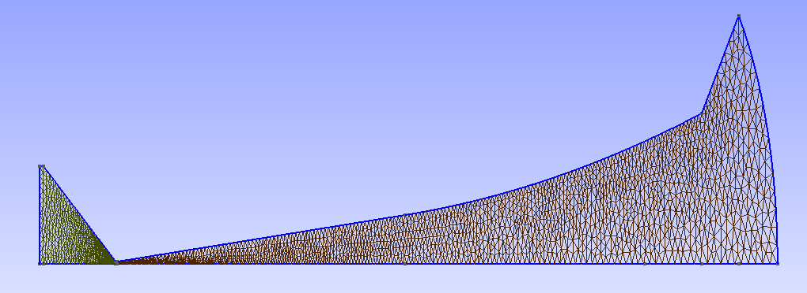
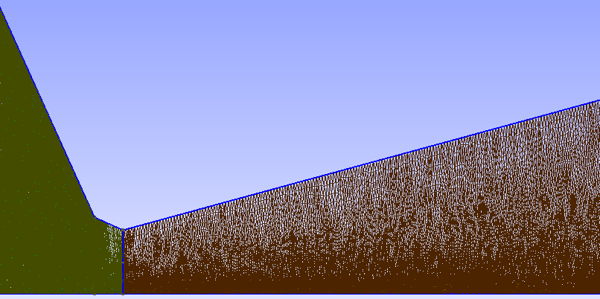
Gmsh: an open source three-dimensional finite element mesh generator
Source body
Mesh size x20
Symmetry plane
Linear mesh size at the nozzle throat ∼1μm
3.5°
R=25 μm
0
x

Slide 6
Hydrogen expansion
H₂ Stagnation conditions:
1bar, 30 K
Nozzle 50 μm
Solution of the Navier Stokes equation by means of OpenFOAM:
Geometry: CERN nozzle, 2D approximation,
Fluid: perfect gas with viscosity, constant C_{p}
Visualization with Paraview
P in Pa, T in K, U in m/s
Limit of Laval nozzle

Slide 7
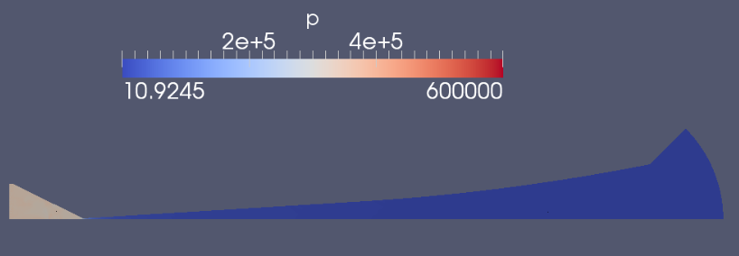
Hydrogen expansion
H₂ Stagnation conditions:
6bar, 30 K
Nozzle 50 μm

Slide 8
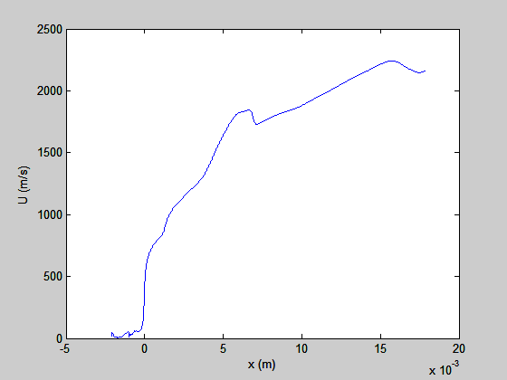
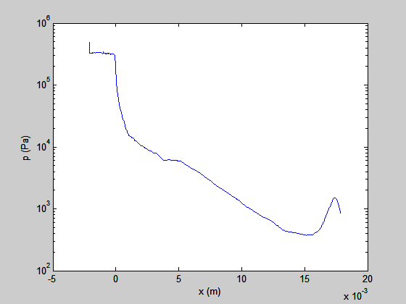
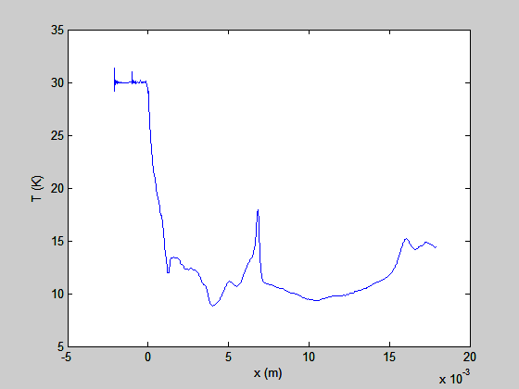
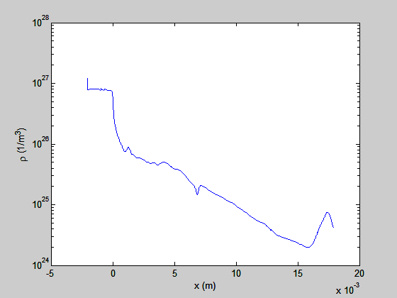
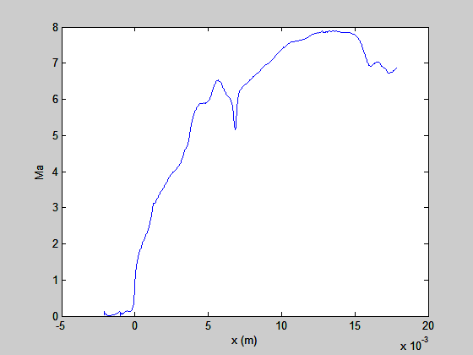
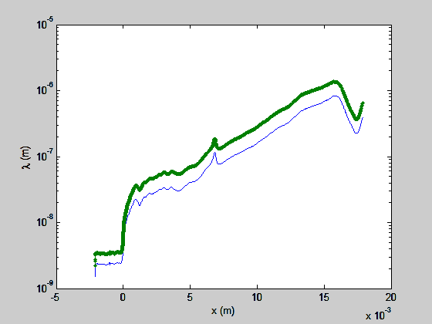
Stagnation conditions: 30K 6 bar, analysis at y=0 (central streamline)
Const. diameter
VSS model

Slide 9
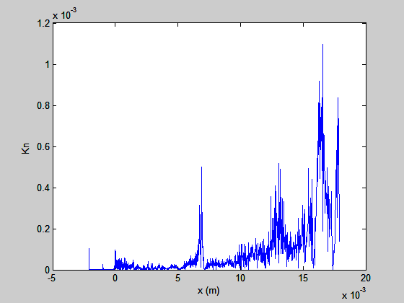
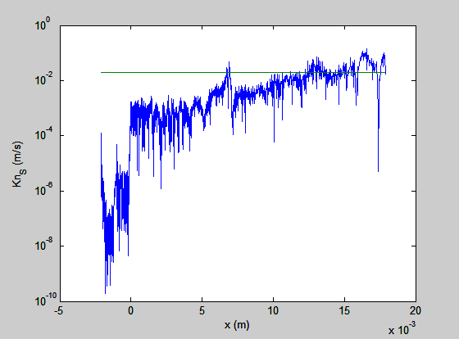
Continuous approach is valid if Knudsen number Kn<0.1 (gas is not rarefied)
Kn=λ/L global Knudsen number (λ mean free path, L characteristic length)
G.A. Bird introduced the local Kn =(λ/ρ) (dρ/dx) where the characteristic length L*= ρ/ (dρ/dx) depends on the gradients of the density which set a limit to the variation of the quantities with respect to the mean free path.
Moreover, for gas expansion, also the speed ratio is important and the corrected Kn_{S} must be less than 0.02 (green line)
G.A. Bird, Molecular gas dynamics and the Direct Simulation of gas flow, Claredon Press Oxford,1994.

Slide 10
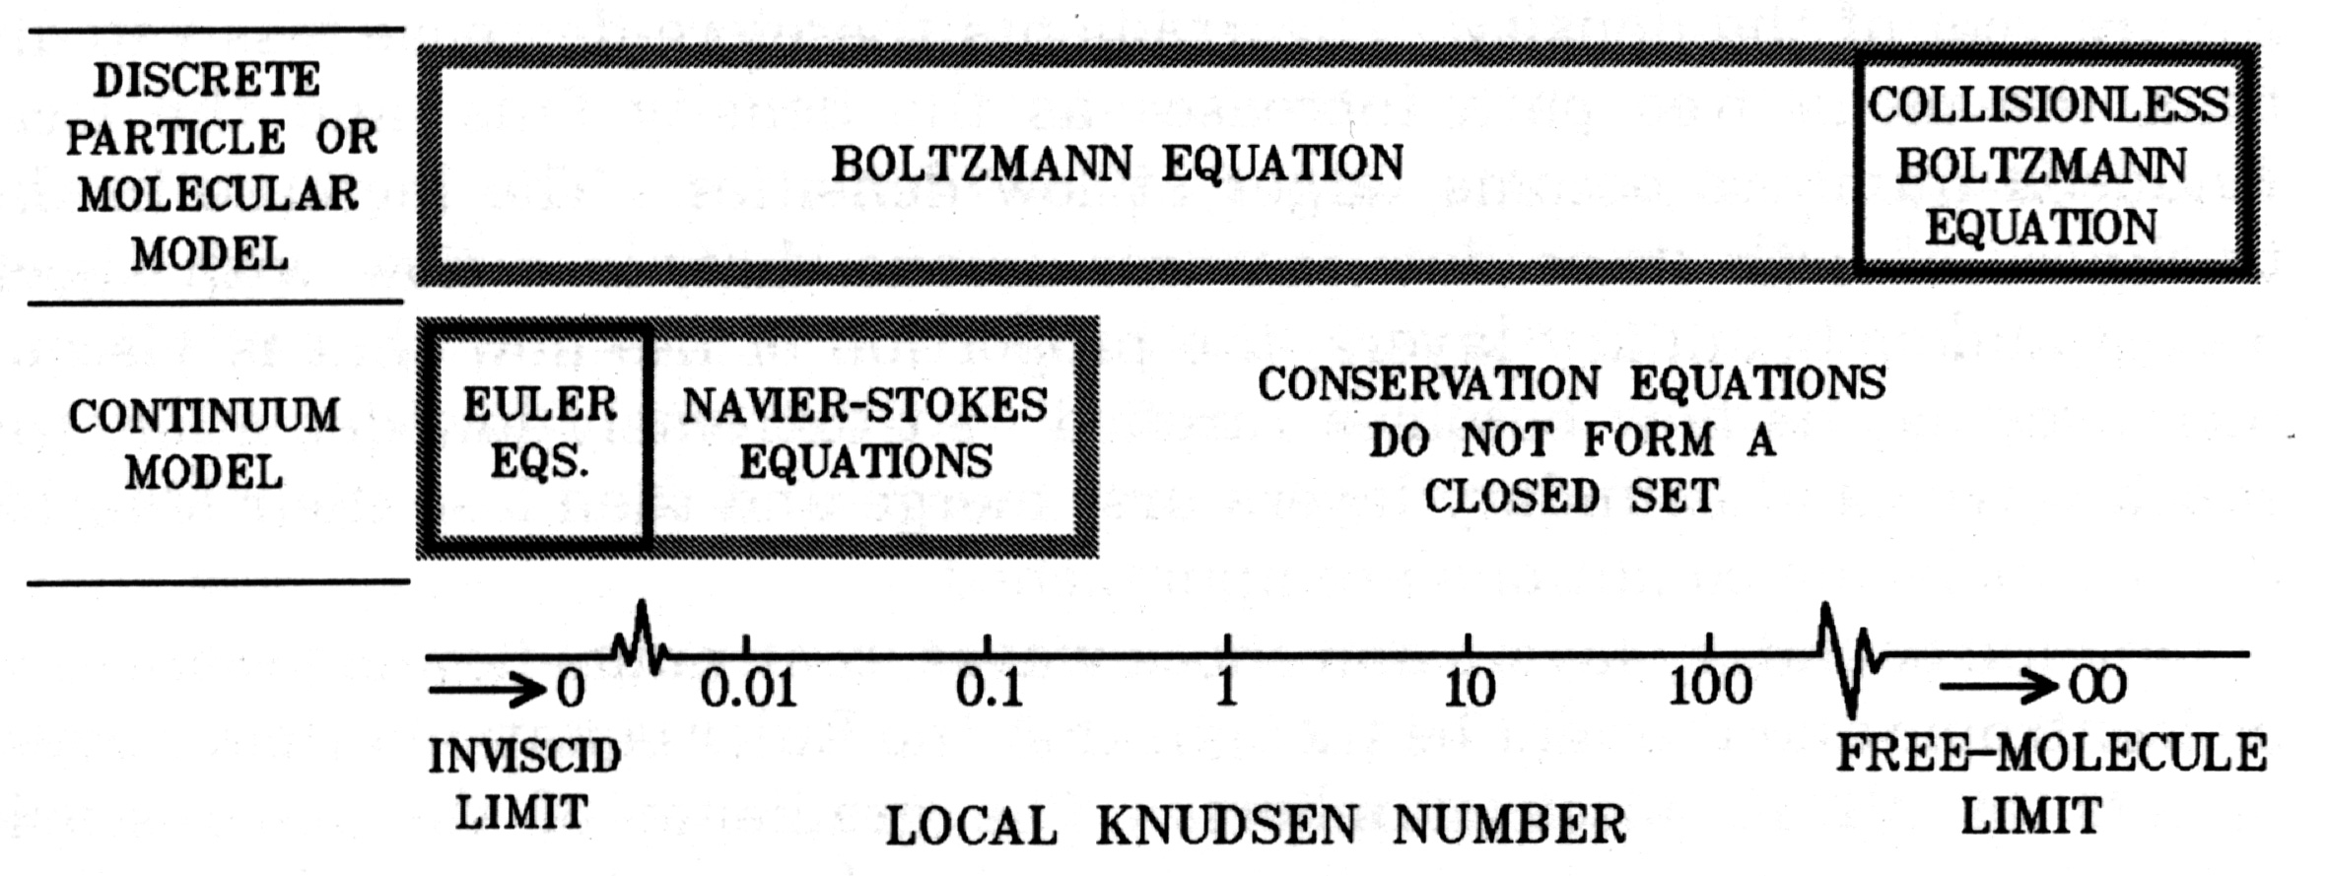
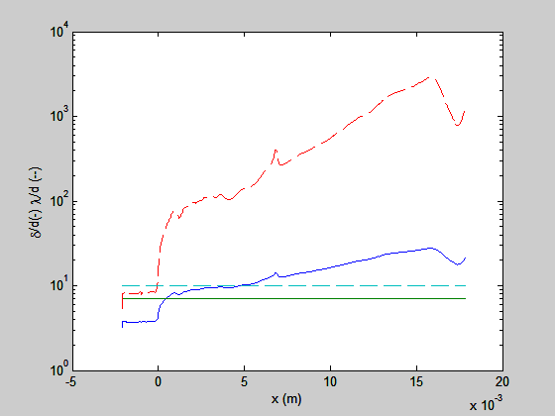
G.A. Bird, Molecular gas dynamics and the Direct Simulation of gas flow, Claredon Press Oxford,1994.
An alternative way to approach the problem is through the particle simulation:
OpenFOAM has both the molecular dynamics solver and the Direct Simulation Monte Carlo solvers dsmcFoam (solver for 3D, transient, multi- species flows).
In this case:
Dilute gas (molecular distance
δ=(1/n)^{(1/3)}>>d
molecular diameter)
to assure binary collisions (δ/d ∼7)
and also λ/d>10 (generally verified).
To avoid coupling between collisions
and good approximation of gradients
the cell size should be less than λ/3

Slide 11
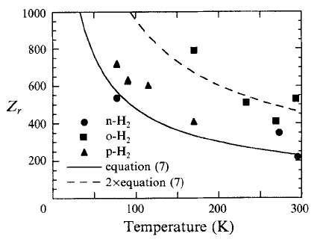
Work to do:
NS:
Enthalpy calculated from the partition function with real gas properties (relaxation properties)
3D axisymmetric geometry
DSMC+NS:
Hybrid simulations (Navier-Stokes+DSMC in the rarefied region)
Attempt to include the cluster condensation
Hardware upgrade
H₂
Monoatomic behavior
I.D. Boyd et al., J. Fluid Mech. 280 (1994) 41

Slide 12
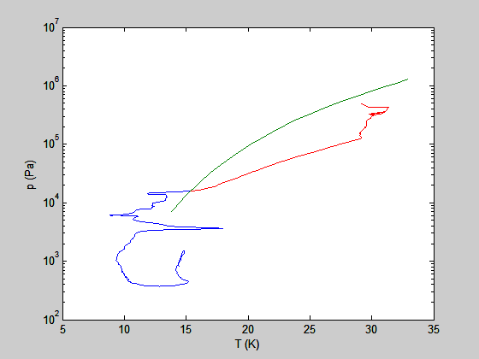
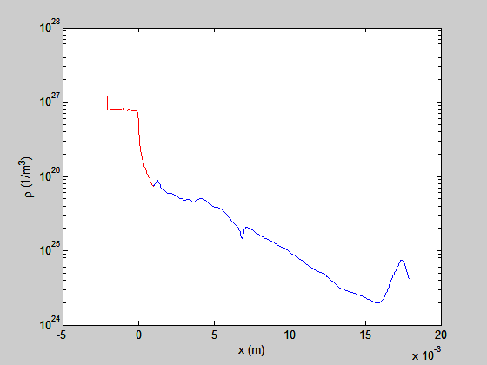
Work to do:
NS:
Enthalpy calculated from the partition function with real gas properties (relaxation properties)
3D axisymmetric geometry
DSMC+NS:
Hybrid simulations (Navier-Stokes+DSMC in the rarefied region)
Attempt to include the cluster condensation
Hardware upgrade
T_{cr}
liquid
X=0.99 mm
vapor
T_{tp}

Slide 13
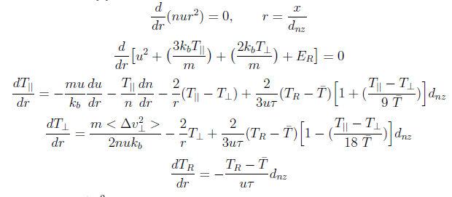
Model: solution of the Boltzmann eq.with the method of moments
Vibrational levels not excited
rotation excited but with a small number of levels θ_{rot}=39K
(monoatomic behavior)
Rotation distribution described by a rotational temperature T_{R}
and the relaxation (Klots, 1982) described by
Spherical symmetric expansion
Assumed solution (monoatomic gas):
Eq.iteratively solved to get n,u(=V), T||, T┴, T_{R}

Slide 14
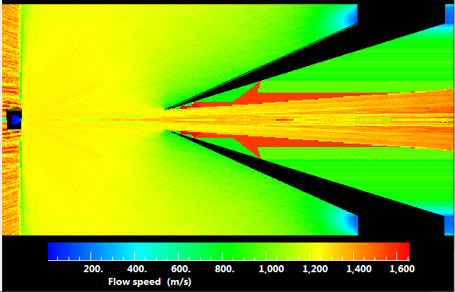
DS2V
Supersonic beam
He source
Central streamline
Skimmer
Software developed by G. A. Bird for 2D and axisymmetric flow

