Slide 1
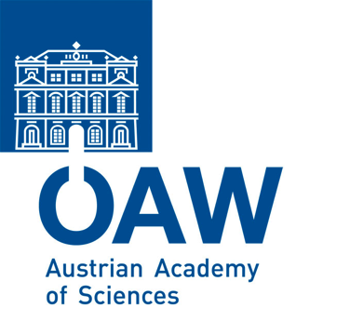
Stefan Meyer Institute for Subatomic Physics Österreichische Akademie der Wissenschaften Overview

Slide 2
About us

Slide 3
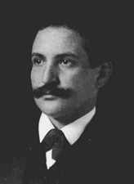
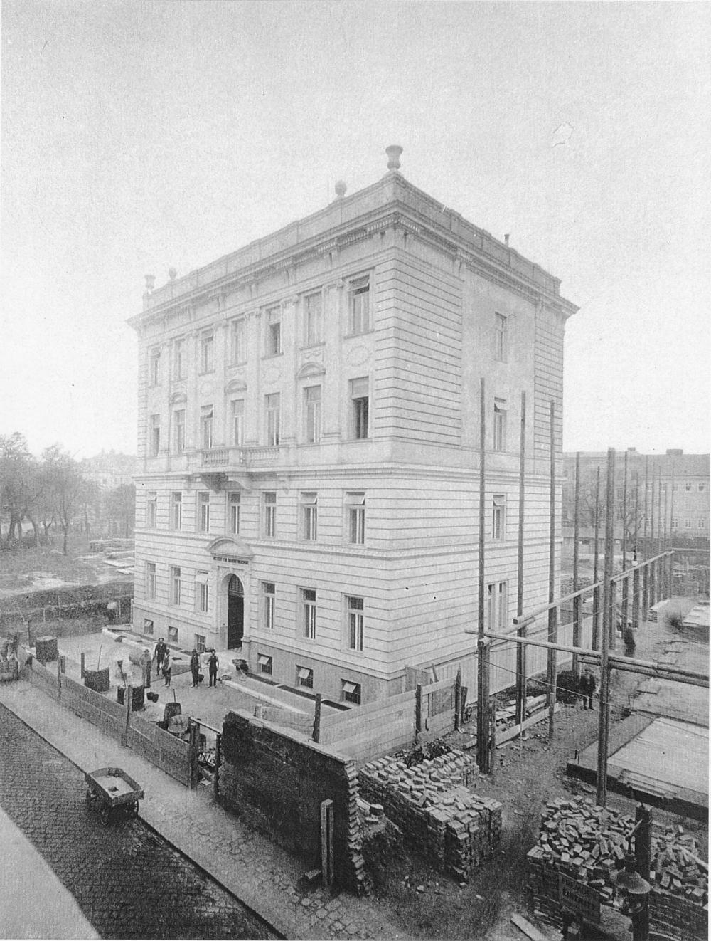
Stefan Meyer Institute – short History
Stefan Meyer (1872-1949) first director of the „Institut für Radiumforschung“
Founded 1910 as 1st institute of the Academy (k.k. Academy)
Austria possessed the only natural source of Radium
1987 Institute for Medium Energy Physics
2004 Renamed in Stefan Meyer Institute

Slide 4
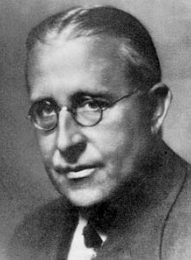
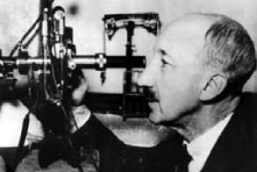
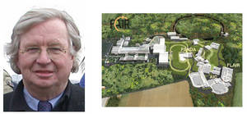
Roots
George de Hevesy (1885- 1966)
- Tracer method
Victor F. Hess (1883-1964)
– cosmic rays
Paul Kienle (1931-2013)

Slide 5
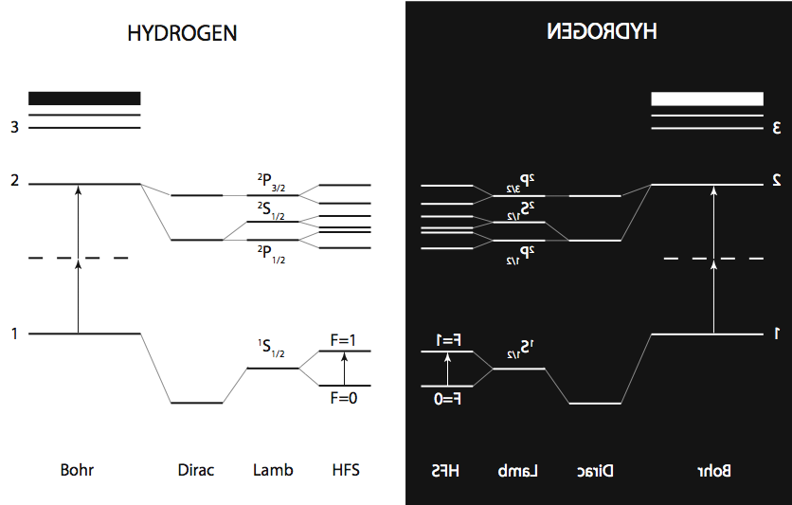
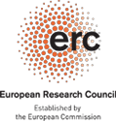
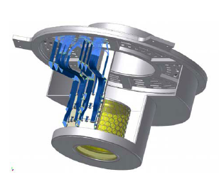
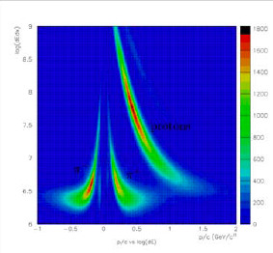
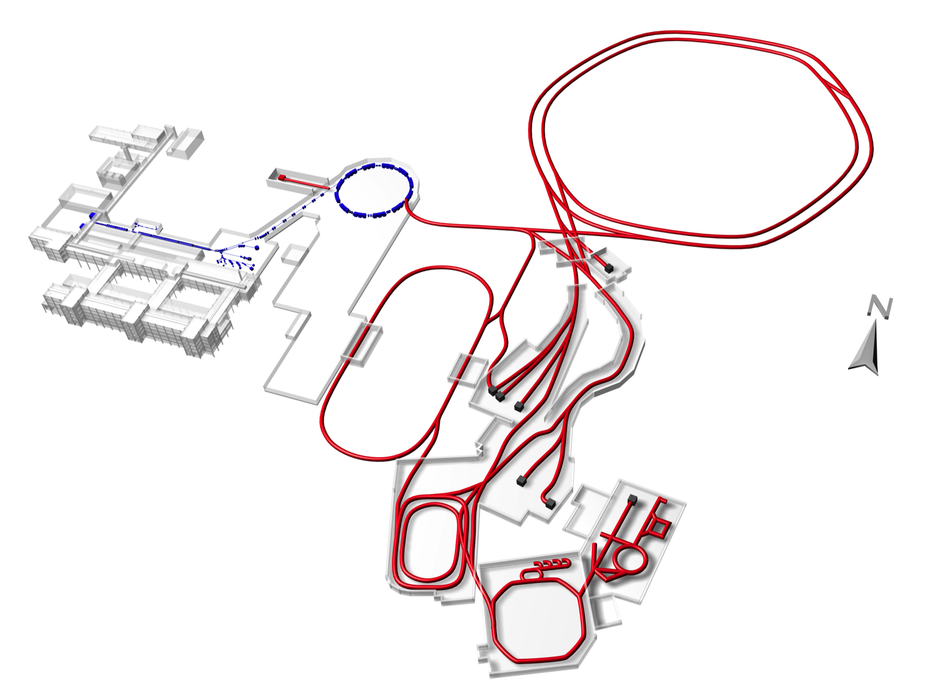
Research
Matter-antimatter asymmetry: ASACUSA @ CERN/AD
Kaon-nucleon interaction: kaonic atoms and nuclei @ DAFNE/LNF and J-PARC
Antiprotons at FAIR – PANDA, FLAIR

Slide 6
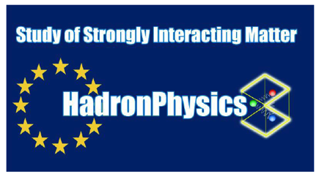
Other Projects
Pionic Hydrogen – finished
VIP - Violation of the Pauli Principle @ LNGS
Detector Developments: GEM, SiPM related
Medical Physics: TOF-PET

Slide 8
Welcome to Vienna
and SMI

