Slide 1


“Measurement of charge radii and moments of exotic nuclides”
Liss Vázquez-Rodríguez^{1,2}
¹Max-Planck-Institut für Kernphysik, Heidelberg, Germany
²Experimental Physics Department, CERN, Geneva, Switzerland

Slide 2
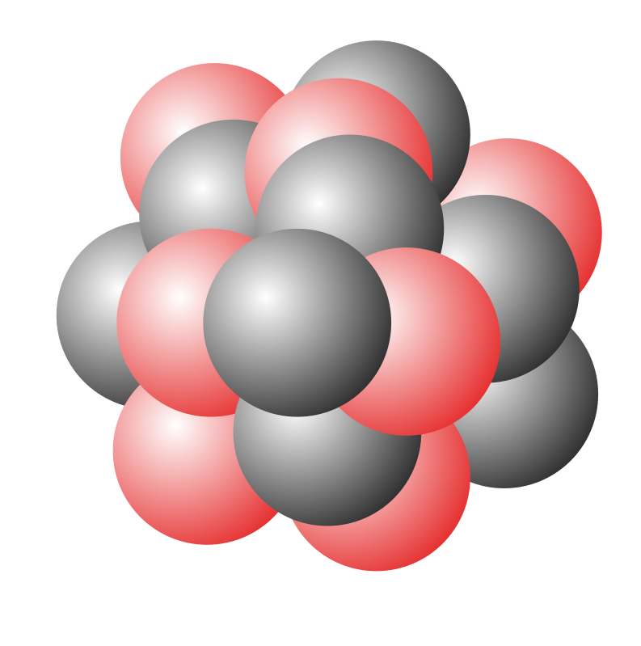
Outline
Laser spectroscopy and the atomic nucleus
The COLLAPS experiment at ISOLDE-CERN
Recent highlights around the Z=50 and Z=82 region
n
p

Slide 3
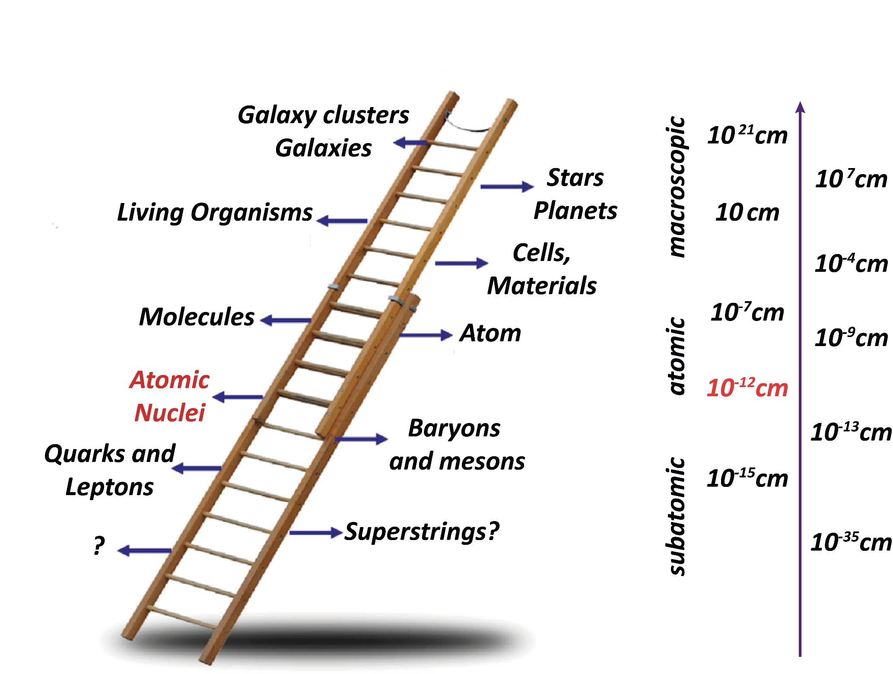

Laser spectroscopy and the atomic nucleus
n
p

Slide 4

Laser spectroscopy and the atomic nucleus
The chart of nuclides
n
p
100
magic numbers!
80
Z=82
Terra incognita
Proton Number
N=126
60
Z=50
40
Z=28
N=82
Z=20
N=50
Stable nuclei (280)
20
Radioactive nuclei, known (3300)
N=28
Radioactive nuclei, predicted(6000)
0
20
40
60
80
100
120
140
160
Neutron Number

Slide 5
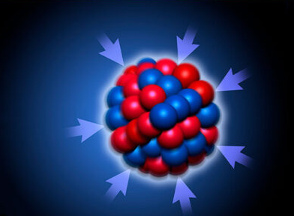
Laser spectroscopy and the atomic nucleus
The atomic nucleus is bound by the strong force
100
80
Terra incognita
Proton Number
60
40
20
0
20
40
60
80
100
120
140
160
Neutron Number

Slide 6

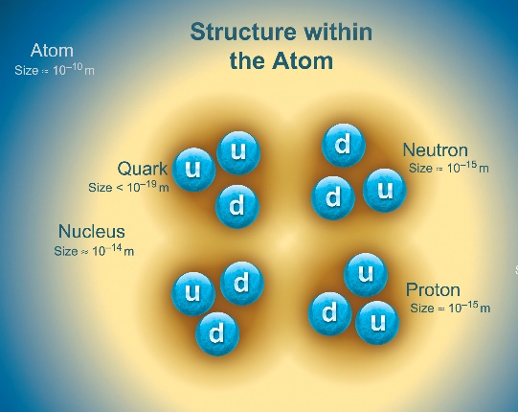
Laser spectroscopy and the atomic nucleus
Goal: Find a comprehensive and quantified model of atomic nuclei
Experiment: access key regions of the nuclear chart to constrains models
and identify missing physics
100
80
Make the link to QCD
Proton Number
60
40
20
Theory: identifies key nuclei and properties to be studied
0
20
40
60
80
100
120
140
160
Neutron Number

Slide 7
Laser spectroscopy and the atomic nucleus
Goal: Find a comprehensive and quantified model of atomic nuclei
Nuclear Moments and Charge Radii of Neutron-Rich Palladium Isotopes
100
First laser spectroscopy measurements of 53Ca and the prospects for measuring 54Ca
Nuclear charge radius measurements in 32Si at FRIB
Experiment
80
Investigation of the proton radius of the neutron-rich Borromean halo nucleus 19B
Proton Number
High-precision laser spectroscopy of helium-like carbon 12C4+
60
Two-Neutron Halo Nuclei With Weak Neutron-Core Interaction
40
20
Ab initio advances for medium-heavy nuclei and electroweak properties
Precision ab initio nuclear structure and implications for fundamental physics
0
Theory
20
40
60
Evolution of the quadrupole moment of Cd and Sn nuclei
80
100
120
140
160
Neutron Number
Shell model investigations along the N=31 and Z=28 chains

Slide 8

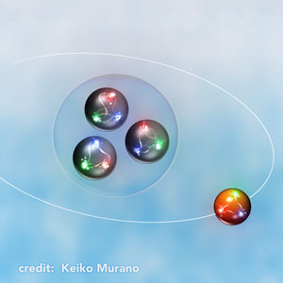
Laser spectroscopy and the atomic nucleus
Open questions in Nuclear Physics Research
What are the Origins of the Elements? (astrophysics)
How, and where, were the heavy elements synthesised?
How do nuclear reactions influence the evolution of massive stars?
…
n
p
What is the Nature of Nuclear Matter? - (nuclear structure)
What are the limits of nuclear existence?
How do simple patterns emerge in complex nuclei?
Are magic number still magic far away from stability?
Can nuclei be described in terms of our understanding of the underlying fundamental interactions?
Are there new forms of structure and symmetry at the limits of nuclear existence?
How do the properties of hadrons emerge from fundamental interactions? - (hadronic physics)
What is the structure of the proton and neutron and how do hadrons get their mass and spin?
How do nuclear forces arise from QCD?
…

Slide 9
Laser spectroscopy and the atomic nucleus
Survey of nuclei probed by laser spectroscopy
n
p
More than 1000 nuclei probed!
Laser Spectroscopy – Institute for Nuclear Physics – TU Darmstadt (tu-darmstadt.de)

Slide 10
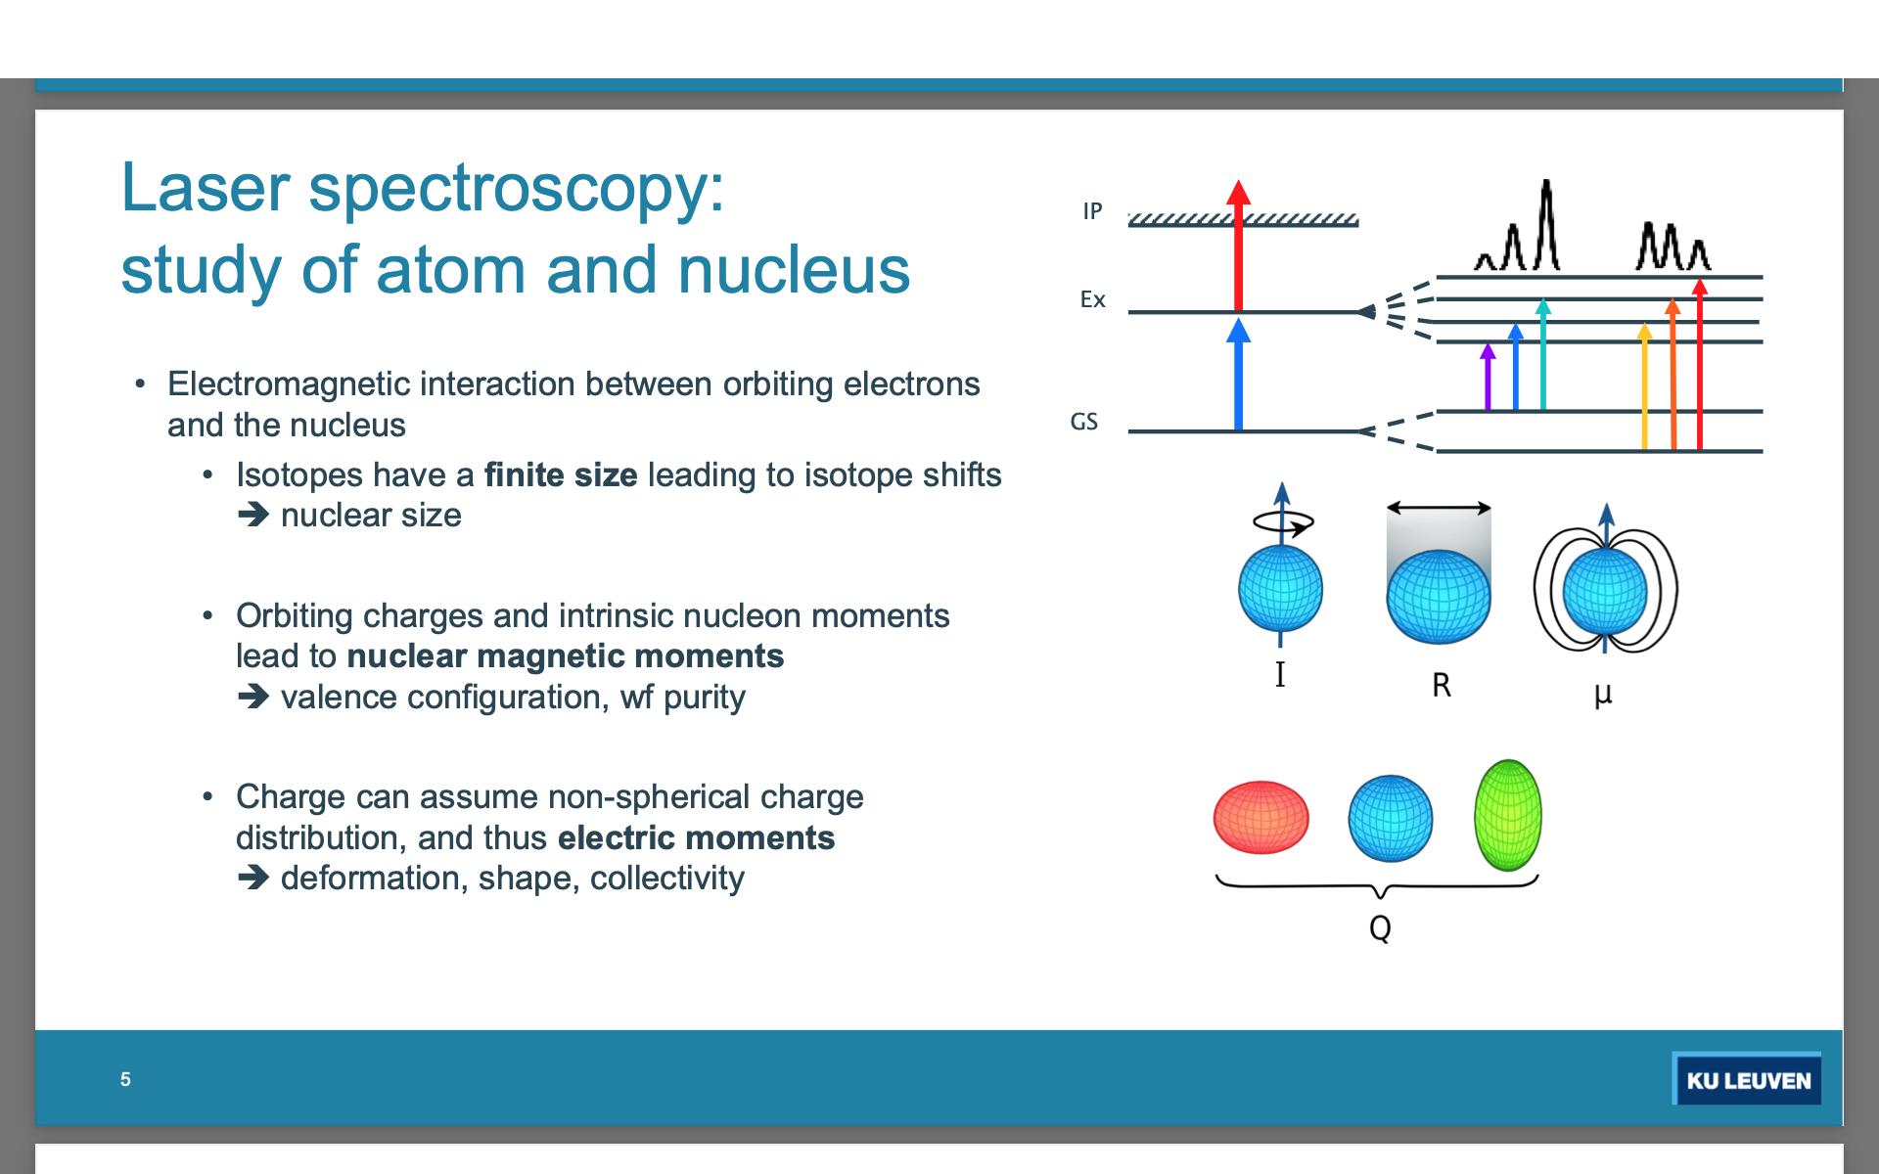
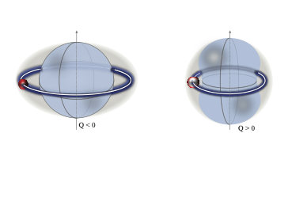
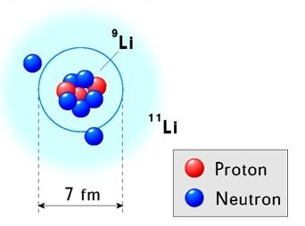
Laser spectroscopy and the atomic nucleus
Exploring the nuclear landscape with laser spectroscopy
Nuclear model independent properties from laser spectroscopy
Spin, magnetic moment
Quadrupole moment
Charge radii
Probes for the Nuclear Configuration
Ordering of shell-model orbits
Robustness of the shell closures
Halo nuclei
Shape coexistence
Te (Sn+2p)?
1g_{7/2}
Z=50

Slide 11
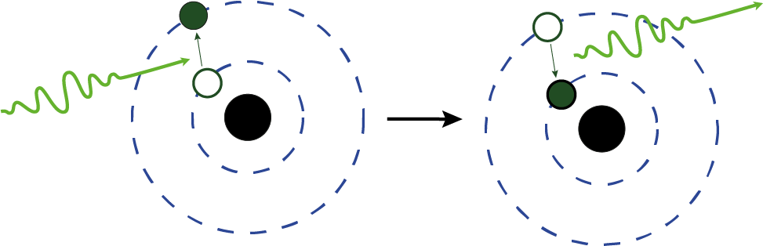
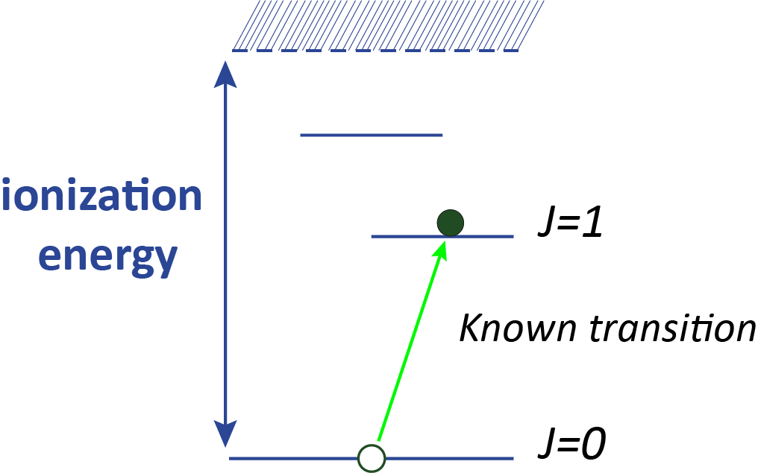
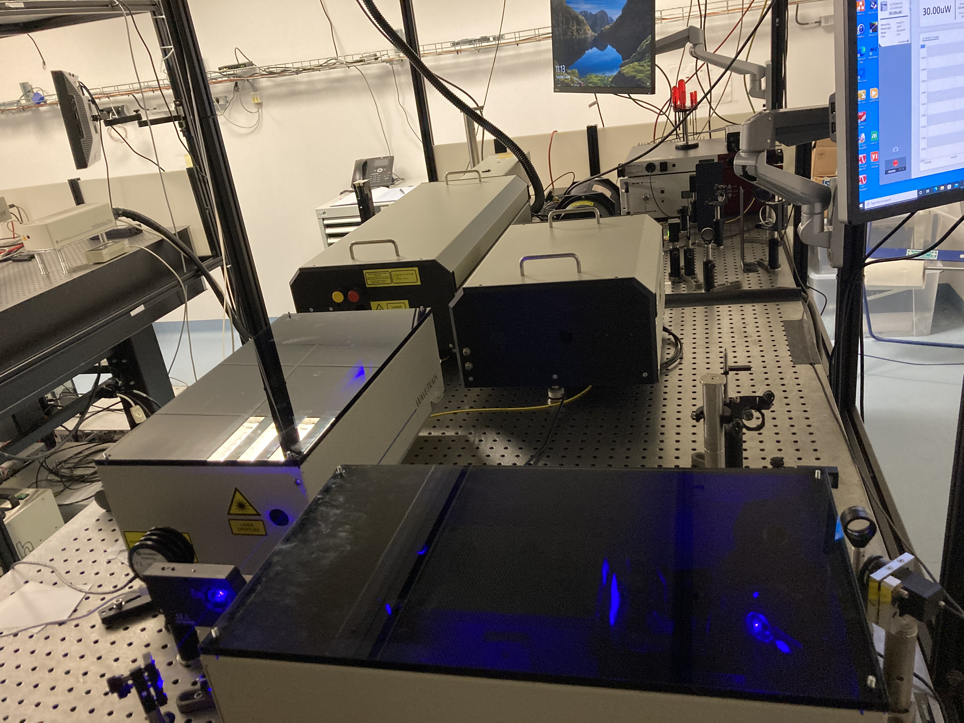
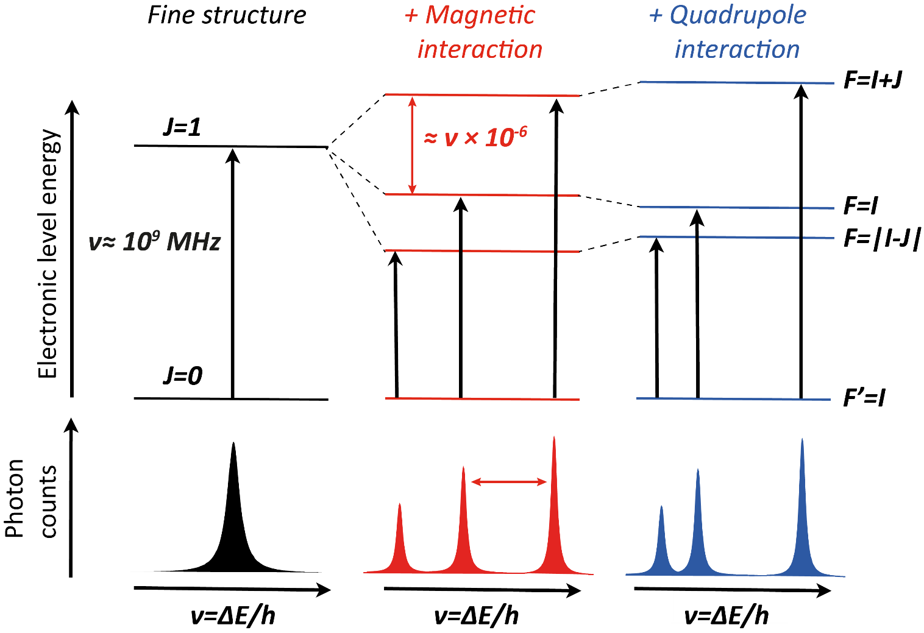
Laser spectroscopy and the atomic nucleus
Principle of laser excitation/ionization
electrons excited
fluorescence
Resonant step- wise excitation of one (or more) electron in the electron shell of the atom.
The transition frequencies(wavelengths) are unique, like a fingerprint for elements and isotopes.
laser beam
What can we get out of atomic spectra ?
Isotope shift
Hyperfine structure
1
2
3

Slide 12
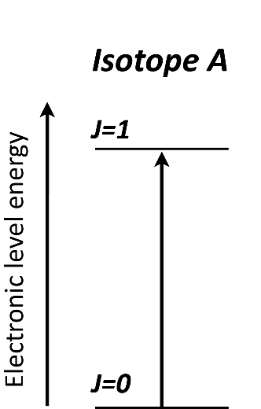
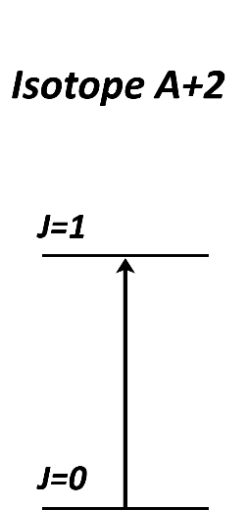
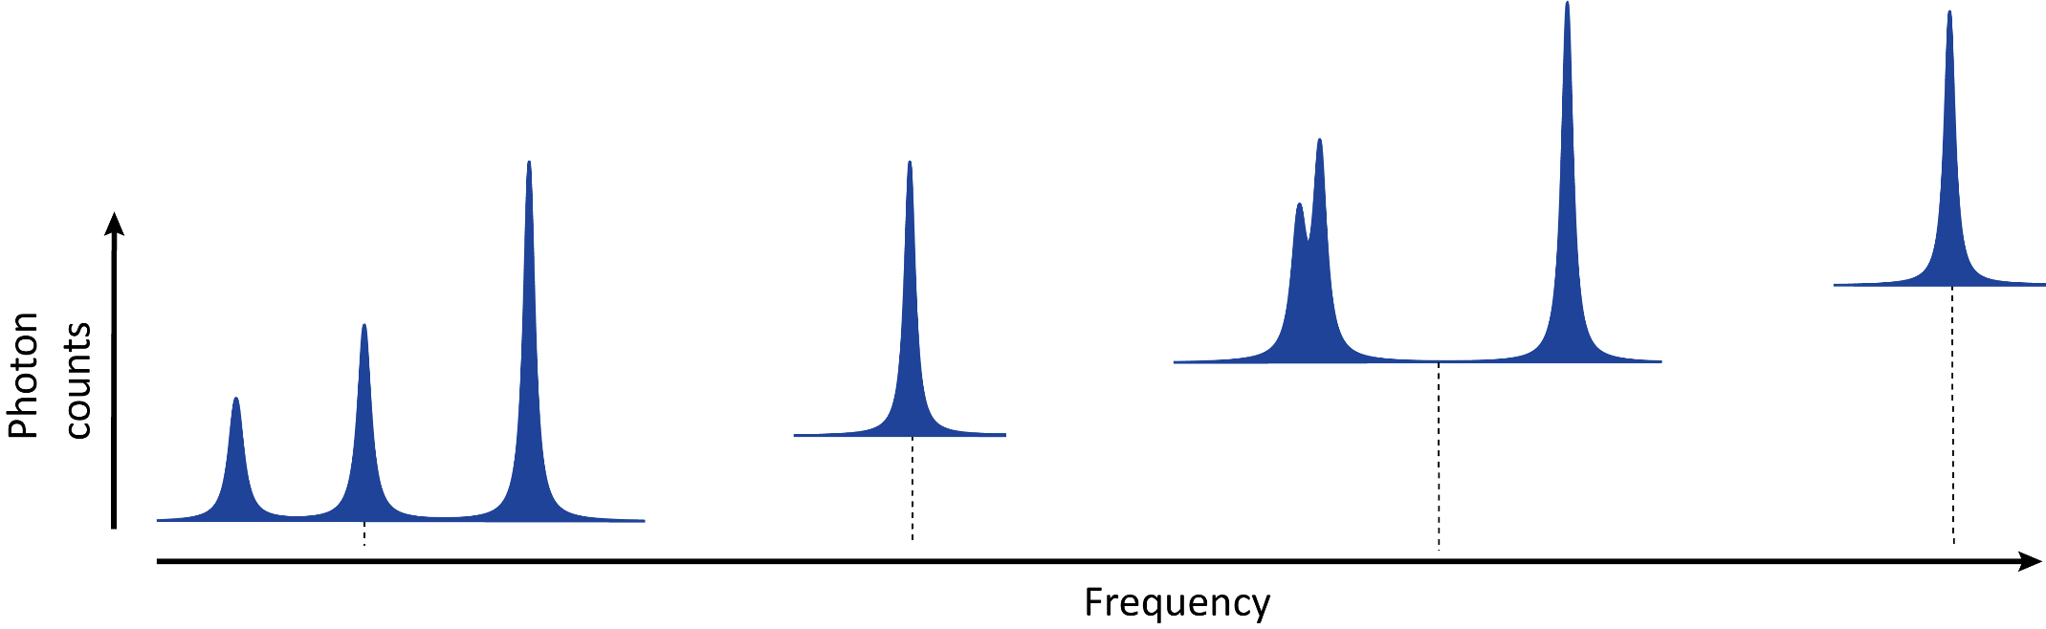

Laser spectroscopy and the atomic nucleus
Isotope shift (IS): Perturbation of the atomic fine structure levels due to nuclear size and mass
Isotope shift
$$δν_{i}^{A, A^{′}}∝δ{\left\langle r^{2}\right\rangle }^{A, A^{′}}$$
mean square charge radii
Isotope A+2
Isotope A
I > 0
I > 0
Isotope shift

Slide 13
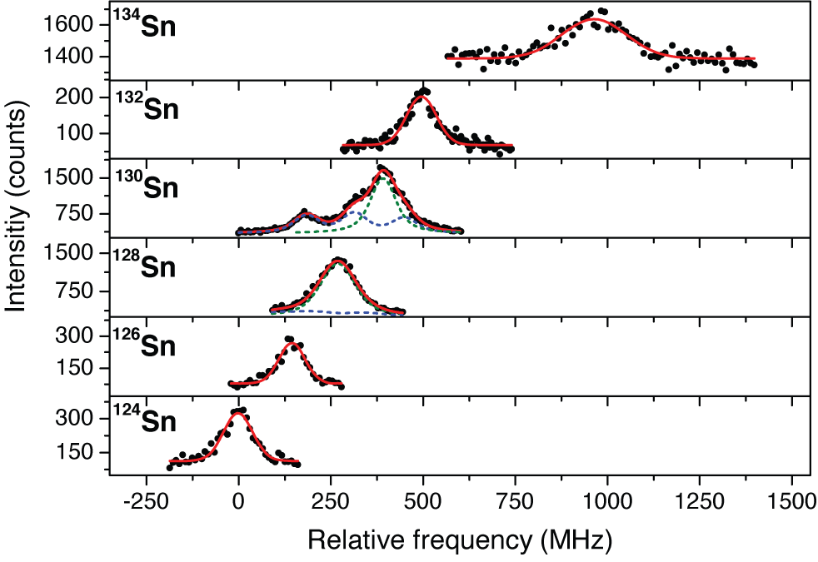
Laser spectroscopy and the atomic nucleus
Charge radii sensitive to shell closures
Experimental isotope shifts in Sn (Z=50)
Nuclear charge radius Sn, exp. vs theory
Shell closure
Isotope shift (MHz
First measurements across N=82 in tin
¹³⁴Sn
T_{1/2} = 1s,
Production: 10⁵ ions/s
Contamination: 10⁹ ions/s
C. Gorges, L. V. Rodriguez et al., Phys. Rev. Lett. 122, 192502 (2019)

Slide 14
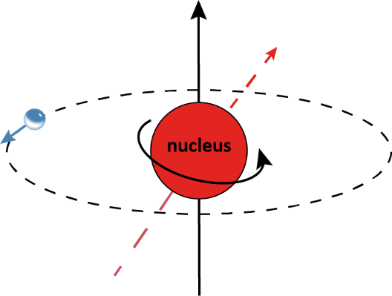
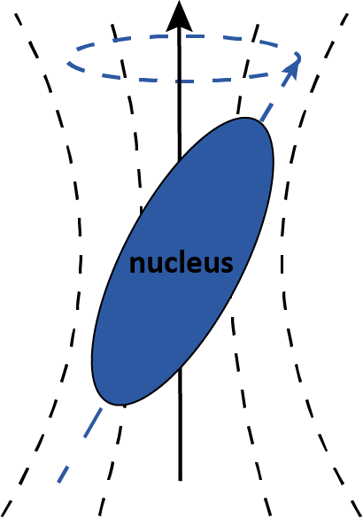
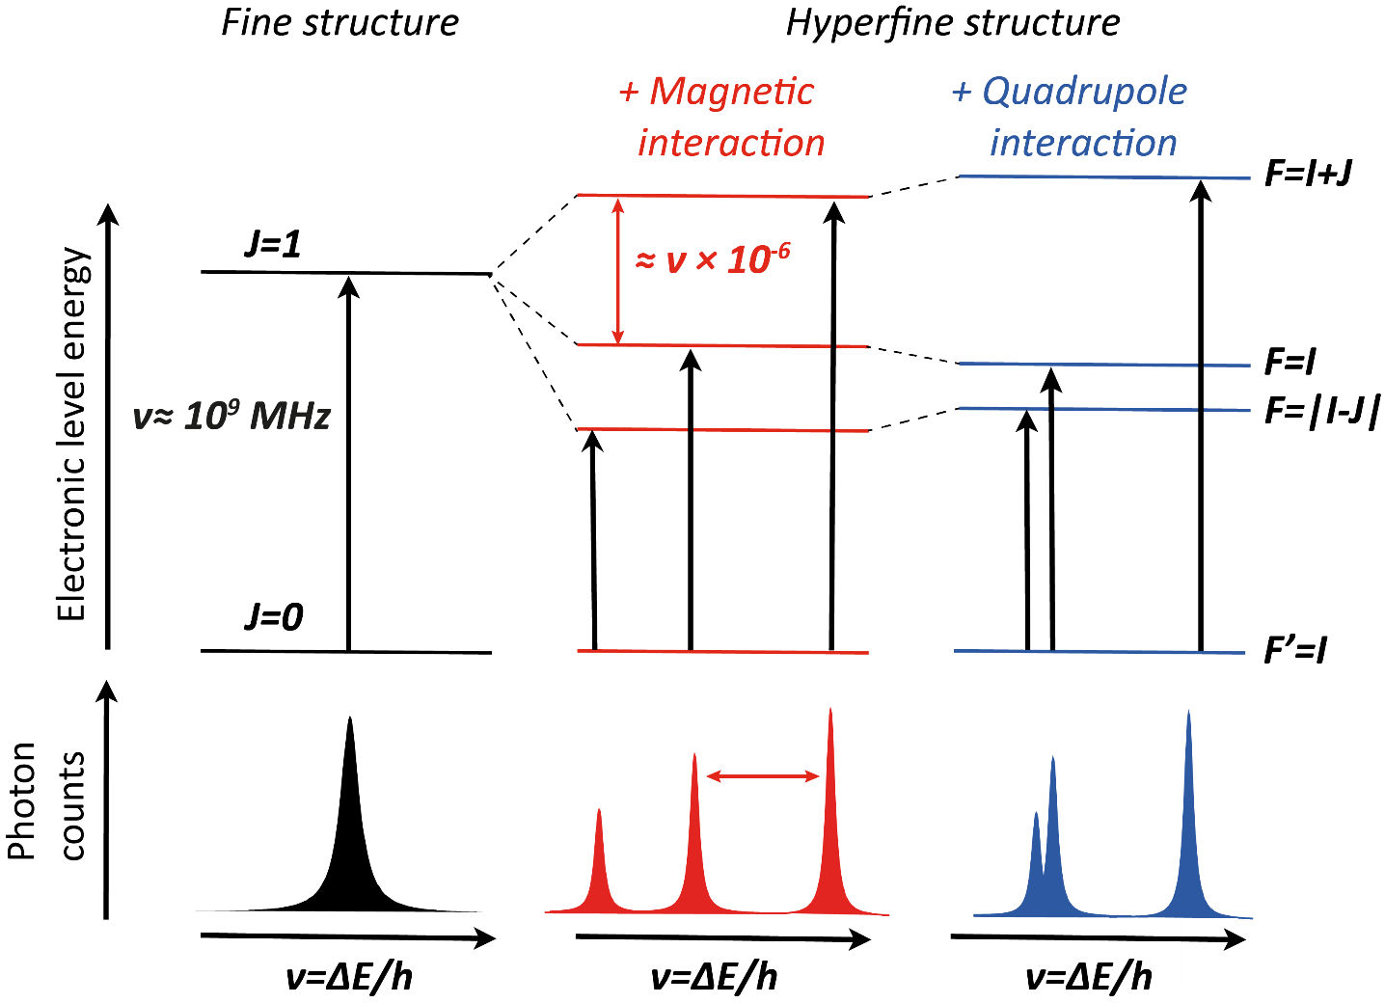

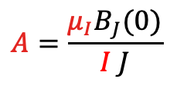


Laser spectroscopy and the atomic nucleus
Hyperfine structure: Splitting of atomic fine structure levels due to interaction of the nuclear multipole moments and the field created by the electrons
F = I + J
e⁻ produce a
magnetic field
Electric field gradient
Hyperfine structure
nucleus possesses a
quadrupole
moment
nucleus possesses a
magnetic moment
Perturbation of the hyperfine levels
Splitting of the atomic energy levels
$$E∝B$$
$$E∝A$$
∝ μ
Hyperfine parameter
Hyperfine parameter
$$A=\frac{μ_{I}B_{J}(0)}{I J}$$
$$B=eQ_{s}V_{JJ}(0)$$

Slide 15
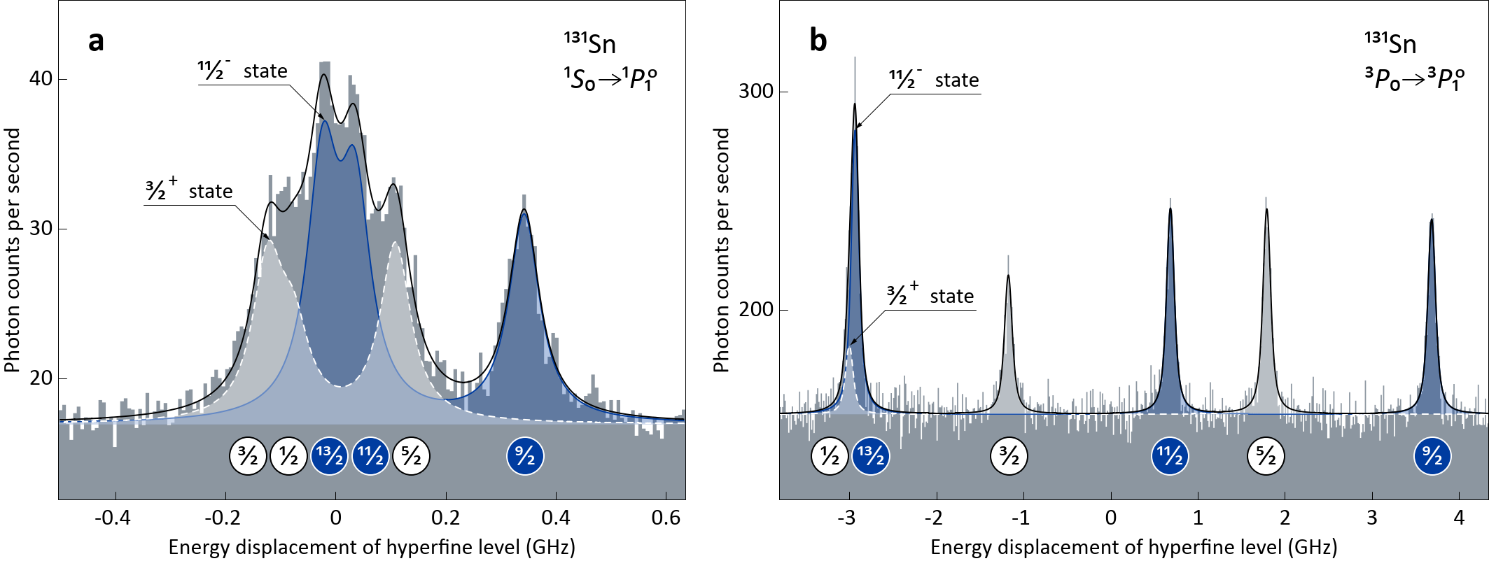
Laser spectroscopy and the atomic nucleus
Example spectra of tin (Z=50) in the ¹S₀ – ¹P₁ and ³P₀ – ³P₁ transitions
Ground (white, T_{1/2}=56 s) and isomeric state (blue, T_{1/2}=58 s) measured in the same spectrum
Spacing between the peaks depends on the selected transition
Very sensitive to quadrupole splitting
Very sensitive to magnetic splitting

Slide 16
Laser spectroscopy and the atomic nucleus
Distribution of laser spectroscopy experiments
Operational
Commissioning
Planning
About 8 operational experimental setup for the study of nuclear properties (high-resolution)
About another 8 in commissioning (in the last 20 years)

Slide 17
Laser spectroscopy and the atomic nucleus
Distribution of laser spectroscopy experiments
“Senior” experiment
in operation since 1980
Operational
Commissioning
Planning
About 8 operational experimental setup for the study of nuclear properties (high-resolution)
About another 8 in commissioning (in the last 20 years)

Slide 18
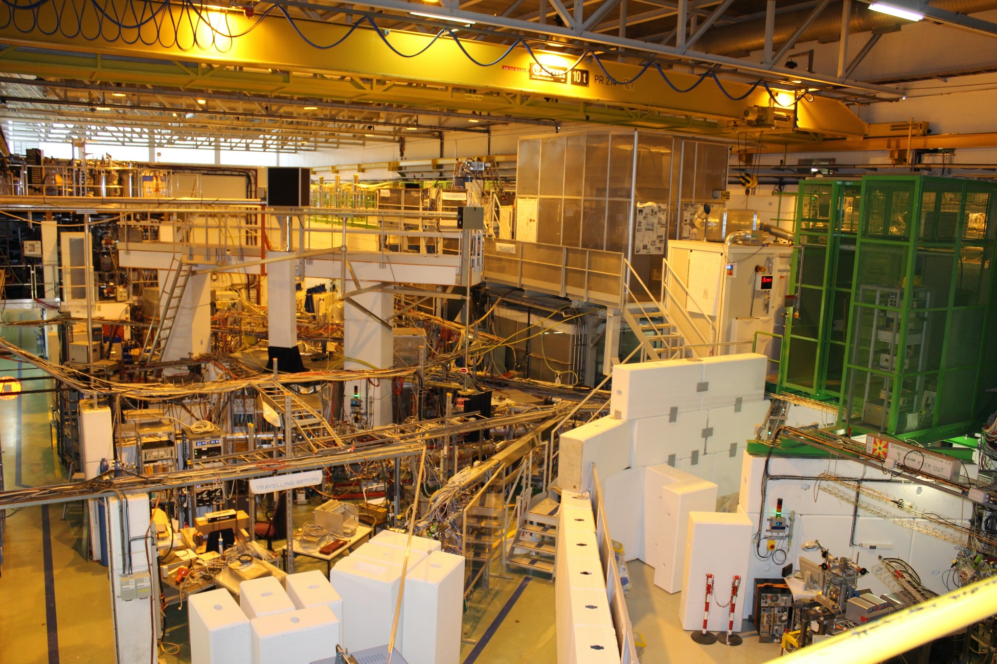
The COLLAPS experiment at ISOLDE-CERN
ISOLDE: CERN‘s radioactive nuclear factory

Slide 19
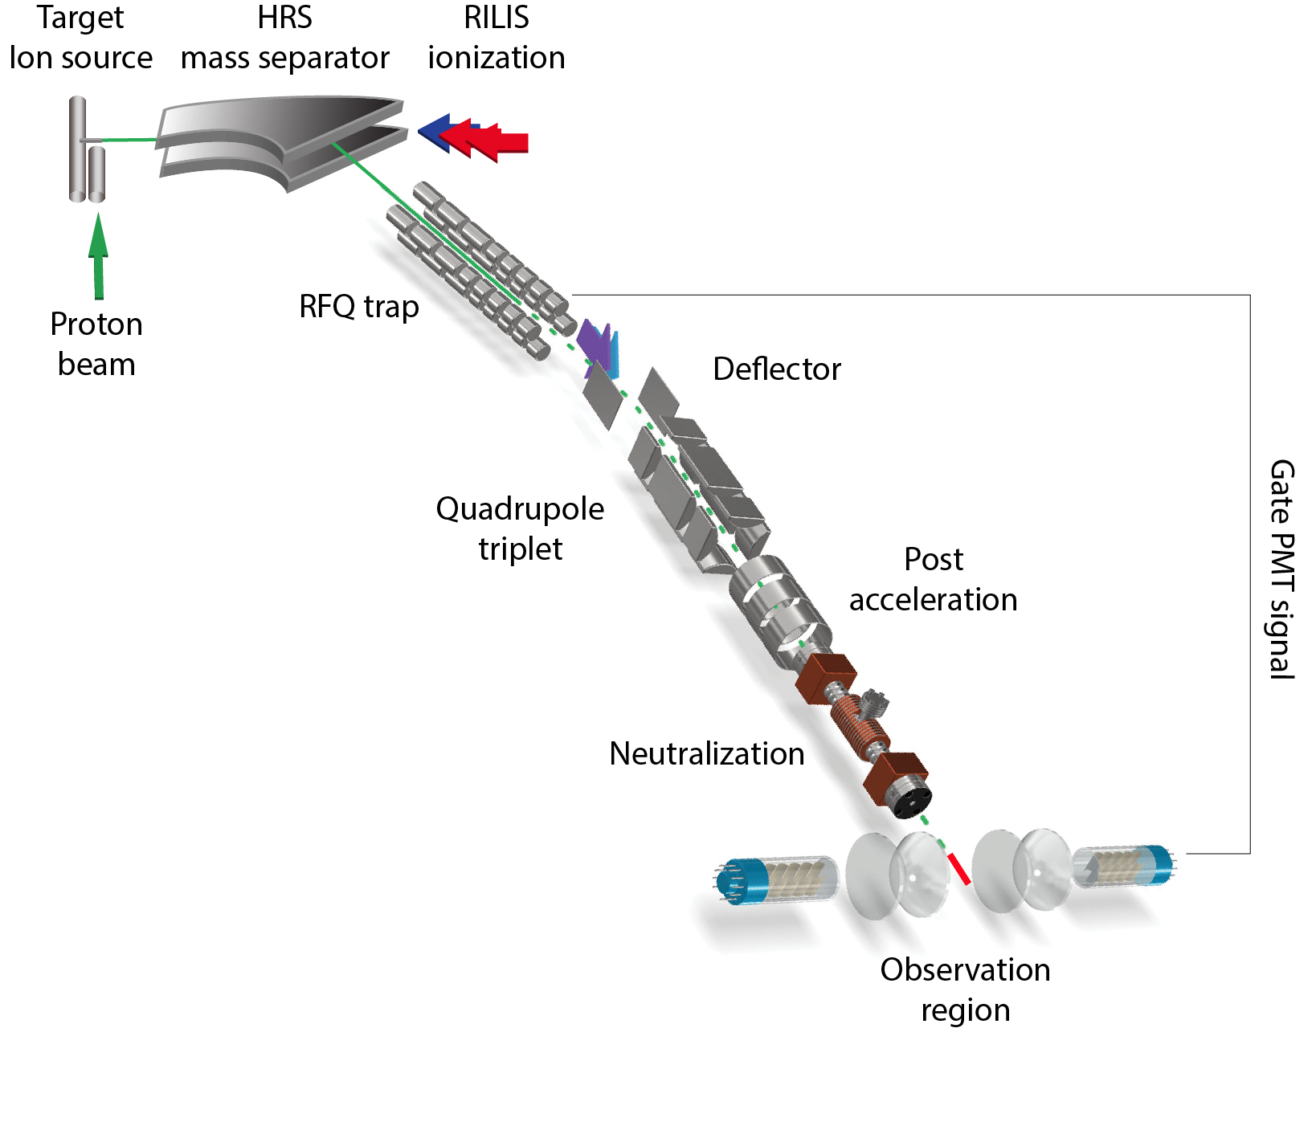
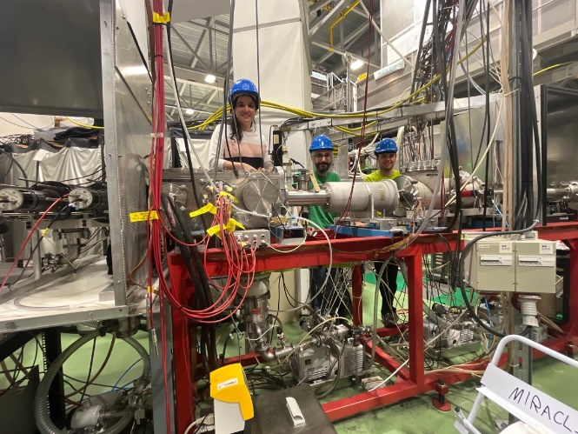
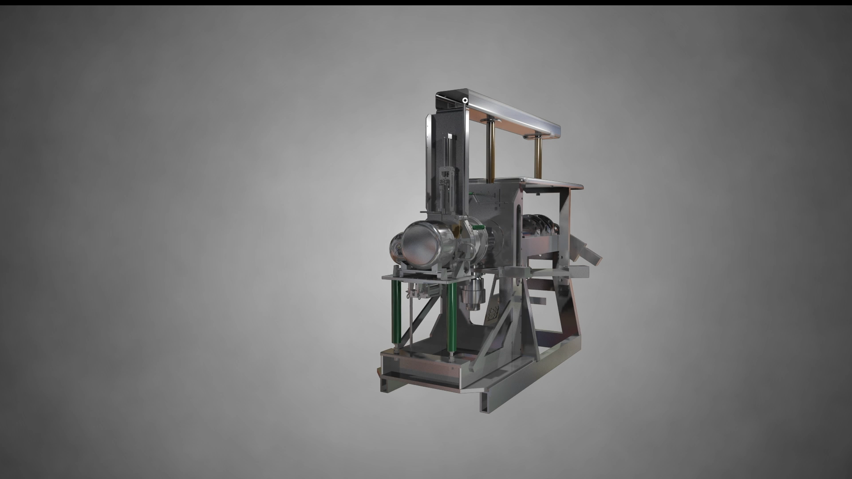

The COLLAPS experiment at ISOLDE-CERN
ISOL beams production
Challenges:
Production rates of ions of interest will be low;
- Wavelengths are difficult to produce
Aim:
Find a spectroscopic scheme that is efficient, sensitive and possible to produce

Slide 20
The COLLAPS experiment at ISOLDE-CERN
The COLLAPS laser lab at CERN
Pump laser
TiSa laser
1st doubling unit
2nd
doubling unit
CERN, 20-12-2022

Slide 21
The COLLAPS experiment at ISOLDE-CERN
last 10 years at COLLAPS …
Ca region
Ni region
100
^{51, 53-64}Mn
⁶³⁻⁷⁹Zn
80
⁴⁴⁻⁵⁰Sc
^{58-68, 70}Ni
Pb region
Pb region
⁴⁰⁻⁵³Ca
⁶⁸⁻⁷⁴Ge
Proton Number
¹⁹⁷⁻²⁰⁹Bi
60
¹⁸⁷⁻²⁰⁸Pb
O region
Sn region
Sn region
40
²⁶⁻³²Al
¹⁸³⁻²⁰⁸Tl
¹⁰⁸⁻¹³⁴Sn
20
¹¹²⁻¹³⁴Sb
¹¹²⁻¹³⁶Te
0
20
40
60
80
100
120
140
160
Neutron Number

Slide 22
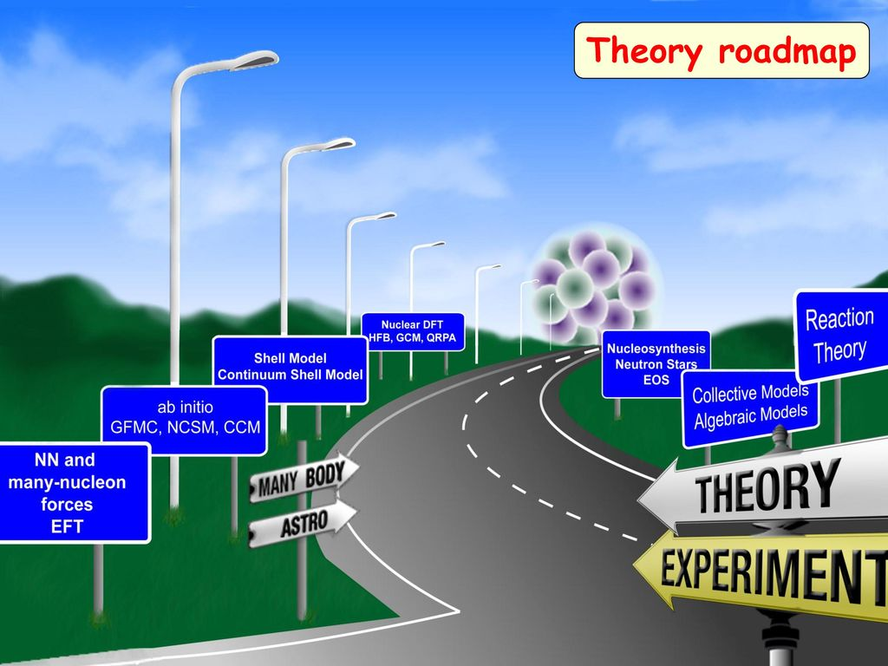
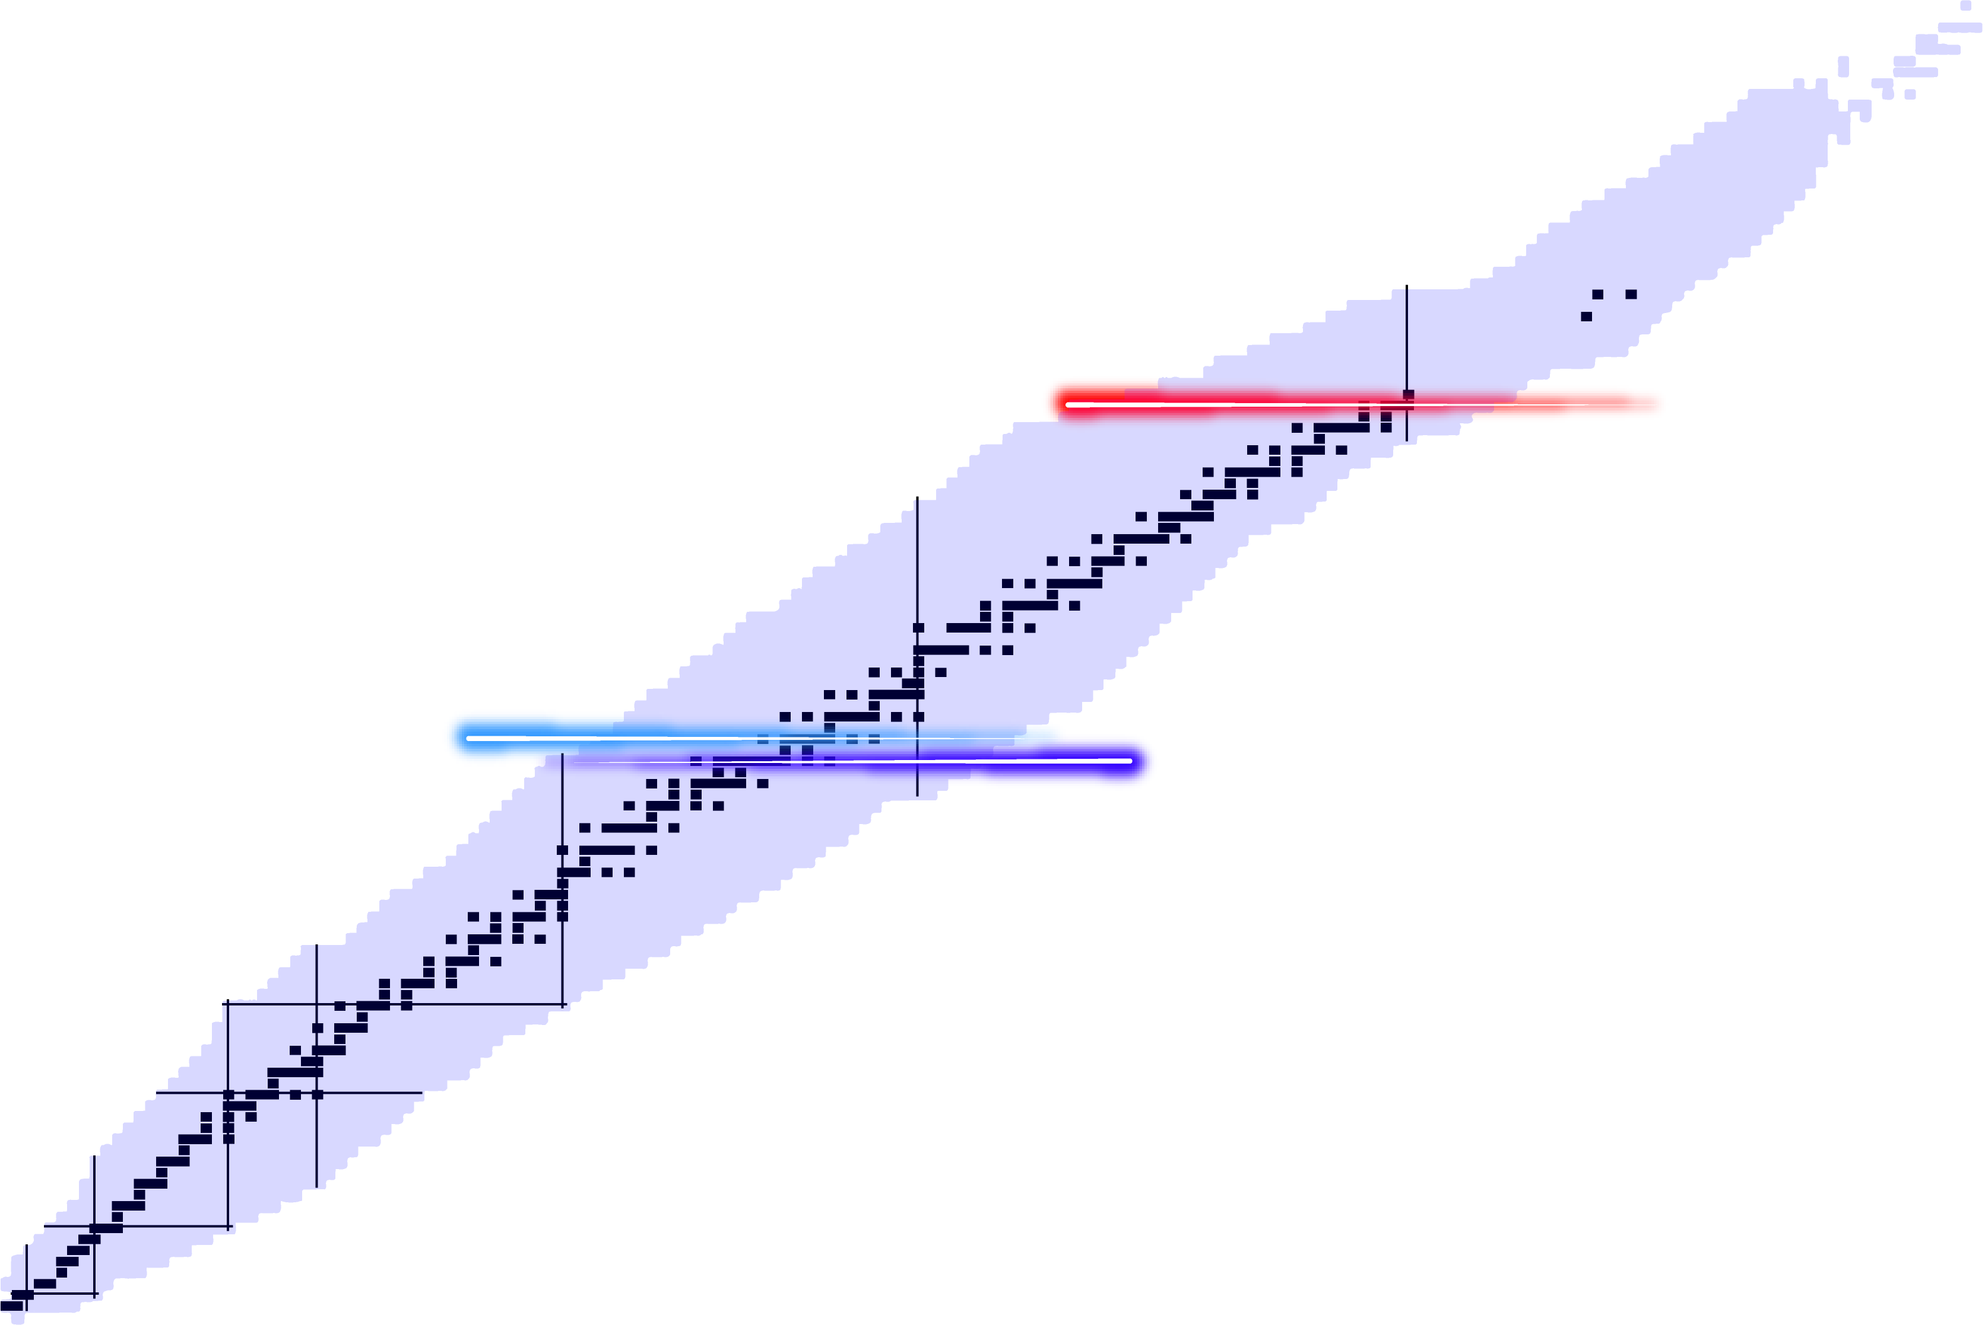
Recent highlights around the Z=50
Why the Sn region?
Semi-magic nuclei are supposed to be “simple”
Ab initio methods reaching the region!
n
p
₅₂Te
₅₀Sn
₄₈Cd
Open question:
Do simple patterns emerge in complex nuclei?
Motivation: the case Cd (Z=48) – Sn (Z=50) – Te (Z=52)
Investigate the effect of 2h (in Cd) and 2p(in Te) in the Z=50 shell closure

Slide 23
Recent highlights around the Z=50
Why the Sn region?
Laser spectroscopy in the Sn region at COLLAPS
Very challenging
due to high contamination in the region
Complicated laser systems
deep UV transitions needed
Z=52
¹⁰²Te
¹¹⁵Te
¹³³Te
¹³⁴Te
Single-particle like systems
¹³³Sb
Z=50
¹⁰⁰Sn
¹¹³Sn
¹³¹Sn
¹³²Sn
¹³³Sn
¹³¹Cd
Doubly-magic?
Doubly-magic nucleus
L. V. Rodriguez et al. Phys. Rev. C 102, 051301 (R) (2020)
S. Lechner et al. Phys. Rev. C 104, 014302 (2021)
D. T. Yordanov, L. V. Rodriguez et al., Comm. Phys. 3, (2021)
S. Lechner et al., Phys. Rev. Lett., submitted, (2023)
L.V. Rodriguez et al.., in preparation, (2024)
N=50
N=82
¹⁰⁰Sn, ¹³²Sn: doubly magic nuclei

Slide 24
Recent highlights around the Z=50
Approach: Measurements of nuclear moments of unique parity orbitals
Spherical shell model
p orbitals
Spherical shell model
n orbitals
Cd (Sn-2p)
Sn (Z=50)
Te (Sn+2p)
126
3p_{1/2}
126
1g_{7/2}
1g_{7/2}
3p
2f_{5/2}
124
1g_{7/2}
3p_{3/2}
118
Z=50
Z=50
Z=50
1i
1i_{13/2}
114
2f
1h_{9/2}
100
2f_{7/2}
90
1h
82
Unique-parity
1h_{11/2}
82
Electric quadrupole moment
Magnetic dipole moment
3s
3s_{1/2}
70
2d
2d_{3/2}
68
Q
μ
2d_{5/2}
64
1g_{7/2}
58
Single particle
1g
50
N
1g_{9/2}
50
N

Slide 25
Recent highlights around the Z=50
Approach: Measurements of nuclear moments of unique parity orbitals
The picture : Cd (Z=48) – Sn (Z=50) – Te (Z=52)
Quadrupole moments
h_{11/2}
N=82
shell closure
Sn, blue
D. T. Yordanov, L. V. Rodriguez et al., Comm. Phys. 3, 2021

Slide 26
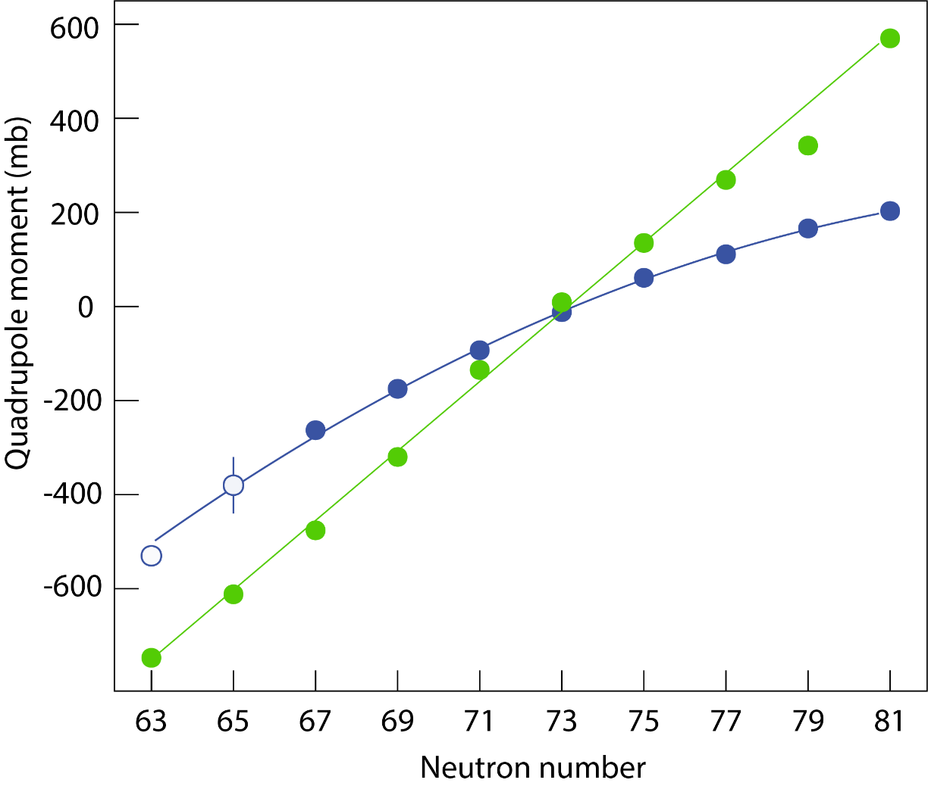
Recent highlights around the Z=50
Approach: Measurements of nuclear moments of unique parity orbitals
The picture : Cd (Z=48) – Sn (Z=50) – Te (Z=52)
Quadrupole moments
h_{11/2}
Sn -2p
N=82
shell closure
Sn, blue
Cd, green
D. T. Yordanov, L. V. Rodriguez et al., Comm. Phys. 3, 2021
L. V. Rodriguez, T. Lellinger, et al. in preparation 2024

Slide 27
The next 3 slides have been removed due to unpublished data

Slide 28
Recent highlights around the Z=82
Experiment: How do nuclear properties evolve from one shell closure to another?
₈₂Pb
₈₁Tl
₅₂Te
₅₀Sn
₄₈Cd
Theory: Can nuclear theory provide a quantitatively understanding at both shell closures?

Slide 29
The next 2 slides have been removed due to unpublished data

Slide 30
Conclusions
Laser spectroscopy is a powerful tool to investigate the atomic nucleus
Electromagnetic moments and charge radii can be extracted with very high precision
Simple trends seem to appear in complex nuclei, however, the understanding of such simple behavior is not based on simple assumptions
Nuclear theory is needed in order to explain the observed behaviors

Slide 31
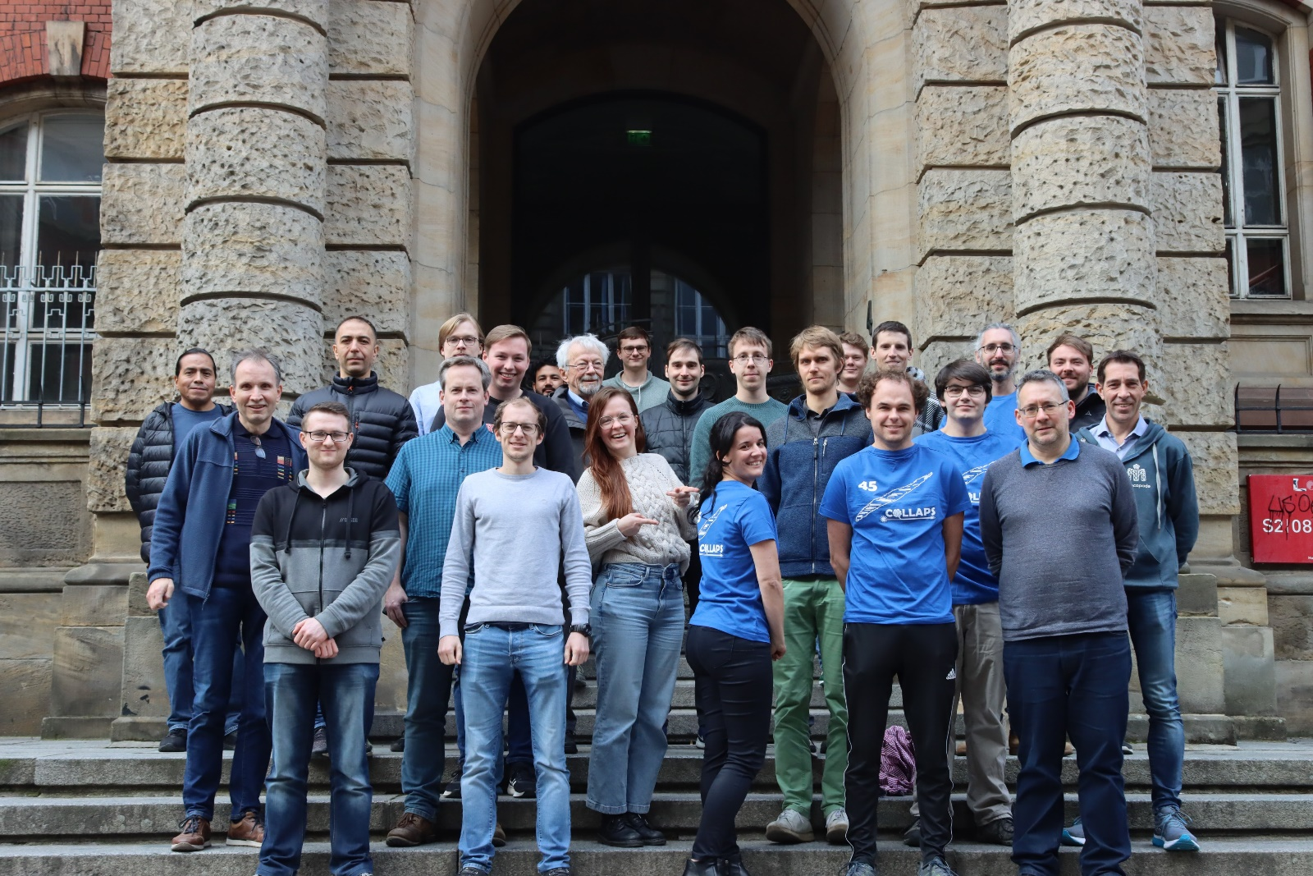



Thank you for your attention!

Slide 32
ISOLDE: CERN‘s radioactive nuclear factory
Spallation
²³⁸U
Fission
Fragmentation
Proton beam
hits the target

Slide 33
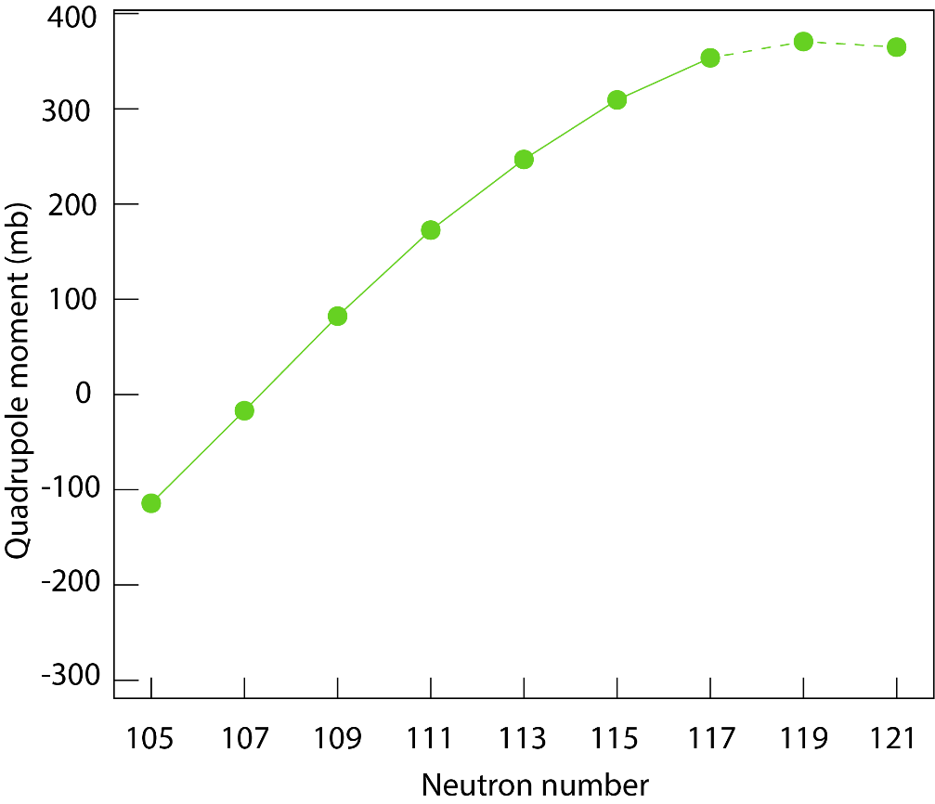
Recent highlights around the Z=82
Simple patterns in complex nuclei: from Sn to Pb
Quadrupole moments
Why can we compare Pb and Tl?
Proton orbits
Neutron orbits
N=126
Pb (Z=82)
3p_{1/2}
2f_{5/2}
3p_{3/2}
i_{13/2}
1i_{13/2}
1h_{9/2}
1h_{9/2}
2f_{7/2}
Qc
Z=82
3s_{1/2}
Pb, green
What happens if we remove 1p from Pb?
D. T. Yordanov, L. V. Rodriguez et al., Comm. Phys. 3, 2021
L. V. Rodríguez, L. Renth, et al., in preparation, 2024

Slide 34
Recent highlights around the Z=82
Simple patterns in complex nuclei: from Sn to Pb
Quadrupole moments
Why can we compare Pb and Tl?
Proton orbits
Neutron orbits
N=126
Pb (Z=82)
3p_{1/2}
2f_{5/2}
3p_{3/2}
i_{13/2}
1i_{13/2}
1h_{9/2}
1h_{9/2}
2f_{7/2}
Qc
Z=82
3s_{1/2}
Additivity rule
7+ : s_{1/2} proton and i_{13/2} neutron
Pb, green
0
1
Q(7+)=[ ]× Qsp + [ ]× Qsn
Q(7+) = Qsn = Q(i_{13/2})
D. T. Yordanov, L. V. Rodriguez et al., Comm. Phys. 3, 2021
L. V. Rodríguez, L. Renth, et al., in preparation, 2024

Slide 35
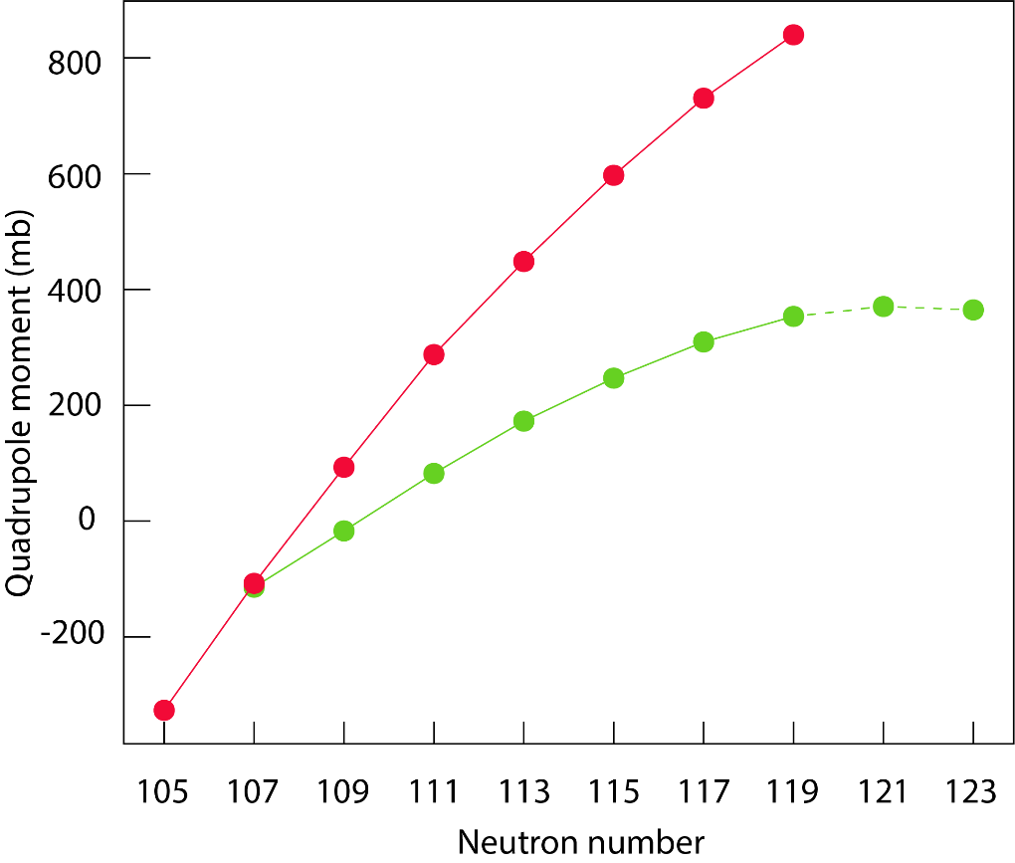
Recent highlights around the Z=82
Simple patterns in complex nuclei: from Sn to Pb
Quadrupole moments
Why can we compare Pb and Tl?
Proton orbits
Neutron orbits
N=126
3p_{1/2}
2f_{5/2}
3p_{3/2}
1i_{13/2}
+ Q_{hole}?
1h_{9/2}
1h_{9/2}
2f_{7/2}
Z=82
Qc
3s_{1/2}
Additivity rule
7+ : s_{1/2} proton and i_{13/2} neutron
Pb, green
Tl, red
0
1
Q(7+)=[ ]× Qsp + [ ]× Qsn
Q(7+) = Qsn = Q(i_{13/2})
L. V. Rodríguez, L. Renth, et al., in preparation, 2024

