Slide 1
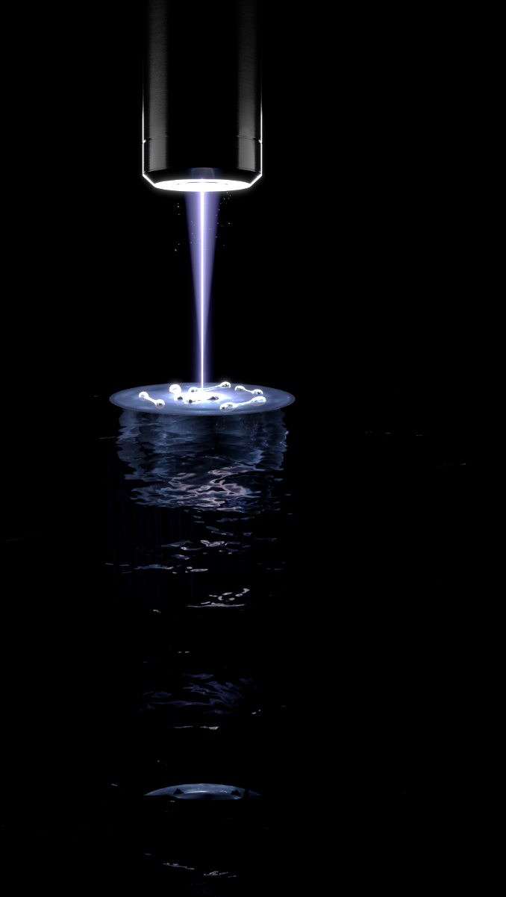

Observing the emergence of elliptic flow
Sandra Brandstetter
Selim Jochim Group
Art by Jonas Ahlstedt / Lund Bioimaging Centre (LIBC)

Slide 2

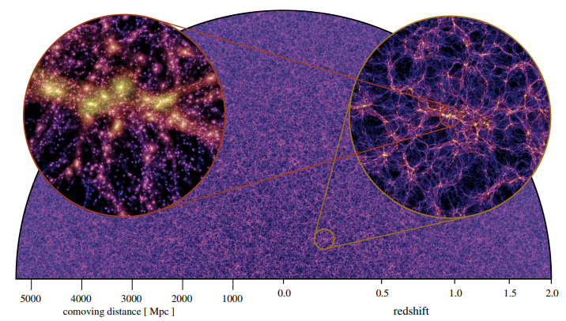
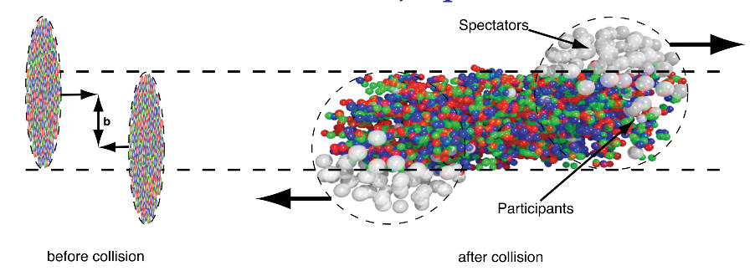
What is a fluid?
Size
R. Snellings, New Journal of Physics 13 (2011) 055008
https://arxiv.org/abs/2210.10059
Continuous medium
Separation of scales

Slide 3
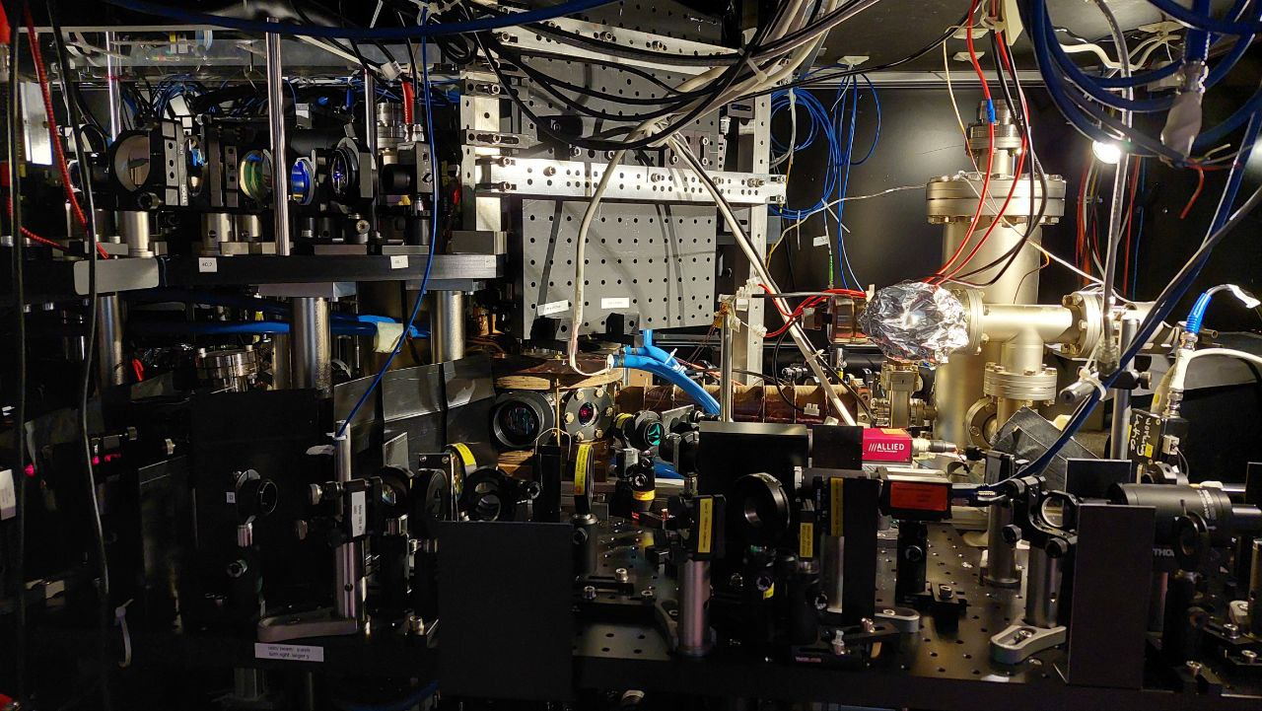
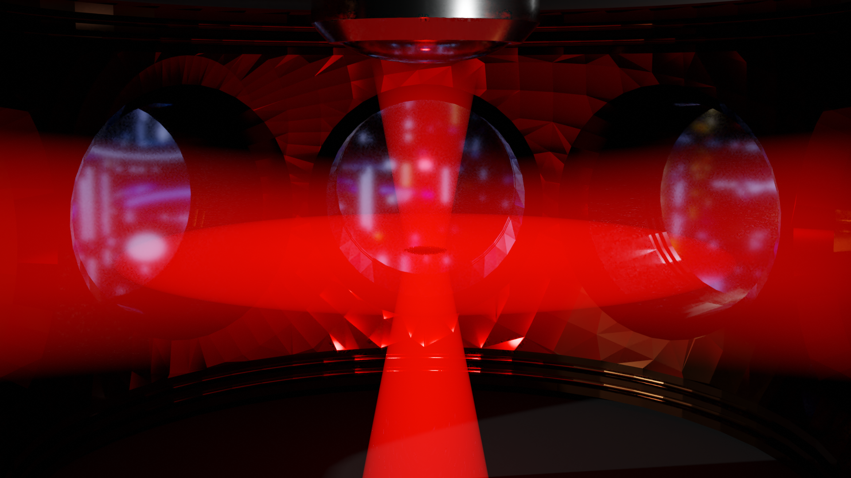
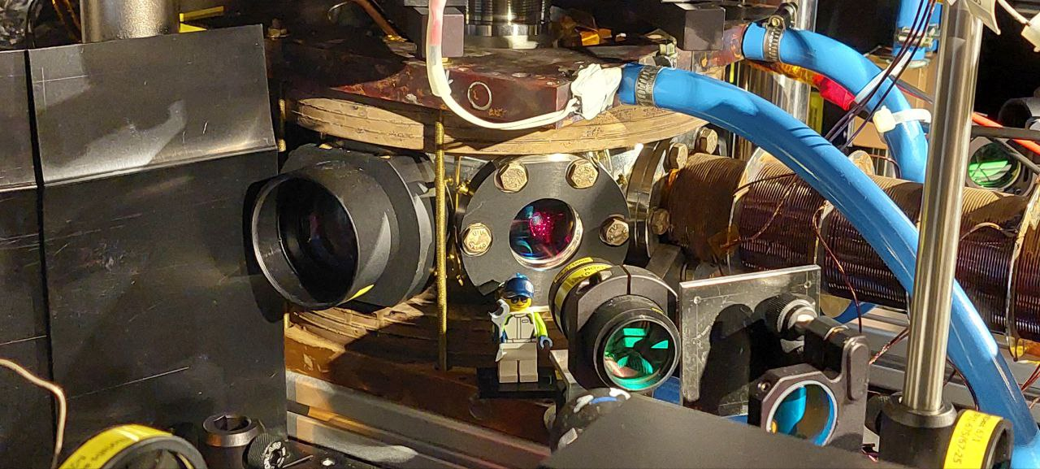
.
Tweezer
2D trap
Notes:
Normal experimental cycle – Oven ZSL MOT ODT -
Start out with equal mixture of 2 spin states of Li 6 – confined in 2 D geometry
Sheet for 2D + tweezer – radial control
Tweezer – 2D sheet, white color

Slide 4
Ultracold quantum gases
T(K)
T(K)
Bosons
Fermions
E_{F}
0
0

Slide 5
How to juggle with single (fermionic) atoms
Producing a super cold sample
k_{y}
k_{y}
k_{x}
k_{x}
F. Serwane et al., Science 332, 336 (2011)

Slide 6
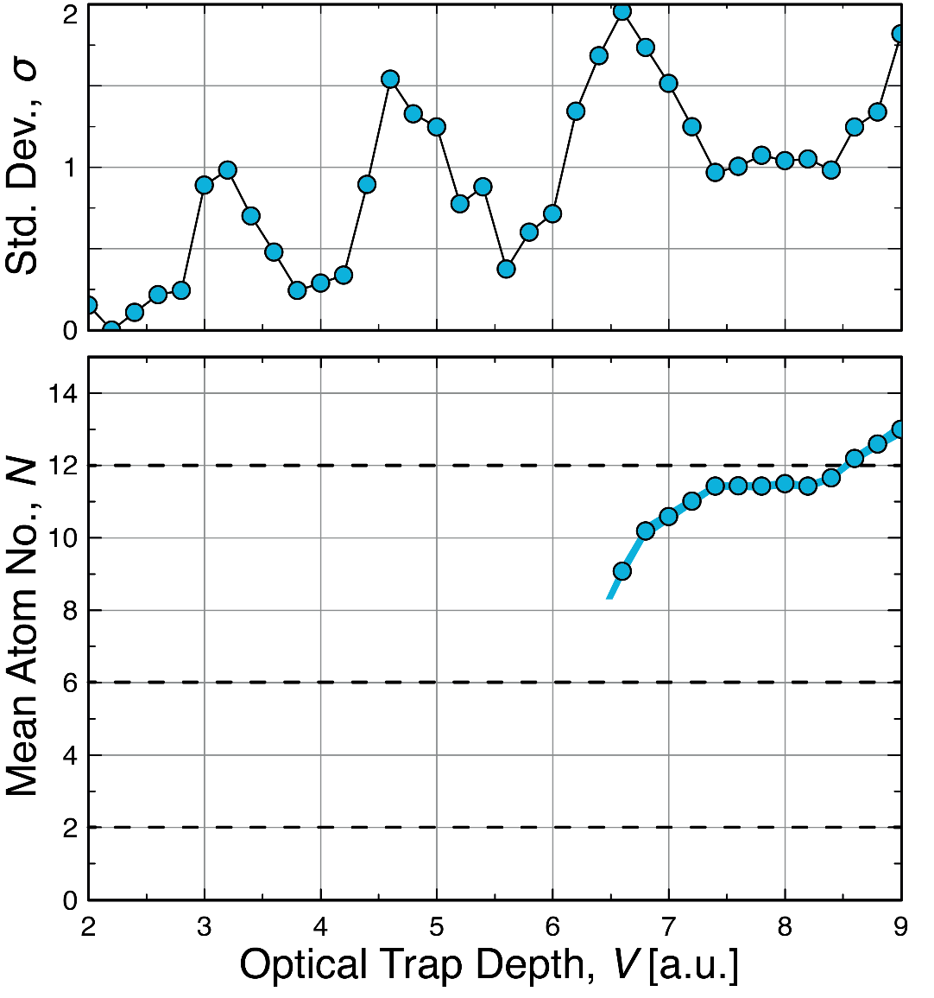
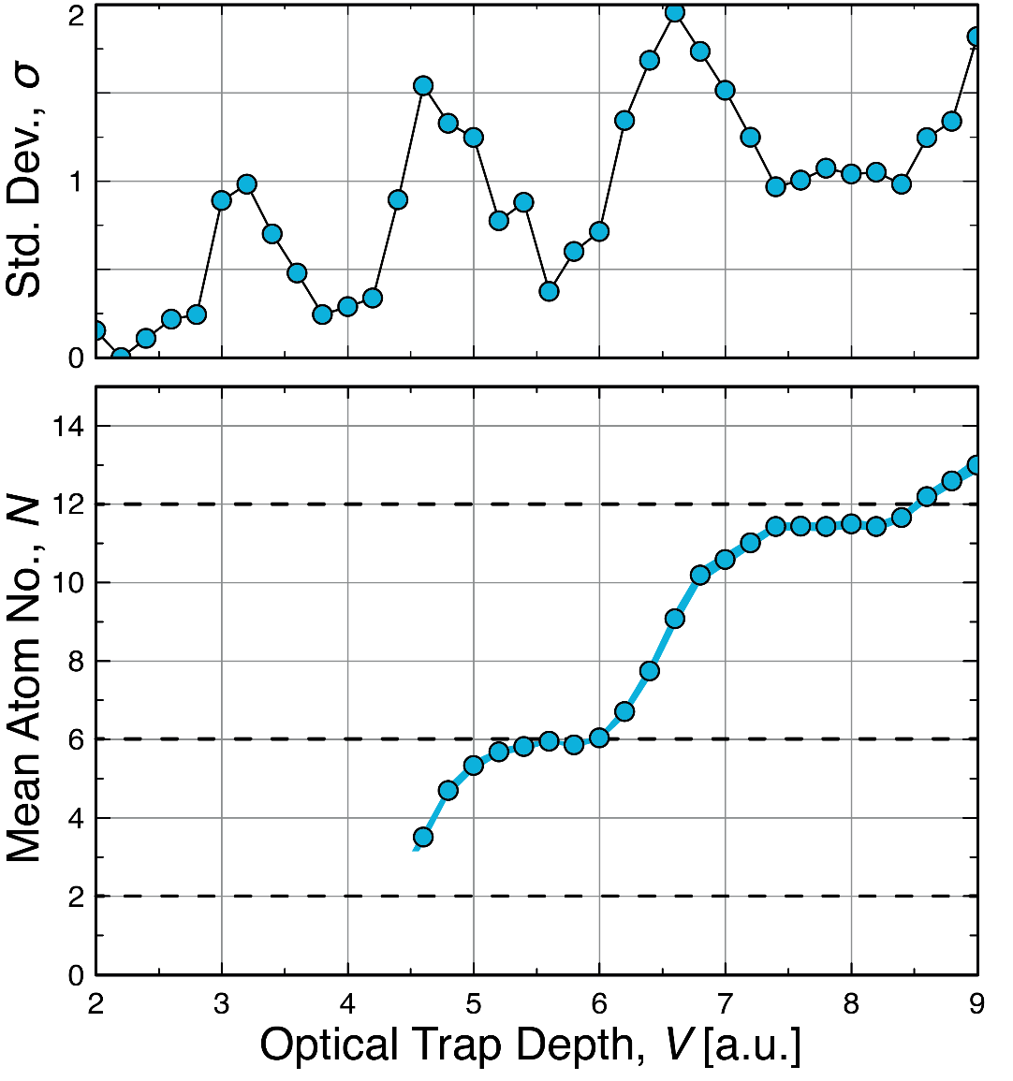
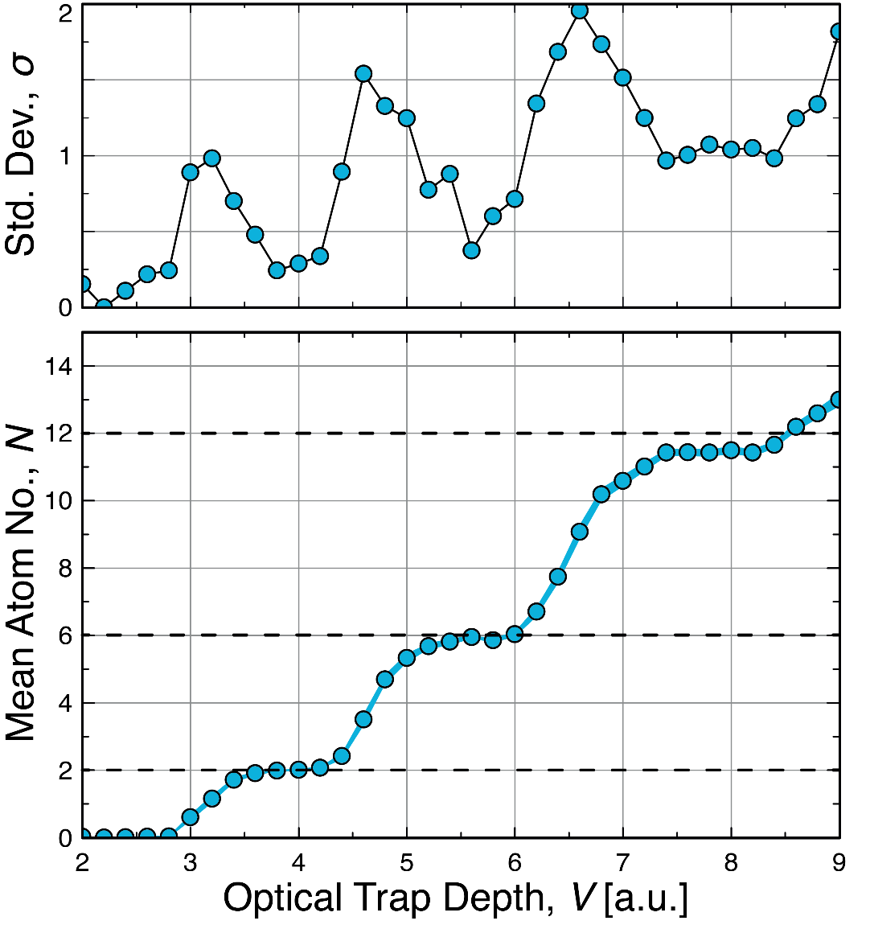
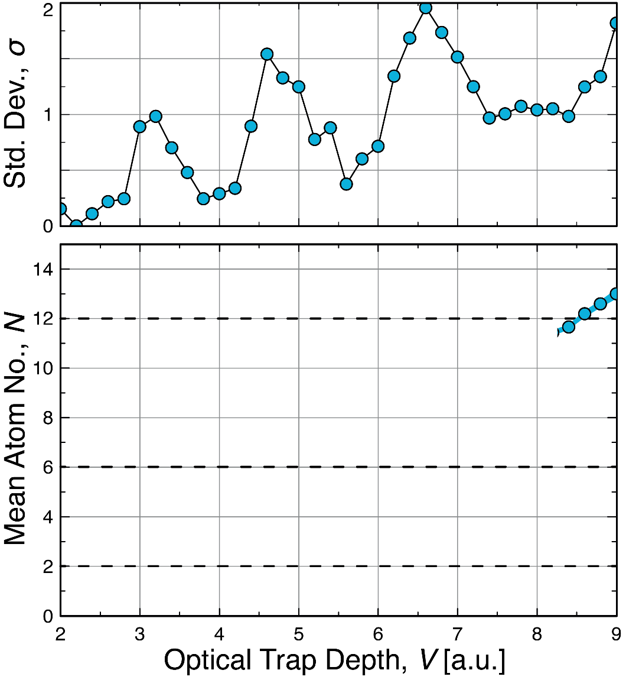


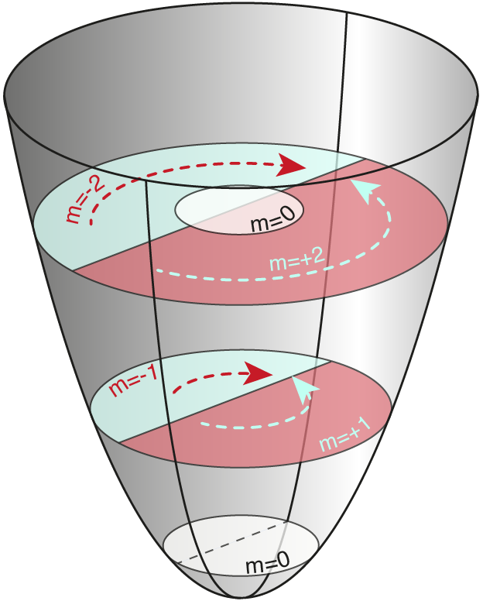
Deterministic Preparation in 2D
Number states
Reduced confinement to ‘spill out’ atoms
Bayha, L et al. Nature 587, 583–587 (2020)
Notes:
Prepare Number states – repeatability – basically T = 0K (dont think about temperature)
Fundamental ingredients – Pauli – fixed number of particles remain trapped
Key word!

Slide 7
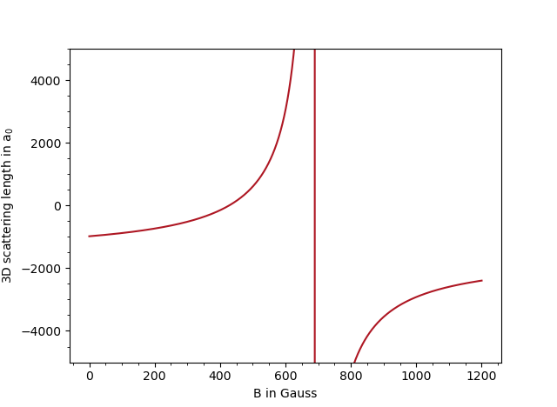

Introducing Interactions
Contact interactions between up and down
Tuneable via magnetic field
In 2D: two particle bound state at any attraction
Binding energy used to characterize system.
$$E_{B}=\frac{ℏ}{2ma_{2D}^{2}}$$

Slide 8
Interaction switch off
Fast interaction switch off
Raman induced spin flip
M. Holten et al., Nature 606, 287–291 (2022)

Slide 9
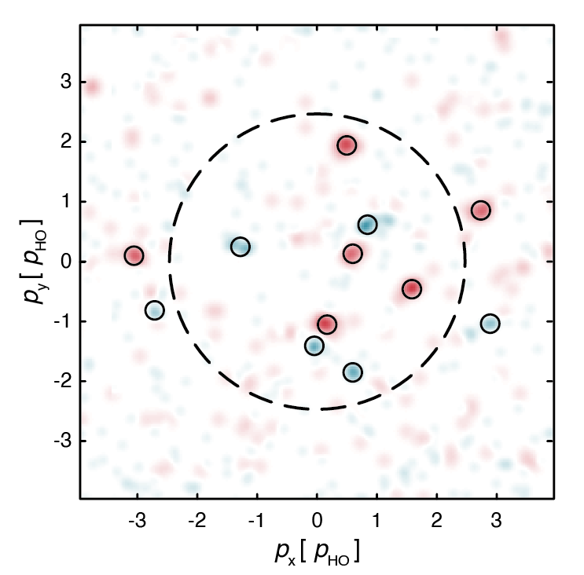
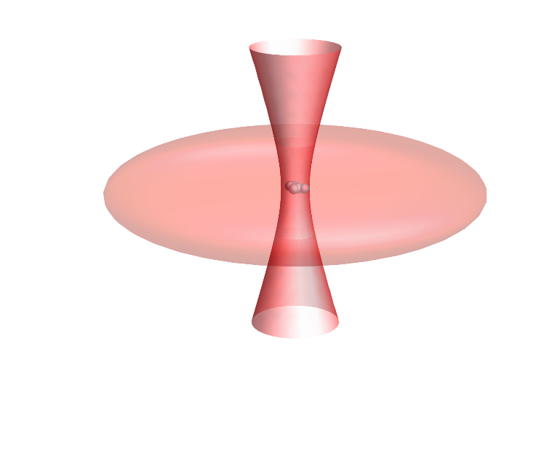
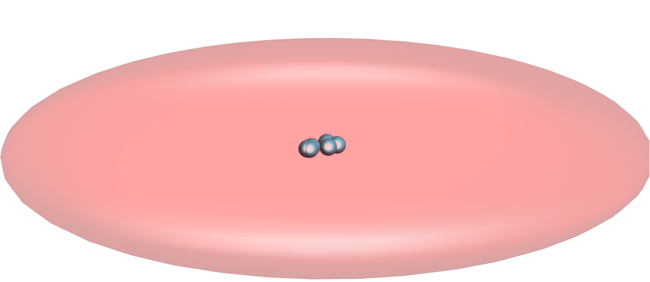
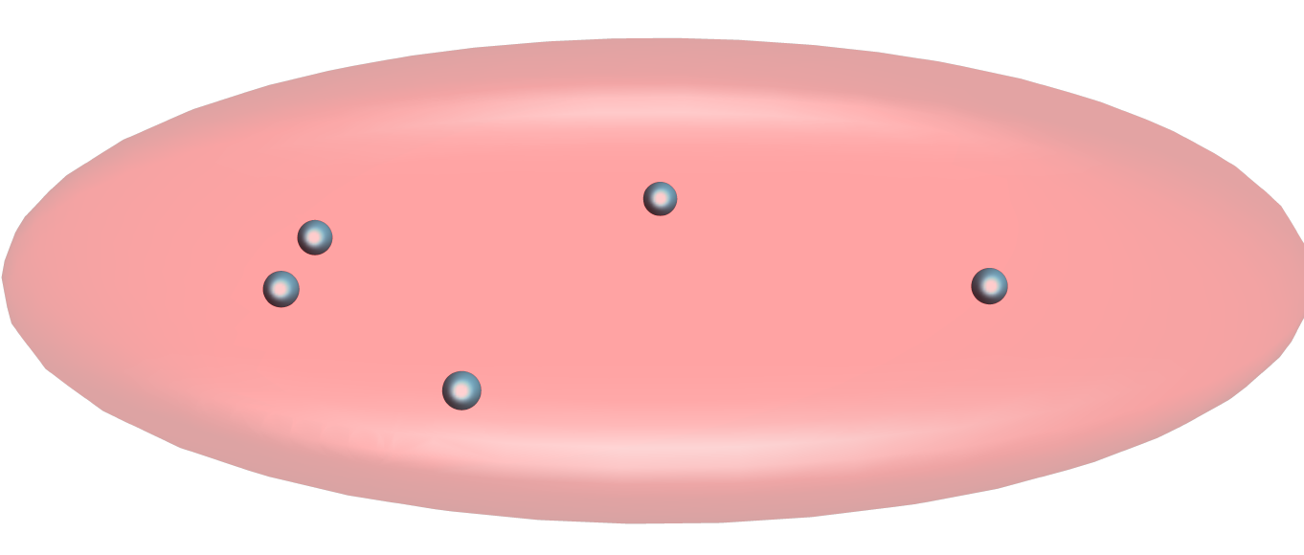
Microscopy – momentum space
x
x
x
Spin Resolved Momentum Distribution
y
p(t_{int})
0
t_{int}
t_{int}+t_{exp}
t
M. Holten et al., Nature 606, 287–291 (2022)

Slide 10
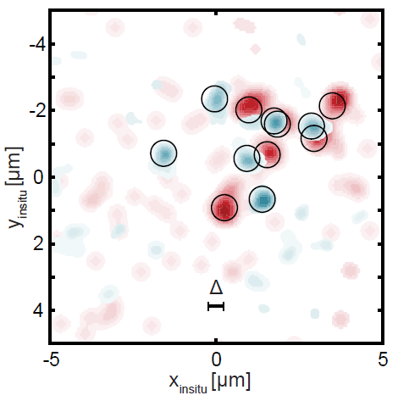
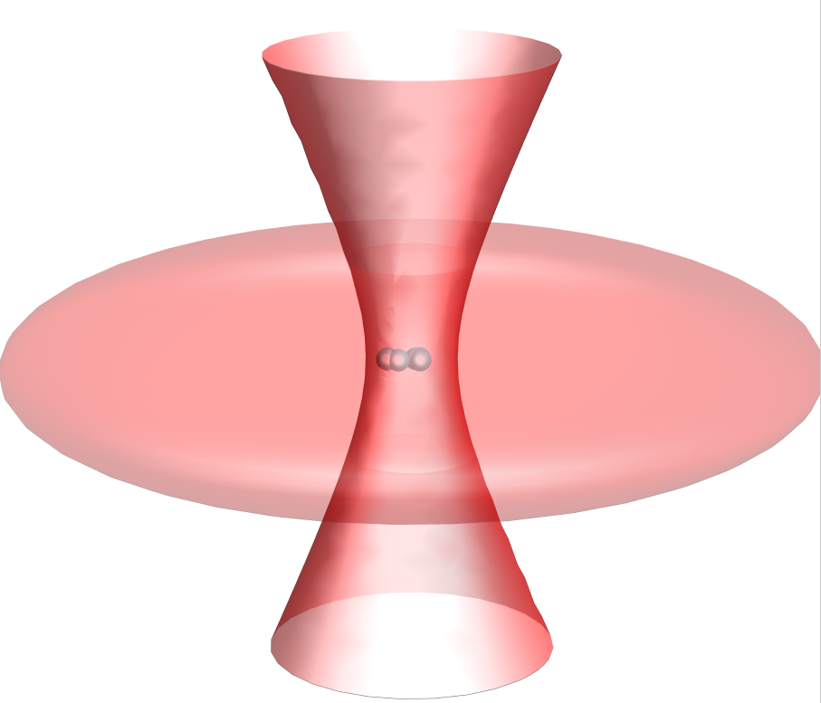
Microscopy – real space
x
x
x
x
y
x(t_{int})
0
t_{int}
t_{int}+T₁/4
t_{int}+T₁/4+t_{exp}
t
[1] Asteria et al. “Quantum gas magnifier for sub-lattice-resolved imaging of three-dimensional quantum systems“. Nature 599, 571–575 (2021)
[2] Murthy et al. “Matter-wave Fourier optics with a strongly interacting two-dimensional Fermi gas”. Phys. Rev. A 90 (2014), 043611
[3] Murthy et al. “Direct imaging of the order parameter of an atomic superfluid using matterwave optics”. Arxiv Preprint (2019). arXiv:1911.10824

Slide 11
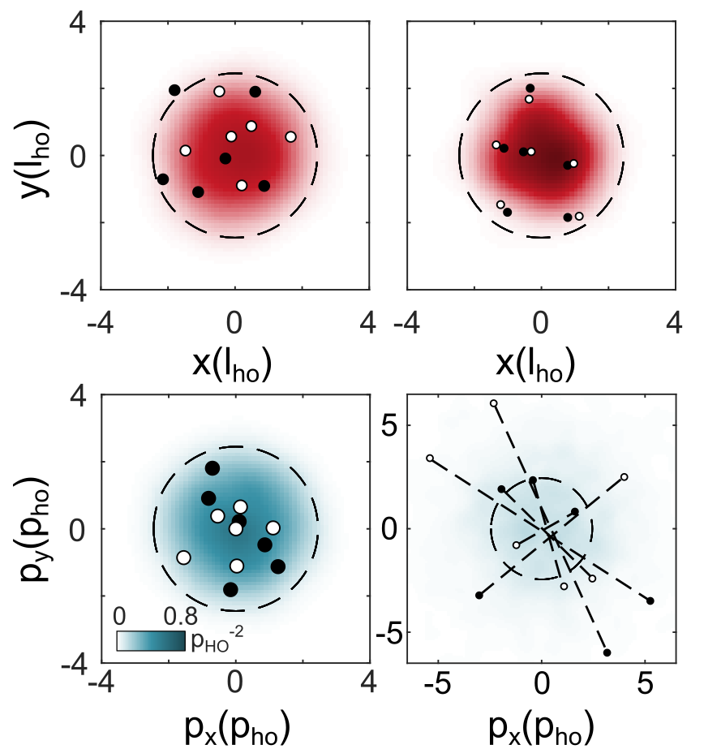

Microscopy of molecules
Non-interacting
Strongly interacting
Momentum space:
Holten et al. Nature 606, 287–291 (2022)

Slide 12
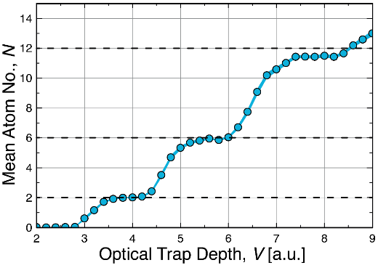
Toolbox
Number states
Tuneable interactions
Instantaneous
switch off
Closed + open shell
BCS side of crossover
Momentum Distribution
Real Space Distribution
Atom number counting

Slide 13
Do 10 particles behave like a fluid?
Art by Jonas Ahlstedt / Lund Bioimaging Centre (LIBC)
Notes:
Classical hydro picture
Elliptic expansion
Interactions – larger forces in direction of larger density

Slide 14
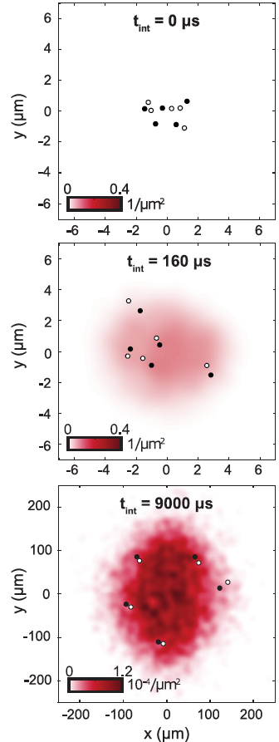
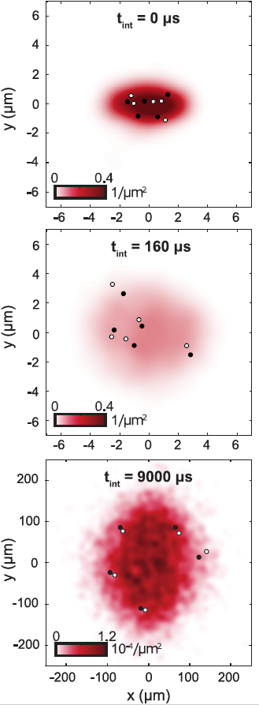
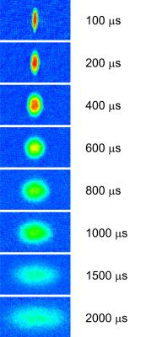
Elliptic flow of 10 particles
Prepare in elliptic trap
5+5 atoms
Strongly interacting
≈1000 samples reveal density
Brandstetter, Lunt et al. arxiv: 2308.09699
K. O‘Hara et al., Science 298, 2179 (2002)
Notes:
A little bit of intuitive theory

Slide 15
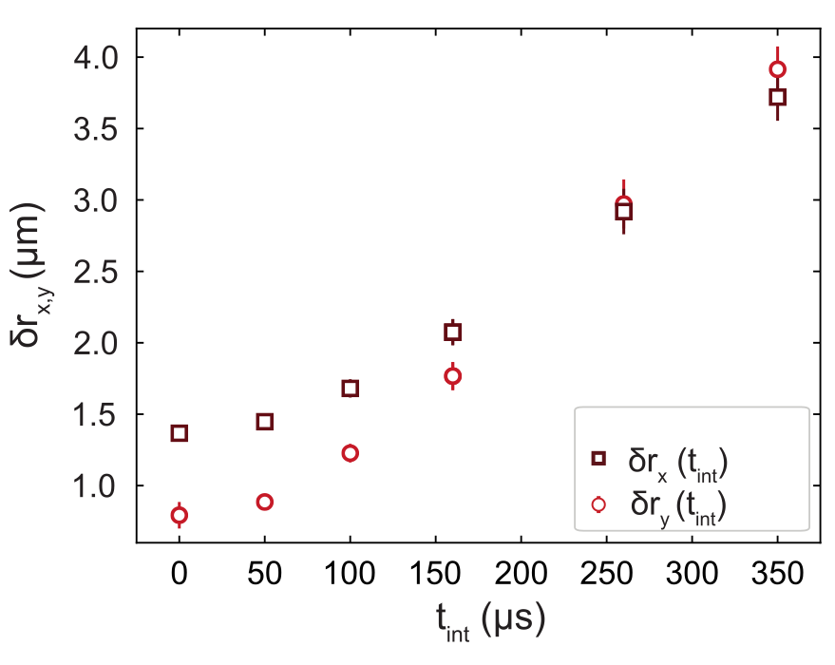
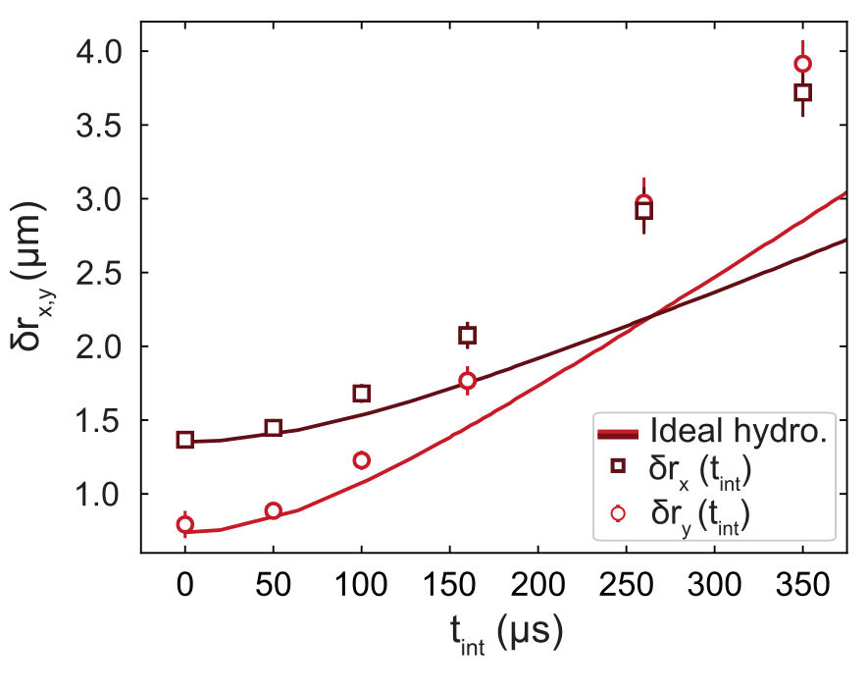
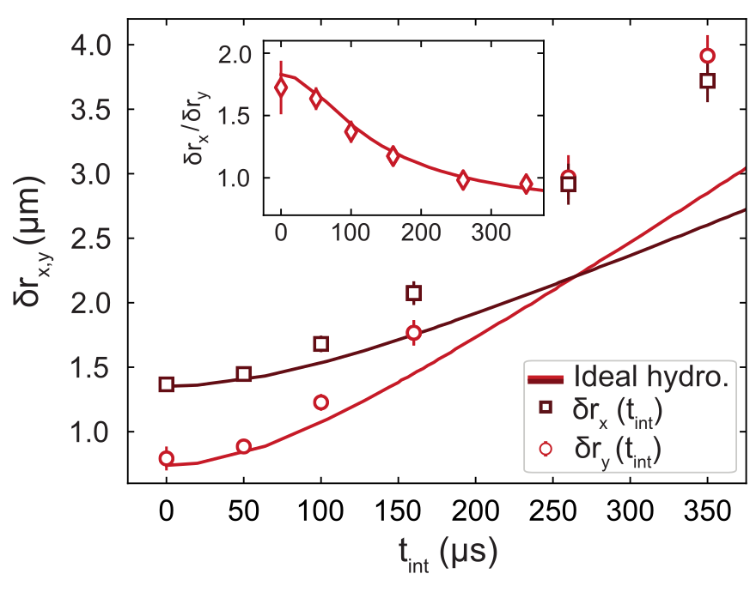
Real space evolution
Brandstetter, Lunt et al. arxiv: 2308.09699
Notes:
Breath
Expalin axis

Slide 16
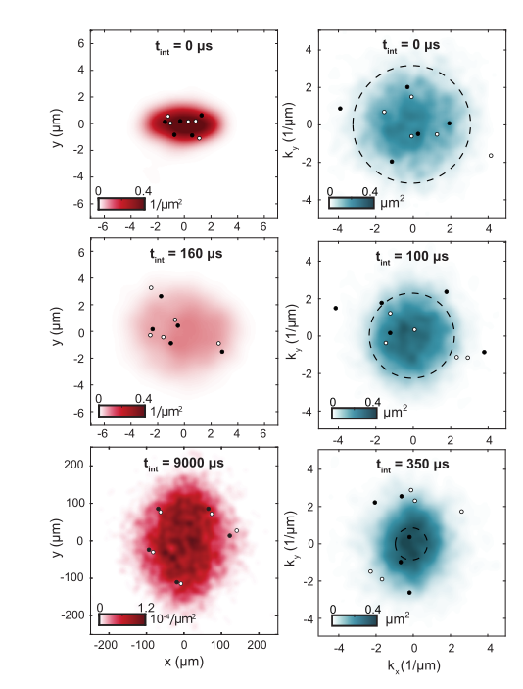
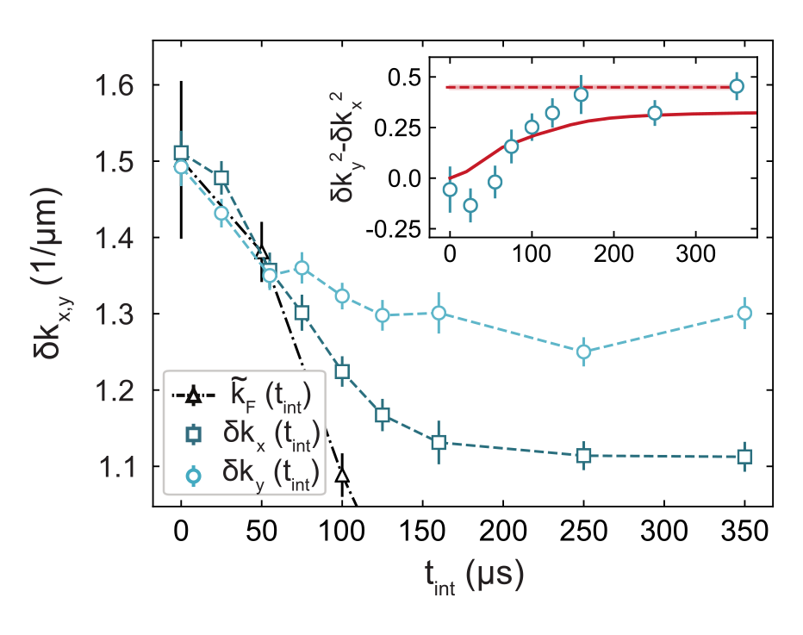
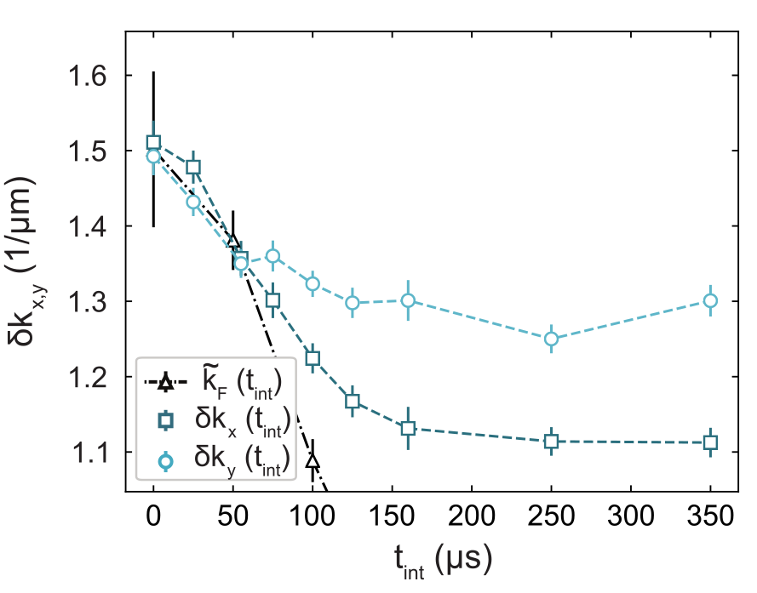
Momentum evolution
Brandstetter, Lunt et al. arxiv: 2308.09699
Notes:
Breath
Redistribution of momenta from strongly confined to weakly confined direction
Decrease: we measure RMS momenta, NOT something like a velocity field – includes fluctuations – decrease as gas expands in x – mechanism unclear
Gas accelerates – momentum space size shrinks
RMS MOMENTUM
Very strong indication for quantum hydro – not thermal!

Slide 17
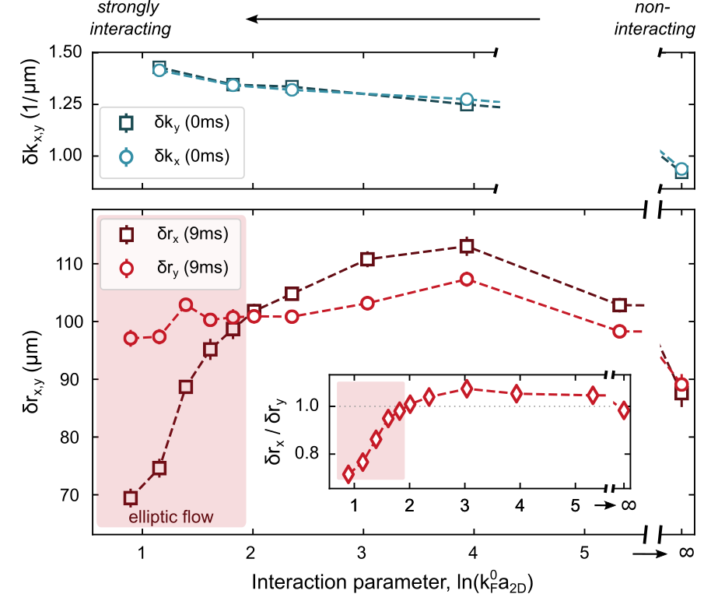
Tuning the interaction strength
Symmetric insitu momenta
Higher interaction strength → stronger ellipticity
Below critical interaction strength
  No inversion
  Initial ellipticity maintained
  Mean field effect
Brandstetter, Lunt et al. arxiv: 2308.09699
Notes:
EB (EF)

Slide 18
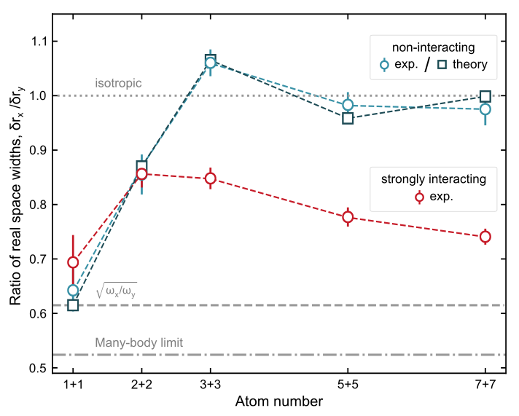
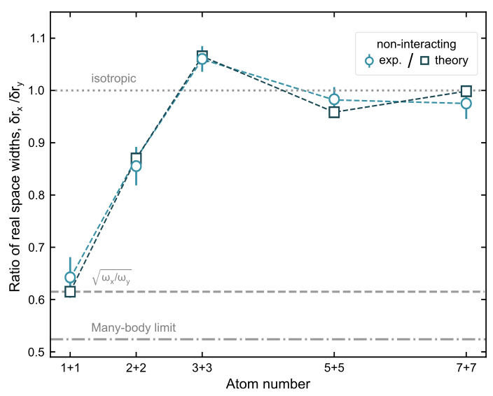
Atom number dependence
Noninteracting:
Higher N → formation of round fermi surface
Comparison to analytic solution of |ψ(p_{x},p_{y})|²
Interacting:
Higher N → stronger ellipticity
Inversion requires interactions
Brandstetter, Lunt et al. arxiv: 2308.09699
Notes:
Breath!
New axis
1+1 -> effectively molecule
Trivial single particle quantum system changes aspect ratio – not necesseraly signature
Few particle behaviour first only 5+5 – stress that 1 is round

Slide 19
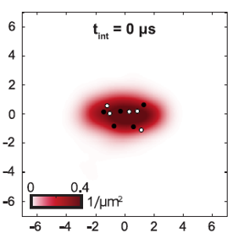
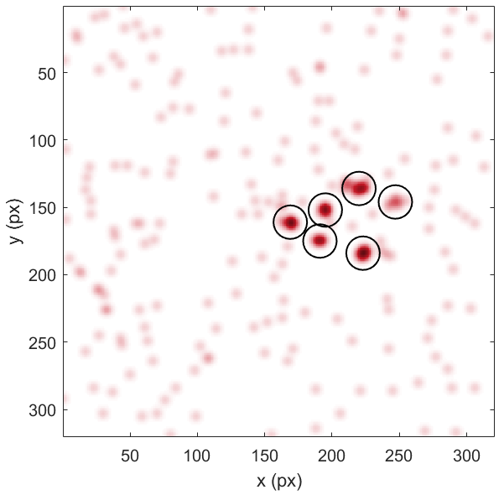
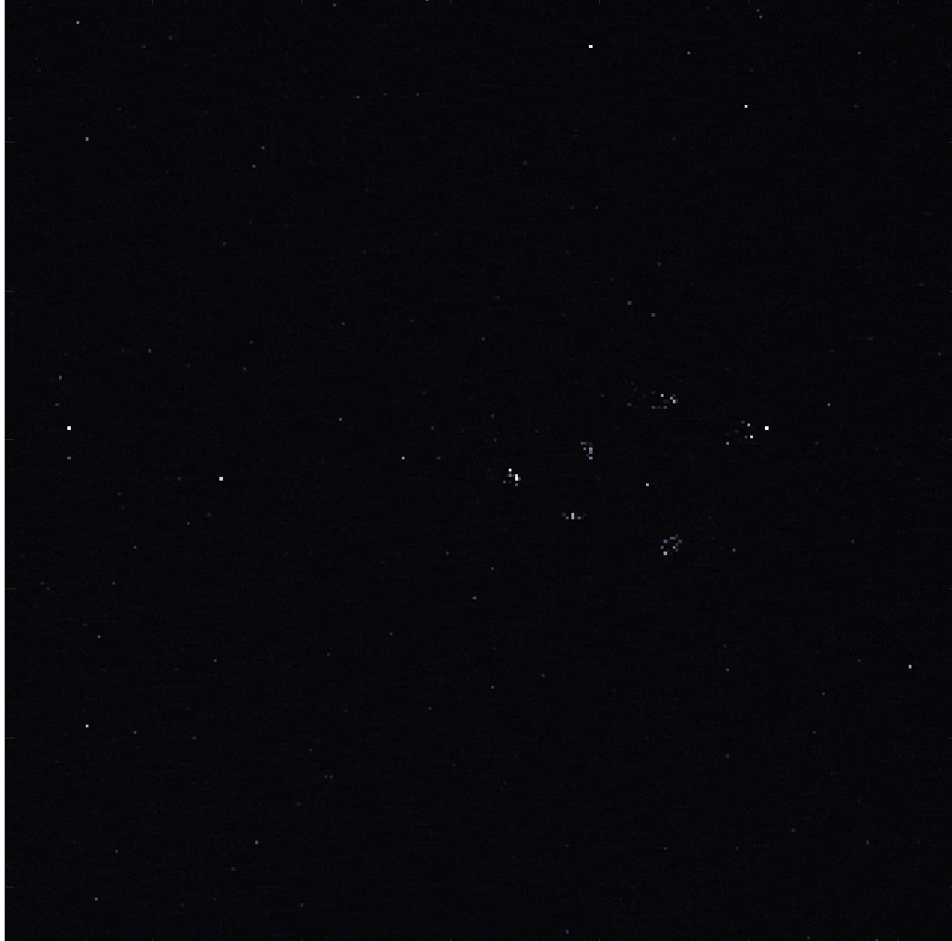
Outlook
Entanglement in initial system
What happens if we turn on interactions during the expansion?
Image reconstruction
Detector Bias
New tools from heavy ion community?
Pair formation during interacting expansion
Role in collectivity
Freeze out radius - HBT

Slide 20
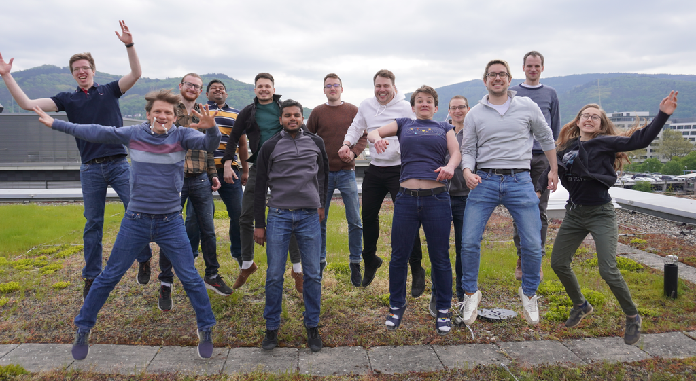







Thank you for your attention!
Maciej Gałka
Tobias
Hammel
Maximilian
Kaiser
Philipp Lunt
Carl Heintze
Suraj Iyer
Jonas
Herkel
Johanna Schulz
Jan Ricken
Paul Hill
Keerthan
Subramanian
Selim
Jochim
Gerhard Zürn
Johannes Reiter
Want to join?
jochim@uni-heidelberg.de

Slide 21

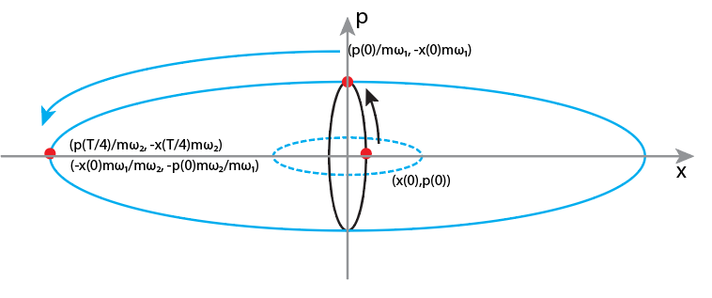
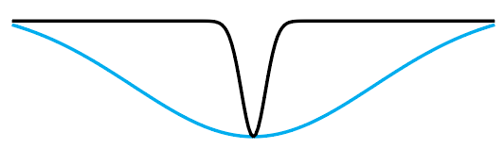
Scheme
A T/4 – propagation in a harmonic trap corresponds to a Fourier transform:
Use two subsequent Fourier transforms - magnification
I Svarchuk et al., PRL 89, 270404 (2002)
A. H. van Amerongen et al., PRL100, 09040 (2008)
S. Tung et al., PRL 105, 230408 (2010)
T. Jacqmin et al., PRA 86, 043626 (2012)
Asteria et al., Nature 599, 571 (2021)
Murthy et al., arXiv:1911.10824
Murthy et al., Phys. Rev. A 90 (2014), 043611

Slide 22
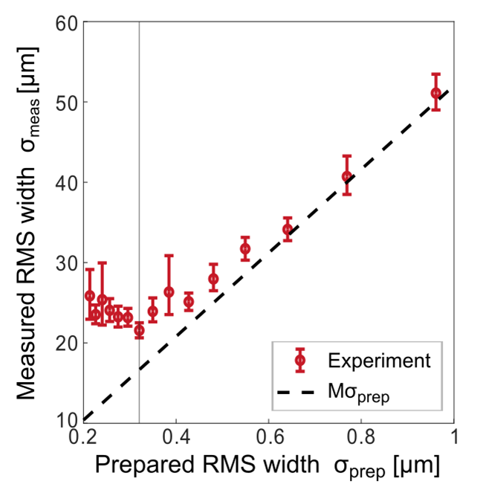
Performance
Resolution: ≈ 300nm
Notes:
Prepared width vs observed width
Avoid long discussion about abberations!

Slide 23
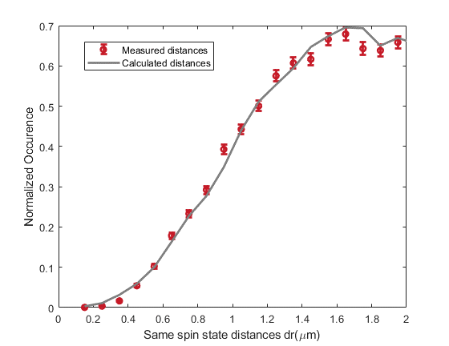
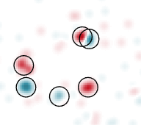
Performance
Resolution: ≈ 300nm
Detection hole < Pauli hole
1
y (l_{HO})
0
-1
-1
0
1
x (l_{HO})
Notes:
Challenge: distinguish individual atoms – sketch – we can distinguish individual atoms

Slide 24
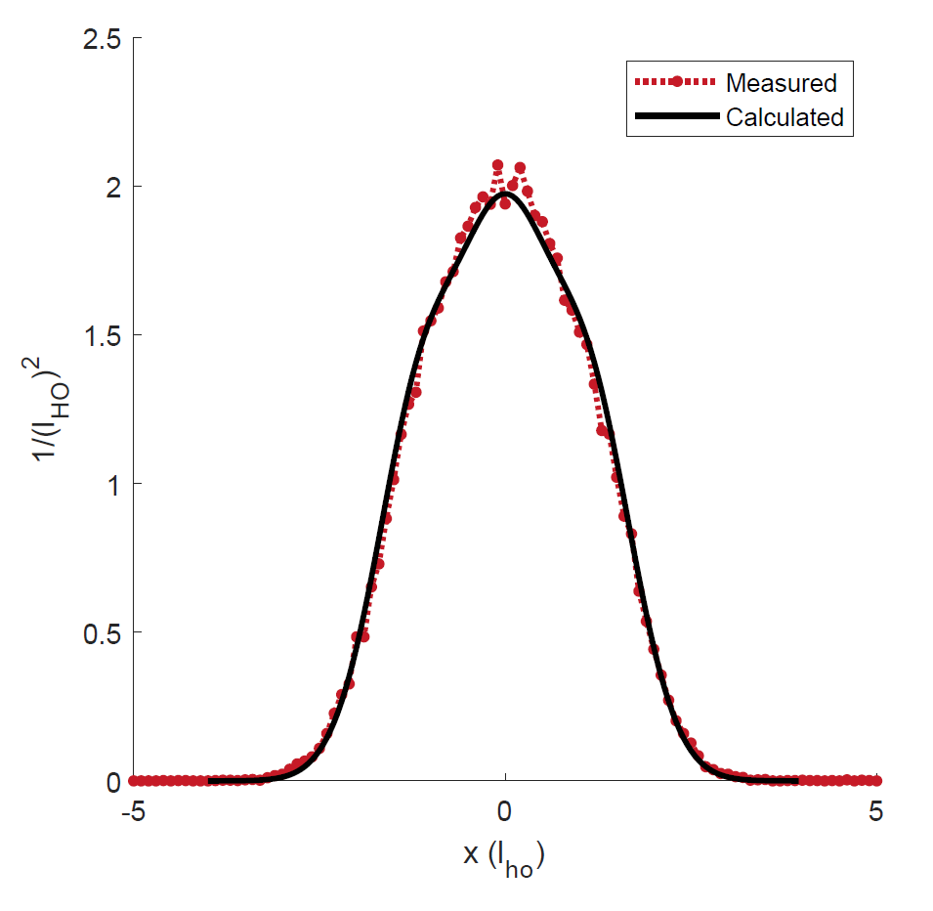
Performance
Resolution: ≈ 300nm
Detection hole < Pauli hole
Deviation from calculated energy:
  3+3 atoms: 1%
  6+6 atoms: 4%
Notes:
3 spin up + 3 spin down atoms
Remove guide to the eye
Main point: precise!

Slide 25
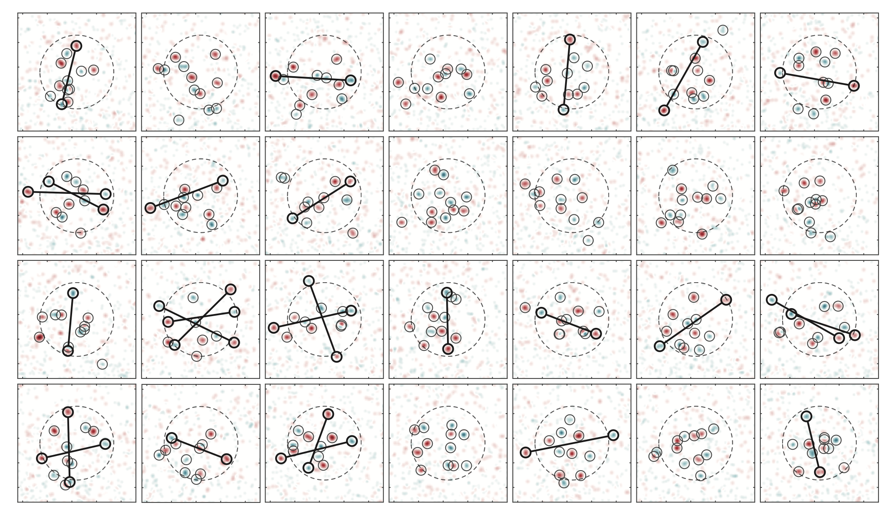
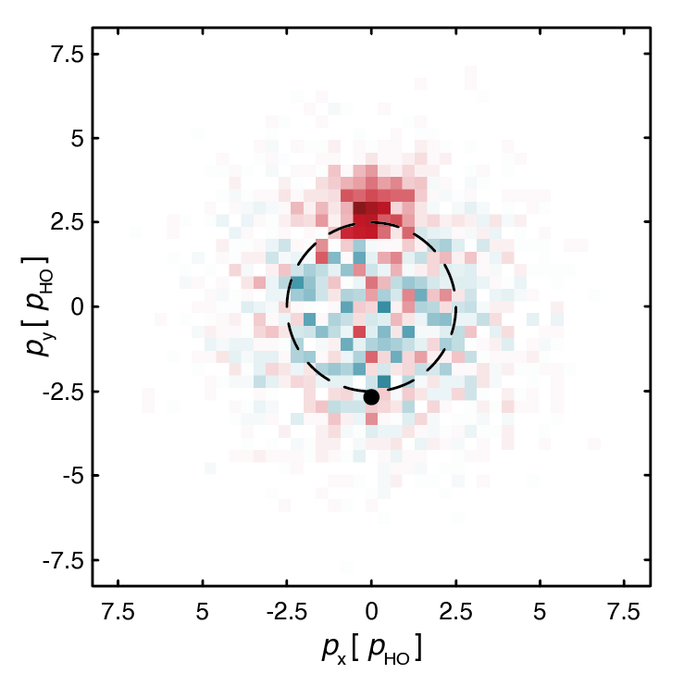
$$𝒞^{\left(2\right)}\left(p_{↑},p_{↓} \right)=<n\left(p_{↑}\right)n\left(p_{↓}\right)>− <n\left(p_{↑}\right)><n\left(p_{↓}\right)>$$
Holten et al. Nature 606, 287–291 (2022)
Notes:
Snapshot of the many particle wavefunction on momentum – all same state, but different snapshots

Slide 26
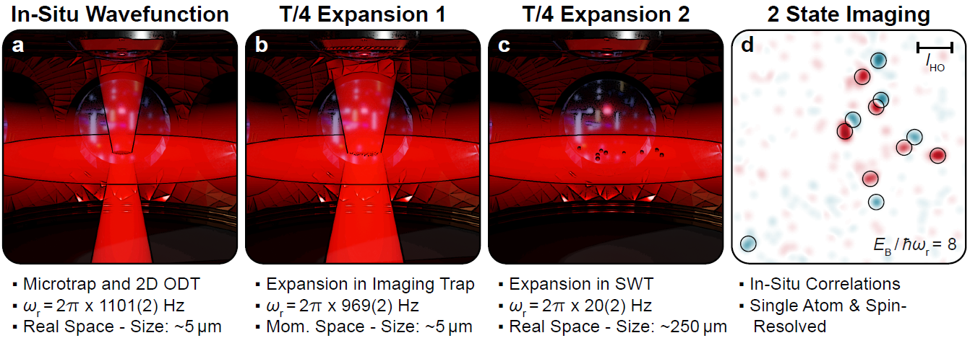
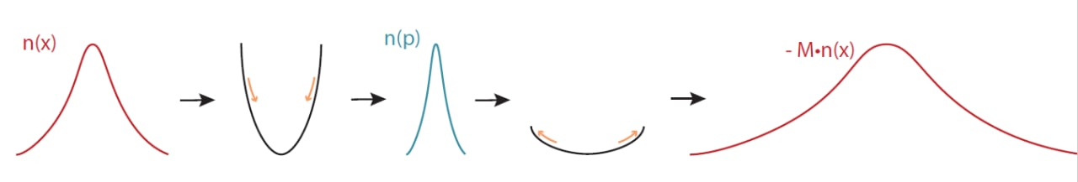

Scheme
[1] Asteria et al. “Quantum gas magnifier for sub-lattice-resolved imaging of three-dimensional quantum systems“. Nature 599, 571–575 (2021)
[2] Murthy et al. “Matter-wave Fourier optics with a strongly interacting two-dimensional Fermi gas”. Phys. Rev. A 90 (2014), 043611
[3] Murthy et al. “Direct imaging of the order parameter of an atomic superfluid using matterwave optics”. Arxiv Preprint (2019). arXiv:1911.10824
Notes:
Needed?
Every shot – projection on position of momentum – C&P Freiburg slide

Slide 27
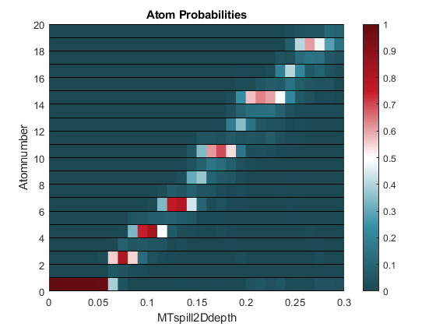
Shell structure anisotropic trap
ħω_{y}= 3∙ħω_{x}
E
ħω_{x}

Slide 28
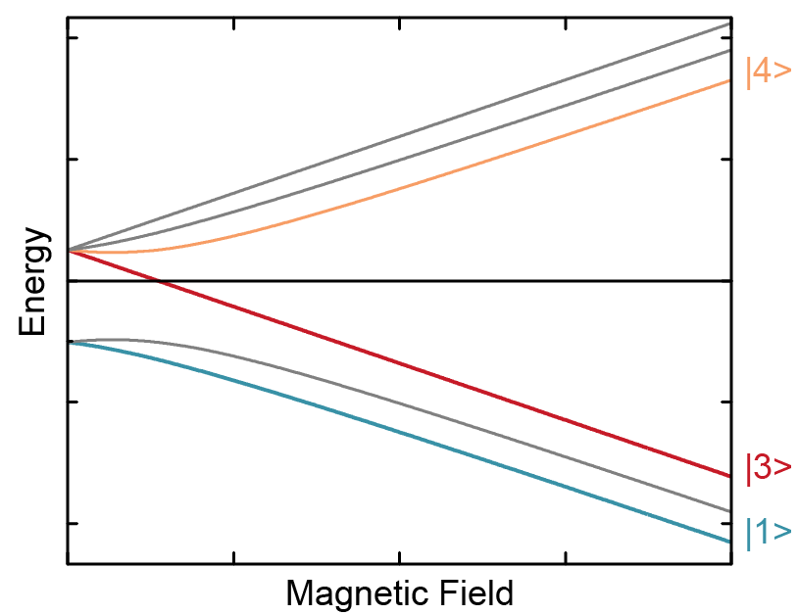
Interaction Switchoff
Use 2 Lasers for Raman transition from |3> to |4>
Interactions are switched off in 370ns
Jump magnetic field to optimal value
Apply radiofrequency pulses to transfer |1> first to |2> and finally to |3>
Image all atoms in |3>
Transfer second spin state back from |4> to |3>
Image all atoms in |3>

Slide 29
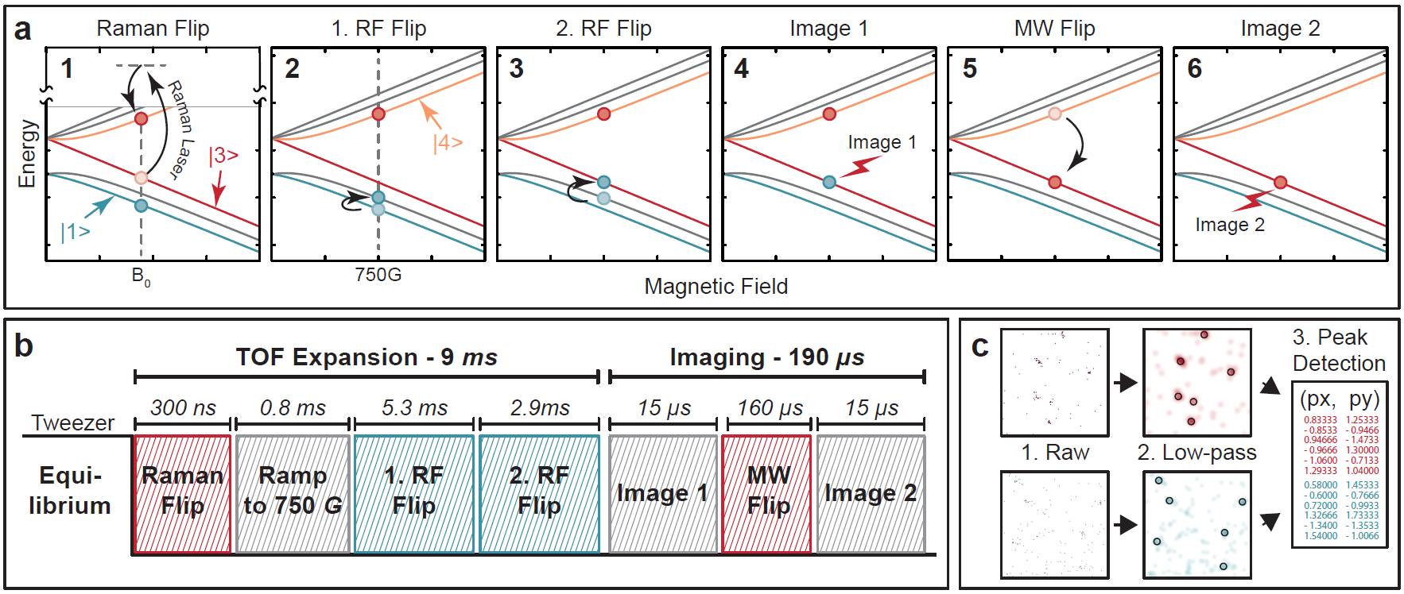
Imaging Sequence

Slide 30
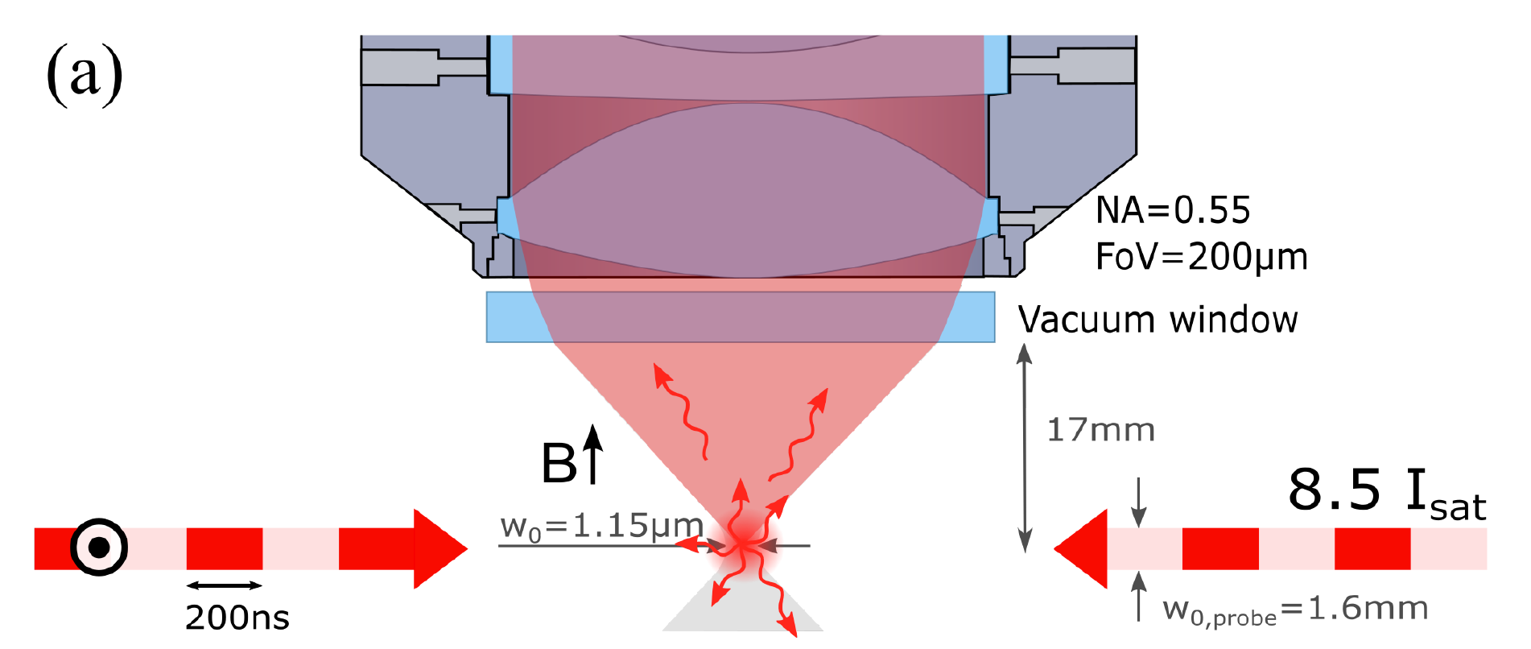
Single-particle detection
Free-space fluorescence imaging:
25 photons/atom
no confining potentials
only resonant light
Light-sheet imaging of Rb: Bücker et al., NJP 11 103039 (2009)
Our work: Bergschneider, Klinkhamer, et al. Phys. Rev. A 97, 063613 (2018)
Notes:
emphasize few photon regime, low background

Slide 31

20 μs exposure
EMCCD camera
background 0.003 photons/pixel
10 μm
Notes:
transition
how many pixels, only 4 brigt ones

Slide 32

20 μs exposure
10 μm

Slide 33


Slide 34

Single-particle detection in free space
Notes:
17 cm width 8 down 10 left

Slide 35


Two State Imaging
Time-of-flight in the non-interacting state to map momentum on position space
Two spin sensitive images in fast succession to obtain full momentum distribution.
Spin Resolved Momentum Distribution
M. Holten et al., Nature 606, 287–291 (2022)

Slide 36

Single Atom Imaging Fidelity

Slide 37


Distribution Fermi gas
Real space:
Momentum space:
Intuitive explanation: asymmetry of trap deforms equipotential lines in x (E_{pot}), but not in p (E_{kin})

Slide 39
Default Text Boxes
Default Caption
Default Text
Default Reference

Slide 40


Symbols

