Slide 1
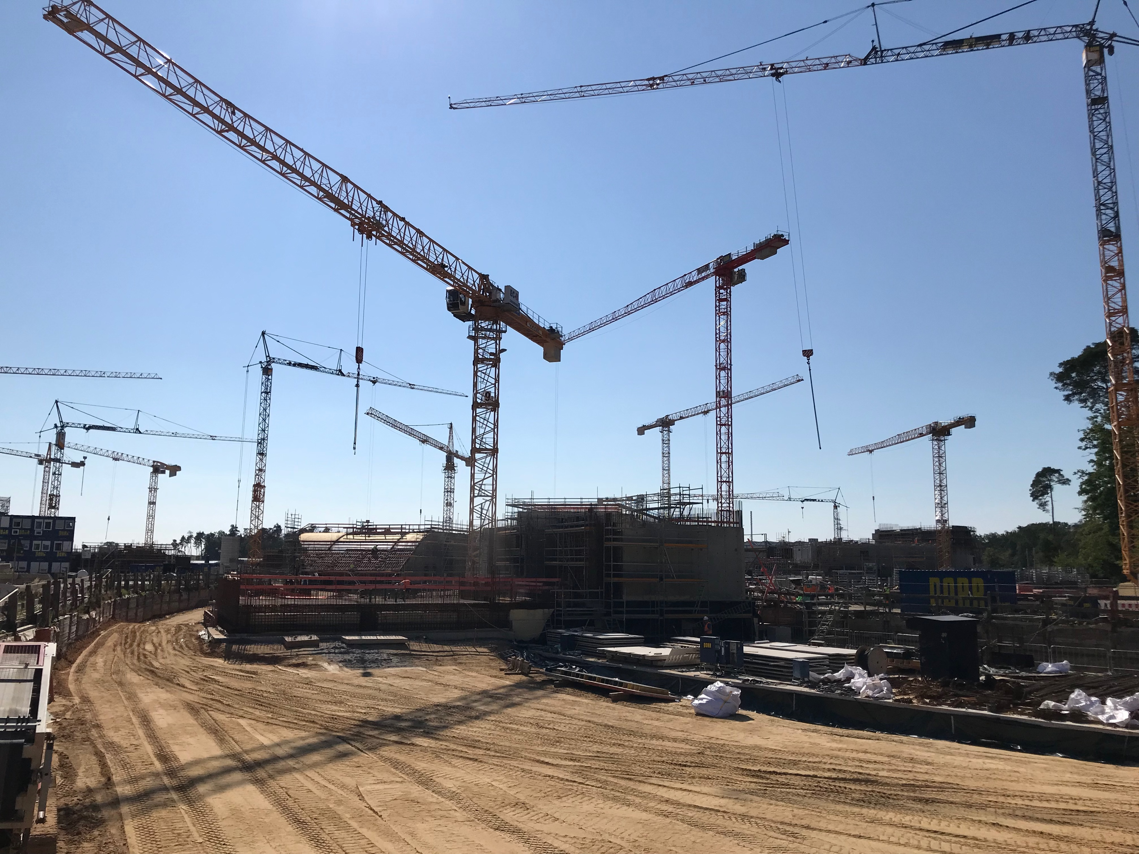
Beamtime schedule 2024-2025 Daniel Severin
Super-FRS collaboration meeting 01/2024

Slide 2
Outlook
2024
Next beamtime 2025
Physics beamtime 2026 and beyond

Slide 3
Outlook
2024
Next beamtime 2025 - 2027
ACC news
- First conclusions of engineering run

Slide 4
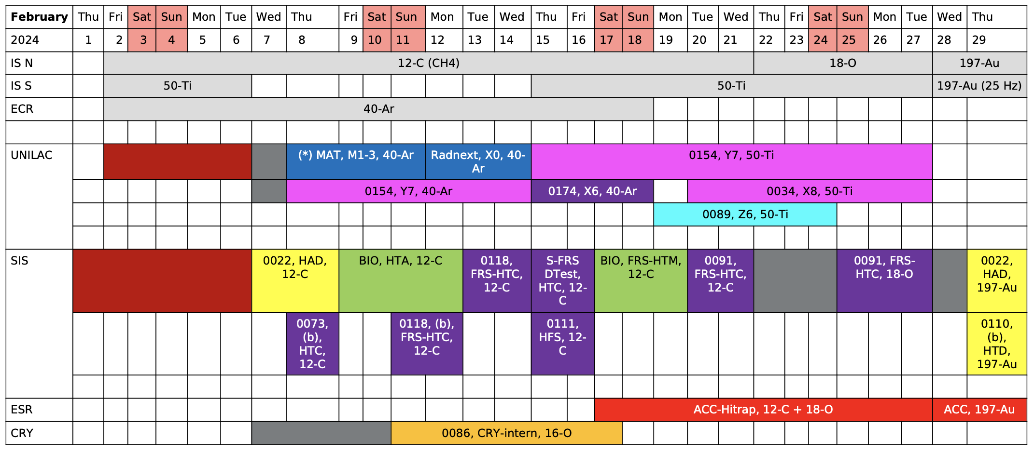
Beamtime 2024 (v7)

Slide 5
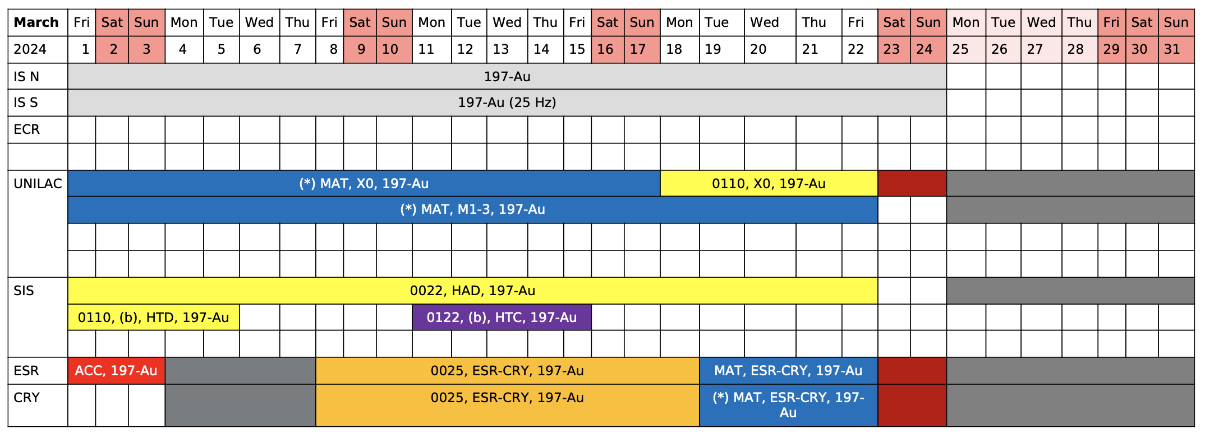
Beamtime 2024 (v7)

Slide 6
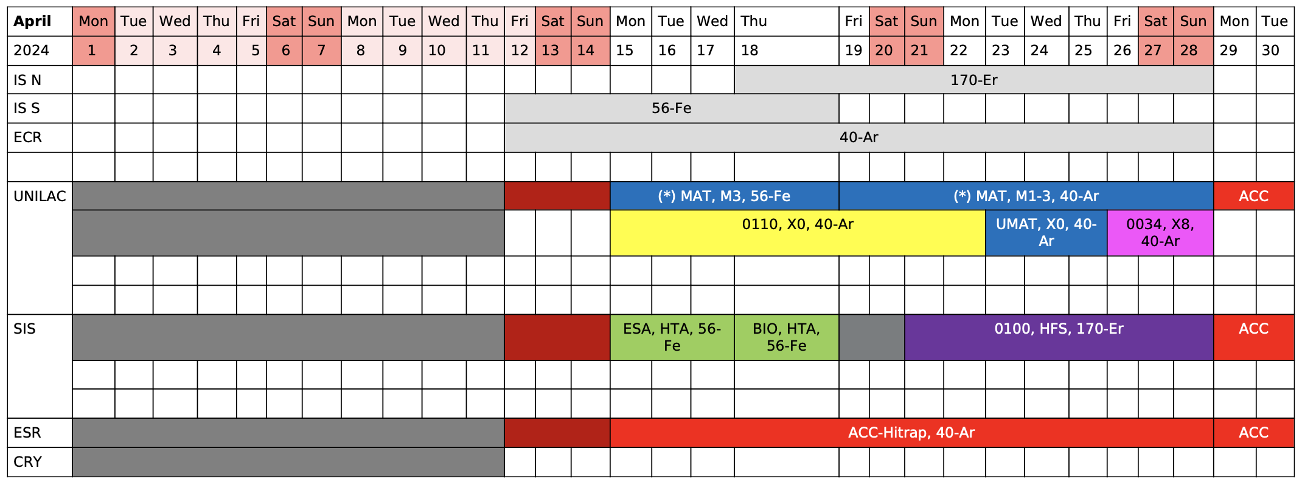
Beamtime 2024 (v7)

Slide 7
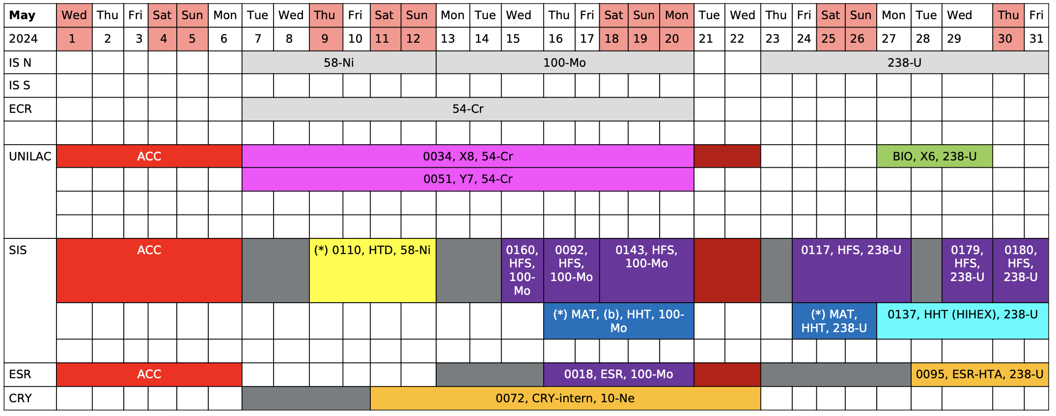
Beamtime 2024 (v7)

Slide 8
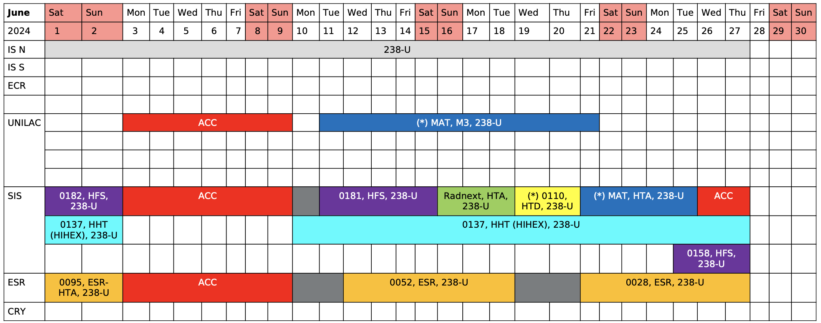
Beamtime 2024 (v7)

Slide 9
Outlook
2024
Next beamtime 2025 - 2027
ACC news
- First conclusions of engineering run

Slide 10
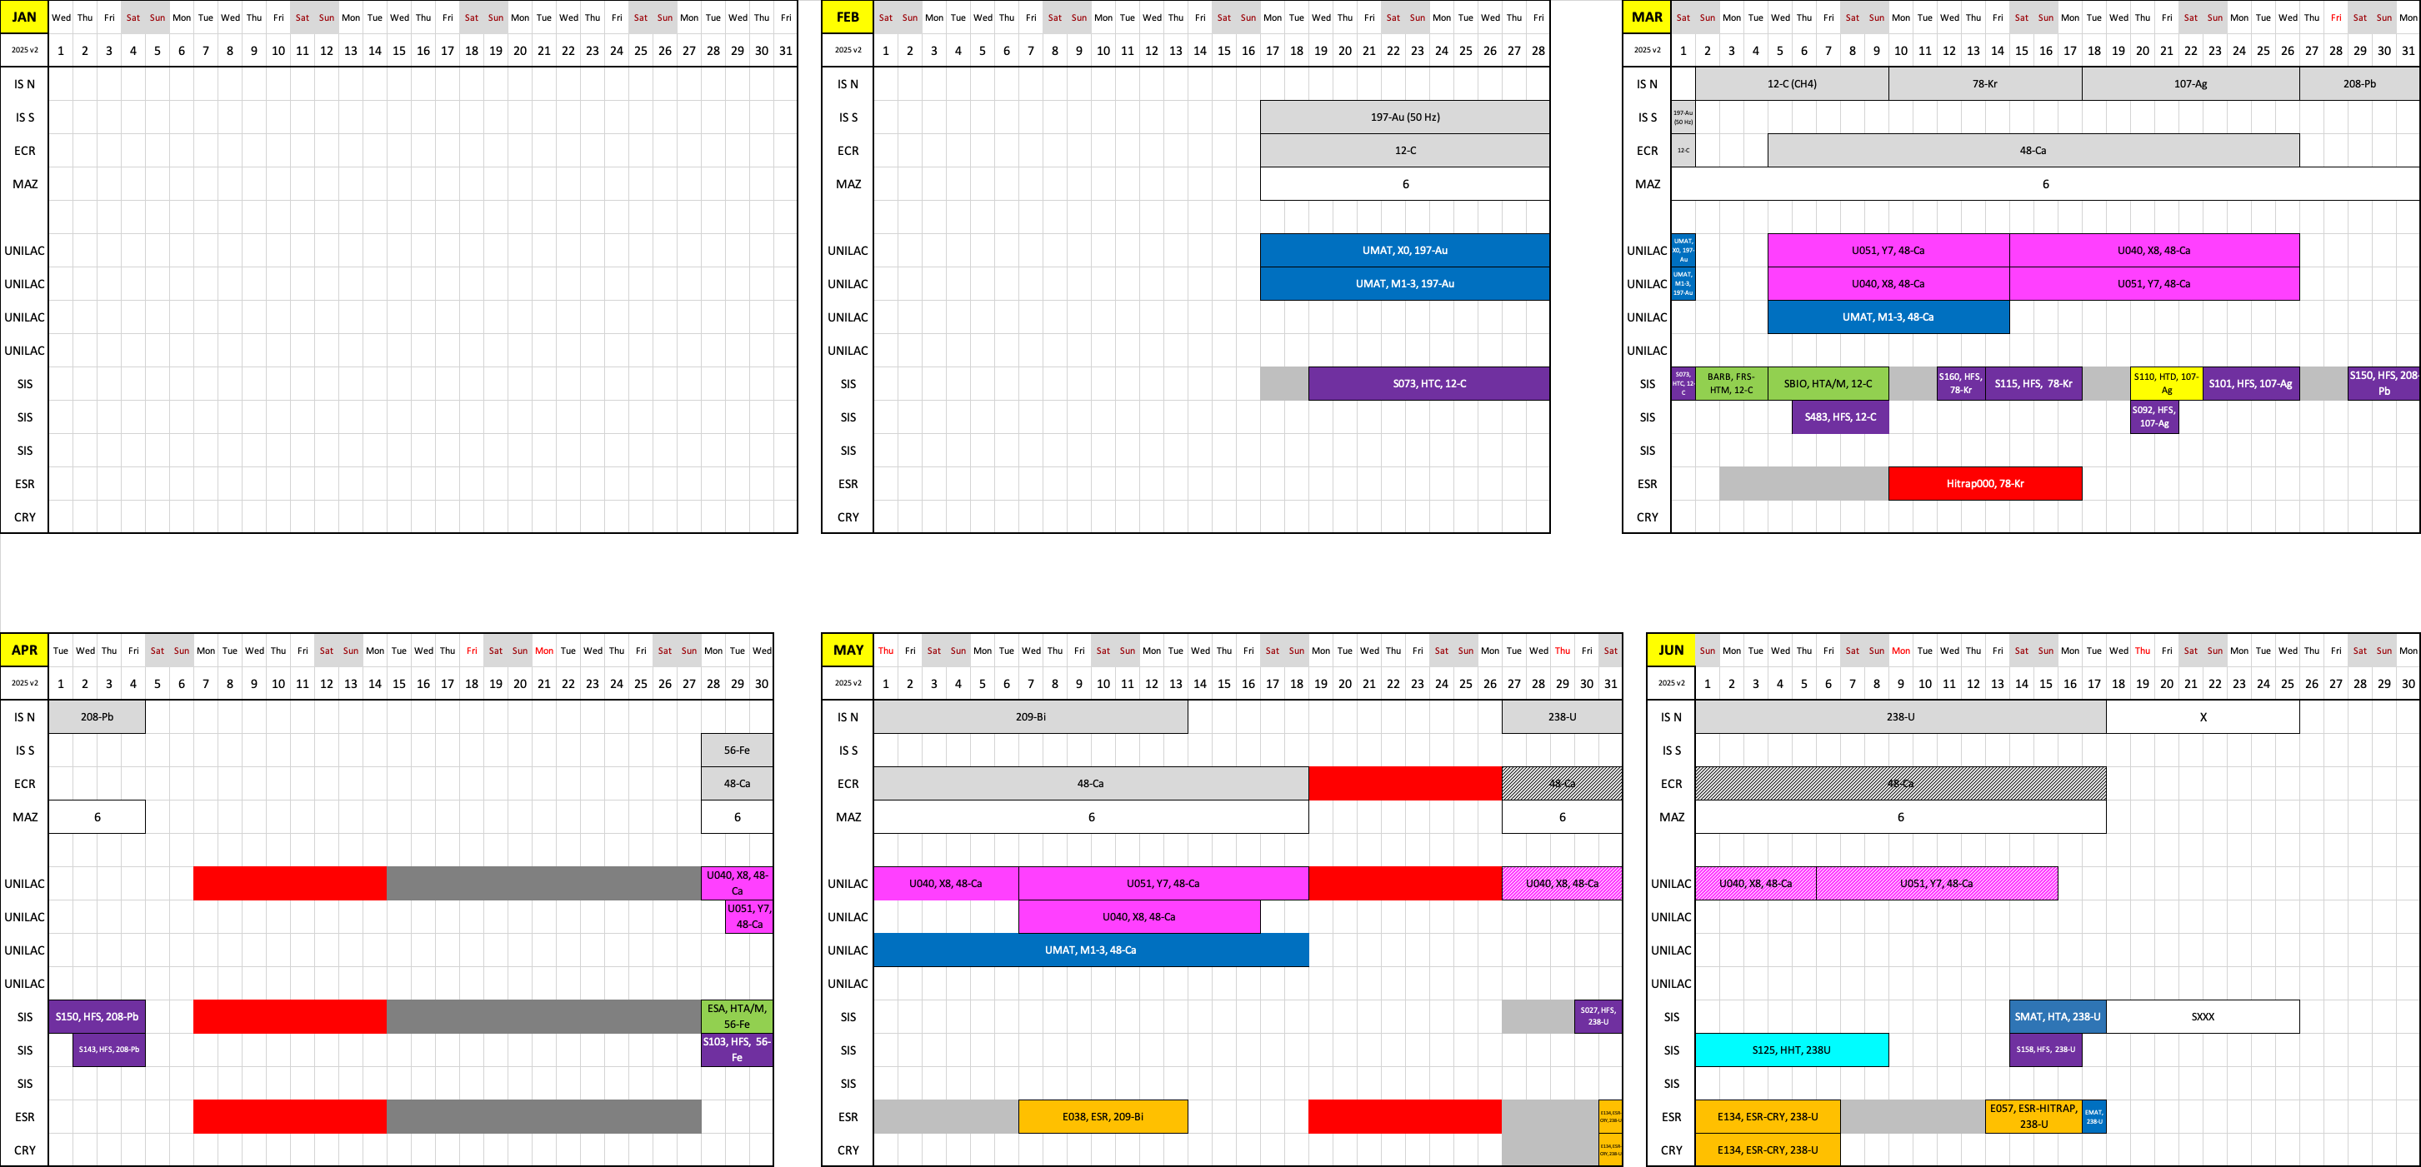
Beamtime schedule 2025

Slide 11
FAIR/GSI strategic operation scenario towards FS+
DRAFT
beam time
Acc. Operation total / days
134
44
140
Pre-paration works
EH
140+30
renovation
EH
140
renovation
EH
140
200
240
240
beam time
Physics beam time/ days
107
0
100
100+30
50
70
min. 120*
180
180
engineering-runs
Project phases (ES, FS, FS+)
FAIR Installation of Accelerator Components
FAIR Hardware Commissioning
FCC OP ready
UNILAC CS ready
DR
FAIR Beam Commissioning
PCP reached
Facility availability
now
included
early science (ES) →
SIS18 → SFRS → NUSTAR
still
missing
first science (FS) →
SIS100 → SFRS → NUSTAR
first science + (FS+) →
SIS100 –> CBM
UNILAC → EH, SIS18 → TH, EX, FRS, ESR → HITRAP, Cryring
2022
2023
2024
2025
2026
2027
2028
2029
2030
FAIR Phase 0
Early Science
Early Science & First Science+
11

Slide 12
Outlook
2024
Next beamtime 2025 - 2027
ACC news
- First conclusions of engineering run

Slide 13
RED input for Engineering run 2023
Er-beam verification
208-Pb high rate (1Hz)
SHE: 54-Cr beam verification
High current campaign ( incl. extraction)
Dual isotope beam development for medical physics
Pion production evaluation run for HADES incl. µ-spill
Spill structure
HEST beam transport HTA, HHT (transmission, stability, focus)
FRS re-commissioning
ESR – HTA beam transport
FRS-ESR beam transport
SIS-ESR beam transport for 2nd beams
ESR deceleration and isochronous mode
SIS-ESR-CRY optimization aiming for CRY int. increase
HITRAP commissioning
DESPEC: detector tests
parallel beam for Cryring experiments with local source
ACC Topics
operator training and Trans FAIR integration
FAIR booster mode
test operation for FAIR in-kind contributions
measurement of standard beam parameters behind SIS18
open slots for prioritized machine experiments
parallel beam for cw-demonstrator operation

Slide 14
RED input for Engineering run 2023
Er-beam verification
208-Pb high rate (1Hz)
SHE: 54-Cr beam verification
High current campaign ( incl. extraction)
Dual isotope beam development for medical physics
Pion production evaluation run for HADES incl. µ-spill
Spill structure
HEST beam transport HTA, HHT (transmission, stability, focus)
FRS re-commissioning
ESR – HTA beam transport
FRS-ESR beam transport
SIS-ESR beam transport for 2nd beams
ESR deceleration and isochronous mode
SIS-ESR-CRY optimization aiming for CRY int. increase
HITRAP commissioning
DESPEC: detector tests
parallel beam for Cryring experiments with local source
ACC Topics
operator training and Trans FAIR integration
FAIR booster mode
test operation for FAIR in-kind contributions
measurement of standard beam parameters behind SIS18
open slots for prioritized machine experiments
parallel beam for cw-demonstrator operation

Slide 15
Engineering run 2023
RED Topics
SHE: 54-Cr beam verification
High current campaign ( incl. extraction)
Dual isotope beam development for medical physics
Pion production evaluation run for HADES incl. µ-spill
Spill structure
HEST beam transport HTA, HHT (transmission, stability, focus)
DESPEC: detector tests
parallel beam for Cryring experiments with local source
ACC Topics
Operator training and Trans FAIR integration
FAIR booster mode
Test operation for FAIR in-kind contributions
Measurement of standard beam parameters behind SIS18
Open slots for prioritized machine experiments
Parallel beam for cw-demonstrator operation

Slide 16
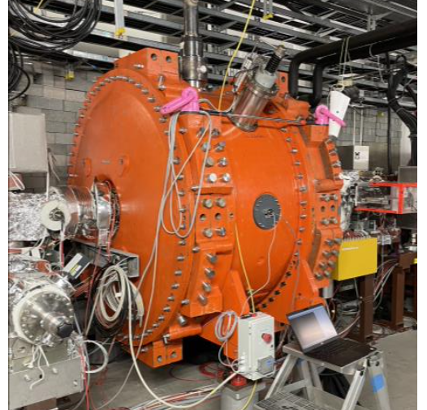
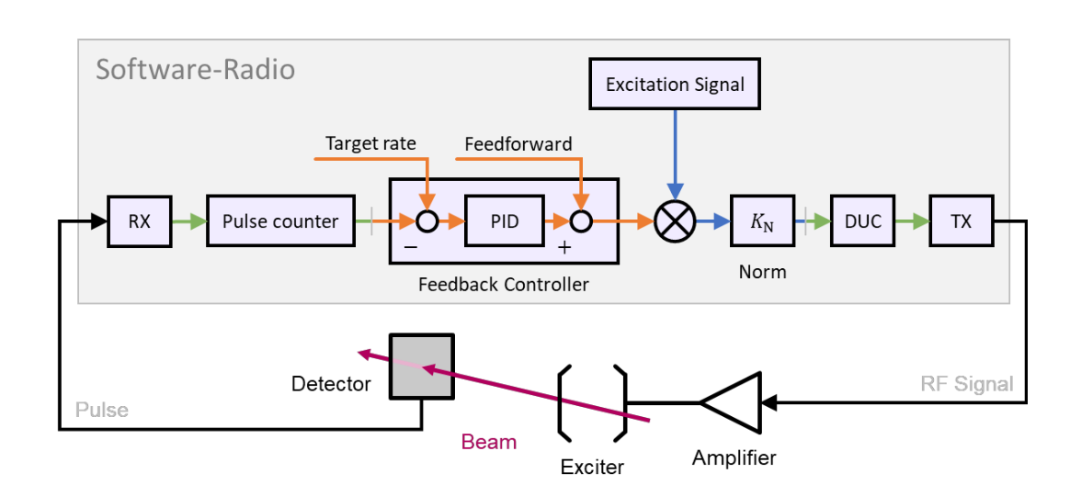
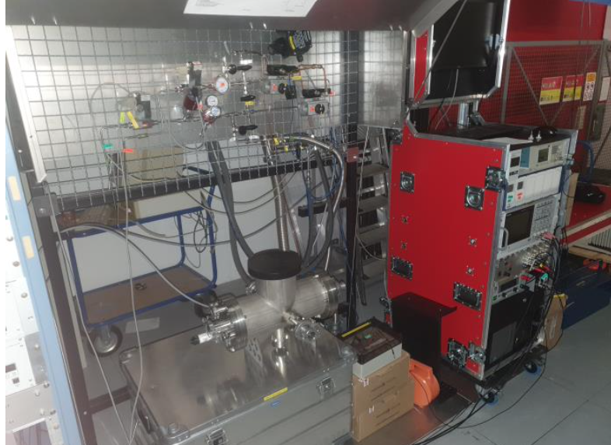
Some ACC develpments
Feedback system for KO extraction
Spill structure
Two options are under investigation
UNILAC pulsed gas stripper
In use already in 2024
From 2026 onwards with H₂
µ-spill structure cavity

Slide 17
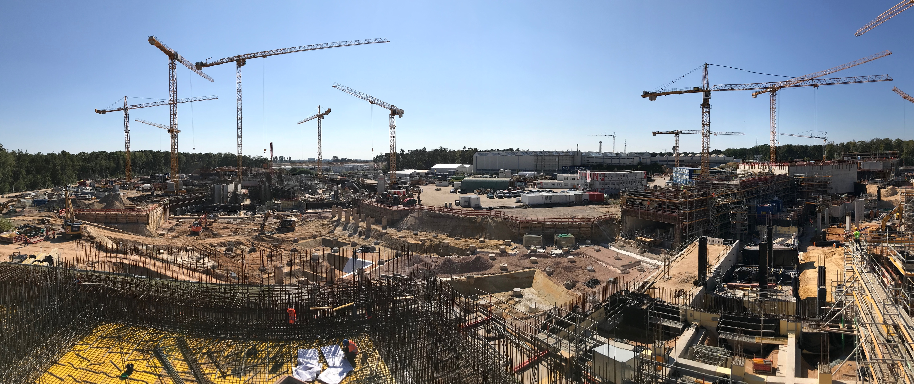
Thanks for you attention!

Slide 18
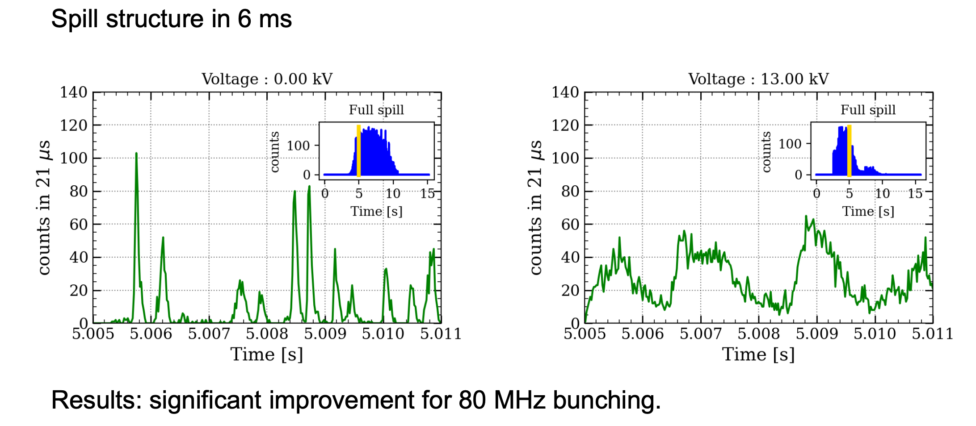
Improved spill structure with spill-structure cavity

Slide 19
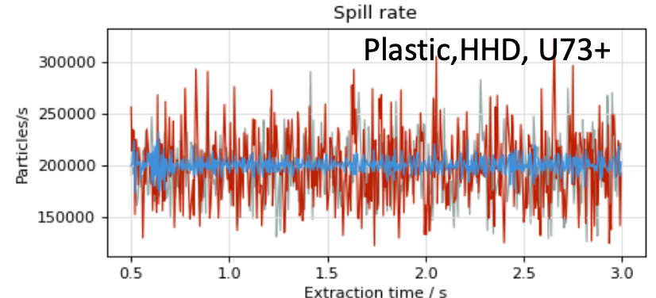
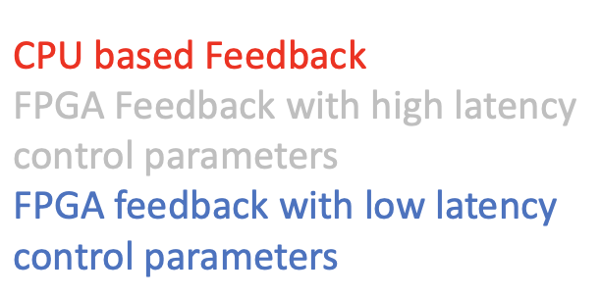
Improved spill structure with KO feedback system

