Slide 1
Simulation of Multi-energy extraction with rfko
Fabien Plassard, Elisabeth Renner, Laurids Adler, Dale Prokopovich, Florian Kühteubl, Alexander Wastl
Slow Extraction Workshop 2024
14th February 2024

Slide 2
INTRODUCTION
Multi-Energy Extraction (MEE): deliver multiple energies within the same cycle allowing to drastically reduce beam-on time.
The goal is to propose a concept for MEE implementation,based on RFKO and suited for the MedAustron accelerators.
In parallel, we will use simulation studies to improve/fine-tune our MEE concept or commissioning:
realistic RFKO excitation tailored to MA optics
Dynamic changes of synchrotron’s elements
Acceleration/deceleration of the beam between extractions
Simulations based on Xsuite code: well suited for MEE RFKO extraction
(many thanks to all Xsuite’s developers!)

Slide 3
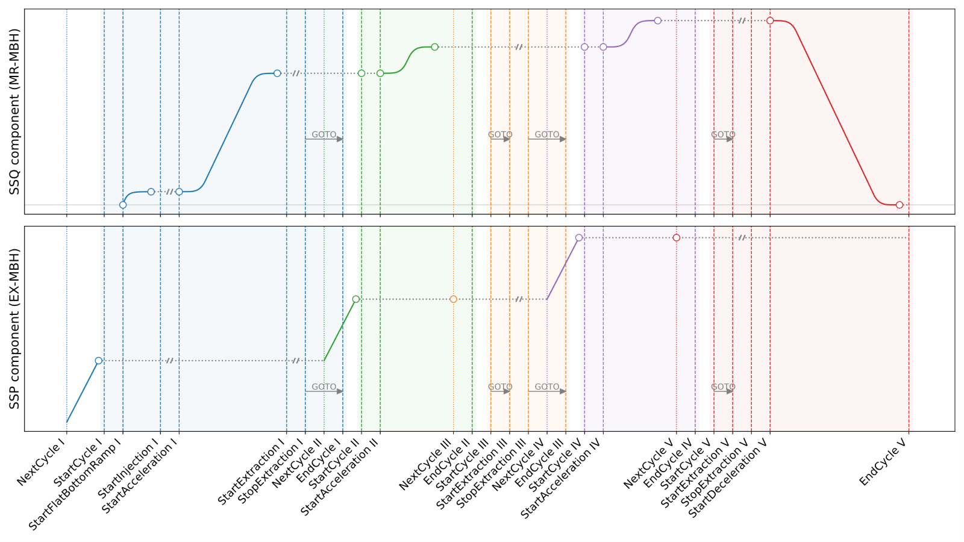
MEE CONCEPT overview FOR MEDAUSTRON
Current concept based on low to high energy layers
Energy steps of <3.8MeV based on our analysis of current treatment planning
Next energy steps triggered by threshold of dose delivered in the room and dose remaining in the ring
re-acceleration and RFKO extraction settings based on pre-computed Setpoint Sequences of RF and synchrotron magnets
New cycle generator adapted to MEE and to our new control system
courtesy of Laurids Adler
Multi-energy acceleration within 1 cycle based on our new cycle generator already successfully tested experimentally

Slide 4
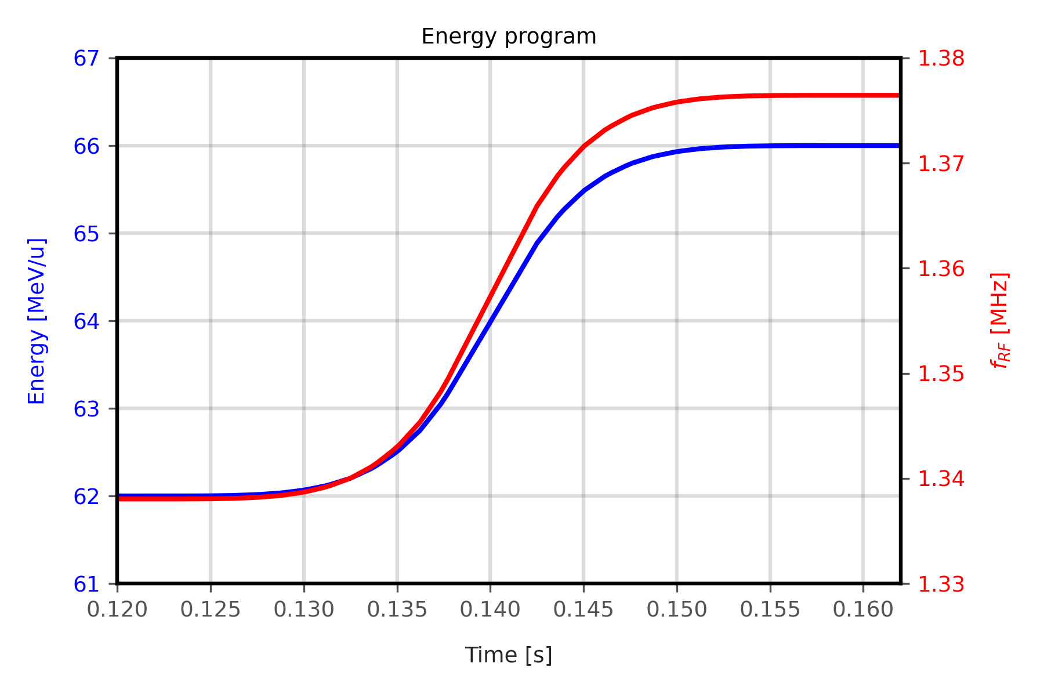
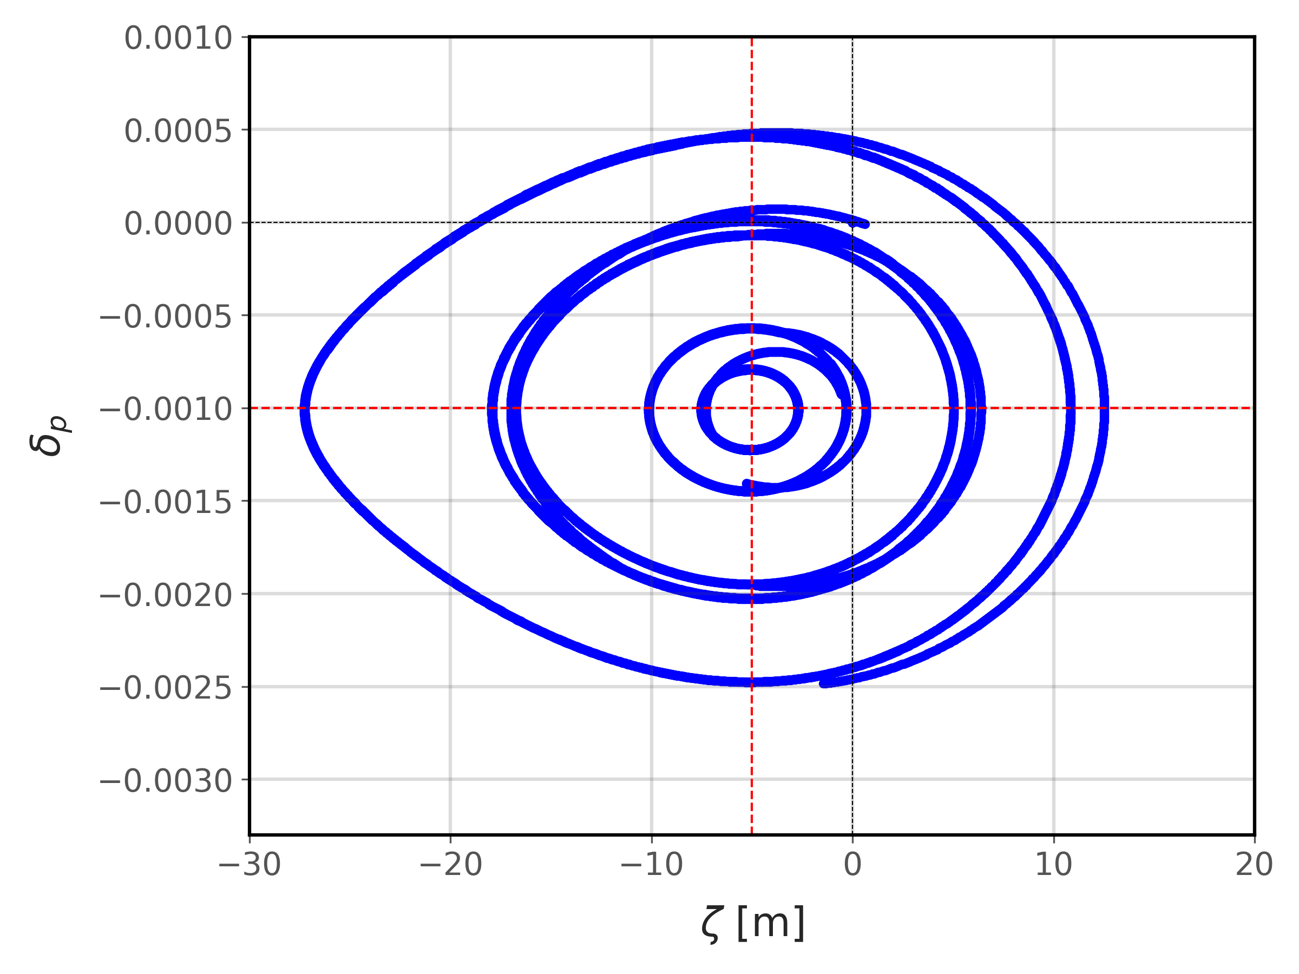
MEE simulation setup: Acceleration
MEE RFKO simulations based on Xsuite:
Recent development of the code to facilitate simulation of acceleration
xtrack.EnergyProgram, RFcavity frequency TbT update, Radial Loop with xtrack.ZetaShift
Based on Xsuite user’s guide example: https://xsuite.readthedocs.io/en/latest/track.html#acceleration
Acceleration
(stable ζ)
Radial Loop contribution

Slide 5
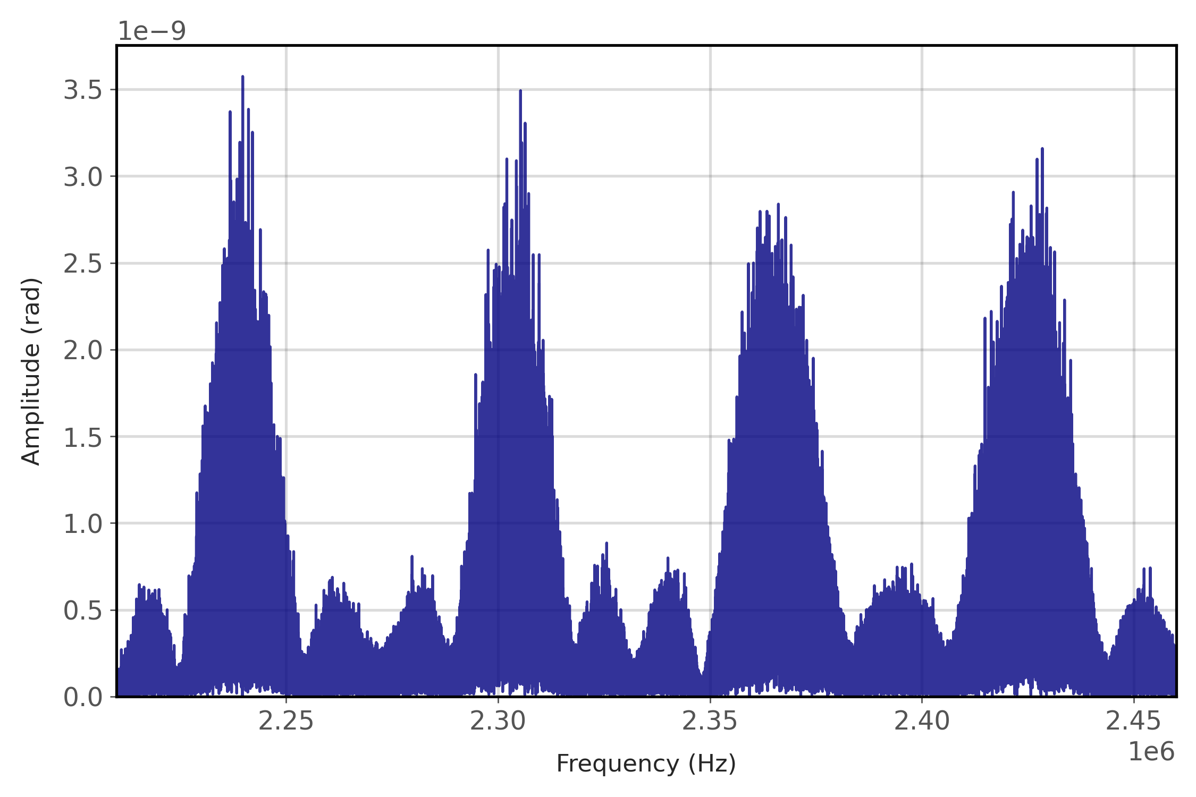
MEE simulation setup: RFKO + MEE
MEE RFKO simulation: example of 4 energies re-accelerated in steps of 4 MeV/u and extracted with amplitude-modulated RFKO
Resonant sextupole ramped down and up before and after acceleration while RFKO kicker is off
RF-Cavity frequency updated TbT
RFKO kicker using xt.Exciter and BPSK frequency modulation
$$f_{RFKO}$$
@62MeV
$$f_{RFKO}$$
@66MeV
$$f_{RFKO}$$
@70MeV
$$f_{RFKO}$$
@74MeV
Applied RFKO FFT

Slide 6
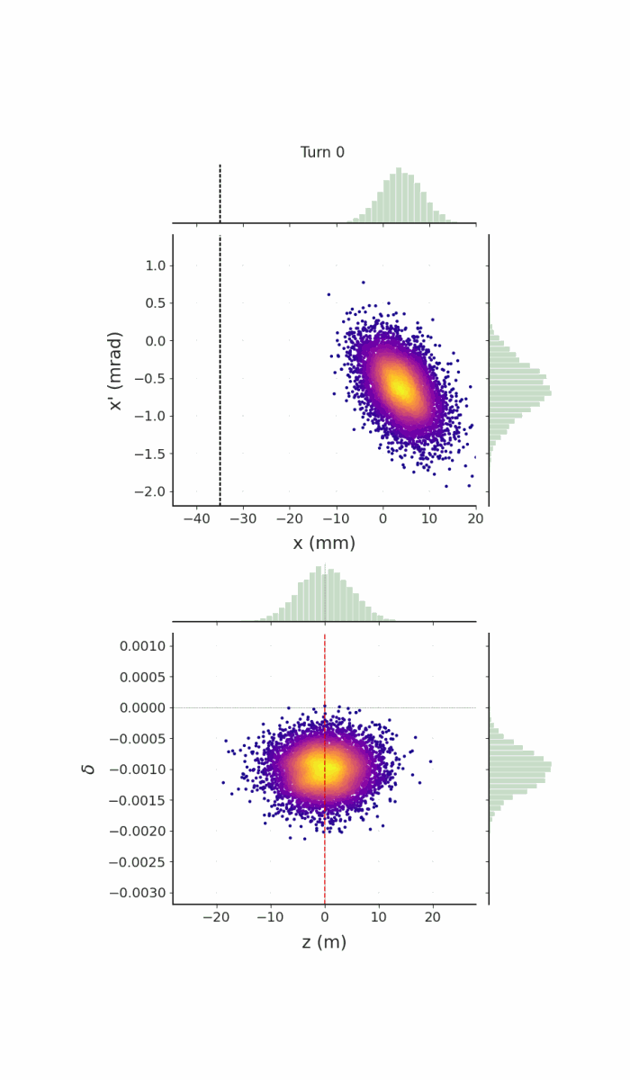
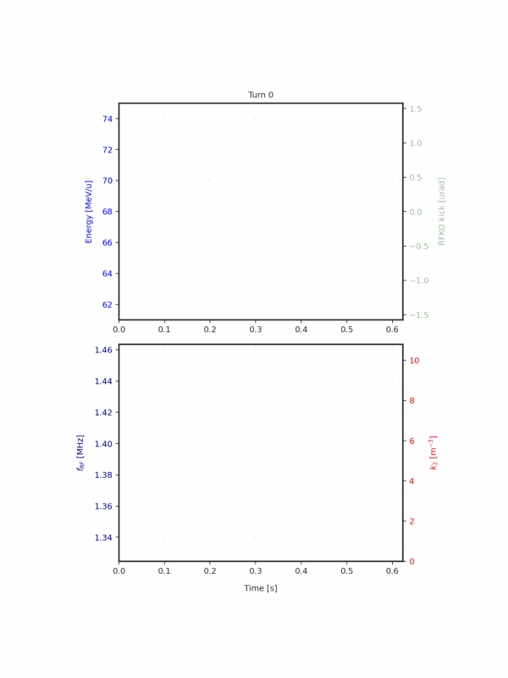
MEE simulation example
Assess the extracted beam properties at ESE at each energy layers to optimize optics and RFKO settings
Optimize RF-cavity voltage/frequency programs based on observed longitudinal dynamics during MEE
7000 particles for ~9e5 turns

Slide 7
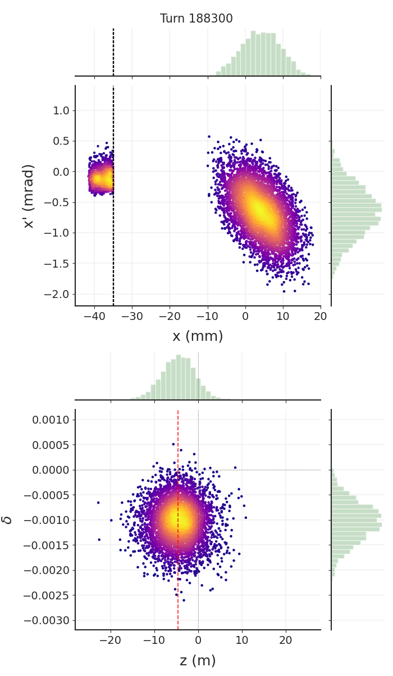
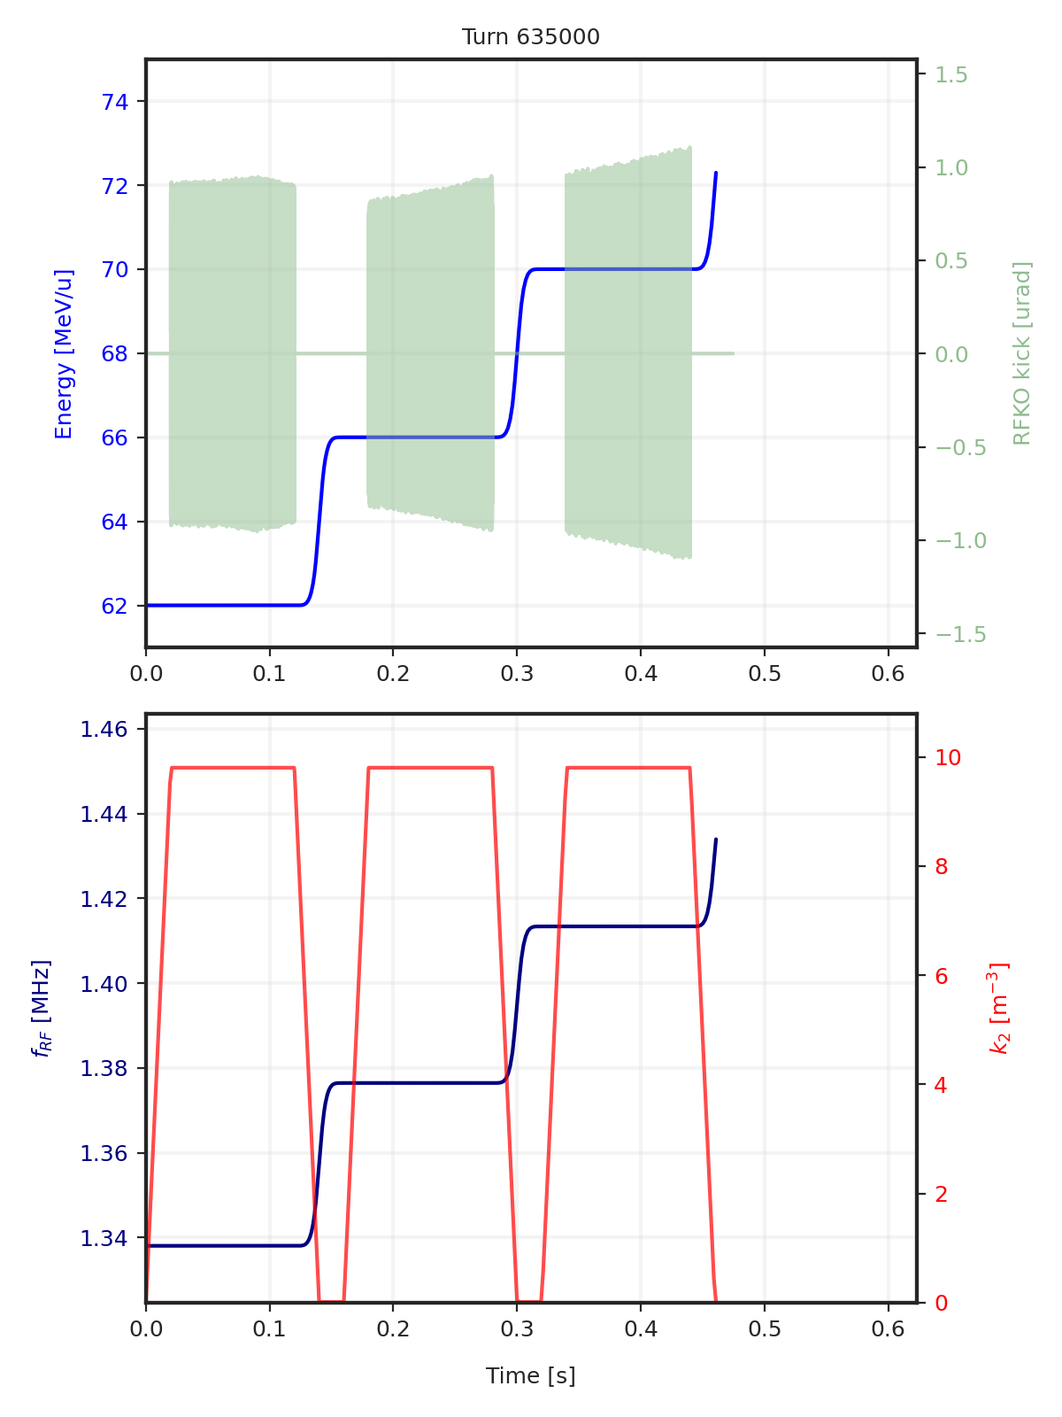
MEE simulation example
Assess the extracted beam properties at ESE at each energy layers to optimize optics and RFKO settings
Optimize RF-cavity voltage/frequency programs based on observed longitudinal dynamics during MEE
7000 particles for ~9e5 turns

Slide 8
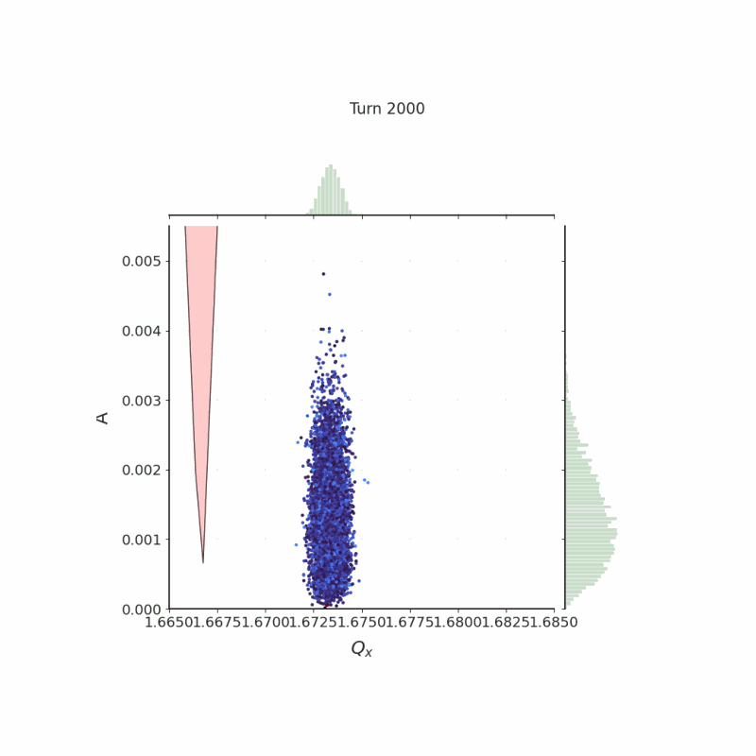
MEE simulation example
Optimize dynamic of the linear/nonlinear optics changes and RF-cavity program based on losses and tune distribution during MEE
7000 particles for ~9e5 turns

Slide 9
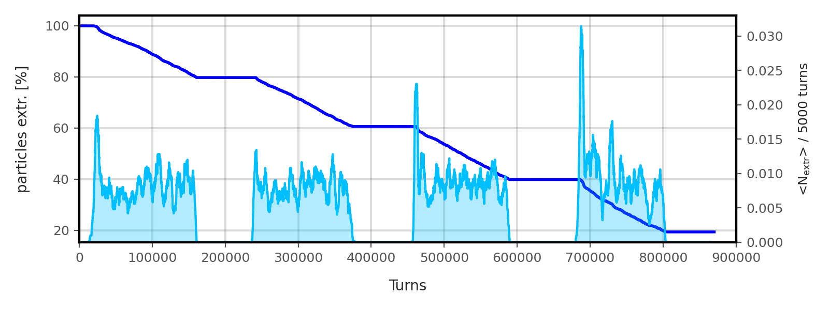
MEE simulation example: RESULTS
Observations on extracted spill quality
Linearity of the extraction rate and intensity ripples at each energy level → optimization of the RFKO settings (central frequencies, bandwidth, amplitude modulation
Beam losses during acceleration and ramping of the resonant sextupole → optimization of the optics, sextupole strength and RF-cavity program

Slide 10
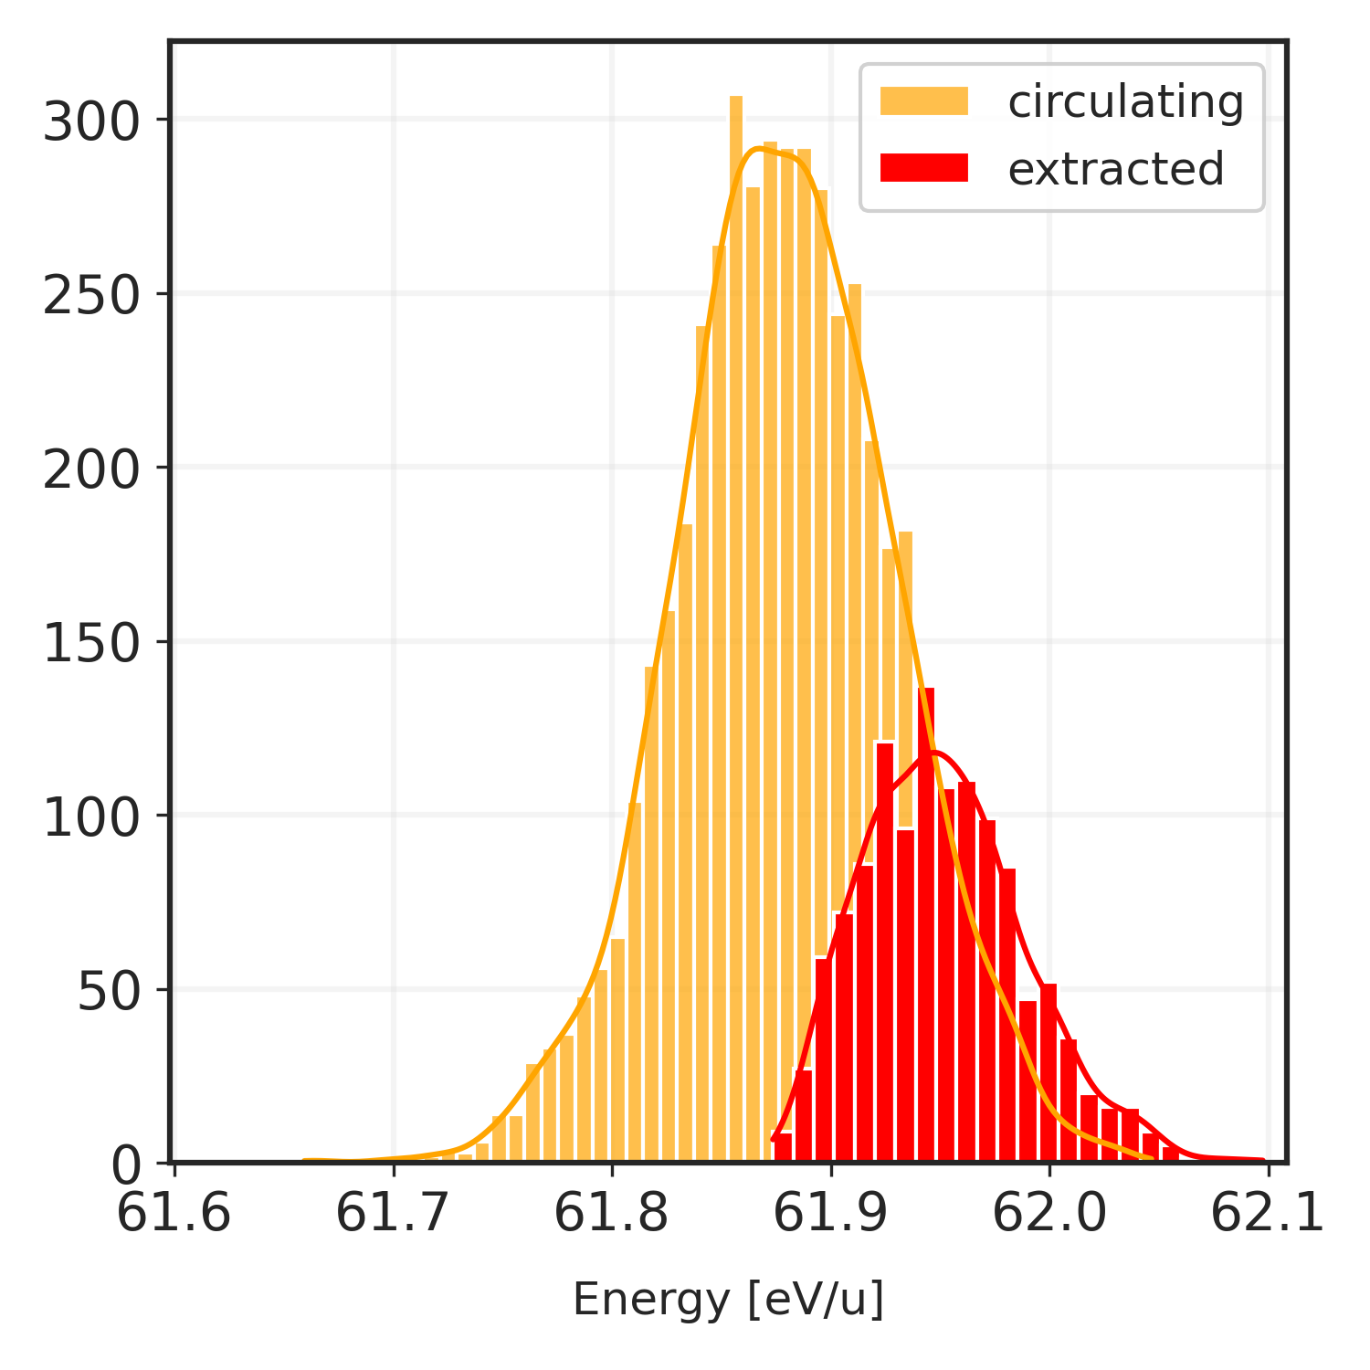
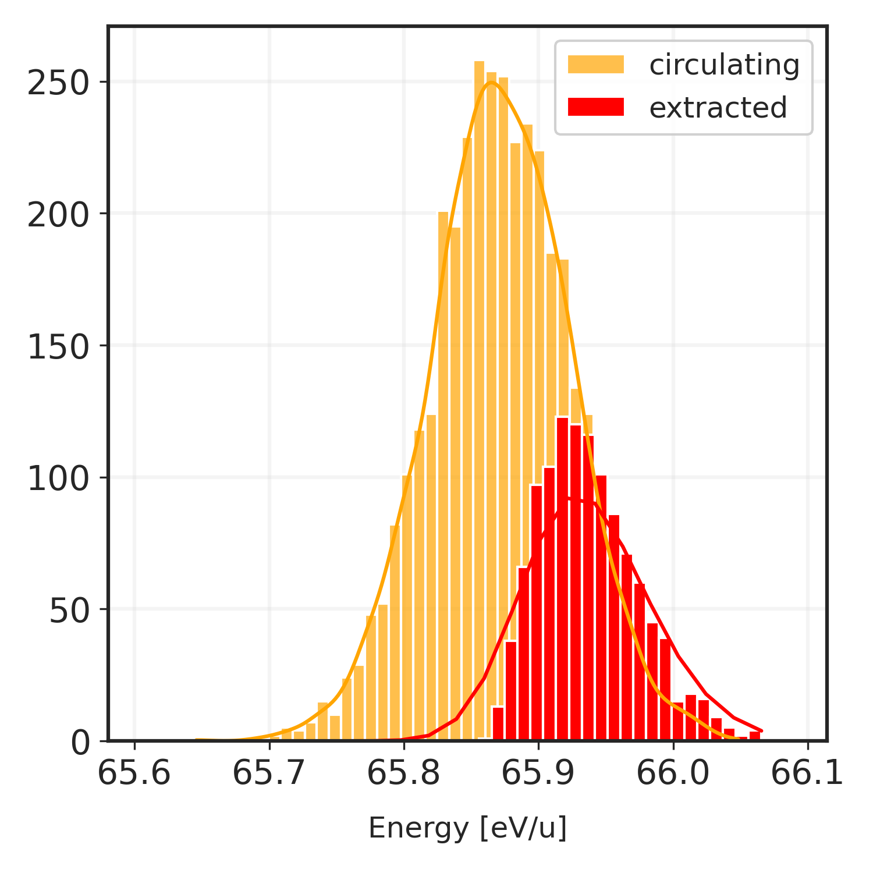
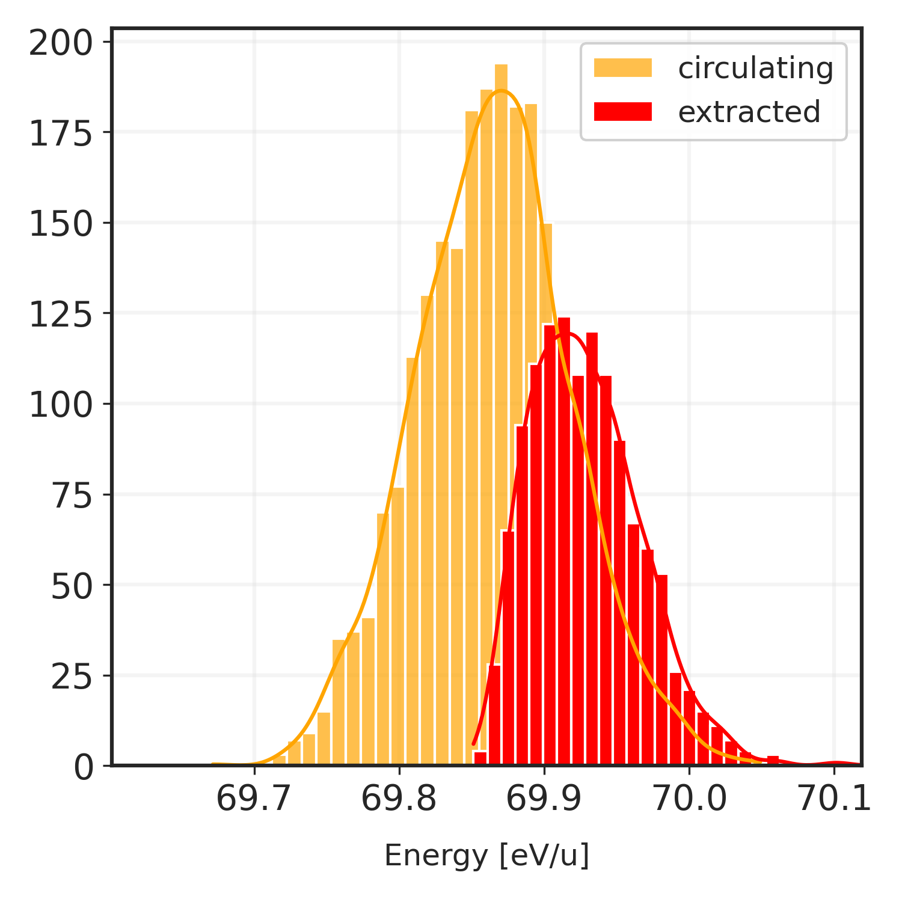
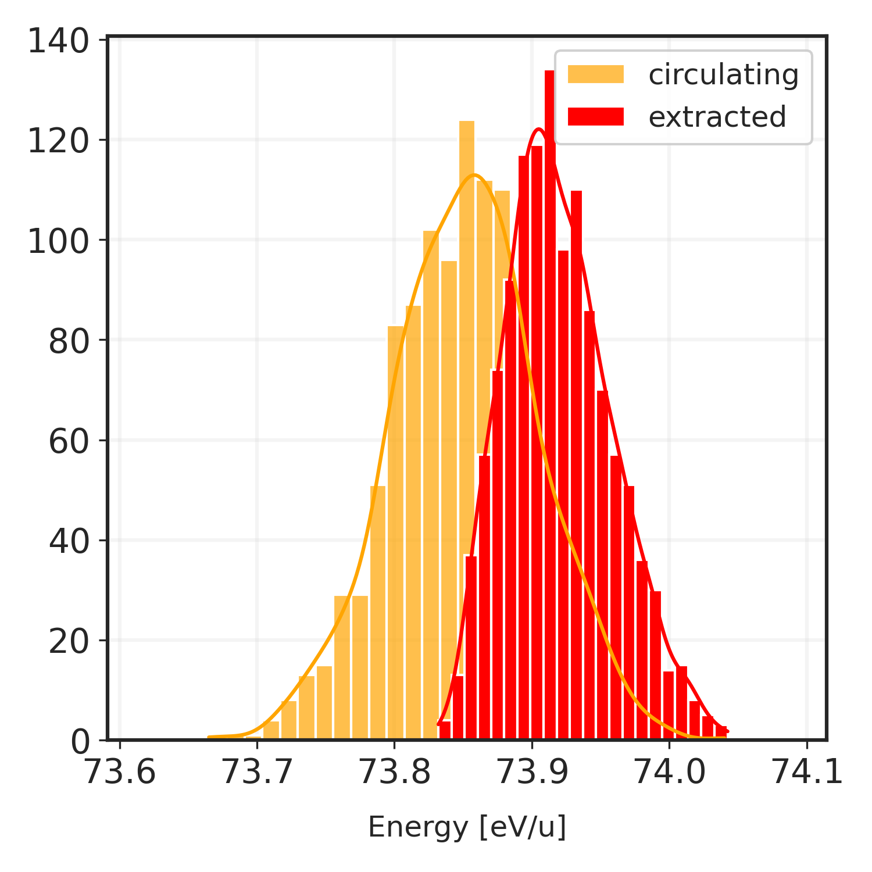
MEE simulation example: RESULTS
Observations on the energy distribution during MEE:
Shift in energy between the circulating and extracted beam
Increase in energy ($Q_{x}>1.666.. ; {dQ}_{x}<0$) →particles with tunes closer to resonance extracted before
Energy oscillations inside the bucket shift the entire distribution → shift depends mostly on longitudinal emittance
Can be optimized RF voltage, tune $Q_{x}$, RFKO excitation…
~ +0.07MeV
62 MeV
66 MeV
70 MeV
74 MeV

Slide 11
conclusion
Thanks to the recent contributions of the Xsuite’s developers, the simulation of realistic Multi-energy extraction has been greatly facilitated
The simulation output can provide valuable insights on the beam properties during MEE:
Extracted beam conditions at each energy layers
Beam losses during re-acceleration
Spill rate and ripple quality
→ Can be used to improve the MEE accelerator program (optics, energy levels, sextupole ramping rate, RF-Cavity and RFKO settings..)
Help the improvement of the MEE concept and commissioning for future MedAustron accelerators

