Slide 1
Slow Extraction Developments at MedAustron
Florian Kühteubl
5th Slow Extraction Workshop
14.02.2024

Slide 2
Slow Extraction at MedAustron
Beam accelerated
to target energy
Phase Jump to increase momentum spread
Resonant sextupole ramped to prepare resonance
Extraction optics
$$Q_{X}=5/3$$
$$Q_{x}^{′}=−4 \\ \frac{Δp}{p}=−2.3E−3$$
Extraction optics
𝑄_𝑋=5/3
𝑄_𝑥^′=−4
Δ𝑝/𝑝=−2.3𝐸−3
Betatron Core accelerates beam into resonance

Slide 3
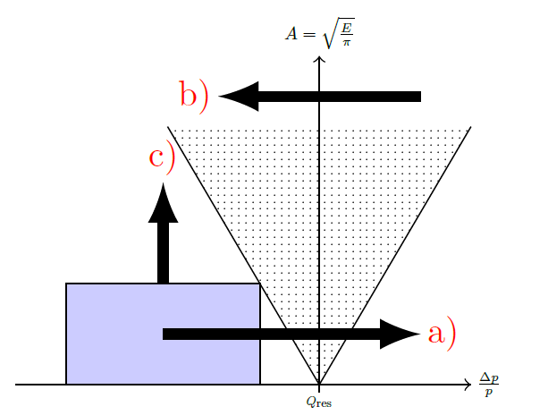
Steinbach Diagram
Stable
area
Unstable
area
Beam
~ΔQ
= 1.6666

Slide 4
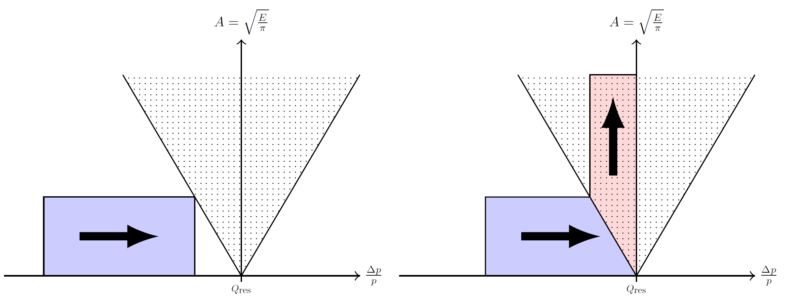
BETATRON CORE EXTRACTION
Betatron Core accelerates particles
Particle momentum is increased
Beam is pushed into resonance

Slide 5
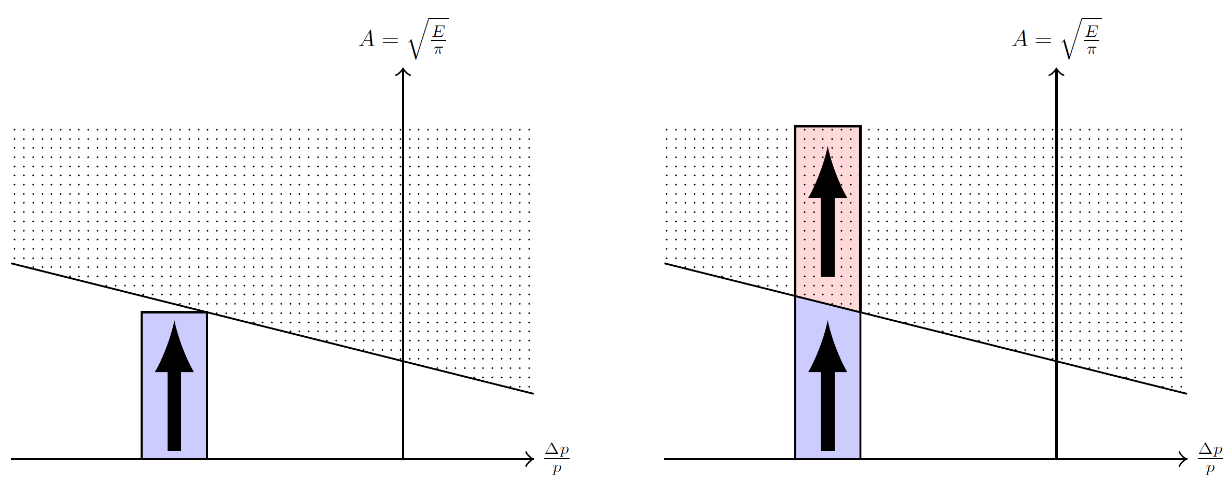

RADIO FREQUENCY KNOCK OUT (RFKO) EXTRACTION
$$f_{0}=f_{rev}∗(n±q_{x})$$
Particle amplitude is increased
Transverse kicker with AC
Frequency matched to beam revolution

Slide 6
ADVANTAGES OF RFKO
Compatible with bunched beam extraction
Changing the beam energy during the spill
→ Multi Energy Extraction
Sub-millisecond adaptation of the beam intensity
→ Dynamic Intensity Control
→ Irradiation Gating
Compatible with FLASH treatment
Ripple reduction by adjusting the excitation pattern and introducing a closed-loop feedback regulation

Slide 7
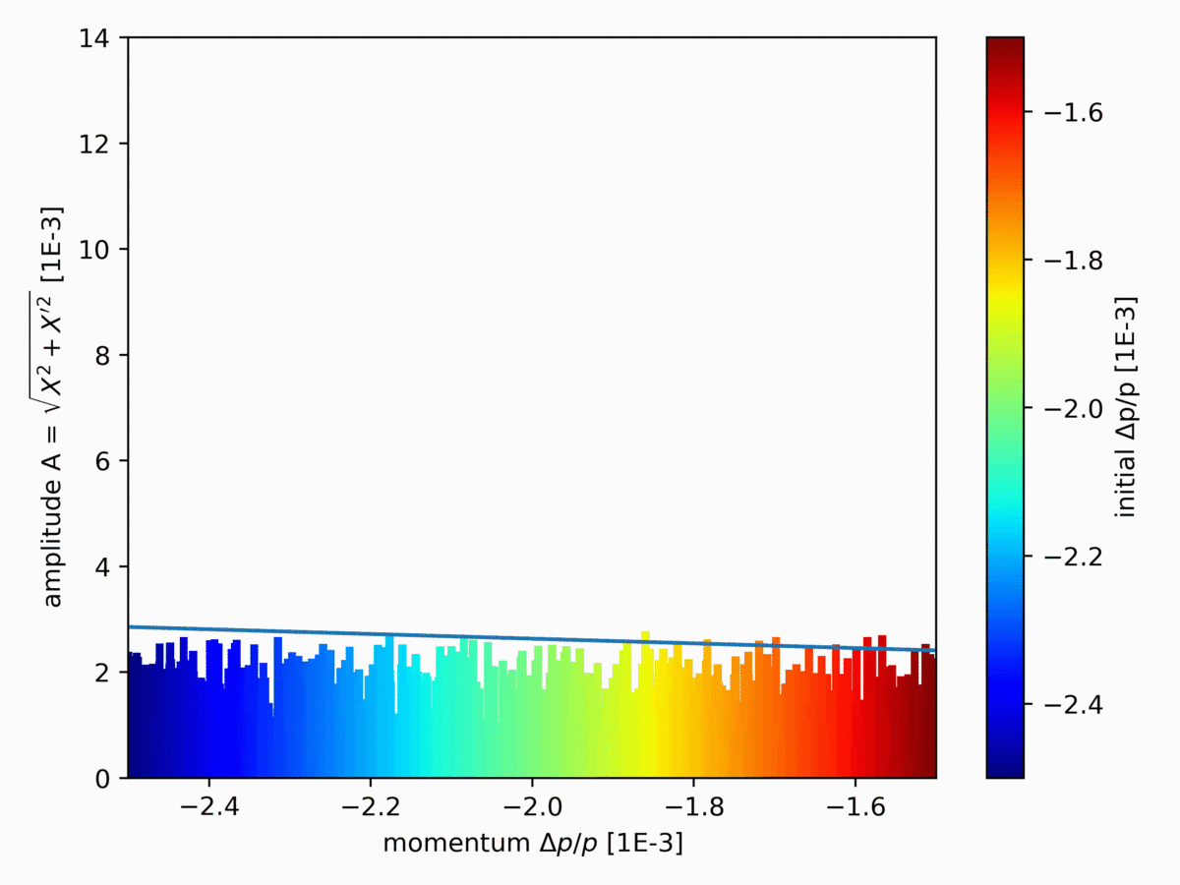
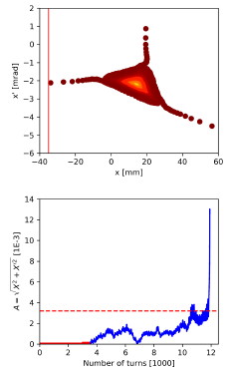
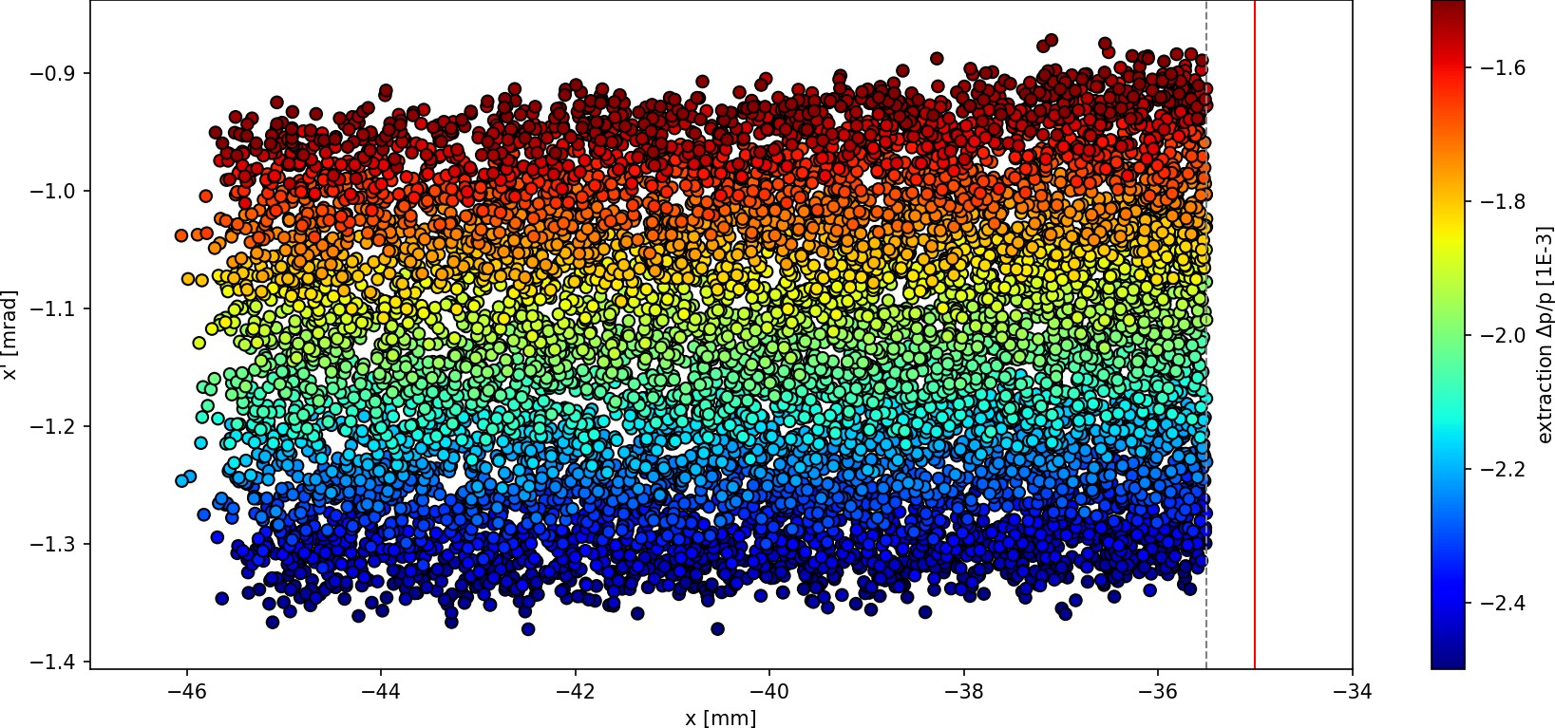
RFKO SIMULATION - PROOF OF PRINCIPLE

Slide 8
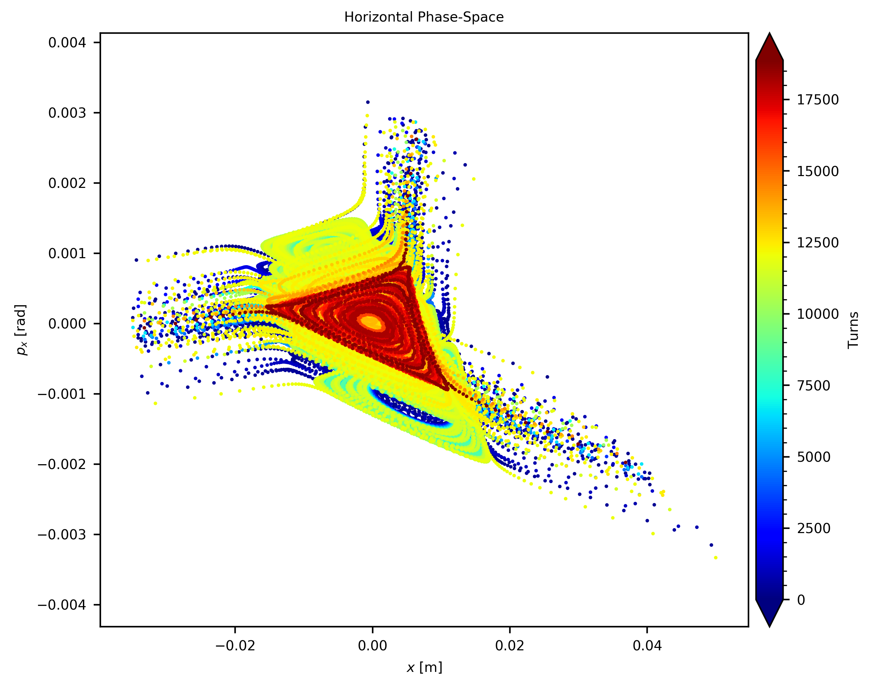
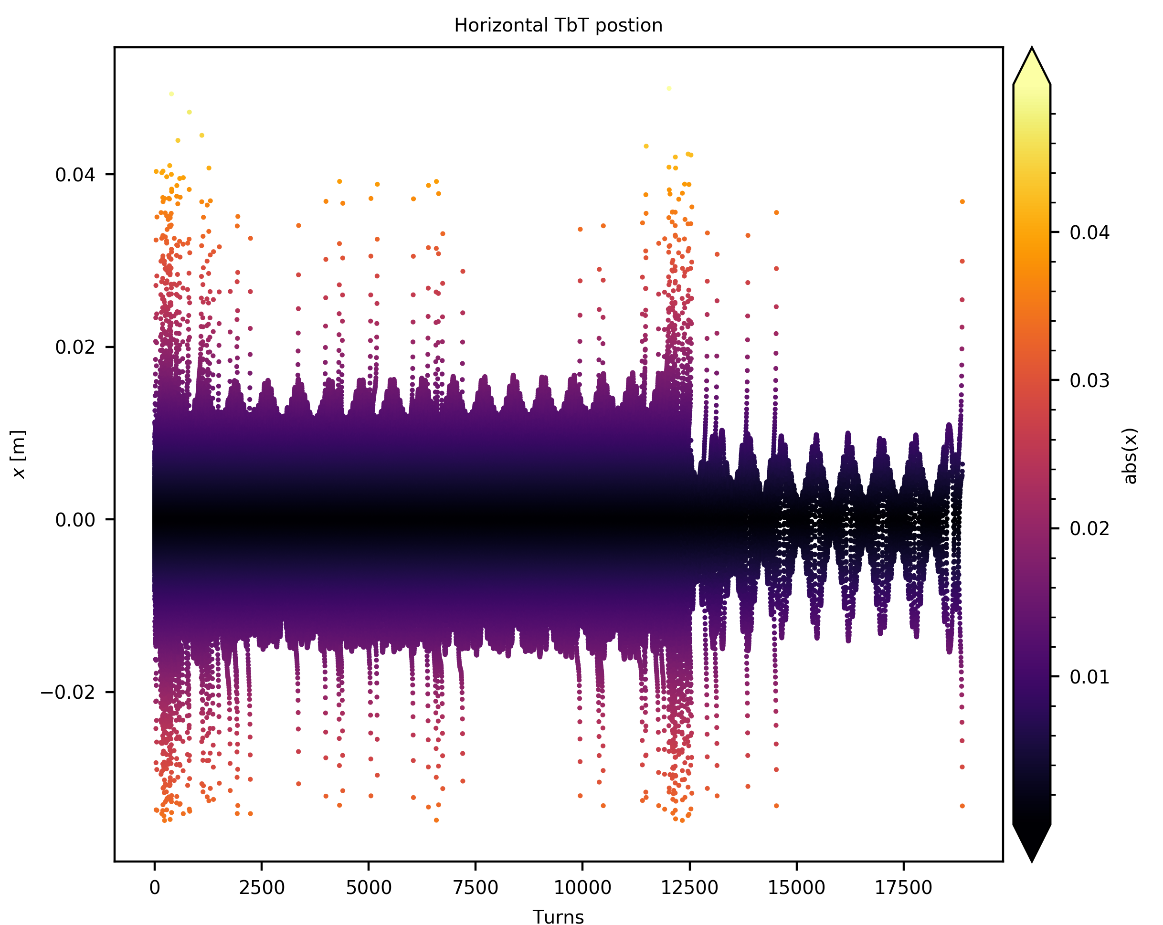
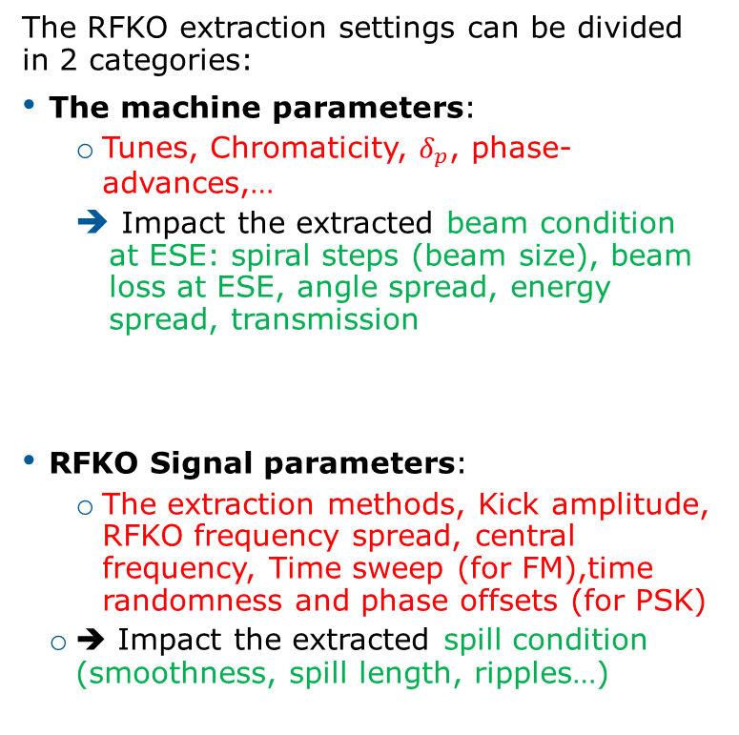
RFKO PARAMETER OPTIMIZATION
The RFKO extraction settings can be divided in 2 categories:
The machine parameters:
  Tunes, Chromaticity, $δ_{p}$, phase-advances,…
  Impact the extracted beam condition at ESE: spiral steps (beam size), beam loss at ESE, angle spread, energy spread, transmission
RFKO Signal parameters:
  The extraction methods, Kick amplitude, RFKO frequency spread, central frequency, Time sweep (for FM),time randomness and phase offsets (for PSK)
  ➔ Impact the extracted spill condition (smoothness, spill length, ripples…)
ESE
ESE
Courtesy of Fabien Plassard

Slide 9
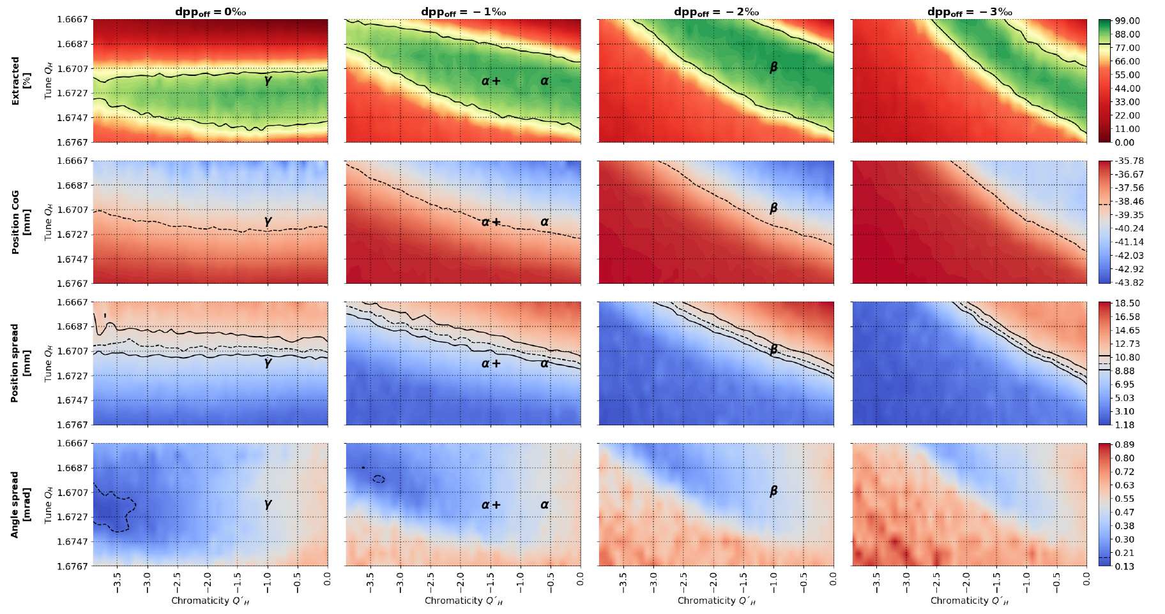
Machine Parameter optimisation
Extraction efficiency
Transmission efficiency
Beam distribution at septa
Dispersion

Slide 10
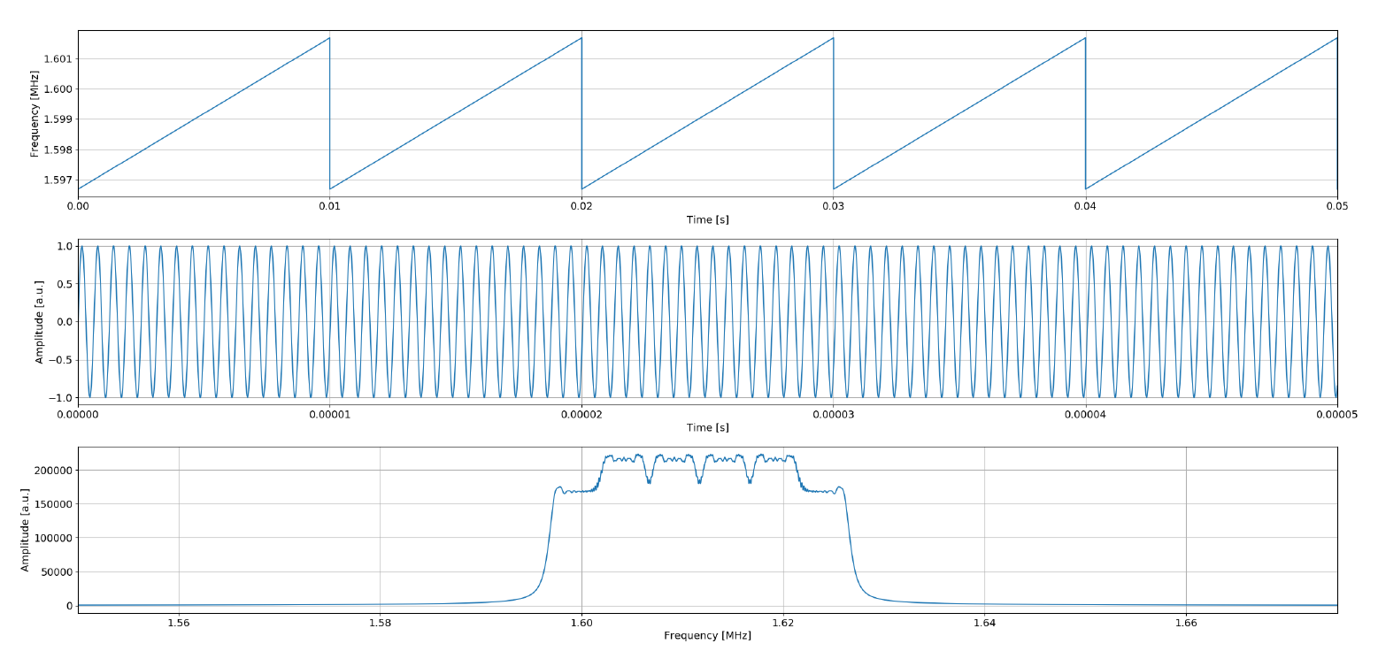
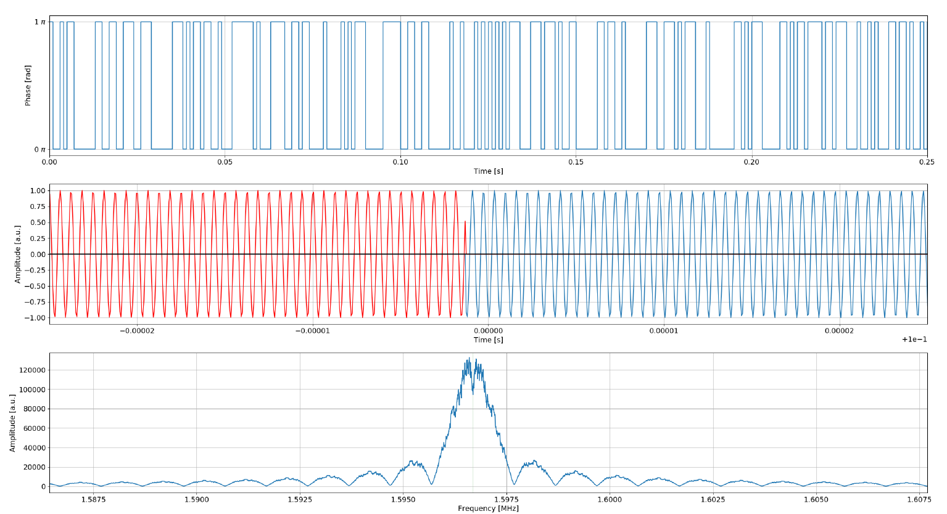



RFKO Signal Optimisation
$$f_{sweep}$$
$$Δf$$
$$f_{0}$$
Frequency
modulation
$$f_{0}, f_{sweep}, Δf$$
Pseudo Random
Binary Phase
Shift Keying
$$f_{0}, f_{shift}$$

Slide 11
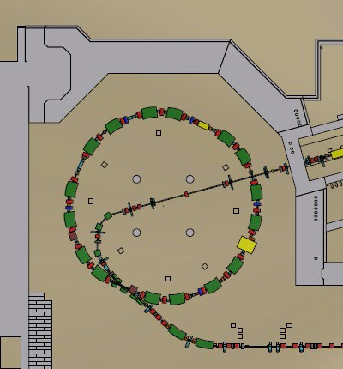
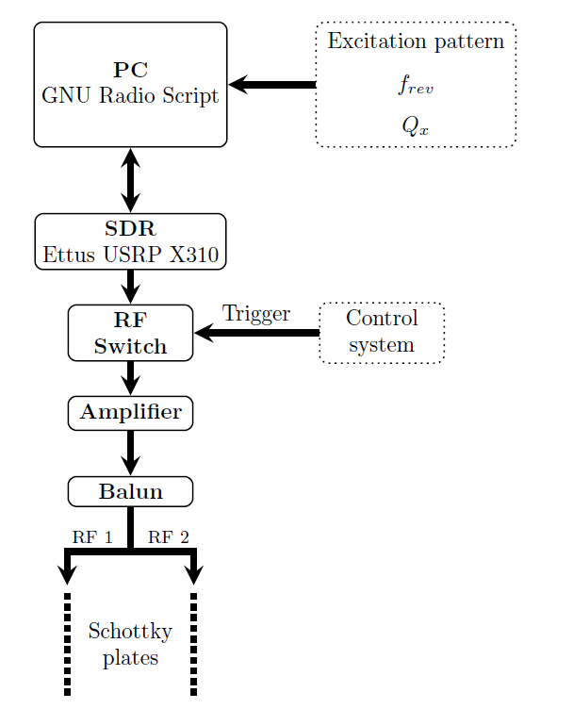
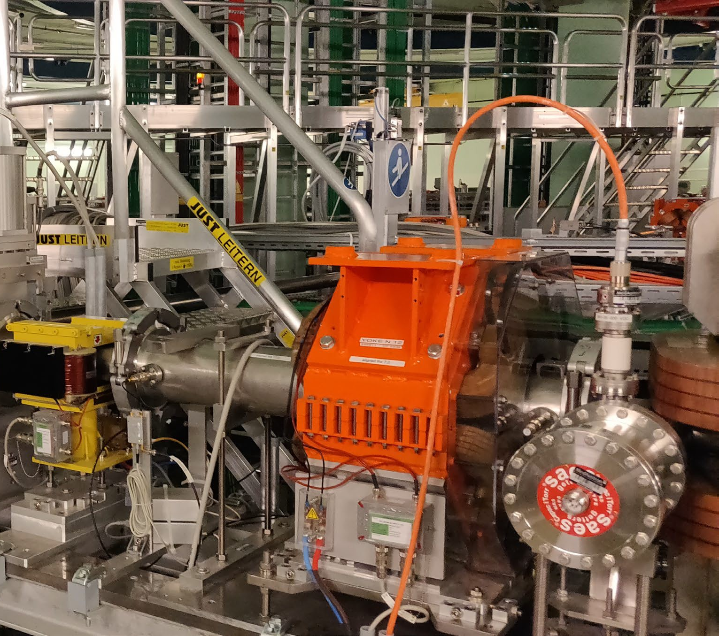
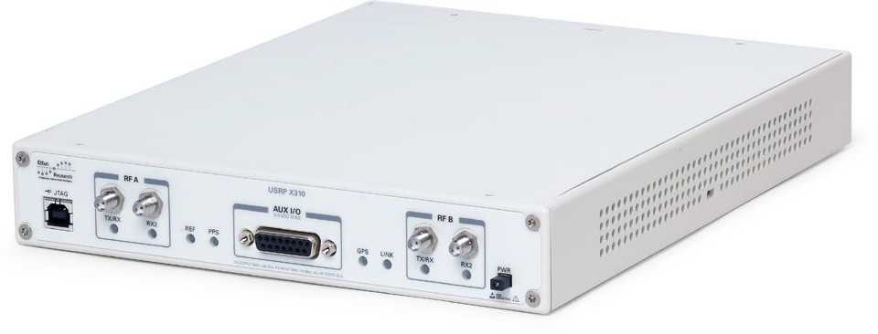
RFKO SETUP
Ettus X310 SDR
Courtesy of X. German

Slide 12
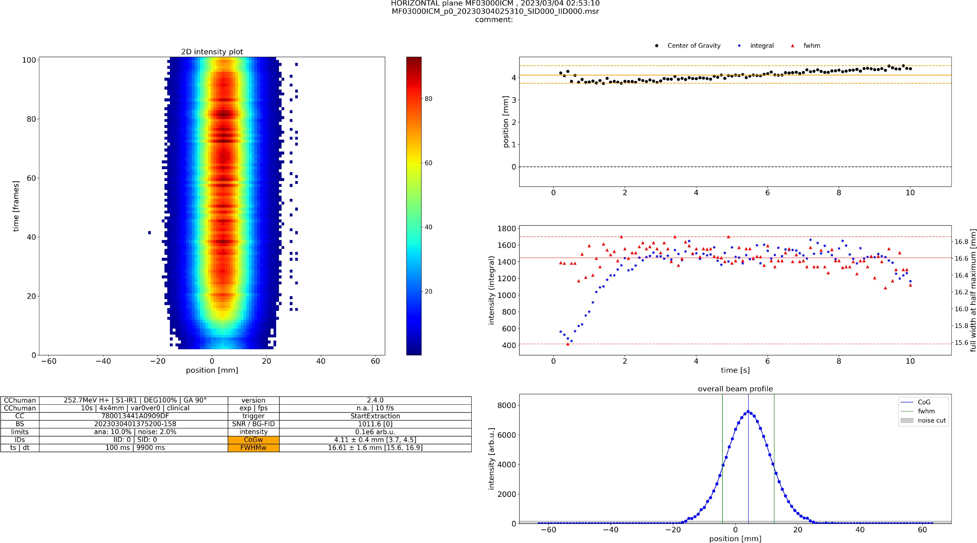
MEASUREMENT RESULTS
First RFKO extraction at MedAustron!
Courtesy of D.A. Prokopovich

Slide 13
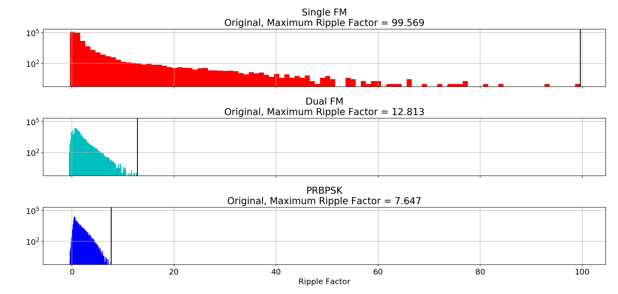
RFKO Beam Quality
For Comparison:
Betatron Core w/ EBC: RF = 3
Betatron Core w/o EBC: RF = 12

Slide 14
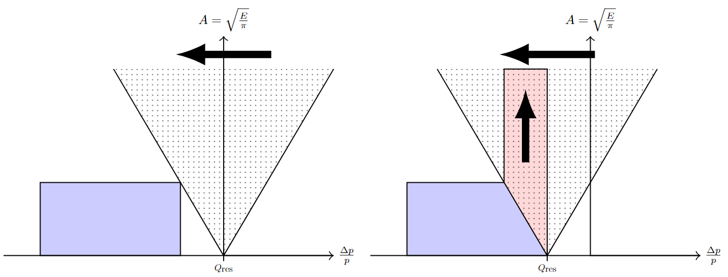
CONSTANT OPTICS SLOW EXTRACTION (COSE)
Resonance is moved into the beam
Linear ramp of all MR magnets
Synchronized ramp of radial beam position
Bunched operation
Multi Energy Extraction

Slide 15
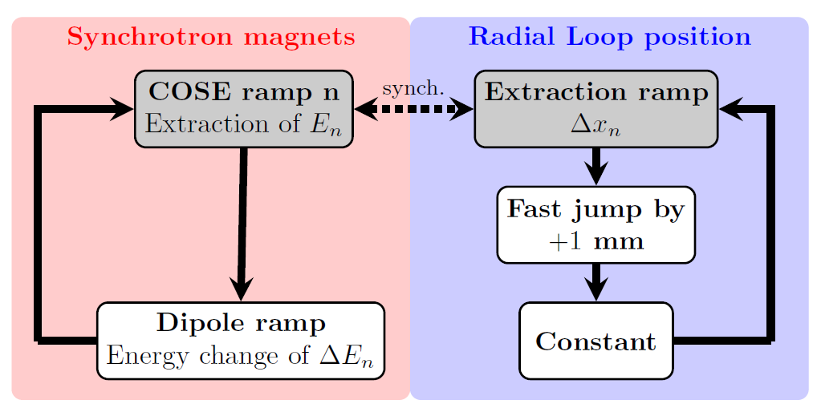
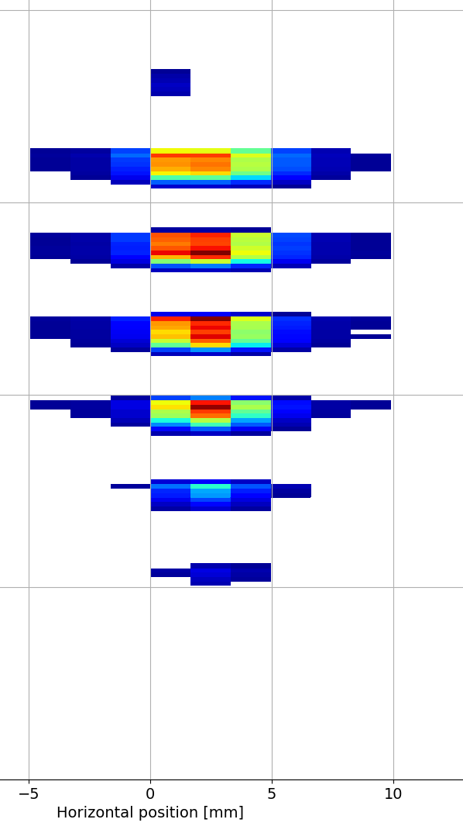
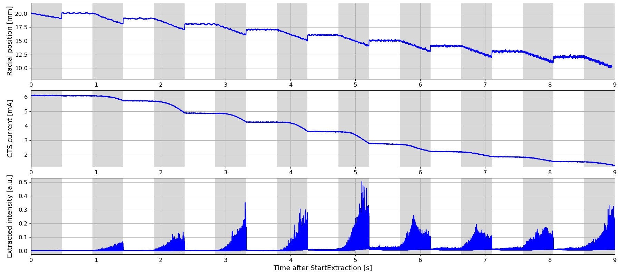
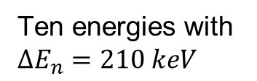
MULTI ENERGY EXTRACTION WITH COSE
Ten energies with $ΔE_{n}=210 keV$
En 1
En 2
En 3
En 4
En 5
En 6
En 7
En 8
En 9
En 10

Slide 16
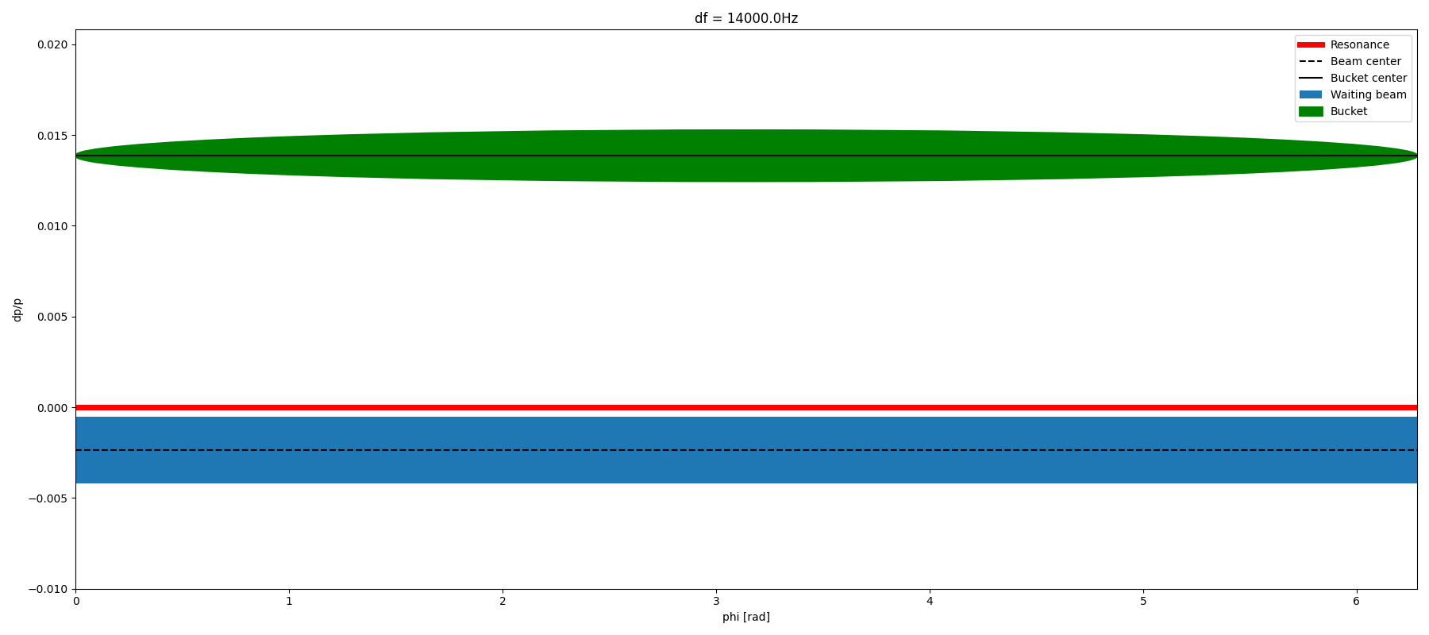
PHASE DISPLACEMENT EXTRACTION (PDE)
Empty bucket is moved through the waiting beam
Sweep can be repeated multiple times
Fast extraction times
FLASH

Slide 17
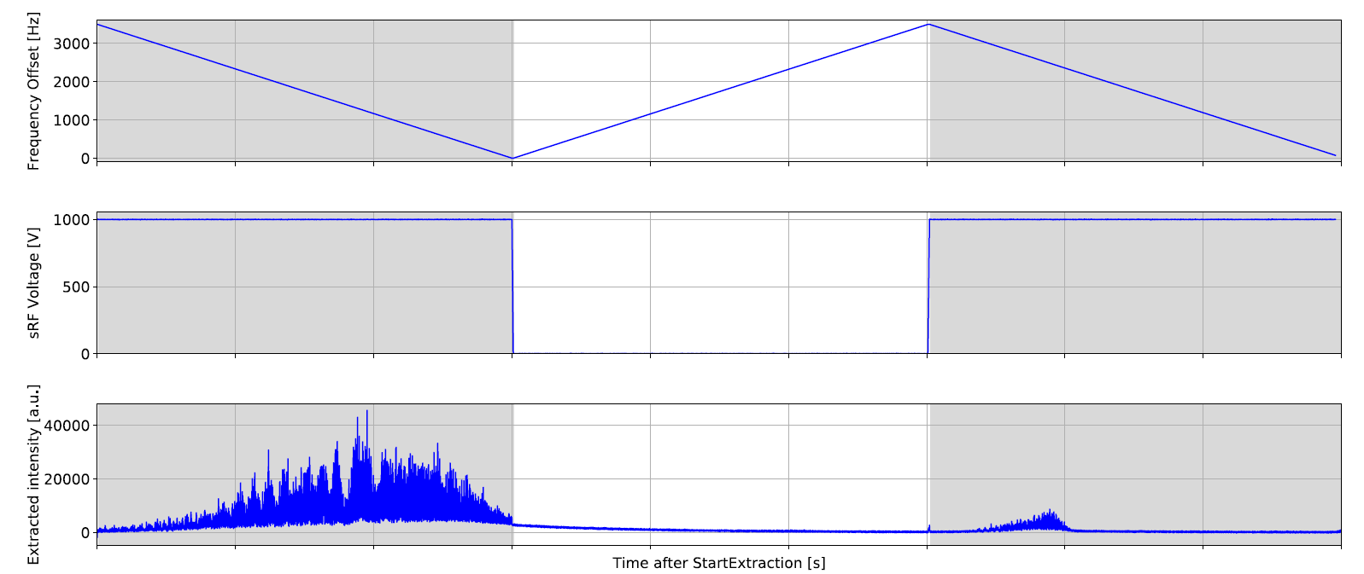
PDE measurements

Slide 18
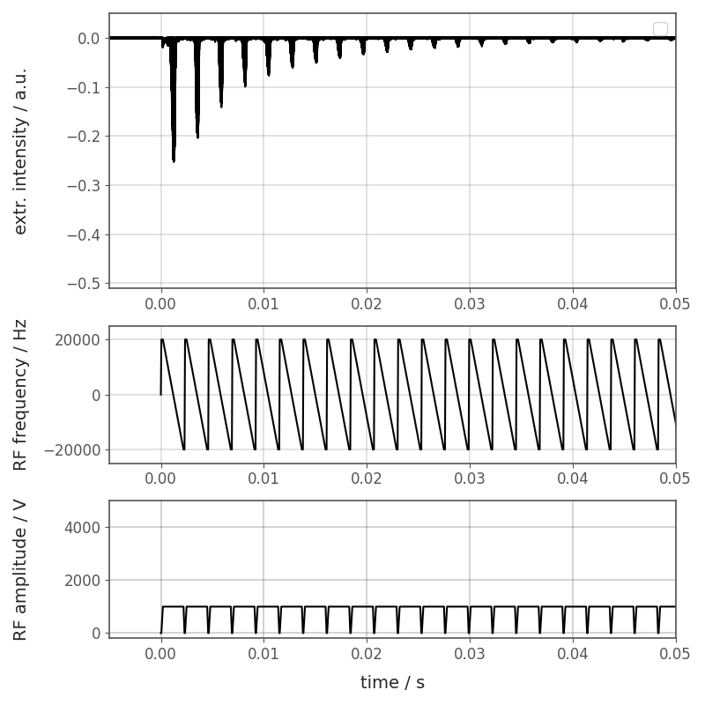
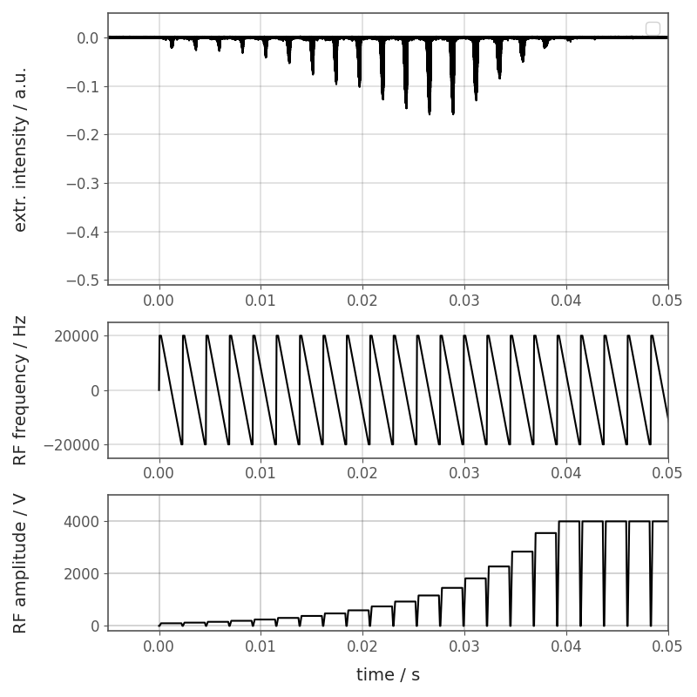
PDE Measurements
Amplitude modulation
Courtesy of E. Renner

Slide 19
Ripple Reduction
Less ripples
Constant dose rate
Faster treatment
Less intensity fluctuations

Slide 20
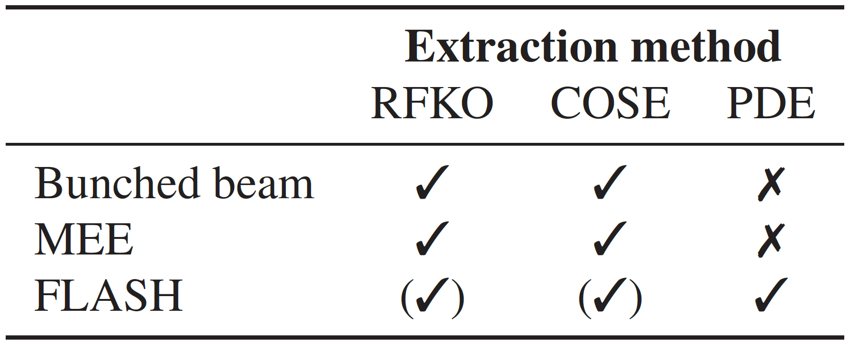
SUMMARY
Successful testing of alternative extraction methods (RFKO, COSE and PDE)
Proof of principle: extraction of the circulating beam into the treatment room
Further optimization and ongoing developments needed
Understanding of complex beam dynamics during extraction

Slide 21
THANK YOU
⚛ RFKO Team: ⚛ Thomas Margreiter
⚛ Xavier German
⚛ Fabien Plassard
⚛ Dale Prokopovich
⚛ Elisabeth Renner
⚛ Mauro Pivi
⚛ Alexander Wastl
⚛ Valeria Rizzoglio
⚛ Claus Schmitzer
⚛ Laurids Adler
⚛ Ivan Strasik
⚛ Felix Feichtinger
⚛ Michael Benedikt
⚛ Lorenz Fischl
⚛ Rebecca Taylor
⚛ Greta Guidoboni
⚛ Pablo Arrutia Sota
⚛ Katrin Holzfeind
⚛ Matthew Fraser
⚛ Clemens Maderböck

Slide 22

THANK YOU FOR YOUR ATTENTION!

