Slide 1
Measuring Small AC Ripple on Strong DC Currents
Slow Extraction Workshop 2024-02-11 - 15
Frank Stulle, Laurent Dupuy, Hervé Bayle (Bergoz Instrumentation)

Slide 2
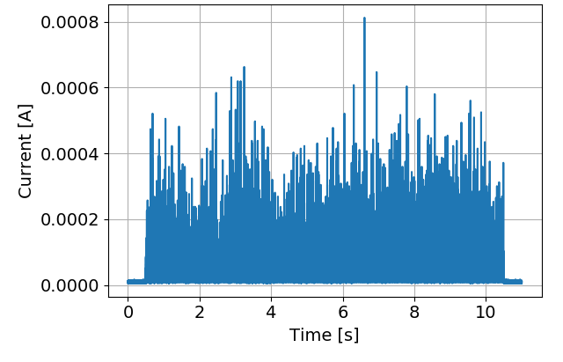
Motivation
Stability of slowly extracted beams ⇕ Stability of magnet power supplies ⇕ Quality of feedback regulation ⇕ Precision of power supply current measurement
Beam
D. Prokopovich et al., “Slow Extraction at MedAustron”, I.FAST REX Kick-Off Meeting, Feb 2021

Slide 3
Development Objective
I.FAST Work Package 5, Task 5.3: “Improvement of resonant slow extraction spill quality”
I.FAST proposal: measure magnet currents to $\frac{∆I}{I_{DC,max}}<{10}^{−6}$
Later communication: measure magnet currents to $\frac{∆I}{I_{DC,max}}≈{10}^{−7}$

Slide 4
Short Interlude
Rewind to Monday 2024-02-12 16:30
Ryotaro Muto, “Spill structure with newly upgraded main magnet power supplies in J-PARC Main Ring”

Slide 5
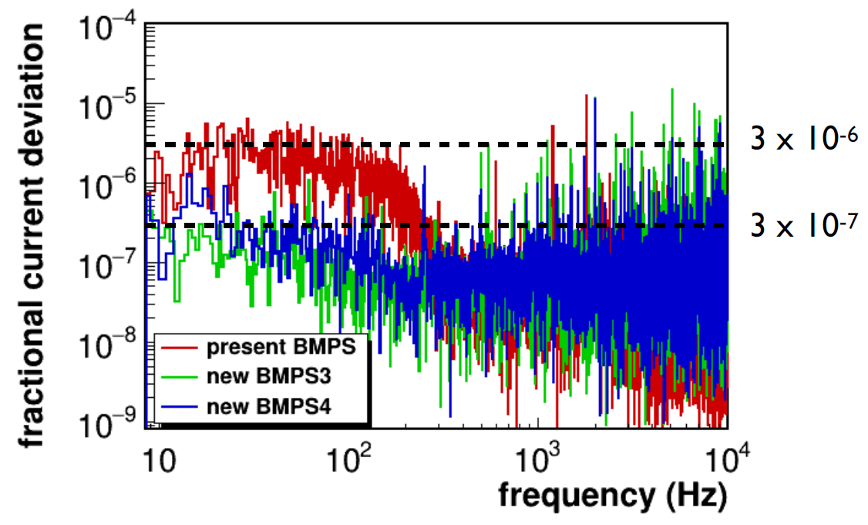
Short Interlude
Question by audience: “Does your DCCT really have 10⁻⁷ resolution?”

Slide 6
Short Interlude
My answer: “Be careful!”
Spectral amplitudes may be at such low levels.
But to get resolution we need to apply the inverse Fourier Transform.
Since spectrum has a certain bandwidth, what we get in time domain is a signal averaged over a certain time window.
Trade-off: good amplitude resolution vs good time resolution!
To my knowledge, there is no current measurement system available that achieves close to 10⁻⁷ resolution with >100 Hz bandwidth.

Slide 7
Short Interlude
Fast Forward to Wednesday 2024-02-14 14:00

Slide 8
Development Objective
Measurement bandwidth $10 Hz$ to $40000 Hz$
Magnet currents up to $I_{DC,max}=10000 A$
Current modulations up to $I_{AC,max}≈1\% I_{DC}$
Collaboration consists of several groups with very different accelerators and very different magnets.
That means, any development must be adaptable to very different requirements.

Slide 9
Development Starting Point
Required AC resolution relative to $I_{DC,max}$: $\frac{σ_{I,AC}}{I_{DC,max}}≈{10}^{−7}$ (⇒ 140dB dynamic range)
Required AC resolution relative to $I_{AC,max}$: $\frac{σ_{I,AC}}{I_{AC,max}}≈{10}^{−5}$ (⇒ 100dB dynamic range)
Required DC accuracy and resolution not properly specified, but certainly a lot less stringent than 10⁻⁷.
⇒ It seems advantageous to separate DC and AC measurements.

Slide 10
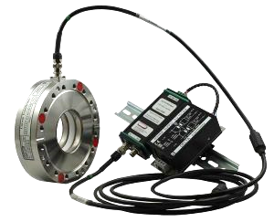
Development Starting Point
We are current transformer specialists.
Hence, we decided to base the development on a current transformer.
AC resolution and bandwidth are almost achieved by ACCT:
ACCT bandwidth 1 Hz – 1 MHz
ACCT resolution <5×10⁻⁵ relative to full scale current
Assuming flat noise spectrum, low pass filtering to 40000 Hz should result in 1×10⁻⁵ resolution.

Slide 11
Challenge
Presence of strong DC currents, i.e. strong magnetic fields ⇒ saturation of magnetic materials used in current transformers
A few Amperes suffice to saturate high performance magnetic materials.
Need to wrap the current transformer in a DC compensation coil.
Required compensation accuracy: ≲1 A $⇒$ $\frac{{∆I}_{DC}}{I_{DC,max}}$ $≲$ ${10}^{−4}$

Slide 12
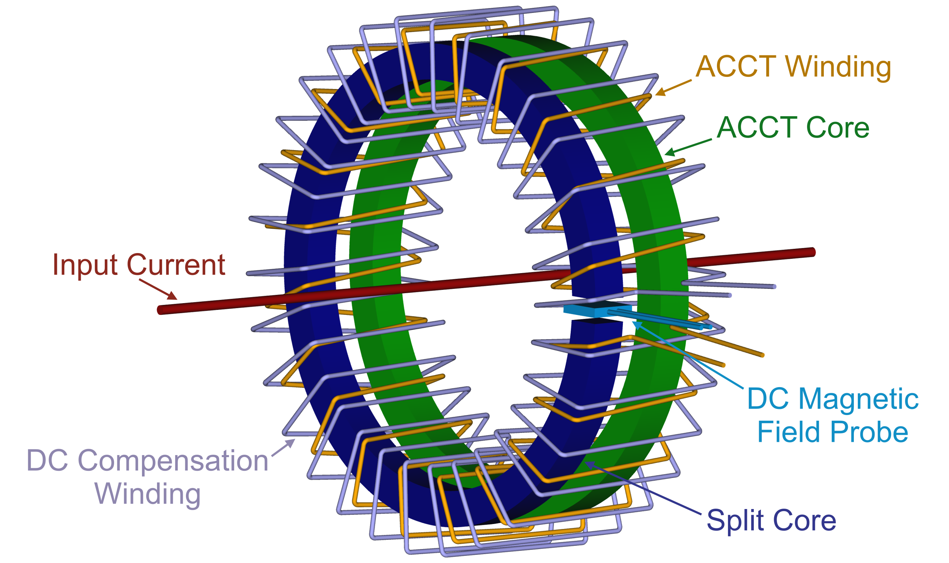
Basic Principle

Slide 13
Basic Principle
(DC – 10 Hz)
(10 Hz – 40000 Hz)
Design choice: both output signals shall be properly in phase.
That means, to reconstruct the full input current spectrum (DC – 40000 Hz):
$$I_{in}\left(f\right)=g_{DC} U_{DC}\left(f\right)+g_{AC} U_{AC}\left(f\right)$$

Slide 14
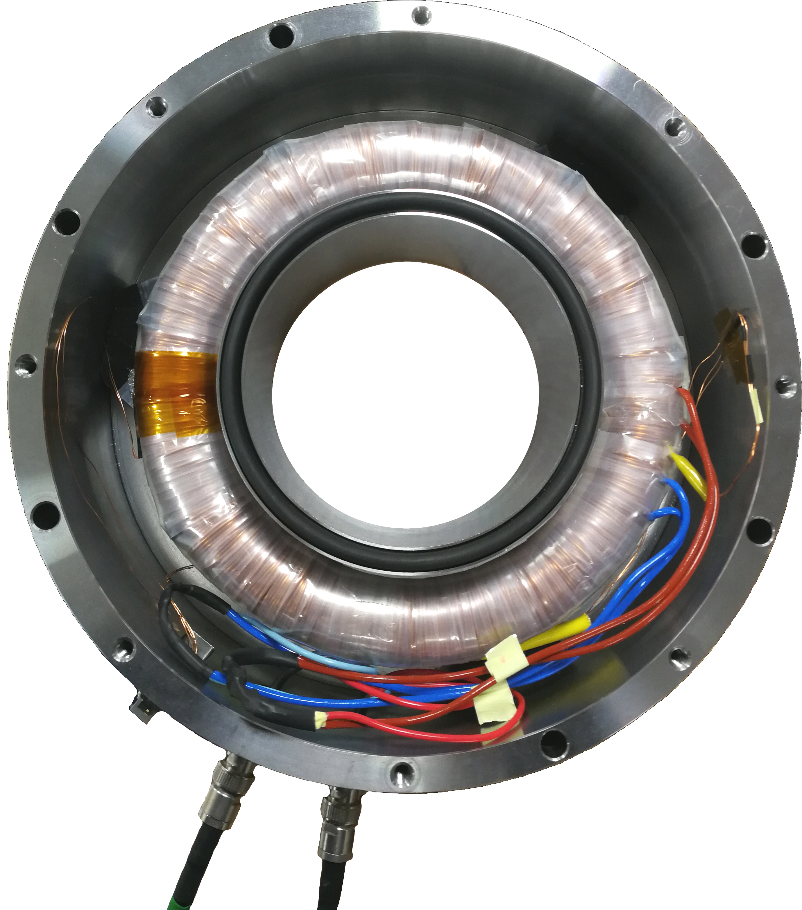
Prototype Specifications
DC: 8 V for 6000 A, DC – ~10 Hz
AC: 10 V for 60 A, ~10 Hz – ~40000 Hz
Two windings, each 1500 turns
110 mm aperture
260 mm outer diameter
80 mm height

Slide 15
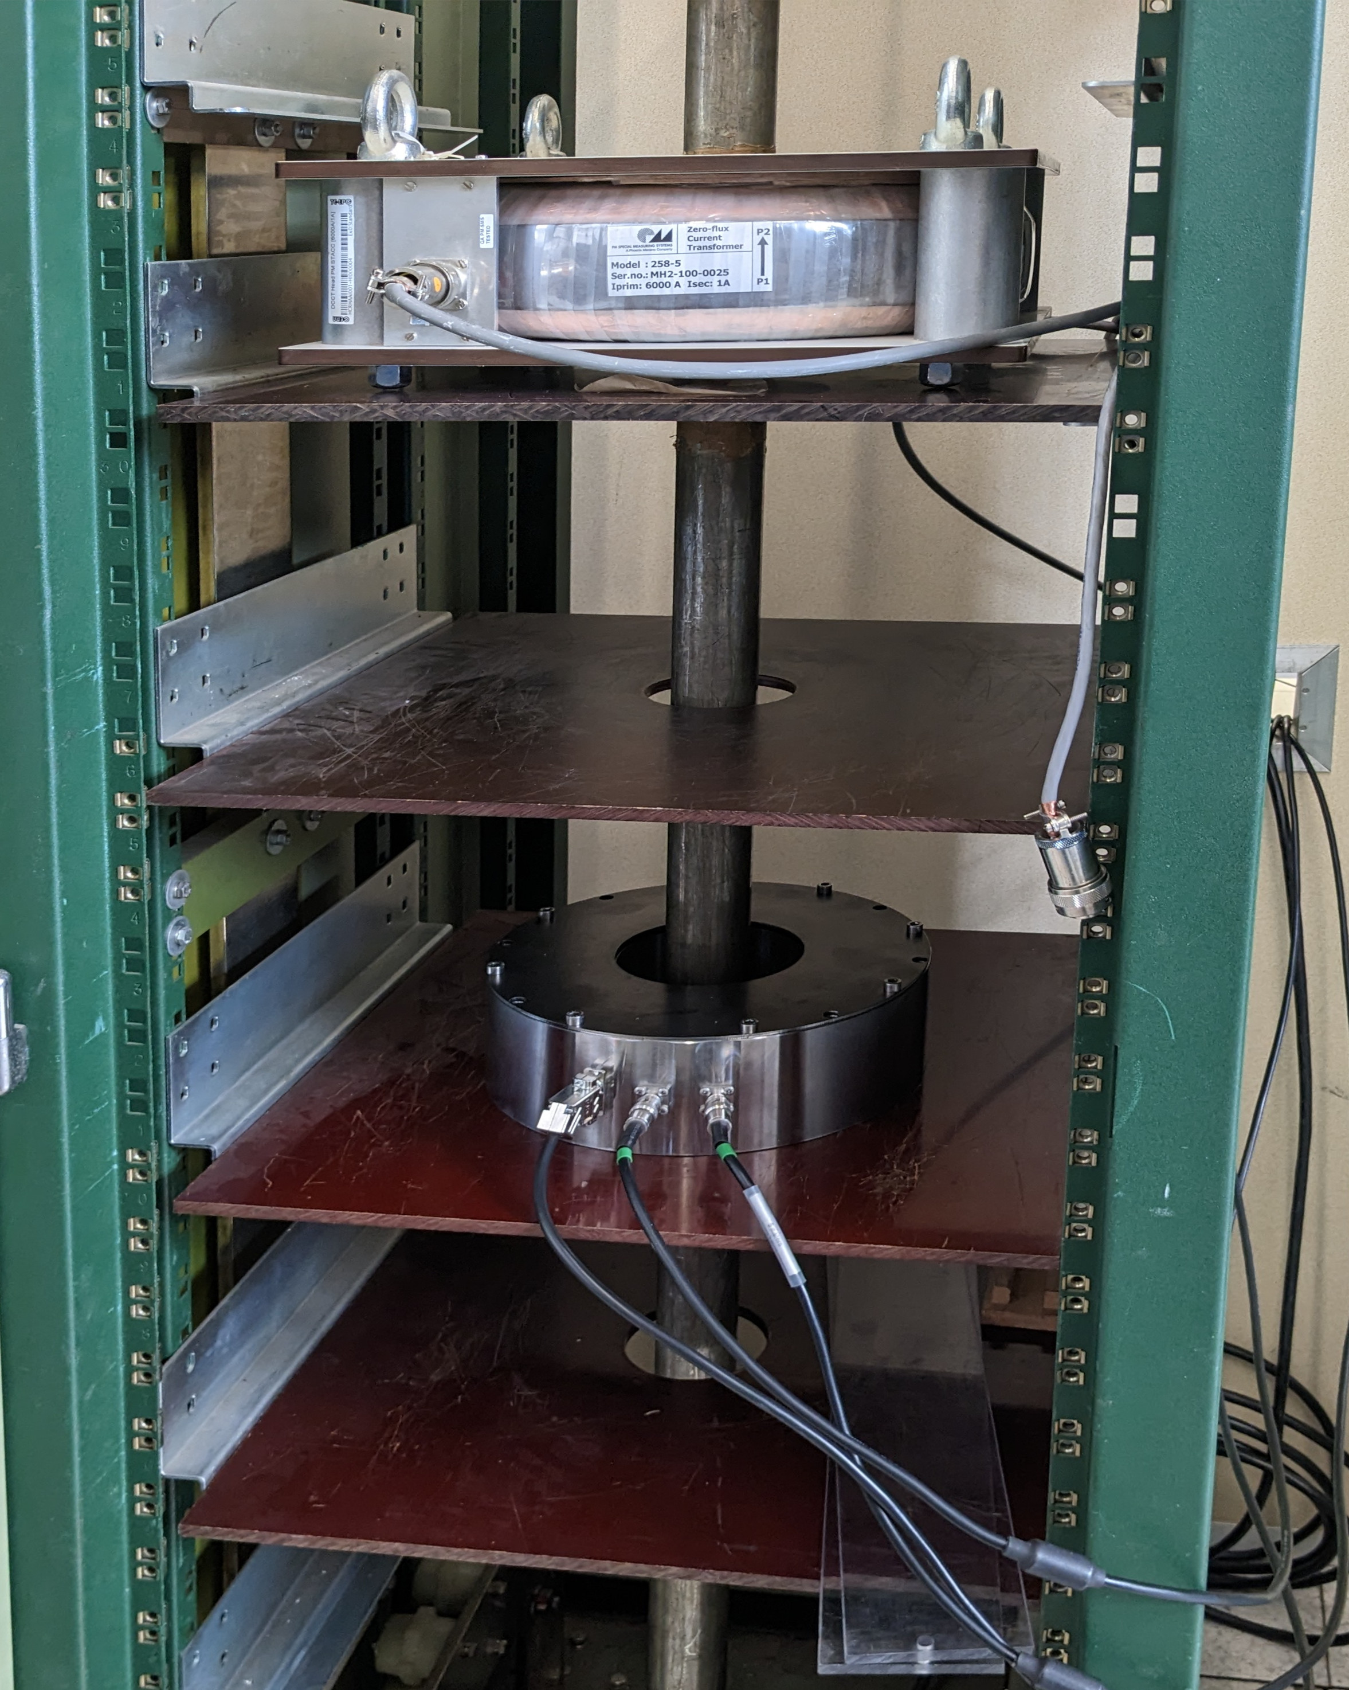
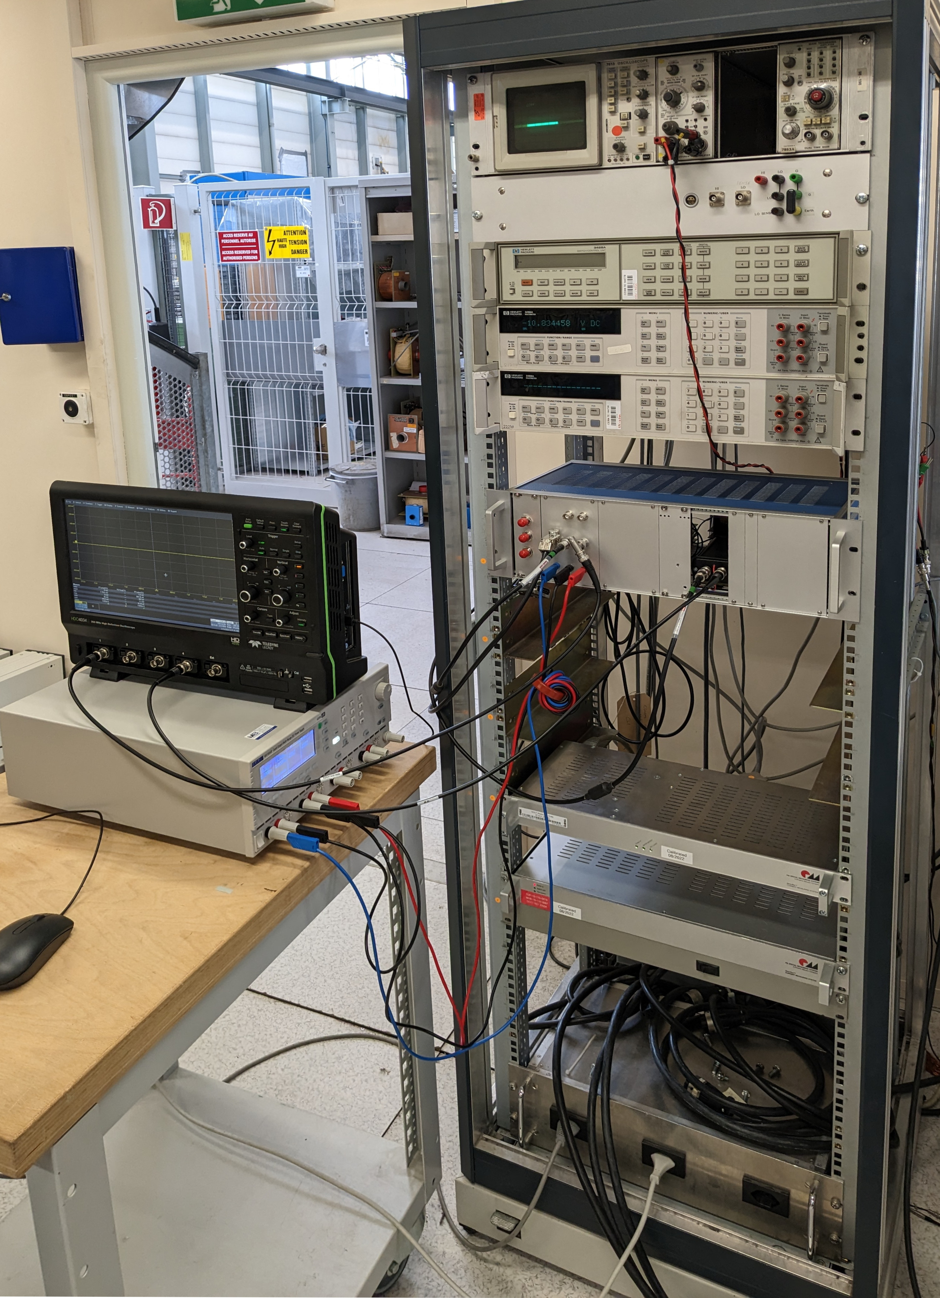
Prototype Tests at CERN
6000 A DC Test Stand
Precision Voltmeters
Reference Fluxgate DCCT
Prototype Electronics
Prototype Sensor
Reference Fluxgate DCCT Electronics

Slide 16
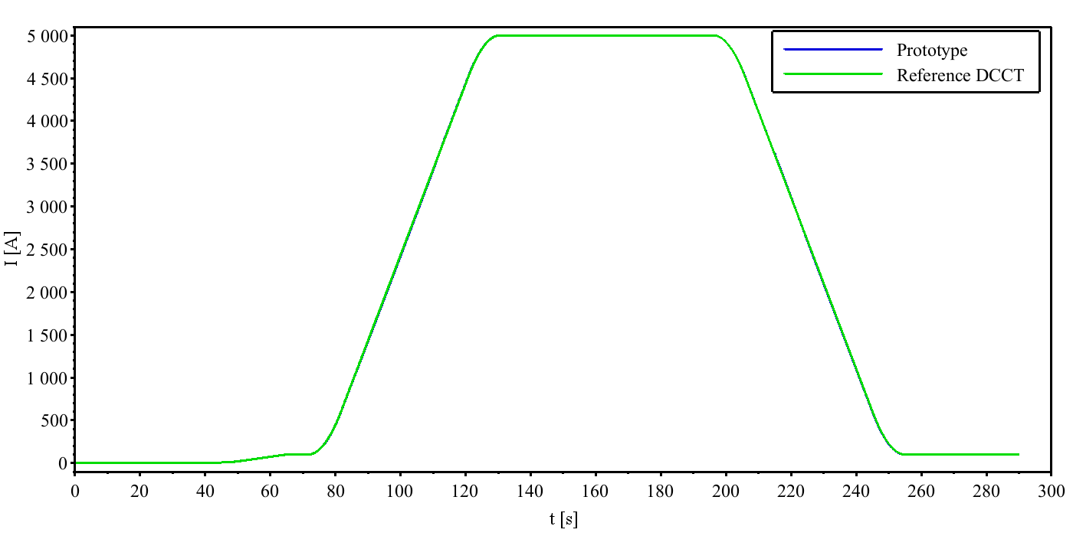
DC Ramp Up and Down
Prototype offset and gain corrected to match reference DCCT
Curves almost exactly superimpose

Slide 17
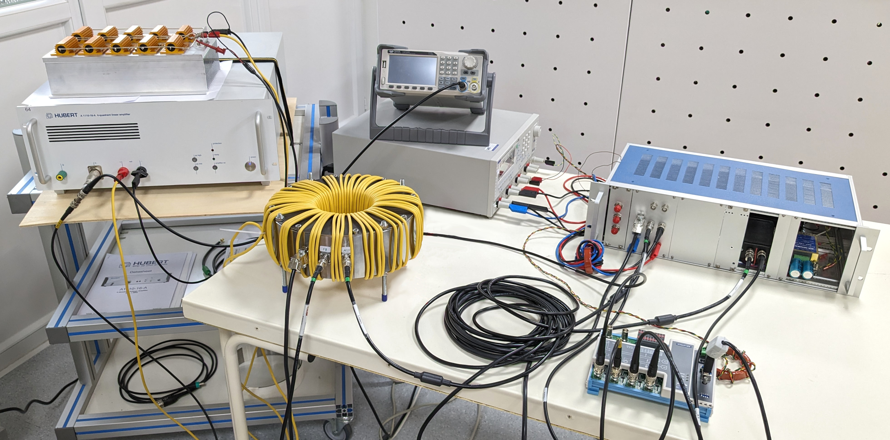
Prototype Tests at BI
Power Amplifier with Load
Signal Generator
Feedback Power Supply
Prototype Electronics
Prototype Sensor 60 turns primary
24bit ADC

Slide 18
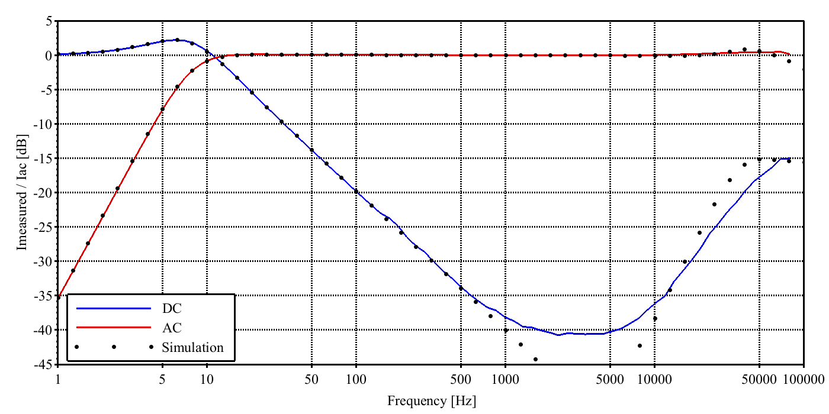
Frequency Response

Slide 19
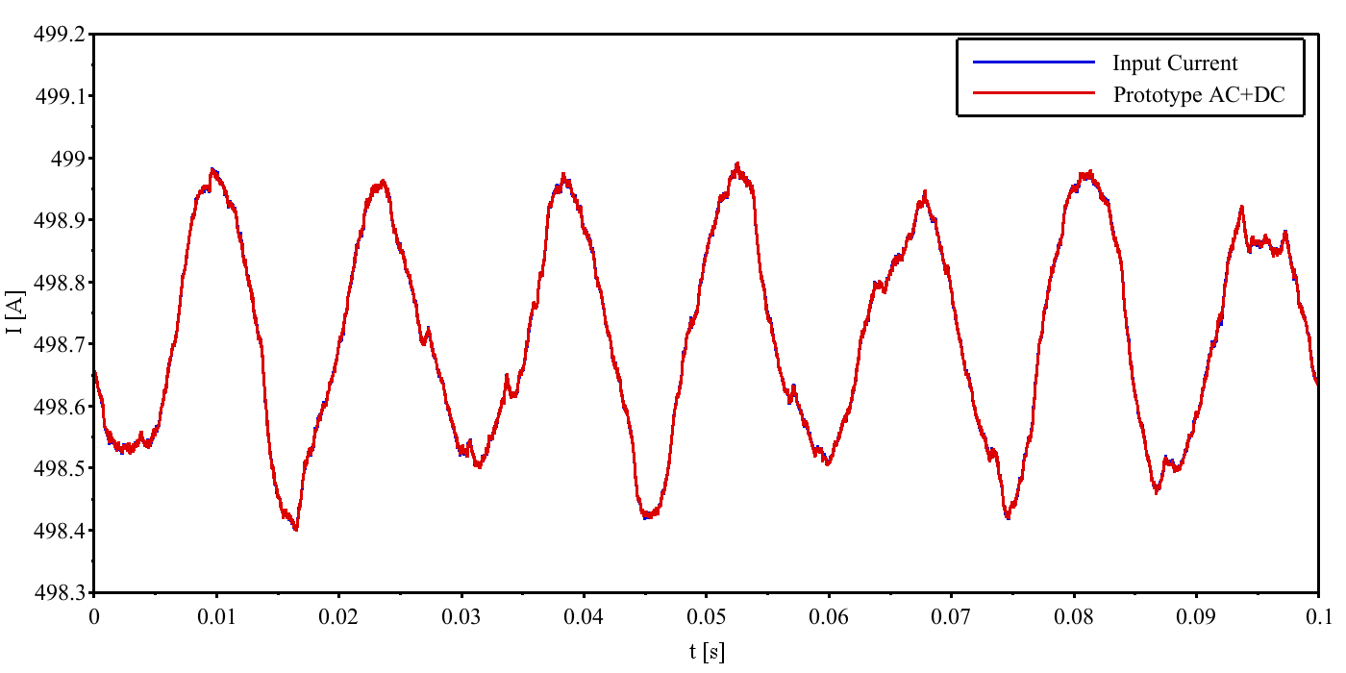
DC + Small AC
500 A_{DC} + 0.5 A_{pp} 70 Hz sine
Curves almost exactly superimpose

Slide 20
Measurements Close-Up
well?
What went
wrong?

Slide 21
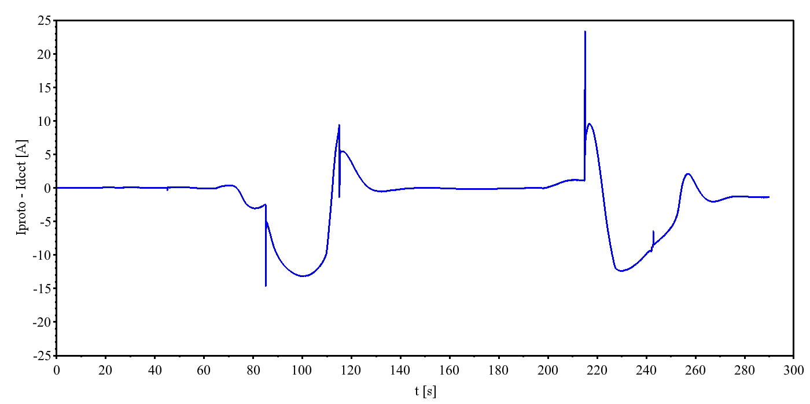
Close-Up DC
stable during flat top
too high error during ramp

Slide 22
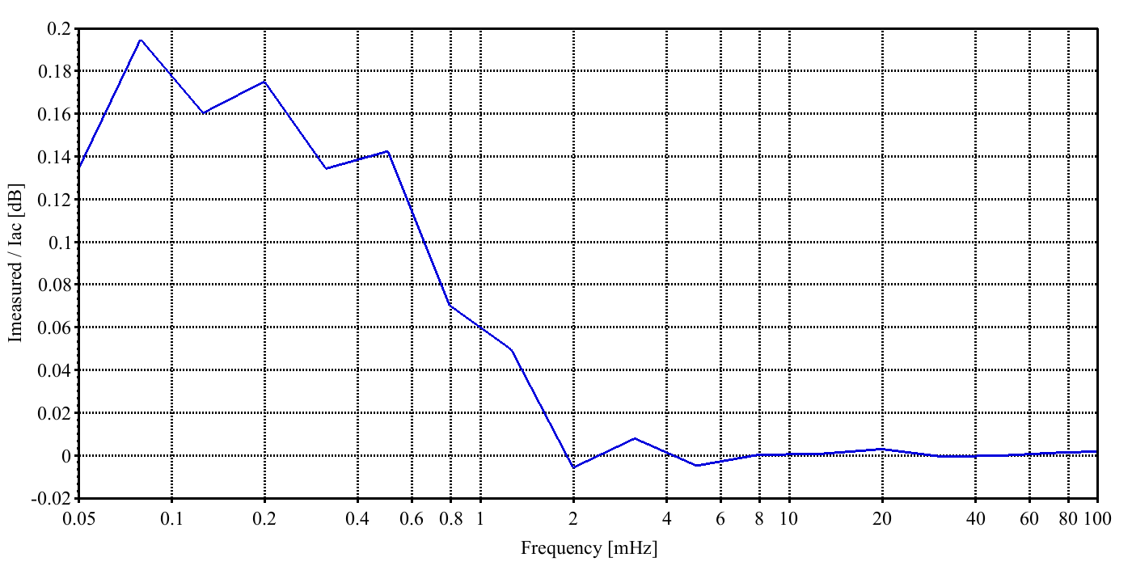
Close-Up Frequency Response
Measured frequency response not sufficiently flat at very low frequencies (<10 mHz) (not visible in simulations)

Slide 23
Close-Up DC / Frequency Response
Apparently, DC compensation was behaving slightly wrong during measurements at CERN.
Some shortcomings were quickly found, others were well hidden.
Nothing was fundamentally wrong.
Re-designed electronics for improved signal accuracy and stability.
New electronics is being assembled now and will be tested soon.

Slide 24
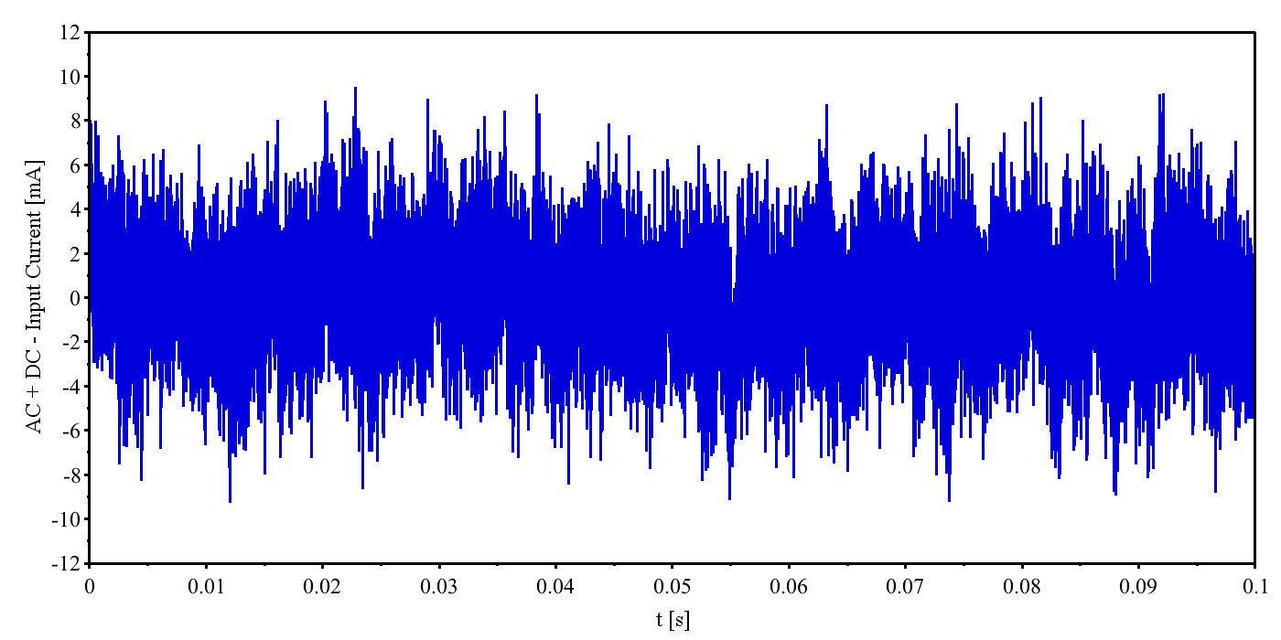
Close-Up AC
Noise = 2.6 mA_{rms} ⇒ 4.3 × 10⁻⁵

Slide 25
Close-Up AC
Input Current: 500 A_{DC} + 0.5 A_{pp} 70 Hz sine
AC Noise: $σ_{I,AC}=2.6 {mA}_{rms}, \frac{σ_{I,AC}}{I_{AC,max}}=4.3×{10}^{−5}$
DC Feedback=Off , Input Current: no DC, ≥0 A_{AC}
AC Noise: $σ_{I,AC}=0.33 {mA}_{rms}, \frac{σ_{I,AC}}{I_{AC,max}}<5.6×{10}^{−6}$
Spec: ${10}^{−5}<\frac{σ_{I,AC}}{I_{AC}}<{10}^{−4}$, 40 kHz BW
same with 0 A input current

Slide 26
Summary
High resolution, high dynamic range current measurement system in development for stabilization of magnet power supplies.
Prototype measurements were rather satisfactory.
Bandwidth surpasses specifications.
Measured AC resolution is (almost) within specifications. And there seems to be potential for further improvements.
However, DC compensation worked less well than expected.
Some corrections and improvements have been implemented already.
New electronics will be finished this week.

