Slide 1
Slow Extraction of Mixed He-2+ and C-6+ Beams for Online Range Verification
5th Slow Extraction Workshop 2024
Wiener Neustadt / MedAustron – 12.-14.02.2024
Elisabeth Renner, Matthias Kausel
elisabeth.renner@tuwien.ac.at
Nadia Gambino, Florian Kühteubl, Valentin Kirchweger, Fabien Plassard, Dale Prokopovich, Claus Schmitzer, Markus Wolf

Slide 2
Outline
Motivation for mixed ⁴He²⁺ and ¹²C⁶⁺ beams
Feasibility study for delivering mixed beams at MedAustron
Considerations for slow extraction of the mixed beam
Outlook & conclusion

Slide 3
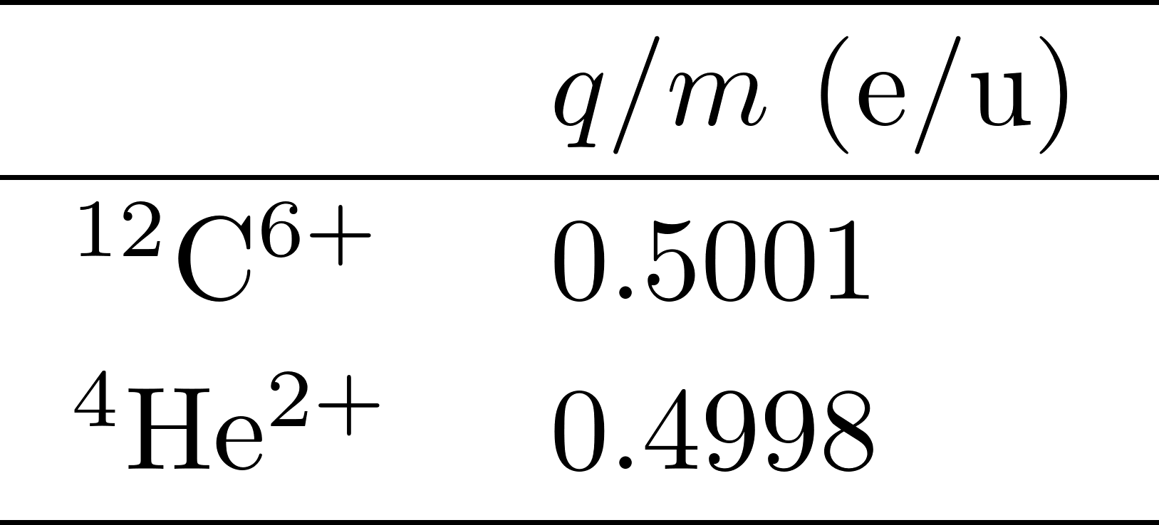
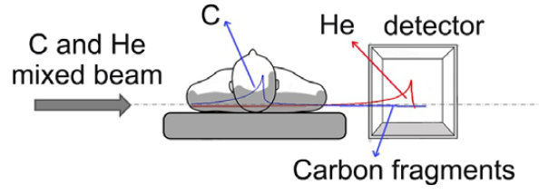
Mixed Beams for Online Range Verification
⁴He²⁺ and ¹²C⁶⁺ exhibit very similar charge-to-mass ratio.
Simultaneous acceleration & delivery to irradiation room could be possible.
Extraction at (almost) same energy per nucleon
Helium has around 3 times the range of carbon at the same energy per nucleon.
Possibility for online range verification, ion CT, …
If extracting an intensity ratio of He:C=1:10, ⁴He²⁺ accounts for only $\sim 1\%$ of the dose delivered to the patient [1].
Note: Helium Bragg peak needs to traverse patient, only possible for larger tumor depths.
Described & proposed in refs. [1-3].
First experimental results at GSI in 2023 – See David Ondreka’s talk!
$${Δ\left(\frac{q}{m}\right)}/{\frac{q_{C}}{m_{C}}}≈−0.065 \%$$
Schematic mixed beam irradiation, Mazzucconi et. al [1]
[1] D. Mazzucconi et.al (2018), https://doi.org/10.1002/mp.13219
[2] L Volz et al (2020), Phys. Med. Biol. 65 055002
[3] Graeff et al (2018), https://doi.org/10.1016/j.ejmp.2018.06.099

Slide 4
Feasibility Study: Mixed Beams @ MedAustron?
Background: MedAustron delivers ¹²C⁶⁺ and p+ for clinical treatment, ⁴He²⁺ is currently being commissioned for non-clinical research.
Objective: Assess the feasibility of delivering a mixed beam for nonclinical research (IR1).
PhD student started in 2023
Collaboration between MedAustron, TU Wien & HEPHY
D. Mixed beam detection:
“Mixed beam dose delivery system”
Detectors for online range verification & imaging in IR1
A. Assess options for
producing the mixed beam in novel sources,
+ transport through LINAC.
Infrastructure at MedAustron:
Separate ion sources producing ⁴He²⁺ (q/m≈0.5) and ¹²C⁴⁺ (q/m≈1/3)
Transport with different q/m through the LINAC, stripping after the LINAC
(Nearly) same q/m≈0.5 in the synchrotron
B. Assess options for mixing the beam during injection.
C. Accelerate and extract mixed beam

Slide 5
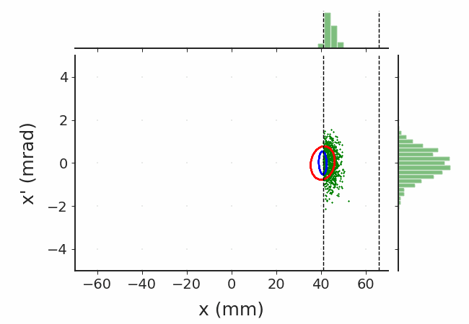
Scenarios for Mixed Beam Generation
Matthias Kausel, Valentin Kirchweger
Generation in a single ion source is currently not possible at MedAustron.
Would require novel source and depending on the source LINAC upgrades (LINAC can only accelerate $\frac{q}{m}≥\frac{1}{3}$).
Investigate sequential injection into the synchrotron as (temporary) alternative production scheme:
“Double multi-turn injection”
1st injector cycle: Inject ⁴He²⁺ into synchrotron + maintain beam at flat bottom (~1s)
2nd injector cycle: Inject ¹²C⁶⁺ on top of ⁴He²⁺ :
Adapt injection bump to sustain small He core
Capture, acceleration + extraction of ion mix
Status:
Managed to operate injector in proposed way & inject He and C sequentially*.
So far, no show-stoppers from the control system identified.
Next steps: optimize injection bump, harmonize injection energy, capture, acceleration, …
* Note: So far, tests focused on demonstrating technological feasibility. He-2+ was still lost when injecting C-6+, injection has not yet been optimized.

Slide 6
Slow Extraction of Mixed He-2+ & C-6+ Beams

Slide 7
Objective & Simulation Set-Up
Objective: Proof-of-principle simulations of the slow extraction of the mixed He²⁺/C⁶⁺ beam to identify challenges & propose mitigation:
Results serve as input for mixed beam generation and detection studies.
Preliminary aim: deliver constant and/or known intra-spill particle fluence ratio of the two species:
Preliminary target is ~ He:C = 1:10 → $ξ\left(t\right)≈0.1$
Is ion distinction possible in a dose delivery system?
Yes: Possibility to adapt $ξ$and/or scanning during the spill ?
No: Can we guarantee a constant species ratio?
Simulation performed using Xsuite [4]:
Enables 6D-tracking of ions with non-nominal $q/m$, also for bunched beams.
Results in this presentation obtained using custom version with fixed bugs concerning non-nominal q/m, as described in issue 446 [5].
Many thanks to all Xsuite developers :)
[4] https://github.com/xsuite/xsuite [5] https://github.com/xsuite/xsuite/issues/446

Slide 8
Transverse Distribution Prior to Extraction
The considered options for generating the mixed-beam result in different initial horizontal emittances.
I) Mixed beam generation in ion source
II) Sequential injection + mixing at flat-bottom
Assume:
Assume:
He-2+
C-6+
He-2+
C-6+
Thus, for the current proof-of-principle simulations, we consider a range of horizontal emittance ratios!
Note: All simulations performed with 10k He-2+ and 10k C-6+ particles → Results will be subsequentially normalized to assumed initial intensity ratio of 1:10

Slide 9
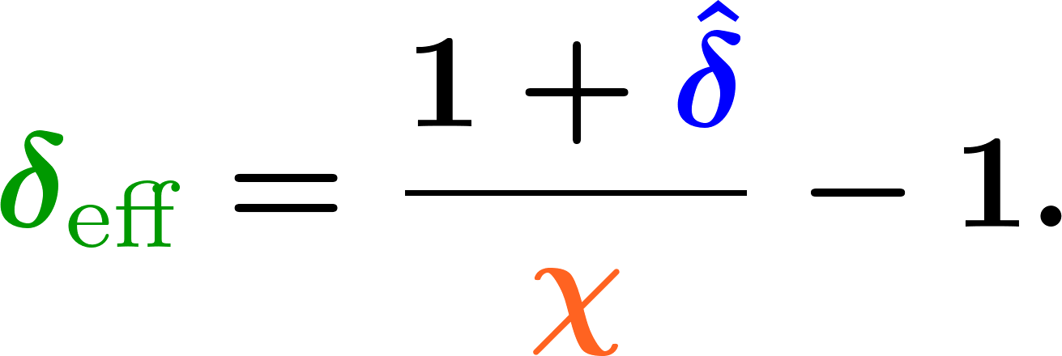
Longitudinal Distribution Prior to Extraction I
⁴He²⁺ has higher rigidity than ¹²C⁶⁺ (reference particle) due to the smaller q/m.
A particle with
and a relative momentum per mass offset
… behaves in a magnetic field like a particle with (see e.g. [7])
nominal charge-to-mass ratio, i.e. $χ_{eff}=1$,
and an effective relative momentum per mass offset
[7] P. Hermes (2016), PhD Thesis, CERN-THESIS-2016-230, https://cds.cern.ch/record/2241364/

Slide 10
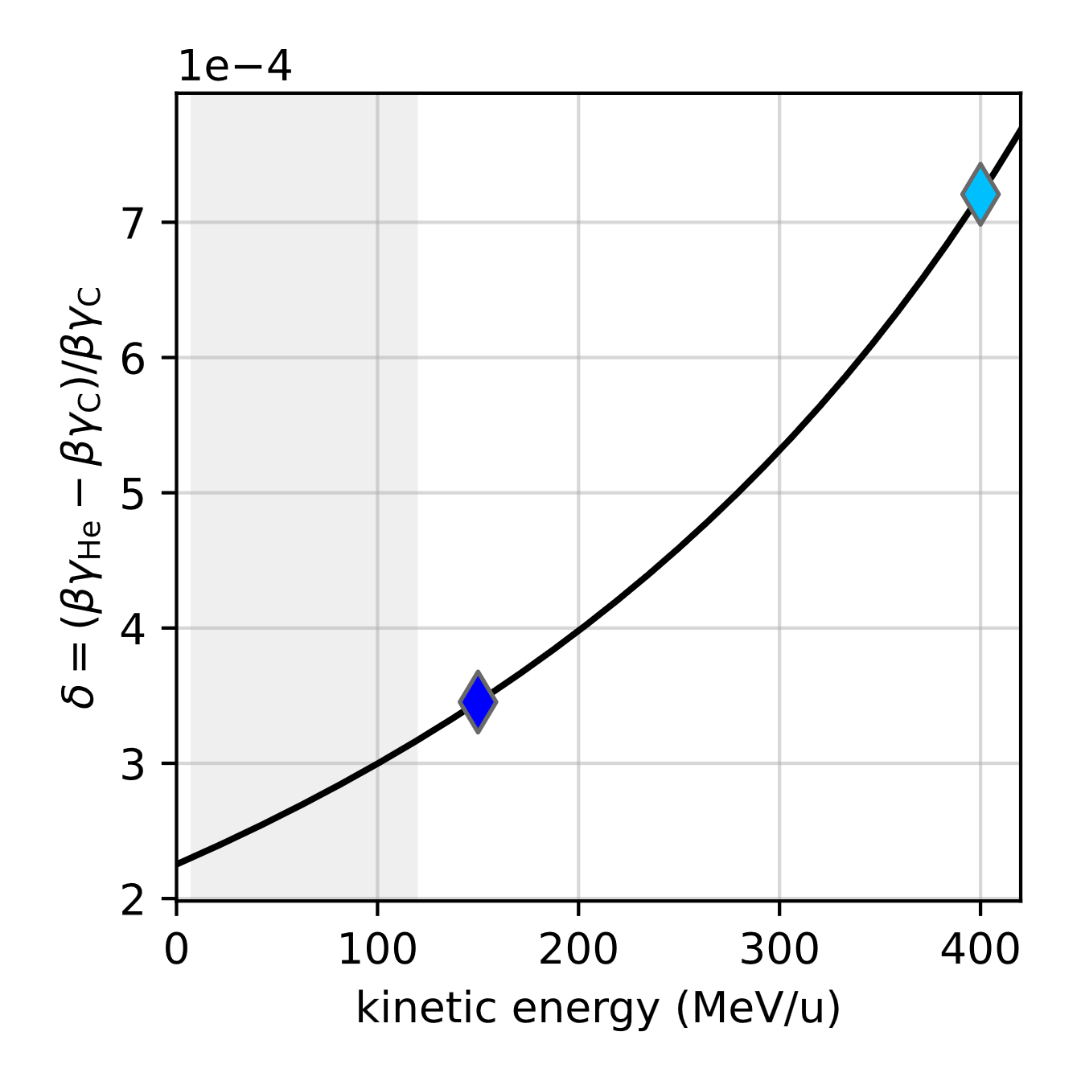
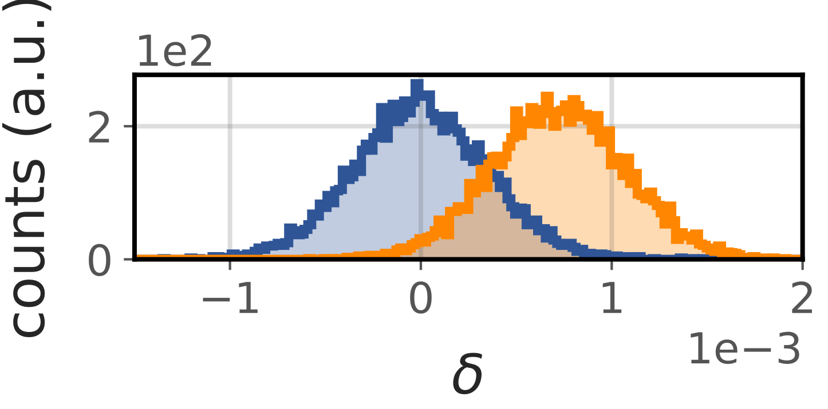
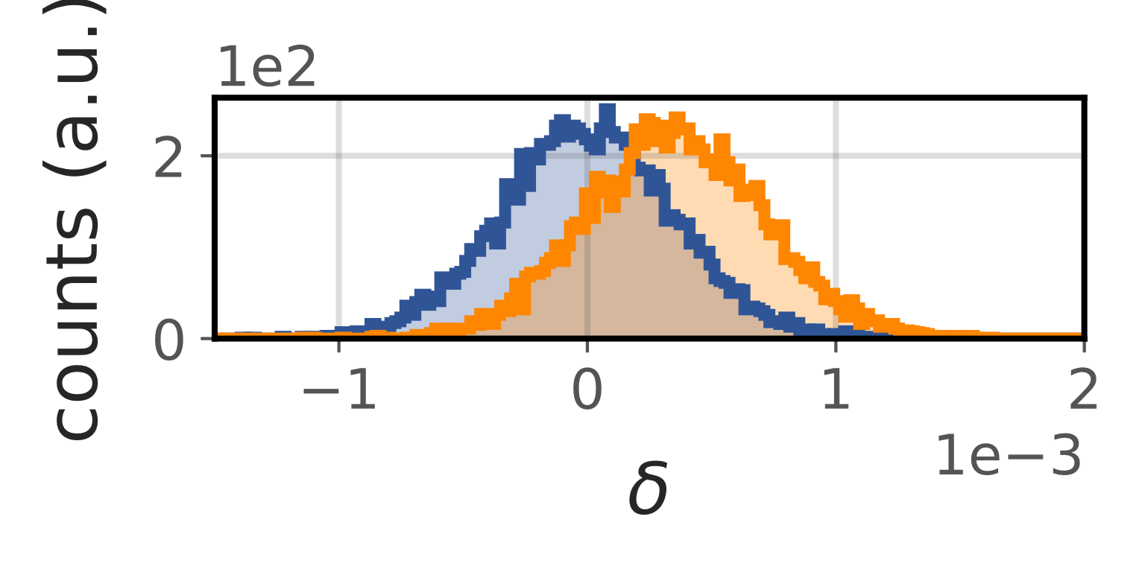
Longitudinal Distribution Prior to Extraction II
Due to the rigidity offset, ⁴He²⁺ is accelerated to a slightly higher momentum/mass than ¹²C⁶⁺.
Synchronous ⁴He²⁺ and ¹²C⁶⁺ with same revolution frequency
Rigidity + path length difference yields relative velocity offset (see e.g. [6])
He-2+
C-6+
and hence relative momentum per mass offset
which depend on the difference between extr. and transition energy
Crucial for small medical machines, e.g. @ MedAustron $γ_{TR}≈2,$ $γ_{C}≈1.1−1.4$
here: $σ_{δ}≈0.35⋅{10}^{−3}$
[6] P. Bryant (1993), The Principles of Circular Accelerators and Storage Rings, Chapter 7.7.6

Slide 11
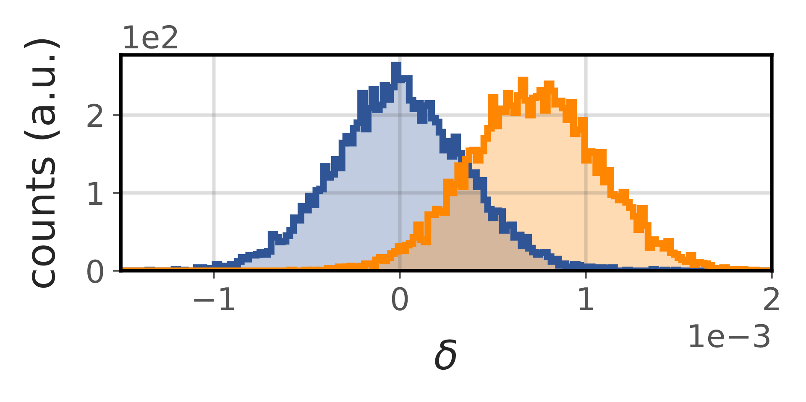
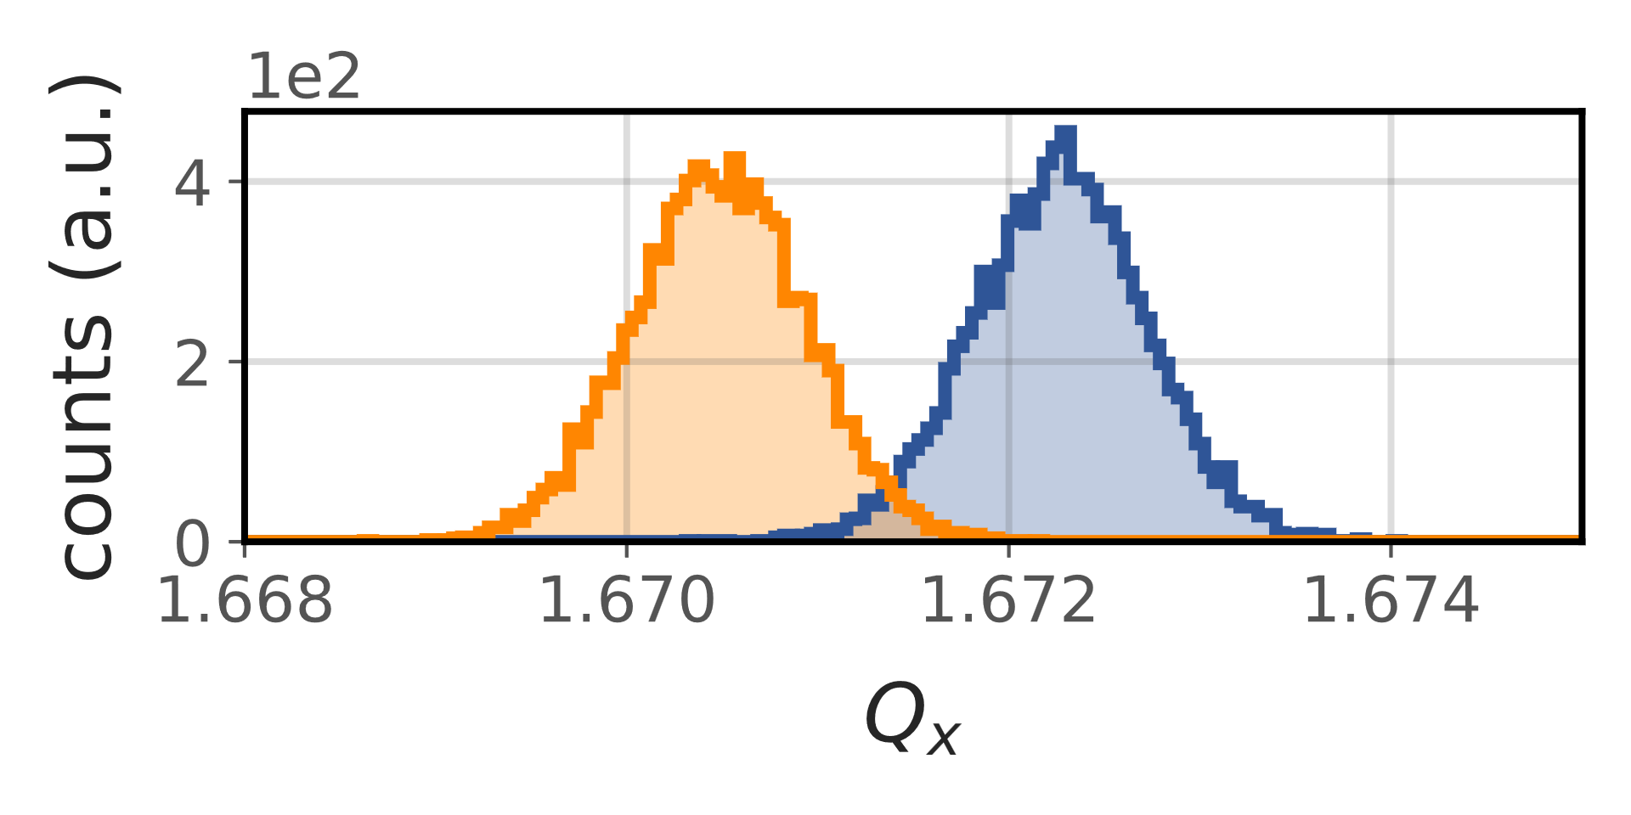
Tune Distribution Prior to Extraction I
Momentum per mass distribution
Tune distribution
$$\hat{δ}$$
$$ΔQ=Q^{′}⋅δ_{eff}$$
He-2+
C-6+
here: $δ_{RMS}≈0.35⋅{10}^{−3}$, $Q^{′}≈−1.3$
[7] P. Hermes (2016), PhD Thesis, CERN-THESIS-2016-230, https://cds.cern.ch/record/2241364/

Slide 12
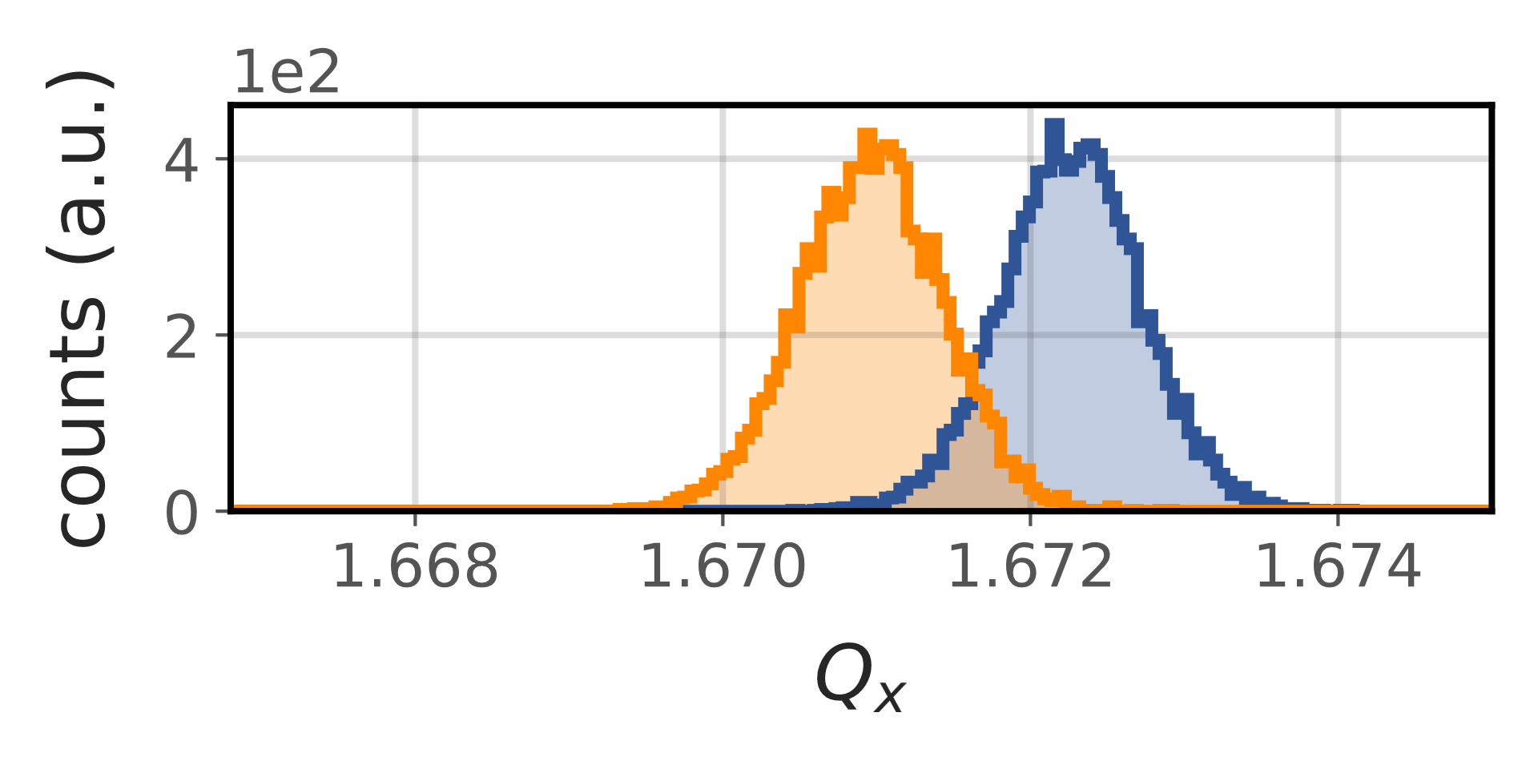
Tune Distribution Prior to Extraction II
Consequently, the tune separation between ⁴He²⁺ and ¹²C⁶⁺ depends on the extraction energy ($Q^{′}≠0$).
$$E_{kin}=400 MeV/u$$
$\hat{δ} =\text{0.72}\text{e}\text{−3}$
$δ_{eff}=\text{1.37}\text{e}\text{−3}$
$$E_{kin}=150 MeV/u$$
He-2+
$\hat{δ} =\text{0.}\text{35}\text{e}\text{−3}$
$δ_{eff}=\text{0.996}\text{e}\text{−3}$
C-6+
here: $δ_{RMS}≈0.35⋅{10}^{−3}$, $Q^{′}≈−1.3$
here: $δ_{RMS}≈0.35⋅{10}^{−3}$, $Q^{′}≈−1.3$

Slide 13
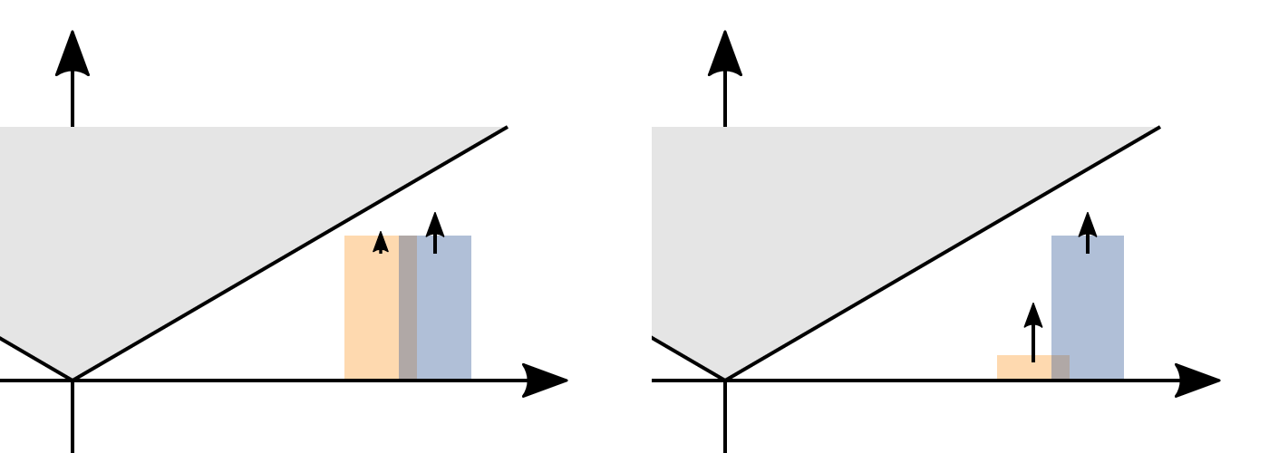
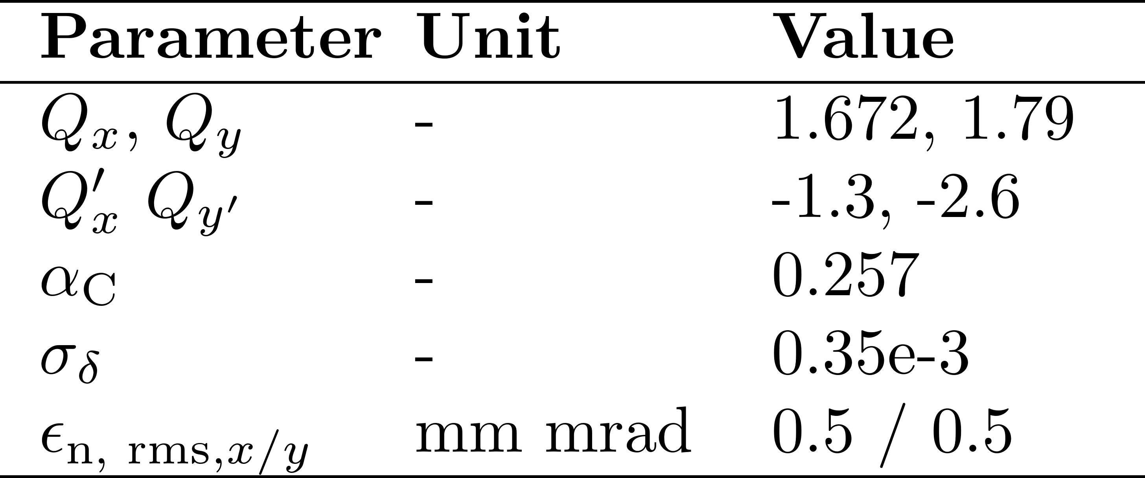
Proposed Extraction Strategy
Summary/Requirements: Aim to simultaneously extract (with similar particle fluence) two ion species, which can feature
energy-dependent tune separation ($Q^{′}≠0)$
and potentially different horizontal phase space distributions.
Baseline: Extraction based on amplitude selection (RFKO)
Multiple knobs for controlling intra-spill ion fluence ratio $ξ$ depending on emittance ratios, extraction energy, …
E.g., $Q, Q_{x}^{′}$ (tune separation), sextupole strength (ratio of stable areas), RFKO excitation signals / combinations, … .
A
A
Q
He-2+
C-6+
Q
Next slides: first, illustrative examples ...
For now, coasting beams preliminarily based on machine settings within the parameter range described in [8] → to be adapted
Today: RFKO excitation (no variation of $Q^{′},$ $k2L$, …)
See talk by F. Kühteubl in the afternoon!
[8] F. Kuehteubl, IPAC23, doi:10.18429/JACoW-IPAC2023-TUPM091

Slide 14
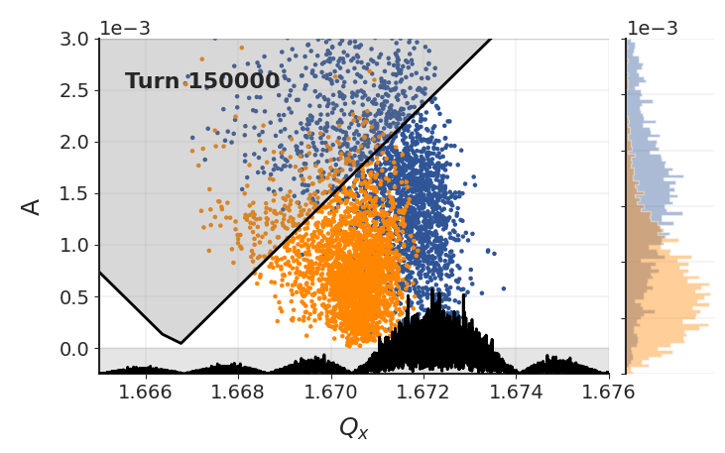
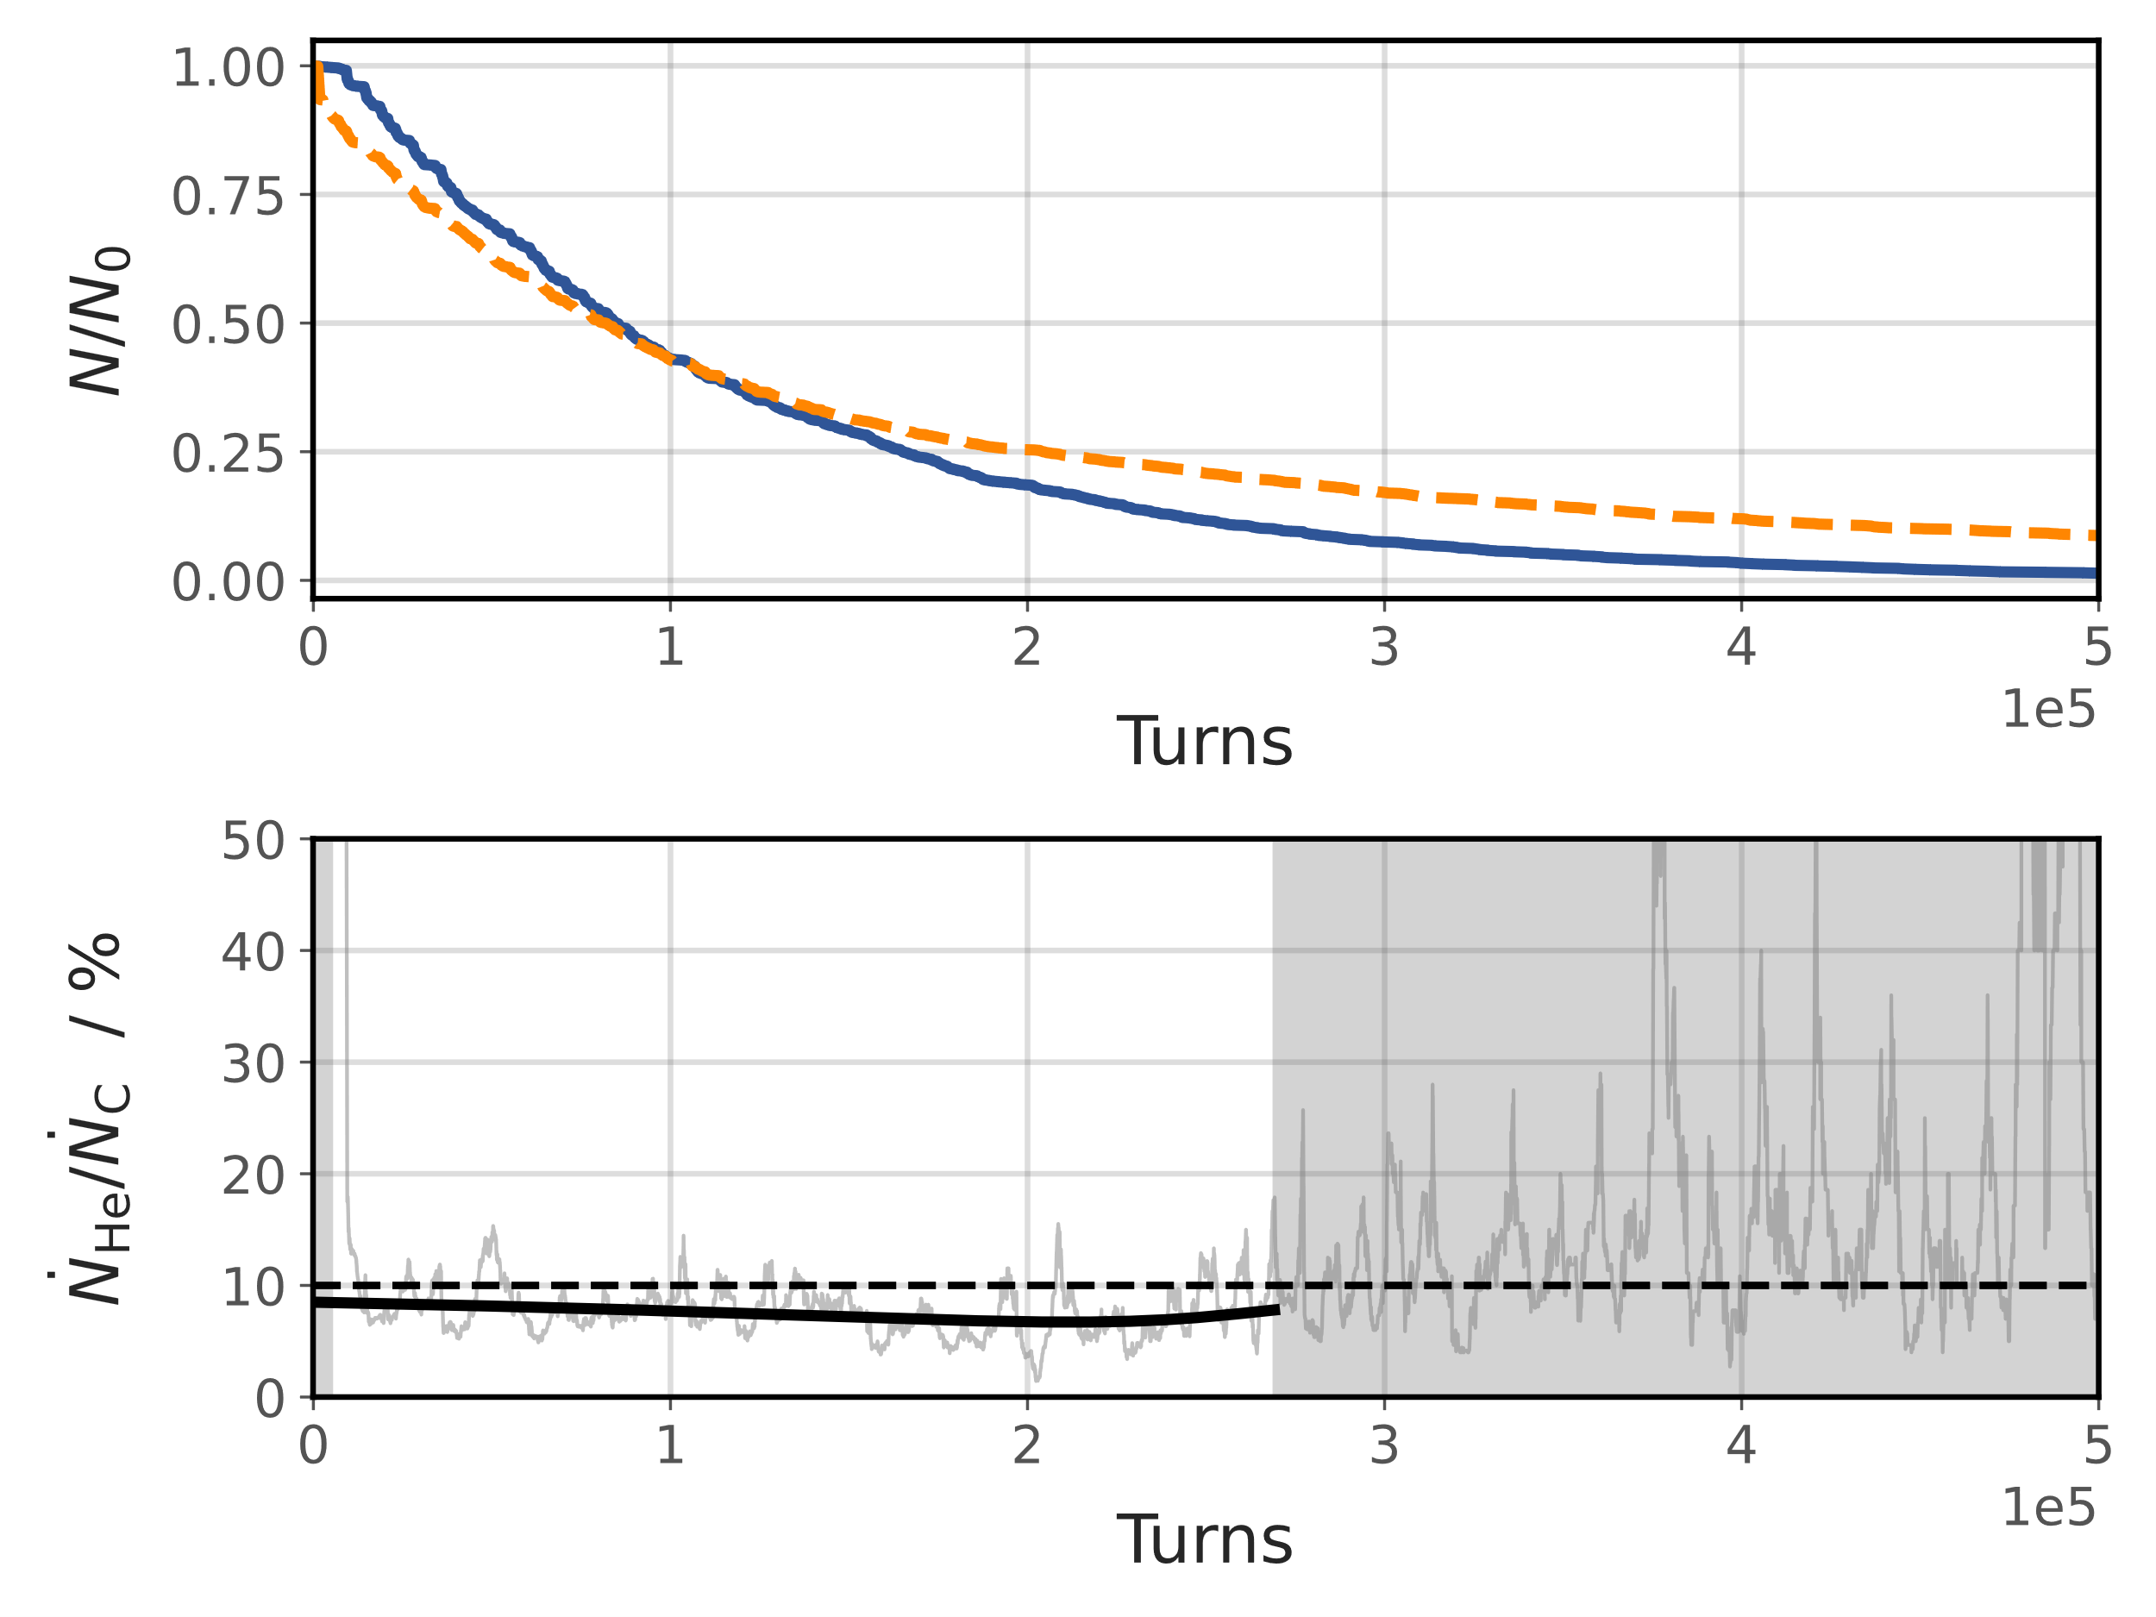
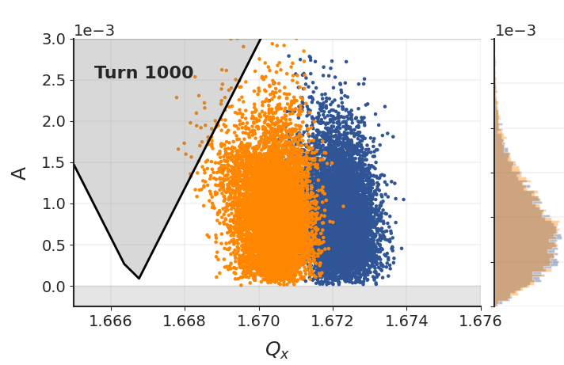
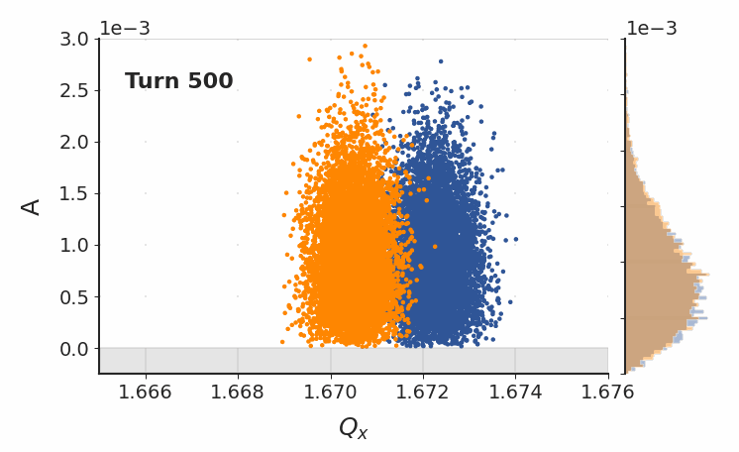
Test Case 1: He & C with Similar Horizontal Emittances
Work in progress
Emittance ratio: $ϵ_{X, He }≈$ $ϵ_{X, C }$
Extraction energy: 400 MeV/u
Intensity ratio in the synchrotron: He:C=1:10
Excitation: single, constant BPSK signal with $BW_{N2N}=10kHz$
B. Extract with ${ξ\left(t\right)= \dot{N}}_{He}:{\dot{N}}_{C}$ depending on applied signal.
Note: Example to show dependency, non-optimized excitation for C-extraction
A
B
A. Initial helium peak during sextupole ramp
C-6+
He-2+
→ Flexibility to close chopper
Turn 150k
C
C. Flexibility to abort extraction once majority of C is extracted.
Here arb. threshold = 90% of C extracted.

Slide 15
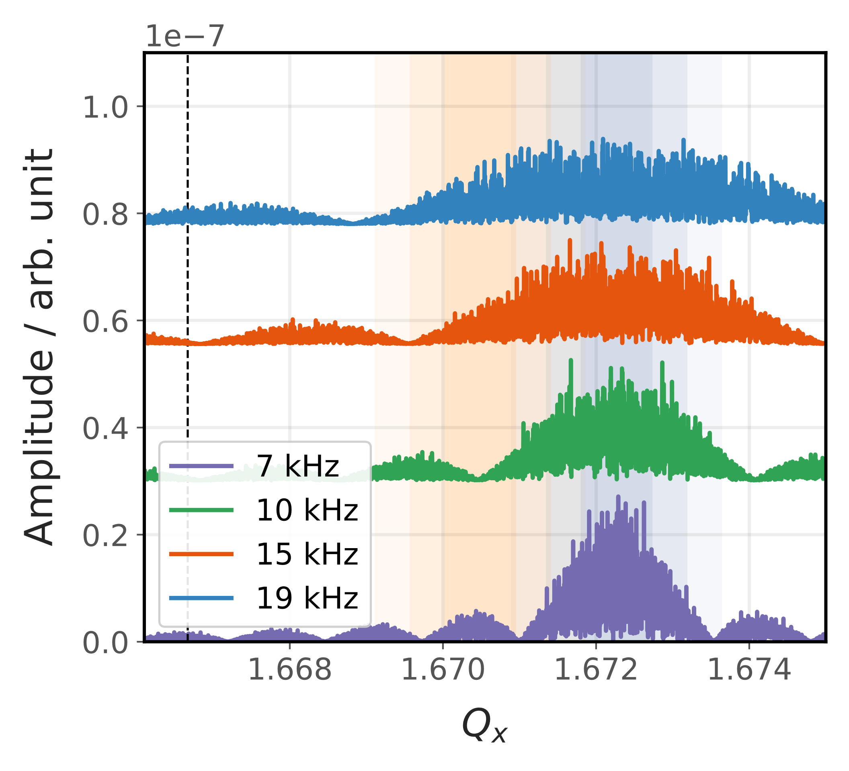
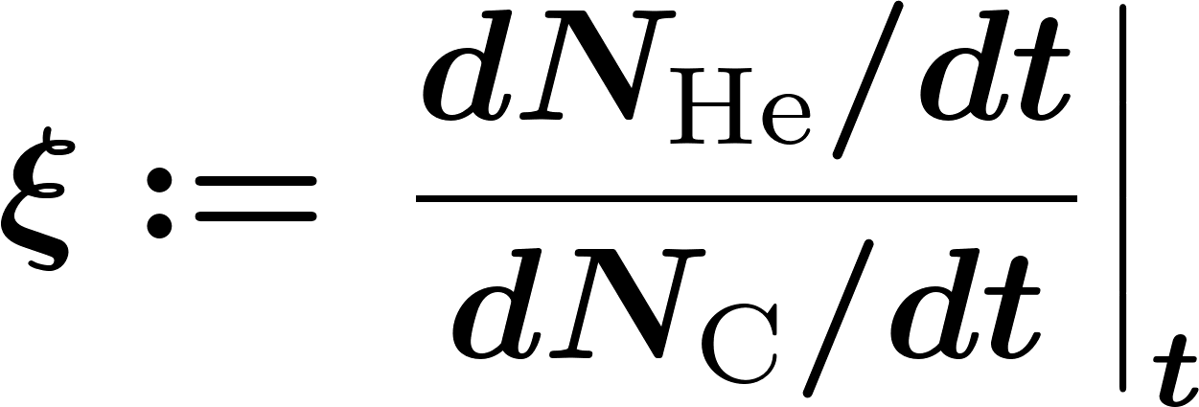
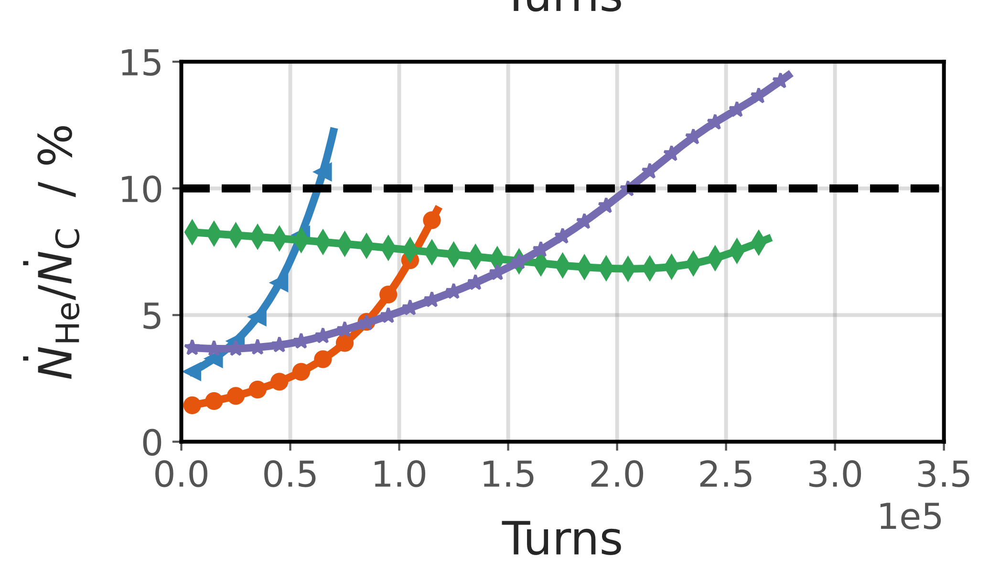
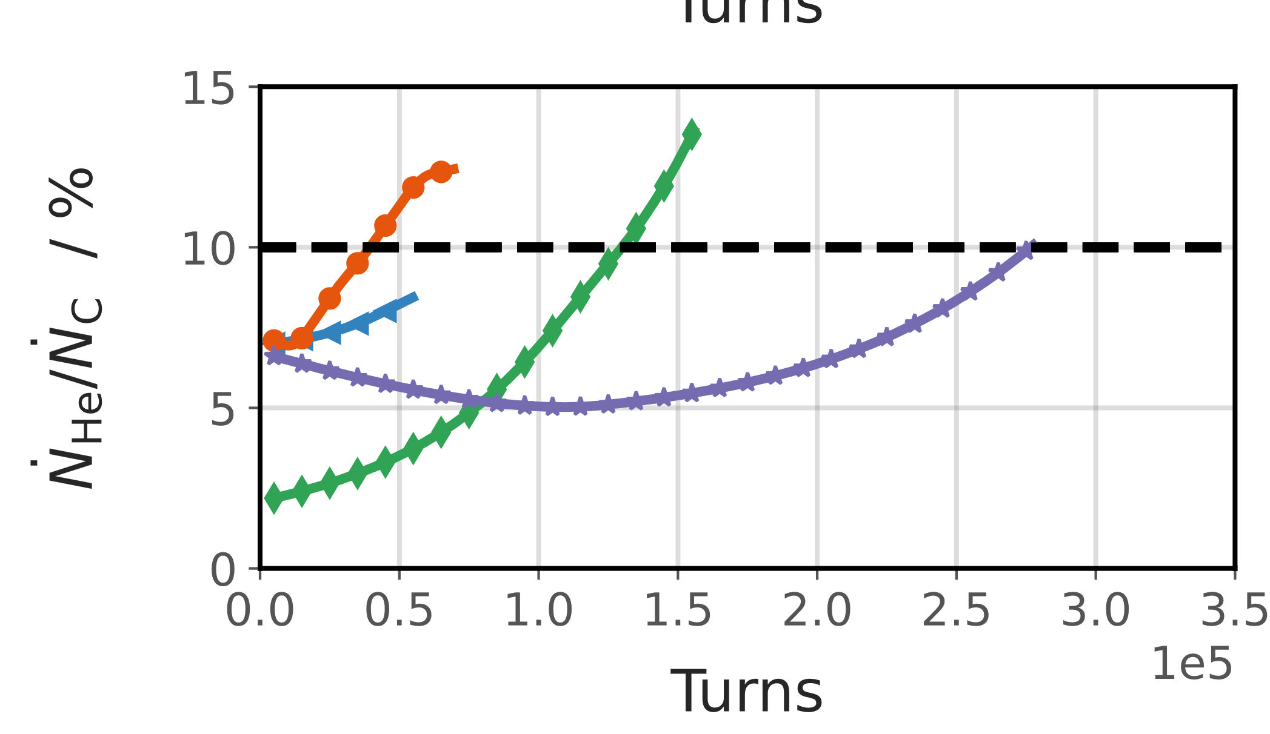
Test Case 1: Sensitivity to PSK Side Lobes
Work in progress
Re. B) First tests to assess impact of applied RFKO signal on ${\dot{N}}_{He}:{\dot{N}}_{C}$(t) by changing BW of BPSK signal
E = 400 MeV/u
E = 150 MeV/u
Demonstrates sensitivity of
to frequencies of nulls and maxima of the side lobes.
Next: combine more targeted multiple (amplitude modulated) signals, adapt Q’ etc. to stabilize $ξ(t)≈const.$,, …

Slide 16
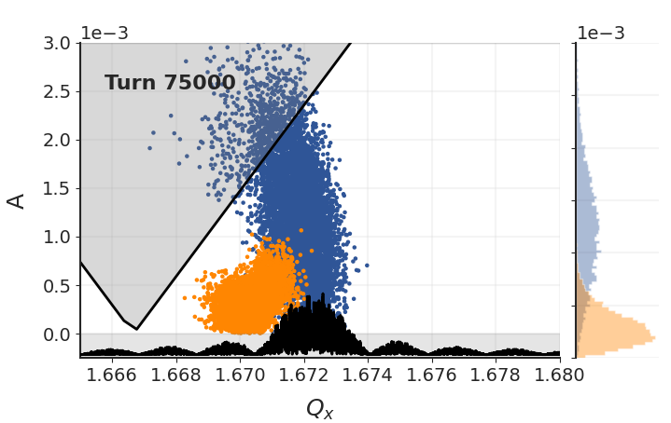
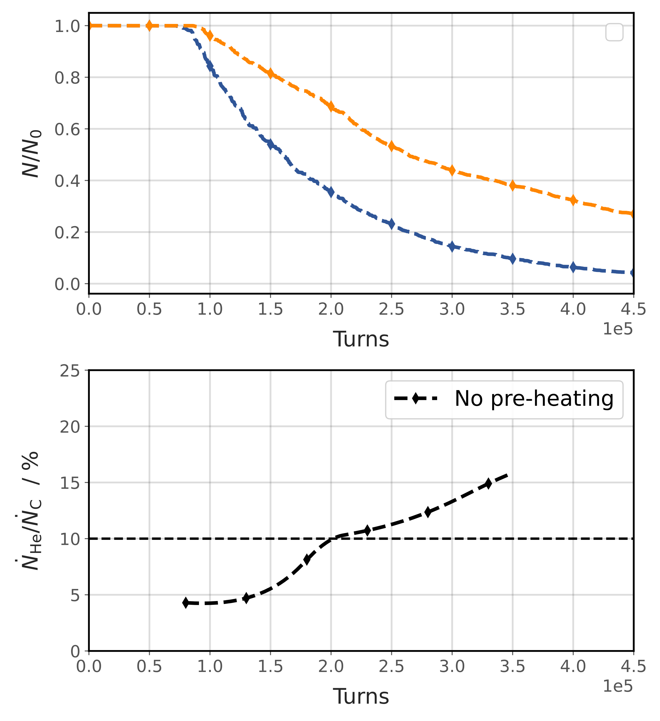
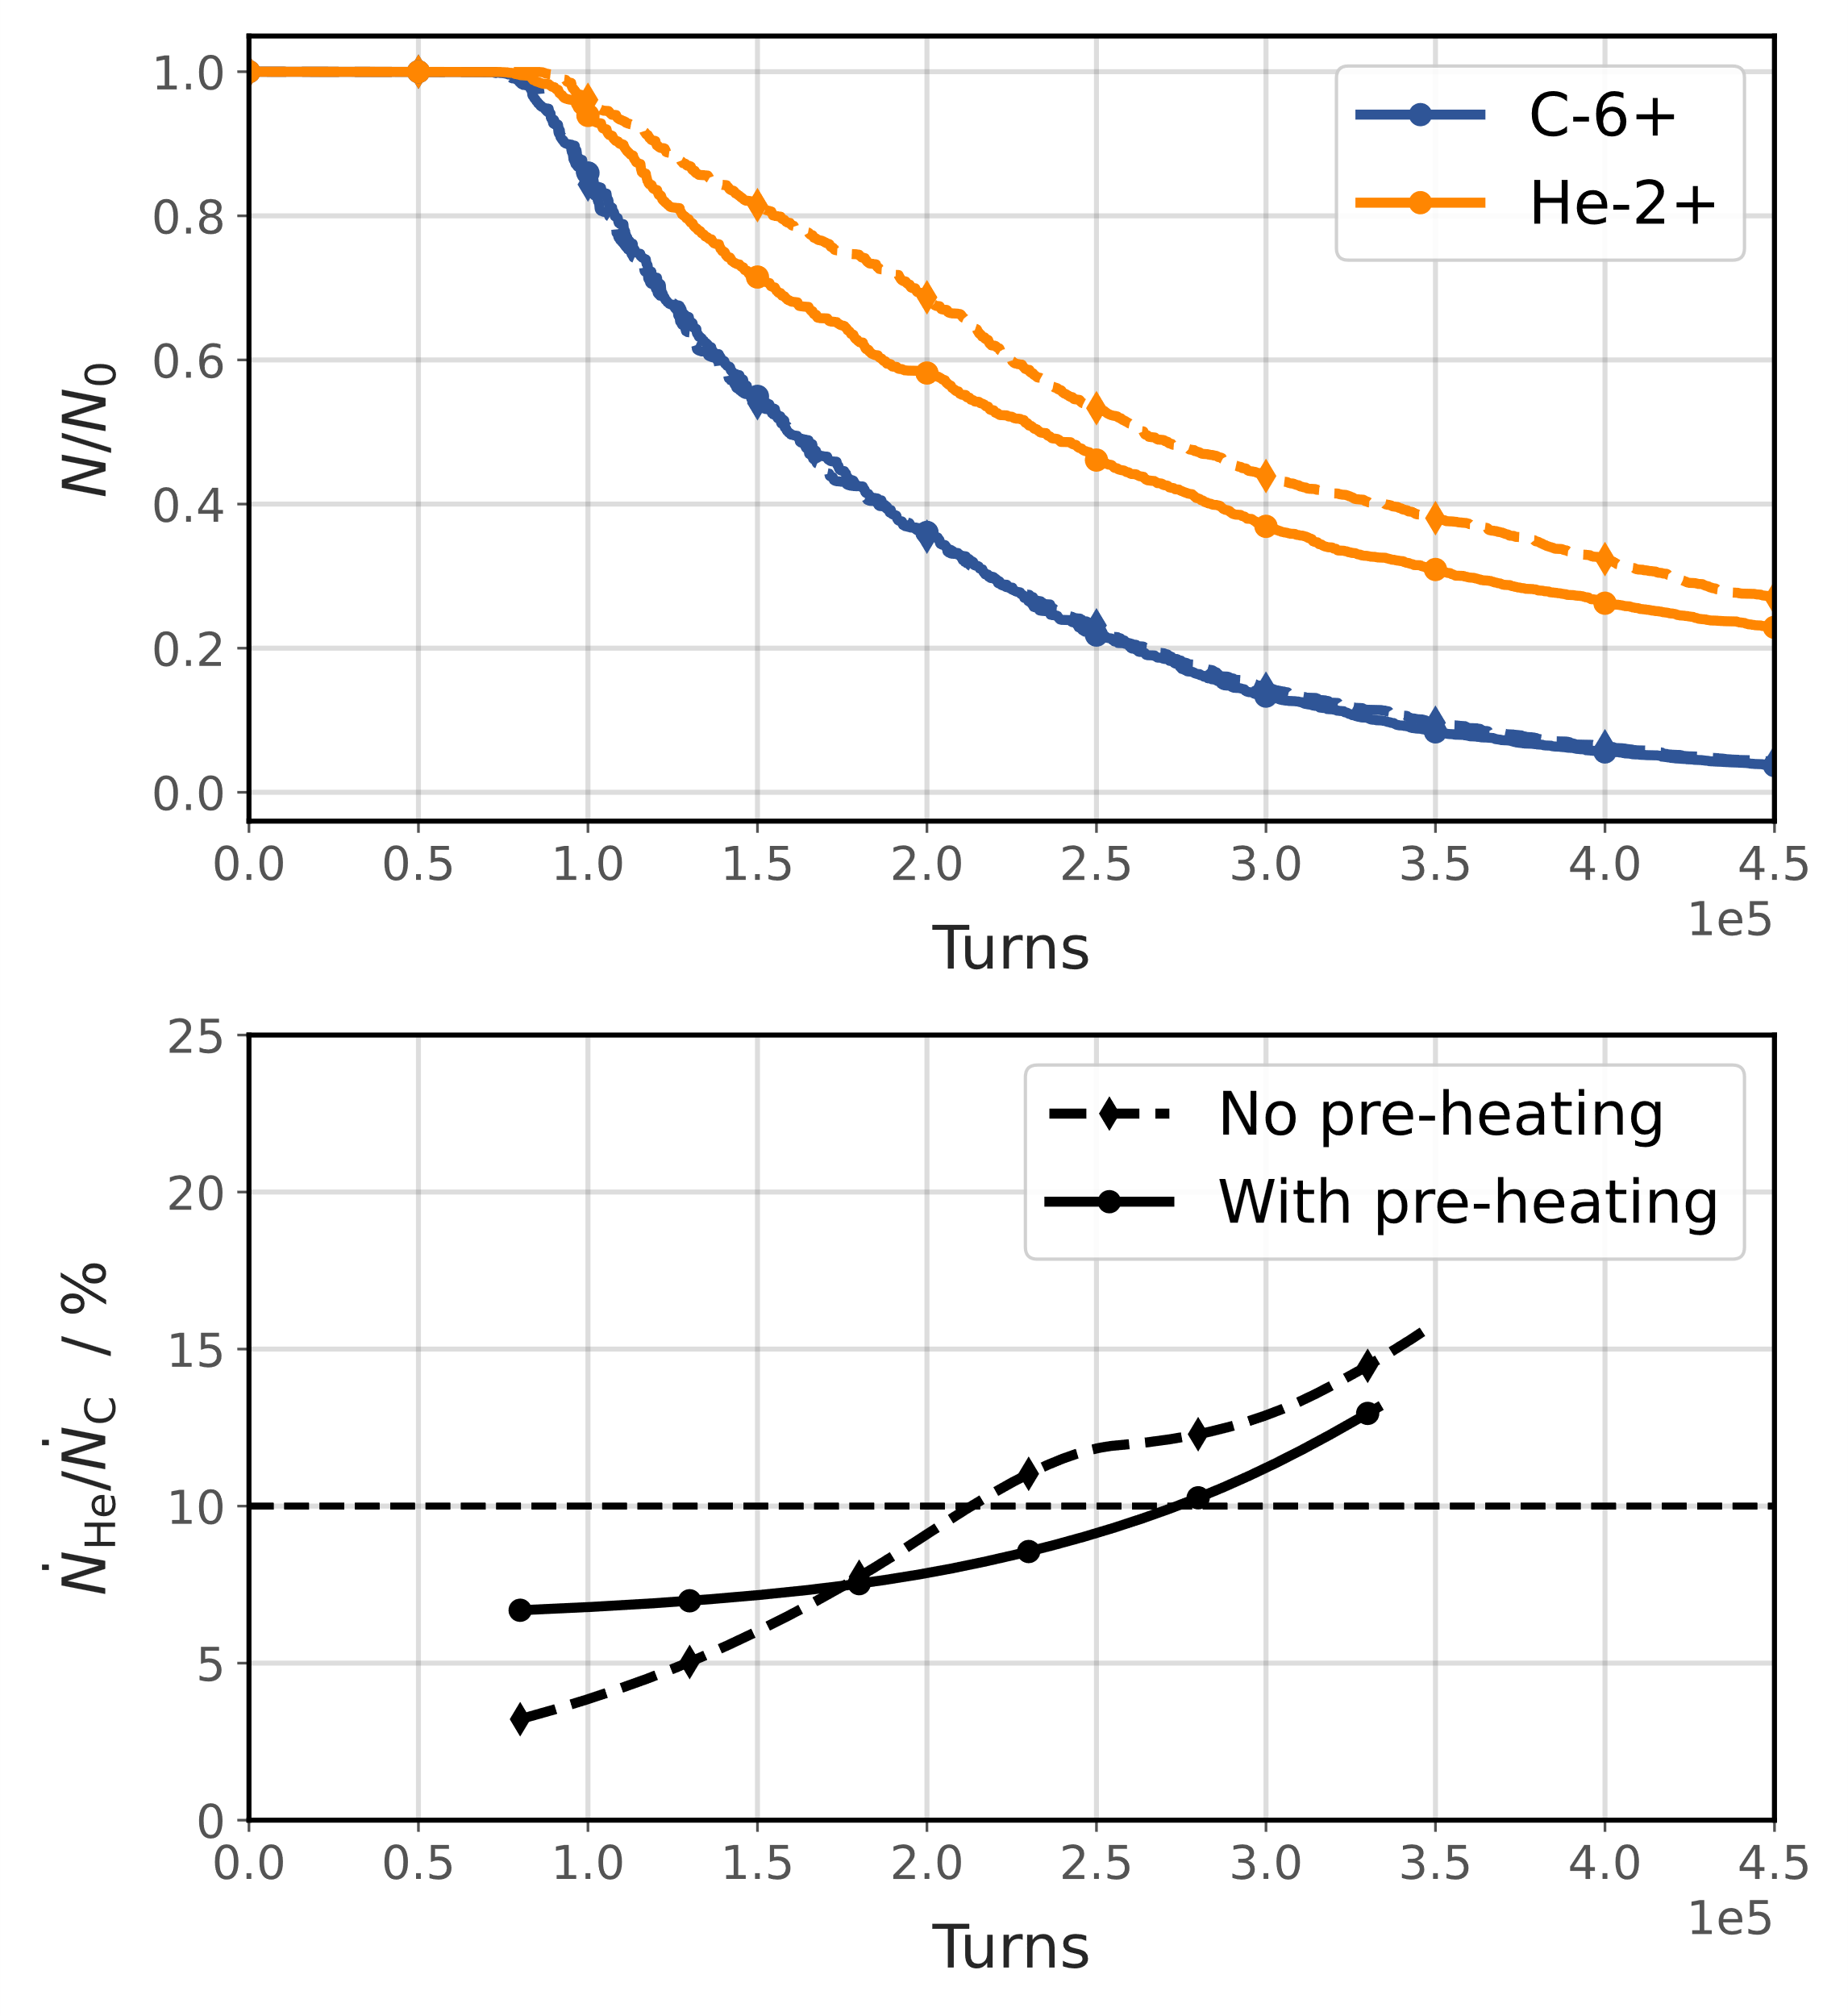
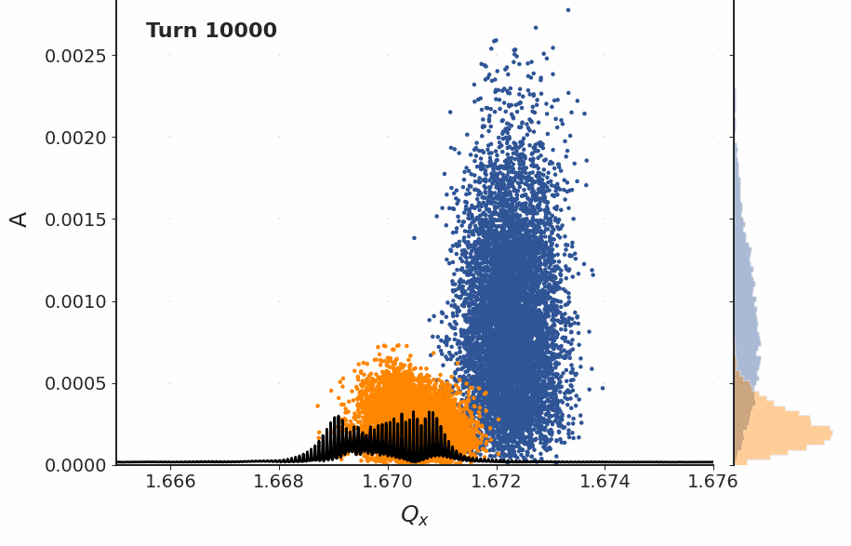
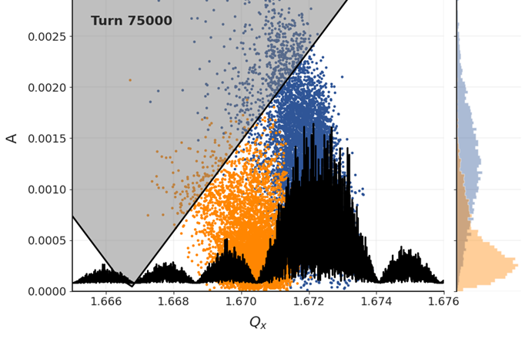
Test Case 2: “Pre-Heating” of Helium Core
Work in progress
Emittance ratio: $ϵ_{X, He }≈$ ${0.05 ϵ}_{X, C }$
Extraction energy: 400 MeV/u
Intensity ratio in the synchrotron: He:C=1:10
Excitation: single, constant BPSK signal with $BW_{N2N}=10kHz$
Ramp sextupole + start extraction
He-2+ heating
A
For $ε_{X, He }≪$ $ε_{X, C },$ selectively increase ⁴He²⁺ emittance prior to extraction:
Apply RFKO excitation only (mainly) in frequency range of ⁴He²⁺.
Here: first example using frequency modulation
Demonstrates beneficial effect, to be optimized!
B
A
B

Slide 17
Conclusion & Next Steps
Take aways:
Study the feasibility of delivering a mixed beam for nonclinical research (TU Wien, MedAustron, HEPHY).
Proof-of-principle simulations using Xsuite for slow extraction of ion mix currently being performed.
Due to the beam rigidity offsets between He-2+ and C-6+, RFKO selected as baseline extraction mechanism.
Evaluating robustness of extraction to differences in momentum/mass between He-2+ and C-6+ (depending on extr. & transition energy) & impact of different horizontal emittance ratios.
Desired input: what is the acceptable range for the intra-spill ion fluence ratio?
Only the beginning of the journey - next steps:
Study different scenarios to further develop extraction set-up, …
RFKO signal composition,
machine settings (chromaticity, tune, momentum spread),
momentum acceptance of extraction line,
ripples, bunched beams, …
Thank you for your attention!

