Slide 1


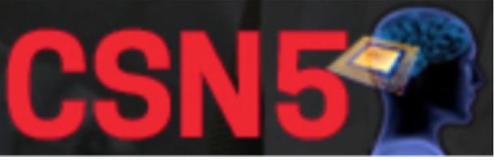
SHERPA
“Slow High-efficiency Extraction from Ring Positron Accelerator”
Young Researcher Grant
(2020-2022)
Dr. Marco Garattini (SHERPA P.I.)
National Laboratory of Frascati (LNF) - National Institute of Nuclear Physics (INFN)
(D. Annucci, O. R. Blanco-Garcia, P. Gianotti, S. Guiducci, A. Liedl,
E. Long, M. Mancini, T. Napolitano, M. Raggi, P. Valente)
“Slow Extraction Workshop 2024”, 13th February 2023

Slide 2

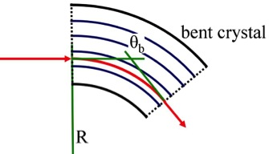
The SHERPA project
R&D study to extract a high-quality e⁺ (or e⁻) beam from one of the DAΦNE rings
The idea is to use coherent processes in a bent crystal to steer the positron beam
Channeling
Bent crystal
DAΦNE
e⁺ (< 500 MeV)
BTF
Target spill parameters:
Energy spread: Δp/p < 10⁻³
Emittance: ε < 10⁻⁶ rad⋅m
Length: Δt ~ ms
Current BTF spill parameters:
Energy spread: Δp/p < 0.5 x 10⁻²
  Emittance: ε < 10⁻⁵ rad⋅m
  Length: Δt ~ 300 ns
VS
Immediate application:
With the SHERPA beam, PADME (“Positron Annihilation into Dark Matter Experiment”) could increase the statistics by a factor ~10⁴ and its sensitivity by a factor ~10²,
largely extending the discovery potential. Now it is limited by VETO pile-up and BKG
This technology can be used for all kinds of lepton particles, positive and negative !!!

Slide 3
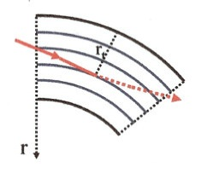
Coherent processes in bent crystals
[1-2]
Dechanneling
3
CH
Test beam on the CERN-SPS extraction line H8
(in the framework of the UA9 experiment)
VC
DC
DC
AM
Volume capture
5
AM
Θ_{c}
VR
VC
Θ_{in}
crystal
Channeling
Volume reflection
Θ_{out}
2
4
ΔΘ
CH
VR

Slide 4
Extraction from DAΦNE
The most common approach to extract slowly from a circular accelerator is
Resonant multi-turn slow extraction technique [27]
Unstable region in the phase space acting on sextupoles
driving the tune towards
the resonant value
(e.g. 3rd order)
gradually eject particles driving them out of the stable region towards the separatrix. Septum is needed.
THE SHERPA INNOVATION:
energy loss by synchrotron radiation + bent crystal =
not-resonant multi-turn ultra-slow extraction by a bent crystal [5,6,7]
The beam halo population is steadily sustained switching off RF, or tuning them properly (e⁺ & e⁻ loose energy by Synchrotron Radiation)
A bent crystal, properly oriented, intercepts the diffusive halo and kicks it by coherent deflection through the inter-planar potential
It might provide a continuous multi-turn extraction with high-efficiency and a
better spill quality in a simpler and cheaper way than resonant extraction
Better control of the extraction time and more collimated extracted beam
Minor ring modifications are necessary !!!
Crystals could also support the resonant approach → crystal-resonant hybrid extraction

Slide 5

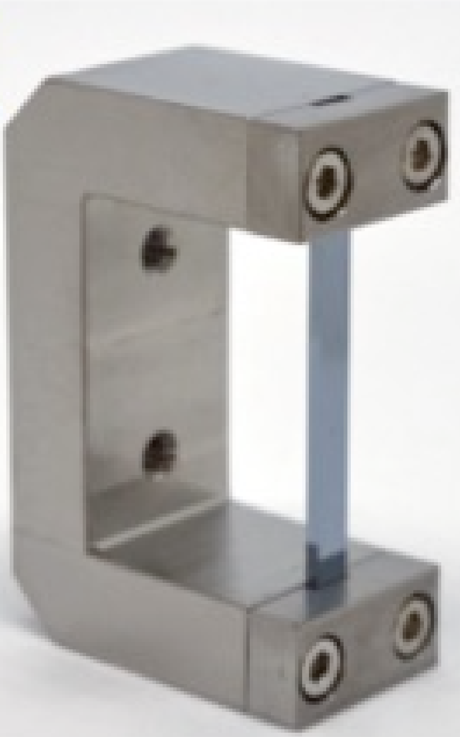
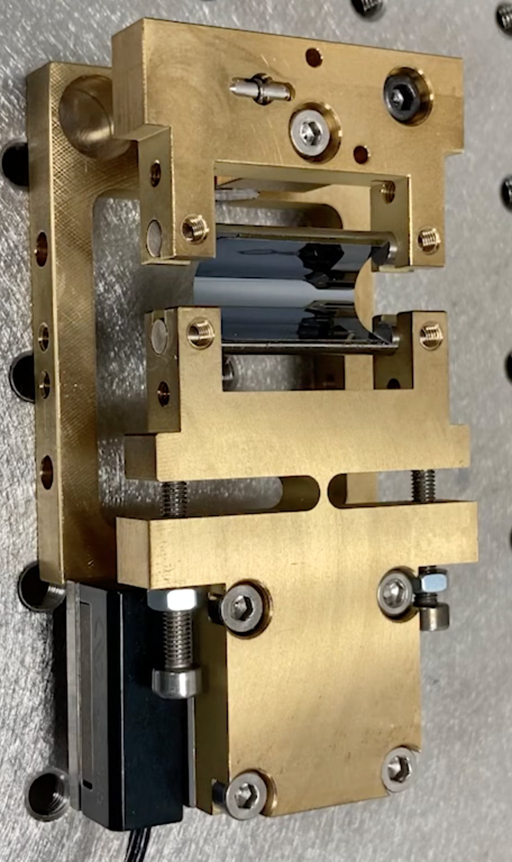
Sub-GeV lepton crystal beam steering
In the depth of the crystal (z) the fraction of channeled particles decreases exponentially
L_{D} is the dechanneling length, proportional to the particle energy
Particle and bent crystal dependent
In Silicon L_{D} is ~400 μm for ~500 MeV e⁺ (~25 mm for 7 TeV p⁺)
Very thin crystals (~15 μm) to reduce the dechanneling and increase the channeling efficiency
Challenging, but feasible
Moreover, a thin crystal will not affect so much the circulating beam
The crystal robustness is guaranteed by several test performed with multi-GeV hadrons [10,26],
but must be considered and evaluated
Sub-GeV
Leptons
crystal
High-energy
Hadrons
crystal
Encouraging results already obtained with sub-Gev particles using thin crystals
[11,12,13,14,15,16]

Slide 6
DAΦNE crystal slow-extraction layouts
DAΦNE
Dumping ring
Crystal
Slow-extraction points
Actual
PADME
DAΦNE
Main rings
New extraction line
The e⁺ ring to be modified
The new BTF extraction line
Other existing elements
New
PADME
options
Crystal characterization
apparatus (BTF-2)

Slide 7
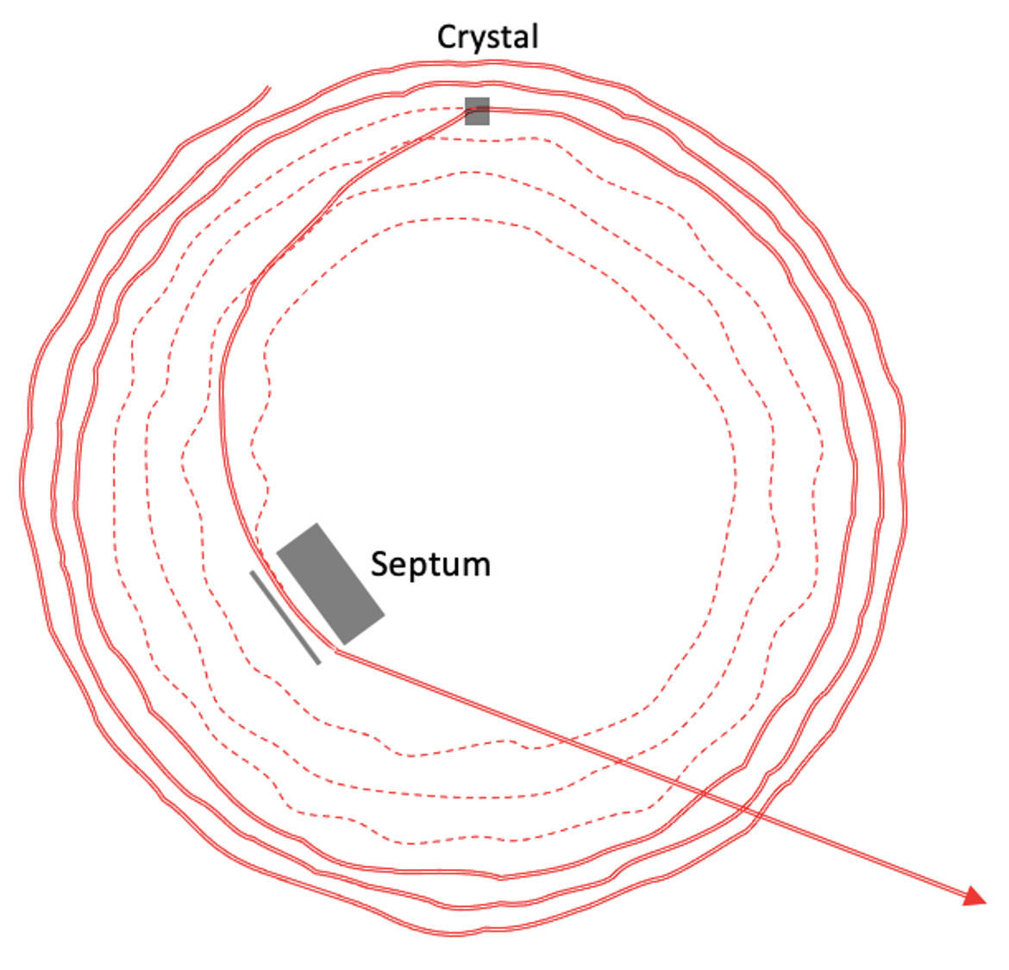
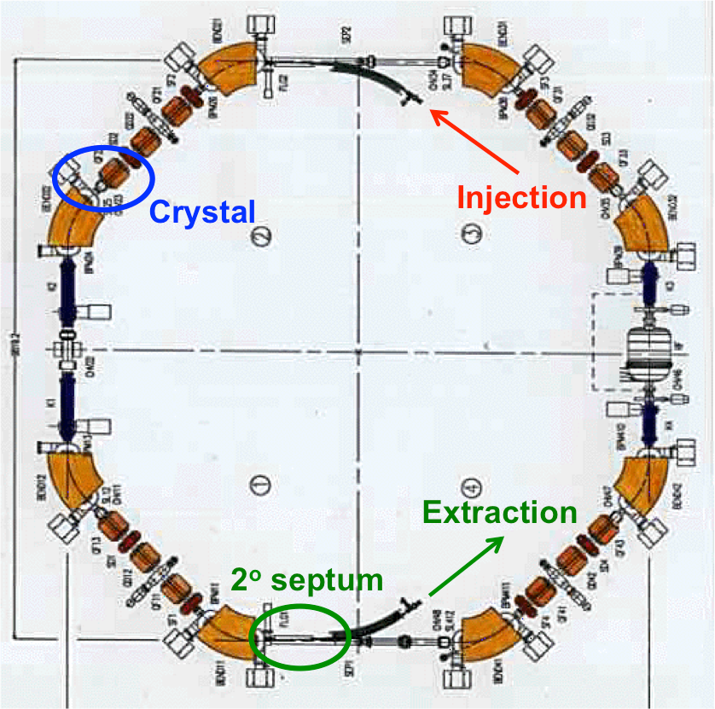
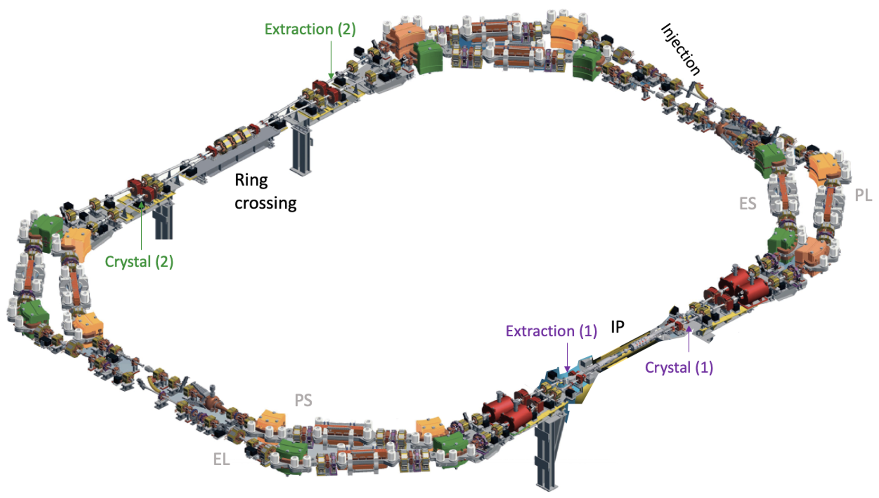
SHERPA extraction simulations
Not local extraction
DAΦNE Dumping Ring solution
DAΦNE Main Ring solution
Injection of pulses ~ the ring length. RF off
Particles slowly lose energy (e.g. by Sync. Rad.) until pass through the crystal that gives a kick to circulating particles
The particles extracted in another point of the ring by the septum
Same hardware of the actual accumulator (except for the crystal)
Some changes in the optics parameters
e⁺ cross the crystal and are extracted by the same septum used to fill the main ring
Actual configuration, except for the crystal and the extraction septum)
Some changes in the optics parameters
e⁺ cross the crystal and is extracted around the I.P. (2 different solutions)
MAD-X simulation studies (O. Blanco, S. Guiducci), without changing the layout of the rings (but only the currents), show that with a crystal deflection of 1 mrad it is possible to obtain
pulses of 0.2 ms (Damping Ring) and up to 0.4 ms (Main Ring)
[29] M. Garattini et al., PRAB 25 (2022) 033501

Slide 8

The Dumping Ring (DR) solution
The best solution:
Extraction septum already present
No hardware modification, except for the Crystal device
Only optics parameter changes
Lower accomplishment and maintenance costs
(1)
High
1 mrad
DR
(2)
Displacement at Septum
Close to 1/4
Extraction steps:
Injection of 100 ns bunches (filling the DR circumference), 10 mm off-axis
The crystal has a transversal displacement of 30 mm from the beam pipe center, to intercept only particles that lose 1 % of the nominal energy (~ 510 MeV)
The crystal will impart to e⁺ a ~ 1 mrad deflection →
It means ~20 mm horizontal displacement at the septum position, enough to be extracted
Switching off RF, e⁺ lose spontaneously (for S.R.) 1% of their energy in ~ 1000 turns:
- e⁺ have 1% of energy spread, so half of them will be extracted in few turns after injection
- The remaining e⁺ will be slowly extracted in ~ 2000 turns

Slide 9
Time distribution of the spill
Rate of e⁺ kicked by the crystal with −20 mm of displacement (or more) at the extraction point
10³ e⁺ simulated
100 turns = 0.1 μs
Quite flat time distribution
Tuning the RF, it should be possible to adjust the spill length and time distribution, especially for the first 100 turns
First try, without any optimization and no hardware modification
Spill length ~ 0.2 ms → ~ 10³ times longer than the longer BTF bunch !!!

Slide 10

The SHERPA Silicon Crystal
Ultra-thin Crystal by INFN-Fe
5 High quality samples
2 Low quality samples
Crystal bending holder by LNF (design INFN-Fe/LNL)
2 from CINEL Company
3 improved by LNF workshop
Beam direction
Quasi-mosasic bending along (111) planes
“Silicon postal stamp” only 15 μm thick!

Slide 11
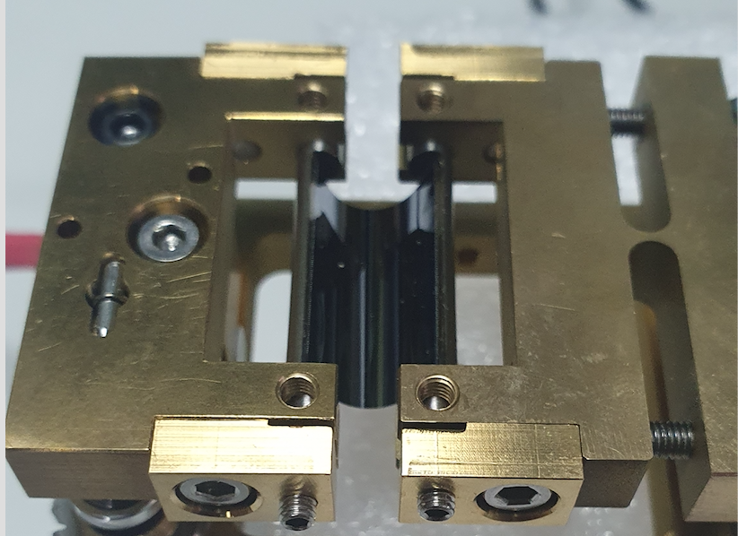
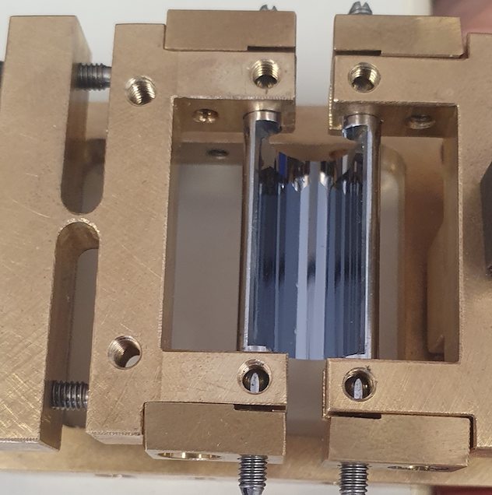
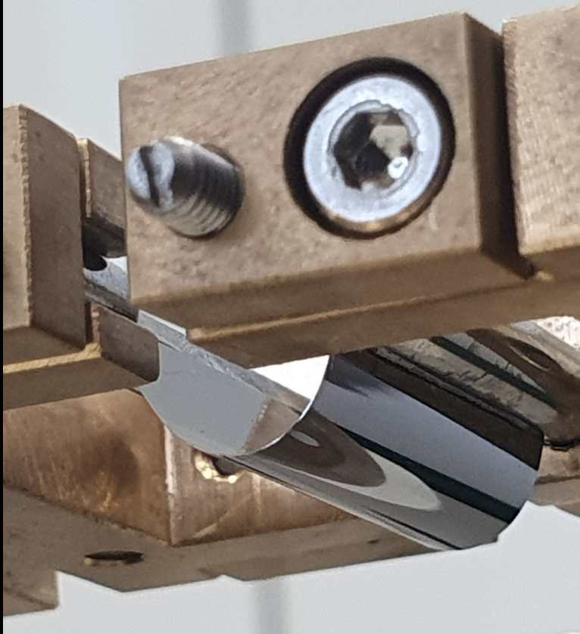
Serial production of crystal systems
In 2023, we managed to glue and bend two INFN-Fe silicon crystals using the first prototypes of bending holder produced at LNF-INFN in 2021
Simplifying gluing, mounting and bending procedure, also an “home-made” bending holder (10 times cheaper!) is able to obtain the same results
INFN-Fe crystal bent by CINEL holder
INFN-Fe crystal bent by LNF-INFN holder
At the first try and without breaking any samples!!! = )
In the next future we will glue and bend other 2 crystal samples
Only beam measurements can provide crystal/bending quality

Slide 12
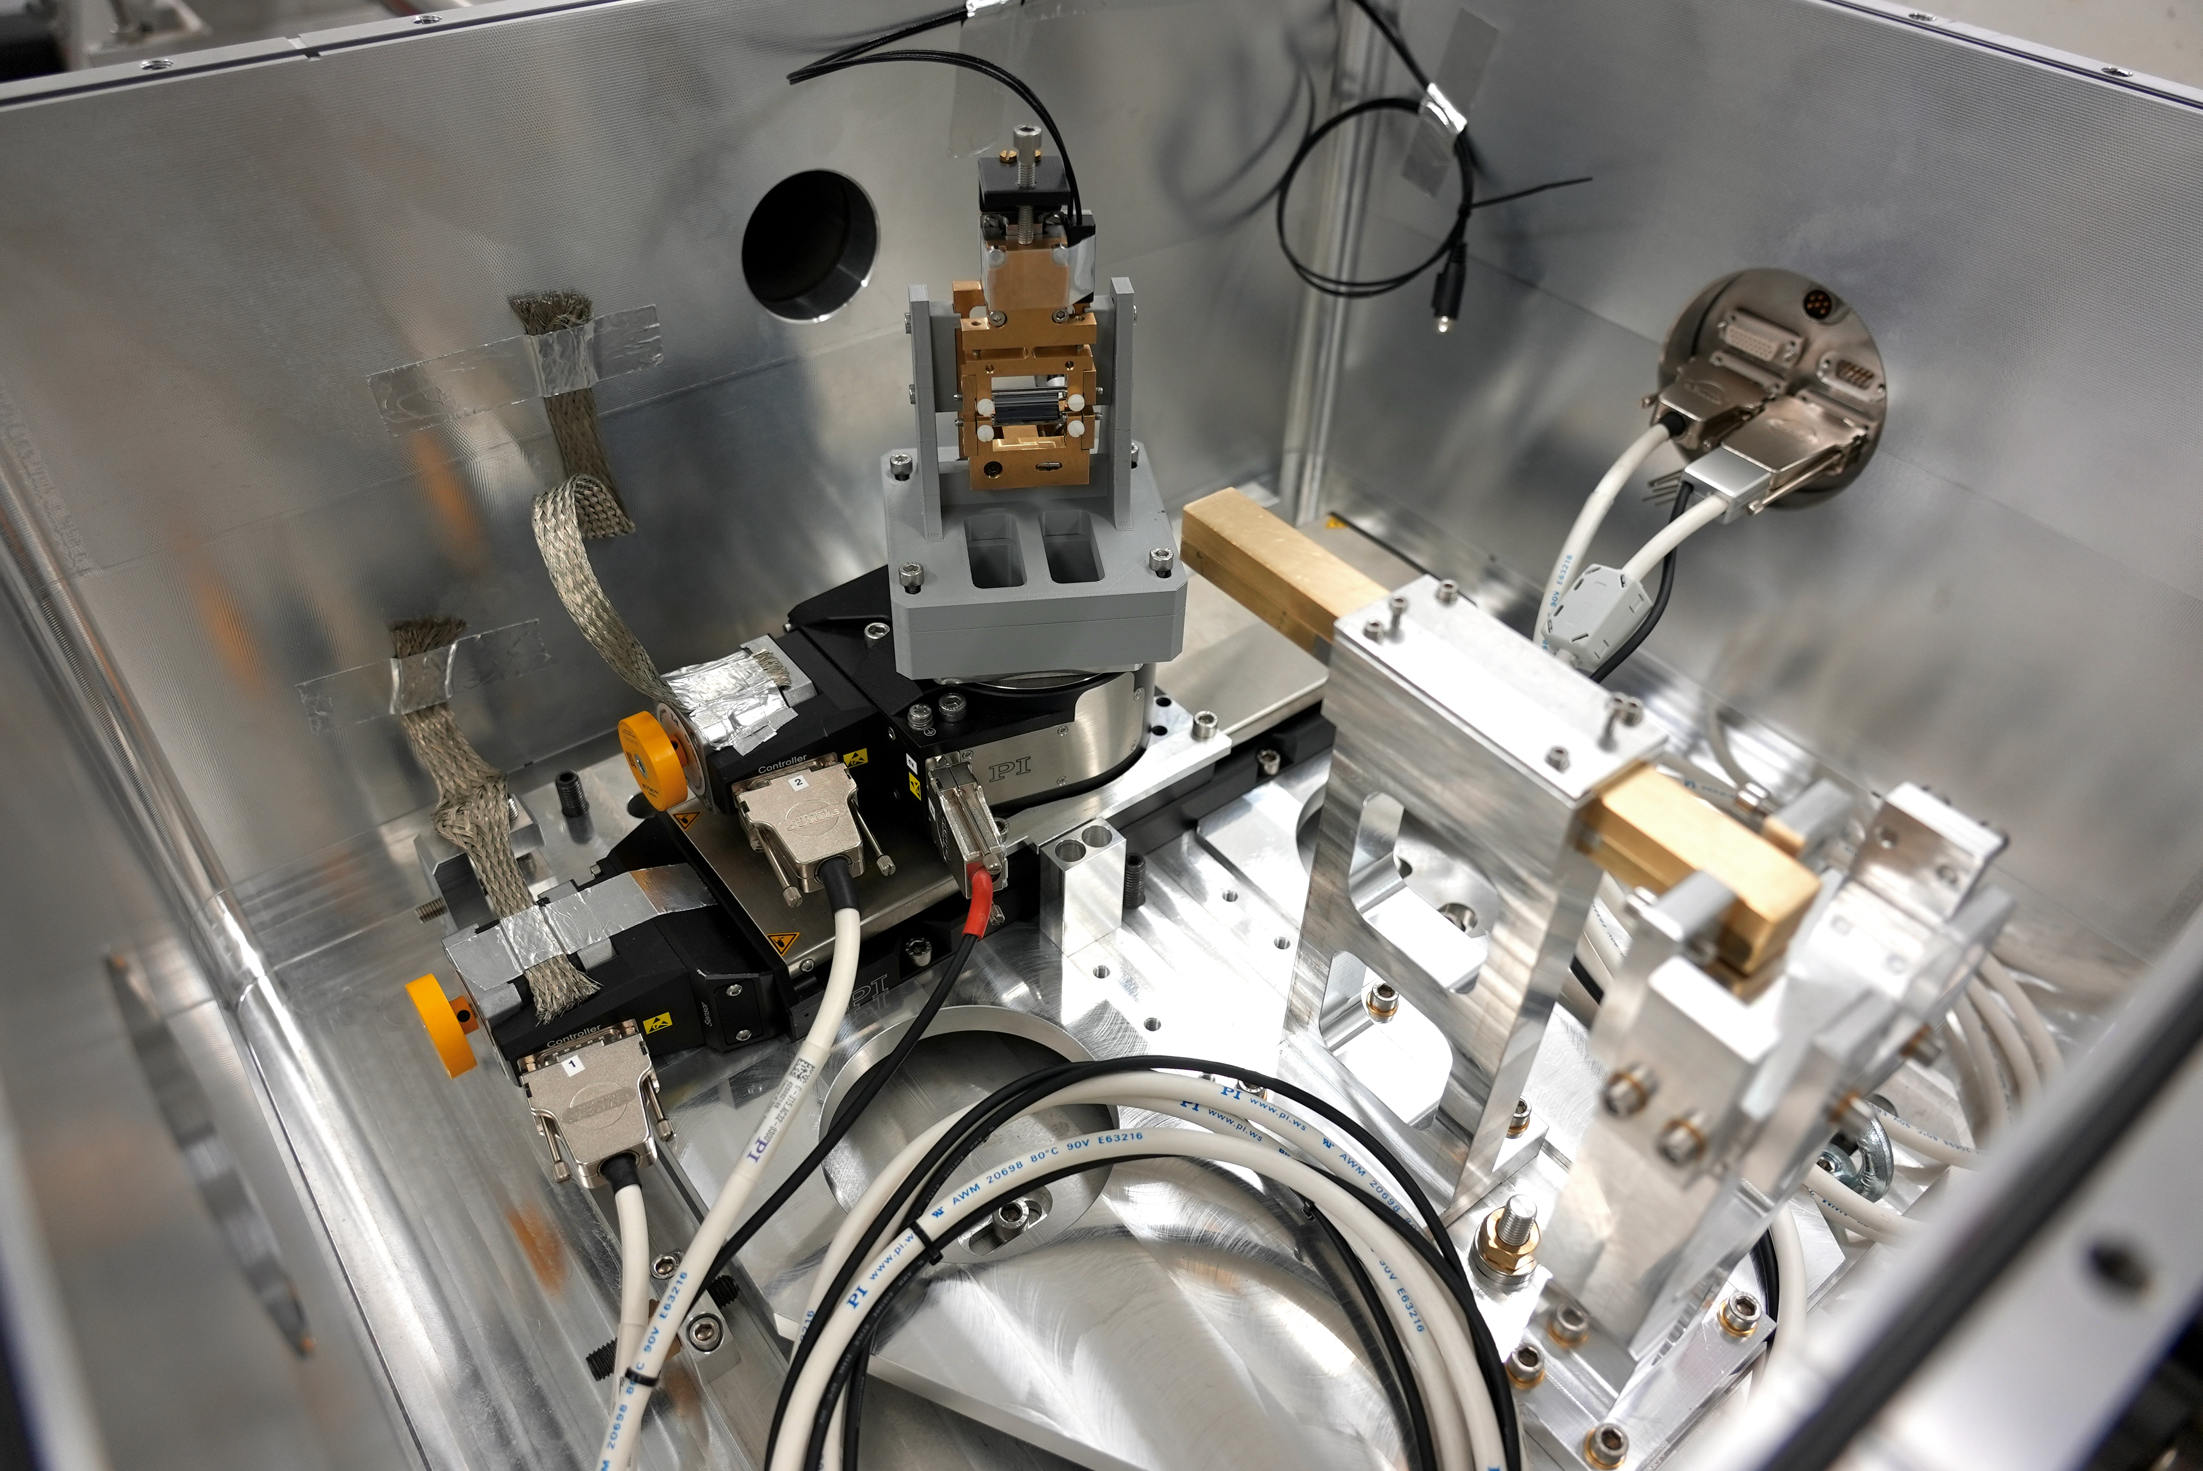
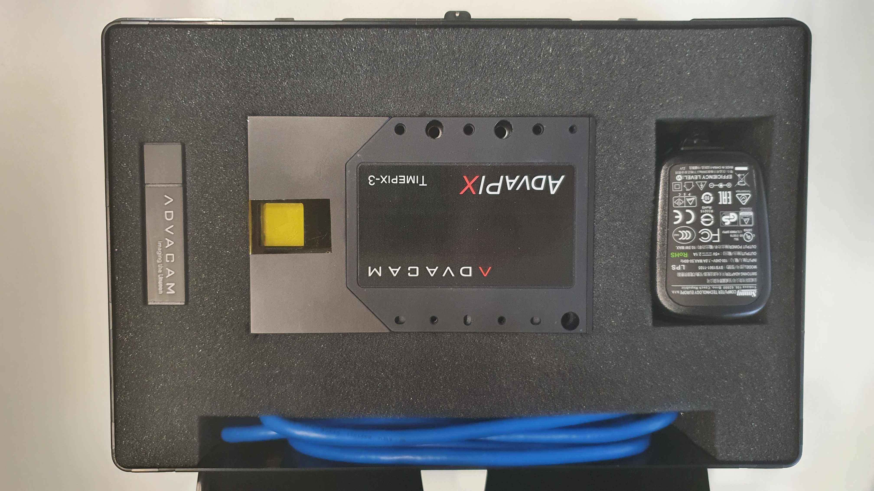
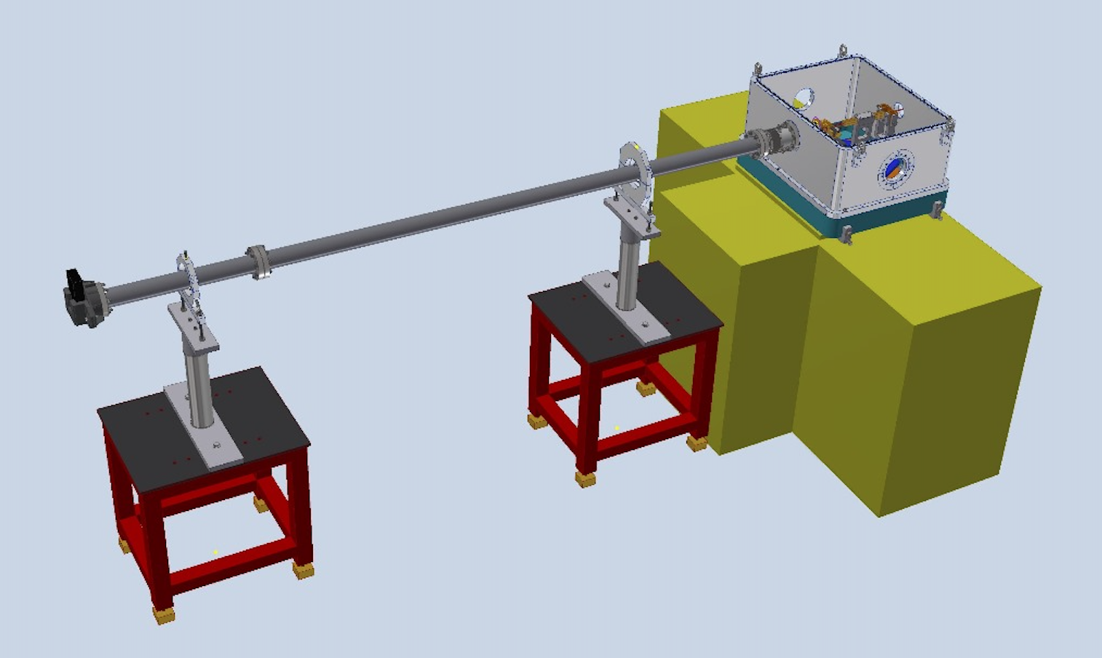
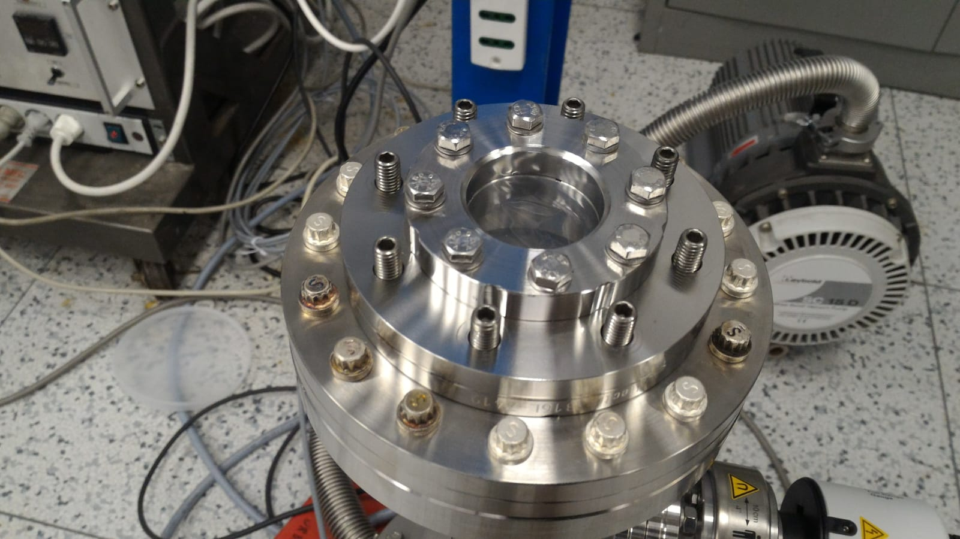
Crystal characterization at LNF-BTF
BTF apparatus scheme for crystal characterization
Tests are perfomed in vacuum
Crystal chamber
2D Detector (TimePix3)
BTF 450 Mev e⁺ & e⁻
~ 3 m
Ultra-thin (27 μm) Mylar windows

Slide 13
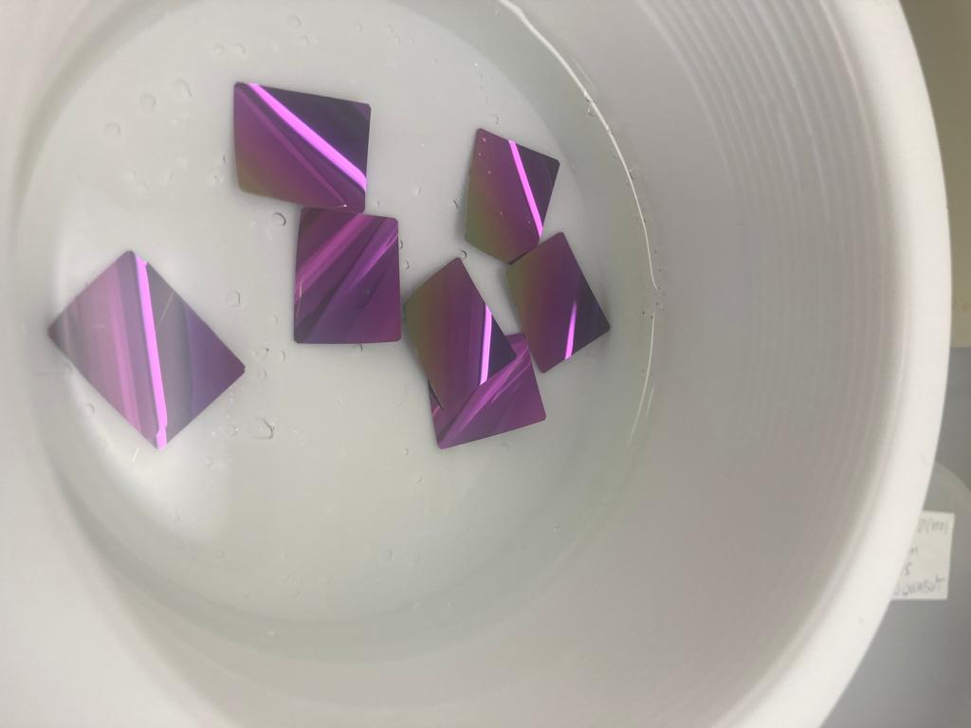
Crystal characterization at LNF-BTF
The Crystal chamber
Ultra-thin (15 μm) Crystal
Brass collimator:
Length: 20 cm
Gap: 0.5 x 0.5 mm²
BTF 450 Mev e⁺ & e⁻
3 axis goniometer

Slide 14
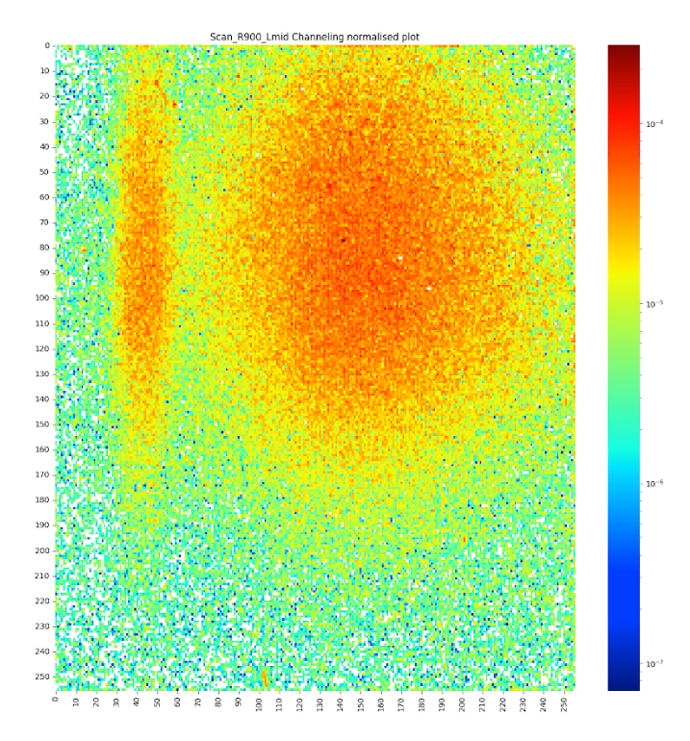
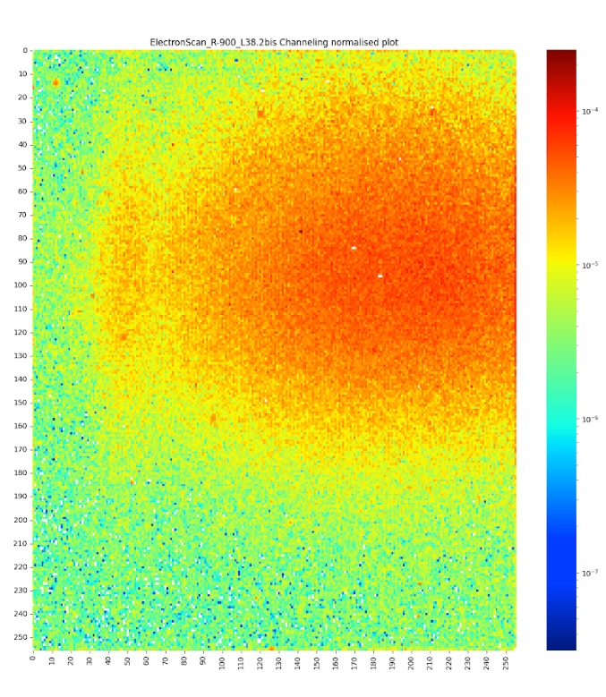
BTF crystal characterization
In December 2023 we manage to characterize the first SHERPA crystal
- We observed ~ 1 mrad deflection of 450 MeV e⁺ & e⁻ by channeling in bent crystal
- The crystal works very well, analysis is ongoing to estimate efficiency
INFN-Fe
Crystal
+
LNF-INFN
holder
Preliminary!
e⁺ CH
TimePix3 image
e⁻ CH
TimePix3 image
First observation for e⁺ at E < GeV !!!

Slide 15
Scientific and technological impact
e⁺ & e⁻ beam manipulation will be useful not only for PADME…
4) e⁺ extraction, collimation, etc…, will be crucial for the new generation of leptons colliders like FCC-ee.
2) High quality photon production using e⁺ channeled in crystal lattices [23]
1) Asymmetric e⁺ (high energy) e⁻ (low energy) colliders for dark matter studies [22]
6) The same is valid for every kind of leptons, negative included
7) The same is valid for higher energies leptons
3) μ production and manipulation in the future μ⁺/μ⁻ colliders. e⁺ beams on low density target e⁻ can produce μ with very low emittance and energy spread, reducing cooling procedures [24,25]
5) Crystals are innovative, effective and cheap, and can also be applied in medical and industrial accelerators, with a strong social-economic impact in the near future

Slide 16
Conclusions
SHERPA aims to study and implement a system to slowly extract a high-quality e⁺ (or e⁻) beam from one of the DAΦNE accelerator rings using a bent crystal
The proposal is based on ultra slow not-resonant extraction, but crystals could also support the resonant approach
SHERPA’s studies demonstrated the crystal non-resonant slow extraction feasibility both on the Dumping and Main DAΦNE rings
The PADME experiment might be the first user of the SHERPA beam, obtaining enormous advantages in terms of duty-cycle and sensitivity
Three crystal system prototypes are ready, and two are under construction. One of them was characterized in 2023
SHERPA is scientifically interesting per se: indeed no crystal-assisted extraction of positrons has been used so far. Moreover, high-quality positron beams are very rare.
SHERPA can provide an important scientific and technological impact on lepton physics

Slide 17
References
[1] M. Biryukov, Y. A. Chesnokov, and V. I. Kotov, “Crystal channeling and its application at high-energy accelerators”. Springer Science & Business Media, 2013
[2] W. Scandale et al, PRL 98, 154801 (2007)
[3] F. Ferroni for the RD22 Collaboration, Nuclear Instruments and Methods in Physics Research A 351 (1994) 183-187
[4] The RD22 Collaboration, Phys. Lett. B 357 (1995) 671-677
[5] A. G. Afonin et al., Phys. Rev. Lett. 87.9 (2001): 094802
[6] Fraser, M. A., et al. “Experimental results of crystal-assisted slow extraction at the SPS.”(arXiv preprint arXiv:1707.05151) (2017)
[7] F. Addesa et al., “The SE-CpFM Detector for the Crystal-Assisted Extraction at CERN-SPS”, IBIC’17, MI, USA, 20-24 August
[8] F. M. Velotti et al., Phys. Rev. Accel. Beams, 22.9: 093502 (2019)
[9] F.M. Velotti et al., IPAC2019, Melbourne, Australia (doi:10.18429/JACoW-IPAC2019-THXXPLM2) (2019)
[10] W. Scandale, M. Garattini et al., European Physical Journal C, EPJC-19-09-144.R1 (2019)
[11] S. Bellucci et al., Nucl. Instrum. Meth. Phys. Res. B 252 (2006) 3–6
[12] S. Bellucci et al., JETP Lett. 2013, Vol. 98, No. 11, pp. 649–651
[13] Guidi V. et al., Phys. Rev. Lett. 108.1 (2012): 014801
[14] W. scandale et al., Physics Letters B 734 (2014) 1–6
[15] A. Mazzolari et al., Phys. Rev. Lett. 112 (2014) 135503
[16] Y. Takabayashi et al., Phys. Lett. B 751 (2015) 453
[18] M. Campbell et al., Nucl. Instrum. Meth. A 633 (2011) S1-S10
[19] A. Natochii et al., JINST 14 P03018 (2019)
[21] M. Raggi, EPJ Web Conf. 142 (2017) 01026
[22] B. Wojtsekhowski et al., arXiv:1705.00051 [physics.acc-ph]
[23] U.I. Uggerhøj, Nucl. Instrum. Meth. B355 (2015) 35
[24] G. S. Sushko et al., J. Phys.: Conf. Ser. 438 (2013) 012018
[25] M. Antonelli et al., Nucl. Instrum. Meth. in Phys. Res. A 807 (2016) 101–107
[26] W. Scandale, M. Garattini et al., JINST_061P_0621 (2021)
[27] S. Guiducci et al., IPAC2018, Vancouver, BC Canada
[28] E. Bagli et al., Eur. Phys. J. C (2014) 74:2996
[29] M. Garattini et al., Phys. Rev. Accel. Beams 25 (2022) 033501
[30] D. Annucci, “Sub-GeV positron channeling in bent crystals” (MasterThesis 2022)

Slide 18

Thank you for your attention !
And thank you very much to the whole SHERPA team, LNF and CSN5!!!
LNF: P. Gianotti, S. Guiducci, O. R. Blanco-Garcia, A. Liedl, M. Mancini, T. Napolitano
INFN-Roma1: P. Valente, M. Raggi, D. Annucci, E. Long
And also to:
INFN-Fe: V. Guidi, A. Mazzolari, L. Bandiera, M. Romagnoni, M. Soldani, M. Tamisari, A. Sytov
INFN-LNL: S. Carturan, D. De Salvador, F. Sgarbossa
“ The higher you climb,
the further you see.
He who sees further,
dreams longer”
Walter Bonatti (Italian Climber)

Slide 19
SPARE

Slide 20





Existing e⁺ beams
Electron-positron colliders
Super KEKB and BEPC-II
  No extracted beam
Secondary positrons
DESY-II
  0.5 to 6 GeV/c positrons
DAΦNE
  Primary (< 500 MeV) and secondary (< 700 MeV) positrons.
  From LINAC, not extracted
CERN SPS North Area
  H4 “dedicated” beam-line, but production also possible in H2 and may be H6-H8
  Up to 200 GeV with variable purity
VEPP
  Not an extracted beam, but by-pass in the VEPP-3 ring (510 MeV)
There is no slow extraction of primary positron anywhere in the world !!!

Slide 21

Proposed high-energy positron beams
^{Electron-positron colliders}
^{DAΦNE}
- Proposal for resonant and not-resonant extraction of primary positrons at 510 MeV
- Proposal for LINAC modifications for bunch extension < 300 MeV
^{CESR}
⁻ ^{Proposal for 𝑛 + 1/3} resonant extraction of primary positrons at 6 GeV not approved
^{LINAC-based}
^{CEBAF at Jefferson Lab}
⁻ Proposal for 11 GeV primary positron source (JPOS), not yet approved, ≈5 years of
^{construction}
⁻ Possibility of secondary positron beams, ???
^{FACET-II at SLAC}
⁻ Proposal for 10 GeV primary positrons (produced from extracted electrons, damped
^{and re-accelerated)}
⁻ Approved but staged to Phase-2, > 2022

Slide 22
Crystal extraction history
  (1990-95) - RD22 at the CERN-SPS as a test bed of beam extraction at LHC: crystal high-efficiency extraction of multi-GeV p⁺ [3-4]
  (1993-98) - E853 at the FNAL-Tevatron as a test bed for the SSC: crystal high efficiency extraction of 900 GeV p⁺
  (2001) - The CERN-INTAS programmes on crystal technology: crystal high efficiency extraction of 70 GeV p⁺ by a short crystal (in IHEP U-70) [5]
  (2016) - UA9 at CERN-SPS: crystal assisted not-resonant & not-local slow extraction of 270 GeV p⁺ in the TT20 north area extraction line [6,7]
  (2018) - UA9 at CERN-SPS: crystal “virtual” not-resonant local beam extraction of 270 GeV p⁺ in channeling mode
  (2018) - UA9 at CERN-SPS: crystal shadowing of the ES-septum and assisted resonant slow extraction of 400 GeV p⁺ [8,9]

Slide 23
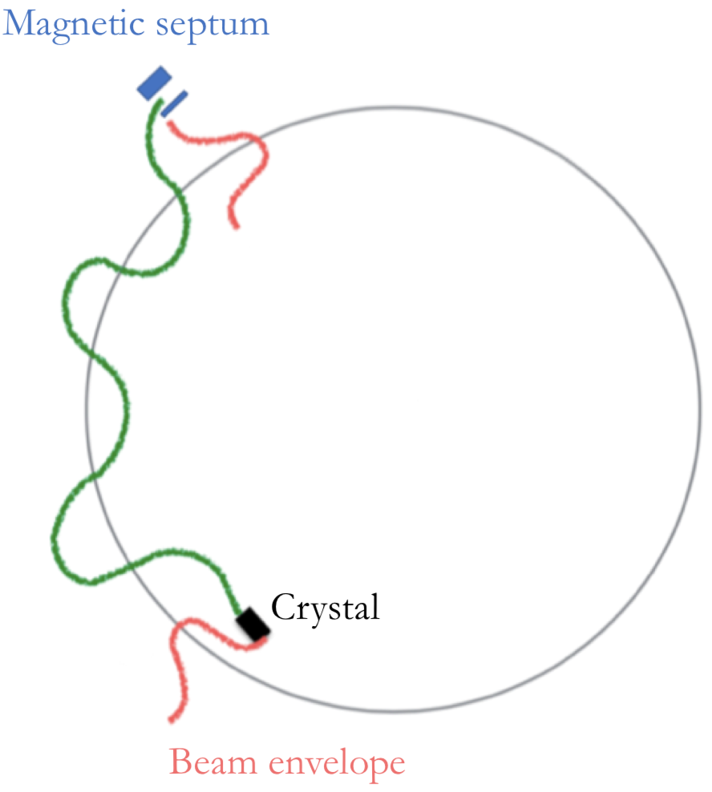

Multi-turn not resonant slow extraction
Not-local extraction
Energy loss by Synchrotron Radiation (RF off)
DAΦNE e⁺ beam
Primary Beam
Beam halo
A e⁺ not deflected by the crystal not necessary will be lost, but can be extracted in a next turn
Crystal
+
Goniometer
Extracted beam

Slide 24
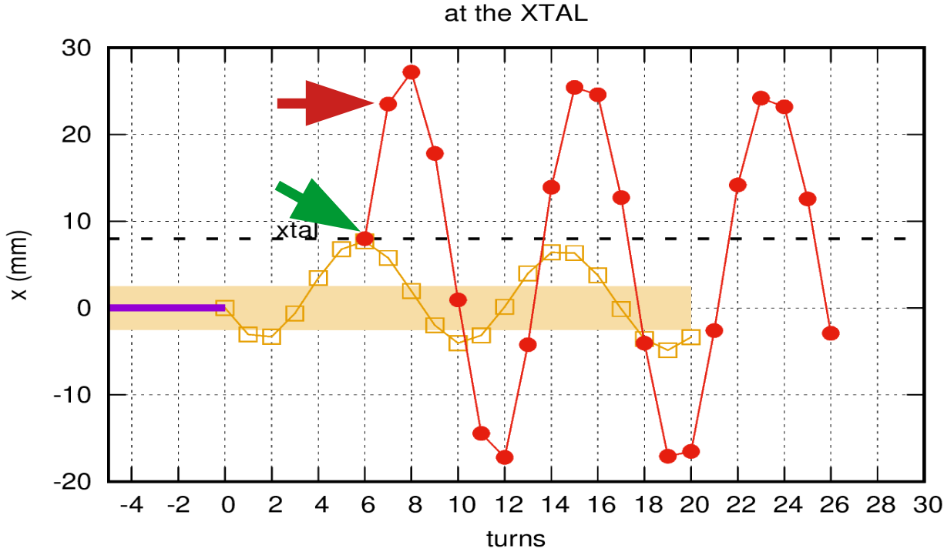
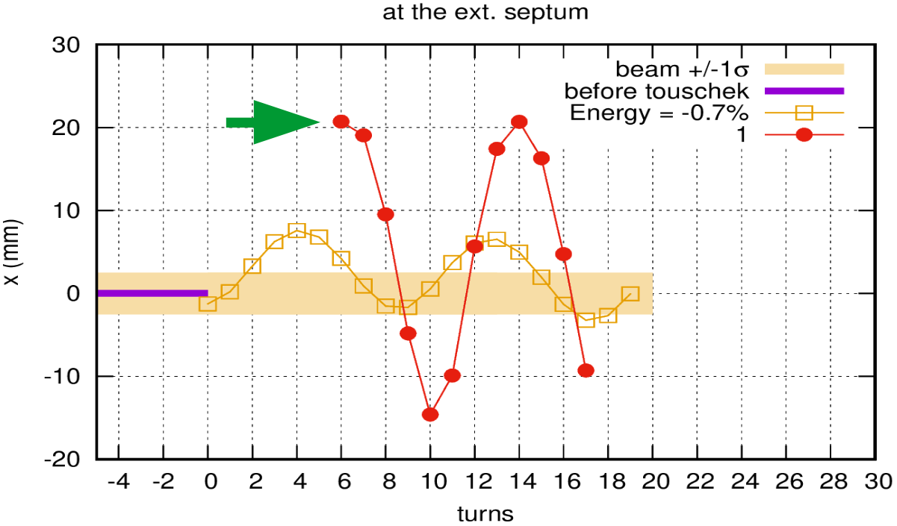
The Main Ring (MR) solution
Same approach of the DR case
e⁺ x-displacement at the crystal position as a function of number of turns
At the crystal: 8 mm at turn 6
The beam can be deflect by the crystal and extracted in the same turn
e⁺ x-displacement at the septum position as a function of number of turns
At the septum: ~ 20 mm at turn 6

Slide 25
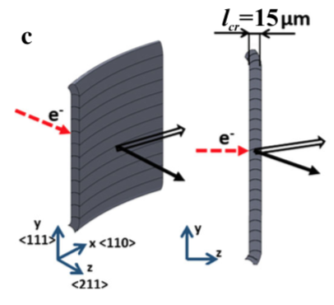
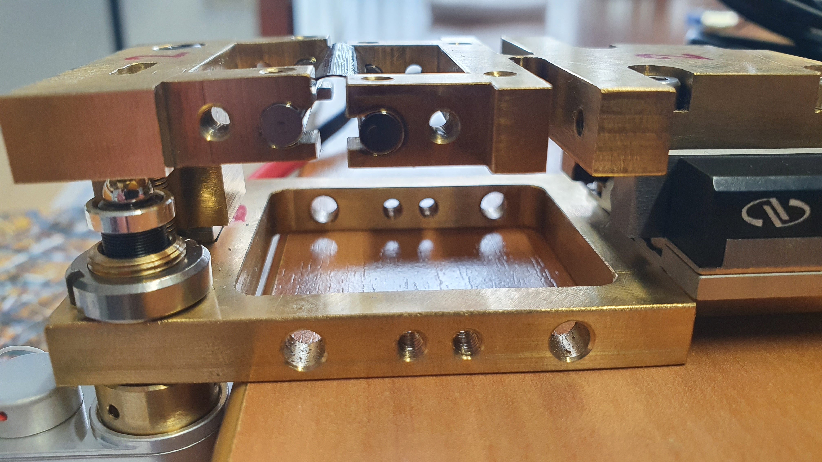
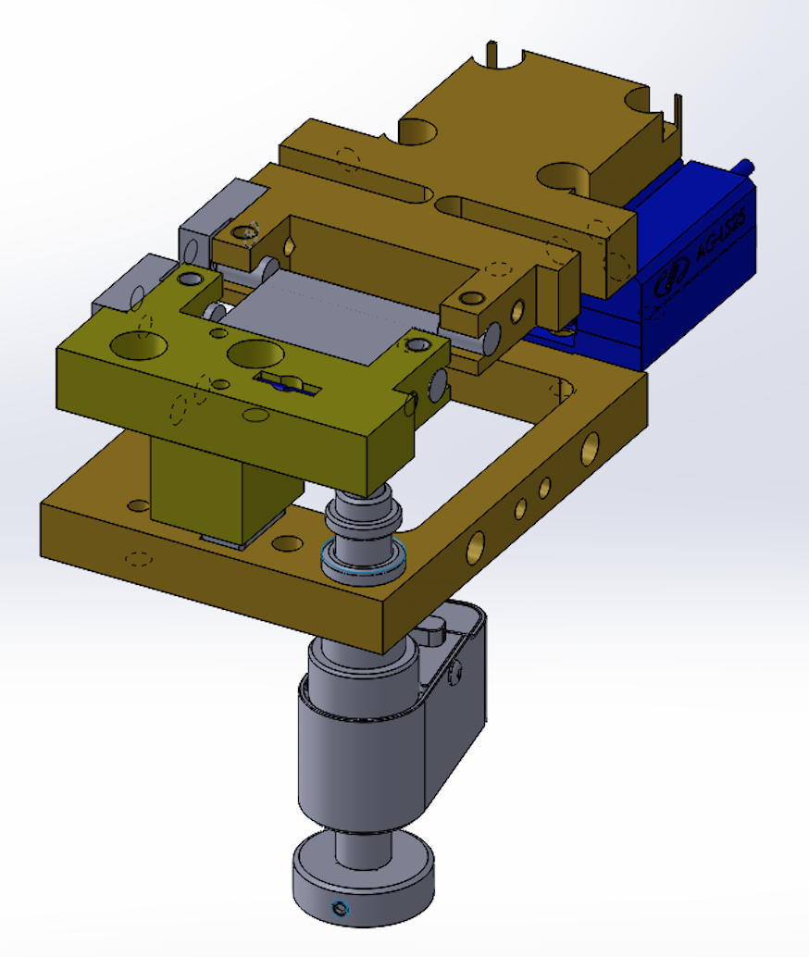
Crystal piezo bending holder
Crystal bending holder by LNF (design INFN-Fe/LNL)
Crystal bending by
linear piezo-motor
Innovation:
~ 15 μm Crystal
The crystal bending and its torsion can be controlled and corrected remotely and in real time !!!
2 prototypes
Ready
+
2 prototypes
to be mounted
Torsion correction
by piezo-finger actuator

Slide 26
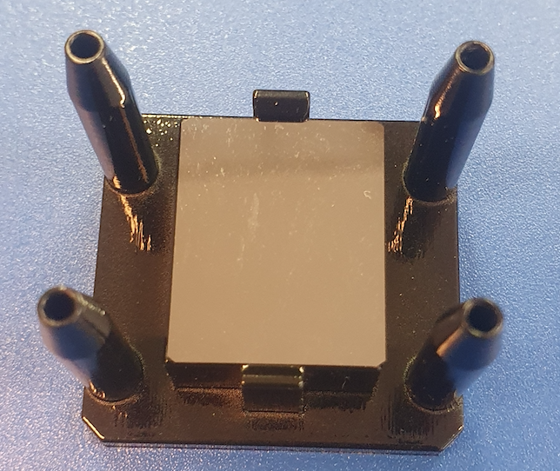
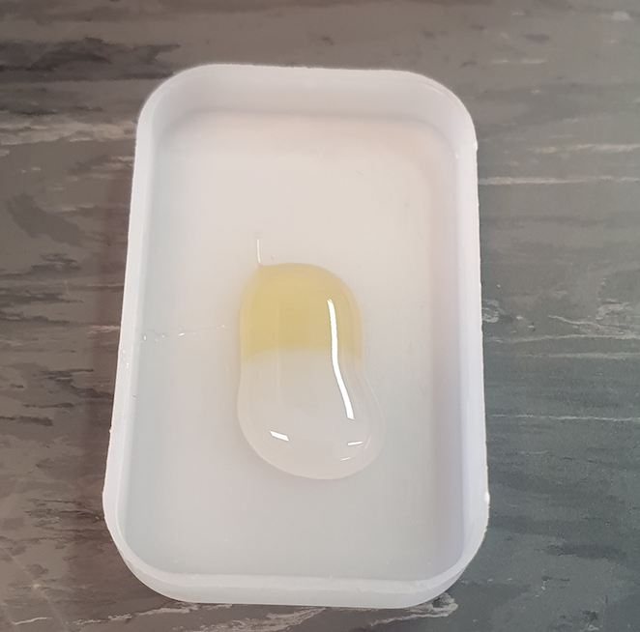
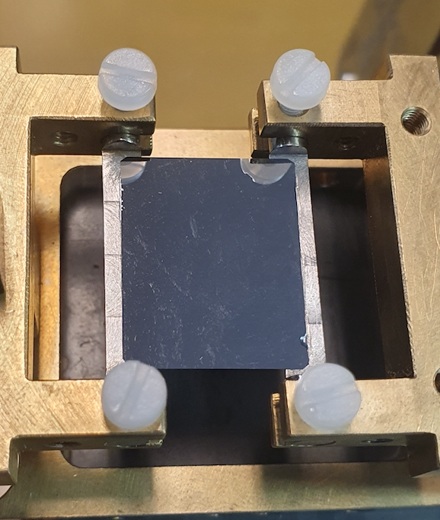
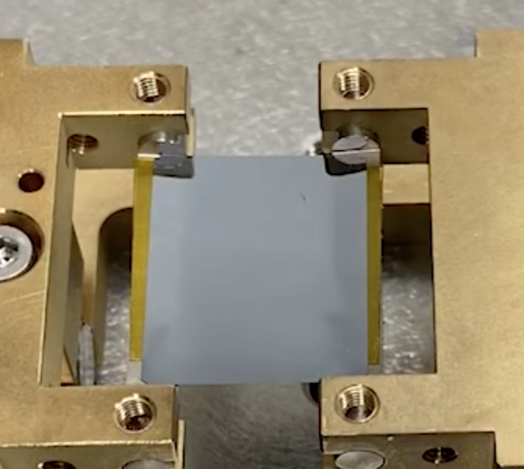
Crystal gluing and mounting system upgrade
Gluing crystal
support
Simple two-components
glue
Special double sided tape
+
Inside vacuum oven
Old gluing system and procedure
(INFN-Fe and LNL- INFN)
New gluing system and procedure (LNF-INFN)
2023
2022
LNF-SPCM
holder
INFN-Fe
crystals
VS
CINEL
holder
Simpler and accurate gluing of the silicon crystal on the bending holder

Slide 27
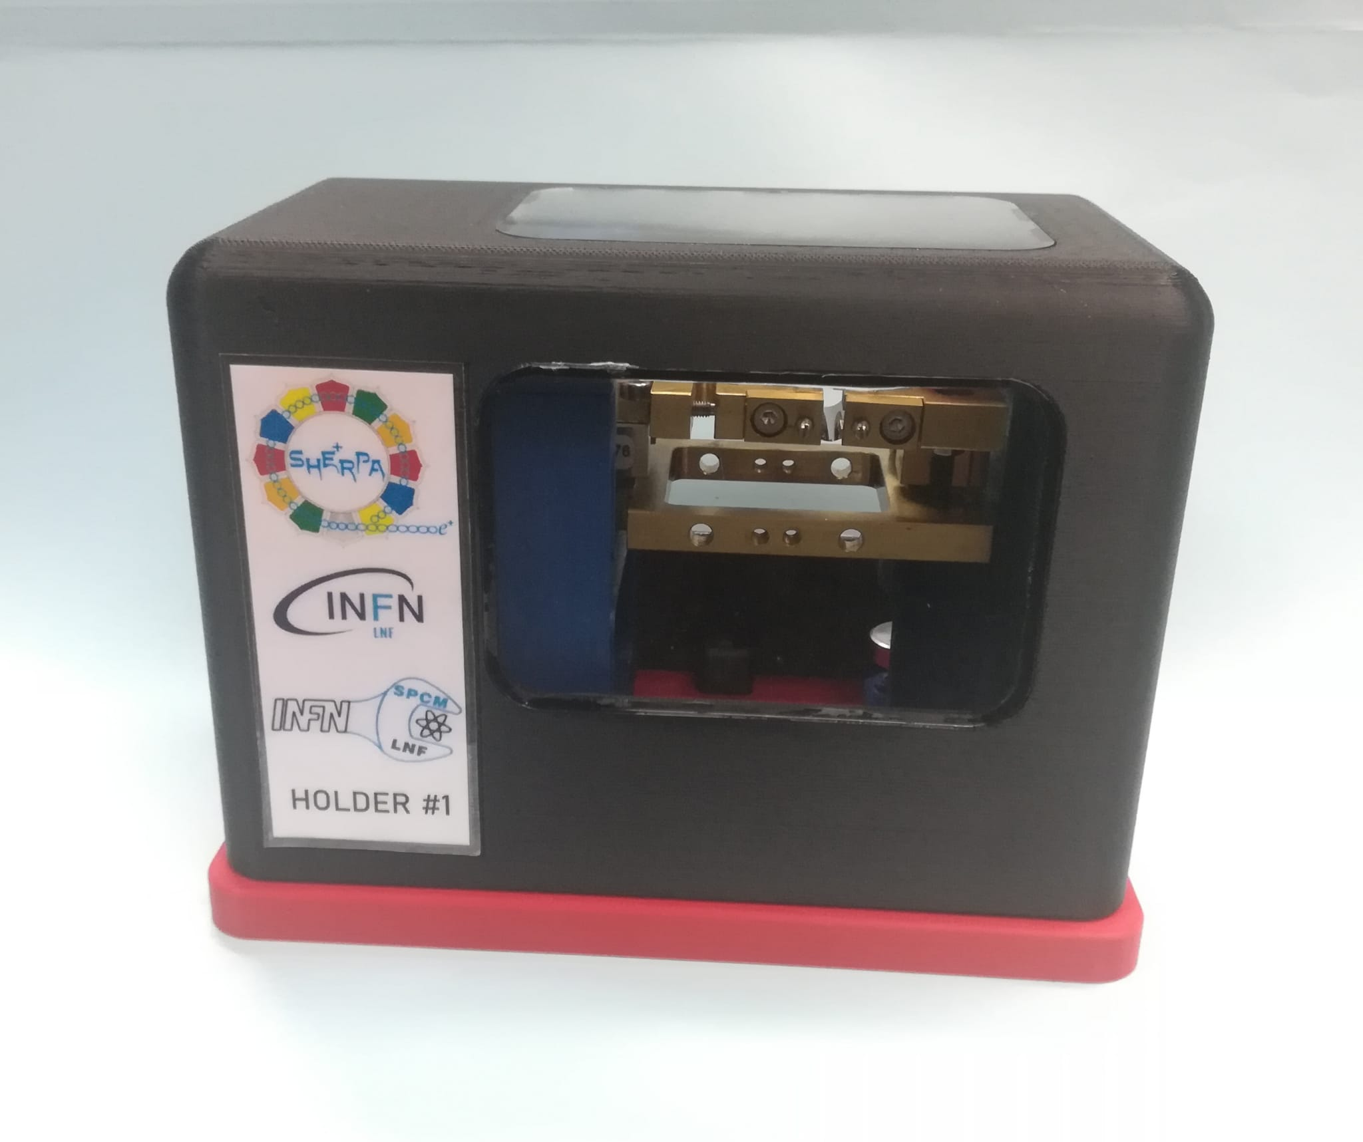
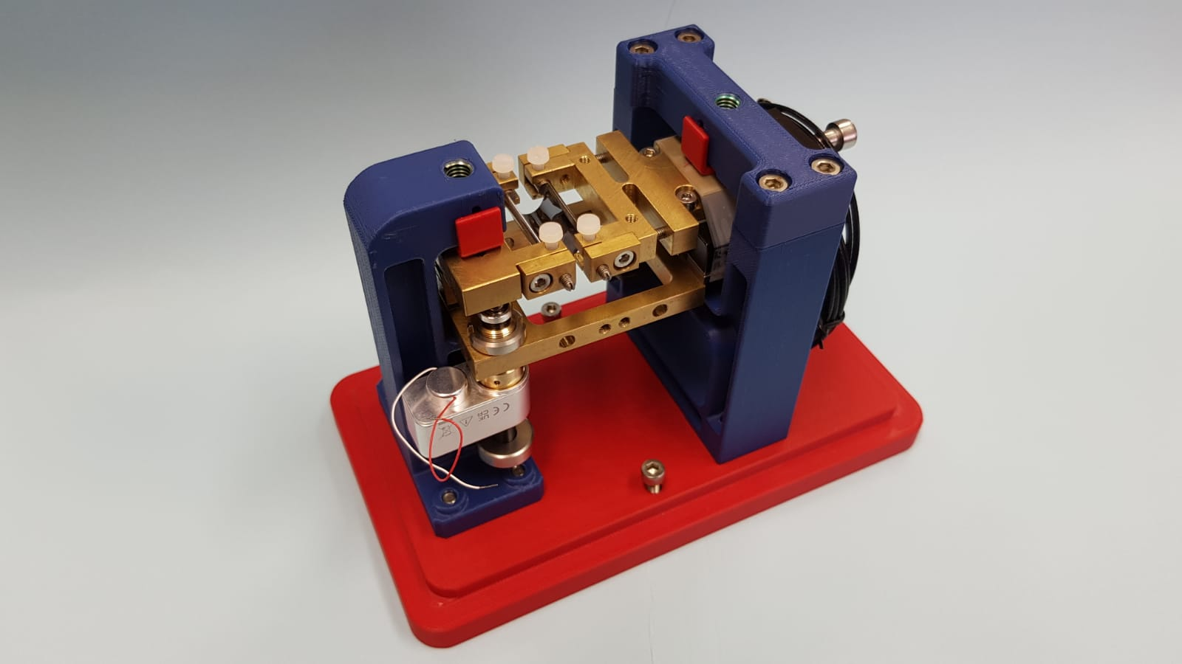
Crystal/holder support and box
At LNF-SPCM we also realized a dedicated support
+
box for the crystal/holder system
This 3D-printed support is very useful during the gluing procedure and also to fix the crystal for a safe transport and manipulation

Slide 28
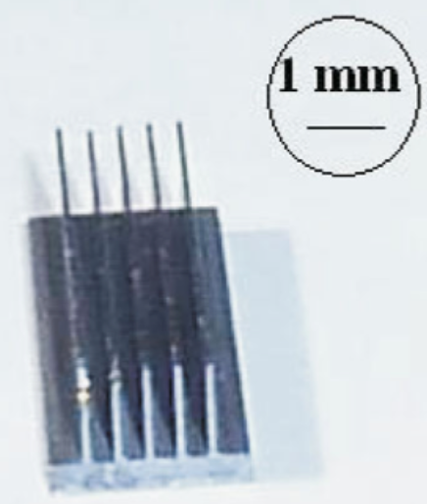
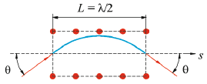
Sub-GeV crystal beam steering: e⁺ & p⁺
The idea is to use the solid expertise developed to
scale crystal extraction from multi-GeV hadron beam to < 1 GeV positron beam
Sub-GeV e⁺ crystal beam steering in two different configuration
at the BTF (Beam Test Facility, INFN-LNF):
2006 – Channeling of 480 MeV e⁺ [11]
- 1 mm thick silicon crystal
~10 mrad with ~10% of efficiency
2013 – Multi volume reflection of 100 MeV e⁺ [12]
5 bent silicon crystals in a raw
5 x ~100 µm thick silicon crystal
5 mrad with ~30 % of efficiency
Ultra-thin crystal mirroring
2012 – Mirroring and Volume-reflection of 2 MeV p⁺ [13] (nanometric crystal!!!)
- ultrathin silicon crystal (100 nm, half wavelength of the planar channeling oscillation)
- Deflection: ~ 5 mrad (CH), ~1 mrad (VR)
- Efficiency: 58% (CH), 42% (VR)
UA9 in 2014 – Mirroring of 400 GeV p⁺ [14]
- 26,5 µm thick silicon crystal
- Deflection: ~ 10 µrad (CH)
- Efficiency: 80% (CH)

Slide 29
Sub-GeV crystal beam steering: e⁻
Also e⁻ crystal beam steering has been performed in different conditions, giving useful references for leptons coherent effects in bent crystals and for thin crystal technology
Negative particle deflection is always less efficient then for positive ones
2014 – (MAMI) Channeling of 855 MeV e⁻ [15]
30 μm Silicon crystal (111),
Deflection: 910 μrad
Efficiency: 20%
2014 – (MAMI) Volume reflection of 855 MeV e⁻ [15]
30 μm Silicon crystal (111),
Deflection:191 μrad
Efficiency: 77%
2016 – (SAGA-LS) mirroring of 255 MeV e⁻ [16]
ultrathin silicon crystal (0.74 µm, half wavelength of the planar channeling oscillation), deflection
Deflection: 450 µrad
Efficiency: 29%

Slide 30
SHERPA 2.0: what else to extract from DAΦNE
By-pass of the dumping ring
The e⁺ & e⁻ rings has to be separated at the interaction points
Adjust the DAΦNE ring optics to fit with the crystal system
Mount the crystal system (gonio, crystal & monitoring)
An extraction line
Not included in the project presented here…
Dumping ring
DAΦNE
New extraction line
The e⁺ ring to be modified
The new BTF extraction line
Other existing elements

Slide 31
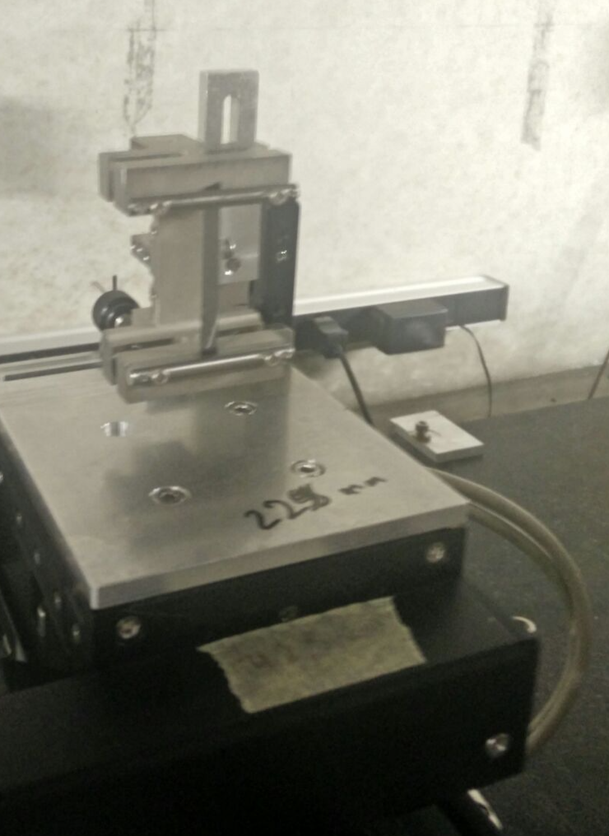
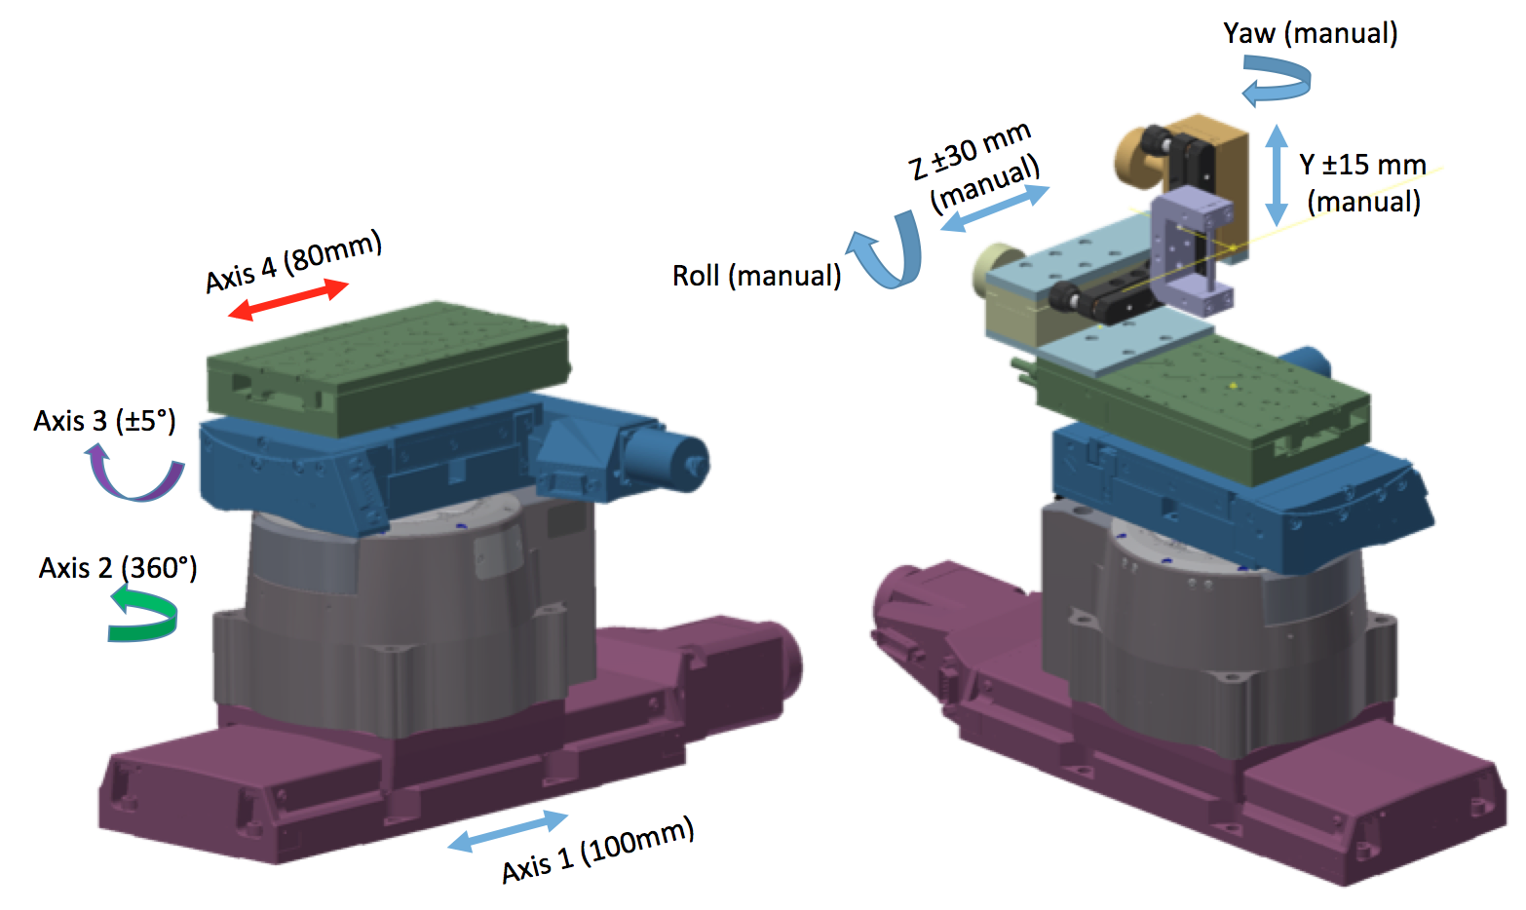
The crystal/goniometer assembly
Crystal
Beam
Axis4- Linear
Axis3- Tilt
Axis2- Rotational
Axis1- Linear
Measurement table

Slide 32
Crystal simulations
To simulate coherent processes in crystals exist several crystal simulation routine, both full analytical and Monte Carlo
They are mainly focused and optimized to high energy hadrons particles, benchmarked with a large amount of data available in literature
At the moment in SHERPA we are developing two Monte Carlo routines, adapting them to sub Gev leptons (e⁻ and e⁺): GEANT4 [28] and FLUKA, ideal to simulate crystal behavior integrated in an accelerator machine
The GEANT4 routine shows nice performance for sub-GeV e⁻, and now we are developing the sub-GeV e⁺ version (CH_{eff} for e⁺ is higher w.r.t. e⁻)
The FLUKA one is developing in collaboration with the FLUKA team at CERN
SHERPA data with sub-GeV e- and e+ will be extremely useful also for simulation benchmark in the next future

Slide 33
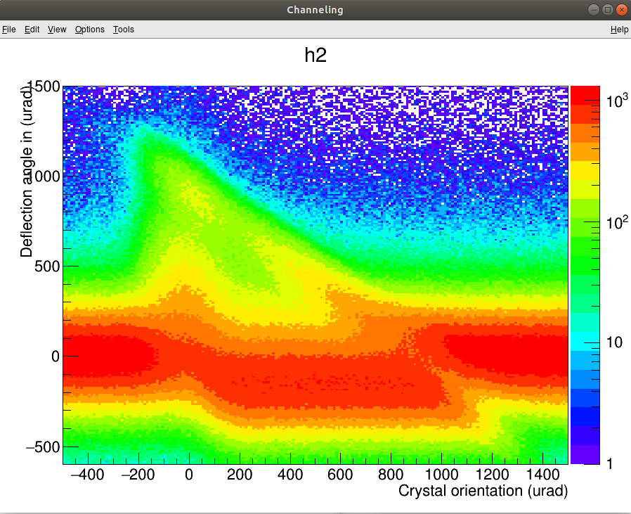
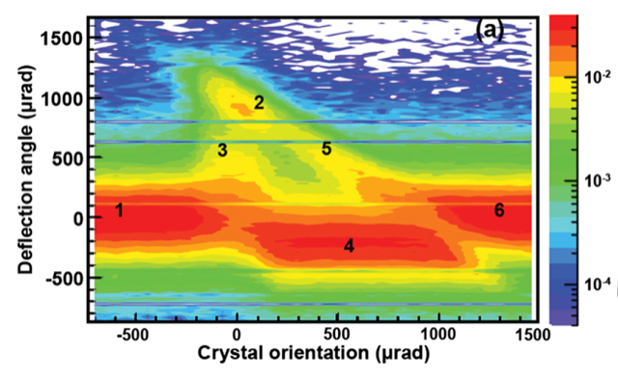
Crystal simulations (e⁻)
We managed to well reproduce the angular scan of a “SHERPA like” crystal tested at the MAMI facility with 855 MeV e⁻ [PRL 112, 135503 (2014)]
MAMI measurements [15]
GEANT4 Monte Carlo
simulations [28]
CH_{eff} = 20%
The difference in channeling efficiency (~ 10%) is probably due to the “rechanneling process”, not yet implemented in 2021…
The CH_{eff} for negative particles is always lower w.r.t. positive particles

Slide 34
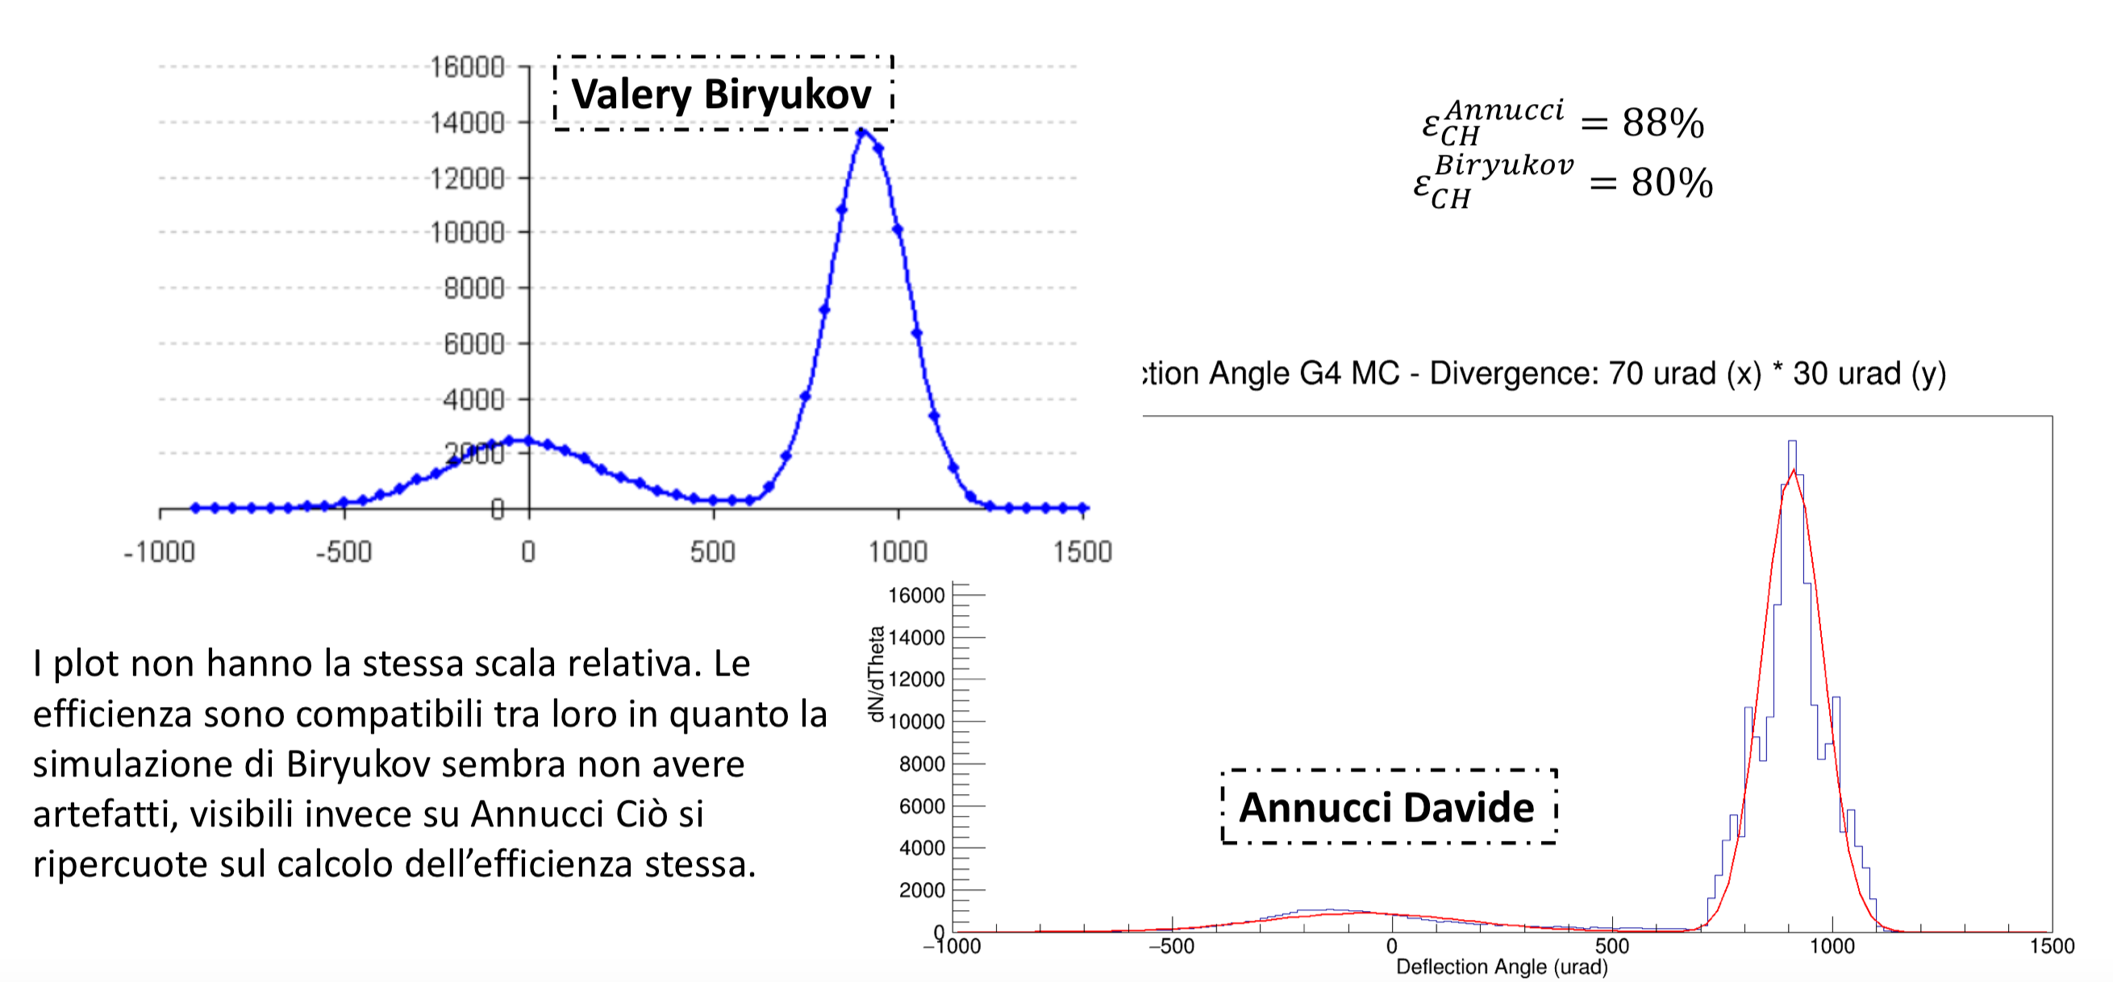
Crystal simulations (e⁺)
We did also a comparison between GEANT4 Monte Carlo simulations and Analytical one of a “SHERPA like” bent crystal for 855 MeV e⁺
Analytical simulations
GEANT4 Monte Carlo
simulations [28]
Analytical: CH_{eff} ≅ 80%
Preliminary
GEANT4: CH_{eff} ≅ 88%
The difference from Analytical and Monte Carlo simulations is probably due to lack of the data benchmark
Measurements and data analysis are in progress to improve simulations…

Slide 35
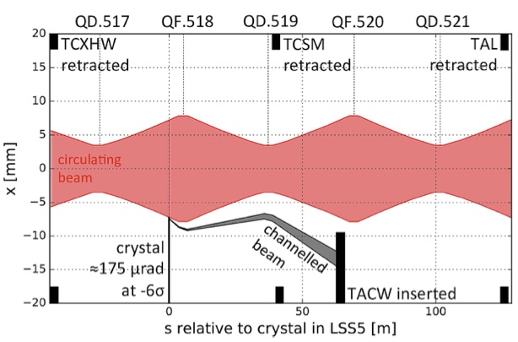
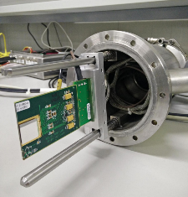
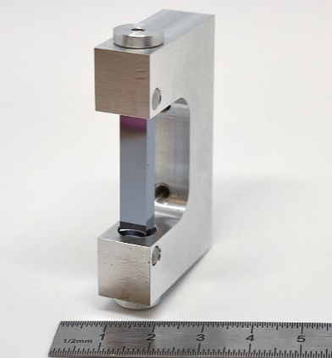
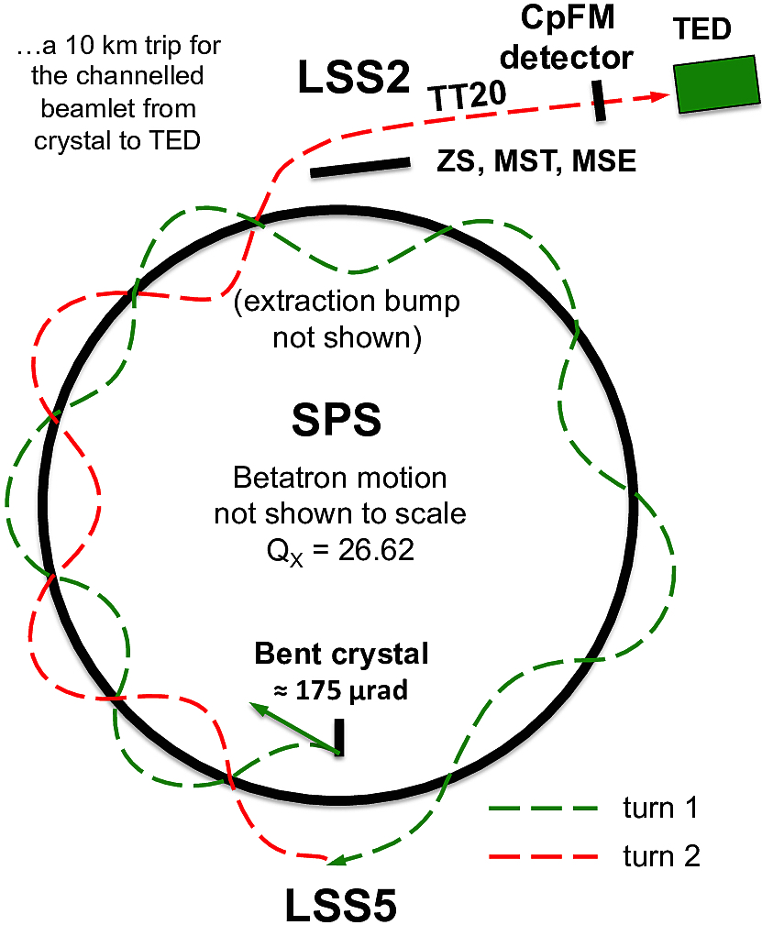
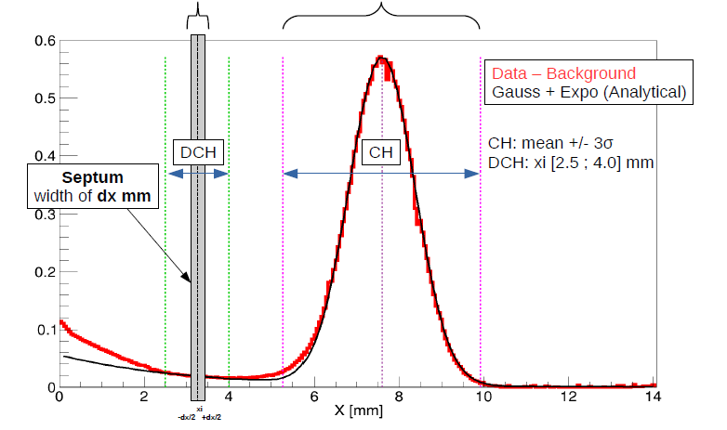
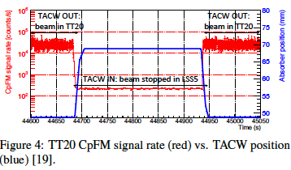
CERN SPS crystal extraction (UA9)
Joint activity with TE/ABT and EN/STI
2016 - slow not-local extraction of 270 GeV p⁺ in channeling mode [6,7(M.G.)] beam into the TT20 extraction line towards the North Experimental Area of the SPS was demonstrated using the extraction septa and a bent crystal
2018 - “Virtual” not-resonant local beam extraction of 270 GeV p⁺ in channeling mode
Timepix
Circulating beam
270 GeV p⁺
Extraction in 2 turns
Edge of the circulating beam core
NDCH(xi)/dx
NCH
Halo density in channeling mode along the horizontal axis
(self-normalized to the total No of impinging particles)
UA9 CpFM
(“Cherenkov for proton Flux Measurements”)
detector for SPS and LHC has seen the extracted beam
0.2 mm thick virtual septum
Extracted beam
loss ratio R ≈ N_{DCH} / N_{CH}= ~6 ‰

Slide 36
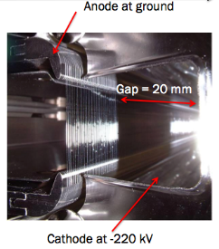
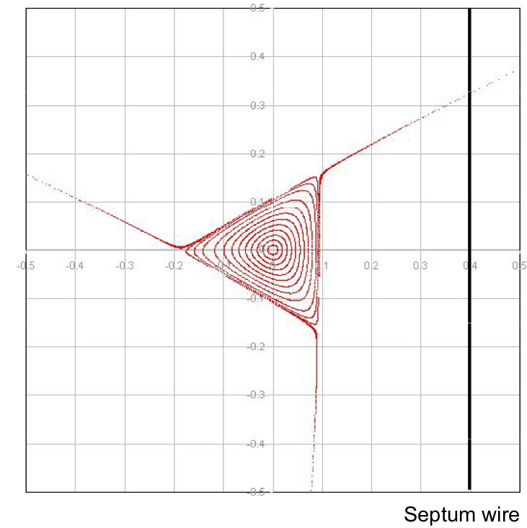
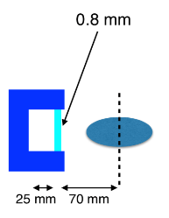
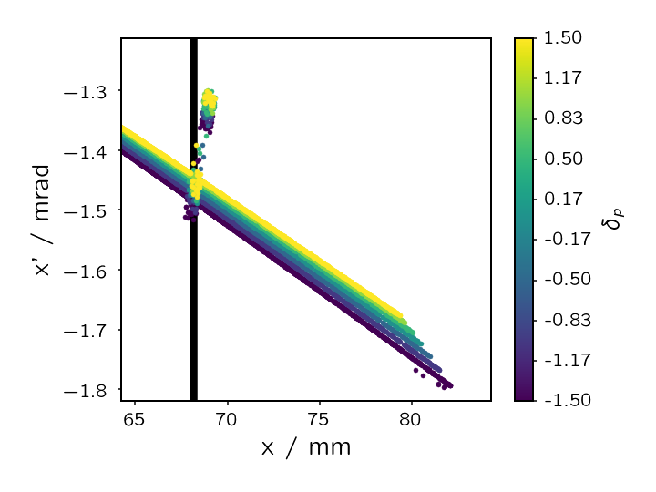
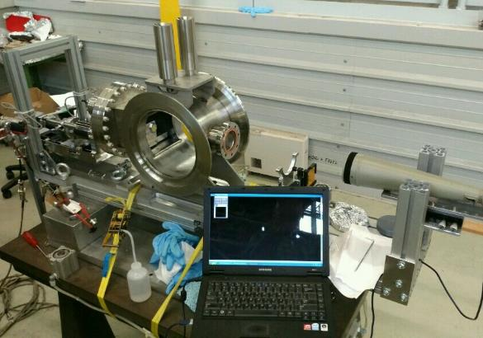
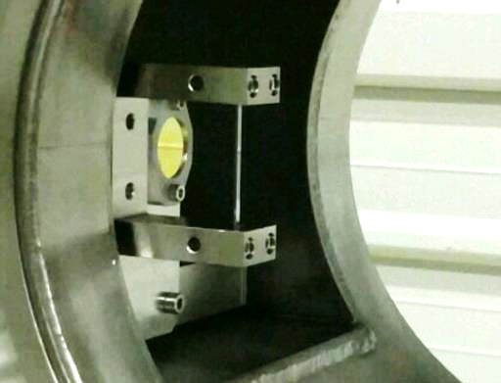
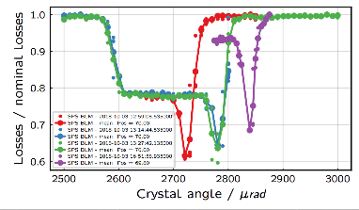
Shadowing of the ES-septum with a bent crystal
Joint activity with TE/ABT and EN/STI
Phase space during resonant extraction
Schematic crystal shape for shadowing
Protons are deflected 5m upstream of the ES, to avoid loss with the anode wires
Channeled particles
not impacting the septum
_{Xn’}
_{Xn}
Septum
Angular position actuator
180 𝜇rad bent crystal
A loss reduction at the ZS of 40%
was recorded on
1-second 400 GeV spill

Slide 37


SPS slow extraction with crystal shadowing
This technique is developed to reduce the number of particles on the SPS
extraction septum (ZS wires) and consequently the extraction losses
A crystal is used upstream to shadow the ZS wires deflecting the particles that would hit him
In 2018, a feasibility test has been performed and a reduction of 40 % of losses with protons and 30 % with lead ions was observed

Slide 38
SHERPA APPLICATIONS
Resuming the main goals
Spill features pursued:
- Energy spread: Δp/p < 10⁻³
- Emittance: ε < 10⁻⁶ rad⋅m
- Length: ms < Δt < s
The most immediate application of such beam is PADME [21], already running at the BTF, but currently strongly limited by the duty cycle
With the e⁺ beam from the LINAC, the maximum rate on the target is <10² e⁺/ns, keeping the event pile-up and the background at an acceptable level
Using the SHERPA extraction, PADME could increase the statistics by a factor 10⁴ and its sensitivity by a factor 10², obtaining a cutting-edge discovery potential
Even an unrealistic very bad extraction efficiency of 5%, with the worst-case scenario of a beam pulse length of 100 μs, SHERPA still improves by a factor 50–100 the PADME sensitivity with respect to the plain LINAC beam
A beam with such characteristics is interesting for any kind of fixed target experiment
Current spill features from LINAC:
- Energy spread: Δp/p ~ 10⁻³
- Emittance: ε < 10⁻⁵ rad⋅m
- Length: Δt ~ 200 ns
VS

Slide 39



Quasi c.w. positron beam applications
PADME is searching for invisble decays of a dark photon A’ eventually produced in the annihilation: e⁺ e⁻ → A’ γ (e⁺ beam on fixed target e⁻)
PADME dark photon sensitivity
(invisible decays)
PADME dark photon sensitivity
(invisible decays)
PADME@BTF
3 days
30 days
ε² = coupling parameter
ε² = coupling parameter
6 months of data-taking at DA$Φ$NE
using resonant estraction, 0.4 ms spills
(optimistic)
$\sim$1 month of data-taking at DA$Φ$NE
using ultra-slow extraction,
(10⁻⁴ extraction efficiency)
(P. Valente, Ferrara workshop on crystal applications, 13 Apr. 2019: https://agenda.infn.it/event/15101/)

