Slide 1
In-house Development of crystal assemblies at CERN (DECRYCE)
O. Aberle, M, Calviani, F. Cerutti, Q. Demassieux, M. Di Castro, L.S. Esposito, S. Gilardoni, H. Havlikova,
T. Lefevre, A. Masi, E. Matheson, I. Ortega Ruiz, A. Perillo Marcone, V. Rodin, R. Scordo, R. Seidenbinder,
S. Solis Paiva, J. Storey
14/02/2024, 5th Slow Extraction Workshop at MedAustron

Slide 2
Outlook
Introduction
  Planar channeling in (bent) crystals
  Beam manipulation
Crystal applications at CERN
  Collimation for ion runs at LHC
  Loss reduction in the SPS
  Future fixed target experiment in the LHC
DECRYCE project
  Development, implementation, and validation of crystal-bender systems to be employed for different applications at CERN
Results from 2023

Slide 3
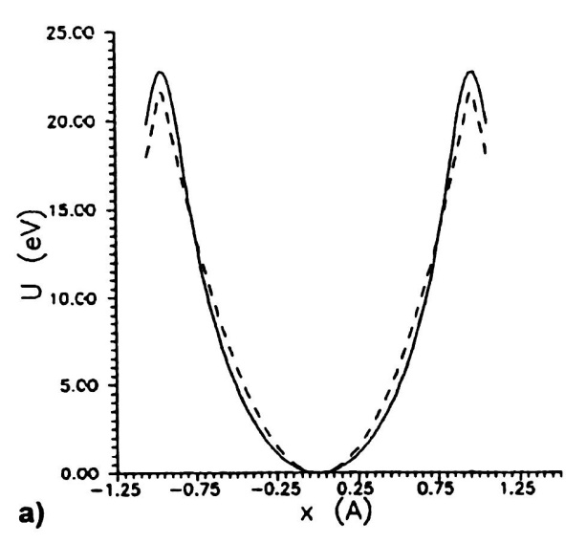
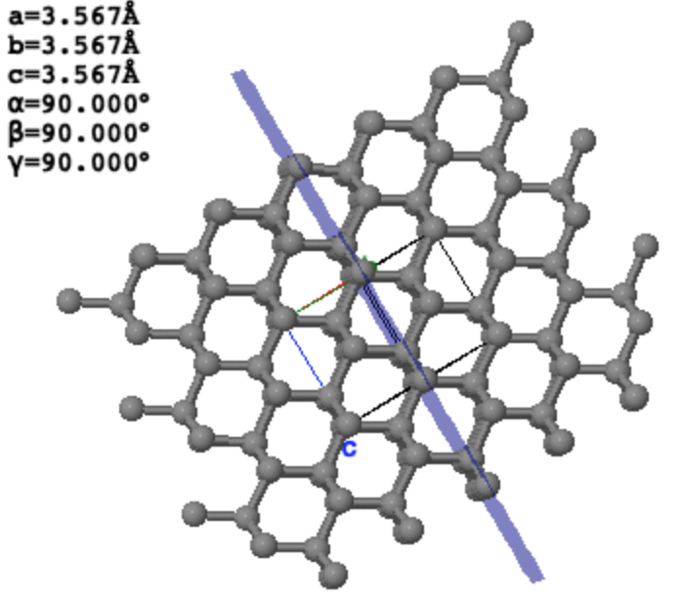
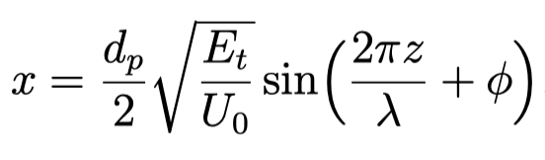
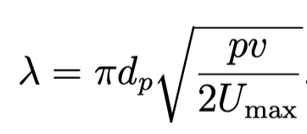

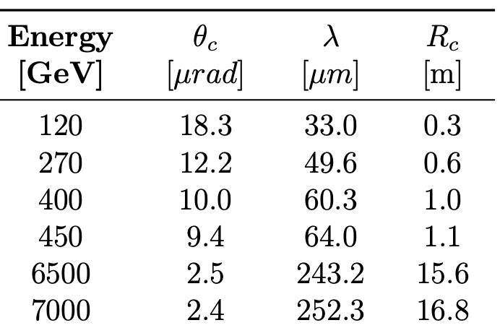
Crystal Planar Channeling
The solution of the equation of motion (in the approx. of harmonic oscillator) shows that channeled particles oscillate with a wavelength proportional to their energy between crystal planes.
d_{p}
(110)
(110)

Slide 4
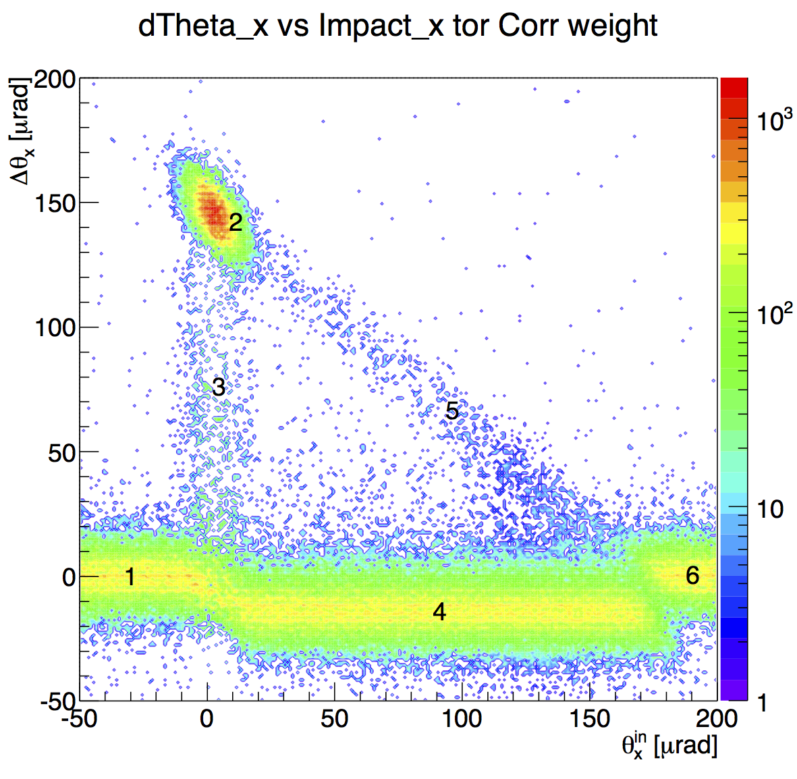
Beam manipulation with a bent crystal
Beam divergence ~ 10 μrad
Two coherent effects can be used in planar channeling for beam deflection in particle accelerators:
  Channeling → larger deflection with smaller efficiency and smaller angular acceptance
  Volume Reflection (VR) → smaller deflection with larger efficiency and larger angular acceptance
2. Channeling
P= ≤ 85 %
W. Scandale et al, PRL 98, 154801 (2007)
W. Scandale et al., Nucl. Inst. and Methods B 268 (2010) 2655-2659
Horizontal deflection angle
5. Volume Capture
3. Dechanneling
6. Amorphous
1. Amorphous
4. Volume Reflection
P = 98 %
Crystal orientation

Slide 5
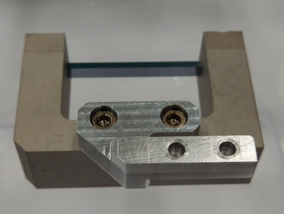
Crystal-based collimation system in the LHC
Cleaning upgrade required to prevent quenches in DS magnets at IR7
11T dipoles not available for TCLD cleaning
New baseline Nov 2020 using TCPC crystal collimators for ion runs
LHC crystal
Operational only for ion-runs (HL-LHC protons runs would require additional absorbers)

Slide 6
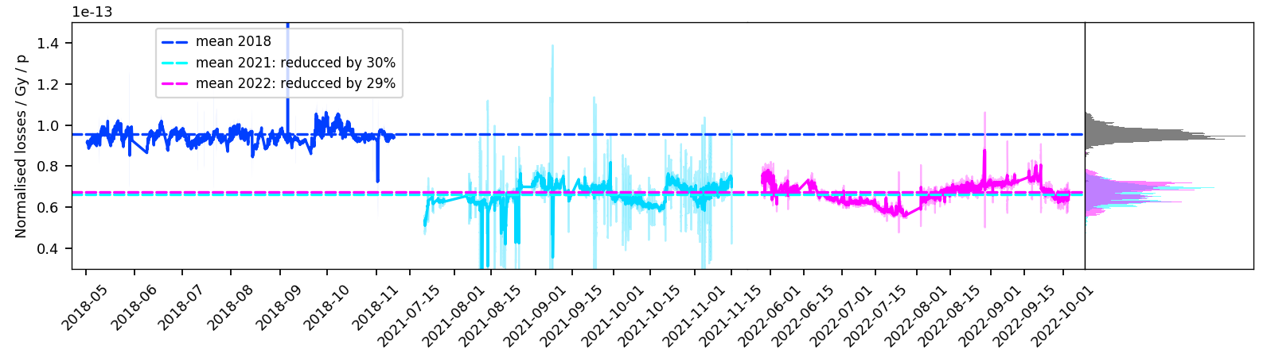
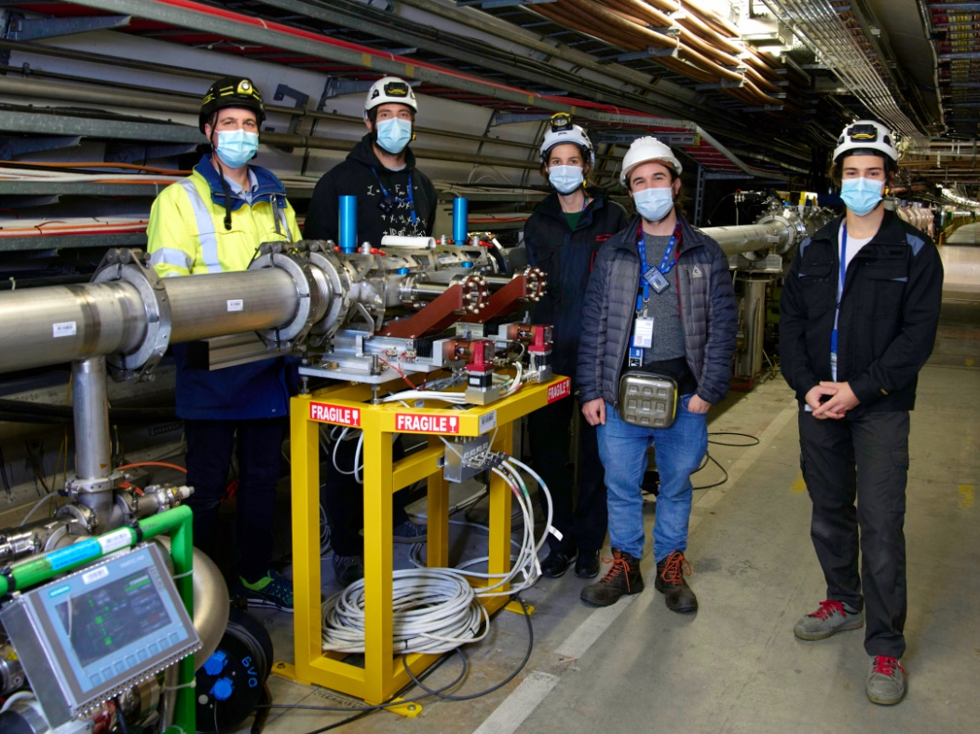
Loss reduction in the SPS
Crystal assisted slow extraction is now operationally (TECS.21602) used to locally shadow the electrostatic septum ZS and effectively reduce unavoidable losses during slow extraction
http://cds.cern.ch/record/969071
Installation of TECA.41777
for non-local shadowing
Non-local shadowing is under test in SPS LSS4 to further reduce the losses at the ZS (See F. Velotti’s presentation “Crystal shadowing”)
Gain can be up to factor of 10 with Multi VR Array (MVRA) crystal
Additional crystals envisaged to reduce losses at TCSC and spitter magnets in North Area
Replacement of ZS by a crystal (see Y. Dutheil’s presentation)

Slide 7
Double Channeling – LHC Fixed Target
In the framework of future fixed target experiment in the LHC, a double crystal layout has been proposed to measure electric/magnetic moment precession of short living particles, thanks to the high equivalent magnetic field generated by a bent crystal.
TCCS
TCCP
D. Mirarchi et at., Eur. Phys. J. C (2020) 80:929
In this scheme:
Secondary halo deflected by a bent crystal (Target Collimator Crystal Splitting) at larger aperture than TCP, akin to a LHC crystal for collimation
Deflected halo impacts on a target
Interaction products channelled by a second bent crystal (Target Collimator Crystal Precession), with a bending angle in the range of 10-20 mrad
Dedicated absorber to intercept deflected halo that did not interact with target

Slide 8
Motivations for the DECRYCE project
During recent years, it has become clear that crystals are envisaged/used in several CERN applications
Getting an in-house production would be beneficial to consolidate the strategical use of bent crystals in present and future projects
The DECRYCE (DEvelopment of CRYstals for Collimation and Beam Extraction) project was established to respond to these needs
The production chain of bent crystal devices consists of
the procurement of very low-dislocation crystal wafers
specific cutting and polishing of crystal strips with respect to the crystal lattice planes
the bender system design and integration
the validation/qualification with X-ray and particle beams

Slide 9
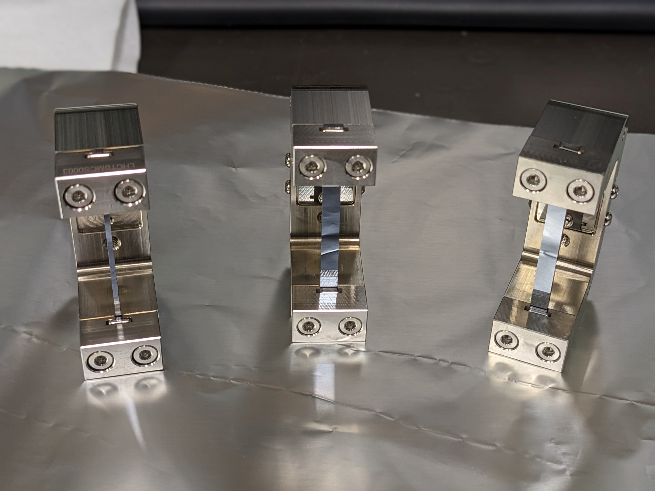
Project structure
WP1 – Project Management
WP2 – Crystal/wafer preparation
WP3 – Design & construction of the crystal bender
WP4 – Characterization of crystal assembly with X-rays
WP5 – Validation of crystal assembly with beam
WP6 – Telescope and data acquisition system for beam validation

Slide 10
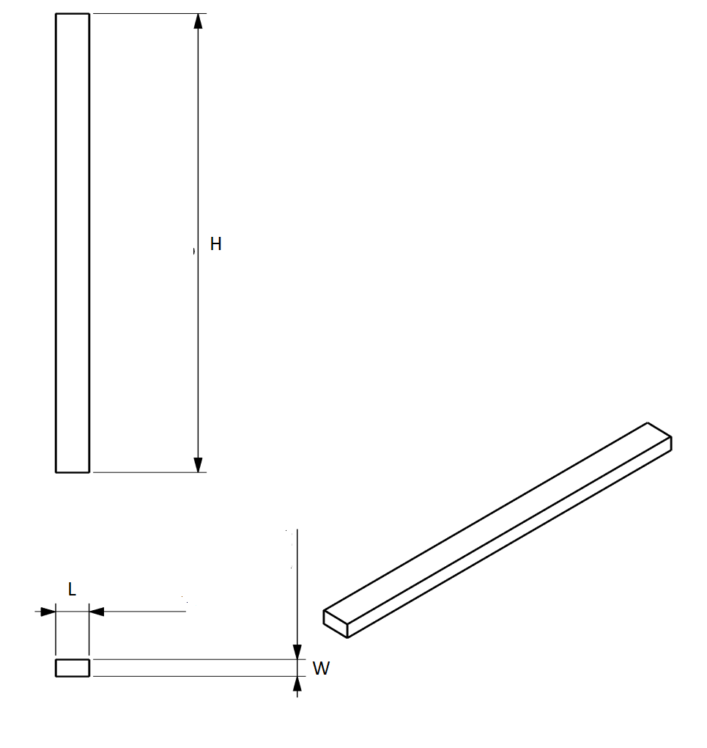
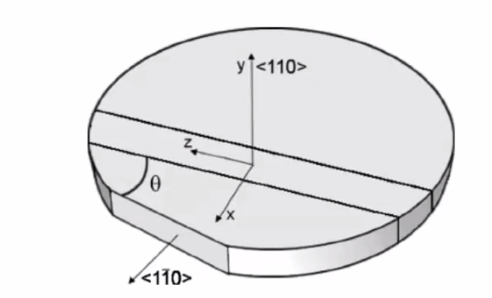
Crystal strip specifications
 | LHC | SPS
Material | Monocrystalline Silicon, undoped
Height | 55 ± 0.1 mm
Length | 4 ± 0.01 mm | 1 ± 0.05 mm
Width | 2 ± 0.05 mm | 0.8 ± 0.01 mm (LSS2) OR 1.8 ± 0.01 mm (LSS4)
Parallelism of height sides | 10 microns along length
Channelling Plane | (110)
Channelling Axis (beam impact direction) | <110>
Miscut for planer channelling | 0 ± 10μrad | 0 ± 100μrad
Cut to offset axial channelling (Angle between x and <1-10>) | +18±0.5mrad OR -18±0.5mrad OR 0±0.5mrad
Surface Roughness of face (Normal to y) | <50 nm Ra(norm)
Surface Roughness of cut faces (Normal to x) | <50 nm Ra(norm)
Dislocation density | < 1 / cm²

Slide 11
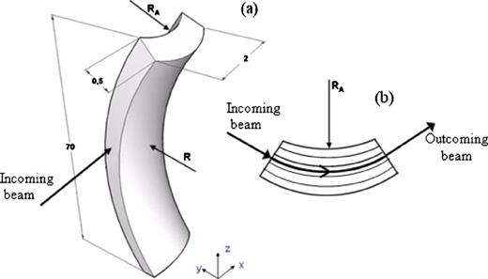
Anticlastic design principle
Primary curvature
Clamping Force ?
Anticlastic
curvature
Angle ?
The bender will create the primary curvature
The ratio between the two curvatures is a material property
Design guideline :
  Minimize dependency of bending with clamping force
  Maximize contact area

Slide 12
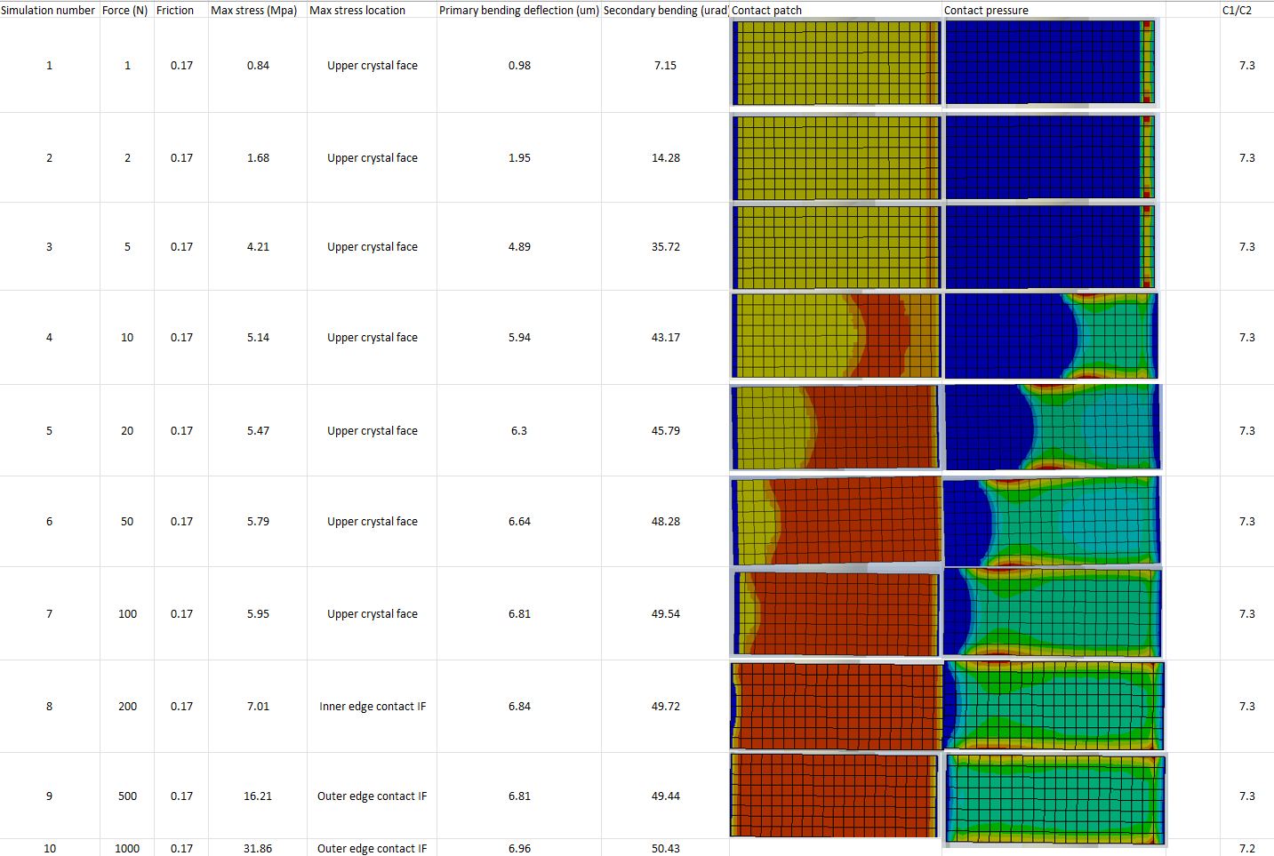
Design studies for the benders
FEM simulations to:
Find the clamp surface angles with an iterative process
Evaluate the effect of clamping force
Evaluate stresses in the crystal
Target clamping force : 50 to 100 N per clamp

Slide 13
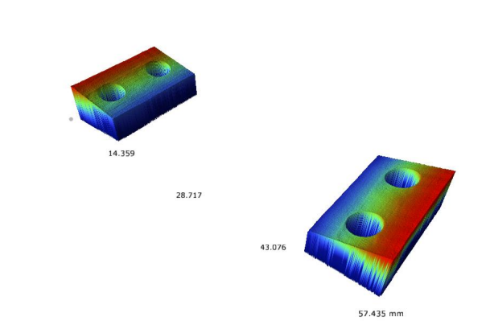
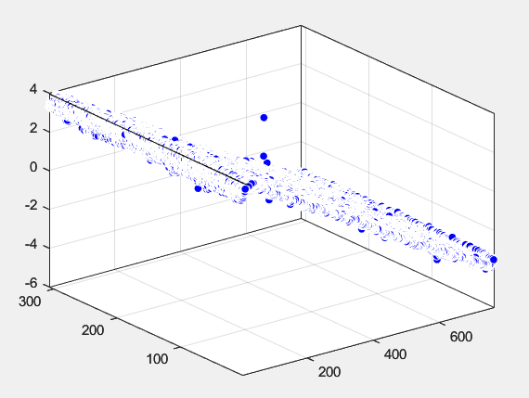
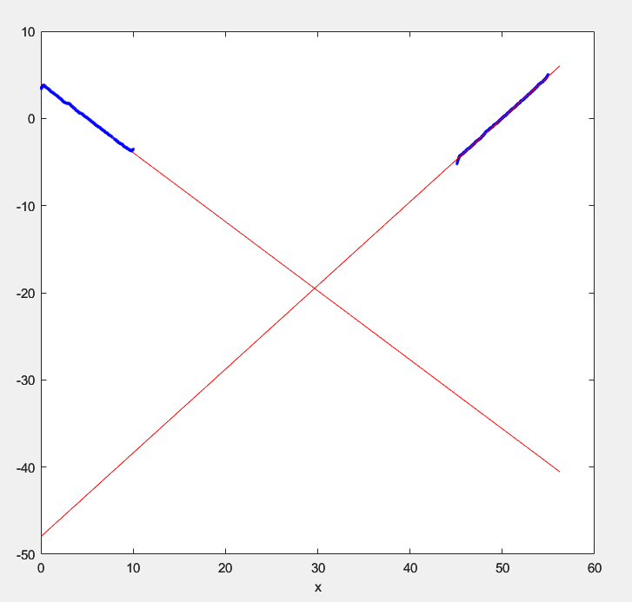
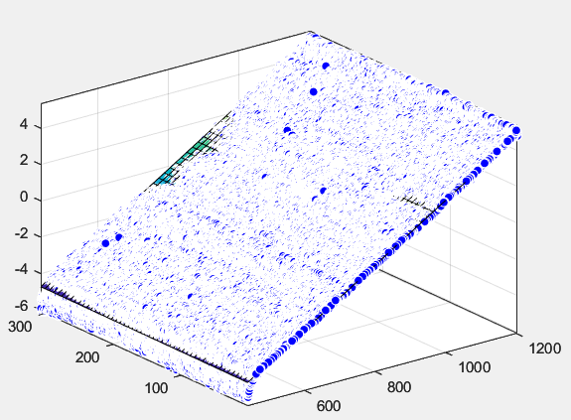
LHC Benders metrology
Bender # | LHC#1 | LHC#2 | LHC#3
180 - Angle (deg) | 0.10042 | 0.09594 | 0.10483
Tolerance (%) | -0.41 | -4.85 | +3.96
Roughness Ra (nm) Left/Right surfaces | 86/82 | 102/86 | 96/91

Slide 14
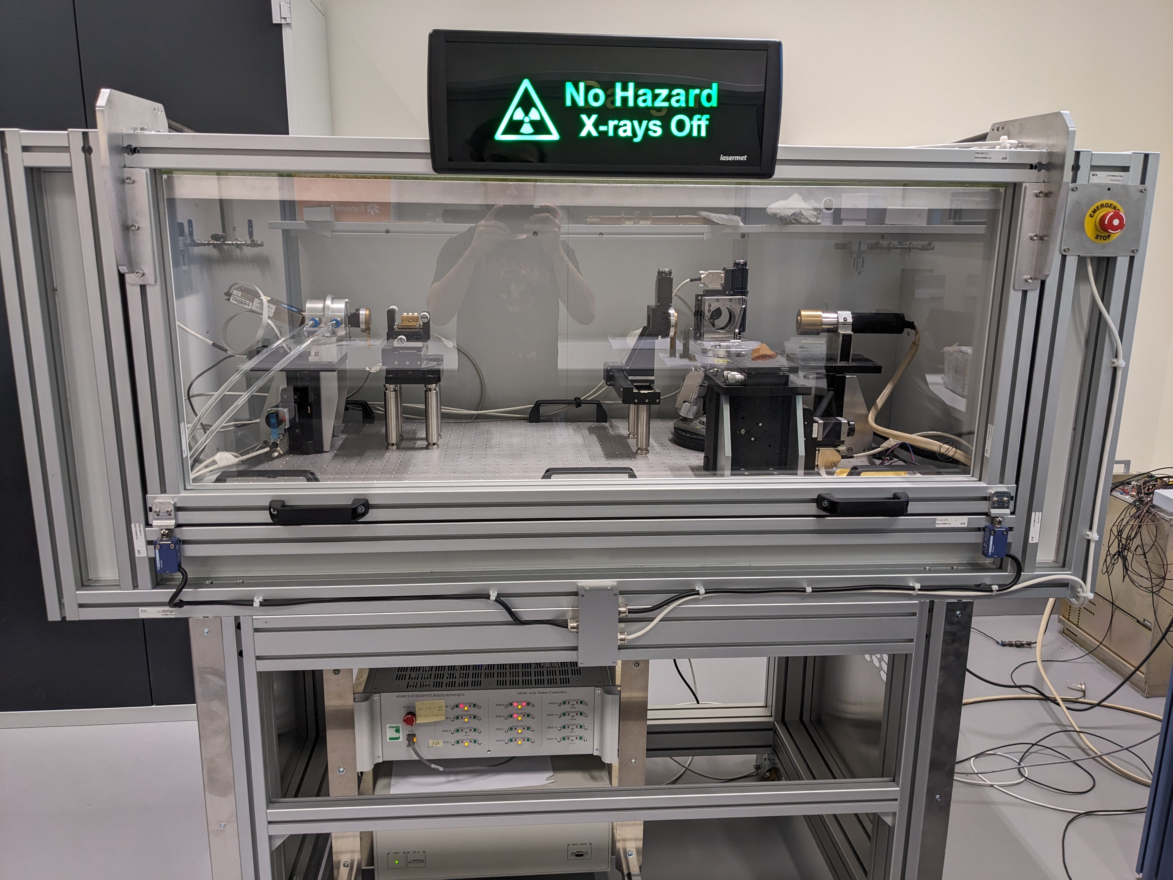
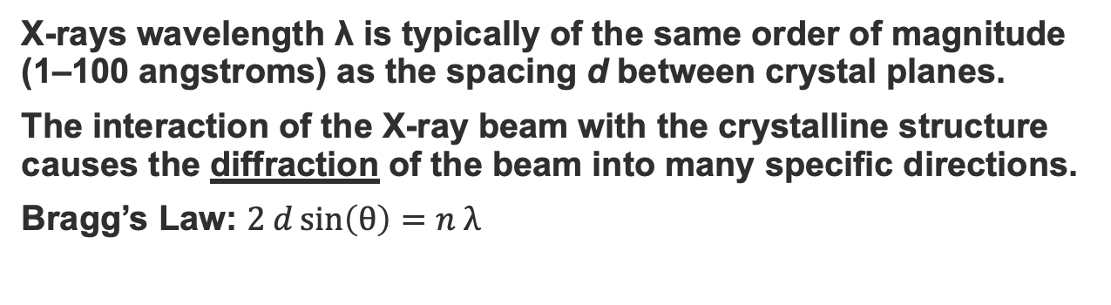
X-Ray Diffractometry for crystal characterisation
X-rays wavelength λ is typically of the same order of magnitude (1–100 angstroms) as the spacing d between crystal planes.
The interaction of the X-ray beam with the crystalline structure causes the diffraction of the beam into many specific directions.
Bragg’s Law: $2 d\sin\left(θ\right)=n λ$
impact footprint
θ
X-ray beam
θ
n
Determination of normal n to crystal area labelled “impact footprint” where X-ray diffraction occurs at Bragg angle Θ_{b}.
θ
θ
Commercial Malvern Panalytic X'Pert machine with modifications and autocollimator from CEM and PNPI
d
Inhouse CERN X-Ray machine for crystal characterisation under commissioning from CEM
Illustration of crystalline diffraction.

Slide 15
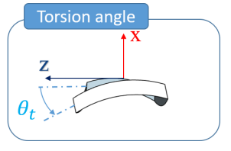
Crystal parameters measurable with X-rays
beam
Miscut angle
(~ 1 – 2000 μrad)
Bending angle
(~ 20 – 300 μrad)
Torsion
(~ 1 – 50 μrad/mm)
+θ_{m}
+θ_{m}
Crystal plane
θ_{b}
Straight crystal
d
Unbent crystal with miscut angle.
Bent crystal
Bent crystal with miscut and bending angles.
Z
Y
τ * h
Torsion as view from top of the crystal.

Slide 16
X-Ray Measurements
Before and After Thermal Cycle Measurements
 | Miscut |  | Bending |  | Torsion
 | Before | After | Before | After | Before | After
LHC#1 * | 254 | N/A | 42 | N/A | 1.6 | N/A
LHC#2 ** | N/A | N/A | N/A | N/A | N/A | N/A
LHC#3 | 164 | 161 | 53 | 52 | 0.1 | 0.8
SPS#2 | 135 | 124 | 193 | 182 | 49 | 17
High Miscut Specs: Possible error in manufacturing process.
Low Bending: Under investigation
High Torsion: Possible torsional effect due to clamps hitting crystal. Crystal dimension mis-match.
* LHC_1 Assembled during H8 Run. No thermal cycle has been applied to it.
** LHC_2 Measurements not possible due to crystal S-Shape.

Slide 17
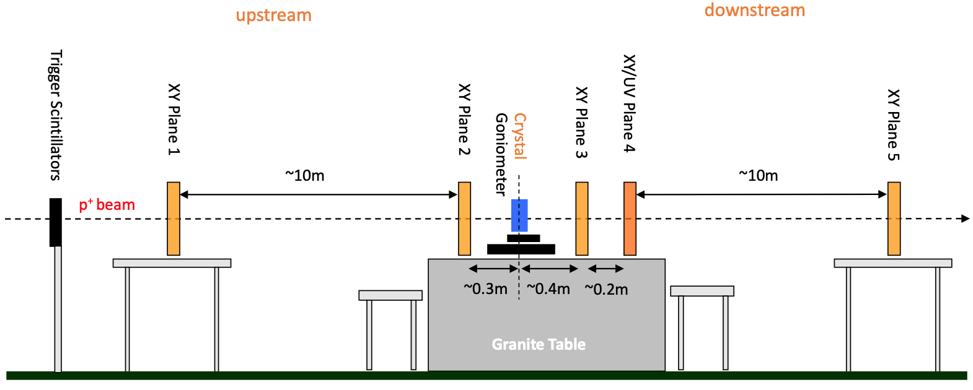
Crystal assembly validation with beam
Schematic layout of the UA9 telescope installed in H8 (North Area)
The validation of crystal assemblies with beam is needed for the final CERN hardware qualification before the installation of the crystals in the machines
The tracker telescope is configured to achieve high angular accuracy/precision with long upstream and downstream arms
Observables:
Efficiency
bending angle
torsion or QM effect, and,
possibly Inelastic Nuclear Interactions (if equipped with additional instrumentations)
It is the only method to measure the crystal channeling efficiency (proportional to in-depth crystal defects), which cannot be measured by the X-ray diffractometer
Acknowledgment of the UA9 for the fruitful collaboration during the data taking in the North Area test beam campaign for the characterization of the first CERN-made crystals

Slide 18
Crystal assemblies tested with beam in 2023
3 LHC and 1 SPS crystals were tested
A LHC crystal (STF-132) was used as reference to ensure the reliability of experimental setup and analysis procedure
Crystal | 1st | 2nd | 3rd
LHC#1 | 20/09 Run 7858 | 21/09 (RM) Runs: 7881,7882,7885
LHC#2 | 27/09 Run 8002 (straight crystal)
LHC#3 | 15/09 Runs: 7773, 7774 | 23/09 (TH) Runs: 7917,7919
SPS#2 | 16/09 Runs: 7782, 7783 | 23/09 (TH) Runs: 7924,7927 | 26/06 (RB) Runs: 7984, 7985, 7986
STF-132 (LHC) As control | 14/06 Runs: 7653, 7654 | 18/09 Runs: 7822, 7826
Several runs to characterize crystals after thermal cycle (TH), remounted (RM) or re-bent (RB)

Slide 19
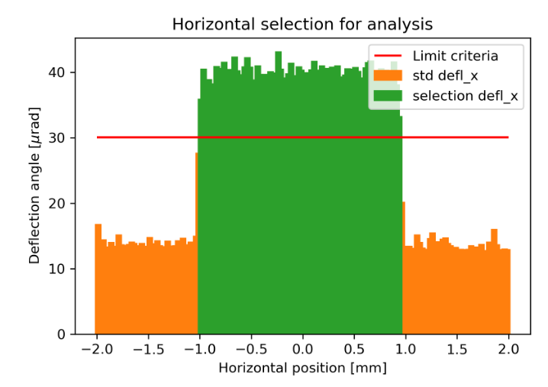
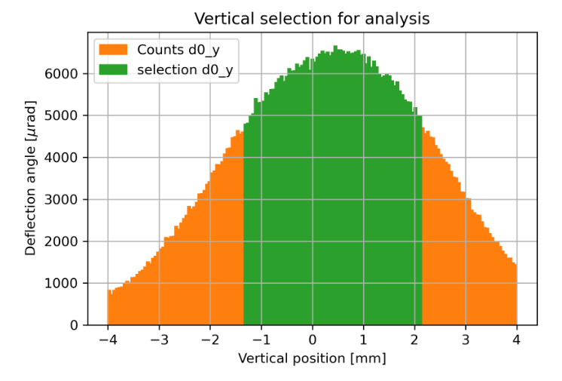
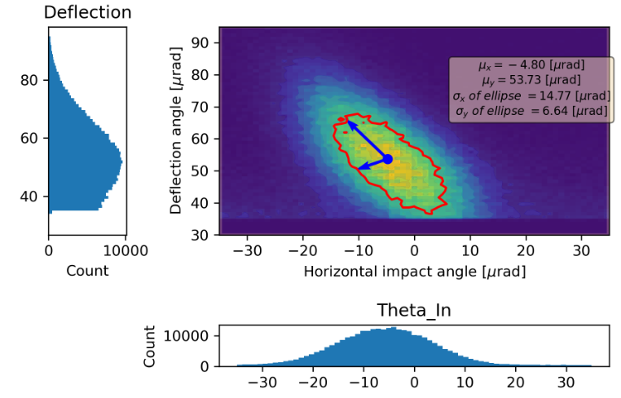
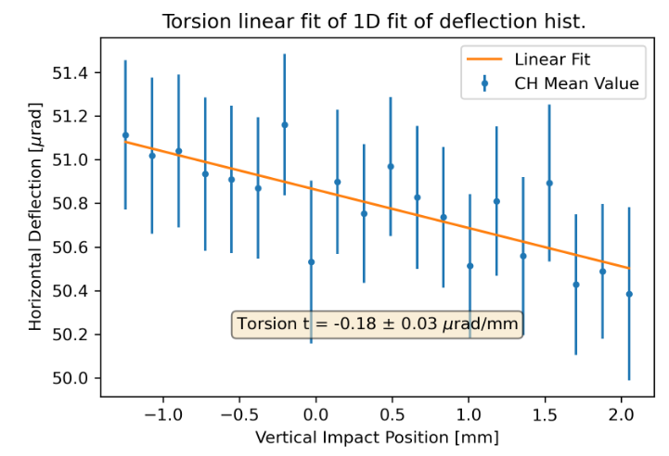
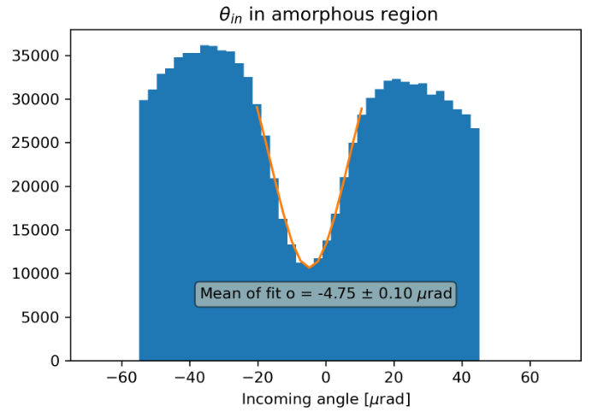
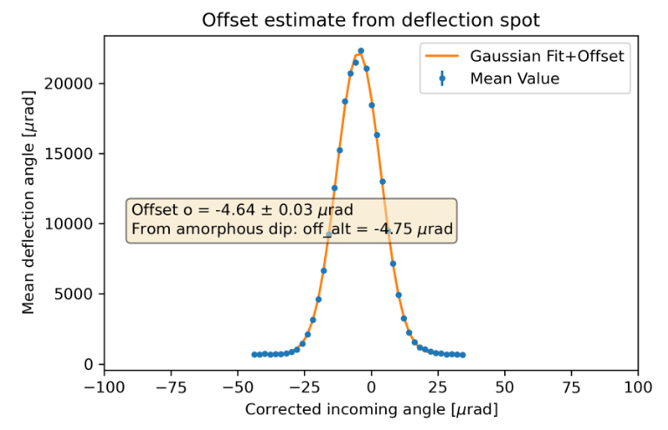
Analysis data flow
Application of geometric cuts for horizontal and vertical distribution of position
Compensation of torsion and incoming angle offset (due to relative alignment of the crystal, goniometer and telescope)

Slide 20
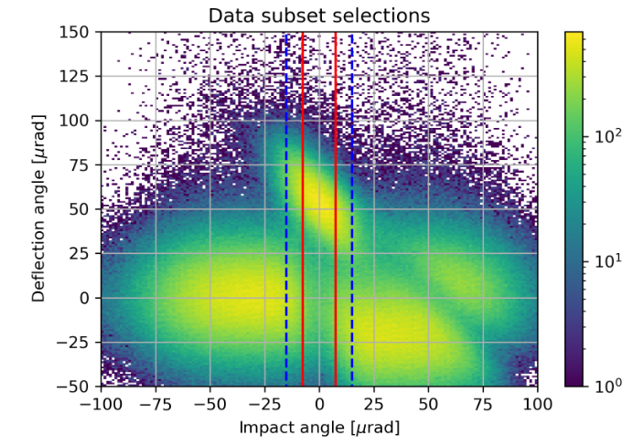
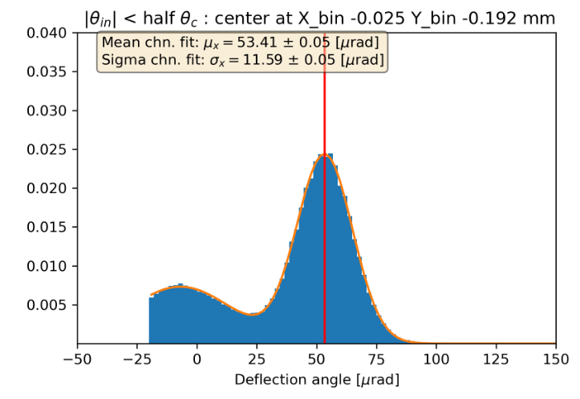
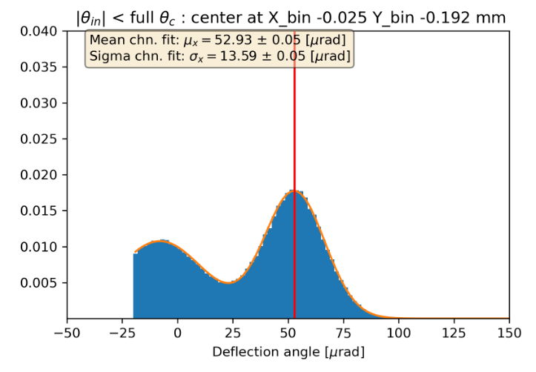
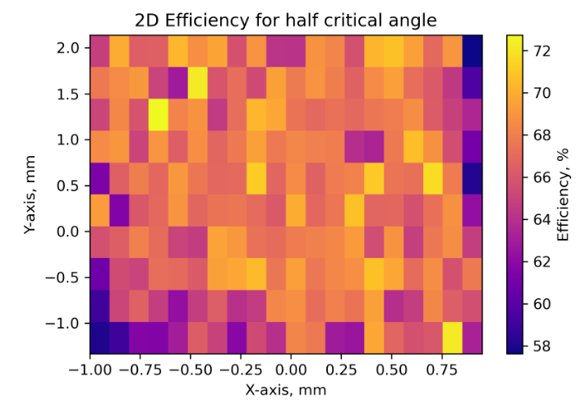
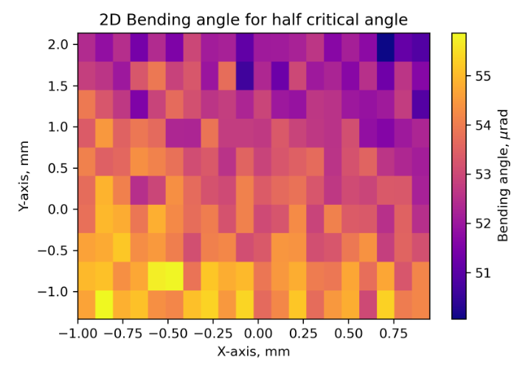
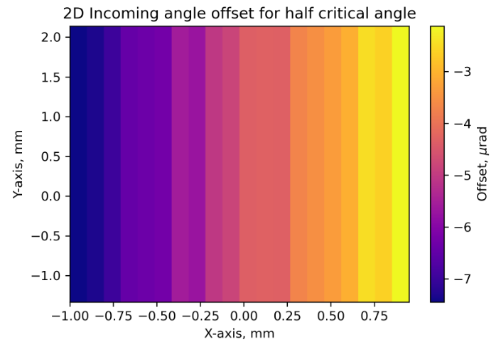
Channeling efficiency analysis (reference crystal)
~66 % at half crit. angle
~53 % at full critical angle
Selection of region of interest and performing fits of channeling spot
2D scan in XY helps to reveal some features of the crystal or measurement details

Slide 21
Performance of crystal assembly LHC#1
Bending (almost) within the specs, very small torsion -> good performance of the bender.
Efficiency smaller than expected (under investigation)

Slide 22
Performance of crystal assembly SPS#2
SPS crystal No. 2, local performance
TH
RB
HCTBMCS001-CR000002
Larger bending angle because of the crystal strip is longer than required specifications
Similar efficiency as LHC crystal (lower than expected)
The bender looks stable after thermal cycle (TH), stability to be verified after re-assembly (RB) procedure

Slide 23
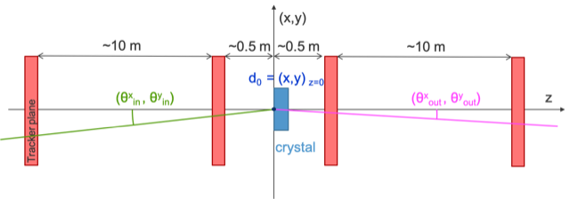
Development of Timepix4 based telescope
Angular precision of the order of few µrad in the incoming arm and outgoing angle (for 400 GeV single positively charged particles)
Acceptance of tracker for crystals with bending angles in the range ~50 µrad up to ~20 mrad
DAQ & FESA SW will be common with other BI applications of Timepix4 (HL-LHC BGI & Timepix4-BLM. )
Project timeline 2024/25
Q1/2 2024
Simulate & optimise telescope design with Allpix Squared (generic pixel detector simulation) + Corryvreckan (reconstruction framework.)
Mechanical design, including thermal simulations.
Milestone #1 = TDR for Timepix4 based telescope + Review expected performance vs. functional specification.
Q3/4 2024
Milestone #2 = Testbeam in H8 EA 138 with basic Timepix3 telescope (short lever arm), with the objective to:
  Develop software for telescope application;
  Gain experience with telescope “workflow”;
  Only basic track resolution & angular resolution.
Q1/2 2025
Timepix4 telescope production & commissioning in the lab.
Q3/4 2025
Milestone #3 = Commissioning & operation in H8 EA 128 of Timepix4 telescope.

Slide 24
Outlook
The first CERN-made crystal assembly prototypes were produced and characterized in the first year of the DECRYCE project.
Gained valuable insights in all the steps of the assembly process, but there are ongoing tasks for the upcoming months to ensure crystals meet operational criteria:
  Refining polishing and dimensions of lateral surfaces
  Addressing miscut polishing
  Investigating the cause of low efficiency
  Enhancing control during the assembly process
  Providing better tooling for measuring/characterizing water/strip/bender/assembly

