Slide 1
ML Techniques in Spill Regulation for Mu2e
Aakaash Narayanan
Slow Extraction Workshop, Wiener Neustadt, Austria
14 February 2024

Slide 2
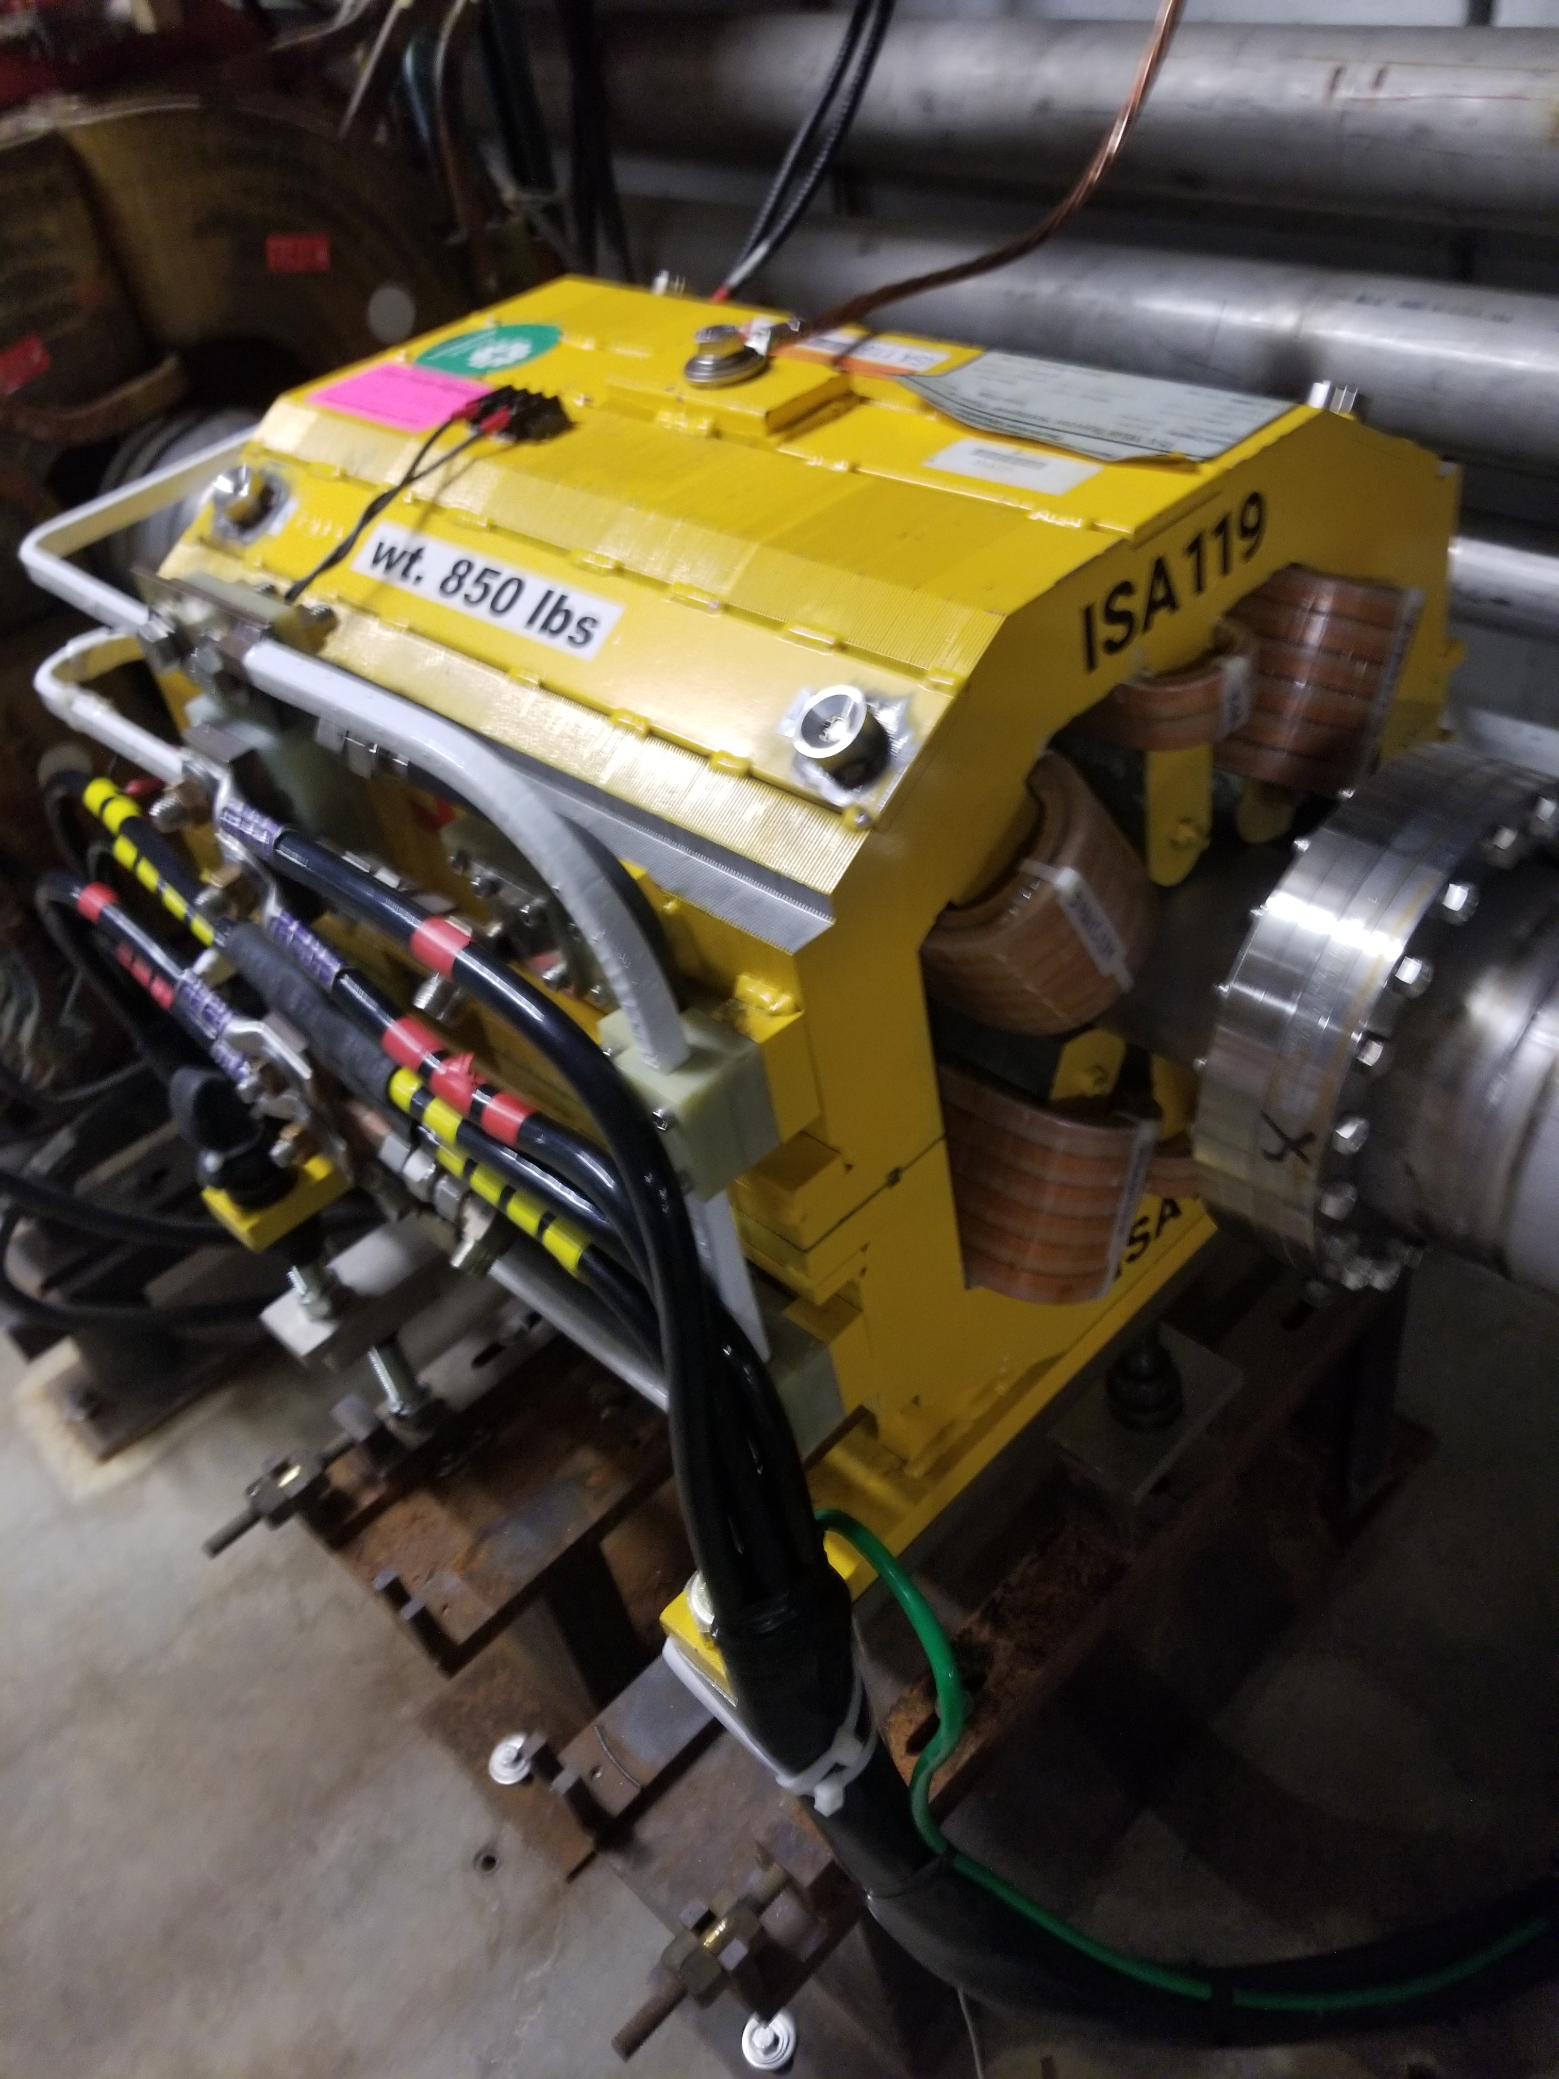
Resonant Extraction for Mu2e
Main types of spill non-uniformities:
Slow variations in the spill rate
Fast random ripples (noise)
Higher order harmonics from power supply
Spill ripples negatively impact the data:
Detector pile-up
Reconstruction inefficiency
Dead time
We need to mitigate:
Slow varying noise that could span across many spill.
Fast variations that could arise within one spill.
Goal:
Spill Duty Factor = $\frac{1}{1+σ^{2}}$ > 0.6
Beam Parameters for Resonant Extraction
Maximum Intensity in DR | < 1 X 10¹² | protons
Revolution time in DR | 1.694 | $μ$s
Orbit length of DR | 505.294 | m
Horizontal tune in DR | 9.650 to 9.666
Protons per extracted pulse | < 4 X 10⁷ | protons
Spill Duty Factor | >60%
Single spill duration | 43 | ms
Beam Power | 8 | kW
Extraction scheme is to excite 3rd integer resonance using fixed strength harmonic sextupoles and move the beam tune closer to 29/3 using dedicated fast tune-ramping quadrupoles.

Slide 3
Spill Regulation System
SPILL REGULATION SYSTEM
Slow Regulation
Fast Regulation
Harmonic Content Tracker
The slow regulation controller will be tracking the slow changes in the spill profile producing corrections to the tune quadrupole current ramp to achieve the uniform spill rate.
The fast regulation system would be supplemented on top of the slow regulation in order to correct for instantaneous ripples in the spill intensity.
The SRS would also be dealing with the n*60 Hz harmonic noise content arising from the power supplies. The controller will determine the harmonic content of the ripple and apply feedforward corrections.
The SRS would also be dealing with the n*60 Hz harmonic noise content arising from the power supplies. The controller will determine the harmonic content of the ripple and apply feedforward corrections.

Slide 4
Spill Regulation System
SPILL REGULATION SYSTEM
Slow Regulation
Fast Regulation
Harmonic Content Tracker
The slow regulation controller will be tracking the slow changes in the spill profile producing corrections to the tune quadrupole current ramp to achieve the uniform spill rate.
The fast regulation system would be supplemented on top of the slow regulation in order to correct for instantaneous ripples in the spill intensity.
The SRS would also be dealing with the n*60 Hz harmonic noise content arising from the power supplies. The controller will determine the harmonic content of the ripple and apply feedforward corrections.
The SRS would also be dealing with the n*60 Hz harmonic noise content arising from the power supplies. The controller will determine the harmonic content of the ripple and apply feedforward corrections.

Slide 5
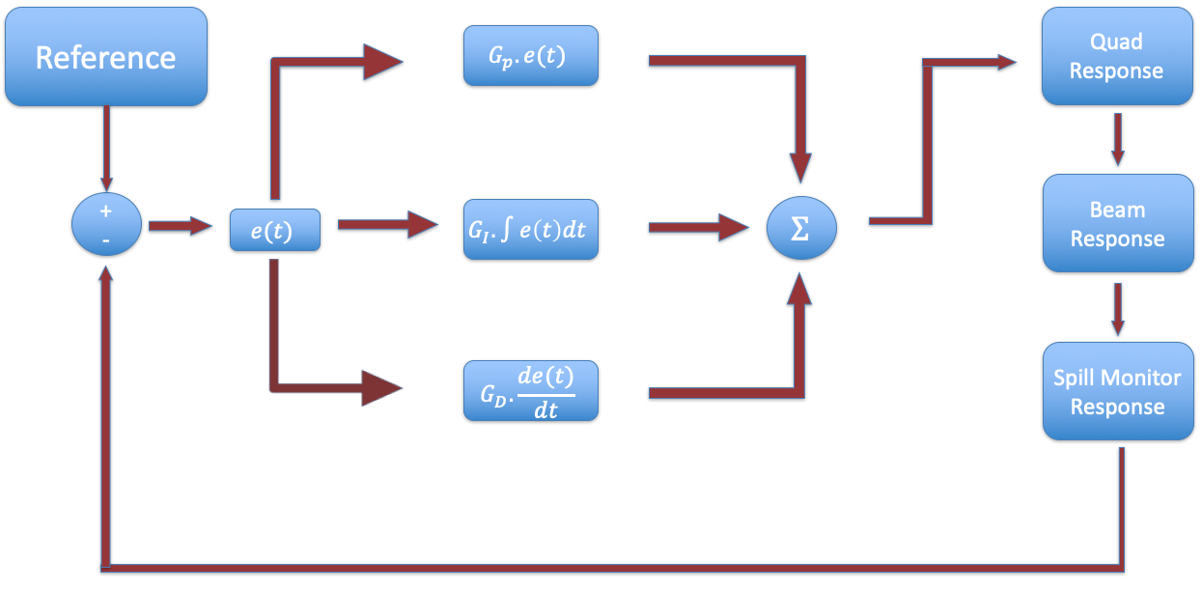
Fast Regulation Loop
The fast regulation loop deals with instantaneous noises that affect the spill quality within one spill.
The instantaneous fluctuations within one spill due to random noises can be large. In the SRS, this is handled by the fast PID loop controller.
We assume here that this noise (ripples) have a random nature or otherwise are a semi-random component of regular harmonic noise that the harmonic controller is not able to suppress.
$$u\left(t\right)=G_{P}e\left(t\right)+G_{I}\int_{0}^{t}{e\left(τ\right)dτ}+G_{D}\left(\frac{de\left(t\right)}{dt}\right)$$
The correction signal to counter the noise will superimpose on top of the ideal tune ramp provided by the slow regulation.
The three main parameters to control the spill quality in the fast regulation loop are the three gain values of the PID controller: ${(G}_{P}, G_{I}, G_{D})$

Slide 6
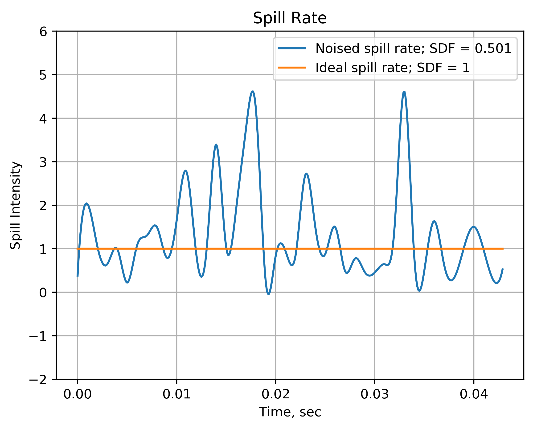
Using Machine Learning
We explore using machine learning (ML) algorithms to tune the PID gain values to achieve an improved spill quality.
The spill quality is quantified by ‘Spill Duty Factor’ (SDF), defined by:
$$SDF= \frac{1}{1+σ_{ \left\{ext. rate\right\}}^{2}}$$
where $σ_{ \left\{ext. rate\right\}}^{2}$ is the variance in the extraction rate computed for one full spill, assuming the average intensity is normalized to 1.
We use a simplified semi-analytical model to simulate the dynamics of resonant extraction in order to generate training data for the machine learning algorithm.

Slide 7
Physics Simulator Model
1
2
3
NOISE GENERATION
PID RESPONSE
MACHINE LATENCY
4
TRANSIT DELAY
7
6
5
SPILL MONITOR
BEAM EXTRACTION
CORRECTED QUADRUPOLE CURRENT
Notes:
E.g., Like RFKO, latency in longitudinal dynamics, etc.,

Slide 8
Physics Simulator Blocks
1
NOISE GENERATION
2
PID RESPONSE
The noise for one full spill is generated in terms of extraction rate. We assume a log-normal distribution for the noise spectrum.
Since the source of noise could emanate from any of the elements in the ring, the noise is pre-generated before the spill and is added directly as fluctuations in the spill.
Ideal spill is normalized to an expectation value of 1.
With the full extraction rate known, the PID calculates the error at every time step and computes the control signal.
At every time step, the difference between the ideal spill and the actual spill is computed, and the PID calculates the control signal to be given to counter the noise in the spill rate.

Slide 9
Physics Simulator Blocks
FIELD SHIELDING EFFECT (LATENCY)
4
TRANSIT DELAY
3
Once the particle is unstable, it does not get immediately extracted once it gets unstable. It takes some finite amount of turns to get to the septum location.
Transit time studies were done to determine the number of turns particles take to get extracted. This delay is modelled into the physics simulator.
The SS beam pipe would screen high frequency components of the quadrupole $\vec{B}$ field.
The PID response in the simulator is thus passed through a low-pass filter to simulate the steel beam pipe screening any magnetic field variations greater than 1 kHz.

Slide 10
Physics Simulator Blocks
5
CORRECTED QUADRUPOLE CURRENT
6
BEAM EXTRACTION
7
SPILL MONITOR
According to our analytical model, the ideal tune current ramp is taken to be a logarithmic function in time. The delayed and low-pass filtered PID response is superimposed with the idealized logarithmic quadrupole current curve.
With the corrected quad current ramp, the total extracted beam intensity is computed for the full spill duration. This would be the fast regulated spill.
The spill monitor block computes the spill rate for one full spill at a time step of 10 kHz (which is the total gain bandwidth of the SRS). We assume the spill monitor to be fast enough to not affect the loop.

Slide 11
PID Tuning Scheme Using ML Simulator
The ML simulator uses the physics simulator iteratively to compute loss functions and optimize the gain values.
EVERY FULL SPILL…
In the very first iteration, the neural network assigns random gain values and calls the physics simulator. The physics simulator then outputs the PID loop regulated spill rate, from which the spill duty factor is calculated.
PHYSICS SIMULATOR
ML
MODEL
Once the SDF is calculated, a loss function $l$ is defined to train the ML model:
$$l={\left(1−SDF\right)}^{2}$$
The machine learning tool used in the optimization of the PID gains is PyTorch (version 1.8.1).

Slide 12
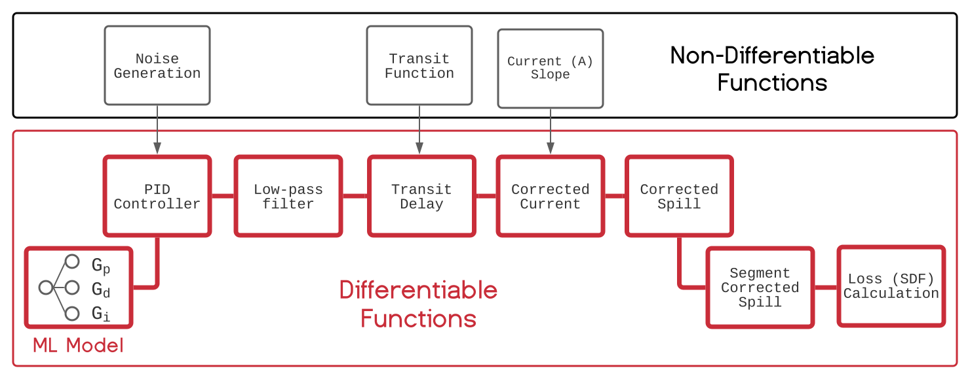
Differentiable Machine Learning Simulator
$$l={\left(1−SDF\right)}^{2}$$
The loss value, along with the previous three gain values, are fed into the neural network.
The neural network then calculates the gradient of the loss function with respect to the PID gain $($i.e.,$δl/δG)$ and backpropogates to update the weights in the direction of minimization of the loss function, outputting new gain values.
Backpropagation is done through with Adaptive Momentum (Adam) optimizer:
Figure: A. Narayanan, M. Thieme, et. al, “Optimizing Mu2e Spill Regulation Algorithms”, IPAC 2021
$$g_{t}=∇_{θ} J\left(θ\right)$$
$$m_{t}=β_{1}m_{t−1}+\left(1−β_{1}\right)g_{t}$$
$$v_{t}=β_{2}v_{t−1}+\left(1−β_{2}\right)g_{t}^{2}$$
where:
$θ$ denotes the network parameters, i.e., weights and biases of the network,
$∇_{θ}$ denotes gradient w.r.t the network parameters, $J(θ)$ is the loss function,
$ε,$ $β_{1},β_{2}$ are constants
$α$ is the learning rate
$$θ_{t+1}=θ_{t}−\frac{α}{\sqrt{\hat{v}}+ε} {\hat{m}}_{t}$$
$${\hat{m}}_{t}=\frac{m_{t}}{1−β_{1}}$$
$$\hat{v}=\frac{v_{t}}{1−β_{2}}$$

Slide 13
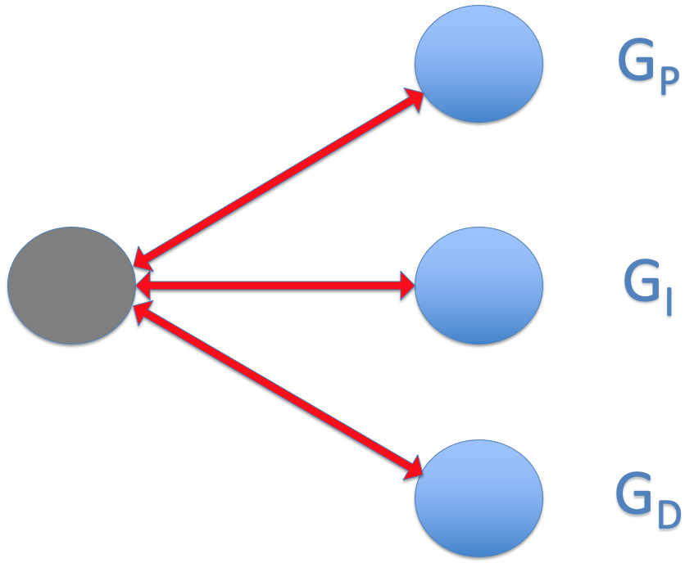
Backpropagation Scheme
With the updated gain values, the physics simulator is run again for a full spill, but this time with a completely new random noise profile.
After the 2nd full spill, the SDF and the loss function are again computed and fed into the neural network to compute the loss gradients.
The neural network again updates the weights and gives a new set of ${(G}_{P},G_{I},G_{D})$, and the physics simulator is called again.
This is done iteratively until the loss function becomes minimal (i.e., the PID loop’s performance becomes maximal).
We refer to this approach as a Hybrid ML Simulator because only those functions which must be differentiable (i.e., $(δl/δG)$ computable) are made so. This allows functions such as noise generation and tune ramps to be pre-computed and excluded from the more computationally expensive gradient calculation and backpropagation steps.
Notes:
In the end, state that the gains are determined and next is to..

Slide 14
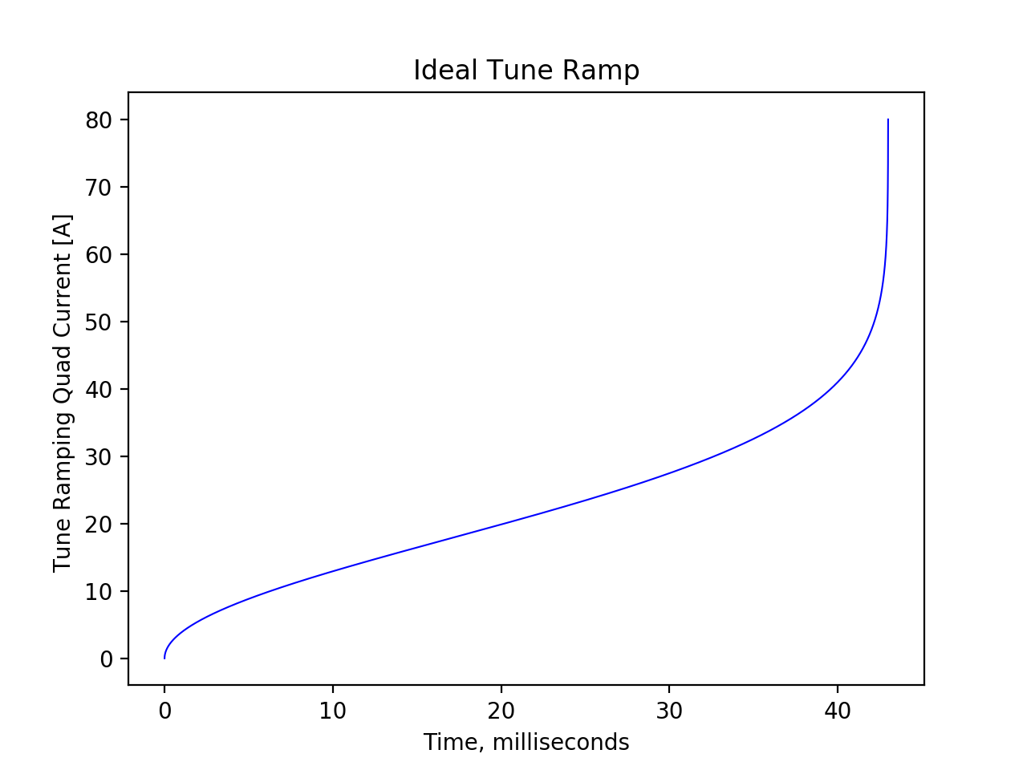
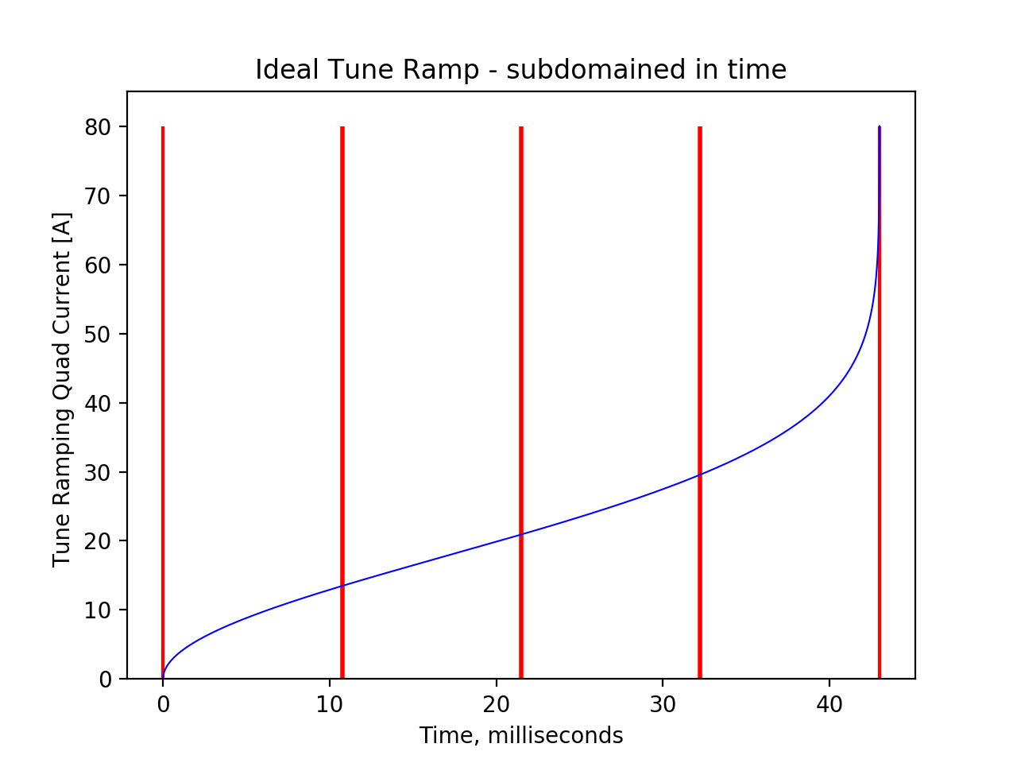
Differentiable Simulator - Results
The sensitivity of control varies across the spill duration.
To characterize this sensitivity, our system divides the full spill into subdomains.
The ML simulator optimizes $\left(G_{P},G_{I},G_{D}\right)$ within each of the subdomain with every spill.
Notes:
Lot of text… cut down. Maybe shorten the bullets.

Slide 15
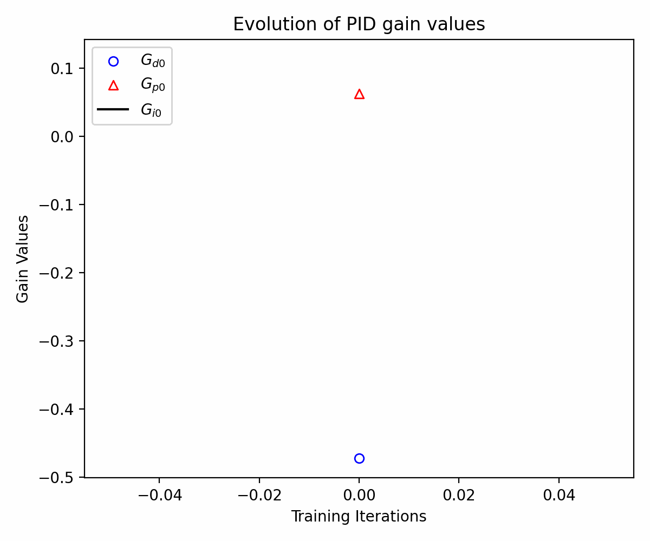
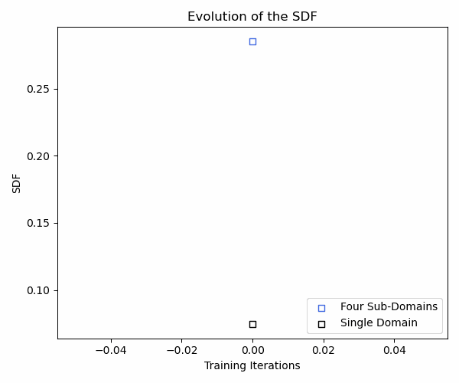
ML Optimization at work…
A. Narayanan, M. Thieme, et. al, “Optimizing Mu2e Spill Regulation Algorithms”, IPAC 2021

Slide 16
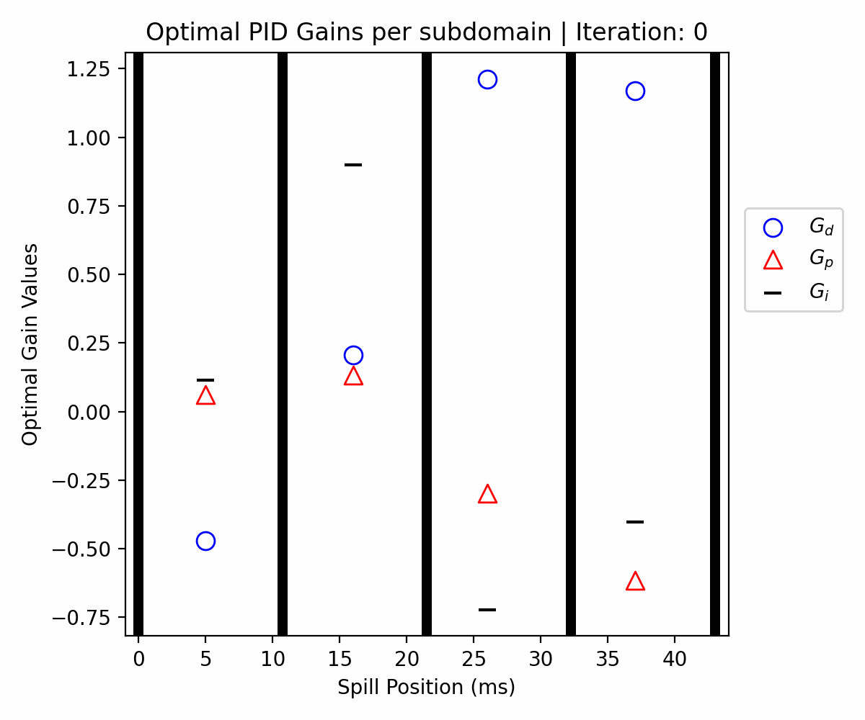
PID Gain Evolution
A. Narayanan, M. Thieme, et. al, “Optimizing Mu2e Spill Regulation Algorithms”, IPAC 2021

Slide 17
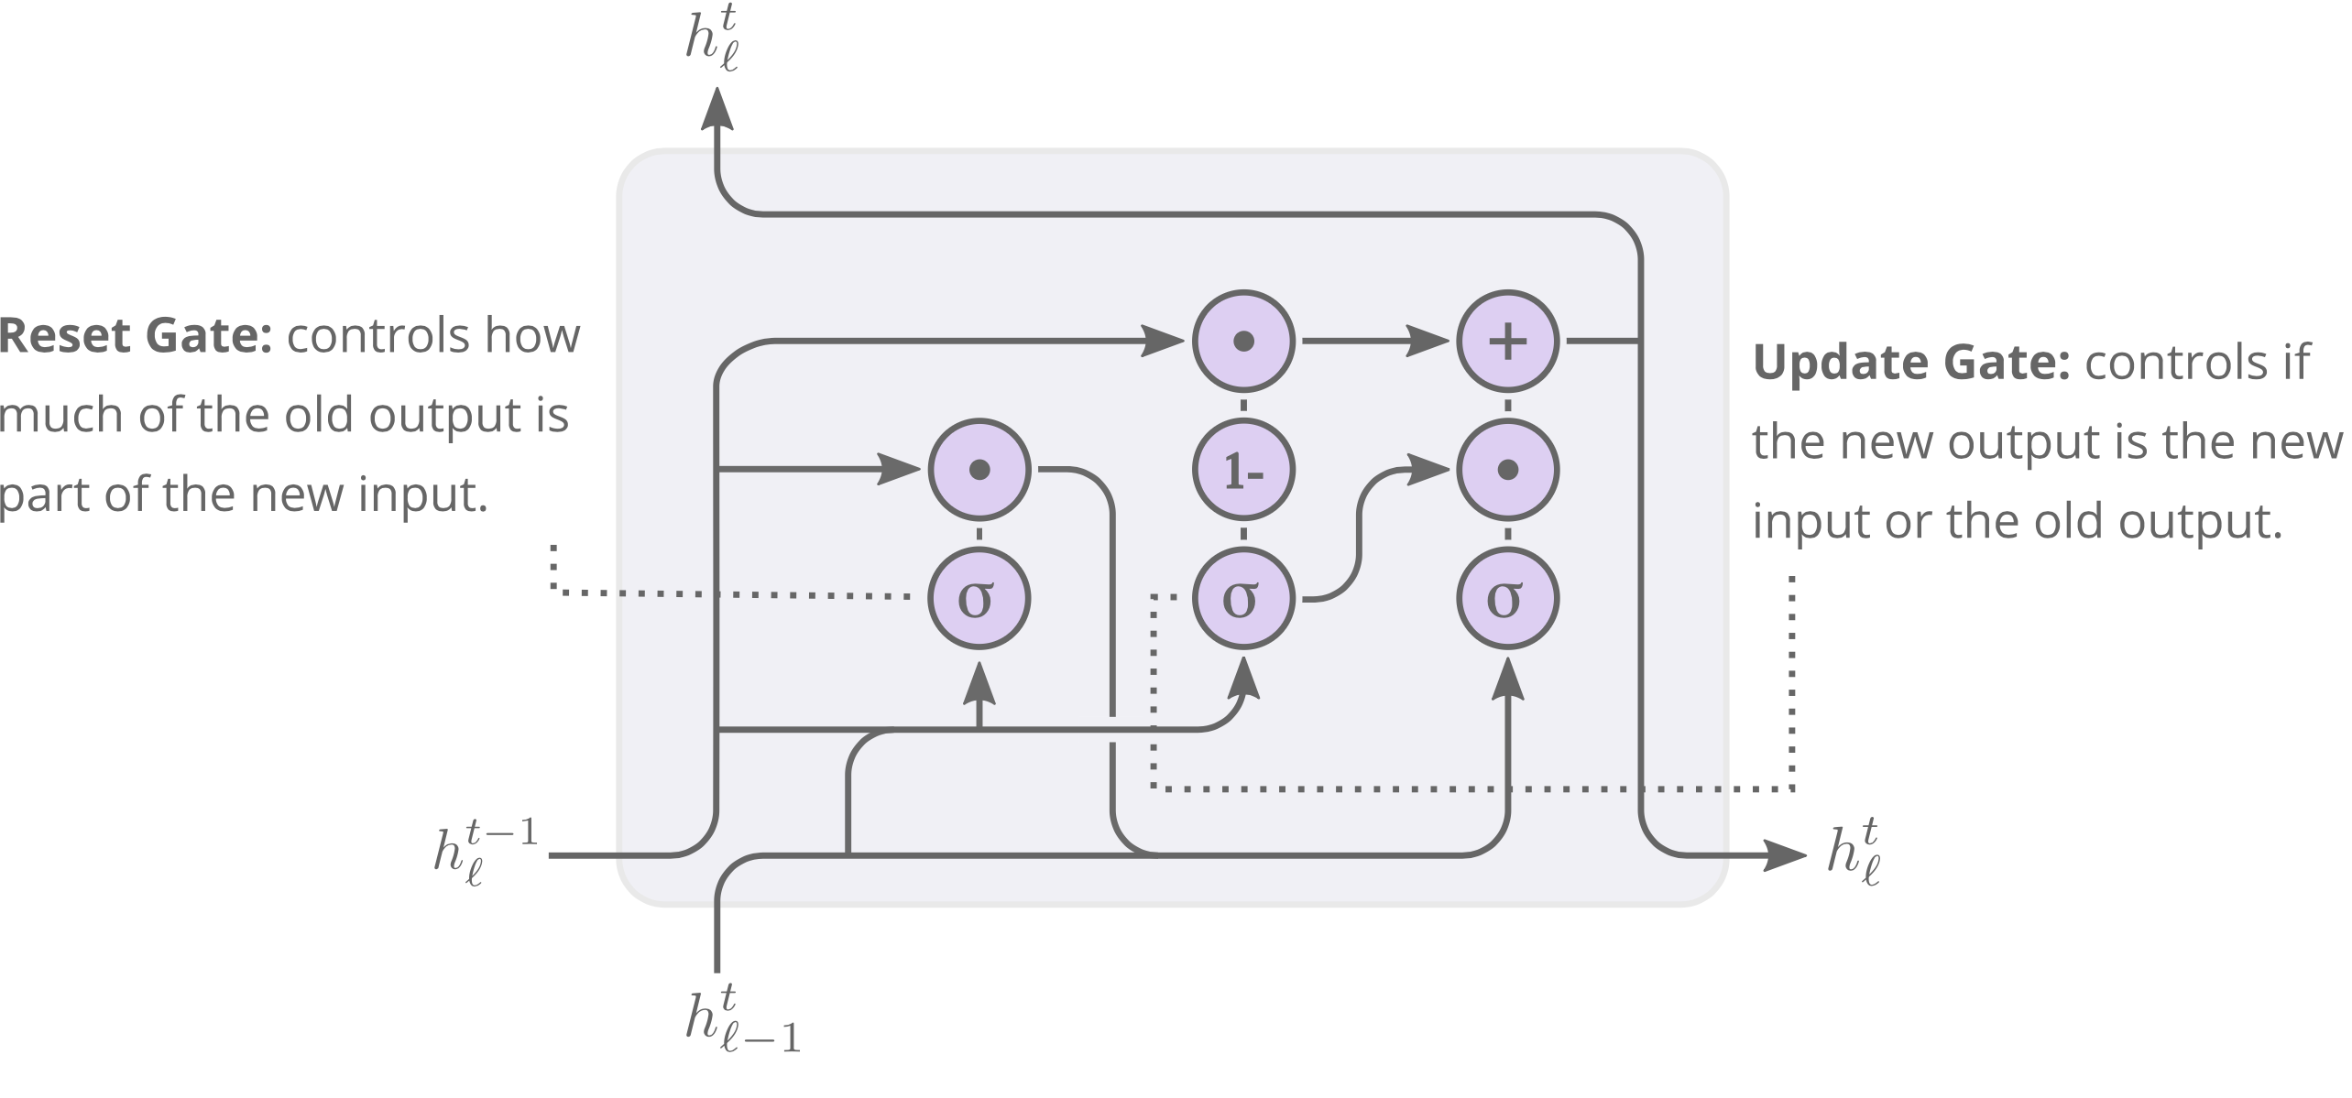
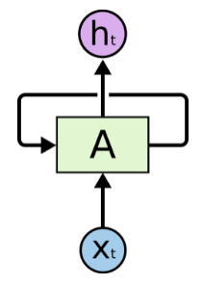
Spill Regulation ML Model
We next explore the possibility of a Machine Learning agent entirely replacing the PID controller, instead of simply tuning the gains of the PID controller.
Since the spill is temporally sensitive, a Recurrent Neural Network was chosen to train the model to emulate the PID controller.
RNNs typically suffer from ‘short-term’ memory (the ‘vanishing gradient problem’).
To over come that, LSTM and GRU are a type of neural network that have ‘internal loops’ that enables connecting temporally sensitive past information to perform present tasks.
Image source: https://colah.github.io/posts/2015-08-Understanding-LSTMs/

Slide 18
GRU ML Model Replacing PID
Time window size = $t_{w}$
$$t_{n}=t_{n+1}$$
$t_{w}$ no. of spill data before $t_{n}$
S$t_{n}$= [s_{tn-tw}, s_{tn-tw+1}, …, s_{tn}]
Spill data of $t_{w}$ previous time steps
Spill data for $t_{n+1}$
S$t_{n}$
I(t_{n})
PHYSICS SIMULATOR
I
Quad current
GRU Neural Net
with 2 hidden layers
ML agent
$t_{w}$ no. of spill data before $t_{n+1}$
S$t_{n+1}$ = [s_{tn-tw+1}, s_{tn-tw+2}, …, s_{tn+1}]

Slide 19
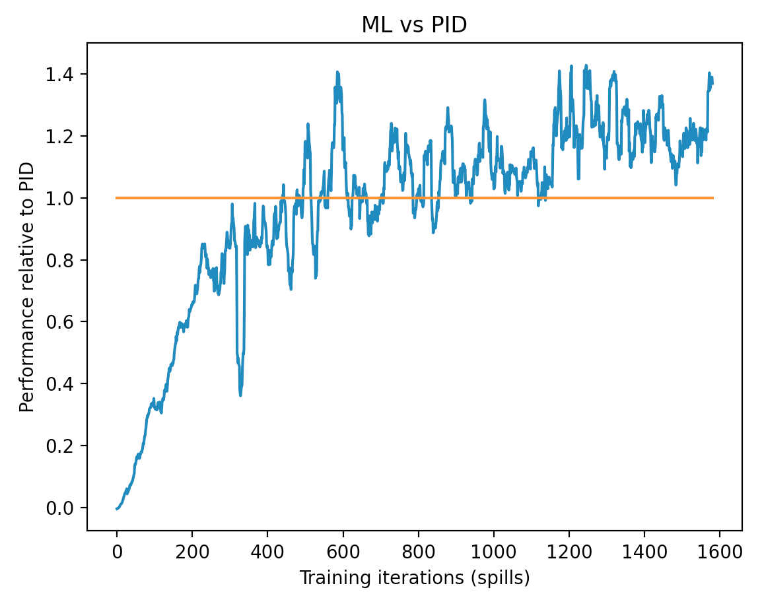
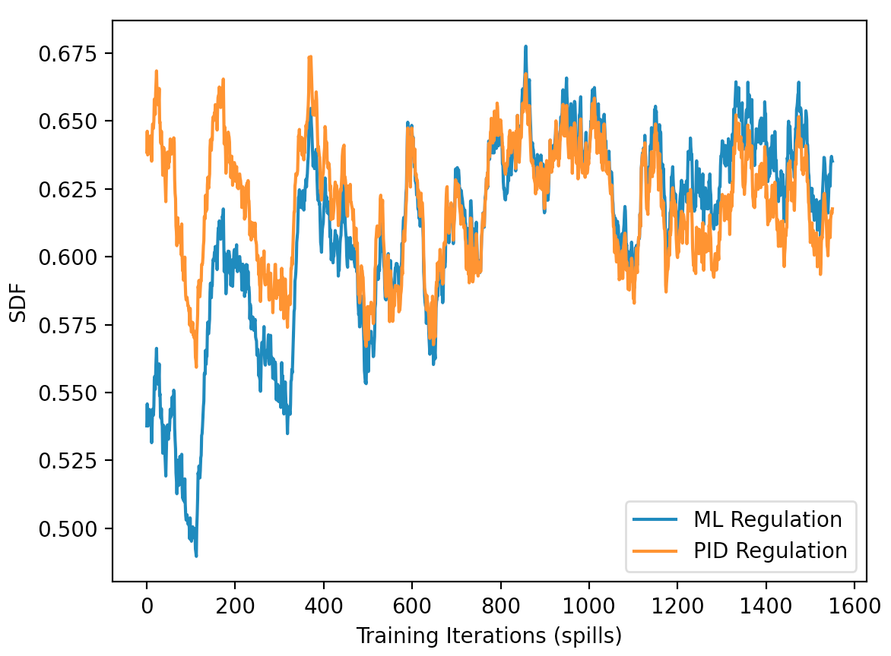
GRU Model Matching PID Performance
Raw SDF
Relative performance to PID
SDF = $\frac{1}{1+σ_{ \left\{ext. rate\right\}}^{2}}$
$$\frac{ML_{SDF}−Noise_{SDF}}{PID_{SDF}−Noise_{SDF}}$$
Blue line =
A. Narayanan, J. Jang, M. Thieme, et al., “ML Techniques in Slow Spill Regulation System for Mu2e”, NAPAC 2022.

Slide 20
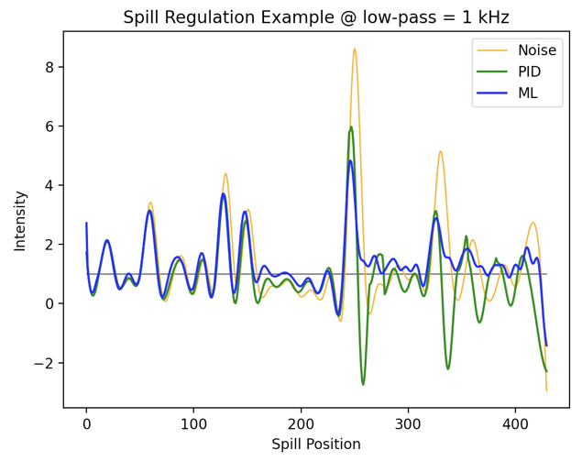
GRU Model Performance
A. Narayanan, J. Jang, M. Thieme, et al., “ML Techniques in Slow Spill Regulation System for Mu2e”, NAPAC 2022.

Slide 21
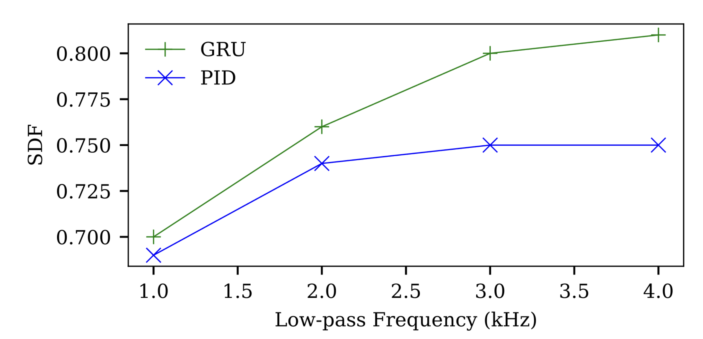
Performance vs Bandwidth
Notes:
We developed a tool and using that we can see how BW is important.

Slide 22
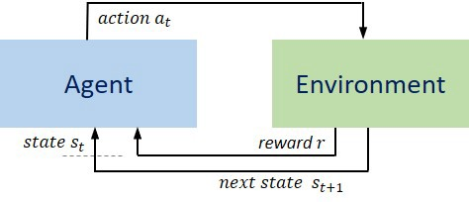
Reinforcement Learning
Reinforcement Learning (RL) is a type of ML technique that enables an agent to interact with the environment by trial and error using feedback from its own actions and experiences.
The action function $a$ is defined as the set of actions taken by our agent in its environment.
The state function $s$ is defined as the set of environment parameters that affect the course of our agent.
The reward function $r$ is defined as a value we assign to a specific action $a$ taken in a specific state $s.$
As the agent progresses in time, we accumulate a set of ($a,s,r):$
$$\left(s_{0},a_{0},r_{1}\right), \left(s_{1},a_{1},r_{2}\right), …, \left(s_{i},a_{i}, r_{i+1}\right), …, \left(s_{T},a_{T}, r_{T+1}\right)$$

Slide 23
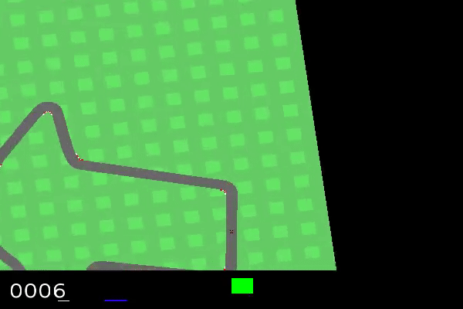
Reinforcement Learning – fun example
Action space:
Accelerate at constant rate
Decelerate at constant rate
Turn right at fixed angle
Turn left at fixed angle
State space:
The raw 96x96 pixels of every frame
Rewards:
-0.1 for every passing frame
1000/N_{tiles} for every track tile visited
Episode finished when all tiles are visited

Slide 24
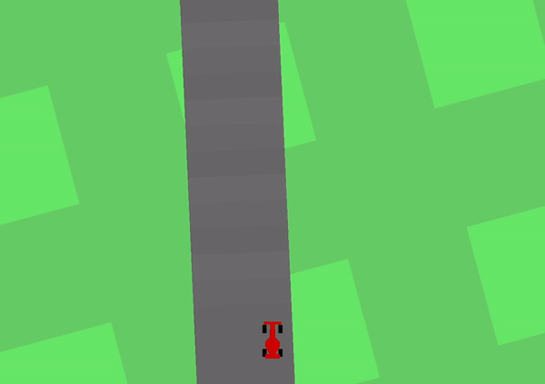
Reinforcement Learning – fun example

Slide 25
Reinforcement Learning in Resonant Extraction
The action variable $a$ is defined as the set of actions taken by our agent in its environment.
The state variable $s$ is defined as the set of environment parameters that affect the course of our agent.
RESONANT
EXTRACTION
The reward value $r$ is defined as a value we assign to a specific action $a$ taken in a specific state $s.$
In the case of slow spill, the action space is continuous as the control signal’s magnitude could be any real number. To deal with continuous action space, we use policy-based actor-critic methods whereby two neural networks are trained.

Slide 26
Reinforcement Learning in Resonant Extraction
Quadrupole current
The action variable $a$ is defined as the set of actions taken by our agent in its environment.
The state variable $s$ is defined as the set of environment parameters that affect the course of our agent.
RESONANT
EXTRACTION
The reward value $r$ is defined as a value we assign to a specific action $a$ taken in a specific state $s.$
In the case of slow spill, the action space is continuous as the control signal’s magnitude could be any real number. To deal with continuous action space, we use policy-based actor-critic methods whereby two neural networks are trained.

Slide 27
Reinforcement Learning in Resonant Extraction
Quadrupole current
The action variable $a$ is defined as the set of actions taken by our agent in its environment.
$e\left(t\right), e^{′}\left(t\right), ∫e\left(t\right)dt, t,$etc.,
The state variable $s$ is defined as the set of environment parameters that affect the course of our agent.
RESONANT
EXTRACTION
The reward value $r$ is defined as a value we assign to a specific action $a$ taken in a specific state $s.$
In the case of slow spill, the action space is continuous as the control signal’s magnitude could be any real number. To deal with continuous action space, we use policy-based actor-critic methods whereby two neural networks are trained.

Slide 28
Reinforcement Learning in Resonant Extraction
Quadrupole current
The action variable $a$ is defined as the set of actions taken by our agent in its environment.
$e\left(t\right), e^{′}\left(t\right), ∫e\left(t\right)dt, t,$etc.,
The state variable $s$ is defined as the set of environment parameters that affect the course of our agent.
RESONANT
EXTRACTION
Scaled with regulation
performance
The reward value $r$ is defined as a value we assign to a specific action $a$ taken in a specific state $s.$
In the case of slow spill, the action space is continuous as the control signal’s magnitude could be any real number. To deal with continuous action space, we use policy-based actor-critic methods whereby two neural networks are trained.

Slide 29
Reinforcement Learning - Actor Critic
ACTOR NETWORK
STATES
RESONANT
EXTRACTION
Actor value :
a real number
[ 21.345]
The actor network takes in the state space variables as the input and outputs the action (i.e., the control signal) to be superimposed to the tune ramp quad current.
This action is played for the next time step and the new spill rate is obtained.

Slide 30
Reinforcement Learning - Actor Critic
CRITIC NETWORK
REWARDS
RESONANT
EXTRACTION
Critic value :
a real number
[ 0.5638]
The critic network takes in the reward values for the episode and gives out a value ‘criticizing’ the how good the action taken was.
This is fed back into the actor network so it takes a better action the next time.
This way, the both the networks together directly learns the policy.

Slide 31
Reinforcement Learning - Actor Critic
TAKE ACTION
RESONANT
EXTRACTION
ACTOR MODEL
LOSS
CRITIC
MODEL
OBTAIN REWARD
RL AGENT
OBSERVE STATE
Actor learns to act better.
Critic learns to criticize better.

Slide 32
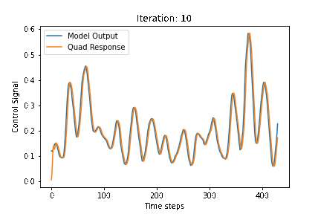
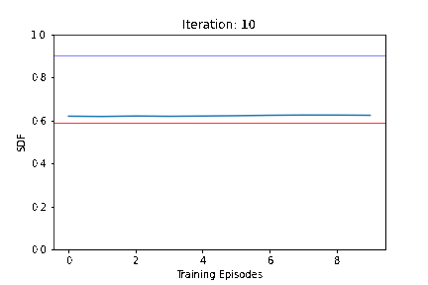
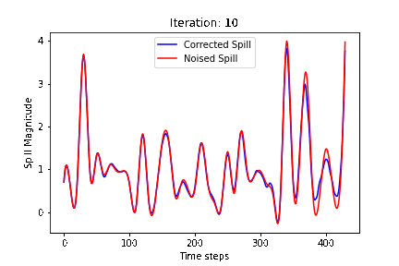
Reinforcement Learning - Initial Results

Slide 33
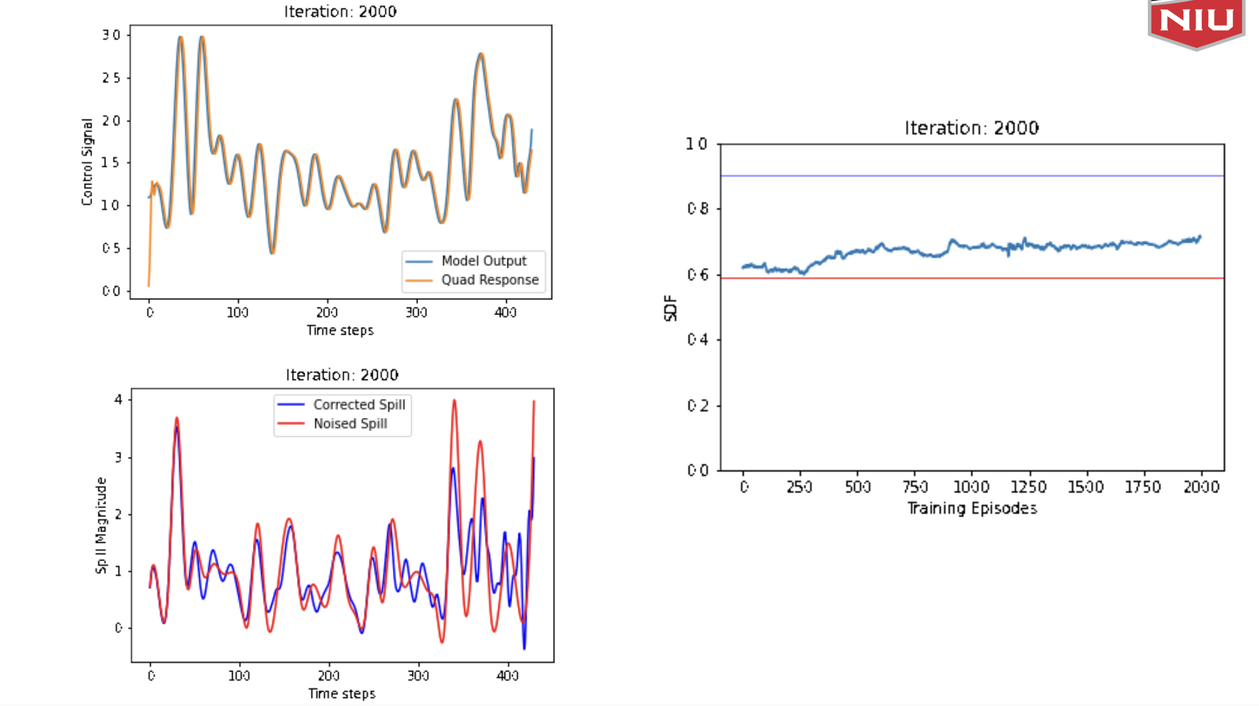
Reinforcement Learning - Initial Results

Slide 34
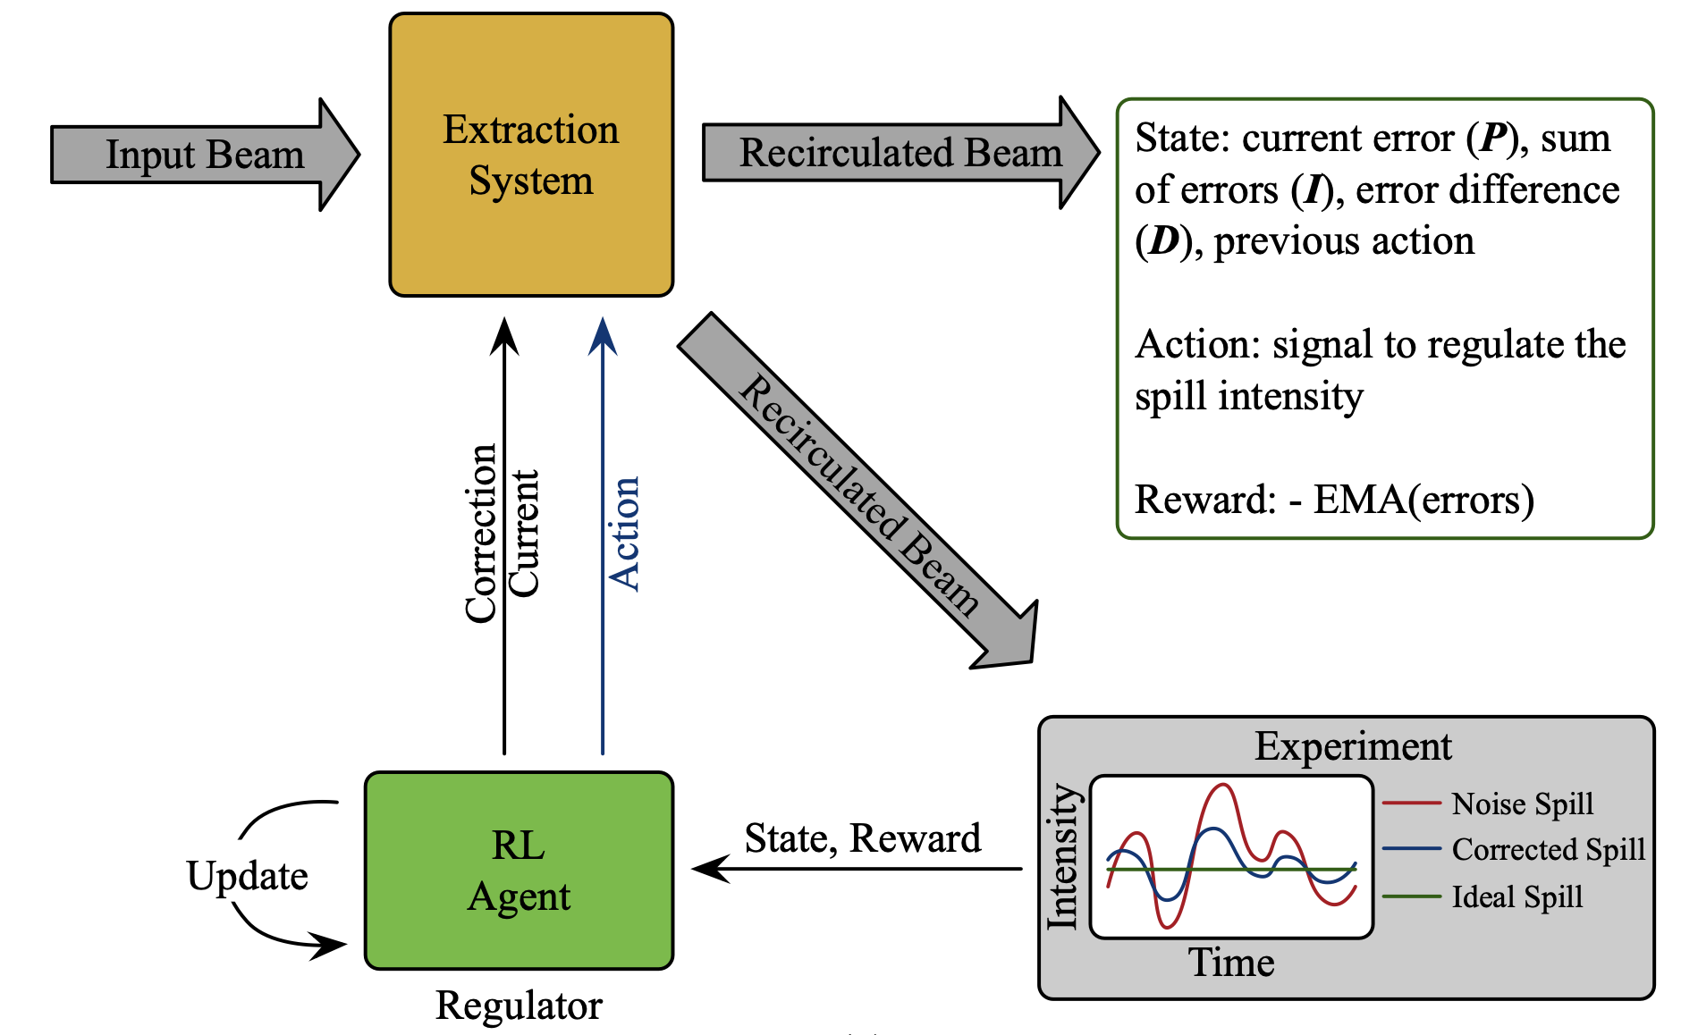
Reinforcement Learning - Neuralized PID Approach
A neutralized PID policy function to optimize the SDF of the spill.
Uses the same physics simulator but with an inductive bias of PID based policy to formulate the state vector.
The PPO algorithm, an RL technique plays a central role in optimizing policy functions to enhance decision-making in sequential tasks and we specifically chose PPO to refine our reward function.
Reward function:
$$r_{t}=−EMA\left(t,α\right)∈\left[0,1\right]$$
where $EMA\left(t,α\right)=α\left| x_{t}−σ\right|+\left(1+α\right)EMA\left(t−1,α\right)$

Slide 35
Reinforcement Learning - Neuralized PID Approach

Slide 36
Reinforcement Learning - Neuralized PID Approach

Slide 37
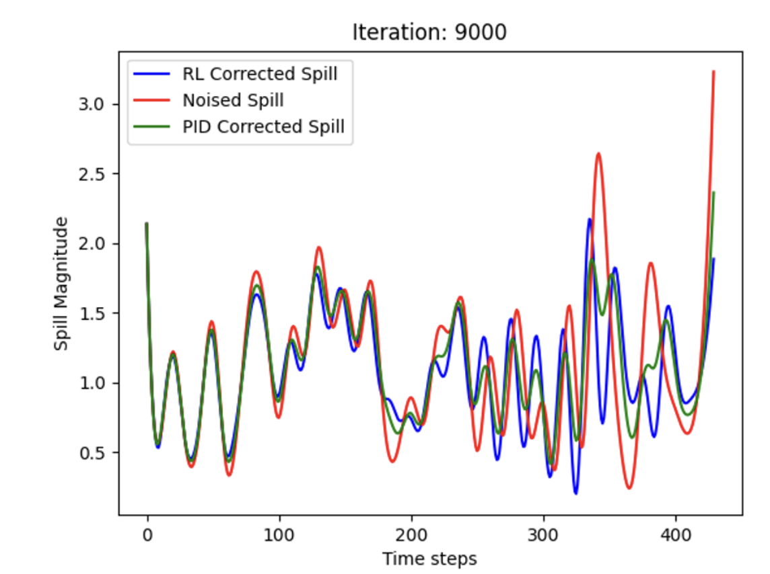
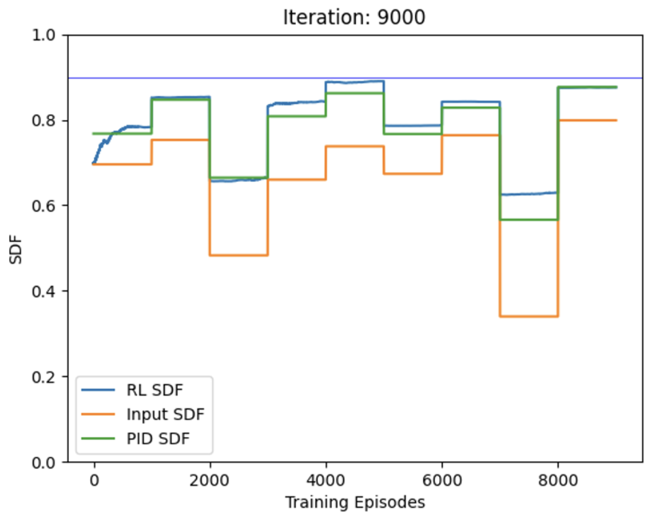
Reinforcement Learning - Neuralized PID Approach

Slide 38
THANK YOU

Slide 39
GRU ML Model Replacing PID
Time window size = $t_{w}$
$$t_{n}=t_{n+1}$$
$t_{w}$ no. of spill data before $t_{n}$
S$t_{n}$= [s_{tn-tw}, s_{tn-tw+1}, …, s_{tn}]
Spill data of $t_{w}$ previous time steps
Spill data for $t_{n+1}$
I(t_{n})
Quad current
PHYSICS SIMULATOR
S$t_{n}$
I
ML agent
GRU Neural Net
with 2 hidden layers
$t_{w}$ no. of spill data before $t_{n+1}$
S_{tn+1} = [s_{tn-tw+1}, s_{tn-tw+2}, …, s_{tn+1}]

Slide 40
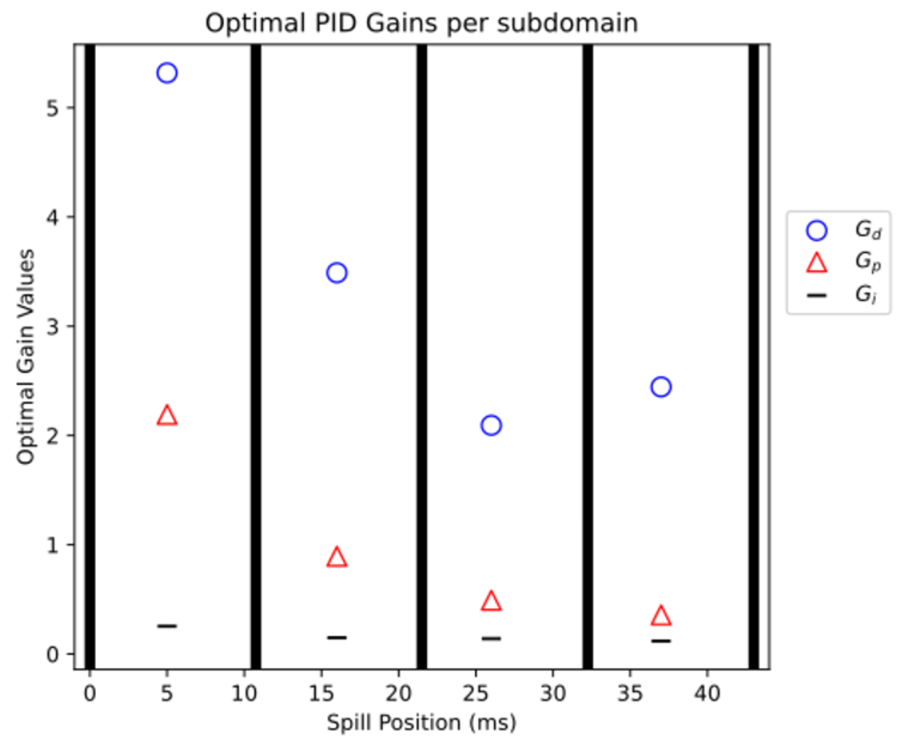

Slide 41
