Slide 1

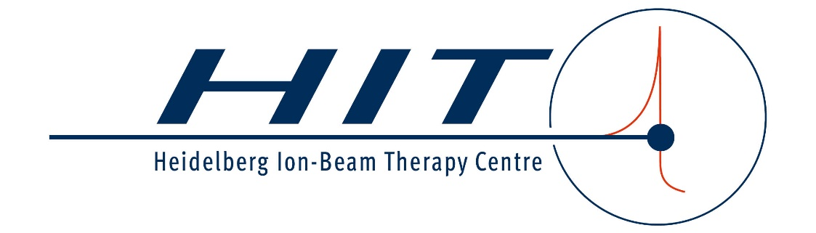
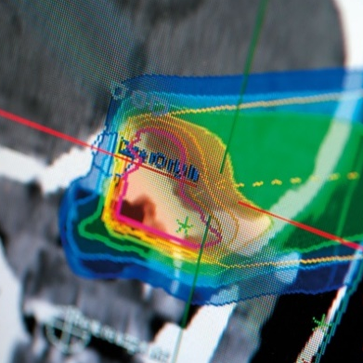
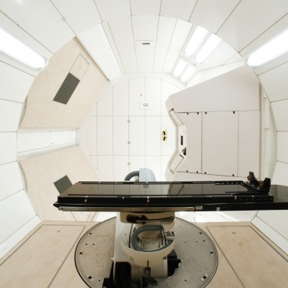
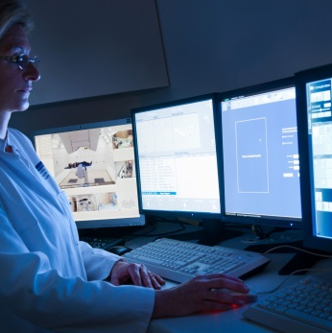

Slow extraction serving
raster scanning at
medical facilities
SX-Workshop 02/2024

Slide 2
Outline
What are the current demands medical facilities make on slow extraction?
What are the future topics much discussed in particle therapy and what do they impose on slow extraction?

Slide 3
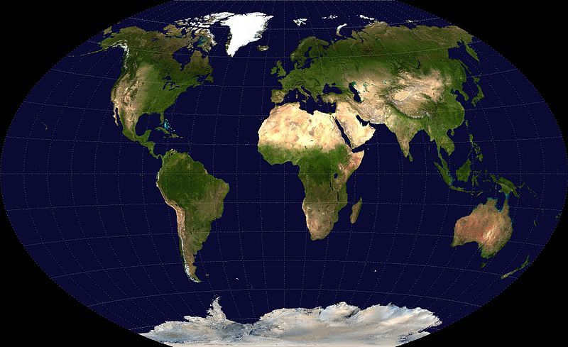
What are medical facilities?
In the accelerator context
Particle Therapy Centers
doing patient treatment
with protons or heavier ions
105 Protons
14 Carbon (+ p)
ptcog.ch/
(Jan. 2024)
Facilities in
operation only.
18
31
46
2
2
3

Slide 4
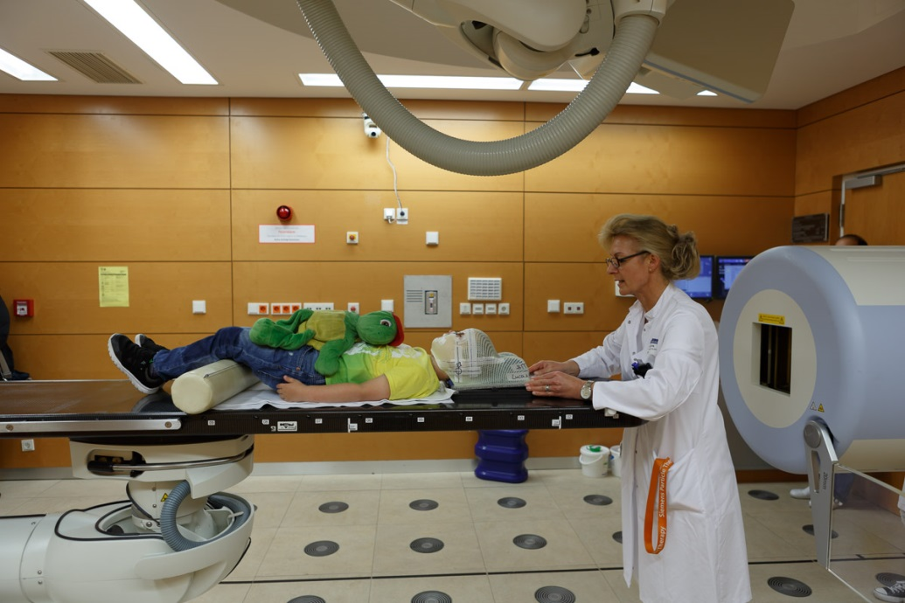
What makes a medical facility special?
“Beam target” is a patient!
Mission: provide particle beams in therapy
quality 335 days / year
Avoid any interruptions to guarantee
therapy success
The dose delivery must be safe and precise
Fast: reduction of irradiation time only
without affecting safety and precision
Large variety of beam parameters (ion types,
energy steps, spot sizes, intensity range, gantry angles)

Slide 5
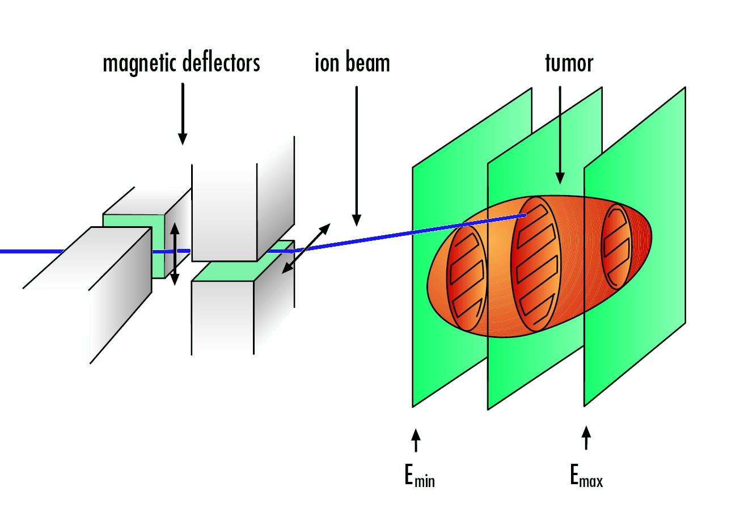
Raster-scanning dose delivery
Tumor is irradiated slice-by-slice and spot-by-spot
Accelerator delivers pencil beams of different ion energies (penetration depth)
Guided by scanning magnets
Monitored in position, width and intensity
Scanning process needs milliseconds per spot
Beam spill of several seconds is needed
Position and intensity is measured, the scanning velocity is adapted
Dose-delivery system
5

Slide 6
Intensity control system
Use intensity signal
Add feedback loop
Position and intensity is measured, the scanning velocity and the intensity are adapted
Therapy- Control- System
RF-KO
exciter
Intensity feedback loop
6

Slide 7
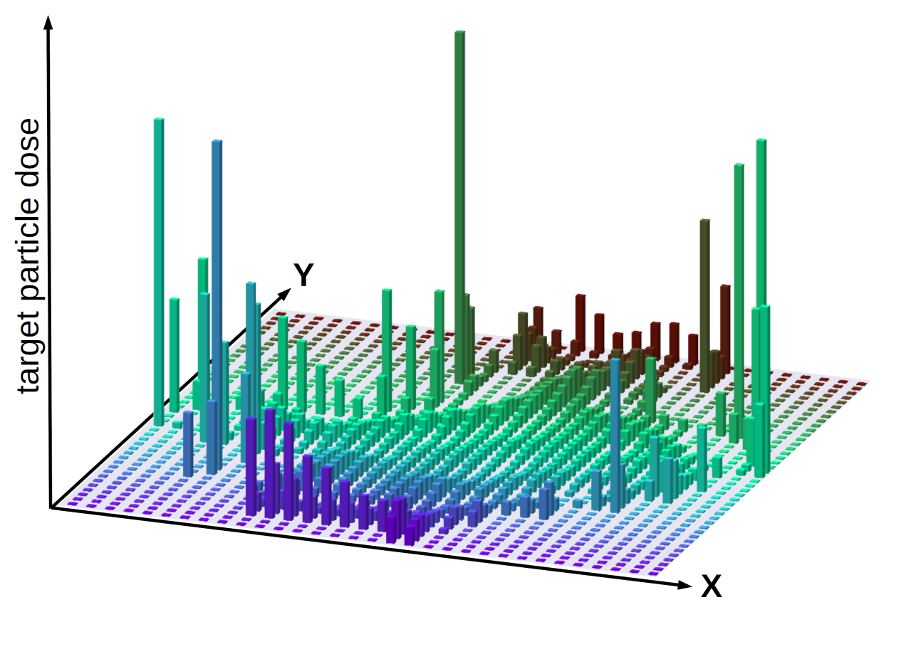
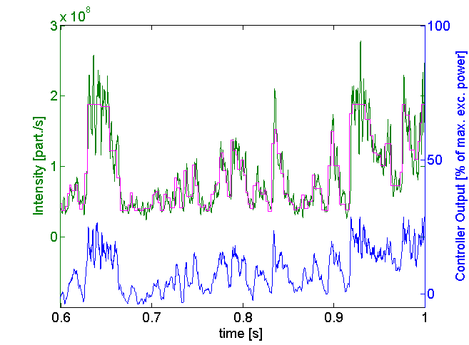
Why a raster-point-individual intensity makes sense
…if you have an intensity control
Dose in each voxel ≠ dose per raster-point
Example of dose distribution of one slice
Fixed intensity: irradiation time per raster point can vary by a factor of 2000!
ions
reference
spill
C. Schoemers et al, Nuclear Instruments and Methods in Physics Research Section A: Accelerators, Spectrometers, Detectors and Associated Equipment, Volume 795, 21 September 2015, Pages 92-99, ISSN 0168-9002, http://dx.doi.org/10.1016/j.nima.2015.05.054

Slide 8
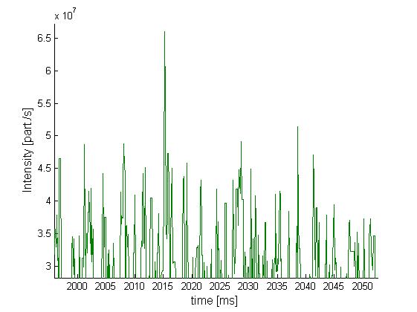
Main interruptions due to safety-interlocks related to intensity
IC interlock for too fast extraction / spikes:
If dose monitors detect intensity too large,
close to current measurement range.
MWPC interlock for too fast irradiation
Time-out for too slow/delayed extraction
(happens only if not intensity controlled)

Slide 9
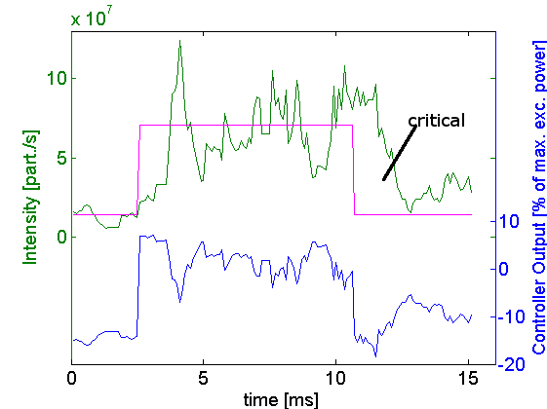
Main interruptions due to safety-interlocks related to intensity
IC interlock for too fast extraction / spikes
MWPC interlock for too fast irradiation:
If some raster-points (@ HIT: >3) are
irradiated too fast without proper position
measurement.
Time-out for too slow/delayed extraction
(happens only if not intensity controlled)

Slide 10
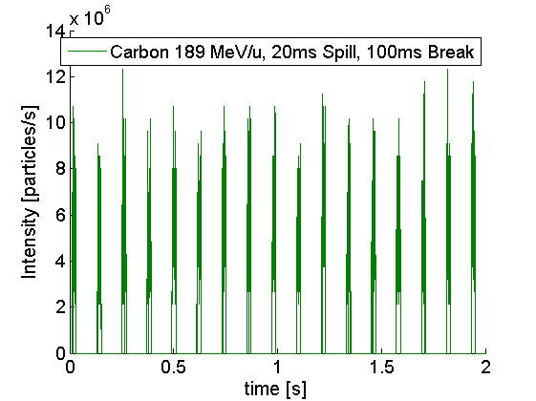
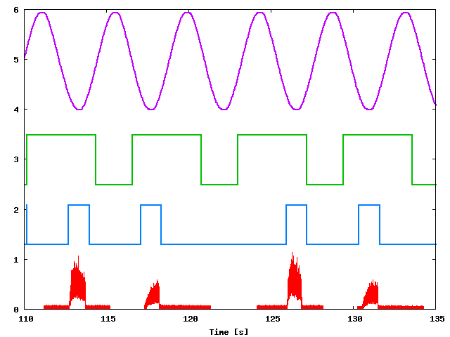
Spillpause – mechanism to spare healthy tissue
Spill pause is a fast beam-off mechanism
Pause and resume the beam extraction
several times on flattop
RF-KO allows spill pause
Used for:
  Scanning without dose deposition
  Respiratory gating
Scan path
Gating
Target
movement
Irradiation window
Tumour
Time
Courtesy of S. Nill & U. Oelfke, DKFZ, C. Bert et al

Slide 11
Conclusion: Ideal spill for therapy today
Intensities in the order of ≈ 10⁷ – 10⁸ /s (Carbon) and 10⁹ – 10¹⁰ /s (Protons)
Intensity controlled (different dose requirements)
Low spill ripple in the regime of 1ms due to raster-scanning
Low spill ripple up to the frequency your dose delivery system sees (“spikes”)
Bunched beam extraction is ok
Spill pause available to shortly interrupt the scanning e.g. also for respiratory gating

Slide 12
Future Projects in IMPT and their impact on SX

Slide 13
“FLASH-effect” – Ultra High Dose Rate (UHDR) Irradiations
What is uHDR: dose rates > 40Gy/s (while standard dose rates (SDR) are << 1Gy/s)
Under investigation: are there biologic benefits when applying uHDR?
“FLASH effect”: normal tissue sparing without sacrificing tumour control?
T. Tessonnier, S. Mein, D.W.M. Walsh, N. Schuhmacher, H. Liew, U. Weber, R. Cee, M. Galonska, C. Schömers, S. Scheloske, S. Brons, J. Debus, T. Haberer, A. Abdollahi, A. Mairani, and I. Dokic. FLASH dose-rate helium ion beams in vitro. International Journal of Radiation Oncology, Biology, Physics, 2021.

Slide 14
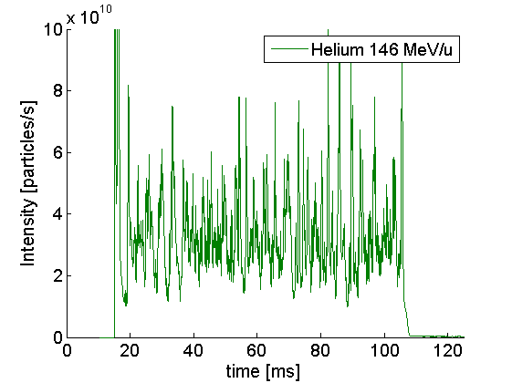
“FLASH-effect” – Ultra High Dose Rate (UHDR) Irradiations
HIT uHDR-spills
Intensity controlled
Optics for faster (but still slow) extraction (increased sextupole strength, quadrupoles closer to 3rd order resonance.
Dose rates up to 200 Gy/s.
Example helium: 3.5e10 particles in 90ms →
3.9e10 part./s. > 50 times higher than therapy
Still applying high quality raster-scanning
C. Schömers, S. Brons, R. Cee, A. Peters, S. Scheloske, T. Haberer, “BEAM PROPERTIES BEYOND THE THERAPEUTIC RANGE AT HIT”, in Proc. IPAC’23, Venice, Italy, May 2023, paper THPM064, http://doi/jacow-ipac2023-thpm064/index.html

Slide 15
“FLASH-effect” – Ultra High Dose Rate (UHDR) Irradiations
Future challenges for SX
Up to now: total dose was independent of the dose rate;
If the Flash-effect is true: dose or biological effectiveness depends on dose rate!
Dose rate will be a significant parameter for the treatment planning system
→ We have to provide stable, predictable spills of a certain uHDR intensity.
Walter Tinganelli, Olga Sokol, Martina Quartieri, Anggraeini Puspitasari, Ivana Dokic, Amir Abdollahi, Marco Durante, Thomas Haberer, Jürgen Debus, Daria Boscolo, Bernd Voss, Stephan Brons, Christoph Schuy, Felix Horst, and Ulrich Weber. Ultra-high dose rate (FLASH) carbon ion irradiation: dosimetry and first cell experiments. International Journal of Radiation Oncology, Biology, Physics, 2021.

Slide 16
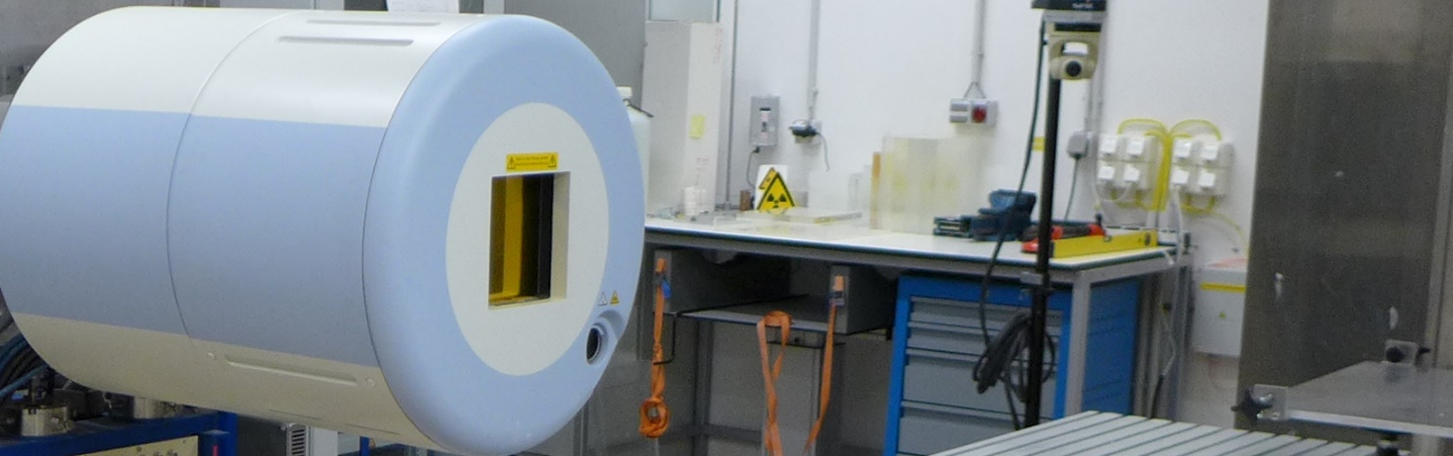
iRAD – Ion Beam Radiography
Detector
Object /
Patient
Idea of ion beam radiography: use particle beams also for imaging
Good for treatment planning – same radiation for image and treatment
Possibility of in situ monitoring
T. Gehrke et al., “Theoretical and experimental comparison of proton and helium-beam radiography using silicon pixel detectors”, Phys. Med. Biol., vol. 63, no. 3, p. 035037, Feb. 2018. https://doi:10.1088/1361-6560/aaa60f
A. Burker et al., “Imaging with Ion Beams at MedAustron”, Nuclear Inst. and Methods in Physics Research, A 958 (2020) 162246, https://doi.org/10.1016/j.nima.2019.05.087

Slide 17
iRAD – Ion Beam Radiography
Carbon – Helium mixed beam
Treatment and online monitoring
at the same time
Accelerate 2 ions with same a/q
to same energy
Carbon ions stop in the patient
Helium ions stop in detector
Simultaneous extraction!
L. Volz, L. Kelleter, S. Brons, L. Burigo, C. Graeff, N. I. Niebuhr, R. Radogna, S. Scheloske, C. Schömers, S. Jolly, and J. Seco. Experimental exploration of a mixed helium/carbon beam for online treatment monitoring in carbon ion beam therapy. Physics in Medicine & Biology, 65(5):055002, feb 2020.
C. Knobloch, M. Metzner, F. Kehrein, C. Schömers, S. Scheloske, S. Brons, R. Hermann, A. Peters, O. Jäkel, M. Martisikova and T. Gehrke. Establishment and evaluation of a water-equivalent thickness calibration for helium-beam radiography with high-energy beams and thin silicon pixel detectors. Medical Physics, to be published 2022

Slide 18
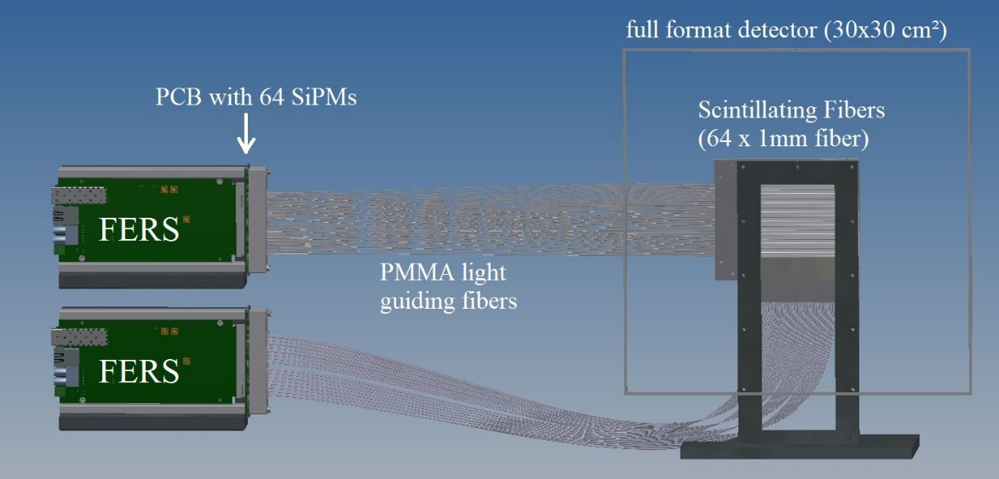
iRAD – Ion Beam Radiography
What the accelerator has to provide
Low total (extra-) dose for imaging part
Increased spill length
Stable low intensity of ≈ 1000 part./s
Detectors for that kind of low intensity
beams e.g. scintillation fibre beam monitor
For mixed beams: simultaneous slow
extraction of 2 different ion types
R. Hermann et al., “Advancements in the scintillation fiber monitor for low-intensity ion beams at HIT”, presented at the IPAC’23, Venice, Italy, May 2023, paper THPL101

Slide 19
Multi ion treatment
What is multi ion treatment: treating the patient with more than one ion type.
Why? Maximize the therapeutic effects;
make use of different LETs (=linear energy transfer, “severeness” of damage)
Two ions → twice the number of slices → double irradiation time
To be comparably fast as now: increase the speed of dose application e.g. higher intensity.
Taku Inaniwa et al, Adaptation of stochastic microdosimetric kinetic model to hypoxia for hypo-fractionated multi-ion therapy treatment planning, 2021 Phys. Med. Biol. 66 205007

Slide 20
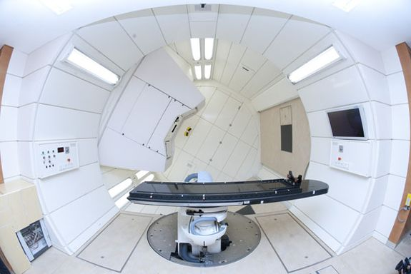
Particle ARC therapy
What is ARC-therapy: delivery
technique with dosimetric
advantages (dose conformity,
treatment time)
Live/dynamic gantry rotation
during irradiation instead of
2-3 fields “step and shoot”.
Already used in standard photon therapy → What about particle-therapy: spot-scanning hadron arc (SHArc)?
beam
Stewart Mein, Thomas Tessonnier, Benedikt Kopp, Christian Schömers, Semi Harrabi, Amir Abdollahi, Jürgen Debus, Thomas Haberer, Andrea Mairani, Biological Dose Optimization for Particle Arc Therapy Using Helium and Carbon Ions International Journal of Radiation Oncology*Biology*Physics, Volume 114, Issue 2, 2022, Pages 334-348, https://doi.org/10.1016/j.ijrobp.2022.04.025

Slide 21
Particle ARC therapy
What the accelerator has to provide
Intensity range comparable to today
But: Stability of intensity!
Apart from SX: Multi-energy mode → fast energy switching mandatory, more degrees of freedom, robust optimization, better coverage, faster irradiation time!
Multi-energy mode requires beam off / on spill pause mechanism

Slide 22
Conclusion to future projects in IMPT and their impact on SX
For different future applications in IMPT the intensity needs to be:
Higher for a reduced irradiation time
Higher (multi ion)
Much higher (for ultra high dose rates)
Lower (for ion beam radiography)
Stable! (always)
Predictable (for ultra high dose rates)

Slide 23
Thank you!
Citations
Many thanks for the discussions with Thomas Tessonnier and contributions from the following companies and institutions: Siemens Health Systems (A. Robin)
https://www.ptcog.site/index.php/facilities-in-operation-public
Stewart Mein, Thomas Tessonnier, Benedikt Kopp, Christian Schömers, Semi Harrabi, Amir Abdollahi, Jürgen Debus, Thomas Haberer, Andrea Mairani, Biological Dose Optimization for Particle Arc Therapy Using Helium and Carbon Ions International Journal of Radiation Oncology*Biology*Physics, Volume 114, Issue 2, 2022, Pages 334-348, https://doi.org/10.1016/j.ijrobp.2022.04.025
Taku Inaniwa et al, Adaptation of stochastic microdosimetric kinetic model to hypoxia for hypo-fractionated multi-ion therapy treatment planning, 2021 Phys. Med. Biol. 66 205007
C. Schoemers et al, Nuclear Instruments and Methods in Physics Research Section A: Accelerators, Spectrometers, Detectors and Associated Equipment, Volume 795, 21 September 2015, Pages 92-99, ISSN 0168-9002, http://dx.doi.org/10.1016/j.nima.2015.05.054
T. Tessonnier, S. Mein, D.W.M. Walsh, N. Schuhmacher, H. Liew, U. Weber, R. Cee, M. Galonska, C. Schömers, S. Scheloske, S. Brons, J. Debus, T. Haberer, A. Abdollahi, A. Mairani, and I. Dokic. FLASH dose-rate helium ion beams in vitro. International Journal of Radiation Oncology, Biology, Physics, 2021.
Walter Tinganelli, Olga Sokol, Martina Quartieri, Anggraeini Puspitasari, Ivana Dokic, Amir Abdollahi, Marco Durante, Thomas Haberer, Jürgen Debus, Daria Boscolo, Bernd Voss, Stephan Brons, Christoph Schuy, Felix Horst, and Ulrich Weber. Ultra-high dose rate (FLASH) carbon ion irradiation: dosimetry and first cell experiments. International Journal of Radiation Oncology, Biology, Physics, 2021. 10.1016/j.ijrobp.2021.11.020
C. Schömers, S. Brons, R. Cee, A. Peters, S. Scheloske, T. Haberer, “BEAM PROPERTIES BEYOND THE THERAPEUTIC RANGE AT HIT”, in Proc. IPAC’23, Venice, Italy, May 2023, paper THPM064, http://doi/jacow-ipac2023-thpm064/index.html
T. Gehrke et al., “Theoretical and experimental comparison of proton and helium-beam radiography using silicon pixel detectors”, Phys. Med. Biol., vol. 63, no. 3, p. 035037, Feb. 2018. https://doi:10.1088/1361-6560/aaa60f
A. Burker et al., “Imaging with Ion Beams at MedAustron”, Nuclear Inst. and Methods in Physics Research, A 958 (2020) 162246, https://doi.org/10.1016/j.nima.2019.05.087
L. Volz, L. Kelleter, S. Brons, L. Burigo, C. Graeff, N. I. Niebuhr, R. Radogna, S. Scheloske, C. Schömers, S. Jolly, and J. Seco. Experimental exploration of a mixed helium/carbon beam for online treatment monitoring in carbon ion beam therapy. Physics in Medicine & Biology, 65(5):055002, feb 2020.
C. Knobloch, M. Metzner, F. Kehrein, C. Schömers, S. Scheloske, S. Brons, R. Hermann, A. Peters, O. Jäkel, M. Martisikova and T. Gehrke. Establishment and evaluation of a water-equivalent thickness calibration for helium-beam radiography with high-energy beams and thin silicon pixel detectors. Medical Physics, to be published 2022
R. Hermann et al., “Advancements in the scintillation fiber monitor for low-intensity ion beams at HIT”, presented at the IPAC’23, Venice, Italy, May 2023, paper THPL101

