Slide 1
CNAO Septum ESE2 Development
J. Borburgh, B. Balhan, R. Barlow, J. Durmus. L. Jorat, C. Martin Martinez, A. Prost, M. Rochouse, P. van Trappen, (CERN) L. Falbo, S. Foglio, L. Lanzavecchia, G. Venchi, (CNAO)
13th of February 2024

Slide 2
Abstract
In 2008, an electrostatic septum was built to a CERN design in industry for the slow extraction in CNAO’s medical accelerator in Pavia. Shortly after it’s installation, several shortcomings revealed themselves, such as limited orbiting beam acceptance and difficulties to operate the displacement system remotely.
In 2020 a collaboration was launched between CERN and CNAO to design a version of the electrostatic extraction septum which mitigates the shortcomings, taking advantage of the latest developments in the field, and upgrade the device to make it suitable for future operational parameters.
This presentation will highlight the innovations implemented and summarise the results of the initial laboratory tests.

Slide 3
Outline
Introduction
Existing septum features and limitations
New septum improvements
Performance
Outlook
References

Slide 4
Introduction
The medical accelerator at CNAO (Pavia, I), uses a slow extraction towards the treatment rooms. One of the elements used for this extraction is the electrostatic septum ESE.
The present septum (ESE) was manufactured in 2008 in industry following a CERN design.
To allow the remote displacement systems to be located on one side of the tank, a cathode inside anode foil support was chosen.
The HV feedthrough was designed and developed by the contractor and is limited to 100 kV.
To be vacuum compatible, as well as to facilitate manufacture, the cathode was made of titanium and the septum of Molybdenum foils of 100 µm thickness.
The foil tensioning system used was based on a bakeable CERN design.
A remote displacement system for the foil position, foil angle and horizontal gap width was foreseen.

Slide 5
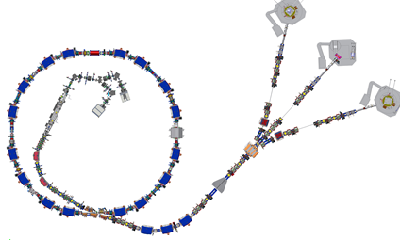
ESE location
LEBT
HEBT
Electrostatic extraction septum
Magnetic extraction septa

Slide 6
ESE1 limitations
Despite good intentions, a few flaws were discovered after installation:
The beam acceptance is reduced since the exit extrusion is not centred on the beam line (20mm too close to the orbiting beam).
Consequently, the cathode and anode displacement range is compromised w.r.t. original requirement.
Although the nominal voltage is 70 kV, the HV feedthrough limitation of 100 kV, limited HV conditioning.
Furthermore, the cathode-inside-anode-support layout complicates conditioning as well.
The anode/cathode displacement system doesn’t function remotely in operation.

Slide 7
ESE1 layout
Septum
Orbiting beam
Beam
Anode support
Offset extrusion, limiting beam acceptance
Cathode
HV feedthrough

Slide 8
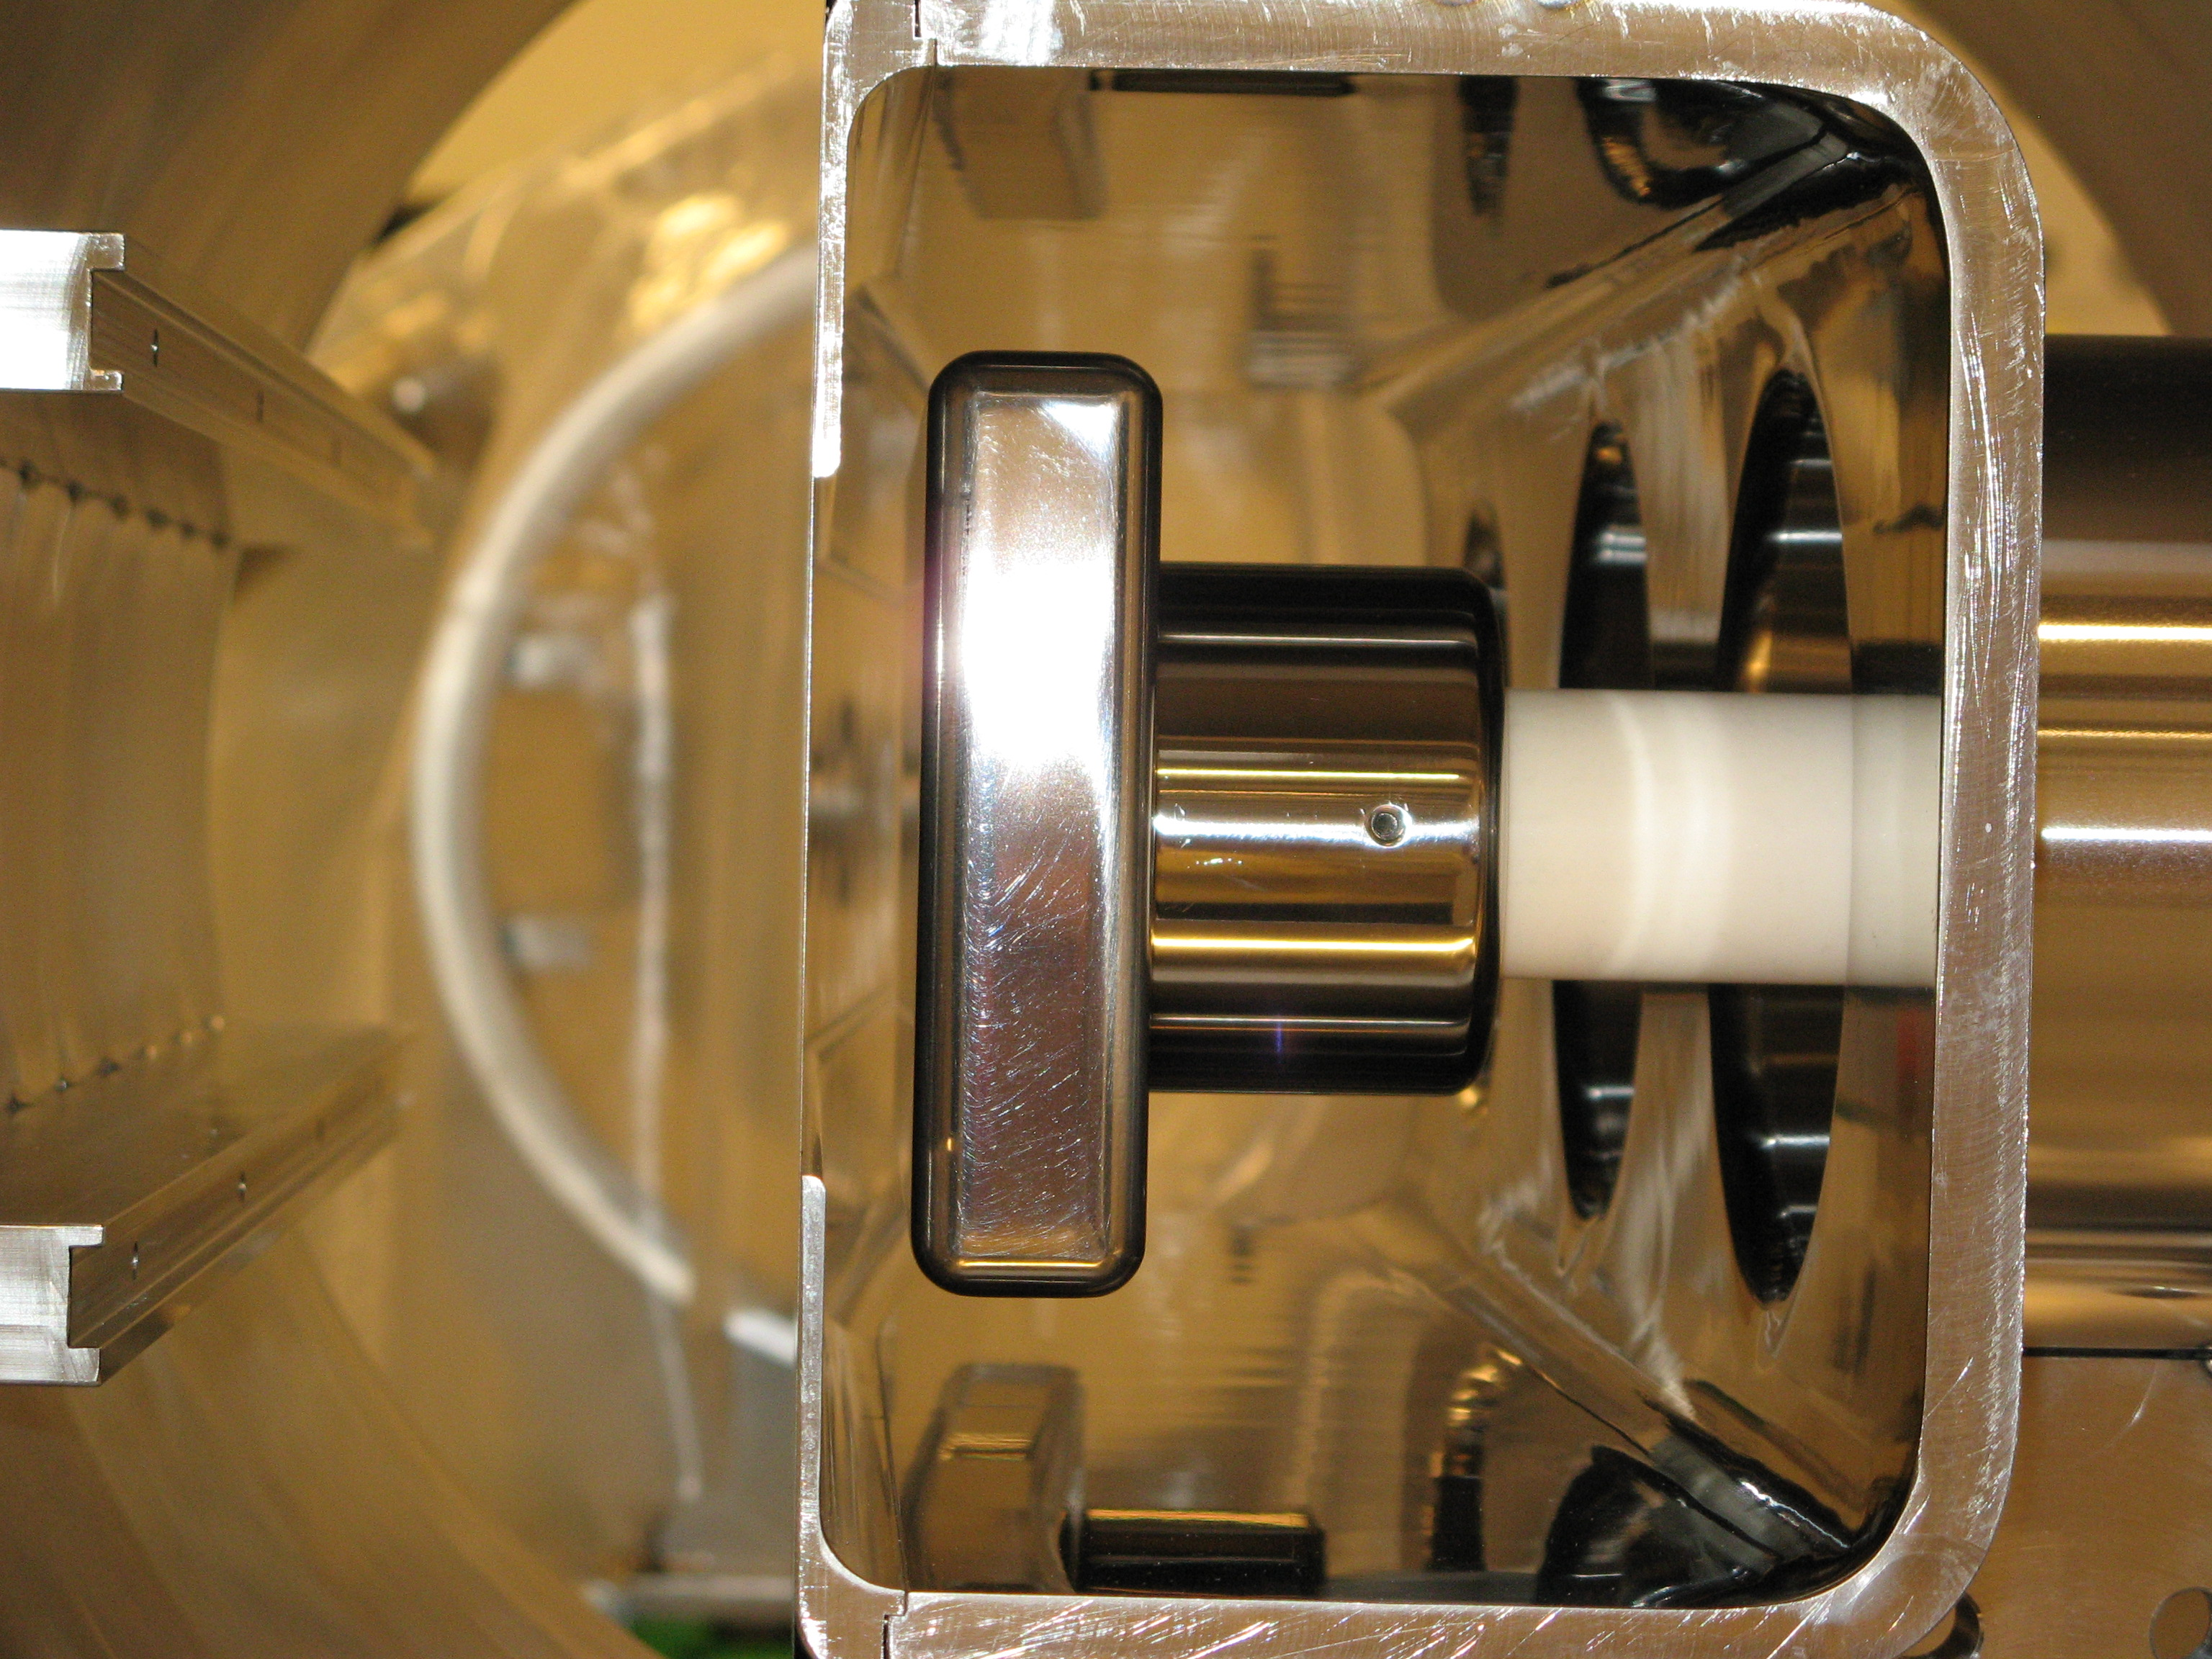
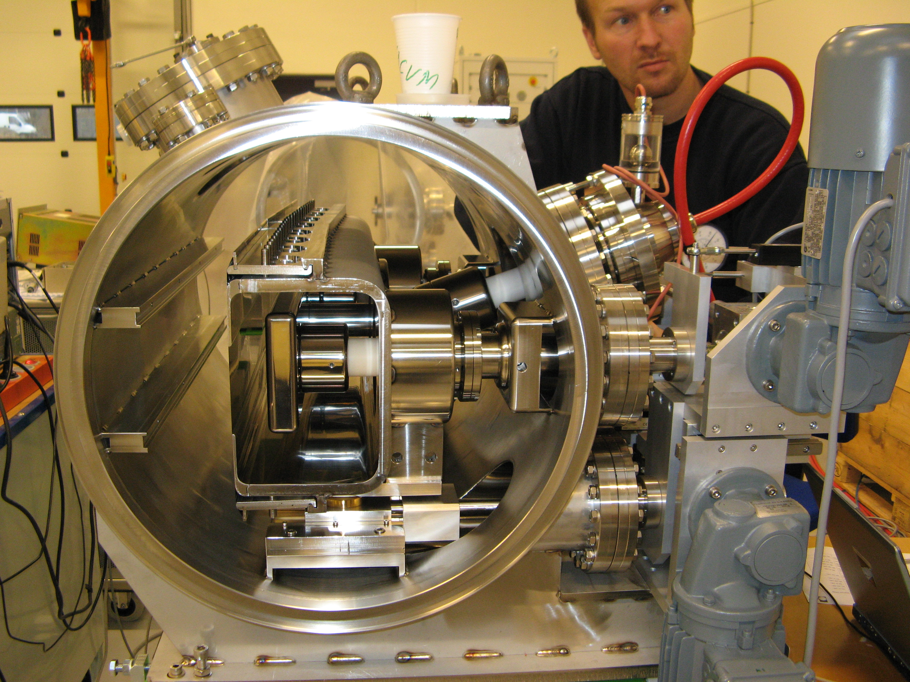
Cross section of ESE1
Anode support
ESE1 side view
Orbiting beam
Cathode

Slide 9
Principal design features ESE2
Vacuum:
2 DN160 flanges for turbo molecular pump and optional ion pump,
2 DN35 flanges for gauges.
HV feedthrough suitable for >160 kV (using 3M Fluorinert FC-770 insulating liquid).
Septum: 100 µm thick Molybdenum foils (10).
Conventional cathode opposite anode layout to facilitate HV conditioning.
Remote displacement system: stepper motors with encoders.
Each mechanical displacement parameter is adjusted with 1 associated stepper motor (gap width, radial septum position, angular septum position).
Notes:
HV feedthrough tested using FC-77; Could consider FC-40 but needs validation.

Slide 10
ESE2 principal parameters
ESE2 parameters
Physical length [mm] | 1055
Septum length [mm] | 860
Septum foil thickness [µm] | 100
Good Field Region (GFR) precision [%] | ± 0.5
GFR at nominal gap [mm × mm] | 15 × 28.8 | (Horizontal × Vertical)
Nominal septum position (range) [mm / mrad] | 35 (15-40) / 0 (-5, +5) | w.r.t. orbiting beam
Nominal gap width (range) [mm] | 15 (10-25) | w.r.t. orbiting beam
Nominal operating voltage (max.) [kV] | 78 (100) | Conditioning possible up to 150 kV
Nominal deflection angle [mrad] | 2.5
Nominal field strength [MV/m] | 5.2
Integrated field strength [MV] | 4.16
Position repeatability [µm] | <10 | Measured with dial gauges
Position precision [µm] | 100 | Requirement
Distance between septum and control rack [m] | 50

Slide 11
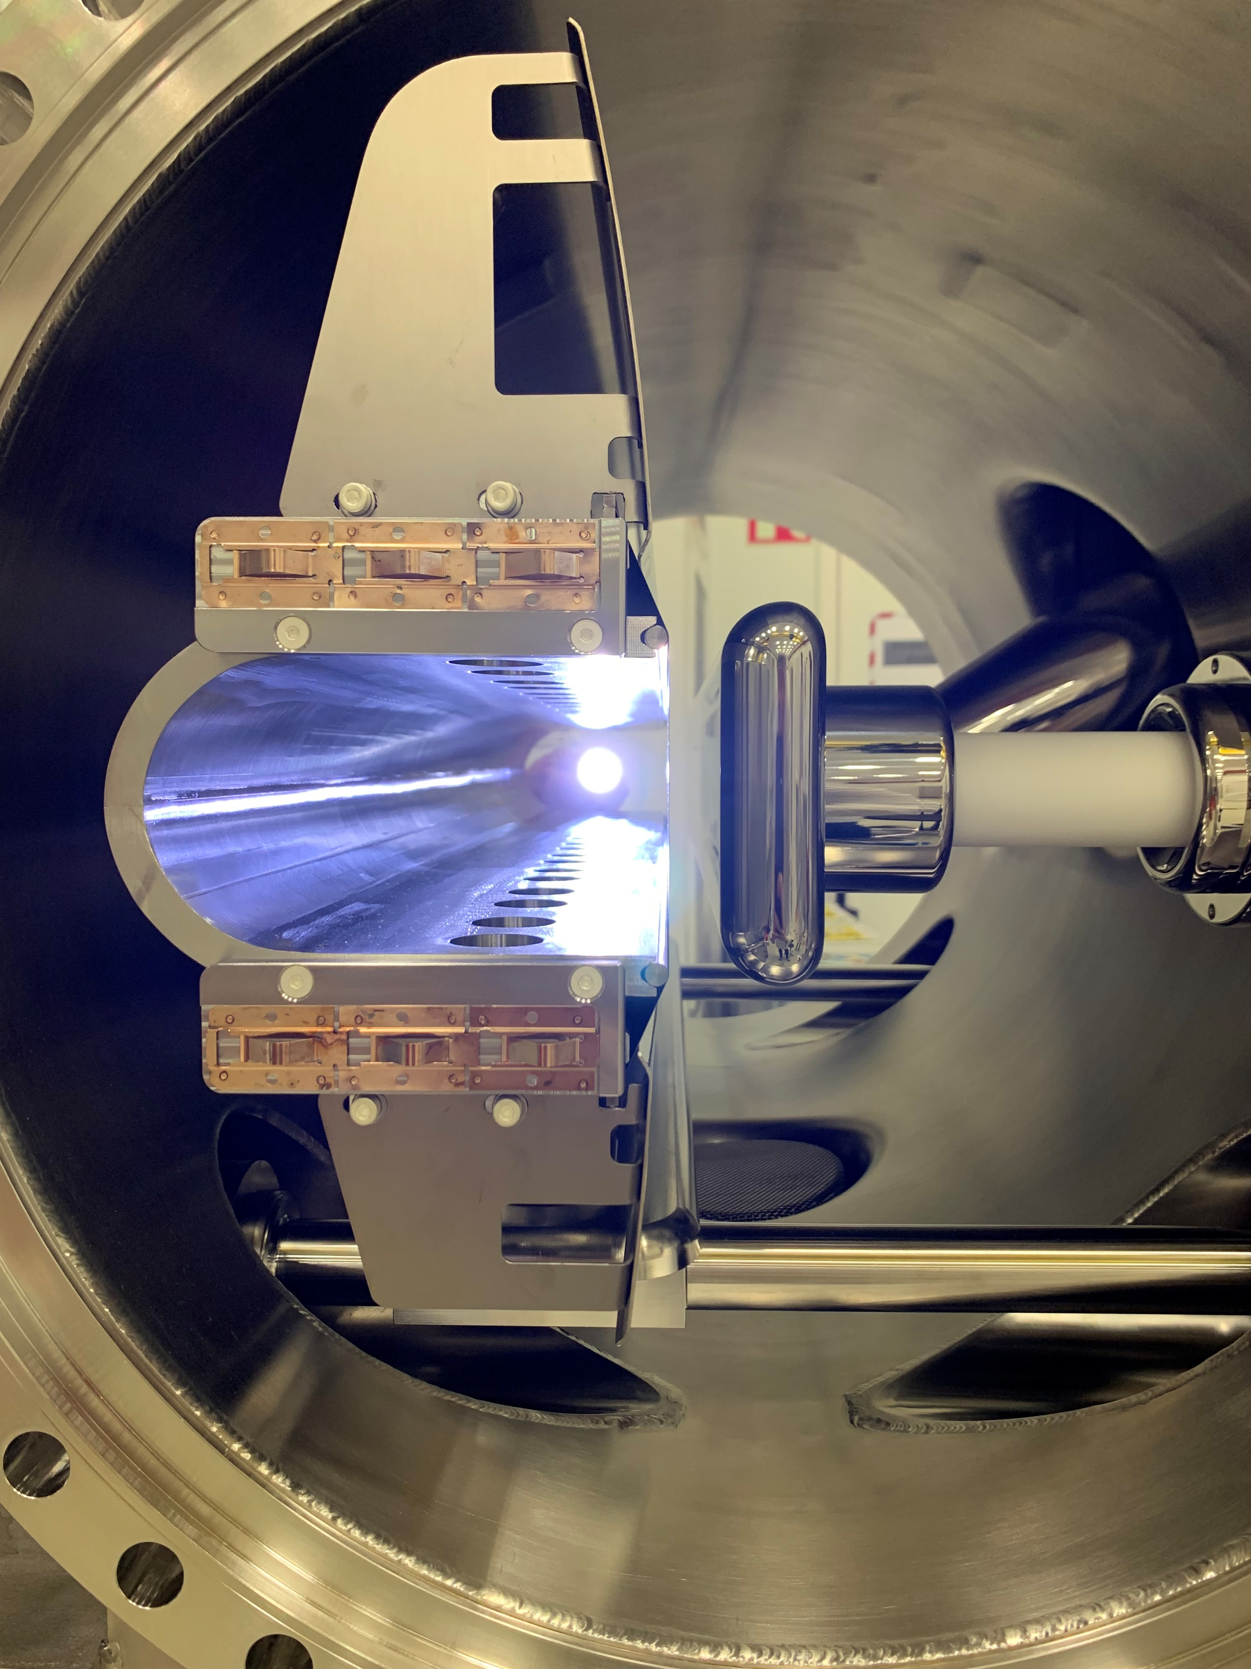
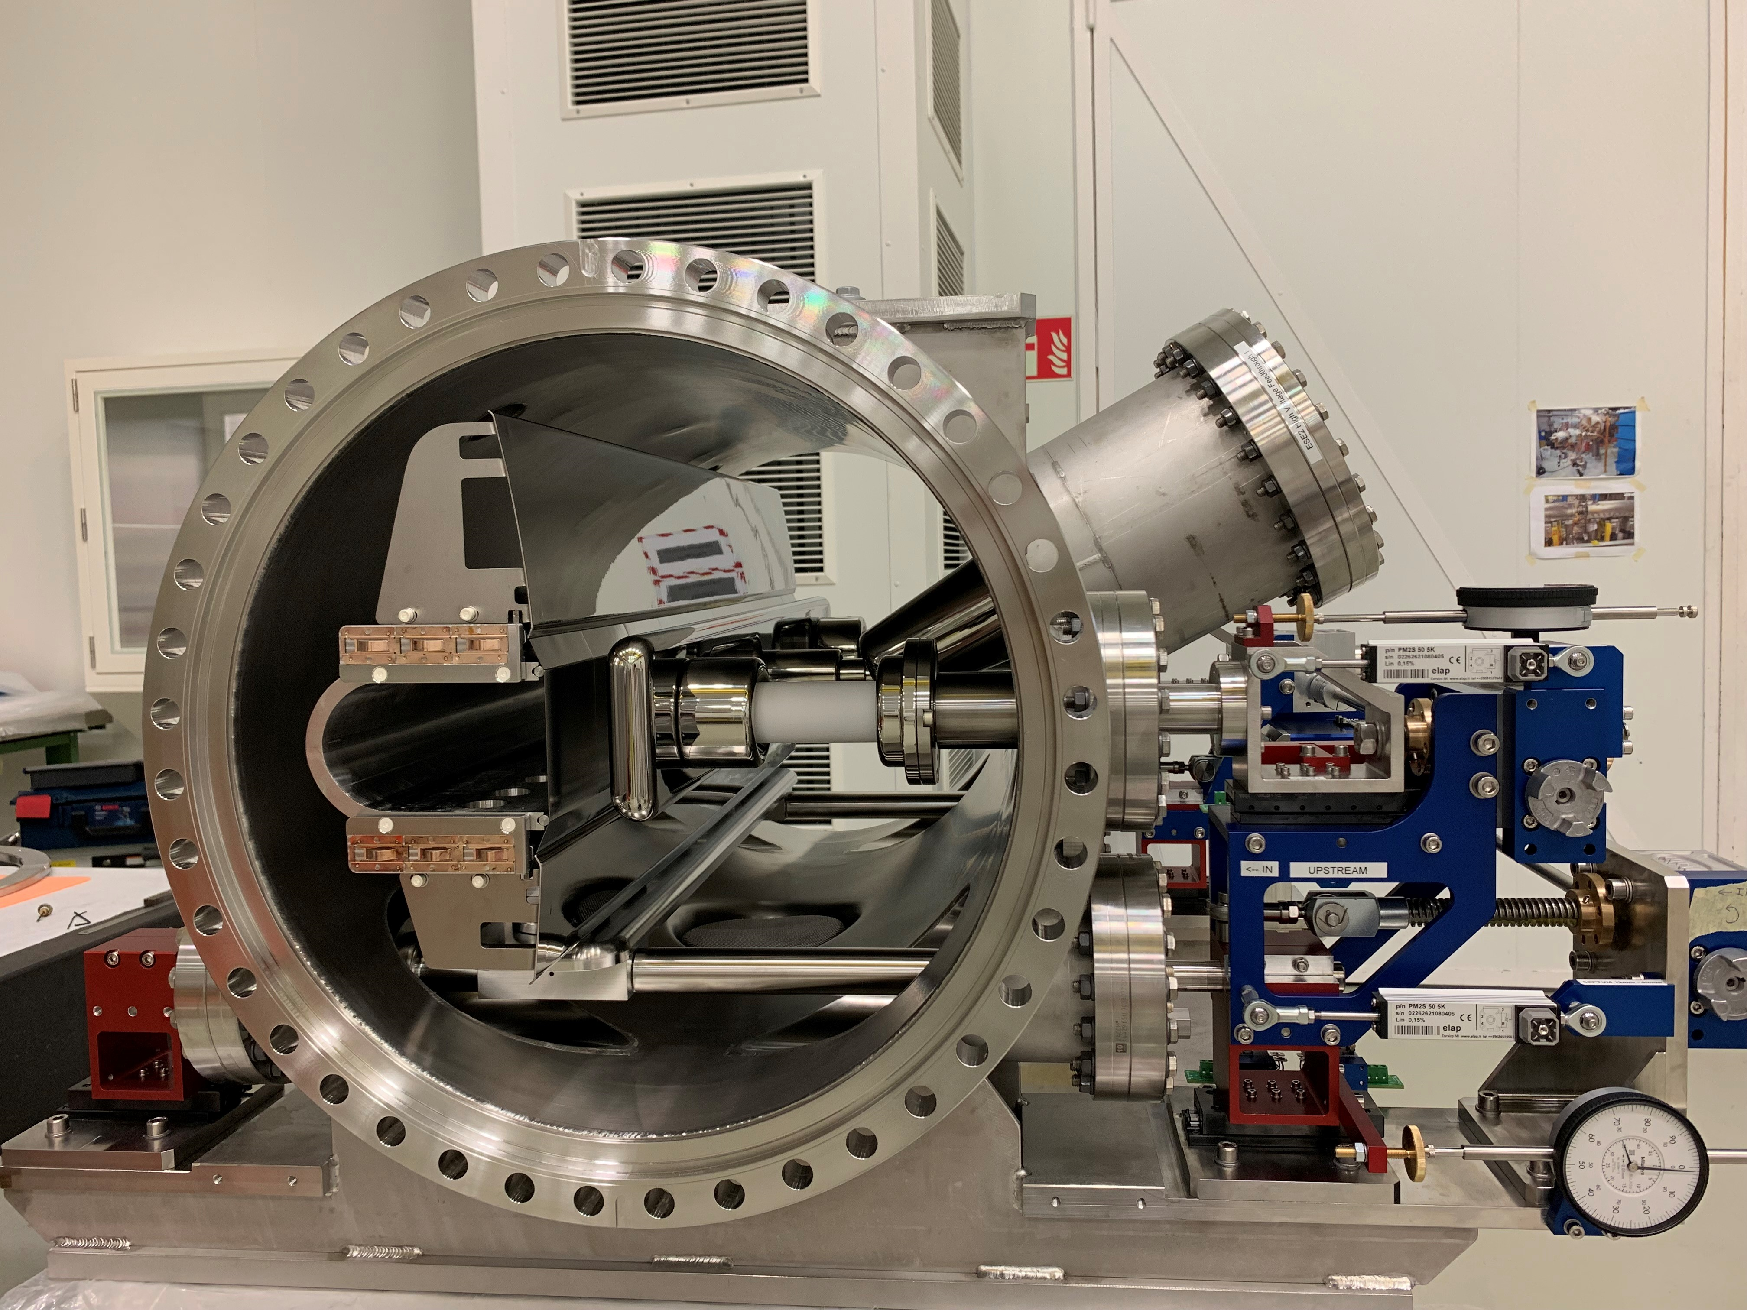
Cross section of ESE2
Anode support
Cathode
Orbiting beam
ESE2 side view

Slide 12
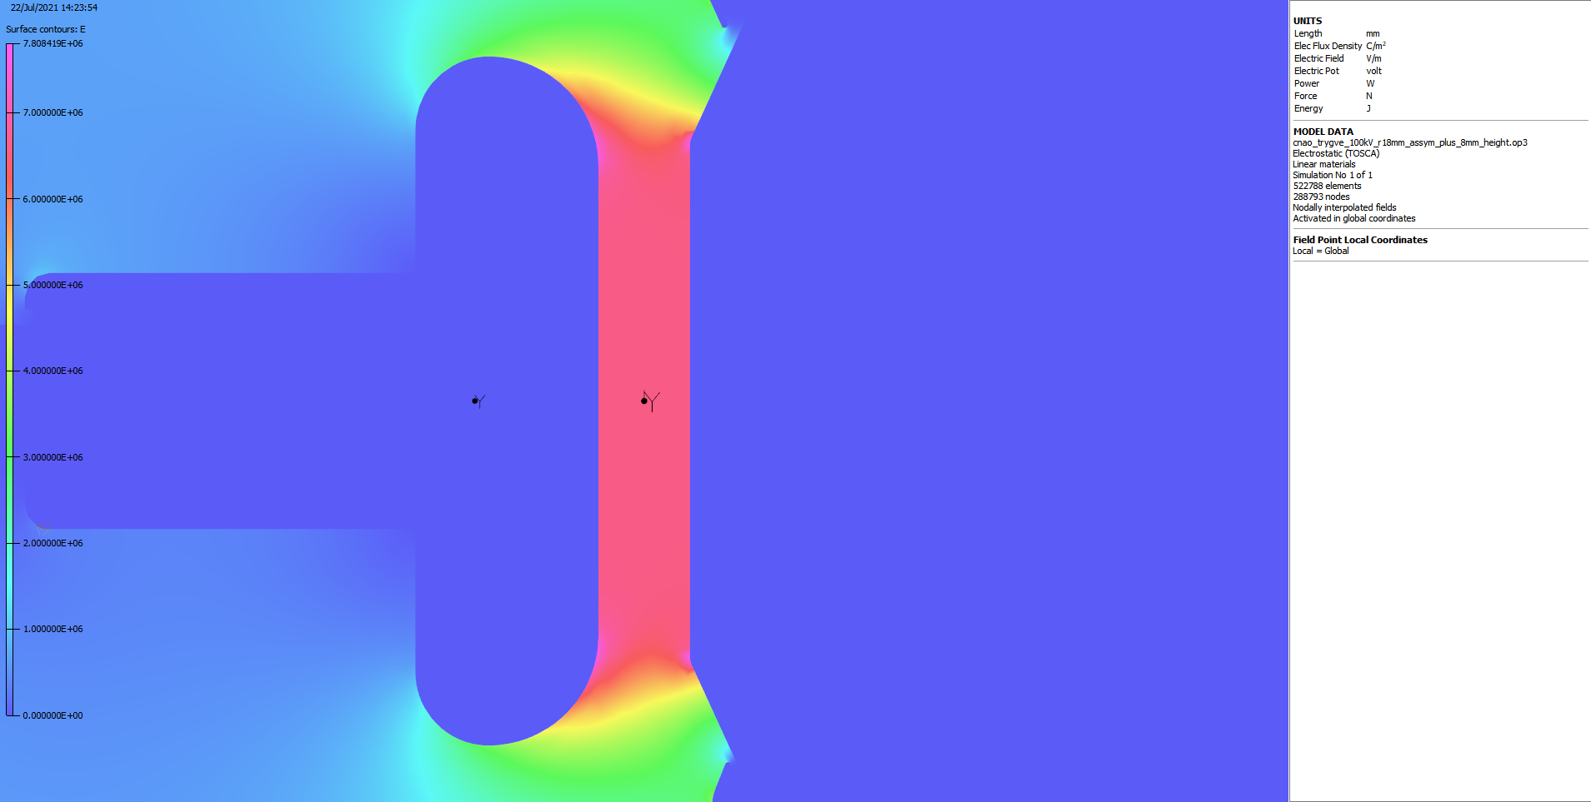
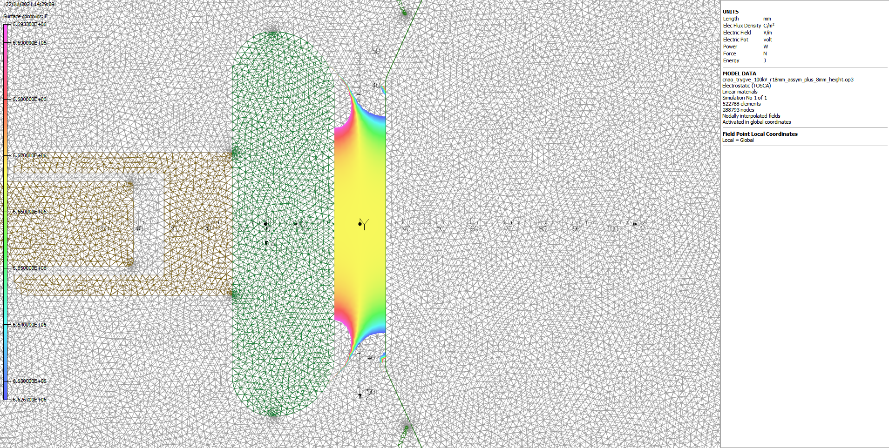
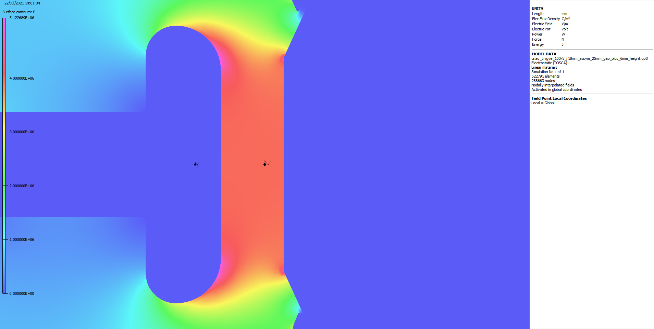
2D field homogeneity
Baseline design
GFR height: 35 mm
Cathode mass: 8.78 kg
Max. cathode field: 8.86 MV/m
GFR requirement @ 15 mm gap (H): ± 0.5 % over ± 28.8 mm (V).
The cathode profile was optimised to:
Minimise cathode field
Minimise weight
Optimised cathode
GFR @ 15 mm (H): ± 28 mm (V)
Cathode mass: 8.50 kg
Max. cathode field: 7.81 MV/m
Courtesy: T. Helseth
GFR @ 25 mm (H): +/-18.2 mm (V)
Notes:
Baseline radius r=8 mm
Optimised design: + 8 mm in height, R=~18 mm, asymmetric front/rear

Slide 13
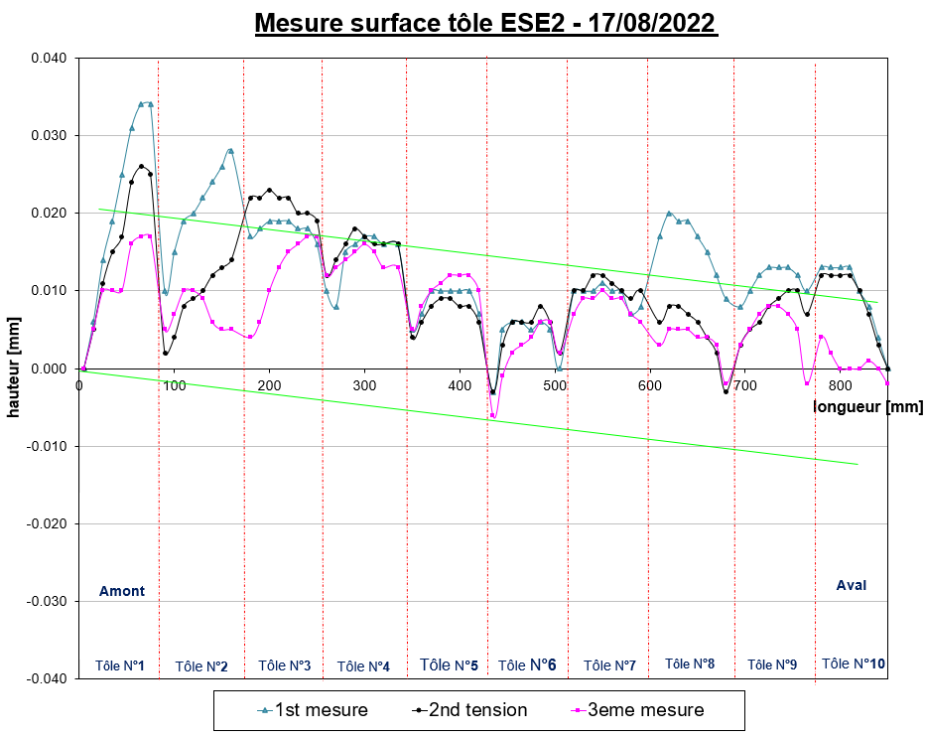
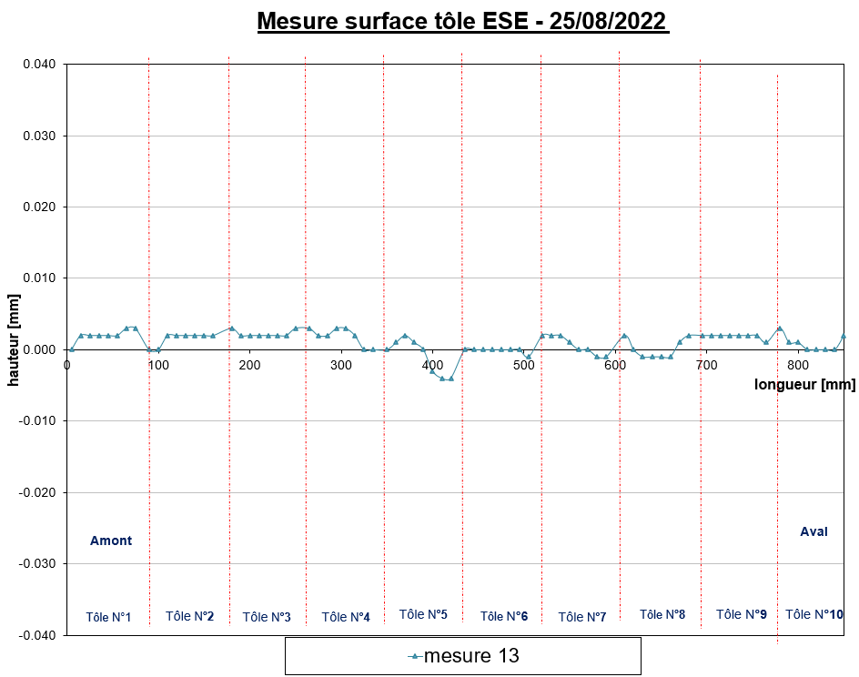
Septum foil straightness
After initial foil fixation the anode straightness was measured.
Subsequently the foil tension was adjusted with the aim to improve the straightness.
Lengthy process, since foils creep for many hours after re-tensioning → daily re-tensioning.
Final achieved overall straightness: < 8 µm.
After 8 days
of tensioning.

Slide 14
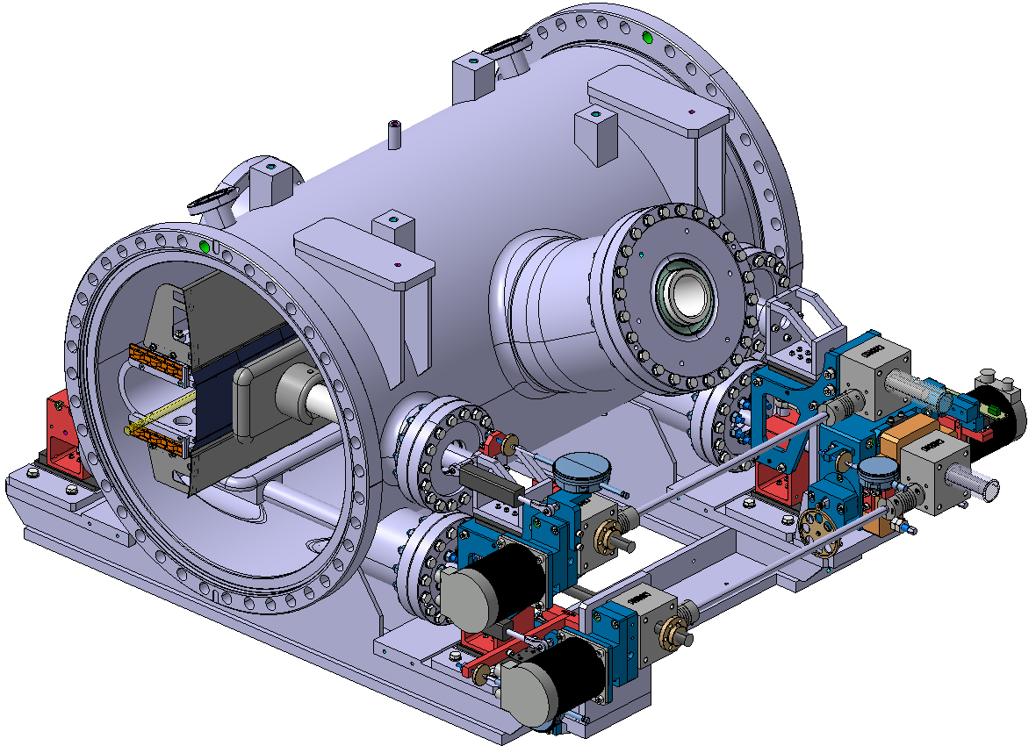
ESE 2 – Motorization
DOWNSTREAM
3 stepper motors :
1 for the radial movement
1 for the angular movement
1 for the gap cathode / anode
All 3 motors are all on the “feedthrough side” of the tank to:
- ease servicing,
- simplify commissioning,
- facilitate integration adjacent to injection line.
Angular motor
UPSTREAM
Gap motor
Radial motor

Slide 15
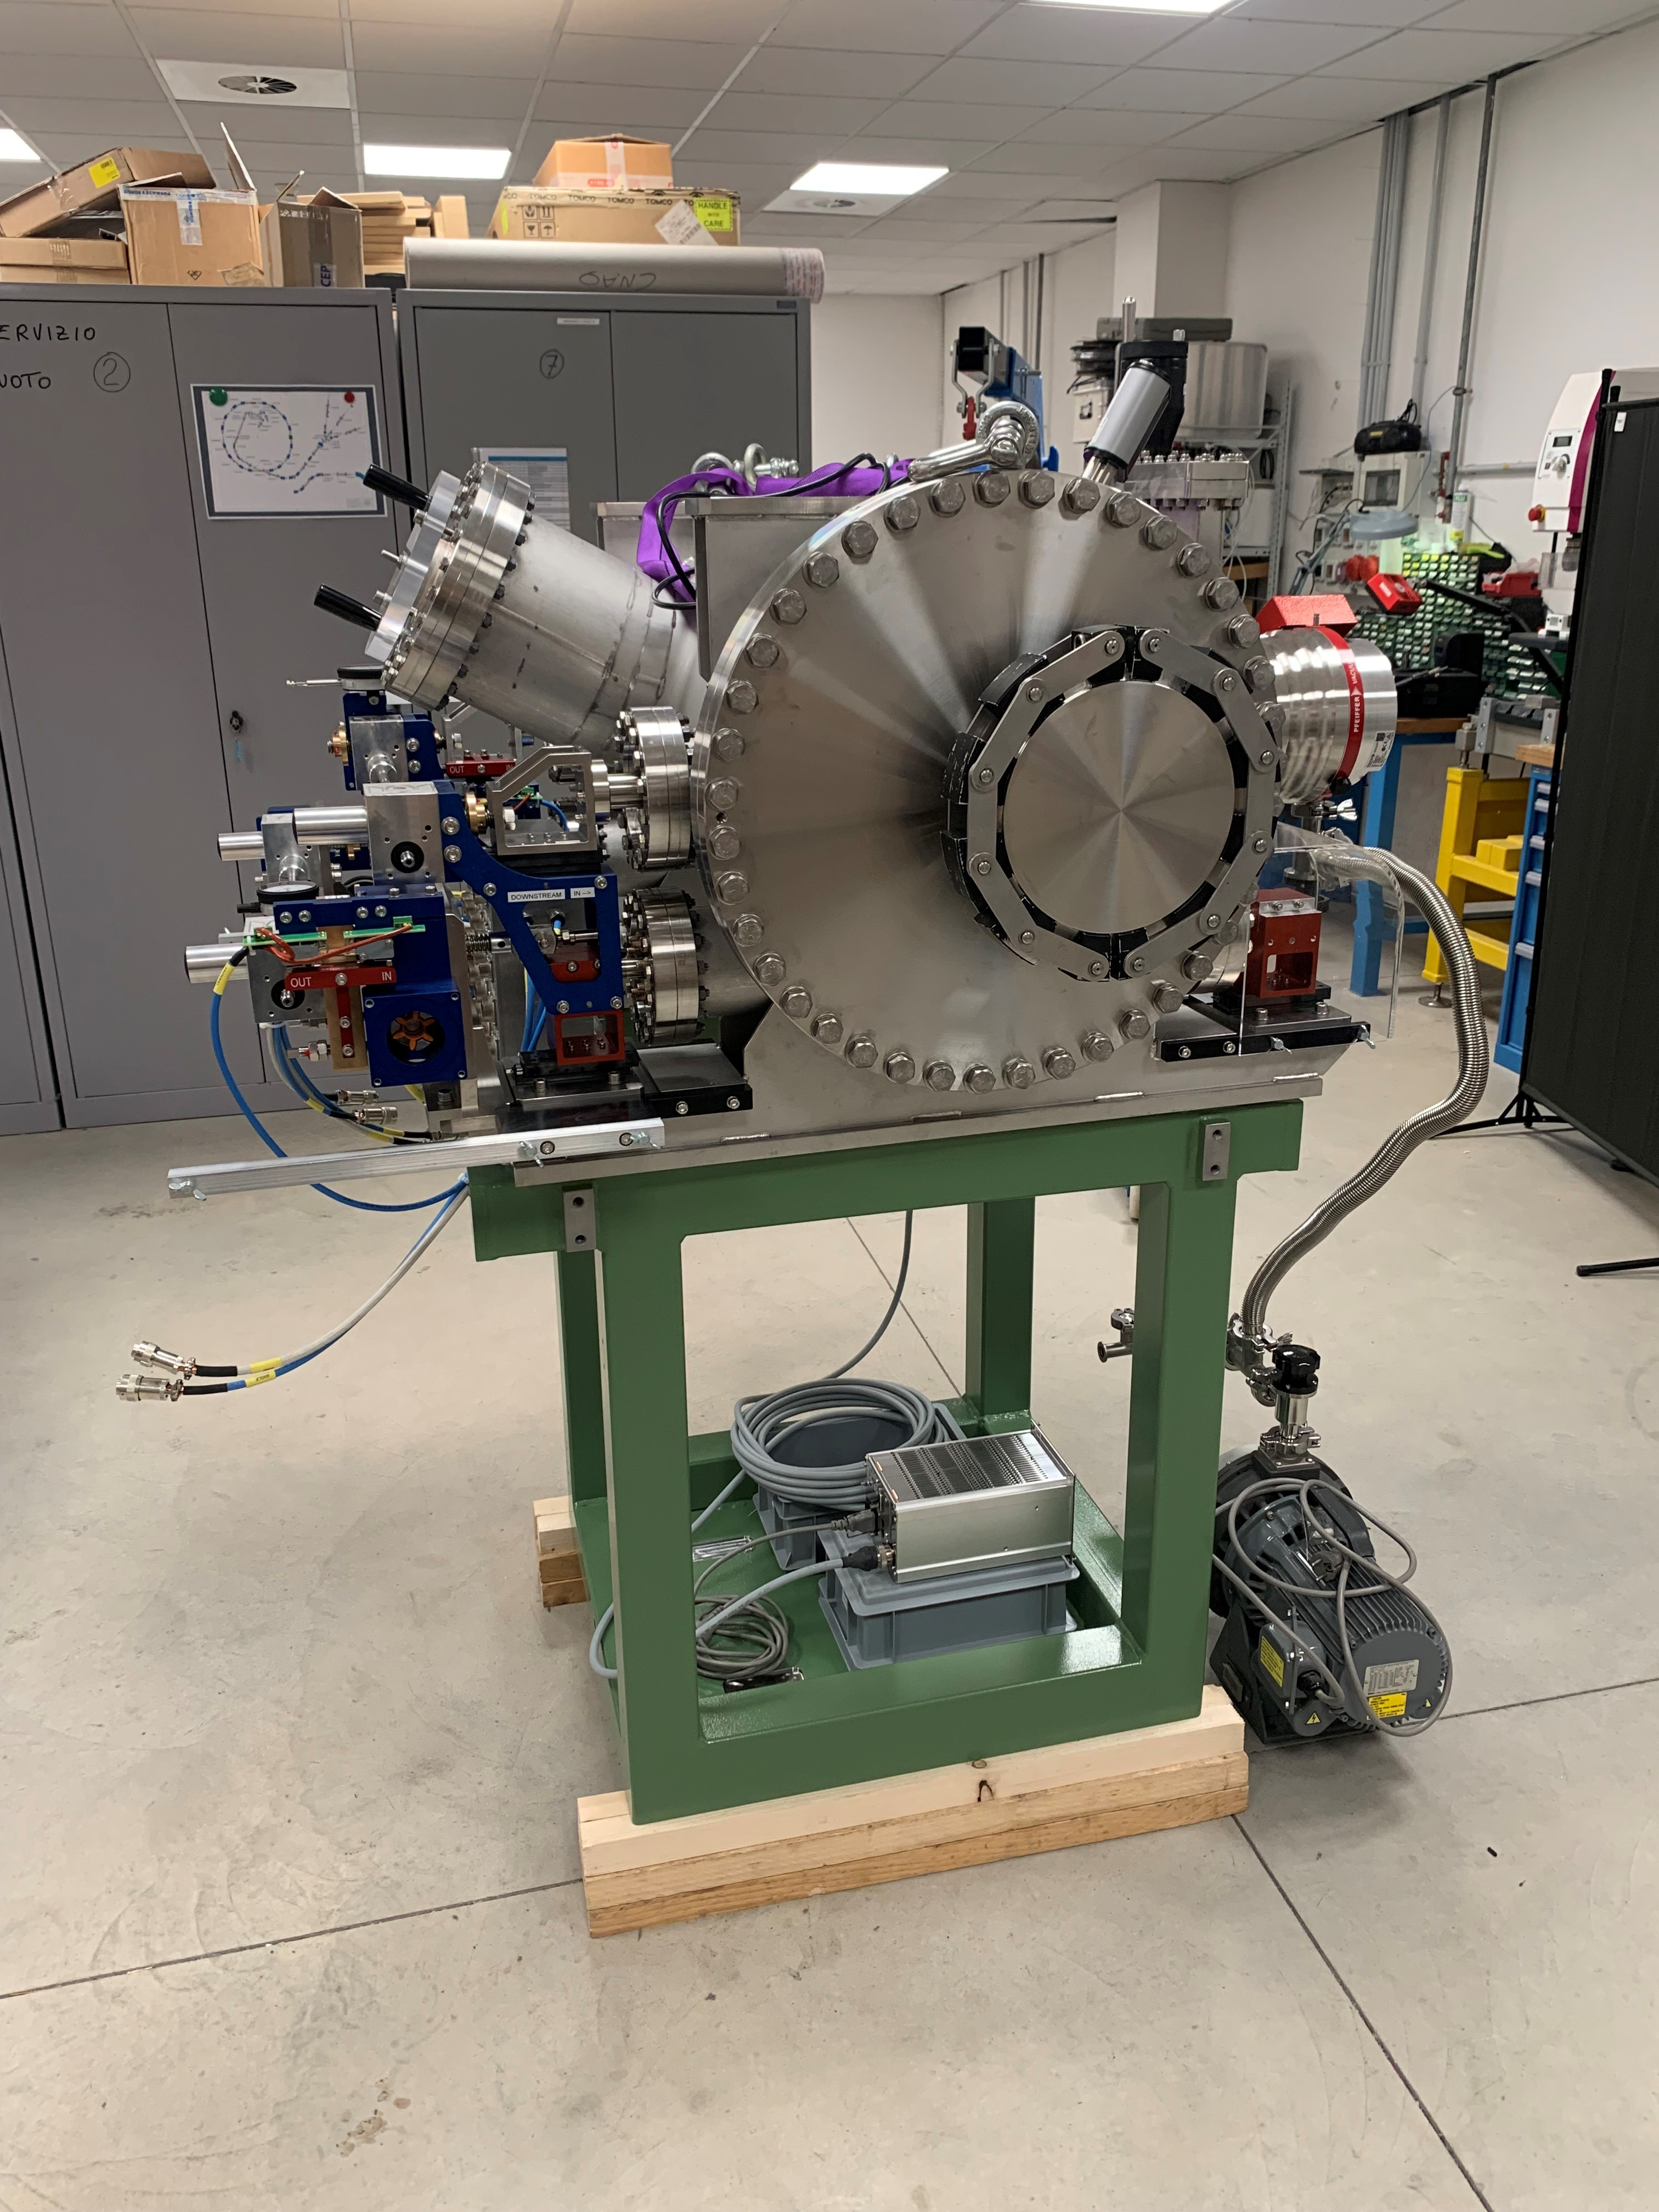
ESE 2 – vacuum
Two DN35 flanges available to plug vacuum equipment.
A DN160 flange available on the bottom of the tank to install a second set of valve + vacuum (ion) pump.
Novel support chassis fits correctly.
A valve and a turbo pump installed on the side of the tank.
The outgassing rate of the fully assembled ESE2 was measured to be 4.9 × 10⁻⁶ mbar.l/s.

Slide 16
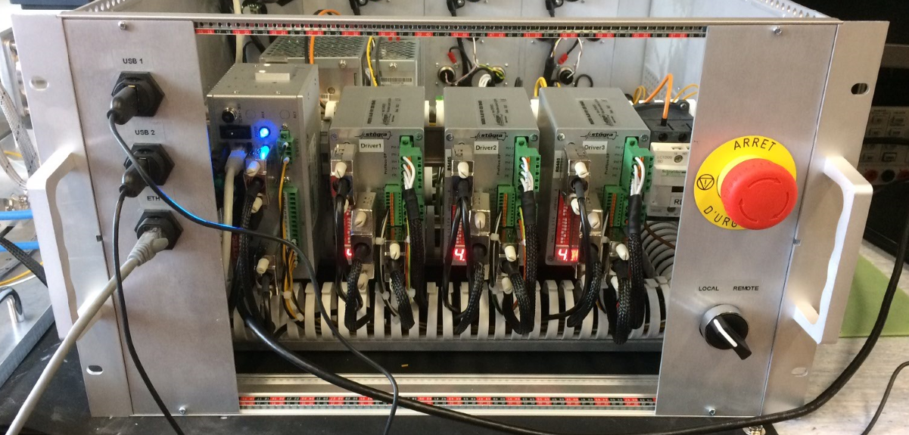
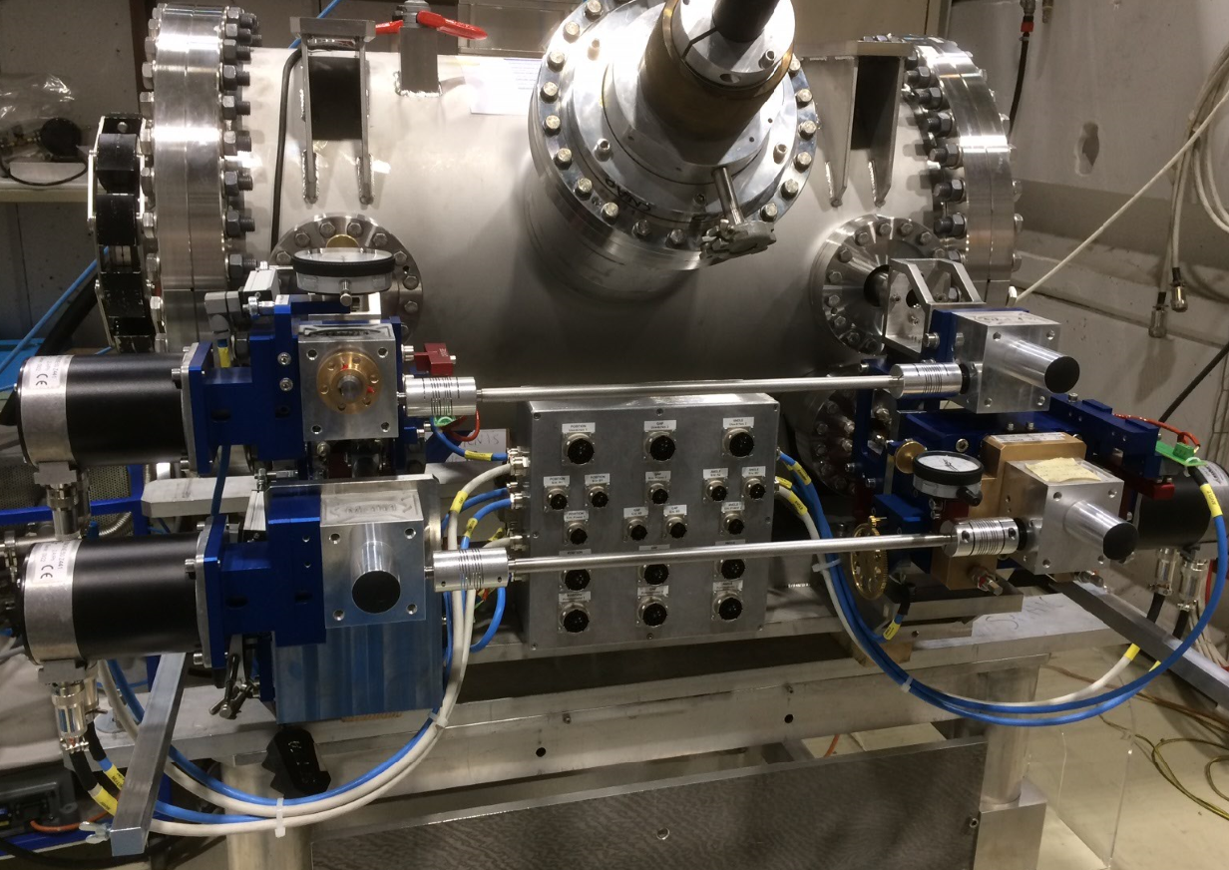
System controls
Interlocking
Equipment emergency stop buttons at ESE2 and at the controls
Displacement system low-level faults,
e.g. stepping motor missed steps (maskable)
Remote displacement system hardware
3-axis positioning system with a precision better than 100 µm
Cable length between septum and control crate 50 m
Stögra stepper motors with integrated encoder for closed loop positioning
Additional position surveillance using linear potentiometers
Two limit switches, one used for calibration procedure.
Stögra WSERS stepper drivers, with RS485 bus
Industrial PC, Welotec Arrakis Mk3, used to communicate with
The 3 stepper drivers over RS485
The CNAO control system (National Instruments PXIe based) over RS485

Slide 17
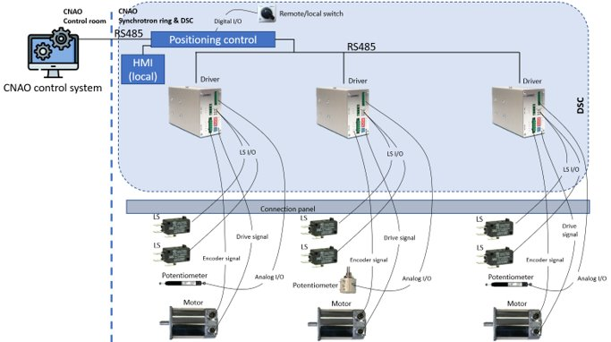
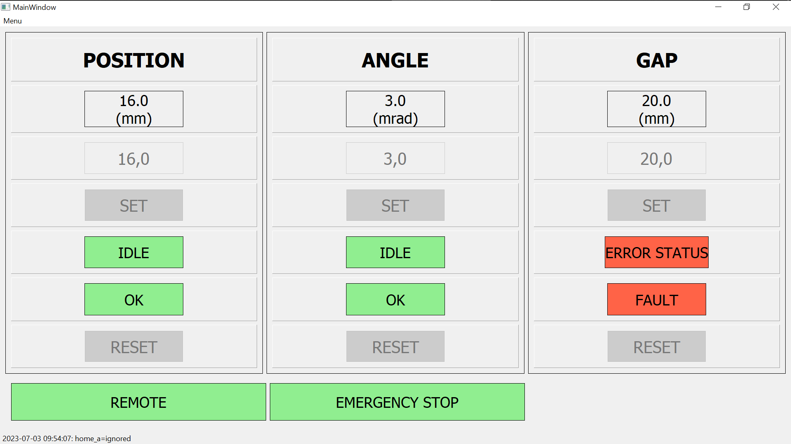
System controls cont'd
Remote displacement system software
C++ software running on the Industrial PC provides the following functionalities:
Interfaces CNAO control system using a custom ASCII-based protocol
Interfaces the Stögra stepping drivers using their custom ASCII-based protocol
→ translates the remote CNAO commands to Stögra driver commands
Provides additional logic such as potentiometer surveillance, calibration value recovery, etc.
Provides a local touch-screen interface

Slide 18
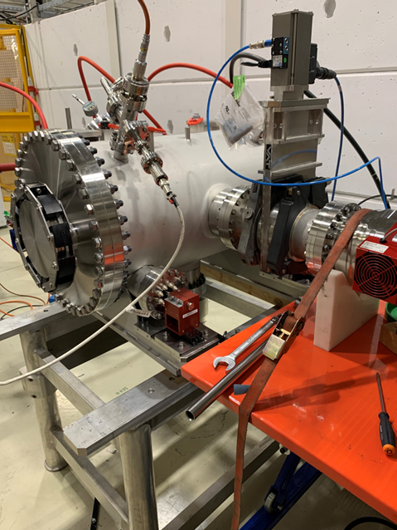
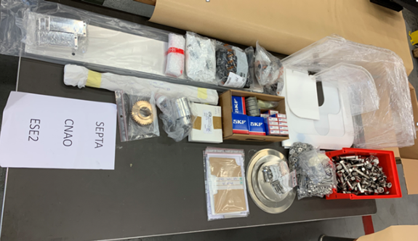
Some impressions
After final assembly.
Undergoing vacuum acceptance.
Spare parts were produced at the same time.

Slide 19
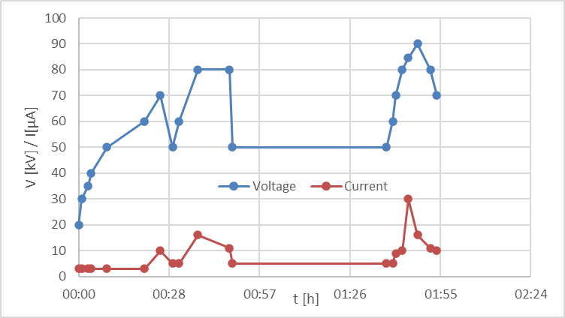
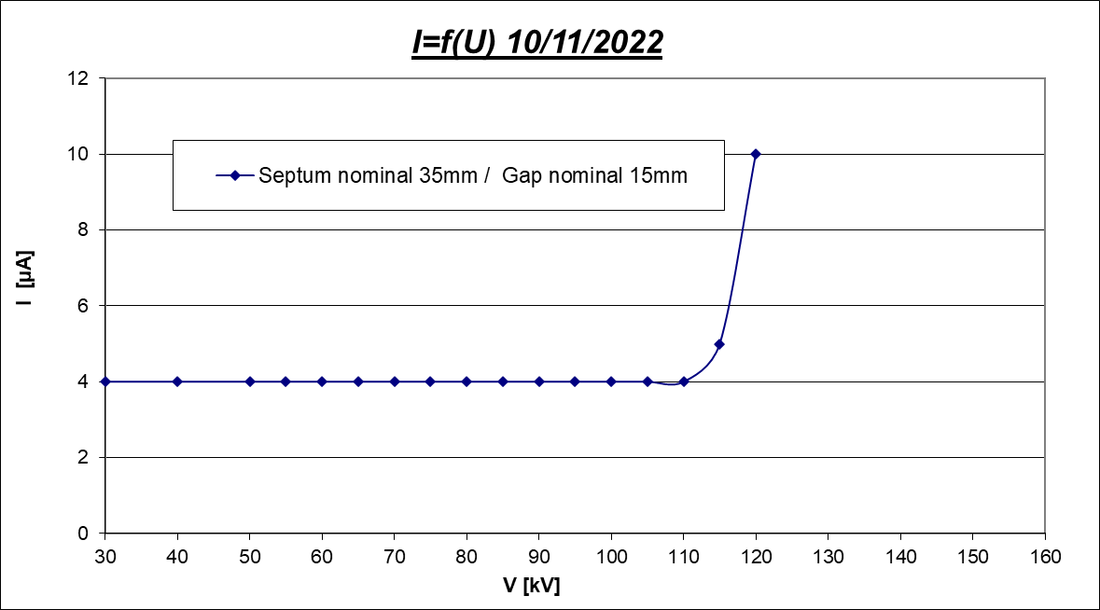
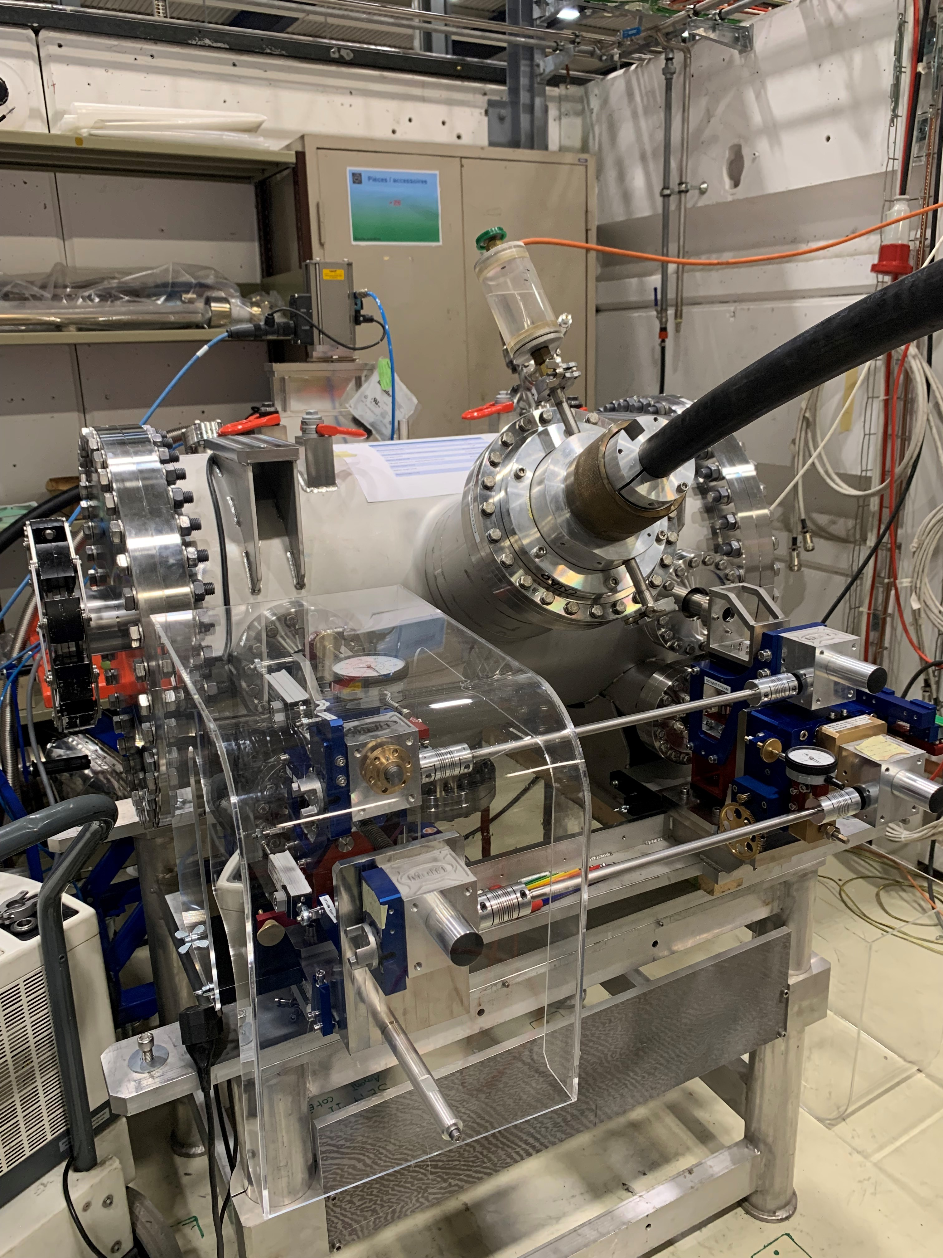
HV conditioning
Max. field achieved:
Gap nominal 15 mm : 7.3 MV/m
During HV conditioning, vacuum went from 2.10⁻⁸ mbar up to 5.10⁻⁷mbar.
Deconditioning test: after venting with dry nitrogen:
only 2 sparks at 90kV.
No current (i.e. < 4 µA) at 100kV.
Performance after conditioning in lab.

Slide 20
Outlook
System was assembled offline at CNAO in autumn 2023. Initial (remote) displacement tests conducted successfully.
Since then, some issues have come up with the displacement system, which are presently under investigation.
Next:
reliability run of remote displacement system.
HV conditioning at CNAO.
Installation in accelerator provisionally planned for 2025.

Slide 21
Lessons learned
Have the dynamic aperture of your design checked independently.
Foresee sufficient margin on max. field and in particular max. voltage the system can handle.
Remote displacement system controls need robust platform and in-depth testing; reliability run to be planned.
Conventional Cathode-opposite-anode layout easier to condition.

Slide 22
References
L. Sermeus et al., “The design of the special magnets for PIMMS/TERA” EPAC 2004, Lucerne, Switzerland
G. Venchi, “CNAO Electrostatic Septum at Extraction MK II - Functional Specification”, EDMS 2453514, CERN, 2020
J. Borburgh, “Conceptual design report CNAO Electrostatic Extraction Septum ESE2”, EDMS 2453525, 2020, CERN
G. Venchi, “Functional specification for the displacement system of ESE2”, CERN EDMS 2680560, 2022
C. Martinez Martin, “CNAO electrostatic septum positioning system (ESE2) system definition and control interface”, CERN EDMS 2645088
J. Borburgh et al., “Conceptual design report CNAO electrostatic extraction septum ESE2”, CERN EDMS 2453525

