Slide 1
Electrostatic Septa Development at FNAL
Fermi National Accelerator Laboratory
Matthew Alvarez and Kathrine Laureto
5th Slow Extraction Workshop at MedAustron in Wiener Neustadt
13 February 2024

Slide 2
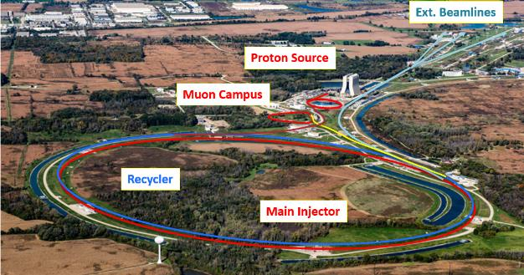
Introduction
Mu2e experiment will study rare neutrinoless decays of muon to an electron
Septum: foil ribbons
Top Functional Requirements
High extraction efficiency:
Greater than 98.5%
Radiation stability:
2+ years of operation
Beam Parameters | Nominal Value
Particles Type | Protons
Kinetic Energy | 8.0 GeV
Spill Duration | 43 ms
Total Number of Protons in a Spill | 1e12
Beam Power | 8 kW
Septa Kick | 2 mrad
Septa Active Length | 3 m
Wilson Hall
ESS2
Quad magnet
ESS1

Slide 3
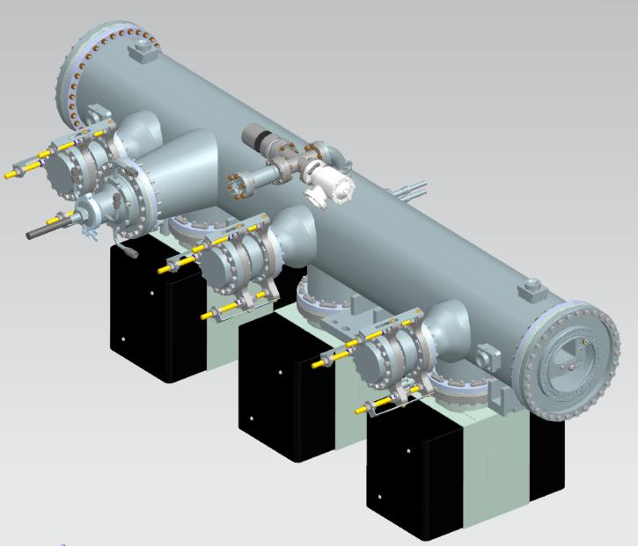
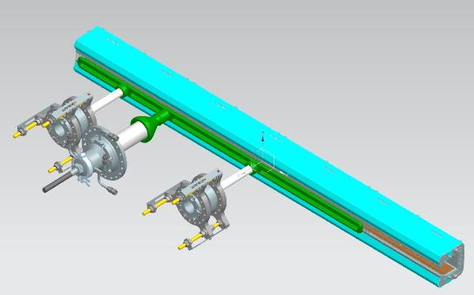
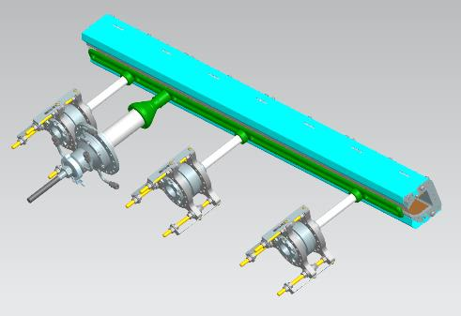
Mechanical Overview
Instrumentation Cross
20kV SHV Feedthrough
Frame Assembly
Cathode
High Voltage Feedthrough (HVF)
Cathode Standoffs (CS)
Vacuum Vessel
Instrumentation Cross
3x 300L/s Ion Pumps
HVF
Vacuum Vessel
Beam Direction
CS
ESS1 (544 foils + 1 diffuser)
ESS2 (643 foils)
Frame
HVF
HVF
CS x2
Cathode
CS x3

Slide 4
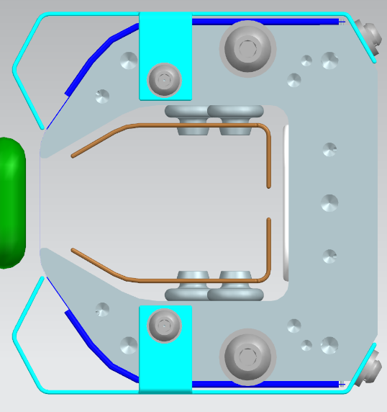
Mechanical Overview: Frame Assembly
Baffles
Springs
Frame
Interchangeable for ESS1 and ESS2
Material: Aluminum 7075
Length: 171.5cm
Springs
17-7PH CH900 Stainless Steel springs
Both tensions (1kg) and retracts the foil ribbon
Higher foil retraction speed ~80m/s (290kph or 180mph)
Clearing Electrodes
±8kV provided by 20kV SHV
Clearing electrodes
Frame
Springs

Slide 5
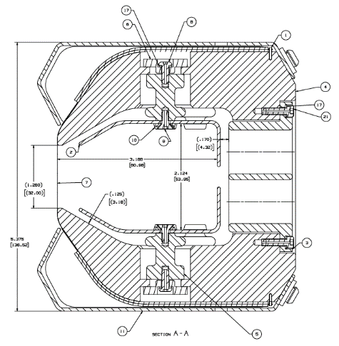
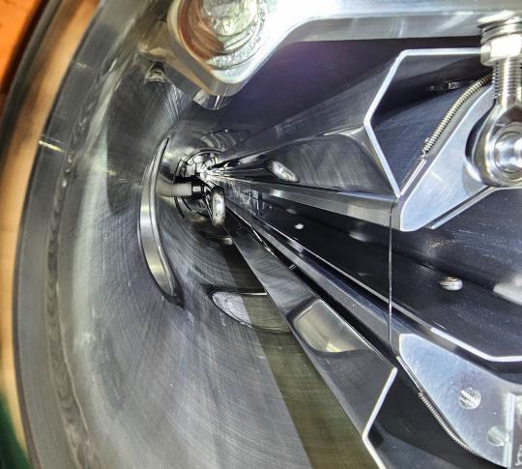
Mechanical Overview: Frame Assembly
Foil Ribbons (W3Re)
Tungsten-Rhenium foil
25µm thick x 1mm wide
Higher mechanical tension than wires
Narrower beam cross section than wire
100µm (MI-52 Septum) vs. 25µm (Mu2e Septum)
Diffuser Foil
ESS 1 Diffuser length: 33.9cm
50µm thick W3Re diffuser foil
Looking into Titanium foil, 70µm
ESS1
Diffuser foil

Slide 6
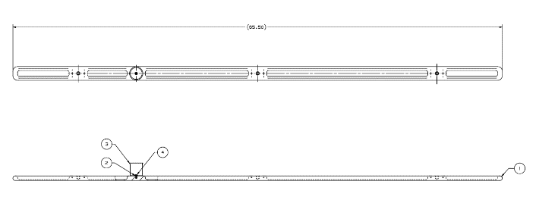
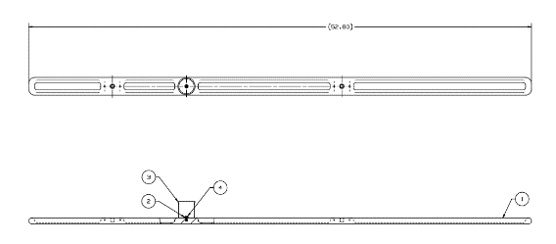
Mechanical Overview: Cathode
ESS2
Material: 304SS
Mechanical Polish: Ra=0.05µm (2µin) with a mirror finish
ESS1 Cathode
Length: 133.6cm
ESS2 Cathode
Length: 166.4cm
Adjustable gap between cathode and foils
Pockets machined to minimize weight
Reduces cantilever stresses on ceramic standoffs
Plan to use electropolishing on the cathodes
ESS2
ESS1

Slide 7
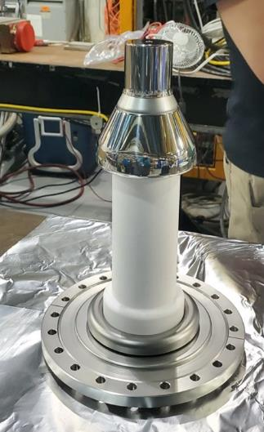
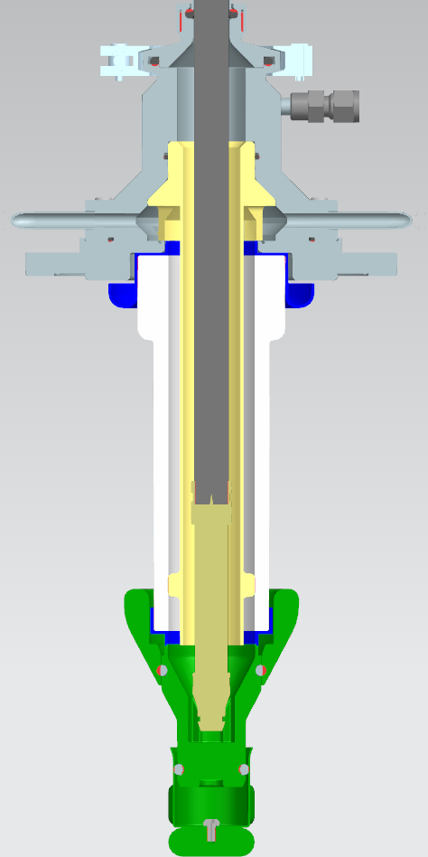
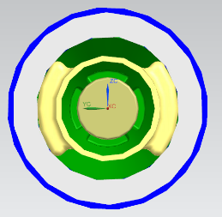
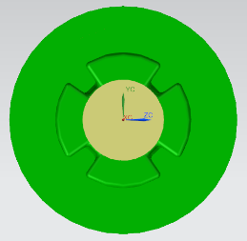
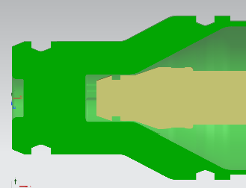
Mechanical Overview: High Voltage Feedthrough (HVF)
Materials
PEEK (yellow)
Al203 (white) ceramic
304SS (grey and green)
Kovar (blue)
3M FC-40 liquid dielectric
47Ω resistor
Plunger assembly
Maintains electrical continuity for different cathode-anode gaps
Out
In
B
B
A
Plunger Assembly
47 Ω Resistor
A
Section B-B
Section A-A

Slide 8
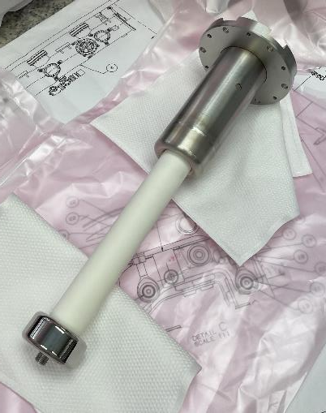
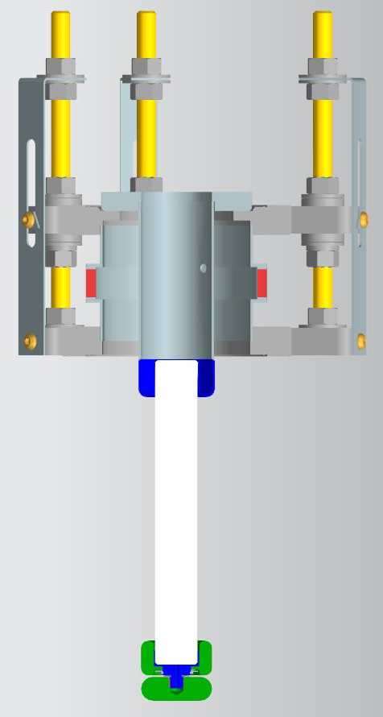
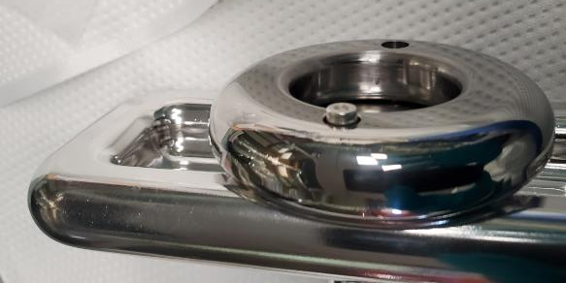
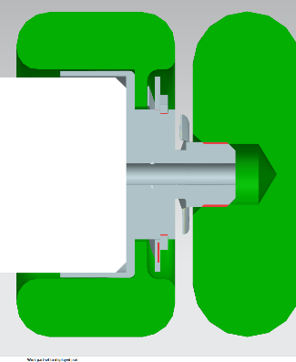
Mechanical Overview: Cathode Standoff (CS)
Port Aligner
Supports the cathode
Materials
Al2O3 (white) ceramic
304SS (grey and green)
Kovar (blue)
Port Aligners
Cathode-Anode gaps of 5-20mm
New Re-entrant Skirt Design
Old Re-entrant Skirt Design
Cathode
Wavy Washers
Cathode
Cathode

Slide 9
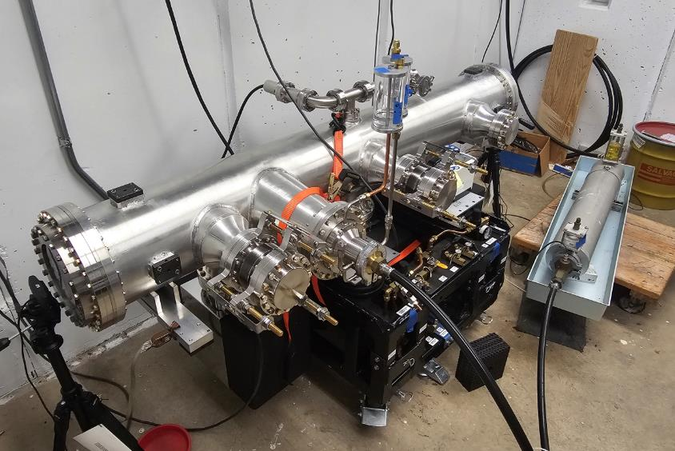
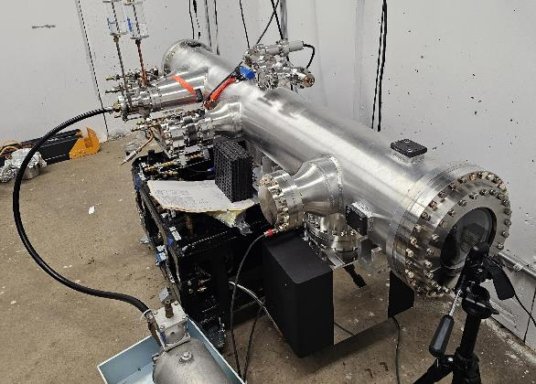
Mechanical Overview: Vacuum Vessel and Fully Assembled Septum
ESS1 Production Septum
Instrumentation Cross
CS
CS
HVF

Slide 10
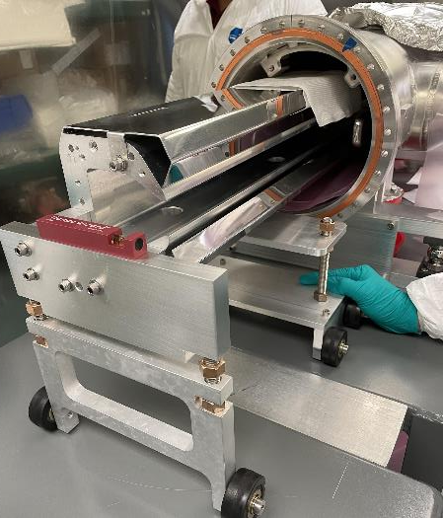
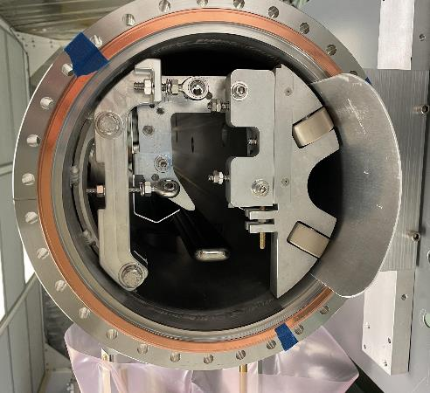
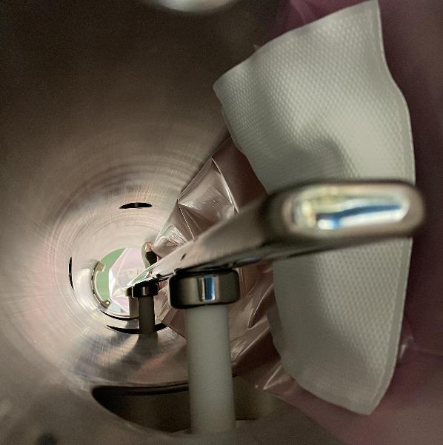
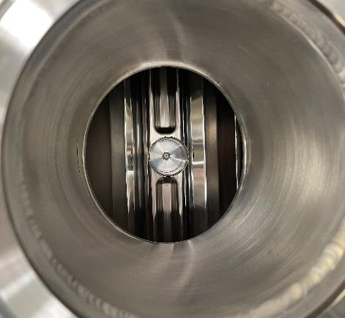
Assembly
Install cathode
Install frame
Install HVF
Step 2
Step 2
Step 1
Step 3

Slide 11
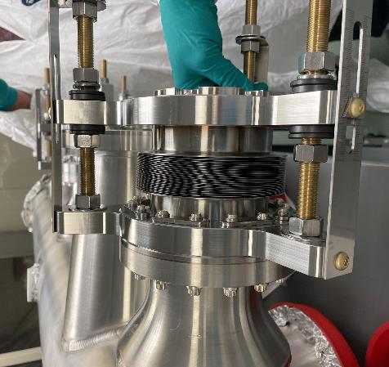
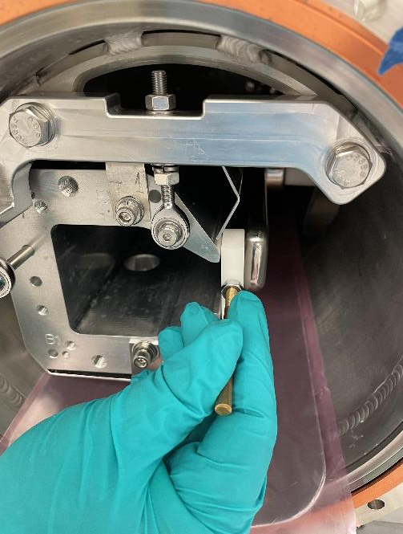
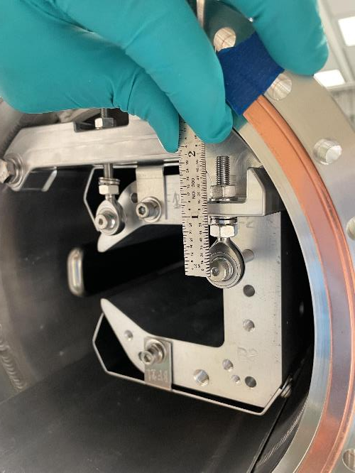
Assembly
4. Set gap between frame and cathode
5. Reference septa to external fiducials (not pictured)
Step 4
Step 4
Step 4

Slide 12
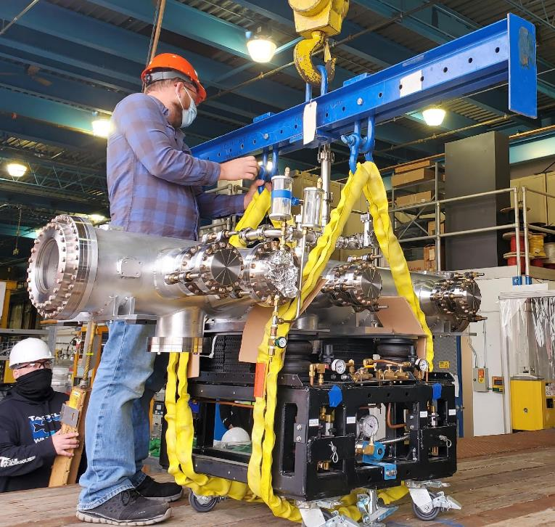
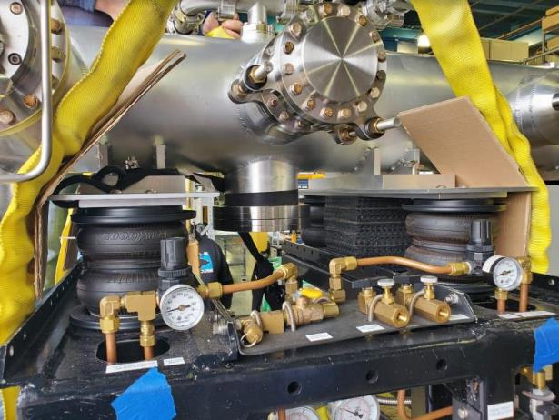
Transportation
Transportation of septum from assembly facility to Muon delivery ring (2.7km or 1.7miles)
Septum uses rubber cribbing to dampen any shock from transport
Truck speed limited under 5 mph (8km/h)
Rubber Cribbing
Transport Cart

Slide 13
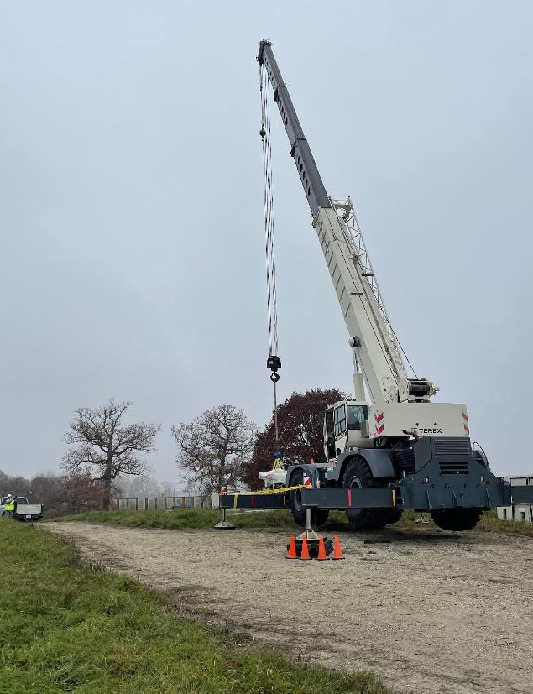
Transportation
ENDAQ sensors used
Data range up to 20g
Sample rate 1000Hz
Pressure, temperature, and humidity measurement taken at 1Hz
Sensor placement (3 total)
2 accelerometers placed on the vacuum vessel
1 sensor placed on the truck
Measured entire process from rolling on the floor to lifting it with cranes
Largest acceleration measured during transport: 1.7g (max 2g)
Septum

Slide 14
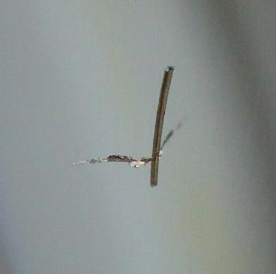
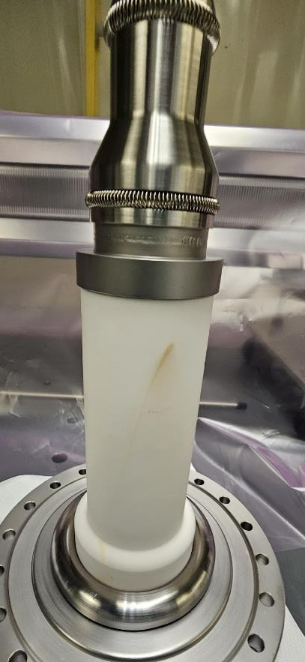
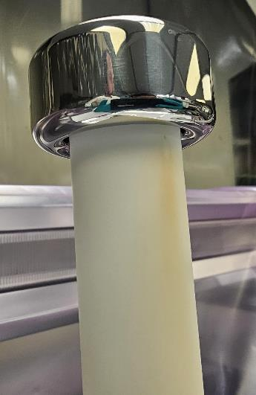
Challenges and Puzzles
Shortage of vendors
Loss of expertise
Cathode, frame, foil ribbon, and polishing vendors
Dust and particulate mitigation in the septa
Finding a replacement for FC-40
HVF
HVF
CS

Slide 15
Current Status
Built and tested the full-scale prototype of ESS2
Installed the prototype in the Muon delivery ring
Updated the production septa design from lessons learned
Assembled the first production septum ESS1
Conditioning/troubleshooting
Began assembly of the production septum ESS2
Looking forward for running them in beam in 2024

Slide 16
Thank you!

Slide 17
Optional Slides of Interest

Slide 18
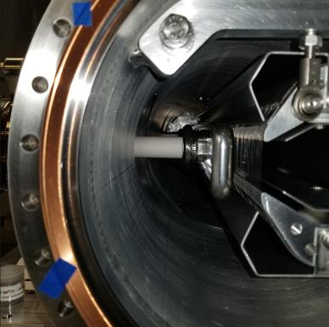
High Level Overview
Mechanical and Electrical Requirements
Number of Septum units: 2
ESS1
Cathode length is 133.6cm
544 foils + 1 diffuser foil
ESS2
Cathode length is 166.4cm
673 foils
Foil
Spacing: 2.54mm
Total active length of septa: 3m
Total Kick: 2mR
Electric Field strength: 100kV (nominal)

Slide 19
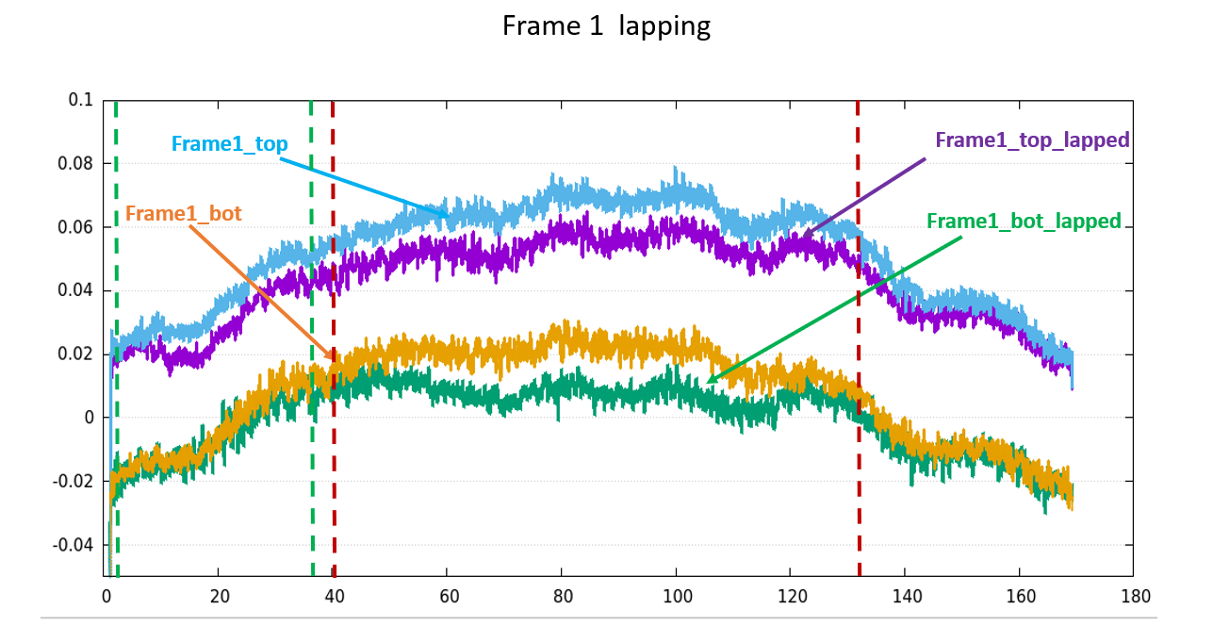
ESS 1 Frame 1 Measurement Data

Slide 20
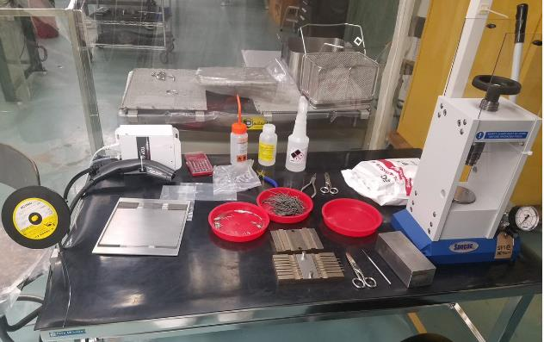
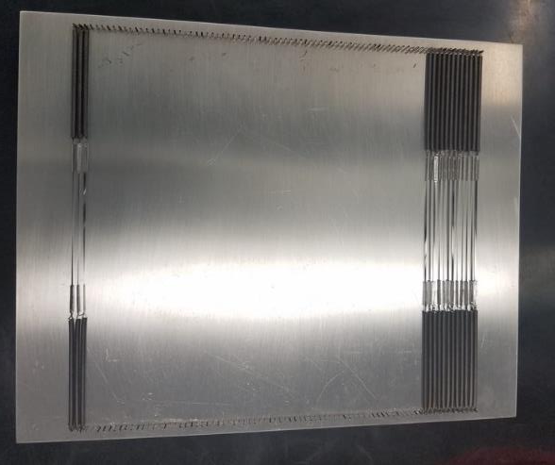
Foil Production
Fabricated onsite
On-the job training required for technician
Foil vendor: H. Cross Company
Material certificates required
Foil measurement tolerances required
Material: W3Re
Foil Geometry
Foil width is .040” (1000um) ±.003” (76.2um)
Foil thickness .001” (25um) ±.0001” (2.5um)

Slide 21
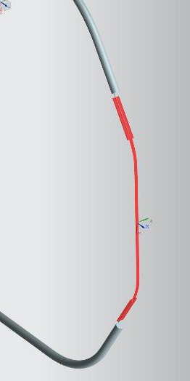
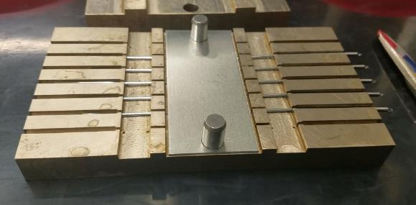
Foil Production
Foil Storage Fixture
Springs and Tubes
304SS Ferrule
N2 Gas (ionizing)
Press
W3Re Foil
17-7PH SS Spring
W3Re Spool
Crimping Fixture
Foil Assembly
Produce 5 foil assemblies at one time
25 tons required to crimp the joint
2.5 tons per crimped joint
Press
SPECAC 25 ton press
Foils will be tested to certify and ensure the load is sufficient and the tool is not wearing.
W3Re Foil
17-7PH SS Spring
304SS Ferrule

Slide 22
Assembly: Cleaning Septum Parts Procedure
Goal: Ensure all parts are cleaned to achieve the best vacuum (E-9 torr)
Processes for cleaning parts (depends on the part)
Dawn dish soap
DI water rinse
Ultrasonic tank
Drying with N2
Alcohol bath
Alcohol wipe
Procedure Outlines
Cleaning of hardware
Cleaning of specific septum parts (frame, ceramics, cathode)
Materials to be cleaned
304SS, 316SS, 18-8SS, 17-7PH SS, W3Re, Al 6061, Al 7075 (frame), Kovar, Al 203, silver plated bolts, PEEK, Nylon, ABS, etc.

Slide 23
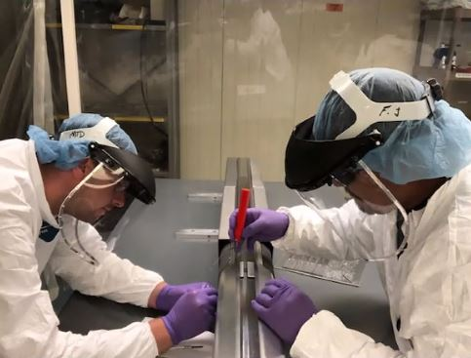
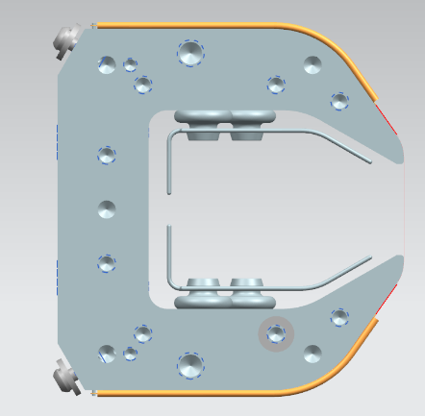
Assembly: Installing Foils onto the Frame
Two people are required, one on either side of the table
Hazard analysis required for access into the cleanroom

Slide 24
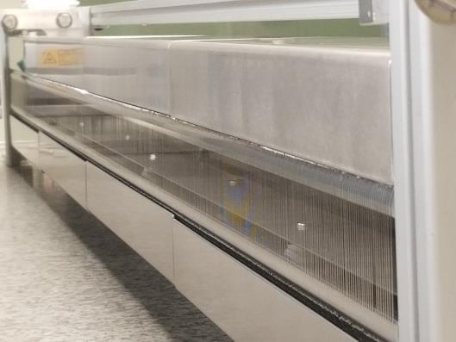
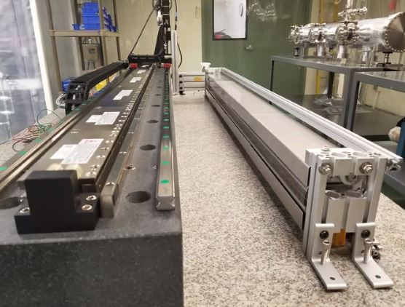
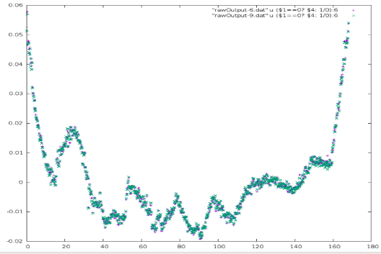
Assembly: QC Frame (Prototype)
+x
0.060
0.050
0.040
0.030
0.020
0.010
0.000
-0.010
-0.020
Diffuser area
Shadow area
+x
80μm
Frame will be measured to see if it is acceptable
If not acceptable, we will need to machine it again with the geometry we require
Send back to vendor
Hand lap and measure to achieve desired profile
Align the foil plane relative to the beam
Forward and backward

Slide 25
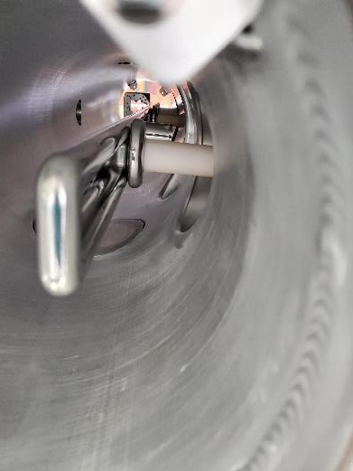
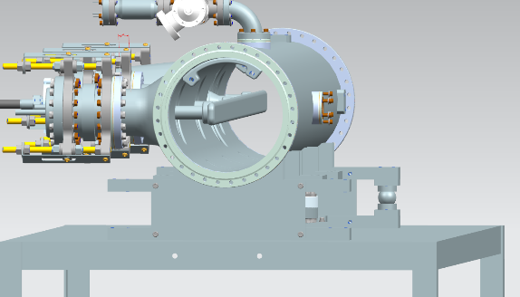
Assembly: Installing Cathode
Port Plug
3 people required
Two people to support the cathode on each end
One person installs cathode standoffs
Ion pump port plugs are installed prior to be placed on the die cart

Slide 26
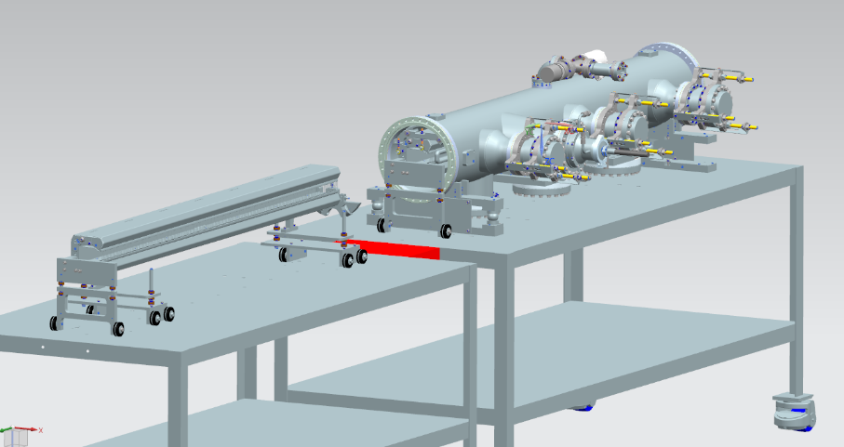
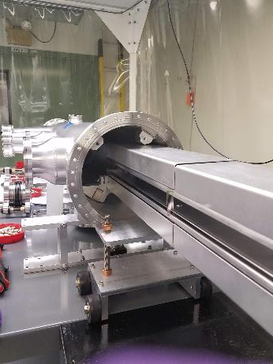
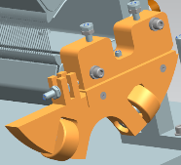
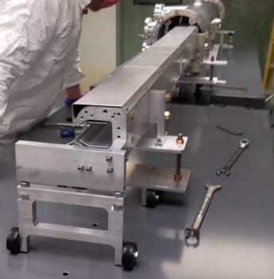
Assembly: Installing the Frame
Frame vessel installation fixture
Trolley
Frame Push Fixture
Trolleys are attached to the back of the frame
Both are removed gradually until the frame support brackets are installed
Frame vessel installation fixture
Rolls the frame within vessel
Frame push fixture
Supports the frame to allow the frame support brackets to be installed

Slide 27
Assembly: Installing the Frame
Frame support bracket
Frame vessel installation fixture
Frame push fixture
Frame support bracket is installed while fixtures support frame within the vacuum vessel
After brackets are installed, the supports are removed
Cathode and frame are aligned
Frame support bracket

Slide 28
Assembly: Placing Septum on Transport Cart
Septum is placed on slings and placed on the transport cart
Ion pumps are installed
Vacuum flanges are installed

Slide 29
Transportation Data: Vessel Sensor P13
1
2
3
4
5
6

Slide 30
Transportation Data: Truck F50 (Truck only)
5
4

