Slide 1
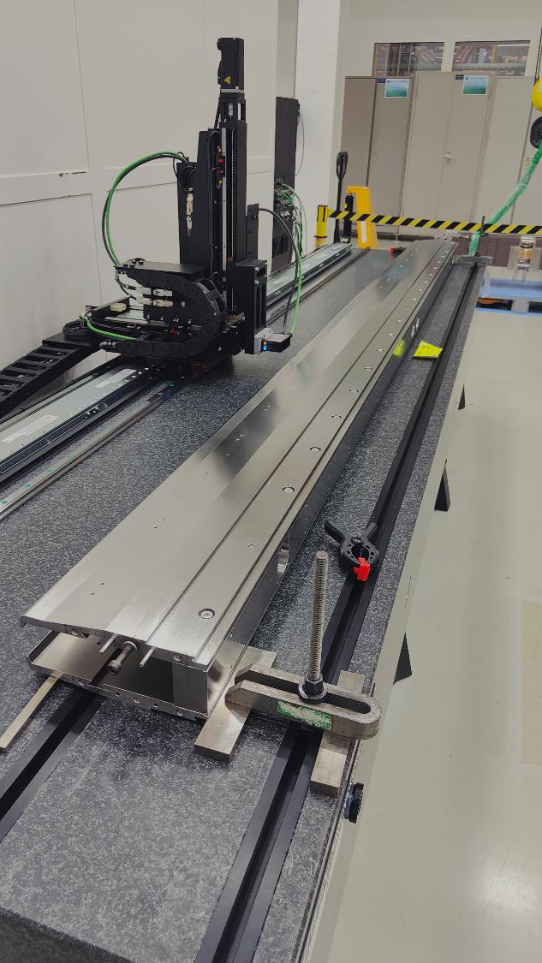
Development of Low-Z septa for CERN's future FT programme
F. Lackner, B. Balhan, J. Borburgh, M. Fraser, L. Jorat, A. Prost,
F. Pirozzi, N. Roudaut, T. v. Uffelen
SX workshop 2024

Slide 2
Outline
Introduction
ZS Low-Z vacuum tank
Study of Low-Z anode
Anode straightness QC
Conclusion

Slide 3
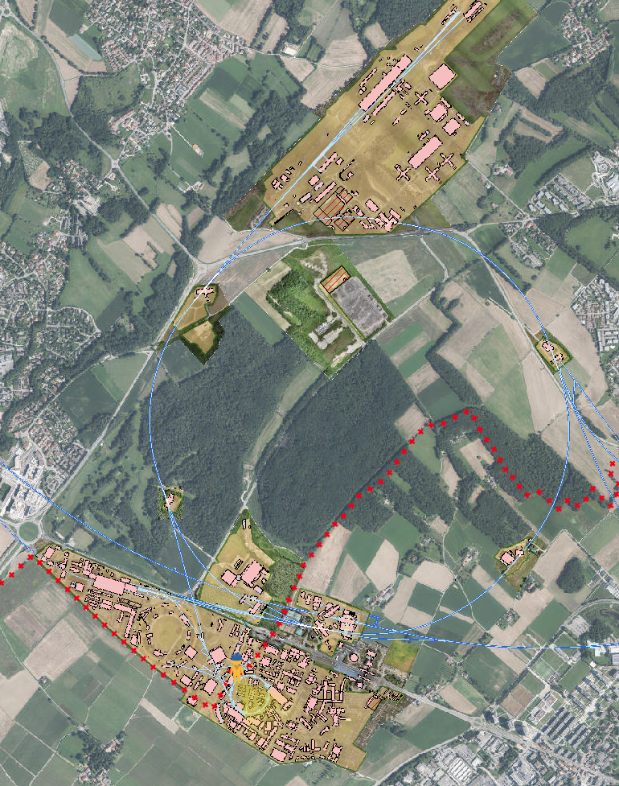
Introduction I
North area
Prévessin
LSS2
Electrostatic septa (ZS) are used in the SPS accelerator, in LSS2, to provide particle beam to the North Area by the slow-extraction process.
(400 GeV/c into the TT20 tunnel, leading the beam to the TCC2 target area)
SPS
Meyrin

Slide 4
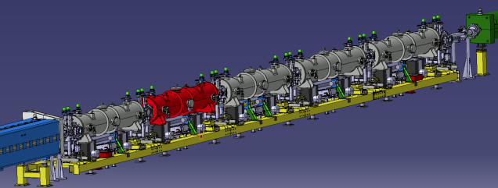
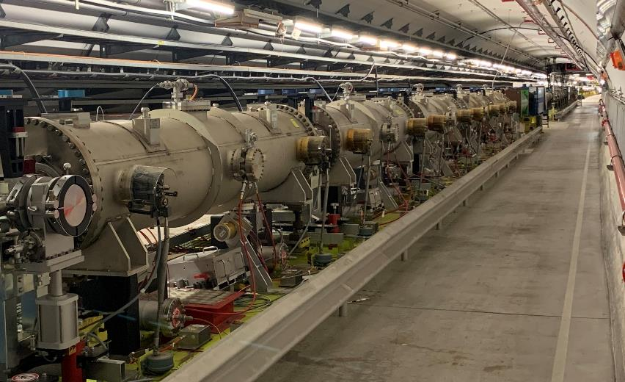
Introduction II
Highest activation on ZS2
5
4
3
2
The current ZS extraction line consists of 5
consecutive modules.
The slow extraction process provokes beam losses which results in high machine activation, reduced component lifetime and severe limitations on personnel access and maintenance.
1

Slide 5
ZS – UHV tank and anode
Each module is composed by a UHV tank in stainless-steel 304L (300 kg) which contains
a stainless-steel or invar anode (~300 kg)
an aluminium cathode
The activation is due to secondary particle shower produced with primary interaction between the extracted particle beam and W26Re septum wires (Ø 60 & 100 µm).
Aim to replace ZS2 tank with low-Z alternative during LS3
Length: 3.3 m, Ø 580 mm
Circulating beam
Extracted beam
Cathode
Septum wires
Anode

Slide 6
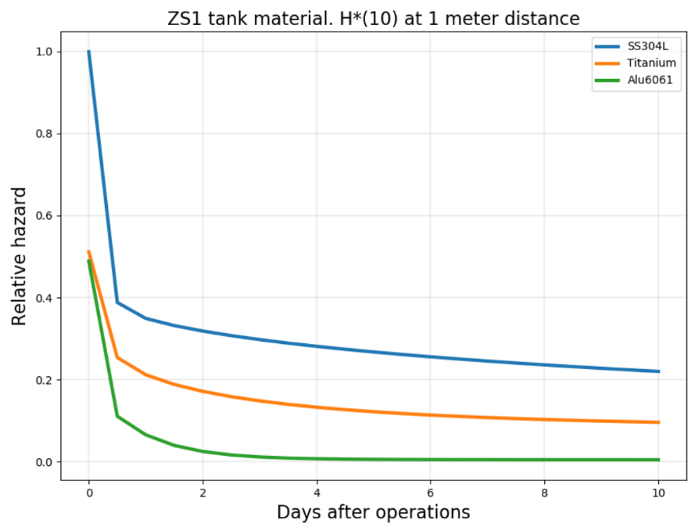
Low-Z tank design motivations
High interest to demonstrate feasibility of low-Z tank:
  Critical element in terms of activation
  Highly beneficial to reduce personnel dose rate
Aluminium providing the best reduction factor producing less dangerous isotopes with respect to stainless-steel
Faster cooldown with respect to titanium
SS304L
Titanium
Al6061
Relative hazard comparison between different material alternatives for the ZS1 tank [2].

Slide 7
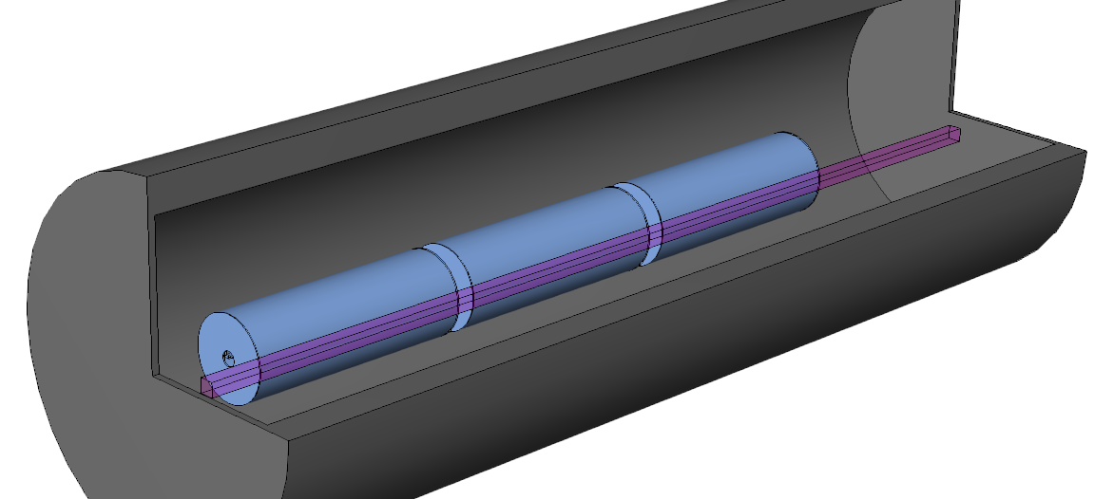
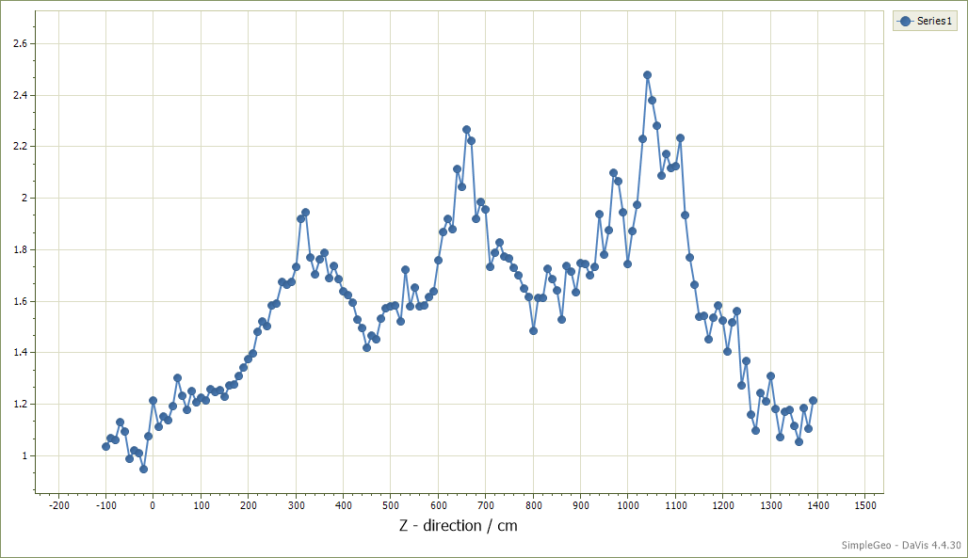
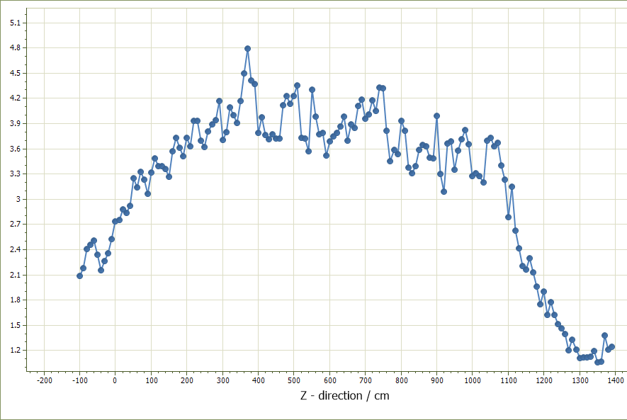
Dose rate comparison
Radiological impact of the material choice of the
ZS elements (HSE - H. Vincke)
Time Frame: 1-week cooling period.
Comparison Volume: Purple bar in picture.
Ratio of current material/low-Z
Szenario | Tank | Anode | Improvement
1 | 304L | 304L
2 | Al5083 | 304L | 2
3 | Al5083 | Al5083 | 4
1/2
1/3

Slide 8
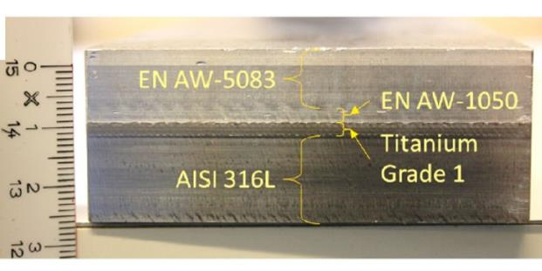
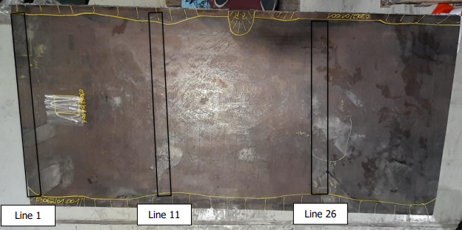
Choice of materials & boundaries
Titanium very challenging in terms of processing (forming, welding, extrusion…)
Selection of Aluminium EN AW 5083-H111, extruded feedthroughs. Widely used for UHV applications, high level of weldability, good extrudability, excellent atmospheric corrosion resistance
Implement explosive bonded low-Z bi-metal ConFlat flanges 316L-5083 (end covers + lateral ports)
Provide a compatible solution for tunnel integration / quick-disconnect flanges
Ensure long term stability (corrosion, allows several openings)
Manufacturing technology validation requires mock-up, welding tests, NDT…
Poster: Ana Teresa Perez Fontenla (CERN-EN) - Advancements in Low Z Materials: Comprehensive Characterization and Applications by the Mechanical and Materials Engineering Group at CERN
Layer 1: X2CrNiMoN17 13-3 1.5 mm
Layer 2: Ti Gr1 / EN AW 1050 H25 21.5 mm
Layer 3: EN AW-5083 H111
Explosive bonded bi-metal (EN-MME)

Slide 9
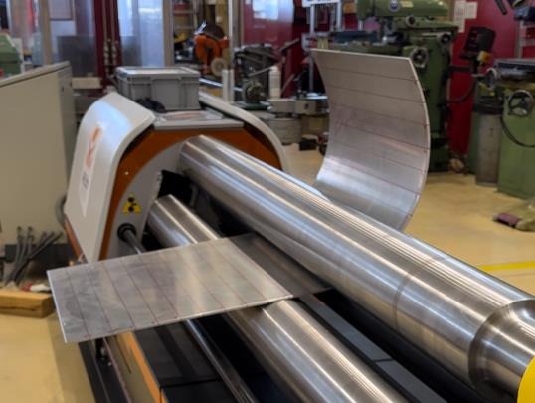
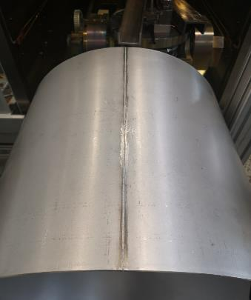
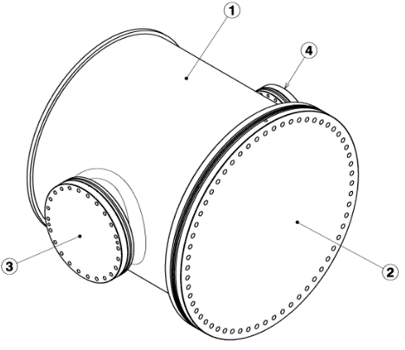
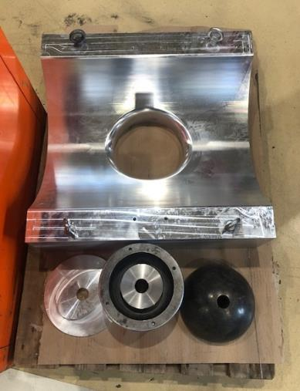
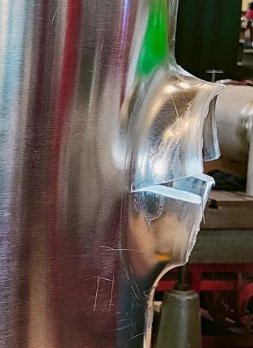
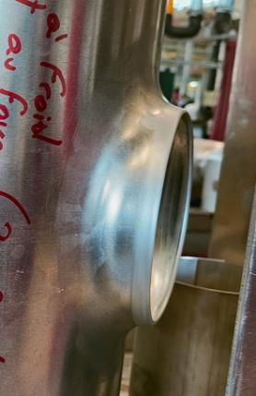
Short-length mock-up fabrication at CERN
Al plate rolling
EBW longitudinal weld
Large flange + cover from bi-metal material
Full validation of all procedures towards Q2
Objectives:
Manufacturing process validation (Al5083)
  Rolling, welding, port extrusions
Assembly test → welding of CF flanges
He-leak test → leak-tightness of non-standard CF sealing system
Cleaning & Ultra-High Vacuum test
High Voltage test
Welding tests & sample NDT
Extrusion at ambient temperature
Extrusion after heating at 300°C
Al vessel extrusion tooling
F. Lackner, SX workshop 2024 - Low-Z septa CERN

Slide 10
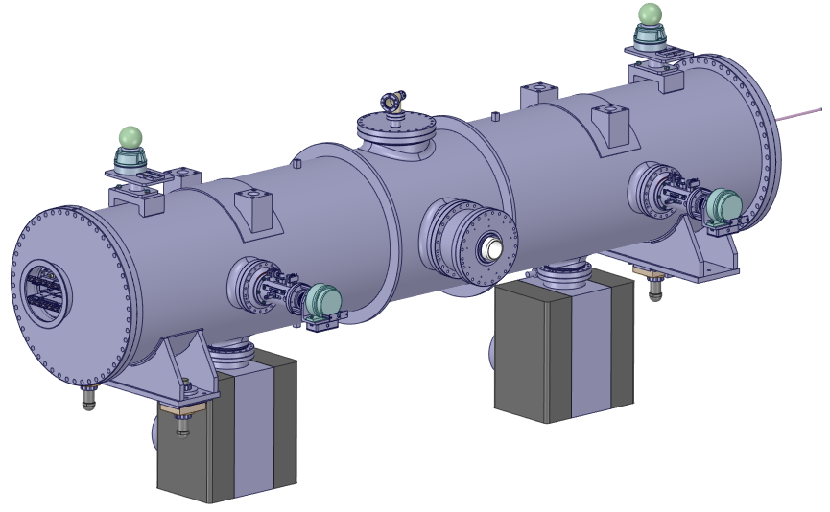
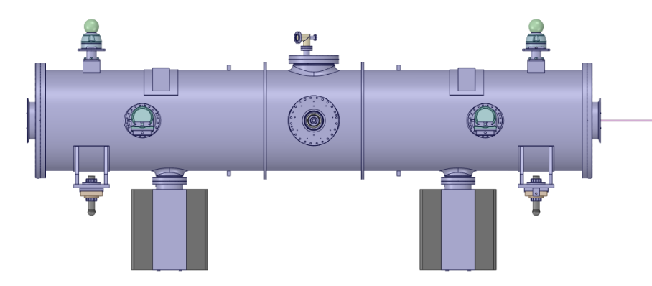

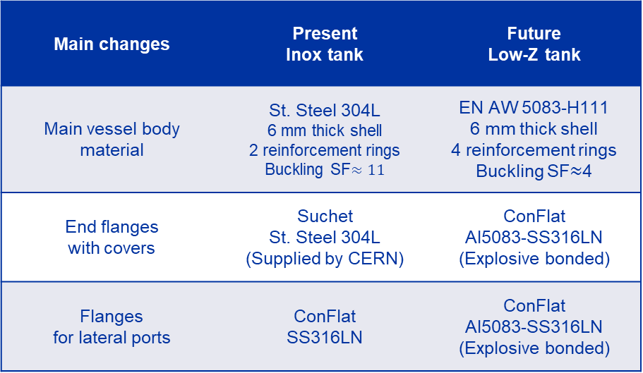


Stainless-steel tank vs low-Z tank
Main changes | Present Inox tank | Future Low-Z tank
Main vessel body material | St. Steel 304L 6 mm thick shell 2 reinforcement rings Buckling SF$≈11$ | EN AW 5083-H111 6 mm thick shell 4 reinforcement rings Buckling SF$≈$4
End flanges with covers | Suchet St. Steel 304L (Supplied by CERN) | ConFlat Al5083-SS316LN (Explosive bonded)
Flanges for lateral ports | ConFlat SS316LN | ConFlat Al5083-SS316LN (Explosive bonded)
Present ZS tank design
Current ZS tank design
Component | Present Tank | Low-Z Tank
Vessel body | 290 Kg | 109 Kg
Single end cover | 86 Kg | 40 Kg
Total tank mass (vessel body + 2 end covers) | 462 Kg | 189 Kg
$$680 mm$$
$$592 mm$$
$$≈3 m$$

Slide 11
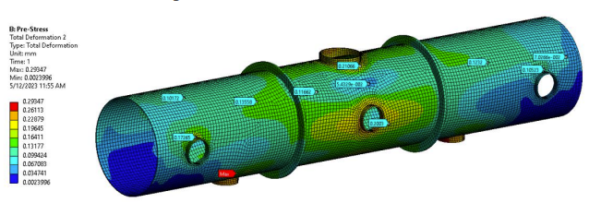
Analytical & numerical validation
Hybrid approach (EN AW 13445-3, FEA, analytics)
Analytical computation of the theoretic buckling pressure
Non-linear numerical model to confirm analytics
FEA non-linear buckling model (both 304L and Al5083)
Al vessel optimization (safety factor vs. mass)
Impact of stiffeners
FEA, deformation
Optimized solution [5]:
6 mm-wall thickness with 2 equally spaced stiffeners, SF = 4.8 considering a conservative cylindrical tolerance equal to 6 mm. SS304L (SF = 11)
Mass reduction respect to the stainless-steel by factor 3, while max total deformations during operation is 0.29 mm. SS304L (0.12 mm)
Currently we consider to add 4 stiffeners to further reduce the deformation while increasing the safety factor against buckling. SS304L (SF = 11)

Slide 12
Anode Low-Z development
Straightness:
Mass:
Thermal impact:
Support position
Minimize deflection
Wires
3rd center support
60 um
Geometry modifications
Increasecross-section?
Wire tension
Topology Optimization
Additive manufacturing
Materials
Classical machining
Al5083
Ti6Al4V
Passive cooling
Opt. thermal conductivity
Active cooling
Integration
Heat dissipation
Impact on Straightness
Replacing Invar anode by low density material (5083-H111) requires to study implementation of passive or active cooling (CTE Al 20x > Nilo36)
Thermal load and mass impact on straightness
Investigate heat load and thermal dissipation (implementation of additional PT100’s)

Slide 13
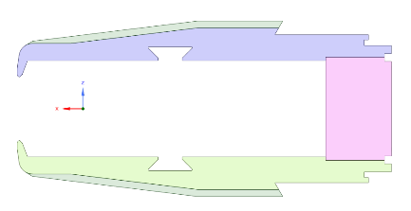
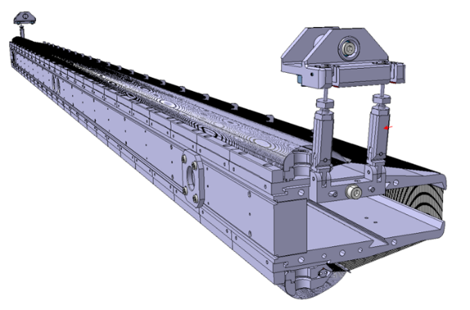
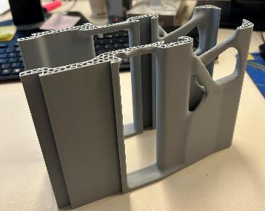
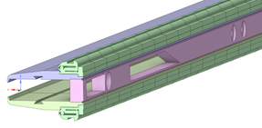
Anode activation – Low-Z?
Improved cross-section
3130 mm
210 mm
AM - segment
Improved topology
Contact points
2080 wires (W26Re), 291 kg
Invar (Nilo36) or inox (304L)
Topology optimization for a 300 mm segment, initially studied to be produced by AM
  AM not yet adequate in terms technology maturity (UHV, HV, cost, surface quality, dimensions)
Al5083, will increase straightness, optimization of support points to reduce long-term bending stress, while improving straightness
Optimization of cross-section
Wire to anode contact point definition varies in function of length

Slide 14
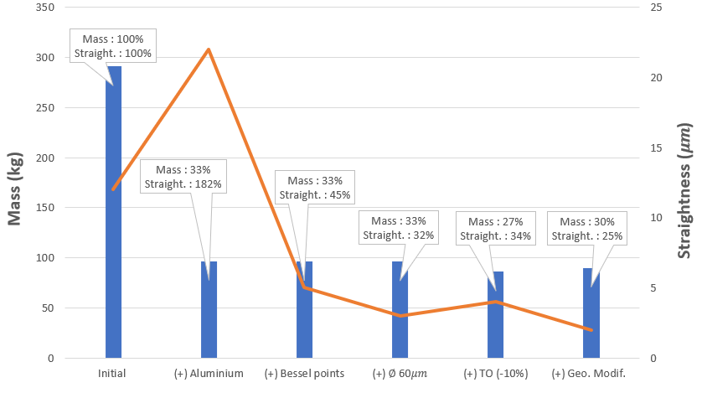
Low-Z anode – numerical results:
Material | Mass (kg) | Straightness (µm)
FeNi36 | 291 | 12
SS304L | 284 | 7
Ti6Al4V | 157 | 12
Al5083 | 96 | 22
Degrading straightness when changing towards Al5083
Further optimizations applied to reduce straightness to acceptable levels

Slide 15
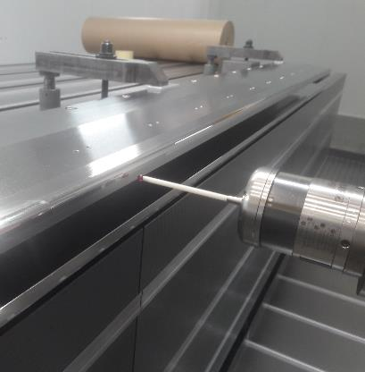
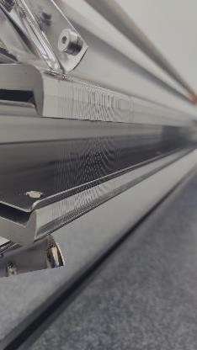
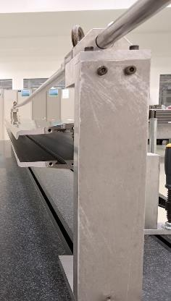
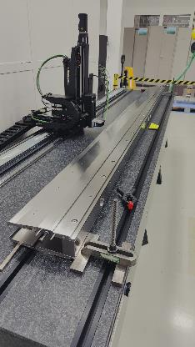
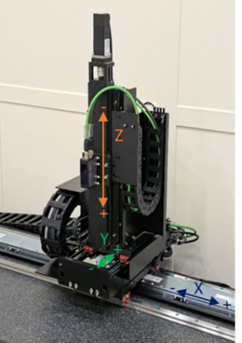
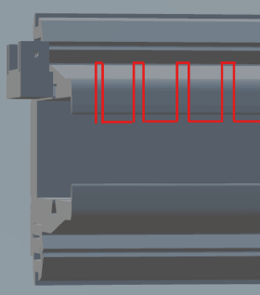
Anode machining & metrology
  Effective stroke (mm): X: 3200, Y: 100, Z: 250
    Positioning repeatability: 2 µm
    Positioning accuracy: 5 µm
Plastic deformation: mitigation by re-machining & ductile (~10 µm)
Commissioning of a new metrology bench:
  Sensor: Measuring range 30 … 70 mm (sweet spot 48 mm)
    Resolution: 0,7..1 µm, repeat. accuracy 0,1..0.3 µm
  Increase of accuracy and repeatability for QC
  Next step: UI implementation + metrology of wires
Validation:
80 anode positions,
18000 points

Slide 16
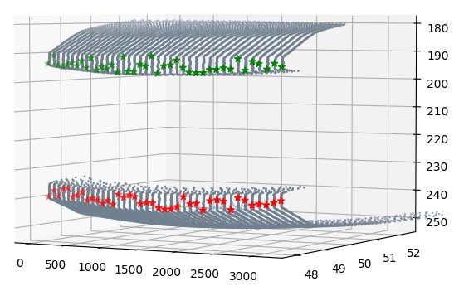
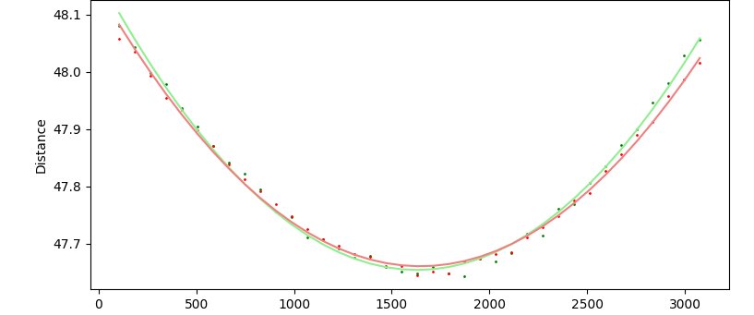
Straightness I
3D dimensional point cloud
  80 scans (bottom and top nose), 18000 points, ≈30 min
3D scatter plot (Matplotlib in Python)
  Rolling average of points, alignment correction
  Derive average straightness
2D plot of max deviation
  Compares to previous measurements by interferometer
 | Max (mm) | Min (mm) | Straightness (µm)
Top nose | 48.118 | 47.665 | 474
Bottom nose | 48.102 | 47.675 | 427

Slide 17
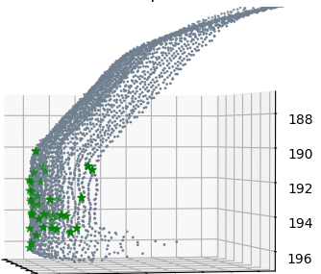
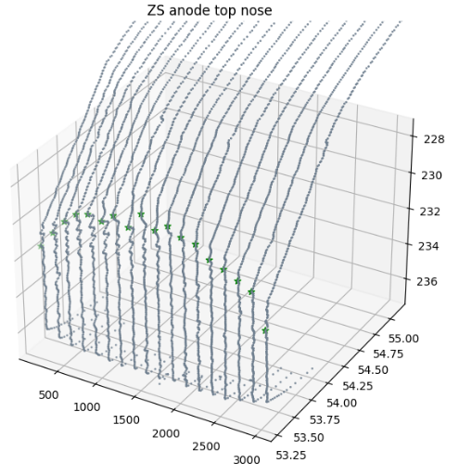

Straightness II
Before machining
After machining
Scan shows improvement of straightness due to machining
Metrology under equivalent support conditions
Measurements taken during linear translation
Implement static measurements
Improvements of machining under discussion, high complexity in supporting
Open task: Develop Metrology of wires
Finalization of control system incl. enhanced functions and UI
 | Max (mm) | Min (mm) | Straightness (µm)
Top nose | 48.118 | 47.665 | 474
Bottom nose | 48.102 | 47.675 | 427
 | Max (mm) | Min (mm) | Straightness (µm)
Top nose | 48.502 | 48.4 | 102 / 40*
Bottom nose | 48.557 | 48.488 | 69
* Top nose metrology under equivalent support condition as for milling

Slide 18
Conclusion and further work
Vacuum tank ZS2:
We aim to build a vessel from Al5083, replacing ZS2 in the LSS2 extraction region during LS3
This allows reducing the dose impact by a factor 2 (considering a 1 week cool down), mass reduction by 67%
Mechanical design, numerical validation has been finalized, manufacturing strategy will be validated based on 1 m long mockup
The construction of mockup advancing, full validation expected in Q2, 2024 (TIG, EB welding, extrusions, cleaning, HV feedthrough, BM-CF-flanges, UHV performance)
Anode:
The anode design has been optimized based on the Al5083 alloy, showing potential to further reduce activation by factor 4 while improving straightness on pure structural assessment
Replacing the Invar36 with Al5083 implies consequences on the thermal impact, studies ongoing
Metrology:
Commissioning ongoing, enhancing anode QC, reveals potential further improvements with respect to machining & nose/wire contact interface.
Control system and UI are currently in development, fully automated process, high accuracy

Slide 19
References
[1] J. Borburgh et al., “Experimental Results of Low-Z Materials as a High Voltage Septum Anode”
[2] D. Bjorkman, “Alternative Material Choices to reduce activation of extraction equipment”
[3] M. Fraser, “Improvement to the SPS Slow Extraction for High Intensity Operation”
[4] H. Vincke, “Dose rates around the LSS2 ZS elements”
[5] F. Pirozzi, “Design optimization of aluminium vessel for ZS extraction equipment via non-linear buckling analysis”
[6] F. Pirozzi, “Development of Low-Z Bimetallic ConFlat Flanges for ZS Tanks”
[7] F. Pirozzi, “Non-Straightness Study of the Anode Support for ZS Septa”
[8] N. Roudaut, “Study of a low-Z material-based anode for the ZS electrostatic septa”
[9] T.v. Uffelen, “Development of a control system for the ZS anode metrology”
[10] H. Vincke, “Study of RP improvements for the ZS elements in LSS2_technical note_vs2”
F. Lackner, SX workshop 2024 - Low-Z septa CERN

