Slide 1
Feasibility study for crystal shadowing in 8GeV
Slow Extraction at Fermilab
V.Nagaslaev (Fermilab)
5th SX Workshop, Wiener Neustadt
February 13, 2024

Slide 2
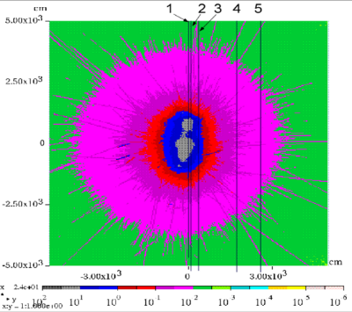
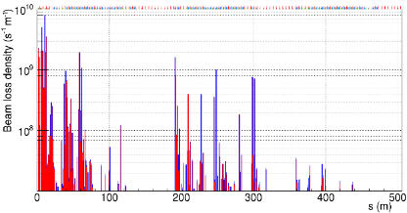
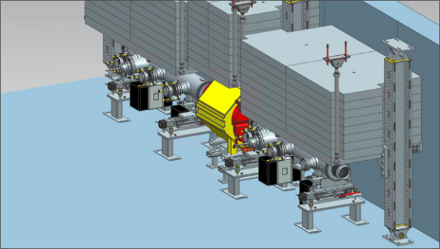
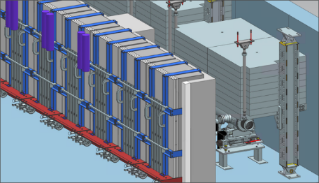
Slow Extraction from DR: Limitations from beam losses
8kW average beam power
Residual radiation
Activation and lifetime
Radiation at public areas
Deliver Ring (DR) shielding
Impact to the Mu2e experiment
Looking for additional mitigation
Parking Lot
Service building 30
Indian road
Losses in the Ring
Radiation levels on ground surface
In-tunnel shielding around the extraction septum

Slide 3
Using channeling in bent crystals at 8GeV
Is crystal shadowing feasible at 8 GeV?
Advantages:
Higher acceptance (critical angle)
Lower beam rigidity
Concerns:
Scattering is higher
Dechanneling processes are stronger
Beam angular dispersion is higher
Crystal:
0.2mm x 0.4mm x 25mm ?

Slide 4
Using channeling in bent crystals at 8GeV
Crystal shadowing successfully demonstrated at SPS
Is it feasible at 8 GeV?
Advantage:
Higher acceptance (critical angle)
Lower beam rigidity
Concerns:
Scattering is higher
Dechanneling processes are stronger
Beam angular dispersion is higher
Crystal:
0.2mm x 0.4mm x 25mm ?

Slide 5
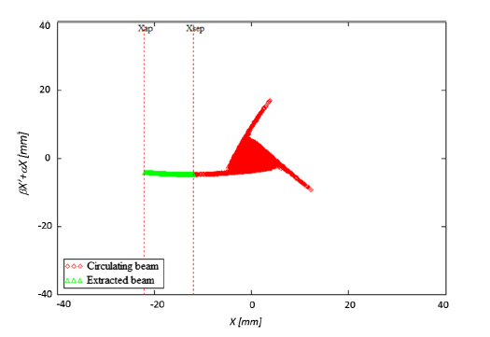
Using channeling in bent crystals at 8GeV
Circulating beam in DR:
angle spread is 10 times the critical angle
Extracted beam angles spread can be made very small
Constraints on extraction:
Low chromaticity
Low D/D’
Beam angle dynamic control

Slide 6
Modelling the crystal collimation (shadowing)
Proof-of-principle study using the fixed crystal geometry
Explore the crystal parameter space

Slide 7
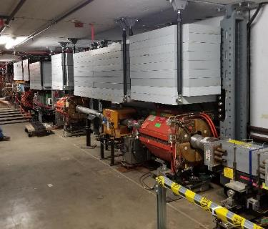
Modelling the effect of the crystal shadowing in the DR
Beam
Proposed tunnel location for the Crystal Collimator
Space available
Sufficient phase advance

Slide 8
Modelling the effect of the crystal shadowing in the DR
Beam
Proposed tunnel location for the Crystal Collimator
Space available
Sufficient phase advance

Slide 9
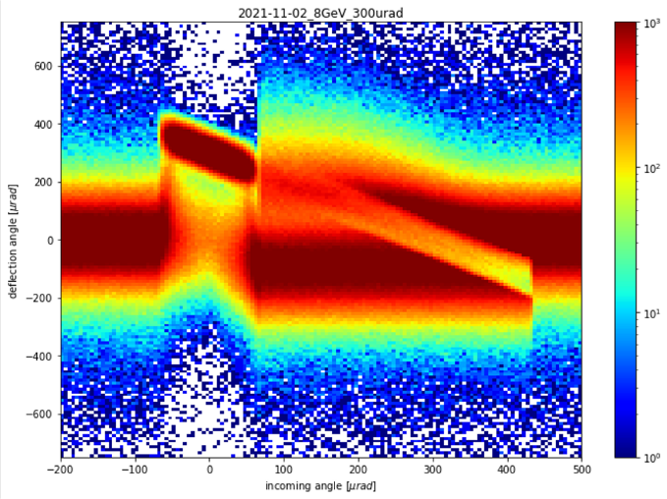
Proof-of-Principle Crystal Shadowing modeling – Phase I
Phase I
Transport in the crystal
FLUKA model
Compute the scattering PDF matrix
220x120, 5x5 uRad bins
Crystal parameters are fixed
L=0.4mm, 300uRad
CERN-Fermilab collaboration
Luigi Esposito, CERN, November 2021

Slide 10
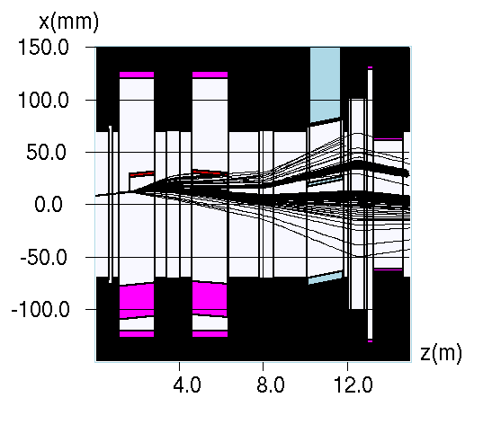
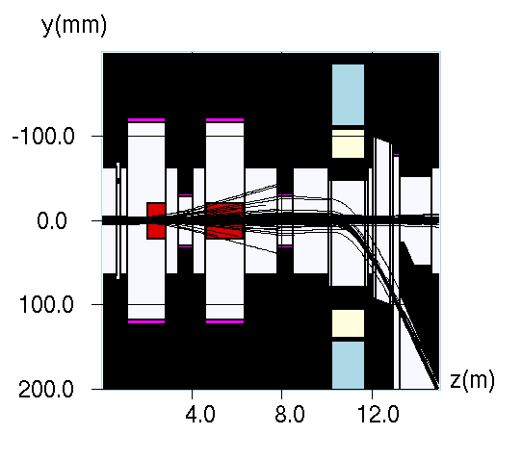
Phase II: Accelerator tracking using MARS
Delivery Ring “Extraction section”
Lattice elements:
ESS1
Q203
ESS2
Q204
Lambertson
C-Magnet
Aperture details
Crystal
Grossly exaggerated
No multi-turn tracking is needed

Slide 11
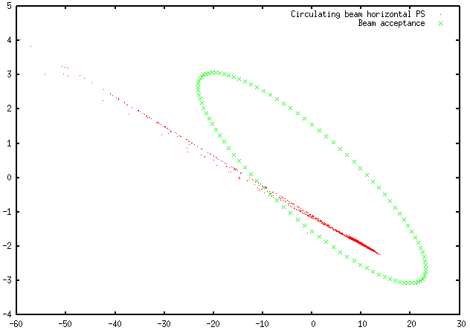
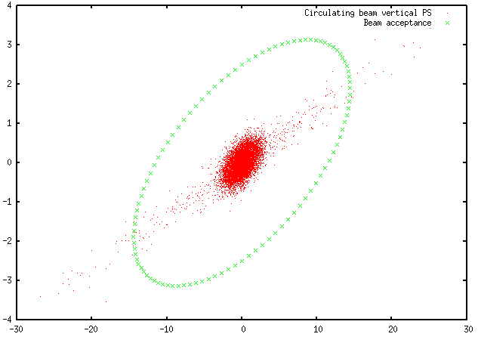
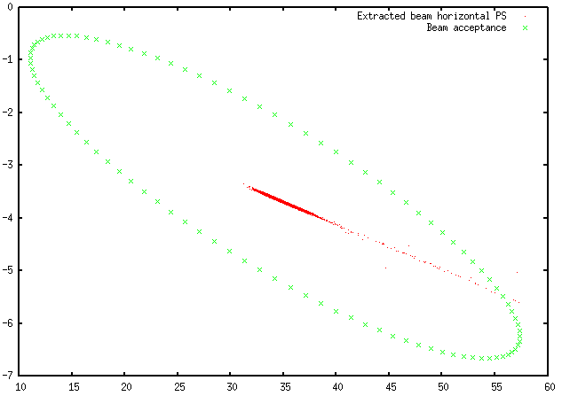
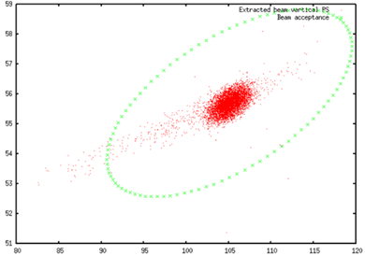
Efficiency calculations in the end of the Extraction section
Filter 1:
Pass through the Extraction section
(survived in tracking)
Filter 2:
Stay in the aperture
(within green ellipses)
Nominal Eff=98.5%
MARS tracking reproduces the design performance

Slide 12
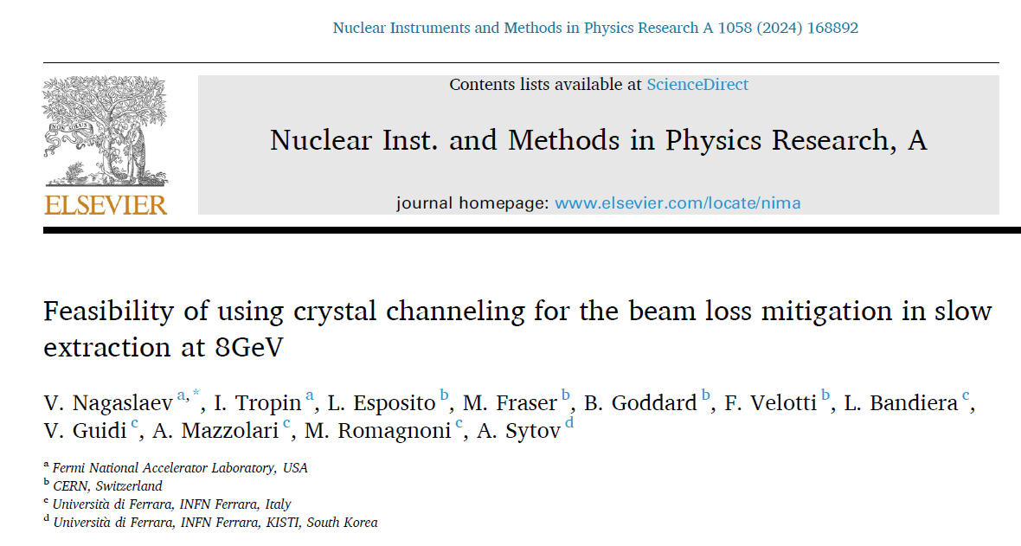
More details about Proof-of-Principle simulation
Detailed analysis of the Proof-of-Principle simulation studies is available online

Slide 13
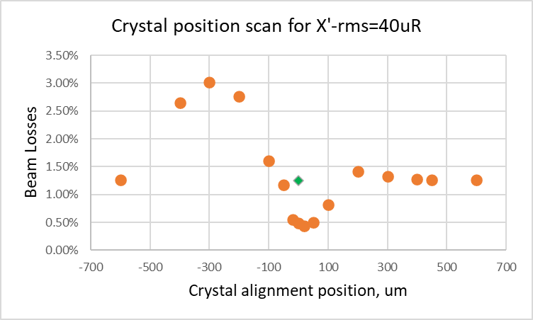
Effect of crystal channeling for the beam design parameters
x3 reduction
With beam divergence rms=40 uR, beam losses drop by over factor of 3

Slide 14
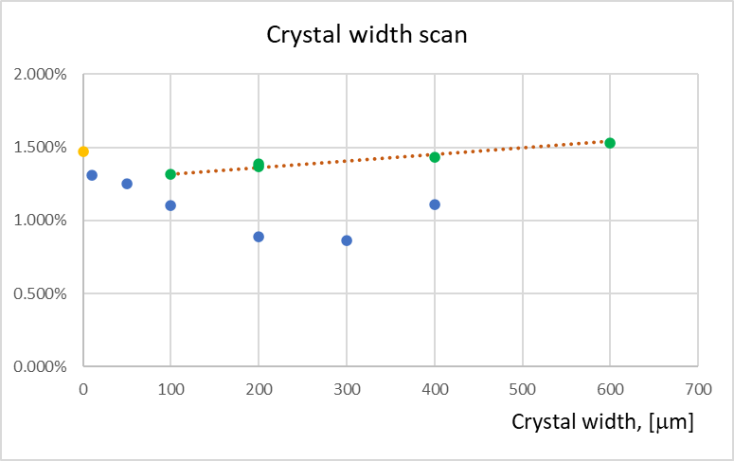
Conservative beam parameters: rms angle=80uRad
Losses with
no crystal
Amorphous
scattering, bulk Si
-41%
Losses with crystal
channeling on
The minimum loss point shows the 41% beam loss
reduction compared to no crystal configuration.

Slide 15
Crystal parameters optimization: WIP

Slide 16
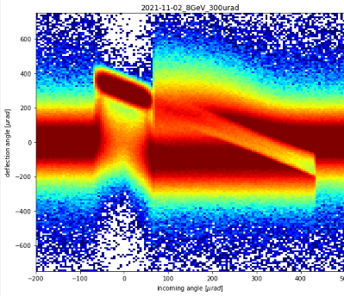
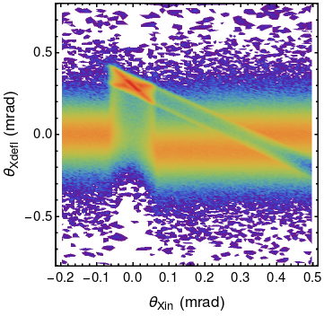
Crystal parameter optimization
To explore further the space of geometrical crystal parameters, we need PDF maps generated for each configuration
The PDF maps were provided by our Ferrara collaborators
Computed using GEANT extension (A.Sytov)
GEANT, b=300uR, L=0.4mm
FLUKA, b=300uR, L=0.4mm

Slide 17
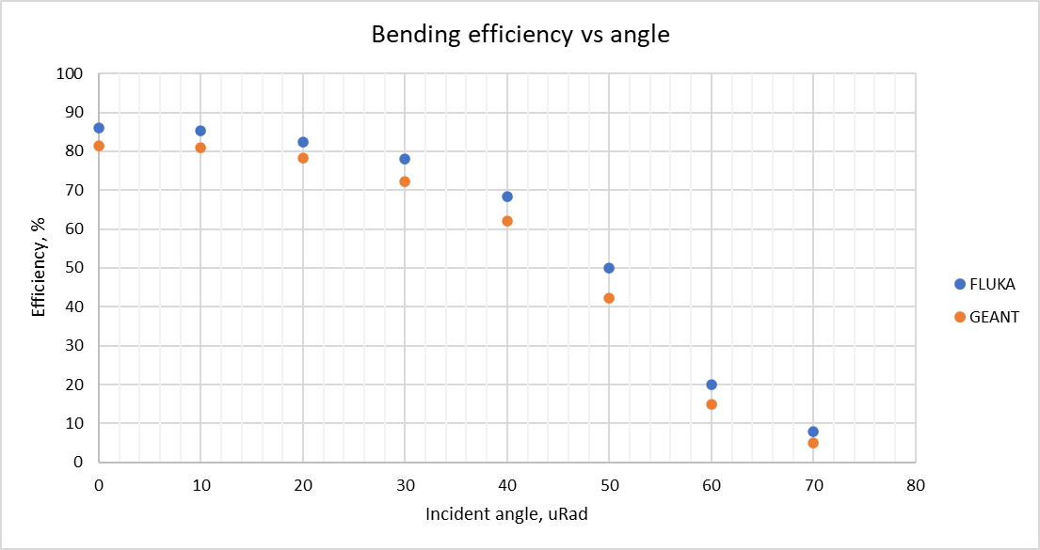
Bending efficiency comparison for 300uR bending crystal, FLUKA vs GEANT

Slide 18
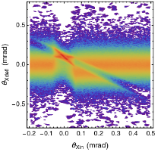
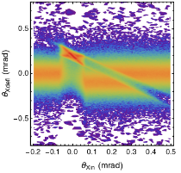
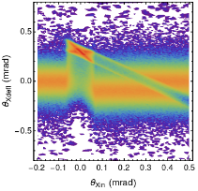
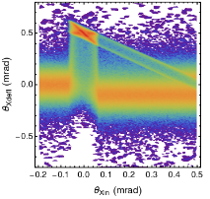
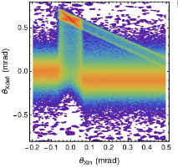
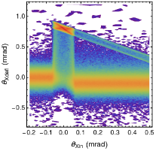
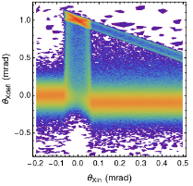
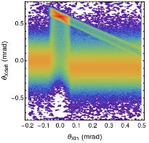
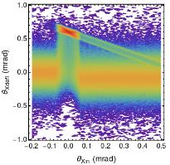
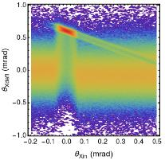
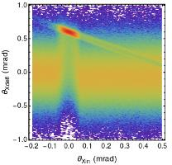
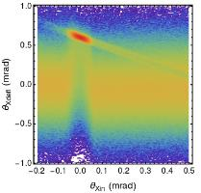
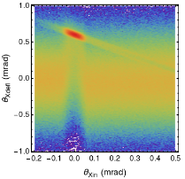
Scattering PDF maps, A.Sytov (GEANT) (not all of them!)
b=100 uRad
b=200 uRad
b=300 uRad
b=500 uRad
b=600 uRad
b=800 uRad
b=1000 uRad
Crystal scattering PDF maps with L=0.4mm, bend=100-1000uRad
L=0.4mm
L=0.8mm
L=1mm
L=2mm
L=3mm
L=4mm
L=5mm
Crystal scattering PDF maps with bend=600uRad; L=0.4mm -5mm

Slide 19
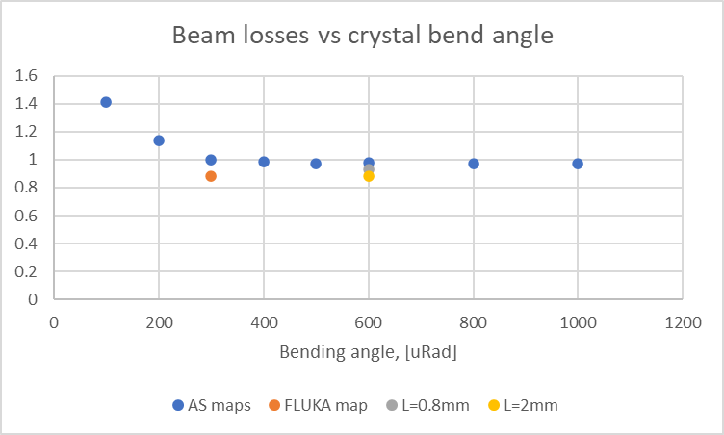
Beam loss comparison for L=0.4mm bending crystal, varying bending angle

Slide 20
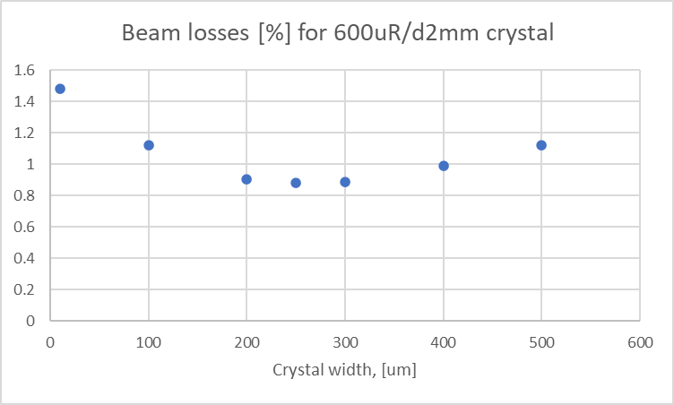
Beam loss comparison for L=2mm crystal, 600uR bending; variable hor. width

Slide 21
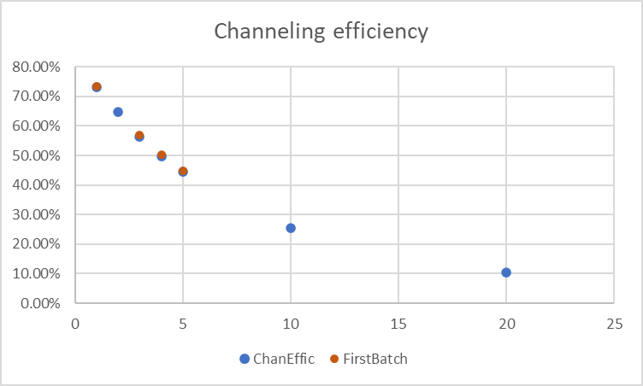
Bending efficiency vs crystal length

Slide 22
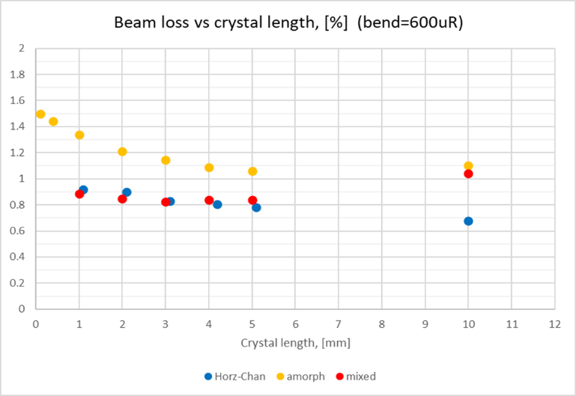
Beam loss comparison for 600uR bending crystal, variable length
Horizontal PDF maps:
Channeling, no vert. MS
Amorphous scattering:
Full MS, no channeling
Full scattering maps:
Horz&Vert - TBD
Mixed scattering:
Horz PDF + amorphous

Slide 23
Conclusions
Using crystal shadowing for beam loss mitigation at 8GeV is feasible
Beam losses reduction over x3 is possible if extracted beam angle spread is kept within the CA.
Strict requirements on the mean angle spread limit the choice of extraction scheme.
Beam losses reduction over 40% with conservative beam parameters is achievable.
Optimal crystal parameters are well within the reach of technology.

Slide 24
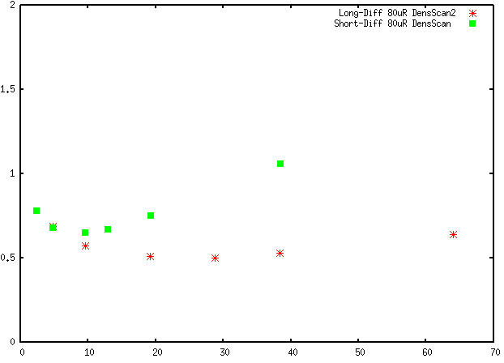
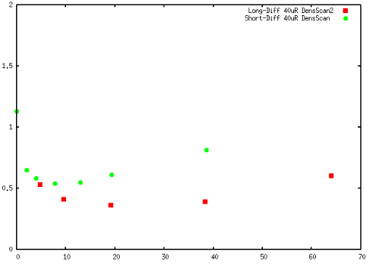
To the diffuser discussion
80 uRad
40 uRad

Slide 25
Back-up

Slide 26
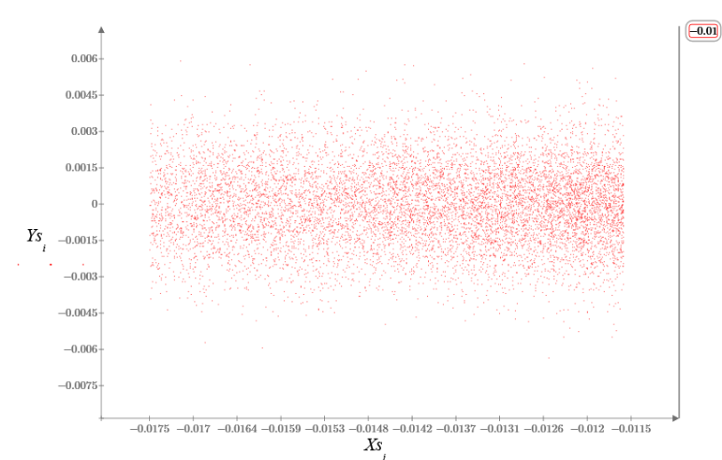
Particle sample for MARS tracking
Beam sample generated based on the full spill tracking simulations with PyOrbit
Beam sample represents one spiral step size
Only narrow part around the septum plane is used, the rest does not contribute to losses
Septum plane
Beam center
Y, [m]
Used beam sample
Full beam sample
X, [m]

Slide 27
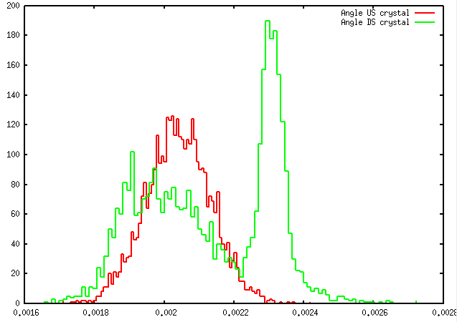
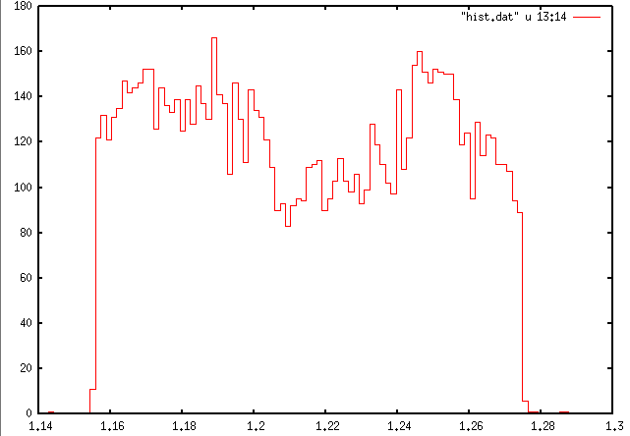
Crystal collimation efficiency – first trial
Crystal at Z=0.3m (1.3m US of foils)
No scattering profile
Volume reflection
Channeling
Effect of scattering
Septum width
Proton angles at the crystal
entrance and exit
Projected beam profile at the
septum entrance
Efficiency improvement is modest – about 10%

Slide 28
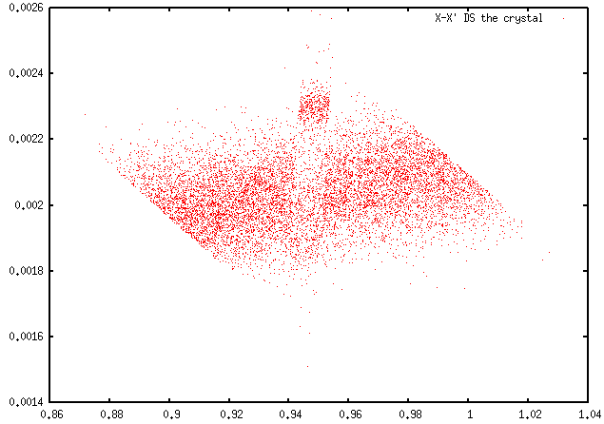
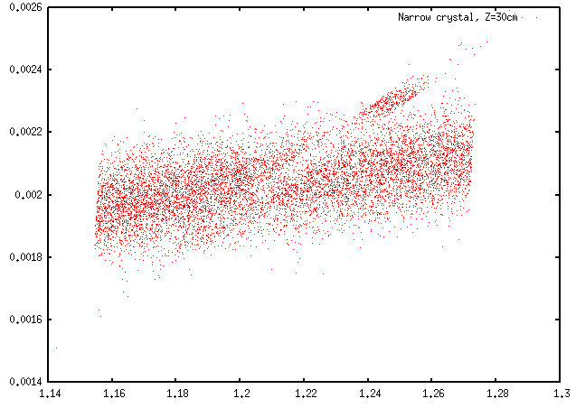
Mixing in the beam phase space at septum
Beam transition from crystal to septum, crystal width=100u
Phase space (X-X’ plane)
at crystal exit
Phase space (X-X’ plane)
at septum entrance
A lot of destructive mixing due to the angle spread

Slide 29
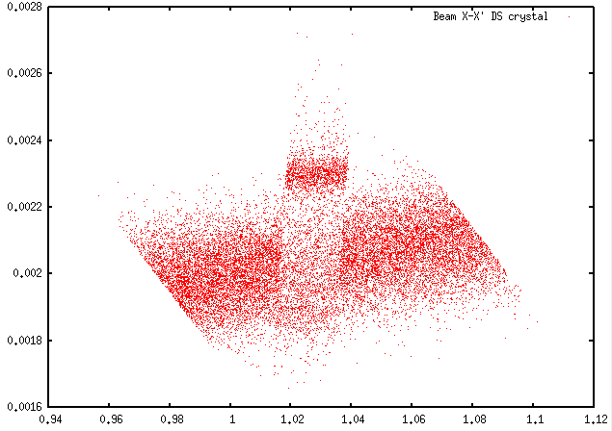
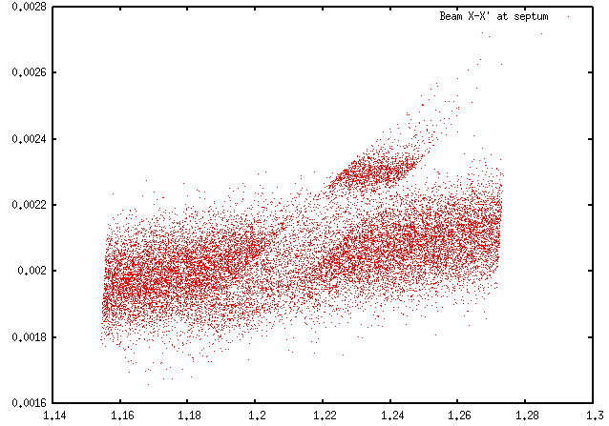
Mixing in the beam phase space at septum – new location & width
Crystal at Z=0.7m (0.9m US of foils), width=200um
Septum width
Phase space (X-X’ plane)
at crystal exit
Phase space (X-X’ plane)
at septum entrance

