Slide 1
5th Slow Extraction Workshop
Challenge of low energy, large emittance beams
Lingxiao Hou
Institute of Modern Physics, Chinese Academy of Sciences (IMP,CAS)
Lanzhou China
February 13, 2024
Notes:
Good morning everyone! I am Hou Lingxiao from the Institute of Modern Physics, Chinese Academy of Sciences. Today, I am going to talk about "Challenge of low[/loʊ/] energy, large emittance beams."

Slide 2
Contents
SESRI introduction
A novel slow extraction scheme for large emittance
Feedback system for beam uniformities
Summary
13/02/2024 Lingxiao Hou Institute of Modern Physics, Chinese Academy of Sciences(IMP,CAS) Challenge of low energy,large emittance beams 5th SX Workshop 1
Notes:
My presentation consists of four parts.
我的报告由四个部分组成

Slide 3
Contents
SESRI Introduction
A novel slow extraction scheme for large emittance
Feedback system for beam uniformities
Summary
13/02/2024 Lingxiao Hou Institute of Modern Physics, Chinese Academy of Sciences(IMP,CAS) Challenge of low energy,large emittance beams 5th SX Workshop 2
Notes:
First, I will now provide a brief introduction to SESRI.
首先是关于报告的背景。

Slide 4
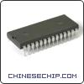
Space radiation research
Space radiation poses a serious threat to the safe operation of spacecraft and the health and safety of astronauts
Space environment
Materials/Devices and Systems
For electronic components: especially the single particle effect caused by a high-energy ion, is one of the main causes of spacecraft failures.
Organism
For astronauts: especially high-energy proton and heavy ion radiation, poses a serious threat to their health and safety.
Space based experiments:
Realistic, expensive, long cycle, difficult to control
Ground based experiments:
Simulation space environment， short cycle, controllable
Ion accelerator is an irreplaceable platform in space irradiation research
13/02/2024 Lingxiao Hou Institute of Modern Physics, Chinese Academy of Sciences(IMP,CAS) Challenge of low energy,large emittance beams 5th SX Workshop 3
Notes:
Space radiation poses a serious threat to the safe operation of spacecraft and the health and safety of astronauts。Simulation space environment on the ground is a short-cycle and controllable solution. Ion accelerator is an irreplaceable platform in space irradiation research.
太空辐射对航天器的安全运行以及宇航员的健康和安全构成严重威胁。在地面模拟空间环境是一种短周期和可控的方案。作为一种重要的地面空间辐射模拟方案，重离子加速器是一个无法被替代的研究平台。

Slide 5
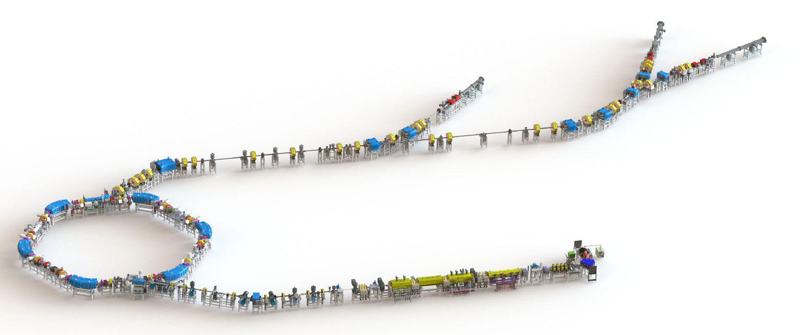
SESRI facility
Space Environment Simulation and Research Infrastructure
2022 in Harbin,China
Full range of ion species facility dedicated to space environment simulation and related science research
Main components: linac injector, compact synchrotron, 3 terminals
Heavy-ion terminal
Typical beams: 100-300MeV@proton, 7 MeV/u@Bi³²⁺
Biological terminal
Proton terminal
Challenge 1: slow extraction of large emittance beams
Challenge 2: Uniformities of large area beams at terminals
synchrotron
Linac injector
（108.48MHz）
ECRIS
（4keV/u, 18GHz）
43.9m
（2.8Tm）
300MeV proton and heavy ion accelerator
13/02/2024 Lingxiao Hou Institute of Modern Physics, Chinese Academy of Sciences(IMP,CAS) Challenge of low energy,large emittance beams 5th SX Workshop 4
Notes:
The SESRI facility, known as the Space Environment Simulation and Research Infrastructure, was completed in 2022 in Harbin, China. It is a full range of ion species facility dedicated to space environment simulation and related science research. SESRI consists of an ECRIS, a linac injector, a synchrotron, and three irradiation terminals. The typical particles include protons of 100-300 MeV and bismuth ions with 7 MeV/u. In the following report, I will introduce two significant challenges in the design and construction of SESRI,the slow extraction of large emittance beams and the uniformities of large area beams at terminals.
SESRI装置，即空间环境模拟与研究基础设施，2022年完成建造于中国哈尔滨，是用于空间环境模拟和相关科学研究的全系列离子物种设施。加速器复合体由一个电子回旋共振离子源(ECRIS)、一个直线级联注入器、一个紧凑型同步加速器和三个辐照终端组成，产生的典型粒子包括100-300MeV的质子和7 MeV/u的Bi³²⁺。加速器设计和运行过程中有两个重要的挑战，第一个是大发射度束流的慢引出，第二个是终端大尺寸束斑扫描的均匀性。接下来我将会介绍针对这两个问题的设计和研究。

Slide 6
Contents
SESRI Introduction
A novel slow extraction scheme for large emittance
Feedback system for beam uniformities
Summary
13/02/2024 Lingxiao Hou Institute of Modern Physics, Chinese Academy of Sciences(IMP,CAS) Challenge of low energy,large emittance beams 5th SX Workshop 5
Notes:
The second part of the presentation focuses on "A novel slow extraction scheme of large emittance.“
报告的第二部分是关于A novel slow extraction scheme of large emittance

Slide 7
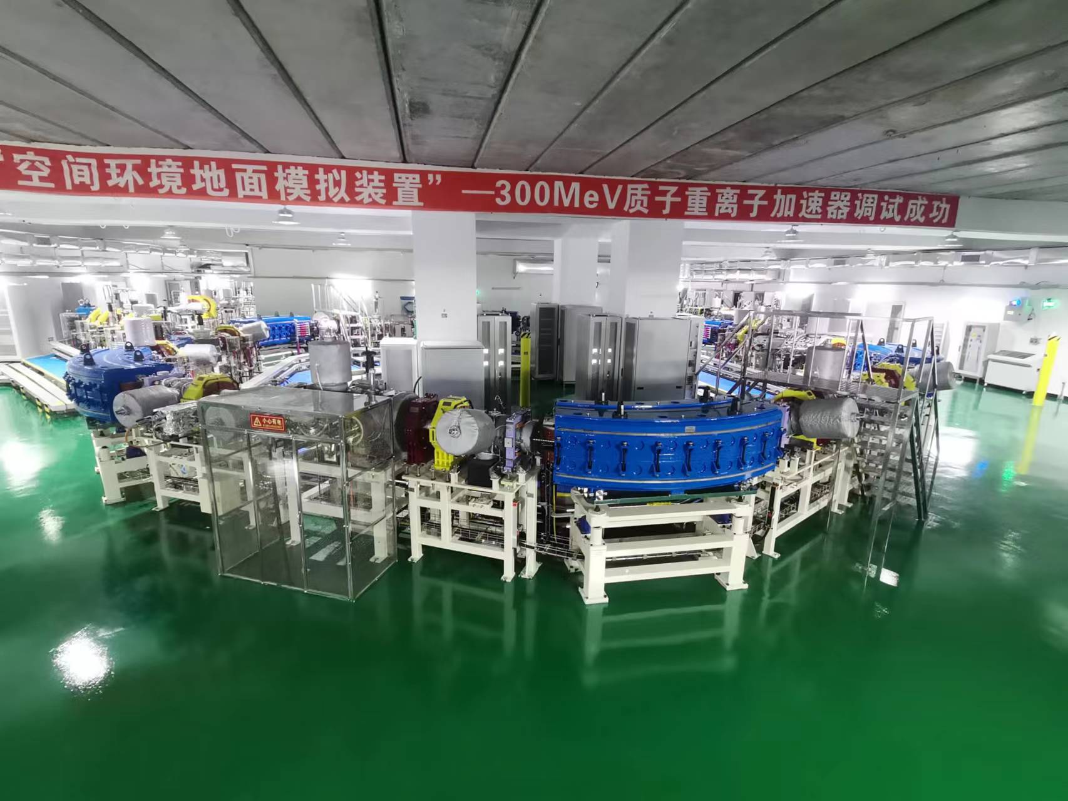
Compact synchrotron
A special hexagon layout of the synchrotron consists of 6 dipoles and 12 quadrupoles
Multi-turn injection and RF-Knockout slow extraction schemes are adopted
Challenge of Ultra-large extraction emittance (110π，7MeV/u@Bi³²⁺)
→ large stable area→ Low efficiency
Ion species | p-Bi³²⁺
Circumference (m) | 43.9
Tune Qx/Qy | 1.68/1.74
Acceptance H/V (π mmmrad ) | 200/30 (Δp/p=0.01)
Injection energy (MeV/u) | 5.6 (p), 2 (A/q=2-6.5)
Injection method | multi-turn injection
Extraction energy (MeV/u) | 100-300 (p), He (80), 7 (Bi³²⁺)
Vacuum pressure (mbar) | 5.0 × 10⁻¹²
SESRI synchrotron
13/02/2024 Lingxiao Hou Institute of Modern Physics, Chinese Academy of Sciences(IMP,CAS) Challenge of low energy,large emittance beams 5th SX Workshop 6
Notes:
In the picture, it is the compact synchrotron of the SESRI facility. A special hexagon layout of the synchrotron consists of 6 dipoles and 12 quadrupoles.Multi-turn injection and RF-Knockout slow extraction schemes are adopted. Ultra-large extraction emittance is a significant[sɪɡˈnɪfɪkənt] challenge, leading to a reduction in extraction efficiency.
Partial parameters of the synchrotron are presented in the table, the ion species range from protons to bismuth, the circumference is 43.9 meters.
图中的是SESRI装置的Compact synchrotron，它是一个特殊的六边形结构，包含6个二极磁铁和12个四极磁铁。Multi-turn injection and RF-Knockout slow extraction schemes are adopted 。巨大引出发射度是同步环设计和运行的重大挑战，会降低引出效率。
同步环的部分参数如表格所示，加速的粒子种类从质子到铋，周长是43.9m。关于引出能量，加速后的质子是100-300MeV,铋是7MeV/u。

Slide 8
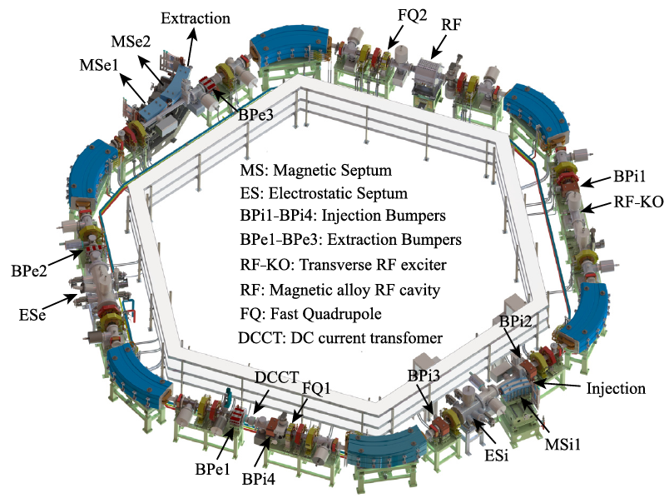
Slow extraction elements
Elements | Amount
Dynamic bumpers | 3
Electrostatic septum | 1
Magnetic septa | 2
Transverse RF exciter(RF-KO) | 1
Chromaticity sextupoles | 4
Resonance sextupoles | 4
Maximum extraction energy (MeV/u) | 7 (²⁰⁹Bi³²⁺)
Maximum extraction emittance H/V (π mm*mrad) | 110/15 (²⁰⁹Bi³²⁺)
Extraction flattop duration(s) | 1~8
Extraction efficiency | ≥ 90%
Difficult for ultra-large emittance !
13/02/2024 Lingxiao Hou Institute of Modern Physics, Chinese Academy of Sciences(IMP,CAS) Challenge of low energy,large emittance beams 5th SX Workshop 7
Notes:
On the left figure is the layout of the SESRI hexagonal synchrotron。The table above contains synchrotron elements related to slow extraction, and the table below shows beam parameters related to slow extraction. Among them, the bismuth beam has the maximum energy: 7 MeV/u and the maximum horizontal emittance of 110 π mmmrad(millimeter-milliradian). The extraction flattop duration[duˈreɪʃn] can reach up to 8 seconds. The designed extraction efficiency needs to reach 90%,which is difficult for ultra-large emittance .
左边是SESRI六边形同步环的结构，上面的表格中包含了慢引出相关的元件，下面的表格中展示了慢引出相关的束流参数。其中铋束有最大的能量：7 Mev/u和最大的水平发射度110 π mmmrad。引出平台长度最大能达到8秒。设计的引出效率需要达到90%,但对于超大发射度来说十分困难。

Slide 9
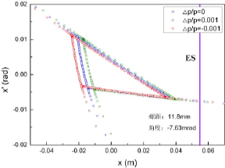
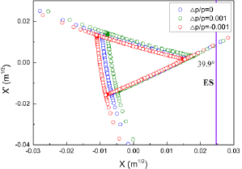
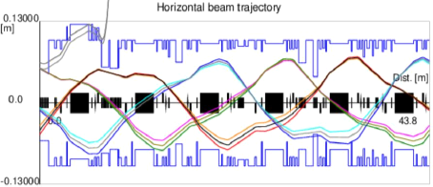
Slow extraction schemes
Horizontal third-order resonance + RF-knockout
Chromaticity sextupoles
→Hardt condition
Resonance sextupoles→A triangular stable region in the phase space
RF-knockout→ Drive particles from the stable region to the unstable region
Horizontal emittance (π mm*mrad) | 110
Horizontal tune | 1.676
Inherent chromaticity | -0.72
Optimized chromaticity | -0.54
Spiral step (mm) | 11.8
Extraction angle(mrad) | -7.63
The phase space at the entrance of ES
The trajectory in the last three turns
13/02/2024 Lingxiao Hou Institute of Modern Physics, Chinese Academy of Sciences(IMP,CAS) Challenge of low energy,large emittance beams 5th SX Workshop 8
Notes:
SESRI adopts a slow extraction scheme that includes horizontal third-order resonance and RF-knockout. It uses chromaticity sextupoles to satisfy the hardt condition. The resonance sextupole magnets are employed to form a triangular stable region[ˈriːdʒən] in the phase space, and RF-knockout is used to drive particles from the stable region to the unstable region. The table on the right shows the design parameters for slow extraction. The left-side diagram represents the phase space at the entrance of the ES, while the right-side diagram represents the trajectory in the last three turns.
SESRI采用的慢引出方案包括水平三阶共振和RF-knockout，使用色品六级铁满足hardt条件，使用共振六级铁形成相空间的三角形稳定区，用RF-knockout驱动粒子从稳定区向不稳定区移动。右边的表格展示了慢引出的设计参数。左边的图表示的是ES入口处的相空间，右边的图表示的是最后三圈的轨道。

Slide 10
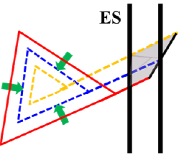
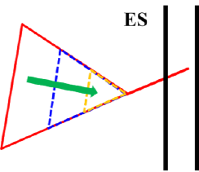
Challenge of large emittance
Ultra-large emittance of SESRI's slow extraction system
Typical emittance for medical facilities : 20~45π mm.mrad
Emittance of 7MeV/u@Bi32+: 110π mm.mrad
→ large stable area
→ low efficiency
Ramping strength sextupole + dynamic bumpers
Ramping strength resonance sextupole magnets
Shrinking the area of the stable triangle and reducing emittance
→ Improving the slow extraction efficiency
Increasing the spiral step and the extraction angular spread
Only sextupole ramping
Dynamic extraction Bumpers
Moving the stable region → Overlap extraction separatrices
Modulating both amplitudes and angles at the entrance of the ES
→ Reduce beam loss & improve extraction efficiency
With dynamic bumpers
13/02/2024 Lingxiao Hou Institute of Modern Physics, Chinese Academy of Sciences(IMP,CAS) Challenge of low energy,large emittance beams 5th SX Workshop 9
Notes:
The challenge in the SESRI's slow extraction system arises from the ultra-large emittance, reaching 110π mm.mrad (millimeter-milliradian) for bismuth. We propose a scheme combining dynamic bump with ramping strength sextupole. The ramping strength resonance sextupole magnets shrink the area of the stable region and reduce emittance. The dynamic extraction bumpers modulate both amplitudes and angles at the entrance of the ES to improve extraction efficiency.
SESRI同步环慢引出系统的挑战来源于极大的引出发射度，对于铋束能达到110π mm.mrad。我们首次提出利用动态bump加六极铁ramping进行束流引出的新型方案。具体物理原理主要是通过调节六极磁铁的强度来控制相稳区的面积，使其在引出过程中逐步缩小。同时用动态凸轨磁铁调节角散和螺距，减少束流损失。

Slide 11
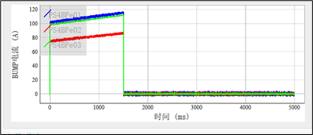
Slow extraction results
Simulating the process of large-emittance slow extraction with SESP (Slow Extraction Simulation Program)
Multi-particle tracking program
Beam loss
Slow extraction uniformity
Spill structure
Phase space
Extraction separatrices
…
Sextupole strength ramping
Stable area shrinking
Dynamic bumpers
Separatrices overlap
Small extraction angle
High efficiency
Online measurement
7 MeV/u@Bi³²⁺
Extraction efficiency≥90%
meet the requirement of intensity in terminal
dynamic bumper
13/02/2024 Lingxiao Hou Institute of Modern Physics, Chinese Academy of Sciences(IMP,CAS) Challenge of low energy,large emittance beams 5th SX Workshop 10
Notes:
We have developed a multi-particle tracking program and simulated the process of large-emittance slow extraction with SESP. The figure shows the simulation result of ramping strength sextupole magnets and dynamic bumpers. In the online measurements at SESRI, the left graph shows the waveform of the dynamic bumper, and the right graph demonstrates[ˈdemənstreɪt] that the extraction efficiency of the bismuth beam exceeds 90%.
之后我们编写粒子追踪程序并模拟了大发射度慢引出的过程，图中展示了strength ramping六级铁和动态Bumper的实际作用。在SESRI的在线测量中，左边的图是动态bumper的实际波形，，右边的图展示了铋束的引出效率超过了90%。

Slide 12
Contents
SESRI Introduction
A novel slow extraction scheme for large emittance
Feedback system for beam uniformities
Summary
13/02/2024 Lingxiao Hou Institute of Modern Physics, Chinese Academy of Sciences(IMP,CAS) Challenge of low energy,large emittance beams 5th SX Workshop 11
Notes:
报告的第三部分是关于Feedback system of beam uniformities
The third part of the presentation focuses on "Feedback system of Beam Uniformities."

Slide 13
Heavy-ion terminal
320mm×320mm is achieved through horizontal and vertical scanning magnets
beams
Multistrip Ionization Chambers(MICs)
Scanning magnets(H/V)
Directly related to the quality of the experimental beams!
Issue 1: How to measure them accurately?
Issue 2: How to optimize their performances, especially beam uniformity?
Irradiation area | 320mm×320mm
Terminal uniformity | >90%
Particle number(ppp) | 10⁸
13/02/2024 Lingxiao Hou Institute of Modern Physics, Chinese Academy of Sciences(IMP,CAS) Challenge of low energy,large emittance beams 5th SX Workshop 12
Notes:
The image shows the heavy-ion terminal in the SESRI facility. A large beam area of 320mm×320mm("three hundred and twenty millimeters by three hundred and twenty millimeters) is achieved through horizontal and vertical scanning magnets. Measurements are conducted using Multistrip Ionization Chambers (MICs) to obtain Irradiation area, terminal uniformity and particle number, as shown in the table. These terminal parameters are directly related to the quality of the experimental[ɪkˌsperɪˈmentl] beam. However, SESRI terminals face two issus: how to measure those parameters accurately and how to optimize their performances, especially beam uniformity.
图片展示的是SESRI装置三个束流终端中的一个，通过水平垂直两台扫描铁和一段直线段实现320mm×320mm的超大束斑，并通过分条电离室（MICs）进行测量，得到扫描面积、粒子数和束流均匀性，如表格所示。放射终端直接关系到实验束流的品质，面临两个问题，分别是如何精确测量，以及如何优化其表现，尤其是均匀性。

Slide 14
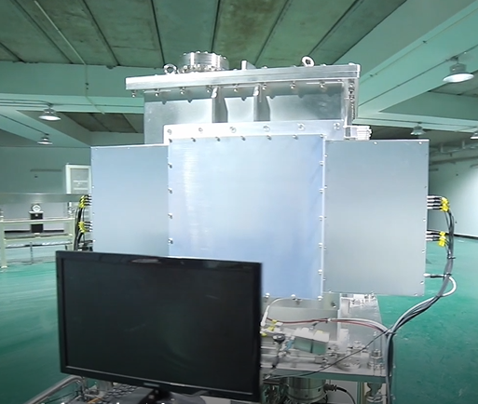
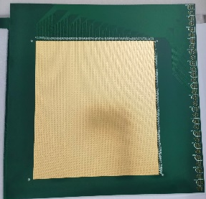
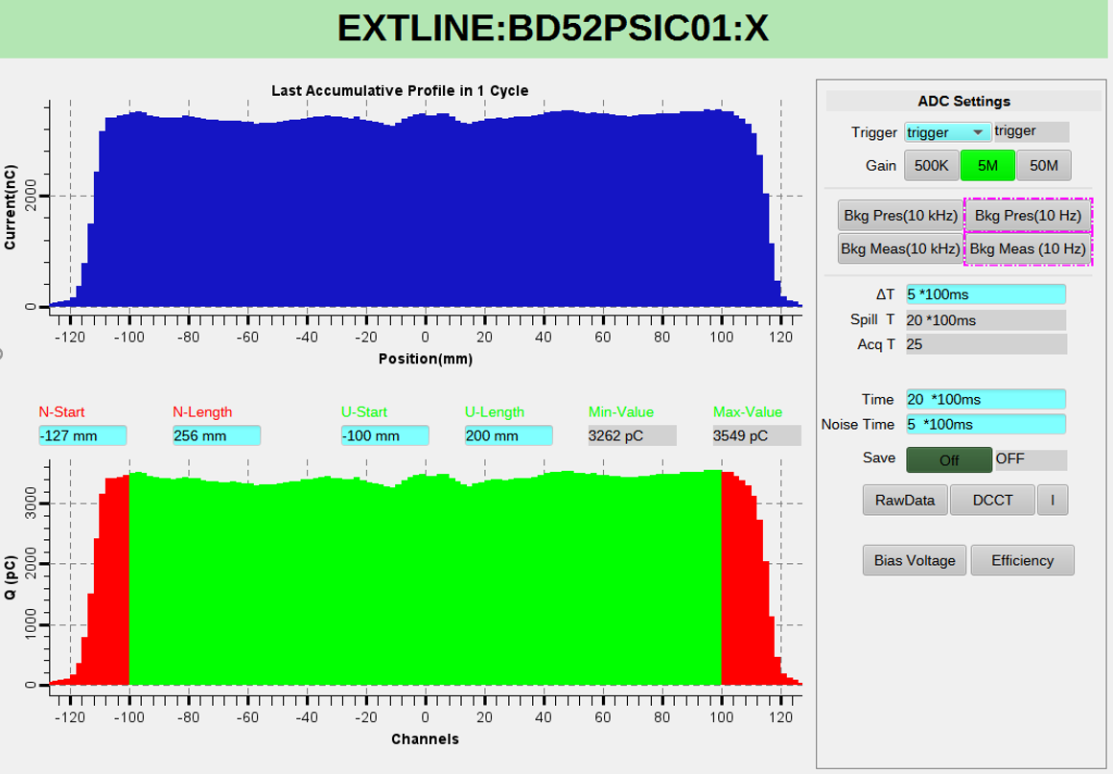
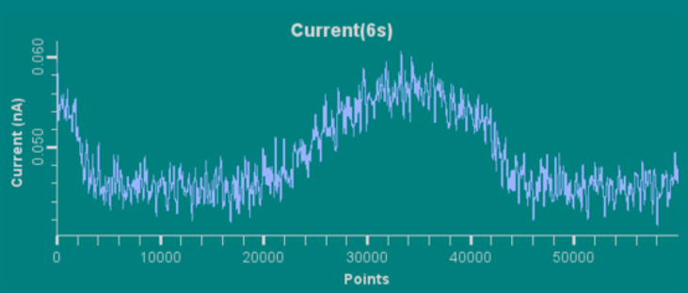
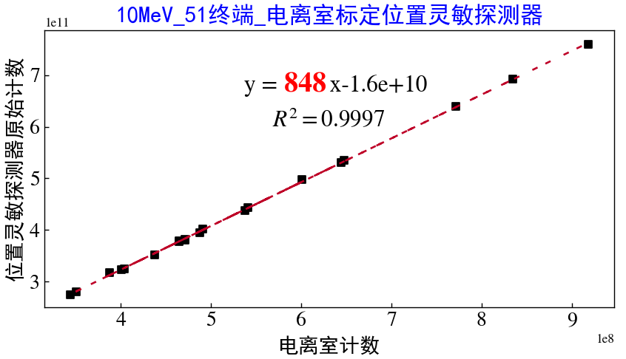
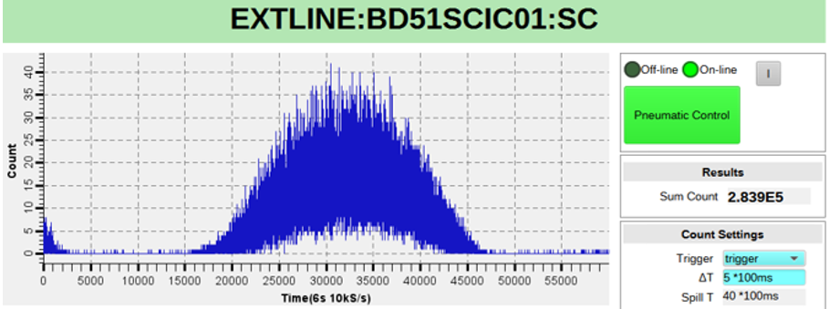
MICs: design and calibration
Independently develop the entire process of MIC probe design, electronics development, data processing, and interaction
Online
Accurate
Flexible
Design of MICs
Linearity & calibration
Probe
Electronics
air
Data Acquisition×2
Analog board×8
AFE×8
ADC
beam
AFE×8
ADC
Data analyses
& interaction
Nonlinearity <0.12%
Cathode
KINTEX7 FPGA
Anode
Digital board×8
Scintillator
Detector
1st calibration
Current
Ionization chamber
2nd calibration
Multistrip
Ionization chamber
ZU + FPGA
AXI4
ARM
1E5~1E6 pps
1E5~1E7 pps
-800V
R²>0.999
Cathode
Anode
Electronics
Data analyses
Accurate measurement at terminals!
13/02/2024 Lingxiao Hou Institute of Modern Physics, Chinese Academy of Sciences(IMP,CAS) Challenge of low energy,large emittance beams 5th SX Workshop 13
Notes:
For accurate measurement of terminal data[ˈdeɪtə]，we independently develop the entire process of probe design, electronics development, data processing, and interaction. On the left, the design of MICs are presented. On the right, various tests conducted for precise[prɪˈsaɪs] measurement are shown, including linearity measurement and detector calibration. A scintillator[ˈsɪn.tɪˌleɪ.tər] detector and a current ionization[ˌaɪənəˈzeɪʃn] chamber were used to calibrate the MICs, and ultimately ensuring the accurate measurement at terminals.
为了应对终端数据的精确测量的挑战，我们实现了探头设计、电子学开发、数据处理及交互全流程自主研制。左边展示了MIC的原理、结构和实物图。右边展示了是为了精确测量做的一些测试，包括线性度和探测器标定，后者采用闪烁体探测器和流强电离室对MIC进行标定,最终确保MIC测量的准确性。

Slide 15
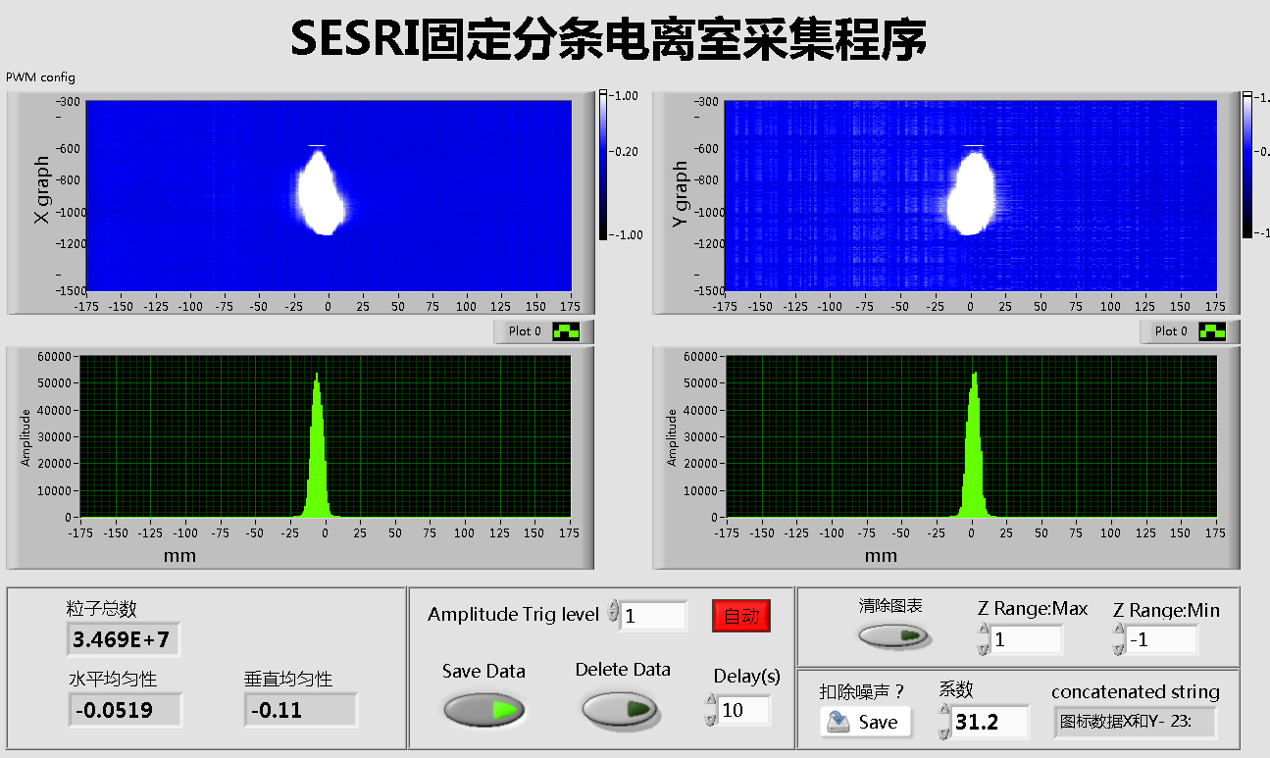
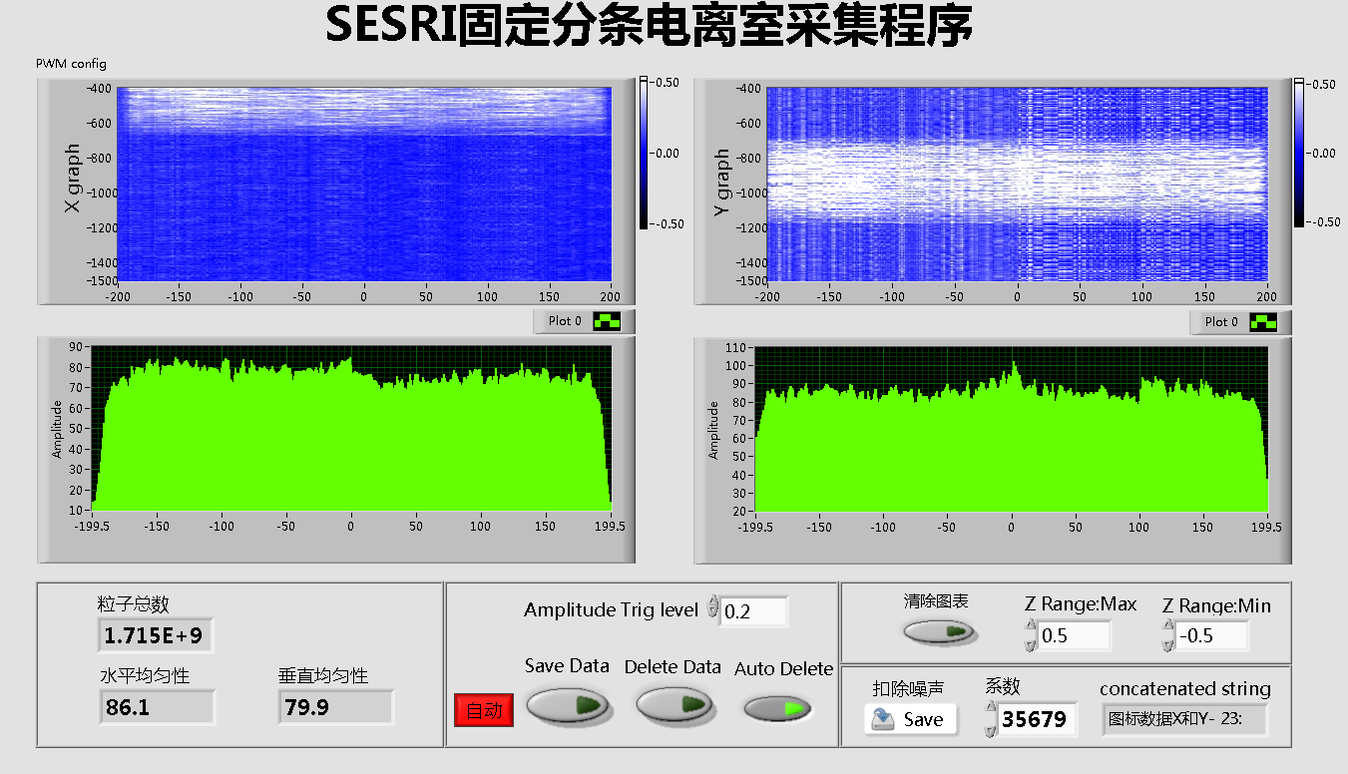
Beam Uniformity
SESRI MICs Data Acquisition Interface
$$U=(1−\frac{Max−Min}{Max+Min})×100\%$$
Beam uniformity :
Source of non-uniformity?
Transverse beam distribution → beamline optics
Spill structure → slow extraction
Deviation of scanning magnets
→ How were these deviations generated?
scanning magnets power off
SESRI MICs Data Acquisition Interface
Uniformity = 79% < 90%
scanning magnets power on
13/02/2024 Lingxiao Hou Institute of Modern Physics, Chinese Academy of Sciences(IMP,CAS) Challenge of low energy,large emittance beams 5th SX Workshop 14
Notes:
On the left are beam profiles measured by MIC before and after loading the scanning magnets. It can be observed that when the scanning area reaches 320mm×320mm, some non-uniformities appears in the beam distribution. Calculating the uniformity using the formula above yields 79%, which is below the target value of 90%. One of the main source of non-uniformities is the deviation of scanning magnets.
左边是是加载扫描铁前后的MIC测量的束流剖面，可以看到当扫描面积到达320mm×320mm时，束流分布产生了一定的不均匀性。通过上面的公式计算其均匀性为79%，小于目标值90%。所以我们需要分析不均匀性的来源，并想办法减少不均匀性。

Slide 16
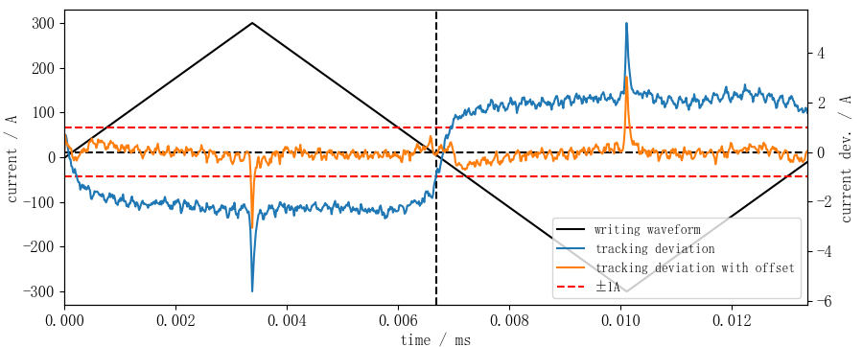
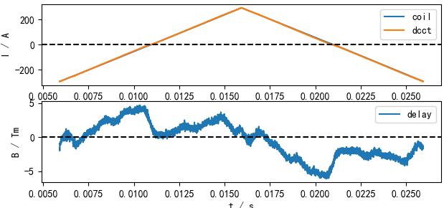
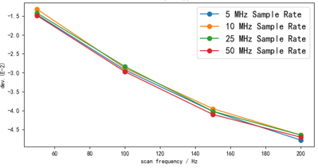
Error Analysis of scanning magnets
Tracking error of Power Supplies
Eddy effects of Scanning Magnets
Triangular wave to scan at a constant rate
Deviation peaks at inflection→Negligible
Deviation of triangular wave< 3 A
Positive correlated with amp. or freq.
Adding a fixed intercept to the triangular wave, reducing tracking error to less than 1A
Max eddy delay is -4.7% because of the rapid ramping of scanning magnets
These errors contribute to beam non-uniformities, requiring solutions!
13/02/2024 Lingxiao Hou Institute of Modern Physics, Chinese Academy of Sciences(IMP,CAS) Challenge of low energy,large emittance beams 5th SX Workshop 15
Notes:
The errors caused by the scanning magnets mainly come from power supply tracking errors and magnetic eddy currents. The left graph illustrates the current deviation of the measured triangular wave, with a maximum value of 3A. To reduce the tracking error, we added[æd] a fixed intercept to the triangular wave, resulting in a tracking error of less than 1A. The right graphs show the measurement of magnetic eddy currents, which can cause a maximum deviation of 4.7%. These errors contribute to beam non-uniformities, requiring solutions.
扫描铁造成的误差主要来源于电源跟踪误差和磁铁涡流。左图展示的是实际测量的三角波的电流偏差，其最大值为3A.为了减小电流的跟踪误差，我们给三角波加了一个固定的截距，此时跟踪精度降低到1A以下。右边展示的是对磁铁涡流的测量，涡流能够造成最大4.7%的相对偏差。来源于扫描磁铁和电源的误差效应最终会造成终端束流的不均匀性，需要解决方案。

Slide 17
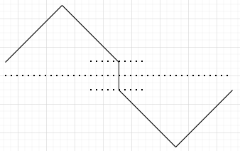
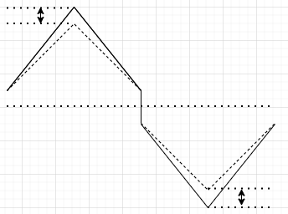
PS waveform & beam profile
Exploring the relationship between PS waveform & beam profile
③Flatness error
①Center
Error
②Edge
error
Beam profile
PS waveform
①Center error
a large peak right in the center
(a cross in 2D plane)
Sourced from zero crossing effect of PS
Adding an intercept to both the semiaxes
②Edge error
unequal heights on positive and negative half-axes
From beam non-uniformity before scanning
Adjusting the amplitude of both the semiaxes
13/02/2024 Lingxiao Hou Institute of Modern Physics, Chinese Academy of Sciences(IMP,CAS) Challenge of low energy,large emittance beams 5th SX Workshop 16
Notes:
To improve beam uniformities, we need to explore the relationship between the scanning magnet waveform and the beam profile. As shown in the right graph, we have divided the non-uniformity of the beam profile into three parts: center errors, edge errors and flatness error. The center error is a large peak right in the center, sourced from zero crossing effect of PS,the solution is to add an intercept to both the semiaxes. Secondly, the edge error is unequal heights on positive and negative half-axes, sourced form beam non-uniformity before scanning, the solution is to independently adjust the amplitude of both the semiaxes.
为了提高束流均匀性，我们需要寻找扫描铁波形和束流剖面之间的关系。如右图所示，我们将束流剖面的不均匀性分成三个部分，包括x=0处的大峰，其他处的小峰，以及正负半轴的不等高。对于x=0处的大峰，解决方法是在三角波的正负半轴分别增加一个截距。对于正负半轴的的不等高，解决方法是单独调节调节三角波的正负半轴的幅值。

Slide 18
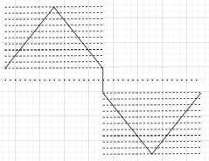
Sliced PS waveform
③Flatness Error
Beam profile
PS waveform
Calculate position x for any PS waveform I(t):
$$x=\frac{μ_{0}NqlL}{mv_{0}^{2}h}×I(t)$$
From tracking error and eddy effect of scanning magnets
Relationship between the values at any position of the beam profiles and the waveforms
Segmenting beam profiles on position(x);
Segmenting PS waveforms by amplitude;
one-to-one correspondences;
Optimize beam profile through precise adjustment of power supply triangular waveforms
13/02/2024 Lingxiao Hou Institute of Modern Physics, Chinese Academy of Sciences(IMP,CAS) Challenge of low energy,large emittance beams 5th SX Workshop 17
Notes:
Thirdly, the flatness error is mainly from tracking error and eddy effect of scanning magnets.According to the formula, we can obtain the relationship between the values at any position of the beam profile and the scanning magnet waveform. Based on this relationship, we segment the beam profile at different positions and segment the scanning magnet triangular wave according to its amplitude. Afterwards we establish one-to-one correspondences. This allow to optimize beam profile through precise adjustment of power supply triangular waveforms
第三，通过公式计算我们可以得到束流剖面任意位置处的值与扫描铁波形的关系，根据这个关系，将束流剖面按不同位置分段，将扫描铁三角波按幅值分段，保证两者分段数量相同，并将两者一一对应，就可以实现通过扫描铁波形微调束流剖面分布。
.

Slide 19
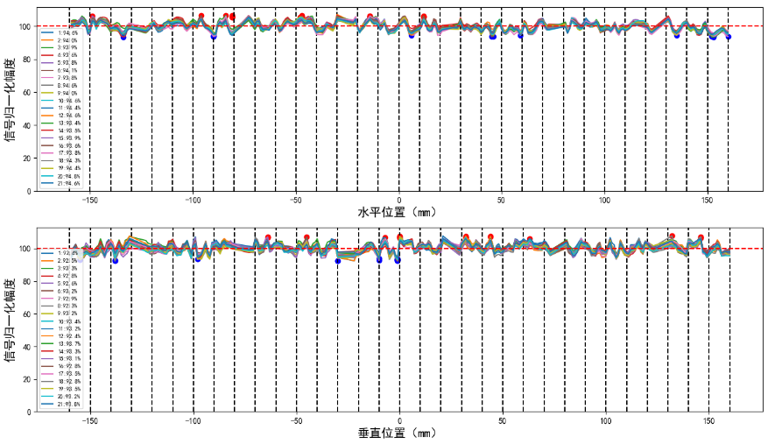
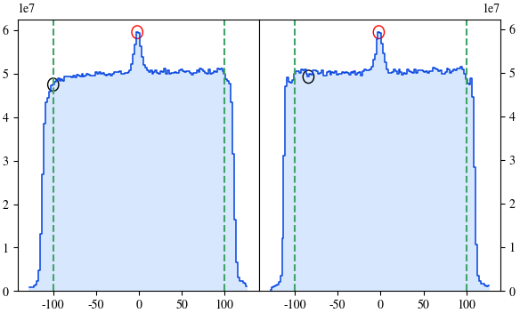
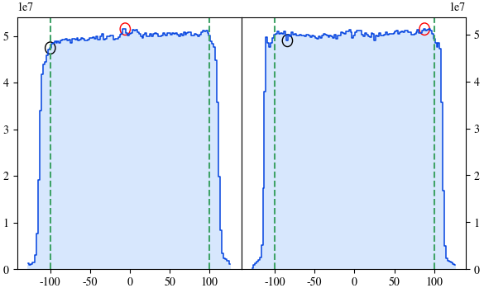
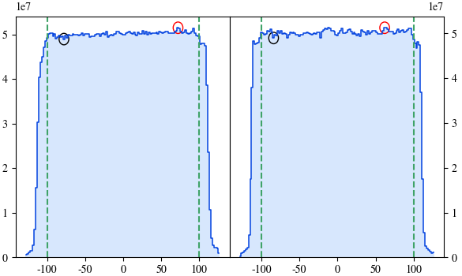
Beam uniformity feedback system
Scanning
Magnet
x
(position on MICs)
Terminal beams
m, q, v₀
L
(distance between MIC & magnet )
Feedback system
MIC probe
Power supply
N, l, h, f, I_{amp}
Calculating…
Long time stability > 95%
Loop 1: Unif.=83.8(H),85.4(V)
Loop 3: Unif.=95.9(H),97.4(V)
Loop 5: Unif.=98.4(H),98.1(V)
Adopting beam uniformity feedback system scheme , all uniformities of beams are better than 95%， and the best one can achieve about 98%
13/02/2024 Lingxiao Hou Institute of Modern Physics, Chinese Academy of Sciences(IMP,CAS) Challenge of low energy,large emittance beams 5th SX Workshop 18
Notes:
The top-left figure illustrates that, everytime beam uniformities are measured by the MIC system, we use the methods[ˈmeθəd] mentioned earlier to optimize the scanning magnets. This enables the establishment of a feedback system for beam uniformities. The right side demonstrates the long time stability of the feedback system. Below shows the results of 5 loops of feedback system in one test, leading to the conclusion that, by adopting the feedback system scheme for beam uniformities, all beam uniformities are better than 95%, with the best achieving over 98%.
左上角展示的是，通过前面几页介绍的优化均匀性的方法优化扫描铁波形后，重复进行束流均匀性的测量，可以形成束流均匀性的反馈控制。右边展示了反馈控制的时间稳定性。下面展示了实际测试的结果，可以得到结论，通过采用终端束流均匀性反馈控制方案，所有终端束流均匀性大于95%，最好的能够超过98%。

Slide 20
Contents
SESRI Introduction
A novel slow extraction scheme for large emittance
Feedback system for beam uniformities
Summary
13/02/2024 Lingxiao Hou Institute of Modern Physics, Chinese Academy of Sciences(IMP,CAS) Challenge of low energy,large emittance beams 5th SX Workshop 19
Notes:
Finally, I will conclude my presentation with a summary.
最后我将对我的报告进行总结。

Slide 21
Summary
Challenge of low energy, large emittance beams
Large emittance slow extraction scheme :
Horizontal third-order resonance + RF-knockout
Ramping strength resonance sextupole + dynamic bumper
Feedback system of beam uniformities:
Multistrip Ionization Chambers(MICs) were designed for large scanning size and were calibrated accurately;
Deviation of scanning magnets resource from PS tracking accuracy and magnet eddy effects, contribute to beam uniformities;
Correlations between waveforms and particle profiles on MICs were discussed and a feedback system was adopted to improve the uniformities of beams to over 95%.
13/02/2024 Lingxiao Hou Institute of Modern Physics, Chinese Academy of Sciences(IMP,CAS) Challenge of low energy,large emittance beams 5th SX Workshop 20
Notes:
To address the challenges of low-energy, large-emittance beams, the SESRI facility has adopted a series of advanced solutions. Firstly, there is the large-emittance slow extraction scheme, the most crucial one is combining ramping strength sextupole and dynamic bumpers. Another one is feedback system of beam uniformities：correlations between waveforms and particle profiles on MICs were discussed and a feedback system was adopted to improve the uniformities of beams to over 95%.
为了解决低能、大发射度束流带来的挑战，SESRI装置采用了一系列先进方案。首先是大发射度慢引出方案，其中最重要的是ramping strength共振六级铁和动态bumper的大发射度慢引出方案。另一个方案是终端均匀性的优化，讨论了MIC上波形与粒子轮廓之间的相关性，并采用反馈控制以提高终端束流均匀性至95%以上。

Slide 22
Thanks for your attention!
Any comments are welcome!
Notes:
Thanks for your attention!
Any comments are welcome!

