Slide 1
Beam Trajectory Influence on Dispersion and Uniform Beams at NSRL
Presenter : Bhawin Dhital
Thanks to : Kevin Brown, Michael Sivertz, Nicholaos Tsoupas, Petra Adams, Trevor Olsen, David Inzalaco, Lucy Lin*
Brookhaven National Laboratory, Upton NY 11973
*Cornell University, Ithaca, NY 14850
Date : February 13, 2024
2024 Slow Extraction Workshop, MedAustron

Slide 2
Outline
BNL CA-D Complex /Booster Synchrotron Facility
NASA Space Radiation Laboratory (NSRL)
Extraction Bumps and Orbit Distortion
Extraction Septa
Dispersion Measurement

Slide 3
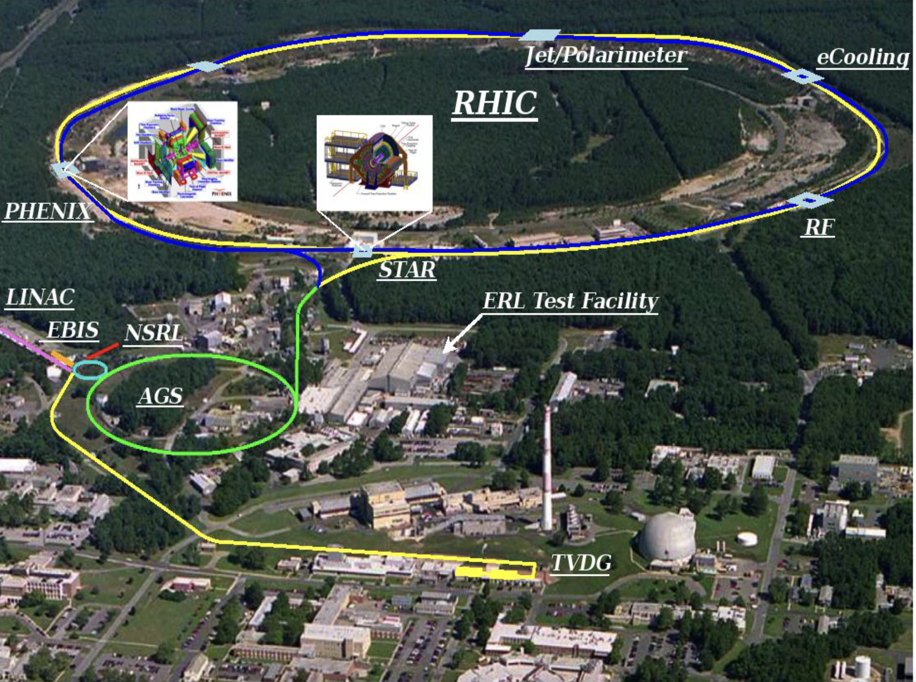
BNL C-AD Complex

Slide 4
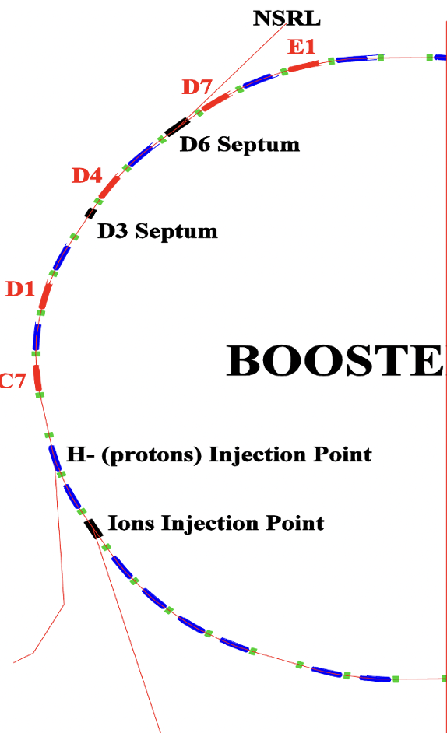
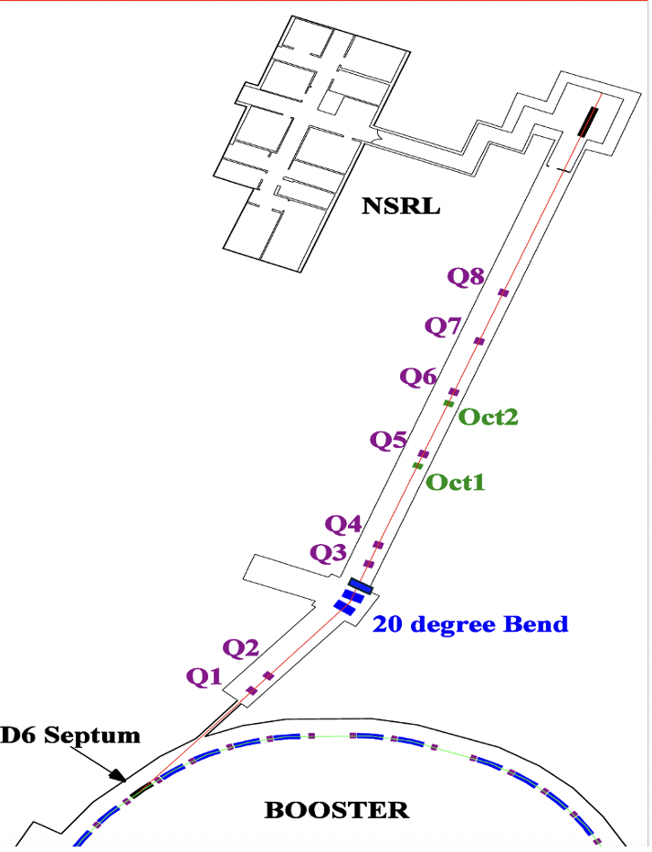
Booster Synchrotron and Slow Extraction

Slide 5
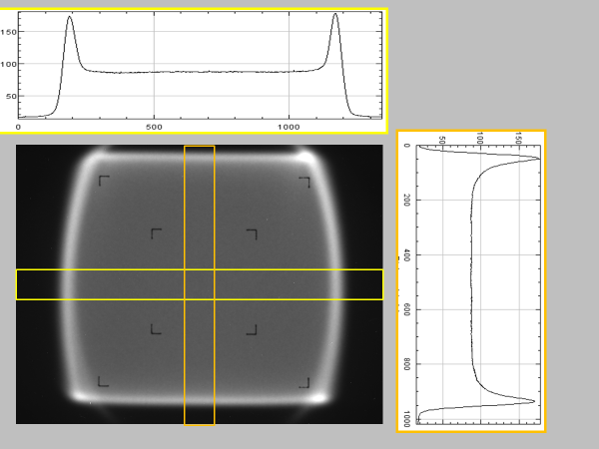
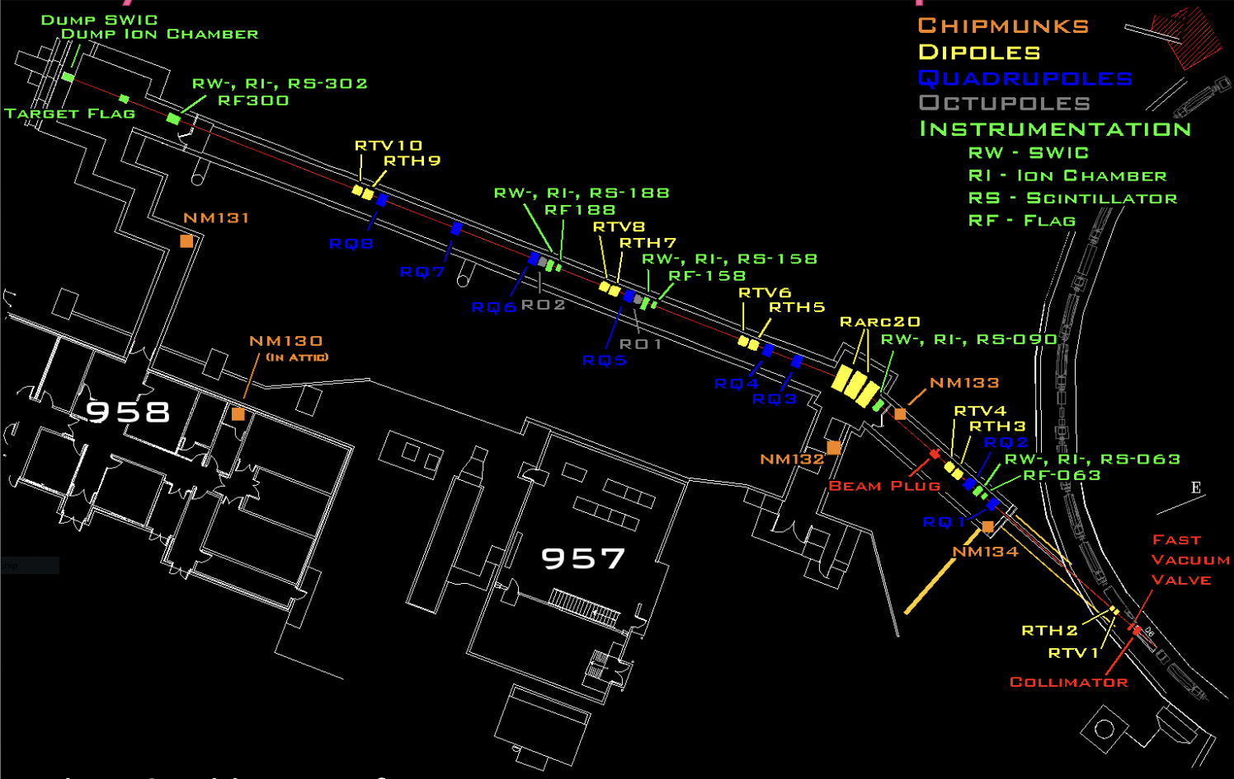
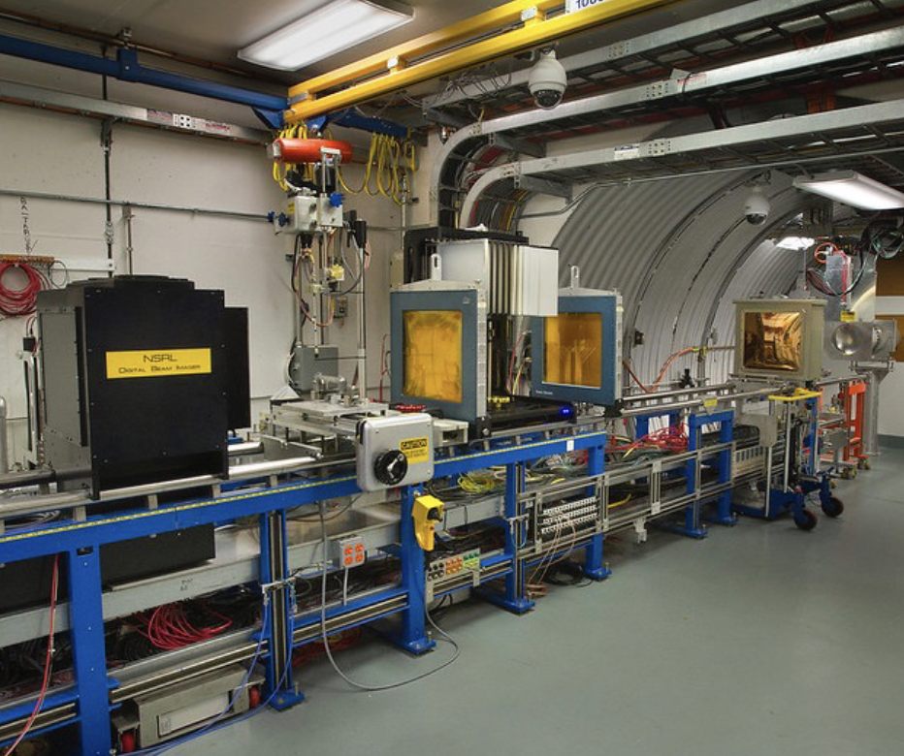
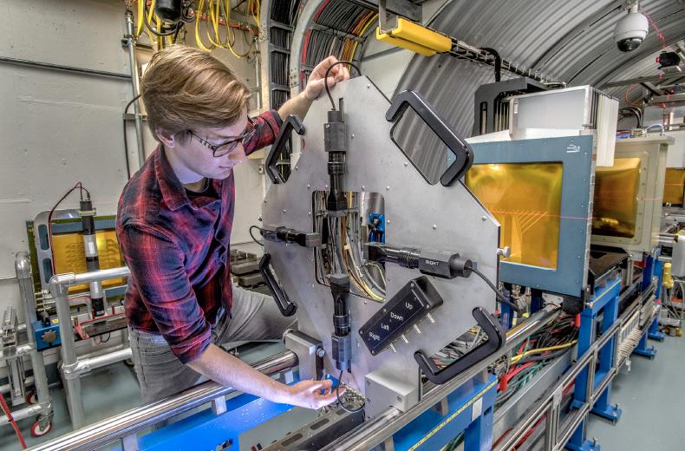
NSRL Transport Line and Uniform Beam
20 cm
Layout of NSRL Transport Line
Uniform beam at the target

Slide 6
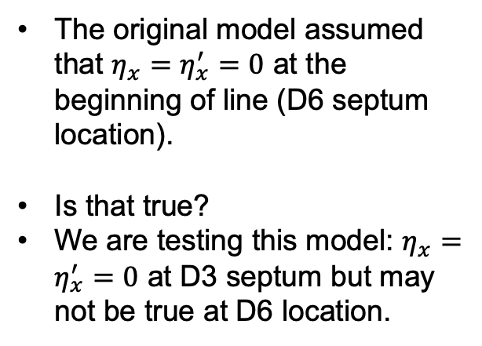
Dispersion and Achromatic Beam line
The original model assumed that $η_{x}=η_{x}^{′}=0$ at the beginning of line (D6 septum location).
Is that true?
We are testing this model: $η_{x}=η_{x}^{′}=0$ at D3 septum but may not be true at D6 location.
D6
Achromatic
PRAB 10, 024701 (2007)

Slide 7
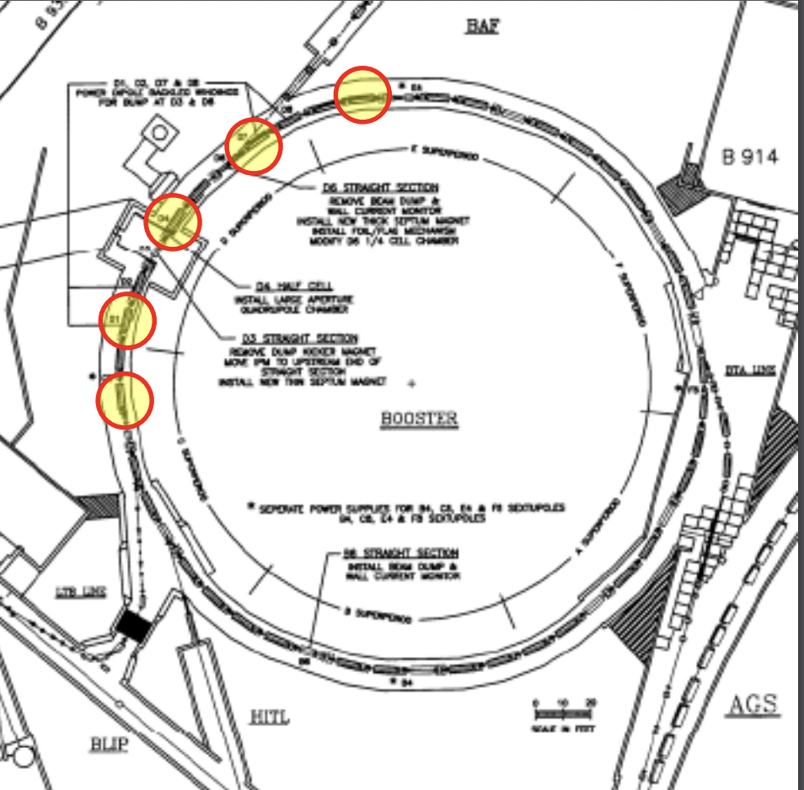
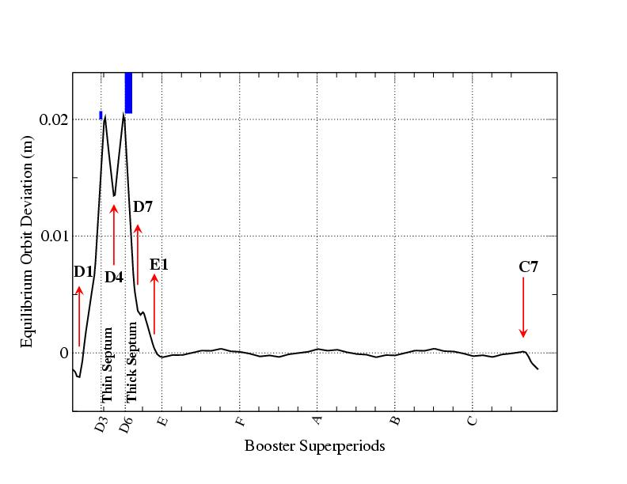
Extraction Bumps and Orbit Distortion
Orbit deformation is used to ensure that the
thin septum is the limiting aperture. If beam
hits anywhere else first, it won’t extract.
K.A. Brown
Five bumps: C7, D1,D4,D7,E1
Bump power supplies provide distortion in orbit (as shown in the right) to control 3 degrees of freedom at the extraction septa (position and angle at D3 septum, position at D6 septum or vice-versa).

Slide 8
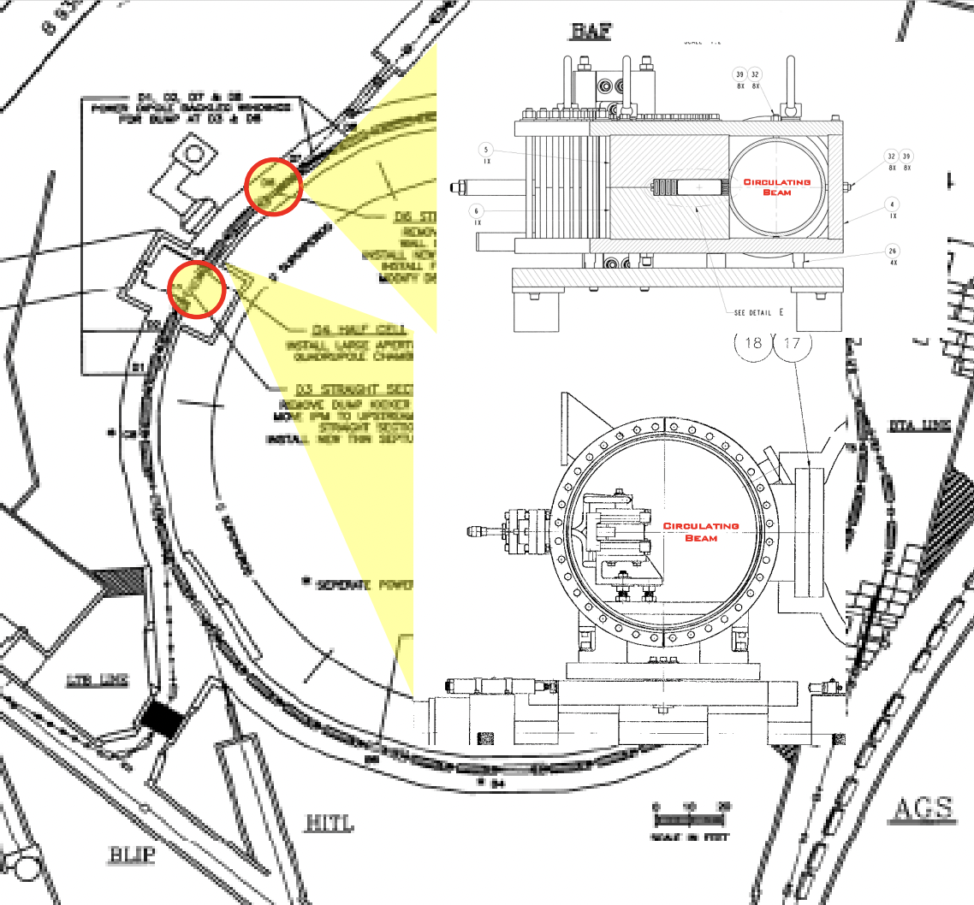
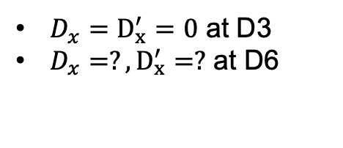
Extraction Septa in the Booster
D6
Two extraction septa are used
First thin septum at D3
  Movable
  3 mrad kick
Second thick septum at D6
  Fixed position
  155 mrad kick
D3
$D_{x}=D_{x}^{′}=0$ at D3
$D_{x}=?,D_{x}^{′}=?$ at D6
Booster layout showing D3 and D6 septa.
D6 septum connecting to the NSRL transport line

Slide 9
Dispersion Measurement
Dispersion $D_{x}=\frac{Δx}{\left(\frac{Δp}{p}\right)}$
Beam size $σ_{x}=\sqrt{{(β}_{x}ε_{x}+{\left(D_{x} Δp/p\right)}^{2}}$
The measurement of the dispersion function in a transfer line plays the crucial role for the development of an accurate optics model for the beam tracking simulation.
Unknown dispersion can lead to overestimated values of beam emittance.
Radial Steering Displacement Method:
Momentum spread $\left(\frac{Δp}{p}\right)=γ_{tr}^{2}ΔR/R_{0}$
$Δx=$measurement of transverse beam displacement (multi-wire)

Slide 10
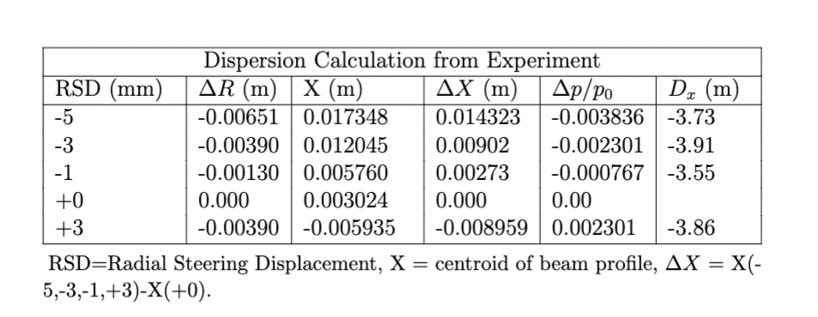
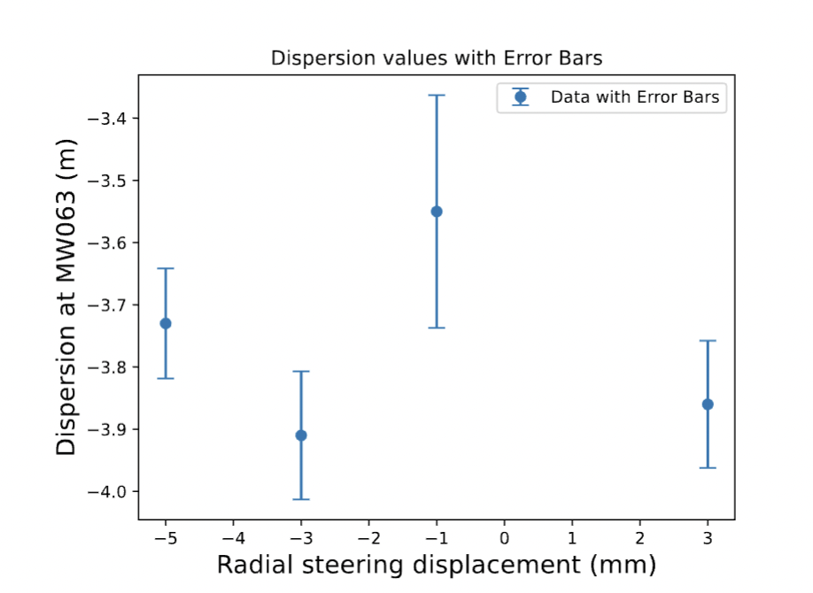
Dispersion from Measurement

Slide 11
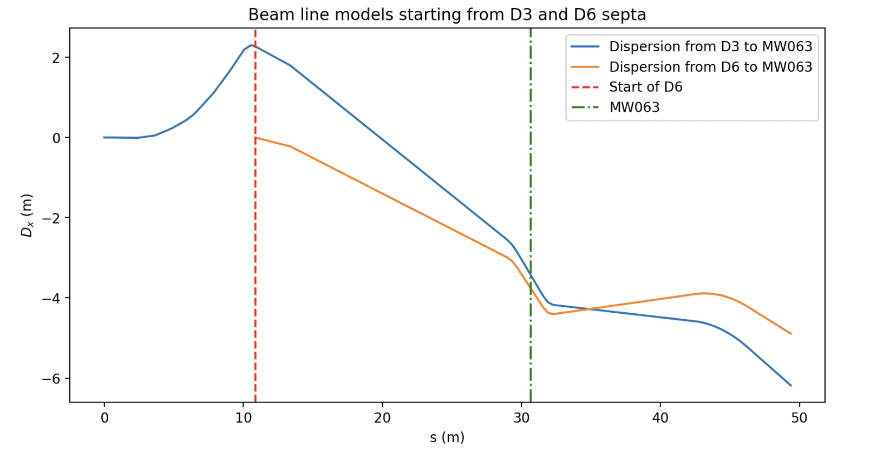
Dispersion from the MADX Models
D3
-3.43
-3.76
-4.70
measurement
*Dispersion values are in MADX unit

Slide 12
Future Work
Figure out the right dispersion value and achromatic condition in the NSRL beam line.
Update the model (based on the measurement).
Calculate the effect of dispersion on the uniform beam at NSRL target.

Slide 13
References
[1] https://www.bnl.gov/nsrl/
[2] https://journals.aps.org/prab/pdf/10.1103/PhysRevSTAB.10.024701
[3] https://cds.cern.ch/record/553445/files/tua83.pdf
[4]https://indico.fnal.gov/event/20260/contributions/56661/attachments/35440/4324/BNLSlowExtraction_ICFA_SXWS_2019.pdf
[5] https://mad.web.cern.ch/mad/
[6] https://cds.cern.ch/record/104153?ln=en
[7] https://www.bnl.gov/isd/documents/81542.pdf
[8] https://accelconf.web.cern.ch/d99/papers/PT10.pdf
[9] https://link.springer.com/book/10.1007/978-3-319-18317-6
[10] https://www.cadops.bnl.gov/Operations/training/operations_training_developme nt/practicals/booster_and_nsrl/BoosterSlowExtractionforNSRL.pdf

