Slide 1
BEAM LOSS OPTIMIZATION FOR SLOW EXTRACTIONS AT MEDAUSTRON
Fabien Plassard, Dale Prokopovich, Florian Kühteubl, Xavier German, Elisabeth Renner
Slow Extraction Workshop 2024
13th February 2024

Slide 2
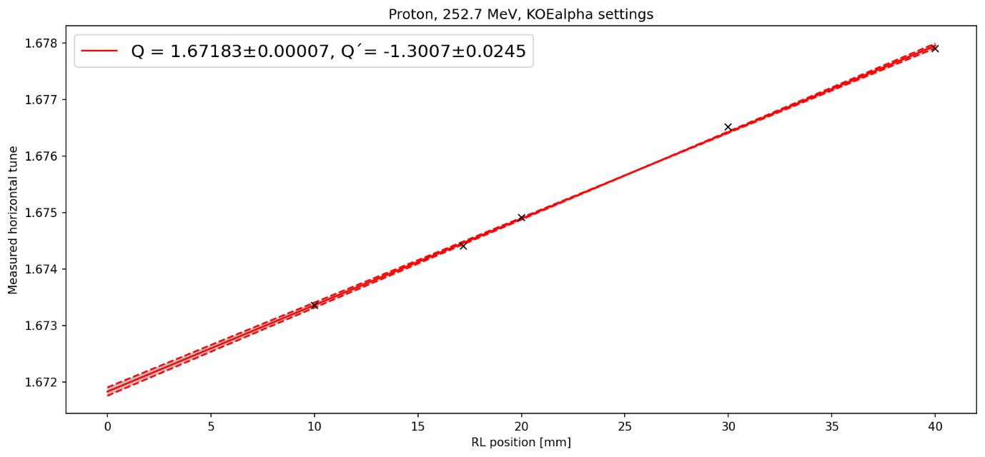
introduction
Currently testing and optimizing RFKO extraction in preparation of a near future implementation
The optics change for RFKO operation have been successfully verified experimentally
Optimal optics settings for our machine is to operate off-momentum by $δ_{p,off}=−0.1\%$ at Flat-top energy maintained by the LLRF correction loops
Proton 252.7MeV | $$Q_{x}$$ | $$Q_{y}$$ | $${Q′}_{x}$$ | $${Q′}_{y}$$
Design | 1.6717 | 1.790 | -1.3 | -3
Measured | 1.6718 | 1.793 | -1.3 | -3.44
During testing, we observed beam losses at flat top energy while ramping up the resonant sextupole
We discuss here the observations and mitigation methods applied to optimize beam loss

Slide 3
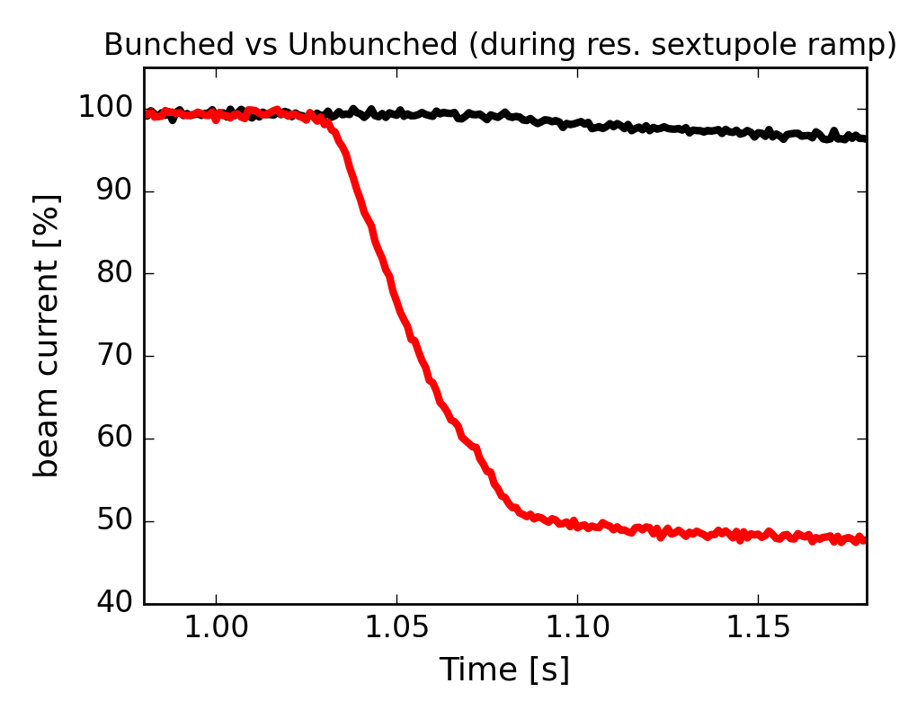
Observed beam loss with rfko optics
Measurement with same design optics for bunched and unbunched beams without RFKO
Large losses for bunched mode during the resonant sextupole ramping
Ramp of the resonant sextupole
Losses from loops OFF

Slide 4
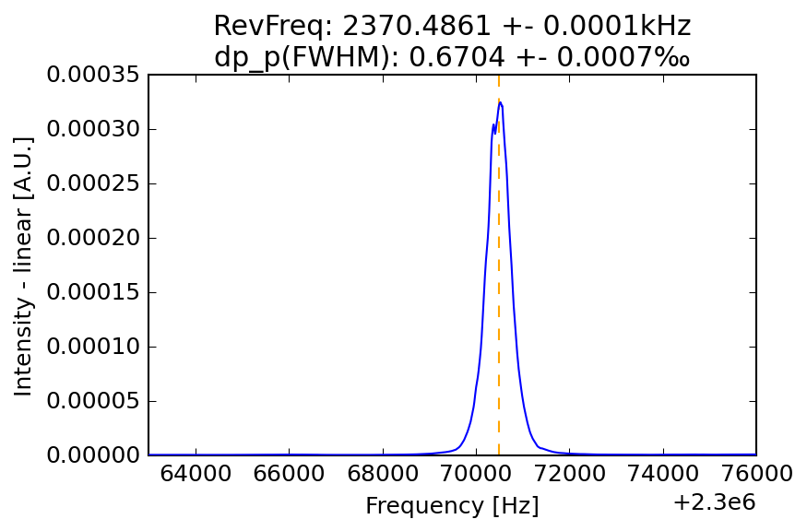
Observed beam loss with rfko optics
UNBUNCHED
Schottky monitor
Momentum spread measured before resonant sextupole ramping is as expected for unbunched beam

Slide 5
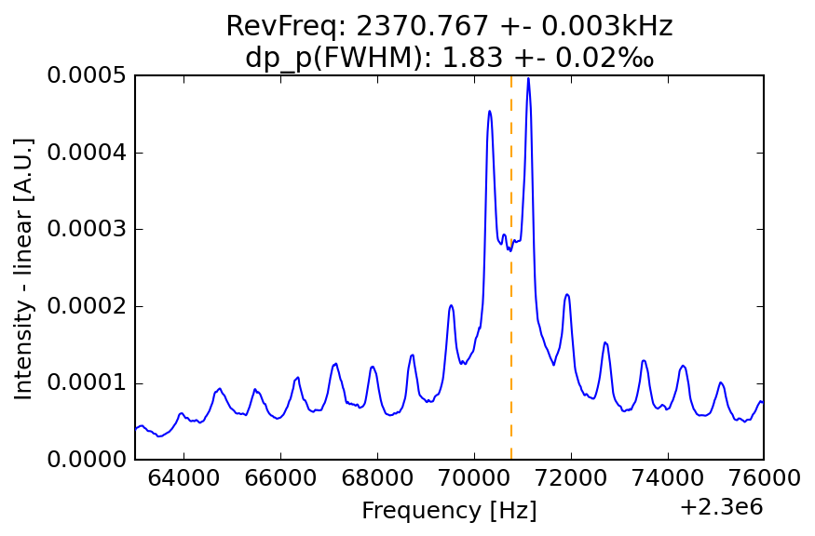
Observed beam loss with rfko optics
BUNCHED
Schottky monitor
Momentum spread measured before resonant sextupole ramping is larger and display a double peak structure around the revolution frequency
Possible synchrotron oscillation from RF mismatch with the beam energy

Slide 6
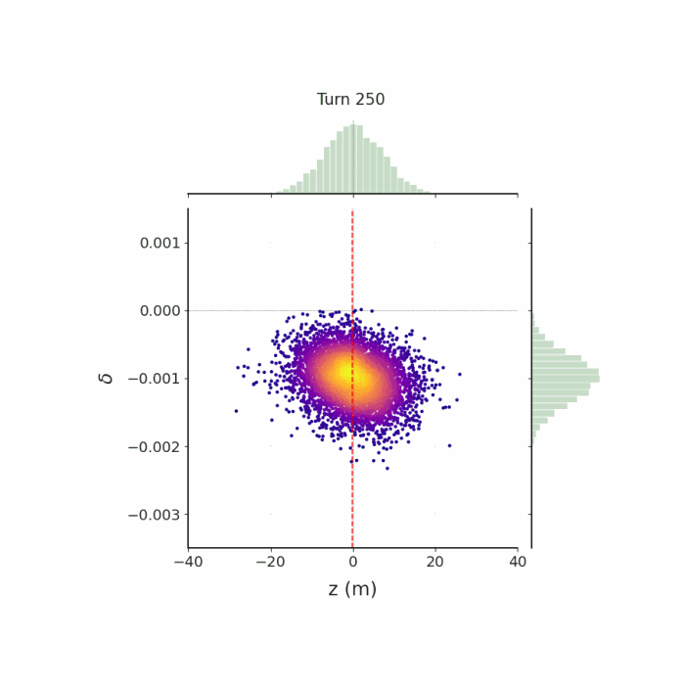
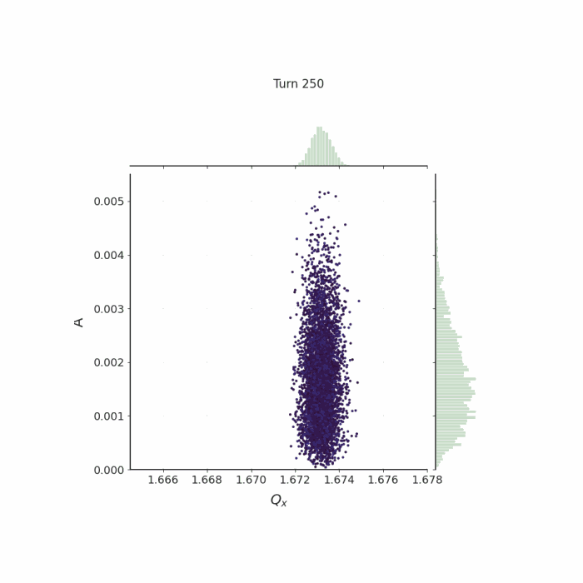
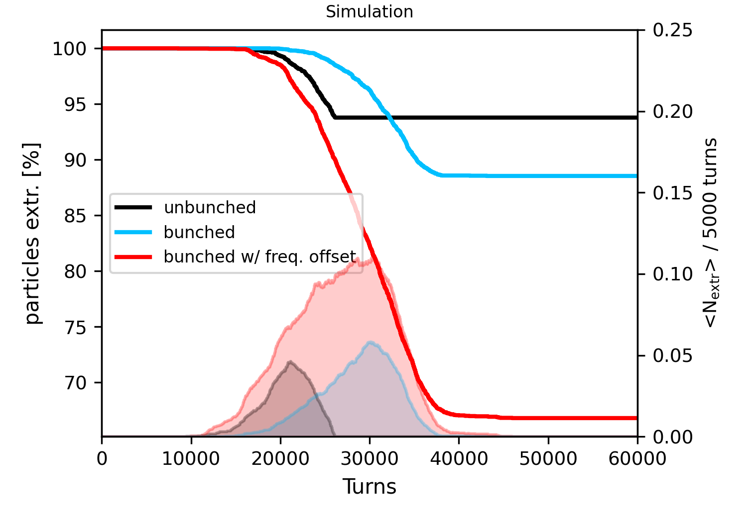
Observed beam loss with rfko optics
Simulation of bunched beam during resonant sextupole ramping with a frequency mismatch of +400Hz for 1 synchrotron oscillation
Can explain the double peak observed on the Schottky showing an energy oscillation and the larger loss during the ramping of the resonant sextupole

Slide 7
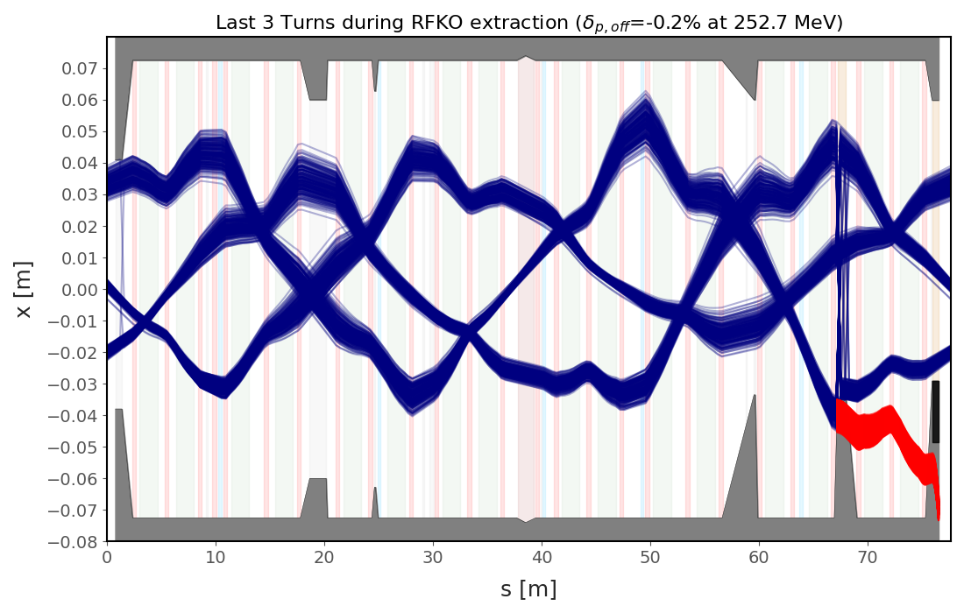
Reducing beam loss with radial loop
Move away from the resonance tune with higher off-momentum offset → change of the LLRF radial loop (change the tune via chromaticity)
Does not solve for the amplitude of the synchrotron oscillations but reduces losses on resonance
ESI
Injection Electrostatic Septum is an aperture bottleneck (loss <0.3%)
Beam loss of <5% expected at Extraction Electrostatic Septum due to the angle of the incoming beam
Simulation of expected beam loss in the ring during RFKO extraction (last 3 turns before loss)
MST
ESE
Extracted beam after ESE kick
Limit of off-momentum operation to -0.2% to avoid larger losses on inj/extr septums

Slide 8
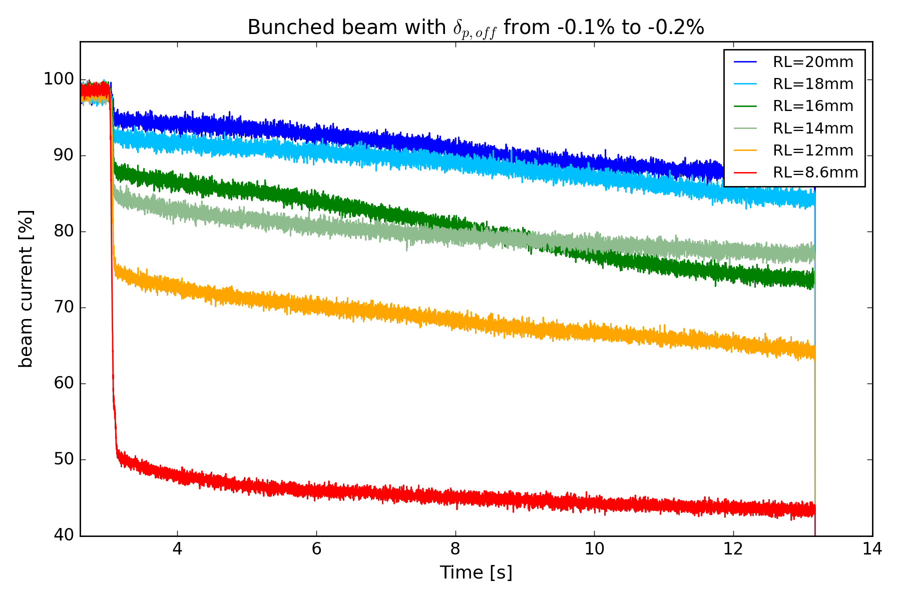
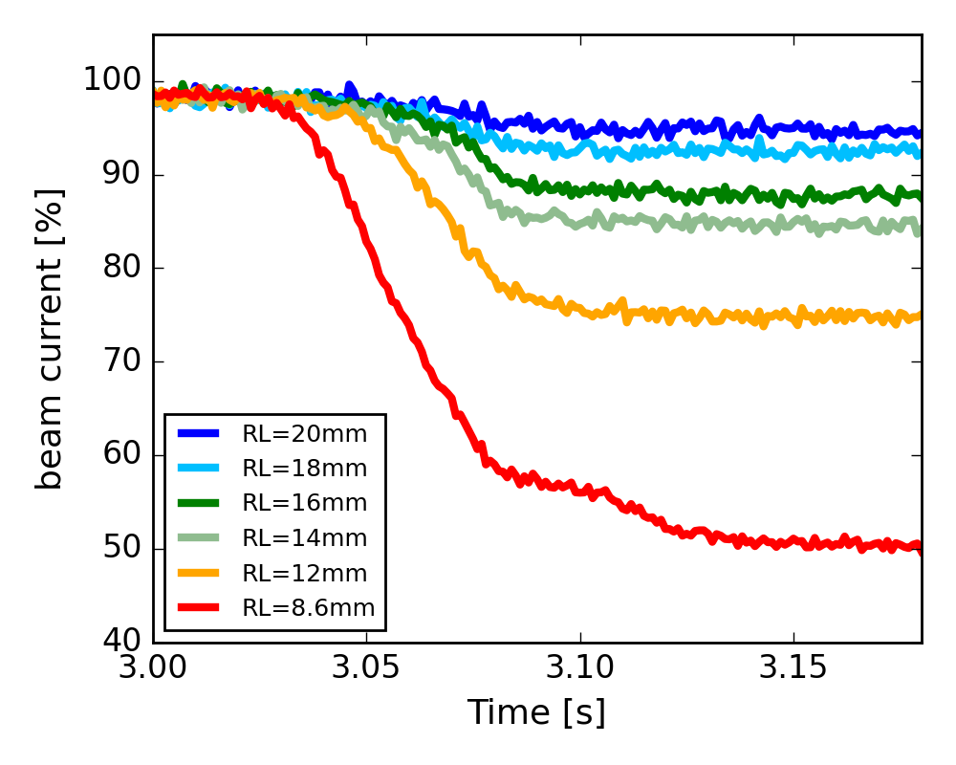
Reducing beam loss with radial loop
Move away from the resonance with higher off-momentum offset → scan of the LLRF radial loop from -0.1% to -0.23%
During sextupole ramp
Reduces loss during sextupole ramping but still visible slow losses during the spill

Slide 9
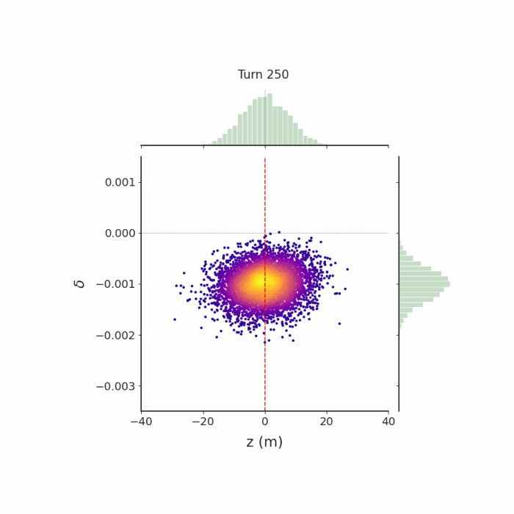
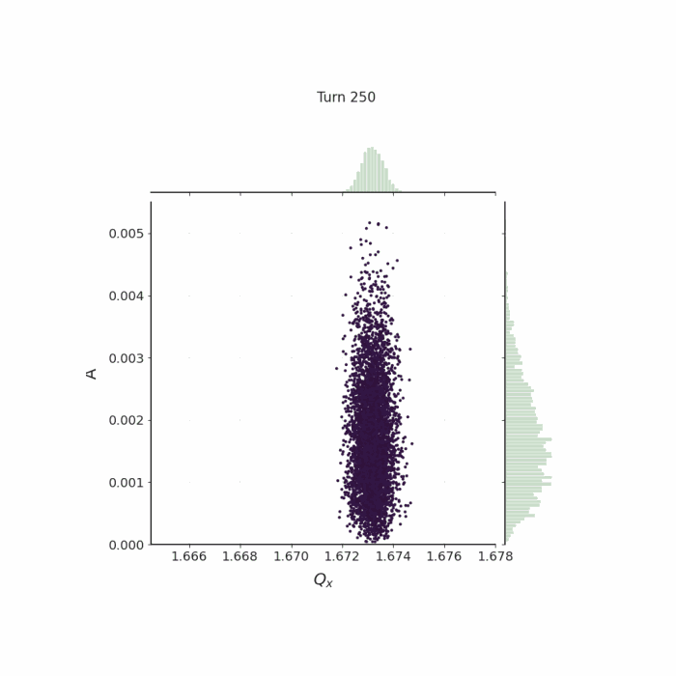
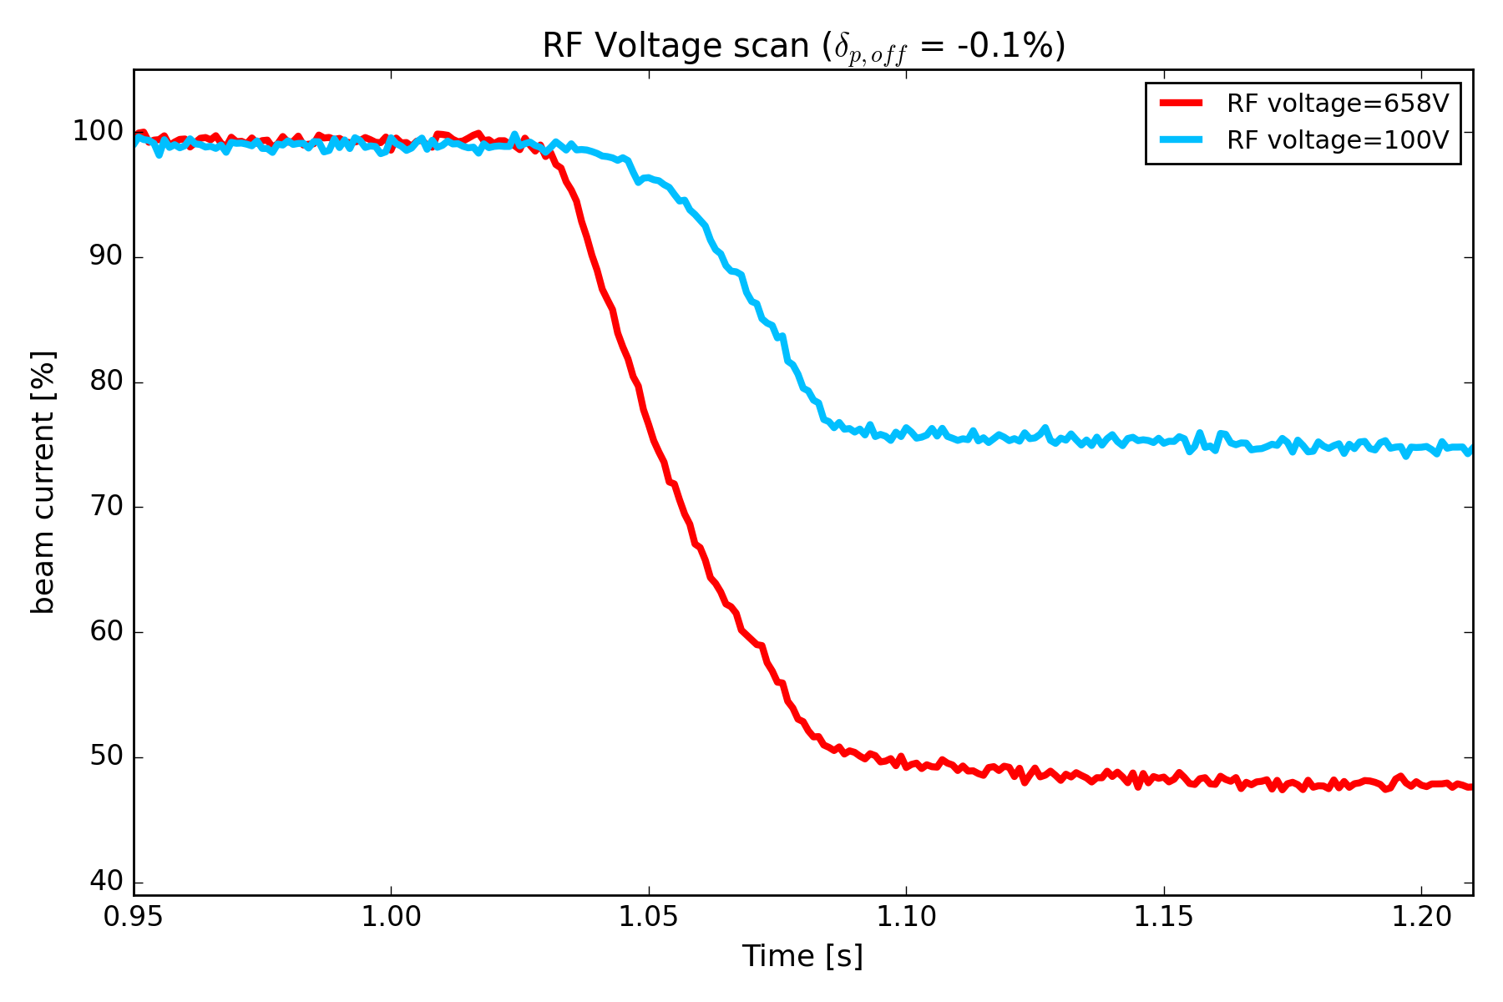
Reducing beam loss with rf voltage
Reduce the amplitude of the energy offset by reducing the bucket height to contain the oscillations
RF 100V
measurement
Reduces beam loss during sextupole ramping → for $δ_{p,off}=−0.1\%$losses are still pretty large..

Slide 10
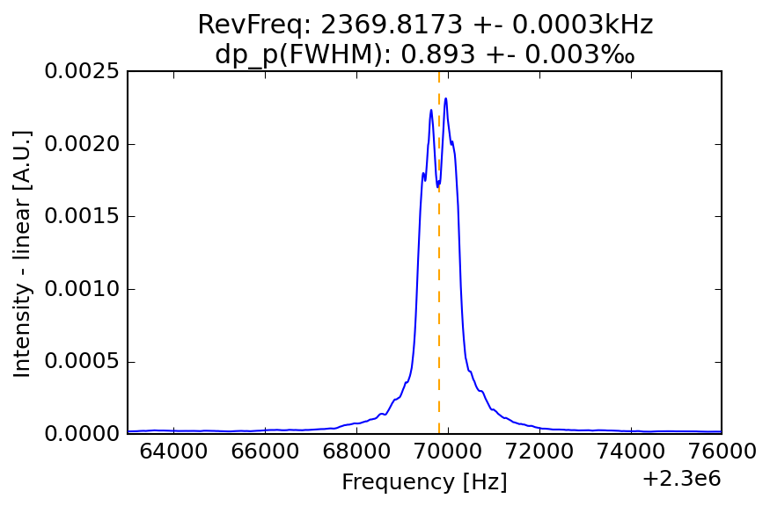
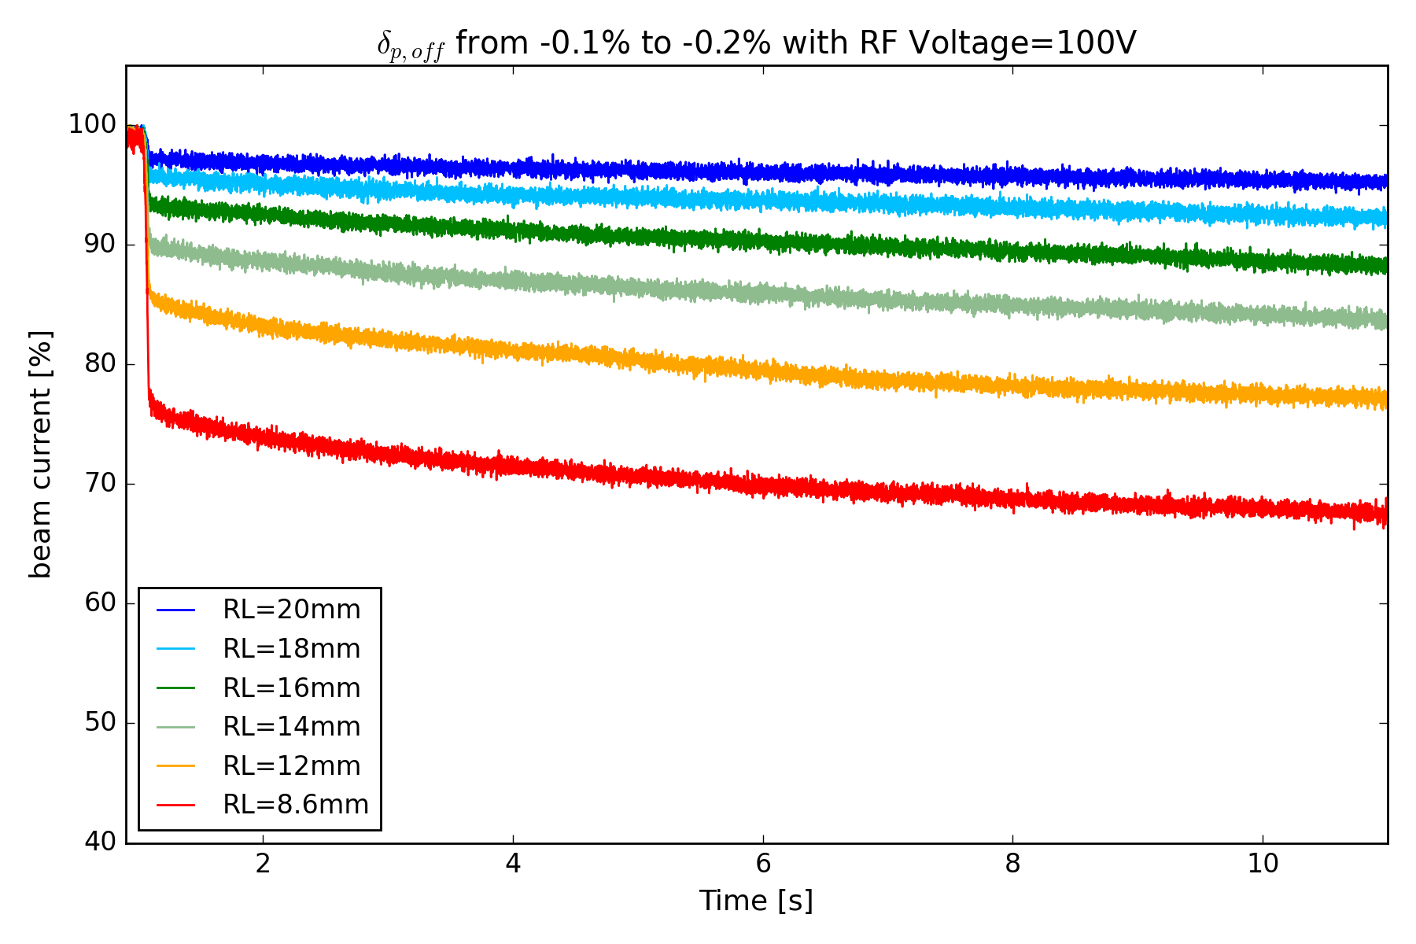
Beam loss mitigation methods
combined voltage reduction and momentum offset increase
RL=18mm
RF 100V
Smaller energy spread and oscillations
Reducing the voltage reduce the losses during the entire spill
New optimal setting for RF voltage <200V and 16mm<RL<20mm

Slide 11
conclusion
Applied methods to minimize the large beam losses observed for bunched operation with our RFKO optics
Losses during the resonant sextupole ramping seems to be caused by a mismatch between the beam and the RF correction leading to energy oscillations
The corrections applied reduce the impact of these oscillations but the source of the mismatch is still present → may be improved with our new LLRF upgrade?
The applied optimization (off-momentum ~<-0.2%, voltage <150V) allows to have an acceptable level of beam loss for stable RFKO extraction

Slide 12
Backup slides

Slide 13
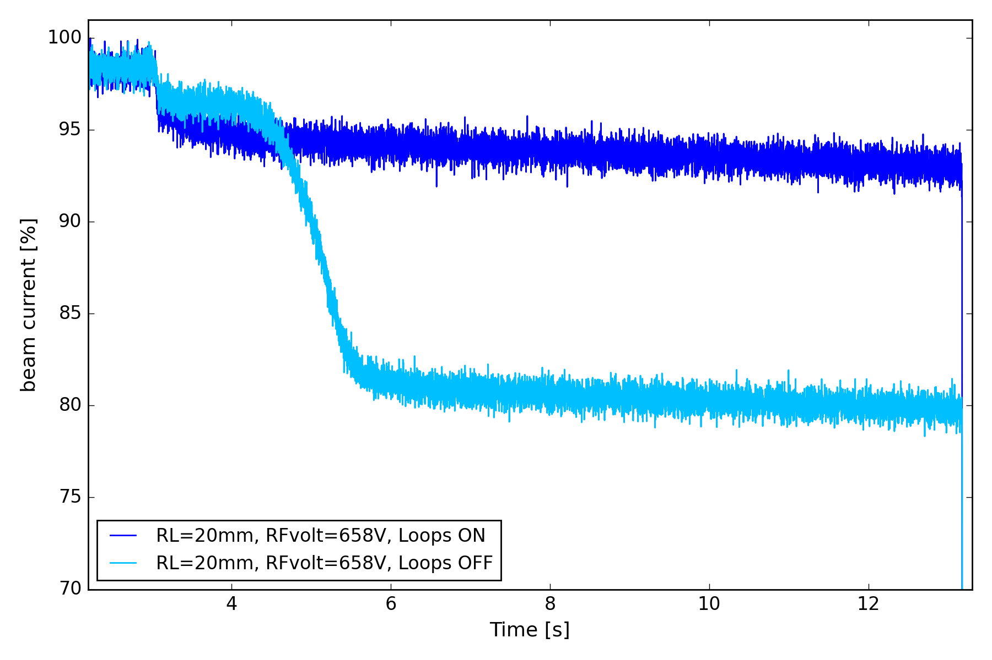
LLRF LOOPS impact DURING EXTRACTION
LLRF correction loop active during the entire spill to avoid losses at mid spill from slow frequency mismatch

