Slide 1
Slow Extraction Workshop, February 11th – 15th, MedAustron
Thomas Sieber (GSI)
for the CCC Collaboration
The Cryogenic Current Comparator (CCC) for nondestructive Spill Measurement in the nA range
Notes:
1

Slide 2
Outline
CCCs at FAIR, Motivation and working Principle
Laboratory Tests and Operation in CRYRING@ESR
Measurement Campaign 2023
Alternative CCC Types, Pros and Cons
Summary and Outlook
February 13th 2024
Slow Extraction Workshop
Thomas Sieber 2
Notes:
2

Slide 3
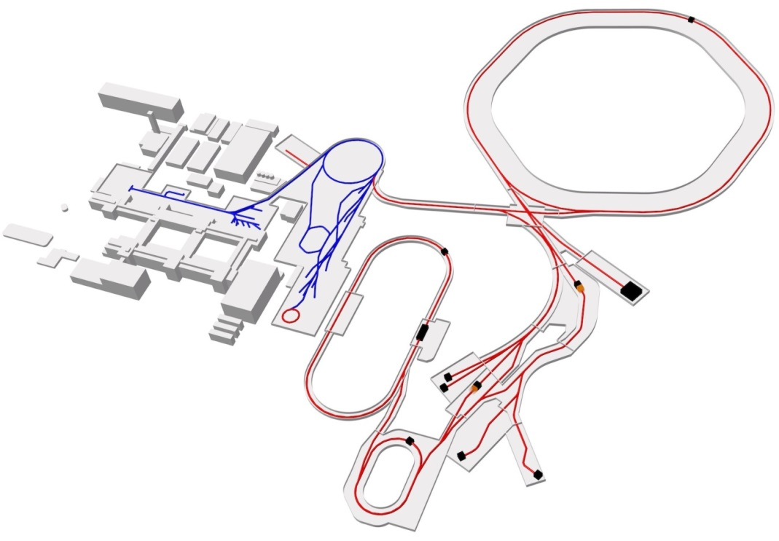
Low Intensity Measurement at FAIR
Nondestructive measurement for low intensity
(nA) beams at FAIR
- Slow extracted beam from SIS100 (RIB, CBM), spill optimization
- Circulating beam in Collector Ring (CR → HESR)
Proton Linac
UNILAC
SIS18
SIS100
FAIR
GSI
CBM
Cryring
PANDA
Super FRS
HESR
CR
NuSTAR
CCC Position
CCC:
Precise measurement of
azimuthal magnetic field
(fT-range) using
DC-SQUIDS
Detector systems used for slow extraction at SIS18 (P. Forck)
SClNT …Scintillator
IC …Ionization Chamber
SEM …Secondary Electron Monitor
February 13th 2024
Slow Extraction Workshop
Thomas Sieber 3
Notes:
3

Slide 4
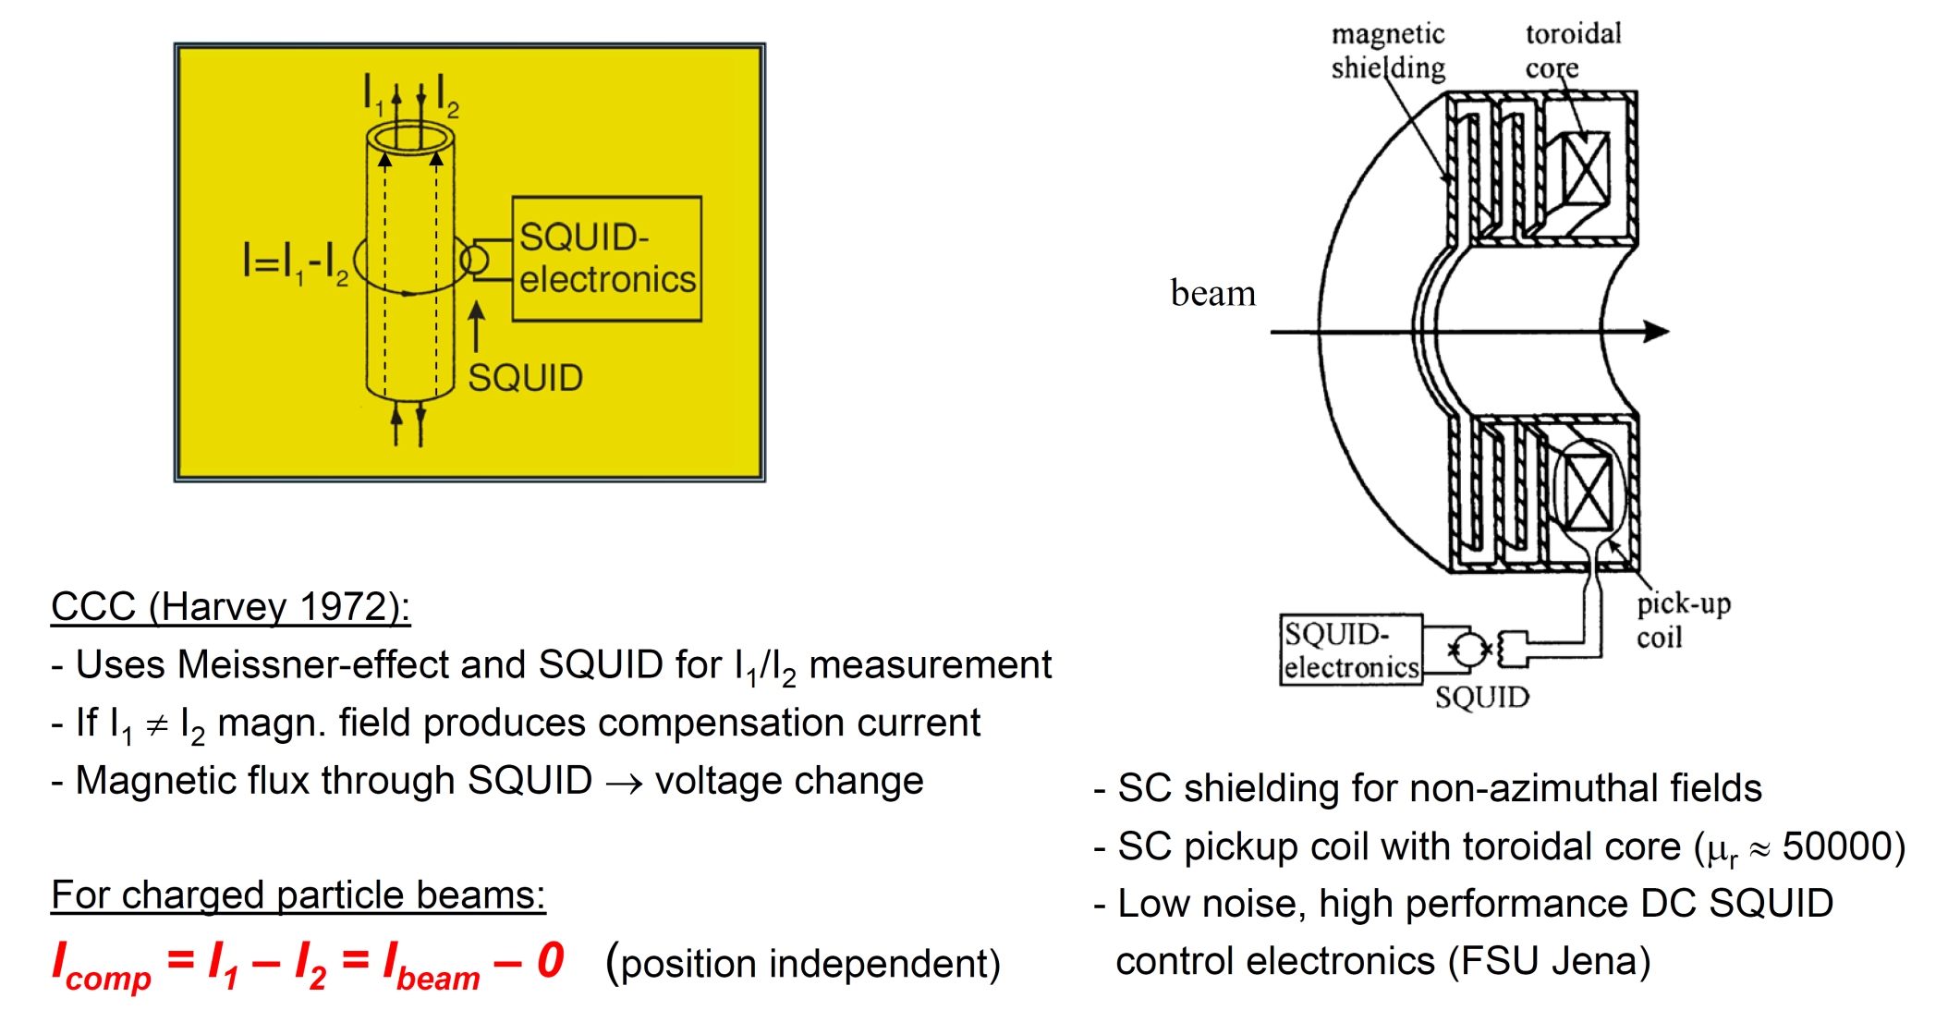
CCC Working Principle
+
→ commercial
products (MAGNICON, SUPRACON)
- FLL electronics: → μΦ₀ Resolution
Proof of Principle in Accelerators: A. Peters at. al. 1994
February 13th 2024
Slow Extraction Workshop
Thomas Sieber 4
Notes:
4

Slide 5
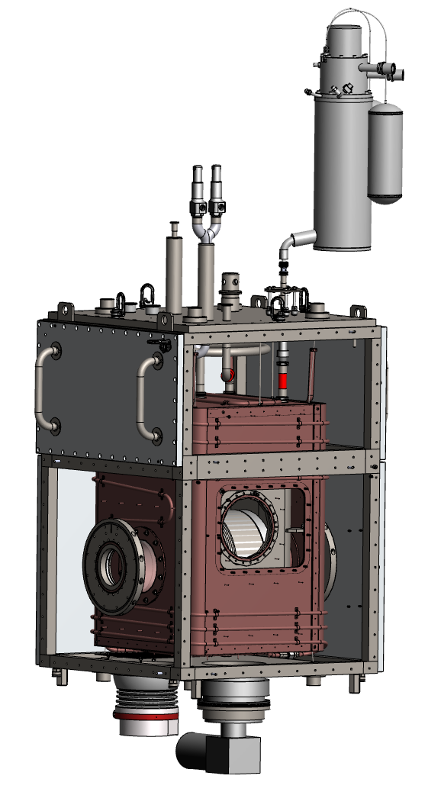
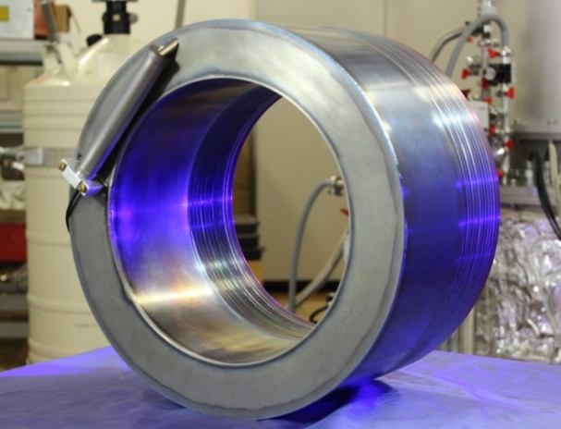
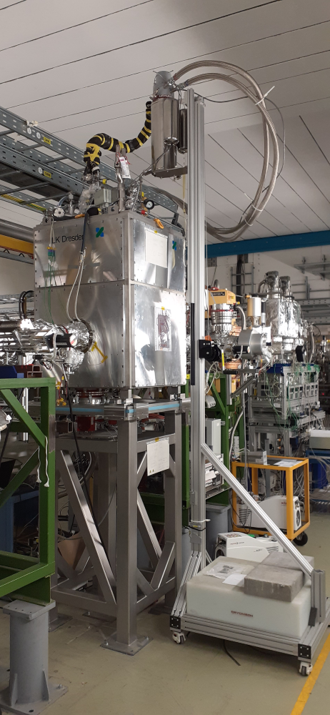
Cryostat Design for CRYRING / FAIR
Cryostat Design
Liquefier
Head
Vacuum Tank
250 mm
Aluminum
Windows
60 kg
Thermal
Shielding
with
Enthalpie Line
1200
System costs (2019)
Nb CCC 180 k€
Cryostat 150 k€
Liquefier 65 k€
SQUID + electronics 10 k€
DAQ 10 k€
Support 5 k€
Total ~ 420 k€
UHV Beam
Tube
Steel
Frame
CCC Installation
in CRYRING
Helium
Container
CCC Shield +
Detector
standing time ~ 10 days
February 13th 2024
Slow Extraction Workshop
Thomas Sieber 5
Notes:
5

Slide 6
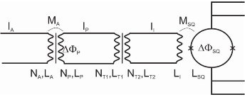
Laboratory Tests I
Pulsed Current Measurement from Calibration Loop
Direct = without Matching Transformer / Balanced = Matching Transformer adjusted
direct
balanced
10 kHz Filter ON
Matching Transformer
balanced
10 kHz Filter OFF
noise spectrum
February 13th 2024
Slow Extraction Workshop
Thomas Sieber 6
Notes:
6

Slide 7
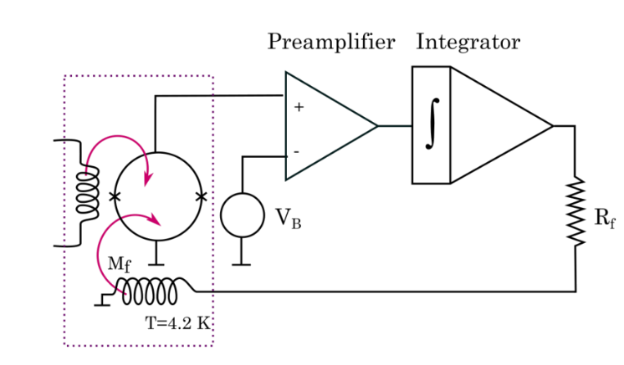
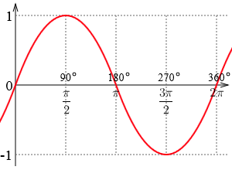
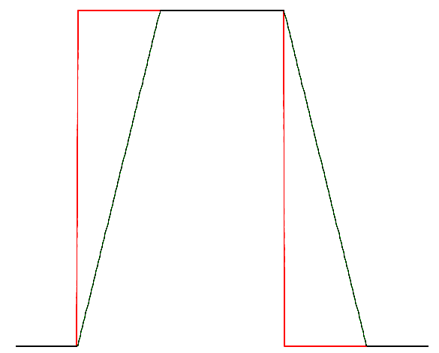
Laboratory Tests II
Tolerable rise time of pulses in flux locked mode → Slew Rate
FLL-Electronics
soft
hard
$$I\left(t\right)=I_{max}∙\sin\left(2π∙f∙t\right)$$
$$SR=\max_{ }\left(\left|\frac{dI_{out}\left(t\right)}{dt}\right|\right)$$
$$\max_{ }\left(\left|\dot{I}\right|\right)=\dot{I}\left(t=0\right)={\left|2π∙f∙I_{max}∙\cos\left(2π∙f∙t\right)\right|}_{t=0}$$
$$SR=2π∙f∙I_{max}$$
direct: 260 nA @ 200 kHz
=> 0.33 µA/µs
balanced: 130 nA @ 200 kHz
=> 0.16 µA/µs
February 13th 2024
Slow Extraction Workshop
Thomas Sieber 7
Notes:
7

Slide 8
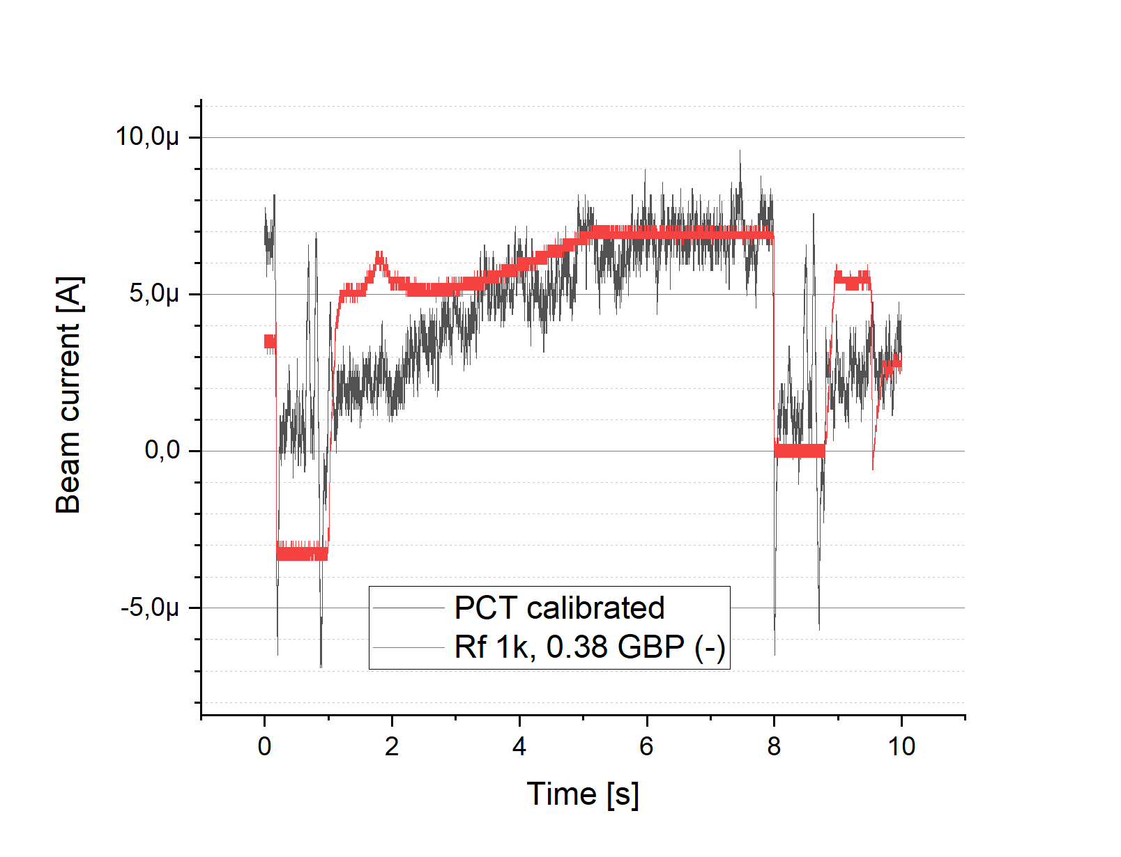
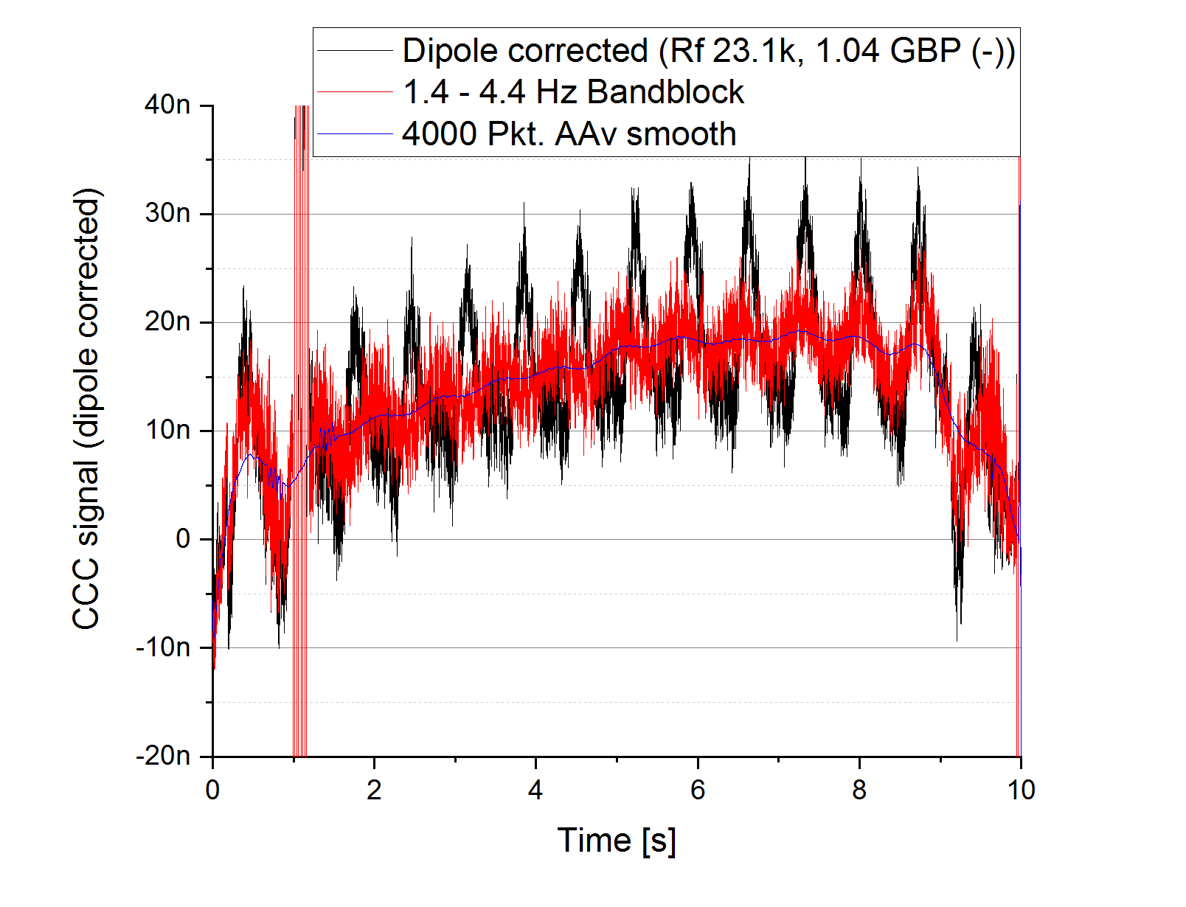
Operation in CRYRING: Challenges at low and high Intensities
High beam currents
High slew rates → loss of signal lock
Threshold around 500 nA of D⁺
add low pass to reduce slew rate
(10 kHz instead of 100 kHz cut off)
Low beam currents
Resolution limited by external perturbations (liquefier, dipole ramp)
hardware optimization
improve software filtering
In general: transition laboratory → accelerator reduces current resolution by factor 10
February 13th 2024
Slow Extraction Workshop
Thomas Sieber 8

Slide 9
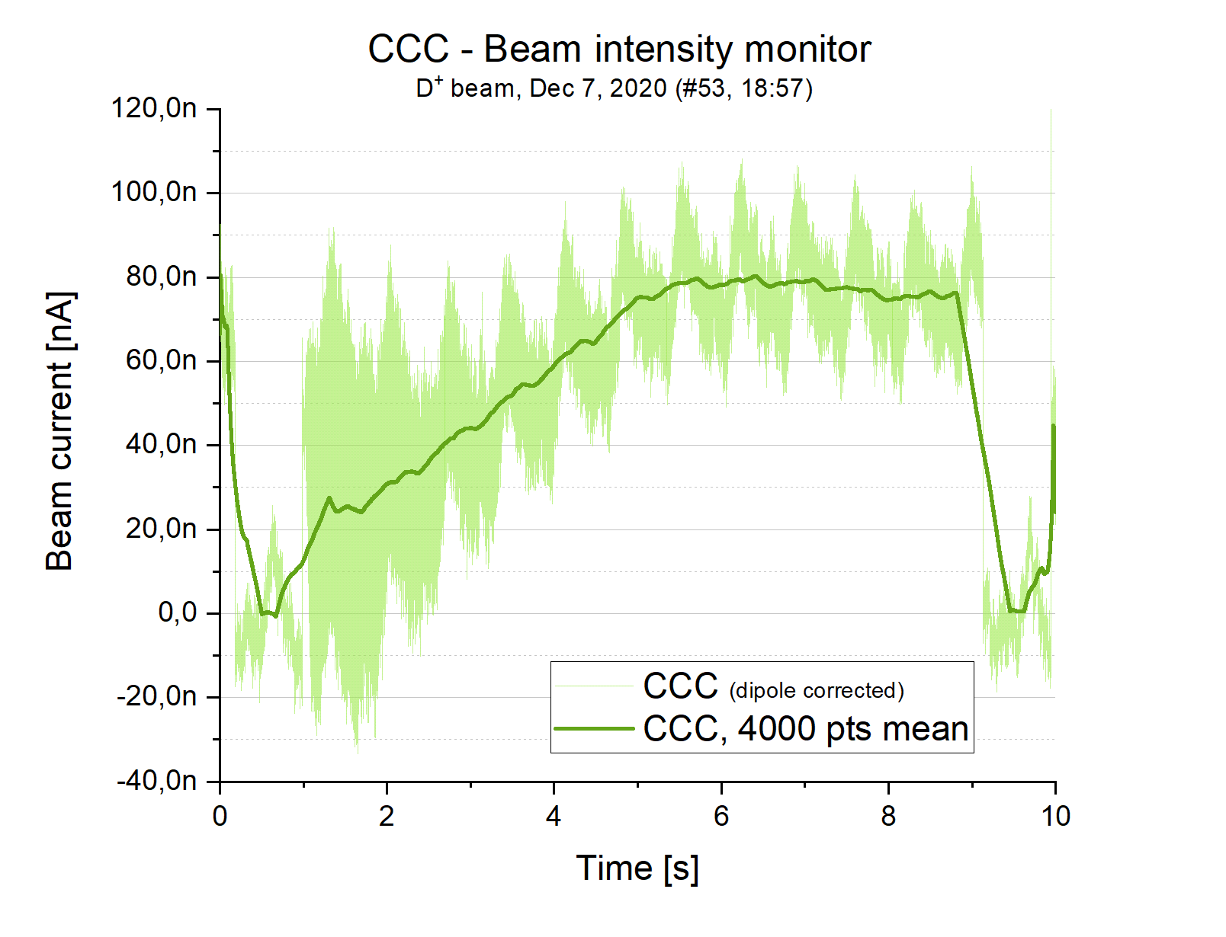
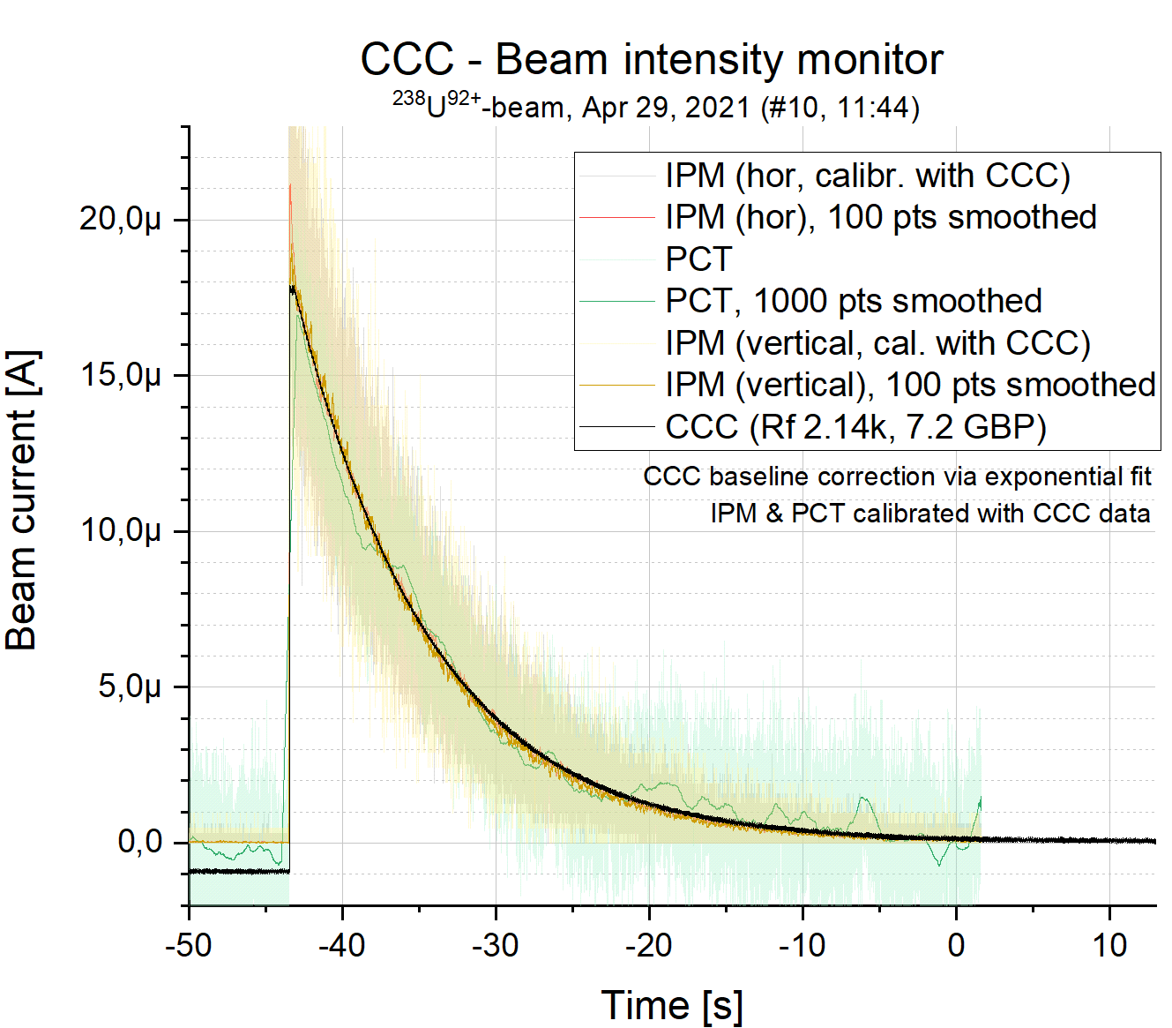
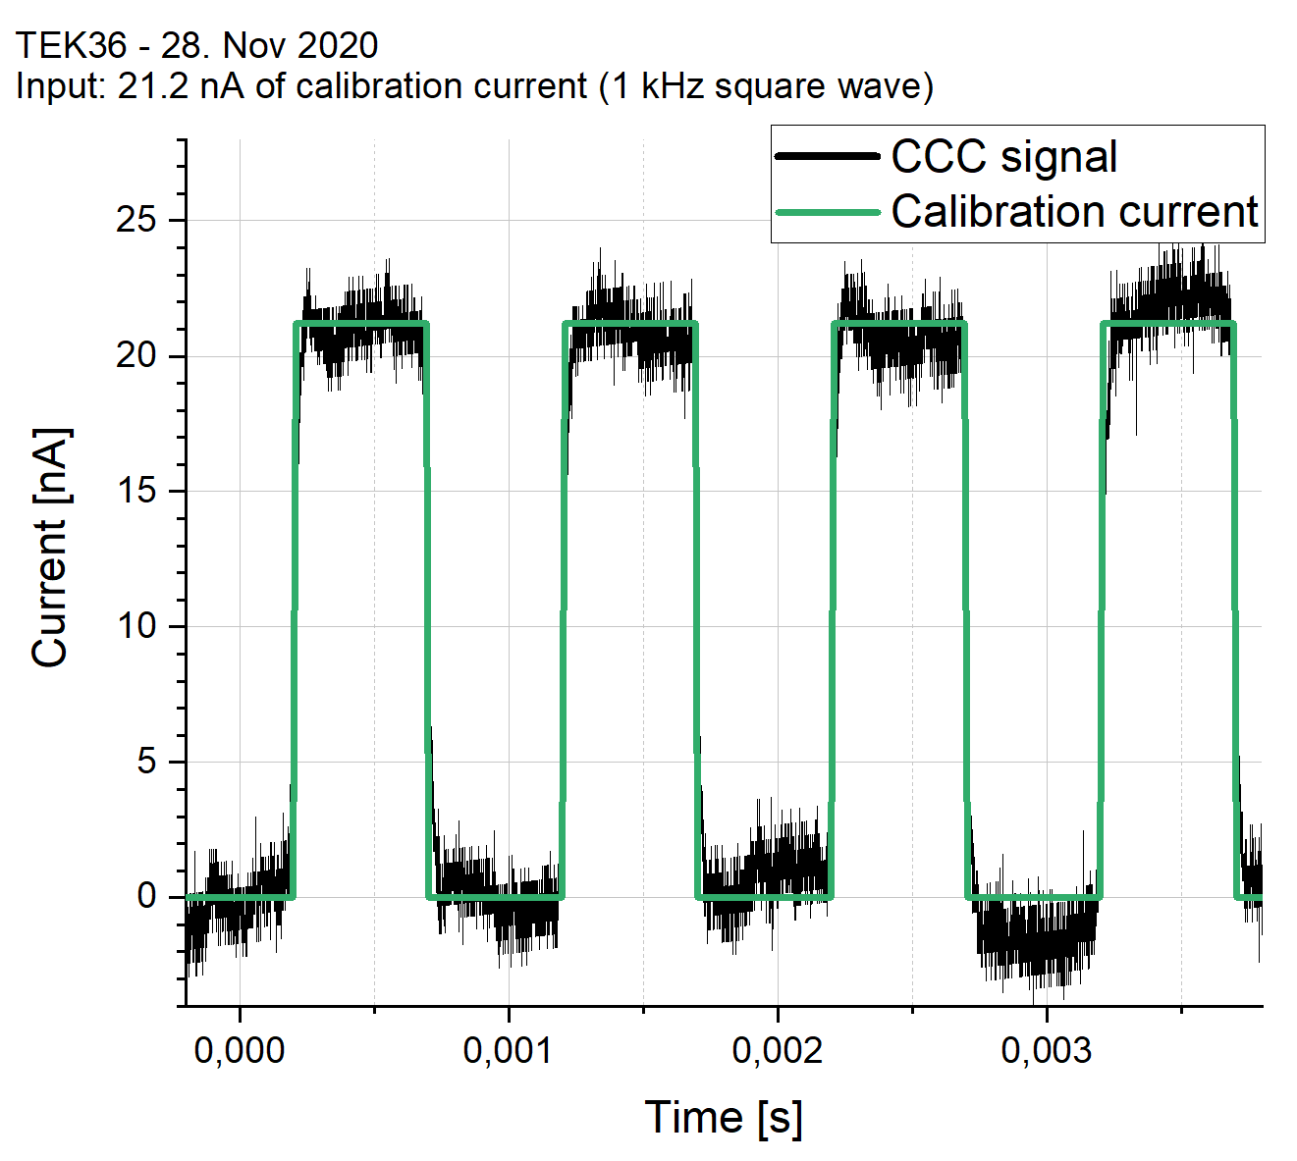
Results from CRYRING
Low Intensity
High Intensity
February 13th 2024
Slow Extraction Workshop
Thomas Sieber
9

Slide 10
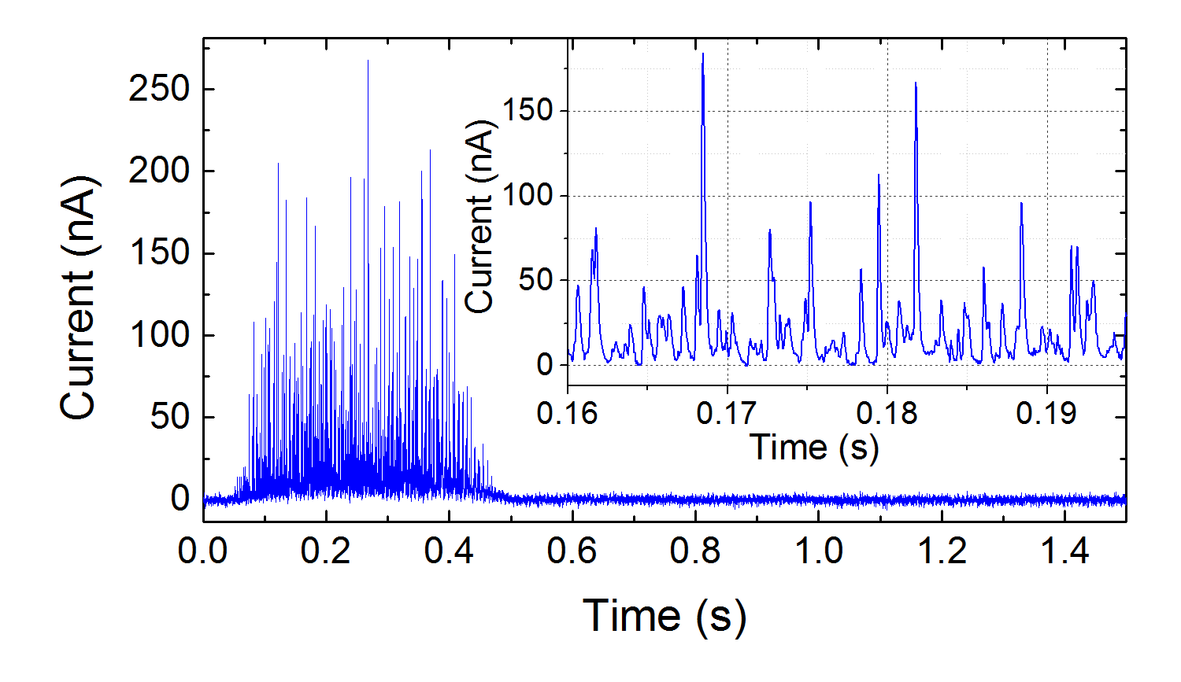
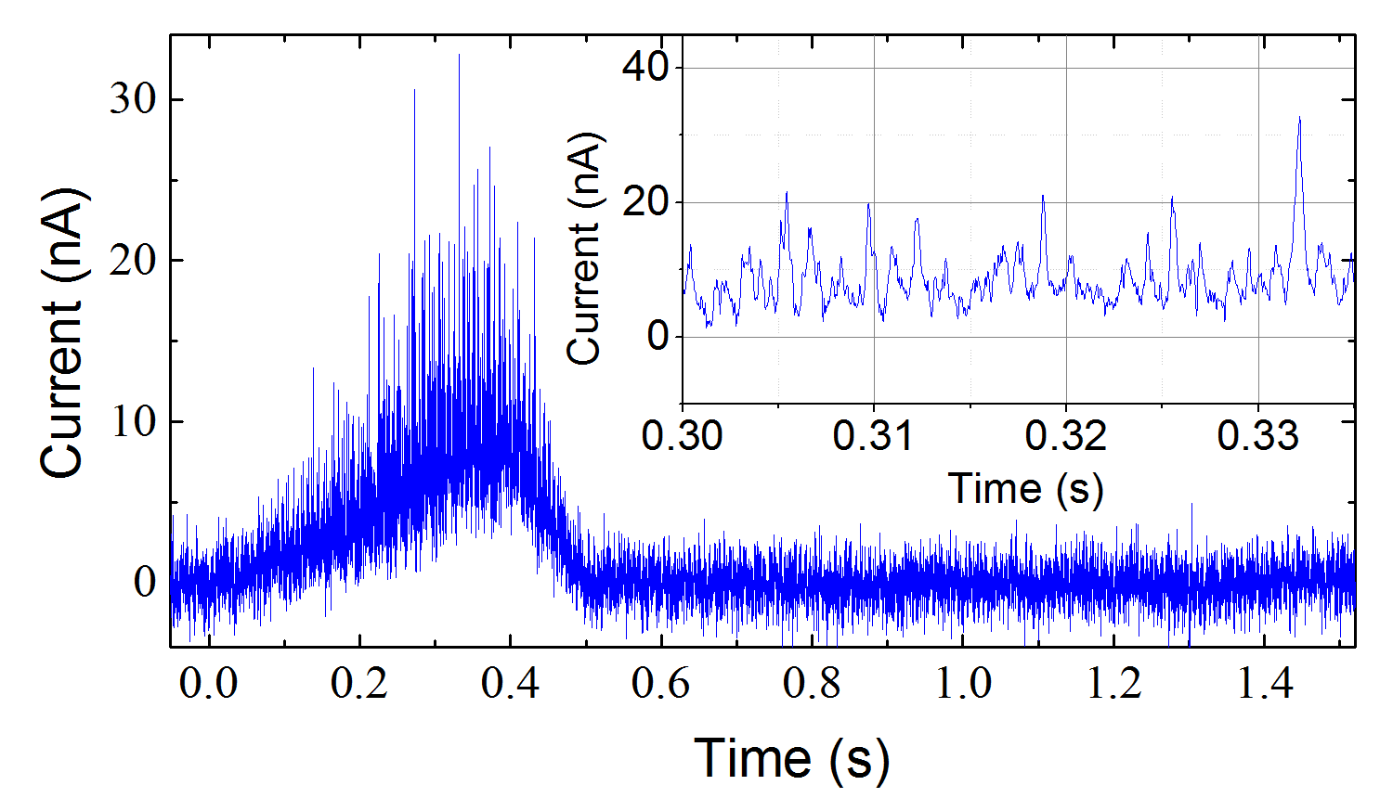
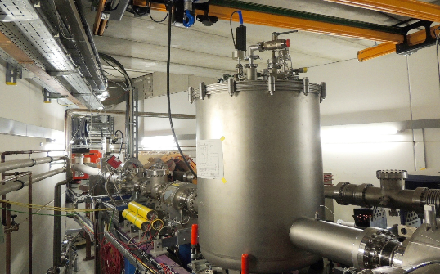
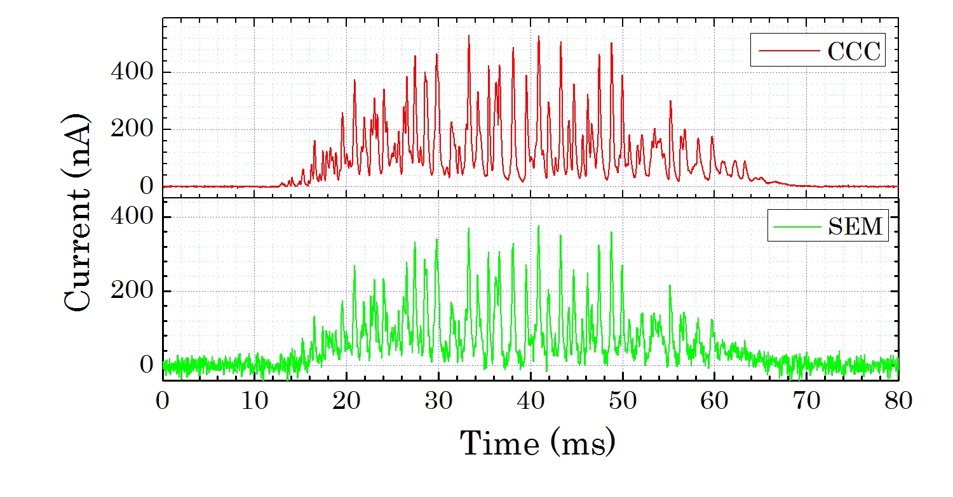
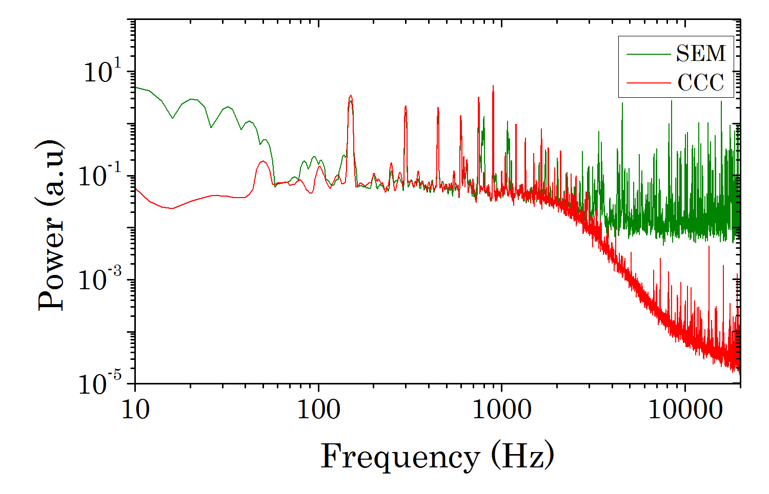
Spill Measurements at GSI - History
Experimental setup
CCC prototype (A. Peters et al.)
Spill analysis unbunched beam
Bunched beam
Forck et. al. 2004, Ne¹⁰⁺, 300 MeV/u, t_{extr} 100 ms – 5 s; FSU Jena SQUID + electronics
Change requests for FAIR:
Beamline and isolation vacuum coupled
~5*10-6 mbar → no UHV operation
Shield not completely enthalpy cooled
additional cold head required
Cooler to be switched off during
measurements (thermal drift)
No liquefier, manual filling → (no standalone operation AND thermal drift)
SQUID, electronics + controls from 80‘s
Magn. shielding, current resolution etc.
Spill measurement with CCC and SEM
FFT
Kurian et. al. 2015, Ni²⁶⁺, 600 MeV/u, t_{extr} 60 ms – 5 s; Magnicon SQUID + electronics
February 13th 2024
Slow Extraction Workshop
Thomas Sieber 10

Slide 11
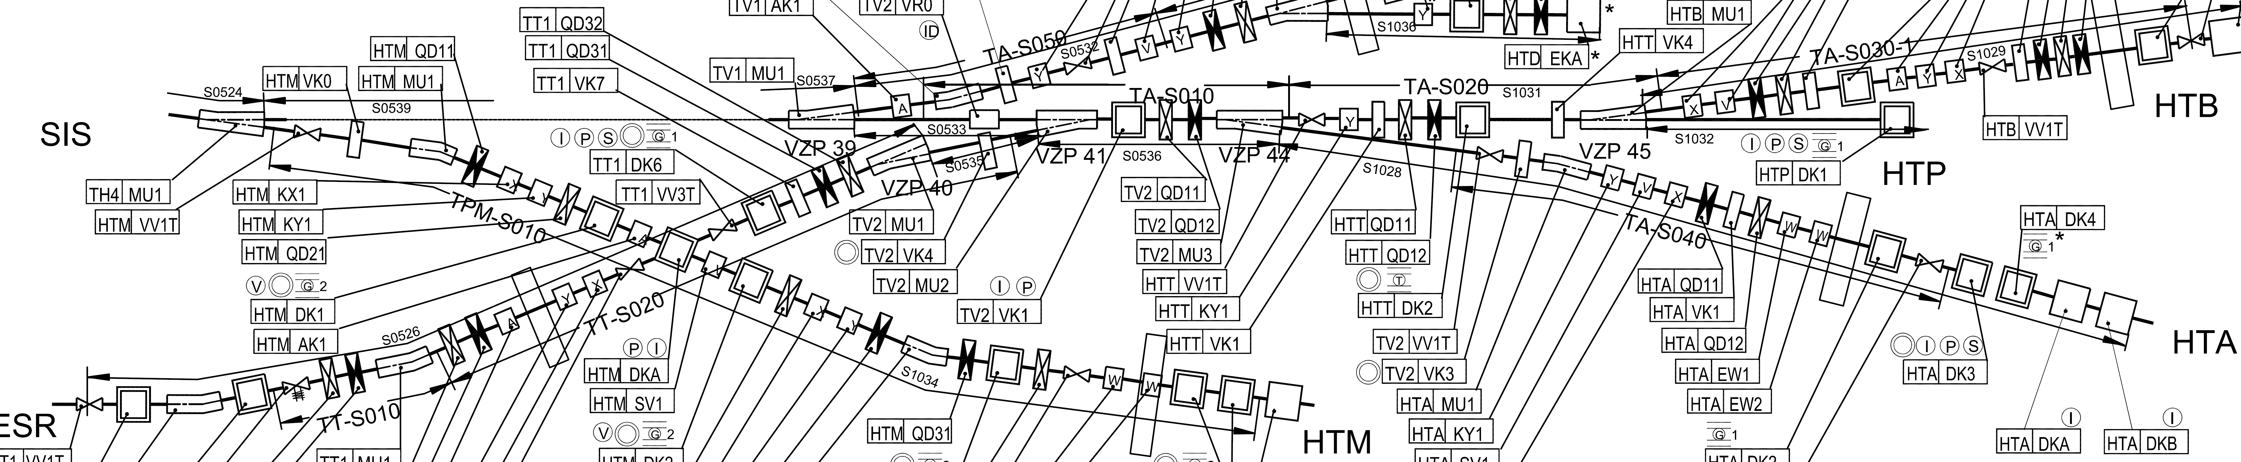
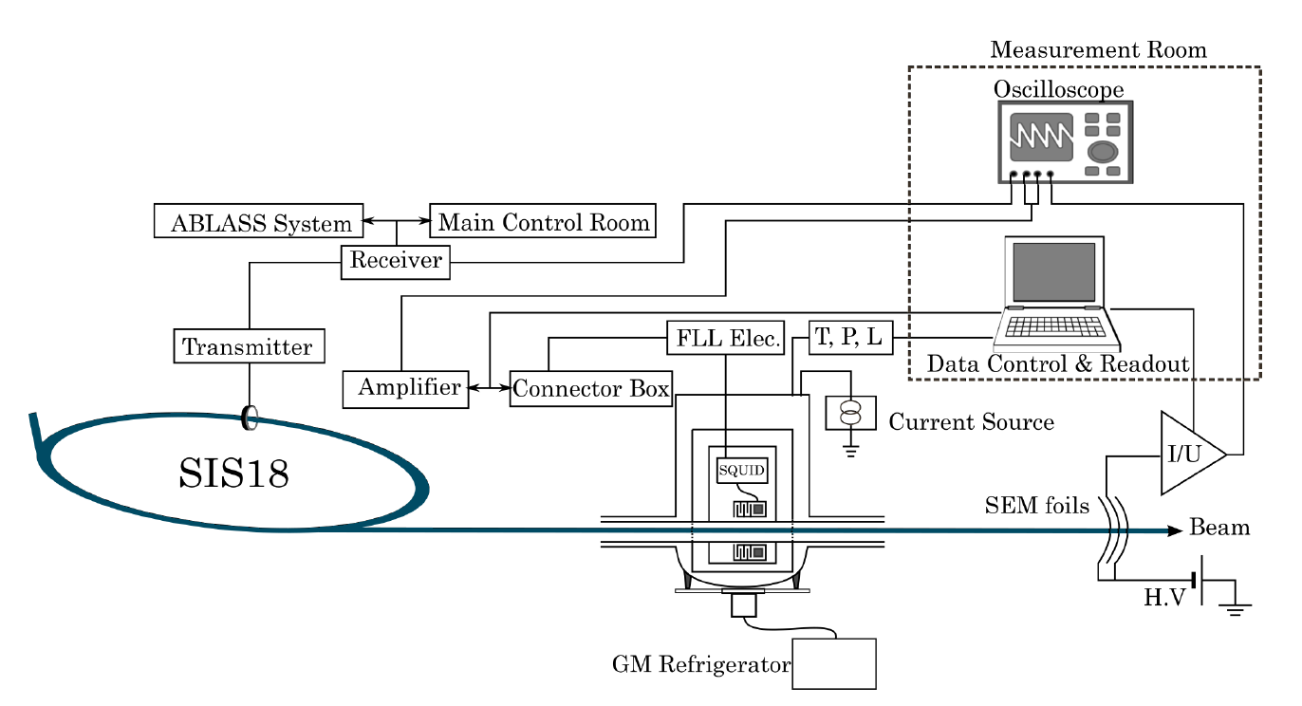
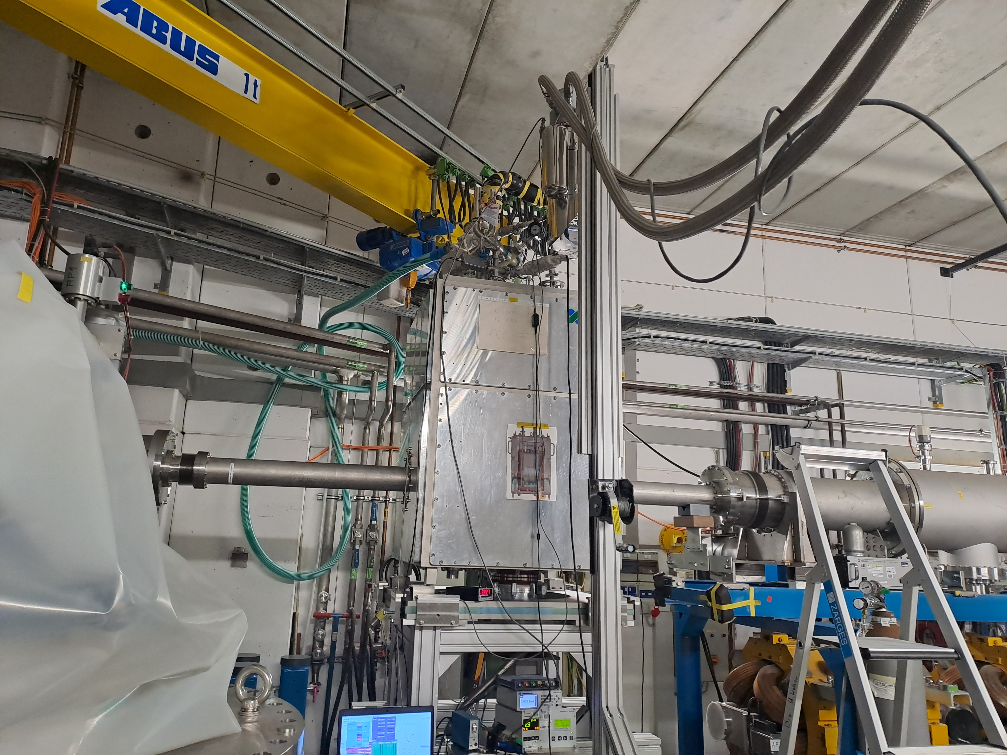
Engineering Run 12/2023 CCC-XD@SIS18
FFT spectrum
Crescimbeni et. al. 2023, U⁷³⁺, 200 MeV/u, t_{extr} 50 ms – 1 s; Magnicon SQUID + electronics
Experimental Setup
CCC installed in exp. cave
February 13th 2024
Slow Extraction Workshop
Thomas Sieber 11

Slide 12
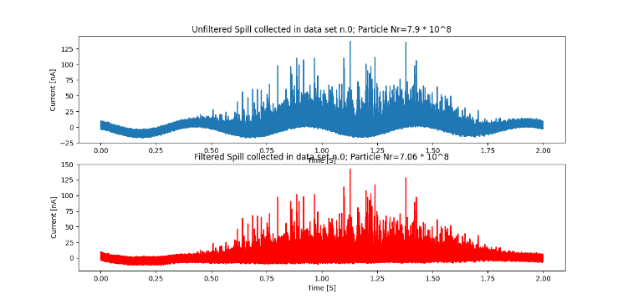
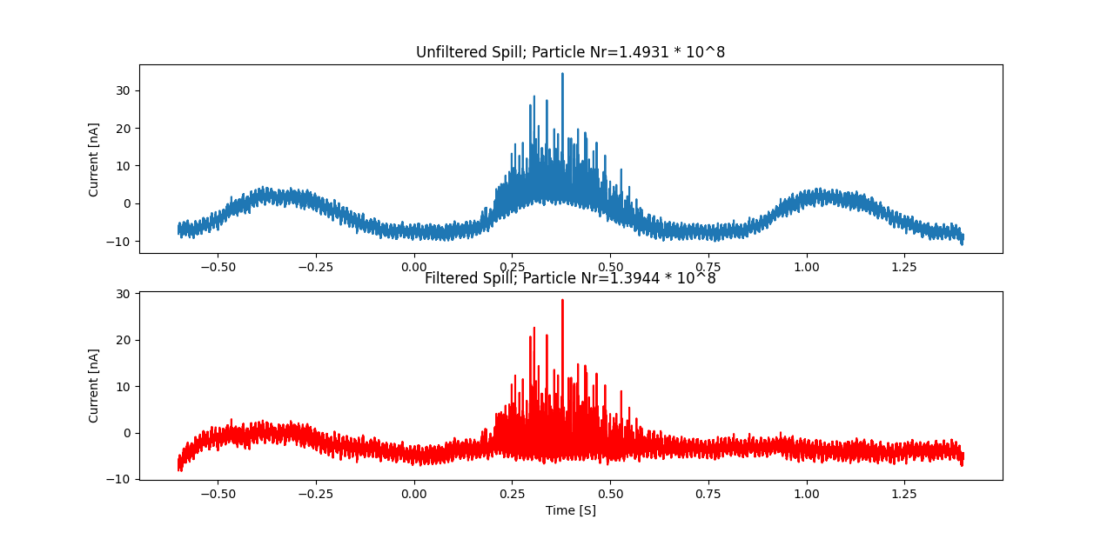
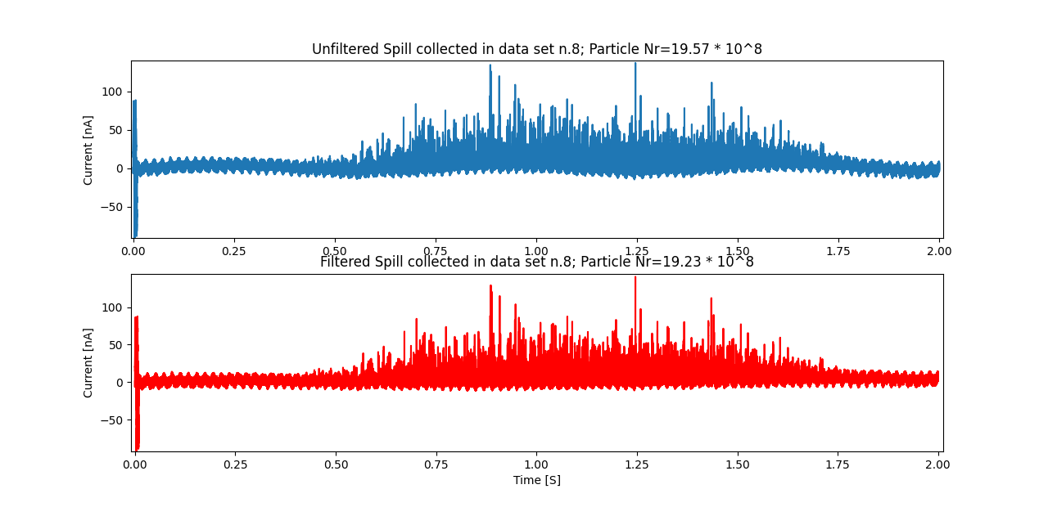
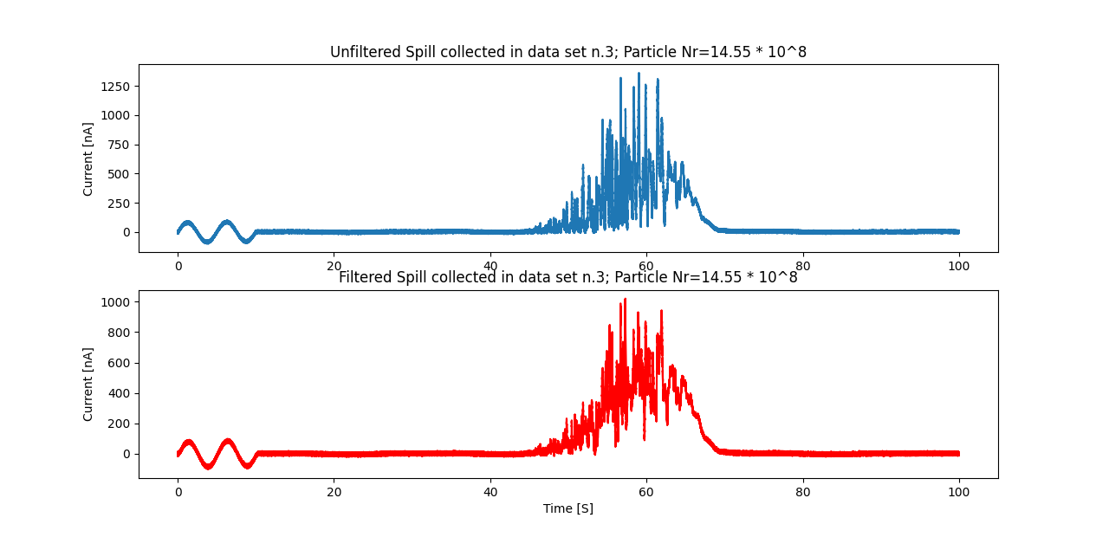
Engineering Run 12/2023 CCC-XD@SIS18
Eliminating Pertubations, investigation of filtering effects (spill shape, particle numbers) …
liquefier off
sine wave superimposed
liquefier on, short spill
liquefier on, long spill
liquefier off, short spill
+ calibration signal
(ms)
February 13th 2024
Slow Extraction Workshop
Thomas Sieber 12

Slide 13
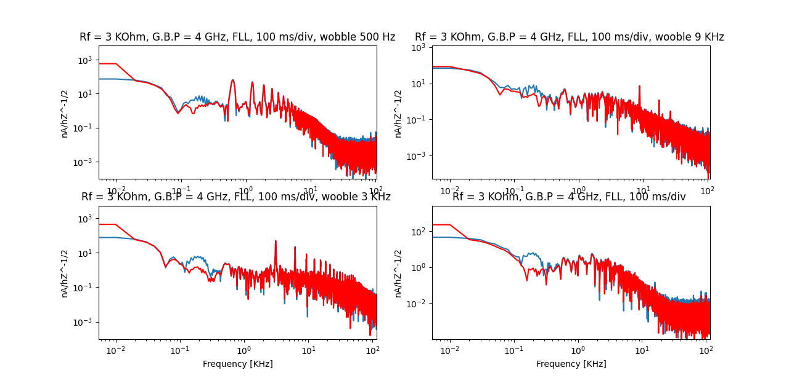
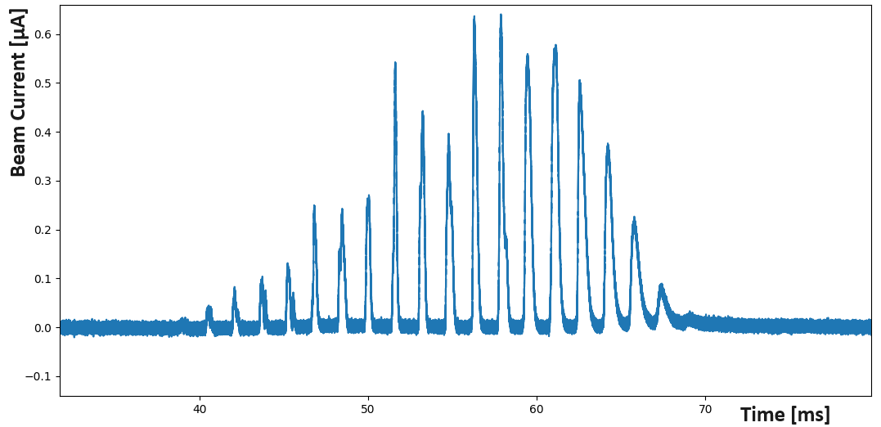
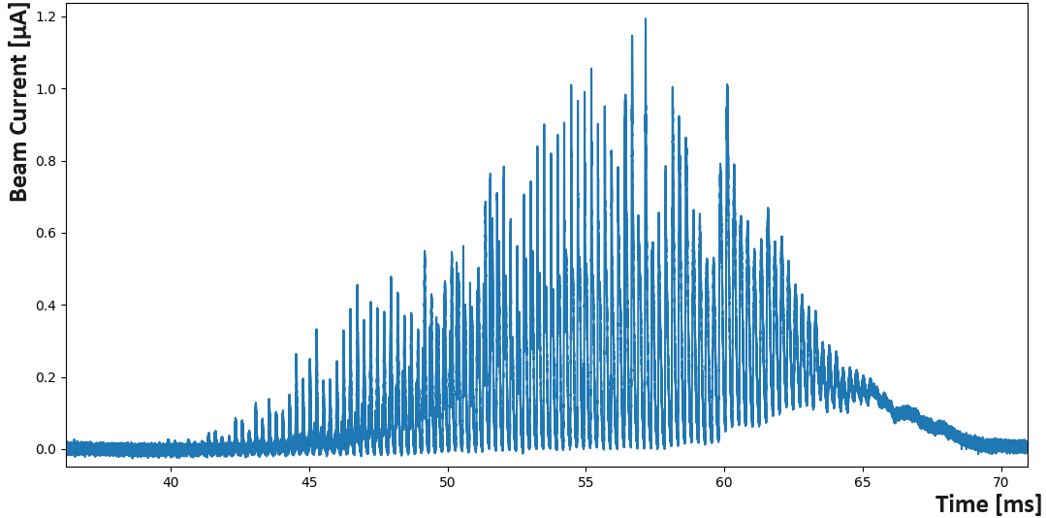
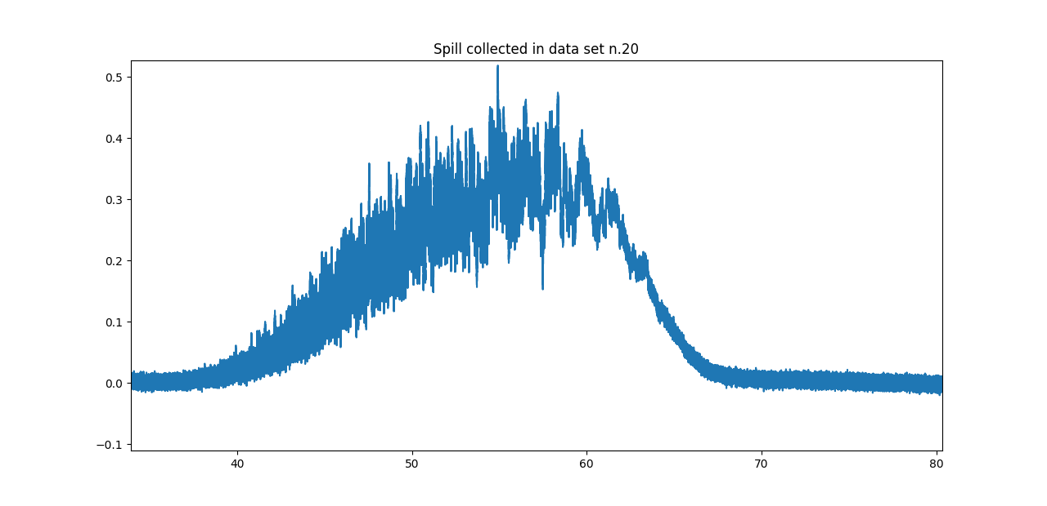
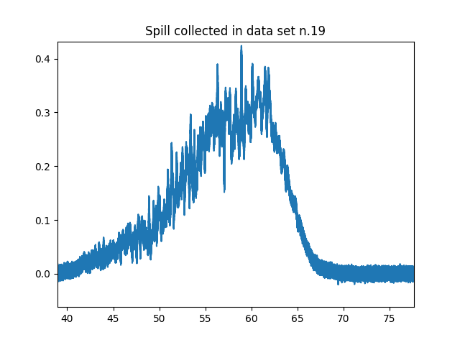
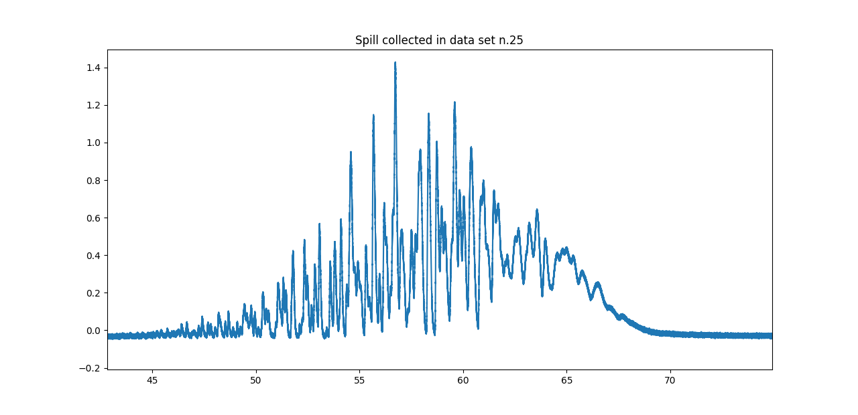
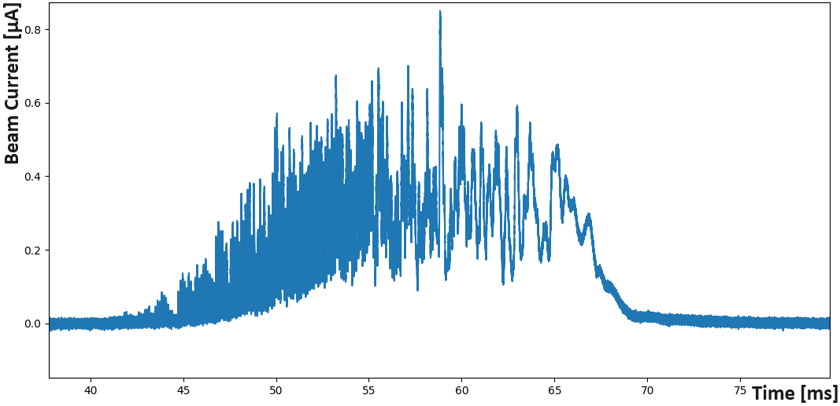
Engineering Run 12/2023 CCC-XD@SIS18
Analysis of spill optimization, tune wobbling …
FFT spectra for different wobbling frequencies
500 Hz
500 Hz
9 kHz
3 kHz
3 kHz
0 kHz
… and bunching
9 kHz
I (µA)
bunched
wobbled
I (µA)
unbunched
bunched
t (ms)
t (ms)
February 13th 2024
Slow Extraction Workshop
Thomas Sieber 13

Slide 14
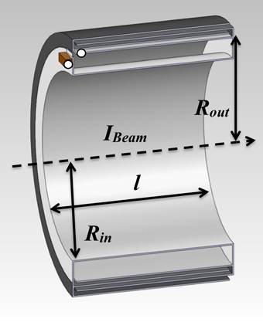
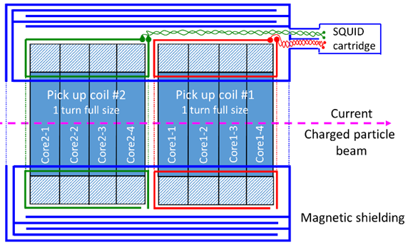
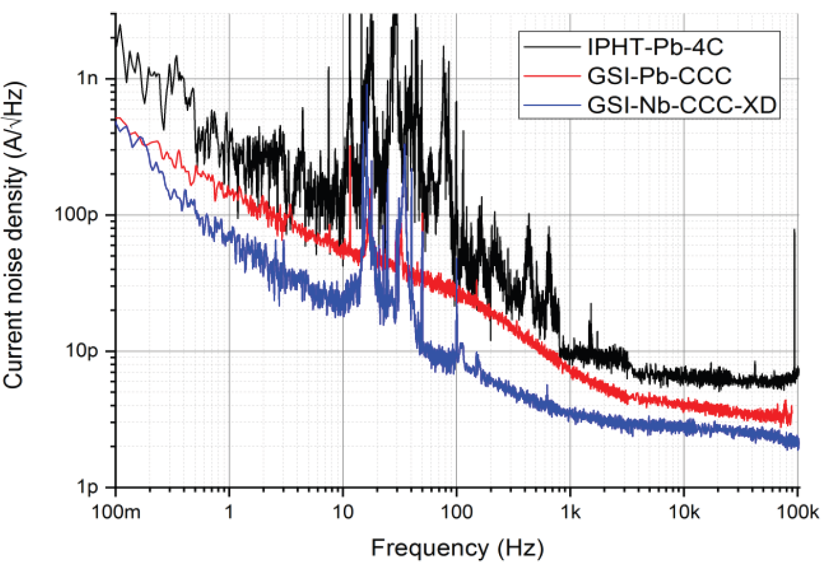
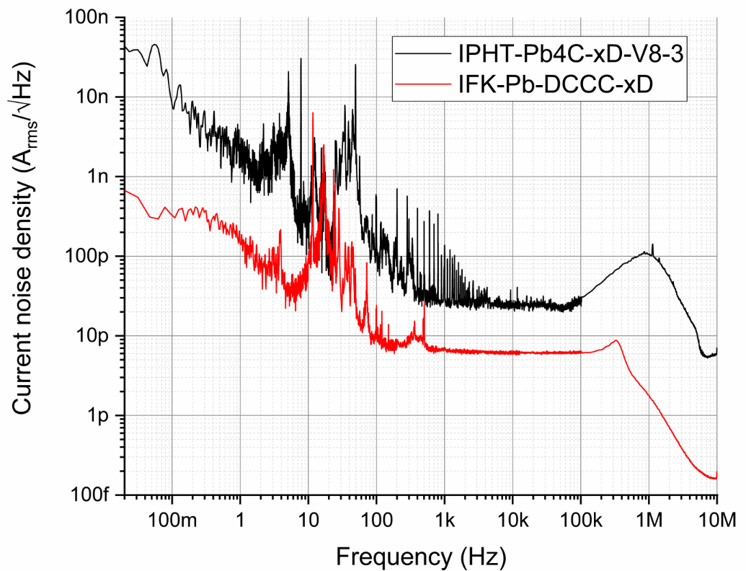
Alternative CCC Types
Axial/Coreless-CCC
Pros
magn. shielding (150 dB instead of 75 dB)
lead / costs
easy manufacturing
[two stage SQUID]
Cons
low coupling
high noise background
Dual Core CCC
Dual-CCC
Pros
magn. shielding (150 dB instead of 75 dB)
lead / costs
easy manufacturing
two stage SQUID
strong coupling
low noise background
redundancy
Noise figures for classical- axial- and dual-CCC
February 13th 2024
Slow Extraction Workshop
Thomas Sieber 14

Slide 15
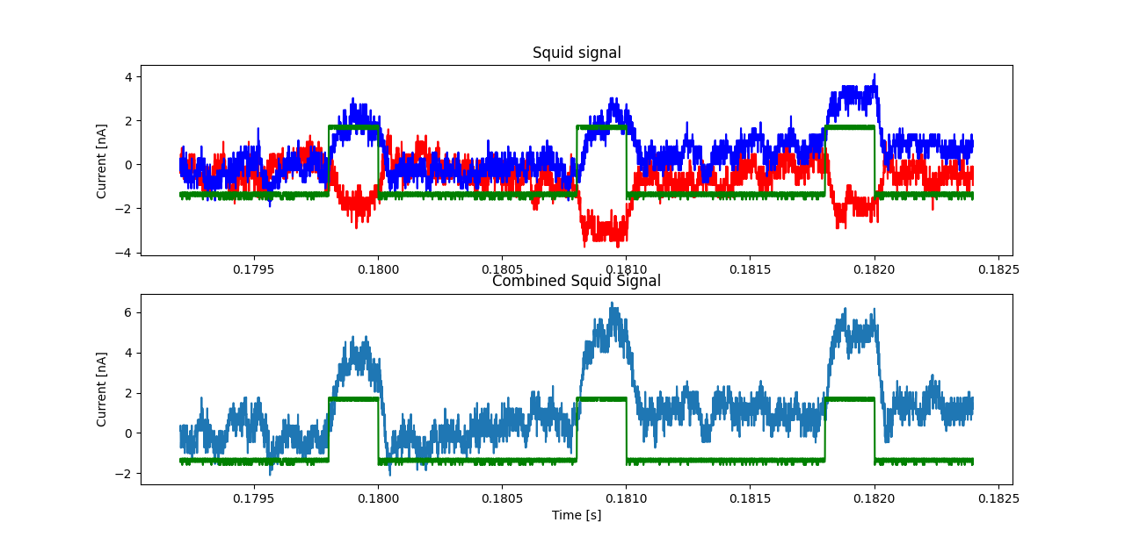
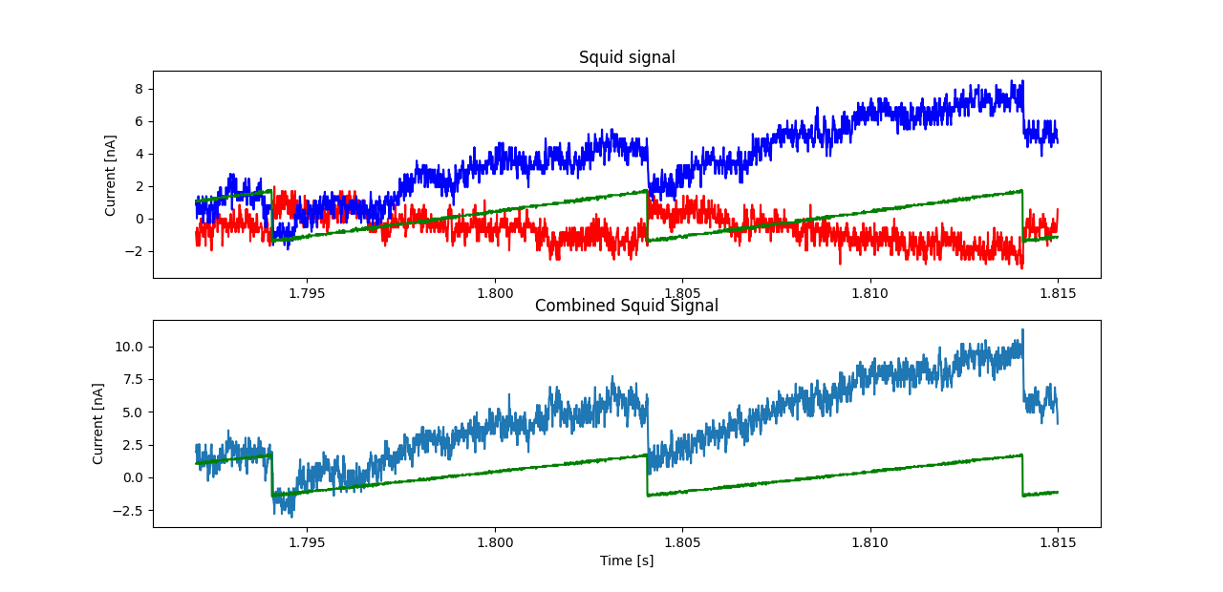
Summary and Outlook
Summary and Outlook
CCC focus at FAIR changed from storage rings to transport sections → FAIR Early Science … FS, FS+ scenarios
CCC-XD successfully operated in storage rings and transport lines, nA and spill measurement could be demonstrated, system fullfills FAIR requirements (almost)
Beamtime in Dec. 2023showed capability for online spill analysis
Axial CCC type shows excellent magnetic shielding, but noise sensitivity too large
Dual core CCC combines advantages of both CCC systems and will be our choice for FAIR
DCCC recently tested in Jena laboratory and ready for installation. Beamtime in April
Todos:
- New thermal shield test (Mai 2024)
- Liquefier test (June 2024)
FESA class and slow controls (cryo system) development ongoing, including all filtering, online data processing and SQUID controls (interaction with spill optimization)
Calibration pulse measurement with Dual CCC, Feb. 2024
February 13th 2024
Slow Extraction Workshop
Thomas Sieber 15

Slide 16





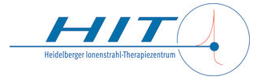
CCC Collaboration 2015 - 2024
HI Jena: T. Stöhlker, V. Tympel
FSU Jena: [R. Neubert, P. Seidel] T. Köhler, J. Golm, F. Schmidl
IPHT: R. Stolz, M. Schmelz, V. Zakosarenko
TEMF: H. De Gersem [N. Marsic] W. Müller
CERN: [M. Fernandes] J. Tan, T. Koettig
GSI: L. Crescimbeni [D. Haider] T. Sieber, M. Schwickert
HIT Heidelberg: A. Peters
February 13th 2024
Slow Extraction Workshop
Thomas Sieber 16
Notes:
16

Slide 17
Thank you for your attention !
Notes:
17

Slide 18
Appendix
September 27th 2022
8. Annual MT Meeting, DESY, Hamburg
Thomas Sieber
Notes:
18

Slide 19
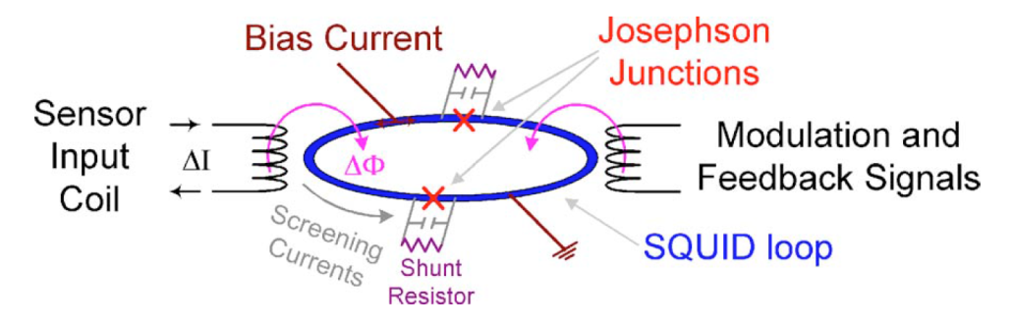
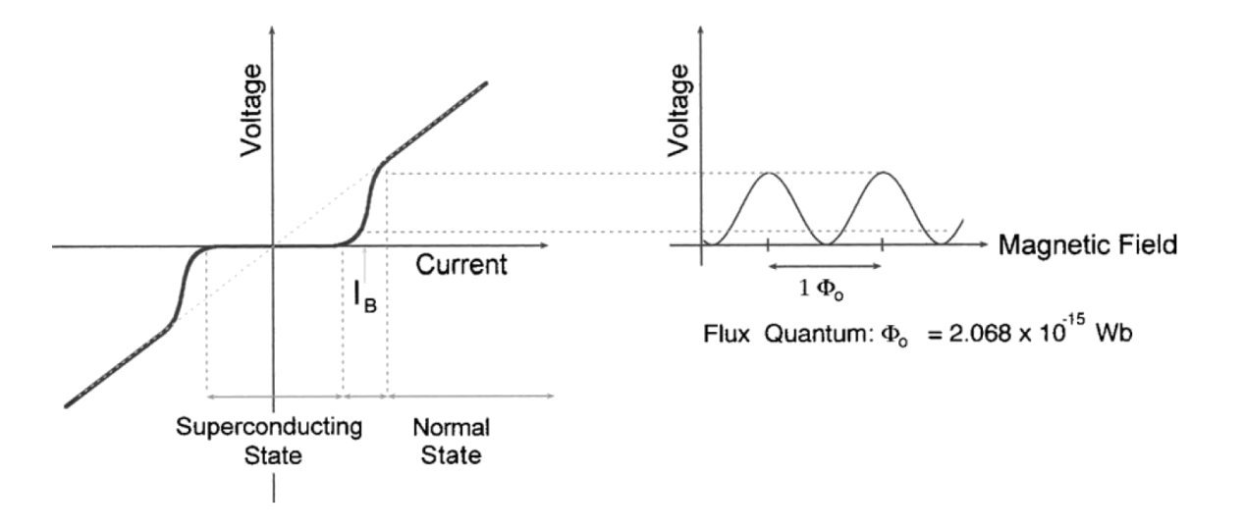

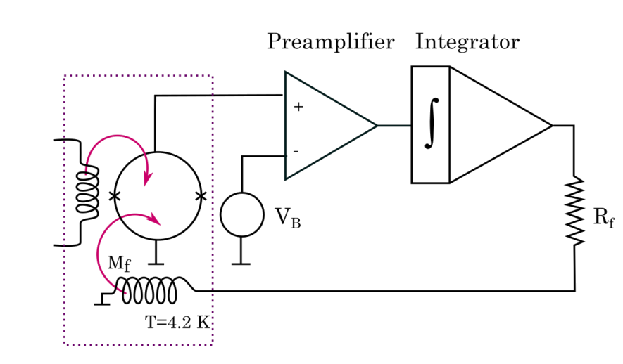
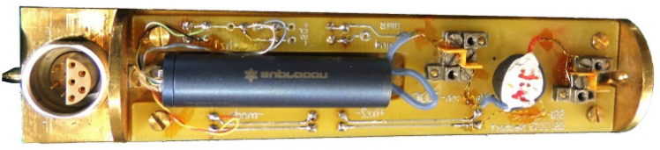
CCC Working Principle II
SQUID principle uses two quantum effects:
Josephson Effect Flux Quantisation
Courtesy R. L. Fagaly, Tristan Techn.
Matching Transformer
Schematic of
the FLL /SQUID
electronics
SQUID Cartridge
February 13th 2024
Slow Extraction Workshop
Thomas Sieber 5
Notes:
19

Slide 20
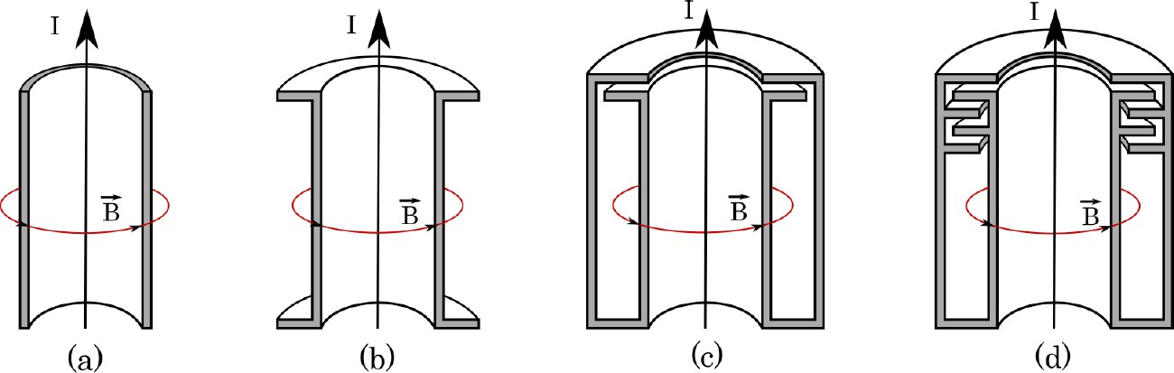
CCC Working Principle II
Evolution from cylindrical over coaxial tp meandrical shielding
Analytical approach by PTB:
Damping is function of radius ratio (R_{out}/R_{in}) and number of meanders
COMSOL + Microwave- Studio calculations for field penetration into the shielding
Example Dipol field:
Attenuation achieved:
~150 dB
BUT:
Beam field (10nA): 50 fT
Earth magn. field: 50 µT
to SQUID
September 27th 2022
8th Annual MT Meeting, DESY, Hamburg
Thomas Sieber
Notes:
20

Slide 21
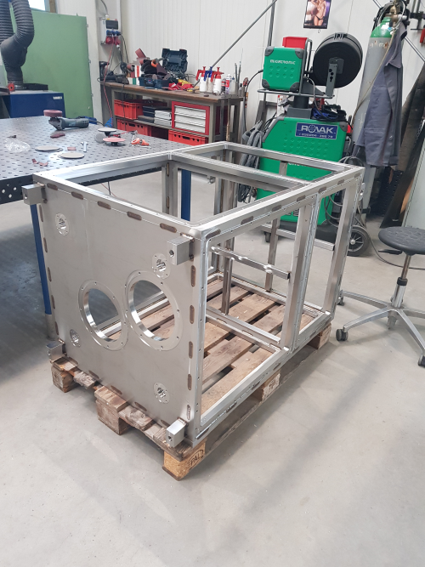
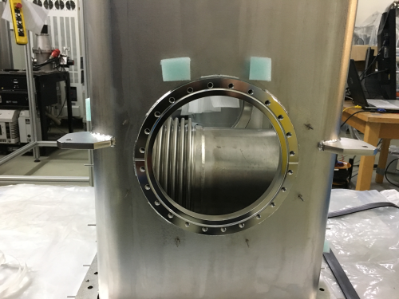
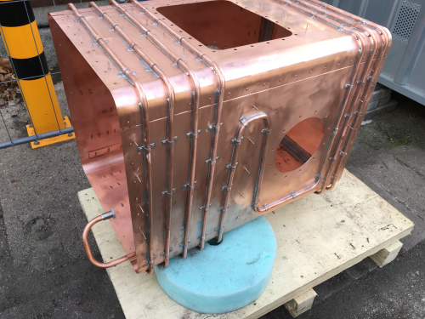
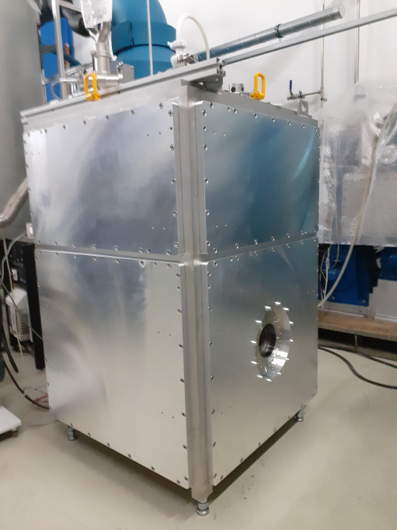
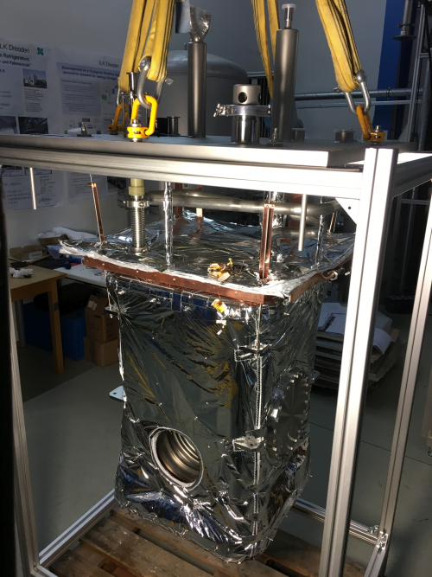

Production of the CRYRING Cryostat
Frame
Thermal
Shield
He-Chamber
Al Windows
mounted
He-Chamber
with MLI
Shield and
tubing with MLI
September 27th 2022
8th Annual MT Meeting, DESY, Hamburg
Thomas Sieber
Notes:
21

Slide 22



Temperature / Pressure Offset Drift
Offset temperature/pressure dependence
Baseline drift of ~1nA/s observed during beam tests, curve flattens when thermal equilibrum is reached
If T/P effect, high relevance due to backpressure +
fluctuations from recovery lines
offline tests with closed exhaust line
- Effect investigated at Jena with 'anticryostat' setup,
decoupling T and P
Reason identified as T-dependent inductance variation
→ can this be avoided ? → coreless CCC ?
26th February 2020
GSI Accelerator Salon
Thomas Sieber
Notes:
22
22

Slide 23





Beam Operation: Pertubations and Filters
Main disturbances: liquefier pulse + dipole ramp
(Origin)
Dipole ramp
deterministic:
subtracted using
transfer function
dipole field
transfer function
correction
Signal from helium
refrigerator (1.4 Hz)
x
=
(no mechanical coupling!)
calculated from
background measurements
February 13th 2024
Slow Extraction Workshop
Thomas Sieber 10

Slide 24



Investigation of new Shielding Design
Simulations performed with MWS to
check shielding properties
Assumptions:
- Material = perfect diamagnet
- Shield currents + toroid not included
- Homogeneous dipole field used
- Real meander geometry used
classic
'classic'
'outer'
'inner'
Shielding design for the FAIR and AD CCC
Number of meanders increases attenuation
CCC-Prototype: R_{in}=75 mm, R_{out}=125 mm → Att. 108 dB
FAIR-CCC: R_{in}= 125 mm, R_{out}=175 mm → Att. ~ 80 dB
→ 4 more meanders required for comparable attenuation
Attenuation decreases for
larger R_{in}
For given R_{in}:
Attenuation increases for
larger R_{out}
R_{out} related to total shield mass
and cryostat dimensions
FAIR
GSI
AD
6th October 2021
HIJ Semiannual Palaver
Thomas Sieber
Notes:
24

Slide 25






Laboratory Tests: Comparison of CCC Types
26th February 2020
GSI Accelerator Salon
Thomas Sieber
Notes:
25

Slide 26
SQUID Development
IPHT cross type JJ technology
sub µm thickness
low junction capacitance
high voltage swings without
hysteresis,
→ low noise
high tolerable background fields
inductance
26th February 2020
GSI Accelerator Salon
Thomas Sieber
Notes:
26

