Slide 1
Slow Extraction workshop Absolute calibration of the secondary emission monitors at CERN J. Bernhard, M. Brugger, N. Charitonidis, M. van Dijk, A. Goillot, M. Fraser, N. Menaa, M. Munos, L. Parsons França, F. Ravotti, F. Roncarolo, P. Simon, J. Tan.

Slide 2
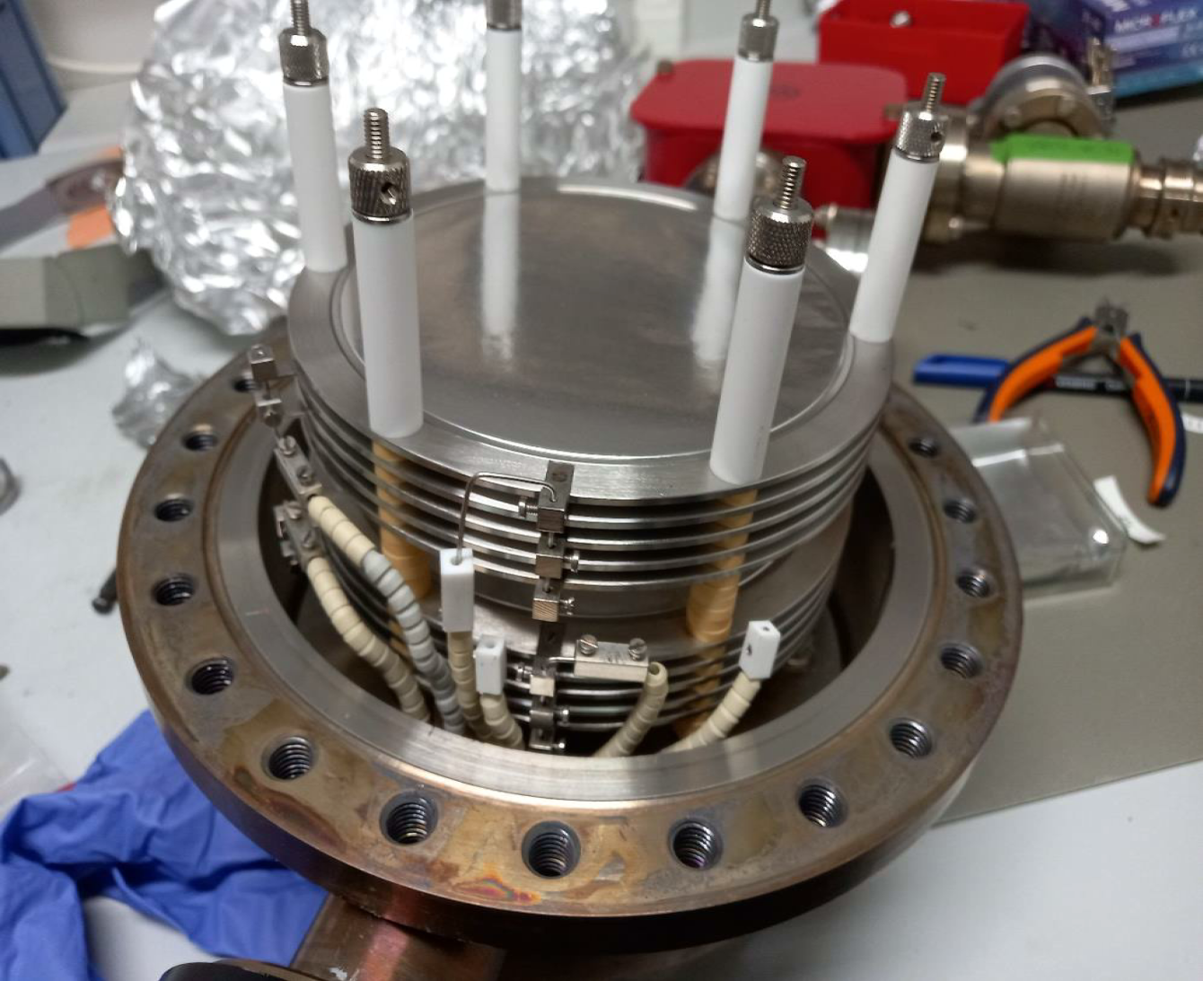
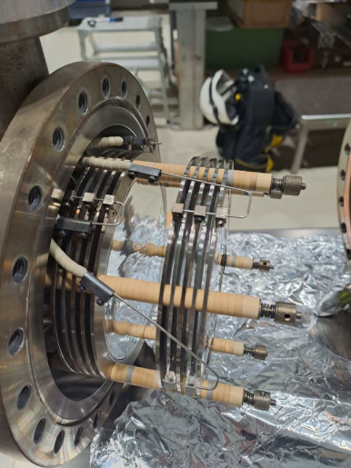
The intensity monitors of the North and East Area
The CERN North and East Area serve a wide variety of fixed target experiments and testbeam users with tailor-made primary and secondary beams
For very high-intensity beams (10¹¹-10¹³ protons) there are not so many detectors capable of measuring the absolute intensity
Choice has been SEM-based detectors
SEM (Ti Plate)
P+
Signal
BIAS
BIAS
e-
L. Parsons Franca
Number of protons in North and East Area primary lines monitored with SEM detectors
It is a beam intercepting device, collecting the small fraction of low-energy secondary electrons emitted from a metal foil when the beam passes through: small current for large beam
Due to high intensity (10¹²-10¹³ protons at 400 GeV/c) but slow extraction (4.8s), other detectors are not considered viable for absolute intensity monitoring
F61.XSEC023 during maintenance
F63.XSEC008 during maintenance
Photos from: A. Goldblatt

Slide 3
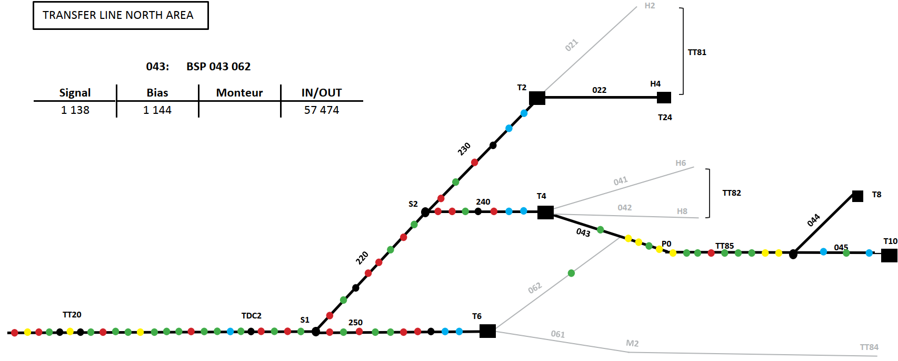
SEM detectors in North Area
The TT20 primary line extraction protons from SPS to the North Area is covered with SEM detectors such that at all points the intensity can be reasonably known
Extraction to North Area from SPS features two splitters (S1, S2)
Two SEMs in the upstream section
SEM before and after each splitter
One SEM upstream (40-50m) before each target
Two SEMs in each target station (one in T10)
TBIU (Target Beam Instrumentation Upstream)
TBID (Target Beam Instrumentation Downstream)
230705
230949
230950
240610
220412
241149
241150
210216
210279
211626
251010
043282
045769
045914
SPS
251247
251248

Slide 4
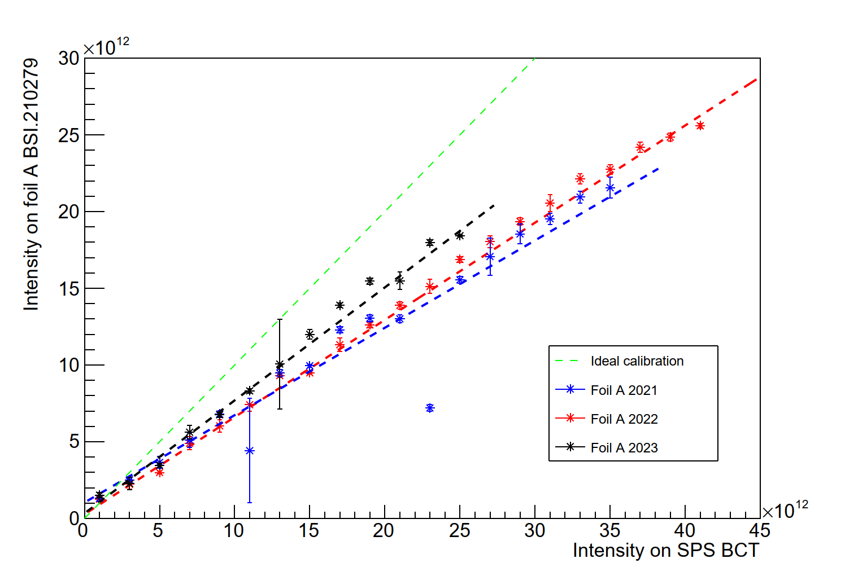
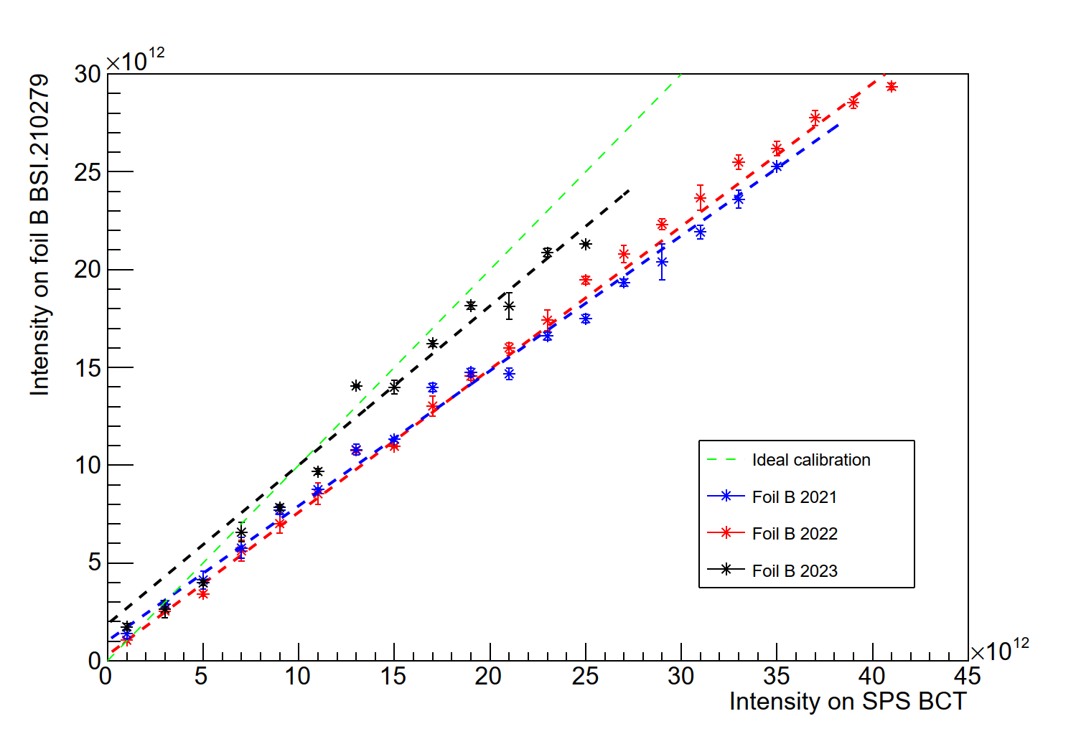
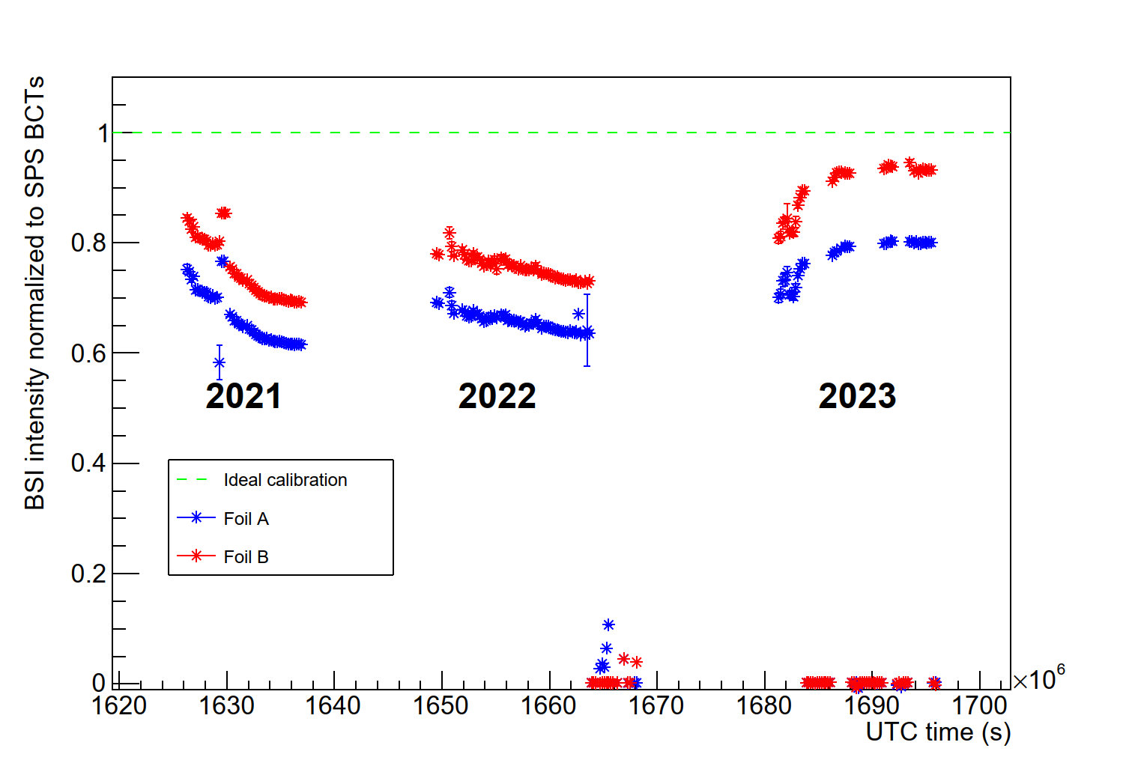
SEM detectors and the difficulty of absolute intensity
Foil A
Foil B
Long-standing uncertainty on NA intensity
Last calibration >20 years ago (?)
Expected ~10%, to have a few % would be good
Observed since many years
SEM intensity != SPS BCT intensity
Unstable over year and from year to year
Not clear what part is the monitor and what part is losses
Displayed most upstream monitor in TT20 (210279, two foils)
Gathering experience in diagnostics
Analyze data from all SEM monitors in North Area
Compare monitors with each other
Develop the diagnostics that will lead to a strategy for addressing the issues
Preliminary
Preliminary
 | Slope foil A | Slope foil B
2021 | 0.569 +/- 0.005 | 0.690 +/- 0.004
2022 | 0.634 +/- 0.003 | 0.731 +/- 0.003
2023 | 0.736 +/- 0.005 | 0.814 +/- 0.005
Preliminary

Slide 5
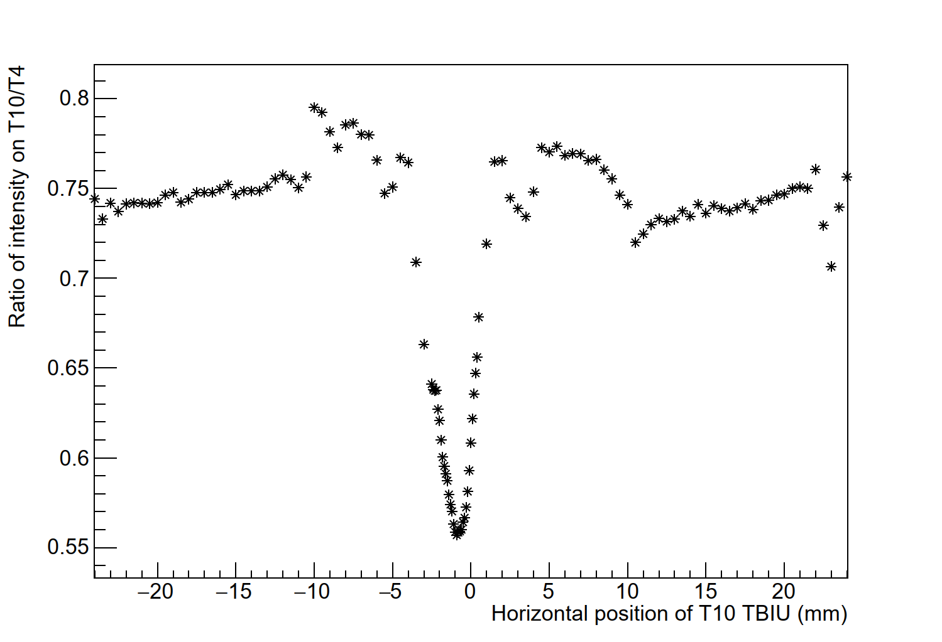
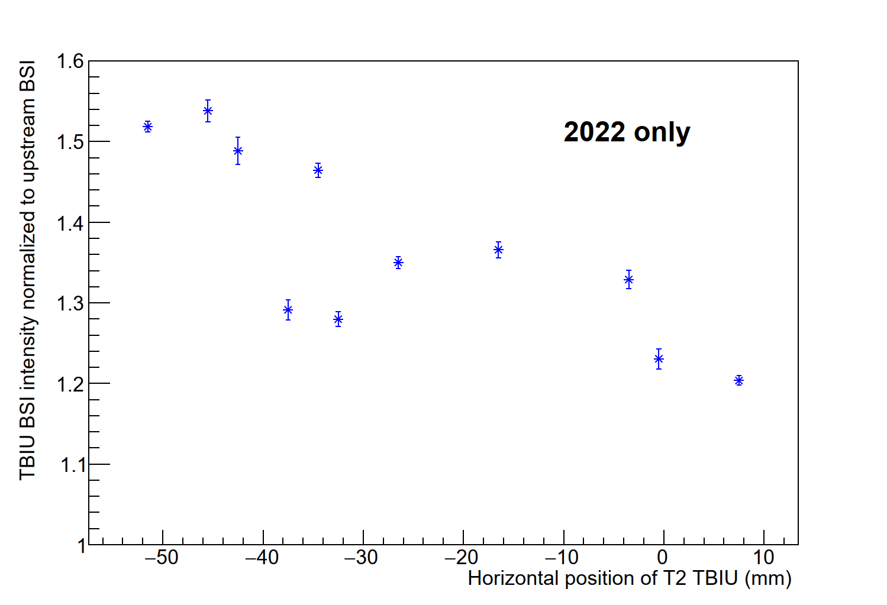
Damage to SEM foils
T10 target TBIU scan
Year to year, the sensitivity of the foils seems to change
Likely caused by small differences in hit position
Each part of the foil has a different history
Beam movement on target monitor (TBIU)
Changing secondary momentum horizontally displaces beam on SEM
Movement on SEM monitor can be ~2mm
Spot size on T4 has σ_{x} ~0.4mm (T2 likely similar)
The SEMs in the target areas are likely not giving an accurate assessment of intensity
Foils in TBIU more damaged than upstream due to small spot size (damage scales with area)
Estimated intensities could be wrong by >20%
Preliminary
T2 target TBIU (2022)
Preliminary

Slide 6
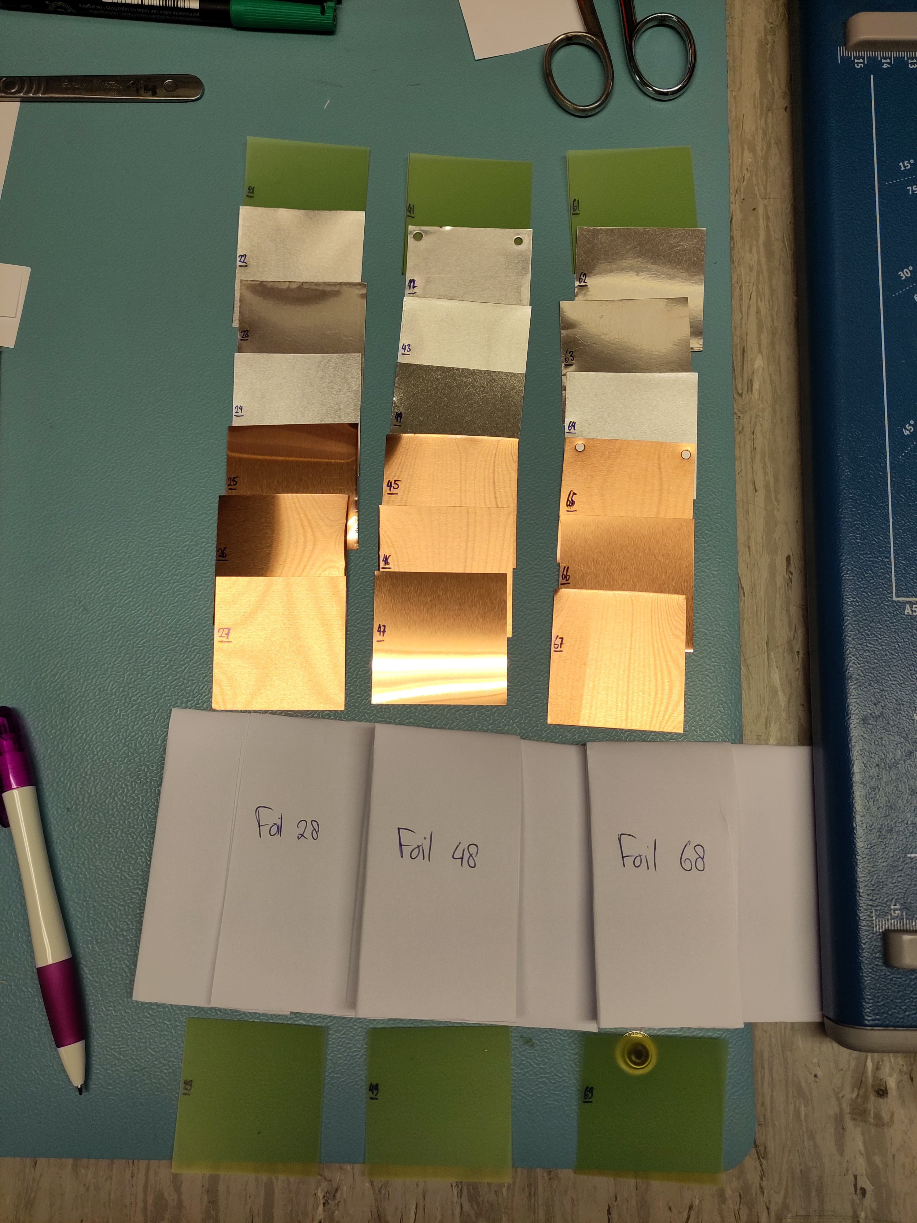
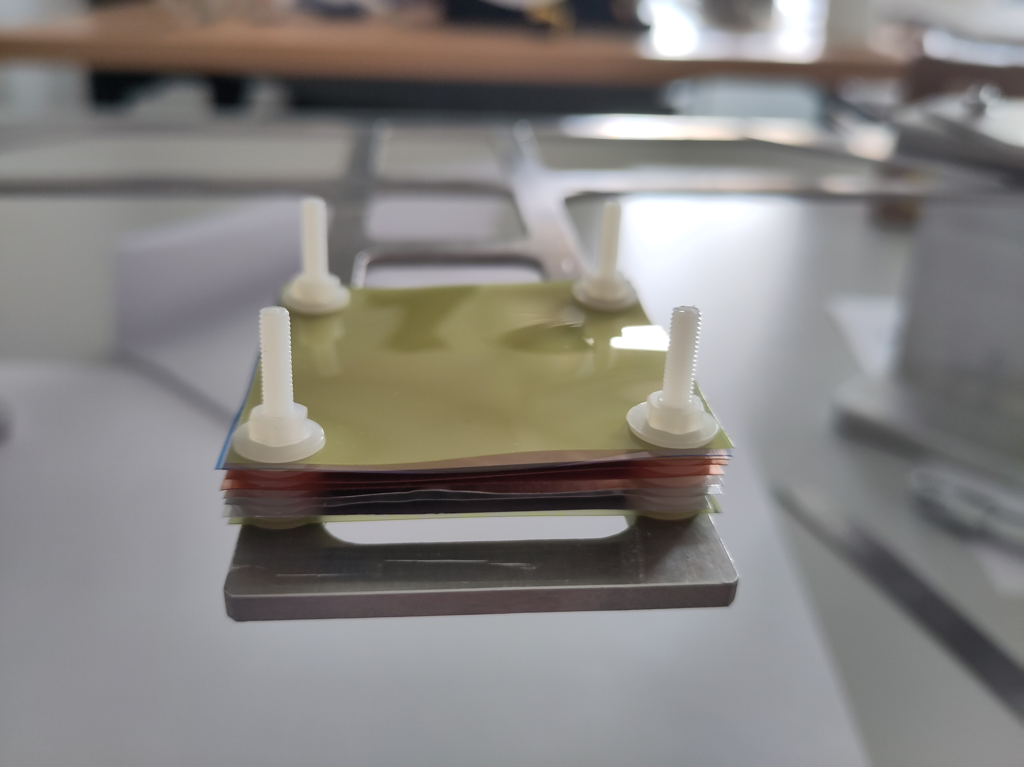
Calibration technique – activation foils
Foils placed in beam are activated mostly by fission driven by the proton beam
Use cross-sections from literature to assess activation
Cross-section values are not unambiguous: the reference type and value matters
For example, the values for isotope production cross-sections from natural copper are usually normalized with respect to values of ²⁴Na measured in a reference aluminium foil
Across different publications, the value used for normalization differs, and the error of the reference is not included
Assess appropriate value, homogenize cross-sections and account for reference error where needed
Foils assessed by means of gamma spectrometry
Correct for half-life of isotopes
Factor in cooldown time between irradiation and correct for growth / decay over irradiation

Slide 7
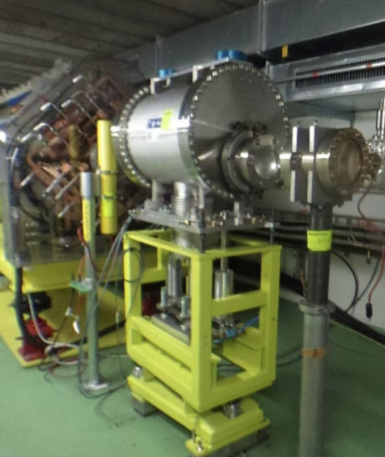
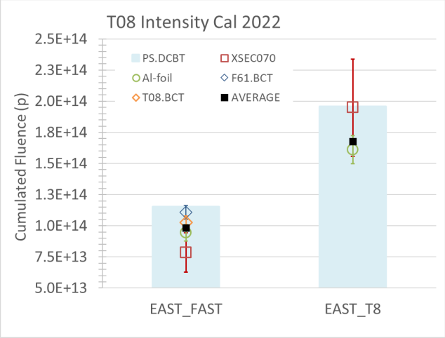
Calibration of SEMs in East Area
SEM-based intensity monitors
Initial comparison between fast BCT and foil activity (2022)
Measurement based on single isotope (²⁴Na in aluminium foils)
Compared with fast extracted beam (few 10s of ns) onto fast BCT
Methods agree with absolute difference of 9.3%
Second irradiation with slow extracted beam (2022)
Measure SEM signal & compare it with foils activity
SEM signal calibration based on resulting measurement
Data collected also with copper foils in 2023
Analysis ongoing and promising
Intensity calibration of T9/T10 primary lines not yet performed
Possibly the factors of T8 can be reused – similar / same detectors
Will be assessed further once analysis of T8 foils is completed
F. Ravotti, EP-Tech-Note-2022-001

Slide 8
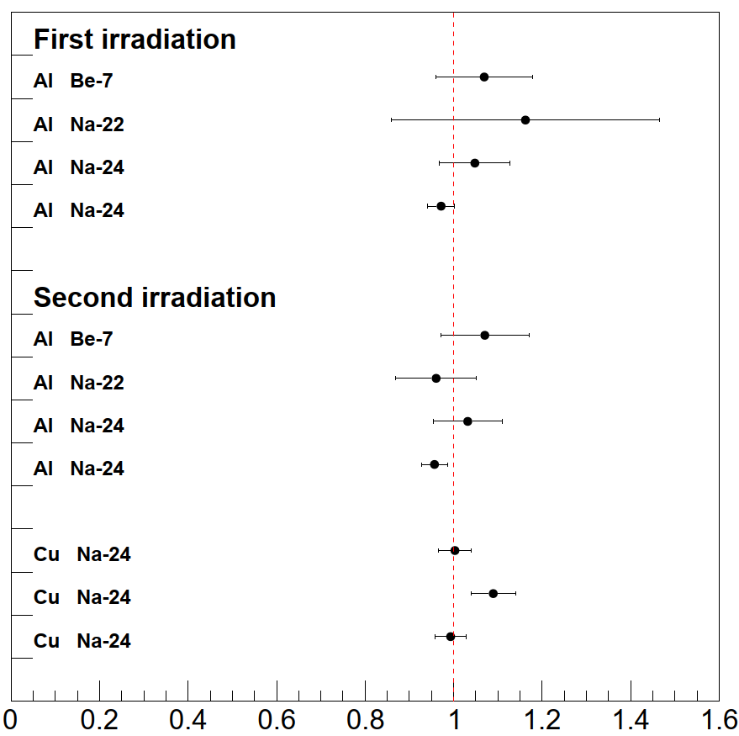
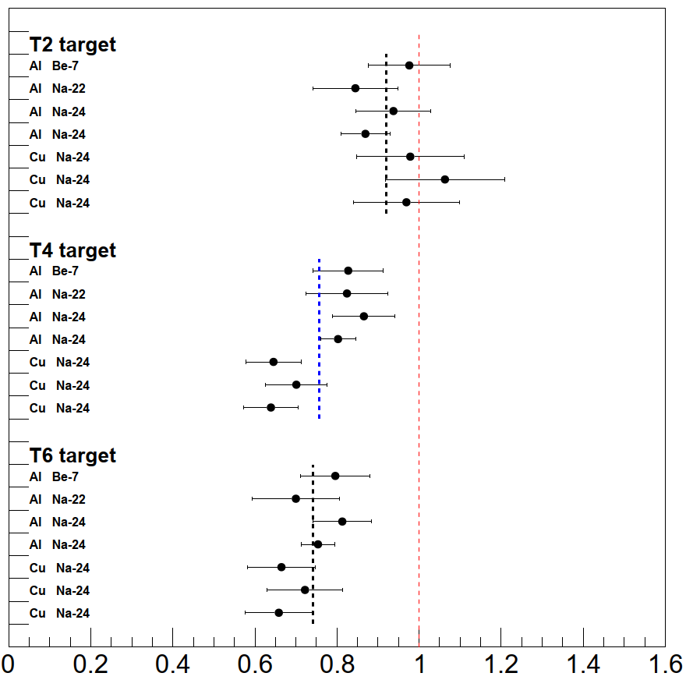
Calibration of SEMs in North Area
Ratio of activation and SEM
Valuable experience gained in 2022 and 2023
Put aluminium / copper foils in line (in this case, near target)
Aluminium is “standard candle”, copper has many isotopes -> statistics
Expose to beam (~100-200 shots), sum up SEM signals
Cross-sections gathered for proton beam >= 300 GeV/c
Divide activity by cross-section, and compare to SEM sum
First set of calibrations done with T10 target
Second set of calibrations done for T2+T4+T6
Measured fewer POT in activation foil than on SEM
Third set of foils measured in HiRadMat (later slide)
Aluminium foils give different results than copper
Impact of neutrons through auxiliary process
Present in both TCC2 and HiRadMat measurements
Still preliminary
Still preliminary

Slide 9
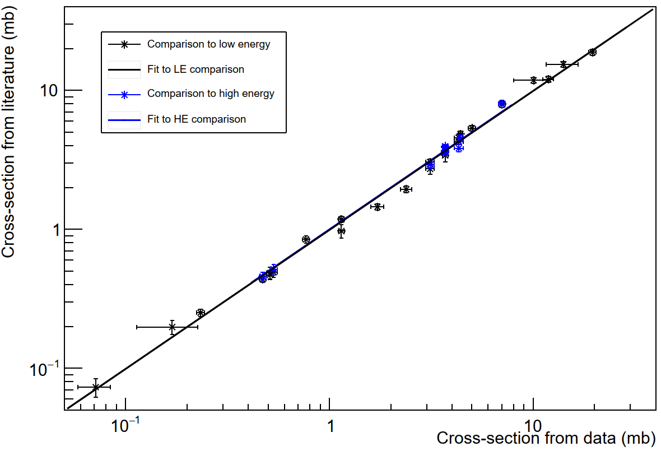
Cross-section measurement in
Series of foils inserted in HiRadMat facility at CERN
Foil stack of 3x100µm pure aluminium, 3x100µm pure copper
440 GeV/c fast-extracted beam, accumulated 9.078e13 POT (ring BCT, assume 2% error)
Substantial material on beam axis (BTV, 6mm carbon) and 3.5m air
Results shown for isotopes measured in copper compared to literature values
Literature values for “low” energy (28-30 GeV) and high-energy (150-800 GeV/c)
All sources using ²⁷Al(p,3pn)²⁴Na as reference normalized to 8.35 +/- 0.4mb (for all energies)
Fit to data gives slope 0.991+/- 0.015 (low energy) Fit to data gives slope 1.000+/- 0.014 (high energy)
Cross-sections not sensitive to energy (28-800 GeV/c)
No measured cross-section increase due to material (⁶⁴Cu not shown, see next slide)
⁵⁴Mn
⁵⁷Co
⁴⁸V
⁵²Mn
⁵⁸Co
⁵⁶Co
⁵¹Cr
⁴²K
⁷Be
⁵⁹Fe
⁴⁶Sc
⁵⁵Co
^{44m}Sc
²⁴Na
⁵⁷Ni
⁴⁷Sc
Still preliminary
⁴⁸Cr
⁴³K
⁴⁷Ca
⁴⁸Sc
²⁸Mg
Isotopes measured in copper foil
⁶²Zn
Cross-section from measurement (mb)

Slide 10
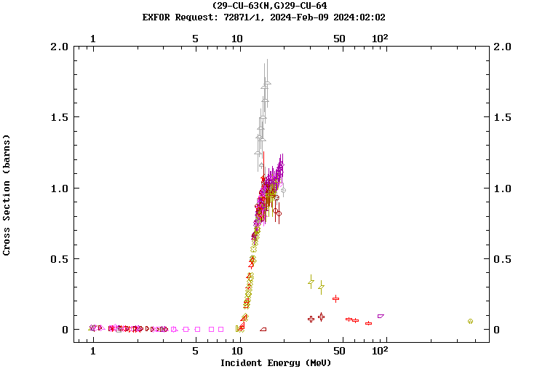
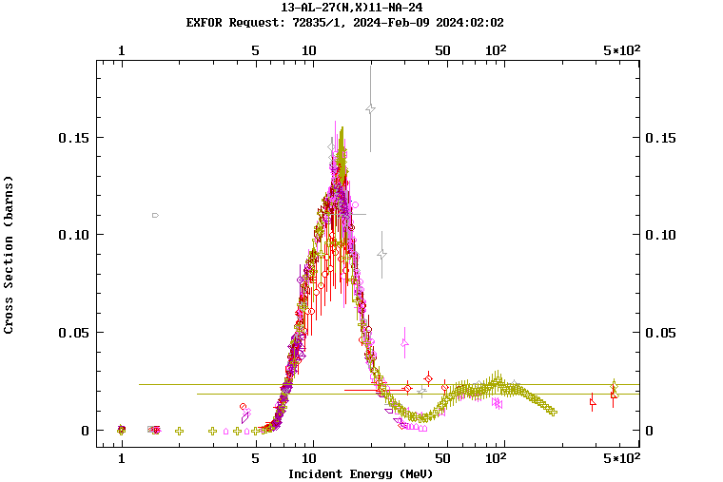
Cross-section measurement in
Both aluminium and copper foils indicate a substantial neutron flux (from material on the beam axis)
Modifies production of ⁶⁴Cu in copper ⁶³Cu(n,γ)⁶⁴Cu
Modifies production of ²⁴Na in aluminium ²⁷Al(n,α)²⁴Na
Material correction for aluminium (1.5% +/- 0.5%) / 100mg/cm²
1520 mg/cm² (for aluminium foil) leads to 8.15 +/- 0.48 mb for ²⁴Na
Correction not well-established for copper foils (and not so relevant)
Results from HiRadMat will be used to update North Area SEM calibrations – substantial effect
EXFOR data
 | Literature CS | Observed CS
²⁴Na from Al foil | Between 7.9-8.8 mb | 9.86 +/- 0.32 mb
⁶⁴Cu from Cu foil | 14.2 +/- 0.7 mb | 23.4 +/- 2.7 mb
Still preliminary
EXFOR data

Slide 11
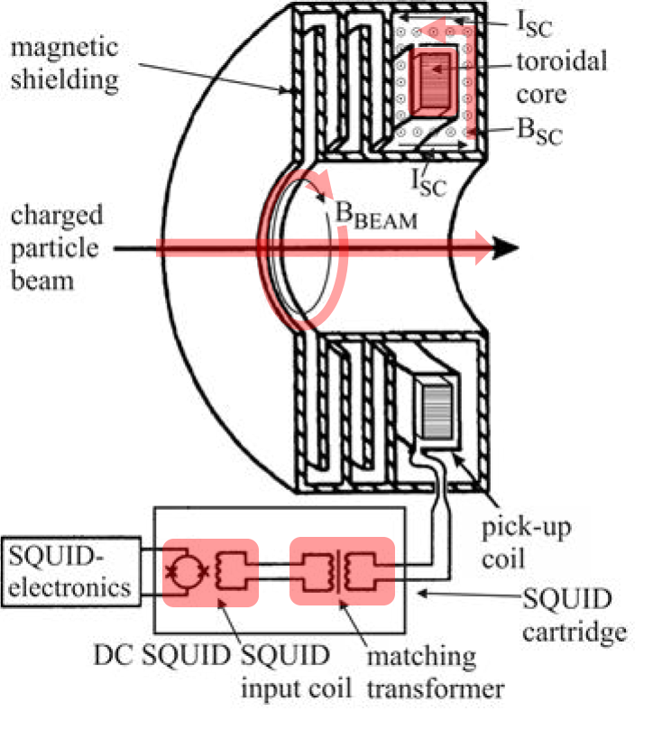
Intensity of DC beams in North and East – options
For future: three possible technologies under consideration: SEM, BCT and CCC
Secondary Emission Monitors are the currently implemented technology
SEM foils in North Area seem to get substantially damaged by beam – possibly even over a single run-year
Coupled to movement of the beam and vacuum history this gives a large (but slow) variations
Beam Current Transformers have been considered (but mostly ruled out)
Ideally, measurement is “short” (1ms or less) – but even fast-pulsed slow extraction to TT20 is 10-20ms
Current lowest current is ~200µA in a ~200µs pulse (end of LINAC3)
Regular slow extraction is 4.8s (equivalent to 1.3µA with 4 10¹³ protons) – unfeasible
Fast extraction (using kickers) is limited in intensity allowed to be extracted to North Area
Cryogenic Current Comparator is an excellent candidate (see next talk!)
Magnetic field of beam induces screening current in superconducting shielding
A single CCC could be used as an absolute standard for the existing intensity monitors
Should be located near a SEM to optimize further cross-instrument studies
Technically feasible, being investigated for deployment in Run4 (2028-2029)
J. Tan

Slide 12
Next steps & future plans
Observation: Continuous degradation of SEM monitors
Consequence: uncertainty of 20% up to 50%, will grow in the future
Full impact on beam operation to be assessed
Will finish analysis of available data far from fully analyzed and condense into strategy
Plan for the future
SEMs are difficult, BCT not (very) possible, but CCC for Run4 (2028-2029) is technically feasible
Finally, CCC is the only viable choice for a sustainable solution
Beam time for two “full” calibrations of North Area requested for 2024
Continue calibration efforts with activation foils until full consensus found
Cross-calibration of SEMs and CCC could be key
Fast foil exchange is crucial for the activation foil calibrations
Investigate mitigation: motorize SEMs? (stepping motors instead of in/out)
Investigate mitigation: adapt SEM design for easier calibration?

Slide 13
Conclusions
SEM detectors based on the principle of secondary emission are used for monitoring the intensity in the CERN East and North area
Extensive fluctuation over time of the detector has been shown
Substantial damage to the foils due to extensive exposure of the beam has been found
Activation foils are used to assess the absolute intensity of the beam for recalibration
Last done >twenty years ago in the North Area, experience is being rebuilt
Experimental results from the HiRadMat facility will be used as the foundation for further calibrations
Not fully clear if aluminium is suitable as the baseline foil due to neutron sensitivity
For the future, multiple different strategies will converge
Continue building expertise and calibrate SEM-based detectors with activation foils as possible
Investigate (one) Cryogenic Current Comparator for an online absolute calibration standard (2028-2029)
Should be located near a SEM to optimize further cross-instrument studies

Slide 14
Closing thoughts
Many thanks to the people who contributed to this talk!
J. Bernhard, M. Brugger, N. Charitonidis, A. Goillot, M. Fraser, N. Menaa,
M. Munos, L. Parsons França, F. Ravotti, F. Roncarolo, P. Simon, J. Tan.

Slide 15
Backup slides

Slide 16
SEMs at the TCC2 targets (T2, T4, T6, T10)
Each target station has three SEM monitors associated
1x “Upstream”
2x target instrumentation (just before and after)
T10 has no TBID
The estimated beam intensity comes from the “upstream” SEM
230705(T2), 240610 (T4), 251010 (T6)
For T10, the estimated intensity comes from the TBIU (045914)
If all goes well, the ratio TBIU / upstream = 1
Upstream monitors are only ~40-50m upstream
230705
230949
230950
240610
241149
241150
251010
045769
045914
251247
251248

Slide 17
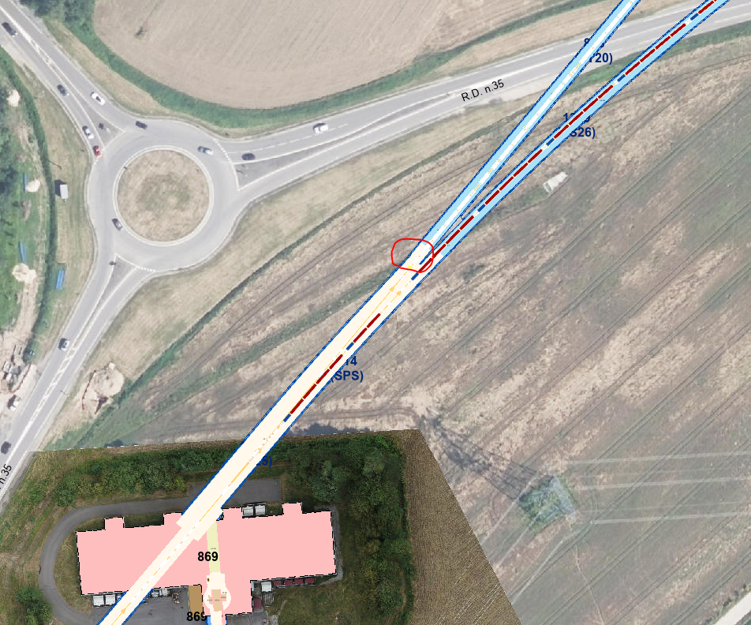
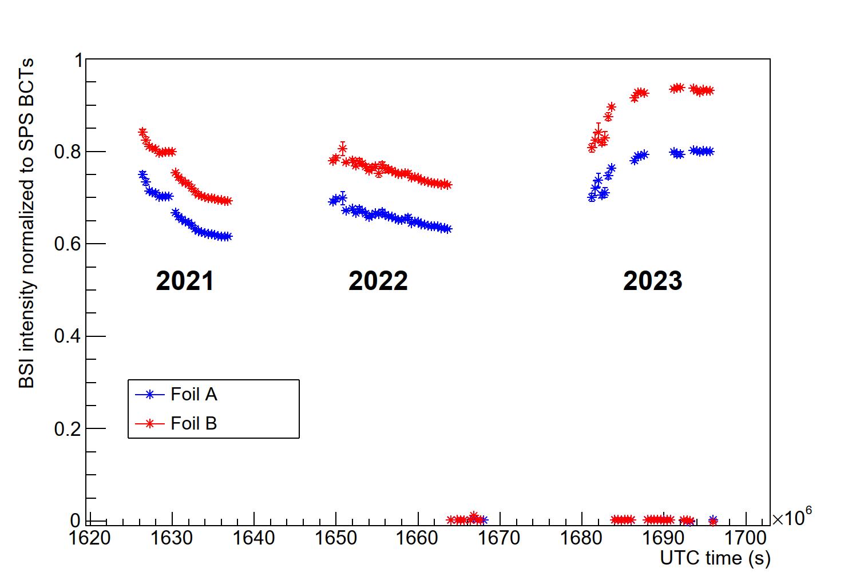
Monitor BSI.210279 (two foils)
Monitor had some issue over part of 2023
TT20
SPS ring
Monitor BSI.210279
Preliminary

Slide 18
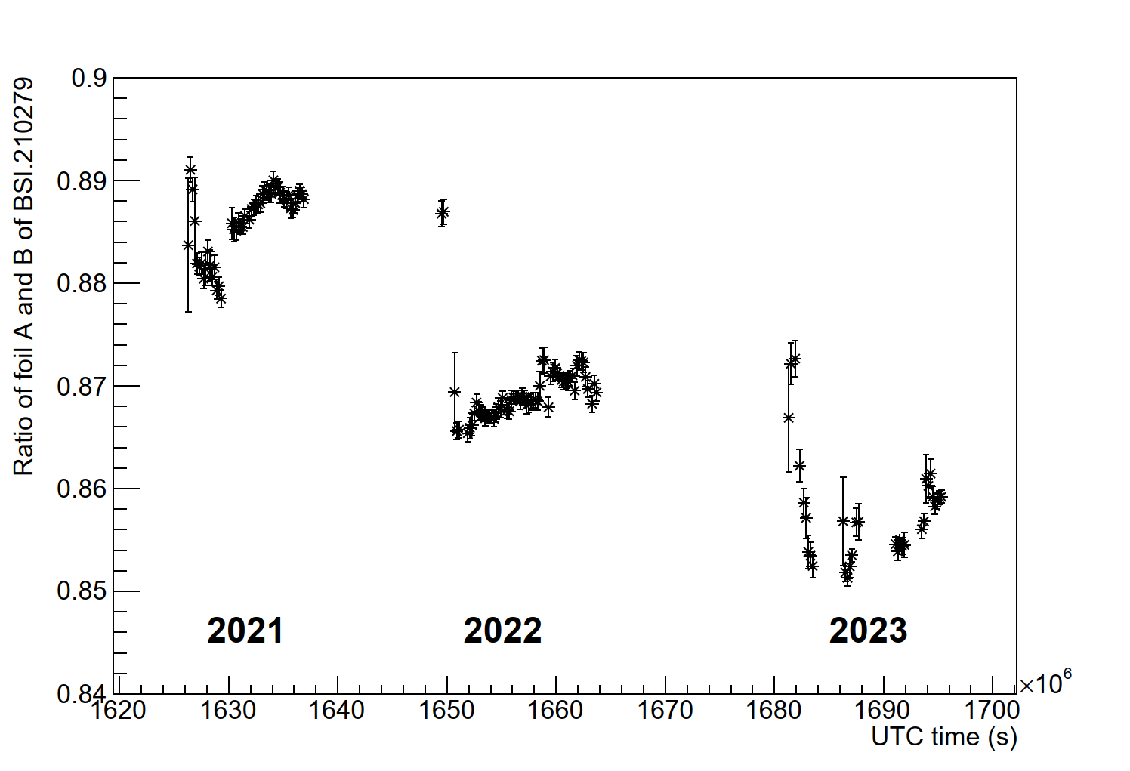
Monitor BSI.210279 (two foils)
Ratio of two foils in the same location
Preliminary

Slide 19
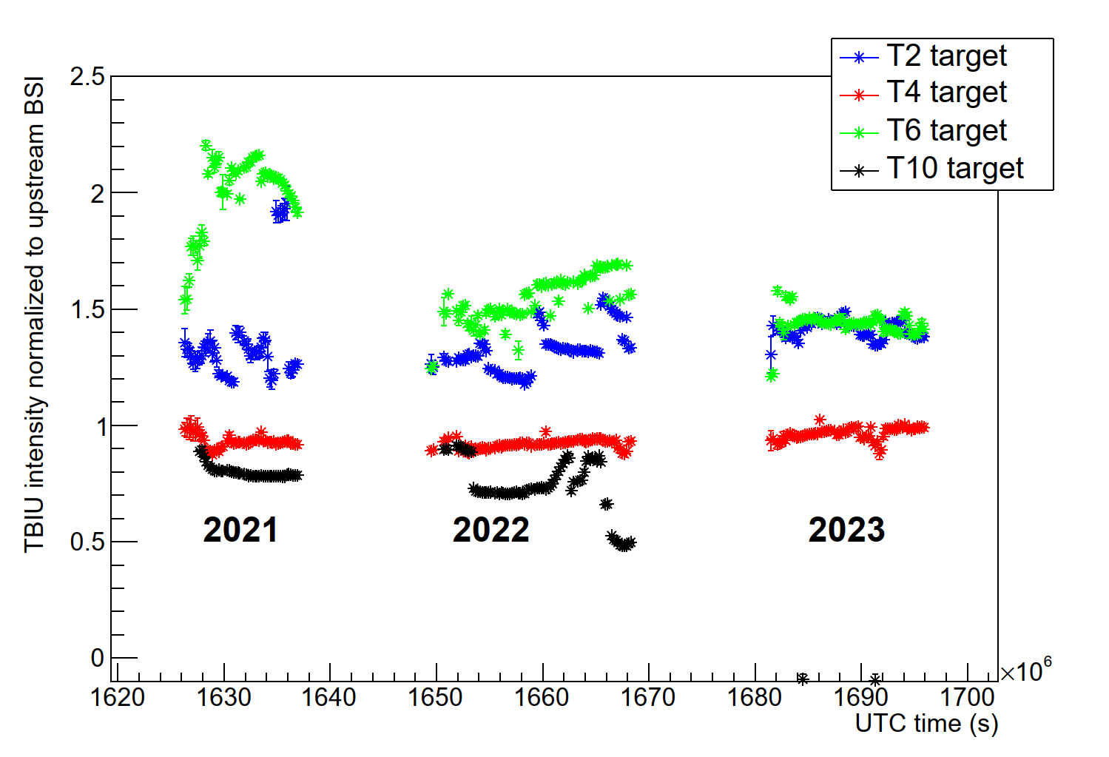
Comparison TBIU and upstream SEM – T2, T4, T6, T10
Use ratio (TBIU / upstream SEM) as an indicator of stability
Indication of good calibration: value equal to 1
Indication of stability: line is flat
Upstream monitor of T10 had some issue in 2023 (?)
Preliminary

Slide 20
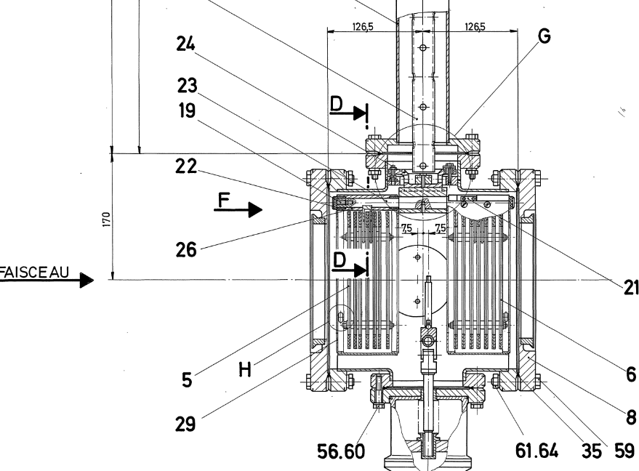
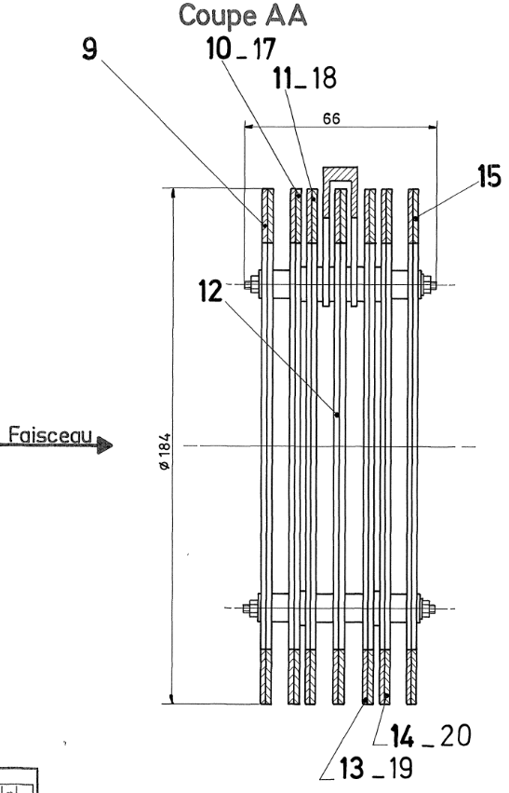
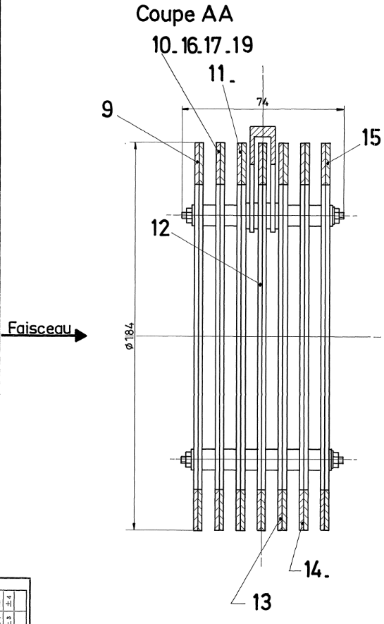
Layout of the TBIU
It was observed at the T10 target that the foils get damaged
Scales with size of beam – more protons per mm2
TBIU has two “heads”, A and B
Beam steering (symmetry) happens on two BSPs
Both of these are located in head A
Assume beam is centered perfectly on those
However, the SEM is located in head B
Distance between the two is around 12.5cm
BSPs
SEM

Slide 21
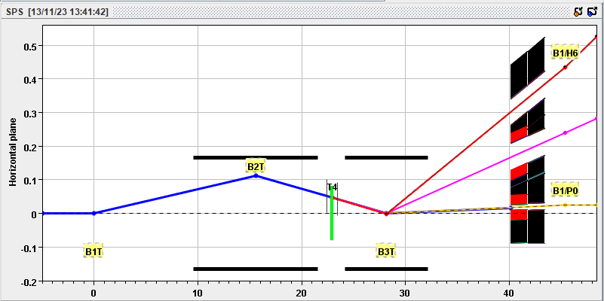
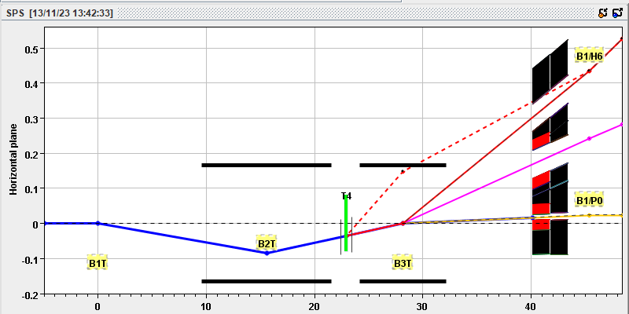
Movement of the beam (example at T4)
T4 standard wobbling
H8 (+180), H6 (+120), P42 (+400)
Wobbling magnets near target allow to angle beam onto target, selecting different momenta for beamlines
Different wobbling settings give a different angle on the target
The TBIU and TBID stations move with the wobbling setting
The beam is then steered using the BSP settings
However, lever arm of 12.5cm means beam is displaced on the intensity monitor
Total difference (for two calculated wobblings) is ~15.7 mrad
Absolute displacement of almost 2mm
Combine with beam size at T4 target
In short, beam moves five sigma between these two settings
H8 (-300), H6 (-120), P42 (+400)
Primary beam size T4 (G. Mazzola)

Slide 22
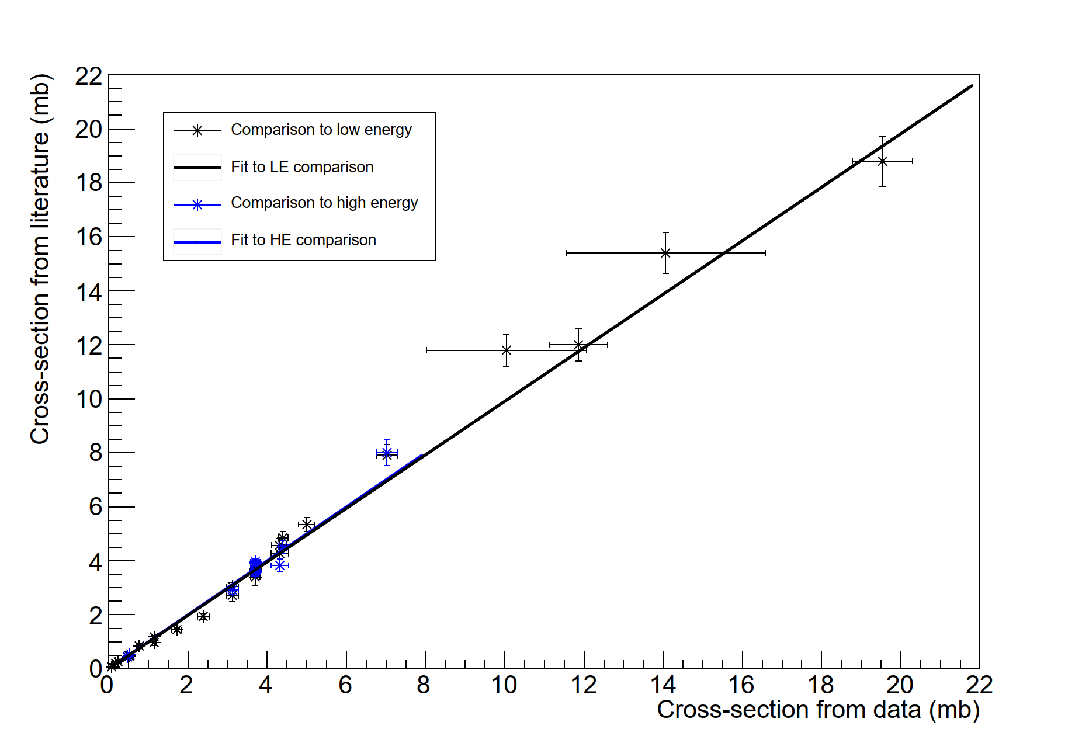
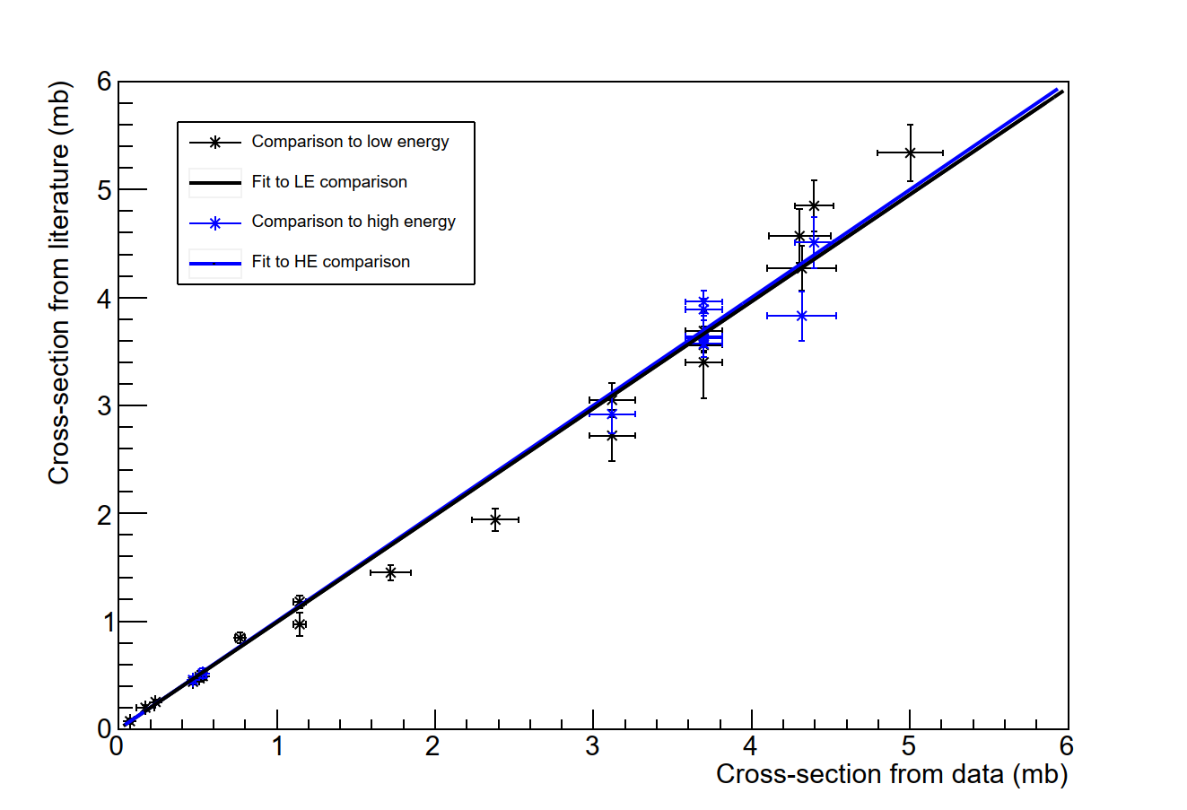
Copper cross-section comparison (linear scale)
Linear version of plot shown on earlier slide
Comparison of absolute cross-sections measured in copper foil exposed to beam in HiRadMat facility
Preliminary
Preliminary

