Slide 1
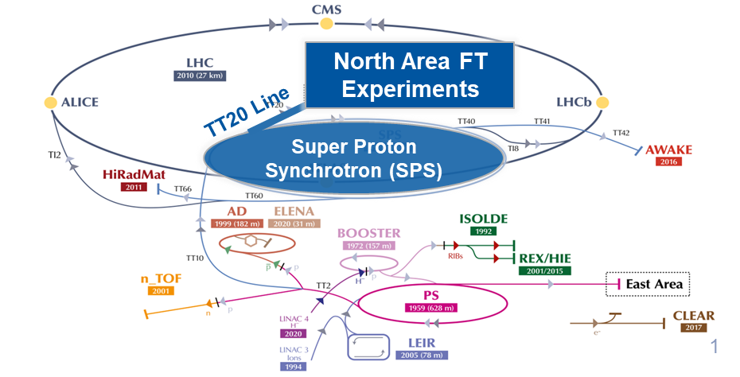
Fast Spill Monitoring at the CERN SPS
Status
&
Plans
F.Roncarolo, CERN SY-BI
S. Benitez, S.Mazzoni, D.Belohrad , S. Burger, M.Martin, A.Goldblatt
E.Calvo, E.Effinger, C.Zamantzas
V.Kain, M.Fraser, F.M.Velotti, P.A. Arrutia Sota
F.Addesa, L.Esposito

Slide 2
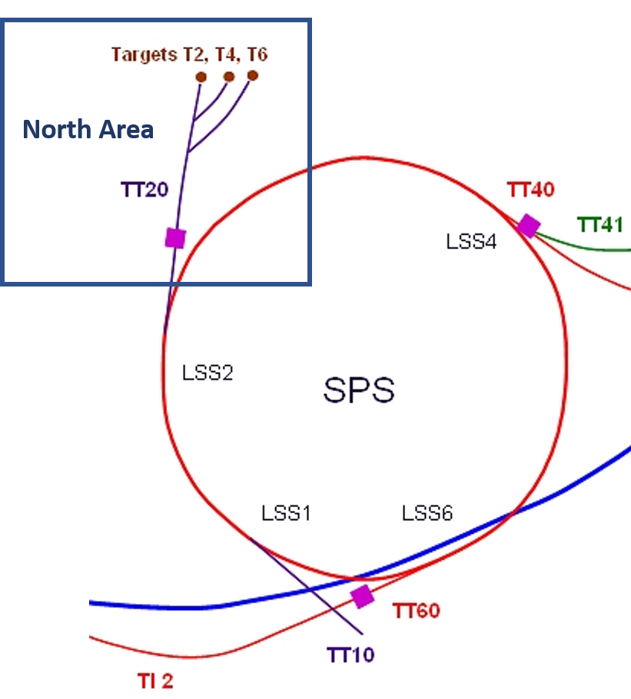
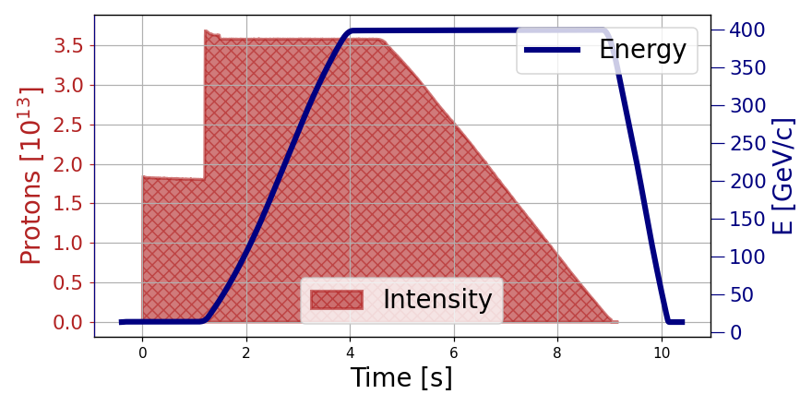
CERN SPS for Fixed Target Experiments
Protons @ 400 GeV sent towards NA experiments via Slow Extraction process
RF disabled at flat top, ideally fully de-bunched beam is sent to transfer line
Spill ‘quality’ affected at macro and micro-structure level by:
hysteresis, non-reproducibility of momentum distribution, regulation and ripples of power supplies, spikes at RF switch-off
Slow extraction
SPILL
V.Kein @ :
SPS_SX_status_plans_Jan2022 (kek.jp)

Slide 3
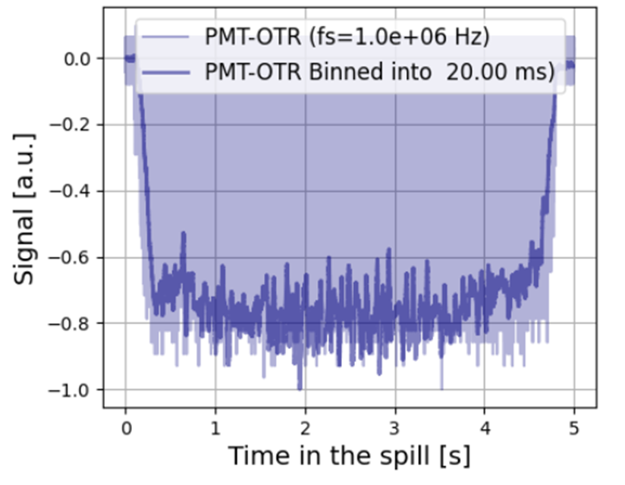
Spill Structure and quality
Ideal Spill
Monitoring the ‘spill quality’
Essential for spill control and successful physics in fixed target experiments
Challenging, at first because single pass de-bunched beams can’t be measured by standard synchrotron diagnostics as Beam Current Transformers
Meas @ 50 S/s
Meas @ 1 MS/s

Slide 4
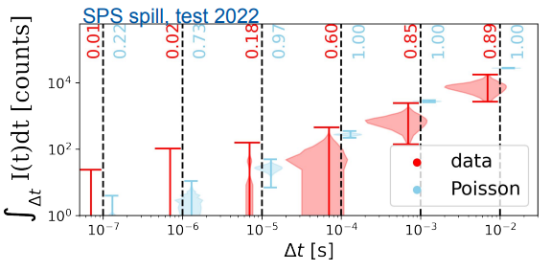
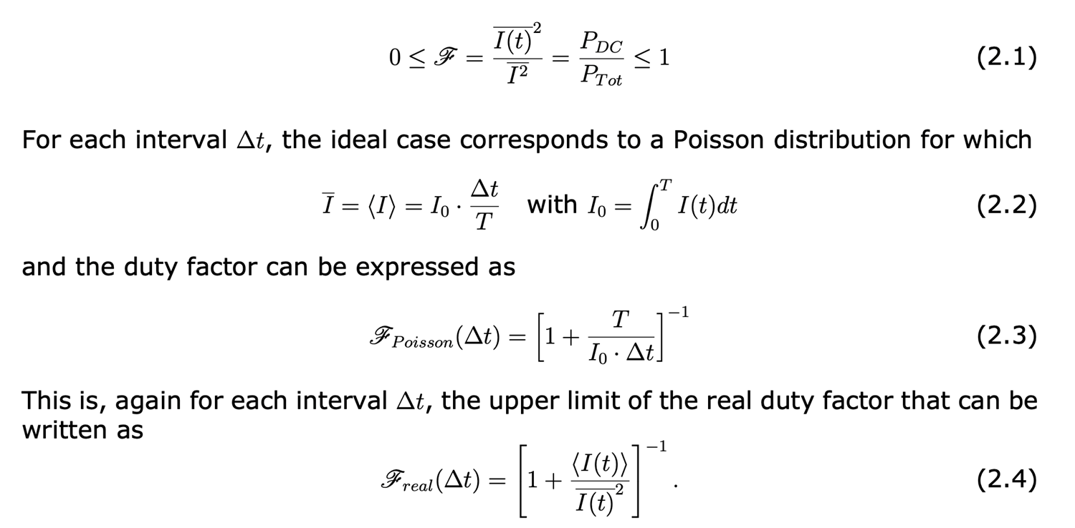
Spill Quality – Duty Factor
P.A. Arrutia Sota
100ns
1us
10us
100us
1ms
10ms
Δ t
Data in the plot was taken with the NA62 GTK detector. Both when comparing the particle-rate histograms and the duty factors, it is evident that the real spill performs significantly below the Poisson limit.
An upgrade of the spill monitors would allow to develop and optimise techniques to mitigate this difference.

Slide 5
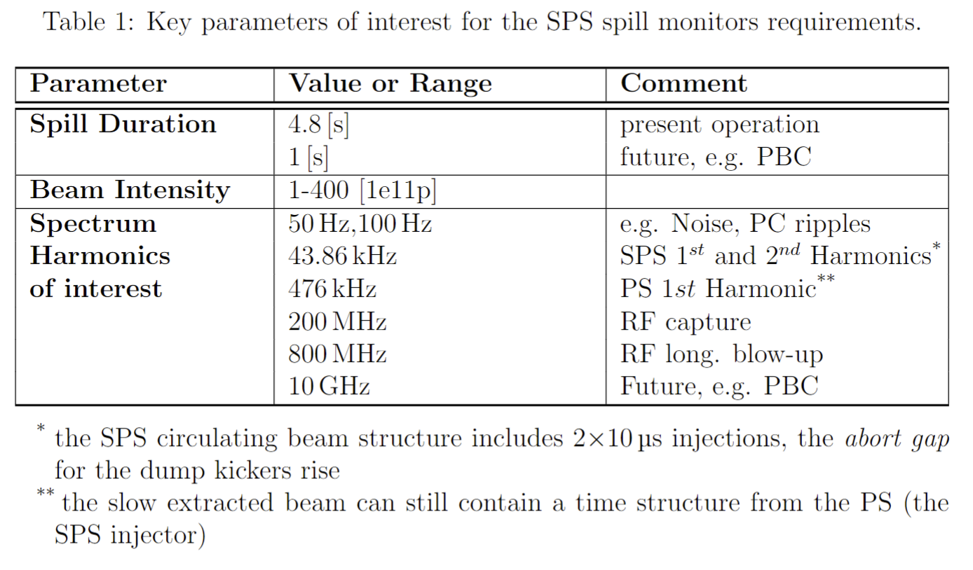
Spill Monitoring Requirements - General
From few nA to few uA
From few Hz to
800 MHz (SPS NA CONS, short term)
several GHz (PBC, long term)

Slide 6
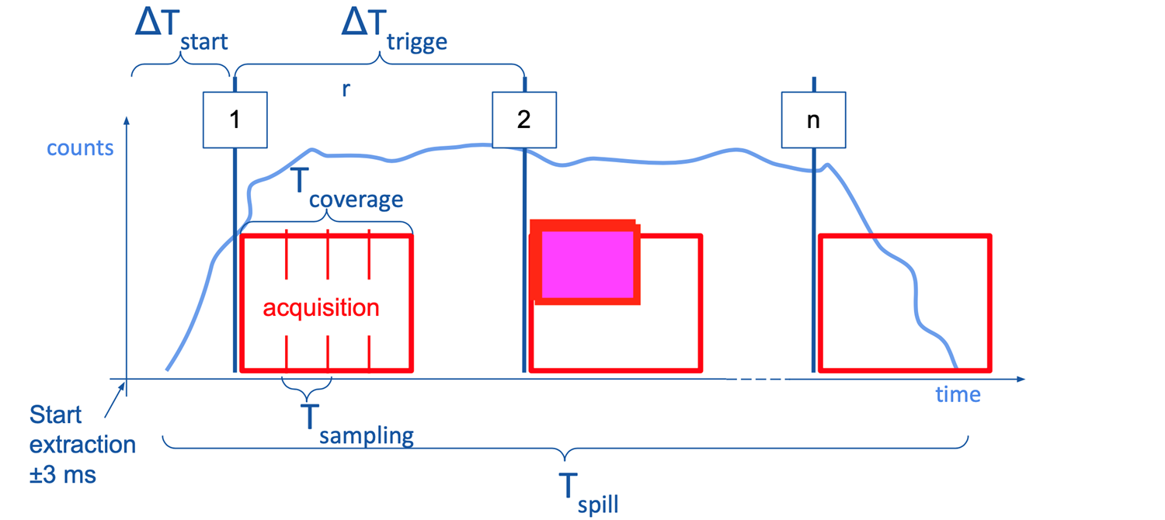
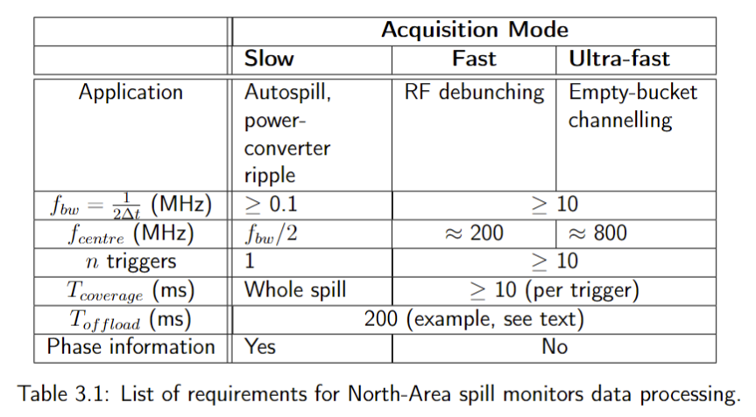
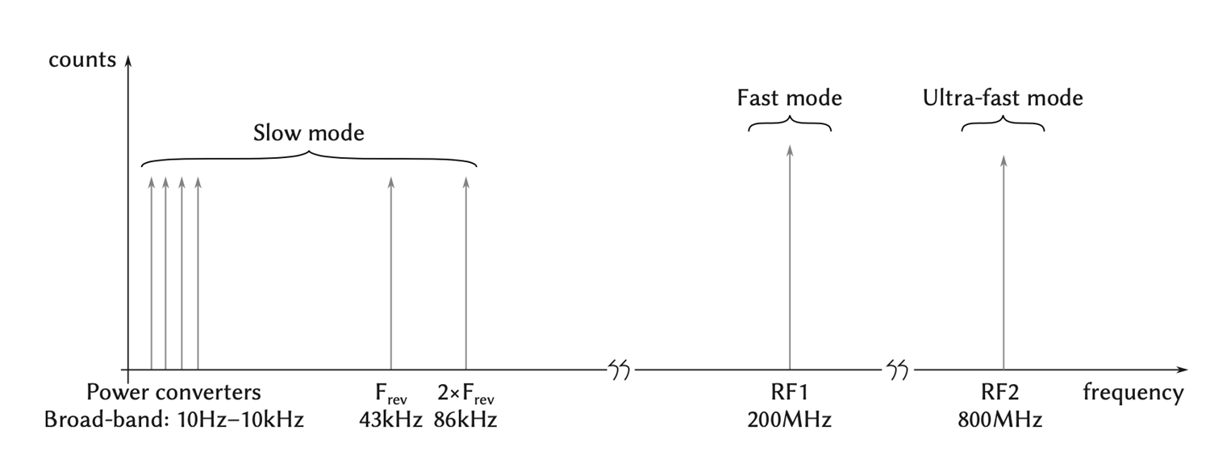
Spill Monitoring Requirements – DAQ
Fast Mode in Time Domain
For NA CONS monitors == current developments
Slow and Fast Modes in Time Freq. Domain

Slide 7
CERN SPS Present Spill Monitors
Secondary Emission Monitor (SEM) | DC → 1-2 MHz
3 x Diamond Beam Loss Monitors (dBLM) | 25 kHZ → 1-2 GHz
Optical Transition Radiation – Photomultiplier Monitor (OTR-PMT | DC → 200 MHz 800 MHz +- xx MHz

Slide 8
CERN SPS Present Spill Monitors
Secondary Emission Monitor (SEM)
2 x Diamond Beam Loss Monitors (dBLM)
Optical Transition Radiation – Photomultiplier Monitor (OTR-PMT)

Slide 9
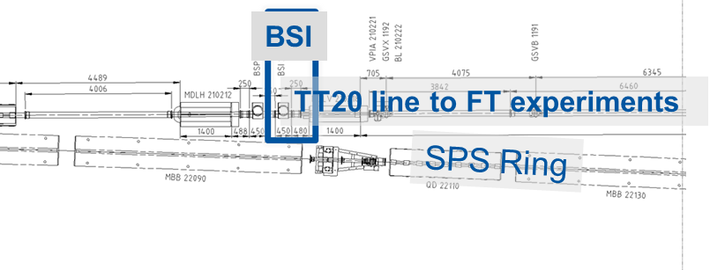
Secondary Emission Monitor (SEM - BSI)
SEM BSI = Aluminum foil
Proton beam generates Secondary Electrons , pulled by bias (+200V) plates to minimize probability of electrons going back to BSI
BSI (Ti Plate)
P+
Routinely used to feedforward magnet power converters and compensate 50-100Hz ripples
e-

Slide 10
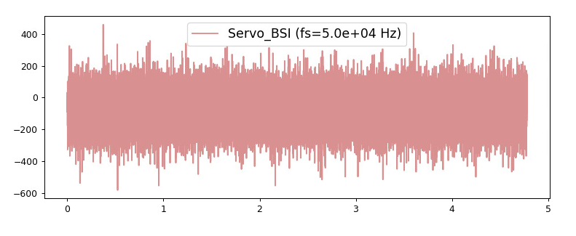
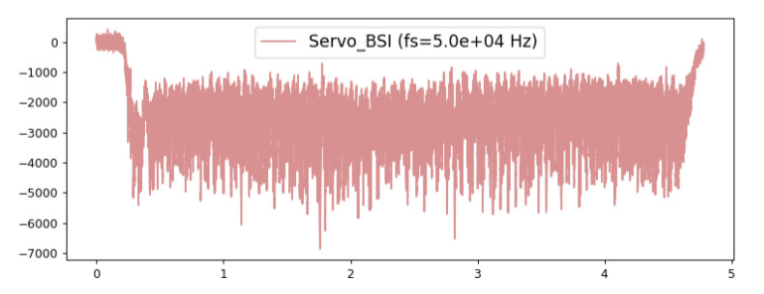
Secondary Emission Monitor (SEM)
DAQ
Amplifier in the tunnel (10MHz BW)
CK50 cables (>200m)
Low pass filter (1kHz) to suppress high freq noise
VME ADC (100kHz BW, 200kS/s, 16bit)
Signal / Noise Ratio (before 2022)
Low signal (SEY=~4%) and pickup noise
SNR = ~ 4000 / 800 (p2p) [ADC counts] ~= 5 in this example, after low pass @ 1kHz
Refurbishment of in vacuum detector + cabling done beginning of 2023. No dramatic improvement. EMI pick-up noise (in vacuum) still suspect.
No beam, During Access
SEM Signal [ADC]
SFTPRO spill, 3e13p
Time [s]
Time [s]

Slide 11
CERN SPS Present Spill Monitors
Secondary Emission Monitor (SEM)
3 x Diamond Beam Loss Monitors (dBLM)
Optical Transition Radiation – Photomultiplier Monitor (OTR-PMT)

Slide 12
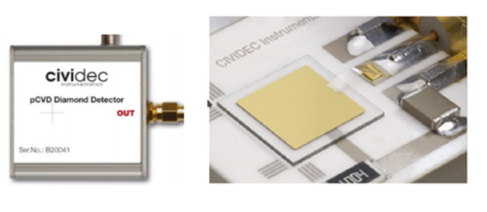
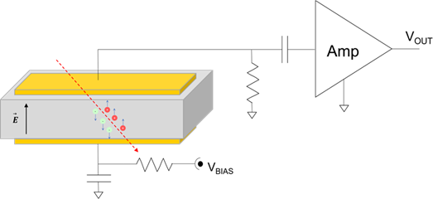
Diamond Beam Loss Monitors (dBLM)
Chemical Vapor Deposition (CVD) , 1cm x 1cm , 500um thick, Gold Coated
Electron-Hole pairs from ionizing radiation traversing the substrate
Used for many years in CERN synchrotrons (LHC, SPS, PS, PSB) and inj/extr beamlines
Rad hard , Fast
E. Calvo Giraldo et al., “The Diamond Beam Loss Monitoring System at CERN LHC and SPS”, IBIC Proceedings, 2022. TU2C2
H. Frais-Kolbl, E. Griesmayer, H. Kagan, and H. Pernegger, “A fast low-noise charged-particle CVD diamond detector,” IEEE Transactions on Nuclear Science, vol. 51, no. 6,pp. 3833–3837, 2004, doi:10.1109/TNS.2004.839366
B. Dehning, E. Effinger, H. Pernegger, D. Dobos, H. Frais-Kolbl, and E. Griesmayer, “Test of a Diamond Detector Using Unbunched Beam Halo Particles,” CERN, Tech. Rep., 2010, https://cds.cern.ch/record/1258407

Slide 13
dBLM DAQ
25kHz - 2 GHz BW
650 MS/s
1GHz MHz BW
Logging DB
Control Room Displays/GUI
Tunnel
Surface
System fully integrated into CERN control system, data logged

Slide 14
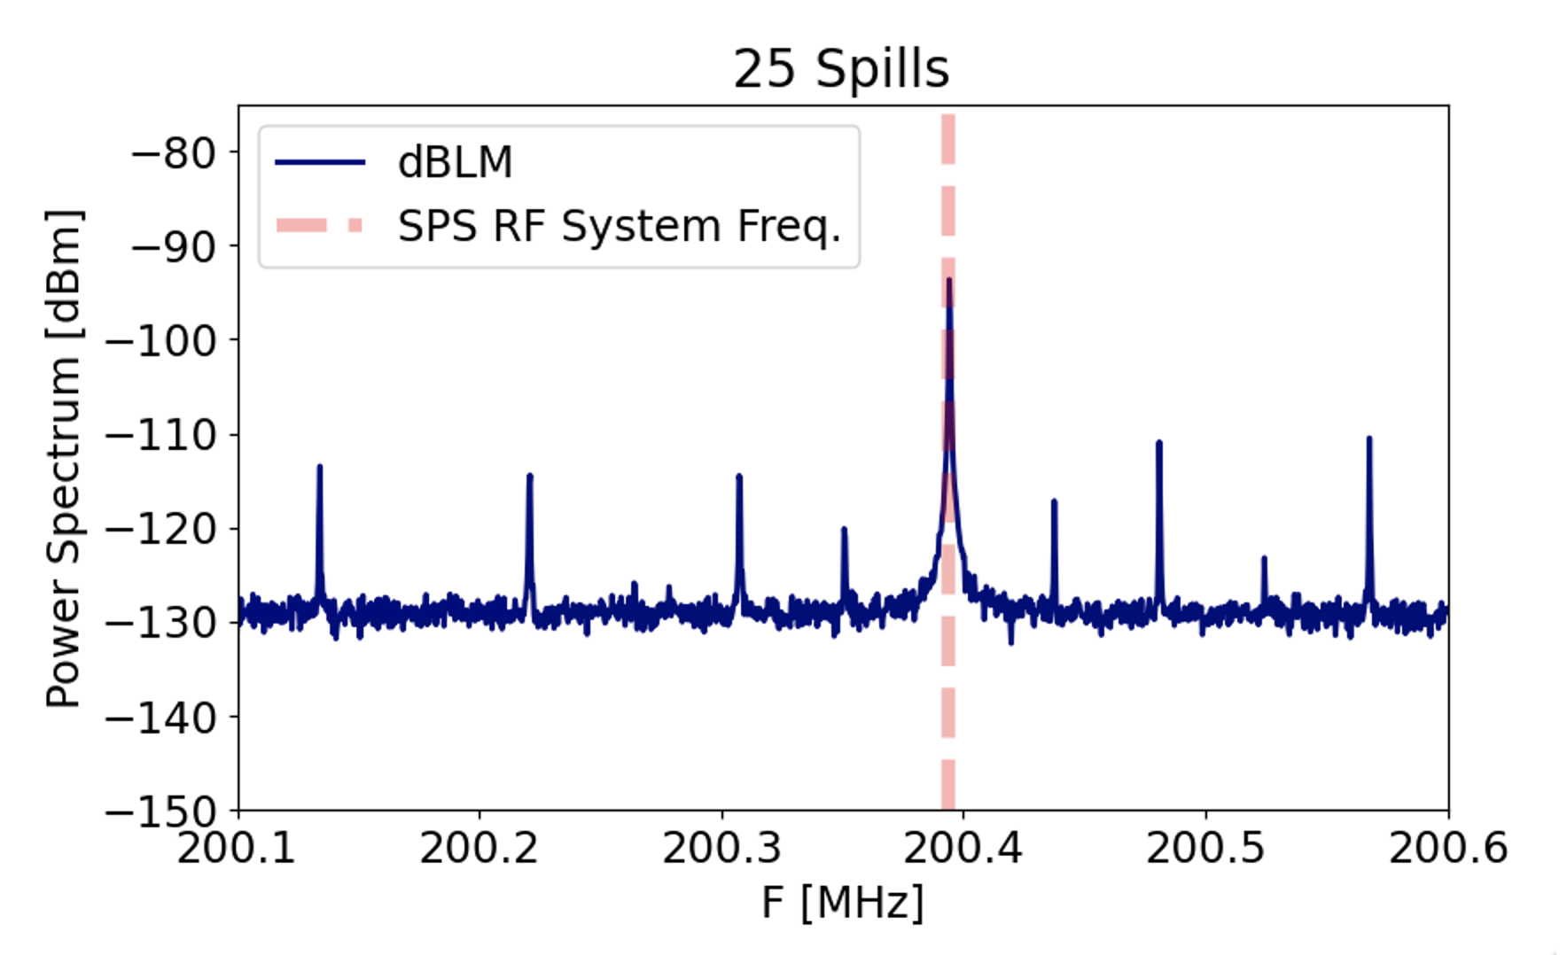
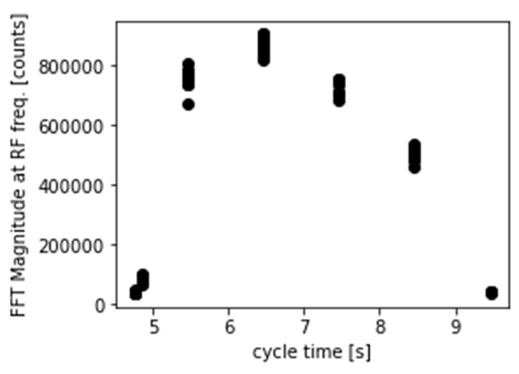
dBLM – Measurement Example
200 MHz Harmonic in a 2ms ‘chunk’ of the spill
200 MHz Evolution along the spill
Measurements achieved after subtracting average signal spectrum without beam
P. A. Arrutia Sota et al. “dBlms first results and md planning, presentation at CERN SLAG” (2022), https://indico.cern.ch/event/1155679

Slide 15
CERN SPS Present Spill Monitors
Secondary Emission Monitor (SEM)
2 x Diamond Beam Loss Monitors (dBLM)
Optical Transition Radiation – Photomultiplier Monitor (OTR-PMT)

Slide 16
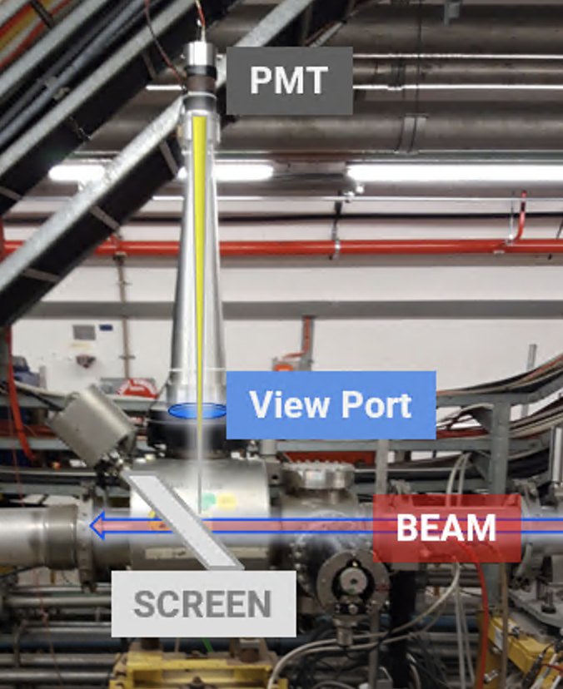
Optical Transition Radiation (OTR) – Photomultiplier (PMT)
Concept: count (instead of ‘standard’ imaging) photons from OTR
2021-2022:
Old system refurbished with new Ti screen, PMT and amplifier
2022-2023
Test measurements via non-operational DAQ (next slide)
From the start we could measure spill structure and power spectrum from DC to 300 MHz
High signal even with OTR screen OUT → System sensitive to beam losses
Small signal increase with screen IN → captured OTR radiation < than expected
OTR light
16

Slide 17
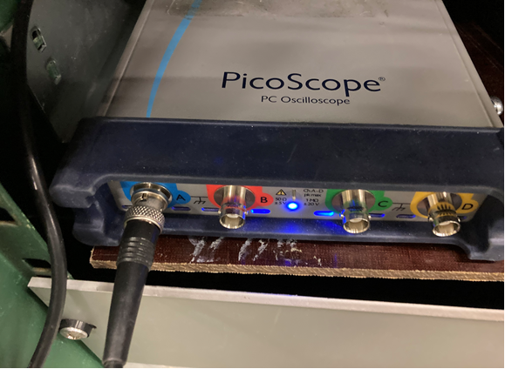
PMT – OTR DAQ 2022-2023
Fast PMT ~ 0.8 ns anode pulse rise time
Wide band (DC-300MHz) amplifier @ PMT output
CK50 cables to surface (>200m)
Signal duplicated to 2 separate PicoScope® digitizers (500MHz BW, 5GS/s, 2GS Memory)
Set at ~low rate (e.g. 1MHz) to cover all spill (5sec)
Set at high rate ( e.g. 625MHz) to cover ‘chunks’ of 1-10 ms along the spill
PicoScope® USB connection to Linux PC integrated into CERN control system (FESA)

Slide 18
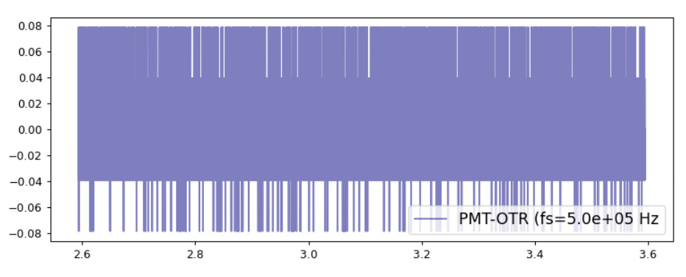
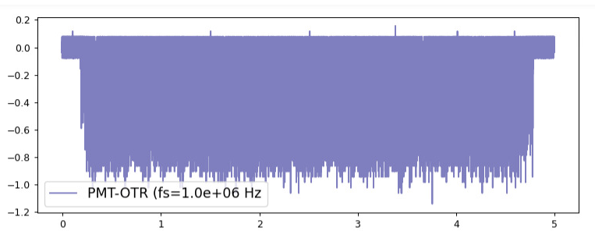
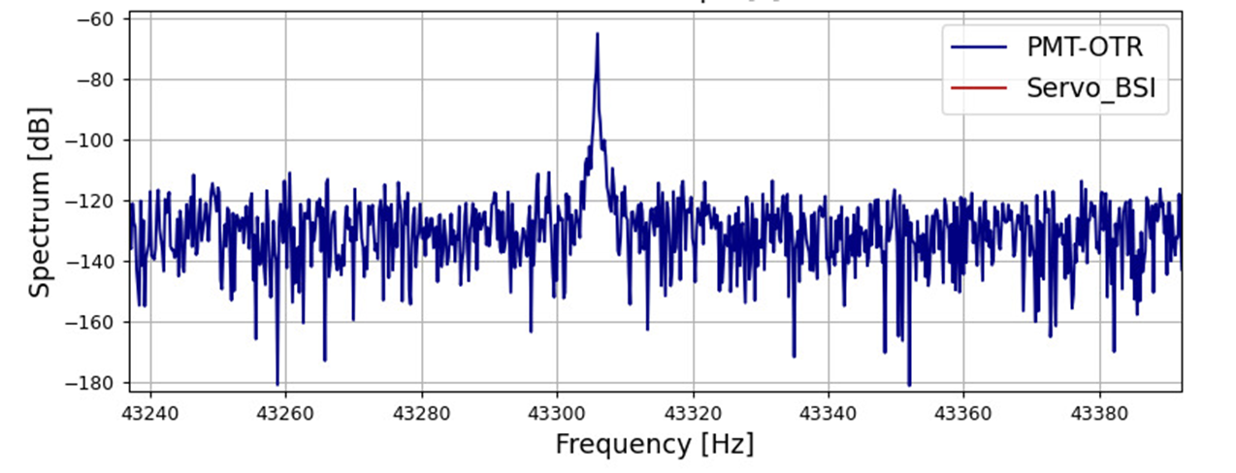
OTR – PMT (example with fs=1MHz)
Low noise.
Here, with no beam and PMT HV ON
SNR~=0.9/0.160=5.6 in this example
Similar to SEM, but here there is no low pass filter
NO BEAM , PMT HV ON
PMT Signal [V]
FFT
SPS frev
BEAM , 3e13 p / spill
Time [s]

Slide 19
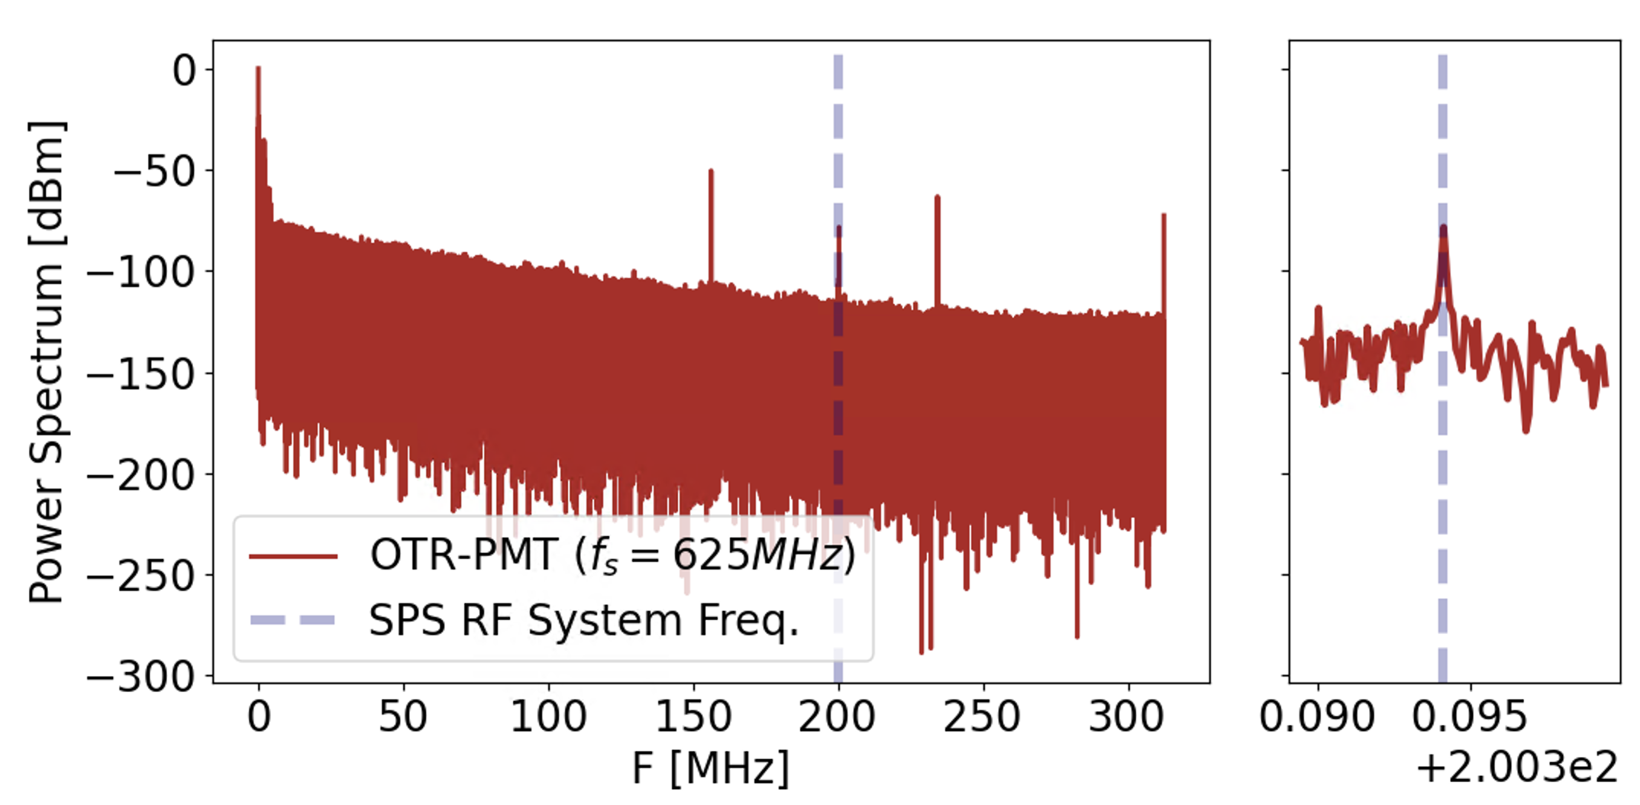
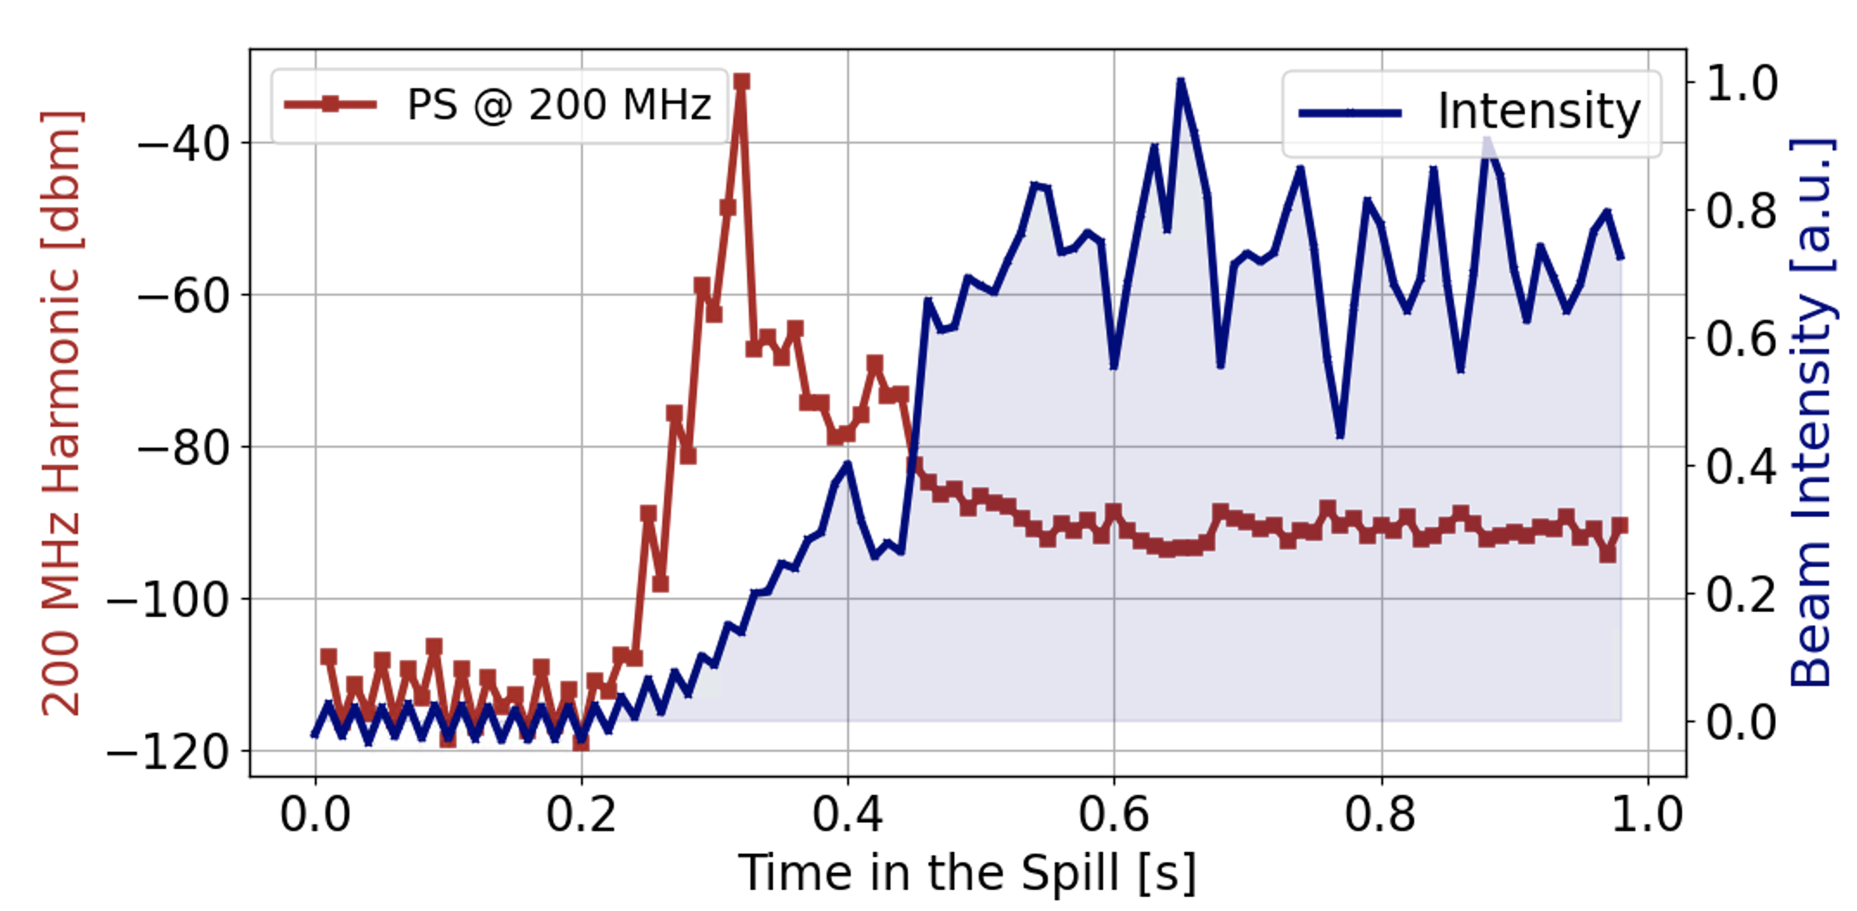
OTR – PMT (example with fs=625 MHz)
High frequency acquisition on a ‘chunk’ to study presence SPS RF (nominal=200.3941 MHz) in spill intensity
Scanned trigger delay to measure 200 MHz harmonic along the spill (here only first part of the spill)

Slide 20
Comparison between SEM and OTR-PMT systems

Slide 21
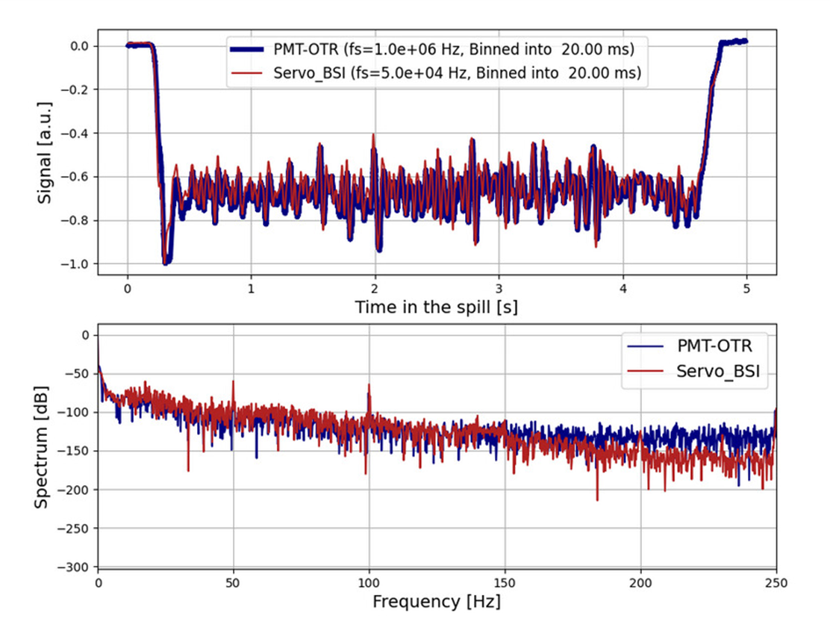
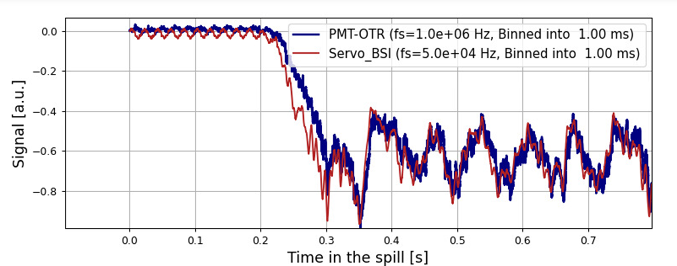
OTR-PMT vs SEM
Binning both monitors in equal time intervals
@ 20 ms
@ 1 ms (Zoom on Start of the Spill)
)
50 Hz ripples w/o beam
10 Hz beam intensity modulation
Impressive agreement between two systems based on different detector, DAQ and 30m apart

Slide 22
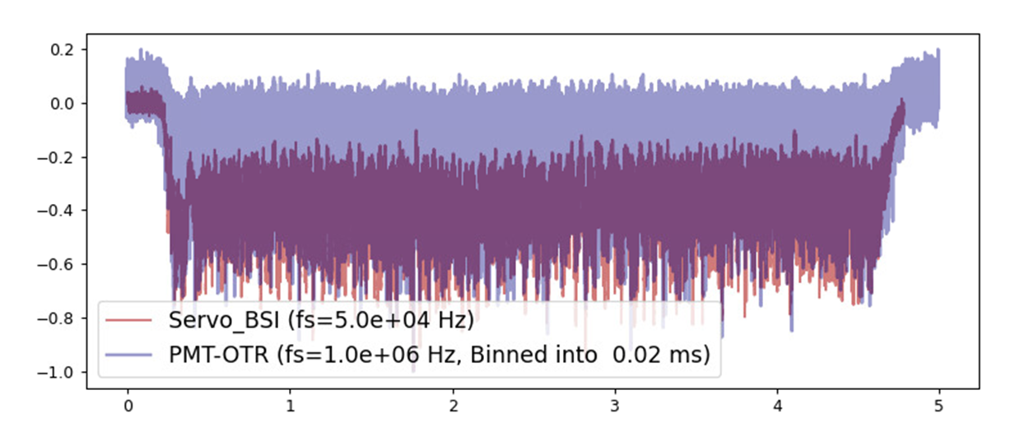
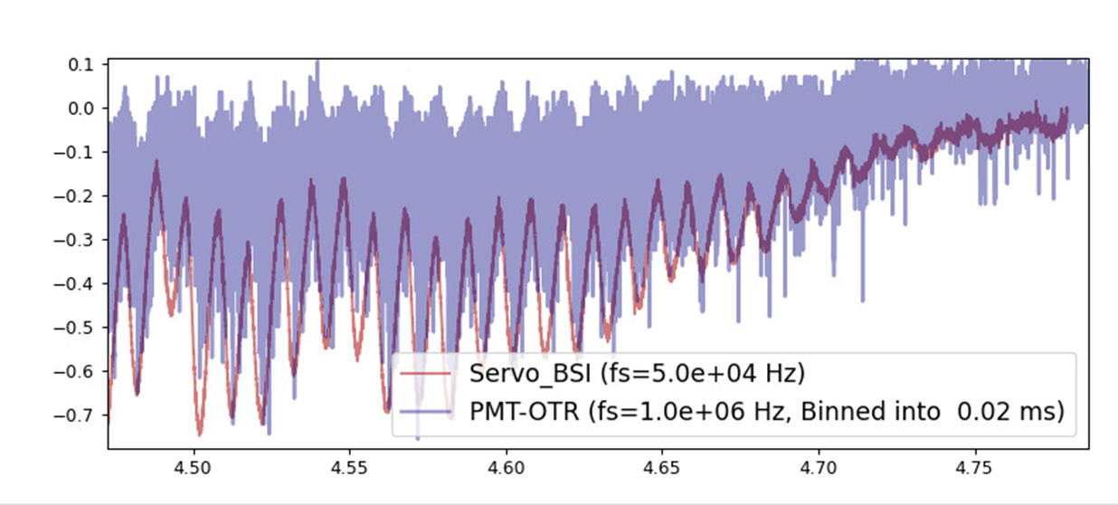
OTR-PMT vs SEM
SEM @ 50 kHz (20us), no binning
OTR-PMT @ 1MHz binned @ 50 kHz (20us)
As expected from SEM setup: low pass filter (1kHz) reduces overall BW, even when sampling at higher rate (50 kHz in this example)
OTR-PMT gives same envelope (100Hz beam intensity fluctuations) but also measures higher frequency beam intensity fluctuations

Slide 23
OTR-PMT system limitations
Location with ‘high’ losses
Limited diagnostics to check OTR screen and optics alignment
Test DAQ based on ‘PicoScopes’
PMT ageing
difficult to quantify and optimize OTR radiation detection efficiency
No possibility for signal conditioning / processing before and after digitization (like with FPGA based DAQs)

Slide 24
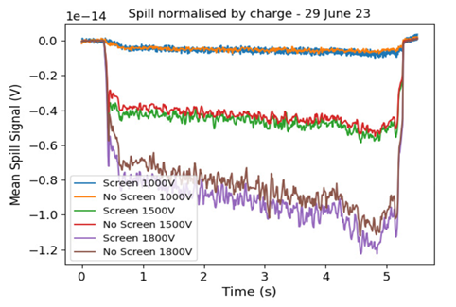
OTR-PMT – screen IN vs screen OUT
After many tests to compare the signal integrated with the screen IN w.r.t. screen OUT, including
PMT voltage scans
Proton beam steering on the screen
Diffusing or focusing radiation on PMT
Kept on seeing small changes with screen IN or OUT
Either very large losses or very low OTR collection efficiency (or large error on simulations of expected number of OTR photons production)

Slide 25
OTR-PMT – screen IN vs screen OUT
December 2023: inspection of screen installation revealed quite a large misalignment ( 3 to 5 degrees ) w.r.t. nominal 45 degrees w.r.t. beam trajectory
Simulations indicate that radiation collection efficiency only few %
This quite ‘big’ issue could mean ‘very good’ news
Alignment for 2024 carefully checked during shutdown + will have diagnostics to check on-line (See later slides)

Slide 26
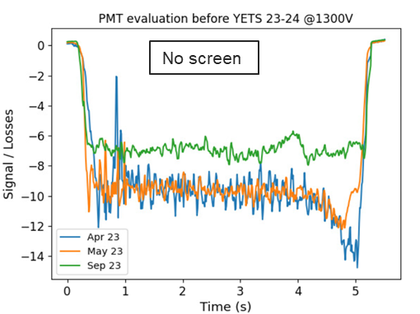
OTR-PMT – PMT ageing
2023 operation / tests with increased HV and high proton losses evidenced the PMT ageing
→ 30-40% signal (normalized to extracted intensity) degradation in Sep w.r.t. Apr/May
Norm. Signal [a.u.]

Slide 27
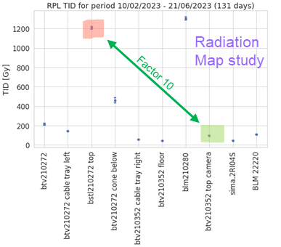
OTR-PMT – Radiation Maps
TID 10Feb2023 – 21Jun23 (131 days)
2022 -2023 PMT location
We looked at available radiation surveys and indeed the present detector location is not favorable.
2024 PMT location

Slide 28
OTR-PMT system refurbishment for 2024 run
Move detector at location with less expected losses
New detector layout including camera for imaging OTR light
New VME DAQ

Slide 29
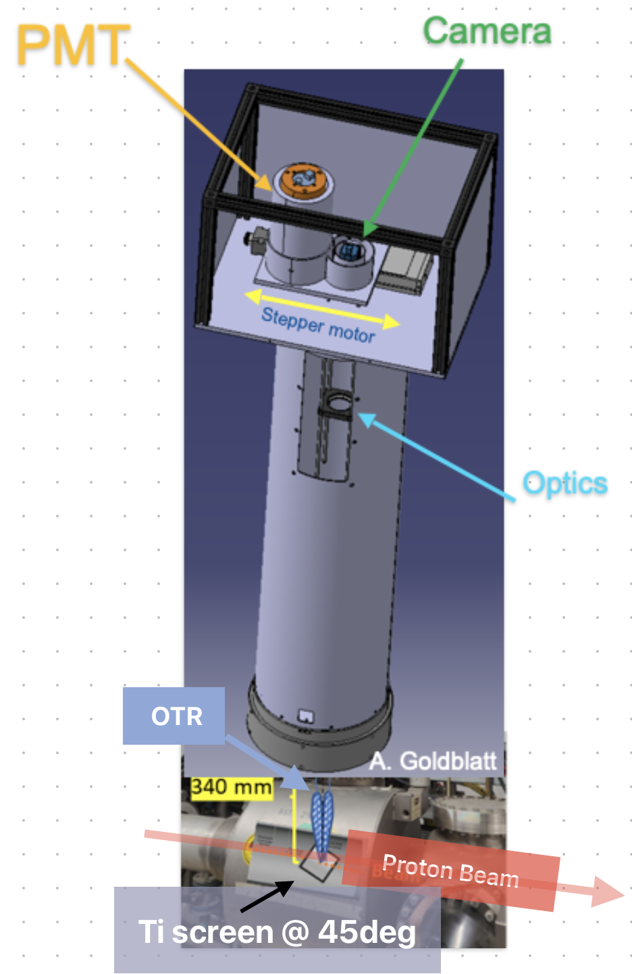
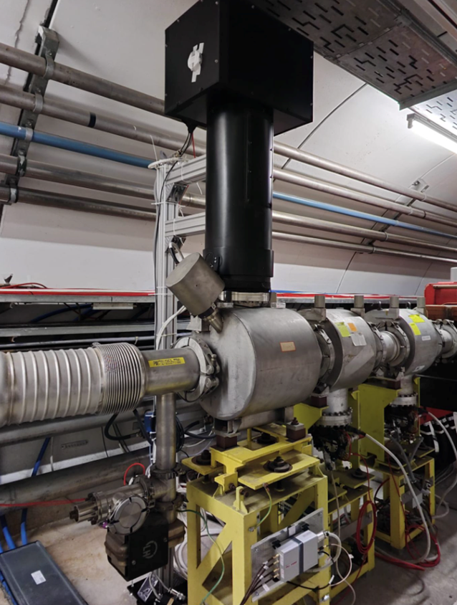
OTR-PMT – New Location, New Layout
The fast spill monitor system was moved to another existing screen station, where 2023 losses where much less
More robust optical design
Added translation stage hosting PMT and Imaging camera, will be possible to check OTR photons are focused on sensor.

Slide 30
New VME DAQ
After formalizing the function specifications for the short term (see initial slides):
Developed, produced and installed (2023-24 winter shutdown) new VME ADC expected to fulfill requirements up to 800 MHz
Few words on how we managed to arrive here in the next two slides

Slide 31
DAQ – from Functional to Engineering Specs
Acquisition Mode | Sampling Rate | Storage Needed | Ccomments / Remarks
Slow | > 200kHz | 32 Mbits | • Suitable for ADCs with a sampling frequency > 200kHz. • Can increase sampling rate and memory for better frequency or temporal resolution.
Fast (up to 200MHz) | ≥ 400 MHz | 64 Gbits | • Requires ADC with minimum 400 MHz sampling rate and sequential triggering mechanism to reduce data storage needs.
Ultra-fast (800MHz) | ≤ 1.6 GHz | Depends | • Can be under-sampled if the ADC and signal path support it. • Alternatively, a fast ADC at > 1.6 GHz can be used, or the 800 MHz frequency can be down-mixed to a compatible band for Fast mode.

Slide 32
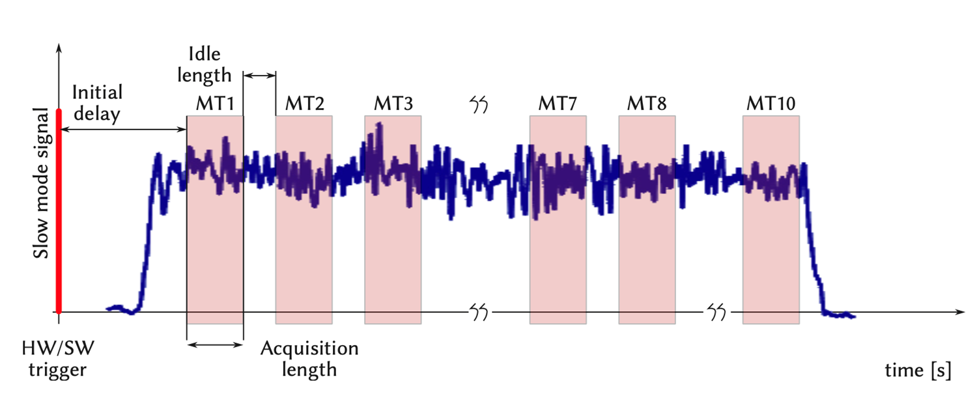
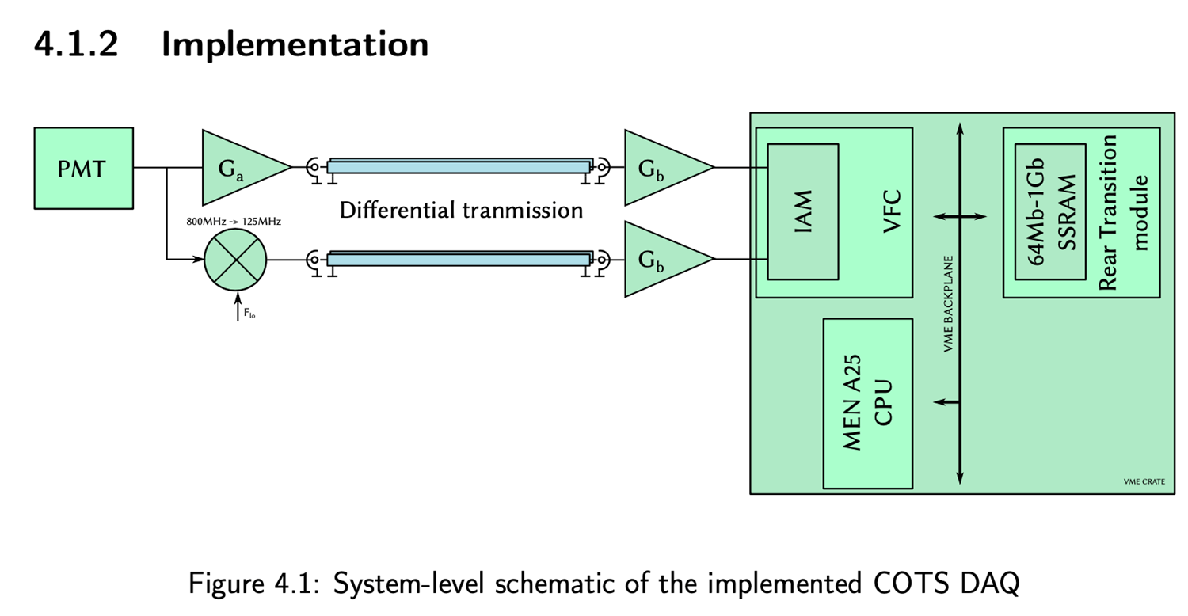
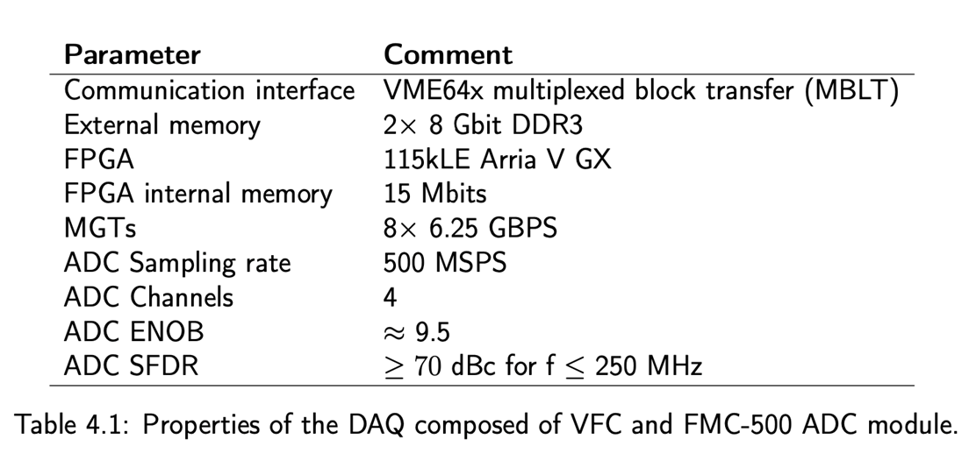
DAQ – Implementation
Fast mode trigger and timing logic
DAQ – VFC + FMC ADC specs
New VME DAQ based on CERN BI carrier board (VFC) with 500MS/s FMC ADC
Designed for DC-200MHz + 800MHz (down conversion to 125MHz) +-100MHz
installed, to be commissioned with beam

Slide 33
PLANS (to go to xx GHz)

Slide 34
Plans towards xx GHz range (DAQ side)
On-going studies (conceptual + few lab tests for the moment
Option | Pros | Cons
ATCA | High-speed communication channels, used in CERN experiments | Expensive, requires minimum configuration, not cost-effective for isolated system
SoC (RFSoC) | Flexibility in choosing ADCs, local communication between ARM CPU and FPGA | Existing modules have low memory, limited availability of larger memory options
PCIe | Widely used standard, high-speed data transfer, supports DMA | Requires PCIe form-factor FPGA carrier with sufficient memory, limited module options with large memory

Slide 35
Towards xx GHz (Detector Side)
Cherenkov detector for proton Flux Measurement (CpFM)

Slide 36
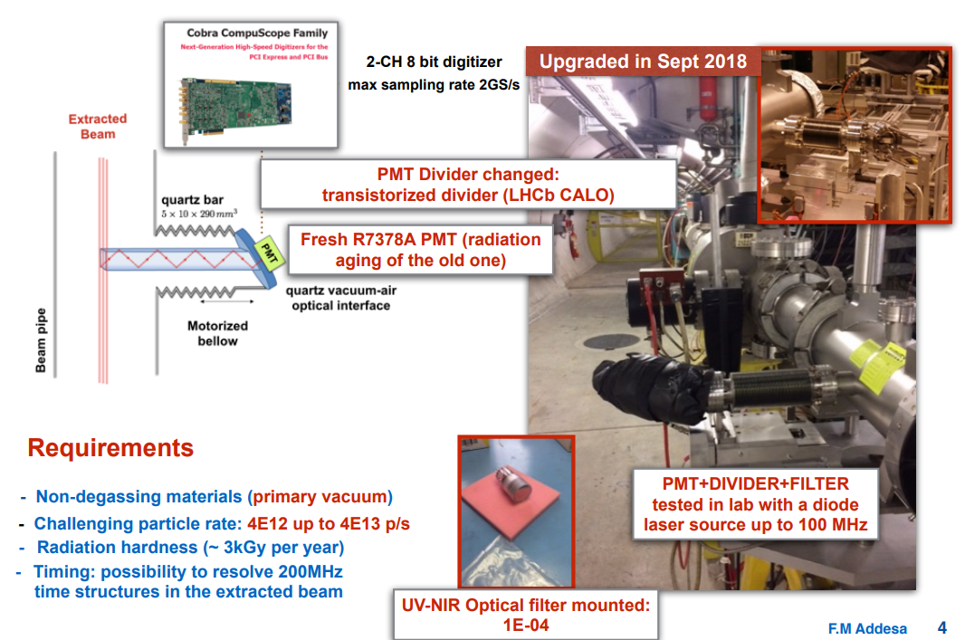
Cherenkov detector for proton Flux Measurement(CpFM)
Plans towards xx GHz range (Detector side)
F. M. Addesa et al. “In-vacuum Cherenkov light detectors for crystal-assisted beam manipulations,” https://cds.cern.ch/record/2661725
In vacuum quartz bar producing Cherenkov light
System evolution of one used with low particle flux for crystal assisted extraction
Can go to few GHz at least (as OTR-PMT, but with better SNR)
Validated in 2018 with custom made DAQ
Plan
Resurrect system
Study ultimate bandwidth
Propose ~standard DAQs

Slide 37
Cherenkov detector (CpFM) – Status
New phase of tests could start end of 2023
The status of the PMT has been checked with photon source in tunnel → ok
Being connected to ‘Picoscope’
The stepper motor, connections of HV functional and integrated in control system.
Installed a new cover, to ensure light tightness.
The dark counts have been measured. The setup is ready and waiting for the beam to measure.
2024 tests will lead to next phase towards fulfilling multi-GHz requirements, with possible options
Consolidate / upgrade present system
Start new design based on same technology , e.g. less invasive radiator, different radiator
Look at other techniques
All this within Physics Beyond Colliders (PBC) project

Slide 38
Outlook / General Remarks
SEM detector is robust in measuring 50-100 Hz, SNR limited
dBLMs surely suitable for high freq. measurements. Poor SNR to be understood
OTR-PMT:
proved to work (as BLM …) up to 200MHz
2024: explore 800MHz, with new VME DAQ. If all ok, port it to ‘operational’ state
For all monitors: maximizing SNR, identifying and mitigating different sources of noise, EMI and background
If some of them are confirmed to be ‘local’, consider new locations (as already done for ORT-PMT)
Going to > 1GHz range implies DAQ upgrades (e.g. optical signal transmission) and/or new techniques (e.g. optical systems like CpFM)
efforts on fast DAQs will be applicable to different techniques.
Depending on existing monitors progress, alternative/complementary methods (gas scintillation, gas ionization) can be considered, not discussed today

Slide 39
BACKUP / SUPPORT / REFERNECE SLIDES

Slide 40
Limitations and plans
System | Limitation(s) that can be improved | Plan
SEM | SNR, Analog BW and Sampling rate | Refurbish in vacuum detector ,consider new amplifier and ADC, aim a removing 1kHz filter
dBLM | SNR | More beam based studies in TT20 Consider option of mono-crystalline detector + amplifier decoupling low and high frequencies ?
OTR-PMT | High signal with screen OUT | Dedicated beam based studies (signal vs beam position) Move or Duplicate PMT (away from losses)
Gas Scintillation | - | Study expected signal levels at SPS
Cherenkov Detector | - | Resurrect system Study fast DAQ that can be integrated into CERN control system

Slide 41
Summary (with present implementations)
System | Analog BW | Sampling | Max Acq Period
SEM | 10 MHz (amplifier) 1 kHz (LP filter) | Up to 200 kS/s | Full Spill
dBLM | 2 GHz Amplifier 500 MHz Digitizer Low Cutoff @ ~25kHz | 650 MS/s (fixed) | Xxx ms
OTR-PMT | 300 MHz Amplifier 500 MHz Digitizer | Up to 5 GS/s | Full spill @ few MHz ~ 3ms @ 5GS/s
The 3 systems have long Cu cables also limiting BW to < 500MHz
Digitization in the tunnel and optical signal transmission is under study (see backup slide)

Slide 42
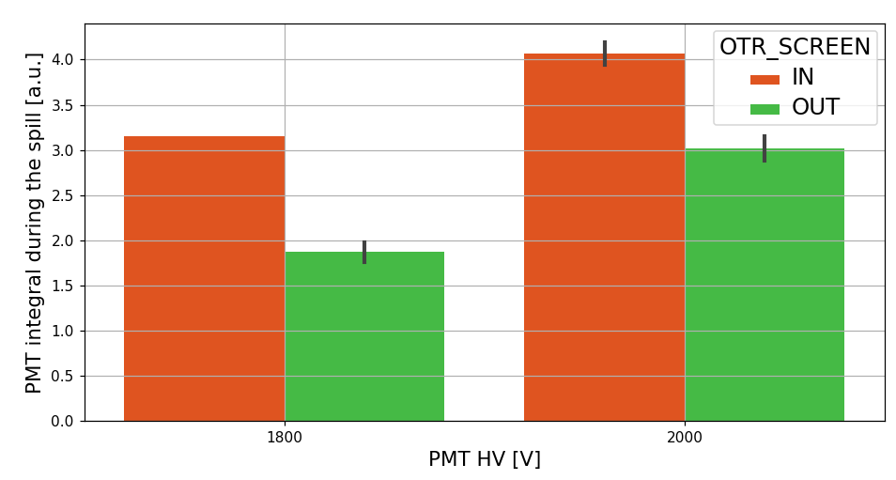
OTR - PMT
Resulted to be very sensitive to beam losses during physics (>1e13 p/spill) even if PMT is 1m away. Plan: move or duplicate PMT and to be dominated by OTR w.r.t. losses

Slide 43
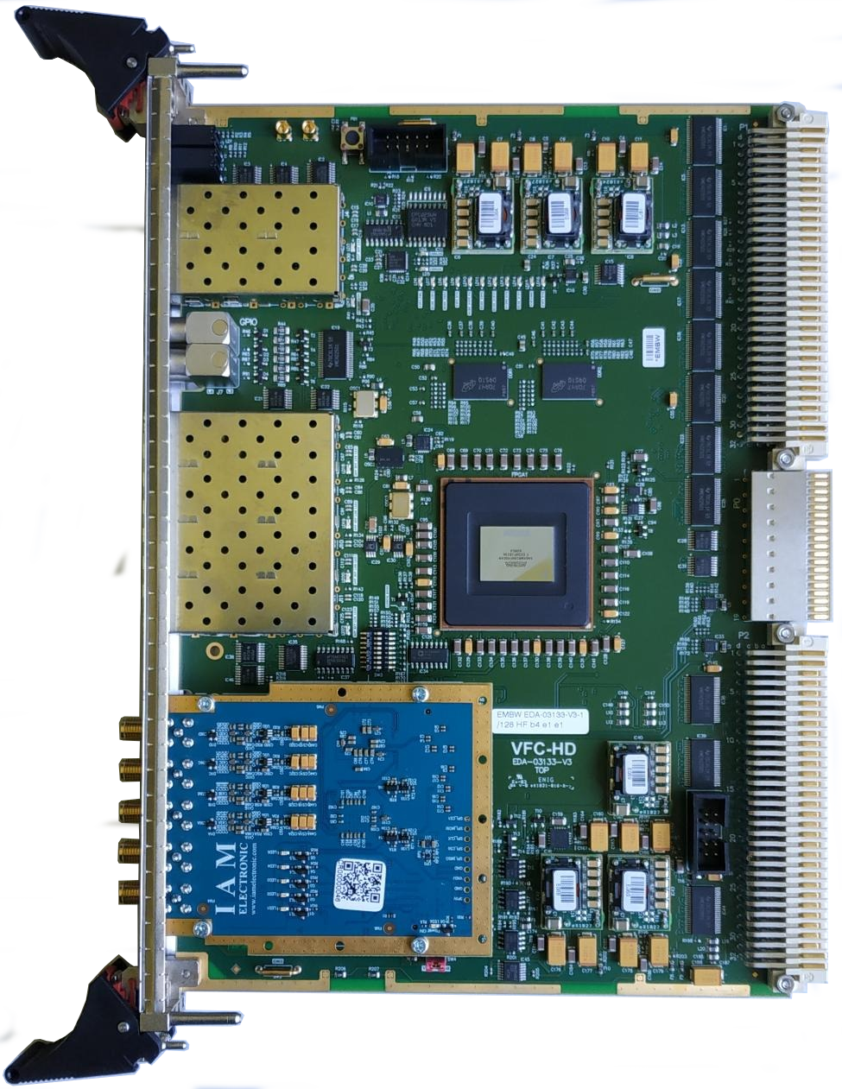
OTR – PMT – Fast DAQ studies
New acquisition system based on VFC+ FMC ADC
single channel acquisition
fast sampling mode with selectable down sampling:
500MS/s @ ~2 seconds of data storage
250MS/s @ ~4 seconds of data storage
slow sampling mode, e.g. 200kHz up to 2 MHz: still to be defined how long acquisition can be stored:
DDR memories store fast sampling data
FPGA internal memory is 64MBits → 1MSample → 5.2seconds

Slide 44
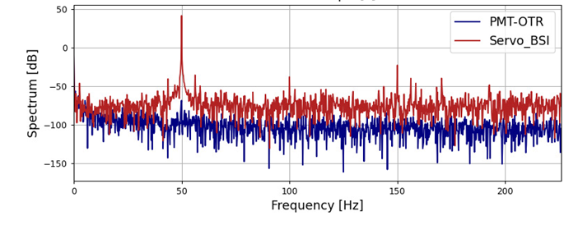
No beam, During Access 13 July ~@ 12:00

Slide 45
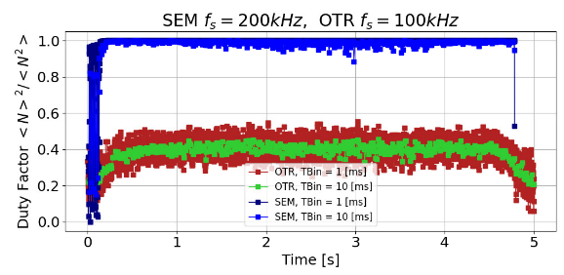
Duty Factor

Slide 46
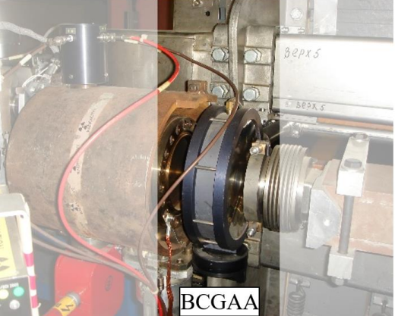
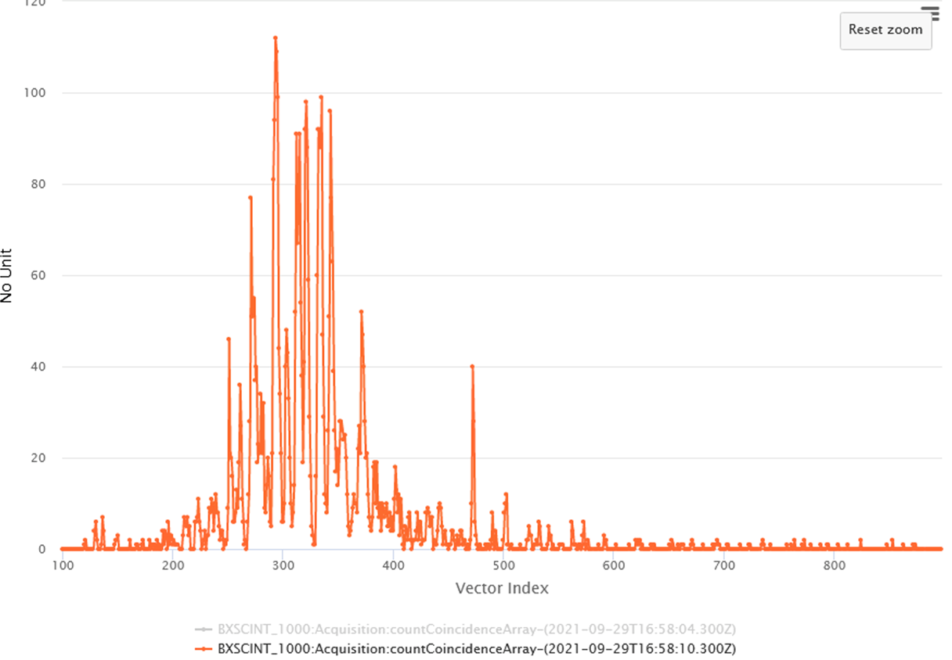
Gas Spill Detector @ CERN PS
24 GeV protons
Based on detecting light emitted by beam-gas interaction
Tank filled with Nitrogen, ~22m from extraction point
Decay time ~ 10ns
Two PMTs in coincidence (to suppress noise)
Analog pulses converted to NIM-standard ( 30 ns, −1 V) and sampled at 2 kHz
DAQ: 10 kHz possible, now set to 2.5kHz
Ultimate BW now anyhow limited by present cables and VME bus
TDC based DAQ under study, could reach 1 MHz
Plan (depending on resources and priorities):
Study signal levels and feasibility @ SPS 400 GeV

Slide 47
dBLM
 |  | Comments/Remarks
Detector / Method | pCVD crystals
Max Sampling Freq | 650 MHz | BI standard carrier board (VFC) + 2 Ch-650 MS/s FMC ADC
Analog BW | Better than ~200 MHz (detector response) | Well suited @ LHC for ghost and satellite bunch measurements
Maximum acquisition window | Few ms (limited by memory buffers and logging DB restrictions)
S/N | To be fully assessed | Noise in TT20 higher than ~all other CERN dBLM locations

Slide 48
OTR - PMT
 |  | Comments/Remarks | Plans
Detector / Method | OTR from Ti screen | With FT physics beams: see signal without screen == losses on PMT | Bring existing PMT (or add second PMT) away from beam pipe to be less sensitive to direct losses
Analog BW | 500 MHz (Picoscope) 200 MHz amplifier | Can look at faster amplifier (or remove it) | Longer term studies: VME digitizer (next slide) digitize in the tunnel and optical signal transmission
Max Sampling Freq | 5 GS/s (Picoscope) | Signal split to two scopes in parallel to have: -chunk at high rate -full spill at low rate
Maximum acquisition window | Full spill (at ~low rate e.g. 1MHz) 10mS @ 625 MHz | Signal split to two scopes in parallel,
S/N | 160e-3 [p2p] /1 [V] = 1./ 0.160 | Low noise

Slide 49
Secondary Emission Monitor (SEM - BSI)
 |  | Comments/Remarks | Plans
Detector / Method | Electrons Secondary Emission from Al Foil | SEY (few 1e-2) changes with radiation and vacuum history | Refurbishments with new detectors assembly in YETS 2022-23
Max Sampling Freq | 200 kHz | Can upgrade to faster ADC
Analog BW | ~10 MHz (Ampli) ~kHz (analog filter) | Both can be made faster if S/N allows | Amplifier tests in the lab, BW studies
Maximum acquisition window | Full Spill
S/N | ~ 4000 / 800 (p2p) [ADC counts] ~= 5 | 50 Hz also with no beam | Noise studies in the lab

Slide 50
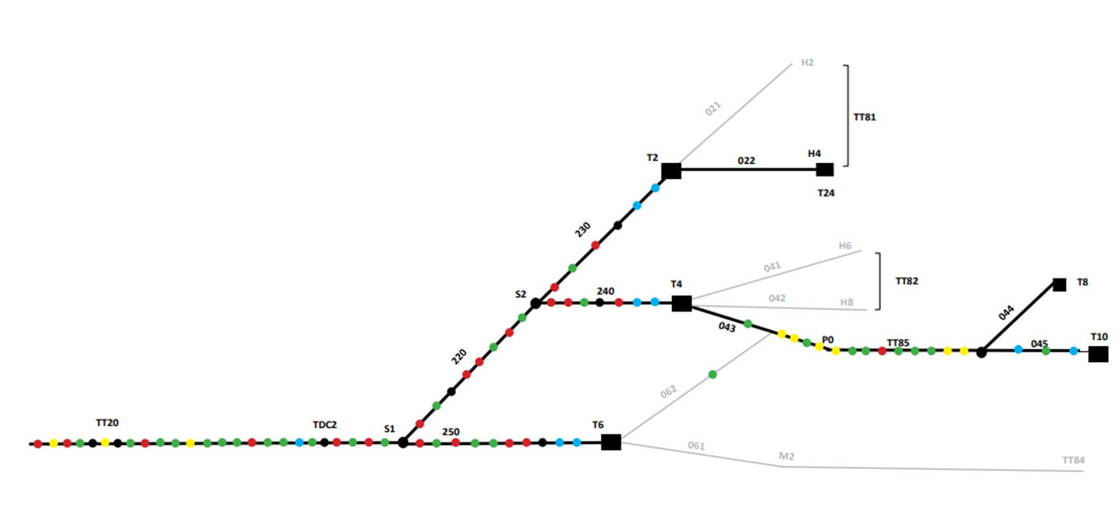
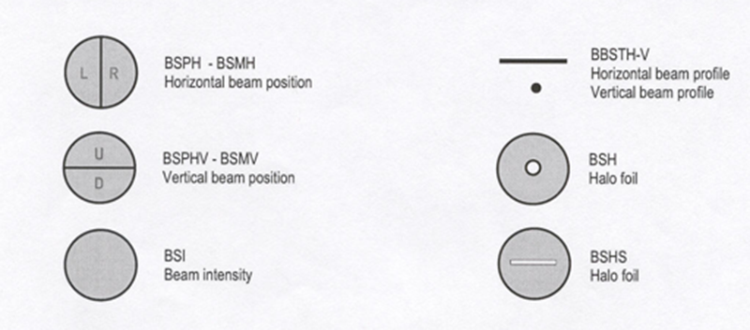
Secondary Emission Monitors (SEM)
~80 monitors + ~50 in target boxes – DAQ sampling @ 50Hz
BSM(H,V)
BSI
BSG(H,V)
BBS(H,V)
BSP(H,V)
1 BSI @ the beginning of the line is read-out with ‘fast’ electronics
SPS Ring
TT20 LINE

Slide 51
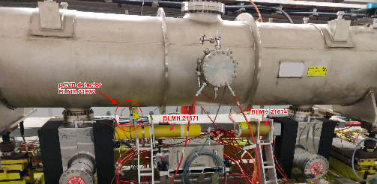
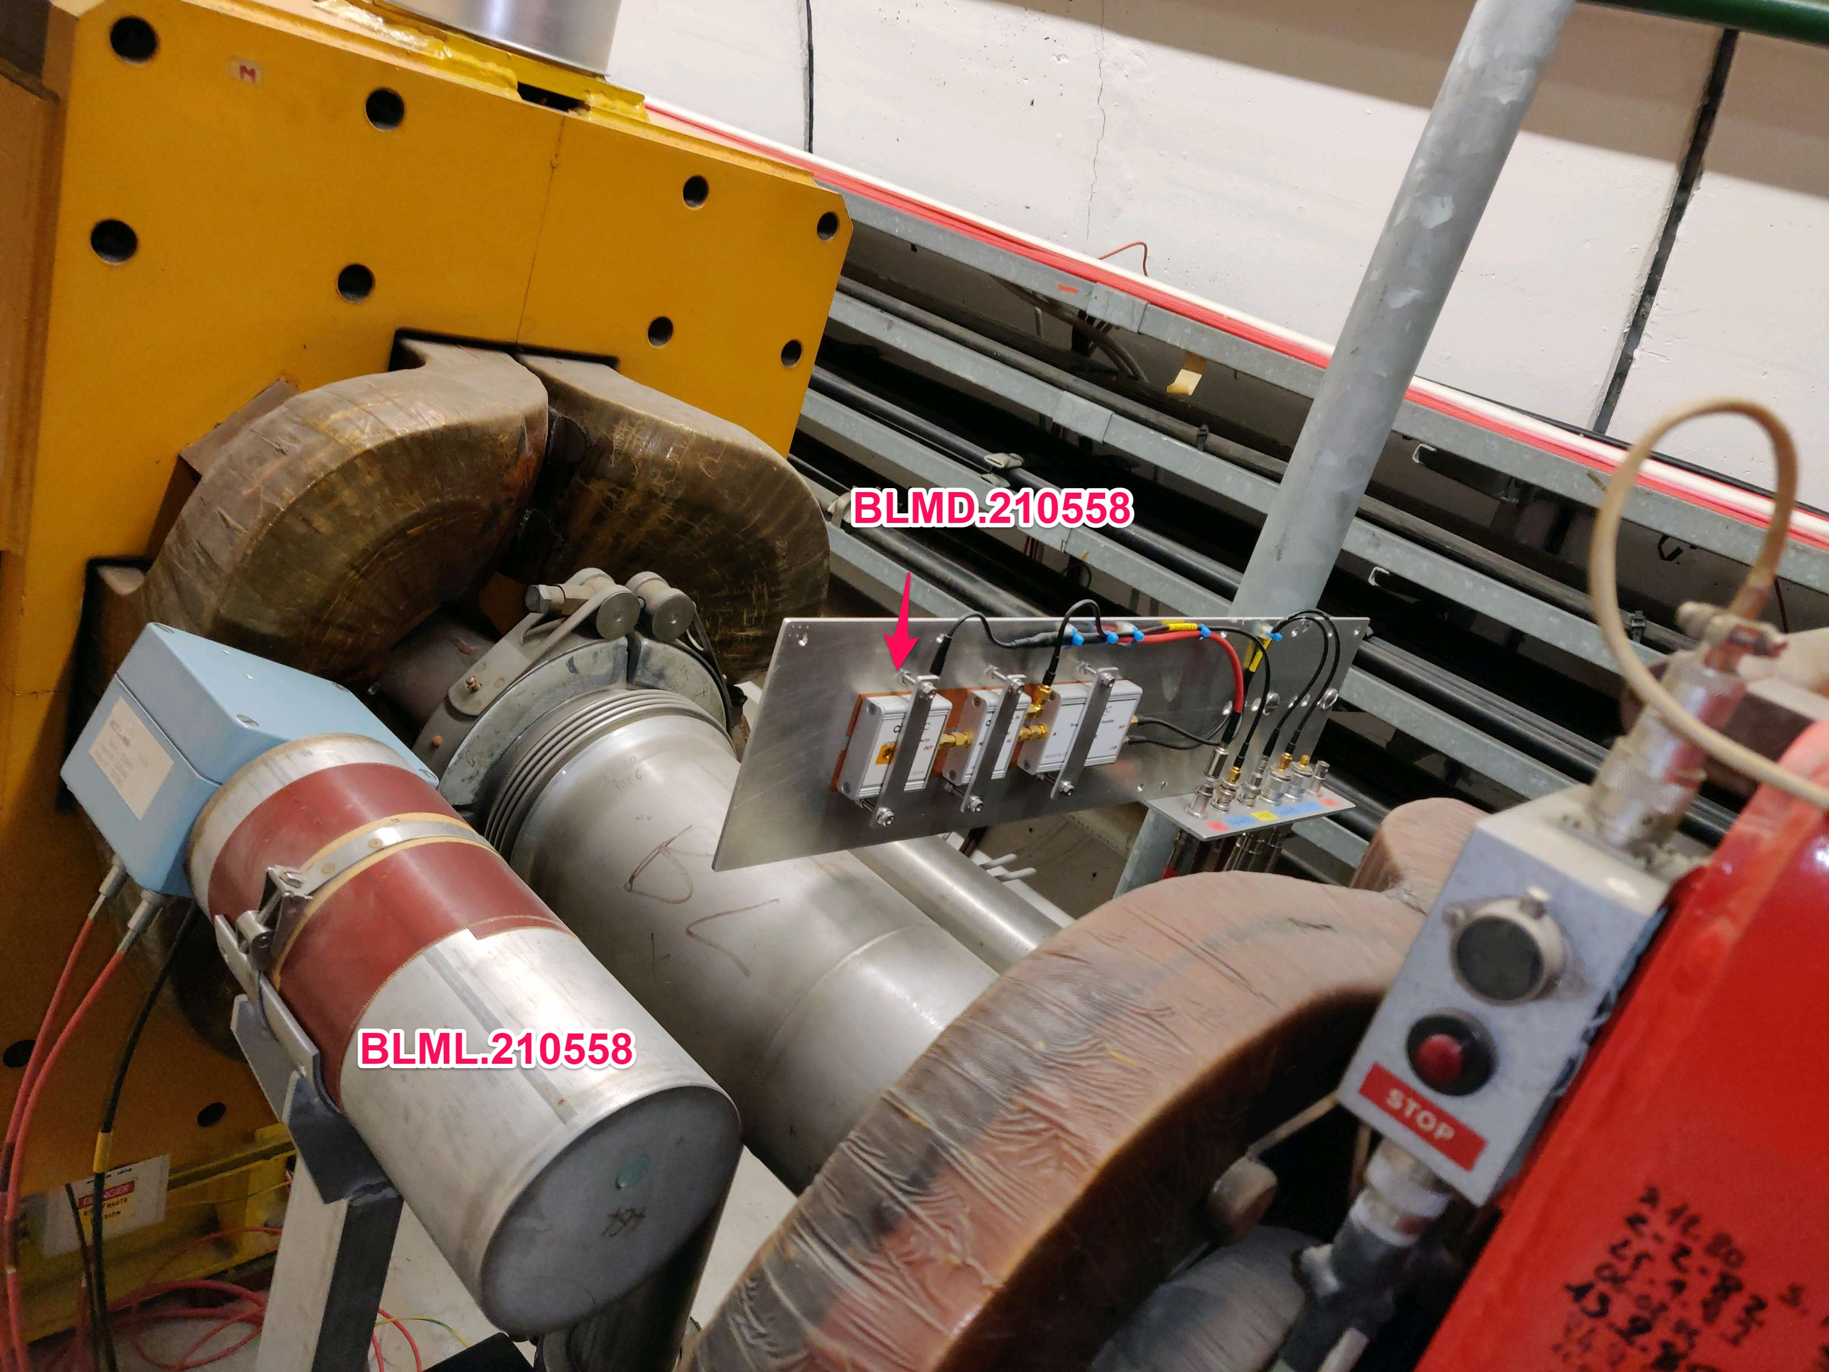
Diamond Beam Loss Monitors (dBLM)
2 dBLM installed in SPS (@electrostatic septum and @transf. line quad)
BLMD21671 @ ZS
Beam
BLMD210558
51

Slide 52
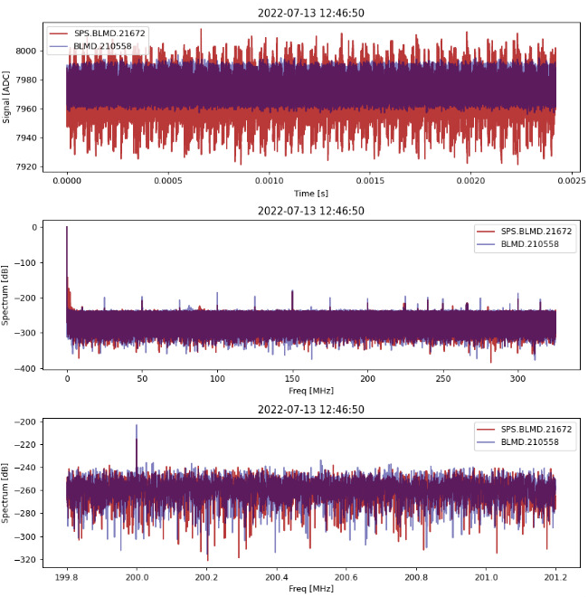
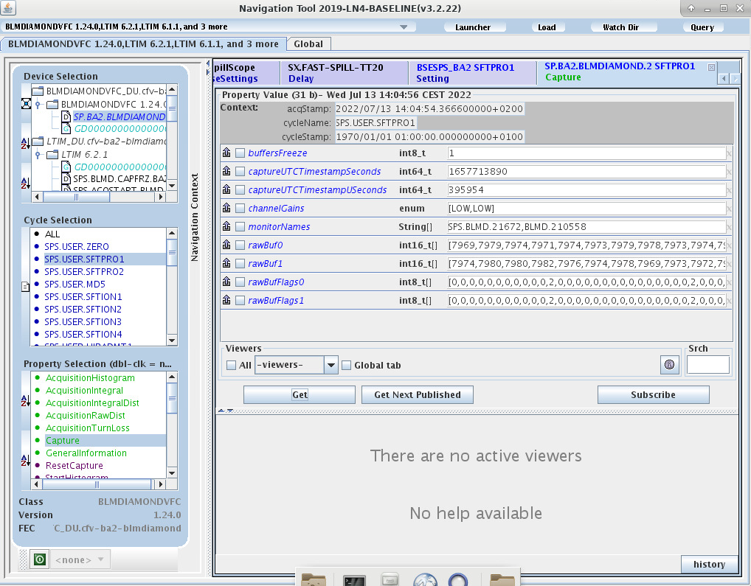
Diamond BLMs
E. Calvo, E.Effinger , C.Zamantzas et al.
No beam, during Access 13 July

Slide 53
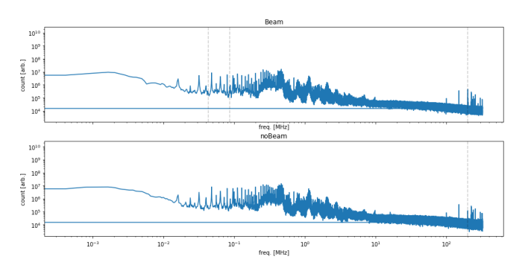
Diamond BLMs
P.A. Arrutia Sota, E. Calvo, E.Effinger , C.Zamantzas et al.
During normal operation, the signal is rather noisy But it is possible to exploit it via processing in the frequency domain (Pablo A., 11 May)
BEAM
NO BEAM
200 MHz
(BEAM) – (NO BEAM) =

Slide 54
Diamond BLMs
P.A. Arrutia Sota, E. Calvo, E.Effinger , C.Zamantzas et al.
Evolution of the 200 MHz Harmonic during the spill (Pablo A., 11 May)
BLMD21671 @ ZS
BLMD210558

Slide 55
Spill Shape Reconstruction in the EAST Area
Spill Shape Reconstruction in the EAST Area through the mixed-secondary radiation field produced by beam-target collisions at CHARM
pCVD dBLM placed inside CHARM irradiation room
Data acquisition with an oscilloscope in the control room
AC signal dBLM noise discrimination, data partitioning in 20 ms, distribution of number of events throughout the 450ms proton bunch → spill shape reconstruction
Analysis of the spill shape consistency over hundreds of multiple consecutive acquisitions in each CHARM positions
Comparison of the spill shape reconstructed by the dBLM with a IC BLM placed on a standing pole
Cross-validation of the analysis with XSEC Data:
F61.XSEC.023
T08.XSEC.070
T08.XSEC.094
This method to reconstruct the spill shape with the dBLM has been validated in all CHARM positions!
Tests in R13 are still ongoing to further investigate the feasibility of the analysis in harsh positions
R5 CuOOOO
Most of the spills’ shape reconstructed by the dBLM are in good agreement with the SEC!
dBLM R5 CuOOOO Spill Shape reconstruction
dBLM - IC BLM - XSEC - XION
comparison
Roberta Provvedi (BE/CEM-EPR), Salvatore Fiore (BE/CEM-EPR), Salvatore Danzeca (BE/CEM-EPR)

Slide 56
OTR - PMT
5 MS/s
5 GS/s
With present setup
full spill at low rate (few MHz, ideal to see 50-100Hz in one shot)
chunks
up to few ms at high rate (e.g. 500-600MHz) to properly sample the 200MHz harmonic
Fractions of ms up to 5 GHz sampling rate

Slide 57
Spill Detectors Locations
Splitters
dBLM1,2
dBLM3 @ ~200m
SEM - BSI @ ~60m
T2
SPS LSS2 (extraction)
OTR-PMT @ ~90m
T6
T4
TT20 Line
~600m
Targets

