Slide 1
An Integrated Beam Physics Simulation Framework
G. Iadarola, R. De Maria, S. Łopaciuk, A. Abramov, X. Buffat, D. Demetriadou, L. Deniau, P. Hermes, P. Kicsiny, P. Kruyt, A. Latina, L. Mether, K. Paraschou, G. Sterbini, F. Van Der Veken, CERN, Geneva, Switzerland
P. Belanger, TRIUMF, Vancouver, Canada
D. Di Croce, T. Pieloni, L. Van Riesen-Haupt, M. Seidel, EPFL, Lausanne, Switzerland
P. Niedermayer, GSI, Darmstadt, Germany
Work supported by:
https://xsuite.web.cern.ch

Slide 2
Outline
Introduction
Motivation
Design goals and constraints
Architecture
Agile development
Lattice modeling, simulation and optimization
Lattice modeling
Single-particle tracking
Dynamic parameter control
Multi-objective optimizer
Simulation of specific processes
Particle-matter interaction
Synchrotron radiation
Handling of collective effects
The Xsuite community

Slide 3
Outline
Introduction
Motivation
Design goals and constraints
Architecture
Agile development
Lattice modeling, simulation and optimization
Lattice modeling
Single-particle tracking
Dynamic parameter control
Multi-objective optimizer
Simulation of specific processes
Particle-matter interaction
Synchrotron radiation
Handling of collective effects
The Xsuite community

Slide 4
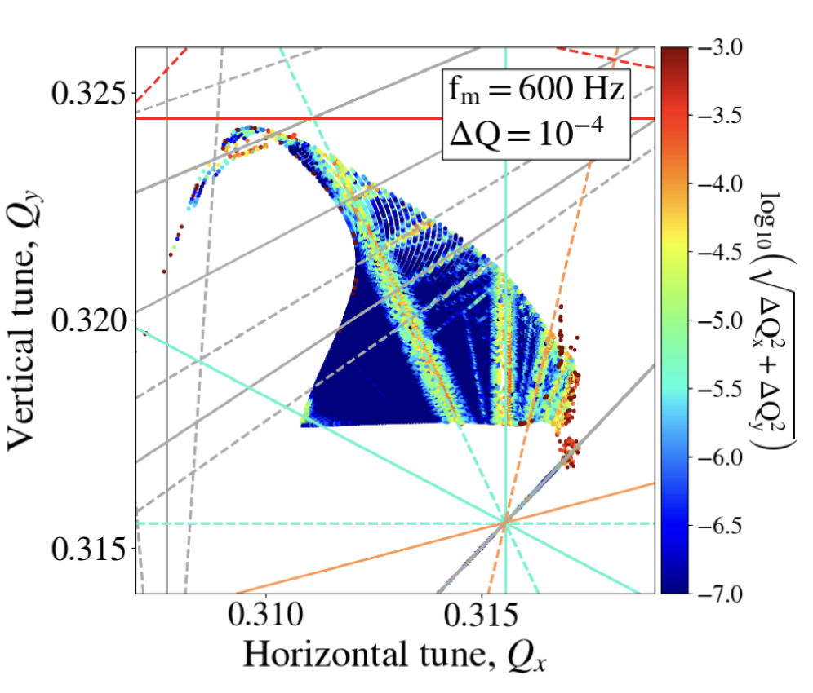
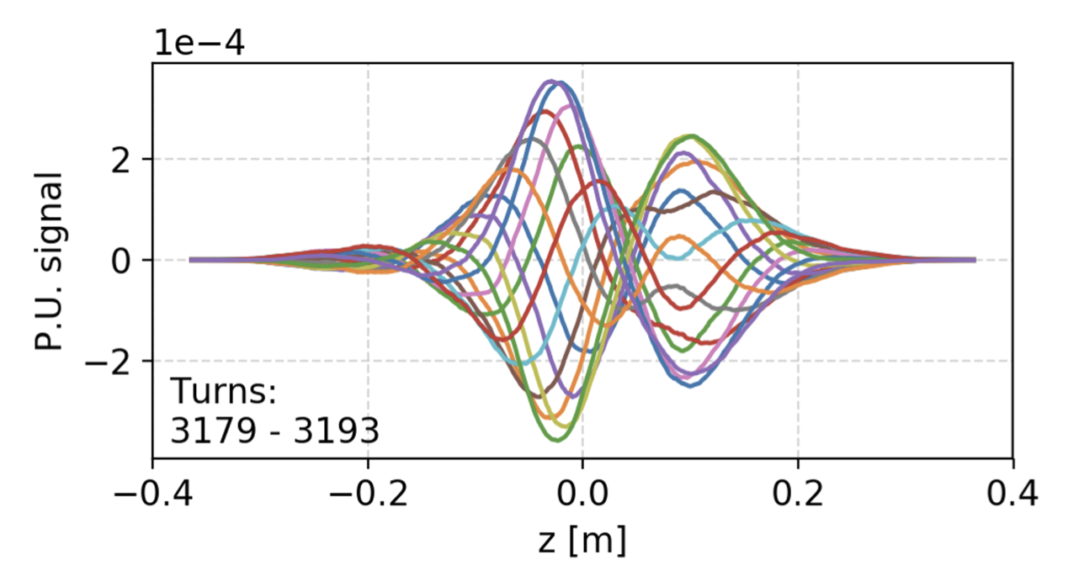
Introduction
CERN has a long tradition in the development of software tools for beam physics
Powerful tools provided to the user community:
MAD-X, standard for lattice description, optics calculation and design, tracking
Sixtrack, a fast-tracking program used mainly for long single-particle simulations
Sixtracklib, a C/C++library for single-particle tracking compatible with Graphics Processing Units (GPUs)
COMBI, for the simulation of beam-beam effects using strong-strong modelling
PyHEADTAIL, a Python toolkit for collective effects (impedance, feedbacks, space charge, and e-cloud).
Developed over decades, providing advanced features in their respective domains
4

Slide 5
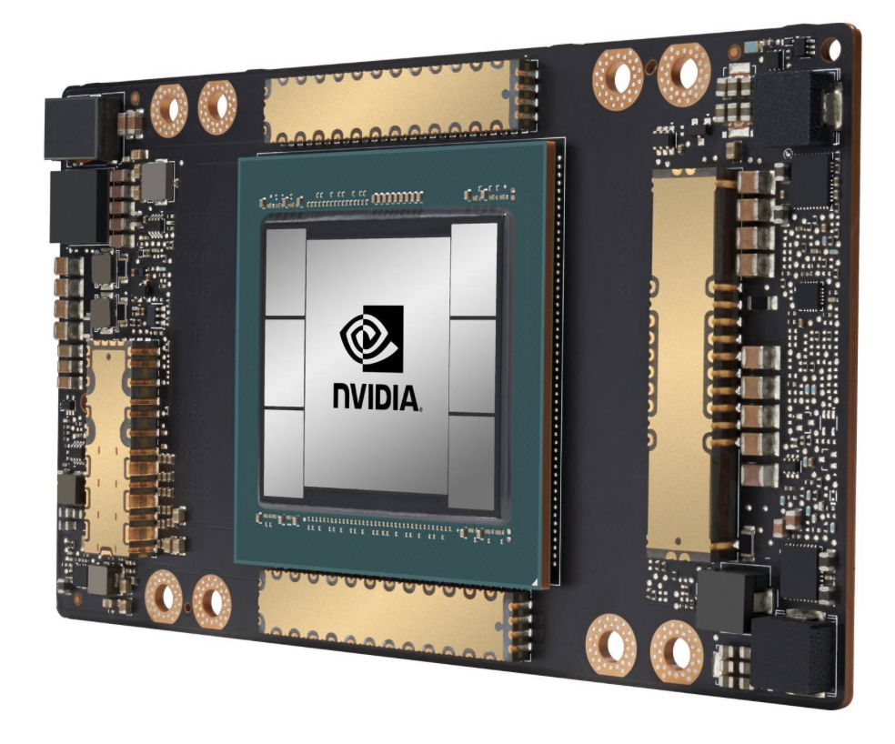
Motivation
Over the years we started to face needs that could not be easily fulfilled with legacy tools:
Integration: difficult to combine features from different codes to simulate complex heterogeneous effects
User interface: need to move away from custom interfaces (text files / ad-hoc scripting) towards standard Python packages
Present de-facto standard in scientific computing
Easy to combine in notebooks or in more complex Python codes
Allows leveraging an ever-growing arsenal of general-purpose Python libraries (statistics, linear algebra, frequency analysis, optimization, plot, etc.)
Boosted by substantial investments from general industry (big data, AI)
GPU acceleration: mandatory for several applications but cumbersome to retrofit in the existing codes
5

Slide 6
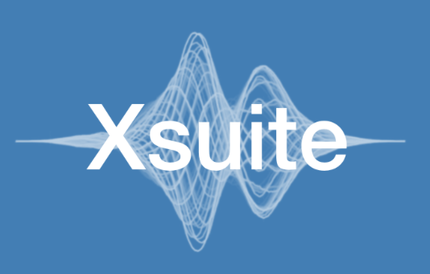
Xsuite
This led to the launch of the Xsuite project in 2021
Main goal: bring into a modern Python toolkit the know-how built in developing and exploiting MAD, Sixtrack, COMBI, PyHEADTAIL etc.,
Designed for seamless integration among the different components and for extendability
Designed to support different computing platforms, including multicore CPUs and GPUs from different vendors
Design constraints:
Need to cover a large spectrum of phenomena and applications (flexibility!)
Need developer learning curve to be short as possible
Features developed directly by field experts
Need to grow the code in a “sustainable” way, being managed and maintained by a small core team experts integrating (in a clean way!) contributions by a wide developer community
6

Slide 7
Xsuite – architecture
Xpart
generation of particles distributions
Xtrack
single particle
tracking engine
Xfields
computation of EM fields from particle ensembles
Xdeps
Dependency manager,
deferred expressions
Physics modules
Xcoll
Particle-matter interaction and collimation
Xobjects
interface to different computing plaforms
(CPUs and GPUs of different vendors)
Lower level libraries
(external, open source)
Hardware

Slide 8
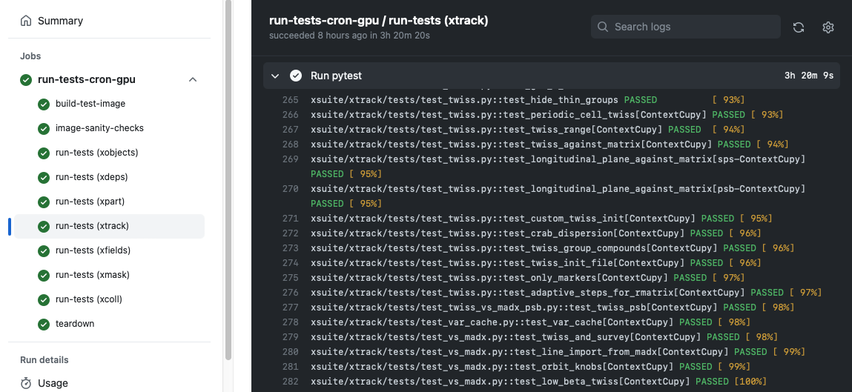
Agile development
Our development follows the agile principles:
We engaged with the user community, encouraging and supporting users to test and exploit available features in full-scale studies since early development stages
Code evolves incrementally, promptly applying needed fixes and improvements
Rely on fast release cycle (new versions released multiple times per month) while ensuring no disruption due to version changes on the user’s side.
Made possible by large investment automatic testing: each version of Xsuite undergoing over a thousand automatic checks (on CPU and GPU)
8

Slide 9
Outline
Introduction
Motivation
Design goals and constraints
Architecture
Agile development
Lattice modeling, simulation and optimization
Lattice modeling
Single-particle tracking
Dynamic parameter control
Multi-objective optimizer
Simulation of specific processes
Particle-matter interaction
Synchrotron radiation
Handling of collective effects
The Xsuite community

Slide 10
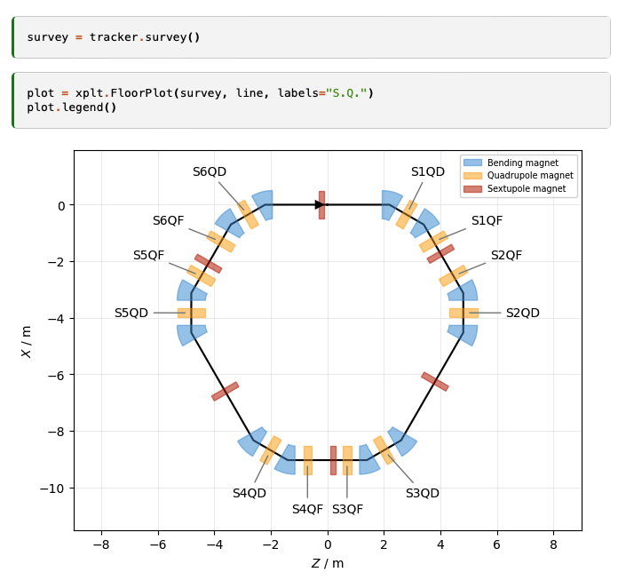
Lattice modelling
Xsuite model of a ring
(represented with the Xplt package)
The beam line is represented as a sequence of Python objects, each corresponding to an accelerator element or to other physical processes (e.g. magnets, cavities, aperture restrictions, etc.).
Can be defined manually or imported from MAD-X
Including tilts, misalignments and multipolar errors
We provide:
“Thin” lattice integration, largely based on the Sixtrack and Sixtracklib experience
“Thick” maps (more appropriate for small rings) are also made available
Dipole edge effects including fringe fields can be modeled either in their linearized form or as full non-linear maps (same fringe model as in MAD-NG and PTC).
→ Good agreement against PTC found for small rings (tested ELENA, PSB, PS, PIMMS, NIMMS)
10

Slide 11
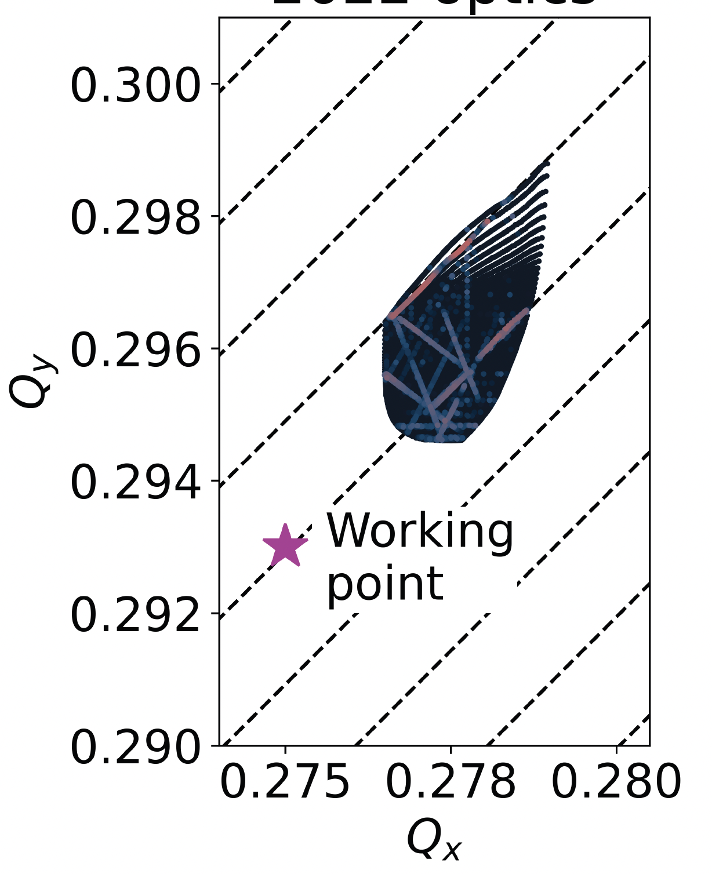
Single particle tracking
To speed up tracking simulations, Xsuite assembles and compiles a C kernel (callable from Python) optimized for the given beamline and specialized for the chosen platform (CPU or GPU)
The tra cking speed is found to be similar to Sixtrack for single-core CPU and about two orders of magnitudes faster than that on high-end GPUs
FMA produced with Xsuite
Tracking time for a typical LHC simulation
Platform | Computing time
CPU (single core) | 190 (μs/part./turn)
GPU (NVIDIA V100, cupy) | 0.80 (μs/part./turn)
GPU (NVIDIA V100 pyopencl) | 0.85 (μs/part./turn)
11

Slide 12
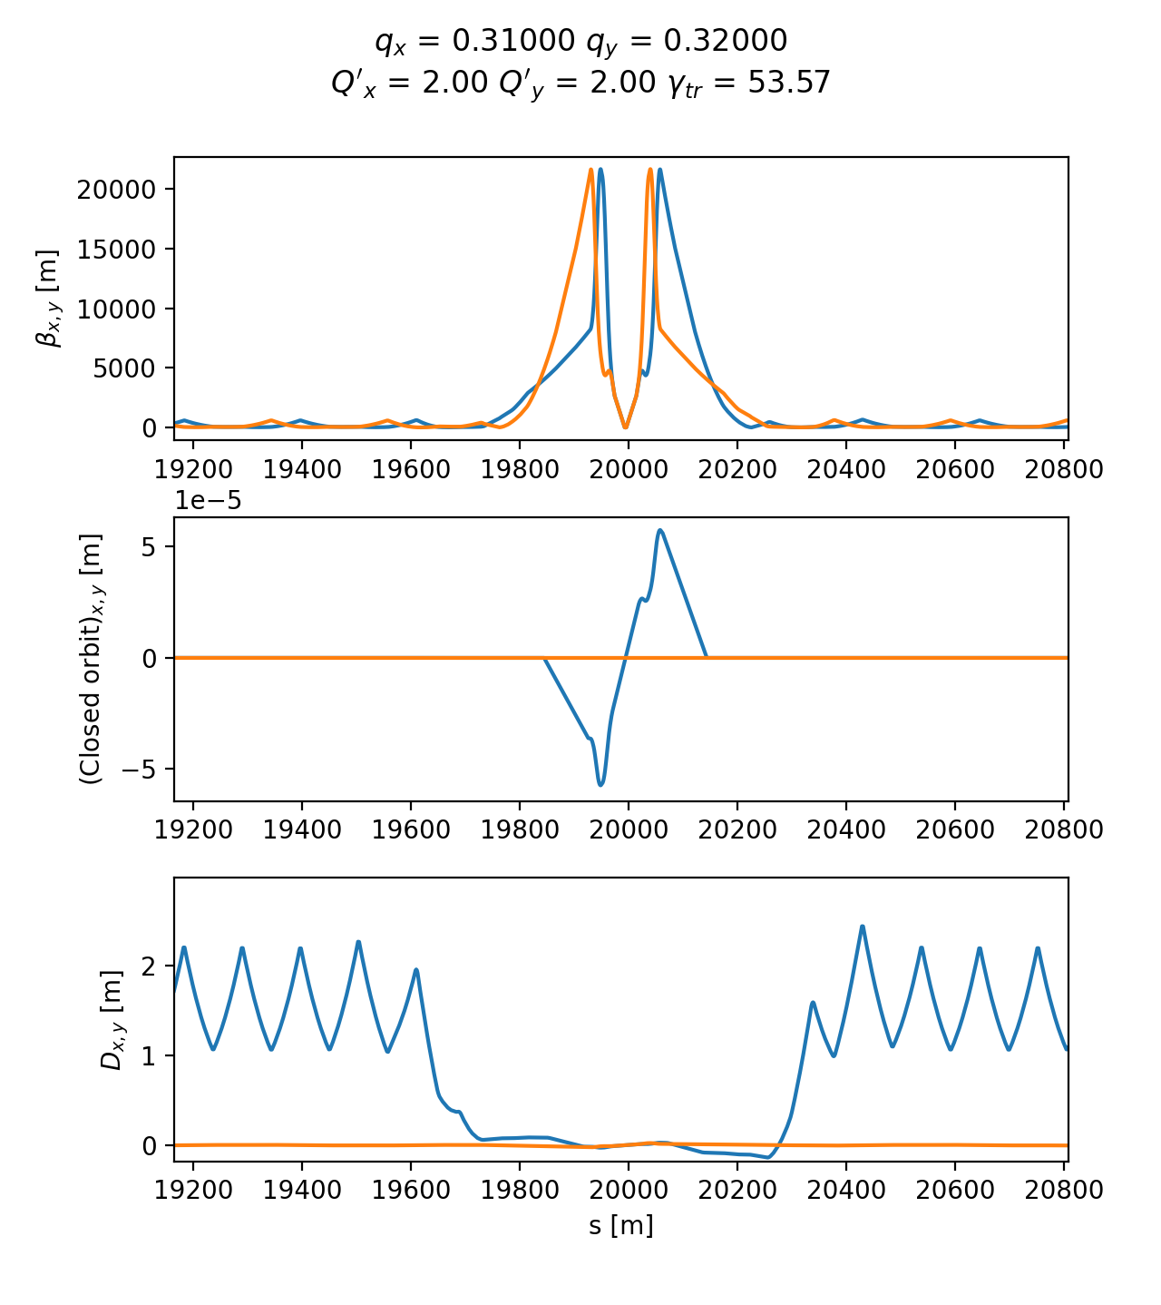
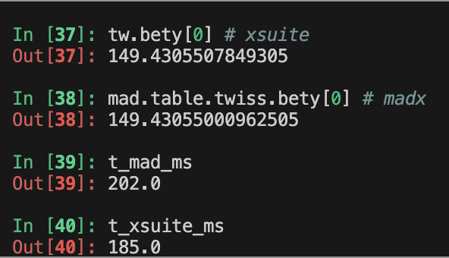
Twiss module
The Xsuite Twiss module can be used to extract lattice functions of a ring or a beamline
The calculation probes the lattice simply by tracking particles:
Closed orbit obtained by applying a Python root finder on the tracking
The Jacobian matrix obtained by tracking (central differences)
Compute “Linear Normal Form” of the Jacobian matrix (diagonalization)
Propagate eigenvectors by tracking
Obtain from the eigenvectors Twiss parameters, dispersion functions, etc.
Can be done also off momentum
This approach has two main advantages
Any physical model included in the tracking is automatically usable in Twiss
Twiss becomes a powerful diagnostics tool on the built tracking model
HL-LHC optics
Accuracy compared to MAD-X: Δβ / β << 10⁻⁴
Computation time is very similar
12
Example
12

Slide 13
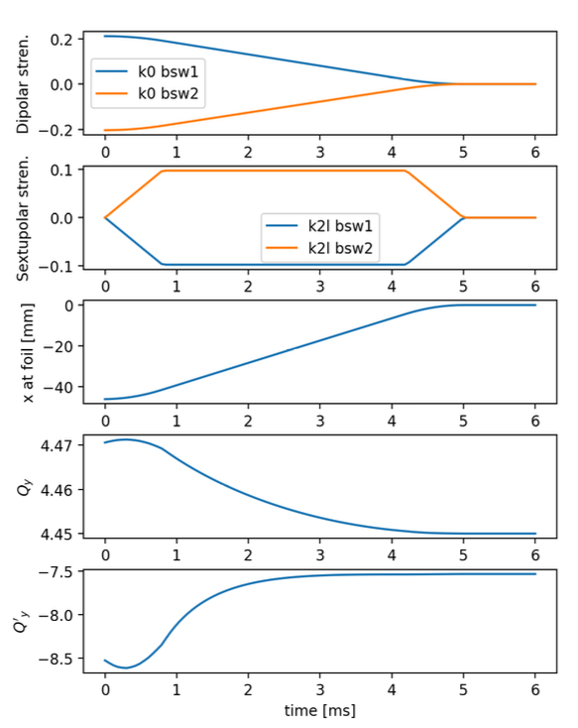
Dynamic control of beam line parameters
Simulation of a fast orbit bump used for the H⁻ injection into the CERN PS Booster
In accelerators often a single high-level parameter can be used to control groups of components with complex dependency relations. (e.g. magnets in series, groups of RF cavities, etc.)
The Xdeps module provides the capability to include such dependencies in the simulation model (as done by MAD-X deferred expressions)
User can also use “Time functions”, i.e. time dependent knobs that are updated automatically during the simulation
→ See tutorial
13

Slide 14
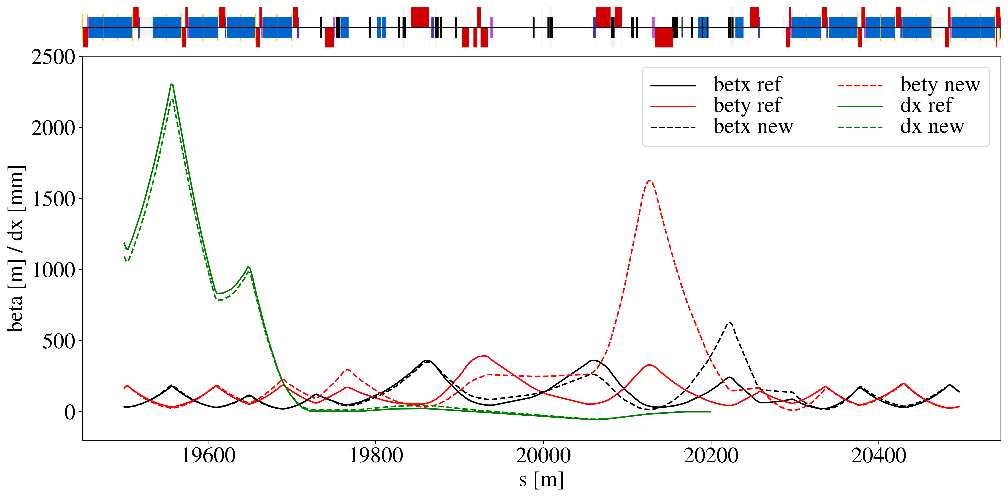
Optimizer
Xsuite provides a multi-objective optimizer to "match" model parameters to assigned constraints (e.g. control tunes, chromaticity, build orbit bumps, modify the optics)
Based on the extensive experience of MAD-X → Uses the same optimization algorithm (Jacobian, proven robustness)
The optimizer can be used to synthesize knobs
Interface designed for usage flexibility. User can intervene in the optimization by:
Enabling/disabling targets or knobs
Rolling back optimization steps
Changing knob limits, target values, convergence tolerances, etc.
→ See tutorial
Optimized optics for the LHC collimation area (designed with Xsuite)
Used for optics matching of the LHC and of FCC-ee colliders
Proved capability of handling large problems with several constraints and degrees of freedom.
14

Slide 15
Outline
Introduction
Motivation
Design goals and constraints
Architecture
Agile development
Lattice modeling, simulation and optimization
Lattice modeling
Single-particle tracking
Dynamic parameter control
Multi-objective optimizer
Simulation of specific processes
Particle-matter interaction
Synchrotron radiation
Handling of collective effects
The Xsuite community

Slide 16
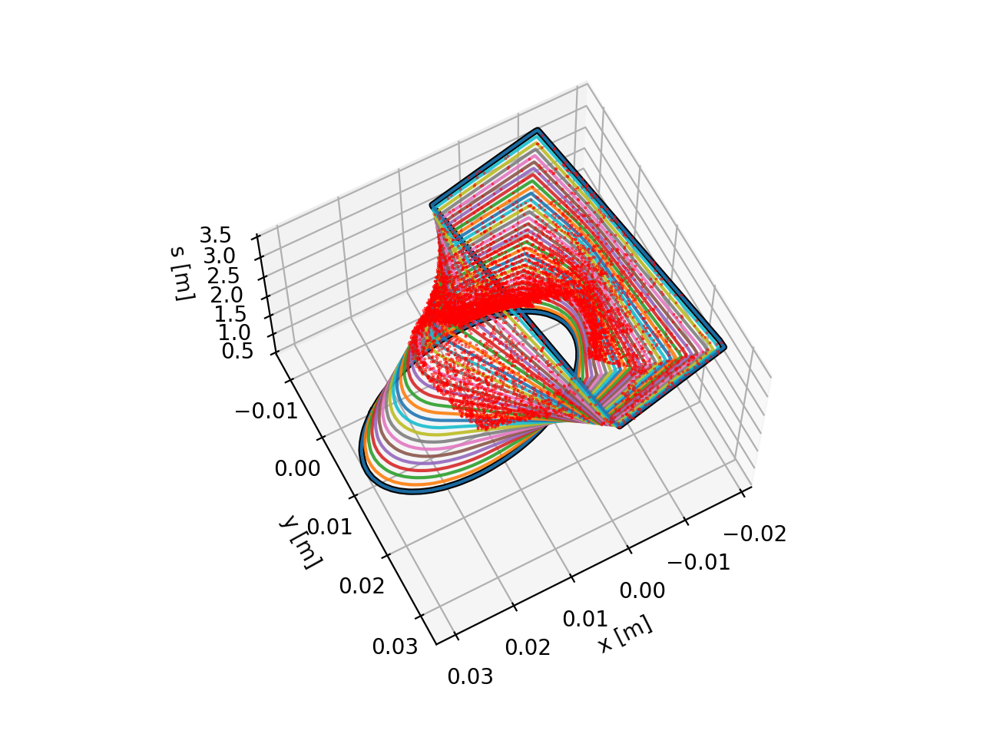
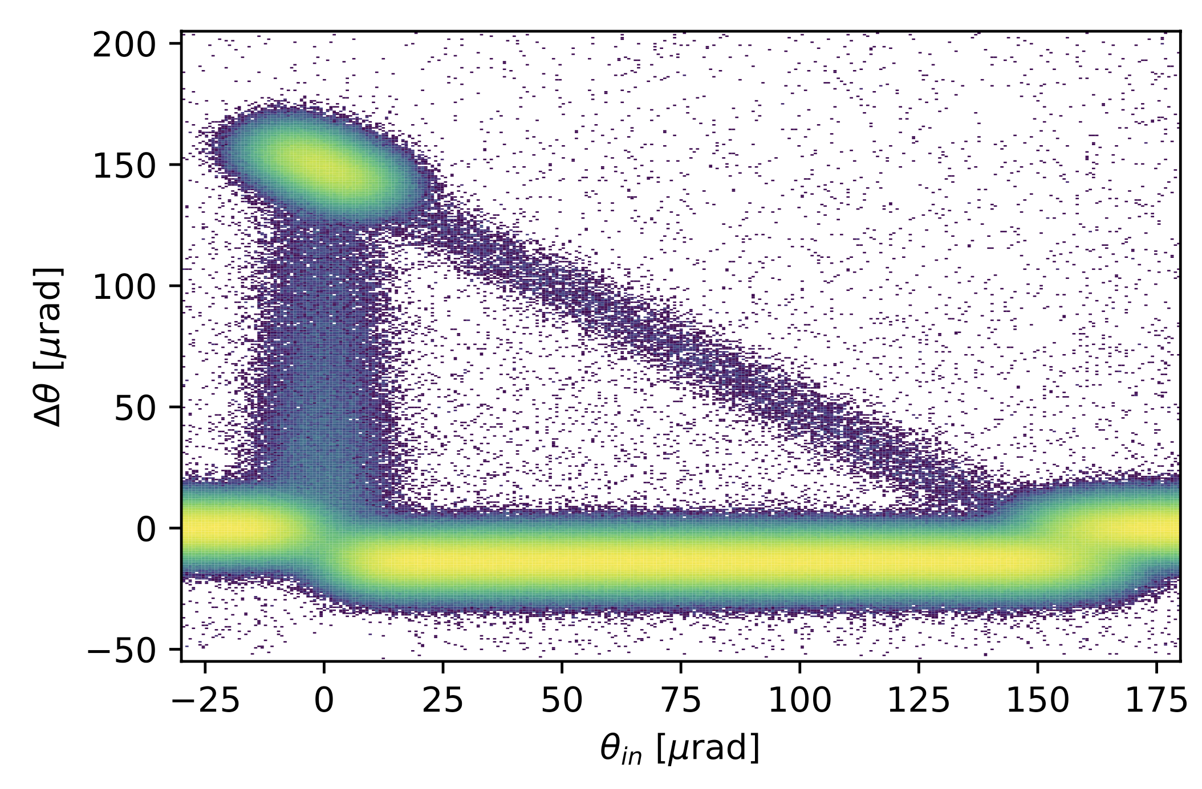
Particle-matter interaction
For collimation studies, the Xcoll module provides three engines to simulate particle-matter interactions:
The “Everest” engine embedded in Xcoll (evolution of K2 module from Sixtrack)
The “Geant 4” engine, based on an interface Xsuite-BDSIM-Geant4
The “FLUKA” engine, based on an interface with the FLUKA Monte Carlo code
To support collimation studies, Xsuite provides:
Tools to automatically install and set collimators in the simulation model
Support for complex aperture modelling and accurate localization of the lost particles along the beam line (typically within 1-10 cm)
Particle deflection from a bent crystal (Everest engine)
Localization of lost particles along a beam pipe with changing cross section
16

Slide 17
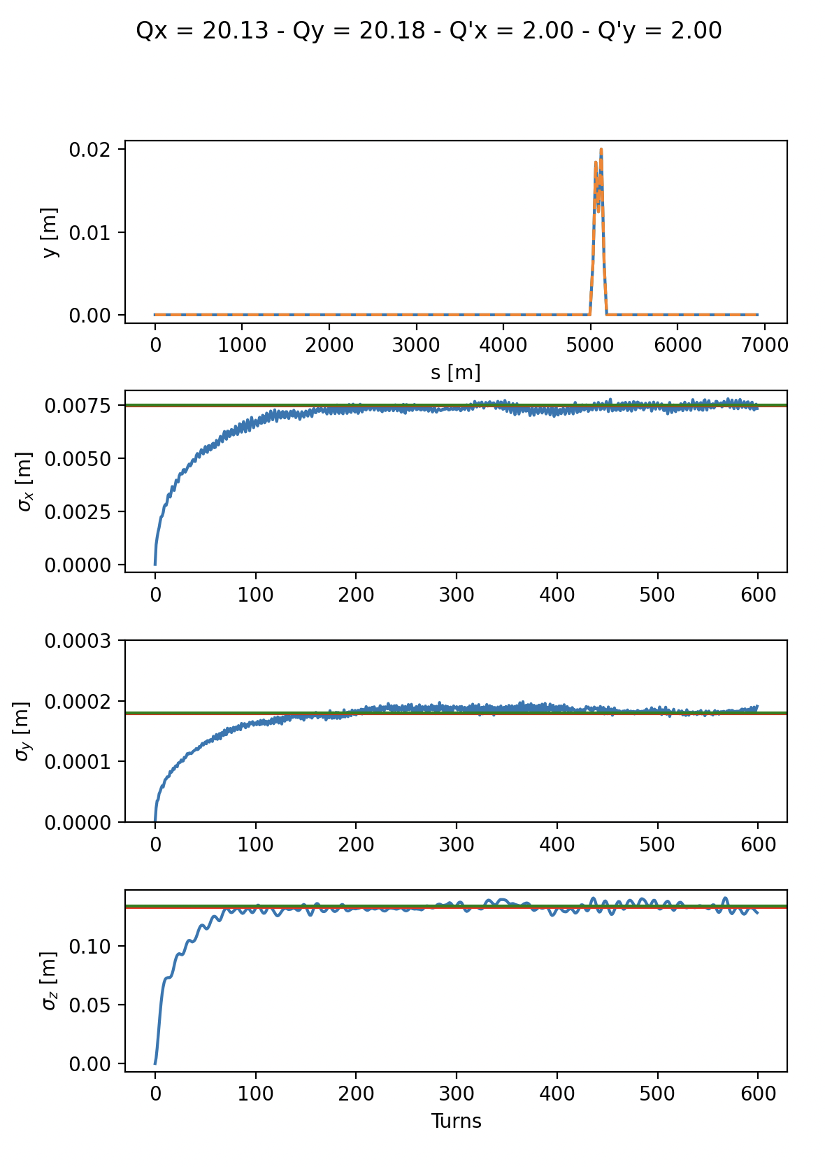
Synchrotron radiation
Equilibrium emittance (twiss vs track)
The effect of synchrotron radiation can be included in Xsuite tracking simulations. Two models available:
The “mean” model, for which the smooth energy loss from the radiation is applied particle by particle
The “quantum” model for which the actual photon emission is simulated⁽¹⁾.
The Xsuite Twiss also includes:
Computation of radiation energy loss, damping times and equilibrium emittances
Algorithm for non-symplectic one-turn map⁽²⁾
An automatic tool is provided for phasing the RF cavities and adjusting magnet strengths to compensate the radiation energy loss (“tapering”)
Twiss (fast)
Twiss (full)
Tracking (300 particles)
⁽¹⁾ Based on H. Burkhardt, “Monte Carlo generator for synchrotron radiation”, 1990. Implementation ported from PLACET (A. Latina)
⁽²⁾ E. Forest, From tracking code to analysis: generalised Courant-Snyder theory for any accelerator model. Springer, 2016
17

Slide 18
Collective effects
Xsuite is designed to include collective effects in the simulations
Handling of collective elements is fully automatic → The Xtrack module identifies the collective elements and splits the sequence:
The non-collective parts are handled asynchronously to gain speed
The simulation of the collective effects is performed synchronously
Available collective effects:
Space-charge, beam-beam, e-cloud (weak-strong) are handled natively
Impedances and feedback systems are handled through an interface with PyHEADTAIL
Space charge
Lattice
Lattice
Space charge
Space charge
Lattice
Lattice
Impedance
Damper
Collective (synchronous)
Single-particle (asynchronuos)
18

Slide 19
Outline
Introduction
Motivation
Design goals and constraints
Architecture
Agile development
Lattice modeling, simulation and optimization
Lattice modeling
Single-particle tracking
Dynamic parameter control
Multi-objective optimizer
Simulation of specific processes
Particle-matter interaction
Synchrotron radiation
Handling of collective effects
The Xsuite community

Slide 20
The Xsuite community
[Activities that are already in production, or for which testing work is ongoing]
LHC and HL-LHC
Tracking for DA - lattice only (M. Le Garrec, E. Maclean, C. E. Montanari , T. Pugnat, D. Veres)
Crab-cavity noise studies(A. Fornara, Uni. Manchester)
Beam-beam weak-strong (G. Sterbini, S. Kostoglou, C. Droin, E. Lamb, D. Christie Uni. Manchester)
Beam-beam strong-strong (X. Buffat)
Wire compensation studies (P. Belanger, D. Kalchev TRIUMF)
Collimation studies (F. Van Der Veken, N. Triantafillou, B. Lindstrom, M. D’Andrea, P. Hermes)
Optics/orbit matching, including RDT matching (B. Lindstrom, K. Paraschou, C. Droin, S. Kostoglou, Y. Angelis)
Non-linear corrections calculation (J. Dilly)
Hollow e-lens studies (P. Hermes + students)
Incoherent e-cloud effects (K. Paraschou)
Beam instrumentation studies (D. Alves, K. Lasocha, SY-BI)
Injector complex (PSB, PS, SPS, LEAR, AD, ELENA)
Space-charge studies (F. Asvesta, T. Prebibaj)
Cooling studies (D. Gamba, P. Kruyt)
Instabilities with wakes and space-charge (X. Buffat)
Slow extraction studies at PS and SPS (P. Arrutia Sota, T. Bass, F. Velotti, SY-ABT)
Ion studies (E. Waagaard)
Beam transfer simulations (F. Velotti, SY-ABT)
MTE simulations, optics+tracking (A. Huschauer, starting)
Light sources (Petra IV, Elettra, Bessy III)
Tracking and DA
FCC
FCC-ee optics matching, tapering + RF phasing (M. Hofer, J. Keintzel, P. Kicsiny (L. Van Riesen-Haupt)
FCC-ee DA studies (M. Hofer, L. Van Riesen-Haupt, EPFL)
FCC-ee and FCC-hh beam-beam-SS&WS (P. Kicsiny, D. Di Croce, EPFL)
Beamstrahlung, Bhabha (P. Kicsiny)
FCC-ee and FCC-hh collimation studies (A. Abramov, G. Broggi)
FCC-ee vibration studies (J.P. Salvesen, M.Hofer, LAPP Annecy collab.)
Compton scattering studies (A. Abramov, I. Debrot, M. Hofer)
Collective effects (M. Migliorati, A. Ghribi - Uni Sapienza, A. Rajabi – Desy)
GSI/FAIR
Space-charge simulations (A. Oeftiger and team)
Slow extraction simulations - SIS18 and SIS100 (P. Niedermayer, C. Cortes)
BTF studies (C. Cortes)
Medical accelerators
Slow-extraction for PIMMS (R. Tailor)
Slow-extraction for MedAustron (F. Kuehteubl, E. Renner, et al.)
BNL - RHIC and EIC
Optics calculations and tracking
Collimation studies
Fermilab – Main Injector, Recycler, IOTA
Tracking studies
Impedance + space-charge simulations
Training (Universiy of Rome and EPFL)
Some numbers
Core team | 3 persons
Contributing developers | 16 persons
User community | ~80 users
Publications including Xsuite simulations (in 2022-23): | 25 papers

Slide 21
Tutorial
21

Slide 22
Xsuite tutorial for Slow Extraction workshop
Studying a simplified slow-extraction scenario for the PIMMS (Proton-Ion Medical Machine) synchrotron⁽¹⁾ (thanks to R. Taylor and E Benedetto for their input)
Tutorial material: https://github.com/xsuite/slow_extraction_tutorial → Try it out!
Instructions on how to install and use Xsuite available at https://xsuite.web.cern.ch
Tutorial structured in four parts:
Part 1:
Import and explore the machine model
Survey and twiss calculations
Optics and chromaticity matching
Part 2:
Characterize beam dynamics close to third-order resonance
Leverage synergy of Xsuite with other Python packages
Part 3:
Control the resonance parameters
How to use Xsuite model combined with an external optimization tool
Part 4:
Simulate a short spill
How to handle machine parameters changing with time (functions)
How to define a custom machine element
⁽¹⁾ CERN-PS-99-010-DI, TERA Foundation

Slide 23
Spare slides
23

Slide 24
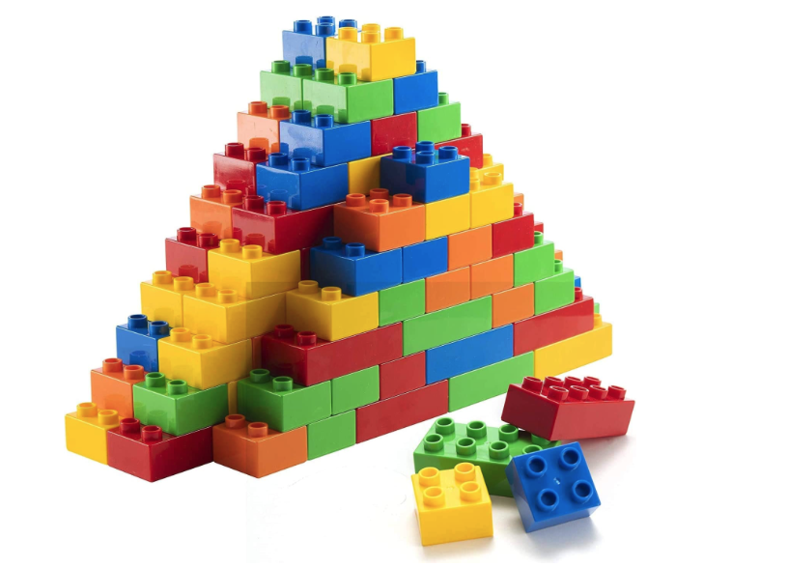
Orthogonal design
Project employs an “orthogonal” design strategy:
Ensure that each functional block remains well-isolated and interacts with the others through clearly defined interfaces
This approach has two key advantages:
Enables contributors to modify or expand specific components without full knowledge of other parts nor of underlying software infrastructure
Minimize codebase complexity, ensuring that it increases linearly rather than exponentially as new features are added
24

